Slide 1
ZDC Status 24 Oct 24
CMS technical coordinator, Austin Ball, said that we should not make a presentation to Working Group 8 since they cannot help us on ZDC without permission from above. I will work with Austin on the appropriate level for such a request.
DOE visit to CMS next Monday
Michael Murray 24th October 2019

Slide 2
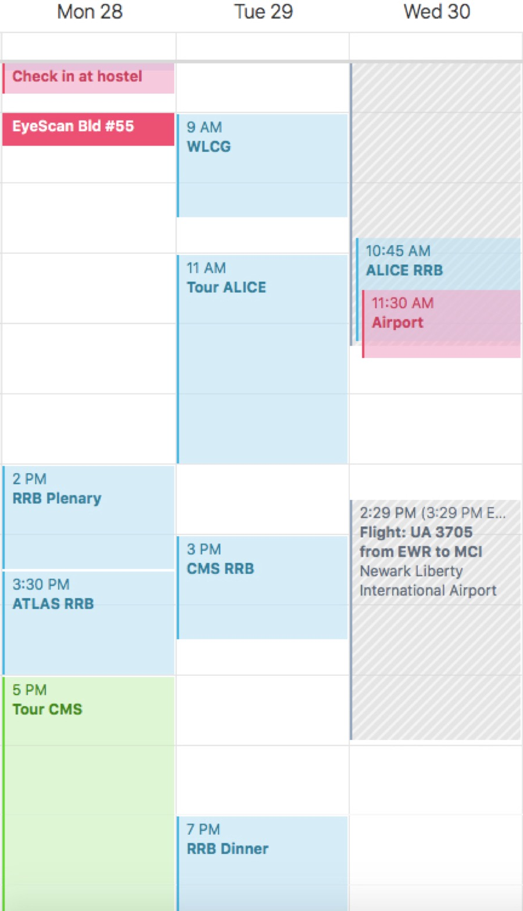
DOE visit to CERN
Underground visit ~ 3 hr
We will not request funds for upgrading CMS ZDC in Run 3 but will ask for help with RPD. We will stress the importance of support to prepare for Run 4.

Slide 3
2018 Calibrations
Resolution = 22%
We need to get these calibrations accepted by HCAL

