Slide 1
Electron transport via defect network
Ieva Guigaitė
Juozas Vaitkus
Darius Abramavičius

Slide 2
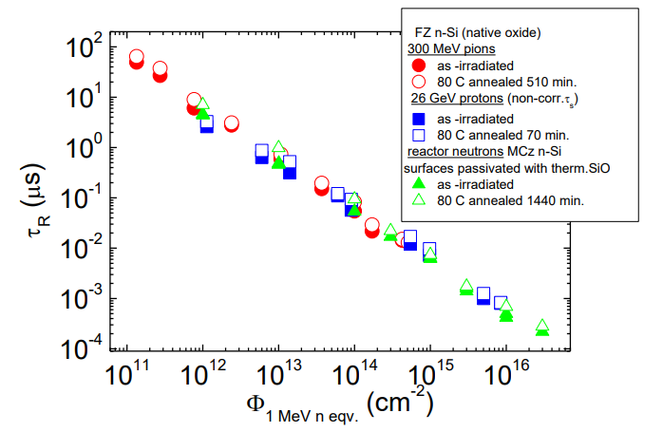
Motivation
Irradiation by high energy particles induced defect network
Electron lifetimes are sensitive to geometry
Defects form nano-size clusters
Bulk theory is not sufficient
24th RD50 workshop, Bucharest

Slide 3
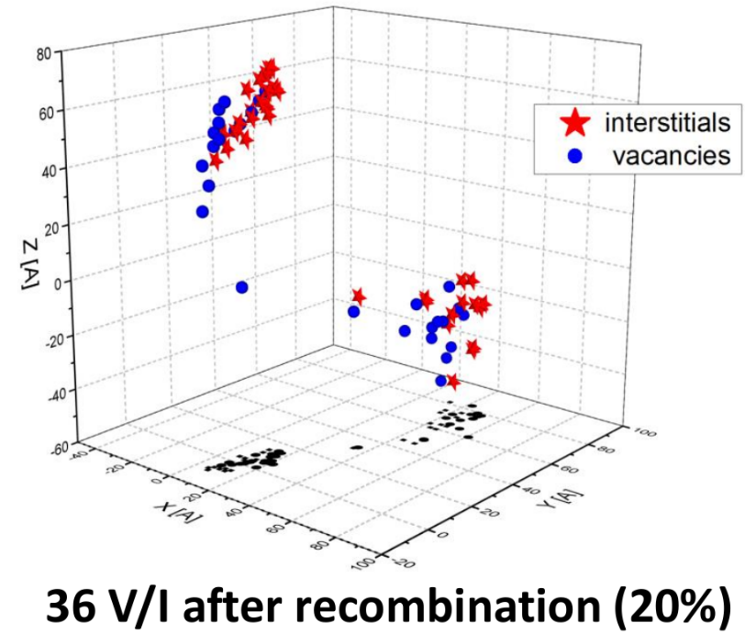
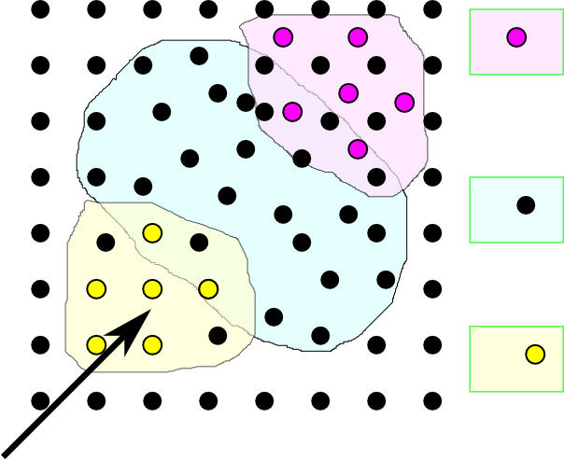
High Energy Particle (HEP) destroys the lattice:
Interstitial-
rich region
Disordered
region
Vacancy-rich
region
TRIM and TCAS simulation results, presented by G. Lindstroem, 24th RD50 workshop, Bucharest, 2014.
After relaxation of cascade deffect and recombination of I-V pairs the rest of the vacancies and interstitials remain separated in space.
HEP

Slide 4
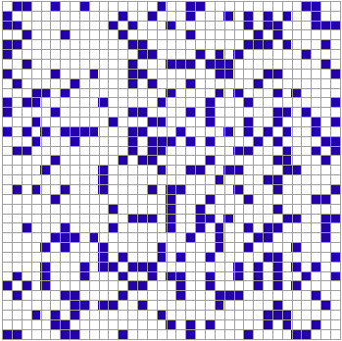
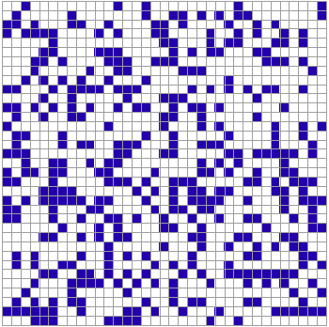
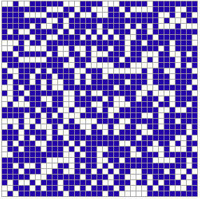
Percolation network
p=0.25
p=0.35
p=0.65
Classical site percolation problem

Slide 5
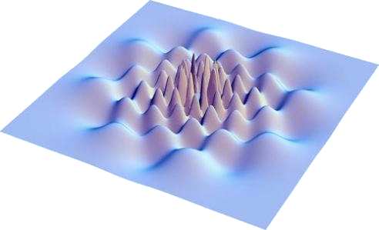

Quantum percolation network
Very sensitive to electron delocalization pattern

Slide 6
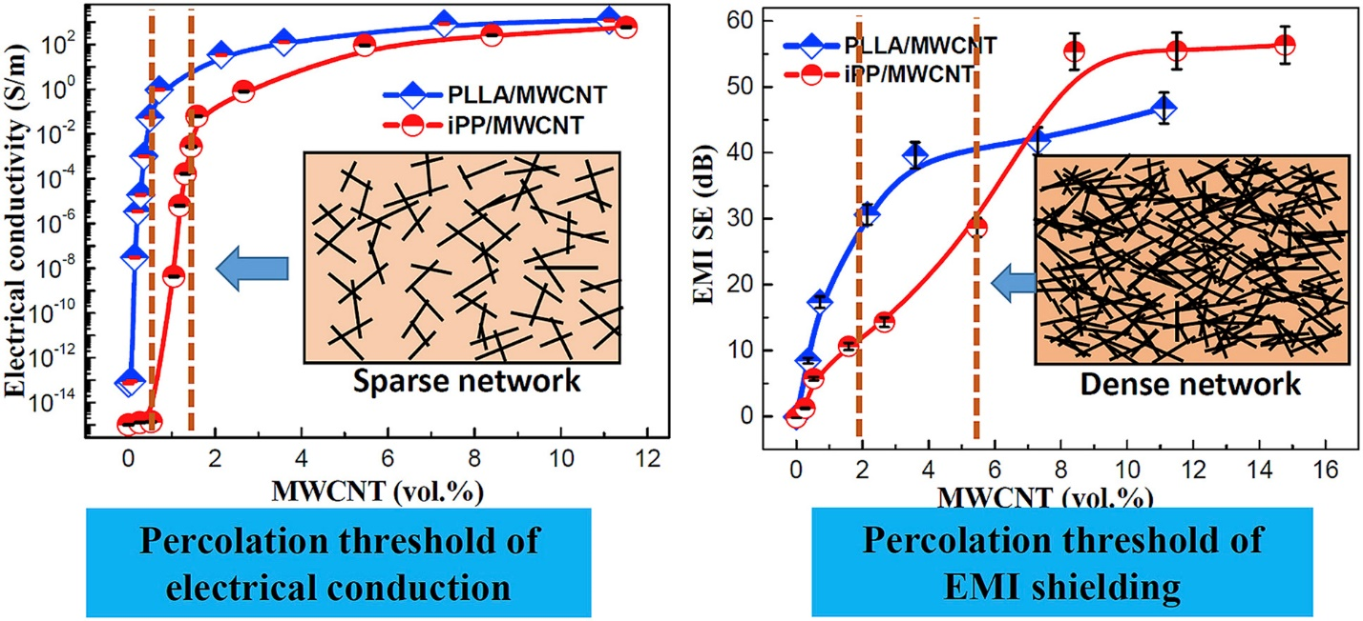
Percolation network
Percolation behavior of electrical conduction has been well demonstrated in conductive polymer composites (CPC), carbon nanotubes.
Composites Science and Technology, v 170, 20 January 2019, Pages 70-76

Slide 7
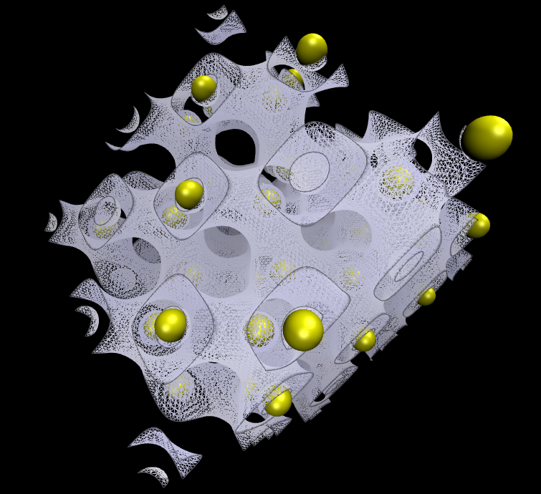
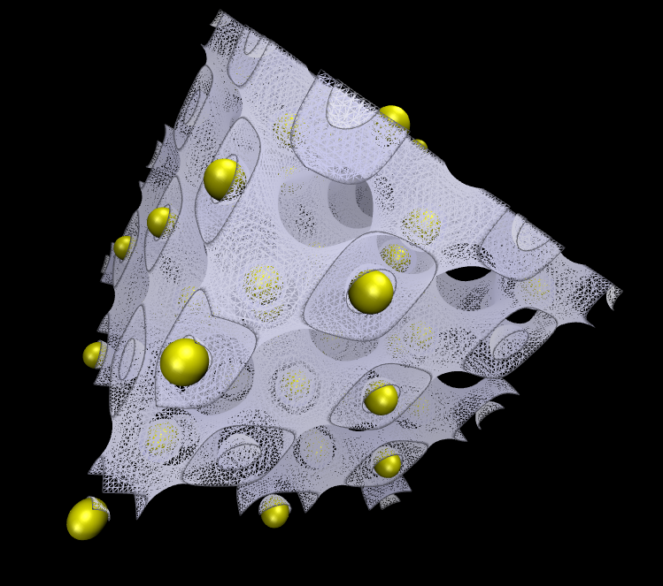
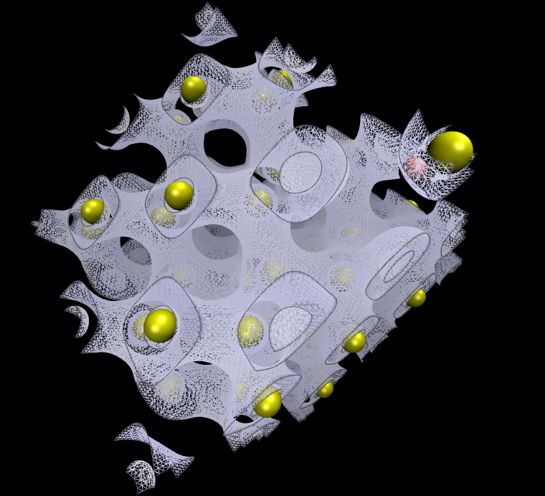
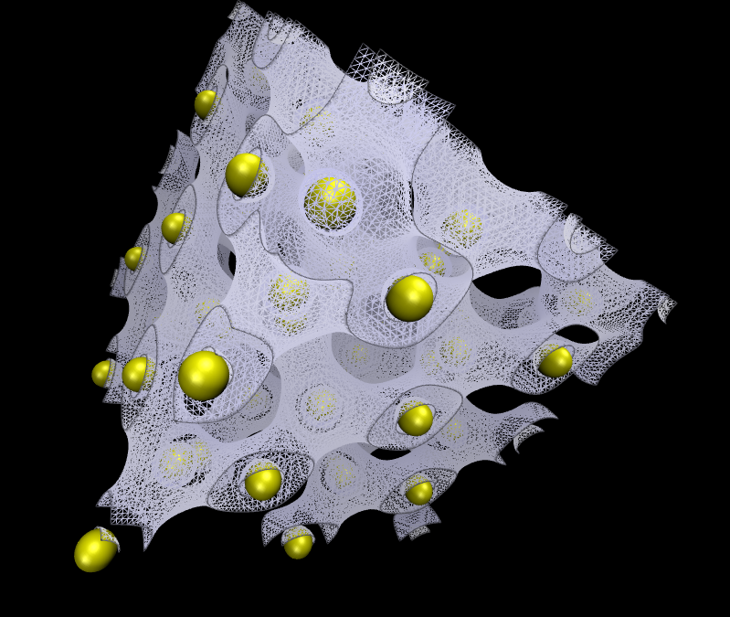
vacancy
Electron density
interstitial

Slide 8
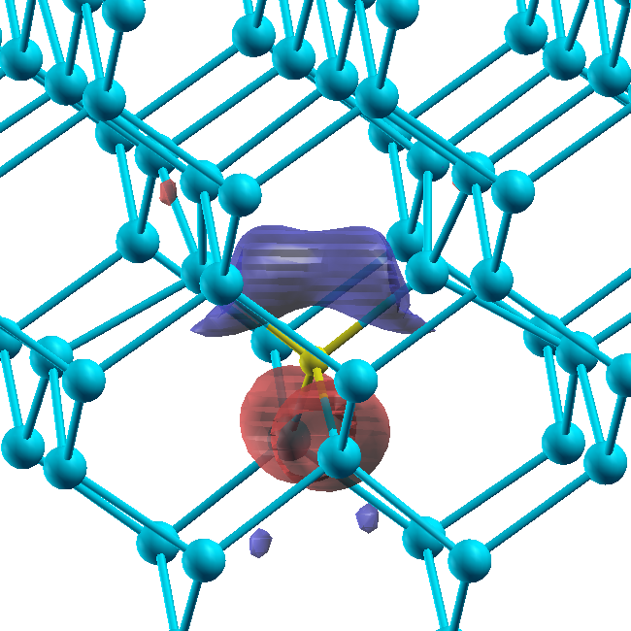
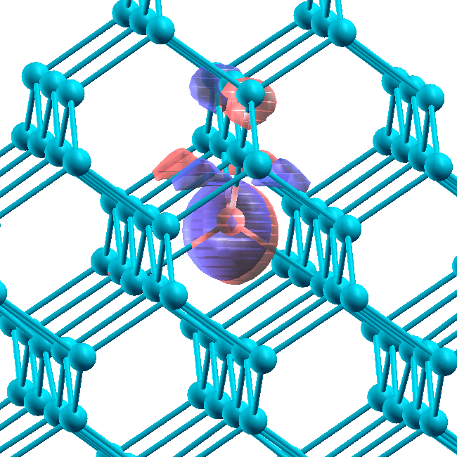
Vacancy and Interstitial defect
Vacancy defect, Td symmetry.
Wave function of a localized electron
in the acceptor site.
Neutral vacancy defect is known to be of
the acceptor type.
Interstitial defect, Td symmetry.
Wave function of a localized hole
in the donor site.
Interstitial defect in Td symmetry state is known
to be of the donor type (Ec – 0.39 eV)
Mukashev et al, Jpn. J. Appl. Phys. 21, 399 (1982).
simulations were performed by Ernestas Žąsinas (Vilnius University)

Slide 9
Quantum percolation network
Very sensitive to electron delocalization pattern

Slide 10
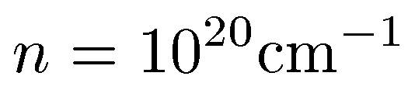
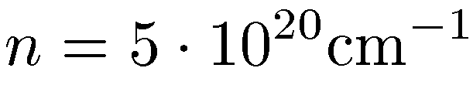
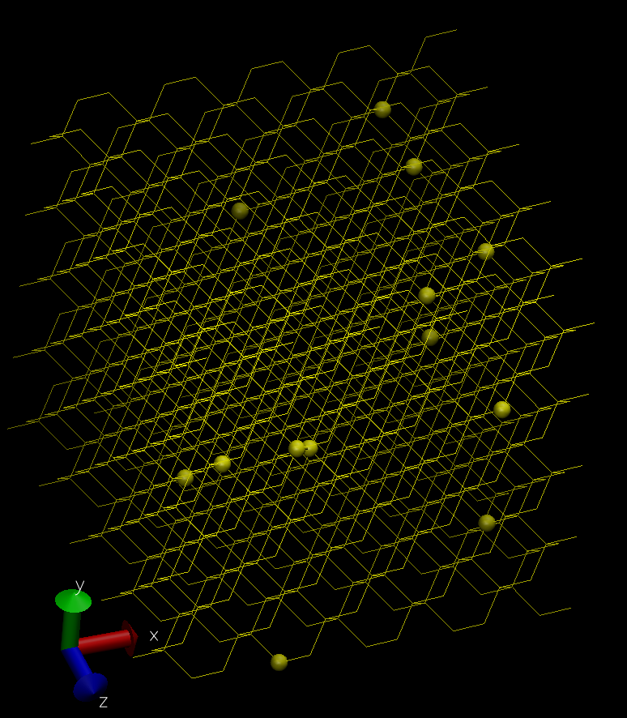
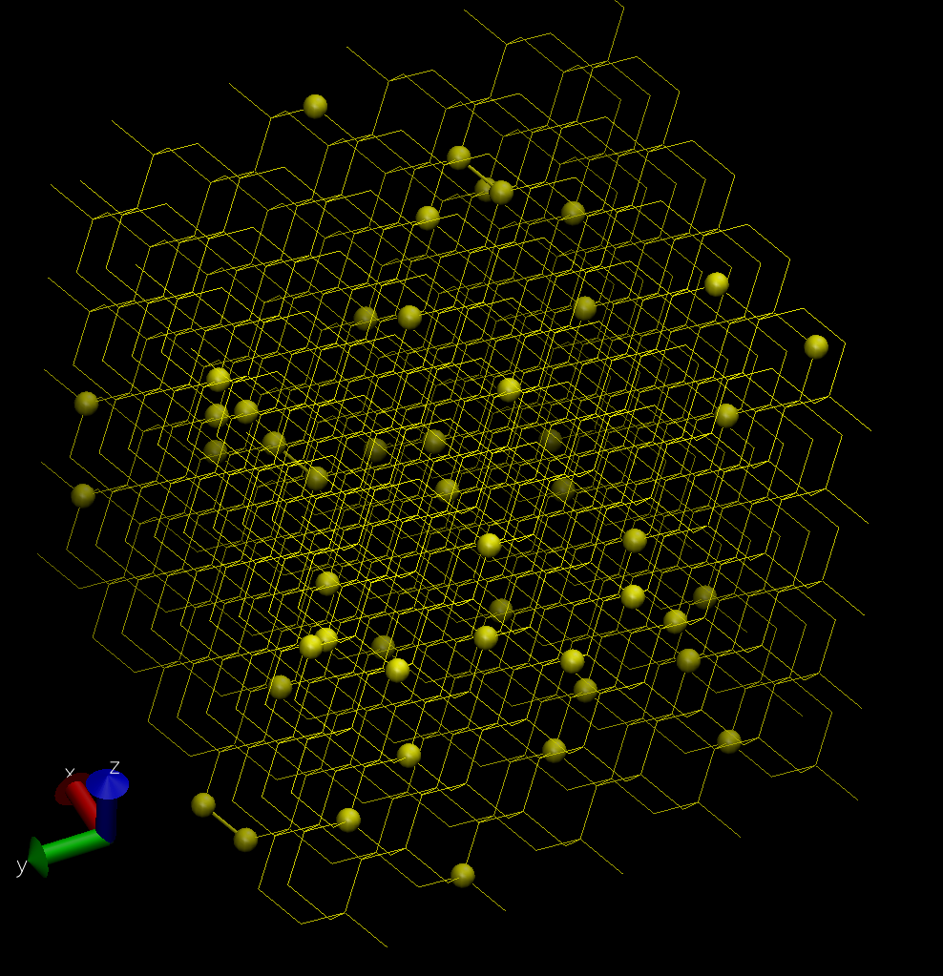
Electron transport network

Slide 11
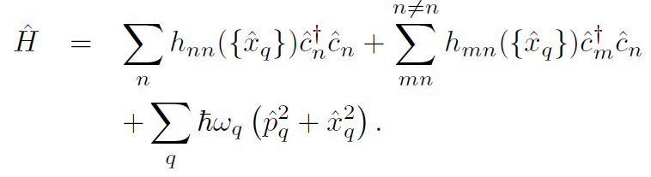
Electron transport theory
Electron creation/annihilation operators
Tight binding Hamiltonian
(only defect sites)
Phonon normal modes

Slide 12
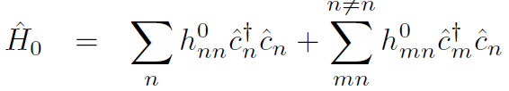

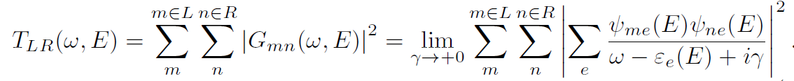
Coherent processes
Zero-order terms
Stationary eigenstates
Electron Green’s function
Transfer amplitude

Slide 13
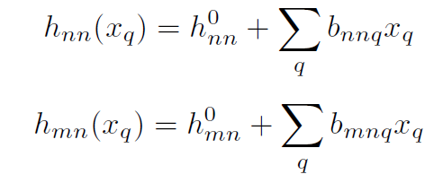
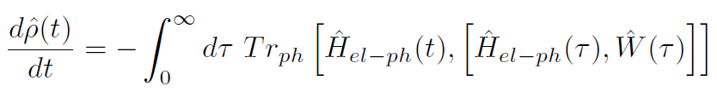
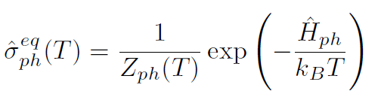
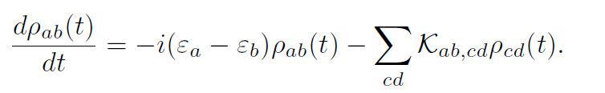

Incoherent processes
Electron scattering by phonons
Quantum master equation
Thermal equilibrium of phonons
Markovian Redfield equation
The “observed” kinetics

Slide 14
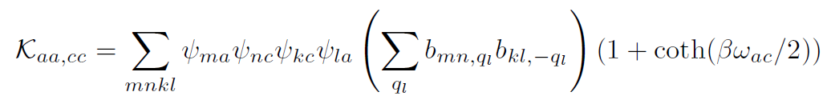
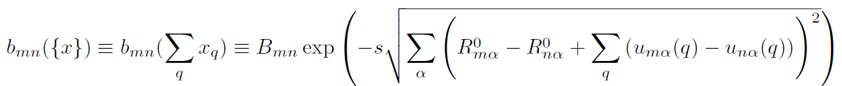
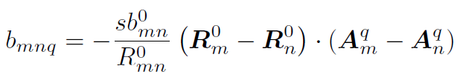
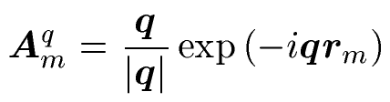
Acoustic phonons
Hopping amplitude depends on distance
For acoustic phonons dispersion relation is simple, wavevectors
Finally the electron transfer rate

Slide 15
Relaxation pathways
(energy representation)

Slide 16
Relaxation pathways
(energy representation)

Slide 17
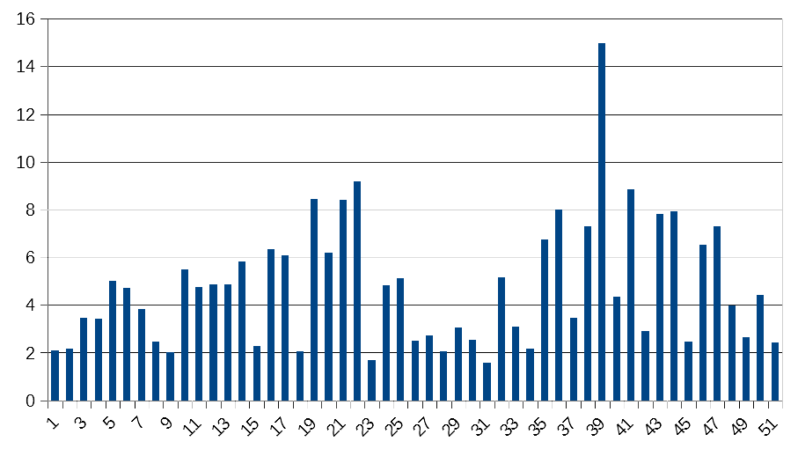
Relaxation pathways
(energy representation)
Electron delocalization extent
Poor correlation with electron energy

Slide 18
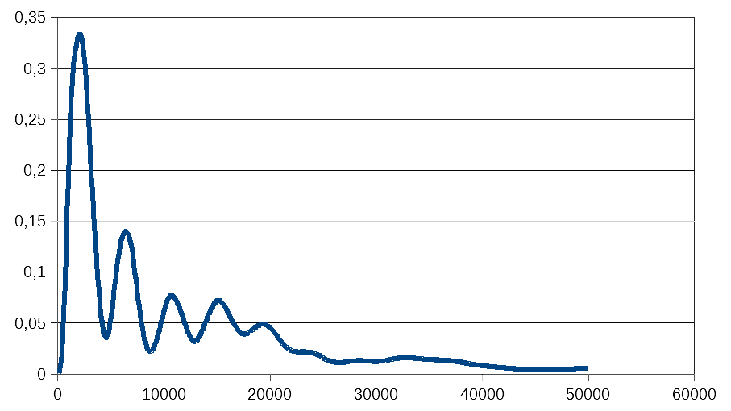
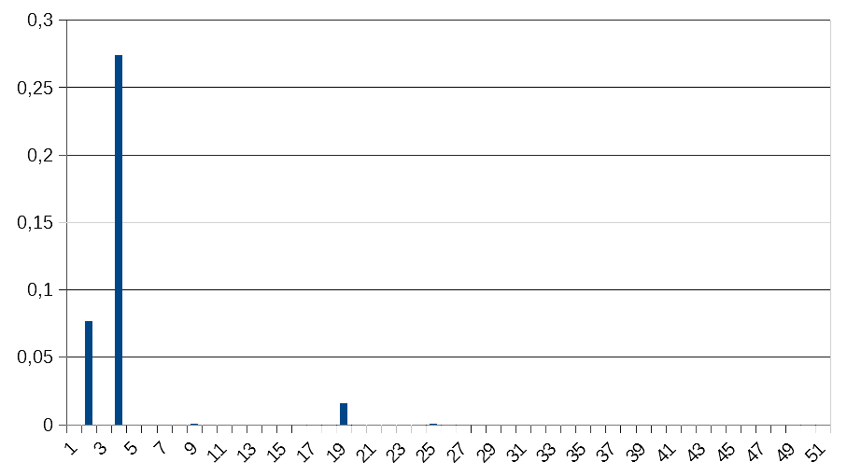
Short range transfer (27-th)
4->2 electron transfer
27-th electron, delocalization = 2,72
Composition in site-basis

Slide 19
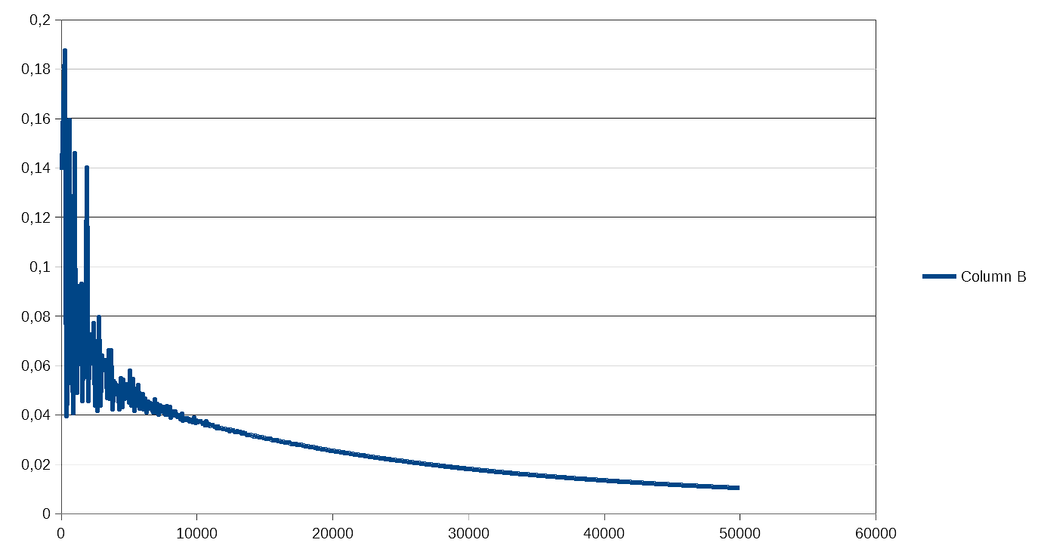
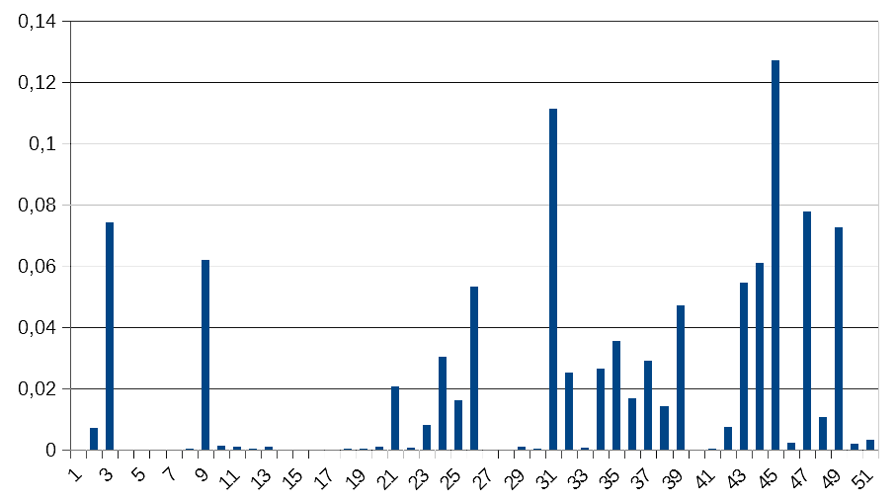
Long range transfer (27-th)
31->45 electron transfer
39-th electron, delocalization = 14,99
Composition in site-basis

Slide 20
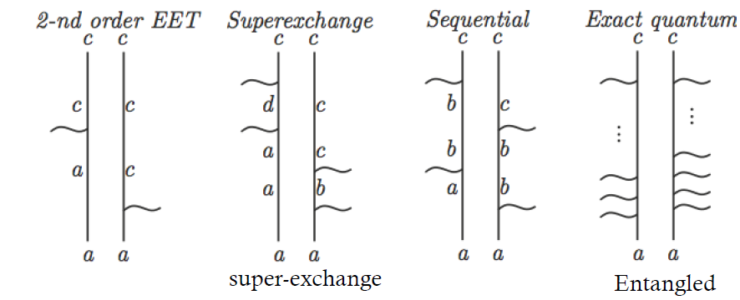
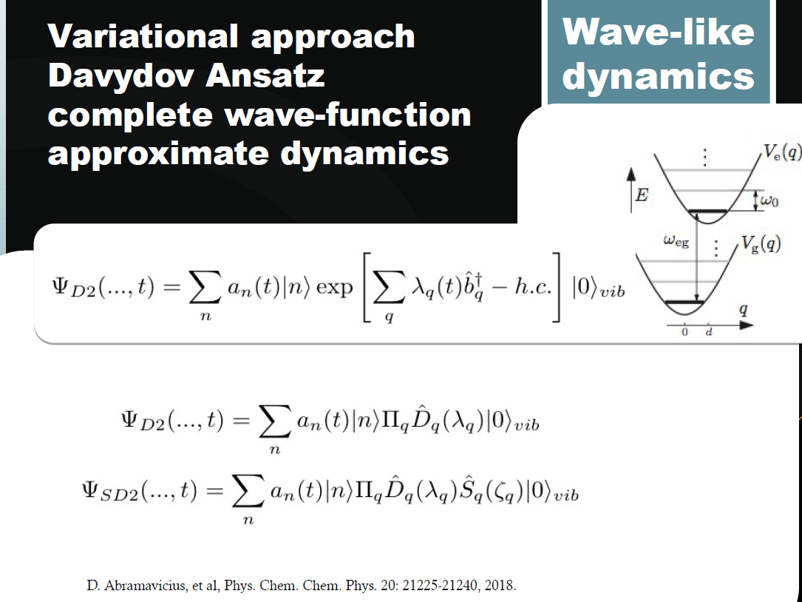
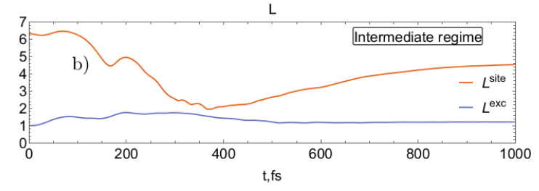
Extensions
Lindblad equation approach
Non Markovian description
Time dependent variational approach
Time dependent delocalization

Slide 21
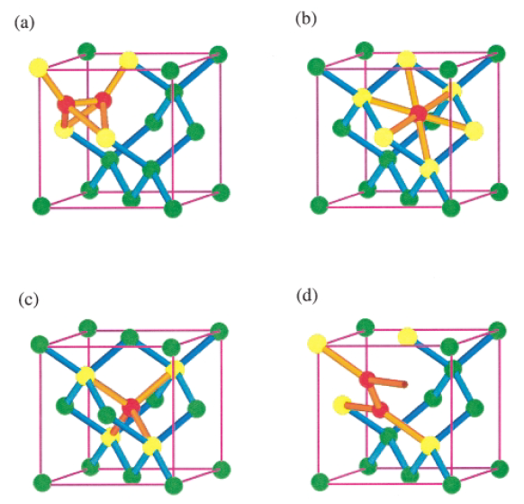
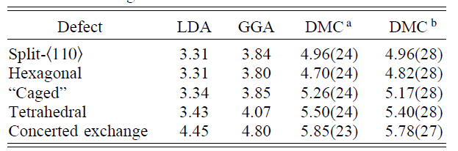
Interstitials
The split-110,
hexagonal,
(c) tetrahedral interstitial,
(d) the saddle point
Formation energies
Phys Rev Lett. 83, 2351, 1999

Slide 22
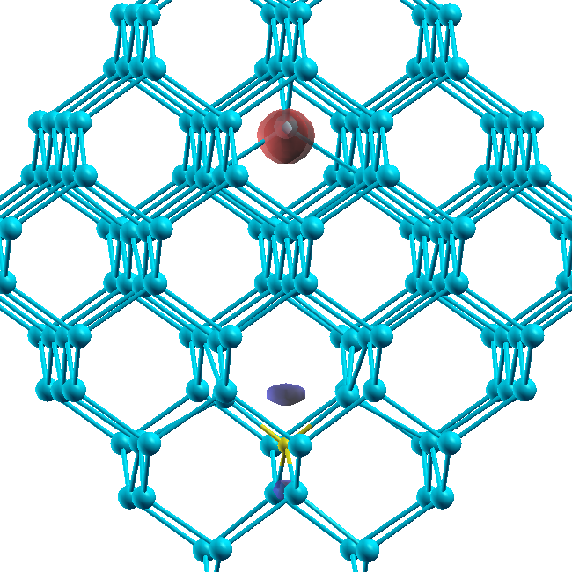
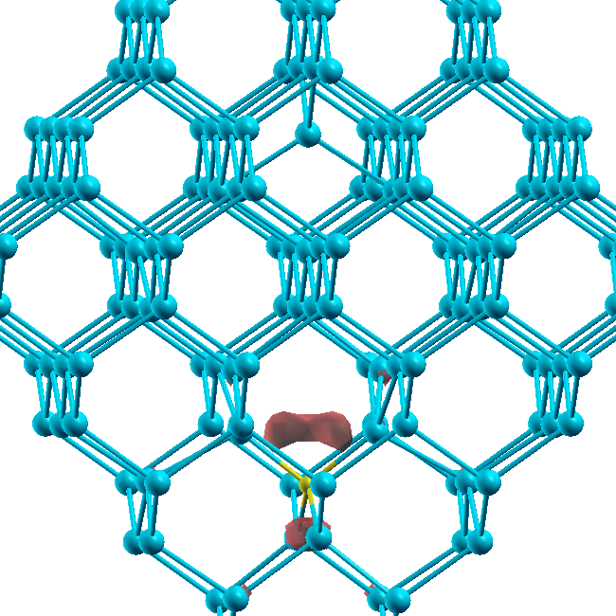
Vacancy – Interstitial pair (Frenkel pair ) defect
When vacancy and interstitial are approached to each other to form a pair
then the extra electrons given by interstitial are “pumped” away from the
interstitial site to the vacancy site. (Like in a ionic type molecule or crystal
electrons mainly are located nearby more electronegative ion.)
! Interstitial and vacancy exchange their roles:
Interstitial turns into acceptor and vacancy into donor:
Charged (-) system, one electron added.
The electron wave function (~80% of it) is
located nearby interstitial site (or the electron
is accepted by interstitial site).
Charged (+) system, one electron removed.
The hole wave function is located nearby
vacancy site (or the electron is donated away
by vacancy site).
simulations were performed by Ernestas Žąsinas (Vilnius University)

Slide 23

Conclusions
Formation of clusters of the defect sites depends strongly on concentration of defects
Acoustic phonon description allows for simple model formulation for incoherent energy transport
Overlap of electron delocalized wavefunctions is necessary for electron transfer
Electron transport pathways can be visualized
Transition from coherent to diffusive transport may be important for various size clusters
Acknowledgement
Some simulations were performed by Ernestas Žąsinas
This work is coherent with CERN RD50 collaboration.
Thanks to Lithuanian Academy of Sciences for the grant LMA-CERN

Slide 24


