Slide 1
Secondary Beamlines Operation
P. Batsela, I. Pagonidis,
Supervisor: N. Charitonidis [BE-EA]
24/09/2021
High School Students Internship Program Greece 2021

Slide 2
Introduction
Secondary beams: different particles with different energies and intensities.
They are used for smaller experiments and for developing detectors or detector components e.g. for the LHC experiment.
The term secondary refers to the generation of particles; meaning particles that were created by very high energy parents (protons or ions) colliding with targets-converters.
In our project we wanted to design a beamline able to transport 25 GeV/c momentum electrons.

Slide 3
Introduction
For the construction of a beamline we need to consider two factors:
The particles we use and b) the equipment.
Principle of operation of this beamline:
Sweeping dipole
+
p+
Target Be
γ
Converter Pb
e-
e+
-
All kind of particles
only neutral particles pass to the conventer
To the beamline

Slide 4
Introduction
Our beamline consists of :
Virtual detectors: detect and collect data of the particles.
Target: generate particles through collisions.
Converter: convert particles, e.g. γ e- e+
Collimators: absorb the particles with different properties that the one we want.

Slide 5
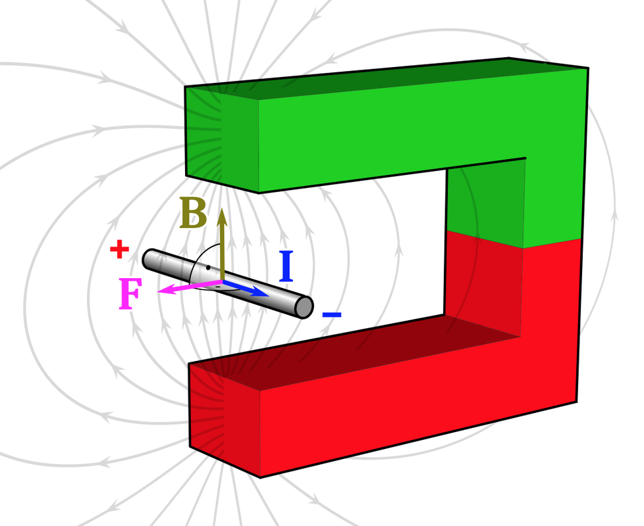
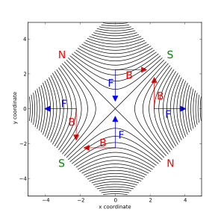
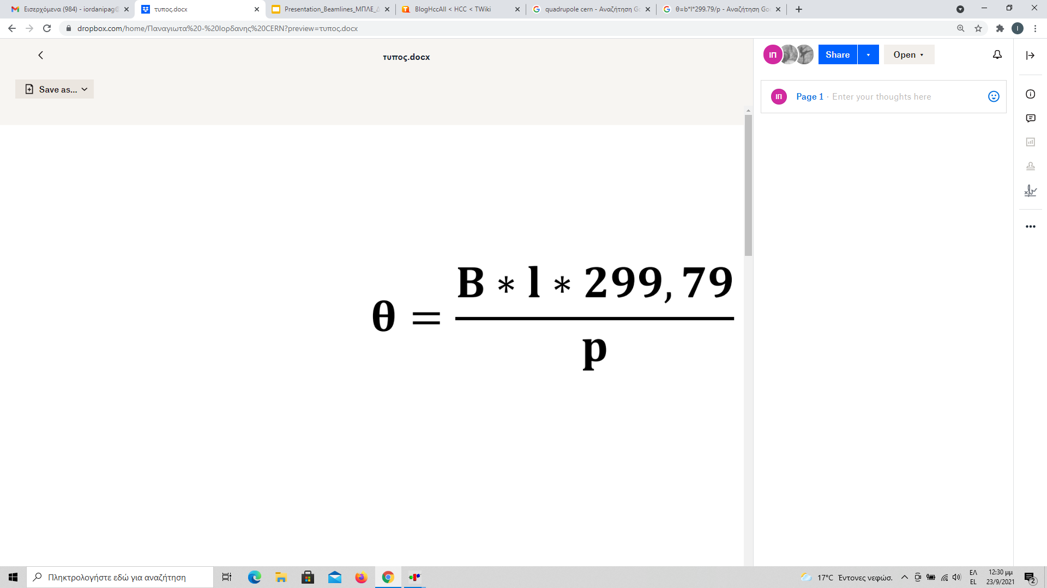
Introduction
Dipole: direct the beam
Quadrupole: focus the beam

Slide 6
The project
For our project we used the G4 Beamline program. With this program we prepared and executed the input file.
Furthermore, we used the program HistoRoot; with this we analyzed the hypothetical results we should get from our detectors. .
Our beam consists of :
4 detectors,
1 Be target,
1 sweeping dipole,
1 Pb converter,
2 dipoles
5 quadrupoles

Slide 7
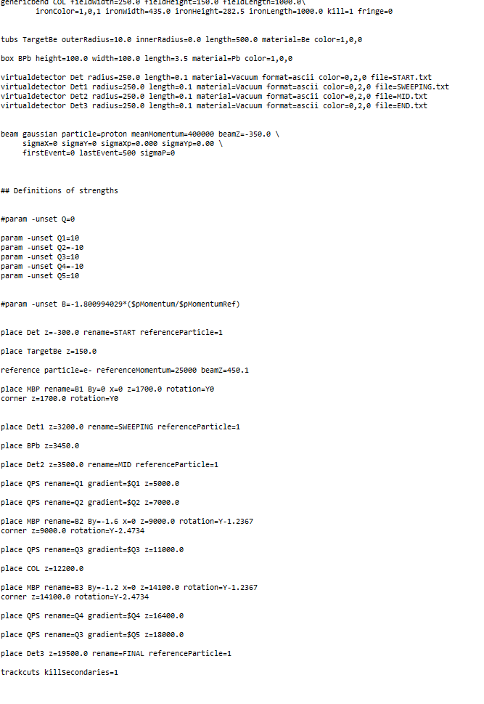
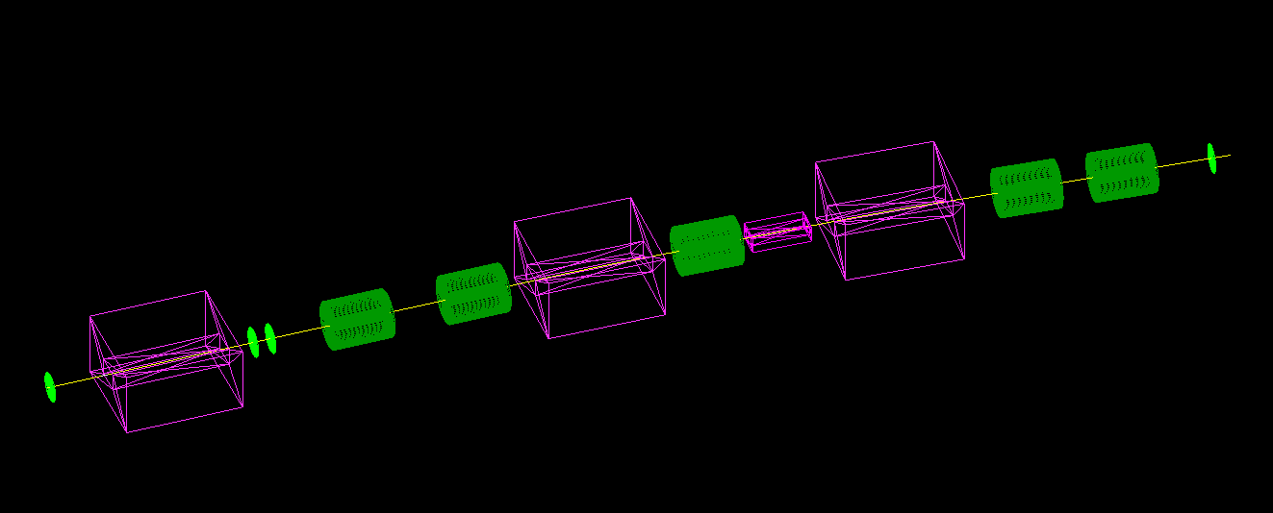
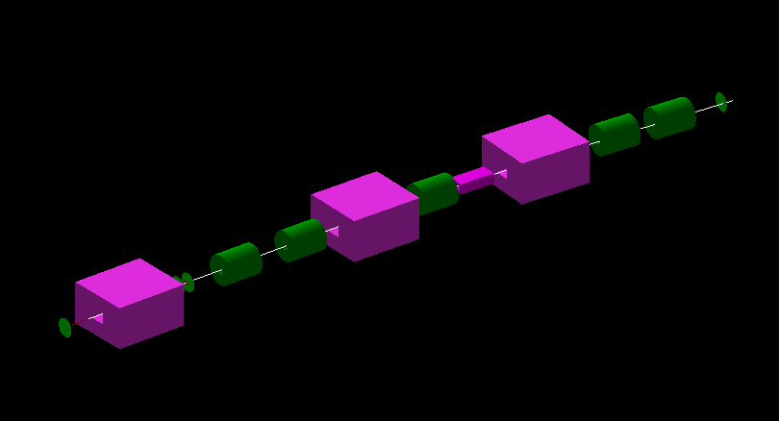
Wireframe
The result
The code

Slide 8
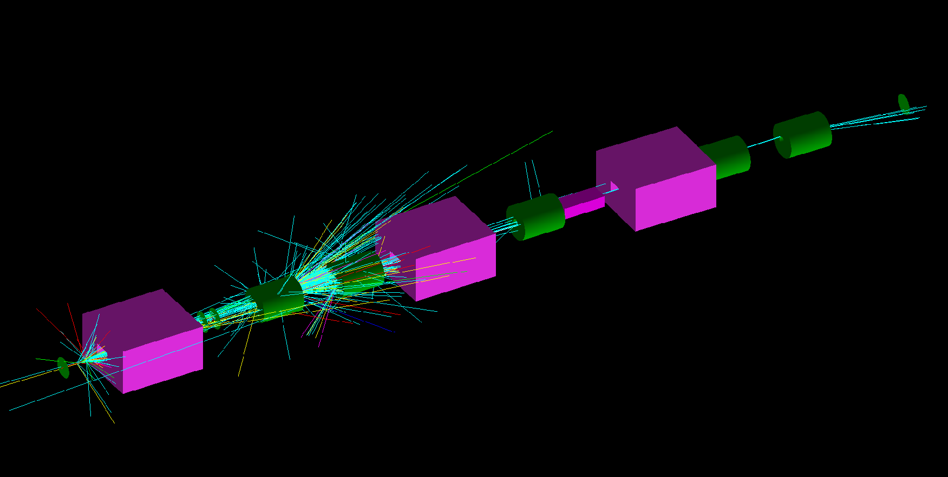
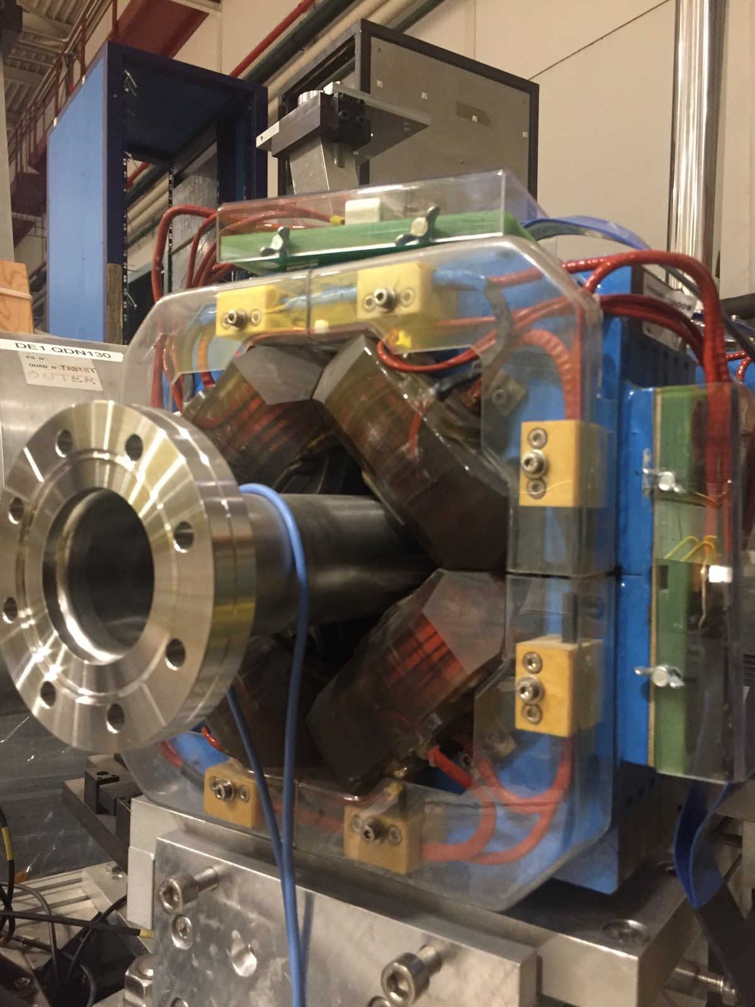
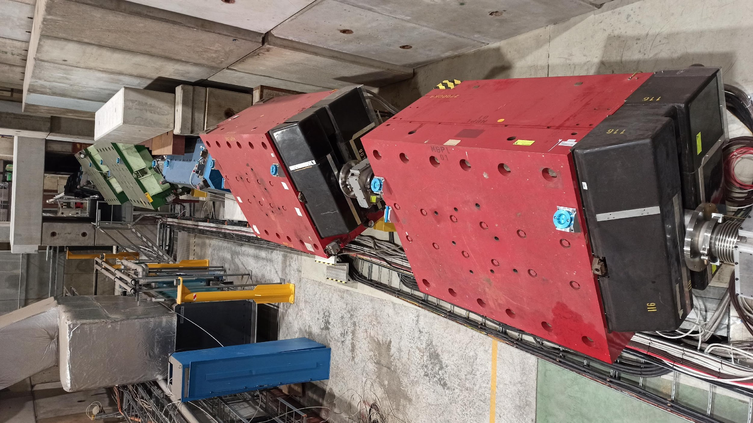
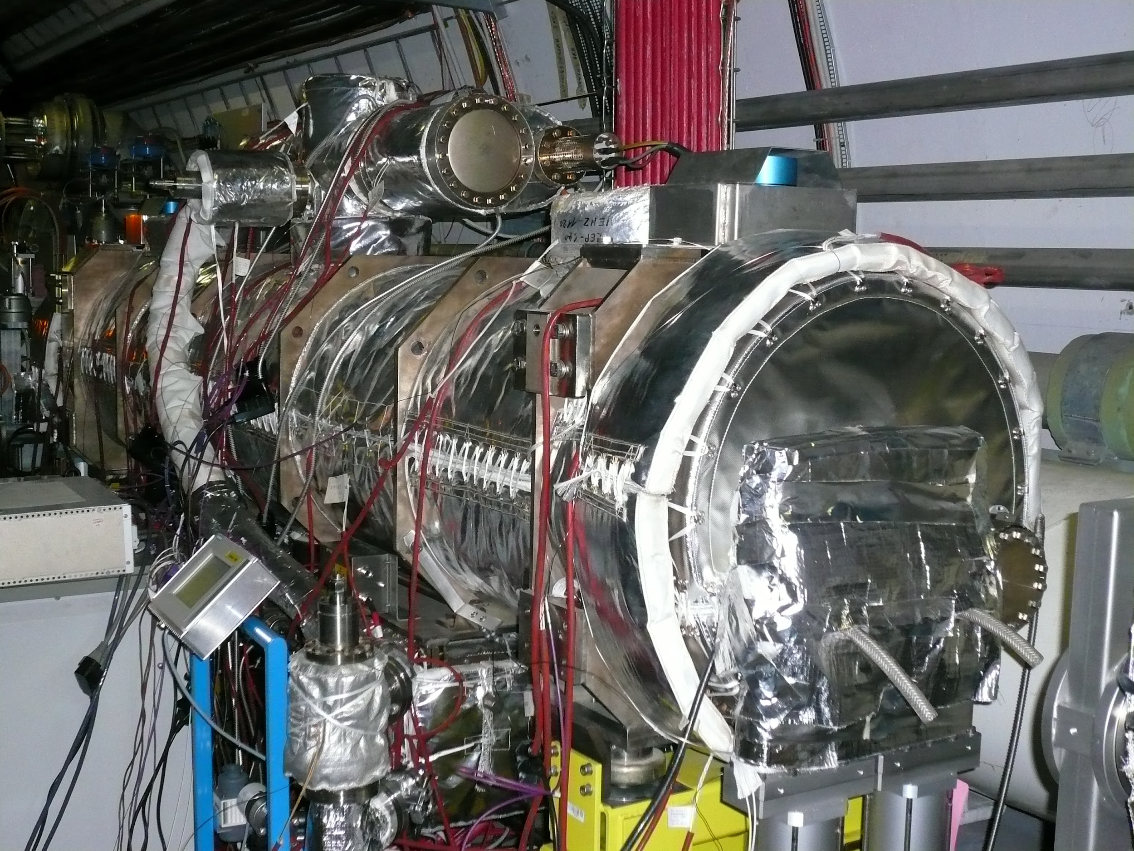
The beamline: simulation vs reality

Slide 9
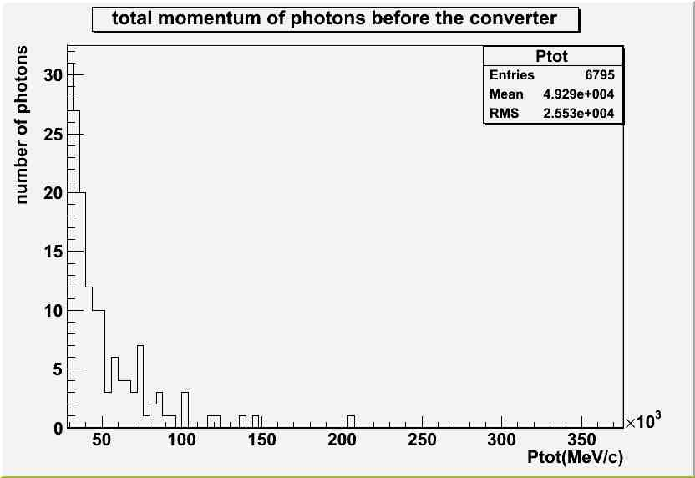
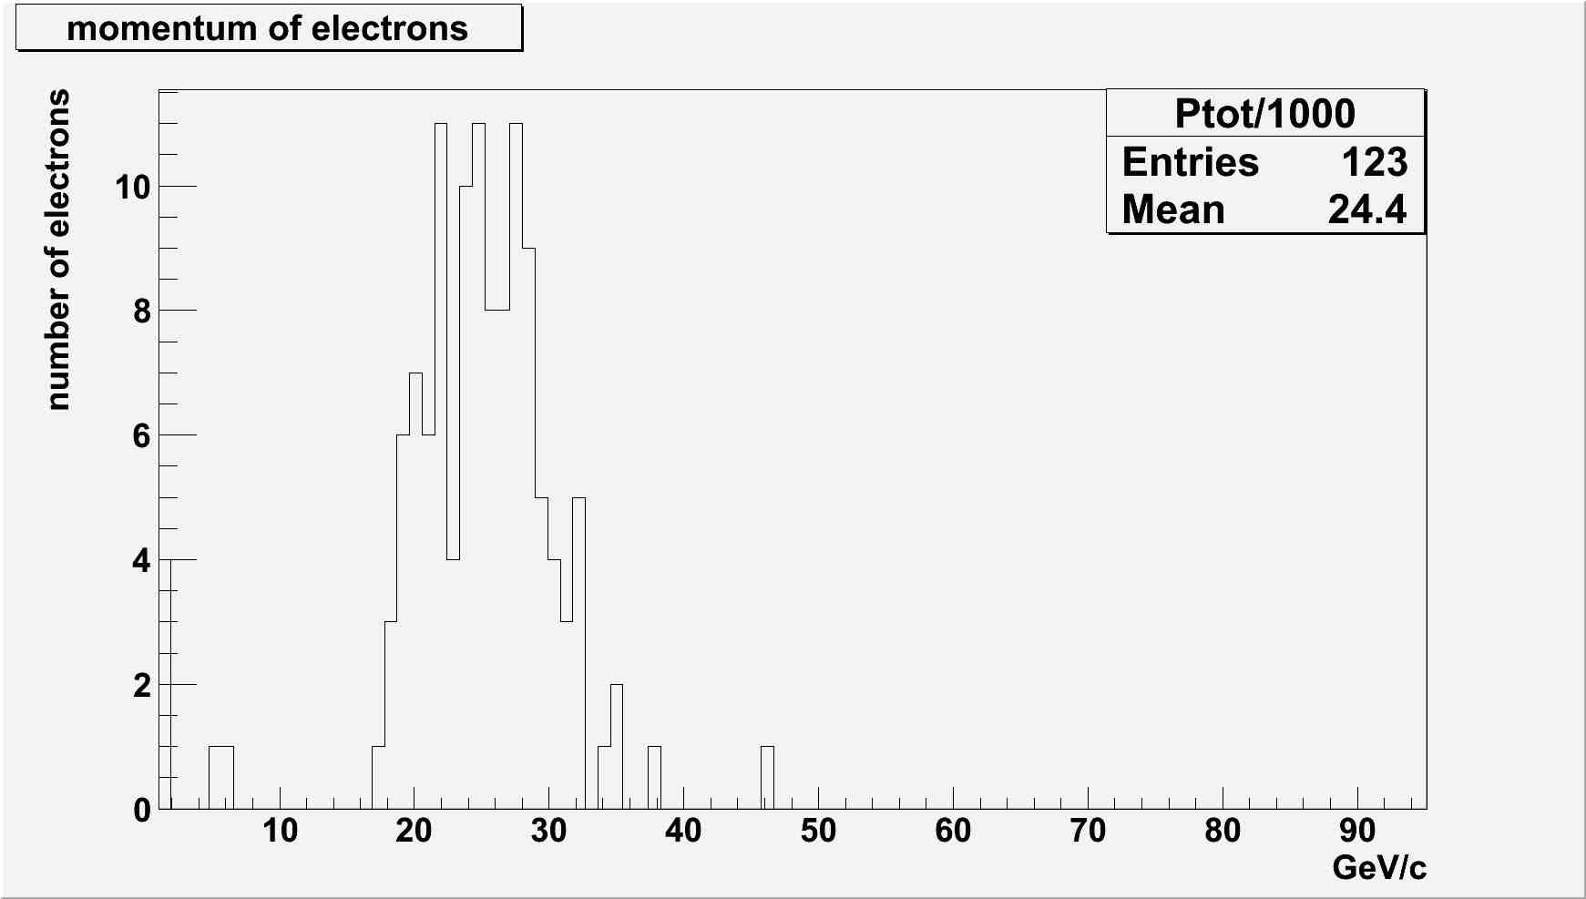
The project

Slide 10
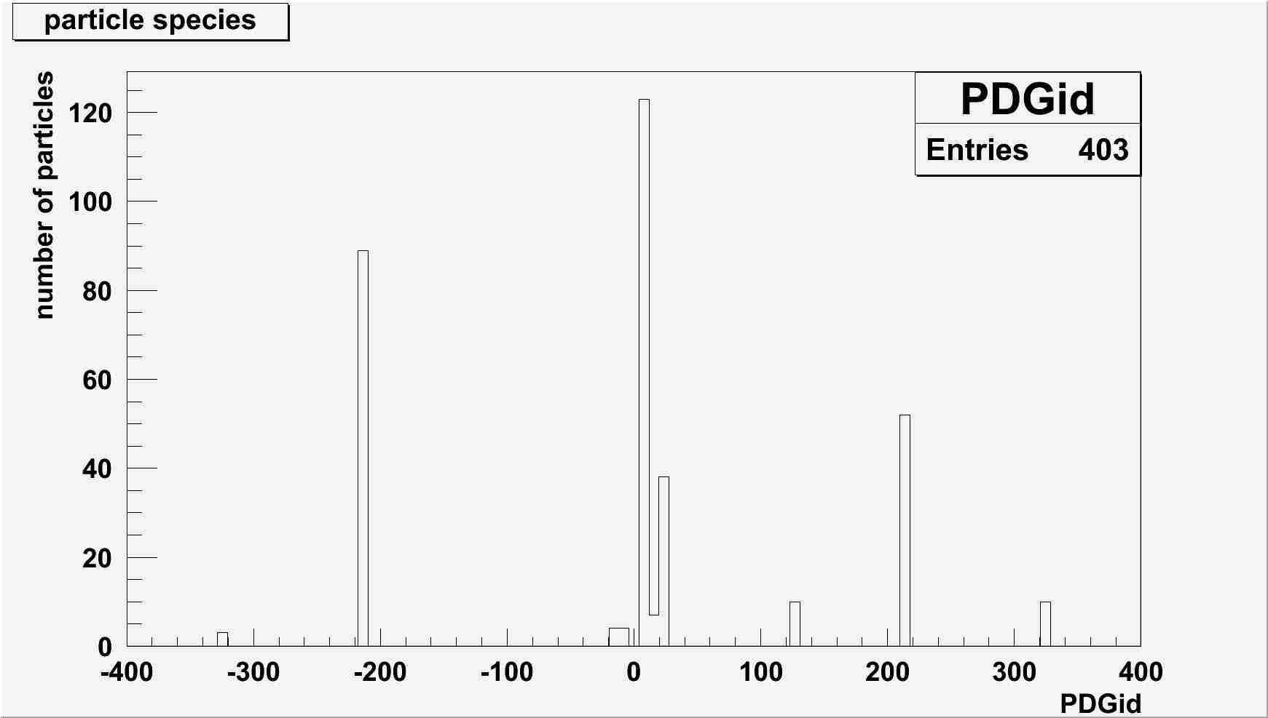
The project
electrons
pions
photons

Slide 11
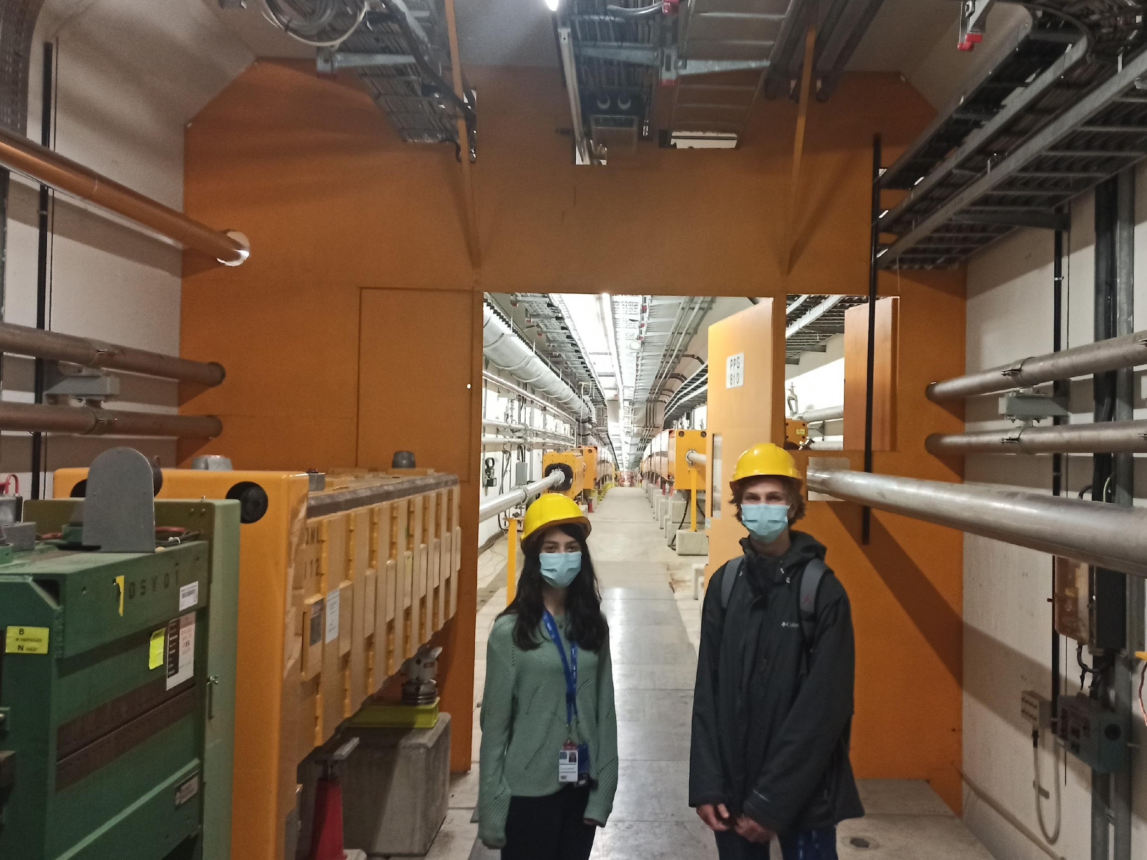
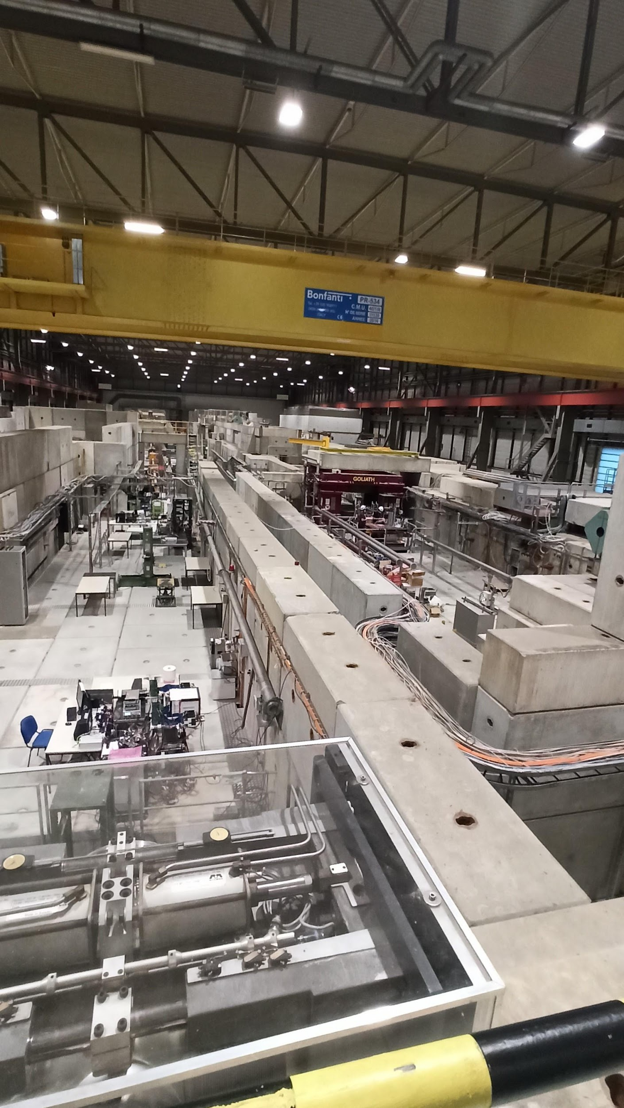
North Area

Slide 12
Thank you for your attention
P. Batsela, I. Pagonidis,
Supervisor: N. Charitonidis [BE-EA]
24/09/2021
High School Students Internship Program Greece 2021

