Slide 1
Welcome
Αντίο!
Welcome

Slide 2
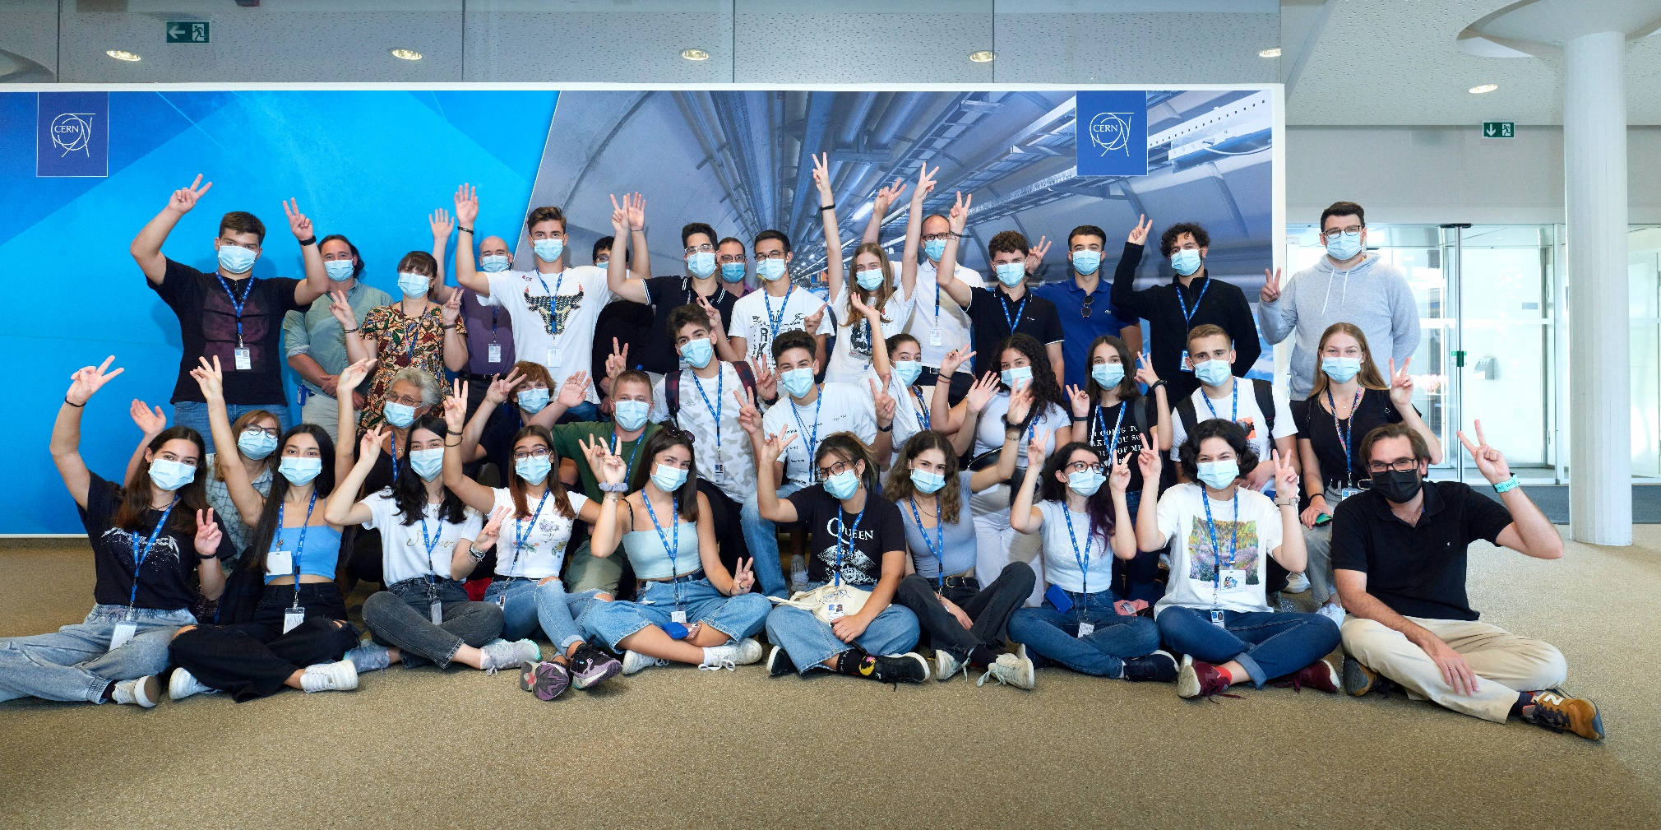
It was a pleasure to have you here!!
… and share some of our experience with you!

Slide 3
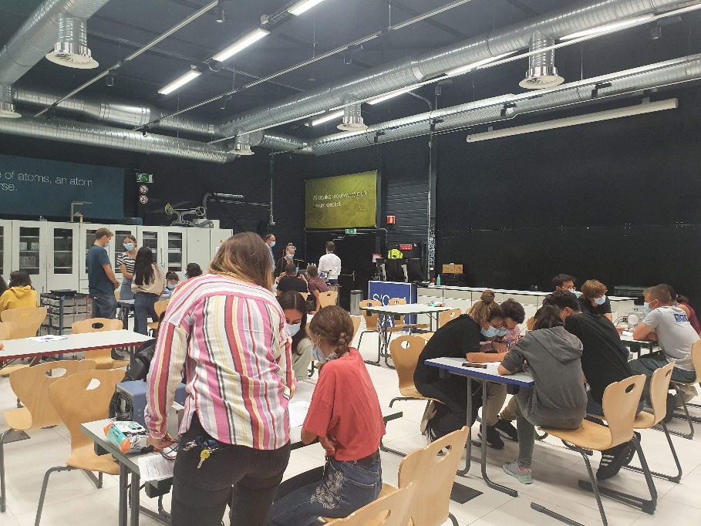
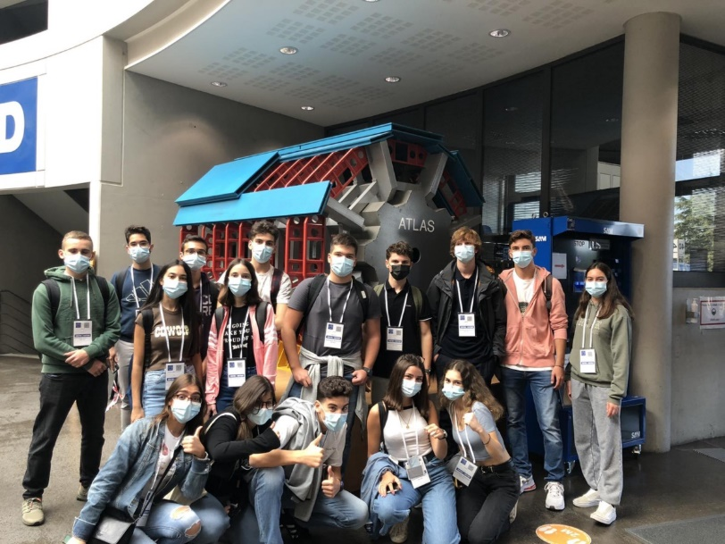
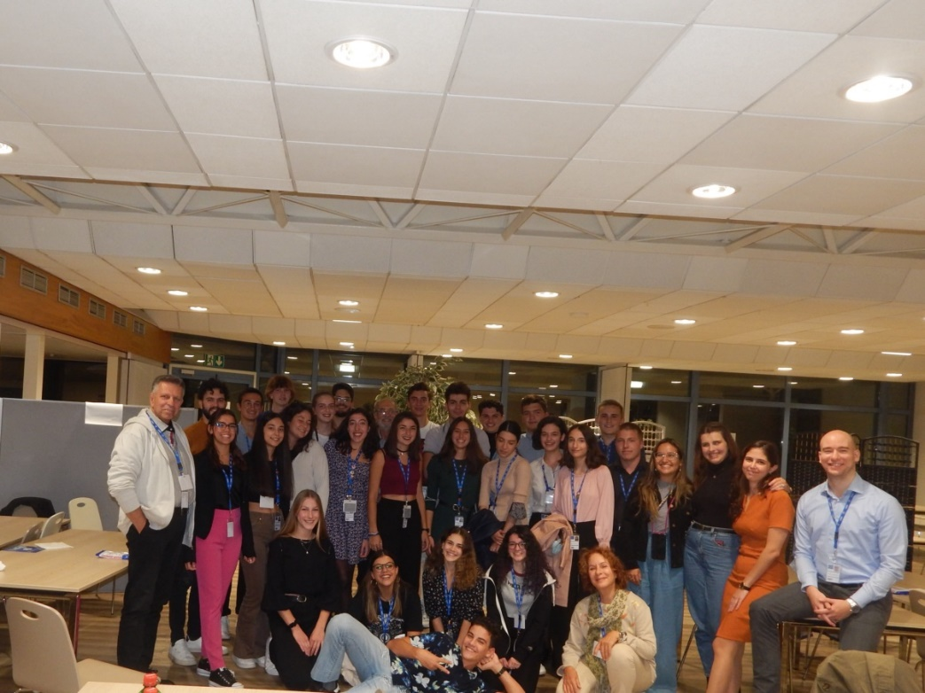
It was a busy, but hopefully also interesting programme…
Please use the presentations, when you return back to school!

Slide 4
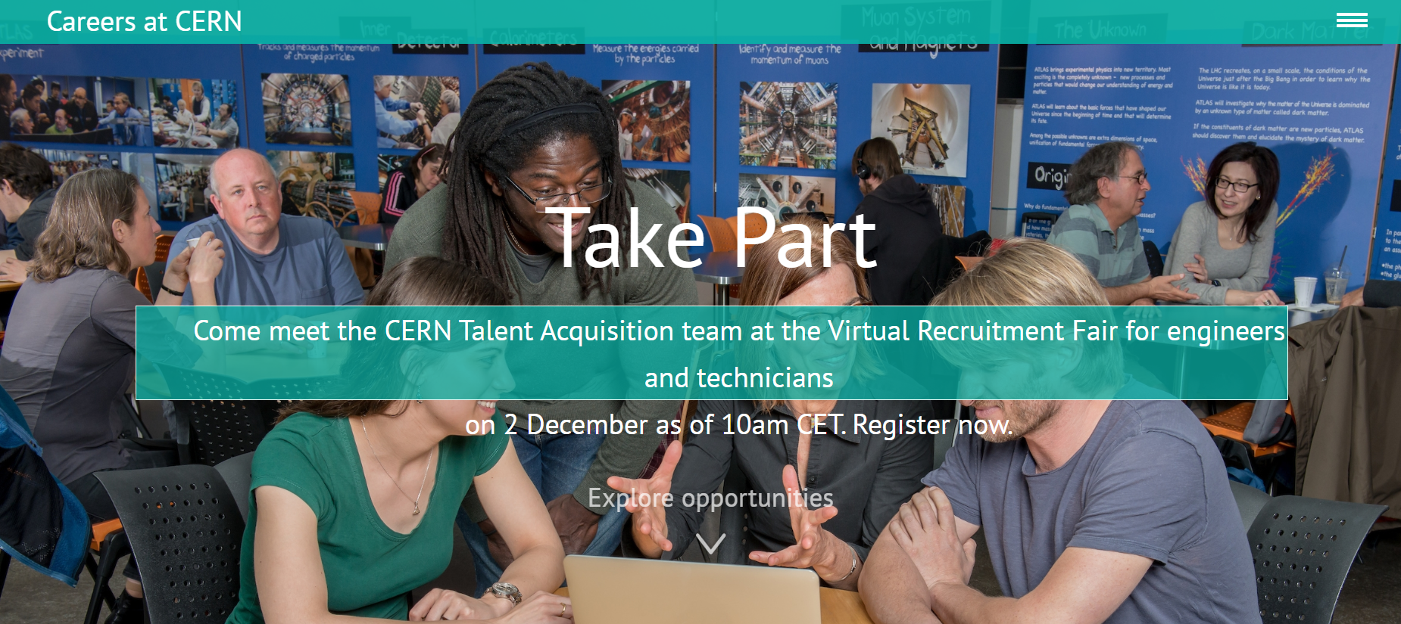
Would you like to come back?
https://careers.cern/

Slide 5
Congratulations
Share your pictures with us! https://cernbox.cern.ch/index.php/s/8ALums38W6KzbbV

Slide 6

A big thanks to:
your project supervisors: Nikolaos Charitonidis, Athanasios Samantas, Despina Hatzifotiadou, Yota Foka, Aris Mamaras, Dimitrios Christidis, Luis Alcerro, Georgios Krintiras, Spyridon Trygazis, Tetiana Pridii, Christina Bolanou, Andrew Purcell,, Gernot Werner Scheerer, Ana Dordevic & Emmanuel Tsesmelis
the numerous guides, lecturers and tutors

Slide 7
A big thanks to:
our selection committee: Evangelos Gazis, Eugenia Tsitopoulou & Emmanuel Tsesmelis
Your teachers: Panagiotis Charatzopoulos & Evangelia Agalopoulou
Our organisational team: Stavie Kotsi, Ece Inci & Feza Tankut

Slide 8
Administrative matters

Slide 9
Hostel check out
You have to check out by 10 am!
There is the possibility to leave your luggage in a safe space at the hostel reception.

Slide 10

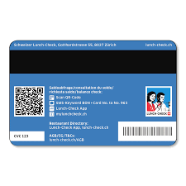
Lunch cards
Leave them at the Hostel reception, before you leave CERN.

Slide 11
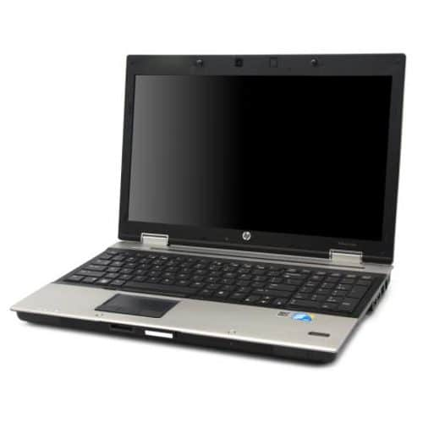


Laptops – we collect them NOW
chargers & cables

Slide 12
Travel Documents
Check in and Greek PLF!
DON’T forget your passports/IDs

Slide 13




Have a safe trip home!
We hope, to see you back in the future!

