Slide 1
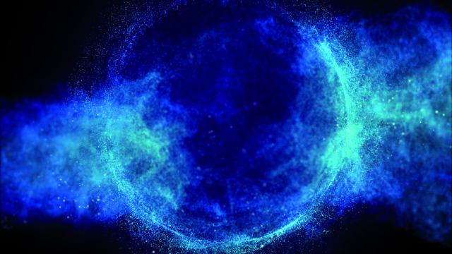
Fizică, acceleratori și detectori
Călin Alexa,
Dept. Fizica Particulelor Elementare, IFIN-HH
Școala Doctorală de Fizică, Universitatea București
Artistic view of the Brout-Englert-Higgs Field

Slide 3
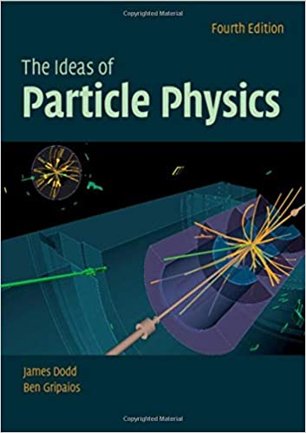
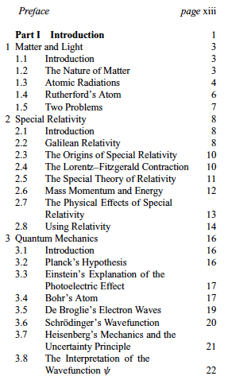
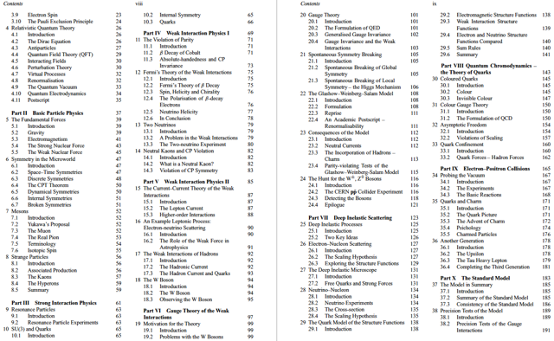
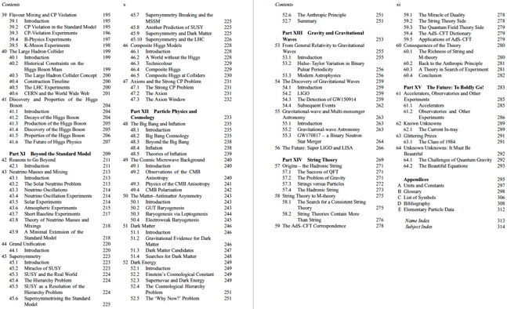
James E. Dodd, St Cross College, Oxford,
Ben Gripaios, University of Cambridge

Slide 4
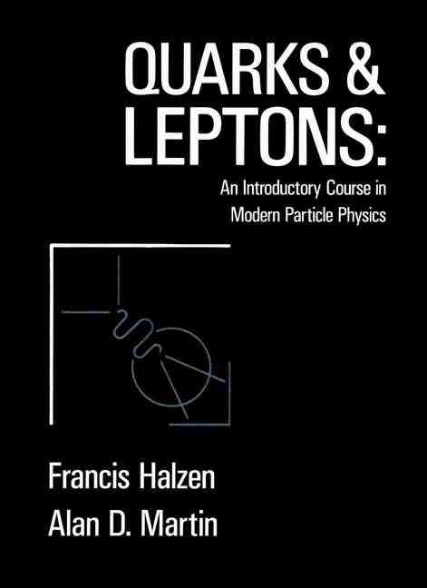
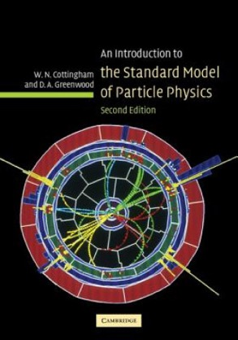

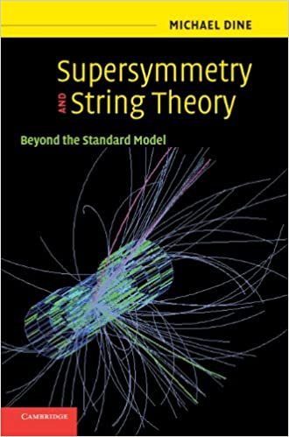

Slide 5
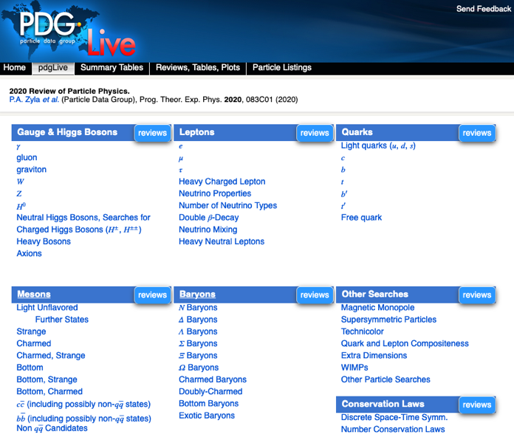
https://pdglive.lbl.gov/Viewer.action

Slide 6
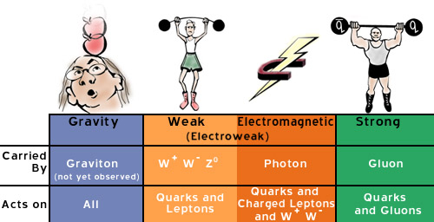
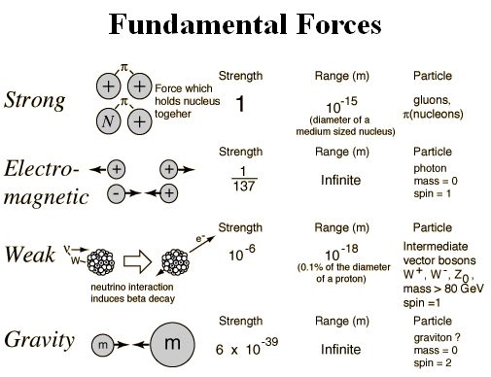

Slide 7
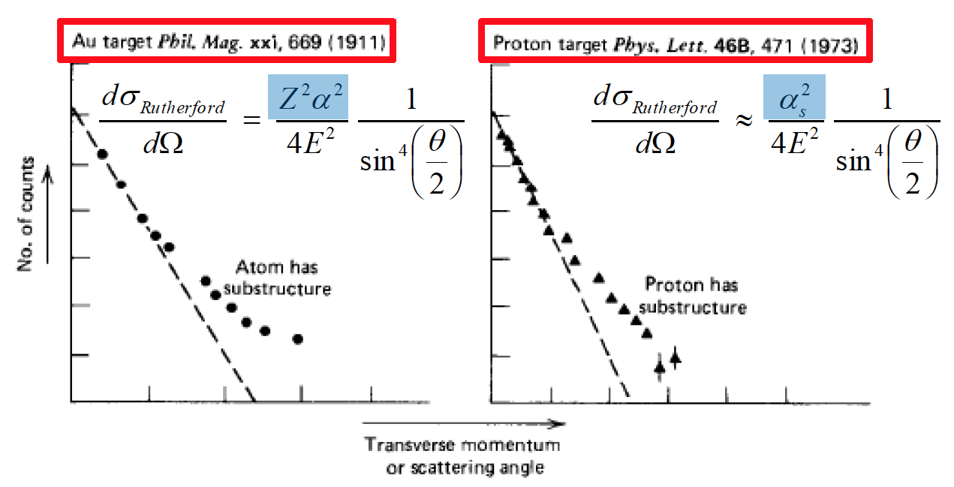

Slide 8
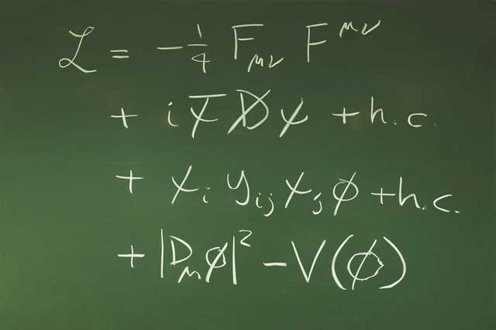

Slide 9
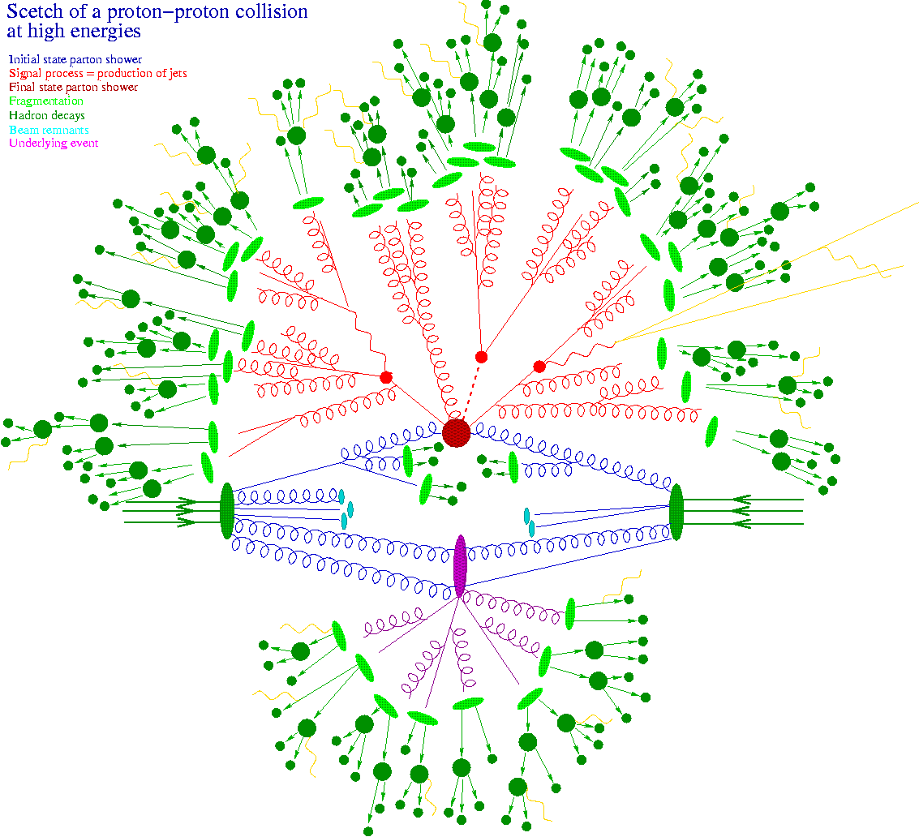


Slide 10
gauge symmetries: spontaneous breaking of a local SU(2) gauge symmetry
the Lagrangian describes three massive gauge fields and one massive scalar h

Slide 11

Animation of the reconstructed mass from Higgs candidate events in four-lepton decays.
https://cds.cern.ch/record/2230893

Slide 12

Animation of the reconstructed mass from Higgs candidate events in two-photon decays.

Slide 13
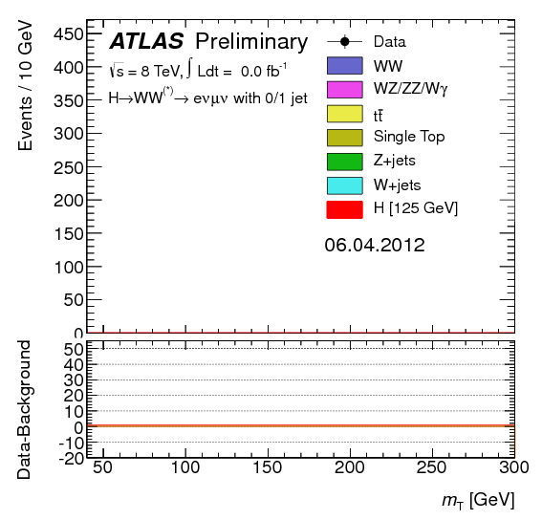
Animation of the reconstructed mass from Higgs candidate events in W-boson-pair decays.

Slide 14
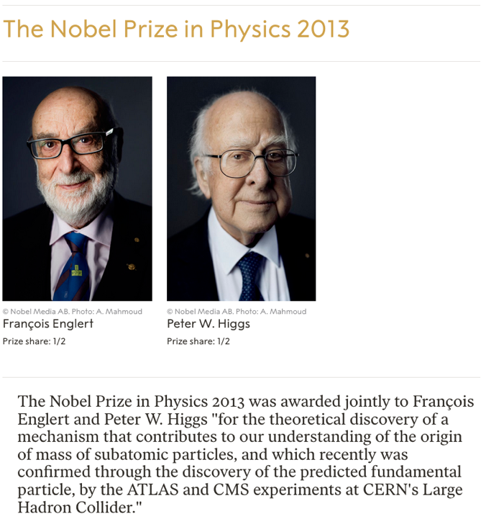

Slide 15
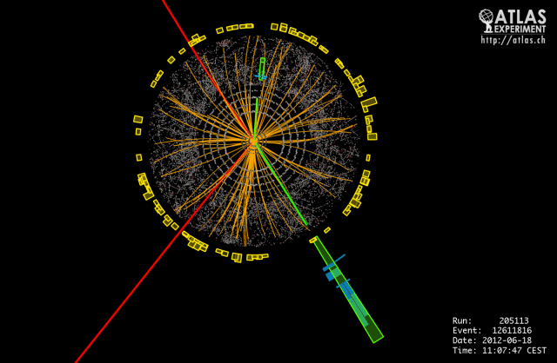
The Higgs boson explained https://home.cern/science/physics/higgs-boson
Event display of a H -> 2e2mu candidate event with m(4l) = 122.6 (123.9) GeV without (with) Z mass constraint.
The masses of the lepton pairs are 87.9 GeV and 19.6 GeV. The event was recorded by ATLAS on 18-Jun-2012, 11:07:47 CEST.

Slide 16
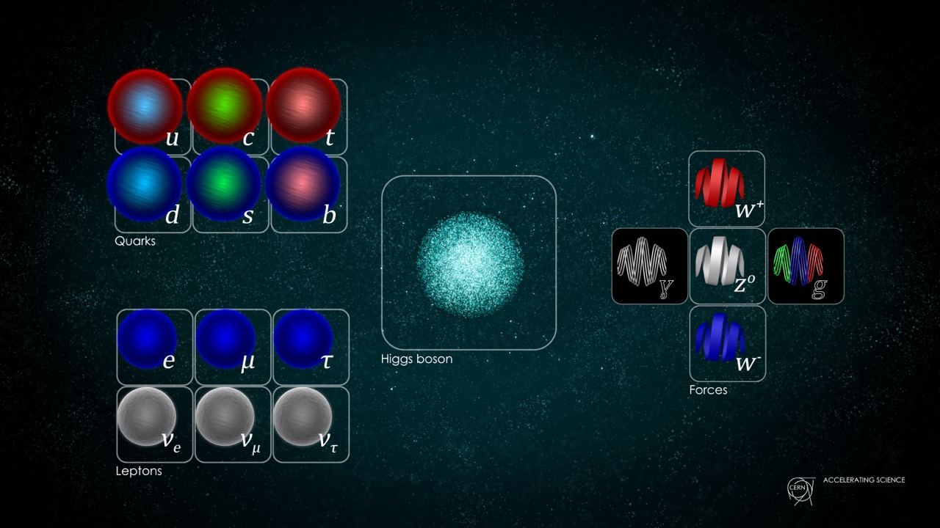

Slide 17
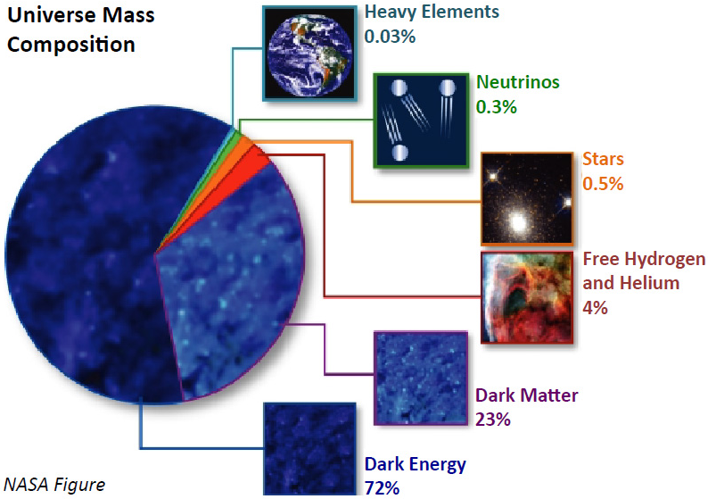
Problems of the Standard Model
P1: neutrino mass
P2: what is dark matter
P3: matter-antimatter asymmetry
P4: expansion of the universe
P5: gravity force has a particle associated?
…
Pn:

Slide 18
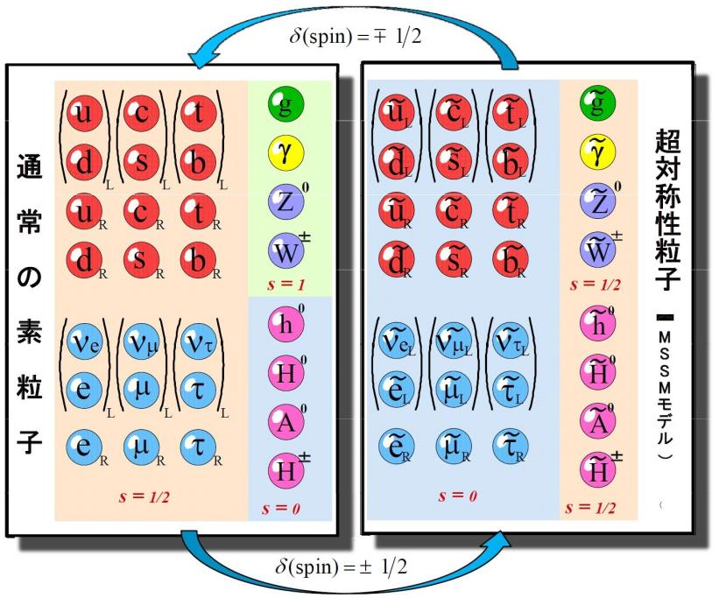


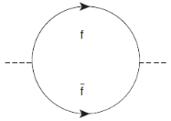
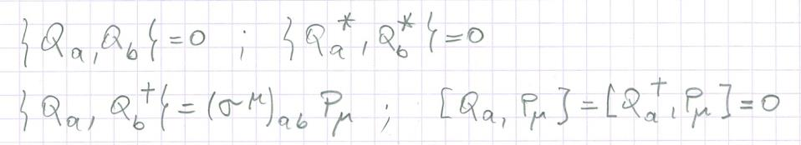

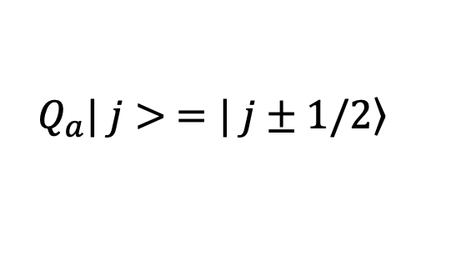
Supersymmetry (SUSY)
+
$$=\left(λ−g_{f}^{2}\right){ Λ}^{2} φ^{†}$$
$$Q_{a}| j> =\left.| j±1/2\right\rangle$$
supersymmetry algebra

Slide 19
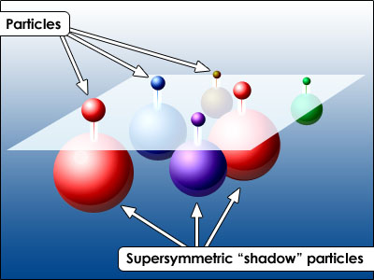

Slide 20
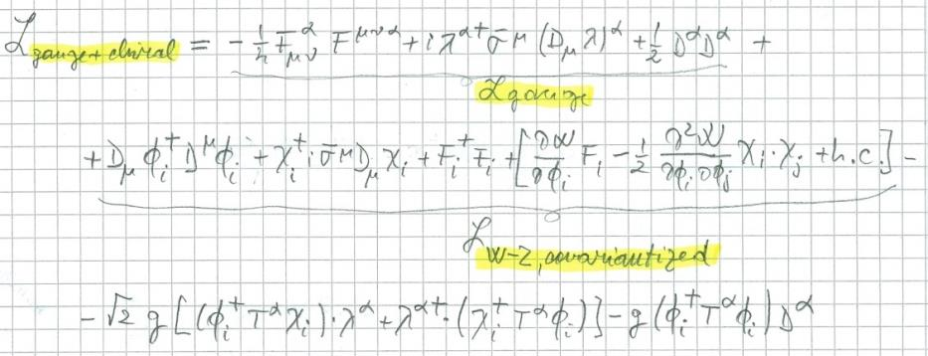
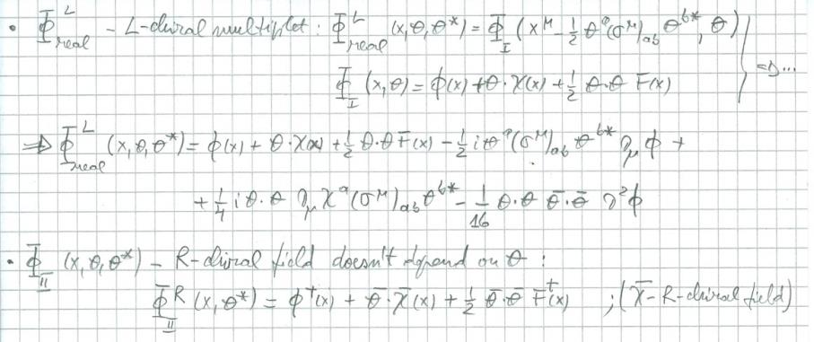

Slide 21
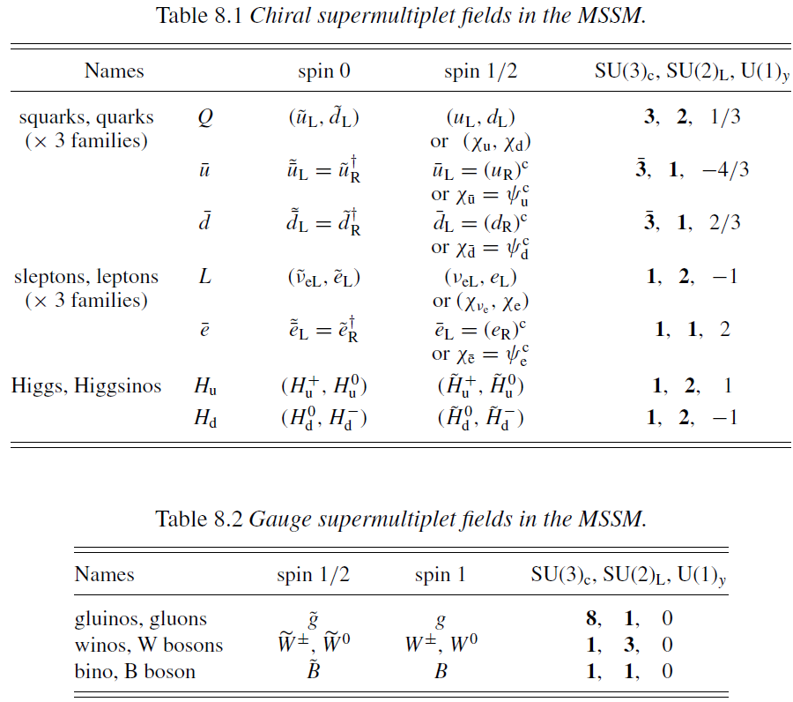
The MSSM

Slide 22
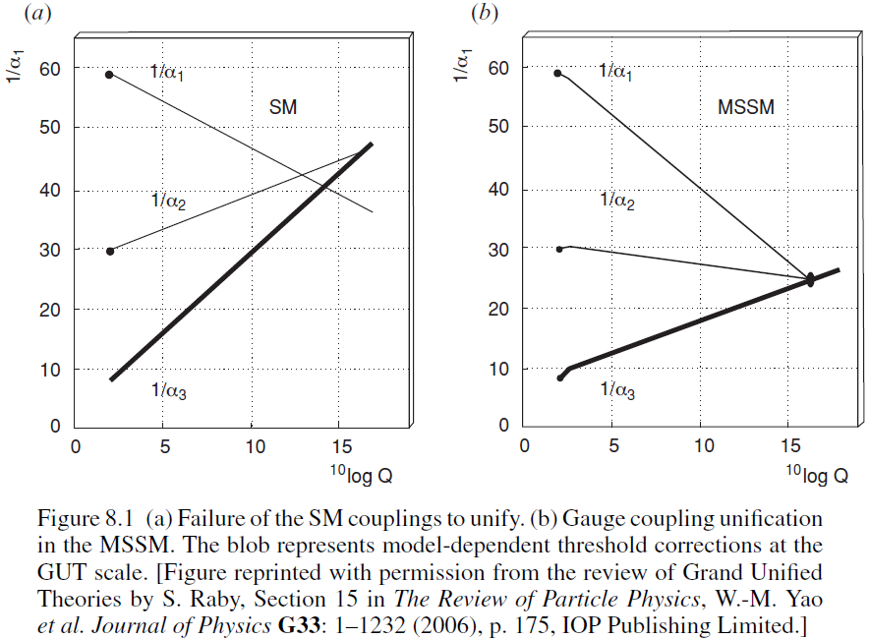
The MSSM: gauge couplings unification in the MSSM

Slide 23
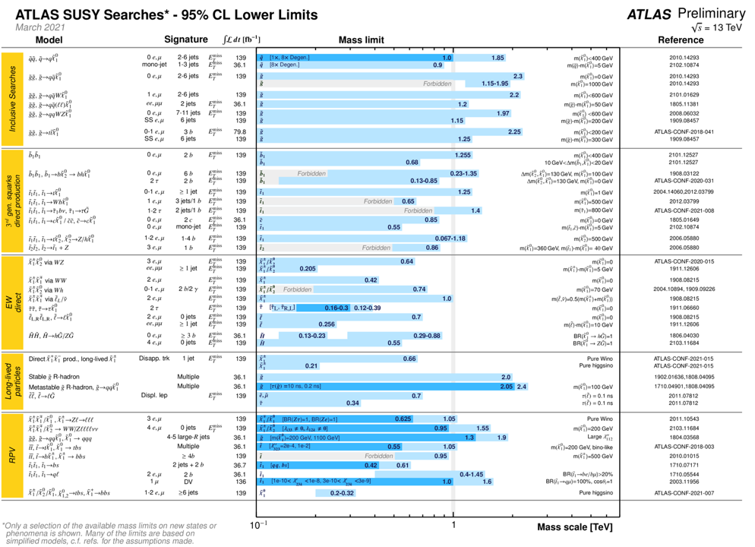

Slide 25
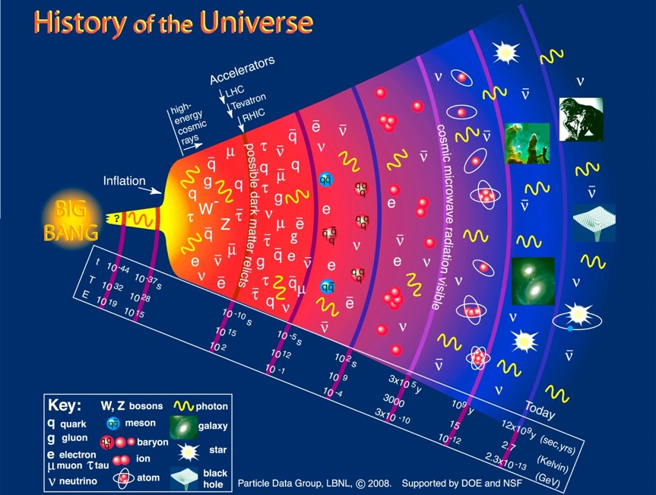

Slide 26
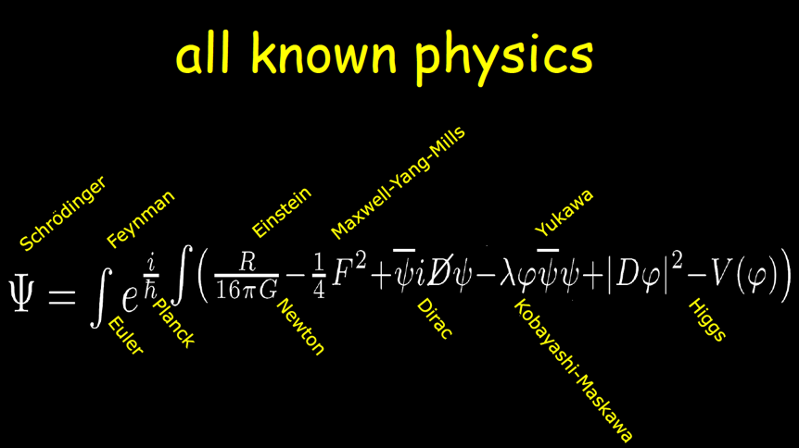
Beyond the Big Bang,
Neil Turok,
Perimeter Institute for Theoretical Physics
https://indico.cern.ch/event/199691/attachments/296929/415045/BeyondtheBigBang0.pdf

Slide 27
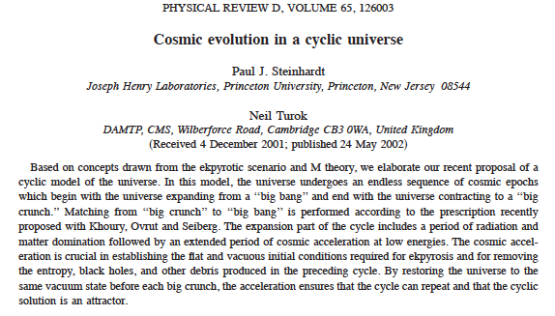

Slide 28

ADD Model:
large extra dimensions - the model was proposed by Nima Arkani-Hamed, Savas Dimopoulos, and Gia Dvali in 1998
“As a consequence, gravity lives in more than four dimensions at macroscopic distances – leading to potentially measurable deviations from Newton’s inverse square law at sub-mm distances. The LHC and NLC are now even more interesting machines. In addition to their traditional role of probing the electroweak scale, they are quantum-gravity machines, which can also look into extra dimensions of space via exotic phenomena such as apparent violations of energy, sharp high-pT cutoffs and the disappearance and reappearance of particles from extra dimensions.” hep-ph/9803315v1

Slide 29
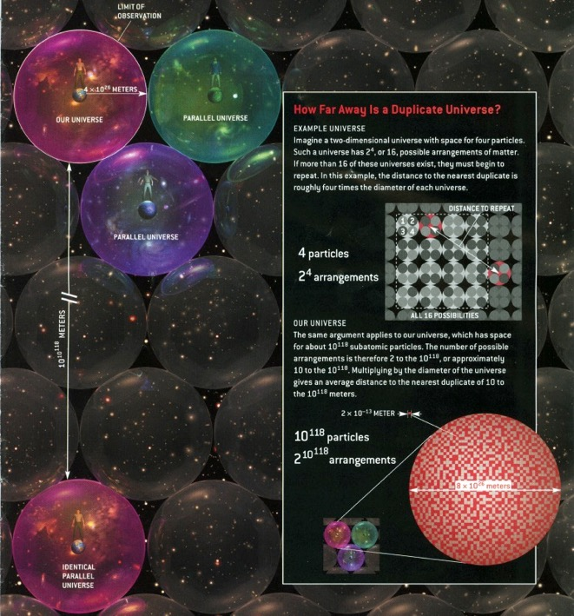

$${10}^{{10}^{118}} meters$$

Slide 30
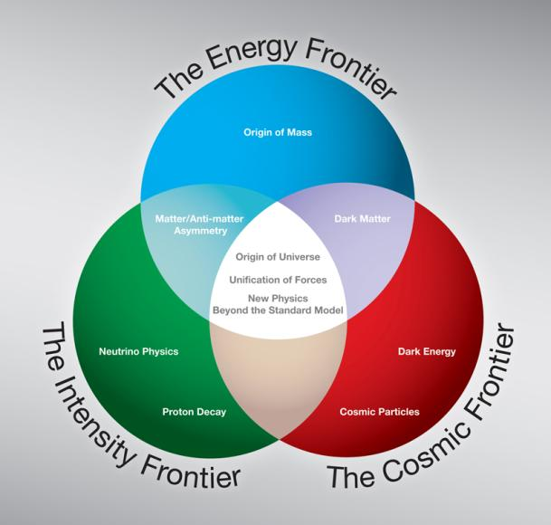

Slide 31
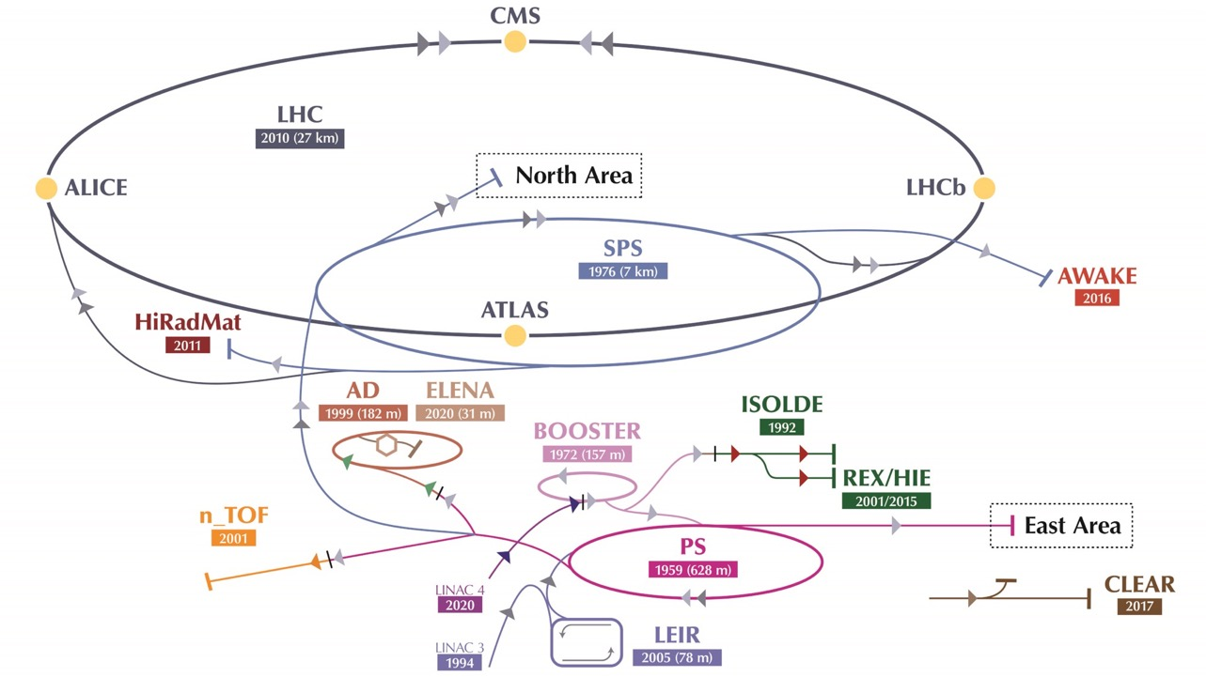

Slide 32
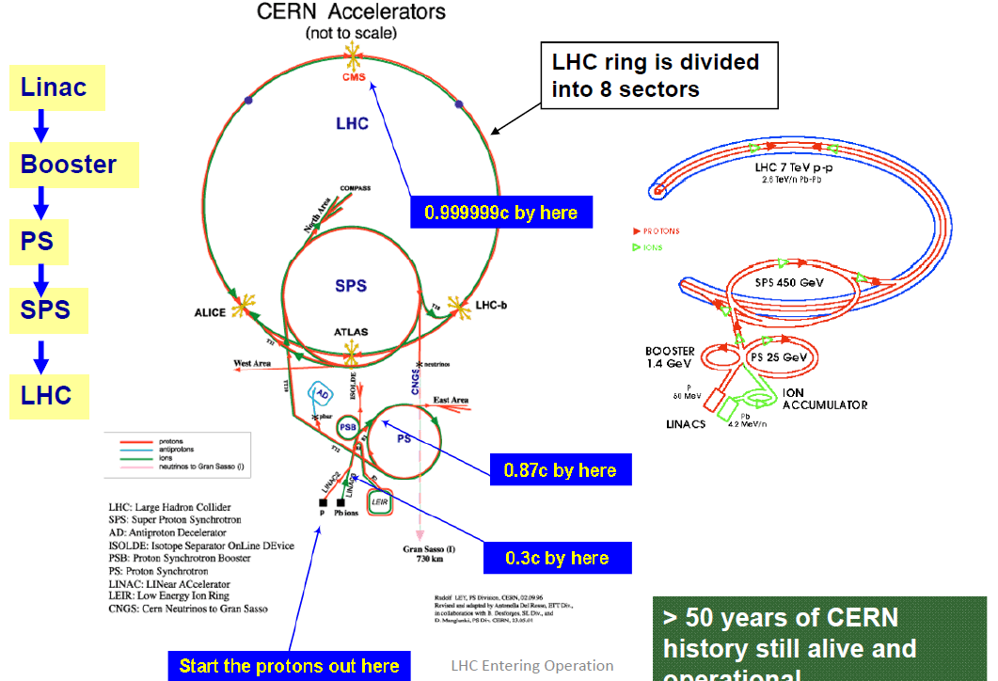

Slide 33
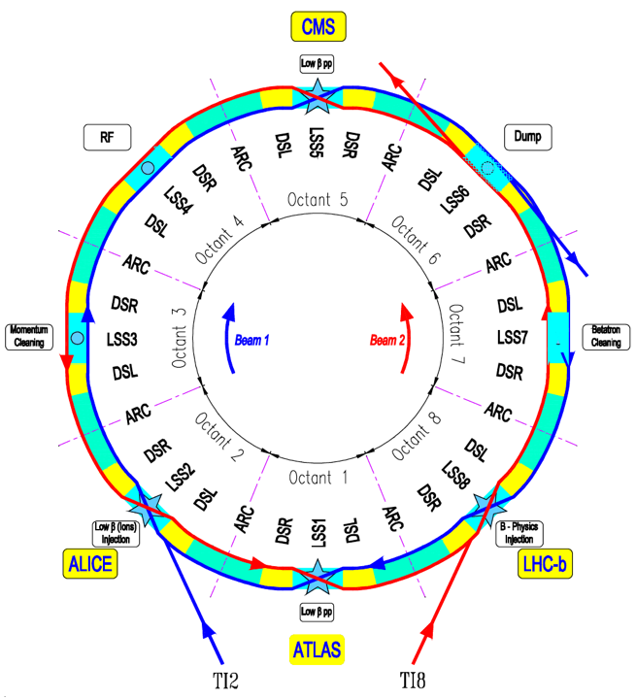
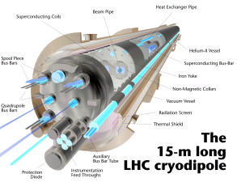
LHC Design Report
https://cds.cern.ch/record/782076?ln=en

Slide 34
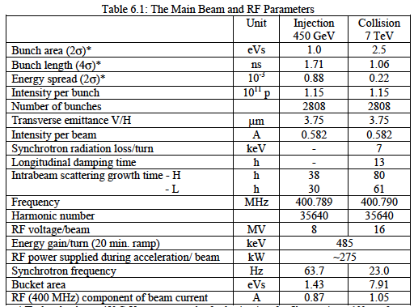
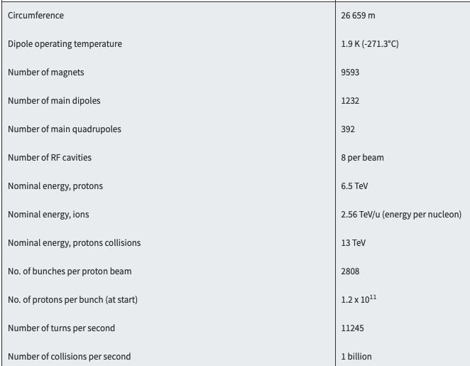

Slide 35
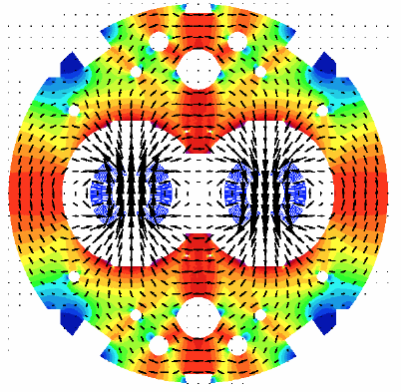
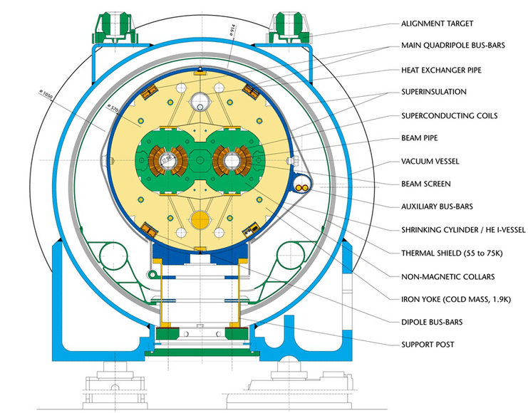
Cross-section of a LHC superconducting cryodipole

Slide 36
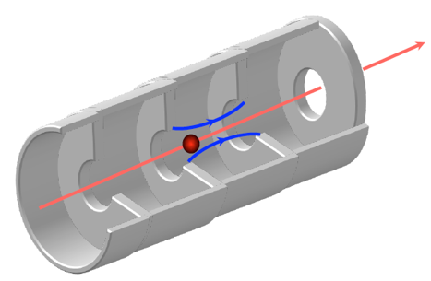
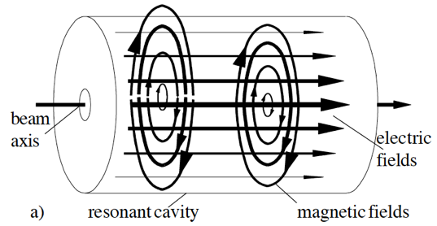
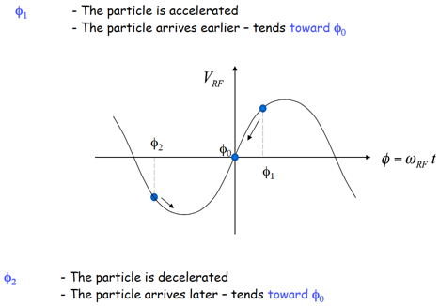
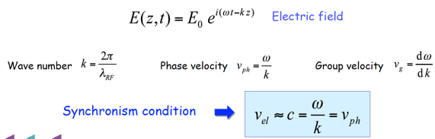
Synchronicity implies that the (time) distance between cavities is a multiple integer of the RF wavelength ω= kv.
The correspondent synchronous RF phase will be Ψ_{s}=ωt-kz

Slide 37
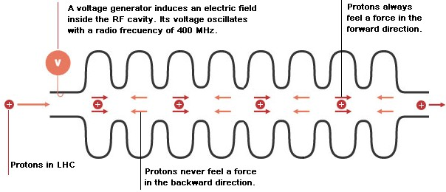
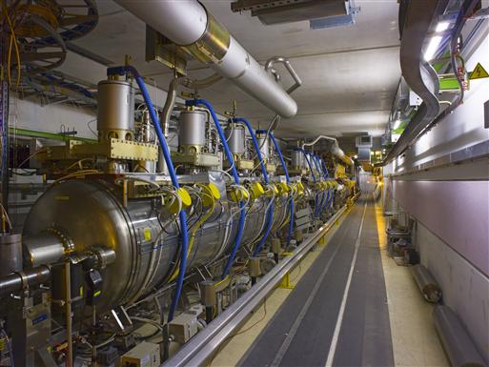
LHC superconducting radio-frequency cavity in the LHC tunnel

Slide 38
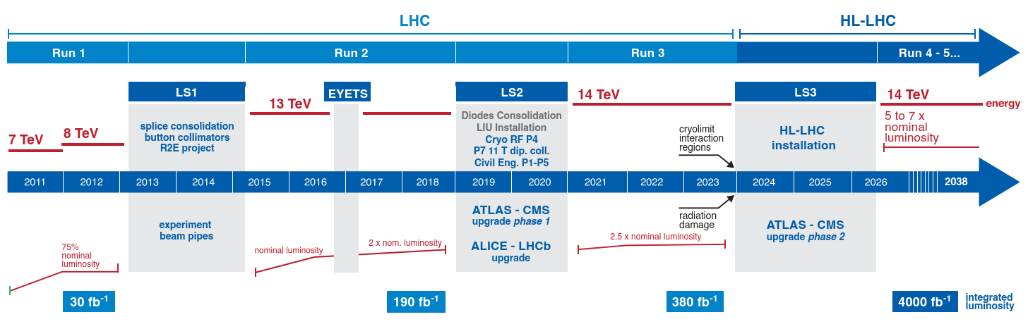
Successful Run 1 and Run 2 : > 189 fb⁻¹
HL-LHC Civil Engineering: a good start - HL-LHC machine in schedule
Run 3 at 14 TeV
End of 2023 : ~350 fb⁻¹ => HL-LHC installation during LS3 (2024-2025)

Slide 39
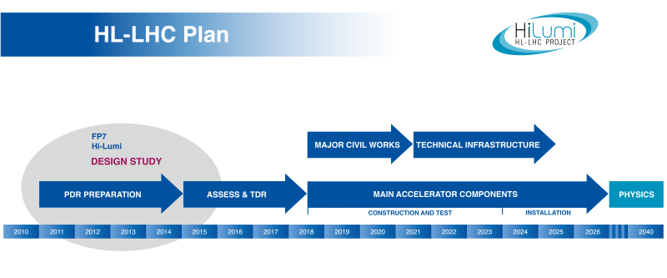

Slide 40


Slide 41


Slide 42


https://europeanstrategy.cern/european-strategy-for-particle-physics

Slide 43



Slide 44


Slide 45


Slide 46


Slide 47


Slide 48


Slide 49


Slide 50


Slide 51


Slide 52


Slide 53


Slide 54


Slide 55

A particle will undergo more than just one interaction process on its path through matter if it is not absorbed in its first interaction.
Charged particles usually lose energy in a large number of subsequent ionisation and excitation interactions with atoms of the medium they pass through.
The probability that a particle interacts with the atoms of a medium is defined by the cross section of a reaction.
The cross section is a measure for the probability of a particle reaction, which in turn depends on the kind and strength of the interaction(s) between the scattering partners. It can be interpreted as an effective interaction area. The cross section represents the effective area of a target particle ‘seen’ by an incoming particle beam.

Slide 56




the number of particles N(x) that have thus far not interacted with the target decreases exponentially with the penetration depth x
$$\frac{dN}{N}=−n σ dx ⟹ N\left(x\right)=N_{0} e^{−μ x}$$
where $N_{0}$ is the original number of particles
and $μ=n σ$
If the beam particles are absorbed when they interact with target particles then μ is called the absorption coefficient or linear attenuation coefficient
the mean free path of a particle: $λ=\frac{1}{μ}=\frac{1}{n σ}$
nuclear cross section: $σ_{nucl}≈π{ r}_{0}^{2} A^{\frac{2}{3}} ≈45 mb{ A}^{\frac{2}{3}}$ (A is the number of nucleons and $r_{0}≈1.2 fm$)
atomic cross section: $σ_{nucl}≈π{ a}_{0}^{2} ≈{10}^{8}b$ ($a_{0}$ is the Bohr radius $\left(a_{0}≈0.05 nm\right)$)
$$\left(1 barn=1 b= {10}^{−24} {cm}^{2} \right)$$
elastic scattering (ex.: ionisation)
inelastic scattering (ex.: excitation of the atom)

Slide 57


Energy loss of charged particles by ionisation
The Bethe–Bloch formula for the average energy loss
the dominant energy loss process of charged particles are ionisation and excitation of the medium’s atoms (up to very high particle velocities, when radiation effects start to play a role)
energy loss of a particle passing through matter arises from a sequence of individual stochastic processes
the average energy loss per path length depends on the properties of the medium a as well as on the mass M and the velocity of the particle
    $$−\left\langle \frac{dE}{dx}\right\rangle =n \int_{T_{min}}^{T_{max}}{T \frac{dσ_{a}}{dT}\left(M,β,T\right) dT}$$
n is the target number density
$dσ_{a}/dT$ the differential cross section for a loss of kinetic energy T in the collision

Slide 58


the Bethe–Bloch formula
is valid for ‘heavy’ particles which includes all particles except electrons and positrons
the mean energy loss in matter is also called stopping power

Slide 59



Energy dependence of $\left\langle \frac{dE}{dx}\right\rangle$
$π^{±}$in silicon
minimum-ionising particles (mips)

Slide 60

knowing the momentum a particle’s mass can be identified by measuring the mean energy loss $\left\langle \frac{dE}{dx}\right\rangle$

Slide 61



The transition to detectors with completely electronic readout proceeded since the 1960s in parallel to the progressing development of highly integrated electronics.
multiwire proportional chamber (MWPC)
G. Charpak (Nobel Prize 1992
drift chamber
cloud chamber

Slide 62

Detector concepts
The spectrometer only measures the scattered electrons (without detecting the recoil system) which is sufficient to determine the relevant kinematical variables. The figure shows a side view of the spectrometer which deflects the electrons upwards. The plane of the view contains the axis through the target around which the spectrometer can be rotated to define the scattering angle. The scattered electrons are deflected by two dipole magnets (B1, B2) and are focused by three quadrupole magnets (Q1–Q3) such that the momenta can be determined by an array of scintillation counters (‘hodoscope’) arranged in the focal plane of the magnet system. The shielded housing which surrounds the hodoscope also contains trigger counters and elements for the identification of the electrons, in particular for separating them from pions.

Slide 63

With the progress in the miniaturisation of electronics, semiconductor detectors became more affordable, allowing also their use
as large volume tracking detectors, in particular in high rate environments (e.g. at LHC).

Slide 64

calorimeters : their principle is based on the total absorption of a particle’s energy

Slide 65


The goal in modern particle physics experiments is often to detect, identify and kinematically reconstruct all particles of a scattering reaction and to achieve that in as much of the full $4π$ solid angle as possible.
General-purpose detectors:
  fixed-target experiments
  collider experiments

Slide 66

General-purpose detectors are constructed in layers each taking over a specific task:
Vertex detectors for the detection of secondary vertices with separation from the primary vertex of the reaction.
Tracking detectors for track reconstruction yielding momentum determination and (sometimes) particle identification.
Optional detectors for particle identification, for example, Cherenkov detectors.
A calorimeter for the measurement of electromagnetic showers (electrons and photons).
A magnet coil in collider experiments; sometimes also in front of the electromagnetic calorimeter.
A hadron calorimeter, usually outside the magnet coil.
Muons are the most penetrating charged particles and therefore they are identified by their detection behind the calorimeters..
One tesla (1 T) is defined as the field intensity generating one newton (N) of force per ampere (A) of current per meter of conductor:
T = N × A-1 × m-1 = (kg x m x s-2) x A-1 x m-1 = kg × s-2 × A-1

Slide 68


Slide 69

https://physicsmasterclasses.org/

Slide 70


