Slide 1
Welcome
Good bye
Welcome

Slide 2
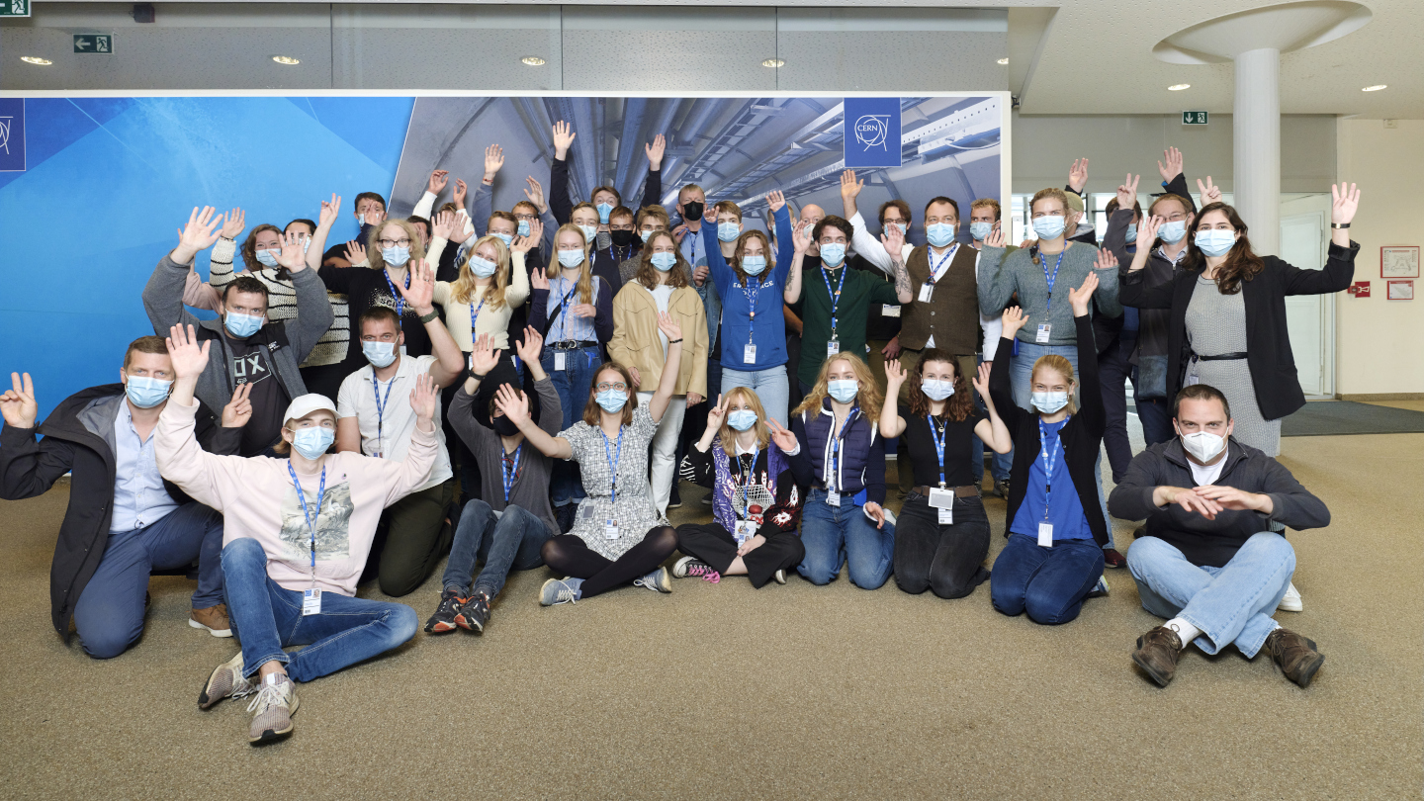
It was a pleasure to have you here!!
… and share some of our experience with you!
19/09-02/10/2021
Danish HSSIP 2021

Slide 3
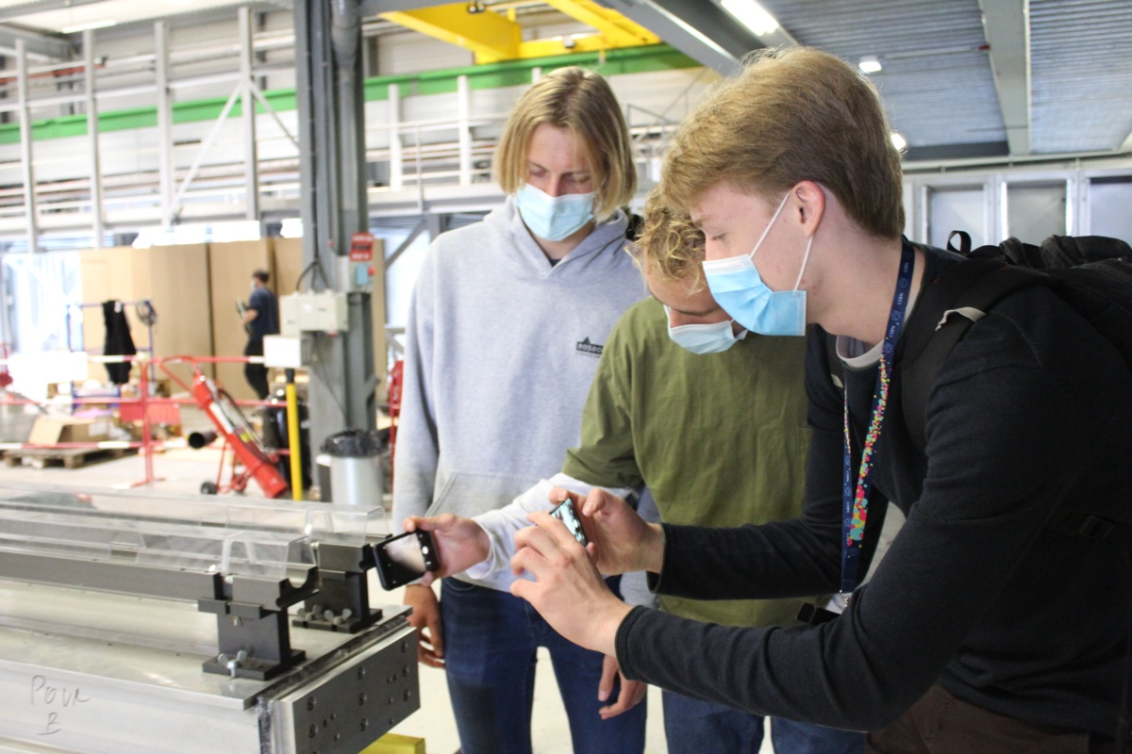
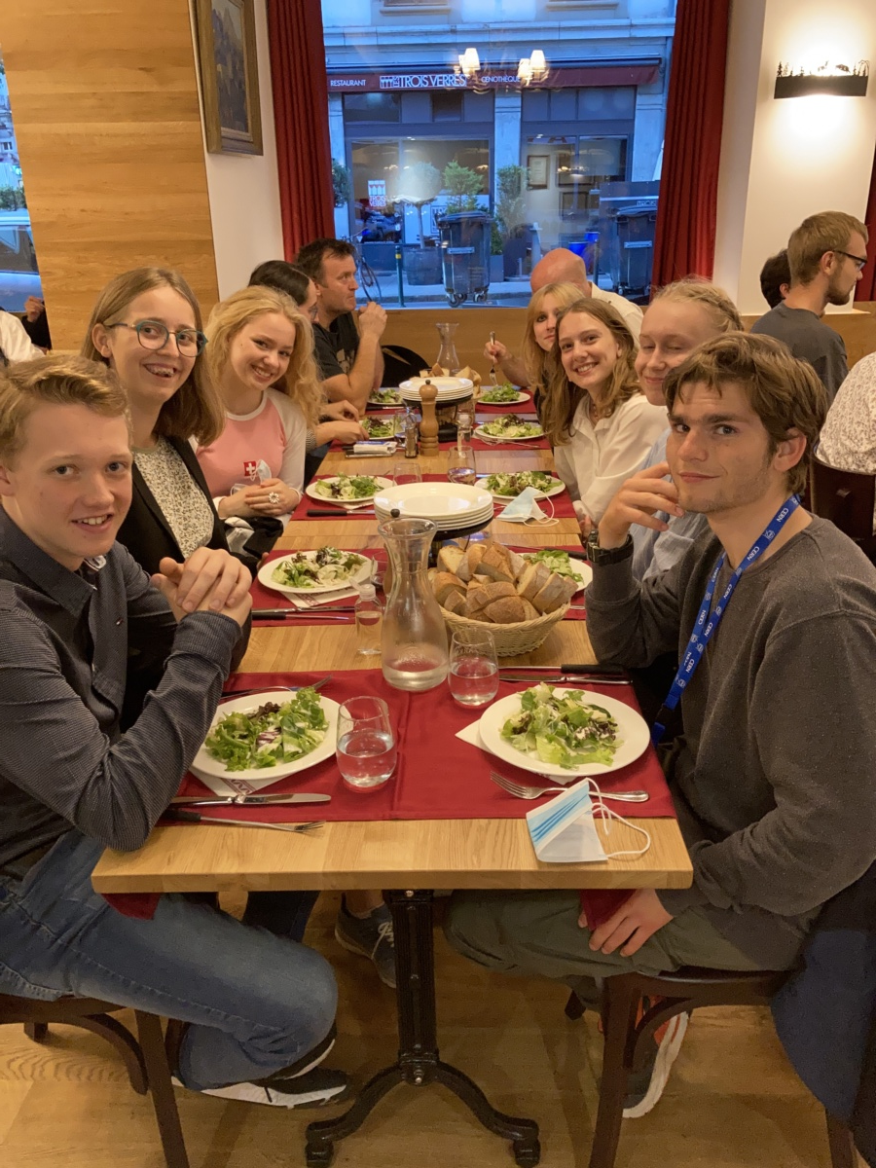
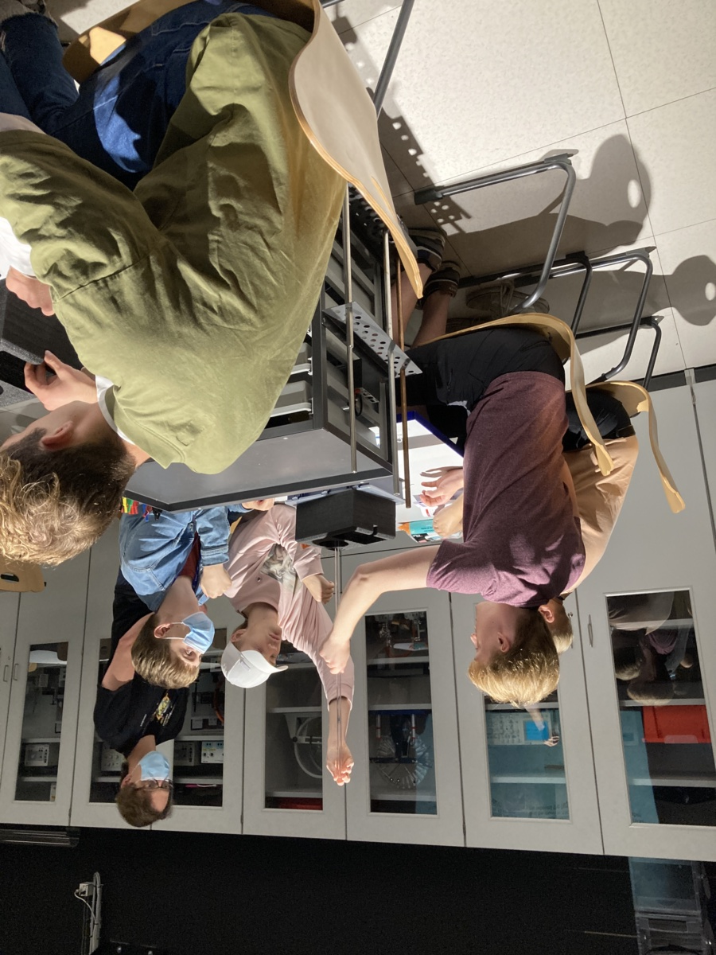
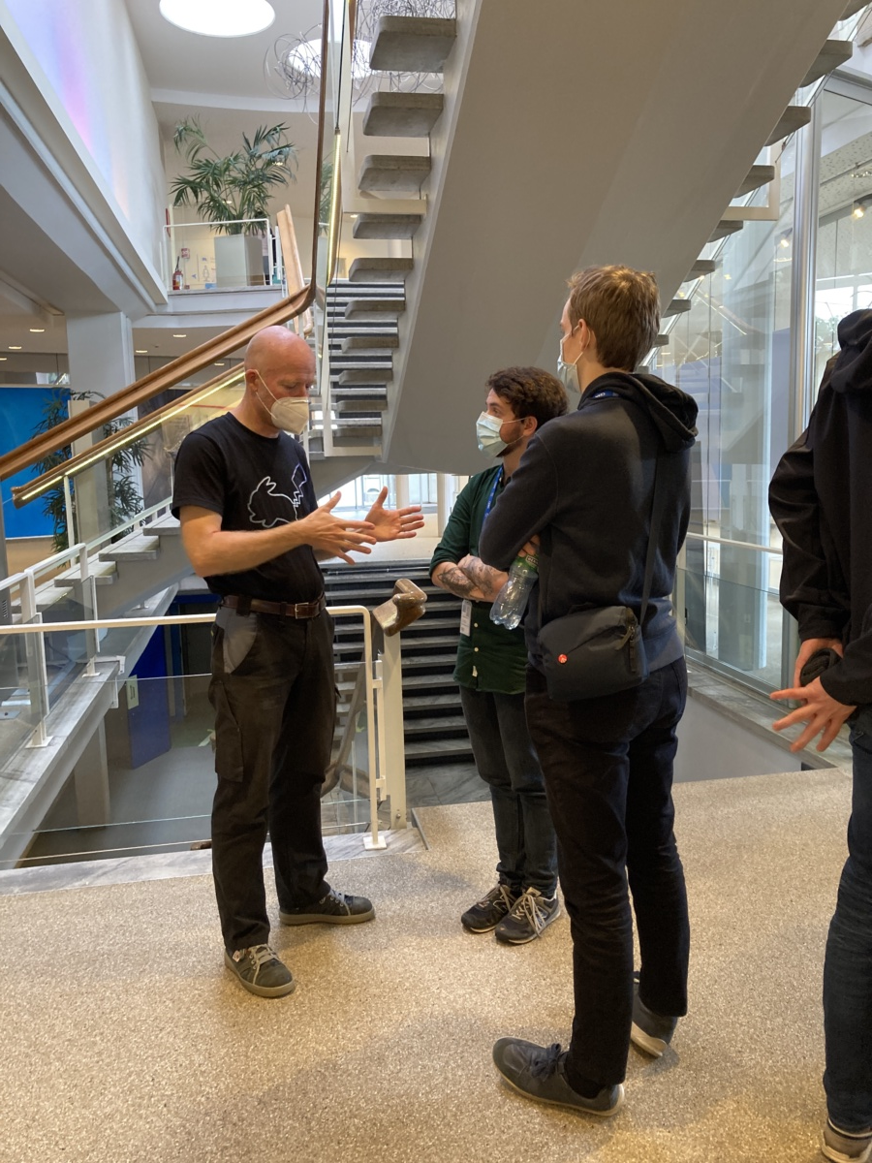
It was a busy, but hopefully also interesting programme…
Please use the presentations, when you return back to school!
19/09-02/10/2021
Danish HSSIP 2021

Slide 4
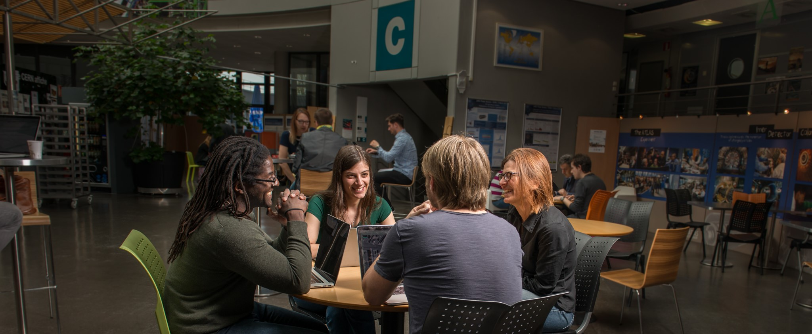
Would you like to come back?
https://careers.cern/
https://cern.ch/bl4s
https://teacher-programmes.web.cern.ch/
19/09-02/10/2021
Danish HSSIP 2021

Slide 5
Congratulations
Share your pictures with us!
https://cernbox.cern.ch/index.php/s/cgW4HGnHMrn5RN7
19/09-02/10/2021
Danish HSSIP 2021

Slide 6

19/09-02/10/2021
Danish HSSIP 2021

Slide 7
En stor tak til:
your project supervisors: Niels Madsen, Wilfried Devauchelle, Jame Storey, Lars Holm Nielsen, Jørgen Christiansen, Alberto Rodriguez, Patricia Verheyden, Daria Dvorzhitskaia, Carla Pitarch, Jesper Nielsen, Henrik Nissen, Alexandre Sinture, Ian Bearden, Peter Granum
the numerous guides, lecturers and tutors
your teachers: Maren Berglioth Malling, Rasmus Olofsson
19/09-02/10/2021
Danish HSSIP 2021

Slide 8
En stor tak til:
The Danish Organization team: Ian Gardner Bearden, Lars Varming Joergensen, Louise Kindt.
Our organization team: Stavie Kotsi, Ece Inci, and Feza Tankut.
19/09-02/10/2021
Danish HSSIP 2021

Slide 9
Administrative matters
19/09-02/10/2021
Danish HSSIP 2021

Slide 10
Hostel check out
You have to check out by 10 am!
There is the possibility to leave your luggage in a safe space at the hostel reception.
19/09-02/10/2021
Danish HSSIP 2021

Slide 11

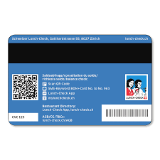
Lunch cards
Leave them at the Hostel reception, before you leave CERN.
19/09-02/10/2021
Danish HSSIP 2021

Slide 12



Laptops – we collect them NOW
chargers & cables
19/09-02/10/2021
Danish HSSIP 2021

Slide 13

Did you give back your dosimeter ?
19/09-02/10/2021
Danish HSSIP 2021

Slide 14
Travel Documents
ID/Passport, Covid-19 related formalities..
19/09-02/10/2021
Danish HSSIP 2021

Slide 15




Have a safe trip home!
We hope, to see you back in the future!
19/09-02/10/2021
Danish HSSIP 2021

