Slide 1
LIU-PS Planning report

Slide 2
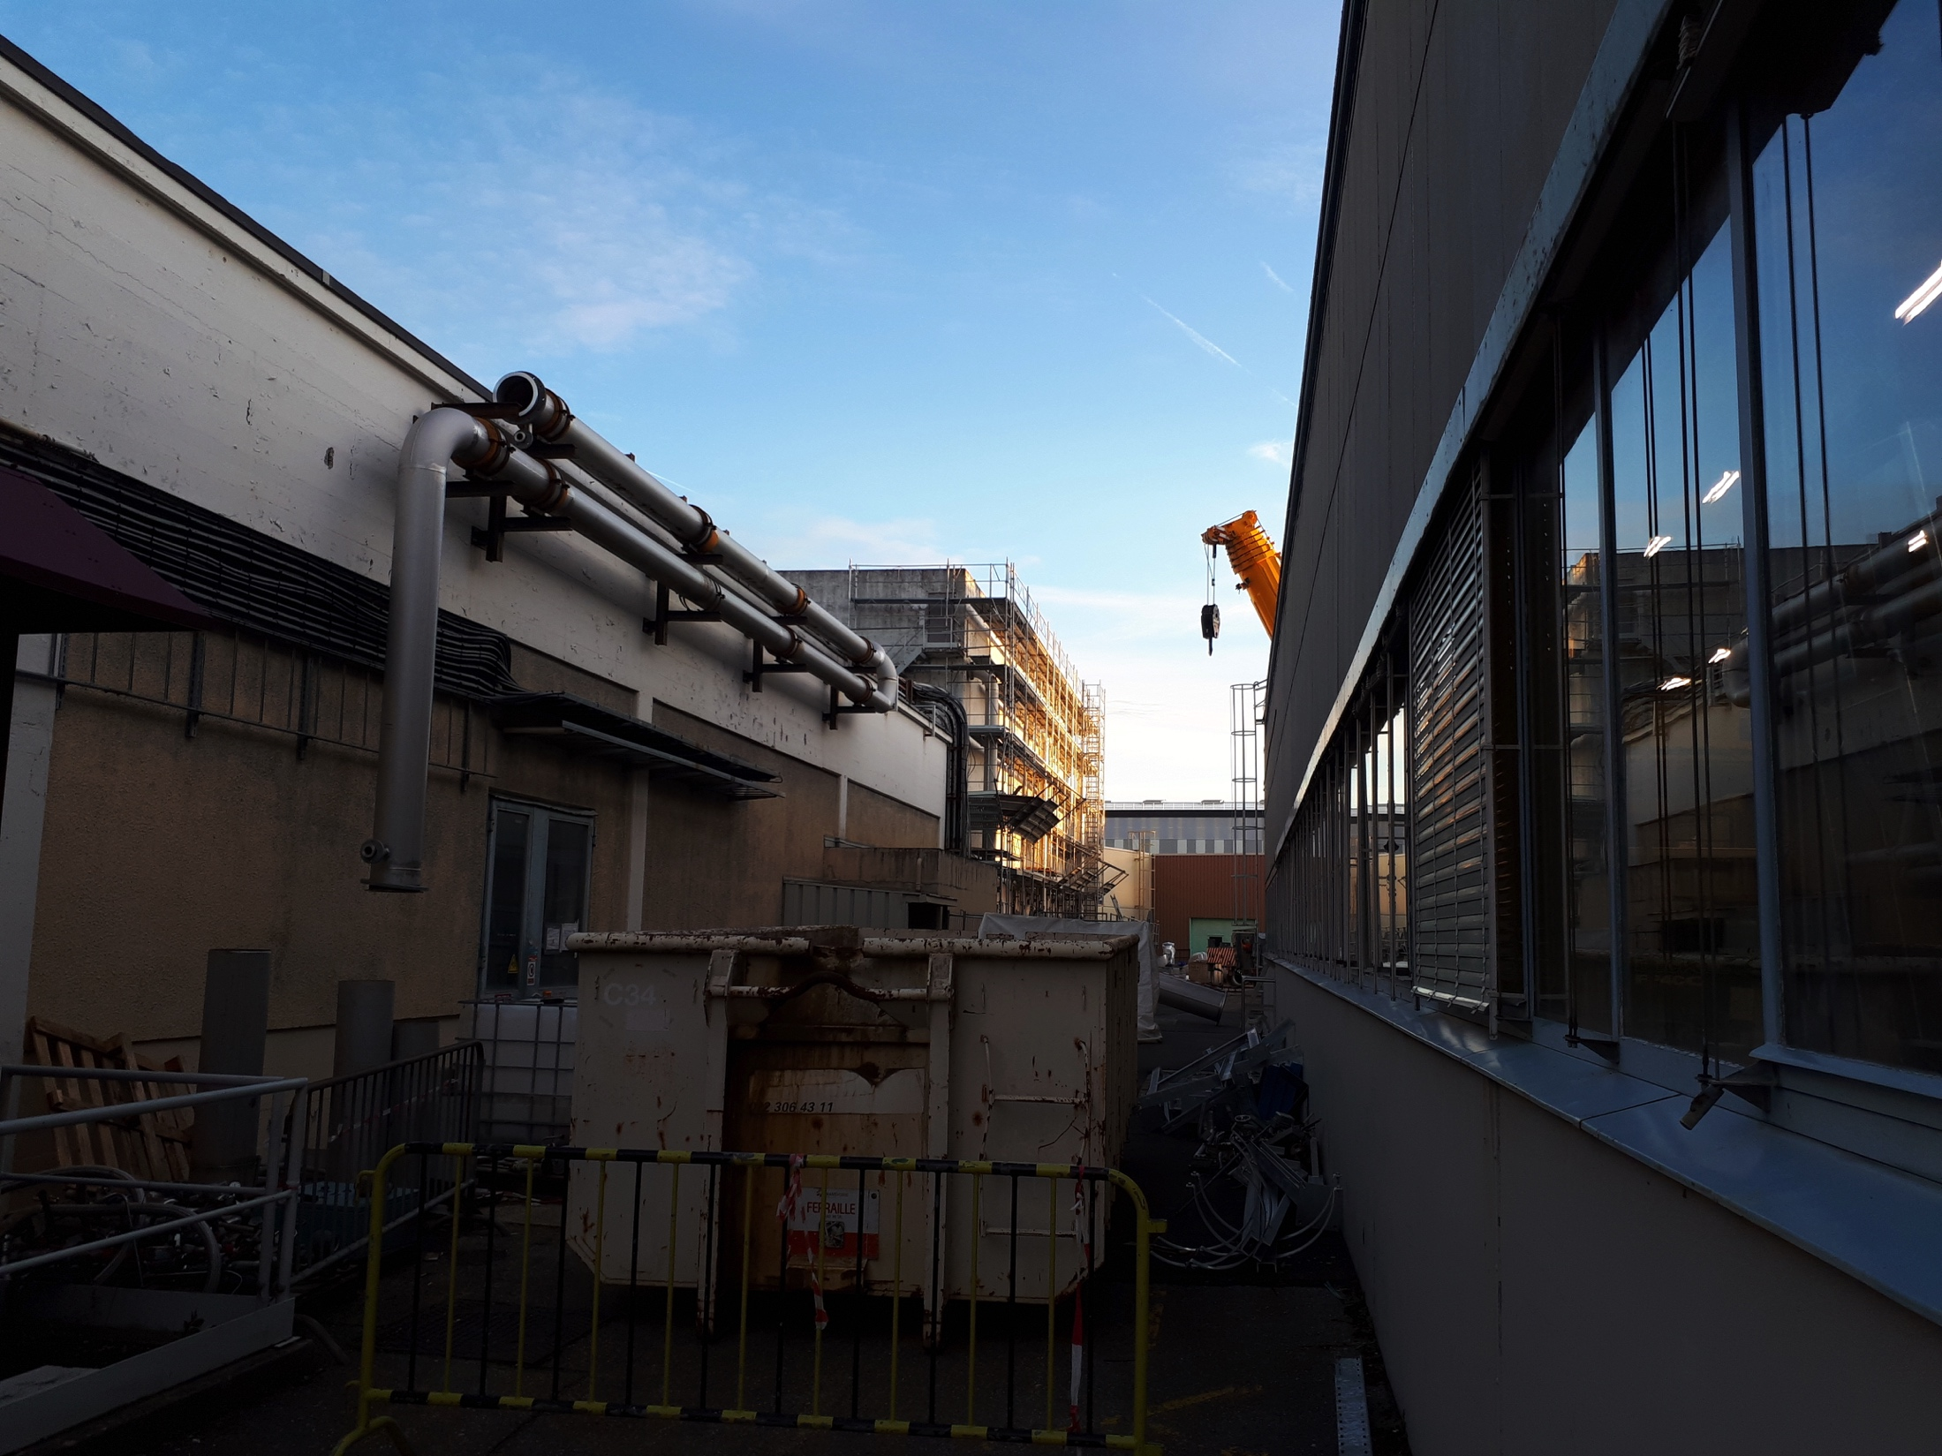
New demineralized water circuit
  News since last meeting:
    A bit of delay on the mechanical works in B355 and B255, but CV confirms that everything will be ready end of 2019
    Connection between gallery 3 and TT2 + outer side of the ring completed
    Connection between gallery 5 and the outer side of the ring completed
    Connection between gallery 7 and the outer side of the ring will follow the gallery 5 connection and the asbestos cleaning
    Connection between gallery 1 and B.355 (last part) will be performed in January 2020
    The new cooling system will be available end of February 2020 to allow starting the ISTs of some systems in March 2020

Slide 3
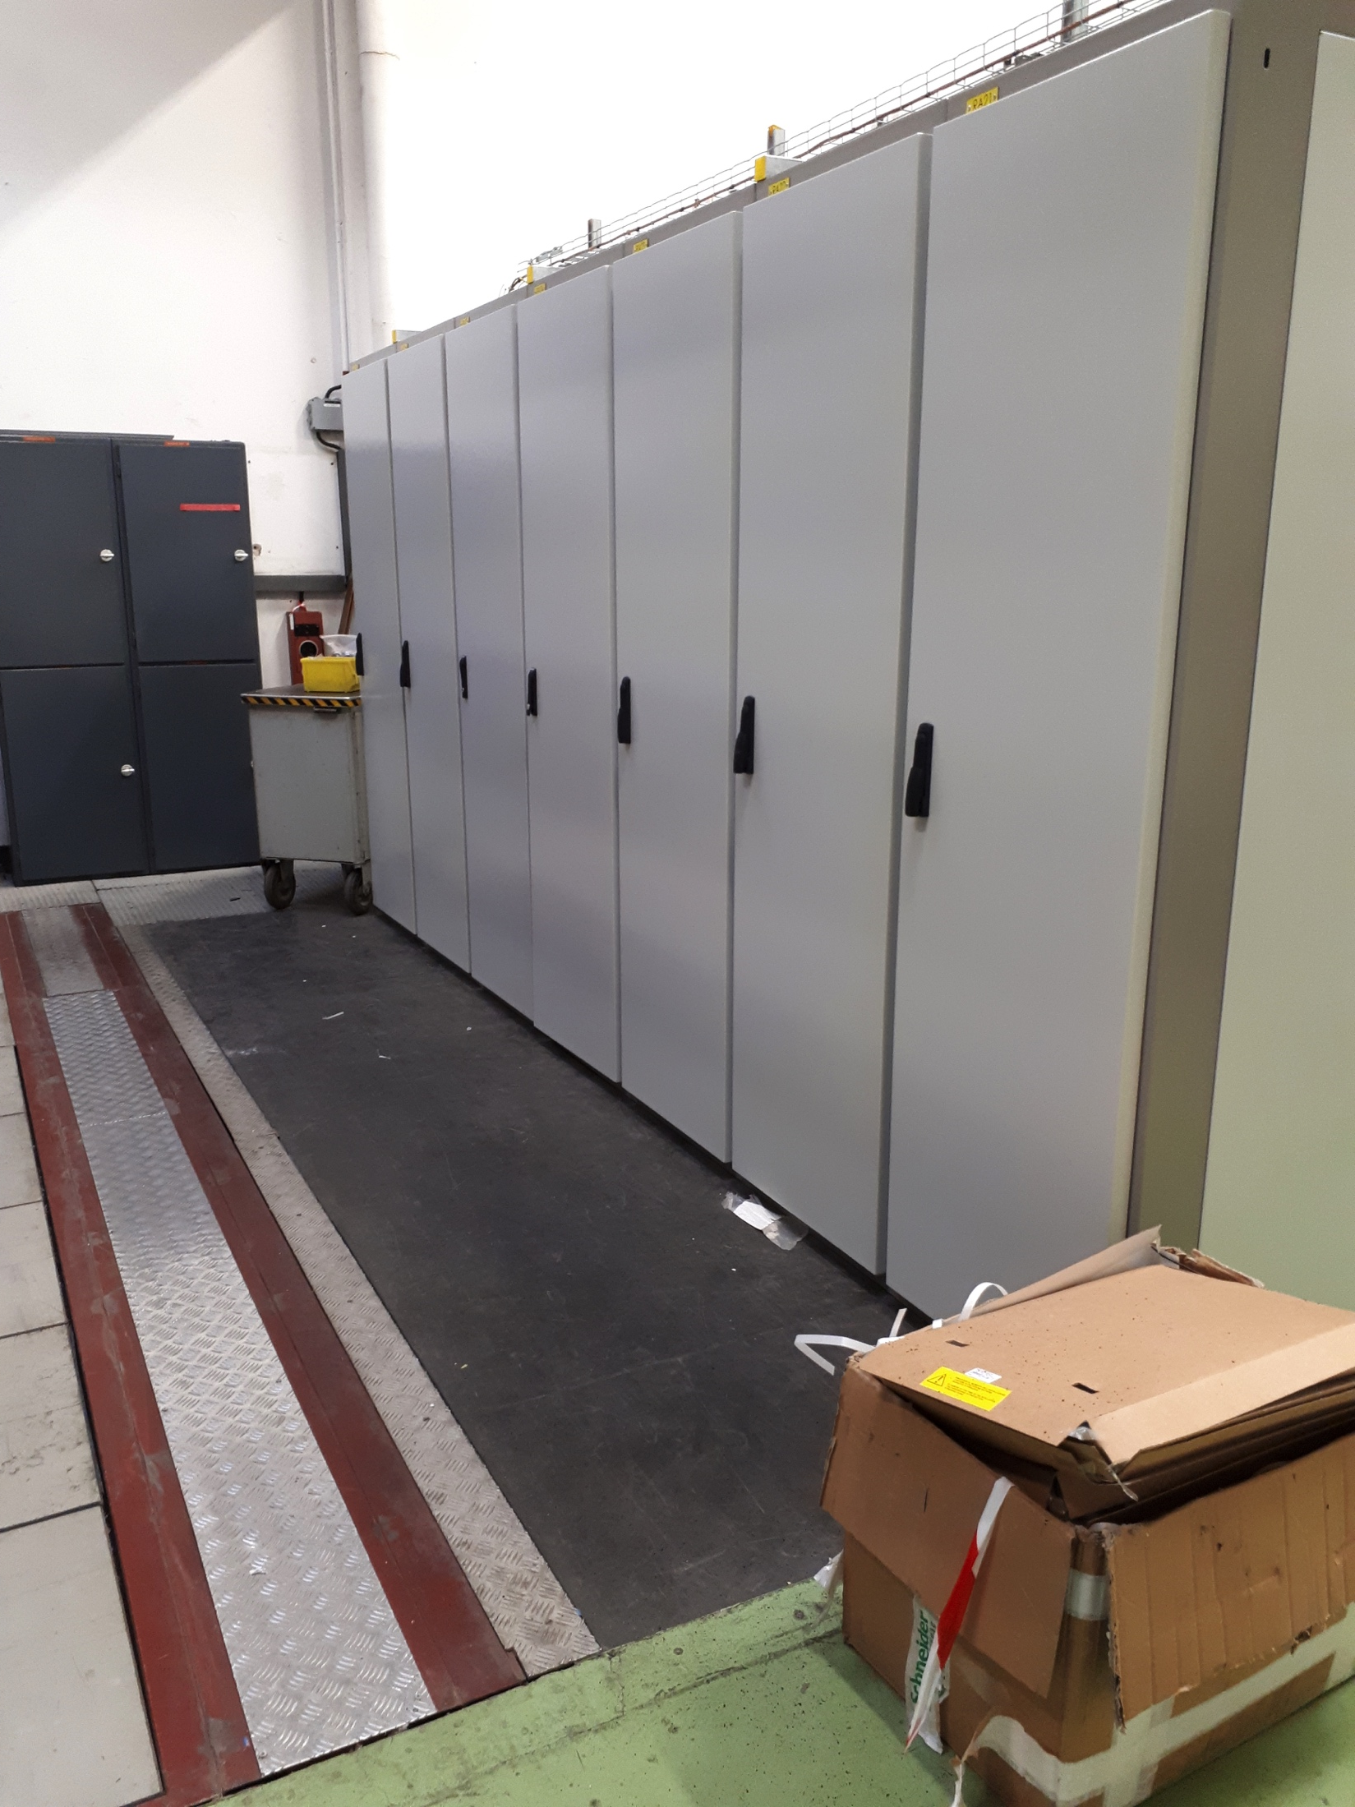
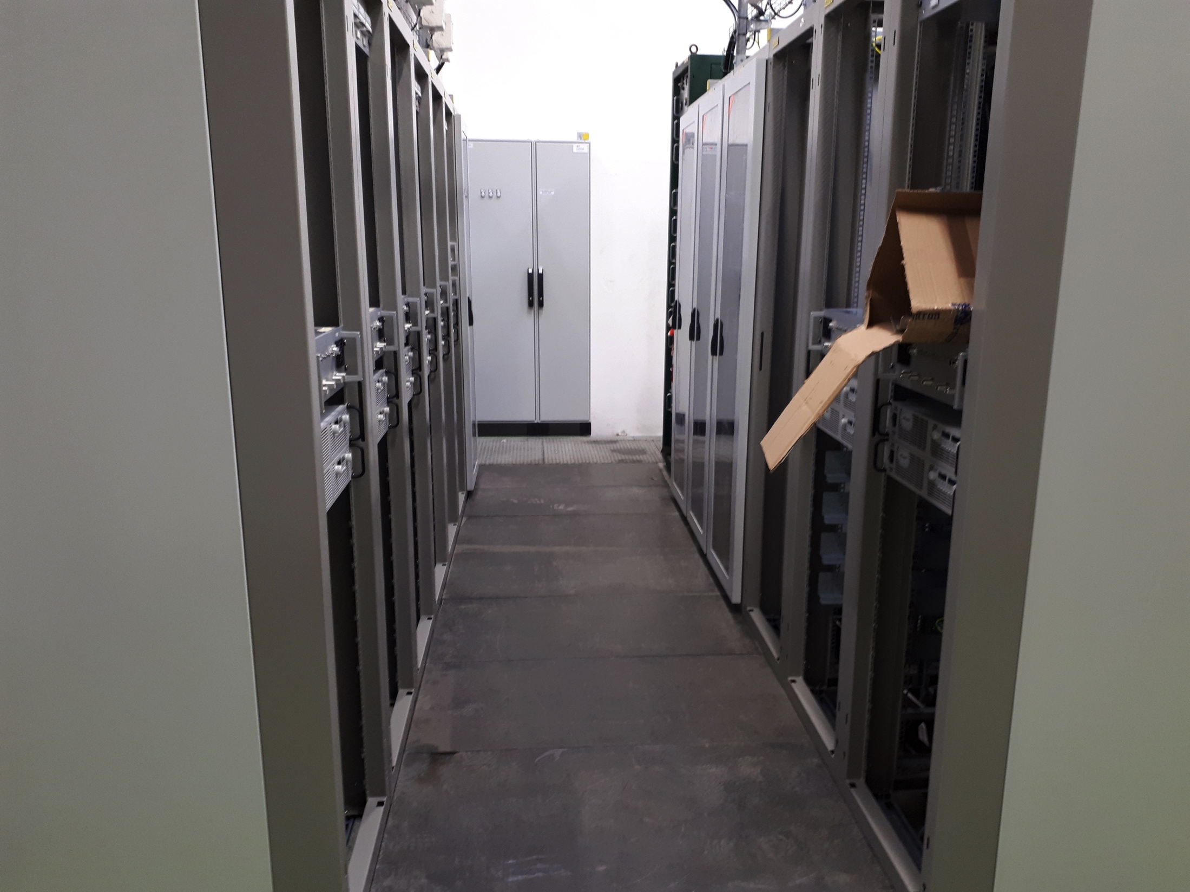
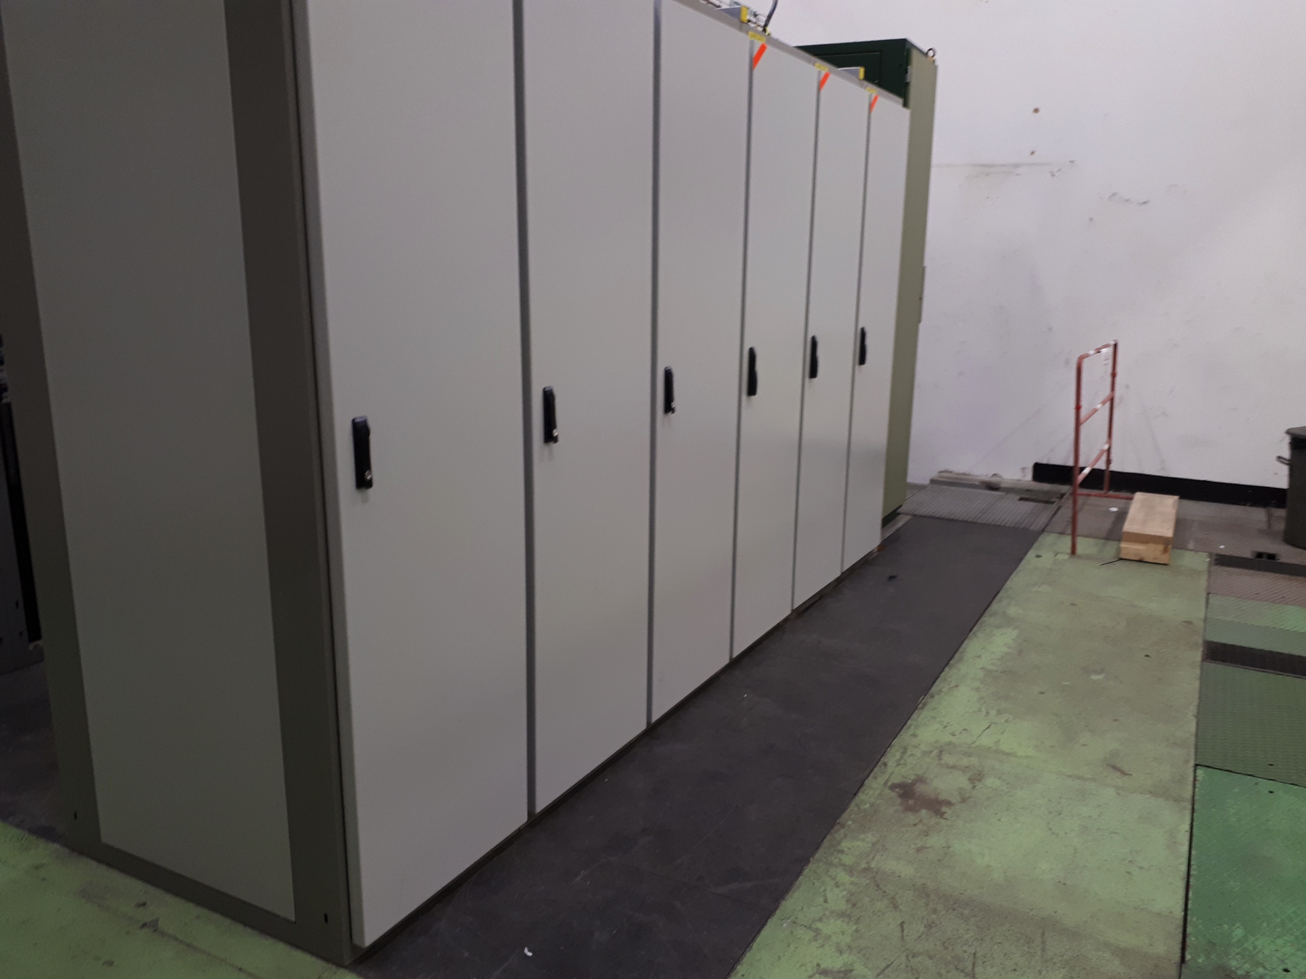
New TFB system
  News since last meeting:
    EN-EL works fully completed and receptioned
    Slabs installed since 11th October 2019
    TFB installation ongoing

Slide 4
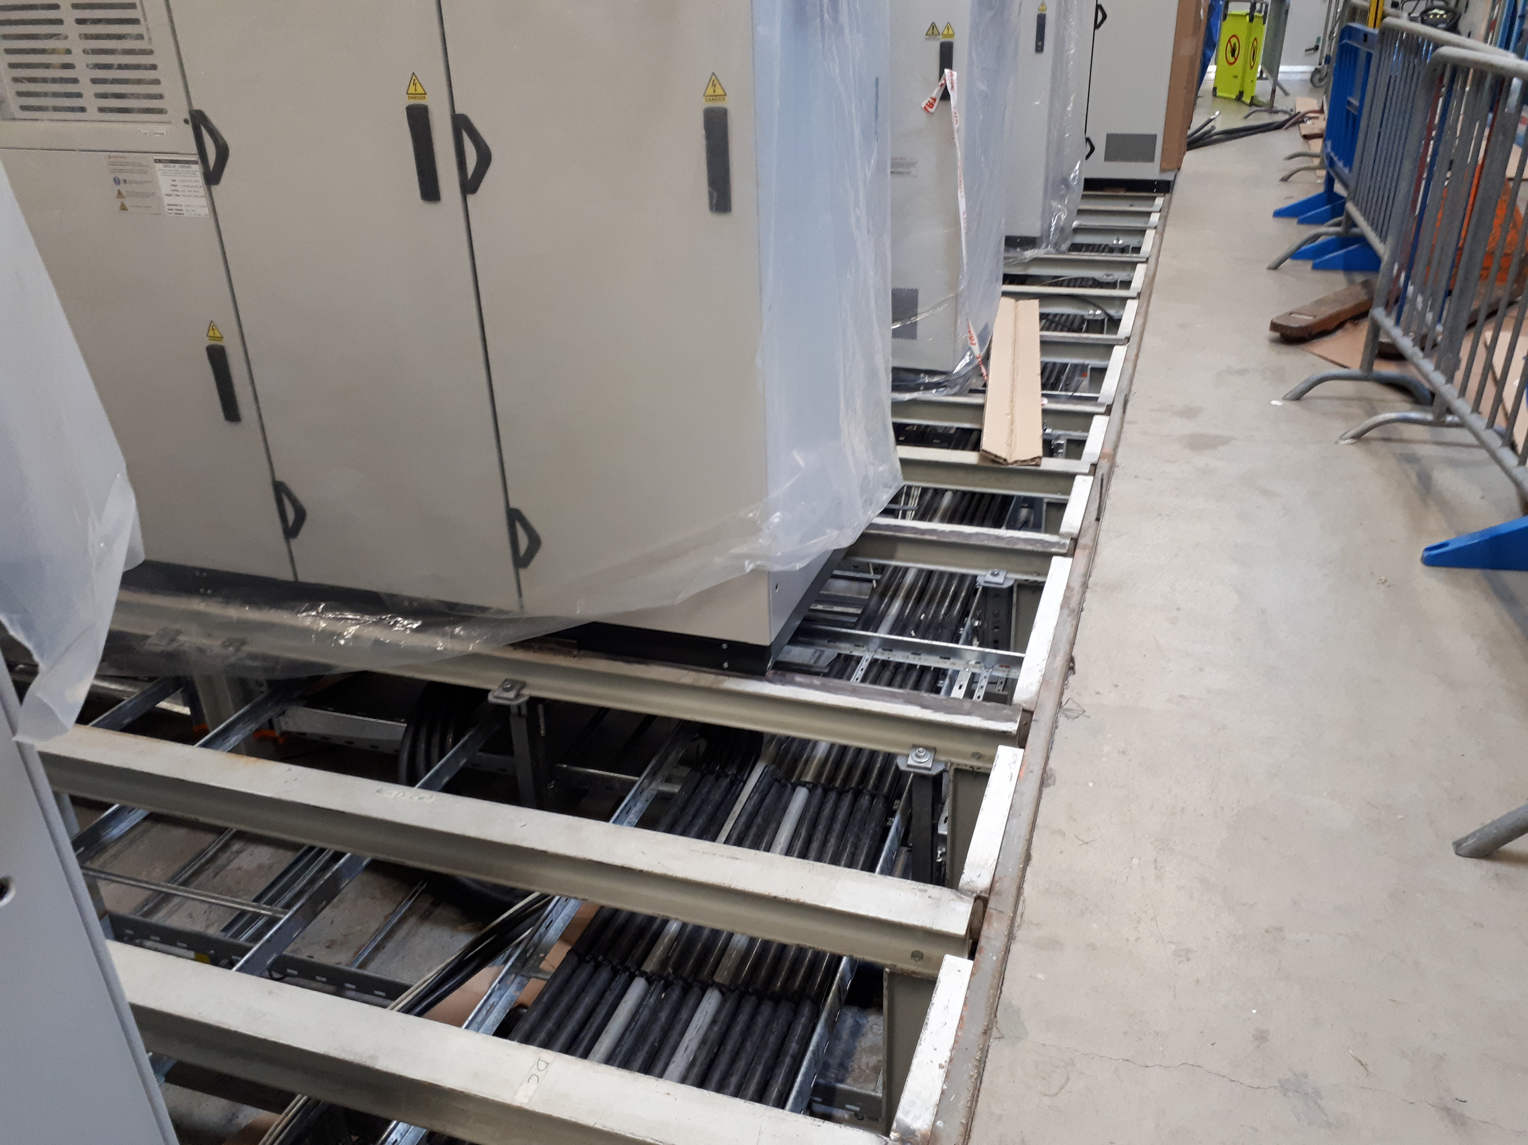
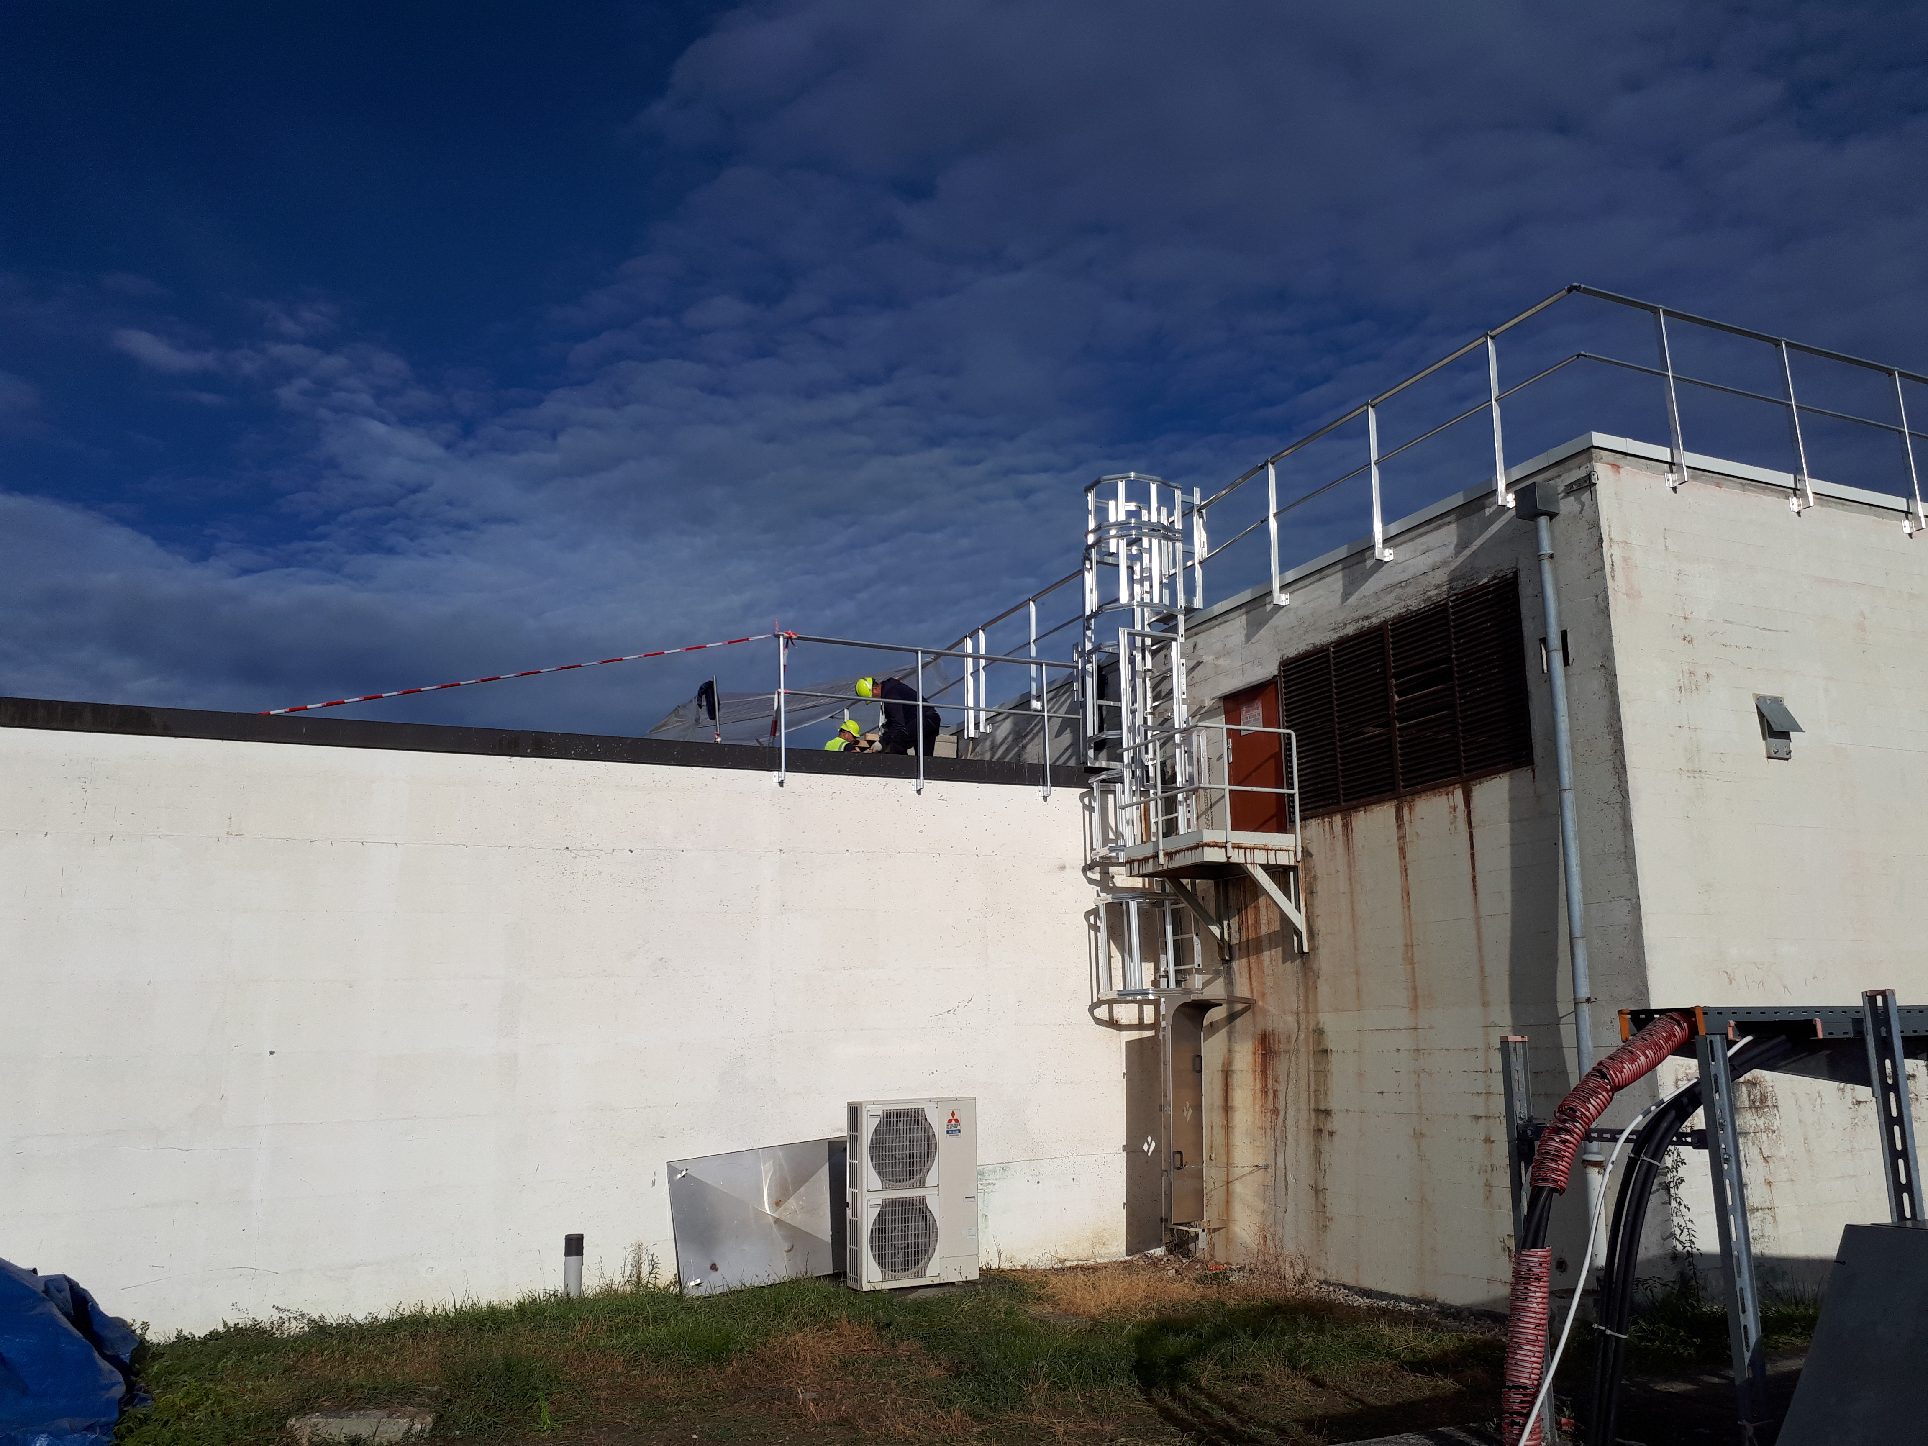
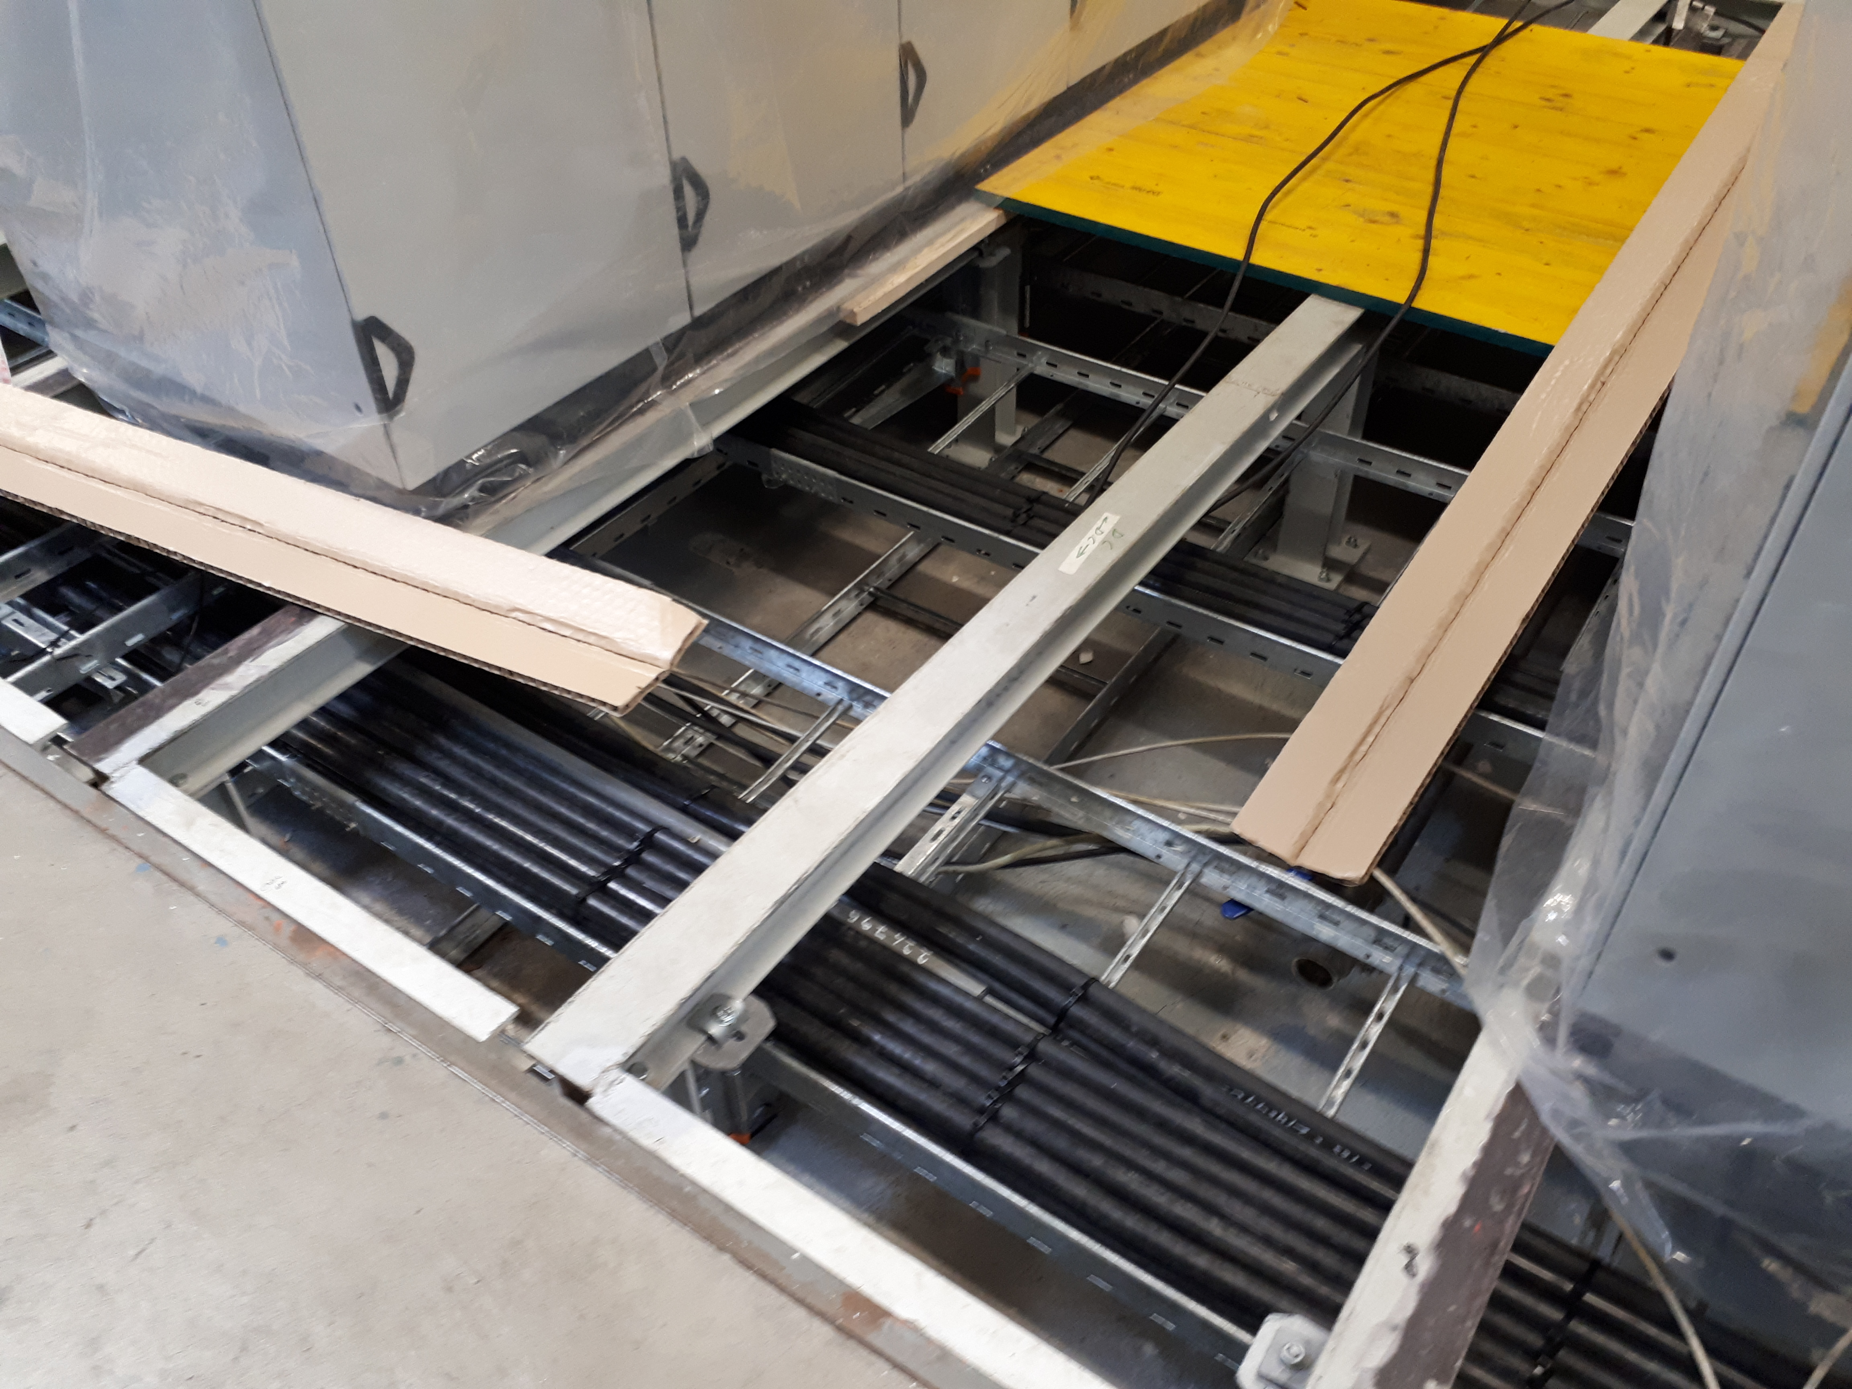
B.269
Power converters are installed with the exception of the small ones that go in R-003
Transformers catch pits have been filled with small rocks
Cabling ongoing
New switch board is installed and connections will be performed soon

Slide 5
Main Units renovation (cons.)
42/43
  already renovated
1/42
  kept in B.150 (MU27) for the LINAC4 connection
39/42
  already re-installed and re-aligned in the machine
1/42
  The alignment of MU87 is ongoing today
  Note:
  MU90 is in the magnet workshop for renovation
  MU101 is already renovated
  Some straight section have still to be re-installed and some MUs reconnected

Slide 6
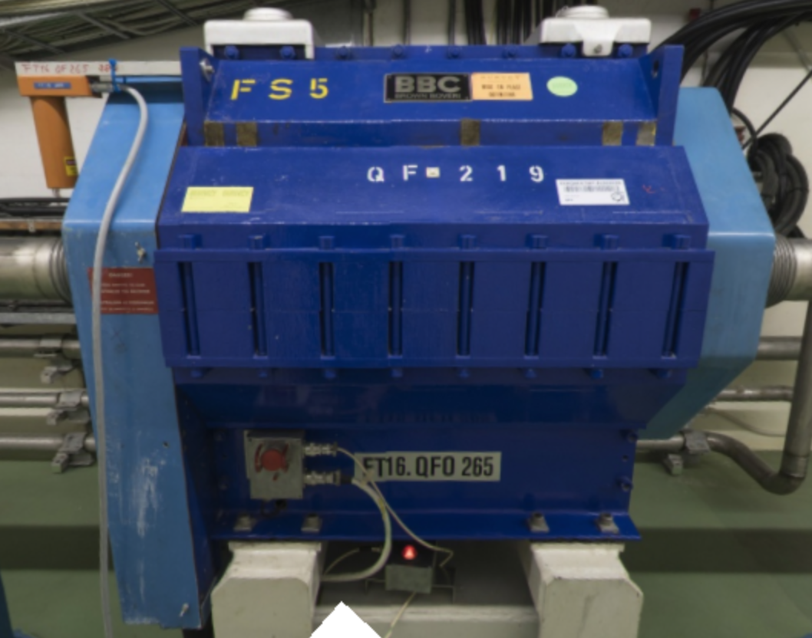
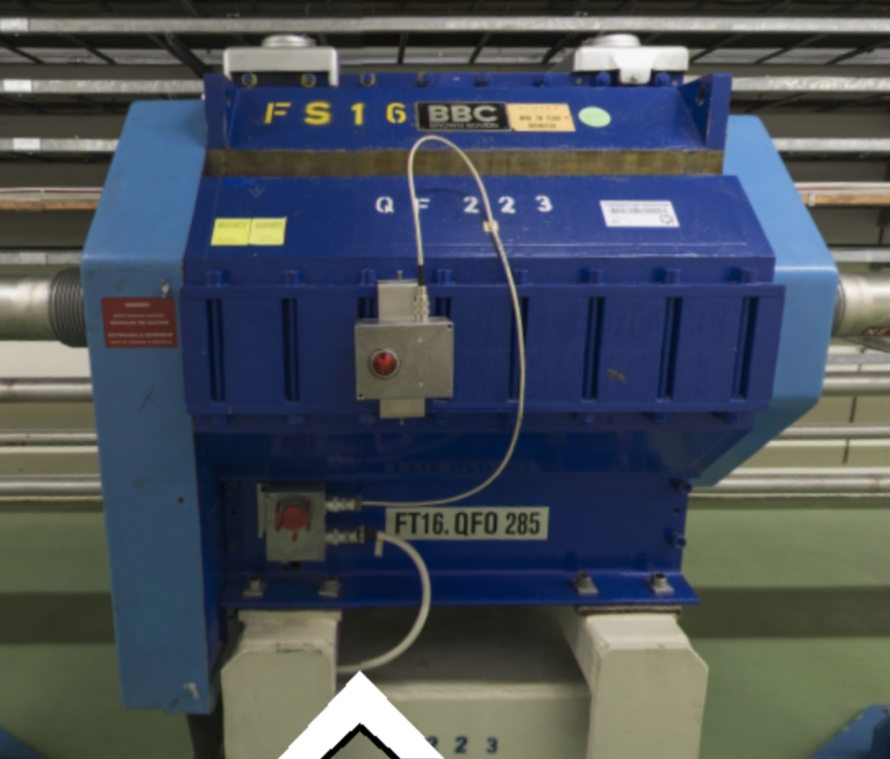
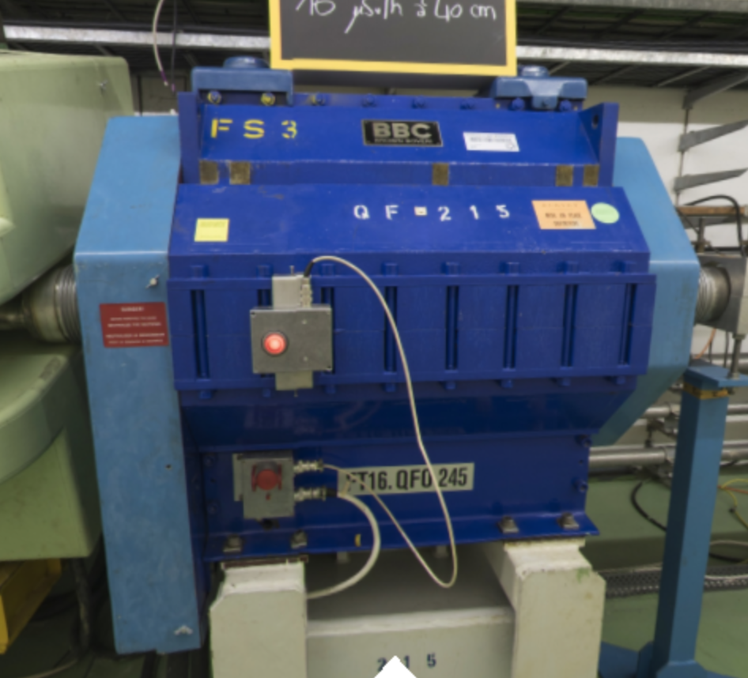
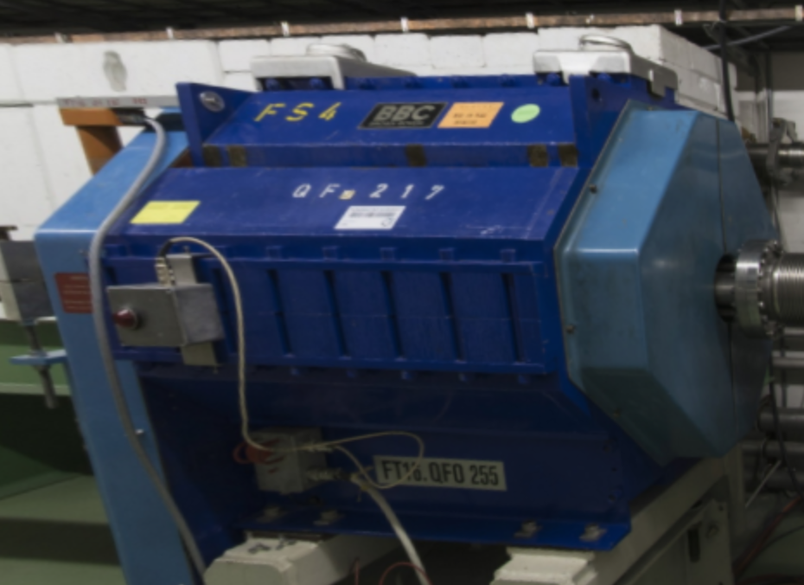
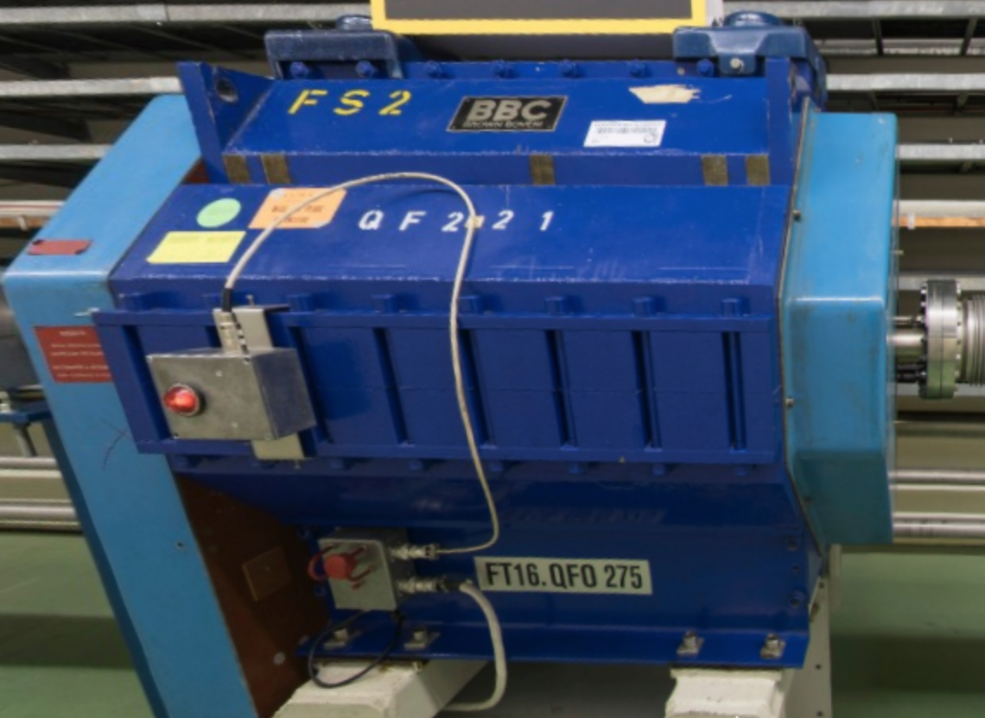
TT2 quads renovation (cons.)
First 5 quads have been renovated
QFN265
QFN285
QFN245
QFN275
QFN275
QFN255

Slide 7
Ring
Asbestos cleaning is progressing well and will be finished in advanced with respect to the planning
General services renovation in the ring is progressing well
Some cabling campaigns have been re-organized due to the asbestos, but are progressing well

Slide 8
Question?

