Slide 1
LIU-PS EVM Status
Data extraction: 30 September 2019 for the CSR

Slide 2
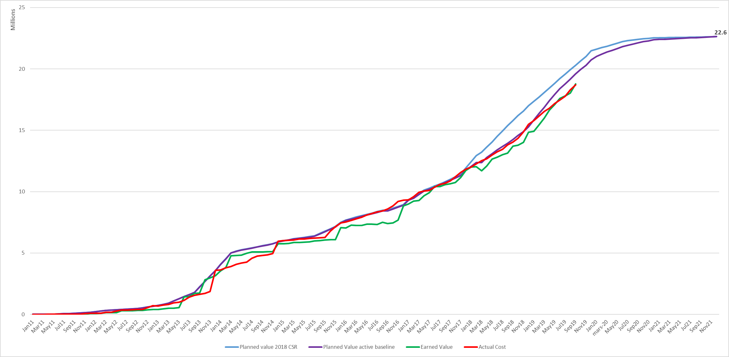
LIU-PS Dashboard

Slide 3
LIU-PS EVM Metrics by Workpackage
SV < -100 kCHF or SV < 2 months

Slide 4
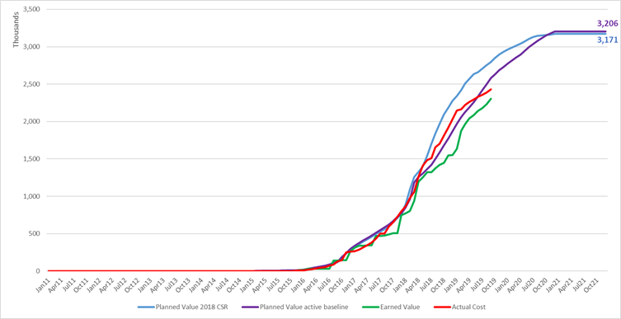
LIU-PS EVM Metrics by Workpackage
LIU-PS 9 - Injection
The delay of 3.4 months is mainly coming from the Bumper 42 and KFA45 magnets, not compromising so far their installation readiness dates.

Slide 5
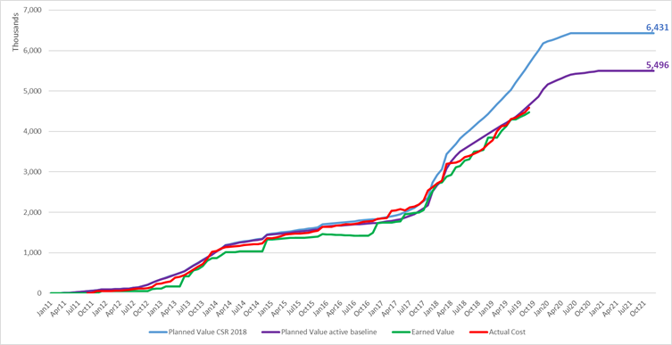
LIU-PS EVM Metrics by Workpackage
LIU-PS 4 – RF systems
As the cost to completion of the LIU-PS 4 workpackage has been reduced by 935 kCHF since the 2018 CSR, the earned value is lower than expected. Compared to the active baseline the RF systems show 1.8 months of delay, mainly on the upgraded 10 MHz power amplifiers, 80 MHz fast ferrite tuner series and PS kicker cavity.

Slide 6
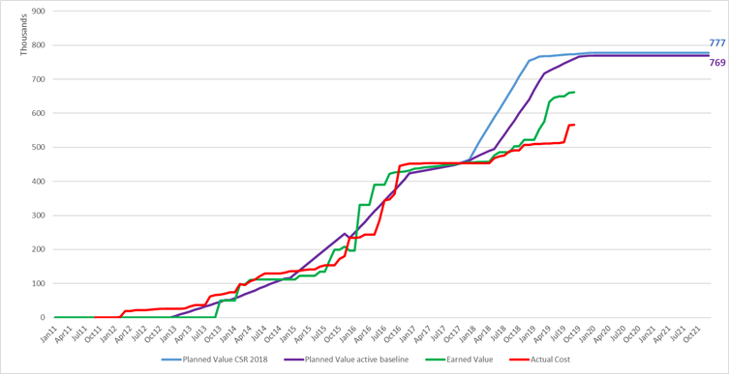
LIU-PS EVM Metrics by Workpackage
LIU-PS 8 – Vacuum systems
The delay in the installation of the injection bumper magnets (from May 2019 to January of 2020) explains the large variance of 8.1 months in test and installation of the injection bumper vacuum chambers.

Slide 7
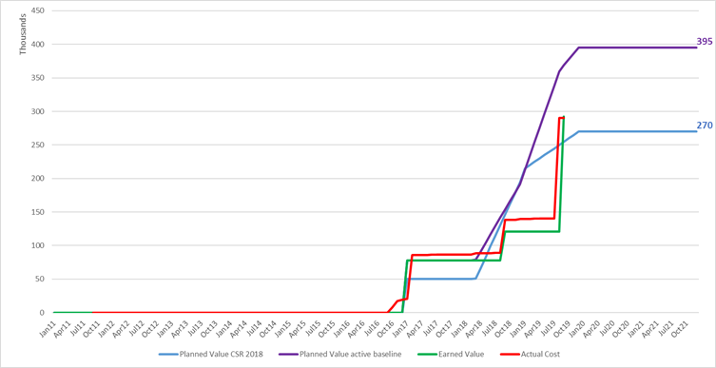
LIU-PS EVM Metrics by Workpackage
LIU-PS 3 – Magnets
The cost to completion of the LIU-PS 3 workpackage has been increased by 125 kCHF since the 2018 CSR to cover higher production costs than anticipated. The schedule variance in the magnet workpackage is coming from the delivery of the IPM vertical magnet (presently planned in January 2020), not compromising so far the installation readiness dates.

Slide 8
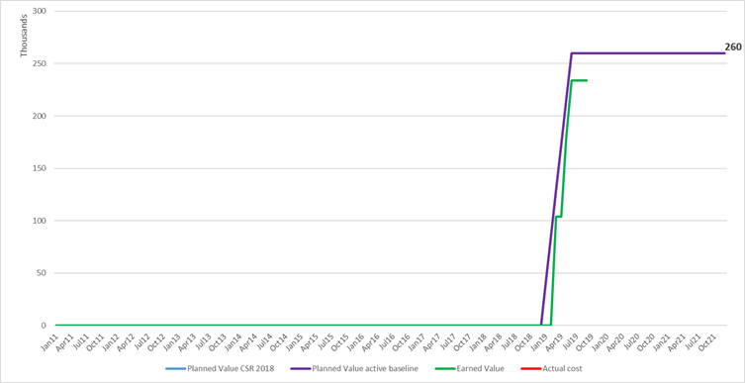
LIU-PS EVM Metrics by Workpackage
LIU-PS 13 – Cooling & Ventilation
Asbestos cleaning work campaigns in the PS machine have delayed the cooling and ventilation activities by 3.6 months. The completion of cooling and ventilation works is now planned in January 2020 instead of July 2019. The activities will be fully charged at the completion of the works.

Slide 9
LIU-PS Main Cost Drivers
For the LIU-PS machine 80% of the costs are concentrated among five groups (BE-RF, TE-EPC, SMB-SE, TE-ABT and BE-BI).

Slide 10
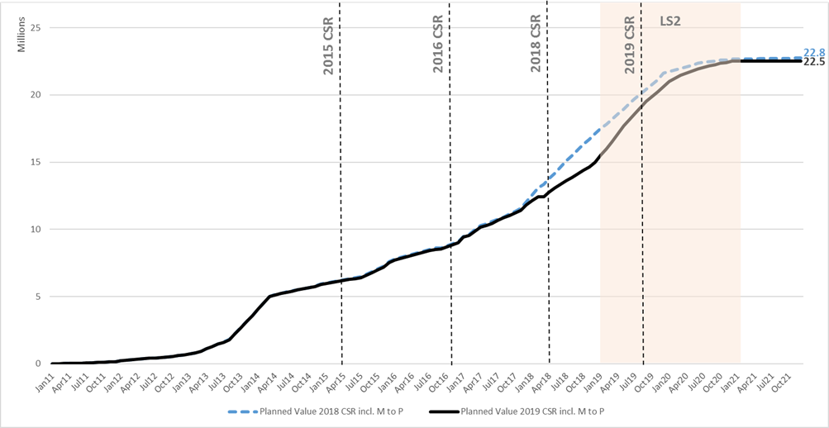
LIU-PS Cost to Completion Evolution

Slide 11
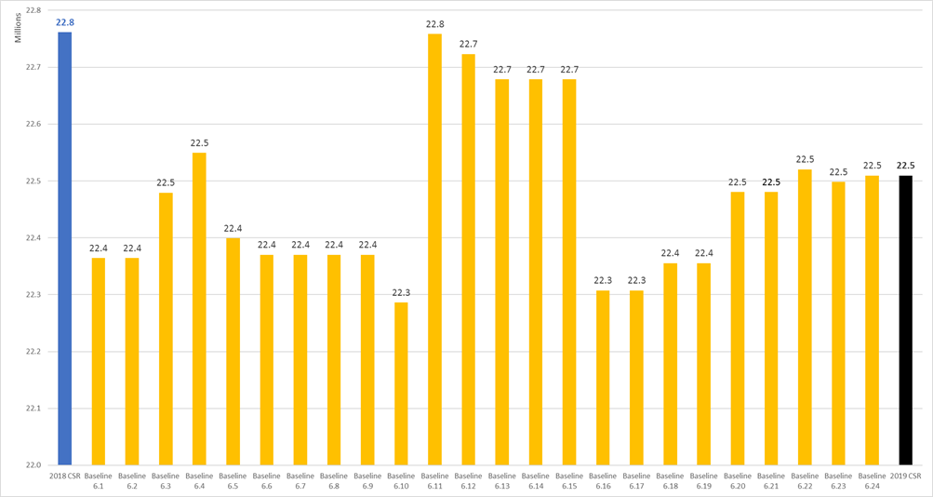
LIU-PS Cost to Completion Evolution

Slide 12
LIU-PS CtC Variations

Slide 13
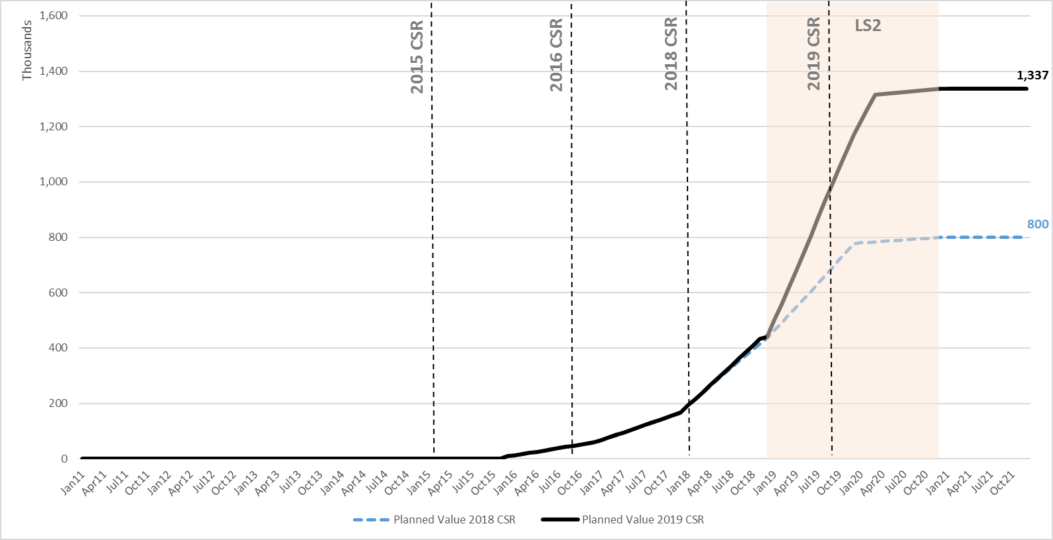
LIU-PS CtC Variations by Wrokpackage
LIU-PS 7 – Beam Intercepting Devices
As the cost to completion of the LIU-PS 4 workpackage has been reduced by 935 kCHF since the 2018 CSR, the earned value is lower than expected. Compared to the active baseline the RF systems show 1.8 months of delay, mainly on the upgraded 10 MHz power amplifiers, 80 MHz fast ferrite tuner series and PS kicker cavity.

Slide 14
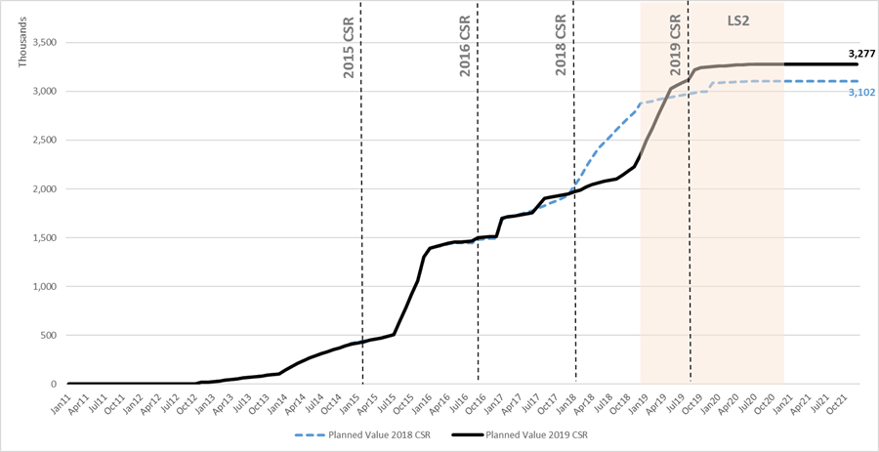
LIU-PS CtC Variations by Wrokpackage
LIU-PS 5 – Power Converters
The cost increase of the power converters workpackage is explained by a final cost higher than expected for the PI.SMH42, PI.BSW42, PI.BSW40, 41, 43 & 44 power converters.

Slide 15
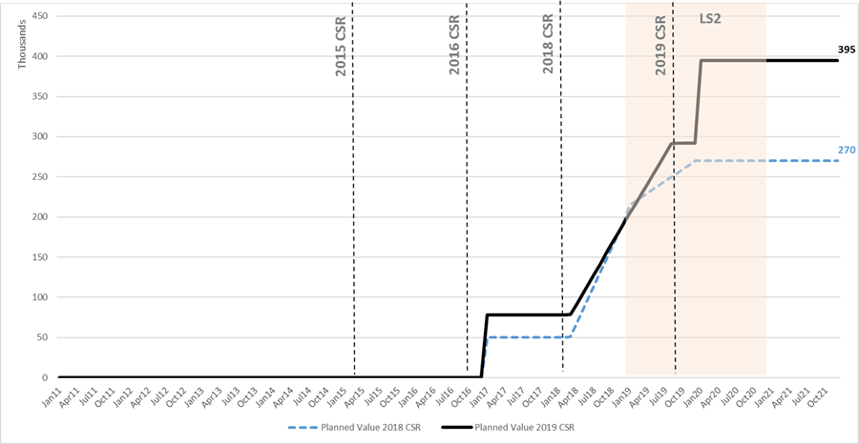
LIU-PS CtC Variations by Wrokpackage
LIU-PS 3 – Magnets
The cost increase of the magnet workpackage is due to a higher cost than expected of the injection bumpers and IPM vertical magnets.

Slide 16
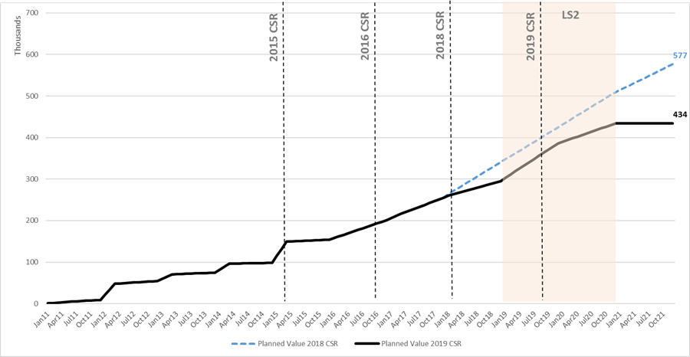
LIU-PS CtC Variations by Wrokpackage
LIU-PS 1 – Management
The cost reductions in the project management workunit are due to less allocation than planned for unexpected works in 2018/19 and budget reallocation to other workunits.

Slide 17
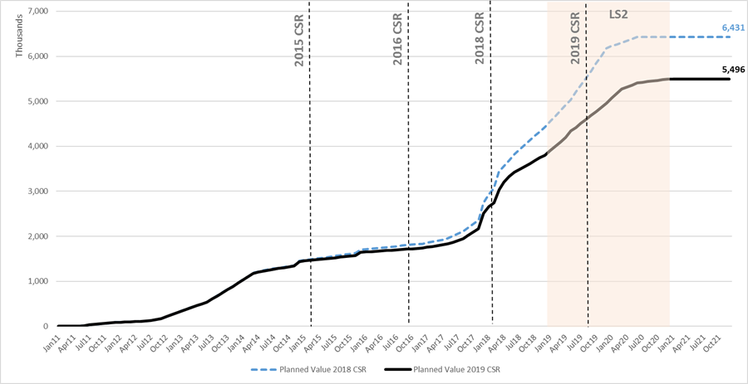
LIU-PS CtC Variations by Wrokpackage
LIU-PS 4 – RF systems
The first part of the cost reductions in the RF workpackage is due to the descoping after the 2018 CSR: one unit less for 80 MHz fast ferrite tuner series and solid state amplifier working prototype removed from the baseline. In addition, a new HL-RF strategy was endorsed in January 2019: only one 80 MHz fast ferrite tuner with loop coupler and 40/80 MHz feedback amplifier limited to the prototype.
In addition, cost reductions were also identified in the 10 MHz feedback systems, PS longitudinal damper and PS kicker cavity.

