Slide 1
Magnetic measurement of
the new 209 bumpers - UPDATE
Marco Buzio TE/MSC
Notes:
Abstract: at CERN, magnetic measurement activities typically concern fields up to about 10 T, with uncertainties in the 10-100 ppm range. Recently, however, a number of applications (mostly linked to beam perturbations at very low energy or over very long distances) have required measurements of much lower field levels, micro to nanotesla. In this talk, we discussed first these applications in order to provide context. Then, we address the different kinds of instrument that can be used at such low field levels, with emphasis on those that are available on the market, mostly for geomagnetic applications. Finally, we describe the facilities available at CERN that can be used to manufacture, test or calibrate sensors and instruments. These include various kinds of controllable scalar or vector field sources, induction- and magnetic resonance-based sensors and teslameters
Ci piacerebbe avere una presentazione, nella prima sessione, sulle tecniche per misurare campi magnetici molto piccoli.
Igiene magnetica ( materiali, viti, saldature), tecniche di misura e mappatura anche su grandi volumi (tipo un criostato di lhc), metrologia dei campi magnetici (tarature, incertezze)...

Slide 2
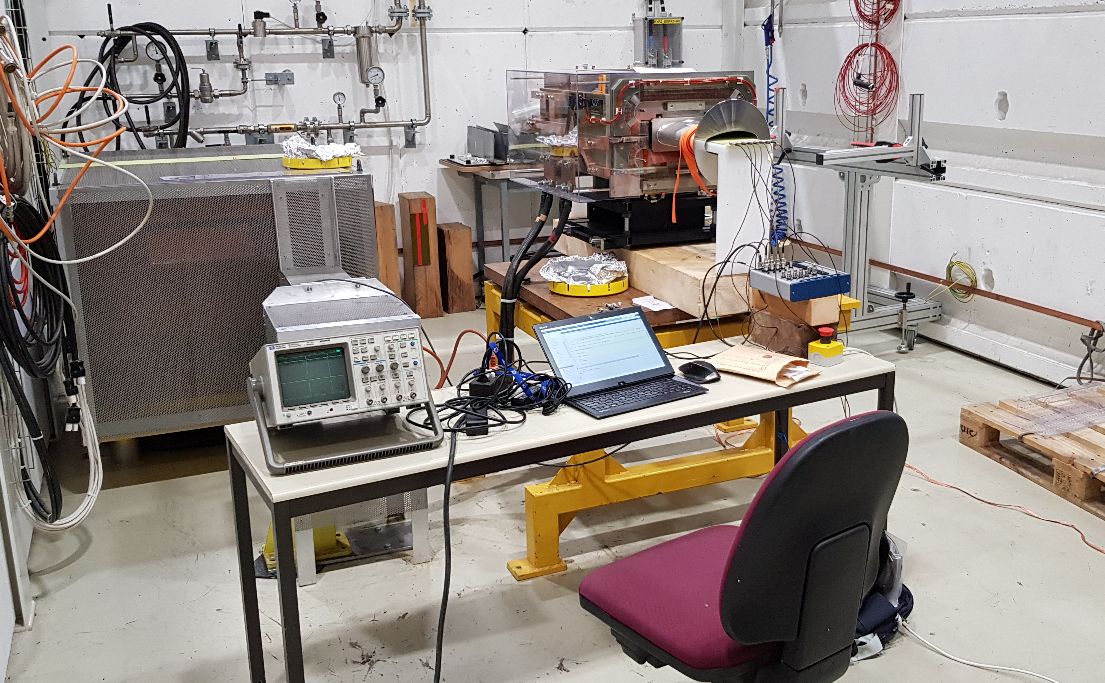
TE/ABT test bench (867-R-X52)
PCB fluxmeter
(full v.c. effect)
NI-6366 USB DAQ

Slide 3
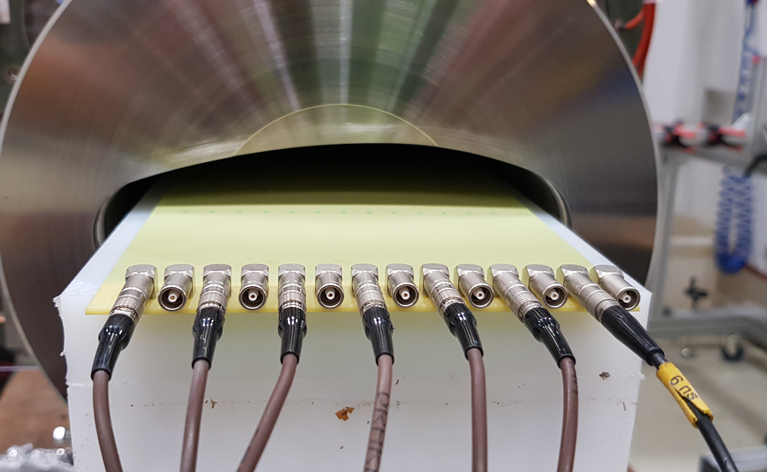
New PCB fluxmeter
7× 1150 mm × 15 mm, 1-turn coils
7× 1150 mm × 3 mm, 1-turn coils

Slide 4
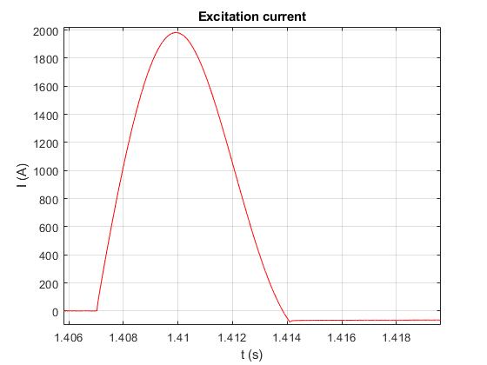
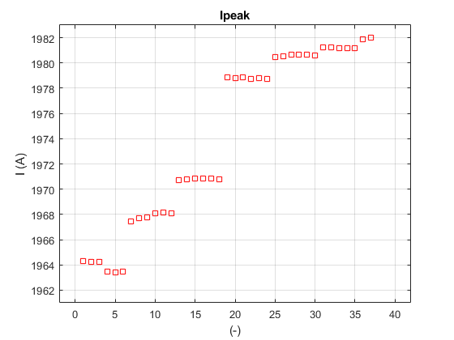
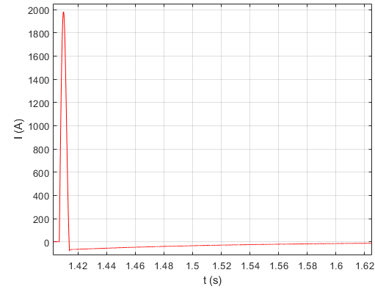
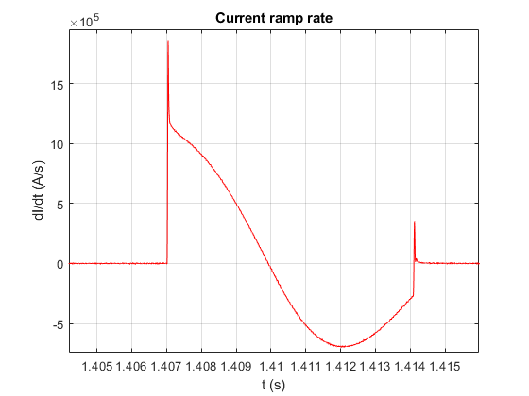
Current cycle – TE/ABT (PS-PO) power supply
Smooth waveform, slow 0.5 s recovery after the pulse
1% current repeatability
Relatively slow peak rate 1.9 MA/s

Slide 5
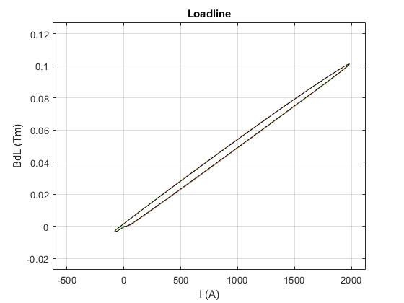
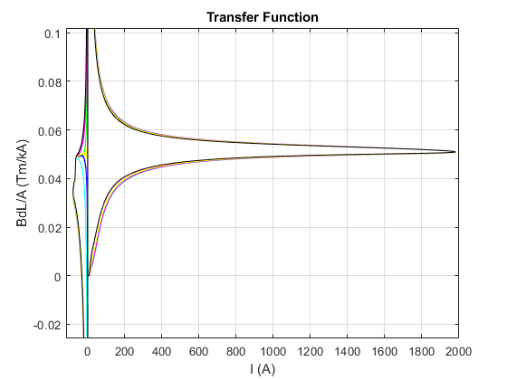
Test results

Slide 6
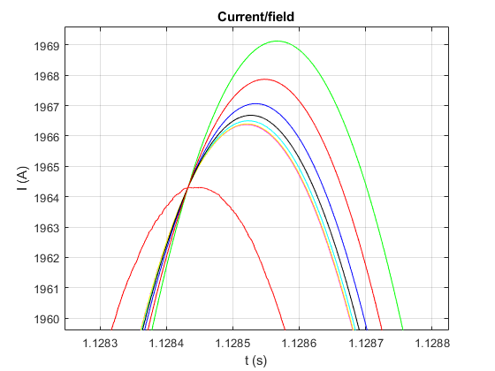
Eddy current induced delay w/ VC
central field
~ 80 μs
(old 209 w and w/o VC: ~ 1/26 μs)

Slide 7
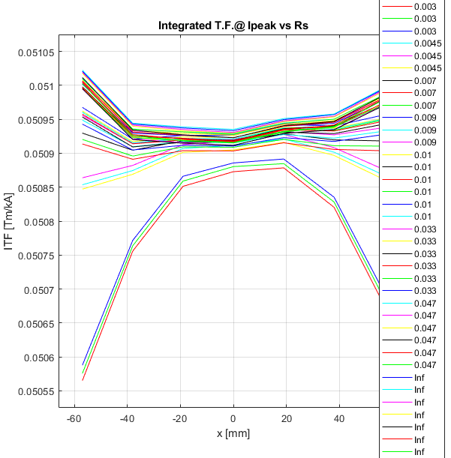
Normalized field profiles
loops open
loops
short-circuited

Slide 8
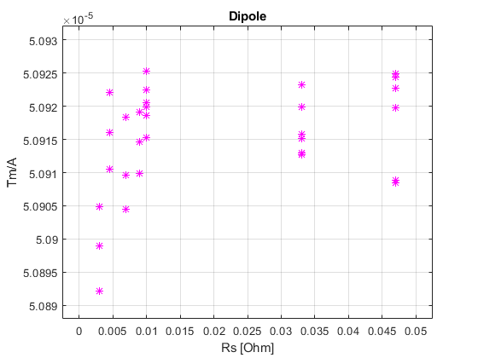
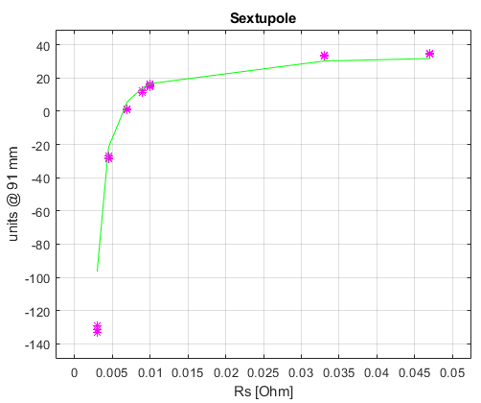
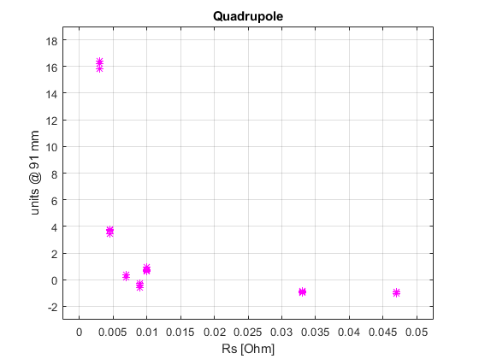

Multipoles vs. loop short resistance R_{s}
R_{s} ≈ 7 mΩ
$$b_{3}=35−\frac{0.15}{R_{0}+R } units @ 91 mm$$

Slide 9
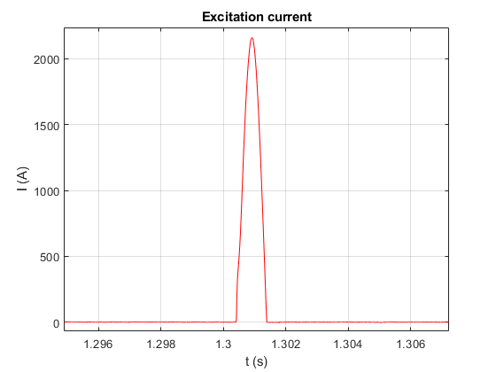
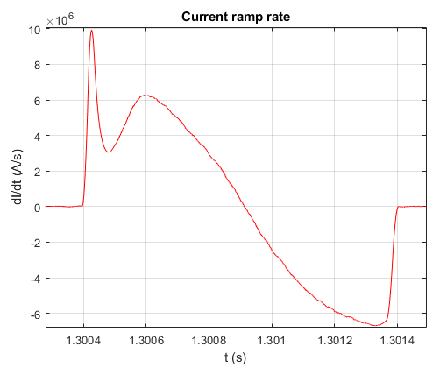
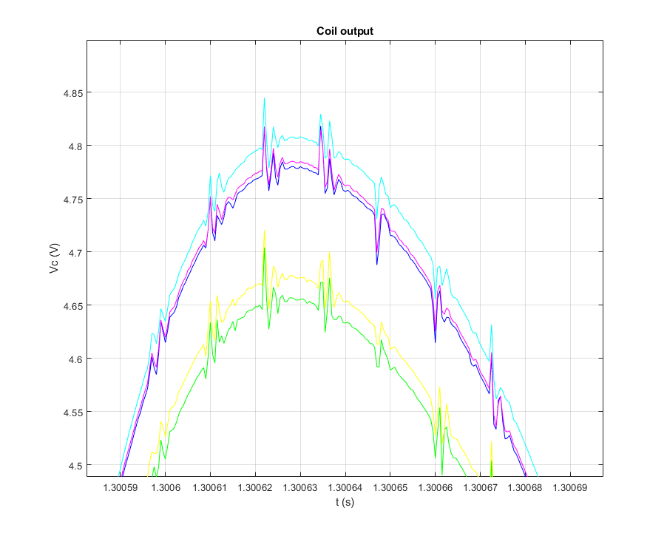
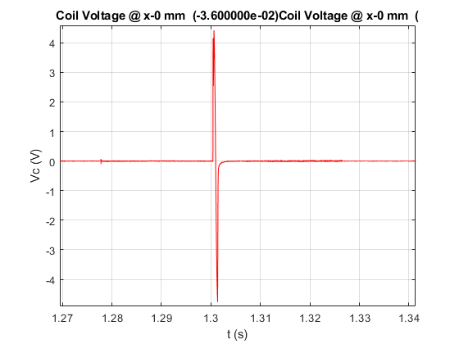
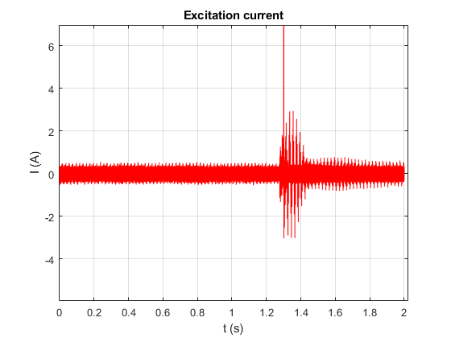
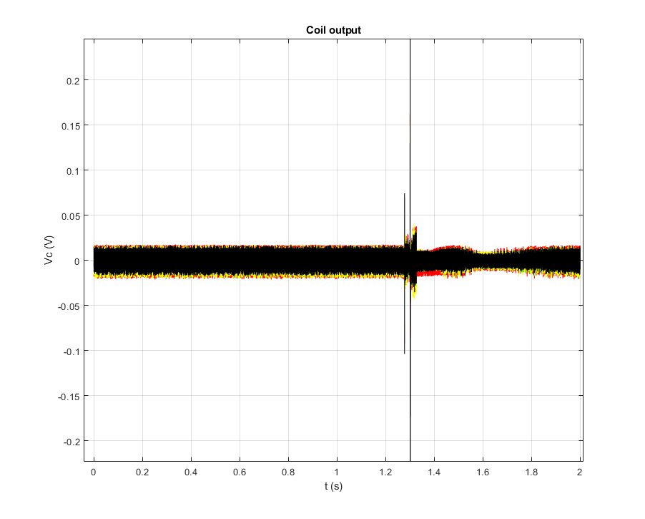
For comparison: measurements with new power supply (June 2019)
10 MA/s peak
optimized
waveform
unsteady
ripple
Unsteady ripple makes
accurate integrator
drift correction difficult

Slide 10
Conclusions
  Tools available to measure dynamic sextupole within 1-2 units accuracy, provided the supplied current is ripple-free
  Possibility of smooth correction of the sextupole vs. loop shunt resistance is confirmed at 1/5 of the operational dB/dt
  Theoretical scaling of the resistance required at the operational dB/dt is possible, but measurement is recommended (present model neglects dynamic contribution of the magnet)
  Second-order differences expected between series units
  Adjustment of Rs after the magnet have been installed possible

