Slide 1
Single transversely polarized DY, observables, TMDs
Aram Kotzinian
Torino Uni&INFN
On leave in absence from YerPhI, Armenia
Introduction
  TMD DFs
  SIDIS
DY
  General expression and LO parton model
Intrinsic transverse parton momenta
  P. Schweitzer, T. Teckentrup and A. Metz article review
  Application to Sivers effect in DY
Discussion

Slide 2
TMD quark DFs of Nucleon
At twist-two we have
6 T-even & 2 T-odd

Slide 3
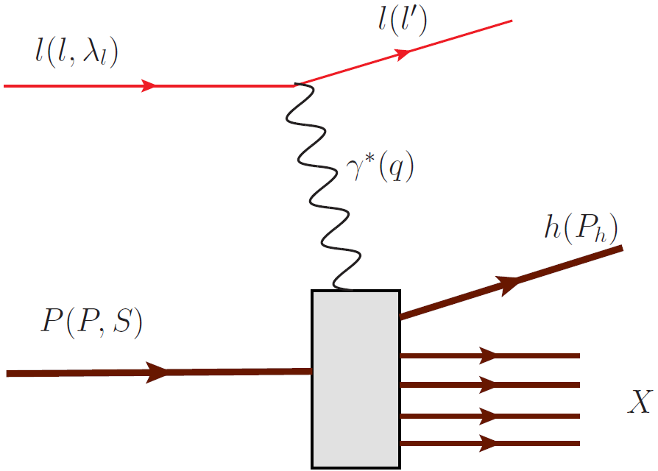
SIDIS
Using current conservation + parity conservation + hermiticity one can show that
18 independent Structure Functions describe one particle SIDIS cross section in one photon exchange approximation.
Moreover, the dependences on azimuthal angle of produced hadron and of
the target nucleon polarization are calculated explicitly and factorized

Slide 4
SIDIS, polarized lepton and target

Slide 5
SIDIS, unpolarized lepton

Slide 6
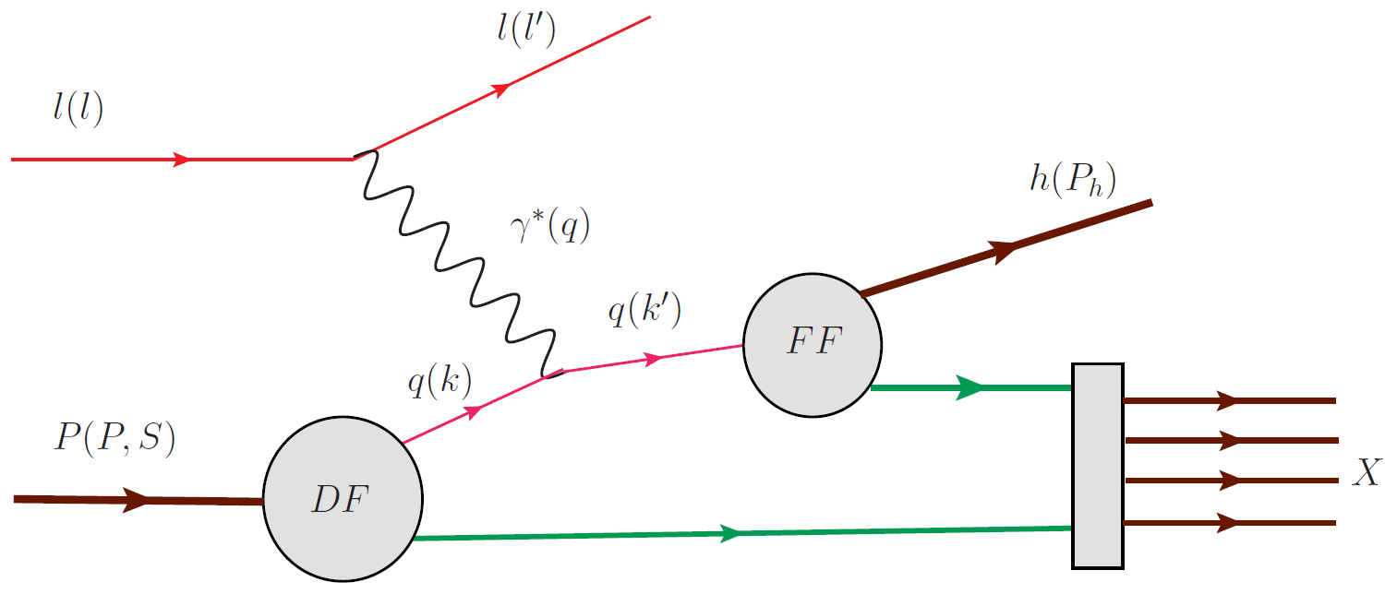
SIDIS, unpolarized lepton, LO parton model

Slide 7
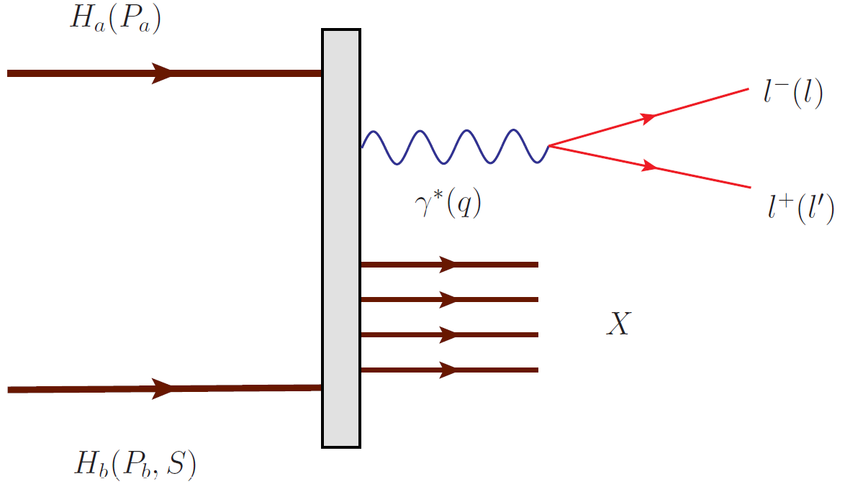
Crossing

Slide 8
DY processes

Slide 9
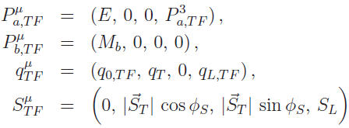
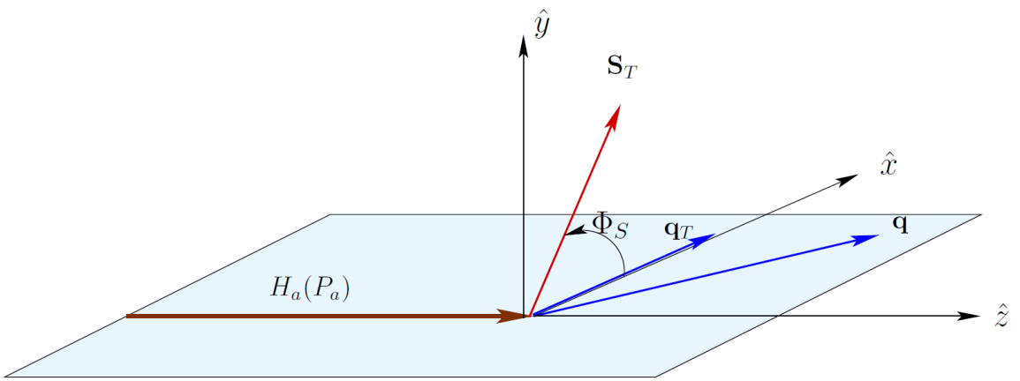
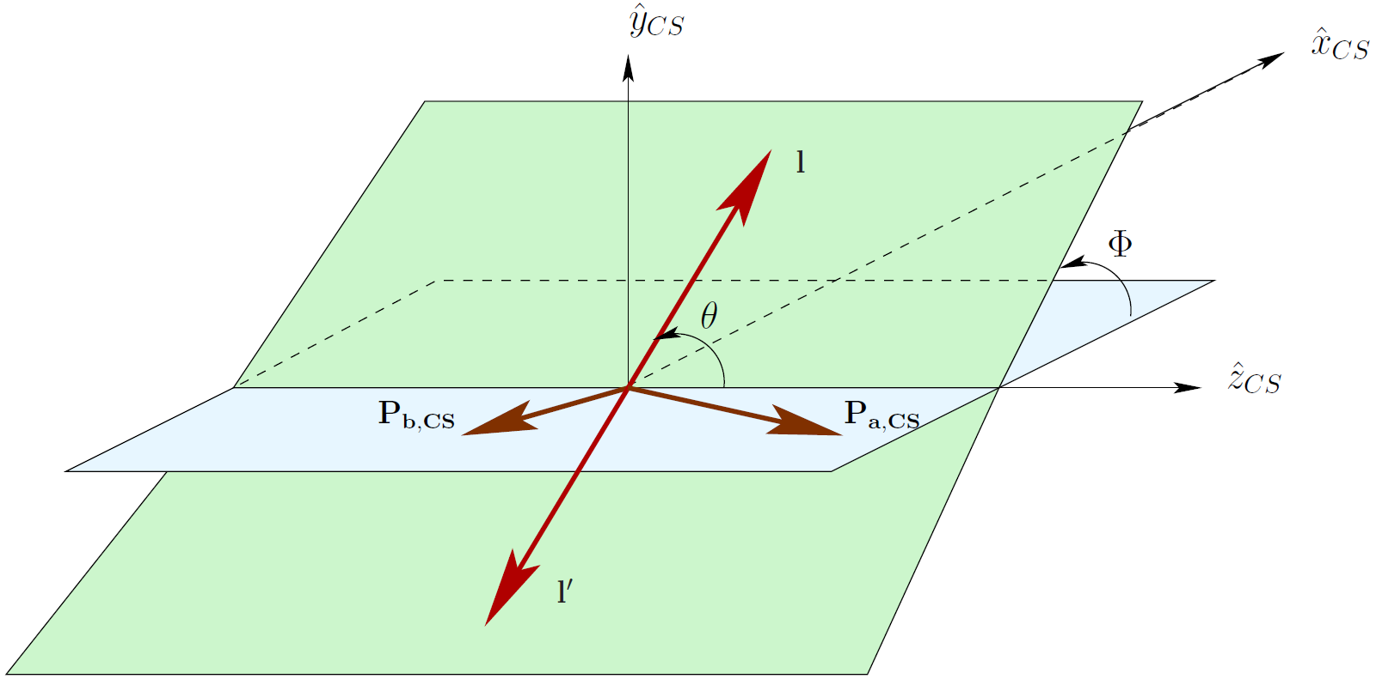
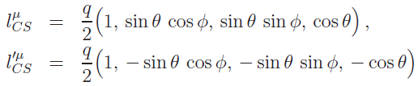
Angular variables
Target rest frame (TF)
Collins-Soper frame (CS)

Slide 10
General expression for DY cross section
(only target is polarized)
S. Arnold, A. Metz and M. Schlegel, PRD 79, 034005 (2009)
48 structure functions if both spin-1/2 hadrons are polarized
as expected from crossing symmetry

Slide 11
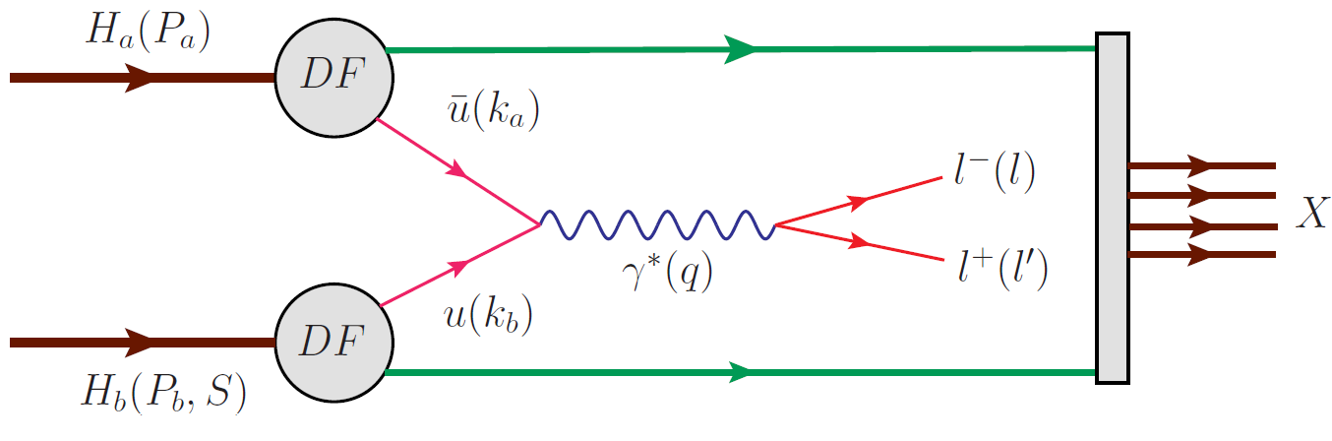
DY-LO, only transversely polarized target

Slide 12
DY-LO asymmetries, transversely polarized target

Slide 13
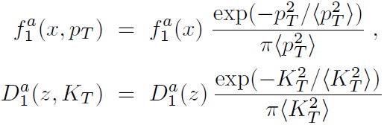



Intrinsic transverse momentum in SIDIS
P. Schweitzer, T. Teckentrup and A. Metz, arXiv:1003.2190v1 [hep-ph,]
Comprehensive analysis of existing unpolarized SIDIS and DY data
SIDIS, factorized Gauss model:
Torino: EMC data
Bochum: HERMES
Old extractions:
In many analyses, for example, extraction of transversity, BM function from SIDIS
and pp and pd DY processes this values are applied

Slide 14
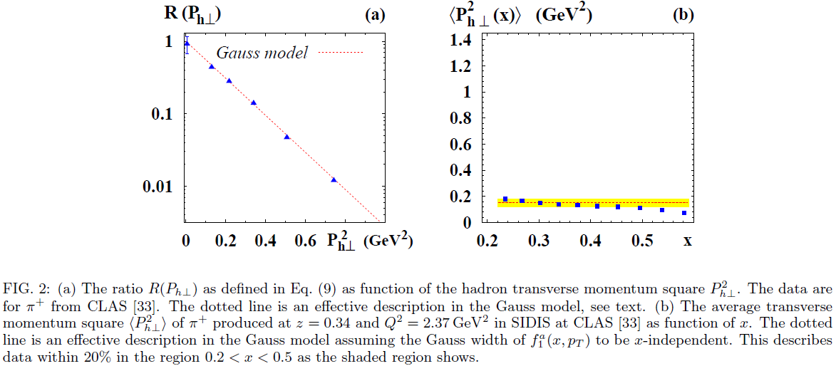
New data from JLab

Slide 15

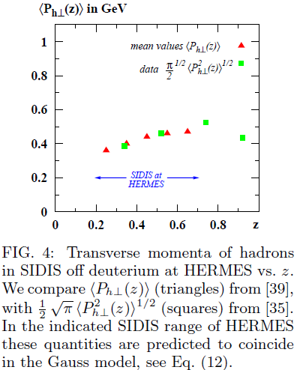
Test of Gauss model at HERMES

Slide 16
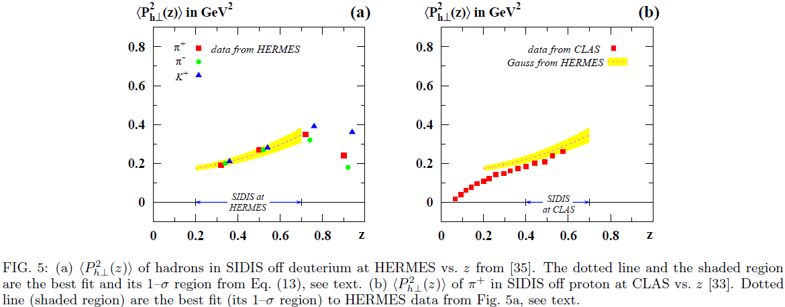

Parameters from HERMES and cross check with CLAS

Slide 17
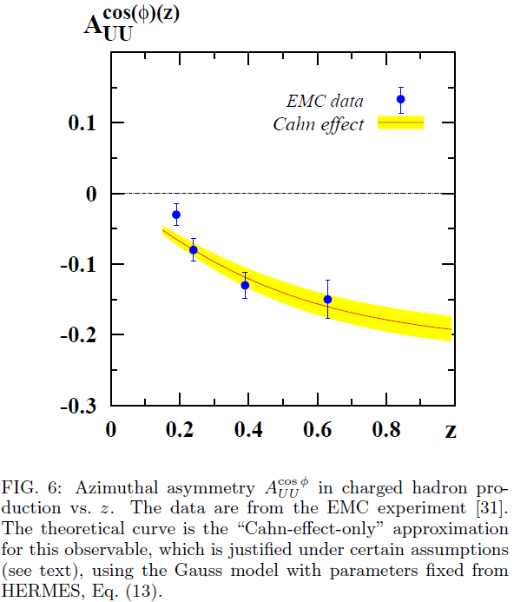
Cahn effect at EMC

Slide 18
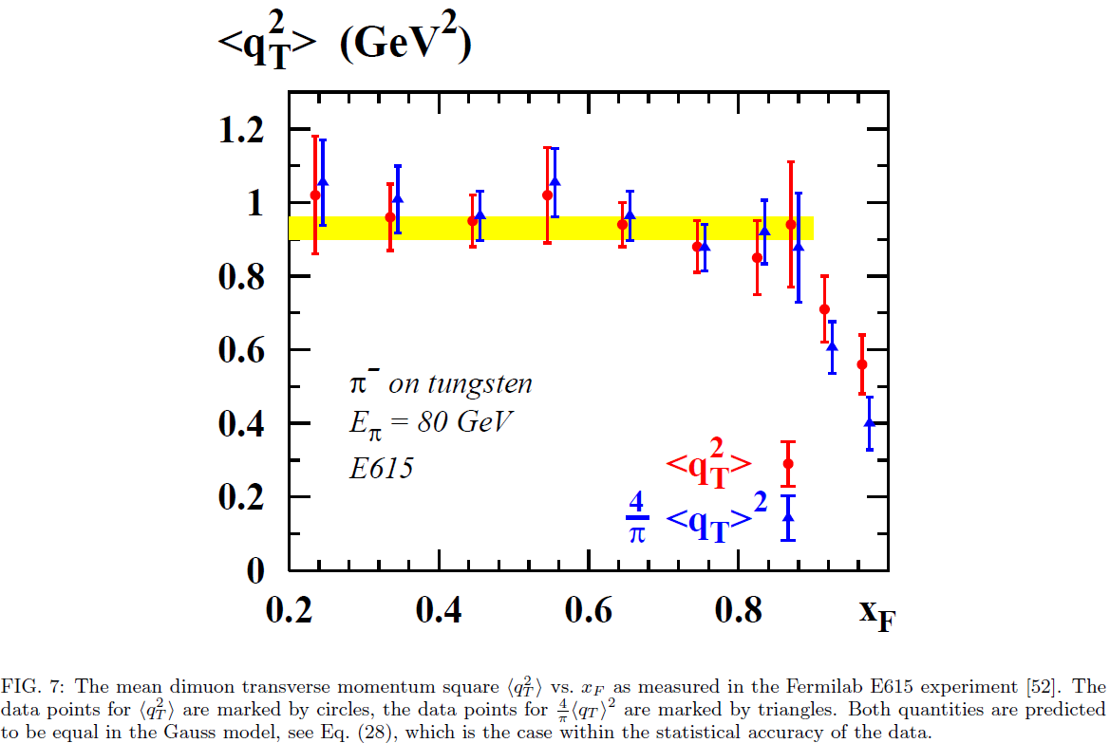

Intrinsic transverse momentum in DY: testing Gauss

Slide 19
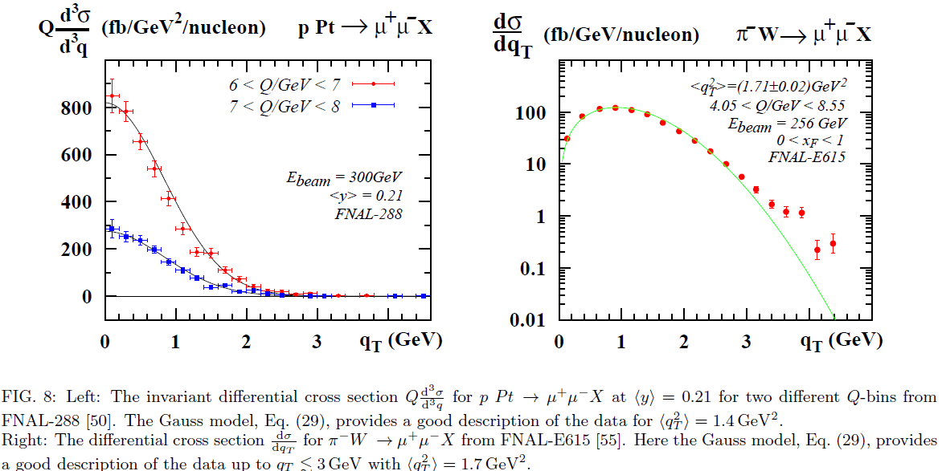

Intrinsic transverse momentum in DY: pion vs nucleon

Slide 20
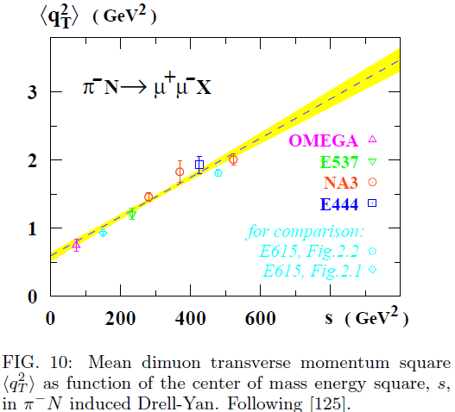
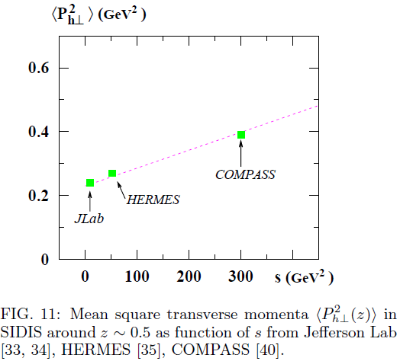
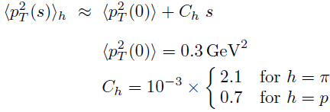
Energy dependence of intrinsic transverse momenta

Slide 21

STM conclusions
“Gauss model works very well in SIDIS and DY”
  No evidence for flavor- or x- or z-dependence of Gauss widths
  Gauss width increase with energy in DY
  This property holds in SIDIS too
    “More precise data from SIDIS are needed…”
“The Gauss Anzatz remains to be tested, in particular, when polarization phenomena are included, and future data may demand to refine it, which will improve our understanding of intrinsic transverse parton momenta.”

Slide 22
Exercise for Sivers effect in DY@COMPASS
Unpolarized PDFs: GRV-P1 pion PDFs (Zeit.Phys.C53(1992)651) and GRV98 LO for proton

Slide 23
Parameterization of TMDs
Torino parameterization for Sivers function (with changed sign for DY case)
Extracted parameters (Melis talk)

Slide 24
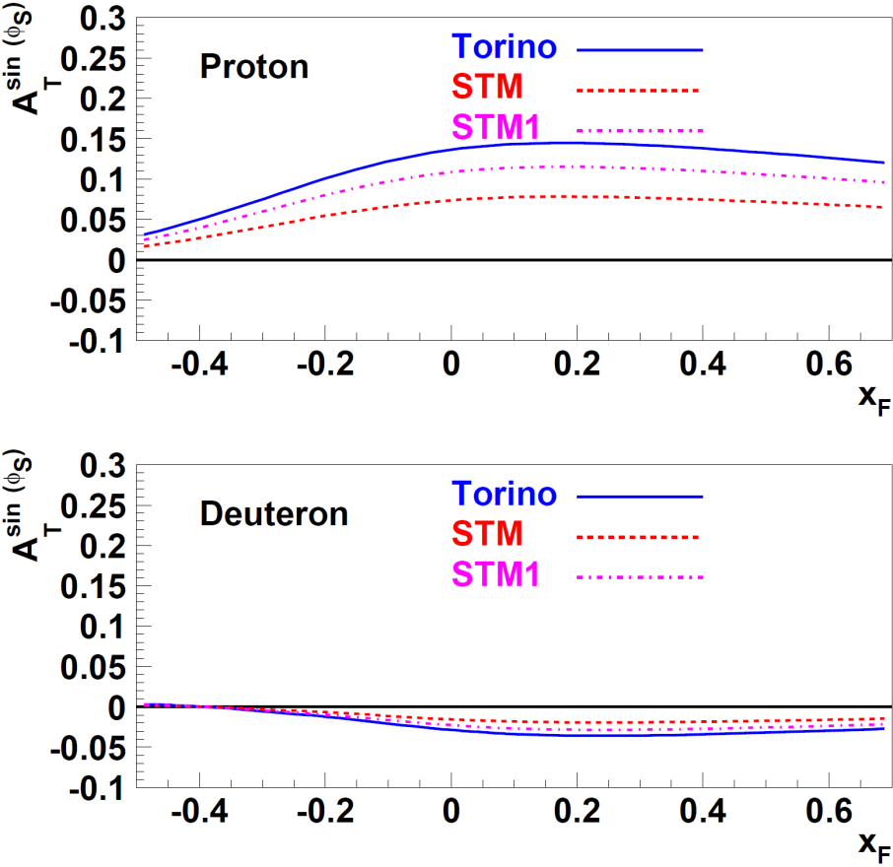
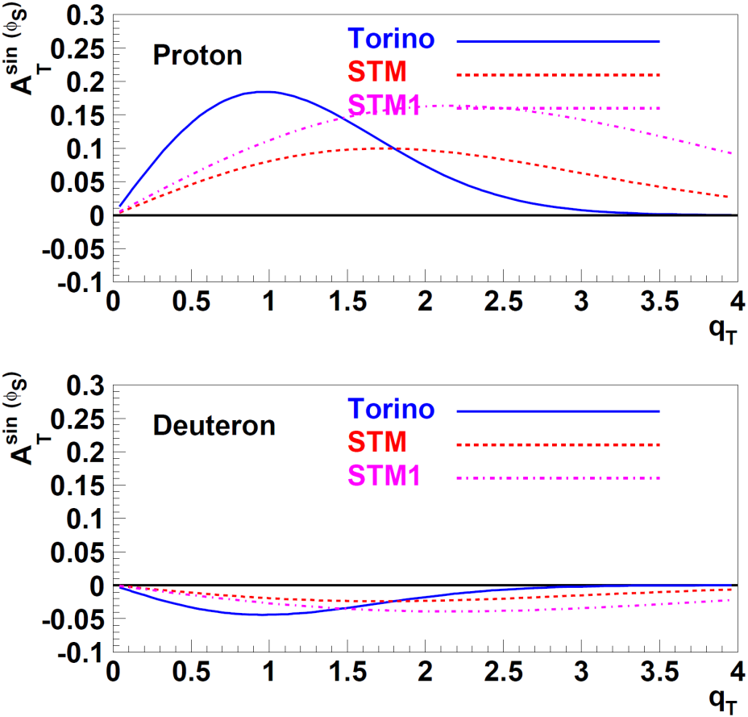
Torino-STM

Slide 25
Discussion
What is the origin of energy dependence of Gauss width?
SIDIS at COMPASS can provide at higher than HERMES and Jlab energy
  new acceptance corrected data on unpolarized TMD DFs
  new data on Sivers asymmetry
    to check the energy dependence of the Gauss width of unpolarized DFs and FFs
    Energy dependence of parameters of Sivers DF
First DY measurements with transversely polarized target at COMPASS will allow to study the universality of spin dependent TMD DFs
    Size and shape of Sivers DY asymmetry dependence on x_{F} and q_{T} will are sensitive to Gaussian width of Sivers function at high energy and Q² and allow to understand if
    this width is energy dependent?
      What is universal: the Sivers PDF or the ratio of Sivers PDF to unpolarized one?

