Slide 1
Beamline Status
Jonathan Lewis
LBNC Meeting
6 December 2019

Slide 2
Outline
Scope Overview
Organization
Design Status
DOE project cost and overall schedule status
ESH
QA
Risks
Plan to CD2
Summary

Slide 3
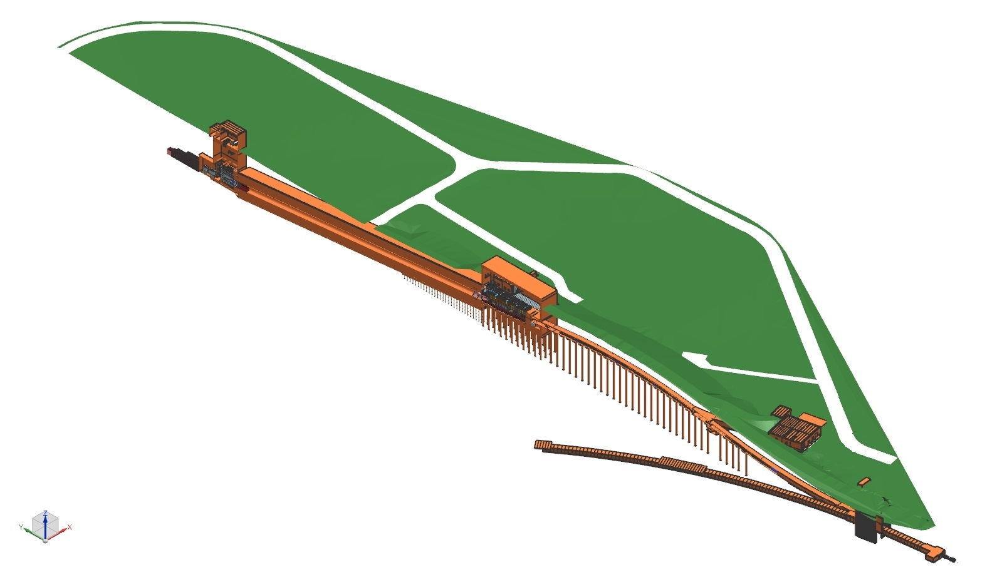
Scope: Beamline Technical Components
Nu Beam
to SURF, SD
Absorber Complex
Primary Beam Complex
Decay Pipe
Target
Complex
Primary
Beamline
Strong Interface and close collaboration with the Near Site Conventional Facilities Team
Fermilab
Main Injector
Tunnel
Proton Beam Extraction
Proton Beam
from MI-10

Slide 4
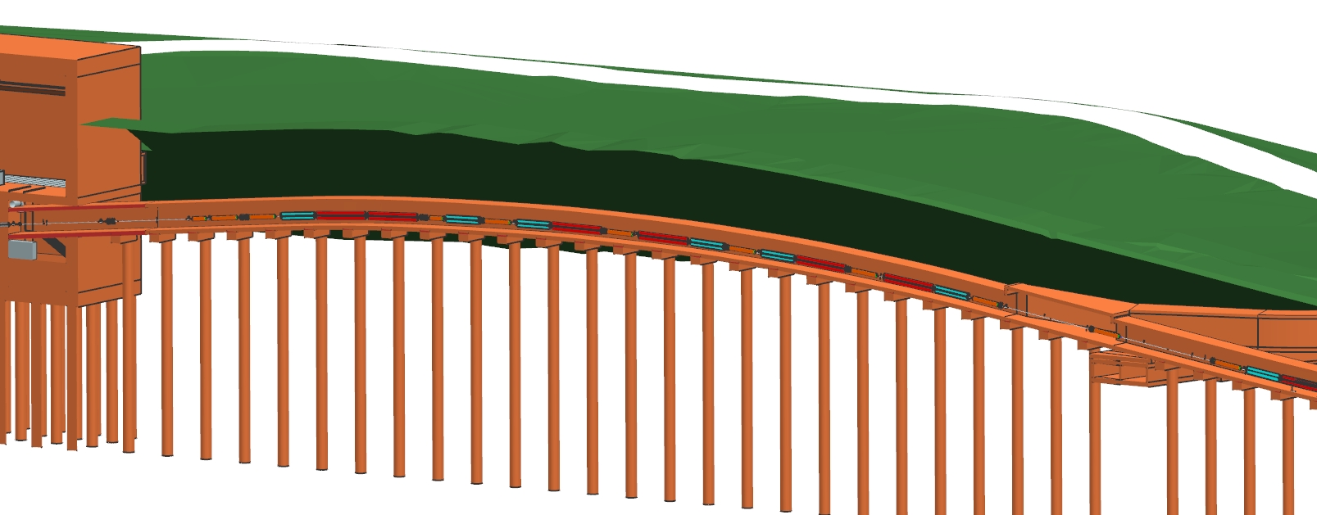
Scope: Primary Beam
Beam optics, magnets, magnet power supplies, water systems, vacuum, beam instrumentation, installation
  International contributions
    Corrector Magnets: IHEP
    Main Dipole & Quadrupole Magnets: BARC

Slide 5
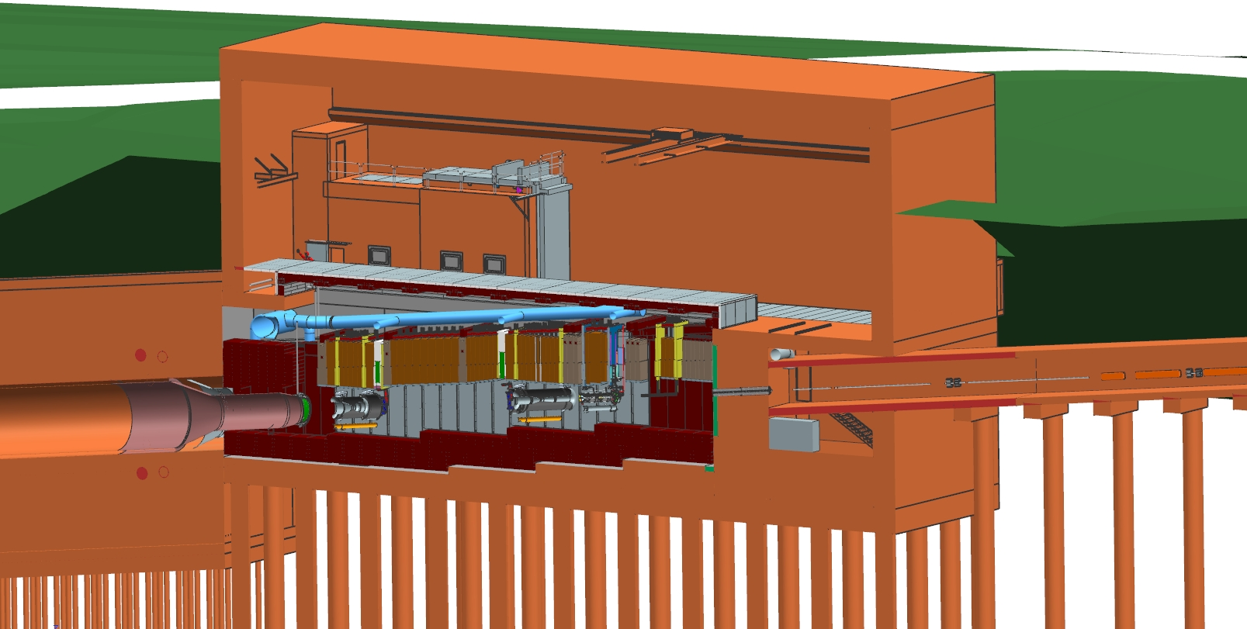
Scope: Target Complex
Hatch Covers
Target
Hall
Work-Cell
←Beam
Primary Beamline
Decay
Pipe
He Gas
N₂ Gas
Horn C
Horn A with Target
Primary Beam Window
Decay Pipe Window
Horn B
Horn A with Target
Baffle
Cooling Panels
Steel Shielding
Baffle, target, focusing horns, support modules, horn power supply, target shield pile, radioactive water systems, remote handling, storage of radioactive components
International Contributions:
    Target, Baffle and associated systems: RAL-UK
    Stripline Feedthrough & Hatch Cover Prototypes: KEK-JPARC

Slide 6
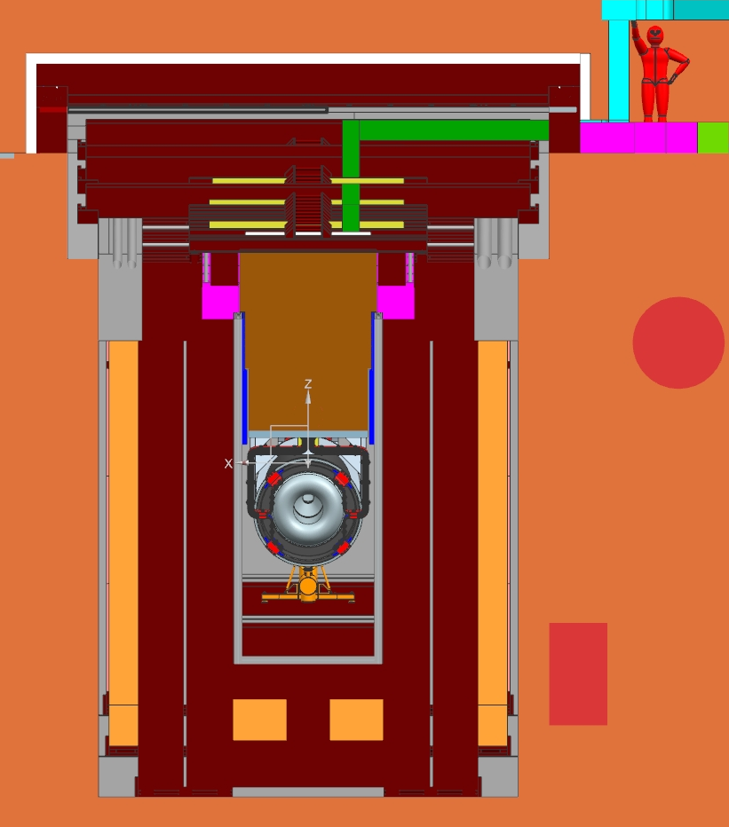
Target Shield Pile – Cross Section View
Hatch Cover
Steel Shielding
Borated Poly (neutron capture)
Steel Wall Shielding (Battlement)
Feed Through
O-ring seal between Hatch Cover & Battlement
Stripline
Horn
Support Module
Steel Shielding
Stainless steel sheet- metal gas-barrier (attached to Bunker)
Nitrogen gas ducts
Concrete Shielding
(Bunker)
Chase water cooling panels

Slide 7
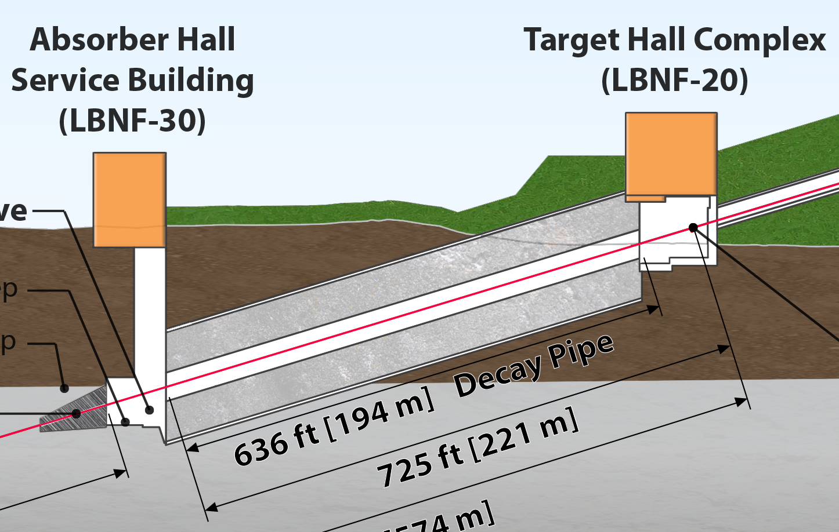
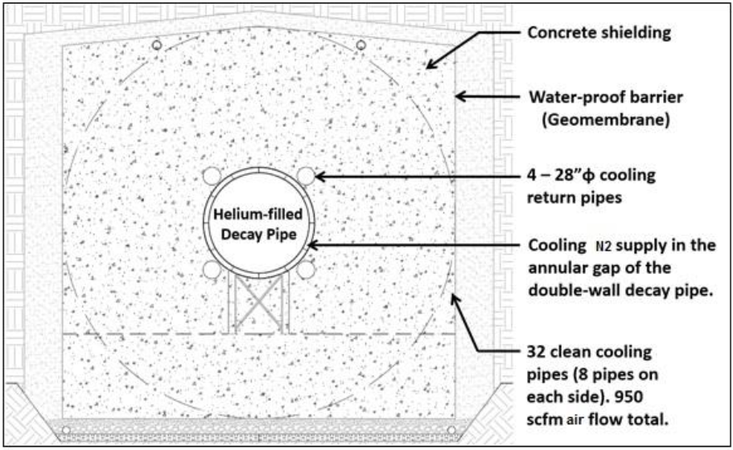
Decay Pipe - Diagram
4 meters
5.6 meters

Slide 8
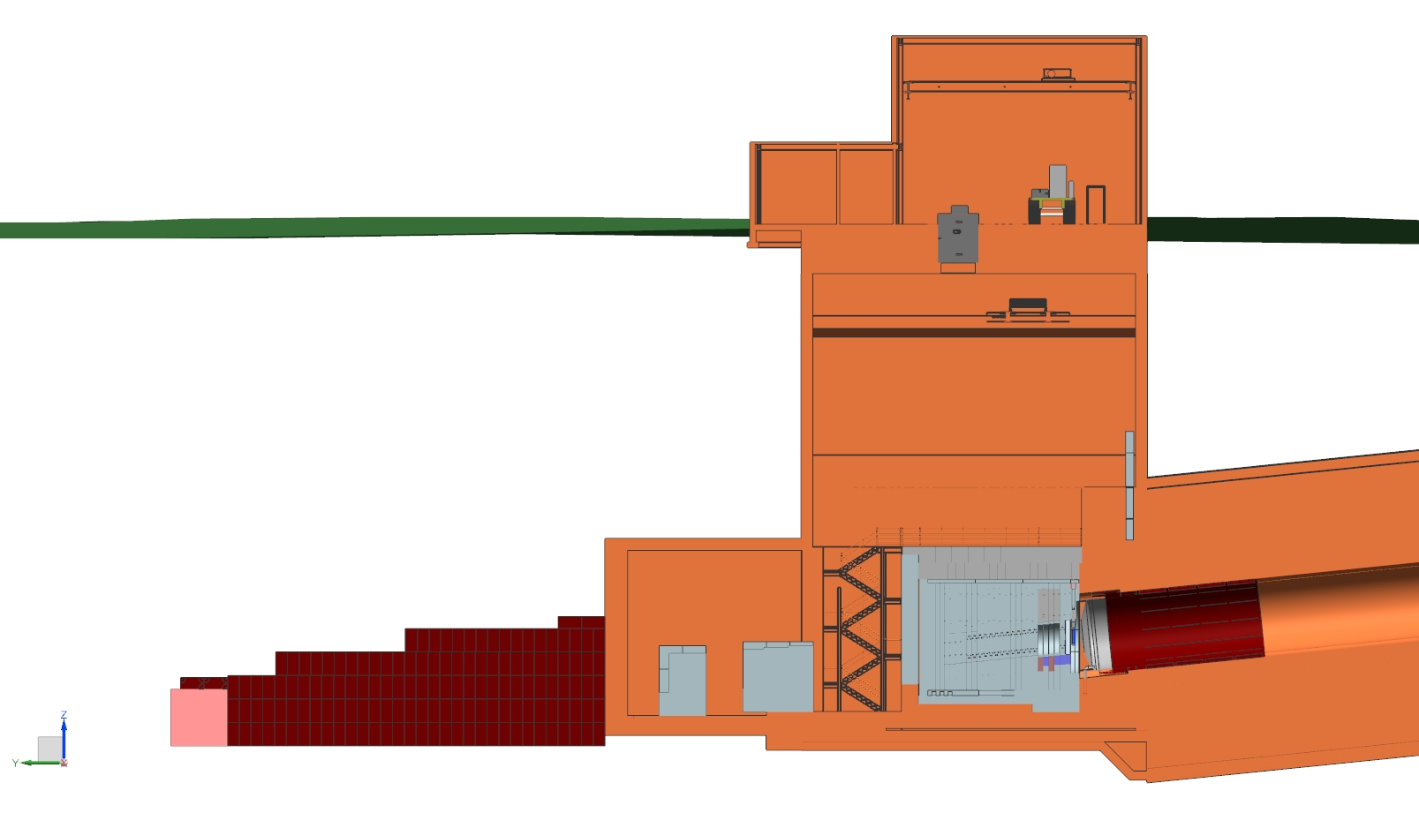
Scope: Decay Pipe and Absorber
Service
Bay
Muon
Monitoring
Alcove
Shielding
Hadron
Absorber
Absorber
Hall
Muon
Shielding
Downstream
Decay Pipe Window
Primary beam window, decay pipe cooling and windows, hadron absorber, hadron monitor, muon systems

Slide 9
Additional Scope
Beamline System Integration
  Controls, Interlocks, Alignment, Installation Infrastructure and Coordination
Project Management
  Includes Beamline Modeling and Radiation Physics & Protection.

Slide 10
Beamline Requirements & Assumptions
Driving physics considerations for the LBNF Beamline are the long baseline neutrino oscillation analyses.
Beam directed towards SURF in Lead, South Dakota, 1300 km from Fermilab (5.8 degree overall vertical bend).
Primary beam, single turn extracted from MI, is designed to transport high intensity protons in the energy range of 60-120 GeV to the LBNF target.
Broad band, sign selected neutrino beam with its spectrum to cover the 1st (2.4 GeV) and 2nd (0.8 GeV) oscillation maxima => covering 0.5 ~ 5.0 GeV.
Uptime (including the accelerator complex) of at least 55%

Slide 11
Beamline Requirements & Assumptions Contd.
All systems are designed for 1.2 MW initial proton beam power and facility is upgradeable to 2.4 MW proton beam power.
All systems that are prone to failure, such as water-cooled systems, are designed to be repairable and/or replaceable.
Overall, LBNF can take up to 20% of lab’s offsite radiation dose budget with stringent limits placed on radiological protection of environment, workers and the public. Self imposed 30% limit of lab’s radioactive air emissions “cap”. Entire facility encapsulated in water-proof barrier.
Facility assumed to operate for 20 years within a 30 year span. Design life of Target & Absorber Hall Complexes and of Decay Pipe is 50 years, design life of water barrier system is 80 years.

Slide 12
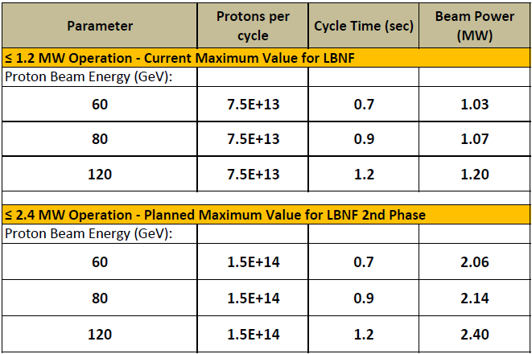
Beamline Operating Parameters
(1.1 – 1.9)x10²¹ POT/yr
Pulse duration: 10 μs
Beam size at target: tunable 1.0 - 4.0 mm
Present size ~2.7 mm
Some Tevatron, NuMI components and some existing Fermilab steel available to LBNF
Actively implementing lessons learned from MiniBooNE, NuMI/MINOS, NuMI/NOvA, JPARC and other Neutrino Facilities.

Slide 13
Systems being designed for 2.4 MW
Upgrading these items later would be prohibitively expensive and inconsistent with ALARA:
  Size of enclosures (primary proton beamline, target chase, target hall, decay pipe, absorber hall)
  Radiological shielding of enclosures (except for the target hall roof that can be easily upgraded for 2.4 MW when needed)
  Primary Beamline components
  Target chase cooling panels
  Decay pipe, its cooling and the decay pipe downstream window
  Hadron Absorber
  Remote handling equipment
  Radioactive Water (RAW) system piping
  Horn support structures are designed to last for the facility lifetime

Slide 14
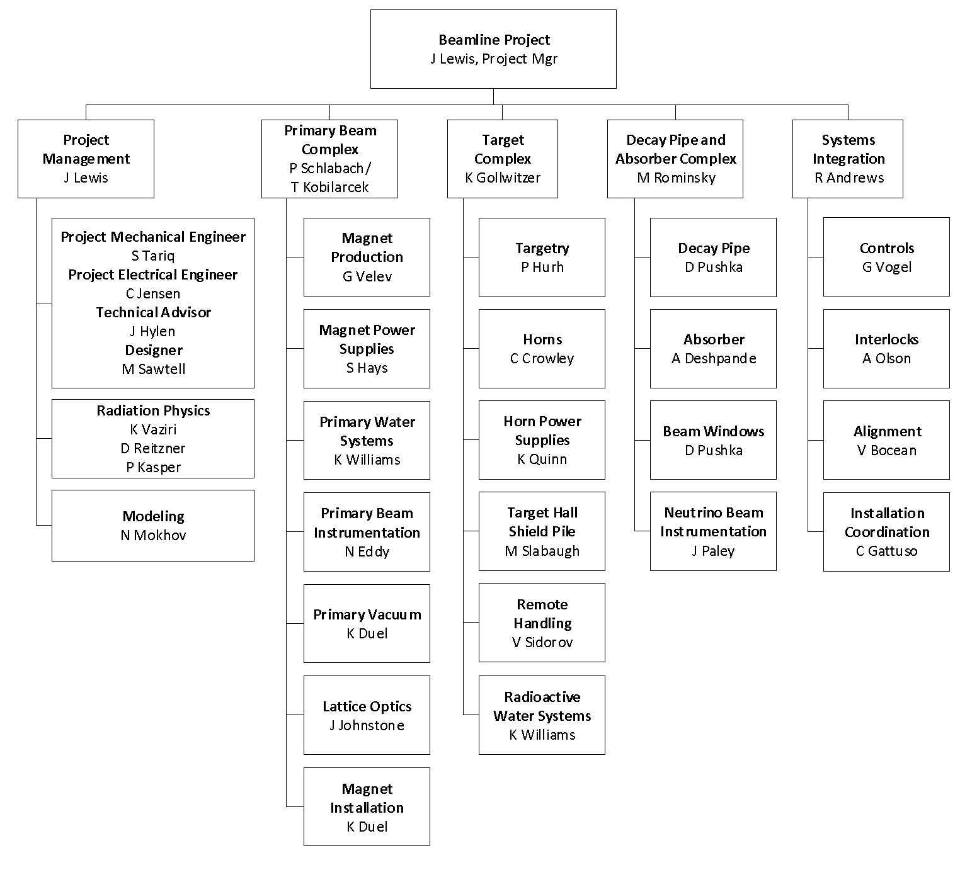
Beamline Organization & Staffing
L2
New to team
L3
Implemented new organization – 5 L3 systems (CAMs) and 21 L4 systems (Technical Managers)

Slide 15
Beamline Design – Recent Progress
Preliminary design progressing – continuing to push hard on design maturity (see next slide) and securing needed resources.
  Continue to mature 3D CAD integration models
Filled management and added mechanical engineering resources
Working with professional estimator to update BOEs for all procurements
Completed all high-level interface specifications and requirements between Beamline and NSCF
  Working with CF to review preliminary design from A/E
Working on Beam-Beam interface definitions – 75% interfaces completed, on plan to complete >90% interfaces by end of CY19.

Slide 16
Design Maturity
WBS Name | Design Maturity
Primary Beam | 0.76
Magnet Production | 0.90
Magnet Power Supplies | 0.75
Primary Water System | 0.50
Primary Beam Instrumentation | 0.80
Primary Vacuum | 0.64
Lattice Optics | 0.92
Magnet Installation | 0.53
Target Complex | 0.45
Targetry | 0.18
Horns | 0.25
Horn Power Supplies | 0.30
Target Hall Shield Pile | 0.65
RAW Water Systems | 0.40
Remote Handling Equipment | 0.50
Decay Pipe and Absorber Complex | 0.39
Decay Pipe | 0.30
Absorber | 0.65
Beam Windows | 0.20
Neutrino Beam Instrumentation | 0.25
System Integration | 0.52
Controls | 0.65
Interlocks | 0.63
Alignment | 0.38
Beamline Installation Coordination | 0.50
Maturity as of 9/30/19
Maturity of Primary Beam, Target Complex, Decay Pipe & Absorber Complex, and Systems Integration weighted by BCWS costs of each element.
  Project Management excluded
Overall: 52%

Slide 17
Beamline Quality of Estimate – based on design maturity

Slide 18
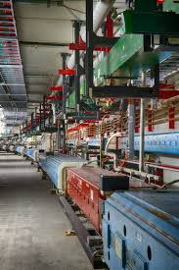
Primary Beam Design Progress highlights
Optimized the layout of the Primary beam Service Building (LBNF 5) and MVA (Magnet Vehicle Access) tunnel for improved utility routing and operational efficiency.
Completed requirements and specifications for the Magnet Vehicle (to transport and install magnets), identified capable vendors, working with procurement on a RFI.
Completed dipole magnet stand design technical review.
Low Conductivity Water system preliminary design nearly done. Review scheduled.
Started on preliminary design for primary beam vacuum.

Slide 19
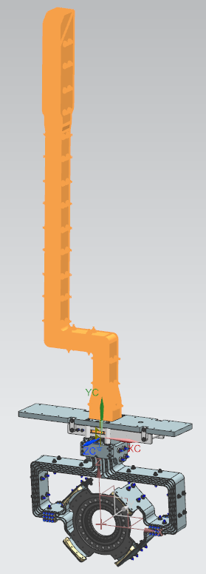
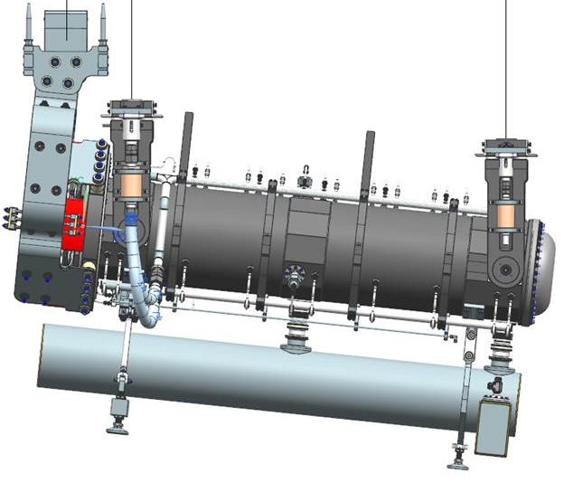
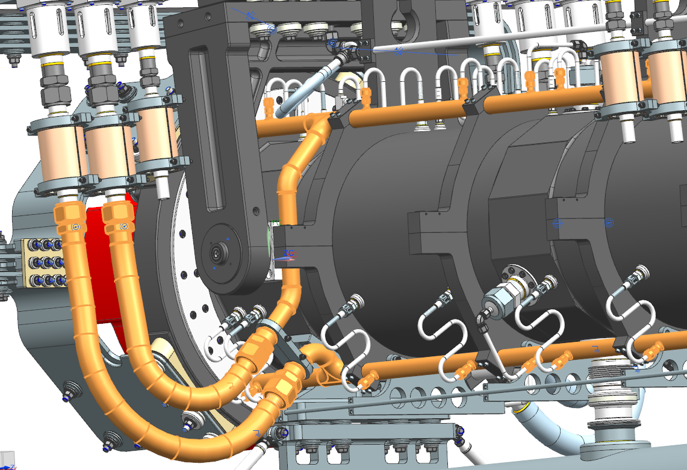
Target Complex Design Status Highlights
Advanced Horn A and module design. Working with RAL on the target interface and exchange mechanism including layout of all the utilities.
Completed thermal analysis for the target shield pile (TSP) – Preliminary results show acceptable temperature distribution.

Slide 20
Target Complex Design Status Highlights
Completed horn stripline electrical design together with the ceramic insulator mechanical design. Also providing stripline electrical design input to J-PARC for the stripline feedthrough.
Made several value engineering and operational improvements to the Target Complex such as relocating the truck bay.
Several technical reviews completed: Horns and stripline FE analysis review, Cooling panel prototype design review.
Advanced conceptual design for control of tritium and ⁴¹Ar

Slide 21
Decay Pipe & Absorber Complex Design Status highlights
Completed conceptual design for decay pipe upstream window exchange mechanism
Advanced the design of the downstream decay pipe N₂ return system.
Completed first pass at installation procedure for Absorber – showed that the existing layout of Absorber Service Building and hatch are adequate for Beamline needs.
Revised accident condition to account for the baflette and reanalyzing decay pipe window
Analyzing absorber to account for 1.5m target

Slide 22
System Integration Design Status highlights
Working on interface control documents within Beamline scope
  147 interfaces identified. Conducting verification with stakeholders
Controls: Preliminary design work was completed in January 2019 with an AD/Controls Preliminary Design review completed in February 2019. Further development contingent on planned accelerator controls upgrade.
Interlocks: Awaiting design of enclosures for delineation of location of entrances.
Alignment: Completed preliminary design, full prototype assembly, and testing of Remote Survey Equipment for Aligning Target and Horns.
Installation Coordination: An internal review of the task estimates (costs and duration) is being conducted, in addition the scope of each task is being verified.

Slide 23
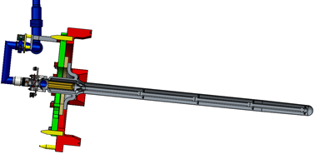
International Partner Status – Contributions
RAL-UK collaboration on target progressing well.
  Considered three target options
  Conceptual design for a cantilevered, helium-cooled graphite cylinder was approved at Aug. 21 review
    1.5m target will be taken to preliminary design and prototyped
      Goal is prototype can act a functional spare
    Lessons to be learned from prototype may allow final design and production target to be longer
      Goal is 4 interaction lengths = 1.8m of graphite

Slide 24
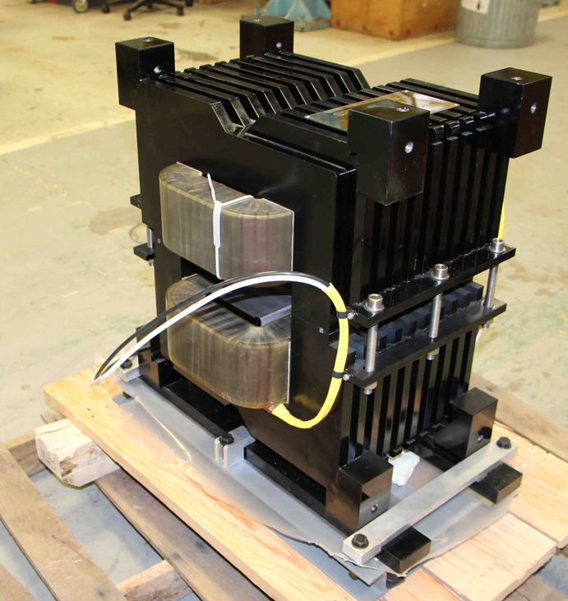
International Partner Status – Contributions
IHEP-China production of corrector magnets completed
  First five magnets have passed all tests at FNAL
BARC-India collaboration solidified
  India to build main dipole and quadrupole magnets
  Using FNAL designs with minor modifications
    Interoperable with existing magnets

Slide 25
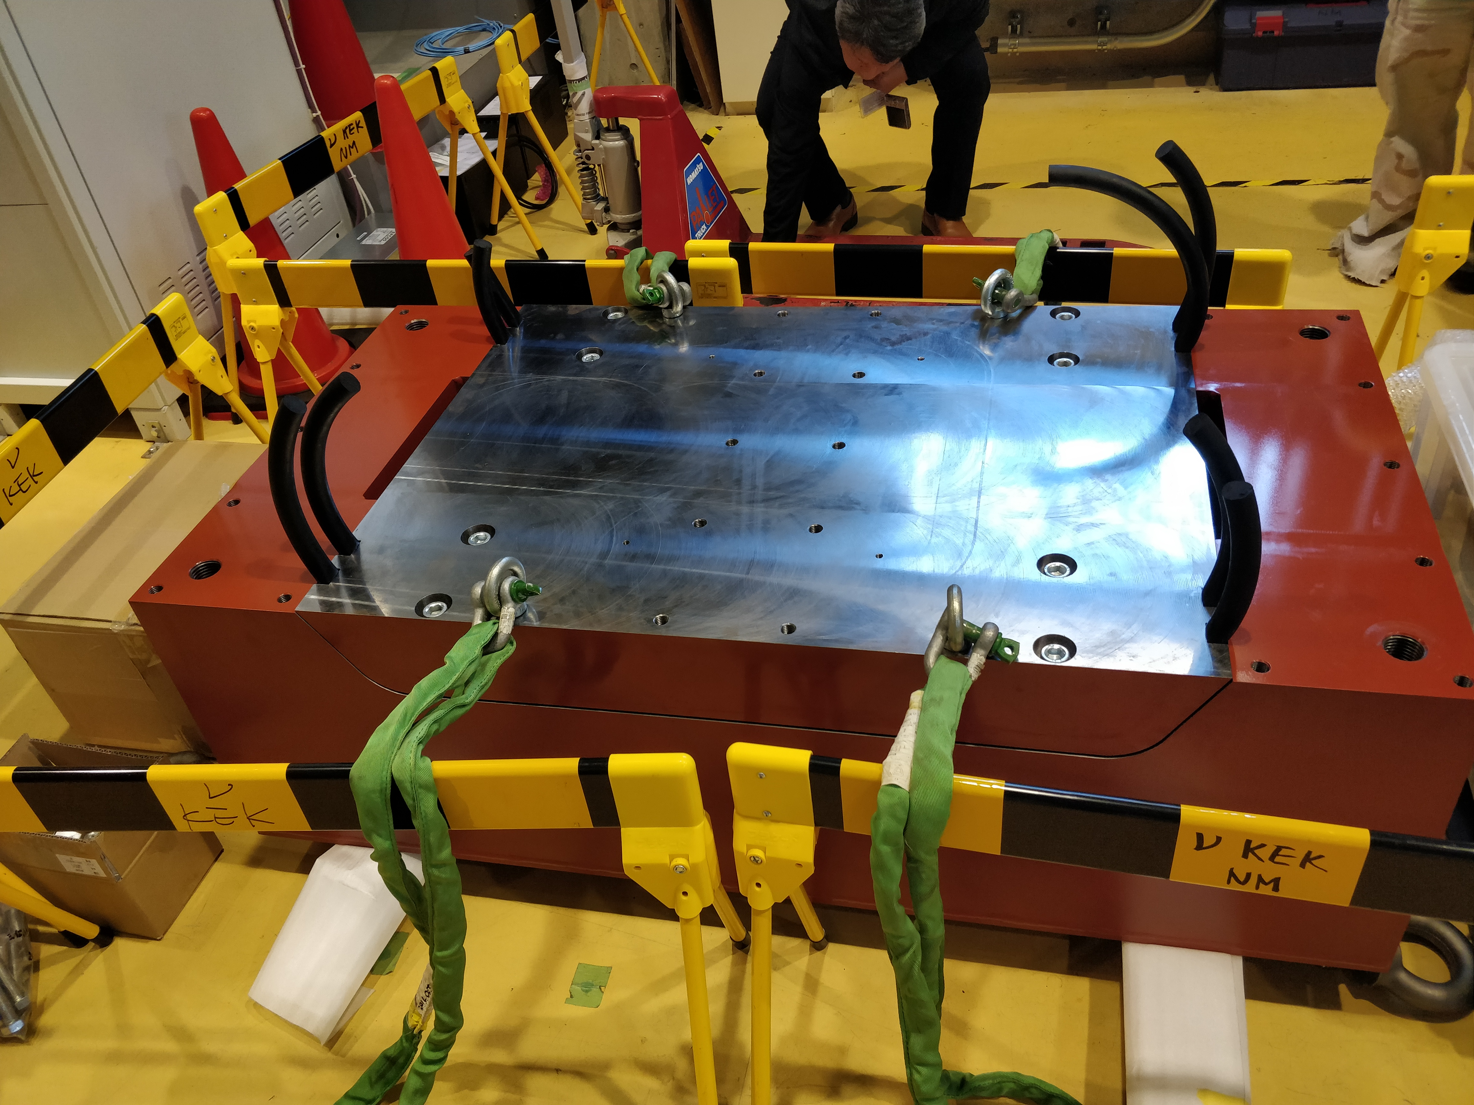
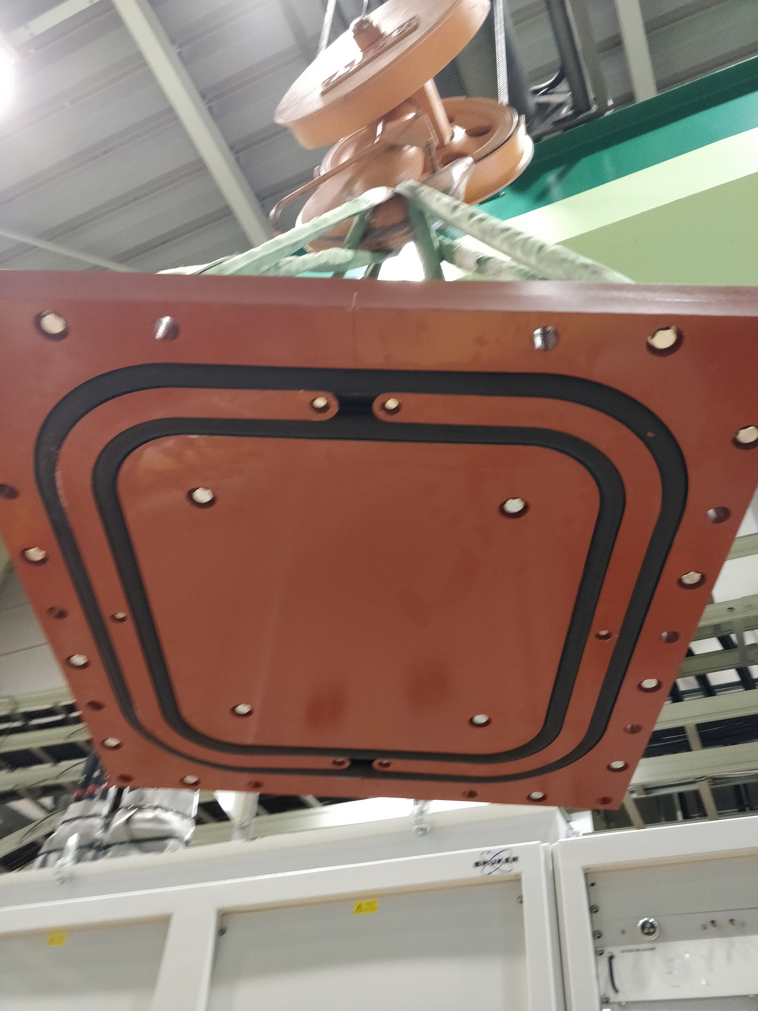
International Partner Status – R&D and Prototyping
KEK-Japan collaboration ongoing – Japan continuing to fund R&D for LBNF beamline in 2019/2020.
  Prototype hatch cover tested at J-PARC and shipped to FNAL
  Prototype fabrication and testing for horn stripline currently underway at J-PARC (Fermilab engineers visited J-PARC in April for the prototype testing).
  Other projects were discussed in Feb 2019
    Helium cooling for target and hydrogen recombination for RAW systems
Hatch Lid
O-ring

Slide 26
Beamline - Schedule Summary
Nov 2020
SP NS – CD-2
Sept-22
SP NS CD-3
Nov-15 CD-1 Refresh Approval
Sep-16 CD-3a Approval
Aug-31
CD-4 (early completion)
Beamline Preliminary Design
Design & Test Firmware for BPM DDC Boards
Decay Pipe and Absorber Complex
Target Complex
BLM/TLM Systems
Beamline Final Design
System Integration (Interlocks)
Primary Beam Instrumentation
Magnets
Material Purchase Constraint
Production Horns A, B, C
Procurement/ Assembly
Target Shield Pile
Conventional Construction
Disassemble MI Components
Extraction Enclosure (Long Shut Down)
Install New / Re-install Existing Components
Upstream of Shield Wall
Primary Beam Enclosure
Target Complex Authorization for Use and Possession
Downstream of Shield Wall
Nearest Critical Path
Install Target Shield Pile/ Battlement/Cooing Panel Install
Remote Handling Installation & Commissioning
A B C
Target Complex
Absorber Complex Authorization for Use and Possession
Mechanical and Electrical Rough-in
Install Horn A, B, C and initial Power-up/ Leak Check chase
Absorber Component Installation
DOE and Non-DOE Activity
Decay Pipe Upstream Window, Muon System - Install
Mechanical and Electrical Rough-in
Beamline Checkout Period
FY19
FY20
FY21
FY22
FY23
FY24
FY25
FY26
FY27
FY28
FY29
FY30
FY31
Material Purchase Constraint
Main injector – Second Shutdown Begins
Absorber Complex
Beamline Complete
Target Complex
Authorization for Use and Possession

Slide 27
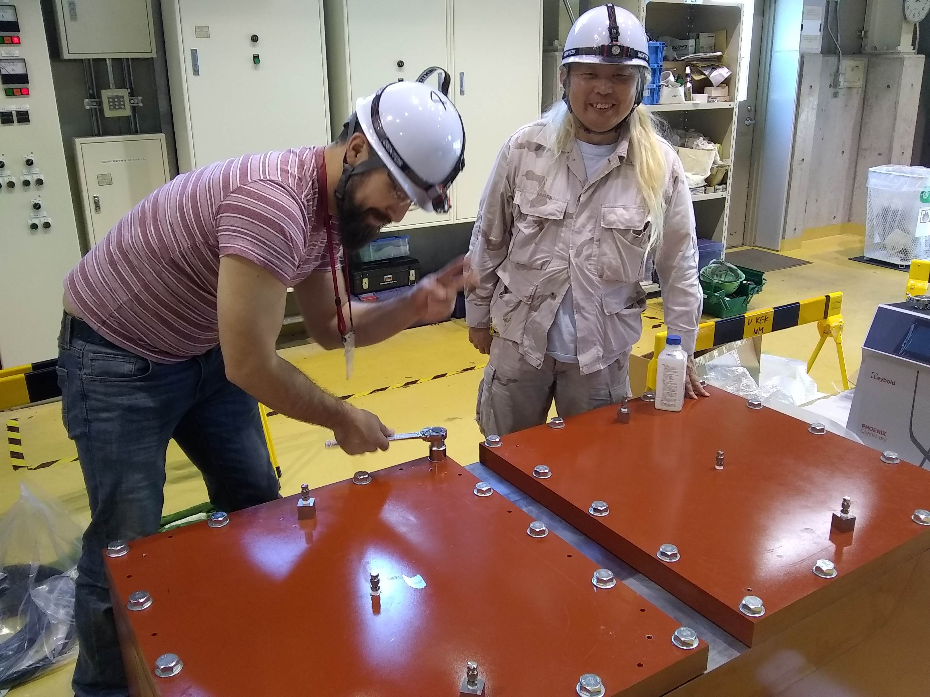
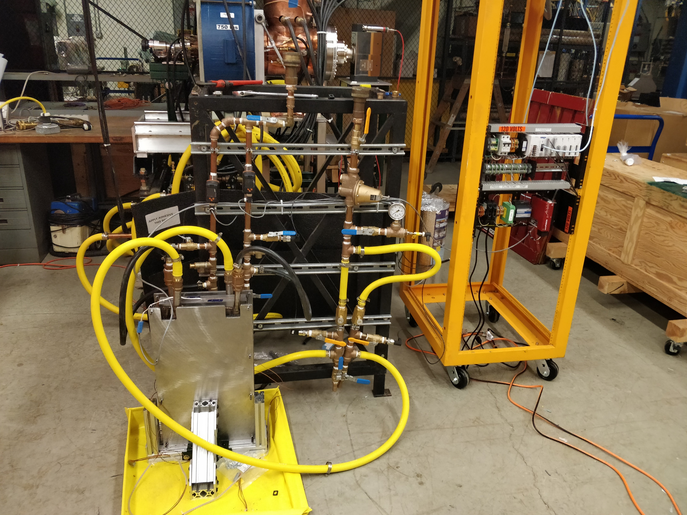
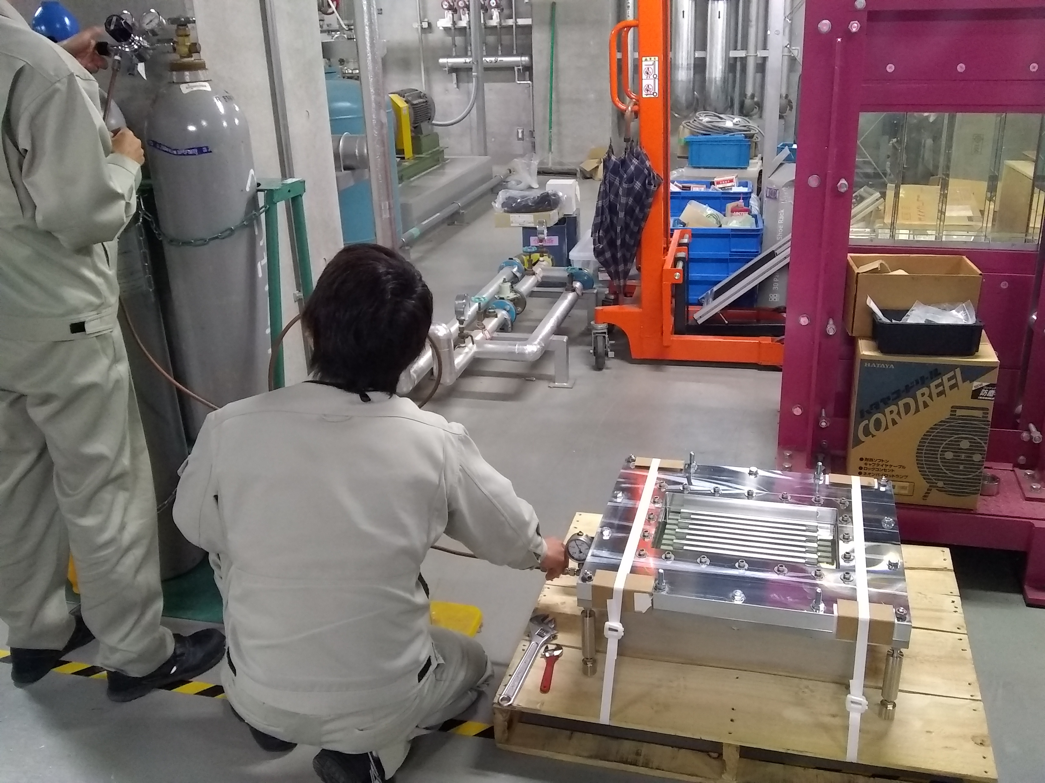
Prototypes
CHARGE QUESTION 1
Prototype development and testing underway for several sub-systems:
Target Shield Pile Hatch Cover prototype being vacuum and pressure tested at J-PARC. Initial results look very good.
(Joe Angelo, FNAL engineer, on left)
Target Shield Pile Cooling Panel prototype being assembled at FNAL
Horn Stripline Feedthrough prototype being pressure tested at J-PARC

Slide 28
Prototyping Plans
Prototype | Institution | Timeframe to be built
Target | RAL/UK | 2019-2021
Horn A | Fermilab | 2021-2023
Stripline for Horn B/C | Fermilab | 2023-2024
Target shield pile hatch cover nitrogen seal | KEK/Japan | In progress
Horn stripline feedthrough | KEK/Japan | In progress
Absorber core aluminum block and cooling lines | Fermilab | In progress

Slide 29
Plans for Reviews
Activity Name | Date |  | Activity Name | Date
Primary Beam |  |  | Target Complex
Preliminary Design Review Primary LCW System | 31-Oct-19 |  | N2 Fill/Purge System Preliminary Design Review | 22-Nov-19
Primary LCW System Electrical Bus Prelim. Design Review | 31-Oct-19 |  | Horn PS Unit Preliminary Design Review | 20-Feb-20
Peer Review Preliminary Design of Vacuum System | 6-Jan-20 |  | Preliminary Design Review RAW Exchange System Skid TH | 24-Mar-20
PBE Quad Stand Preliminary Design Review | 13-Jan-20 |  | Prelim. Design Review Shielding/Cooling Panels RAW | 24-Mar-20
Magnet Install Plan Preliminary Design Review | 16-Jan-20 |  | Preliminary Design Review Target RAW Skid | 24-Mar-20
Kicker Preliminary Design Review | 10-May-21 |  | Preliminary Design Review Horn A RAW Skid | 24-Mar-20
Decay Pipe and Absorber |  |  | Preliminary Design Review Intermediate Cooling Skid TH | 8-Apr-20
Absorber Components Preliminary Design Review | 7-Jan-20 |  | Battlement & Hatch Cover System Preliminary Design Review | 30-Apr-20
Decay Pipe Air Cooling Routing Preliminary Design - review CF design | 6-Mar-20 |  | Preliminary Design Review Horn B RAW Skid | 15-May-20
Decay Pipe Preliminary Design - review of CF design | 12-Mar-20 |  | TH Shielding Preliminary Design Review | 27-May-20
Preliminary Design Review Intermediate Cooling Skid AH | 24-Mar-20 |  | Target Chase Cooling Preliminary Design Review | 27-May-20
Preliminary Design Review Absorber RAW Skid | 24-Mar-20 |  | Preliminary Design Review Horn C RAW Skid | 19-Jun-20
Preliminary Design Review RAW Exchange System Skid AH | 31-Mar-20 |  | Horn PS Preliminary Design Review | 24-Jun-20
Decay Pipe Upstream Window Preliminary Design Review | 22-May-20 |  | Baffle Module/ Carrier Prelminary Design Review | 22-Sep-20
Beam Windows Preliminary Design Review | 26-May-20 |  | He System Preliminary Design Review | 20-Oct-20
Neutrino Beam Instrumentation Prelim. Design Review | 9-Apr-21 |  | Target Preliminary Design Review | 24-Nov-20
Preliminary Design Hadron Monitor and Review - Labor | 13-May-21 |  | Baffle Carrier & Module Structural & Thermal Analysis Rev. | 15-Jun-21
RH Absorber Complex Preliminary Design Review | 17-Sep-21 |  | Remote Handling TH Preliminary Design Review | 27-Aug-21
 |  |  | Horns Preliminary Design Review | 6-Apr-23

Slide 30
Beamline Labor Resource Profile – (FY19+)

Slide 31
Beamline Labor Resources by Type (Est to Complete) – FTE-Years

Slide 32
Beamline Management and Resources
We have individuals identified in the schedule through FY20. For Lab planning purposes we provide as well the disciplines needed by Fermilab Divisions/Sections beyond FY20.
All of the Beamline labor is fully matrixed from AD, TD, and PPD.
  PPD provides FEA expertise plus mechanical design engineers
  TD provides most of primary beam technical expertise (magnets)
  AD provides the lions share of effort on Beamline
The Beamline Manager has bi-weekly meetings with Head and Deputy Head of Accelerator Division to discuss LBNF Beamline issues and resources
Given that majority of Beamline resources are from Accelerator Division, an MOU is being developed between Beamline and AD.

Slide 33
Beamline Management and Resources (2)
Proactive succession planning ongoing and critical given the duration of this project.
AD has hired a number of junior engineers to help fully staff beamline design efforts – new engineers are working on magnet installation, primary vacuum, LCW, and stripline design.
Competing programmatic priorities (PIP-II, Mu2e, Operations) continues to be a challenge for some of our key engineering resources.

Slide 34
ESH Radiological Issues
Radiological safety issues cover both off-site and on-site
Main Beamline Radiological Issues:
  Ground water and surface water
  Prompt radiation
  Residual radiation
  Activated air emissions
Continue to incorporate design improvements from latest MARS simulations and calculations plus lessons learned from NuMI
The LBNF radiological design goal is to contribute to less than 30% of the limits of the environmental radiological quantities specified by the Fermilab policies and implement ALARA in all aspects of the design.
Shielding
Shielding & remote handling
Containment & controlled release

Slide 35
Beamline Approach to ESH and QA
ESH and QA incorporated into all activities with continual involvement of LBNF ESH and QA managers.
Compliance with Fermilab’s Engineering Manual, ES&H Manual (FESHM), Radiological Control Manual (FRCM), and QA Manual together with the LBNF/DUNE QA Plan, plus compliance with all national codes and standards (ASME, OSHA, etc.).
Preliminary Design reviews, Final Design Reviews and Production/Operational Readiness Reviews included in the schedule for all activities, together with focused technical reviews as called by project management. Compliance with the LBNF Review Plan.
All procurement activities include requirements and spec docs with vendor/fabrication oversight and inspection upon delivery.

Slide 36
Beamline Approach to ESH and QA (2)
ESH Construction Safety Specialist under Beamline Project Management during the installation phase.
Full-time construction oversight by lead engineers (plus other experts as needed) during installation to assure everything meets design specifications.
Construction Coordinator/Task Managers will be performing the responsibilities of Quality Assurance Representatives to ensure requisite Quality Control is being adequately performed and documented during construction.
LBNF QA Manager will perform assessments on the effectiveness of the Beamline team’s compliance with the LBNF DUNE QA Plan

Slide 37
Beamline Risks Status
Beamline Risks: 39
  Threats: 39
    Risks Rank: 7 High, 13 Medium, 20 Low/Negligible
  Opportunities: 0
Since January 2019, we have closed/retired 4 risks and added 13 new risks.
  Retired risk BEAM-107 (Unacceptable Magnetic Field Uniformity at Horn Drain Ports), significant schedule risk driver for DUNE/LBNF.
We have a well-developed and mature process for managing risks – risks are actively evaluated and updated, plus the project holds annual/biannual risk workshops to assess all risks.
Risks from in-kind partners are included with a schedule impact only – joint risk workshop held with RAL to align our risks, plan to do the same with other partners.

Slide 38
High and Medium Risks – Current
→
Updated - changed from Low to High
→
Redefined/changed from Med to High
→
New Risk
New Risk
→
Updated - changed from Low to Medium
Redefined risk
New Risk
New Risk
New Risk
New Risk
New Risk
→ Risks to be addressed before CD-2

Slide 39
Beamline Strategy to prepare for CD-2
Focus on design maturation and completing interface definitions.
Progress as necessary the design of non-DOE scope items (where partners have yet to engage), to inform the preliminary design of interfacing systems within the DOE scope.
Although we do not anticipate any major unresolved technical issues post CD-2, we are capturing the design uncertainty by introducing cost and schedule risks.
Mitigate identified risks associated with cost/schedule drivers.
Complete Preliminary Design Report, followed by DOE Independent Technical Review, and Director’s Review prior to CD-2.

Slide 40
Summary
Beamline design continues to progress according to plan
Significant work to enable CF preliminary design by A/E
We are working to a plan that will get us to an appropriate design maturity for CD-2 where our cost is well understood.
Beamline organization is fully staffed and focused on completing the design

Slide 41
Backup

Slide 42
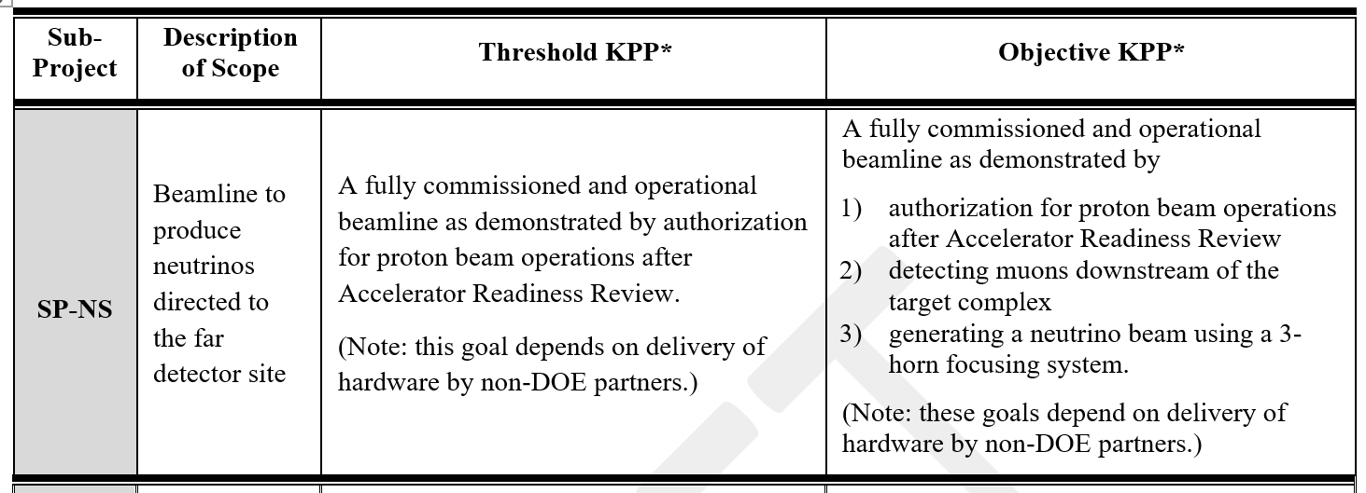
Key Performance Parameters
The plan is set up to achieve the Objective KPP

Slide 43
Advisory bodies and tools to guide us through CD-2
Beamline Technical Board
Focused Design Reviews
Risk Workshops with outside consultant and SME’s
NSCF/Beamline weekly integration meetings
We are currently exercising “EVMS-light” on a monthly basis within the Beamline Team. A plan exists to have EVMS fully implemented in March 2020, prior to CD-2
We will document the design status in a Preliminary Design Report (PDR) by March 2020, in time for the CD-2 related Technical Reviews.

Slide 44
Beamline - Main Milestones Status

Slide 45
Beamline - Main Milestones Status

Slide 46
Beamline High Level Milestones/Important Dates
DOE Review: October 2020
  CD-2 Director’s Review: April 2020
  CD-2 Preliminary Design Complete for Baselining → Independent Technical Review of Beamline: April 2020
  Decision on DOE-non-DOE scope: April/May 2020
  DOE Independent Cost Estimate/Review: April-August 2020
CD-2 Approval: October 2020
CD-3 Approval: September 2022
AUP (Acceptance for Use and Possession) for Primary Beam Enclosure, Target Hall Complex and Absorber Hall Complex: Nov-Dec 2026
Beamline Installation Complete: April 2029

Slide 47
Primary Beam - Schedule Summary
July-20
CD-2 SP-FS
CD-3 SP-FS-FSCF & FD
Nov-20
CD-2 SP-NS
Sept-22
CD-3 SP-NS & SP-FS-Cryo, FS I/I
Nov-15 CD-1 Refresh Approval
Sep-16 CD-3a Approval
Vacuum
Magnets
Primary Beamline Preliminary Design
LCW
Vacuum
Magnet Power Supply
BLM/TLM Systems
Design & Test Firmware for BPM DDC Boards
Primary Beamline Final Design
Primary LCW Water System
Magnet Installation
Material Purchase Constraint
Kicker Magnet Assembly
Magnets
Magnet Power Supplies
Procurement/Assembly
Vacuum
Primary LCW Water System
Conventional Construction
Disassemble MI Components
Extraction Enclosure (Long Shut Down)
Install New / Re-install Existing Components
Upstream of Shield Wall
Primary Beam Enclosure
Downstream of Shield Wall
Magnet Final Alignment
BLM/TLM System – Test & Commissioning
DOE and Non-DOE Activity
Beamline Checkout Period
FY19
FY20
FY21
FY22
FY23
FY24
FY25
FY26
FY27
FY28
FY29
Material Purchase Constraint
Main injector – Second Shutdown Begins
Authorization for Use and Possession - EE/PBE/LBNF 5

Slide 48
Target Complex - Schedule Summary
July-20
CD-2 SP-FS
CD-3 SP-FS-FSCF & FD
Nov-20
CD-2 SP-NS
Nov-15 CD-1 Refresh Approval
Sep-16 CD-3a Approval
Sept-22
CD-3 SP-NS & SP-FS-Cryo, FS I/I
RAW Water
Horn PS Supply
Remote Handling
Horns
Test Prototype Horn A
Target Complex Preliminary Design
Target Shield Pile
Targetry
Remote Handling
Target Shield Pile
Targetry
Target Complex Final Design
RAW Water
Horn PS Supply
Horns
Horn PS Unit Prototype Testing
Procure, Assemble and Test Horn Prototype A
Horn PS Unit Production Module - Assembly and Testing
Testing Horns
Horn PS Assembly Complete - Ready for Horn Testing
B C A
Procure, Assemble Horn A, B and C; Near Critical Path
Material Purchase Constraint
Install Target Shield Pile/ Battlement/Cooling Panel Install
A B C
Installation
Remote Handling Installation & Commissioning
Mechanical and Electrical Rough-in
Install Horn A, B, C and initial Power-up/ Leak Check chase
Beamline Checkout Period
FY19
FY20
FY21
FY22
FY23
FY24
FY25
FY26
FY27
FY28
FY29
Material Purchase Constraint
Horn A Prototype Complete
Target Complex Authorization for Use and Possession
Beamline Complete
Near Site Critical Path
Non-DOE Activity

Slide 49
Decay Pipe and Absorber Complex - Schedule Summary
July-20
CD-2 SP-FS
CD-3 SP-FS-FSCF & FD
Nov-20
CD-2 SP-NS
Sept-22
CD-3 SP-NS & SP-FS-Cryo, FS I/I
Nov-15 CD-1 Refresh Approval
Sep-16 CD-3a Approval
Decay Pipe and Absorber Complex Preliminary Design
Decay Pipe & Beam Windows
Hadron Monitor
Absorber
Decay Pipe and Absorber Complex Final Design
Material Purchase Constraint
Decay Pipe Upstream Window
Fabrication & Procurement
Primary Beam Window –
Decay Pipe Downstream Window
Absorber Fabrication Procurement
Final Diamond Detector
Absorber Hall Authorization for Use and Possession
Decay Pipe Upstream Window, Muon System - Install
DOE Activity
Absorber Component Installation
Mechanical and Electrical Rough-in
Beamline Checkout Period
DOE and Non-DOE Activity
FY19
FY20
FY21
FY22
FY23
FY24
FY25
FY26
FY27
FY28
FY29
Material Purchase Constraint
Absorber Hall Authorization for Use and Possession
Beamline Complete

Slide 50
Risks are ranked by probability and impacts
Plan Risk Management
Iterate / Communicate / Review / Improve
Identify
risks
Analyze risks
High Rank
32 LBNF/DUNE Risks in total
Develop risk responses
Low Rank
Medium Rank
54 LBNF/DUNE Risks in total
63 LBNF/DUNE Risks in total
Monitor and
Control risks
More details in M. Elrafih’s LBNF/DUNE Risk Management breakout talk.

Slide 51
Beamline Labor Resource Profile FY19-22 – FTE-Years

