Slide 2
CERN Science Gateway
Ana Godinho (Head of Education, Communications and Outreach)

Slide 3
The context
CERN has
Reputation as a world-leading scientific research centre
Unparalleled research infrastructures
Renowned expertise in science education and outreach
Well-established ability to foster peaceful collaboration of scientists from all over the world
Science Gateway will position CERN to uniquely
engage the public in the value and multi-faceted role of science in society
inspire young generations
Notes:
A world where science and learning are integral to human culture and to the lives of all citizens

Slide 4
CERN Science Gateway aims to
Inspire & Educate
Inspire more young students to pursue a career in science. Expand our current offer of educational programmes to ages 5+.
Empower visitors of all ages to make sense of the science that shapes their lives. Convey the importance and relevance of fundamental science in bringing nations together through peaceful collaboration and driving innovation.
Conserve and display the heritage of big science, the objects and stories that transmit the tremendous human endeavour in a tangible way.
Build ties across Member States and beyond, sharing content and encouraging co-creation with other museums, science centres and education networks.
Engage
Treasure
Collaborate
Notes:
We will do this by creating inspirational learning experiences about CERN and about science through exhibitions, laboratories and science events…in a new outreach centre

Slide 5
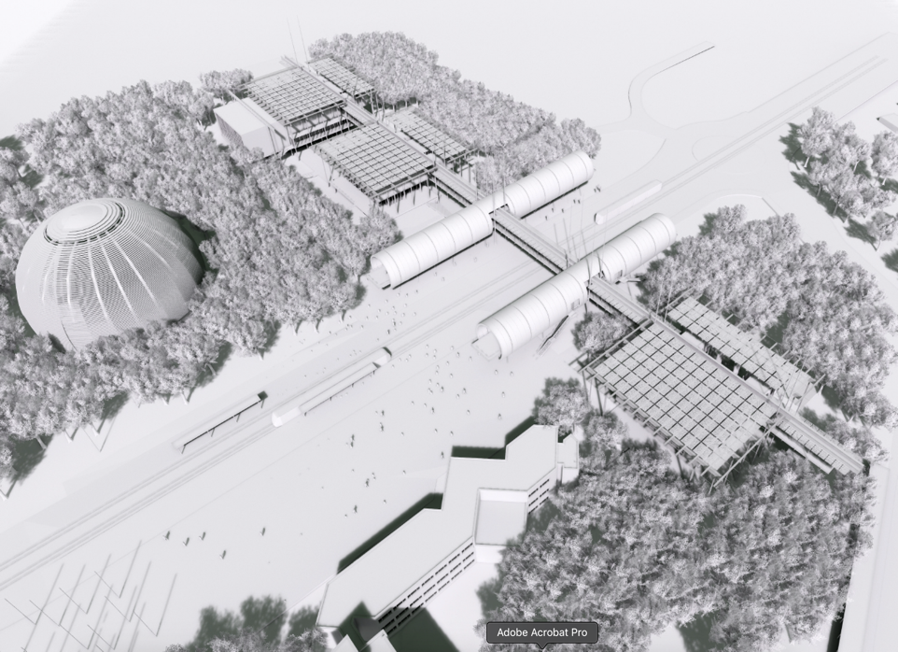
The Building
Designed by architect
Renzo Piano
(RPBW)
“It’s a place where people will meet. Kids, students, adults, teachers and scientists, everybody attracted by the exploration of the Universe, from the infinitely vast to the infinitely small. It is a bridge, in the metaphorical and real sense, and a building fed by the energy of the sun, nestling in the midst of a newly grown forest.”

Slide 6
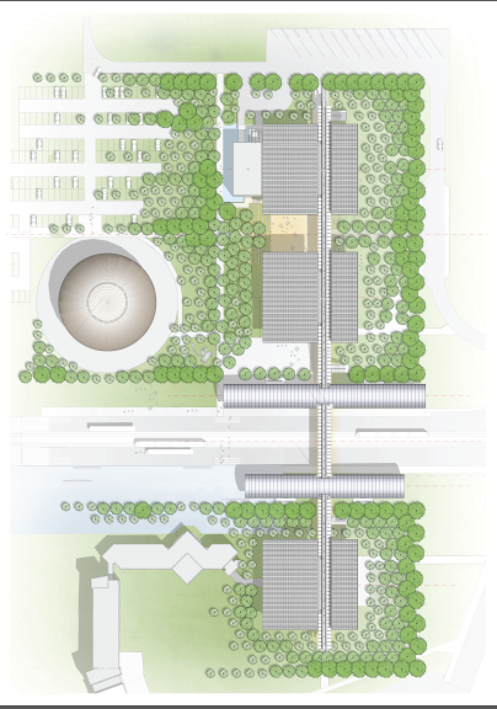
Content across Science Gateway
Auditorium
Science shows
Debates & Conferences
Science film screenings
The Globe
Start of guided tours
Temporary exhibitions
Labs
Enquiry-based learning
Hands-on experimentation
Permanent
Exhibitions
Discover CERN
Our Universe
Hands-on Exhibits (Quantum World)

Slide 7
Themes (some proposals)
States of matter
Technology
Fields
Structure of matter
Scientific reasoning
…
Auditorium
Stages of
cognitive development1,2
(Age group)
Education Labs
Pre-
(5-7 years)
Concrete
(8-11 years)
Formal
(12-15 years)
Post-formal
(>16 years)
Exhibition
Location/type of activity
Notes:
Visitors of the laboratories can navigate through a menu of different themes.
Themes are very general terms, which give the visitors an idea what the experience in the laboratory is about.
The themes, age groups and Science Gateway buildings (exhibitions, laboratory and auditoriums) form a three-dimensional structure. This three-dimensional structure will provide a holistic visitor experience in Science Gateway.

Slide 8
Themes (some proposals)
States of matter
Technology
Fields
Structure of matter
Scientific reasoning
…
Auditorium
Stages of
cognitive development1,2
(Age group)
Education Labs
Pre-
(5-7 years)
Concrete
(8-11 years)
Formal
(12-15 years)
Post-formal
(>16 years)
Exhibition
Location/type of activity

Slide 9
Example
Auditorium | Education Labs | Exhibition
Context “Acceleration” and the age group >16 years

Slide 10
Example
Auditorium | Education Labs | Exhibition
Science show “How to make particles faster.” Showing different ways to accelerate
Context “Acceleration” and the age group >16 years

Slide 11
Example
Auditorium | Education Labs | Exhibition
Science show “How to make particles faster.” Showing different ways to accelerate | Theme: Fields: “Electron beam experiment” Theme: Structure of matter „Medical Application“ Theme: Fields: „Particle Traps“
Context “Acceleration” and the age group >16 years

Slide 12
Example
Auditorium | Education Labs | Exhibition
Science show “How to make particles faster.” Showing different ways to accelerate | Theme: Fields: “Electron beam experiment” Theme: Structure of matter „Medical Application“ Theme: Fields: „Particle Traps“ | Hand-on exhibit “Study a proton beam” or “play with a salad bowl accelerator.”
Context “Acceleration” and the age group >16 years

Slide 13
Science Gateway Education Labs

Slide 14
The Building

Slide 15
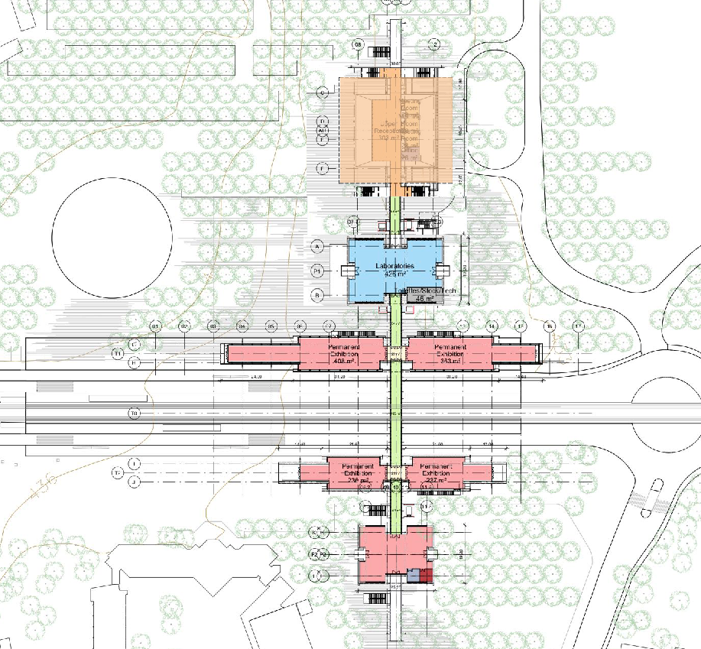
The Building
Plan Building
Auditorium
Labs
Permanent
Exhibitions

Slide 16
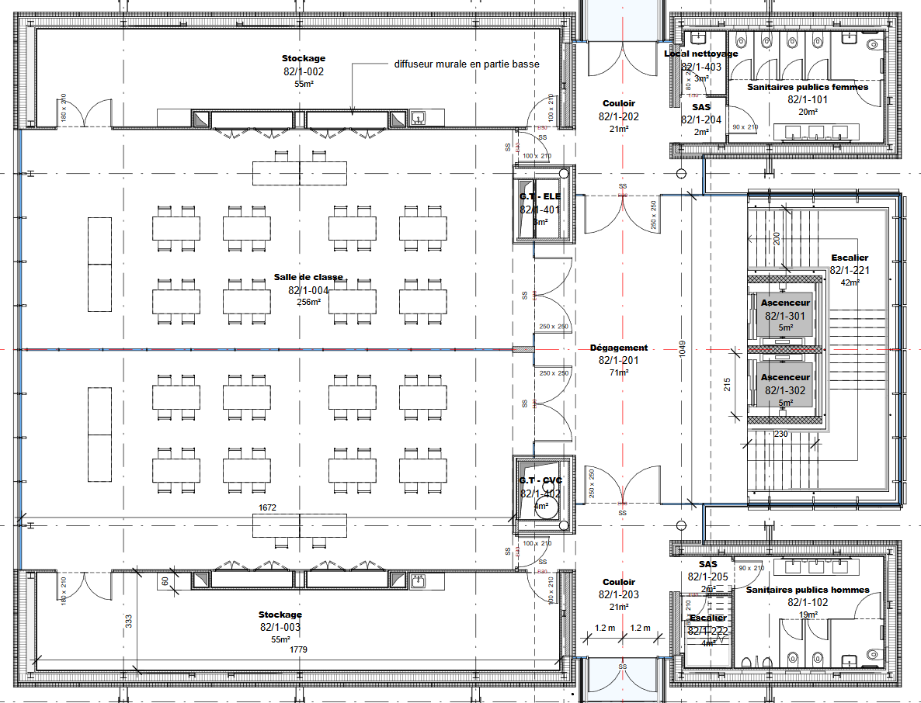
The Building
Plan Building
Storage
Auditorium
Labs
Permanent
Exhibitions
Storage

Slide 17
Content structure
Module

Slide 18
Content structure
Module
Context | Content

Slide 19
Content structure
Module
Context | Content
Connection to CERN and to the Exhibition | Connection to Curriculum

Slide 20
Content structure
Module
Context | Content
Connection to CERN and to the Exhibition | Connection to Curriculum
Age independent | 5-7 years | 8-11 years
 | 12-15 years | 16+ years

Slide 21
Kick-off Workshop

Slide 22
The agenda

Slide 23
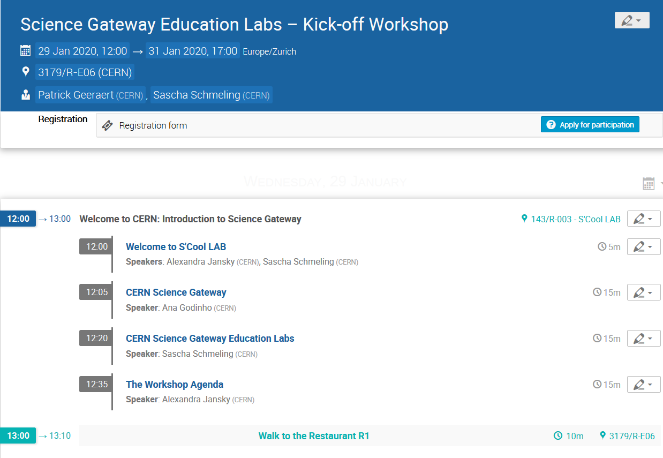
The agenda
https://indico.cern.ch/event/858188/timetable/

Slide 24
Your Particle Badges

Slide 25
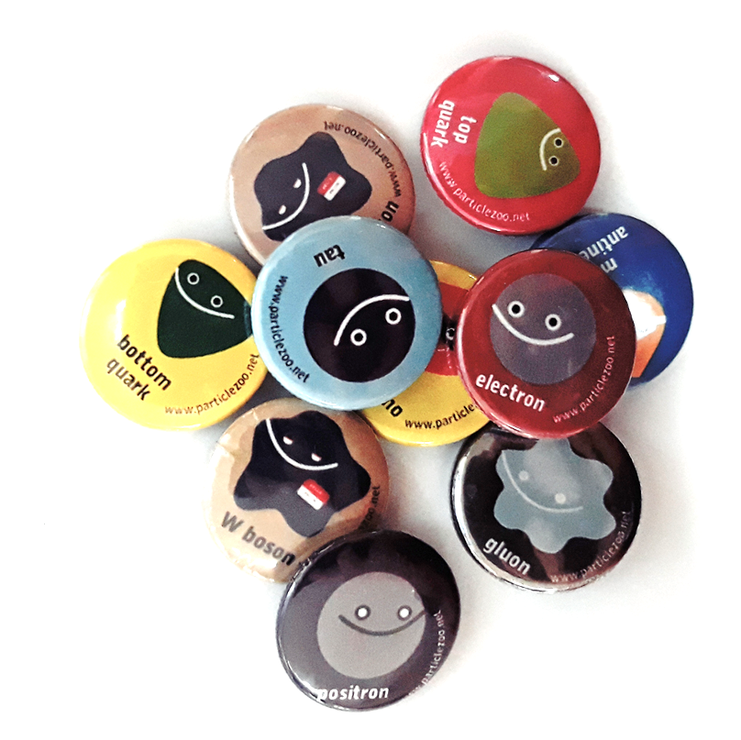
Your Particle Badges
Goup work
Underground Visit

Slide 26

Réponds à 7 questions
et découvre quelle particule élémentaire te correspond le mieux !
Answer 7 questions & find out which particle best fits your personality!
► cern.ch/identities

Slide 27
Group work
Group size: 5-7 participants
Work place: containers or open spaces in IdeaSquare
Overall goal: Collaborate
Module |  |  | Ideas for activities
Context | Content
Collision | 5-7 | 8-11
 | 12-15 | 16+
Detecting | 5-7 | 8-11
 | 12-15 | 16+
Computing | 5-7 | 8-11
 | 12-15 | 16+

Slide 28
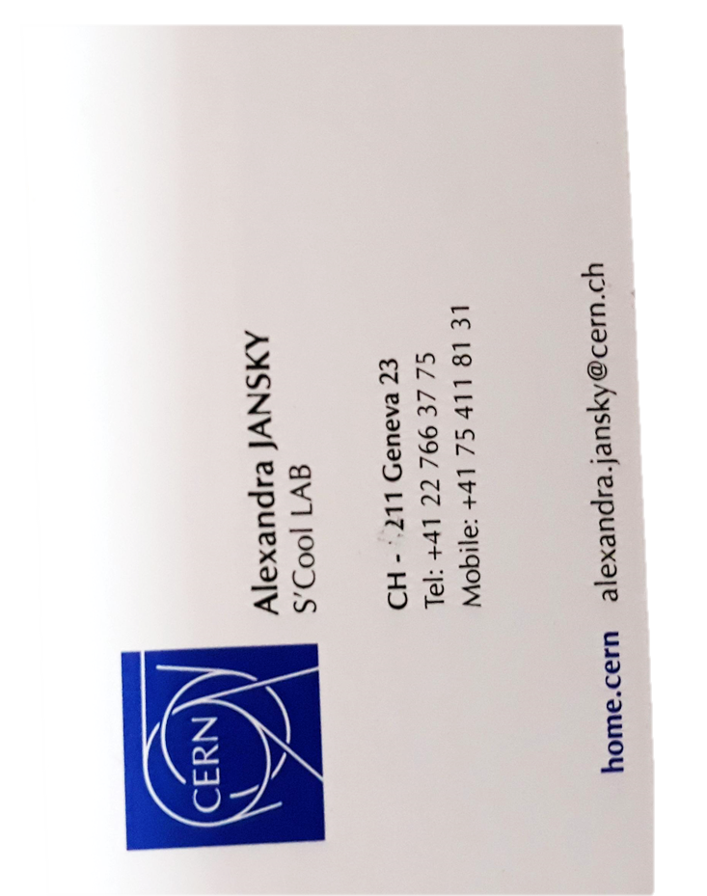
Group work
Today
Tomorrow
Friday
Groups work on content for a specific age group
Groups work on uploaded experiments
Assign them to context and find opportunities for other age groups
Time to say good-bye
Module
Context | Content
Collision | 5-7 | 8-11
 | 12-15 | 16+
Detecting | 5-7 | 8-11
 | 12-15 | 16+
Computing | 5-7 | 8-11
 | 12-15 | 16+
Stay
in
touch

Slide 29




Underground Visit
What?
Who?
Where?
When?
ATLAS
Please note that for safety reasons, the following type of people cannot go
underground:
reduced mobility
medical implants
Pregnant woman
Your guide will pick you up at
IdeaSquare,
Geneva,
Switzerland
Thursday
09.00 - 10.00 Electrons
11.00 - 12.00 Higgs
12.00 - 13.00 Tauons
13.00 - 14.00 Photons
14.00 - 15.00 Neutrinos
15.00 - 16.00 Muons

Slide 30
Food and drinks
Today
Tomorrow
Friday
13.00
Lunch in CERN‘s Restaurant R1
Croissants and fruit
Croissants and fruit
12:30 – 14:30
&
19:00 -21:00
Lunch and Dinner
Buffet from CusineLab in IdeaSquare
19.00
Dinner at Auberge Satigny
Transport from Hotel and back to the Hotel

Slide 31
Thank you for your attention

