Slide 1


Simulation status of the EPD at STAR
5th Day of Femtoscopy
Gyöngyös, Hungary
31 October 2019
Roland Pintér, Physics MSc I.
Eötvös Loránd University
Supervisor: Máté Csanád

Slide 2
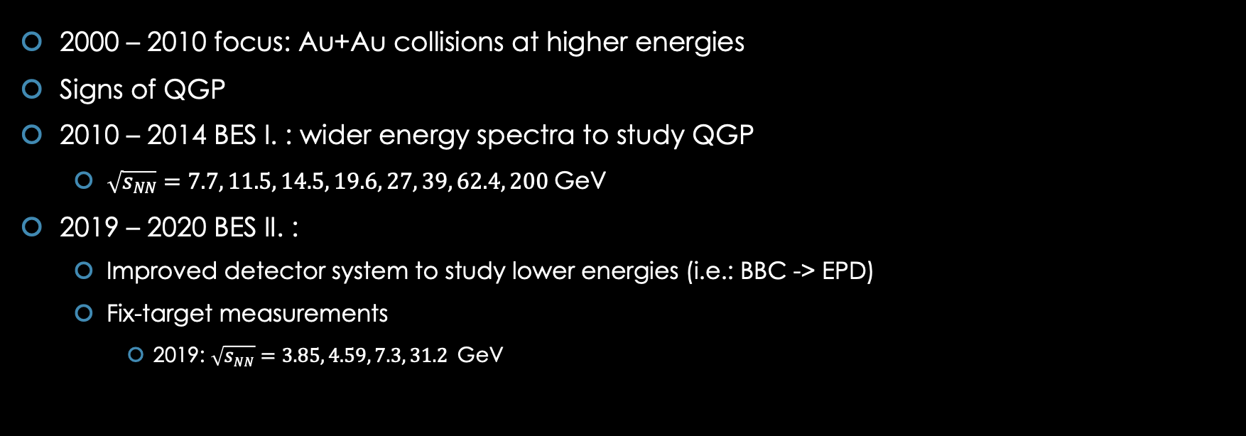
Beam Energy Scan @ RHIC
2000 – 2010 focus: Au+Au collisions at higher energies
Signs of QGP
2010 – 2014 BES I. : wider energy spectra to study QGP
  $\sqrt{sNN}=7.7, 11.5, 14.5, 19.6, 27, 39, 62.4, 200$GeV
2019 – 2020 BES II. :
  Improved detector system to study lower energies (i.e.: BBC -> EPD)
  Fix-target measurements
    2019: $\sqrt{sNN}=3.85, 4.59, 7.3, 31.2$GeV

Slide 3
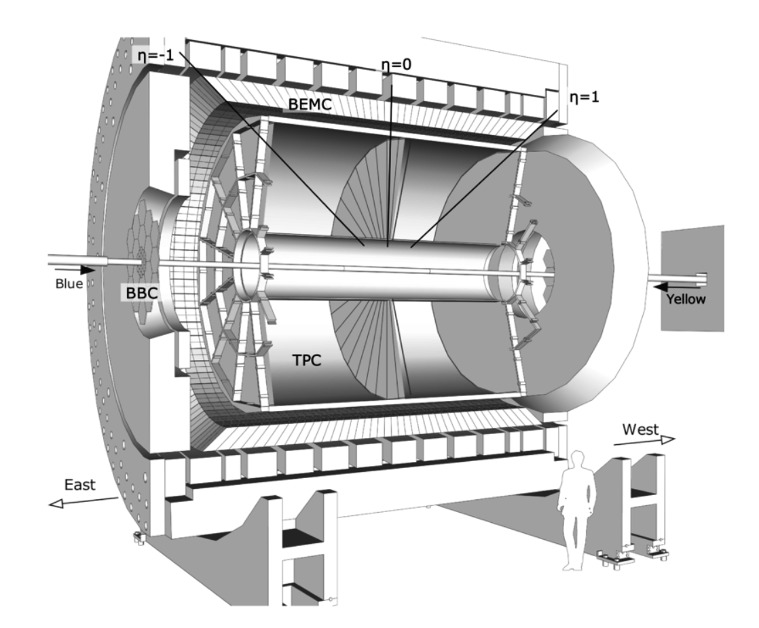
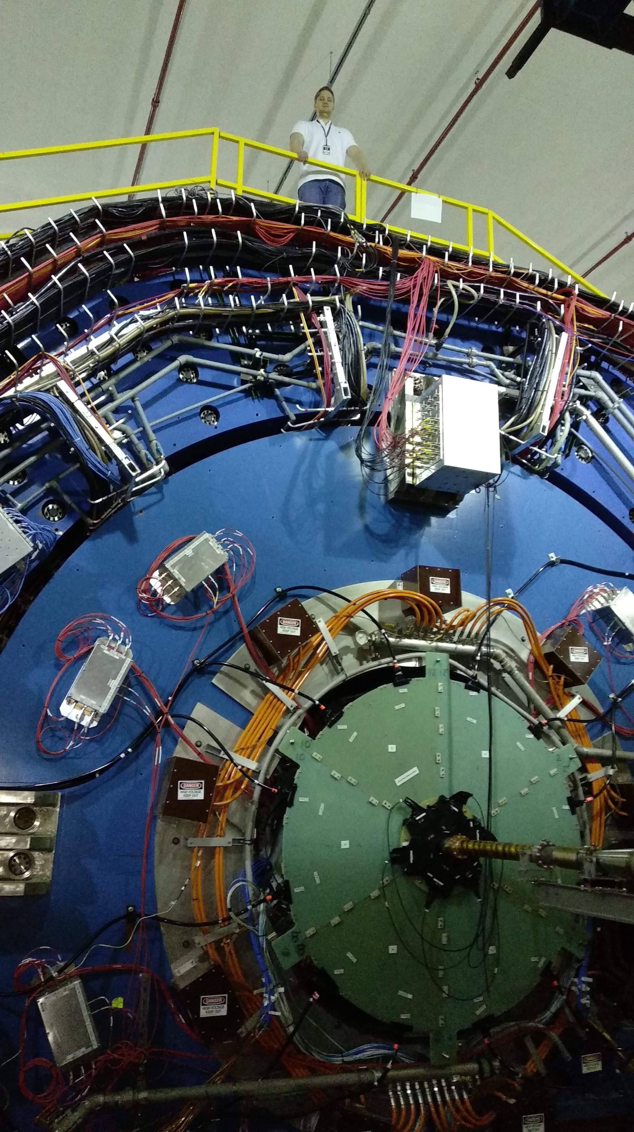
STAR detector
Figure represents the state until ~ 2017
From 2017, improvements were planned & made
Newer, recent schematics are not available
TPC: track reconstruction, p, dE/dx (ionization)
TOF: outside of the TPC, increases PID efficiency
BBC: scintillator, triggering events, 1st order event plane
EPD: scintillator, event plane dependent measurements, higher order event plane

Slide 4
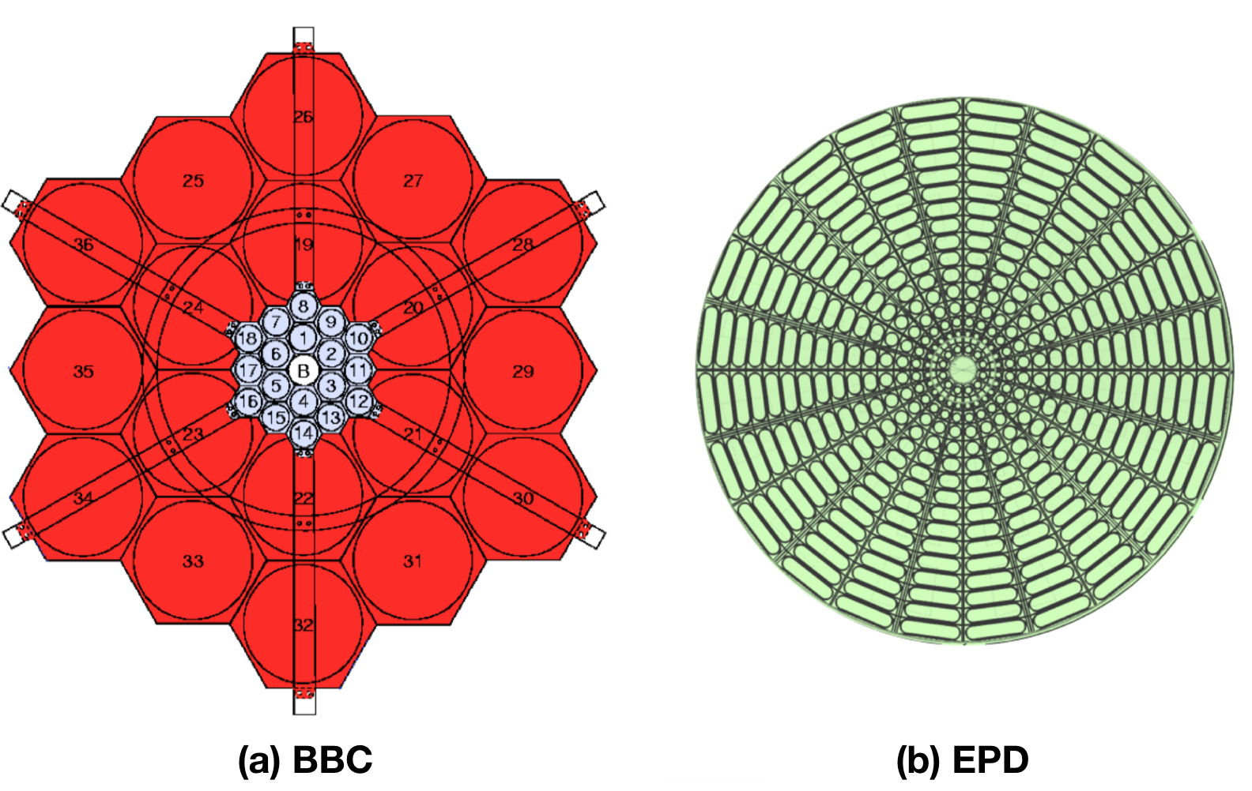
EPD, as part of BES II.
EPD as an improvement of the BBC
Scintillator detector
Goal: Event plane dependent measurements (i.e.: of HBT-radii)
EPD got installed in 2018
EPD group at STAR, lead by Mike Lisa
I’ve joined the EPD group in April 2018, where I’m working on the simulation of the EPD

Slide 5
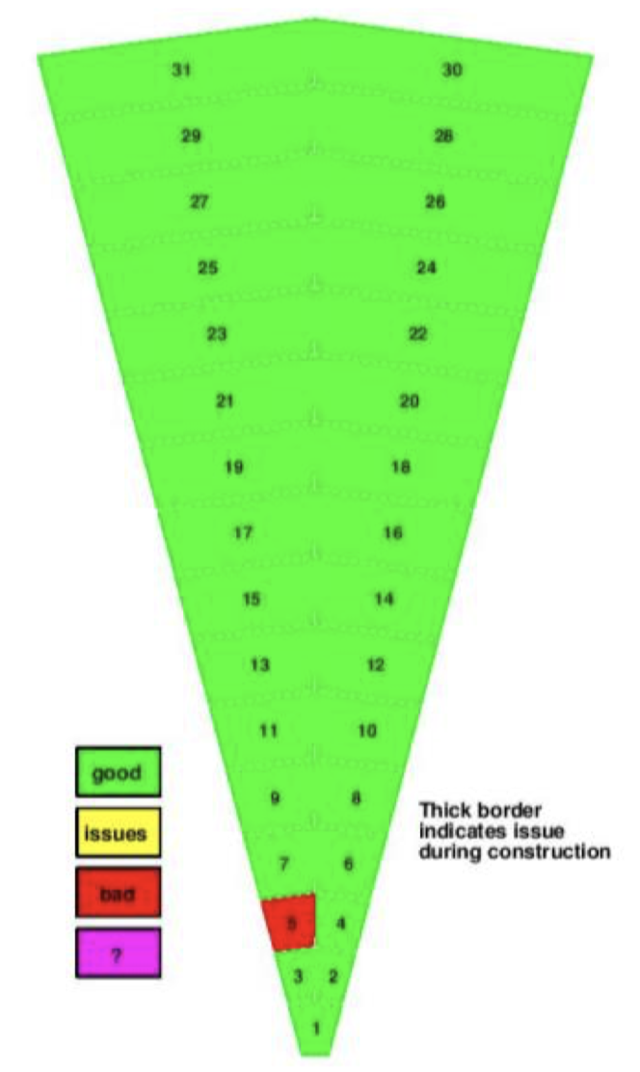
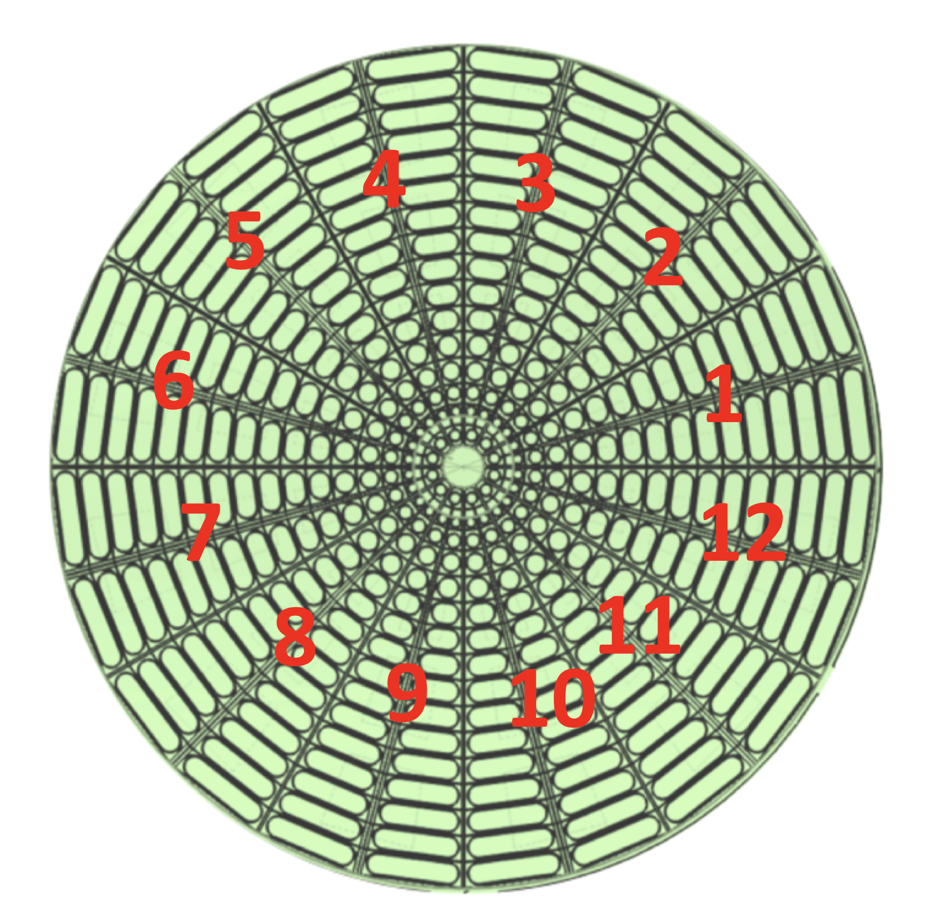


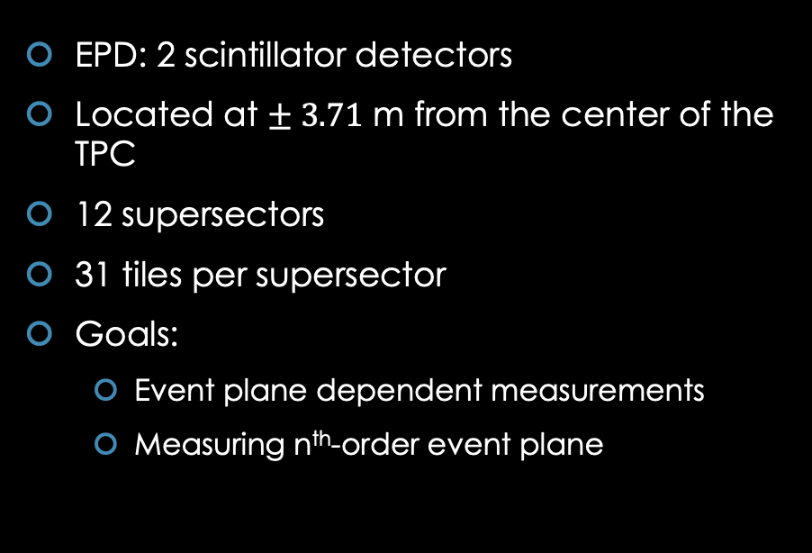
EPD
EPD: 2 scintillator detectors
Located at $± 3.71$ m from the center of the TPC
12 supersectors
31 tiles per supersector
Goals:
  Event plane dependent measurements
  Measuring n^{th}-order event plane
n^{th}-order event plane:
$$ψ_{n}⋅n=\arctan\left(\frac{\sum_{i}{w_{i}\sin\left(nφ_{n}\right)}}{\sum_{i}{w_{i}\cos\left(nφ_{n}\right)}}\right)$$
$w_{i}$: weight factor
$φ_{n}$: azimuth angle

Slide 6
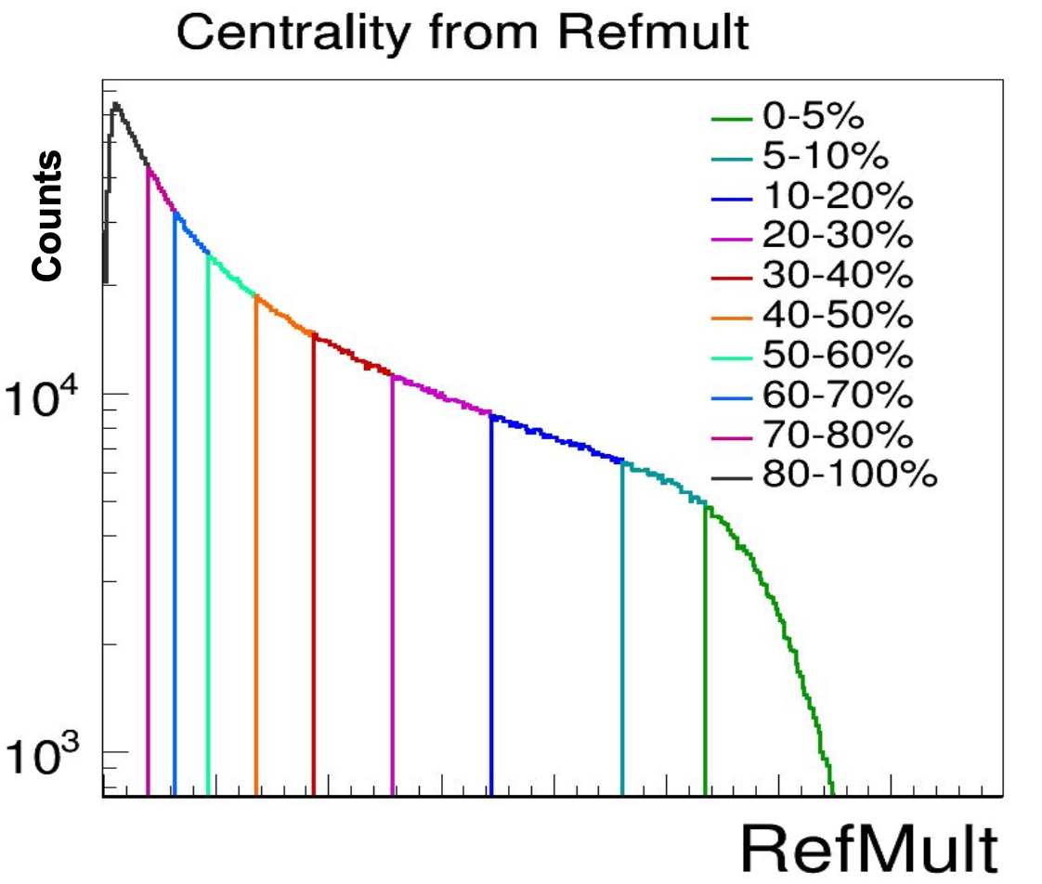
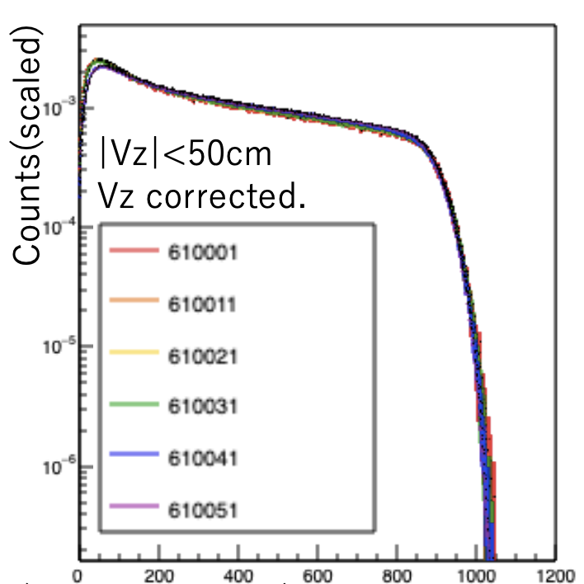
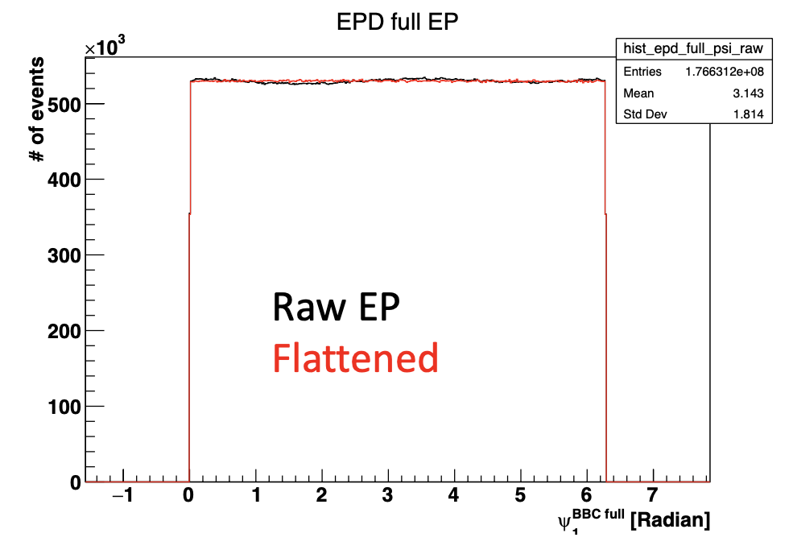
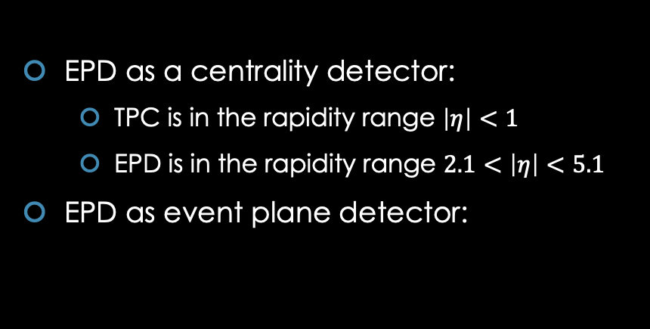
Examples: EPD’s use in real analysis
TPC
EPD
Yuri Sato, Univ. of Tsukuba
Skipper Kagamaster, Lehigh University
EPD as a centrality detector:
  TPC is in the rapidity range $\left|η\right|<1$
  EPD is in the rapidity range $2.1<\left|η\right|<5.1$
EPD as event plane detector:
x axis: nMIP sum for 12 outer rings
Yang Wu, STAR collaboration

Slide 7
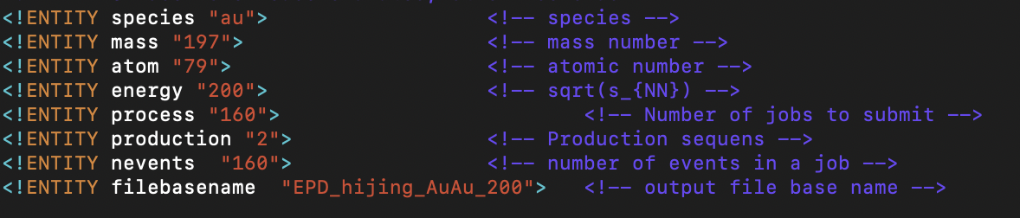

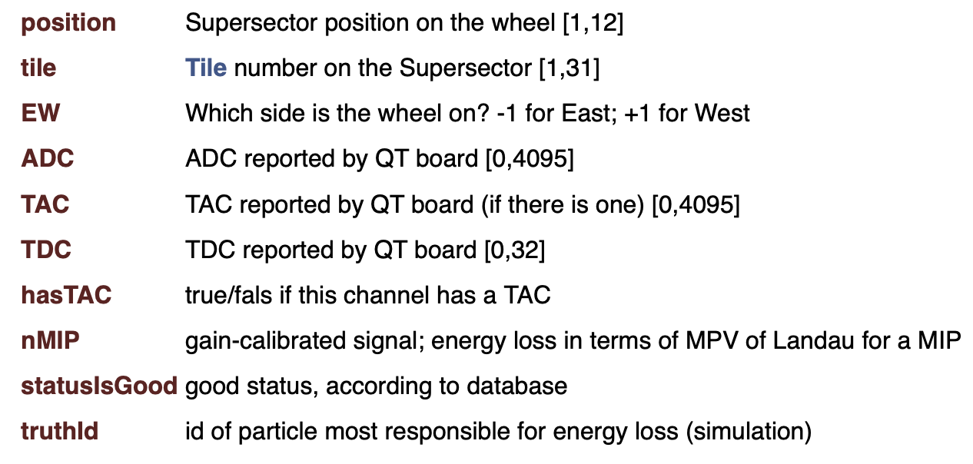
Simulation process of the EPD
Collisions are simulated with HIJING
HIJING outputs are fed to the STAR simulation software (starsim)
Starsim outputs are MuDst.root files
MuDst.root at STAR: used data structure until 2018, data stored in root TTree structure
Simulation MuDst.root files contain information about tracks:
  Coming from HIJING
  Hitting the EPD

Slide 8
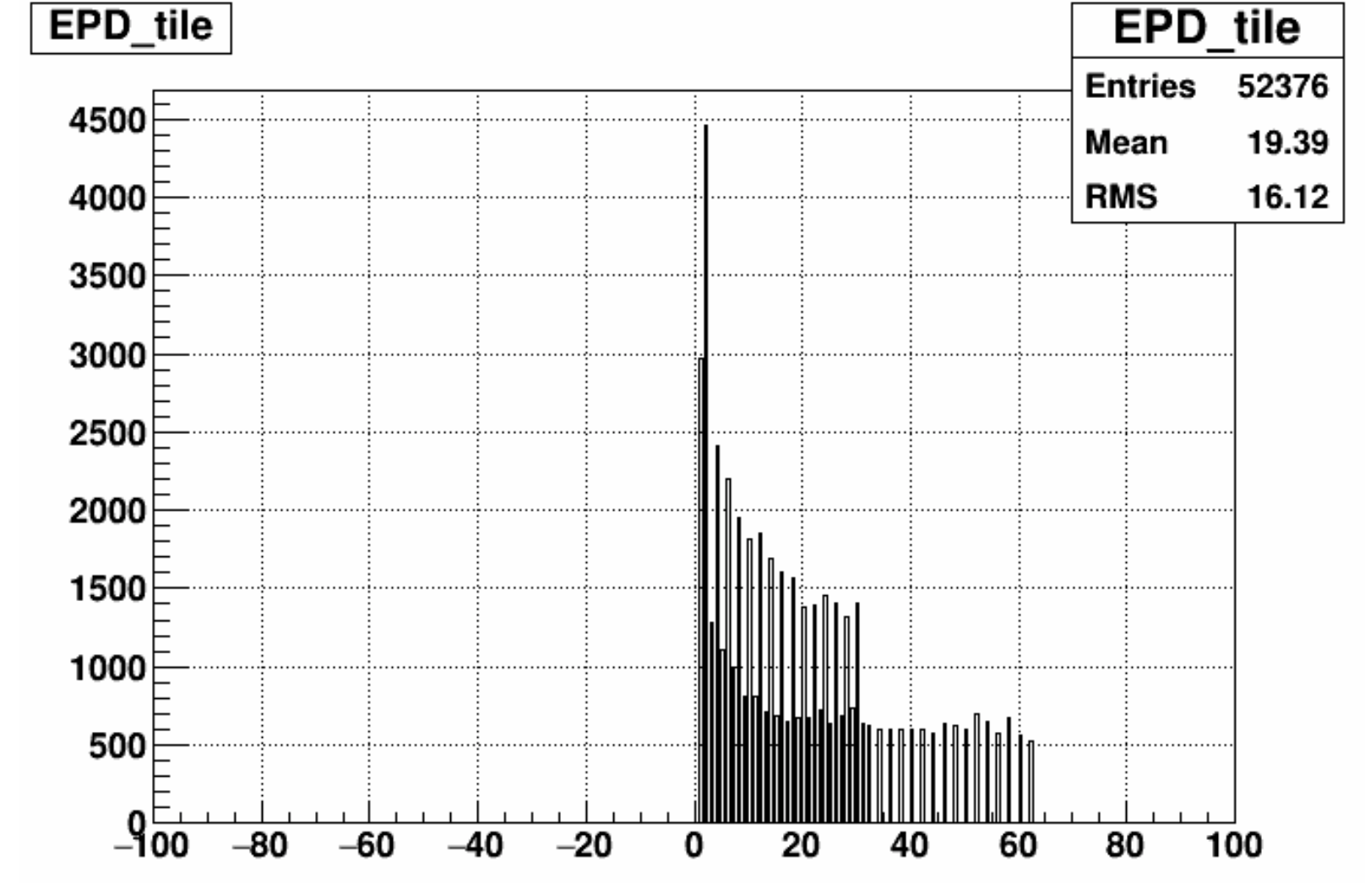
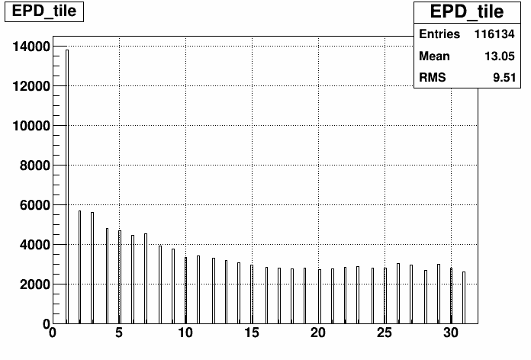
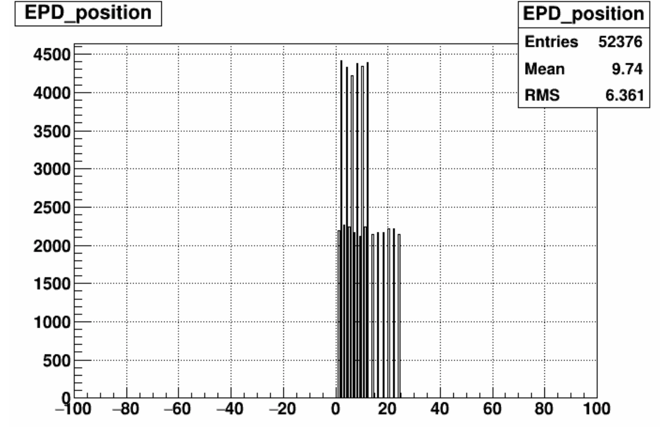
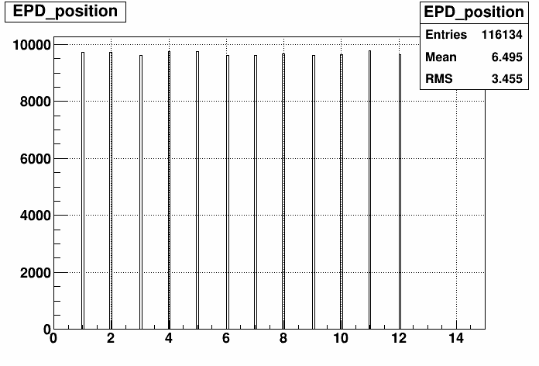
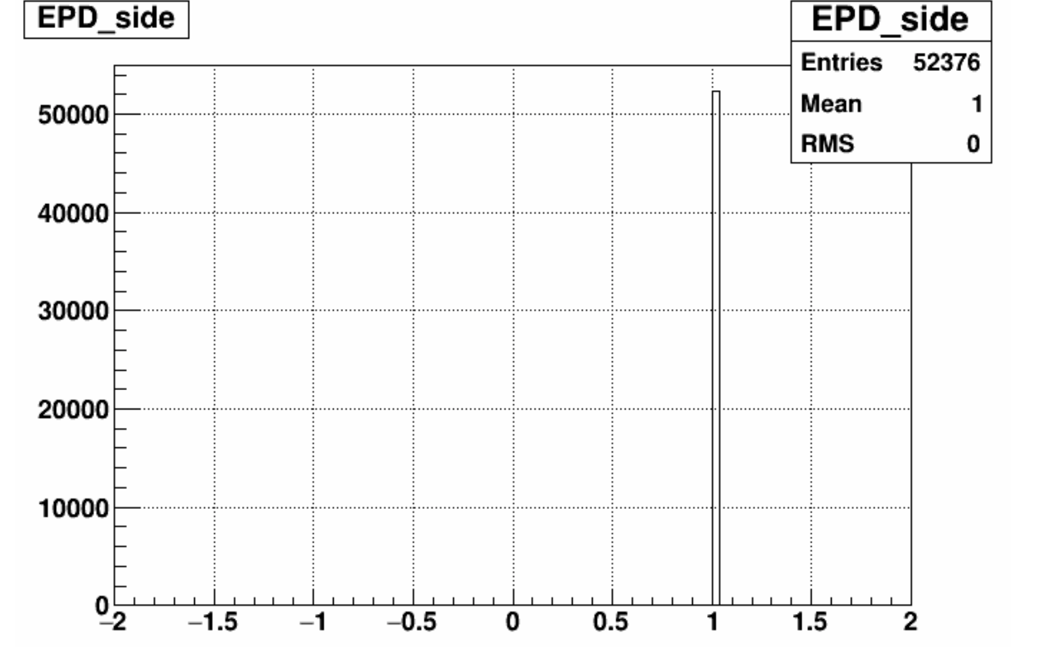
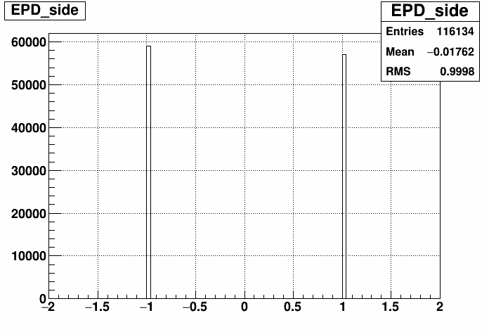
Fixing the 1st problems
[1,31] interval, ok!
Should be [1,31]
As a first step, I fixed these problems in the simulation
[1,12] interval, ok!
Should be [1,12]
West hits, ok!
-1 and +1 values, ok!
No East hits in the simulation?

Slide 9
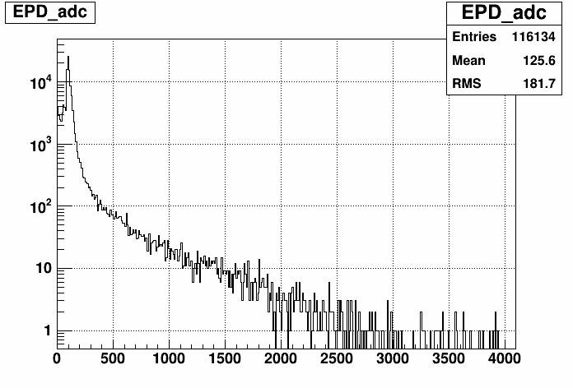
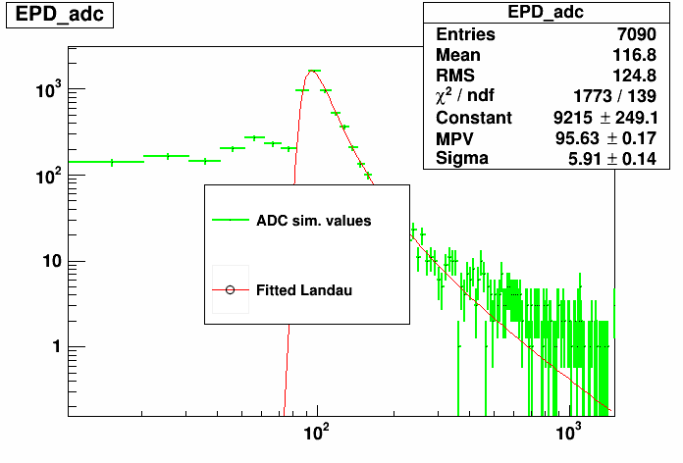
2nd problem: ADC
EPD stores a variable, called ADC [0,4095]
ADC distribution should fit to a Landau distribution
Problem: at low ADC values, Landau distr. doesn’t describe the ADC in the simulation

Slide 10
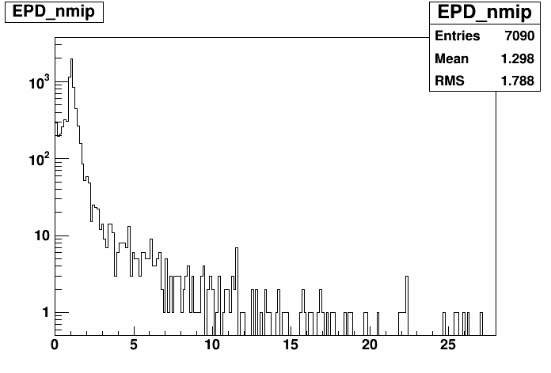
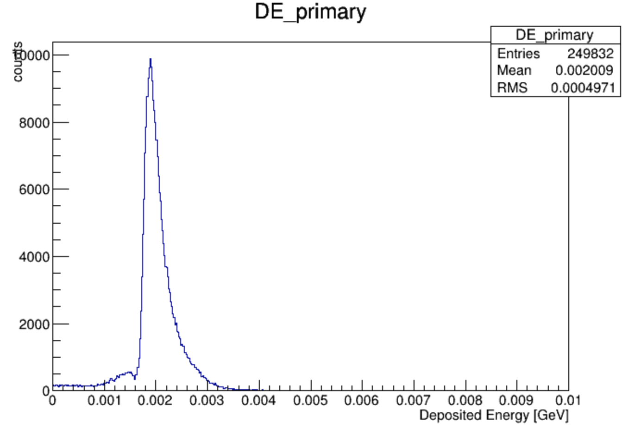
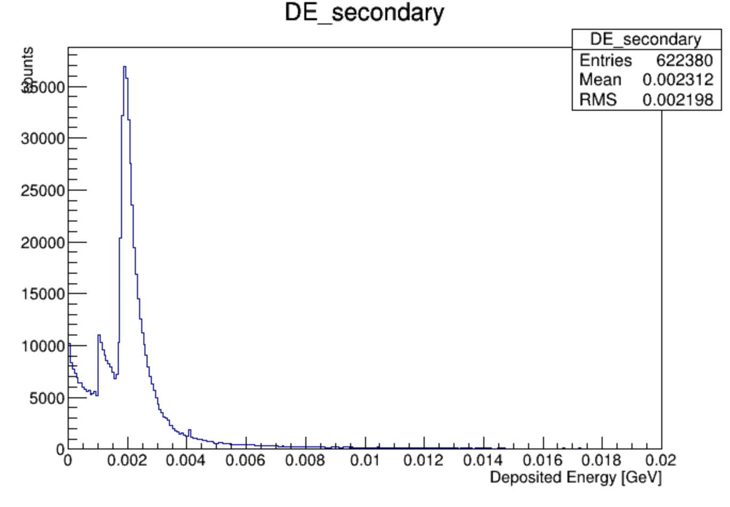
nMIP distribution
From EPD’s ADC, nMIP can be calculated
nMIP = „number of minimum ionizing particles”
nMIP = deposited energy in the EPD in Landau units
nMIP = ADC distribution / max(ADC distribution)
nMIP cannot be trusted until ADC is fixed (low ADC values are not corresponding to real data)
Simulation plots from 2018:
- In plastic scintillators dE/dx ~ 2 MeV/cm, EPD is made from 1.2 centimetres thick scintillators
- Conclusion: shape of nMIP is similar to last year’s DE plots

Slide 11
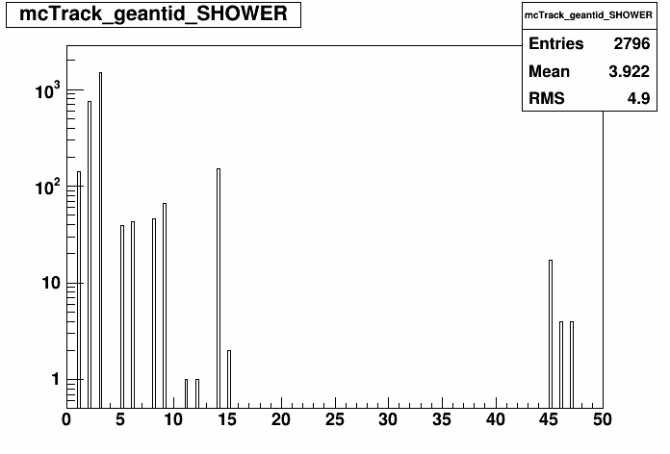
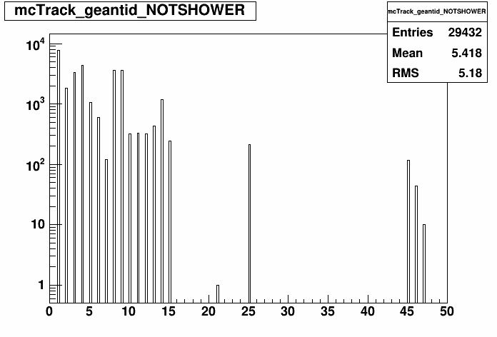
PID: shower / not shower
StMuMcTrack → IsShower()
  1 if shower track, 0 if not
  Still confusing what does shower / not shower means
  Shower = secondary track? (i.e.: from decays)
  Not shower = primary tracks? (from the collision)
  IsShower() contradicts these meanings
Remark: Geant ID 4 = neutrino
Scintillator detectors only detect charged particles → neutral particles should not be detected by the EPD in the simulation

Slide 12
Problems, possible solution?
Problems:
  ADC at low values does not correspond to real data
  nMIP is derived from ADC, thus it cannot be trusted until ADC is fixed
  PID: why can the EPD detect neutral particles?
Possible solution, as a next step: „particle gun” method
  Just send 1 single particle through the middle of a tile ← that would be the entire event
  Make the particle orthogonal to the face of the tile
  Without magnetic field
  If the data from this makes sense, let’s dive deeper in the simulation software to see where the problems lie

Slide 13
Conclusions, next steps
Use the particle gun method, to see if those results make sense
Fix the current problems
Analyzis of real collision data, to exactly compare with simulation results
Writing Scientific Students’ Association thesis (TDK) this month:
  Analyzing real collision EPD data (to do...):
    Centrality measurement with nMIP
    Measuring 2nd-order event plane
  Simulation work overview
Thanks for your kind attention!

Slide 14
Back-up slides

Slide 15
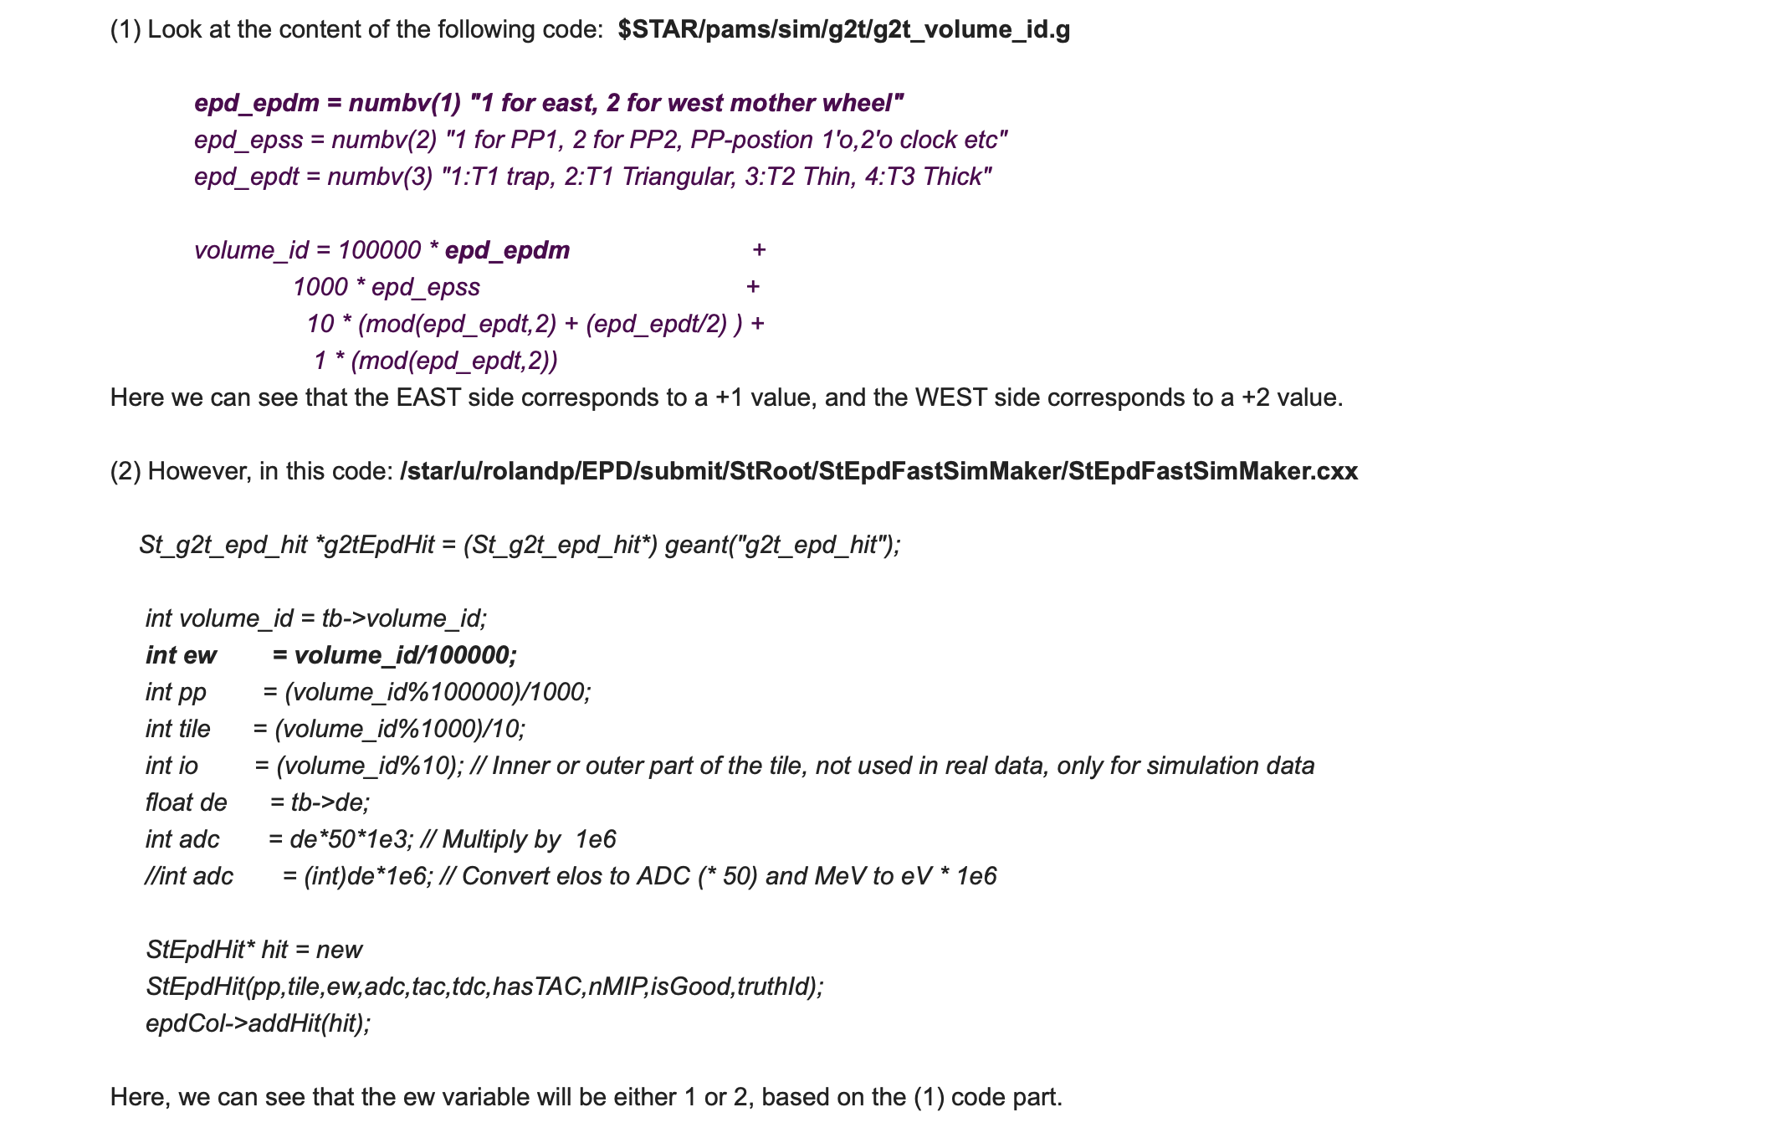

Slide 16
