Slide 1
POPS: Power for PS
A novel 60 MW Pulsed Power System based on Capacitive Energy Storage
POCPA workshop
Jean-Paul Burnet
14-16 June 2010

Slide 2
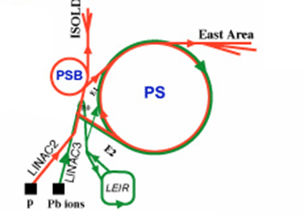
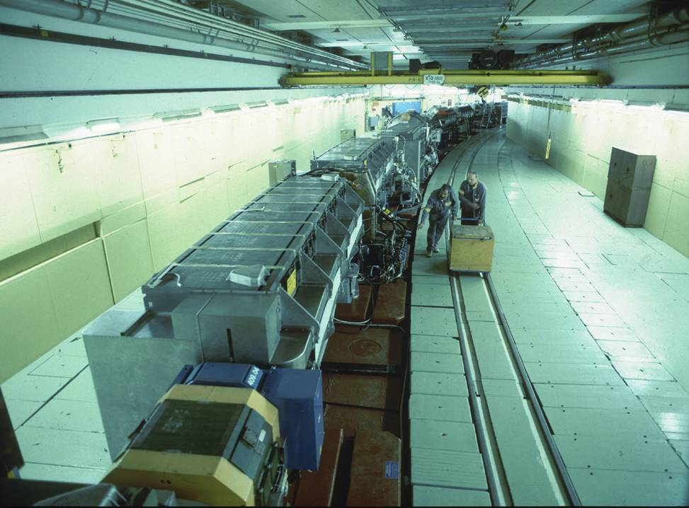
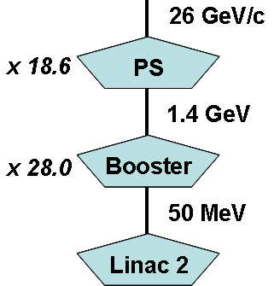
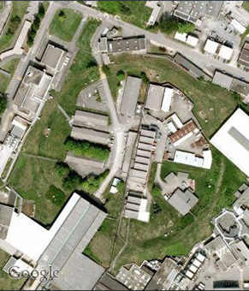
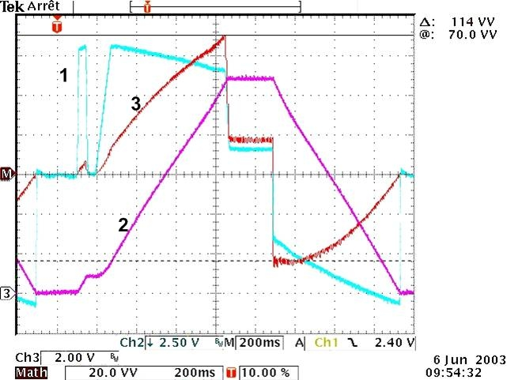
Introduction to PS machine
5500A
Cycle : 1.2s
100 magnets: 0.9H, 0.35 Ω
1- Voltage : ± 9000V
2- Current : 0 to 5500 A
3- P = ± 40 MW
with dP/dt = ± 1 MW/ms
0A
2

Slide 3
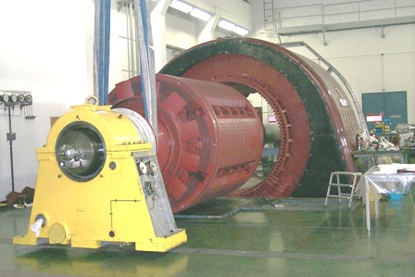
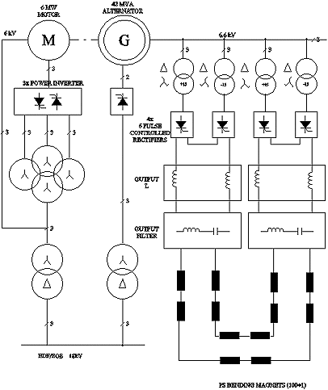
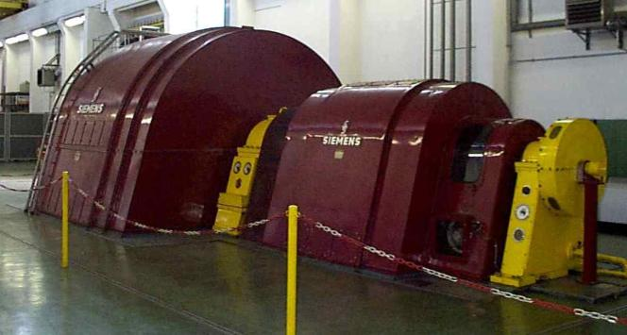
Present power system: kinetic storage
Ratings
Load: 1 H / 0.32 Ω
DC output: 6 kA / 12 kV
Generator: 90 MVA
Motor: 6 MW
Speed: 1000 rpm
Rotors weight: 80 +10 T
By courtesy: I. Marneris
Few numbers:
Number of cycles per year: 6-8 millions
Number of cycles since 1968: >300 millions!!!
3

Slide 4
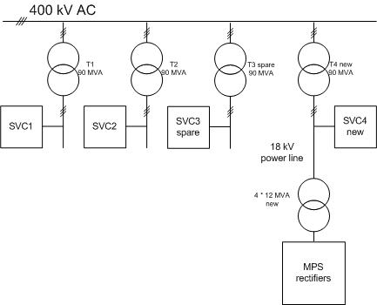
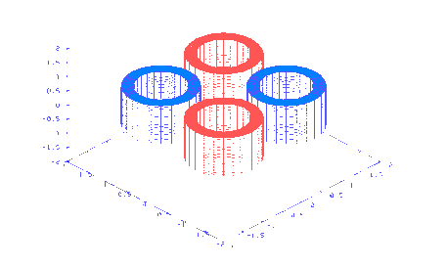
Research of new power system
Many studies were done between 2003 - 2007
Electrical network:
Connect the load directly to the 400kV
Rotating machine:
Not anymore an industrial solution!
Local energy storage system
SMES: No industrial product
Capacitors: Mass production
Solution retained by CERN : →

Slide 5
Power system based on capacitive storage
The energy to be transferred to the magnets is stored in capacitors
DC/DC converters transfer the power from the storage capacitors to the magnets.
Four flying capacitors banks are not connected directly to the mains. They are charged via the magnets
Only two AC/DC converters (called chargers) are connected to the mains and supply the losses of the system and of the magnets.
Chargers
Patent
The global system with dedicated control has been filed as a patent application. European Patent Office, Appl. Nr: 06012385.8 (CERN & EPFL)
Flying capacitors

Slide 6
Basic principle
Magnets current and voltage
Stored magnetic energy
12MJ
Power to the magnets
Capacitor banks voltage
Power from the mains
+50MW peak
5kV to 2kV
10MW

Slide 7
POPS contract
The Challenge: Power electronics for 60MW !!!
European tour of industry (potential suppliers): Seems possible to make such system!
After call for tender: only one offer from CONVERTEAM
POPS project :
December 2007: Contract signature
January 08 – December 08: Design CVT & CERN
December 08 – April 09: Civil engineering works
June 09: First delivery from Converteam
June – December 09: Installation
January 2010: Commissioning
March 2010: First test with 10 SPS magnets
July 2010: Final reception tests
Next shut down: Bus bar installation
April 2011: POPS in operation
Budget
Converteam: 9.23 M€ + 1.05 M€ (spares & maintenance for 5 years)
Infrastructure: 2 M€ (25% civil engineering, 30% cooling ventilation, 17% electricity)

Slide 8
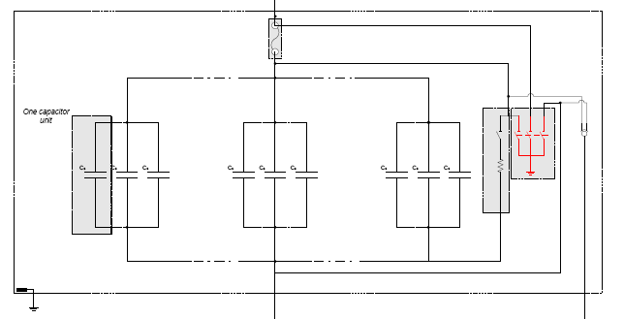
Capacitor banks
Capacitor banks
  5kV Dry capacitors
  Polypropylene metalized self healing
  Outdoor containers: 2.5m x 12m, 18 tons
  0.247F per bank, 126 cans
  1 DC fuse
  1 earthing switch
  3 MJ stored per bank

Slide 9
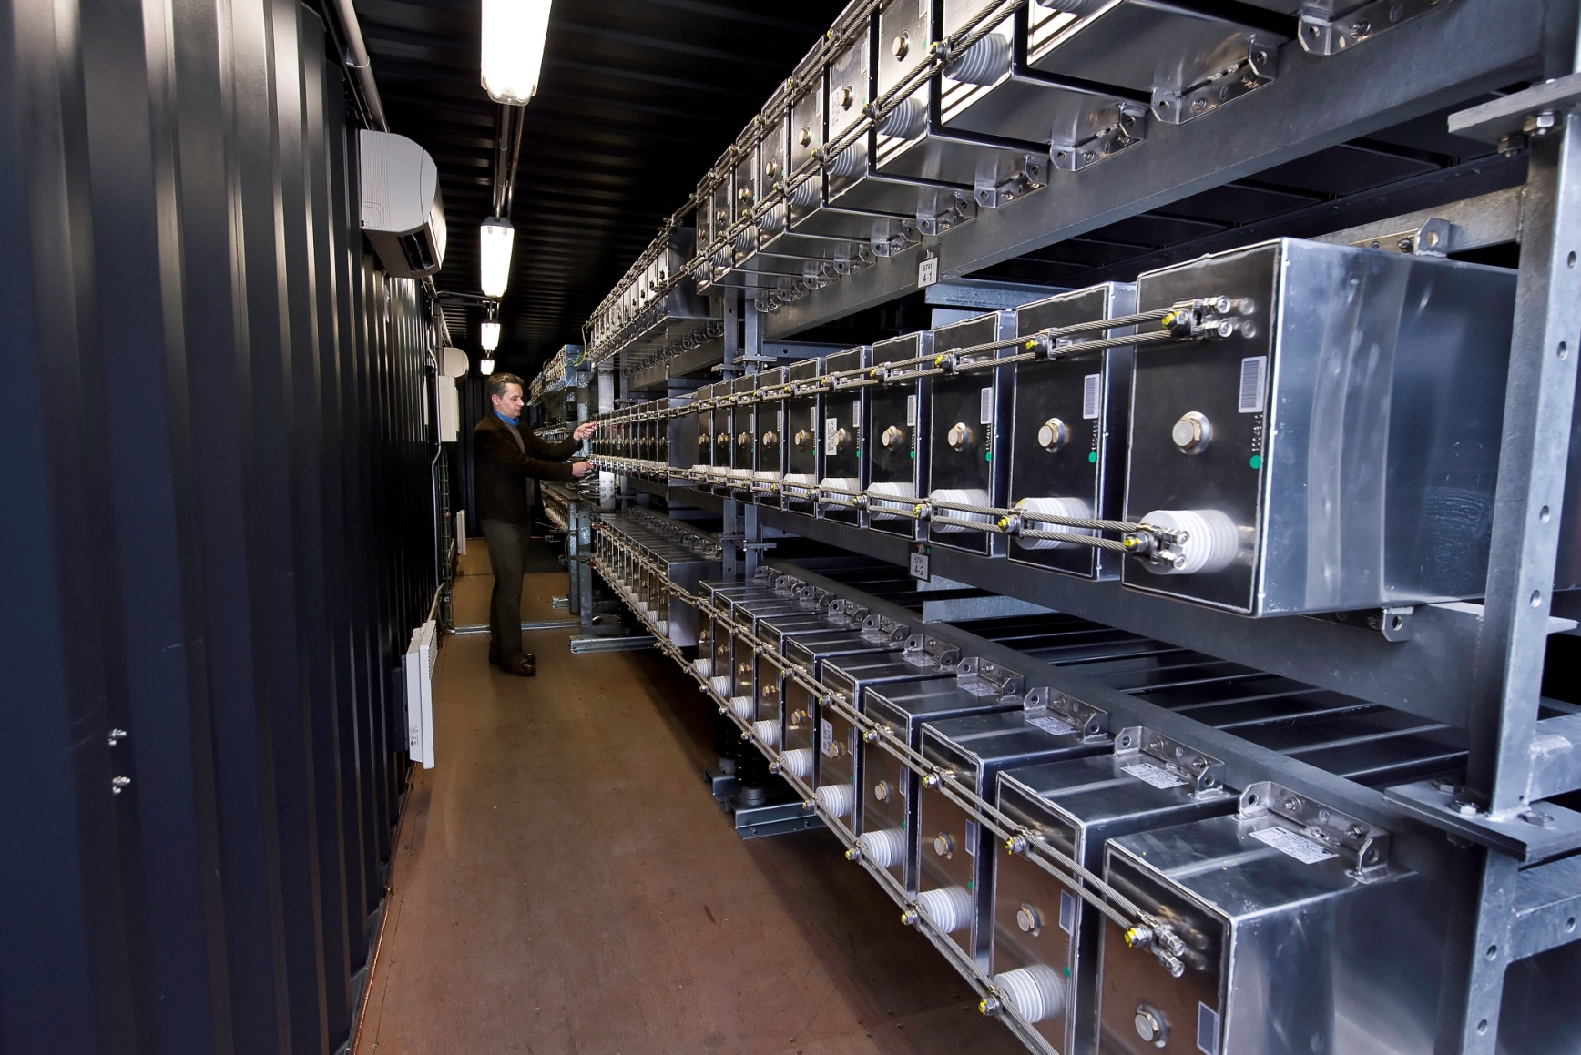
Capacitor banks

Slide 10
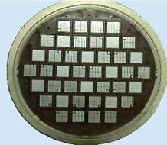
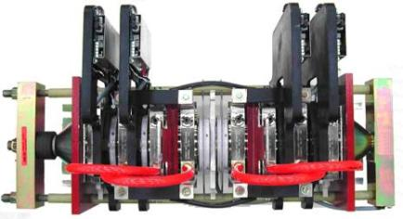
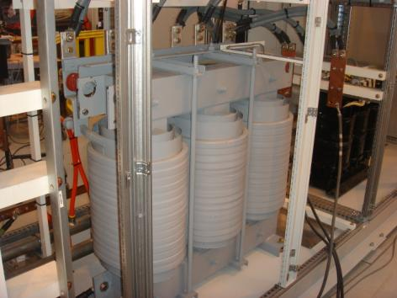
DC/DC converters
Main ratings of the DC/DC converters:
Two “drives” (2.6kA /5kV) to make a DC/DC converter
NPC topology, press-pack IGBT
16 drives in total
12 coupled chokes: 26 m³, 48 tons, 180 kW of losses

Slide 11
DC/DC converters
By interleaving the firing pulses, the output filter is reduced and the bandwidth of the voltage loop is three times higher than the individual switching frequency (333Hz).
First output voltage harmonic: 2kHz, 4Vrms

Slide 12
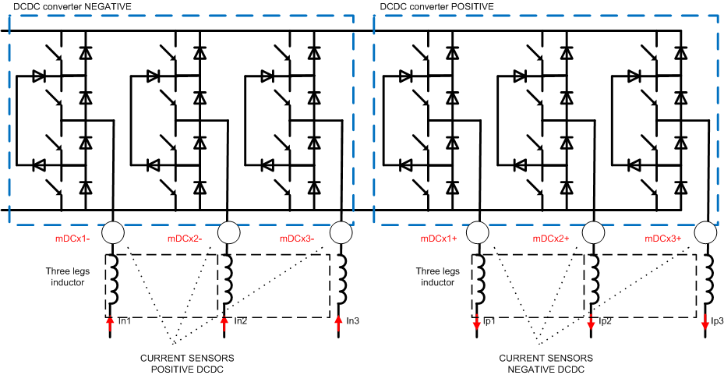
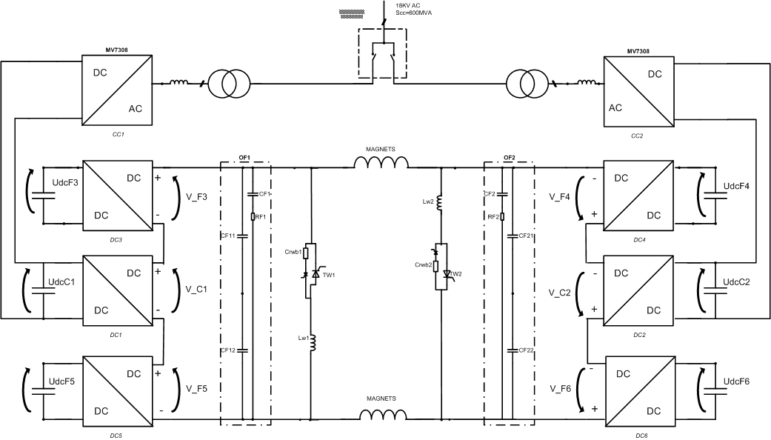
Interleaving
Six DC-DC converters connected in series to build up the magnet voltage.
Two AC-DC rectifiers (AFE) to provide for system losses .
Two DC-DC converters connected directly to the AFEs (chargers) all others have floating DC bus (floatings).
The basic DC-DC converter is made with a positive and a negative converter based on 3 level topology with 3 legs in parallel.

Slide 13
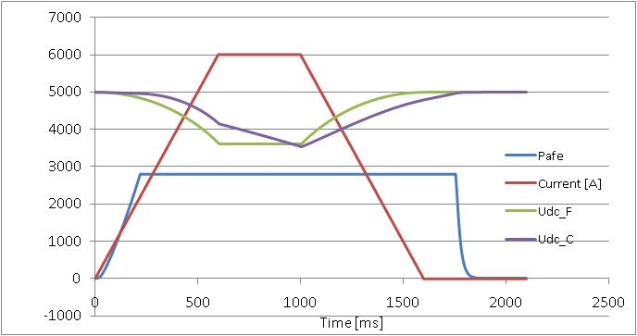
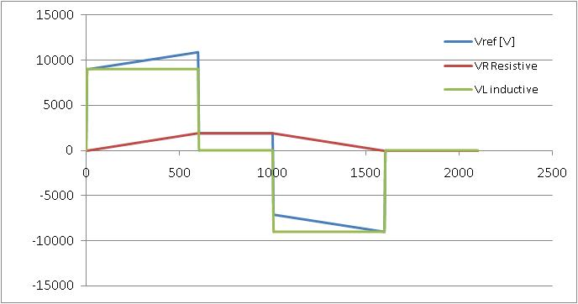
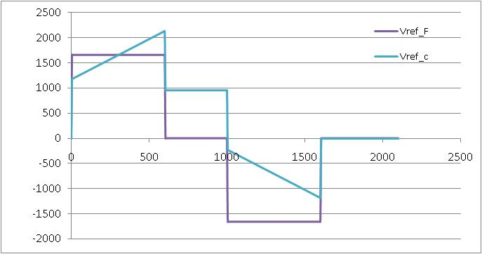
Interleaving
The discharge of charge capacitors is influenced by the amount of power drawn by the network
Voltage reference is divided among the DC-DC converters on the principle that floating shall provide inductive voltage drop only (magnetic energy), while chargers can give a portion of the magnetic energy and all the system losses.
The Inductive voltage drop is constant during current rump up and down and zero during flat top
The voltage reference for the chargers is the resistive voltage drop plus a portion of the inductive one.

Slide 14
Interleaving
To greatly reduce the harmonic content of the output filter and reduce at the same time the size of the output filter, interleaving is applied among different legs inside a single converter and among converters as well.
F floatings = 8000 Hz
F chargers = 4000 Hz
90°
333 Hz
1000 Hz
2000 Hz
2000 Hz

Slide 15
POPS infrastructure
POPS required:
600 kW cooling tower
170 kW air-conditioning
200 m² indoor
800 m² outdoor
10 MVA on the 18kV network (3 switch-gears)
700 kVA on the 400V network
POPS budget:
Converteam: 9.23 M€ + 1.05 M€
(spares & maintenance for 5 years)
Infrastructure: 2 M€ + …
(25% civil engineering, 30% cooling ventilation, 17% electricity)

Slide 16
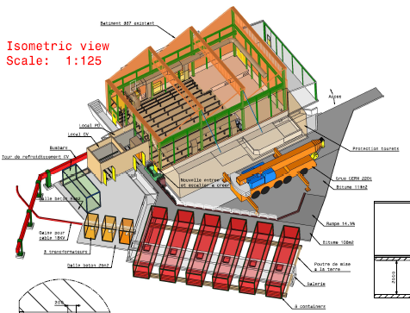
Outdoor layout

Slide 17
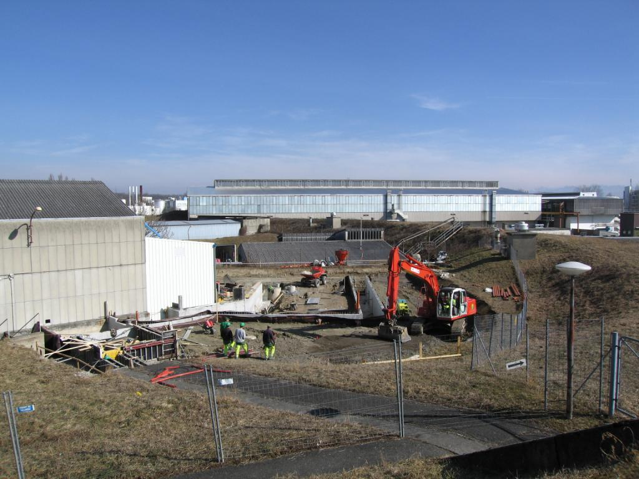
Outdoor layout

Slide 18
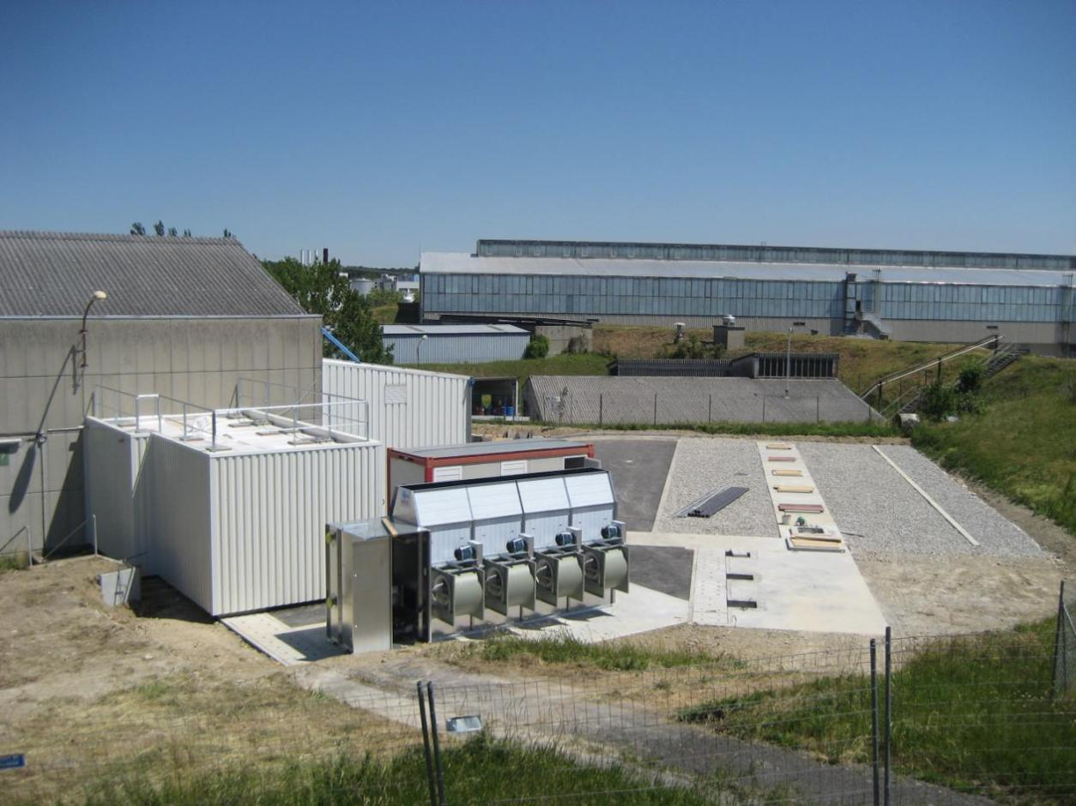
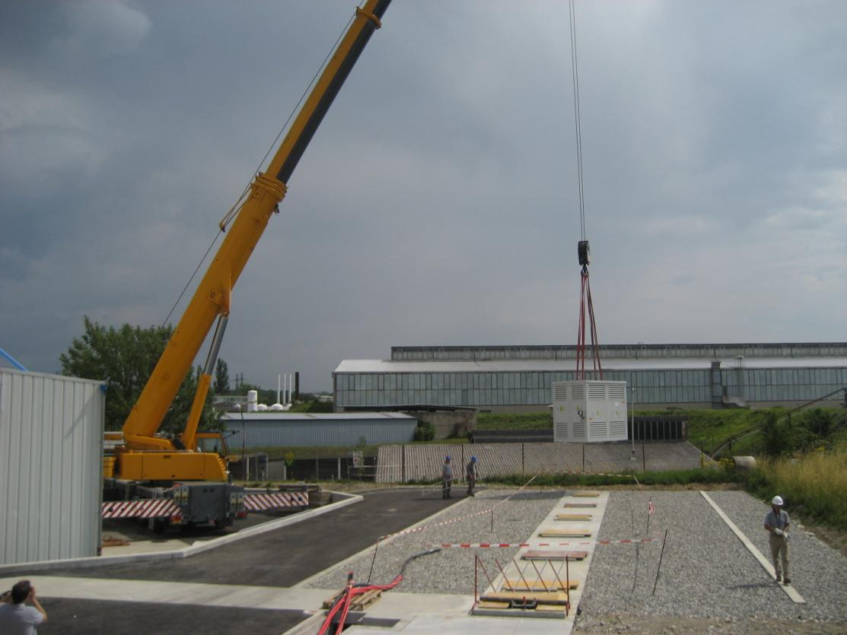
Outdoor layout

Slide 19
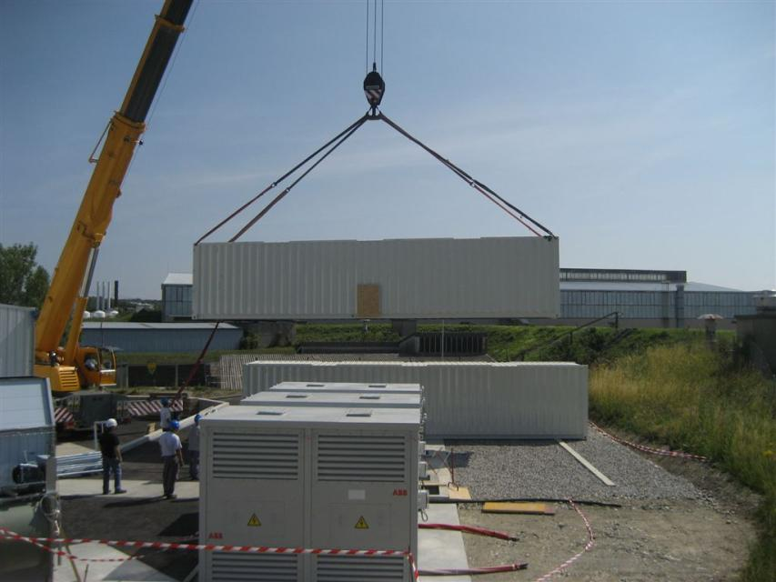
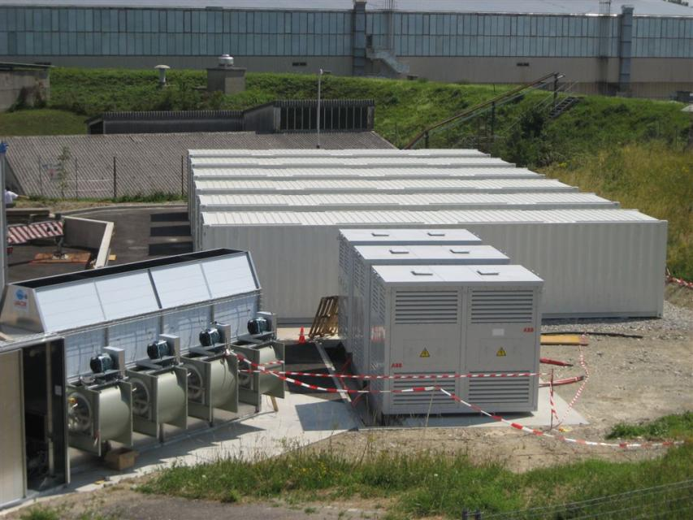
Outdoor layout

Slide 20
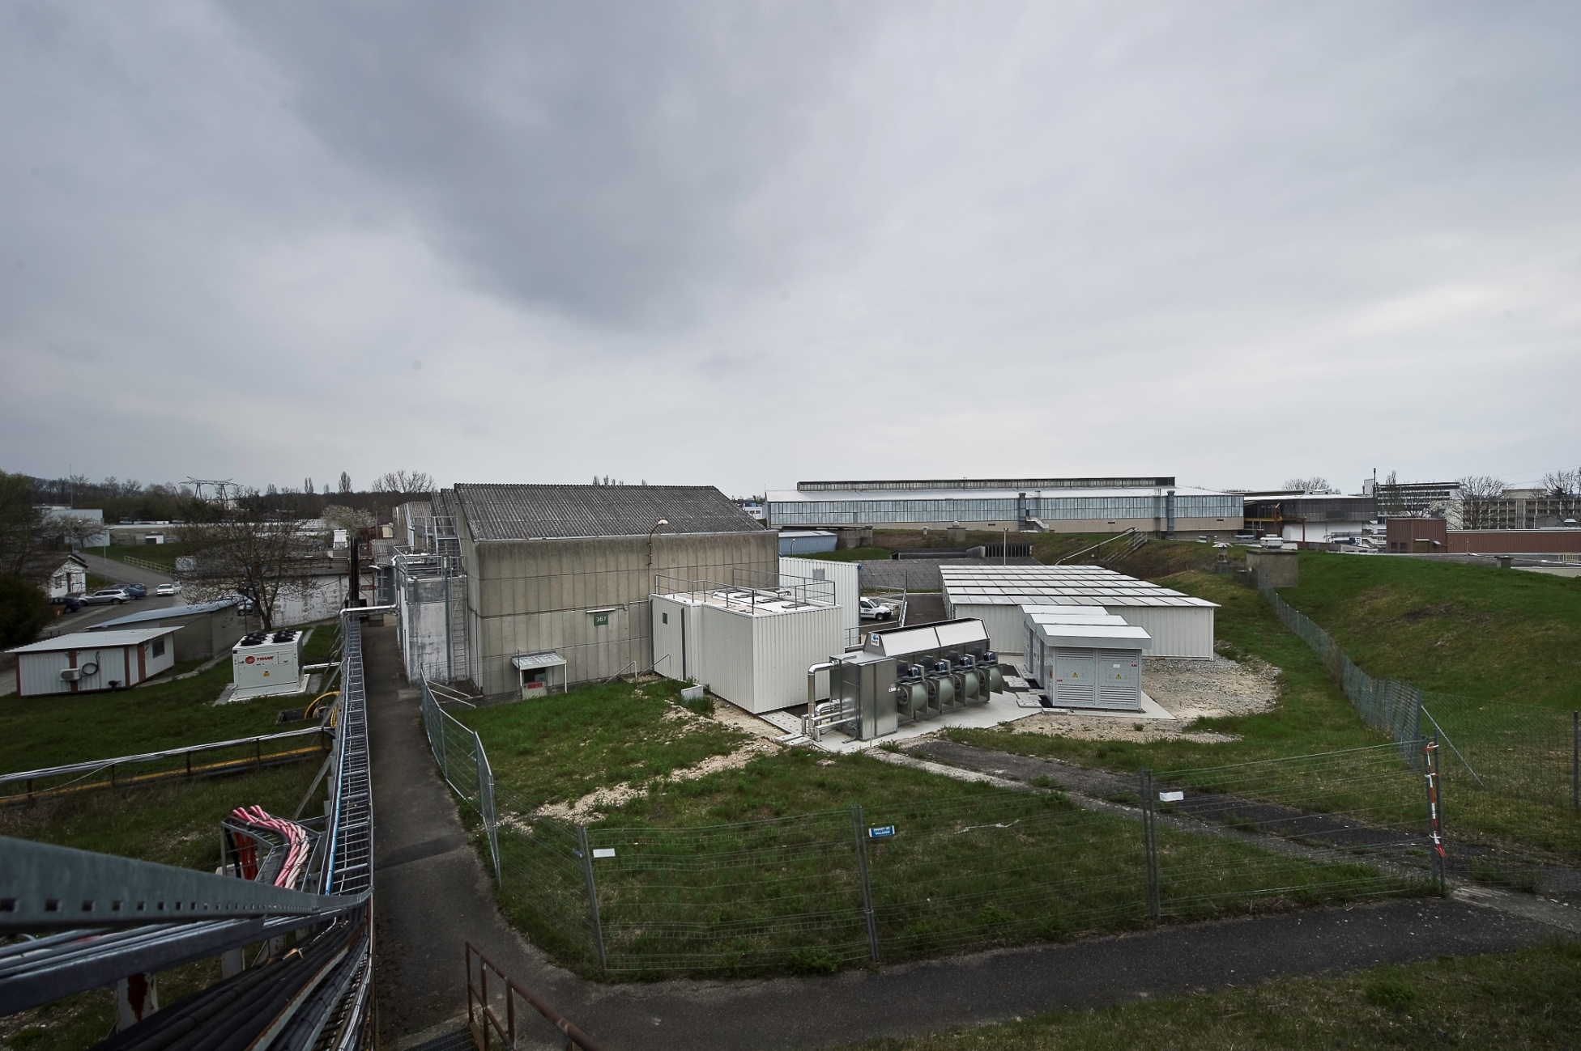
Outdoor layout

Slide 21
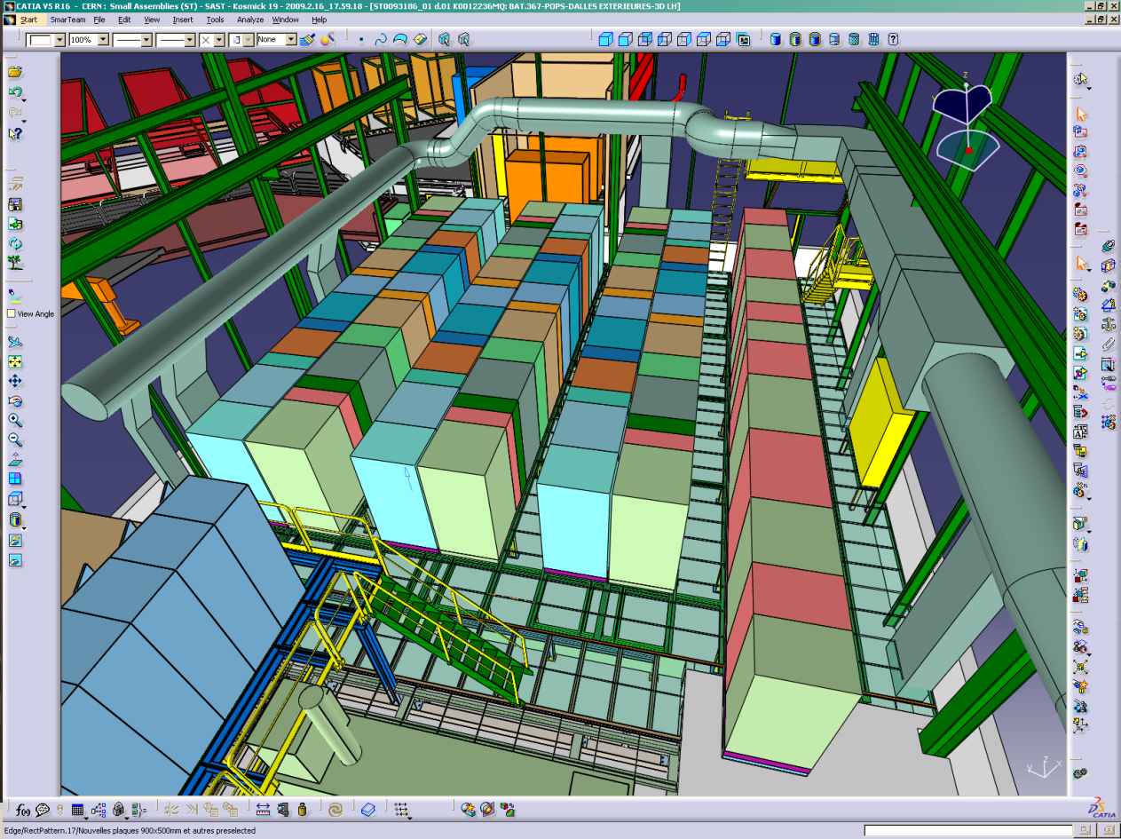
Indoor layout

Slide 22
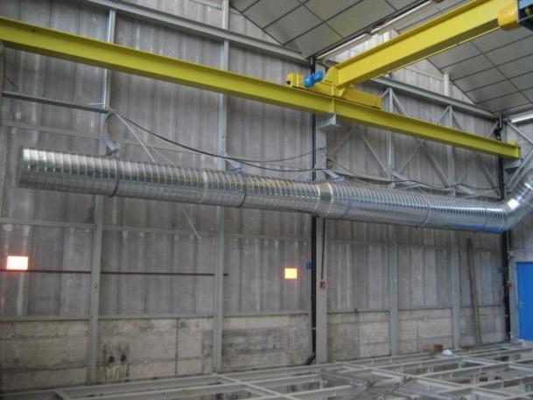
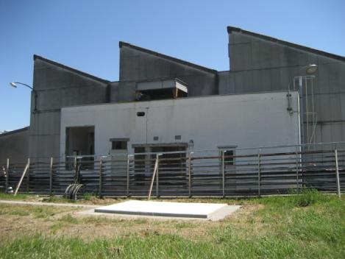
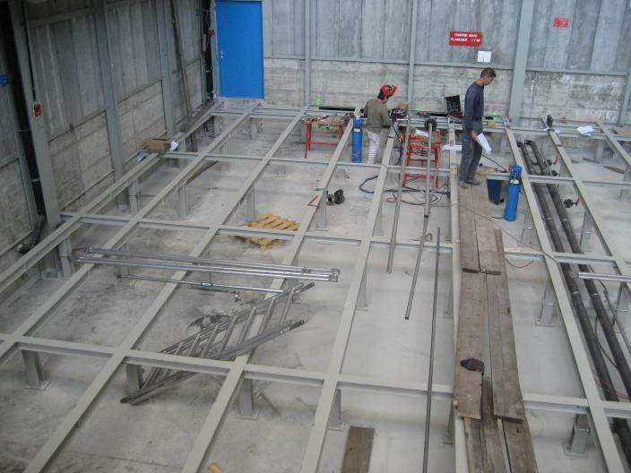
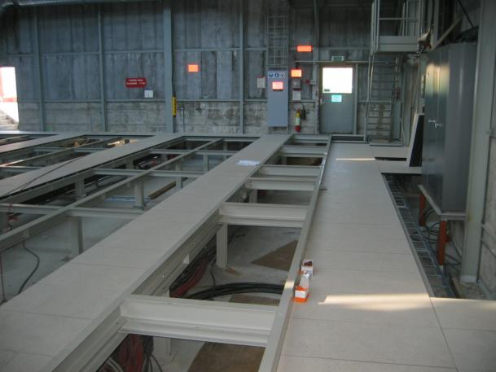
Indoor layout

Slide 23
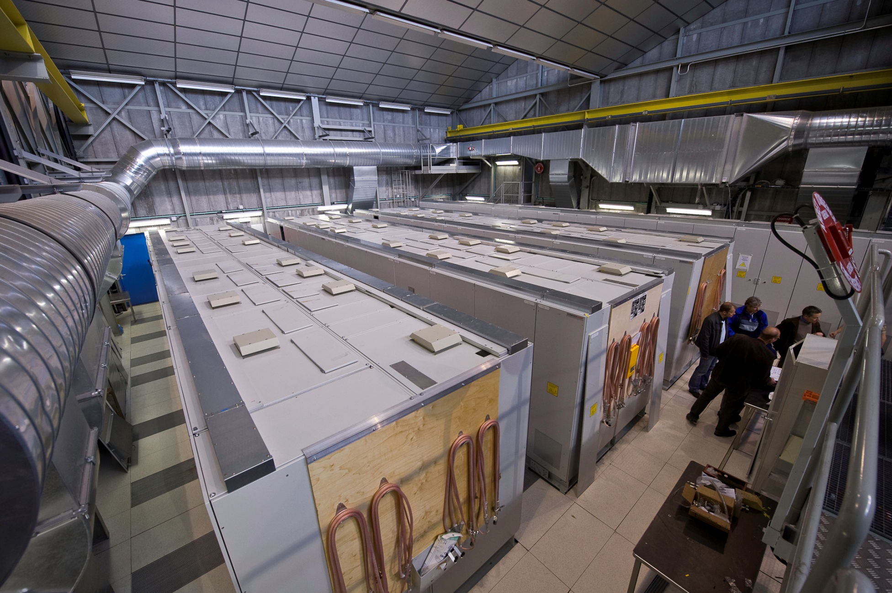
Indoor layout

Slide 24
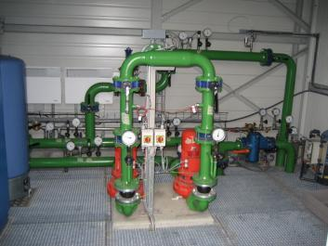
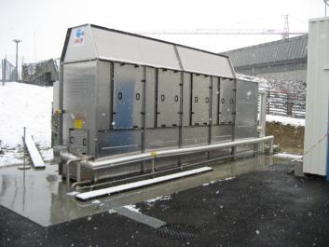
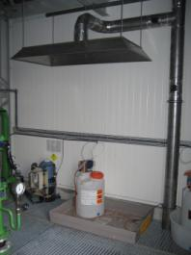
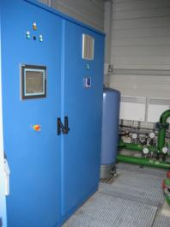
Water cooling system
POPS required a water cooled circuit of 600 kW
POPS has a dedicated cooling tower

Slide 25
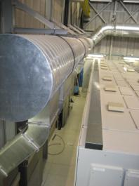
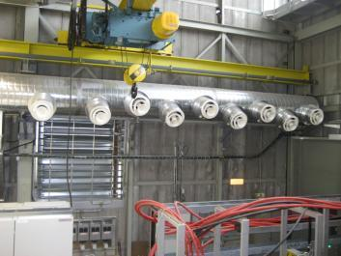
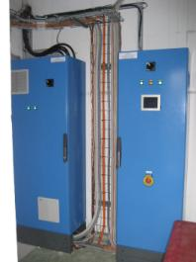
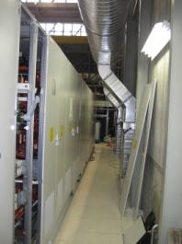
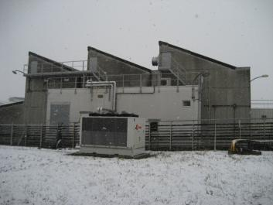
Ventilation
POPS required 170 kW of air conditioning
For both systems, it is impossible to commission at full load without the PS magnets.

Slide 26
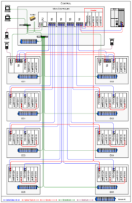
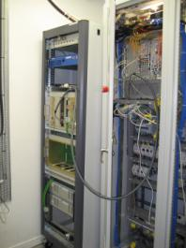
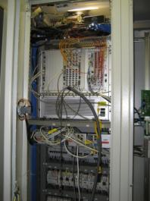
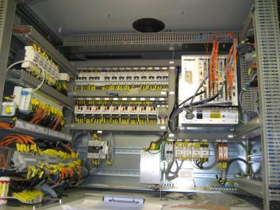
POPS control
All IGBT are fired directly by the main controller via optic fibers.
CERN provide the function generator (FGC) including the digital
current loop.
The main controller receives a voltage reference from the FGC.
The main controller has two powerful CPU with dedicated software tools
From Converteam.
Operators will use an HMI for cmd & status.

Slide 27
POPS control

Slide 28
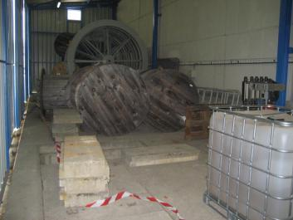
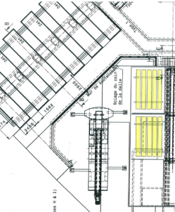
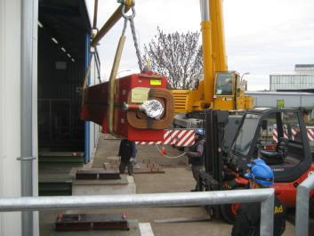
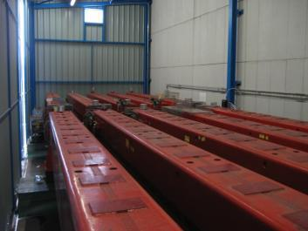

POPS commissioning
The commissioning started in January 2010
The commissioning was done on a dummy load because we will have no shut down of the LHC during 3 years.
At nominal peak current: 6kA
But at low rms current (1kA) and low output voltage (<1kV)
Only 1/10 of the nominal energy (1.8MJ instead of 12MJ)
10 SPS magnets
6kA peak
10 mH

Slide 29


POPS commissioning
First, the power transformers (2.5MVA)
Tr1 and Tr2 tested at no load.
Maximum Inrush observed 7.5*In
Still to be done:
Heat run (impossible without the load!)

Slide 30


POPS commissioning
Test of the capacitor banks individually
Capacitor charged up to 4.2kV with an external power supply
Discharged through the 96 ohm resistance.
Max resistor ΔT 140ºC

Slide 31

POPS commissioning
Test of AFE with a capacitor bank
16s
30s
Vdc
Vdc+; Vdc-
Id
Precharge with limiting resistor
Precharge without limiting resistor
C B closed and AFE modulating

Slide 32
POPS commissioning
progress step by step
Power up AFE1 + DCDC1 + DSP1 + magnets
Power up AFE1 + DCP1+ DSP1 + DCP3 + DSP3 + magnets
Power up AFE1 + DCP1+ DSP1 + DCP3 + DSP3 + DCP5 + DSP5 +
magnets

Slide 33



POPS commissioning
Full power test, final reception tests:

Slide 34


POPS performances
Current balance ok
Interleaving ok
Energy management ok
Validated by using only 1/10
Of the capacitor banks.
To be improved:
Voltage ripple at low current (IGBT minimum conduction time)
Interface with FGC (voltage reference from CERN and current loop)

Slide 35
POPS operation
How POPS will not be a single point of failure?
No unique device!
POPS is modular and redundant
POPS can work with :
Only 1 transformer over 2 (rms magnet current reduced by 40%)
Only 1 AFE over 2 (rms magnet current reduced by 40%)
Only 5 DCP over 6
only 5 DSP over 6

Slide 36



POPS Safety
POPS has a complete key locking system for doors and mechanical switches
The configuration will be set by the HMI
The key locking system will authorize operation
The grounding is done with mechanical switches managed by key locking system

Slide 37

POPS conclusions
POPS was a great challenge !!!
CERN has to learn and ‘tame’ it
It needs to be fully validated on load

