Slide 1

SLAC Program For High Availability Power System
2nd Workshop on Power Converters for Particle Accelerators (POCPA)
F. Rafael et ALL
Power Conversion Department – Sustaining Engineering
14-16 June 2010 -- CERN -CH-1211 Geneva, Switzerland

Slide 2
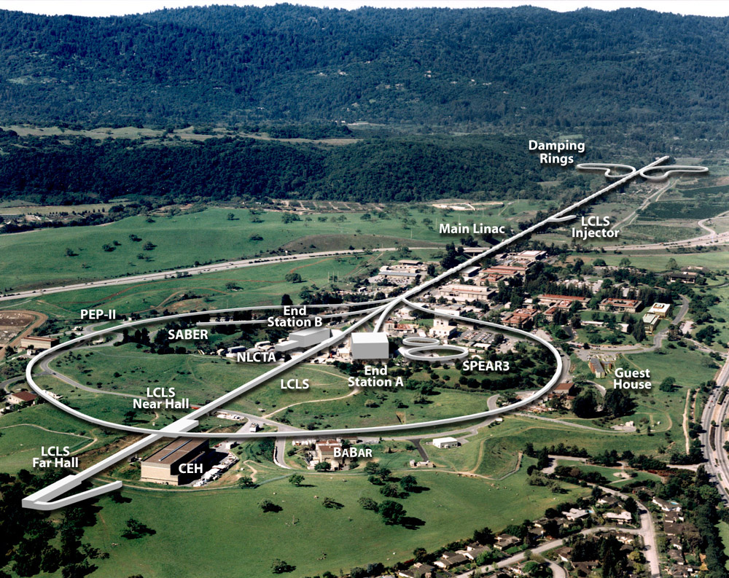
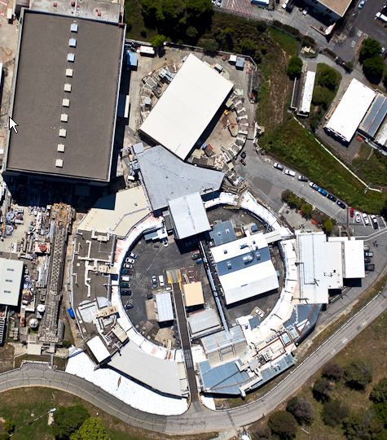
SLAC Facilities
Sustaining Engineering
SSRL (SPEAR3)
LCLS (LINAC)

Slide 3
Procurement
Power supply Specification
  Off the shelf:
    Use as much as possible International Standards:
      MIL
        Components de-rating
      EMC
        Special grounding requirements ( P. Bellomo)
  Specials:
    Design review
  KISS – Keep It Stupid Simple

Slide 4
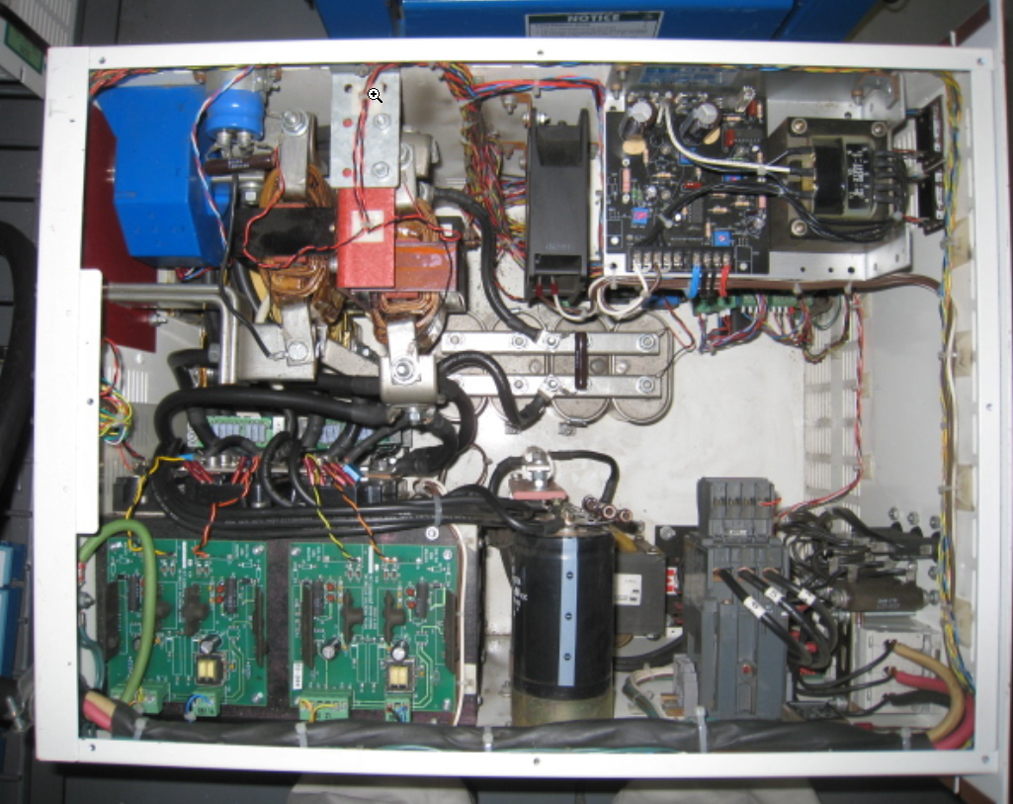
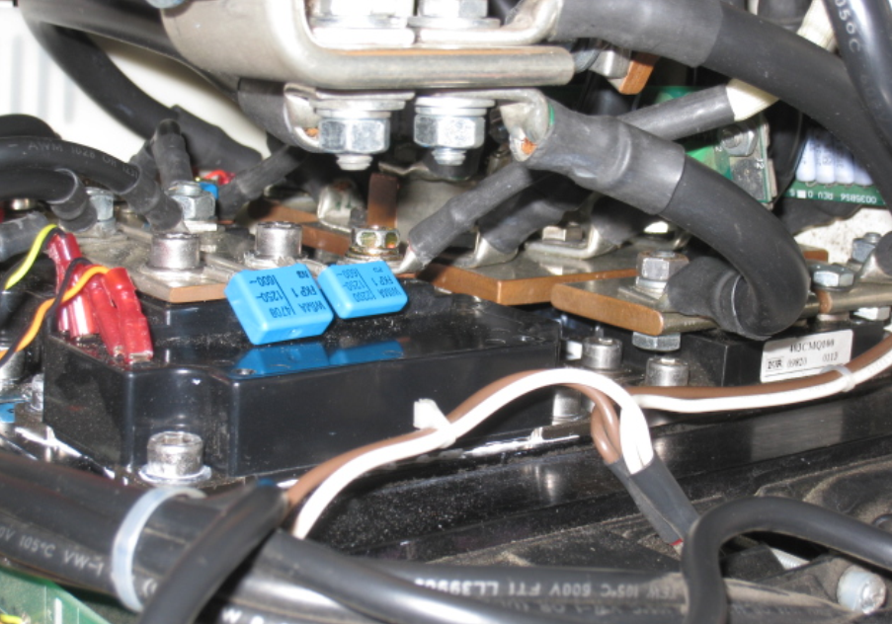
Procurement
Vendor Qualification
  Quality Control (ISO)
  Local/Domestic Service Center
  Spare parts availability
  Product Roadmap
Typical
10 hr MTTR
Rectifier assembly

Slide 5
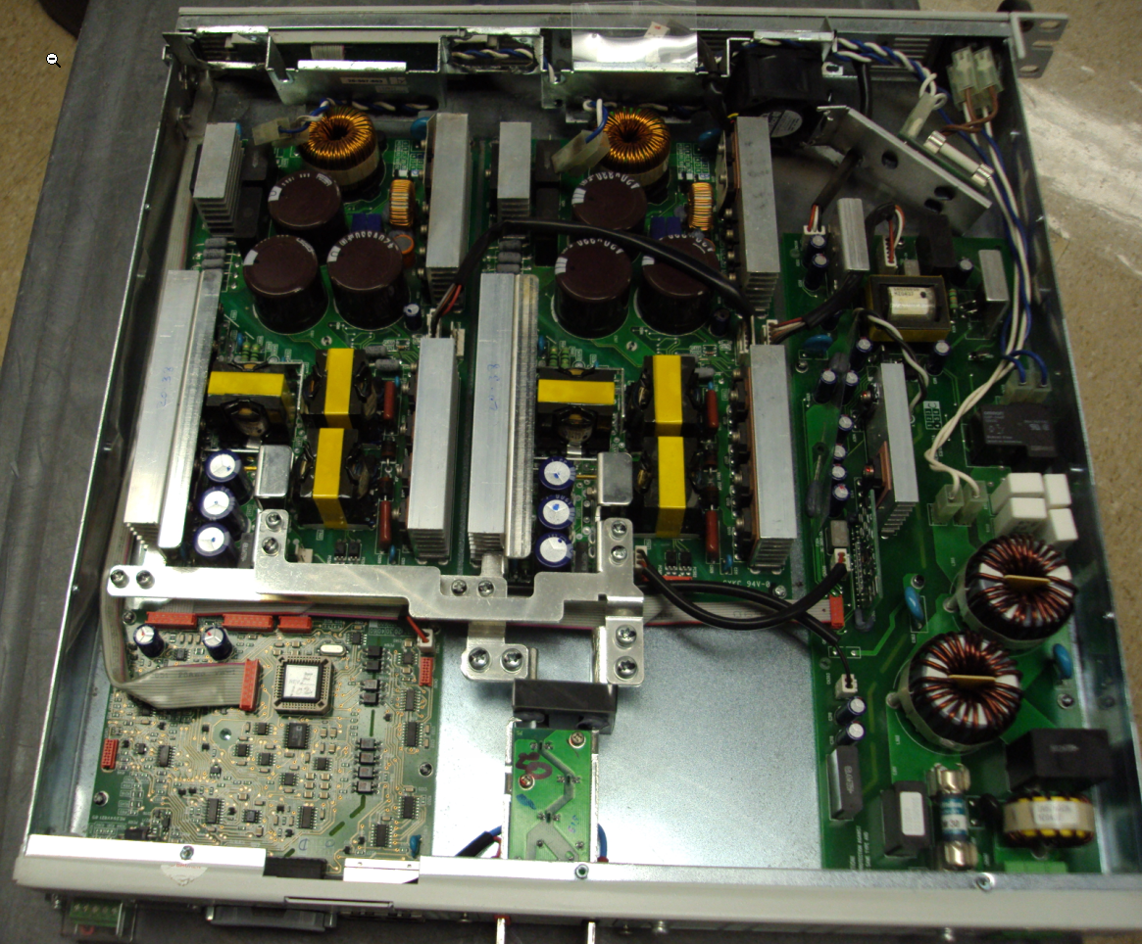
Procurement
Modular Design

Slide 6
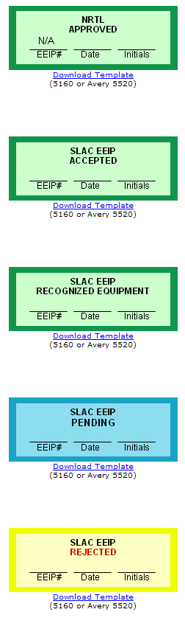
Test Acceptance & Integration
Off the Shelf Power Supplies
  Receive in lots and test it
Specials Power Supplies
  Test in the Vendor
SLAC – Electrical Equipment Inspection Program – EEIP
Based on
  UL – 508A – Industrial Control Panels
  UL – 61010A-1 Electrical Equipment for Lab. Use
Primary deployed for safety, has demonstrated improvement in reliability and used as part test acceptance and QA.
http://www-group.slac.stanford.edu/essg/eeip/program.htm

Slide 7
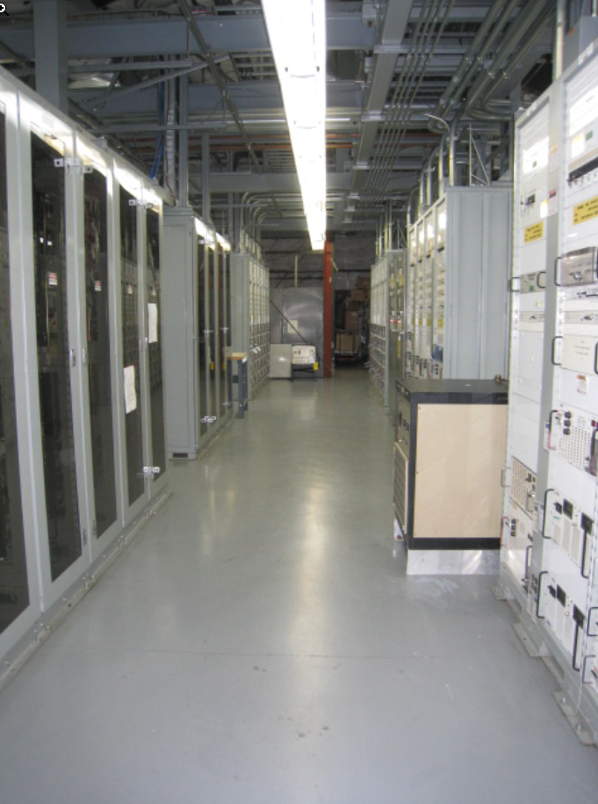
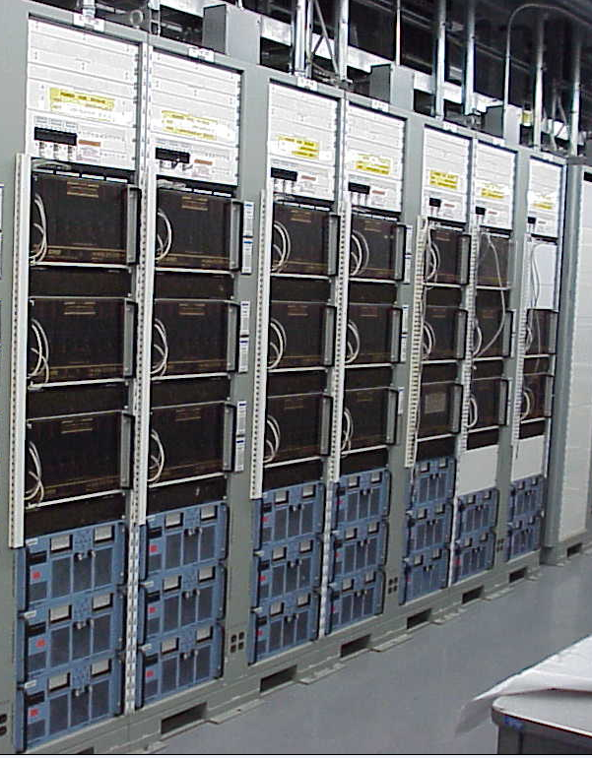
SPEAR3 Power Supplies Enviroment
B-118
PS
Building

Slide 8
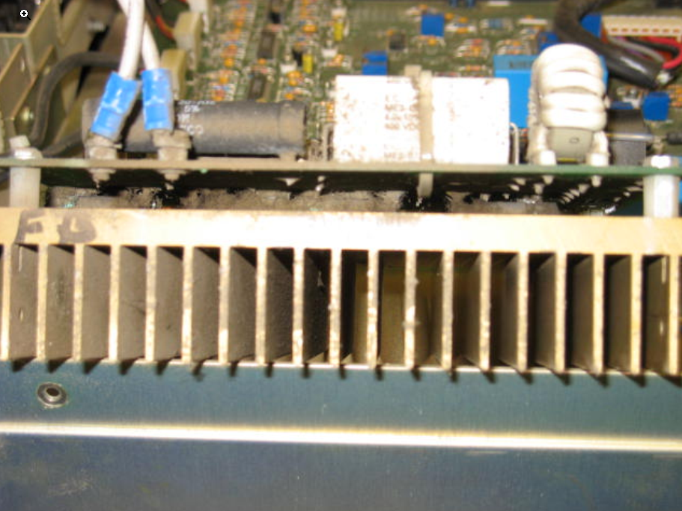
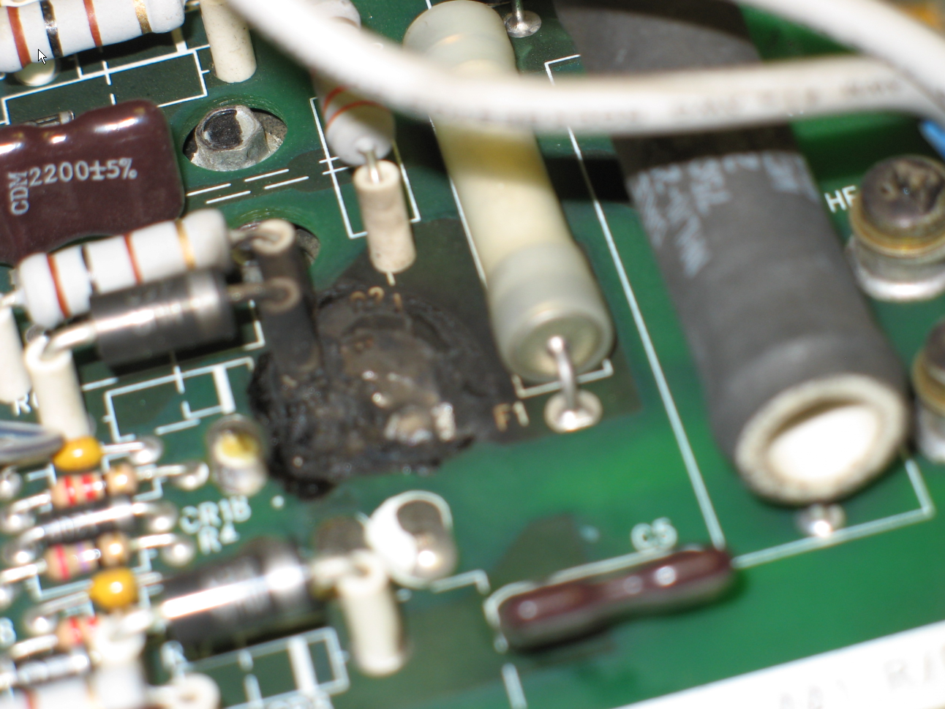
Clean Environment
Dust
Fire Hazards

Slide 9
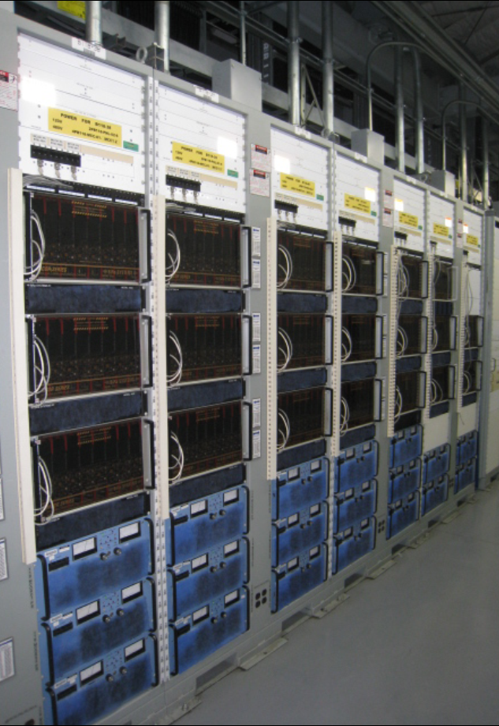
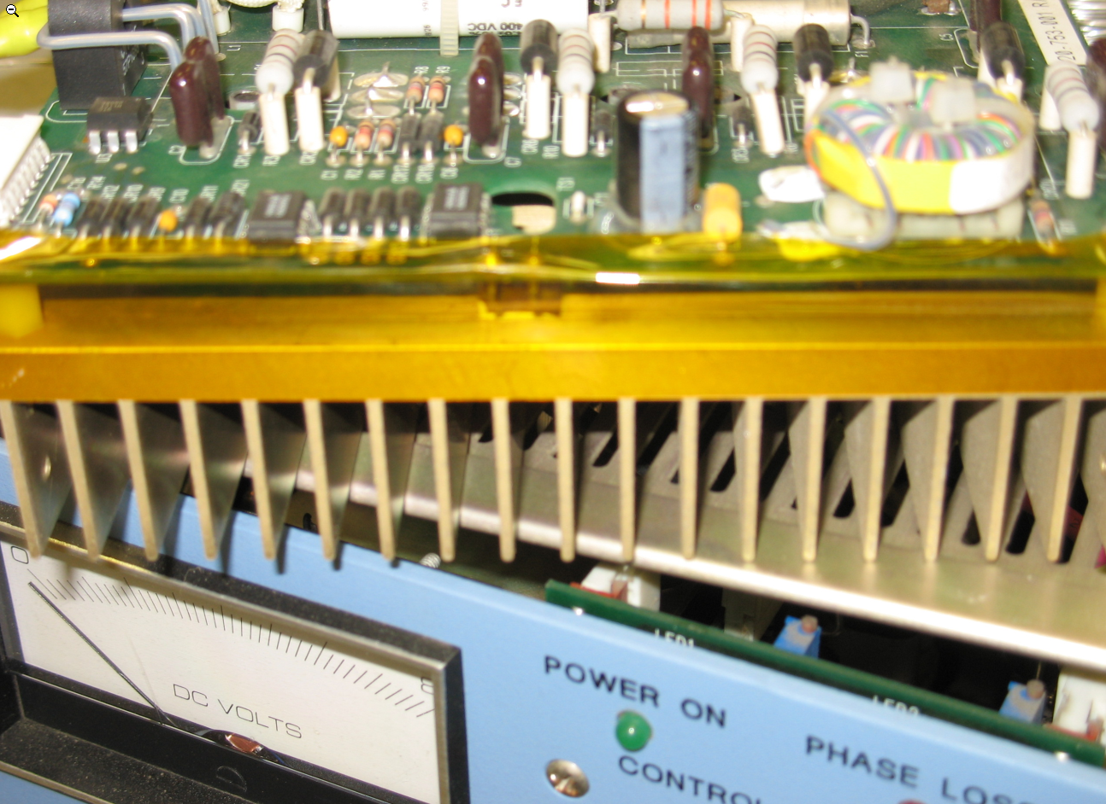
SPEAR3 MCOR System
Barrier Protection
Filters

Slide 10
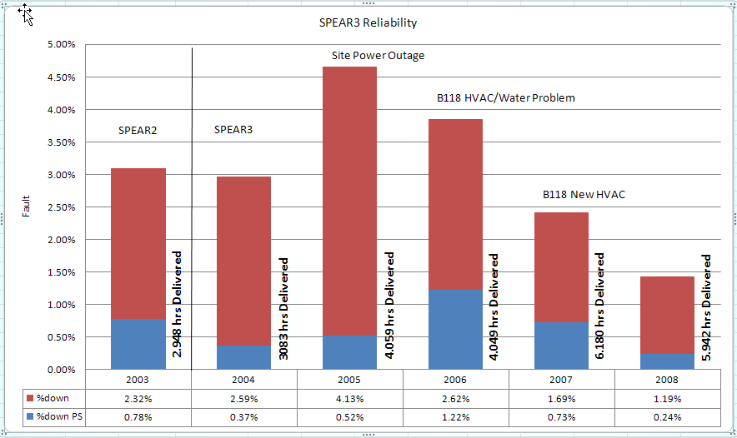
SPEAR3 Operation

Slide 11
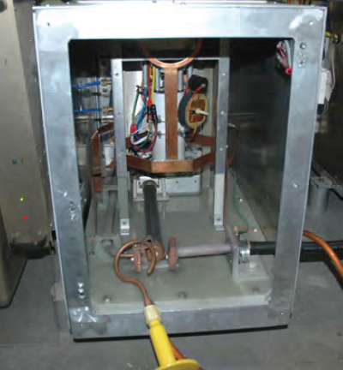
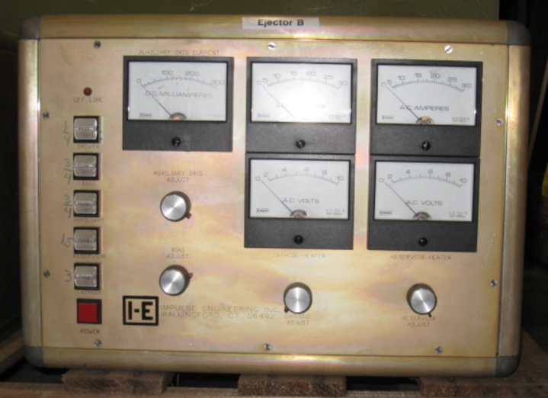
SPEAR3 Injector Requirements
Identify power electronic critical equipments
  Lower MTBF
  High MTTR

Slide 12
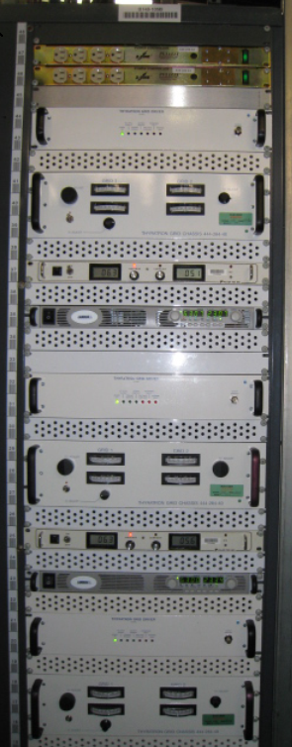
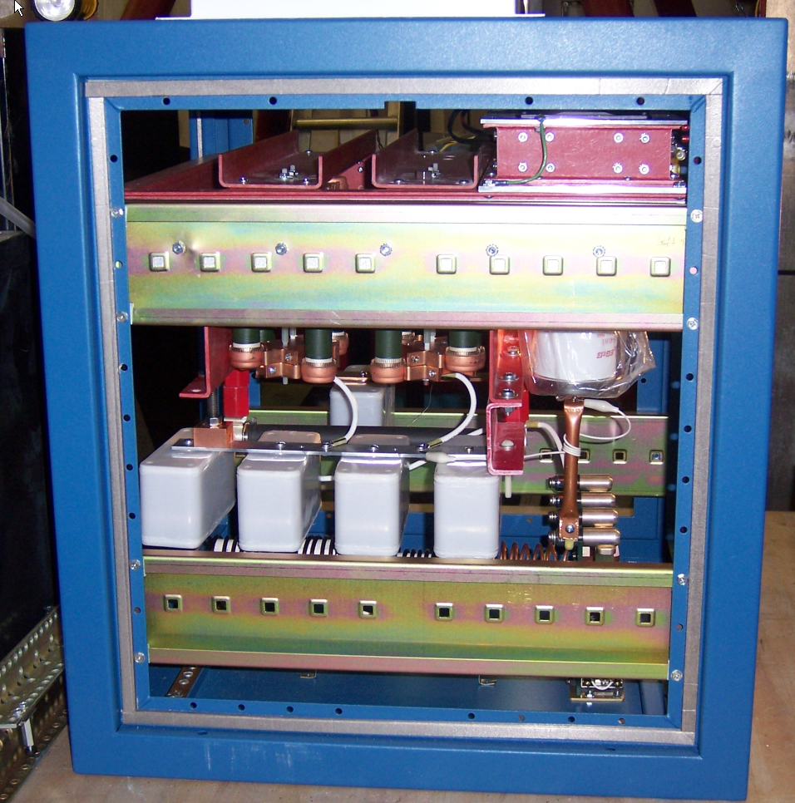
SPEAR3 Injector Requirements
New Booster kickers pulsers
Modular
Off-shelf
Design Target:
Minimize EMI
Avoid “homemade” solutions
Low MTBF & MTTR
Remove auxiliary circuitry from ACC housing

Slide 13
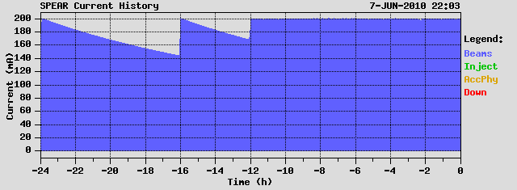
SPEAR3 Top - Off
Top-off phase I
  1 % @ 200 mA ( injection every 10 min)
Top-off Phase II (FY 2011)
0.1% @ 500 mA ( injection every 60 -90 Sec)

Slide 14
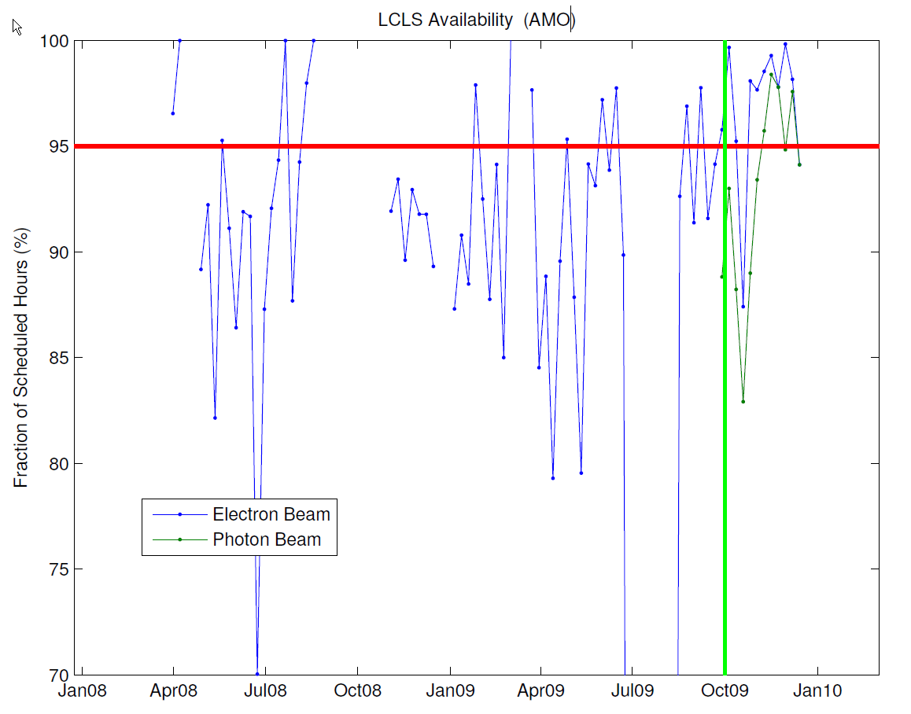
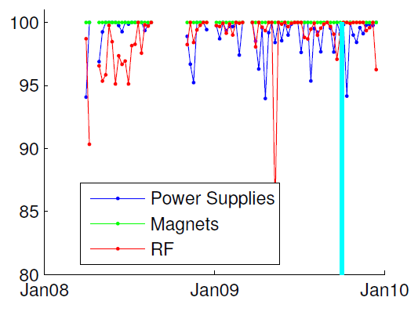
LCLS – Operation
Power Systems

Slide 15
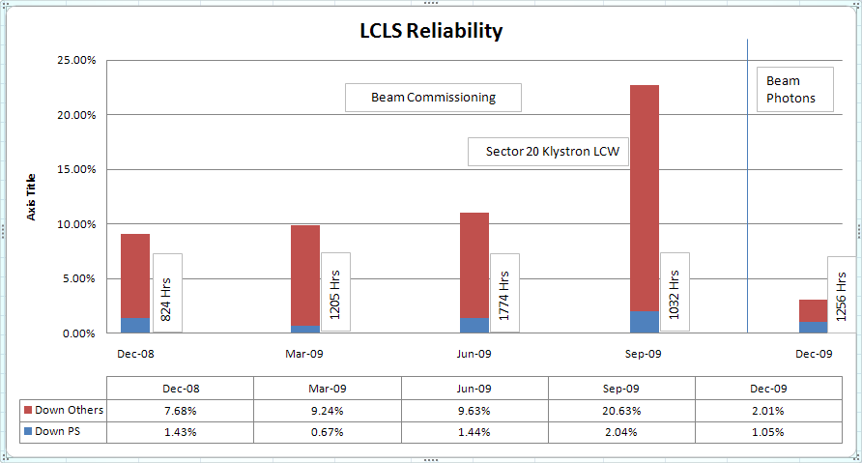
LCLS Availability

Slide 16
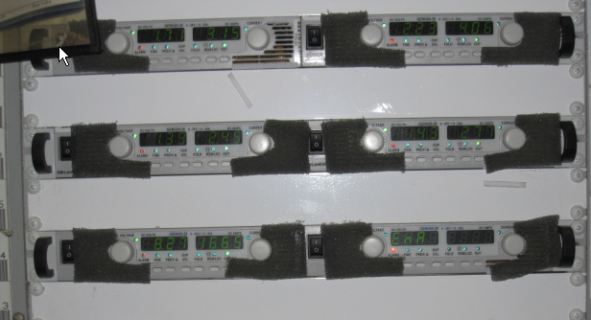
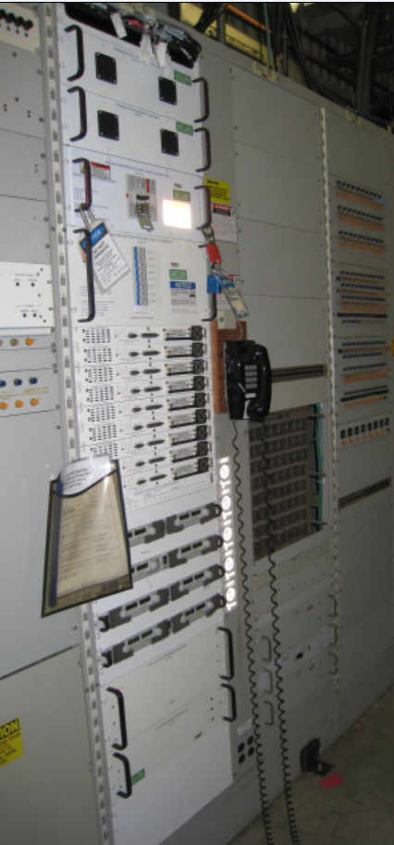
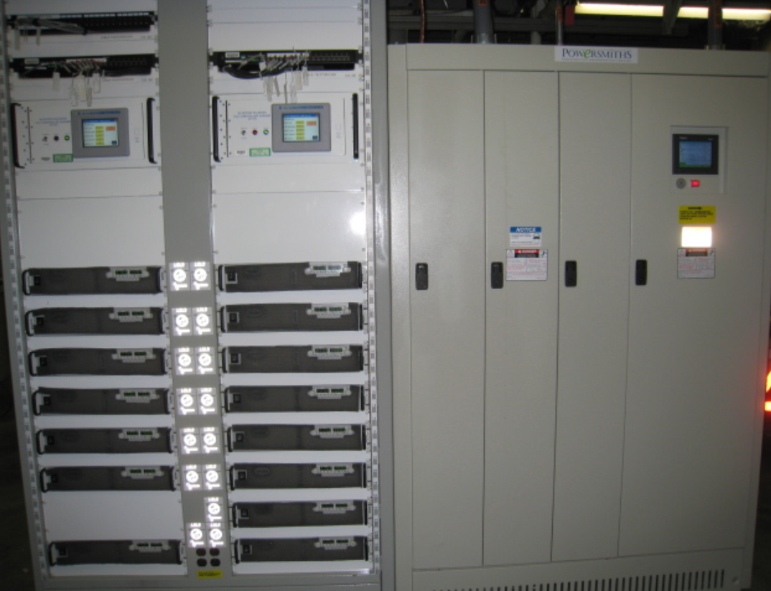
LCLS AIP’s
QE Magnets
Klystron Solenoid

Slide 17
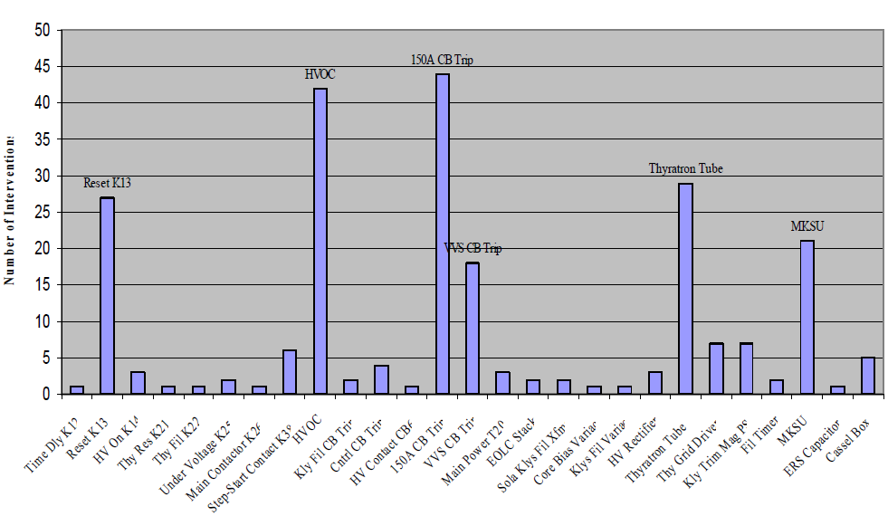
LCLS Modulators

Slide 18
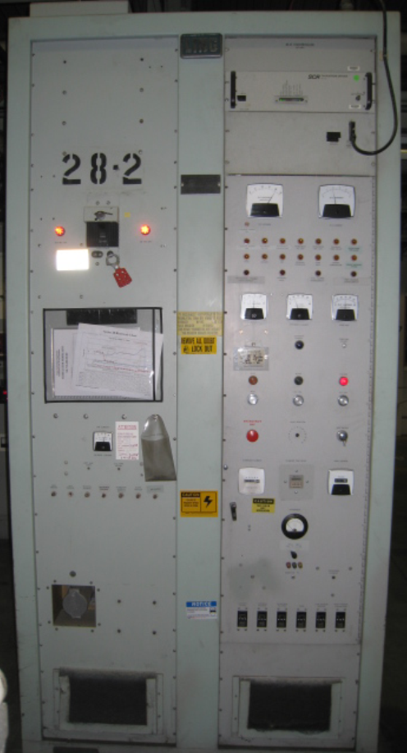
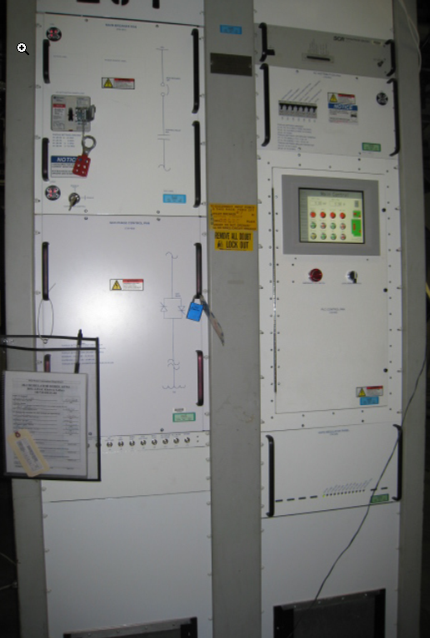
LCLS Modulators
1/3 of LINAC (2 MI)
10 Sectors
8 Modulators per Sector
Modernization
Cabinet 1
  AC input
  IOC’s
  Interlocks
Cabinet 2 and 3
  PFN
  Switch (thyratron)

Slide 19
HAPS - High Availability Power Supply
Paul Bellomo and Dave MacNair
SLAC National Accelerator Laboratory
ARW Vancouver, Canada January 26-30, 2009
Non-redundant - PEP II, SPEAR 3, LCLS (1994 – 2006)
Power supply quantity is hundreds, not thousands
Power supply availability budget is modest 98%
Non-redundant supplies satisfied availability budget
Redundant power systems not readily available from industry
Redundant systems would not fit within cost and schedule constraints
Redundant - KEK ATF 2 (2006 – 2008)
Mock-up of ILC Final Focus accelerator
Magnet power supplies ILC-like

Slide 20
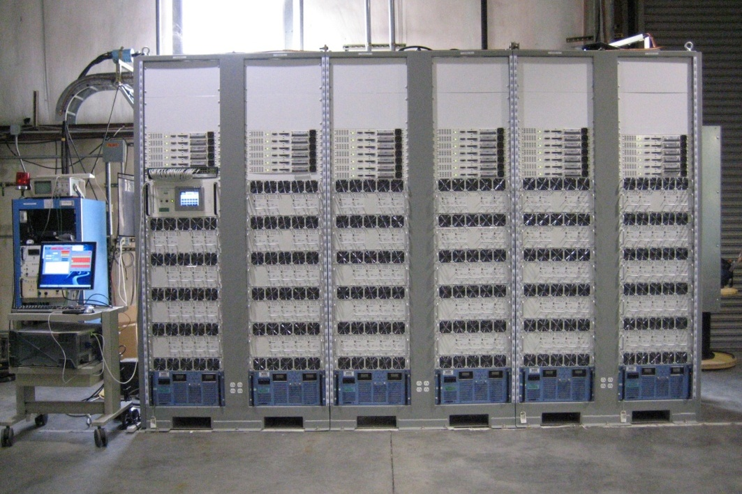
SLAC Next-Generation
KEK ATF 2 Approach
By P. Bellomo & D. MacNair

Slide 21
HAPS – Next
    Goals
    All components N+1 modular and redundant
    Power module hot-swappable
    Unipolar or bipolar output from a single unipolar bulk voltage source
    Imbedded controller with digital current regulation
    Capable of driving superconducting magnets
    High bandwidth for use in BBA or closed orbit correction systems
    High stability and precision output current
    High accuracy read-backs
    Scalable to higher output levels
    Applications
    ILC and other future accelerators

Slide 22
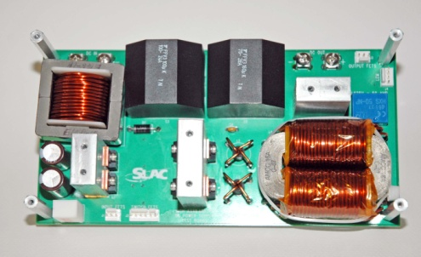
CD 4
Phase-2 Installation

Slide 23
Questions?

