Slide 1

Arc Flash Hazard and Mitigation
2nd Workshop on Power Converters for Particle Accelerators
June 14 – 16, 2010
Paul Bellomo
Notes:
Look at and incorporate Fundamentals of Power Electronics into the talks
Power Electronics Fundamentals can be found via a web search

Slide 2
Motivations and Topics
Electrical arc flash accident at SLAC October 2004
Possible unfamiliarity by others outside of U.S.A.
Define an arc flash and how it can be encountered
Define potential hazards and injuries associated with an arc flash
Calculate the potential hazard for arc flash
Mitigating the potential hazards associated with arc flash

Slide 3
THE ELECTRICAL HAZARDS
There are 3 types of electrical hazards
1. Shock, with which most of us are familiar
2. Arc Flash, which will be covered at more length in subsequent slides
3. Arc Blast, which is the explosive energy from the pressure wave produced during an arc flash incident

Slide 4
A Word on Safety Standards
USA
National Electrical Code NFPA 70 - 2008
Deals with hardware design, inspection and installation
Most Articles not applicable to power systems, but some examples that do are grounding and discharge of stored energy in capacitors

Slide 5
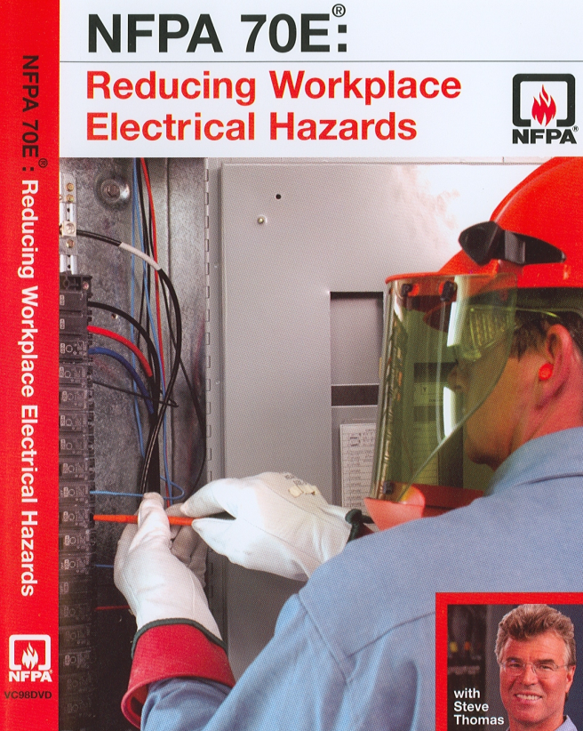
Some Standards - Continued
Standard for Electrical Safety in the Workplace
Addresses employer and employee safety in the workplace
Focus is on procedures, personnel protective equipment
Attempts to mitigate effects of three major electrical hazard types – shock, arc flash and arc blast
IEEE 1584 – 2002, Guide for Performing Arc Flash Hazard Calculations

Slide 6
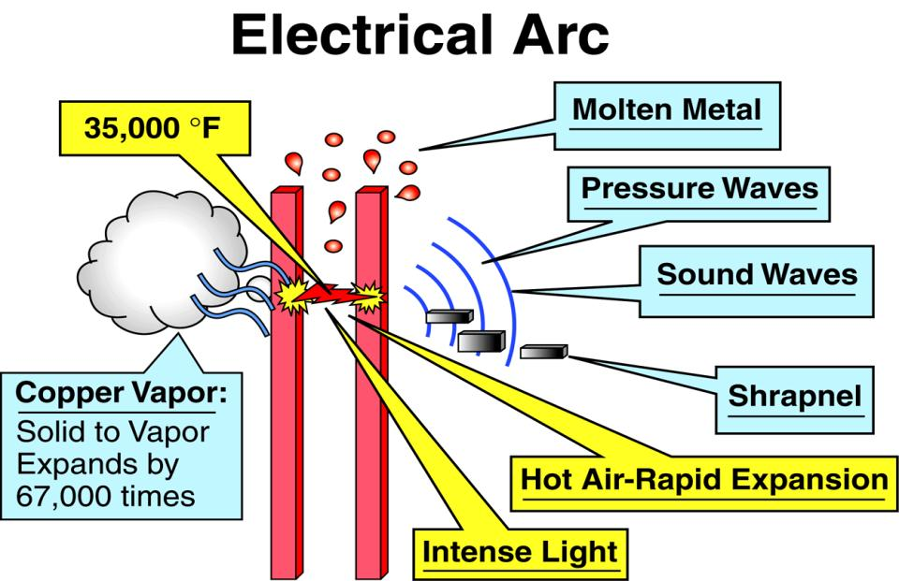
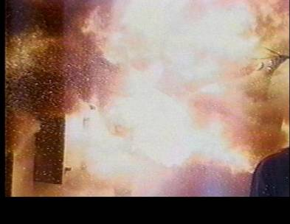
What is an Arc Flash and Arc Blast?
The insulation and isolation of energized parts fail
The short circuit vaporizes copper, producing a hot plasma gas in air exceeding a temperature of 35000 º F
The explosive fireball expands at sub-sonic speeds. It injures faster than the worker can sense that anything unusual has happened.
It is primarily a burn and an explosive hazard, not an electrocution hazard
It can be initiated and occur in many ways causing severe burns, blindness, deafness, dismemberment and death
They occur 5 to 10 times a day in electric equipment in the USA alone

Slide 7
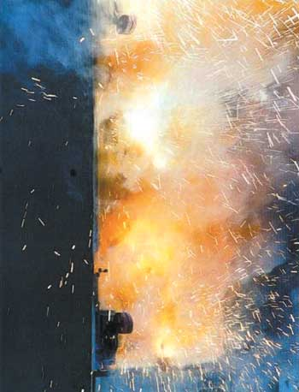
Possible Causes of Arc Flash and Arc Blast
Tool inserted or dropped into a breaker or service area
Equipment cover removal causes a short
Loose connections on bus work
Improper bus work fabrication
Insulation breakdown due to environmental factors or equipment aging
Failure to ensure equipment is de-energized before work
Primarily instances occur above 208VAC

Slide 8
Injuries Associated with Arc Flash
Third Degree Burns
Blindness
Hearing Loss
Nerve Damage
Cardiac Arrest
Concussion
Death

Slide 9
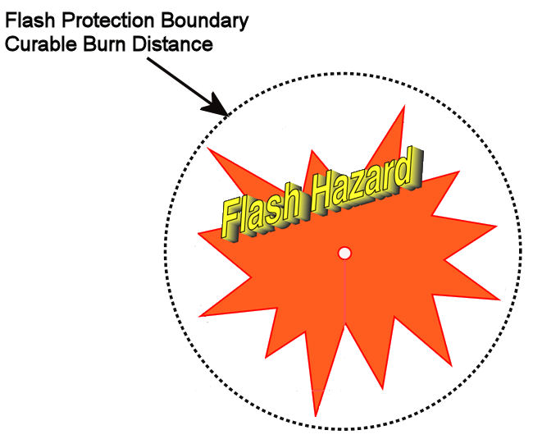
Arc flash protection boundary is the distance from the arc at which a person could receive a second degree (curable) burn on the torso or face. It is the boundary at which the arc energy density =1.2 cal/cm ² = 5 J/cm ². This is comparable to holding the flame from a cigarette lighter on the skin for 1 second

Slide 10
Reasons for Arc Flash Hazard
Large amount of power available at equipment (example: large utilization equipment such as a dipole supply
  Very often more economical to build one large substation than several small ones
Importance of arc-flash hazard not recognized. The first major paper not written until 1982
Heretofore protection coordinated based on minimizing equipment damage from overheating or fire, not personnel. So thermal time constants properly set
  Minimize nuisance trips due to line transients, inrush current, etc so fast time constants improperly set. These could minimize the arc flash hazard to personnel

Slide 11
Arc Flash Hazard
An arc generates power that radiates out from a fault
The total energy is the product of the arc power and duration of the arc
The energy density decreases with distance from the arc
Flash protection boundaries and energies are calculated using NFPA 70E [example Table 130.7(C)(9)(a)] and IEEE1584
The calculations entail knowing the voltage class of the equipment, some details about its manufacture, the available short circuit current and the opening times of the protective circuit breaker(s)

Slide 12
Early Model
In 1982, the first calculations concerning arc-flash were published by Ralph Lee
  Calculated the maximum available power from an arc
  Assumed the power density dropped off as the inverse square of the distance from the arc
  Related the energy to biological studies that determined the second-degree burn threshold
Formula for working distance to avoid second-degree burns reproduced in 130.3(A) of NFPA 70E

Slide 13
First Empirical Models
Mid 1990s, other teams from DuPont, Doughty, et. al., and IEEE Working Group 1584, performed a set of experiments to measure the heat, pressure and sound generated by an arc
Wanted empirical data to quantify arc flash hazards
  Measured dependence on arcing current
  Measured voltage dependence
  Measured dependence on distance from arc
  Detailed configuration and enclosure dependencies. Found that enclosures focus the energy and pressure blast from the arc
Flash protection boundary more conservative than Lee's
Formulae reproduced in 1584 and Annex D.6 of NFPA 70E
Developed an algorithm to conservatively estimate the arc-flash hazard

Slide 14
IEEE 1584
The Algorithm
  Acquire system data
  Calculate bolted fault current from standard engineering formula
  Calculate 100% arcing and 85% arcing currents from IEEE 1584 formula
  Use appropriate time-current curve of clearing device to determine clearing times
  Calculate arc-flash energy at the appropriate working distance using the worst case from the 100% arcing or 85% arcing currents

Slide 15
NFPA 70E and IEEE 1584 208VAC Exemption
Arc needs to sustain itself in order to generate enough heat to cause burns
Empirical evidence from studies showed that it was extremely difficult to sustain an arc from a 208VAC system
Statement from IEEE 1584 “The arc-flash hazard need only be considered for large 208 V systems; systems fed by transformers smaller than 125 kVA should not be a concern.’’

Slide 16
Calculation Assumptions
Nothing in the panel being operated, including the main breaker, will protect us in case of an arc-flash during the operation of any part of that panel
  Main breaker could fail on line side during operation
  Arc-flash originating at operated breaker could spread to line side of main breaker
The fronts of the panel-boards and switchboards provide no protection against arc-flash
Independent of the clearing time of the upstream protective device, the worker will move away from exposure in less than 2 seconds, so that “two seconds is a reasonable maximum time for calculations”

Slide 17
Bolted Fault Current Calculation
Power from a three-phase Wye or Delta transformer is
The full load line current is
Available short circuit current using the transformer rating and circuit impedances (mainly leakage inductance of transformer)

Slide 18
IEEE 1584 Calculation - Arcing Current
Empirical formula from IEEE 1584
  Bolted fault current (I_{bf} in kA)
Must calculate arcing current (I_{a} in kA) at which the flash energy is generated
  I_{a} lower than I_{bf} therefore may last a longer time than I_{bf} since it may take longer for the protective device to clear
  K is the value for the arc ambient (0.153 for open air, 0.097 for boxes)
  V is the system voltage in kV
  G is the conductor gap in mm (25mm for 480VAC MCCs and panels)
Use 100% I_{a} and 85% I_{a} for clearing times from breaker or fuse time-current curves

Slide 19
Clearing Times
Once the arcing currents are determined, the clearing times must be determined
We must identify the upstream fuse or breaker that will clear the fault
The manufacturer's time-current curves for the appropriate device are identified
The arcing current is found on the x axis and the clearing time is read from the y axis
Notes:
INSTRUCTOR NOTES:

Slide 20
Protective Devices
Protective devices act to clear fault currents
Fuses (fixed time-current curves)
Molded Case Circuit Breakers (MCCB)
  Thermal
  Magnetic (adjustable)
  Electronic (adjustable)
Low Voltage Power Circuit Breakers (adjustable)
Vacuum Contactors with Protective Relays (adjustable)

Slide 21
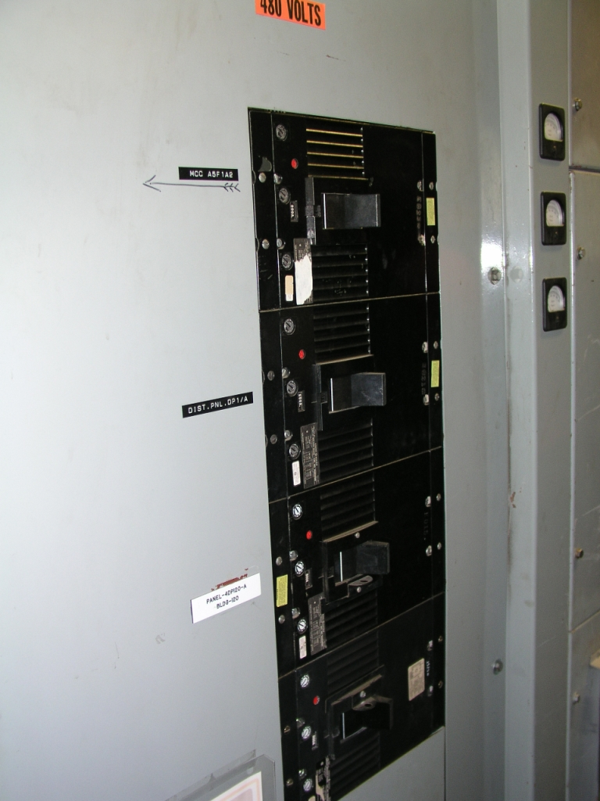
Molded Case Circuit Breakers
Panel-board with 4 - 800A MCCBs
Thermal-magnetic
Adjustable with front panel rotary switches

Slide 22
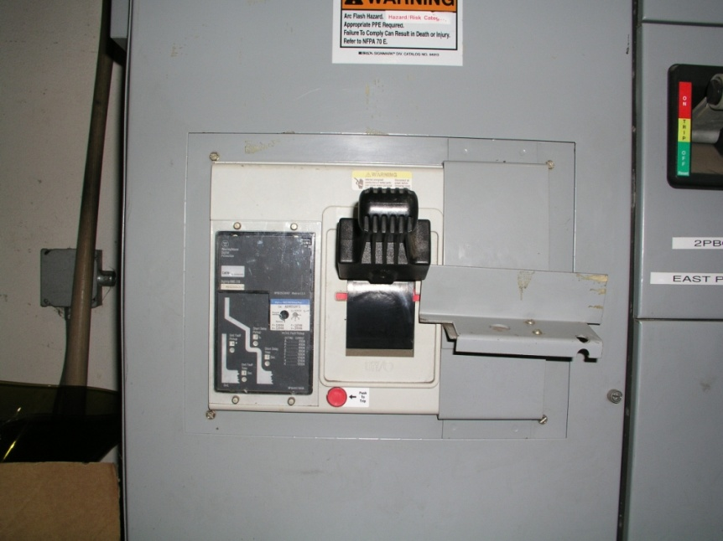
Molded Case Circuit Breakers
Motor Control Center (MCC) main breaker (2000A)
Separate Frame and Trip units
Adjustable with front panel rotary switches
Electronic Trip Control LSIG
  Long Time
  Short Time
  Instantaneous
  Ground Current

Slide 23
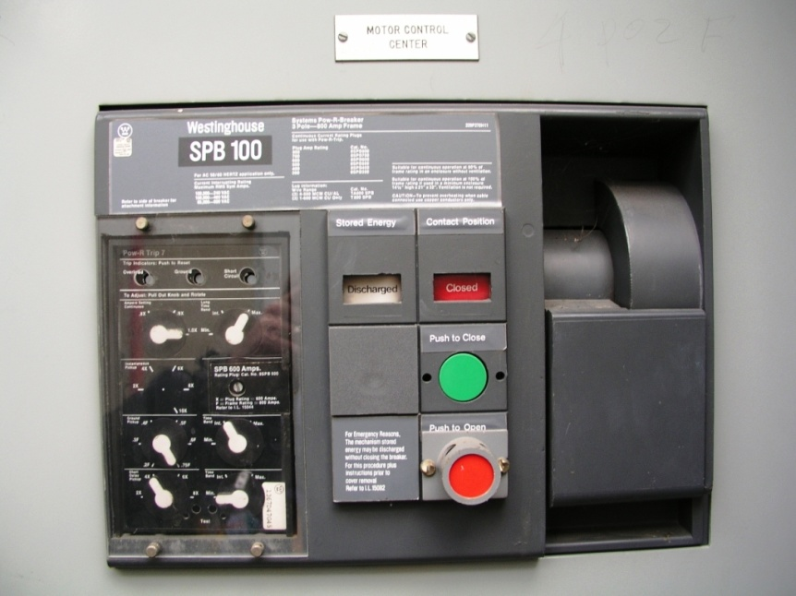
Low Voltage Power Circuit Breaker
First breaker downstream of transformer
Separate frame and trip unit
Rated up to 4000A
Trip units are adjustable via front panel controls
Typically inside a substation

Slide 24
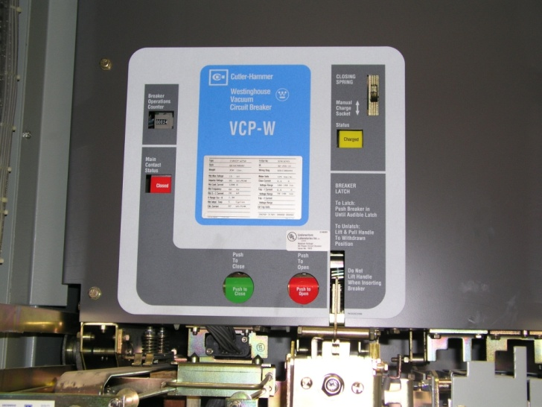
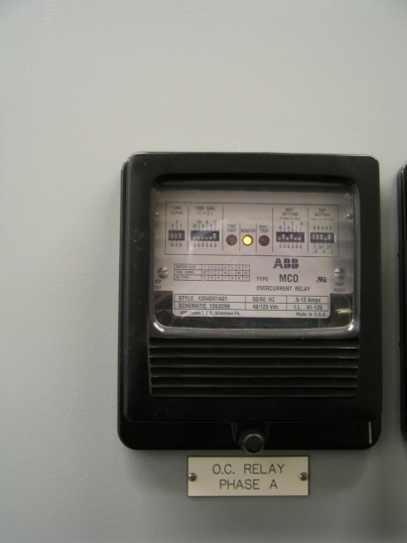
Medium Voltage Breaker and Protective Relay
Protects primary side (12.47kV) of transformer
Breaker has tripping mechanism but no sensor
Protective relay
  Connected to current transformers on bus
  Activate breaker tripping mechanism
  Adjustable via DIP switches

Slide 25
Time-Current Curves
Each protective device has a time-current curve
  Current on x-axis
  Time on y-axis
Currents below the trip value will not open the device
Currents slightly above the trip value will trip after a long time to prevent fires from heating in the wires
Currents very much larger than the trip setting signal a fault and trip the device as quickly as possible
Adjustments set these values and, if applicable, the intermediate behavior of the breaker

Slide 26
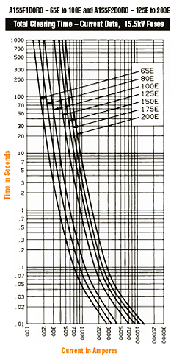
Typical Medium Voltage Fuse Time-Current Curve (Ferraz-Shawmut)
Non-adjustable
Top of y-axis is 1000 seconds and fuses not yet open on 2X over-currents
These fuses take more than 0.1 second to open on 10X overcurrent
Different classes of fuses for different voltages and currents
Notes:
INSTRUCTOR NOTES:

Slide 27
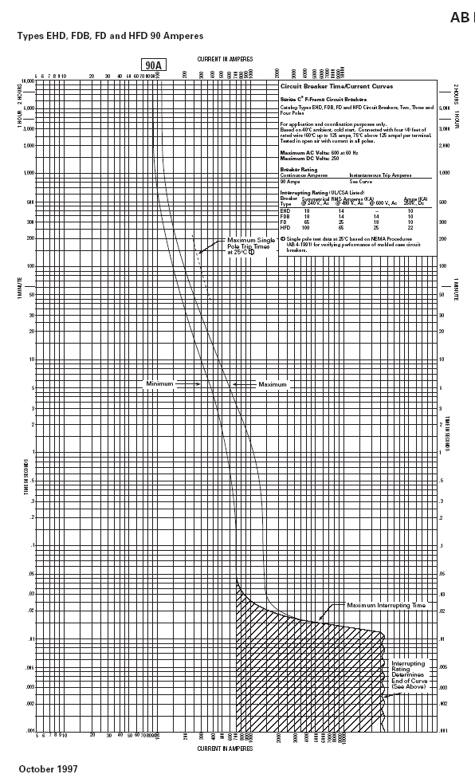
Typical Breaker Time-Current Curve (Cutler Hammer)
Thermal breaker (90A)
Small over-current takes
> 30 minutes to trip
Lines of constant I²t (constant energy) protect against thermal damage
17X (1530A) over-current trips in 30 msec
Very high currents trip in 16 msec
Note that curve gives min, max tolerance band
Min
Max
30ms
16ms
1530A
7000A
Notes:
INSTRUCTOR NOTES:

Slide 28
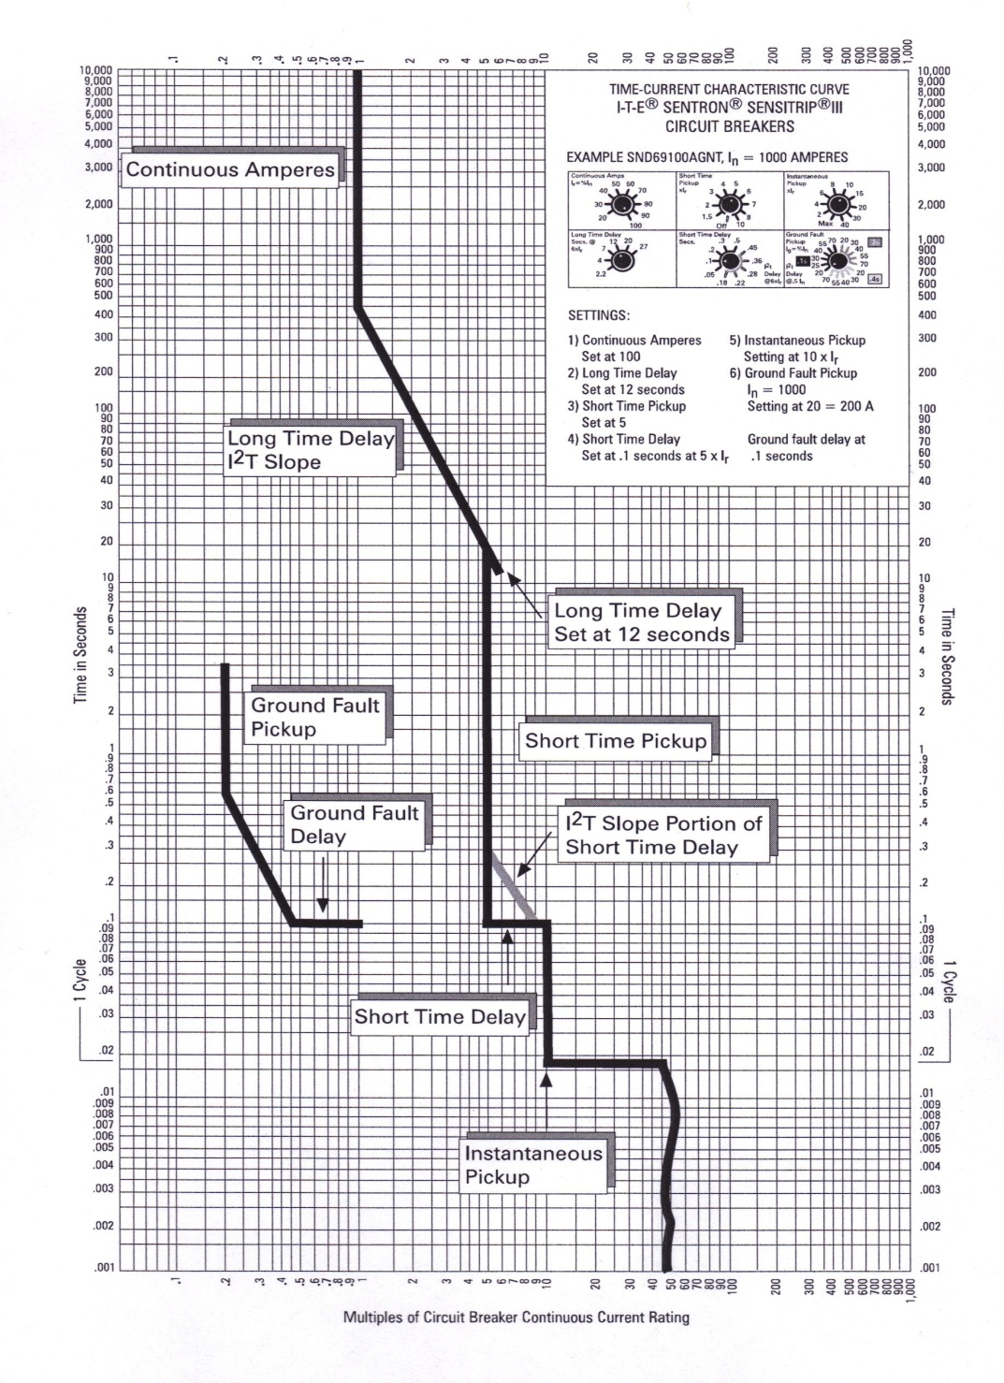
Adjustable MCCB (LSIG) Time-Current Curve(C-H)
Adjustable breaker can set various parameters
  Long time moves left hand side vertical bar
  Short time pickup sets intermediate vertical bar
  Short time delay sets intermediate pedestal
  Instantaneous setting determines current at which instantaneous trip occurs

Slide 29
Normalized Incident Energies
Once the system configuration and arcing currents are known, the “normalized”, and 85% normalized, arcing energies are calculated
K₁=-0.555 for enclosed arcs, K₂=-0.113 for a grounded system
I_{a} = 100% arcing current in kA, I_{85a} = 85% arcing current in kA
  G is the conductor gap in mm (25mm for 480VAC MCCs and panels)
E_{n}, E_{85n}, are expressed in cal/cm²
Notes:
INSTRUCTOR NOTES:

Slide 30
Actual Incident Energies
Then the 100% actual and 85% actual arcing energies are calculated
E_{a}, E_{85a} are expressed in cal/cm2
  C_{f} = 1.5 (voltages below 1 kV and = 1.0 for voltages above 1 kV)
  t_{a} and t_{85a} are 100% and 85% arcing time in seconds, obtained from the appropriate time-current curve
  0.2 is an empirical time expressed in seconds
  610 is 24 inches expressed in mm
  D is working distance in mm
  x (1.641 in most 480VAC systems) is a system-dependent, dimensionless, distance factor from Table 4 of IEEE 1584 or Table D.7.2 of NFPA 70E

Slide 31
Working Distance
The “safe” working distance is defined as the minimum distance at which the worker's body and torso receives a second degree burn
(E_{a} or E_{85a} =1.2 cal/cm²)
Invert the previous formulas to obtain the Flash Protection Boundary distances (E_{a} or E_{85a} =1.2 cal/cm²)
Take the larger of the arcing energies and distances for use on the arc flash hazard labels
Notes:
INSTRUCTOR NOTES:

Slide 32
Hazard/Risk Category
The hazard/risk category is determined by selecting the row for which
E_{min} < E_{a} < E_{max} (cal/cm²) at the working distance
The appropriate Personal Protective Equipment (PPE) required is then determined from Table 130.7(C)(10) and Table 130.7(C)(11) of NFPA 70E
E_{min} | E_{max} | Hazard/Risk Category
0 | 1.2 | 0
1.2 | 4 | 1
4 | 8 | 2
8 | 25 | 3
25 | 40 | 4
Notes:
INSTRUCTOR NOTES:

Slide 33
B620 Calculation
Calculate two arc-flash energies
  Operate 150A feeder breaker in MCC
  Operate breaker downstream of clean power transformer
Main transformer
  1MVA 12.47KV/480V, Z = 5.57%
Clean power transformer
  112.5 kVA 480V/480V, Z = 5.60%

Slide 34
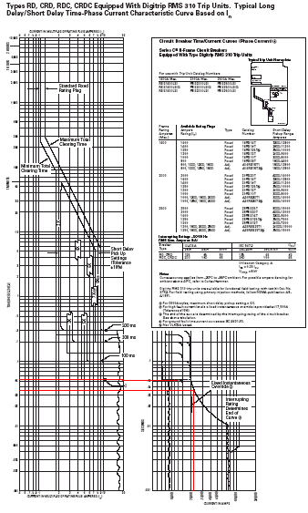
MCC Feeder Breaker Calculation
I_{fl} = 1.2 kA
Z = 5.57%
Fault currents
  I_{bf} = 21.6 kA
  I_{a} = 12.7 kA
  0.85I_{a} = 10.8 kA
Clearing times from
C-H AD 29-167R
Curve SC-5630-93
  t_{bf} = 0.040 s
  t_{a} = 0.051 s
  t_{0.85a} = 0.051 s
Times are short because breaker is set at its fastest setting
Notes:
INSTRUCTOR NOTES:

Slide 35
MCC Feeder Breaker Calculation
Working distance is 30” (because breaker is recessed from handle)
E_{a} = 0.94 cal/cm²
E_{0.85a} = 0.79 cal/cm²
Maximum energy (0.94 cal/cm²) less than 1.2 cal/cm² so operation of this circuit breaker is Hazard/Risk Category 0
Table 130.7(C)(9)(a) not applicable because
  I_{bf} < 65 kA
  t_{clear} > 0.030 seconds

Slide 36
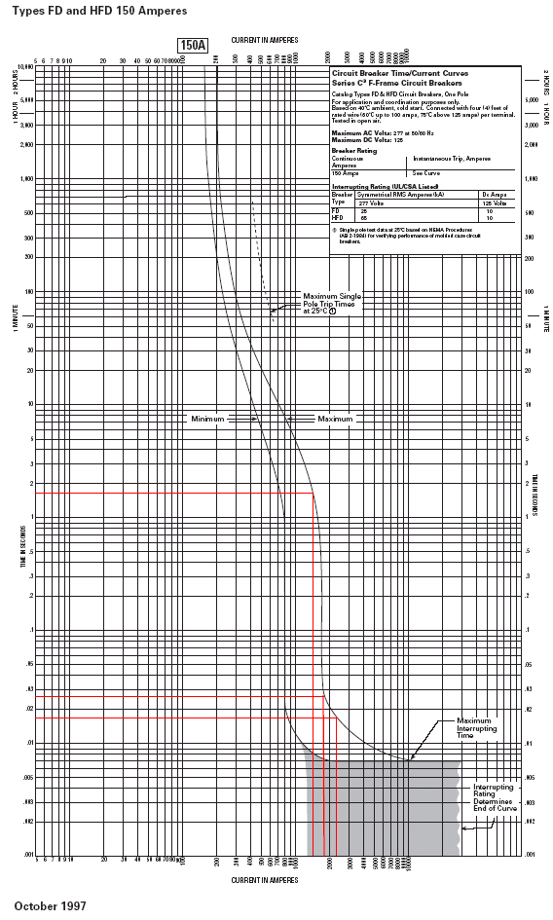
Clean Power Breaker Calculation
I_{fl} = 135 A
Z = 6.23%
Fault currents
  I_{bf} = 2.2 kA
  I_{a} = 1.8 kA
  0.85I_{a} = 1.5 kA
Clearing times from
C-H AD 29-167F
Curve SC-4438-88A
  t_{bf} = 0.017 s
  t_{a} = 0.024 s
  t_{0.85a} = 1.6 s
Time is large because system is not properly coordinated
Notes:
INSTRUCTOR NOTES:

Slide 37
Clean Power Breaker Calculation
Working distance is 18” (NFPA70E standard)
E_{a} = 0.12 cal/cm²
E_{0.85a} = 6.9 cal/cm²
Maximum energy (6.9 cal/cm²) between 4 and 8 cal/cm² so operation of this circuit breaker is Hazard/Risk Category 2
Table 130.7(C)(9)(a) not applicable
  I_{bf} < 25 kA
  t_{clear} > 0.030 seconds
112.5 kVA transformer in circuit led to long clearing times of upstream breaker
Reduce arc-flash by
  Using faster clearing time upstream breaker
  Adding separate downstream breaker or fuse

Slide 38
Mitigating the Arc Flash Hazard
Decrease available energy by using smaller upstream transformer (208V transformers less than 125 kVA pose no arc-flash hazard)
Decrease clearing time
  Size breaker trip units more aggressively
  Choose breakers for instantaneous trip times (smaller frame sizes generally trip faster than larger frame sizes)
  Choose breakers with adjustable trip units including adjustments for instantaneous trips
Protective devices upstream of transformers need to allow “inrush” current when transformer is energized. Using only upstream sensors, it is difficult to be as aggressive as desirable for arc-flash protection downstream of transformer. Add over-current devices on transformer secondary
Notes:
INSTRUCTOR NOTES:

Slide 39
Mitigating the Arc Flash Hazard
Insert fast acting breakers or fuses in separate enclosures between the transformer and the equipment that needs to be operated. In general, separate the enclosures that contain arc-flash generated in that enclosure
Increase distance between worker and source of arc-flash
  Use remote controls to operate high arc-flash hazard devices
  Use extension handles on breakers to increase working distance of operation
  Install meters or lights on equipment fronts to verify the system is de-energized before work is started
  Install IR view-ports on panels that need to be monitored for over-temperature
Install protective devices that sense arcs and not just over-current

Slide 40
Mitigating the Arc Flash Hazard
Typical Protective Clothing and Minimum Ratings Abridged NFPA 70E Table 130.7(C)(10)and (11)
Hazard Risk Category | Clothing Description | Required Minimum Arc Rating of PPE [J/cm2 (cal/cm2)]
0 | NM long sleeve shirt, NM long pants, safety glasses, hearing protection, leather gloves (as needed) | NA
1 | FR long sleeve shirt, FR pants or FR coverall, safety glasses, face shield or flash hood, hard hat, hearing protection, leather gloves, leather work shoes (as needed) | 16.74 (4)
2 | FR long sleeve shirt, FR pants or FR coverall, safety glasses, face shield or flash hood, hard hat, hearing protection, leather gloves, leather work shoes (as needed) | 33.47 (8)
2* | FR long sleeve shirt, FR pants or FR coverall, safety glasses, face shield and Balaclava, or flash hood, hard hat, hearing protection, leather gloves, leather work shoes (as needed) | 33.47 (8)
3 | Refer to the NFPA Table | 104.6 (25)
4 | Refer to the NFPA Table | 167.4 (40)

Slide 41
Mitigating the Arc Flash Hazard - Ground Hooks
The possibility of residual stored energy in capacitors is high. Use bleeder resistors and one or more ground stick to remove the stored energy

Slide 42
The Arc Flash Hazard from Capacitors
Arc flash protection boundary determination from energy stored in capacitors

Slide 43
Hazard Labels
The WARNING label is for operating enclosed circuit breakers. No shock hazard listed. Note the requirement for identification of the equipment to which it will be affixed
The DANGER label is for exposed, energized work. Shock and arc flash hazards listed. Arc flash hazard category typically higher than for the Warning Label. Note the requirement for identification of the equipment to which it will be affixed

Slide 44
Conclusion
More information
  http://ieeexplore.ieee.org/servlet/opac?punumber=8088
  NFPA 70E 2009 Edition
  http://www.mt-online.com/articles/0204arcflash.cfm
  http://www.eaton.com/ecm/idcplg?IdcService=GET_FILE&dID=12075
  http://www.eaton.com/ecm/idcplg?IdcService=GET_FILE&dID=118182
  http://ecatalog.squared.com/pubs/Circuit%20Protection/0100DB0402.pdf
Notes:
http://www.mt-online.com/articles/0204arcflash.cfm
The Dangers of Arc Flash Incidents by Linda K. Fischer, Associate Editor
http://www.eaton.com/ecm/idcplg?IdcService=GET_FILE&dID=12075
Understanding Arc Flash Hazards by Kevin Lippert
http://www.eaton.com/ecm/idcplg?IdcService=GET_FILE&dID=118182
Practical Arc Flash Reduction by Hodder, Vilcheck, Croyle, McCue
http://ecatalog.squared.com/pubs/Circuit%20Protection/0100DB0402.pdf
Arc Flash Application Guide from Square D (Schneider Electric)

