Slide 1


Update on longitudinal impedance requirements
Ivan Karpov
Acknowledgements:
Theodoros Argyropoulos, Elena Shaposhnikova,
Alexey Burov, Rama Calaga, James A. Mitchell,
Sergey Antipov, Helga Timko
162th HiLumi WP2 Meeting, 19 November 2019

Slide 2
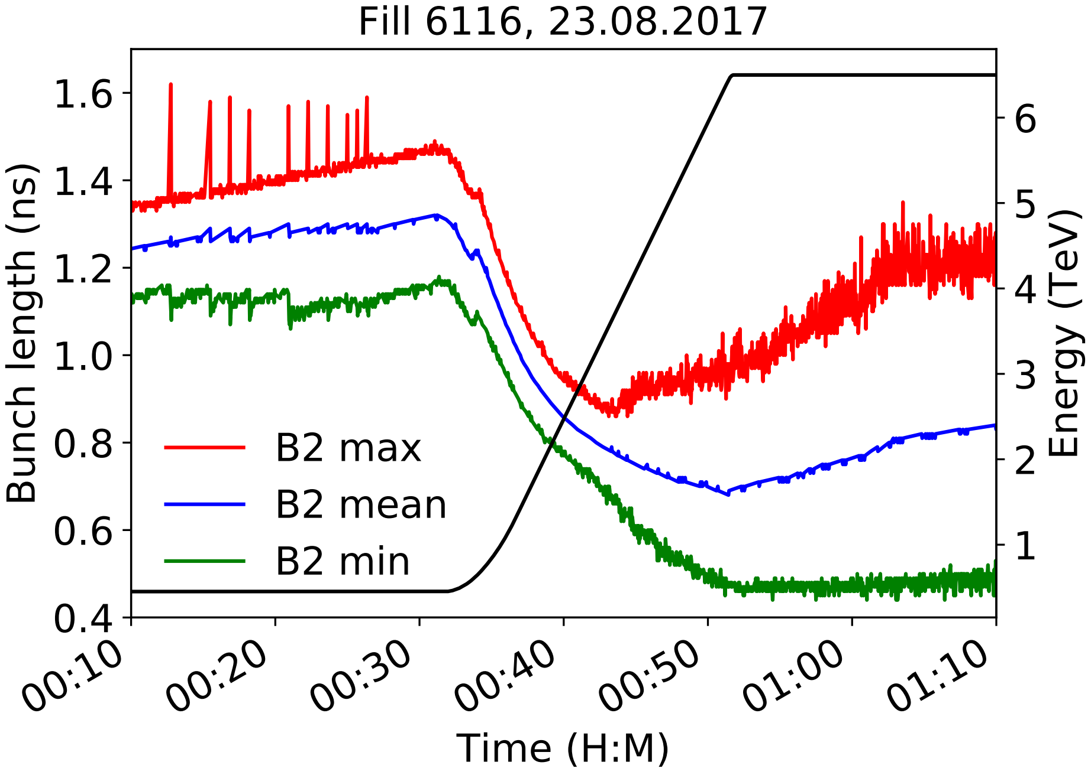
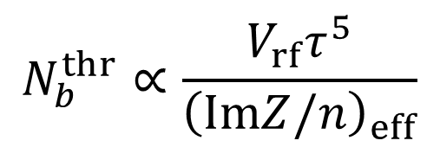
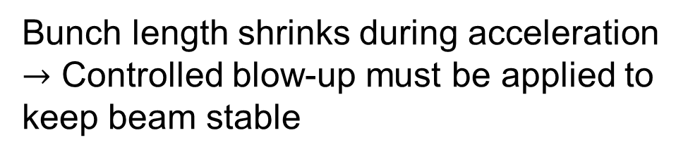
Longitudinal single-bunch stability
LHC
Loss of Landau damping (LD) in longitudinal plane is important intensity limitation in LHC.
Based on Sacherer formalism the intensity threshold is (F. Sacherer, 1971)
Controlled blow-up: off
rf voltage
bunch length*
$$N_{b}^{thr}∝\frac{V_{rf}τ^{5}}{{\left(ImZ/n\right)}_{eff}}$$
Bunch length shrinks during acceleration
$→$ Controlled blow-up must be applied to keep beam stable
effective impedance
*$τ=τ_{FWHM}\sqrt{2/\ln{2}}$ is scaled from full-width half-maximum (FWHM) bunch length

Slide 3
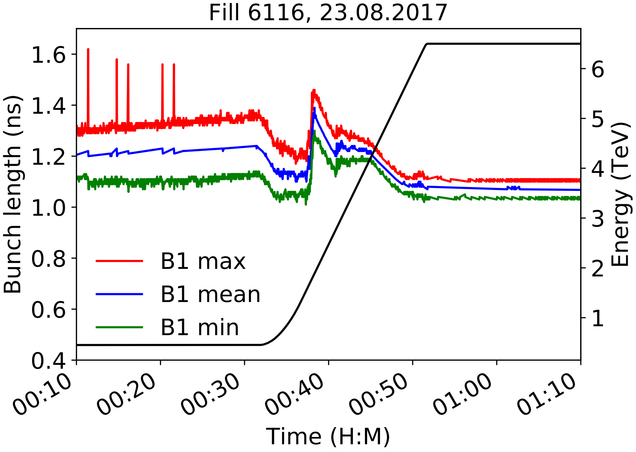
Longitudinal single-bunch stability
LHC
Loss of Landau damping (LD) in longitudinal plane is important intensity limitation in LHC.
Based on Sacherer formalism the intensity threshold is (F. Sacherer, 1971)
Controlled blow-up: on
rf voltage
bunch length*
$$N_{b}^{thr}∝\frac{V_{rf}τ^{5}}{{\left(ImZ/n\right)}_{eff}}$$
Bunch length shrinks during acceleration
$→$ Controlled blow-up must be applied to keep beam stable
effective impedance
*$τ=τ_{FWHM}\sqrt{2/\ln{2}}$ is scaled from full-width half-maximum (FWHM) bunch length

Slide 4
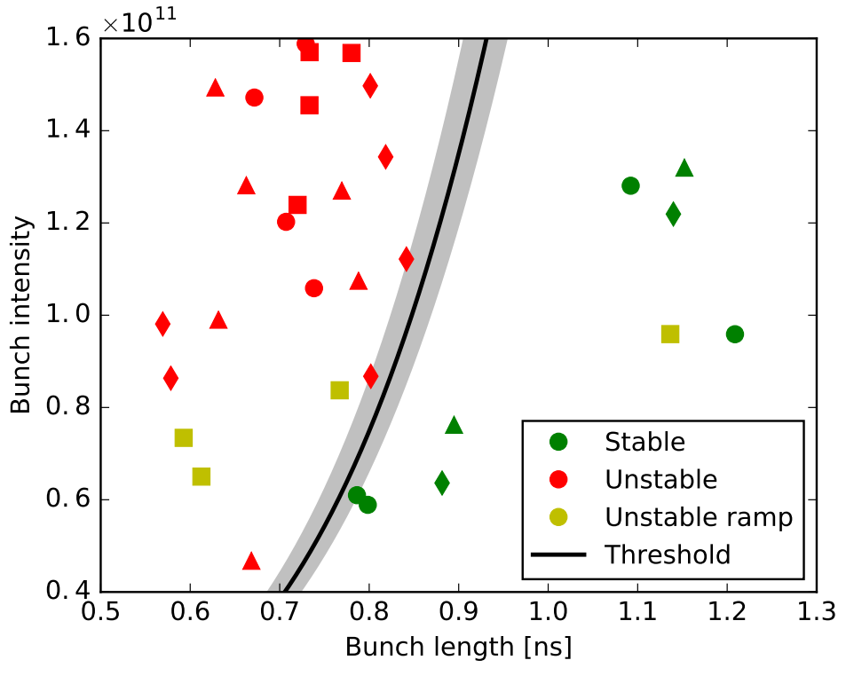
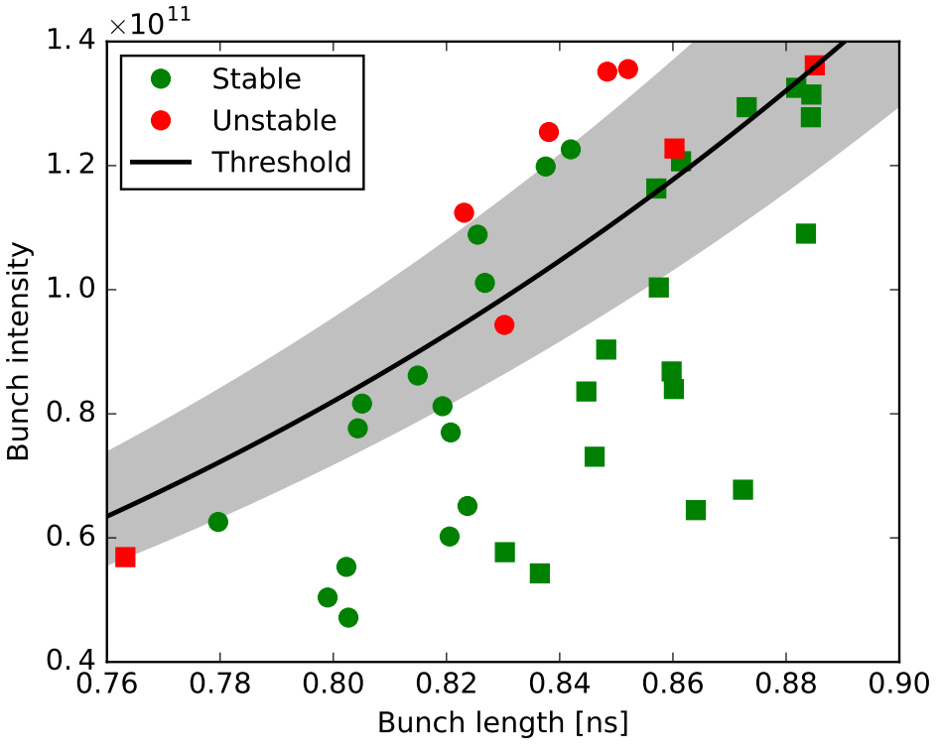
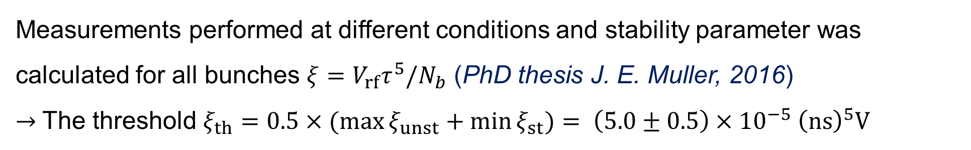
Loss of Landau damping in LHC: measurements
MDs in 2015, $V_{rf}$= 12 MV, beam energy 6.5 TeV
Measurements performed at different conditions and stability parameter was calculated for all bunches $ξ=V_{rf}τ^{5}/N_{b}$ (PhD thesis J. E. Muller, 2016)
$→$The threshold $ξ_{th}=0.5×(\max{ξ_{unst}}+\min{ξ_{st}})= \left(5.0±0.5\right)×{10}^{−5} {\left(ns\right)}^{5}V$

Slide 5
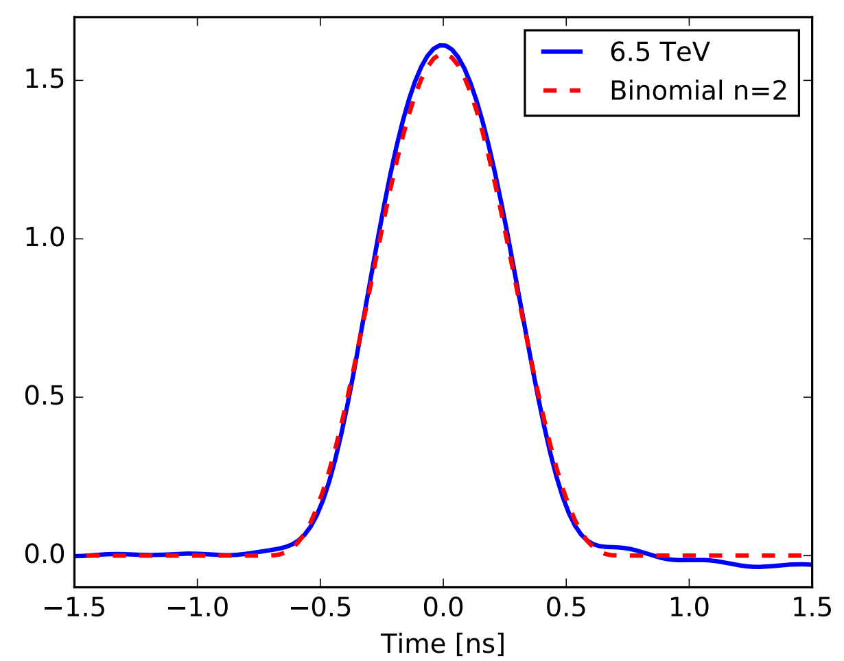
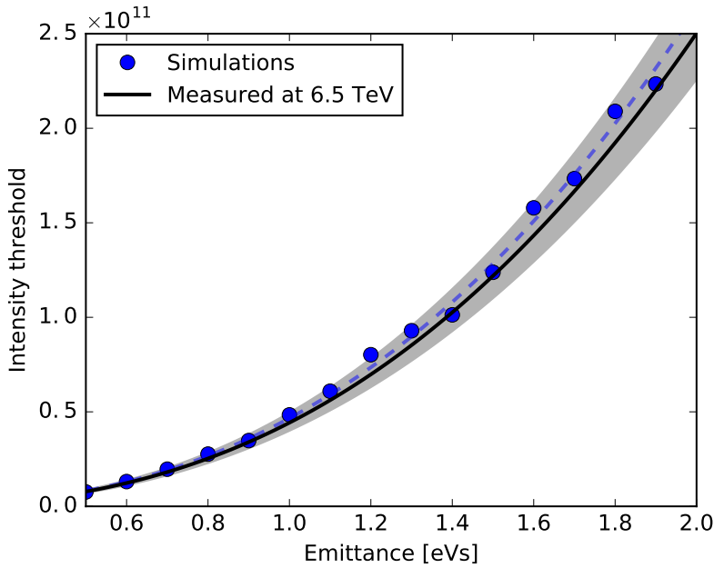
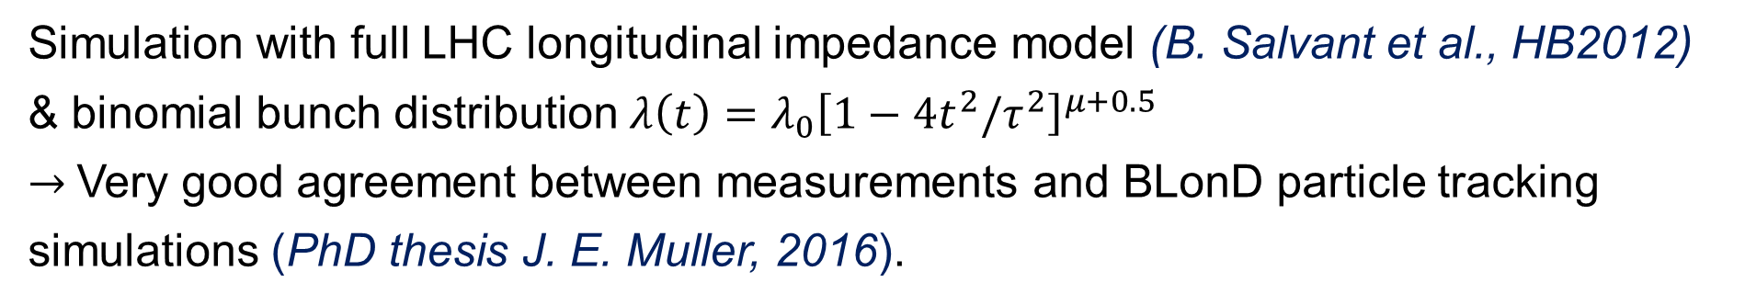


Comparison of measurements and simulations
— Measurement
at 6.5 TeV
- - Binomial fit
$μ=2$
(fit $τ^{5}$)
Line density (arb. units)
Simulation with full LHC longitudinal impedance model (B. Salvant et al., HB2012) & binomial bunch distribution $λ\left(t\right)=λ_{0}{\left[1−4t^{2}/τ^{2}\right]}^{μ+0.5}$
$→$Very good agreement between measurements and BLonD particle tracking simulations (PhD thesis J. E. Muller, 2016).

Slide 6
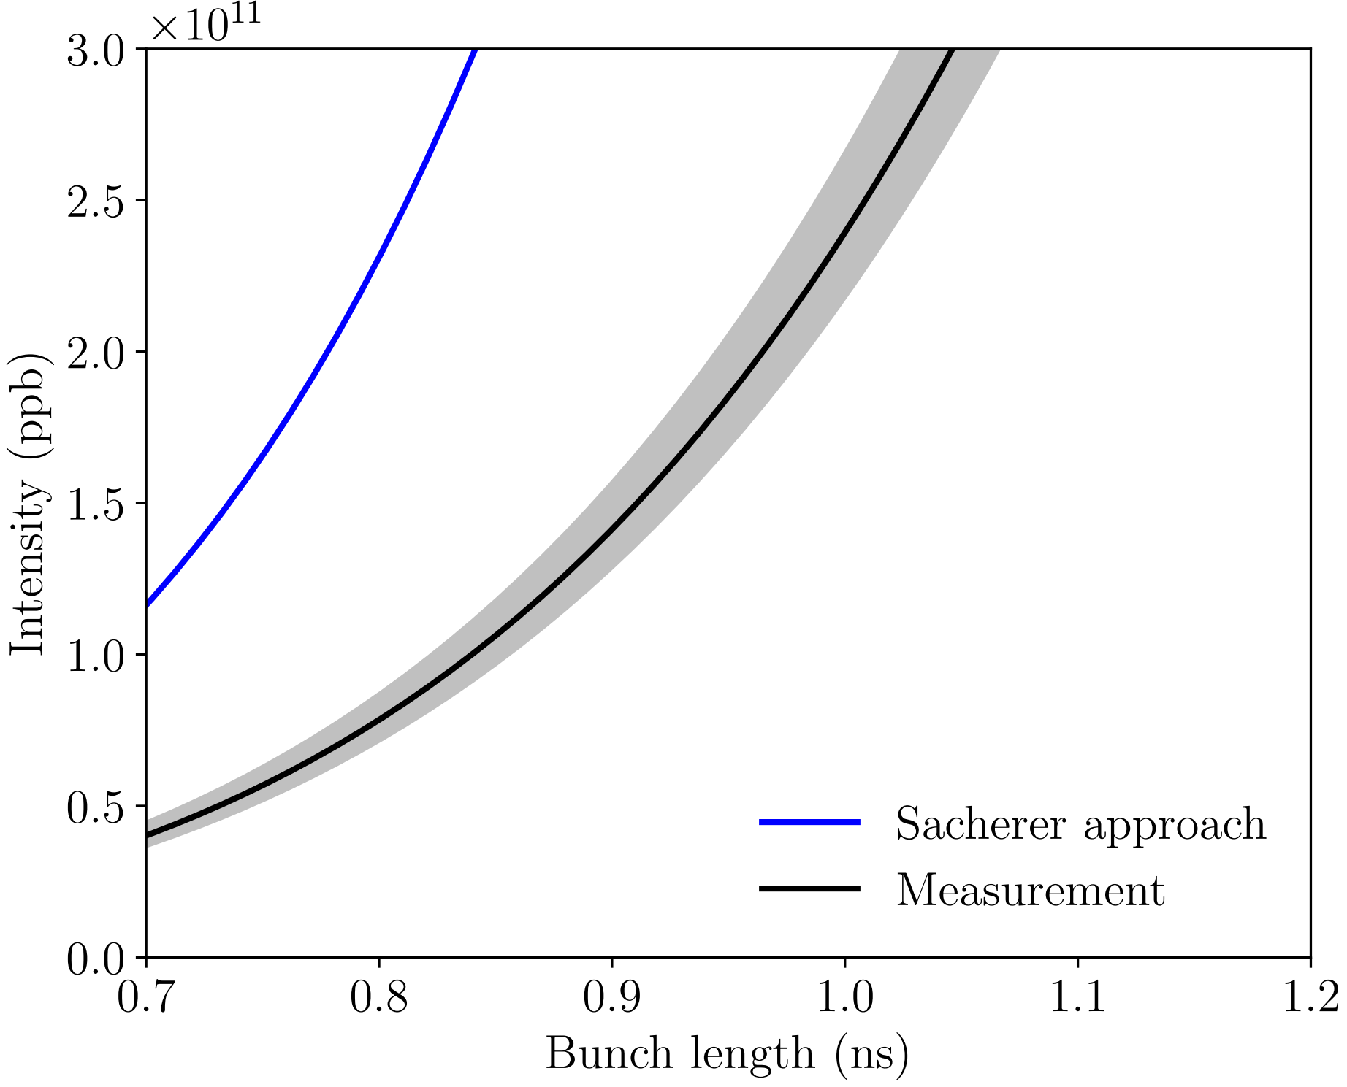
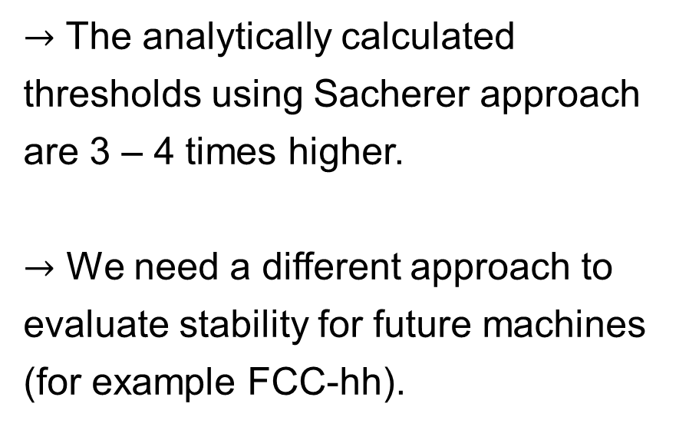

Comparison of measurements and analytic calculations
$→$ The analytically calculated thresholds using Sacherer approach are 3 – 4 times higher.
$→$ We need a different approach to evaluate stability for future machines (for example FCC-hh).
$${\left(ImZ/n\right)}_{eff}≈0.09 Ω$$
(fit $τ^{5}$)

Slide 7
Analytic approaches
Vlasov equation for a small perturbation of stationary distribution can be converted in matrix equations by:
Discretization in action variable (K. Oide & K. Yokoya, 1990).
Loss of LD is interpreted as emerged van Kampen coherent modes
(semi-analytic code by A. Burov, 2010, recently translated in Python by
T. Argyropoulos, 2019).
Expanding in modes of ring azimuth (A. N. Lebedev, 1967).
Both approaches were implemented in a new semi-analytic code MELODY (Matrix Equations for LOngituDinal stabilitY evaluation, 2019)

Slide 8
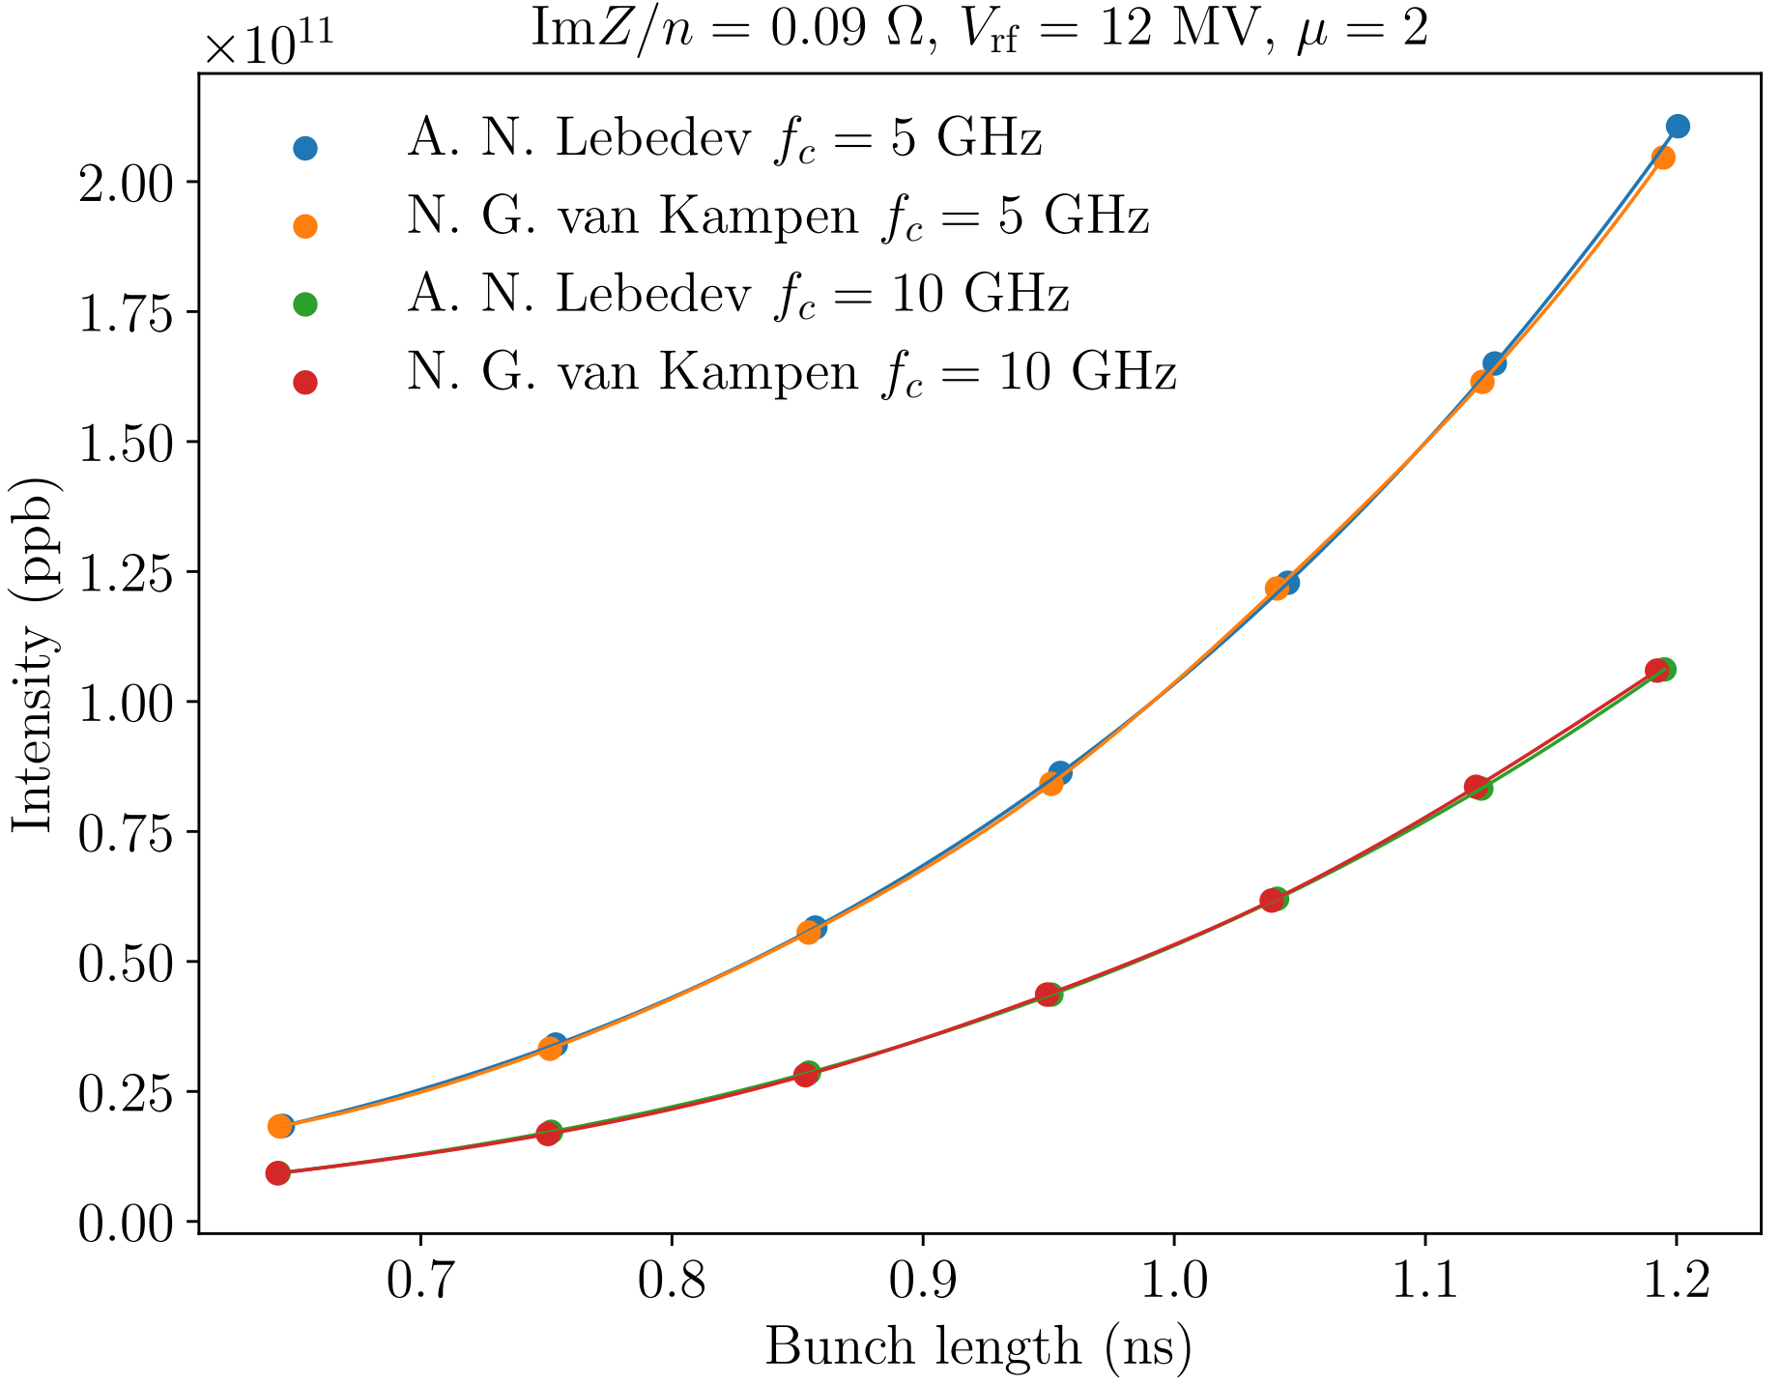

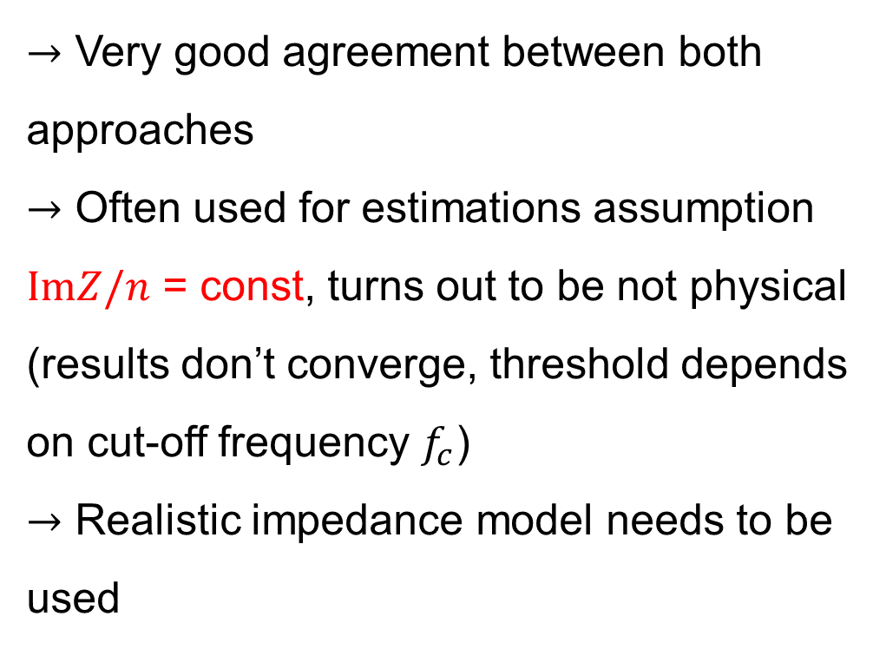

Comparison of analytic approaches
LHC at 6.5 TeV, $ImZ/n=0.09 Ω$ = const
$→$ Very good agreement between both approaches
$→$ Often used for estimations assumption $ImZ/n$ = const, turns out to be not physical (results don’t converge, threshold depends on cut-off frequency $f_{c}$)
$→$ Realistic impedance model needs to be used
$$×2$$

Slide 9
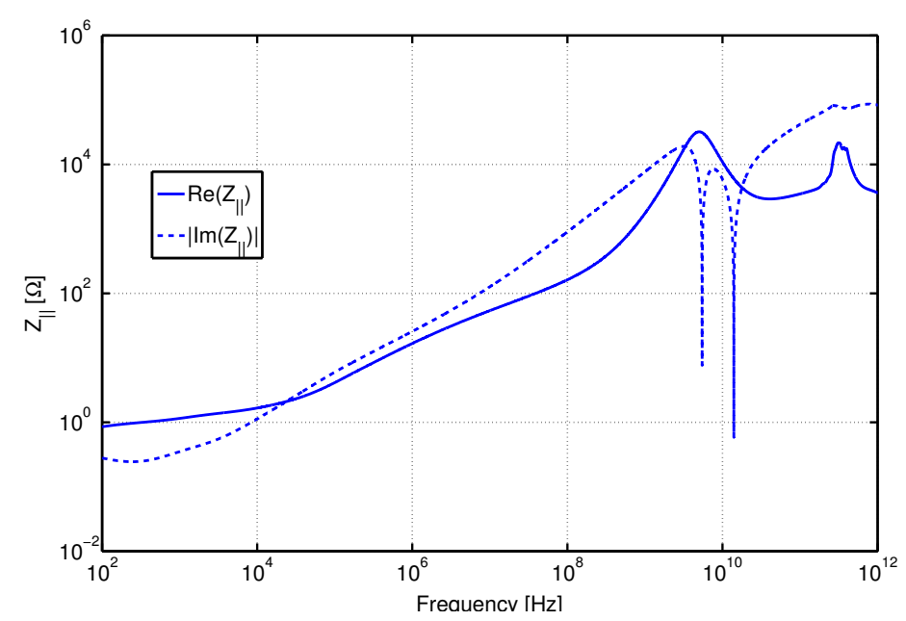
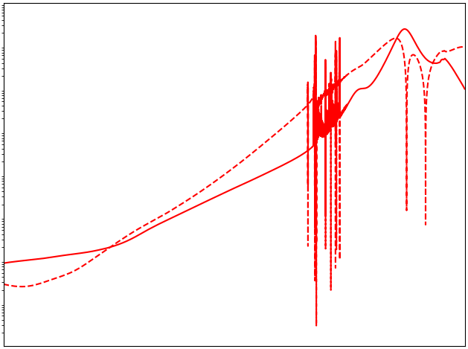

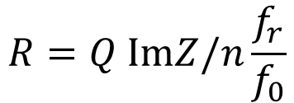
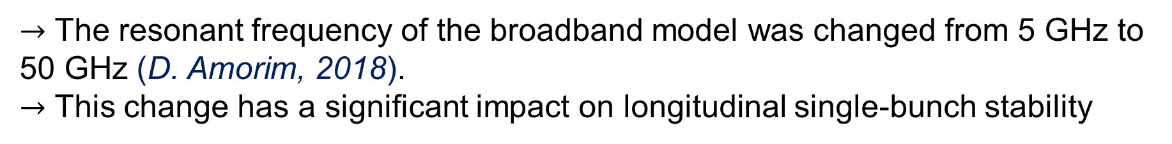




LHC/HL-LHC impedance model
Blue - N. Mounet, PhD thesis, 2012
Red - HL-LHC impedance model
Broad-band impedance model
(LHC Design Report, 2004)
$$R=Q ImZ/n\frac{f_{r}}{f_{0}}$$
Impedance (Ω)
$$Q=1, f_{r}=5 GHz$$
$ImZ/n=0.07 Ω$ for injection optics
$$f_{r}=5 GHz$$
$$50 GHz$$
$ImZ/n=0.076 Ω$ for squeezed optics
Frequency (Hz)
$→$ The resonant frequency of the broadband model was changed from 5 GHz to 50 GHz (D. Amorim, 2018).
$→$ This change has a significant impact on longitudinal single-bunch stability

Slide 10
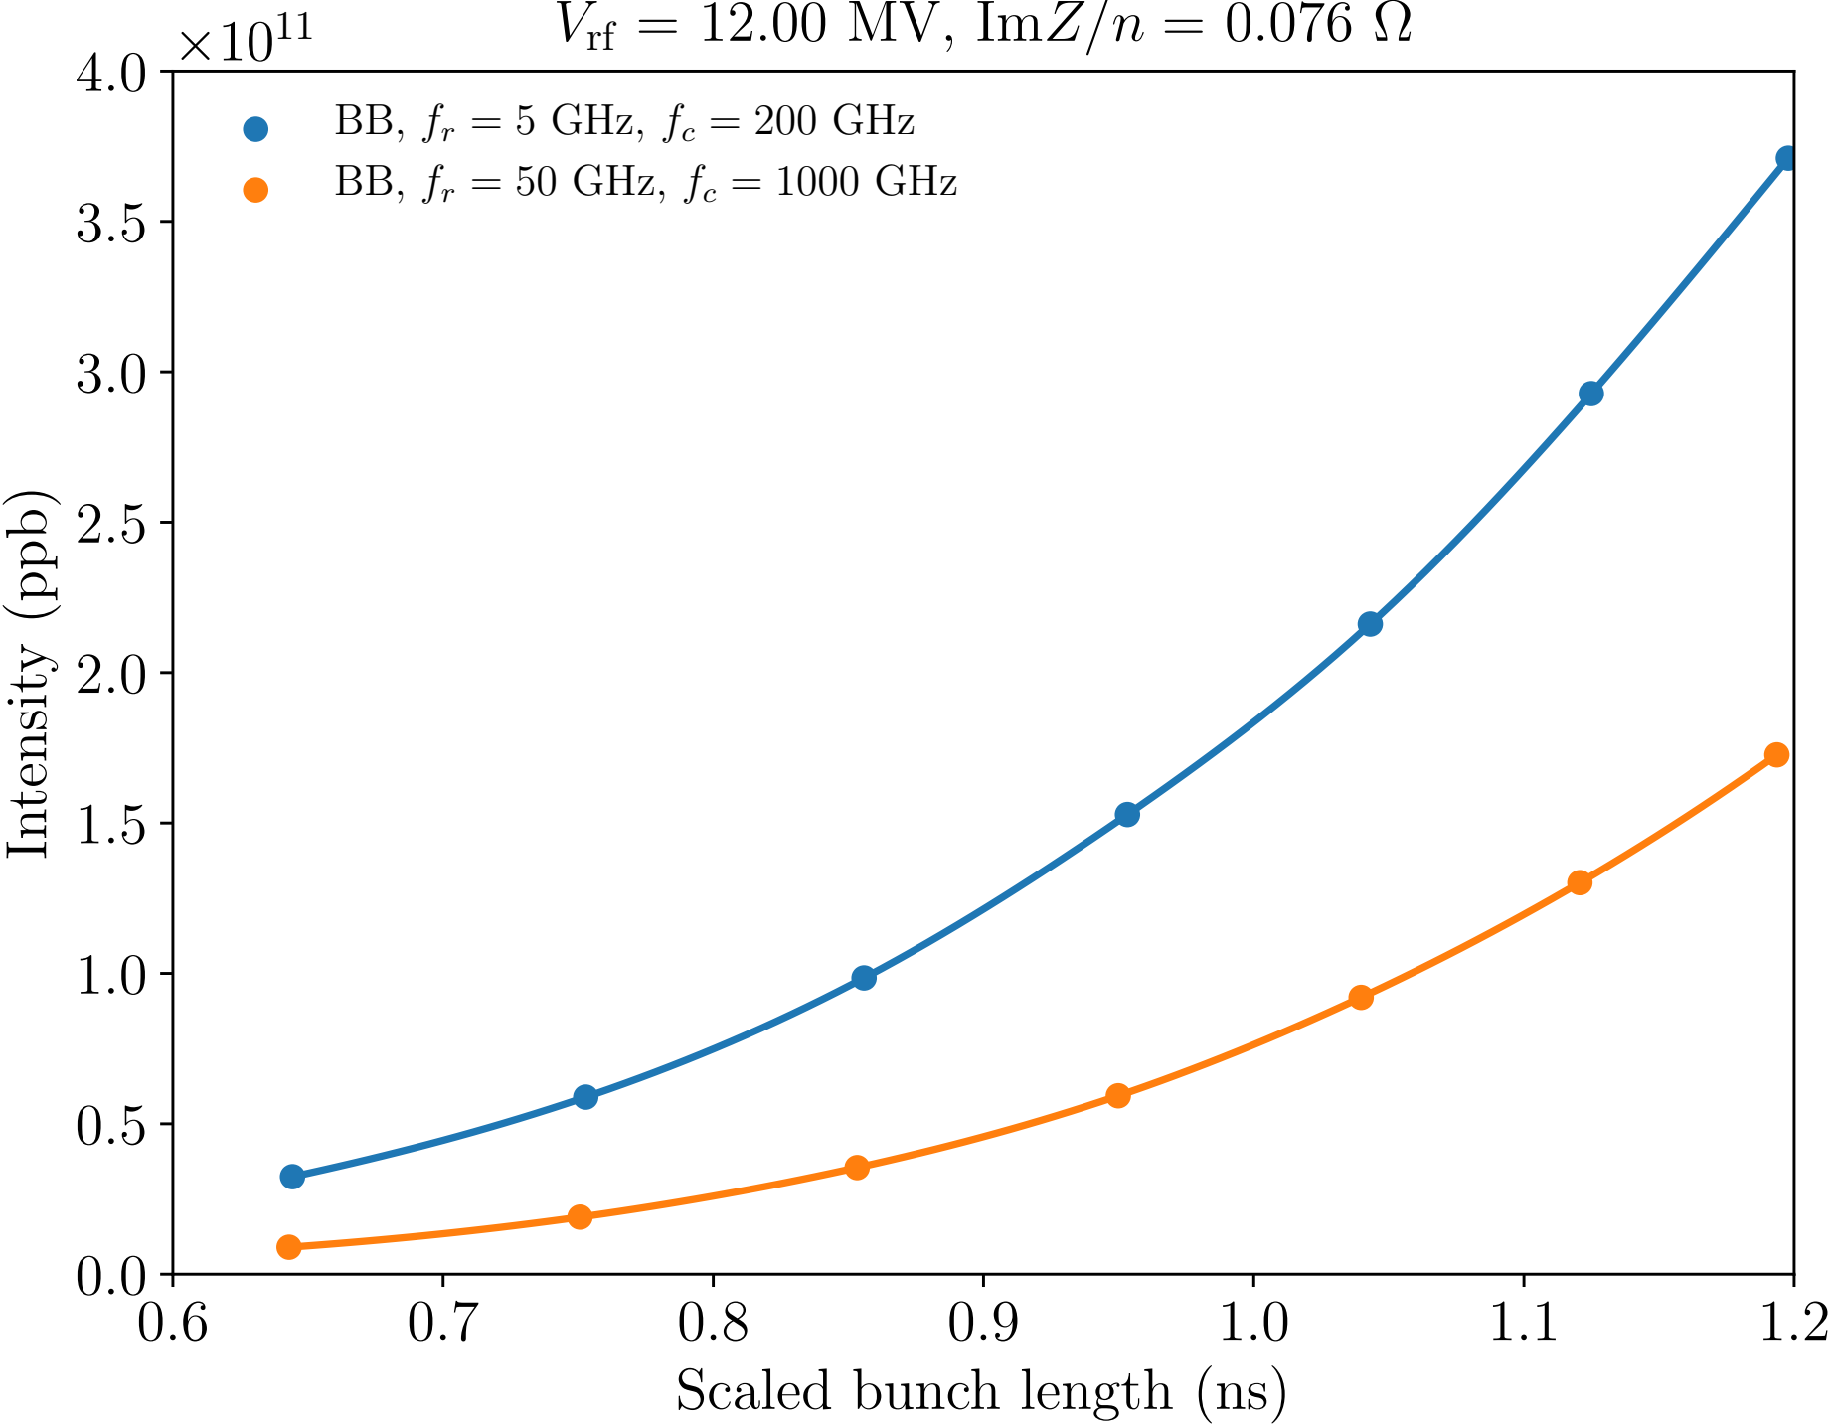


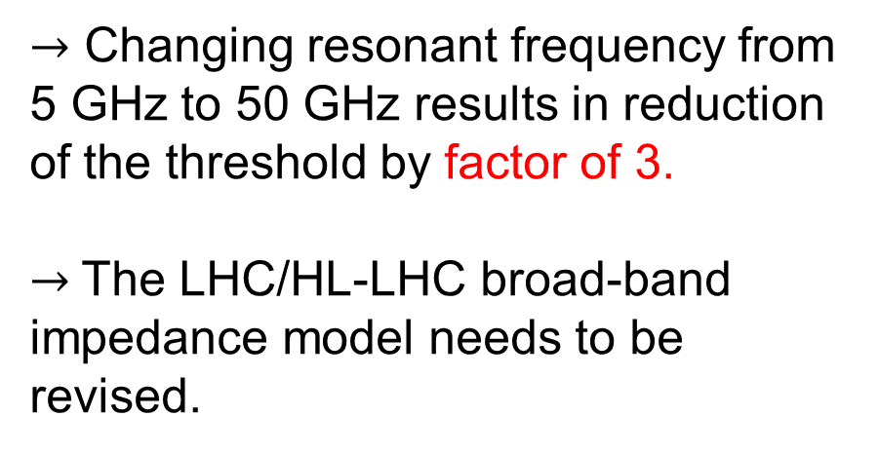
Stability threshold for broad-band impedance
MELODY results
$→$ Changing resonant frequency from 5 GHz to 50 GHz results in reduction of the threshold by factor of 3.
$→$The LHC/HL-LHC broad-band impedance model needs to be revised.
$$R=Q ImZ/n\frac{f_{r}}{f_{0}}$$
$$Q=1$$

Slide 11
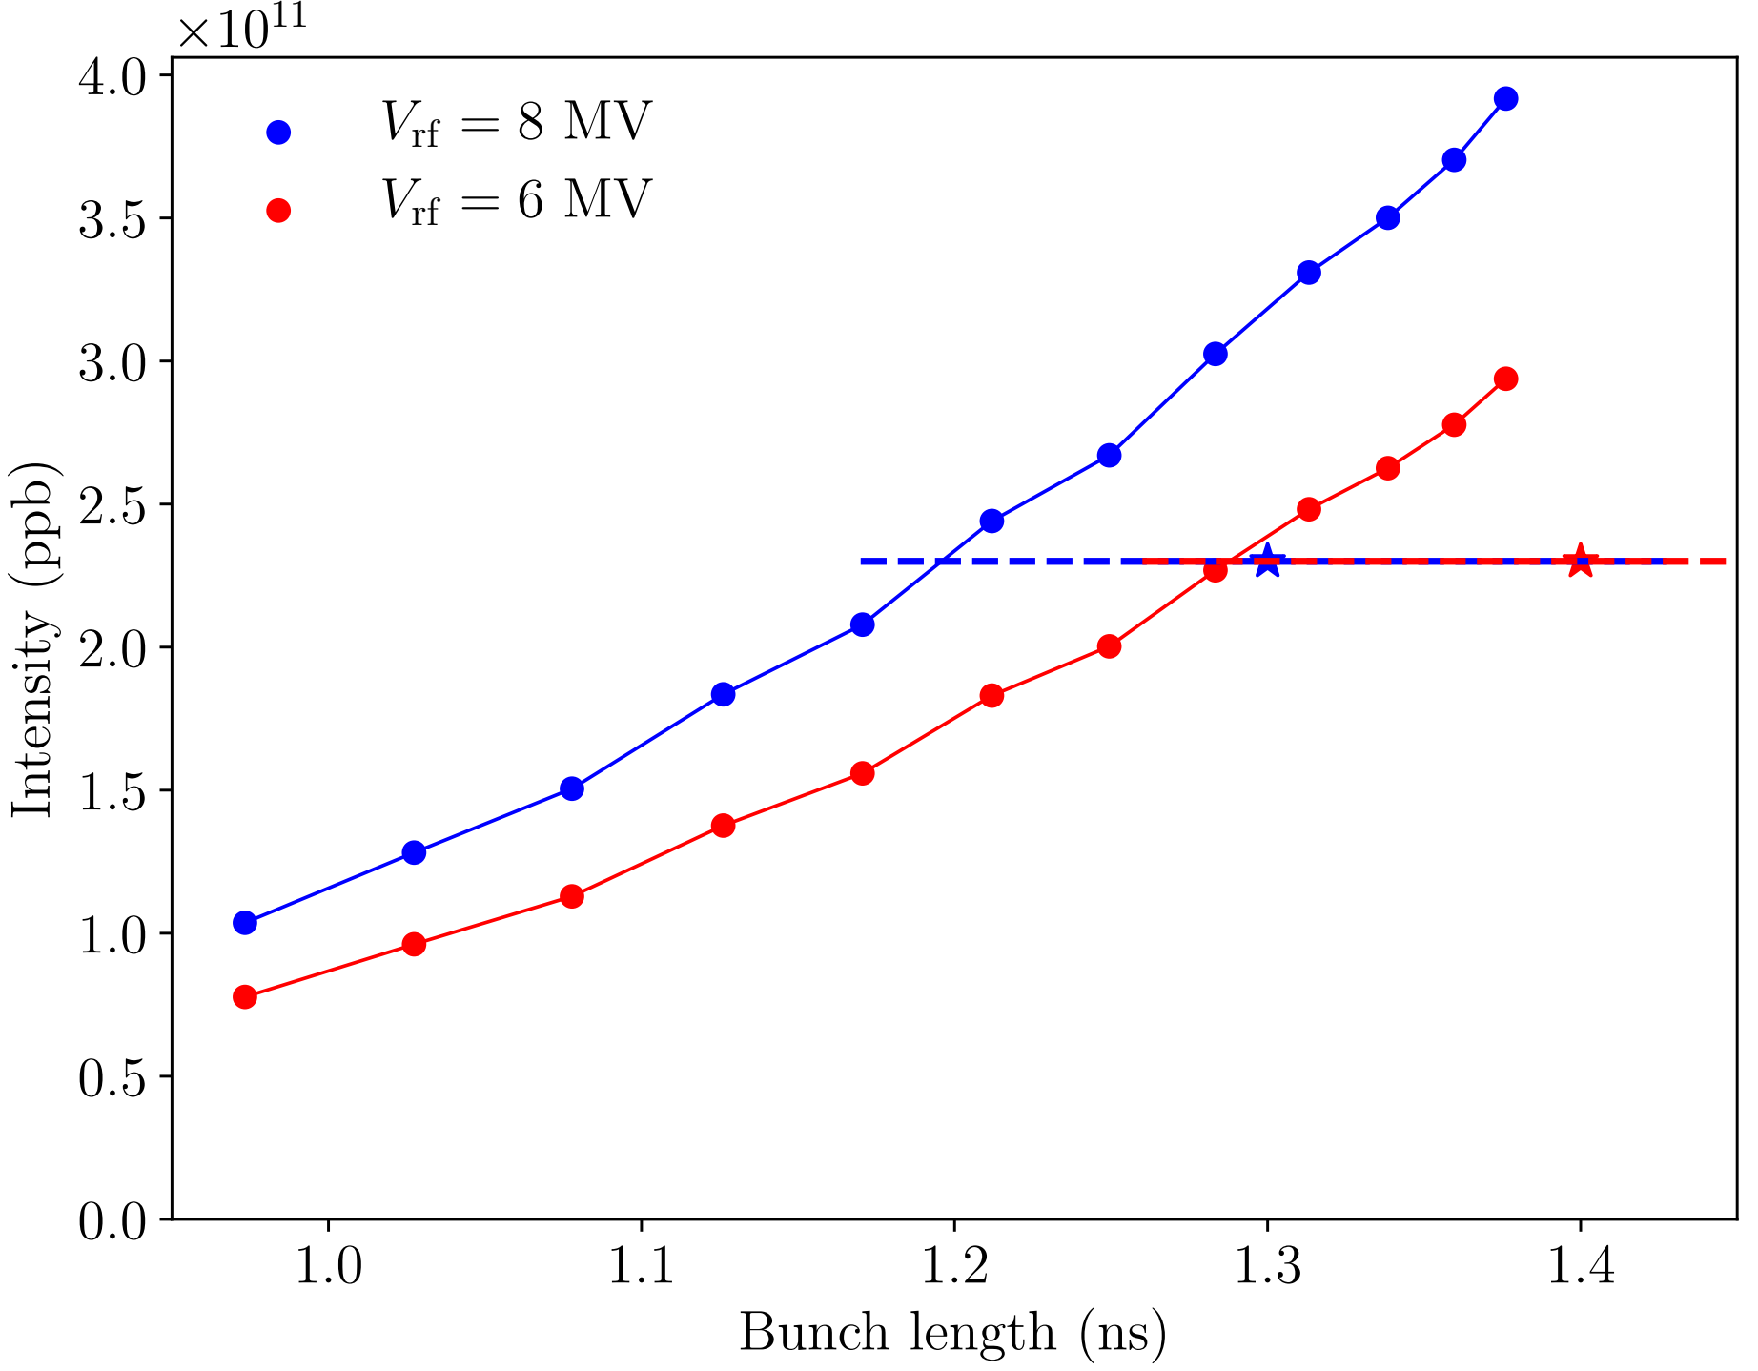
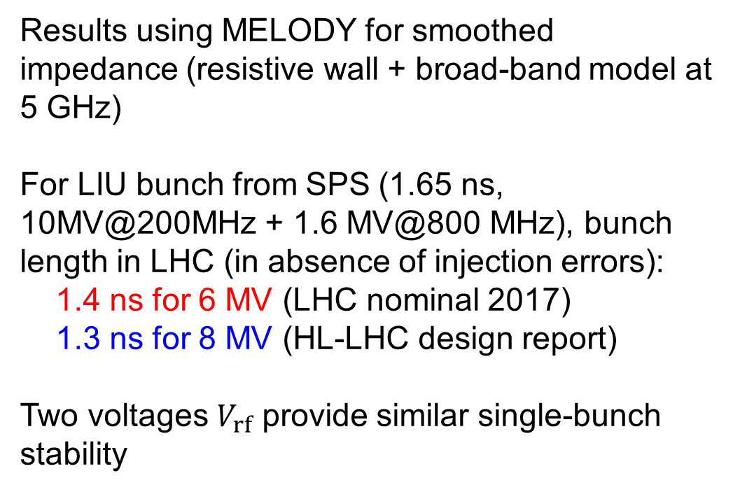
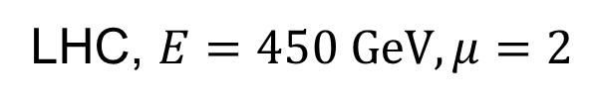
Single-bunch stability at 450 GeV
LHC, $E=450 GeV, μ=2$
Results using MELODY for smoothed impedance (resistive wall + broad-band model at 5 GHz)
For LIU bunch from SPS (1.65 ns, 10MV@200MHz + 1.6 MV@800 MHz), bunch length in LHC (in absence of injection errors):
1.4 ns for 6 MV (LHC nominal 2017)
1.3 ns for 8 MV (HL-LHC design report)
Two voltages $V_{rf}$ provide similar single-bunch stability

Slide 12
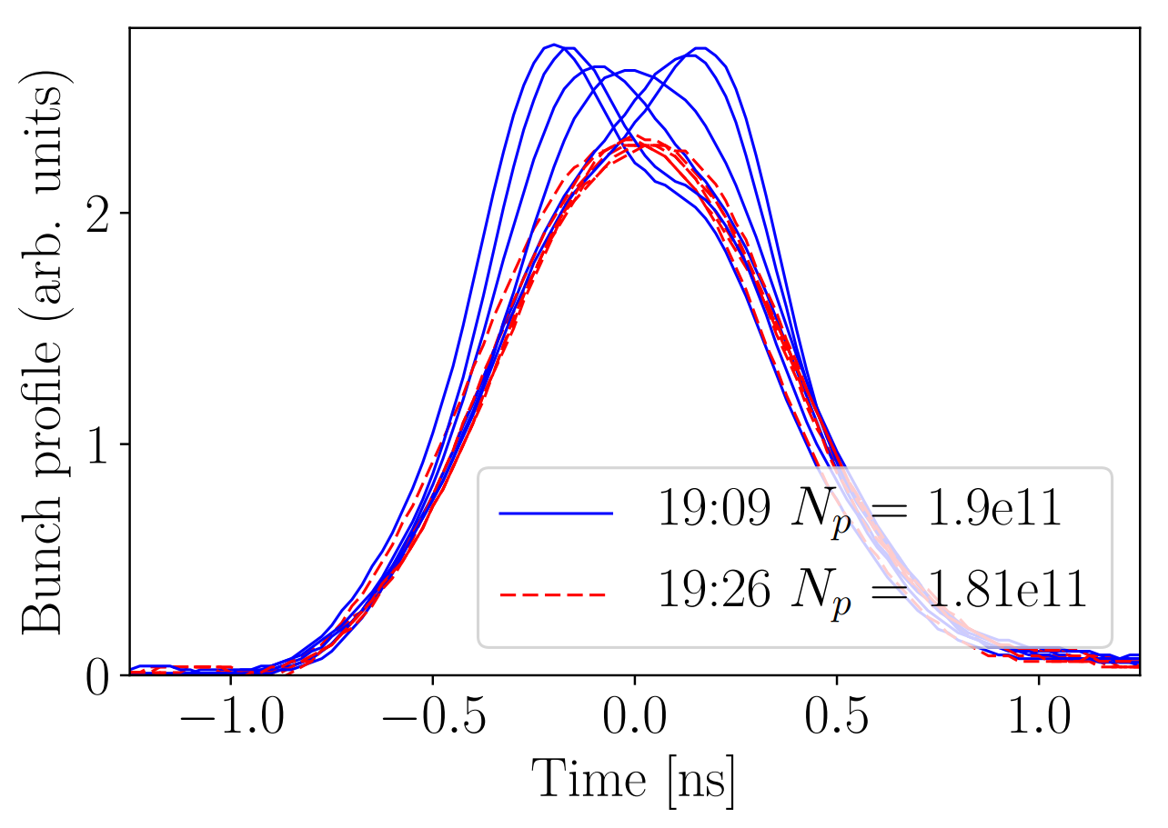
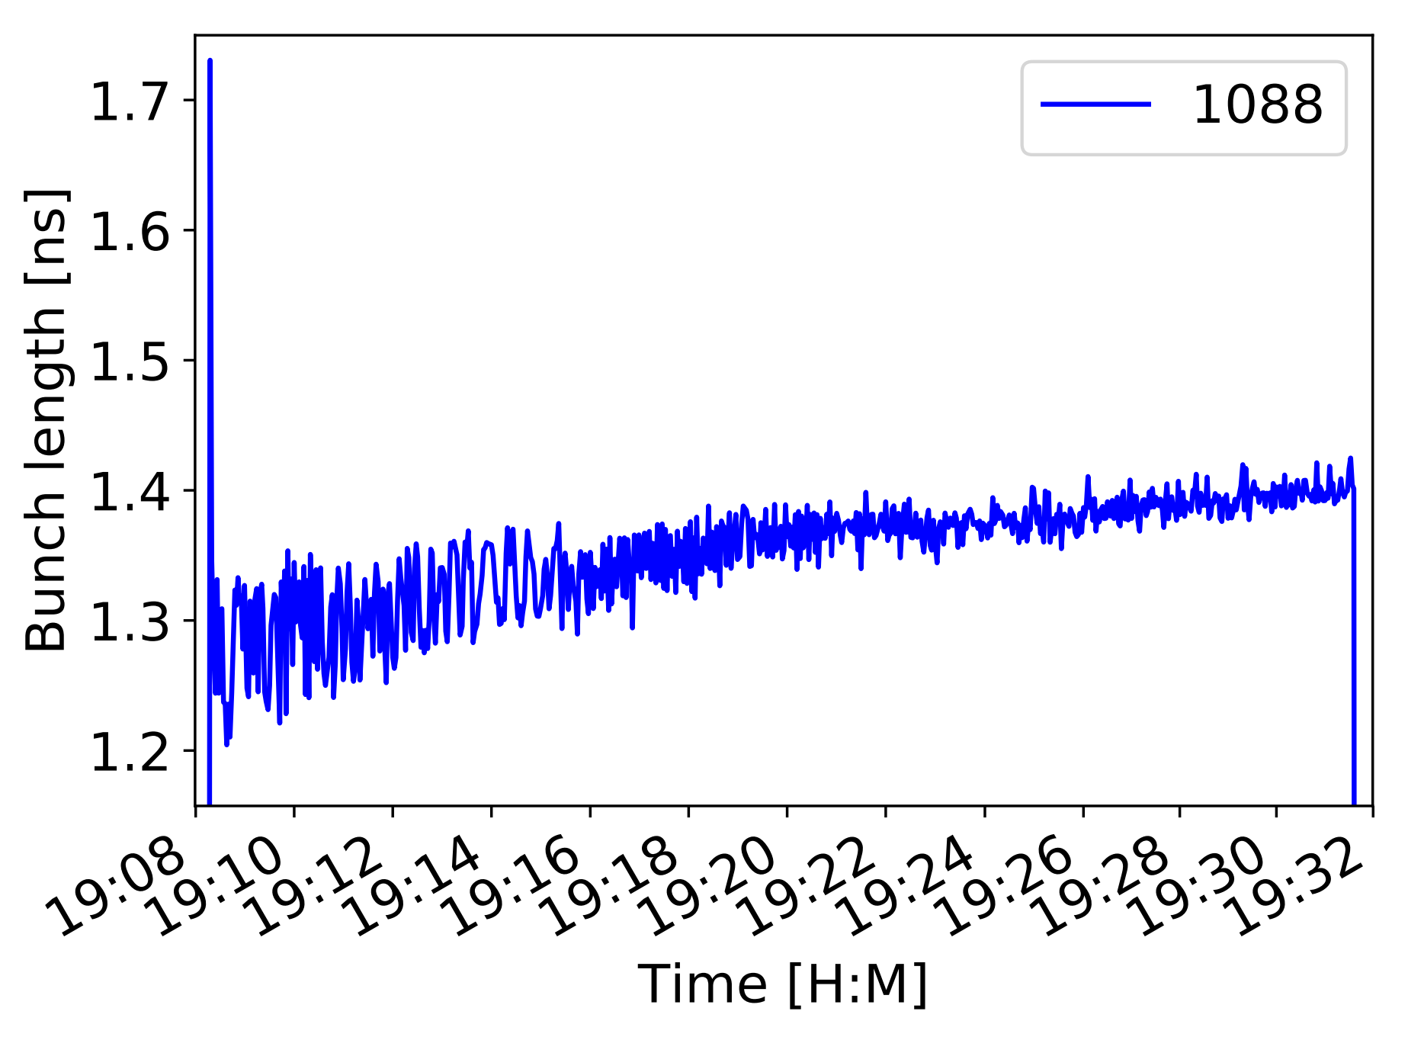
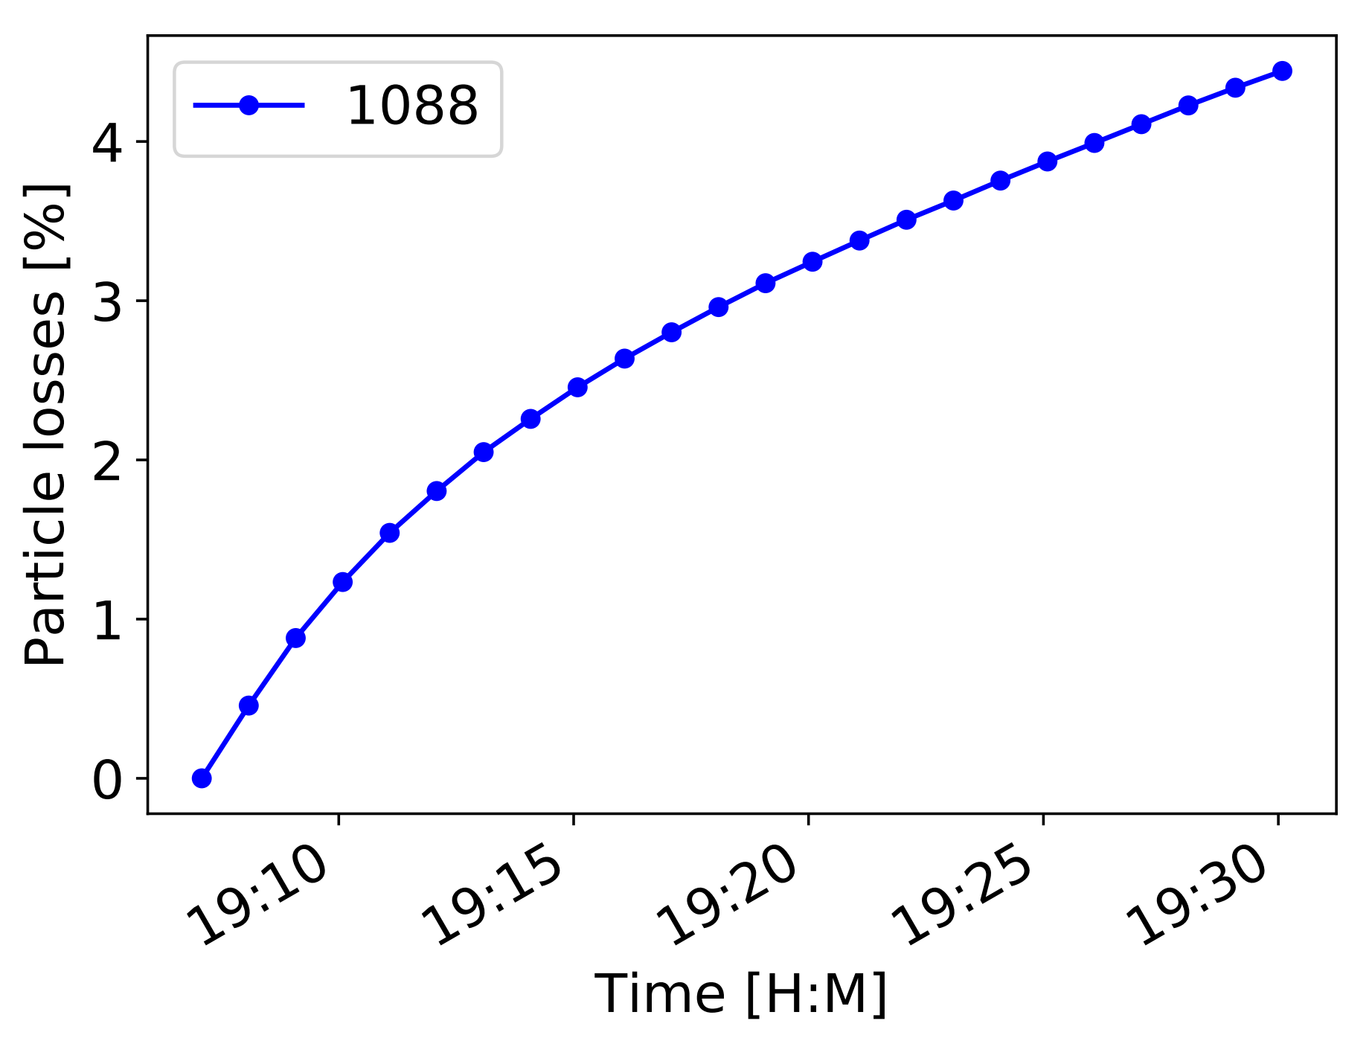
Persistent oscillations after injection
LHC MD 2017
During 20 min oscillations lead to ~10 % bunch lengthening and ~5% particle loss
(H. Timko et al., HB2018)
Similar oscillations were observed in Tevatron (R. Moore, PAC2003)

Slide 13
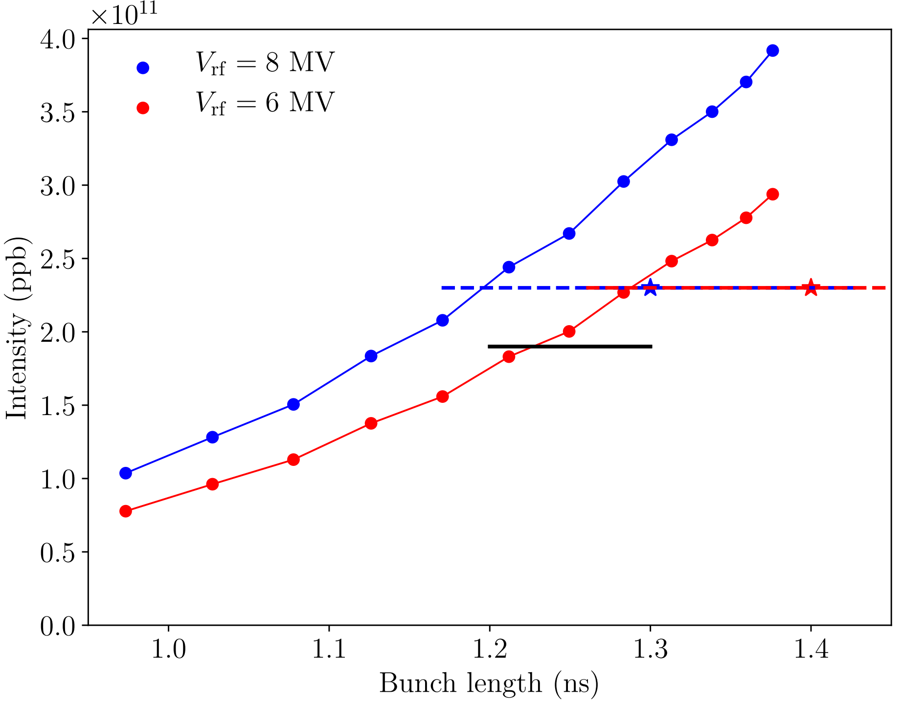
Persistent oscillations after injection
LHC, $E=450 GeV, μ=2$
MD data

Slide 14
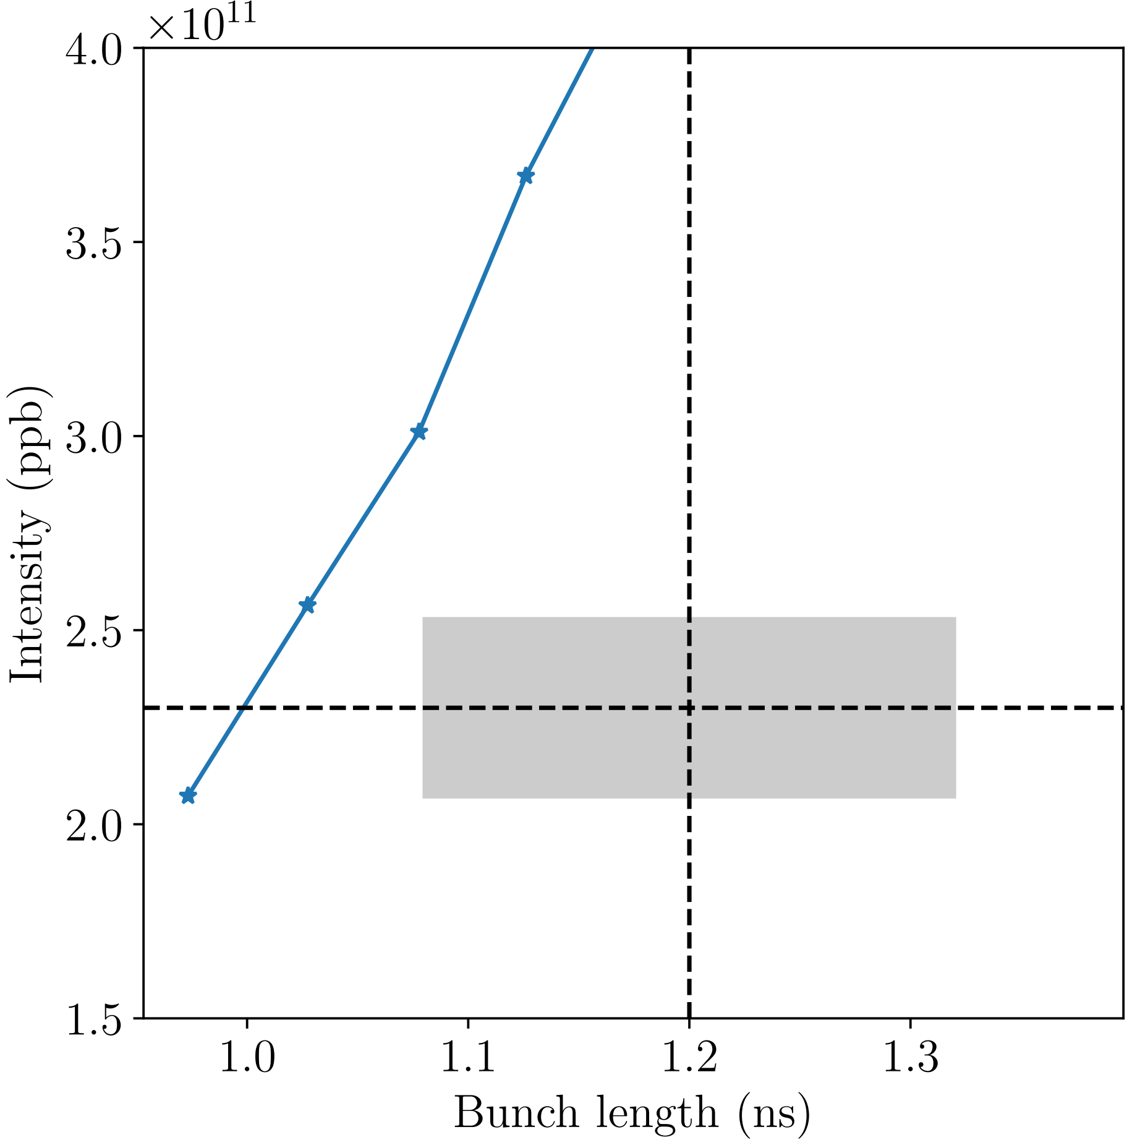
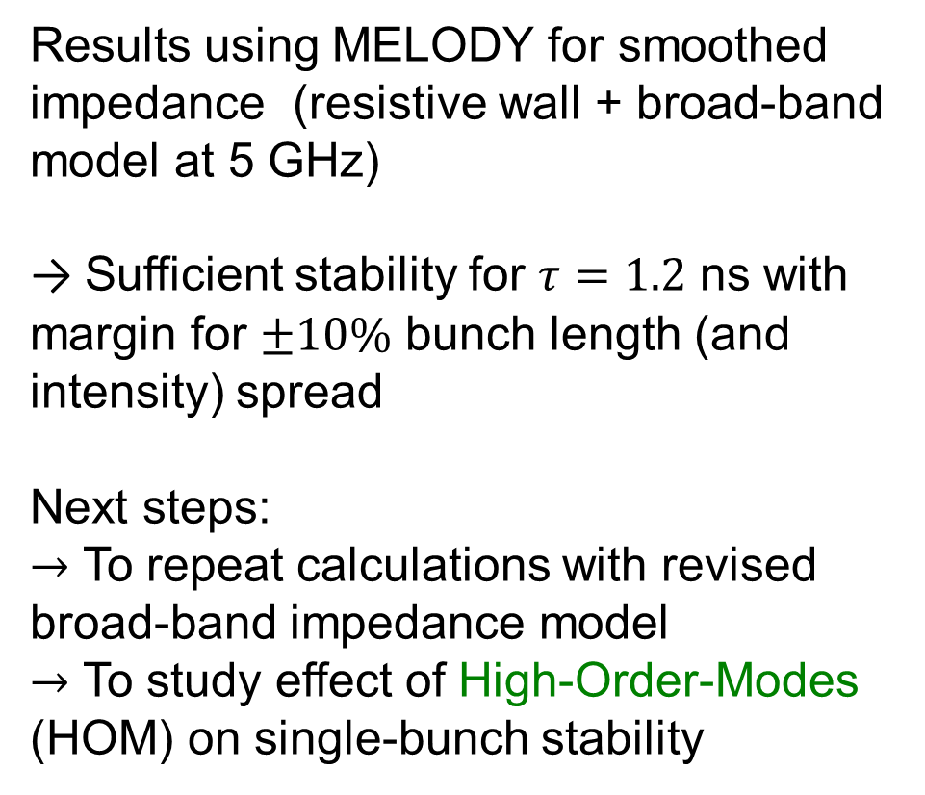

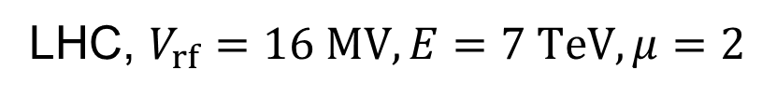
Single-bunch stability at 7 TeV
LHC, $V_{rf}=16 MV, E=7 TeV, μ=2$
Results using MELODY for smoothed impedance (resistive wall + broad-band model at 5 GHz)
→ Sufficient stability for $τ=1.2$ ns with margin for $±10\%$ bunch length (and intensity) spread
Next steps:
$→$ To repeat calculations with revised broad-band impedance model
$→$ To study effect of High-Order-Modes (HOM) on single-bunch stability
Baseline bunch length
$±10\%$ spread

Slide 15
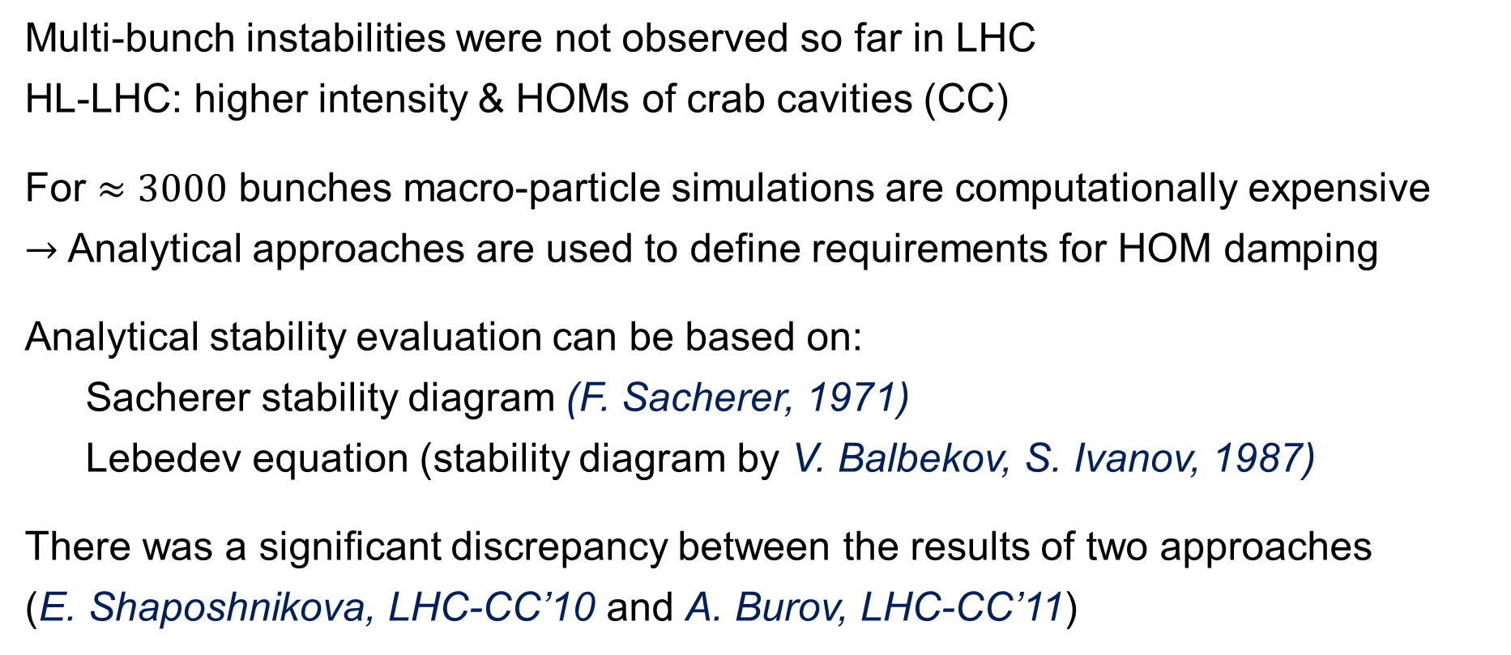
Stability of multi-bunch beam
Multi-bunch instabilities were not observed so far in LHC
HL-LHC: higher intensity & HOMs of crab cavities (CC)
For $≈3000$ bunches macro-particle simulations are computationally expensive
$→$ Analytical approaches are used to define requirements for HOM damping
Analytical stability evaluation can be based on:
  Sacherer stability diagram (F. Sacherer, 1971)
  Lebedev equation (stability diagram by V. Balbekov, S. Ivanov, 1987)
There was a significant discrepancy between the results of two approaches
(E. Shaposhnikova, LHC-CC’10 and A. Burov, LHC-CC’11)

Slide 16
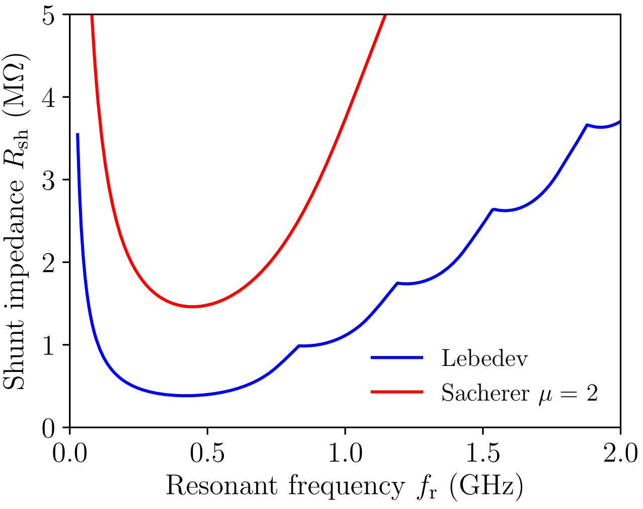
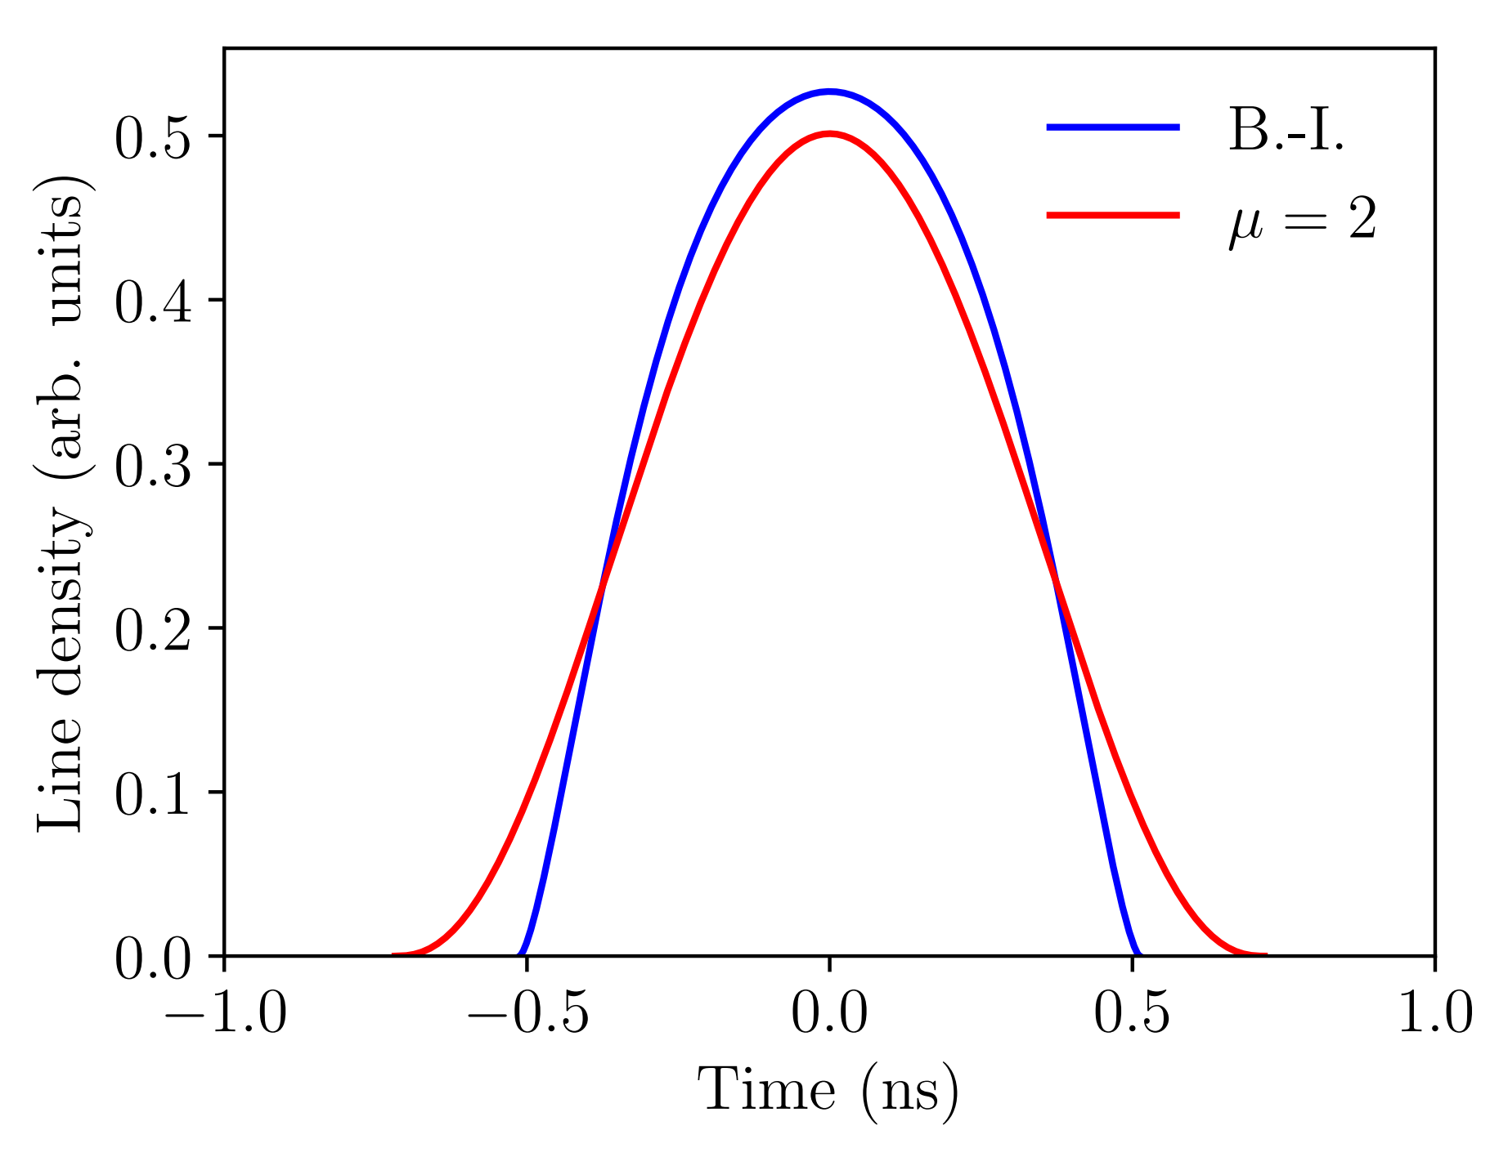


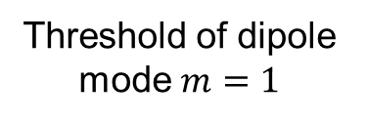



Lebedev vs Sacherer approach
$$V_{rf}=16 MV, τ=1.2 ns, E=7 TeV$$
Binomial vs Balbekov-Ivanov distribution
Threshold of dipole mode $m=1$
$$m=4$$
$$m=3$$
$$m=2$$
$$×3.8$$
B.-I.
$$m=1$$

Slide 17
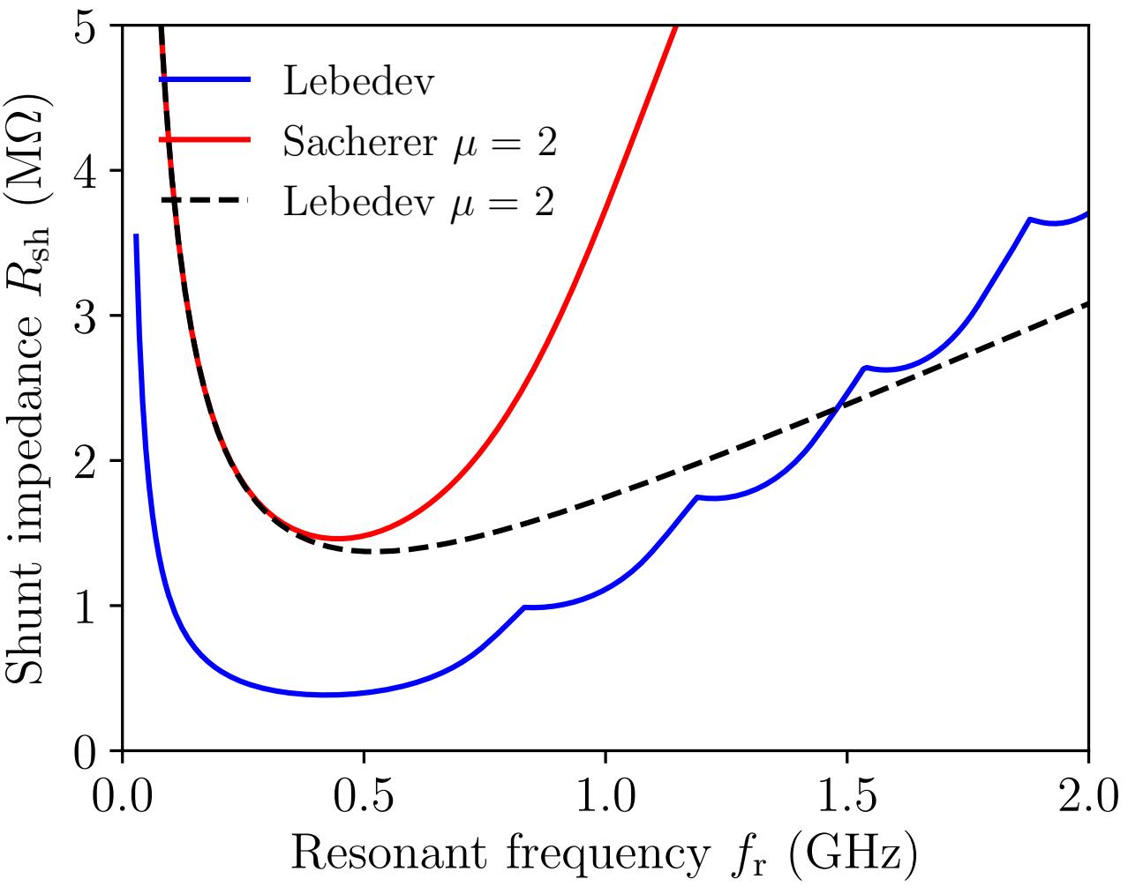
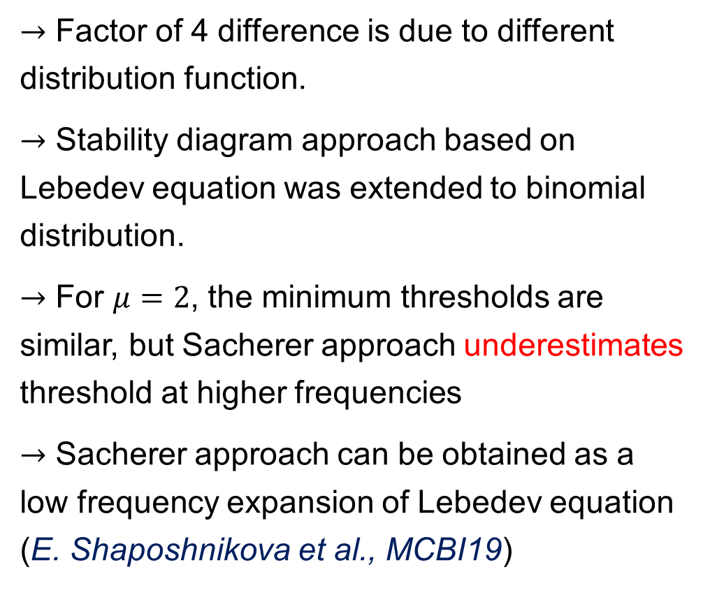
Lebedev vs Sacherer approach
$$V_{rf}=16 MV, τ=1.2 ns, E=7 TeV$$
$→$ Factor of 4 difference is due to different distribution function.
$→$ Stability diagram approach based on Lebedev equation was extended to binomial distribution.
$→$ For $μ=2$, the minimum thresholds are similar, but Sacherer approach underestimates threshold at higher frequencies
$→$ Sacherer approach can be obtained as a low frequency expansion of Lebedev equation (E. Shaposhnikova et al., MCBI19)
B.-I.
Threshold of dipole mode $m=1$
$$m=4$$
$$m=3$$
$$m=2$$
$$m=1$$

Slide 18
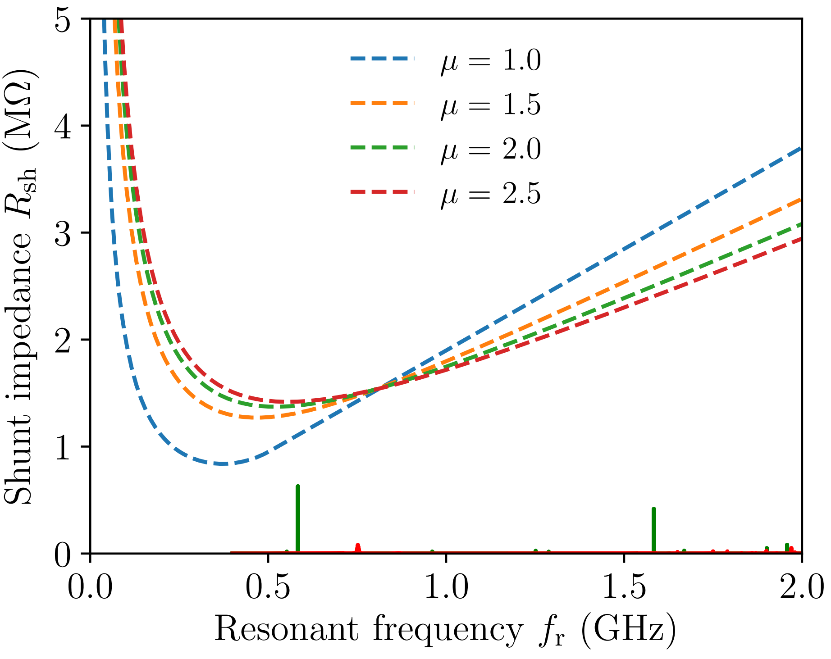
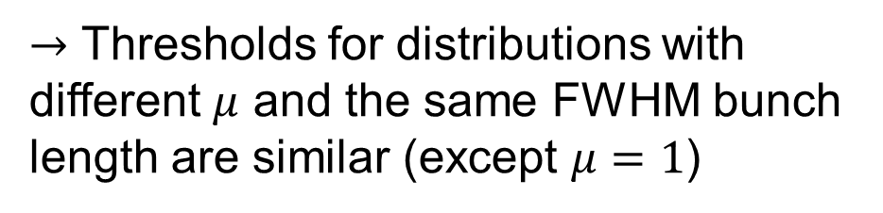
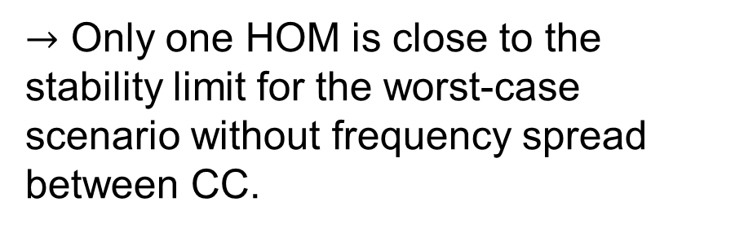
Results for HL-LHC flat top
$$V_{rf}=16 MV, τ=1.2 ns, E=7 TeV$$
Crab cavity HOMs:
HL-LHC Double Quarter Wave (DQW) × 4
HL-LHC RF-Dipole (RFD) × 4
$→$ Thresholds for distributions with different $μ$ and the same FWHM bunch length are similar (except $μ=1$)
$→$ Only one HOM is close to the stability limit for the worst-case scenario without frequency spread between CC.

Slide 19
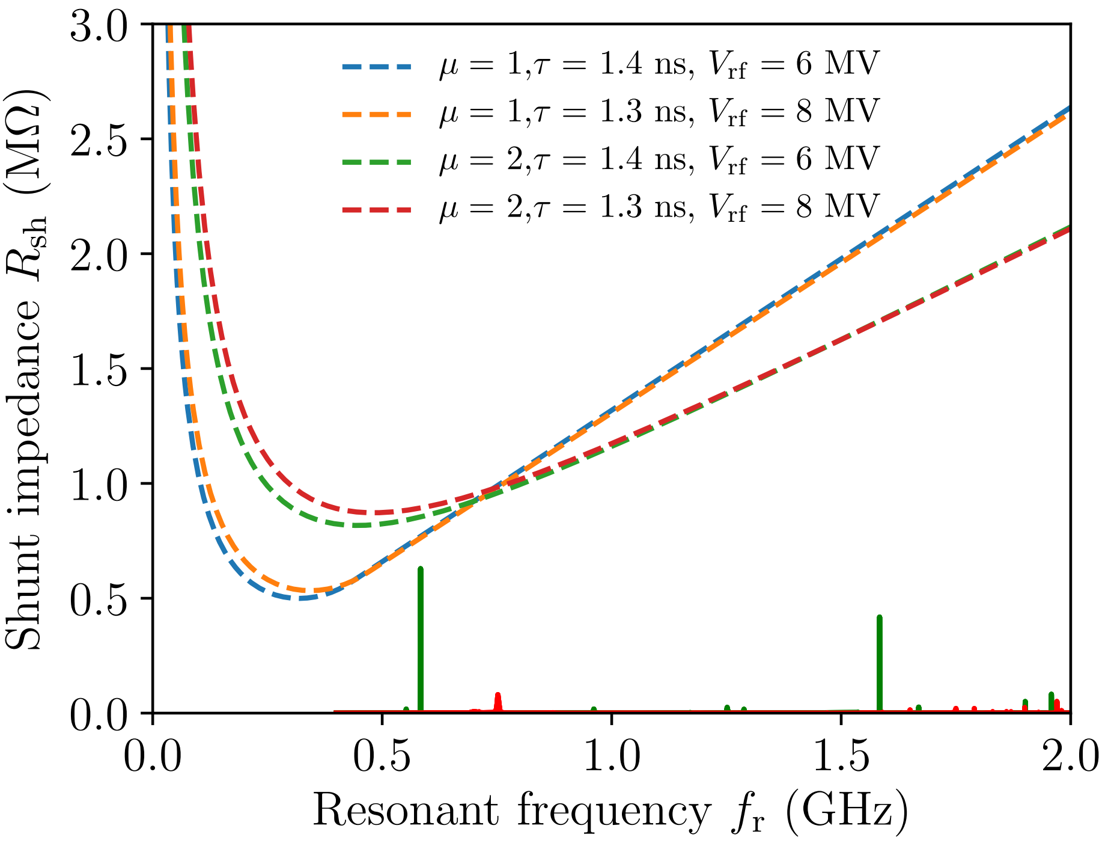
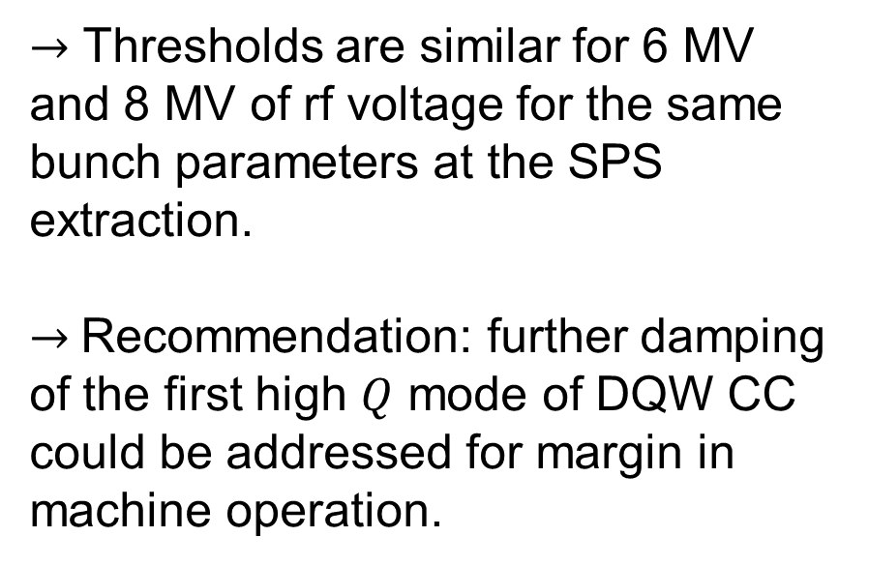

Results for HL-LHC flat bottom
$$E=450 GeV$$
Crab cavity HOMs:
HL-LHC Double Quarter Wave (DQW) × 4
HL-LHC RF-Dipole (RFD) × 4
$→$ Thresholds are similar for 6 MV and 8 MV of rf voltage for the same bunch parameters at the SPS extraction.
$→$Recommendation: further damping of the first high $Q$ mode of DQW CC could be addressed for margin in machine operation.

Slide 20
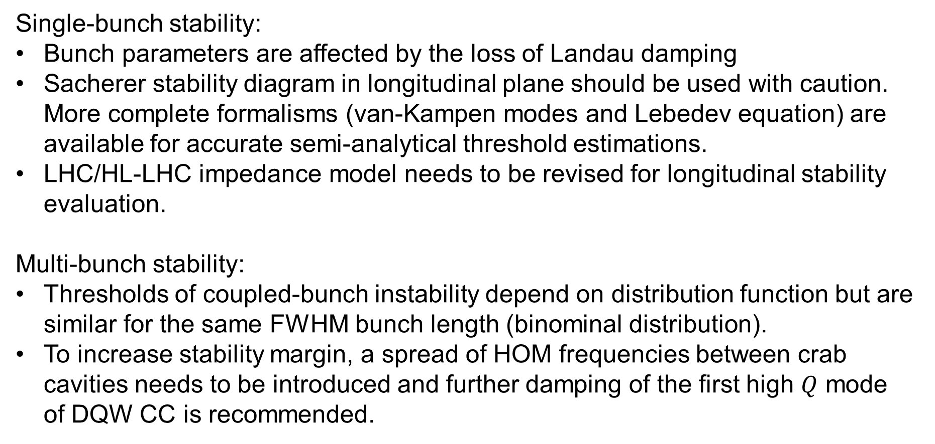
Summary
Single-bunch stability:
Bunch parameters are affected by the loss of Landau damping
Sacherer stability diagram in longitudinal plane should be used with caution. More complete formalisms (van-Kampen modes and Lebedev equation) are available for accurate semi-analytical threshold estimations.
LHC/HL-LHC impedance model needs to be revised for longitudinal stability evaluation.
Multi-bunch stability:
Thresholds of coupled-bunch instability depend on distribution function but are similar for the same FWHM bunch length (binominal distribution).
To increase stability margin, a spread of HOM frequencies between crab cavities needs to be introduced and further damping of the first high $Q$ mode of DQW CC is recommended.

Slide 21
Thank you for your attention!

Slide 22
Spare slides

Slide 23
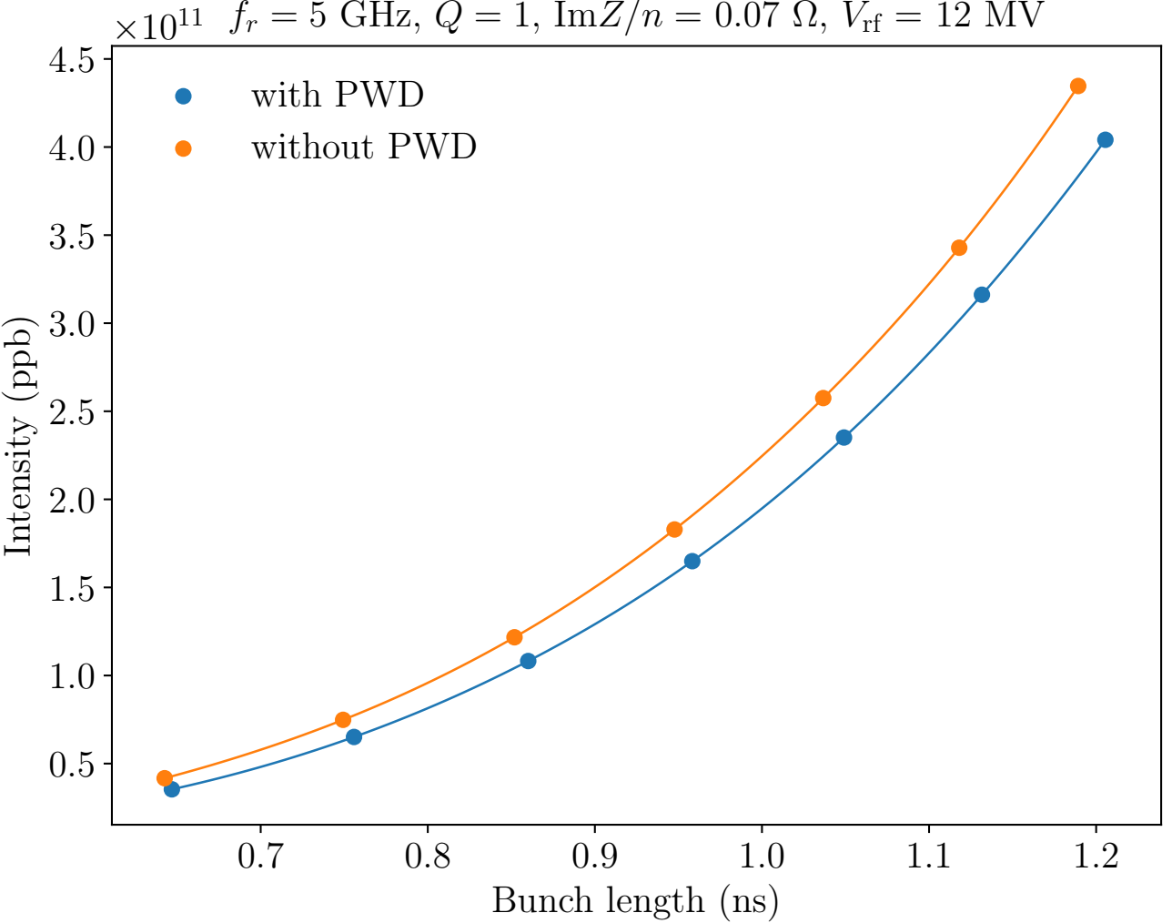
Impact of potential well distortion
Difference is about 10 %

Slide 24

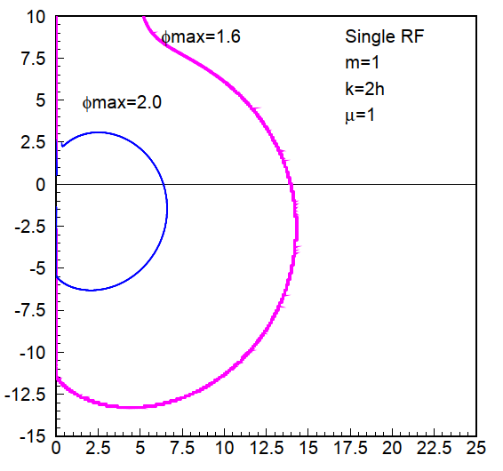




Landau damping for multi-bunch beam
Stability diagram for
For narrow band impedance with ω_{r}, only one resonant harmonic k_{r} = ω_{r} /ω₀ = lM + n can be kept (M - number of equidistant bunches) in Lebedev’ equation:
M
From stability diagram
(V. Balbekov, S. Ivanov, 1987):
M
unstable
stable
with
→ Beam is stable if vertical line 1/R_{sh} is inside stability region

Slide 25
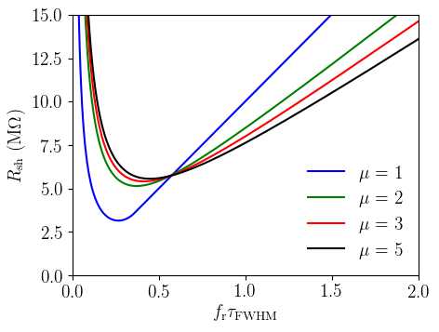

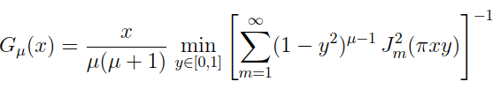
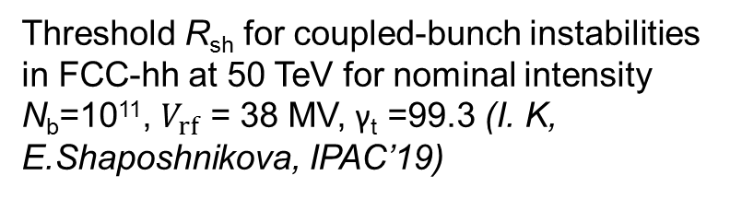

Multi-bunch threshold
In single RF system the threshold (no acceleration) for binomial distribution
where
Threshold R_{sh} for coupled-bunch instabilities in FCC-hh at 50 TeV for nominal intensity N_{b}=10¹¹, $V_{rf}$ = 38 MV, γ_{t} =99.3 (I. K, E.Shaposhnikova, IPAC’19)
$→$ The FWHM bunch length is important

Slide 26
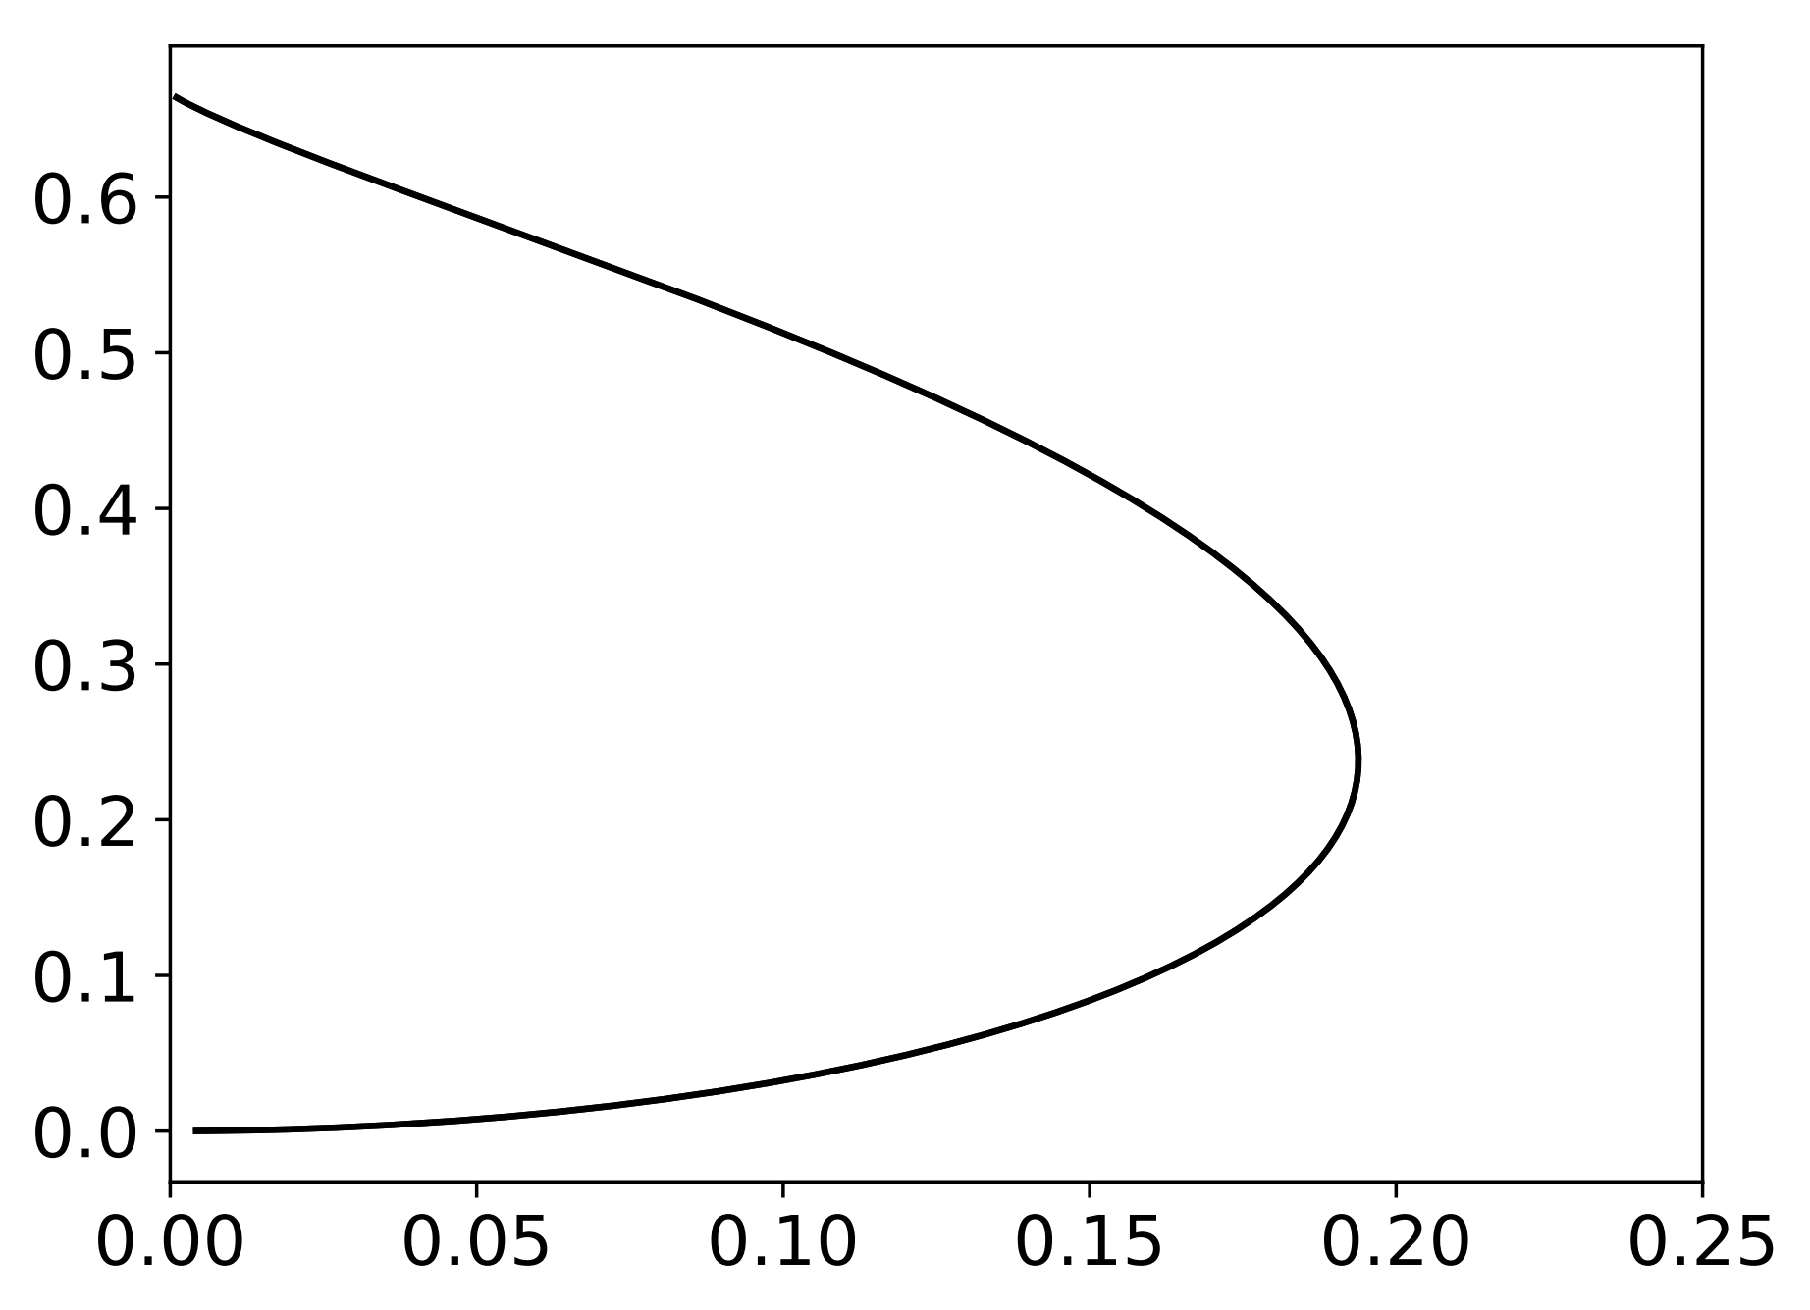

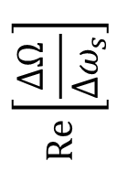





Sacherer’s formalism
Stability diagram for parabolic line density
Coherent mode
Landau damping is lost if coherent mode shift $ΔΩ$ normalized by incoherent spread $Δω_{s}$ lies outside of stability diagram (F. Sacherer, 1971)
Unstable
Simplified threshold $N_{b}=V_{rf}τ^{5}/ξ$
$$Re\left[\frac{ΔΩ}{Δω_{s}}\right]$$
Stable
Stability parameter $ξ∝{\left(Z/n\right)}_{eff}$
Effective impedance
$${\left(Z/n\right)}_{eff}=ω_{0}\frac{\sum_{q}{\frac{Z^{∥}\left(ω_{q}\right)}{ω_{q}}}\frac{J_{3/2}^{2}\left(ω_{q}τ\right)}{|ω_{q}τ|}}{\sum_{q}{\frac{J_{3/2}^{2}\left(ω_{q}τ\right)}{|ω_{q}τ|}}}$$
$$Im\left[\frac{ΔΩ}{Δω_{s}}\right]$$
$$ω_{q}=qω_{0}+ω_{s}$$
$→$ For the case of the LHC impedance model $ξ≈1.4×{10}^{−5} {\left(ns\right)}^{5}V$, (${\left(Z/n\right)}_{eff}≈0.09 Ω$ )

Slide 27




Measurements of the loss of Landau damping threshold in LHC
MD 2011,
$V_{rf}$= 5 MV, $E$ = 450 GeV
Measurement were performed at different conditions, but with all efforts only a limited parameter space was available during each of MDs (PhD thesis J. E. Muller, 2016). Threshold curves correspond to a fit $N_{b}=Vτ^{5}/ξ$ .
$→$As the result, $ξ = \left(5.0±0.5\right)×{10}^{−5} {\left(ns\right)}^{5}V$ was obtained.
$→$ The thresholds predicted from Sacherer’ stability diagrams are 3 – 4 times higher than measured thresholds.

Slide 28



Measurements of the loss of Landau damping threshold in LHC
MD 2011,
$V_{rf}$= 5 MV, $E$ = 450 GeV
MD 2011,
$V_{rf}$= 12 MV, $E$ = 4 TeV
Measurement were performed at different conditions, but with all efforts only a limited parameter space was available during each of MDs (PhD thesis J. E. Muller, 2016). Threshold curves correspond to a fit $N_{b}=Vτ^{5}/ξ$ .
$→$As the result, $ξ = \left(5.0±0.5\right)×{10}^{−5} {\left(ns\right)}^{5}V$ was obtained.
$→$ The thresholds predicted from Sacherer’ stability diagrams are 3 – 4 times higher than measured thresholds.

Slide 29


Measurements of the loss of Landau damping threshold in LHC
MD 2011,
$V_{rf}$= 5 MV, $E$ = 450 GeV
MD 2011,
$V_{rf}$= 12 MV, $E$ = 4 TeV
MD 2015,
$V_{rf}$= 12 MV, $E$ = 6.5 TeV
Measurement were performed at different conditions, but with all efforts only a limited parameter space was available during each of MDs (PhD thesis J. E. Muller, 2016). Threshold curves correspond to a fit $N_{b}=Vτ^{5}/ξ$ .
$→$As the result, $ξ = \left(5.0±0.5\right)×{10}^{−5} {\left(ns\right)}^{5}V$ was obtained.
$→$ The thresholds predicted from Sacherer’ stability diagrams are 3 – 4 times higher than measured thresholds.

Slide 30


Measurements of the loss of Landau damping threshold in LHC
MD 2011,
$V_{rf}$= 5 MV, $E$ = 450 GeV
MD 2011,
$V_{rf}$= 12 MV, $E$ = 4 TeV
MD 2015,
$V_{rf}$= 12 MV, $E$ = 6.5 TeV
MD 2015,
$V_{rf}$= 12 MV, $E$ = 6.5 TeV
Measurement were performed at different conditions, but with all efforts only a limited parameter space was available during each of MDs (PhD thesis J. E. Muller, 2016). Threshold curves correspond to a fit $N_{b}=Vτ^{5}/ξ$ .
$→$As the result, $ξ = \left(5.0±0.5\right)×{10}^{−5} {\left(ns\right)}^{5}V$ was obtained.
$→$ The thresholds predicted from Sacherer’ stability diagrams are 3 – 4 times higher than measured thresholds.

Slide 31





Comparisons with simulations
Simulation setup (PhD thesis J. E. Muller, 2016):
Number of macro-particles $5×{10}^{5}$
50 slices per bucket ($f_{c}$= 10 GHz) for induced voltage calculation using full impedance model
Initially matched bunched is kicked by 1 degree
Stability criterion:
Bunch is stable if oscillation amplitude is reduced below 0.2 degrees
BLonD simulations using full LHC impedance model agree very well with measurements
$V_{rf}$ = 12 MV
Simulations for double rf system**
However, the stability threshold can significantly vary depending on the chosen criteria based on the final oscillation amplitude (PhD thesis T. Argyropoulos, 2015)
$→$Different method to find absolute threshold is needed

Slide 32







Lebedev’ approach
Matrix equation (A. N. Lebedev, 1967) in variables with
where and normalization
where
It allows to evaluate both single- and multi-bunch stability
Was extensively used to evaluate coupled-bunch instability thresholds due to narrow-band impedance (V. Balbekov, S. Ivanov, 1987) and for combination of narrow-band resonator and ImZ/n = const (M. Blaskiewicz, 2009)
$→$ For single-bunch case it was considered to be not numerically tractable

Slide 33



Landau damping: Van-Kampen modes
Method (A. Burov, 2010): find Van-Kampen modes solving Vlasov equation for perturbation f(J,ψ,t) of stationary distribution function F(J) expanded (Oide & Yokoya, 1990) as
Mode below threshold
Without mode coupling the matrix equation (in action J) is
2
where
Loss of LD
and
Incoherent frequencies
Continuous spectrum - singular modes from incoherent band. Discrete modes - coherent solutions described by regular eigenfunctions → their existence outside incoherent band serve as criterion for loss of LD

Slide 34


Van-Kampen vs Lebedev approaches
A new numerical code was developed to solve Lebedev eigenvalue problem
The thresholds are calculated using Lebedev and Van-Kampen and approaches for broadband impedance and following parameters:
$R=(ImZ/n)f_{r}/f_{0},$ $f_{r}= 5 GHz,Q=1,$
$f_{c}=20 GHz,$ $ImZ/n= 0.076, μ =2,$
$V_{rf} = 12 MV$
Distribution function
$→$ Very good agreement between two approaches

Slide 35



Preliminary comparisons with measurements
Measurements at 6.5 TeV, $V_{rf} = 12 MV$ (PhD thesis J. E. Muller, 2016)
● A. N. Lebedev
+ N. G. van Kampen
The thresholds are calculated using Lebedev and Van-Kampen and approaches for broadband impedance and following parameters:
$R=(ImZ/n)f_{r}/f_{0},$ $f_{r}= 5 GHz,Q=1,$
$f_{c}=20 GHz,$ $ImZ/n= 0.076, μ =2,$
$V_{rf} = 12 MV$
$→$ Reasonable agreement between measurements and semi-analytic calculations.
$→$ Scaling law is different in comparison to simplified Sacherer’s approach

Slide 36



Calculation results
Case of inductive impedance $ImZ/n=const.$
Threshold significantly depends on the cut-off frequency $f_{c}$
For the case of symmetric potential well
$$I_{mk}\left(𝒥\right)≈i^{m}J_{m}\left(\frac{k}{h}\sqrt{2𝒥}\right)$$
So diagonal elements of the matrix diverge
$$V_{m}\left(𝒥,𝒥\right)=2ImZ/n\sum_{k}{J_{m}^{2}\left(\frac{k}{h}\sqrt{2𝒥}\right)→∞}$$
$$V_{m}\left(𝒥,𝒥\right)=2ImZ/n\sum_{k}{J_{m}^{2}\left(\frac{k}{h}\sqrt{2𝒥}\right)→∞}$$
$→$ Realistic impedance model needs to be used

