Slide 1
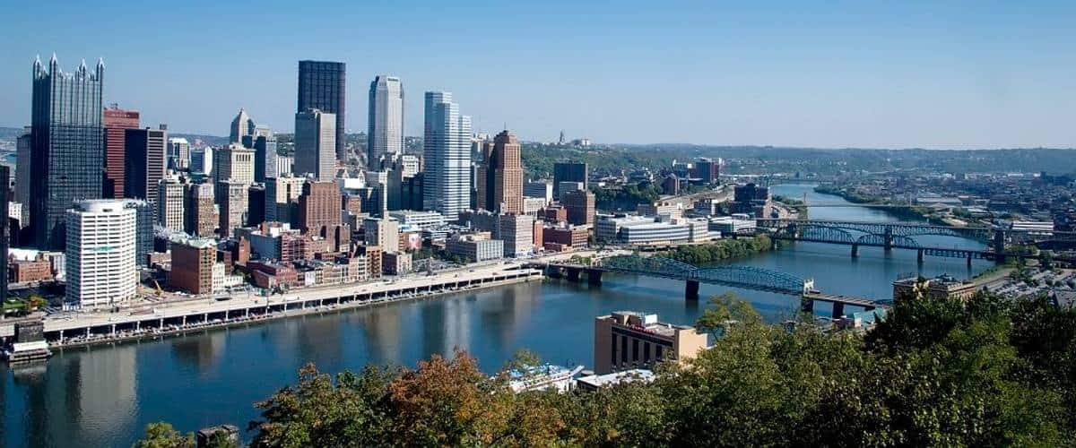
Gravitational Waves from Early-Universe Turbulent Sources
Tina Kahniashvili
(Carnegie Mellon University & Ilia State University)
In collaboration with: Axel Brandenburg, Arthur Kosowsky,
Sayan Mandal, Alberto Roper Pol
Pheno 2020: May 4, 2020

Slide 2
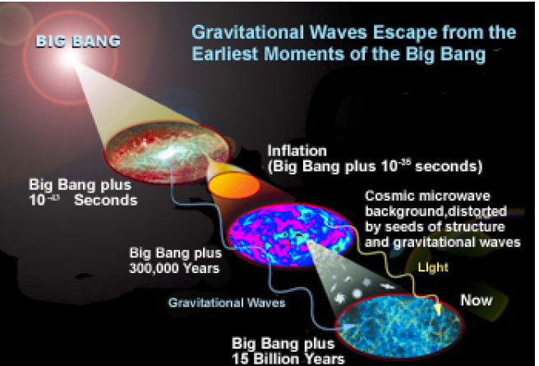
gravitational waves astronomy
Advantage
Connection with High Energy Physics – the best
laboratory to test the energy scales EVEN near the Planck
scale
Disadvantage
Direct detection
is complicated

Slide 3
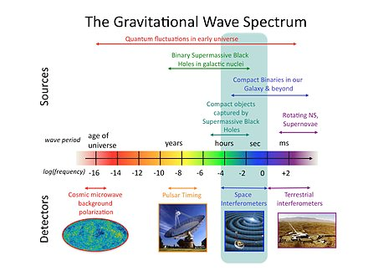

Slide 4
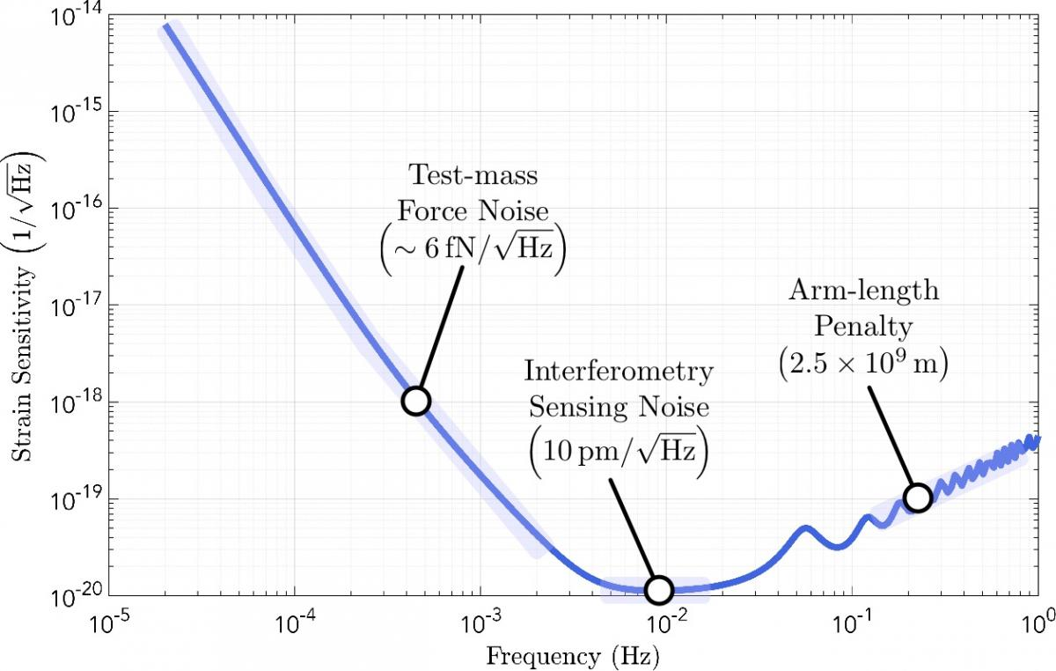
LISA sensitivity & electroweak scale physics
Credit: LISA Consortium
LISA’s peak sensitivity corresponds to ~ 1/10 of Hubble horizon at 1 TeV energy scale
Hubble frequency
f₀=10⁻⁴Hz (T/1Tev)
https://www.lisamission.org/multimedia/image/lisa-sensitivity
Large Hadron Collider (LHC) vs relic gravitational waves:
Detecting New Physics?

Slide 5
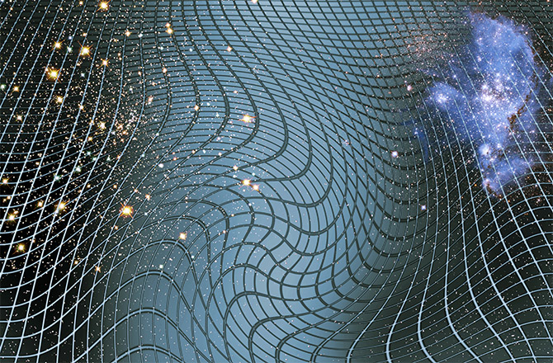
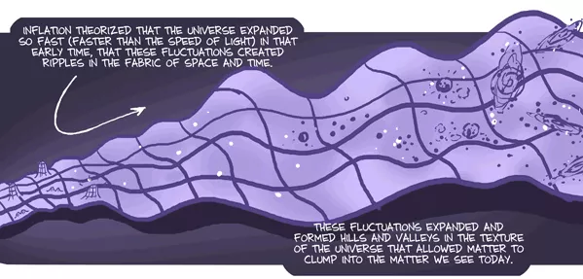
relic gravitational waves signal - LISA
The very early universe
  Phase transitions
  Turbulence
  Seed magnetic fields
  MHD turbulence

Slide 6
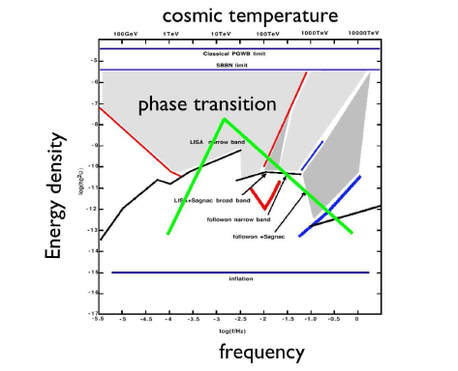
relic gravitational waves from phase transitions
Pioneering works:
Winicour 1973
Hogan 1982, 1986
Turner & Wilczek 1990
Kosowsky et al. 1992
Kosowsky & Turner 1993
Kamionkowski et al. 1994
:
C. Hogan, 2006

Slide 7
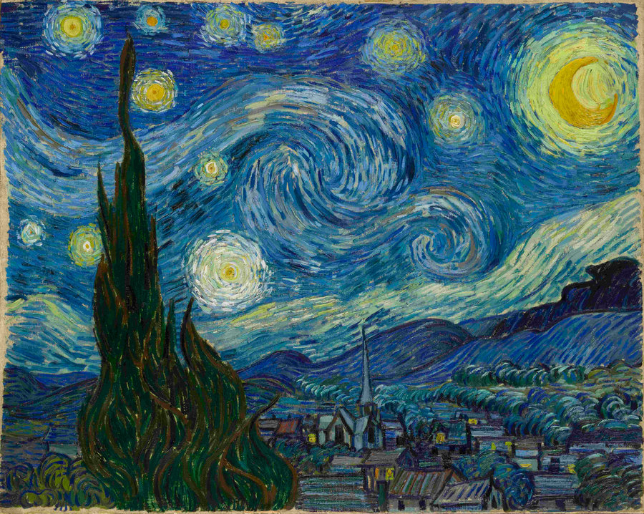
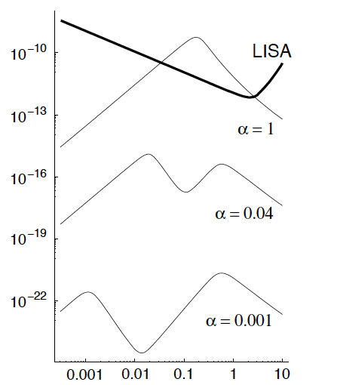
turbulence vs. gravitational waves
“Van Gogh's Turbulent Mind Captured Turbulence” credit Cosmos and Culture, 2015
Kosowsky, Mack, Kahniashvili, 2002
Dolgov, Grasso, Nicolis, 2002
Nicolis, 2004
Kahniashvili, Gogoberidze, Ratra, 2005
Nicolis 2004

Slide 8
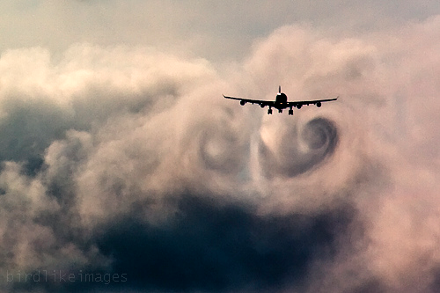



sound waves from turbulence
Aeroacoustic:
Sound waves generation by turbulence
Lighthill, 1952
Proudman 1952

Slide 9
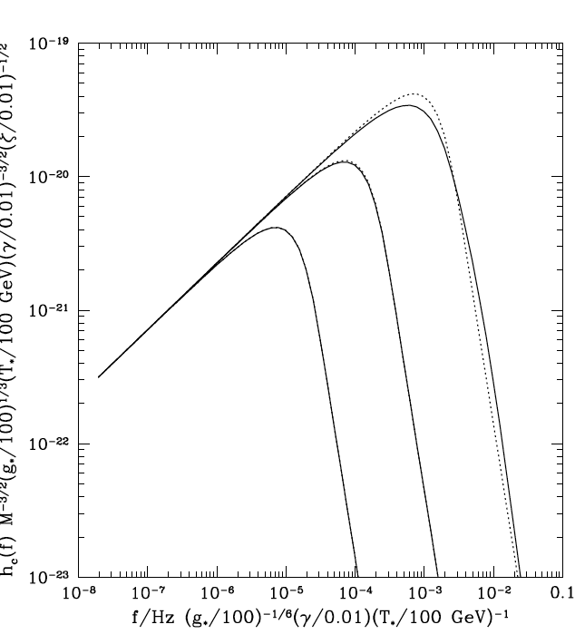



aeroacoustic approximation
Gogoberidze, Kahniashvili, Kosowsky 2007
Parameters:
τ_{T} turbulence lasting time
k₀ stirring scale
M = v₀/c - Mach number
R^{3/4}=k_{d}/k₀ - Reynolds number

Slide 10


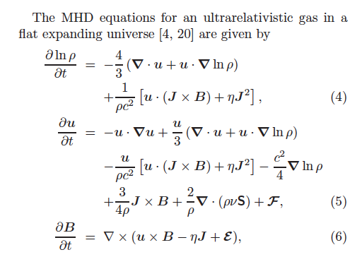
numerical simulations
To account properly non-linear processes (MHD)
Not be limited by the short duration of the phase transitions
Two stages turbulence decay
  Forced turbulence
  Free decay
The source is present till recombination (after the field is frozen in)
Results – strongly initial conditions dependent
Grishchuk 1974

Slide 11
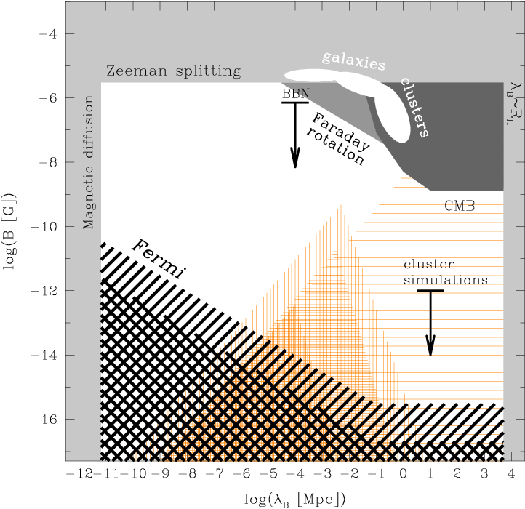
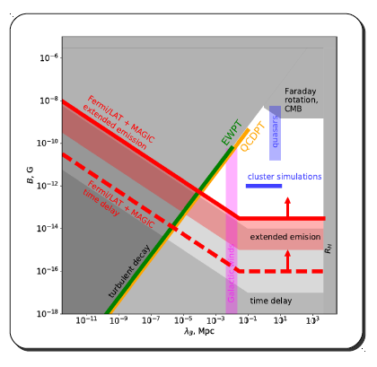
why primordial MHD turbulence?
Observations – lower limits of extragalactic magnetic fields in voids
Neronov & Vovk 2010
Vovk’s courtesy 2018

Slide 12
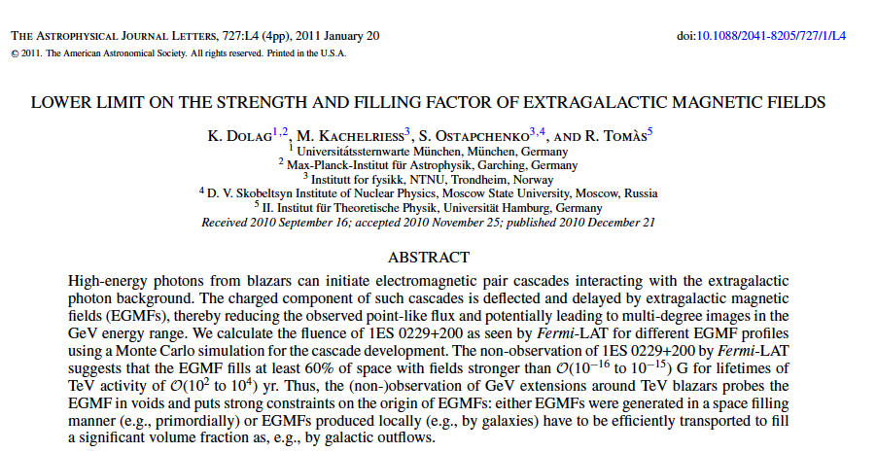
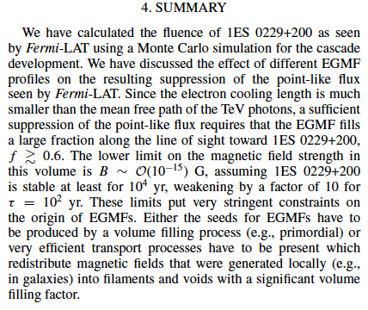
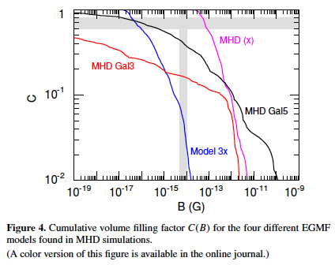
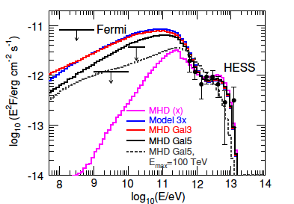
primordial or astrophysical origin?

Slide 13
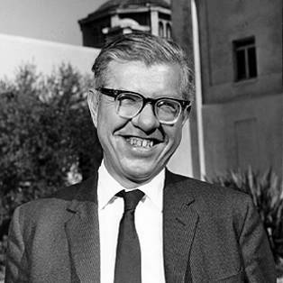
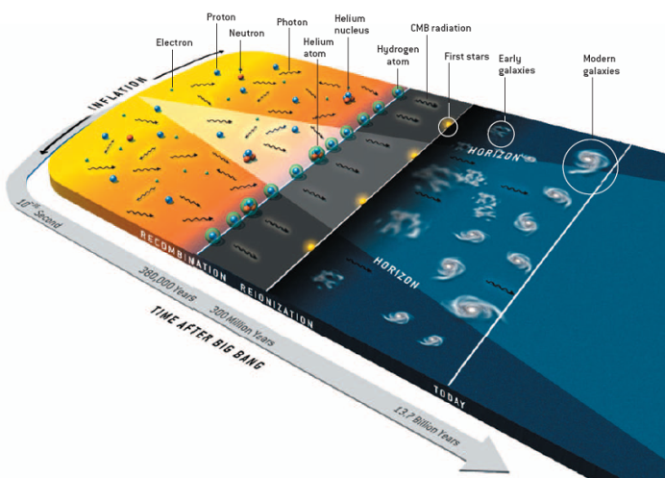
magnetogenesis
F. Hoyle in Proc. “La structure et
l’evolution de l’Universe” (1958)
inflation
phase transitions
supersymmetry
string cosmology
topological defects

Slide 14
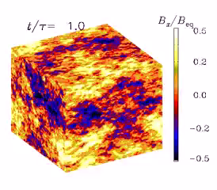
MHD turbulence
Cosmic magnetic field origin – generation in the early universe
Primordial magnetic fields – effects on phase transition physics
Generation of turbulence
MHD turbulence decay
PENCIL CODE 3D compressible MHD
Brandenburg, Kahniashvili, Tevzadze, 2015

Slide 15
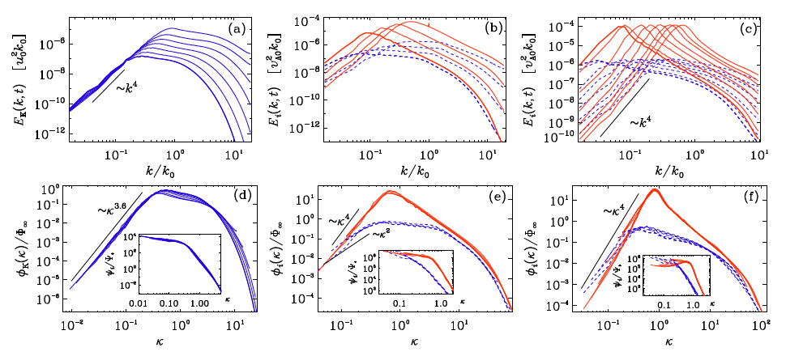
classes of turbulence
Brandenburg & Kahniashvili 2017

Slide 16
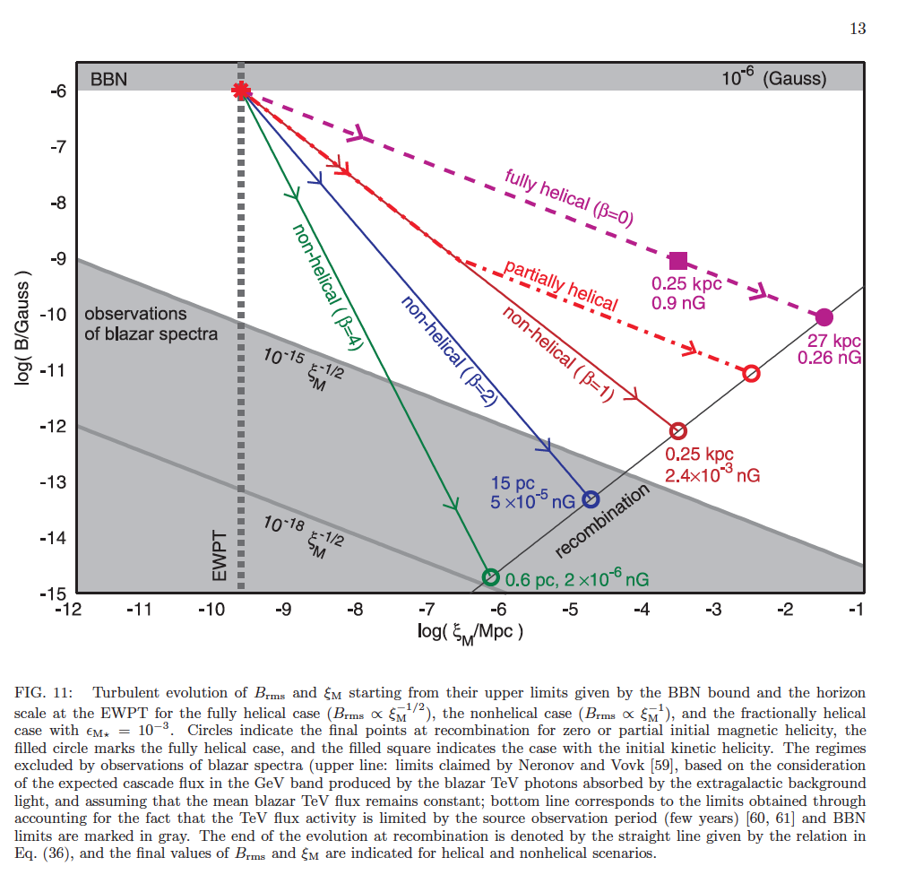
Brandenburg, et al. 2017

Slide 17
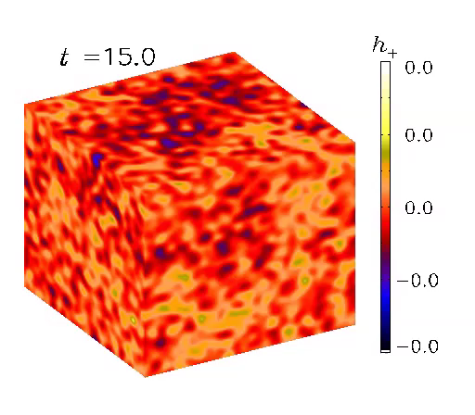
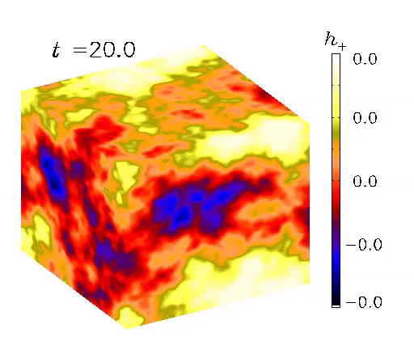
gravitational waves from turbulence
Acoustic turbulence
Vortical turbulence

Slide 18
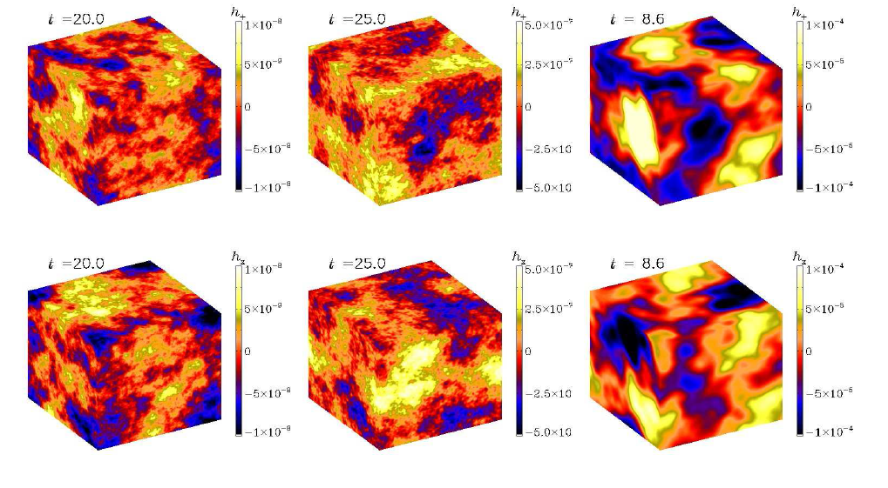

gravitational waves: results
Roper Pol et al. 2019, 2020

Slide 19
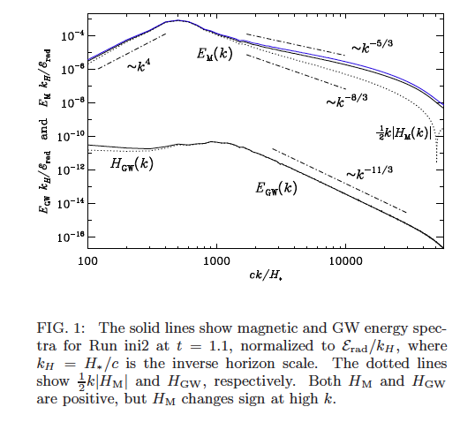

Slide 20
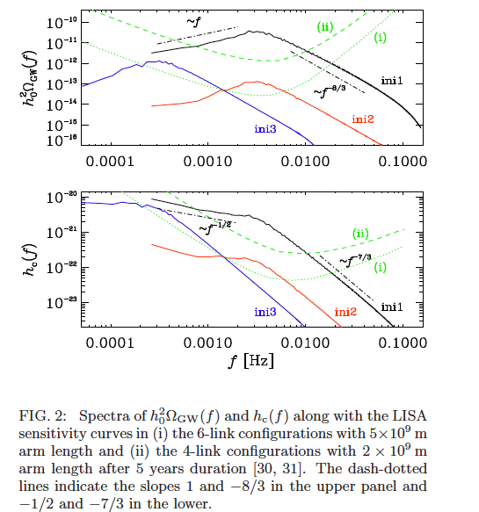

Slide 21
conclusions
Primordial turbulence is potentially detectable by LISA
Primordial magnetic fields can serve as seeds for the observed cosmic magnetic fields.
Presence of primordial magnetic field makes the signal substantially stronger and allows it to spread over a wide range of frequencies.
LISA mission offers a possibility to understand the physics of phase transitions (and possibly baryogenesis)
Parity violating sources produce circularly polarized gravitational waves, and the polarization degree might be around 100% (for fully helical sources).

Slide 22
Thank you!

