Slide 1
40 Years of Electron Cooling at CERN
Gerard Tranquille BE-BI-EA

Slide 2
Outline
A brief introduction to electron cooling
  What?
  Why?
  Very basic theory of electron cooling
  Electron cooling hardware
The CERN electron coolers
  The ICE age – the birth of electron cooling at CERN
  LEAR – electron cooling in operation
  From LEAR to LEIR
  AD – cooling for antimatter
  ELENA and the future

Slide 3
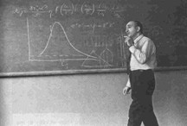
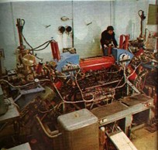
What is electron cooling?
A fast process to shrink the size, divergence and energy spread of a stored charged particle beam without the loss of intensity (phase-space compression).
Loss free compression of ion beams
  Accumulation of rare species of charged particles
  Luminosity increase for colliding beam experiments
  Smaller spot sizes for fixed-target experiments
  High resolution experiments with internal targets
Compensation of beam heating effects
  Intrabeam, residual gas and internal target scattering
Electron target for precision experiments e.g. recombination
Proposed by Gersh Budker in 1966 for increasing the luminosity in hadron colliders.
First demonstration on the NAP-M ring in 1974 at Novosibirsk.

Slide 4
Why electron cooling at CERN?
Improve the quality of low energy ion beams
  Many experiments on LEAR and AD were/are not possible without electron cooling
  Used to cool (anti)protons, H⁻,oxygen, argon, xenon and lead ions
Increase the duty cycle of the machine
  At low energies electron cooling is faster than stochastic cooling
LHC and North Area request a variety of ions
  Injection scheme requires fast cooling and stacking

Slide 5
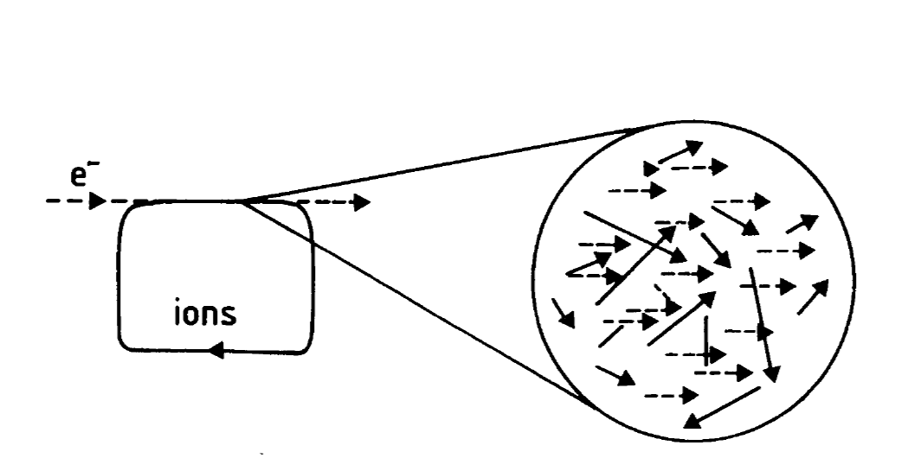
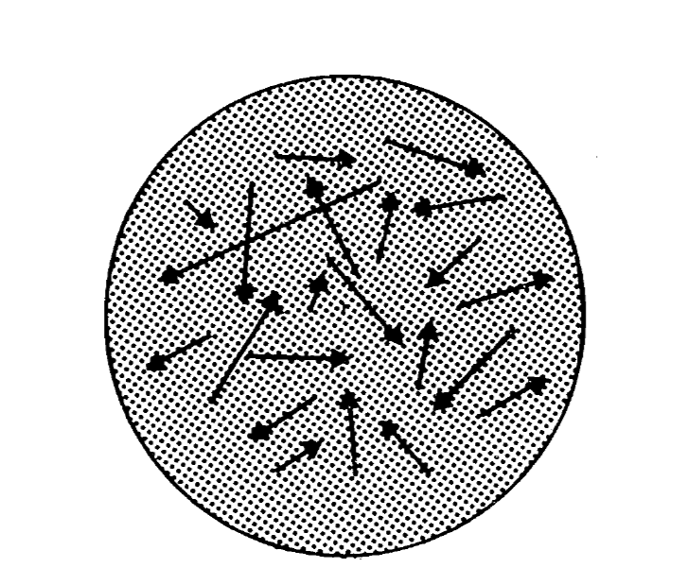
Simple theory electron cooling
To cool a stored ion beam with electrons a monochromatic electron beam is overlapped with the ion beam in a straight section of the ring.
The velocity of the electrons is made to match the average velocity of the ion beam.
In the rest frame of the electrons the ions are seen as passing through the electron gas with a variety of velocities
The ions transfer their energy to the electrons through Coulomb scattering.
The electrons are continuously renewed -> heat exchanger

Slide 6
Analogy with the mixing of gases
Two gases of different
temperatures T1 and T2
tend to an equilibrium
temperature T3
As the electron beam is continuously renewed, the ion beam temperature tends to the electron beam temperature.
The velocity spread is reduced by a factor (m/M)^{1/2}

Slide 7
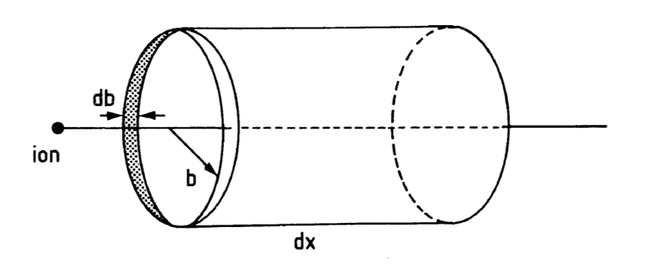
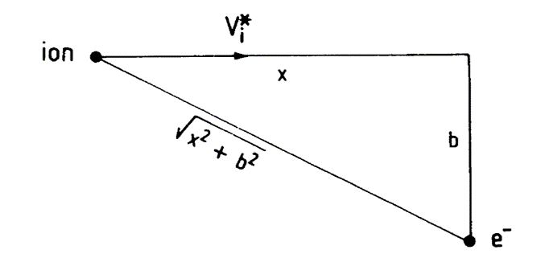




The cooling force
Consider a single electron-ion collision in the electron beam rest frame.
The ion moves with a velocity V_{i}* and scatters from the electron at impact parameter b.
$$∆E^{∗}(b)= \frac{{∆P^{∗}}^{2}}{2m_{e}}=\frac{2Z^{2}e^{4}}{m_{e}b^{2}V_{i}^{∗2}}$$
The energy transferred from the ion to the electron is
When an ion passes through a large number of electrons, we have to integrate over all possible impact parameters to obtain the energy lost as it travels a length dx through an electron cloud of density n_{e}*.
$$−\frac{{dE}^{∗}}{dx}=2π \int_{b_{min}}^{b_{max}}{b db n_{e}^{∗}{∆E}^{∗}\left(b\right)= \frac{4πZ^{2}e^{4}}{m_{e}V_{i}^{∗2}}n_{e}^{∗}ln\frac{b_{max}}{b_{min}}}$$
The electrons also have a finite temperature T_{e} and hence a velocity distribution f(V_{e}) which can be considered to be Maxwellian characterised by its velocity spread Δ_{e}.
$$f\left(V_{e}^{∗}\right)=\frac{e^{{−V_{e}^{∗2}}/{∆_{e}^{2}}}}{∆_{e}^{3}}$$
$$T_{e}=\frac{m_{e}∆_{e}^{2}}{2}$$

Slide 8
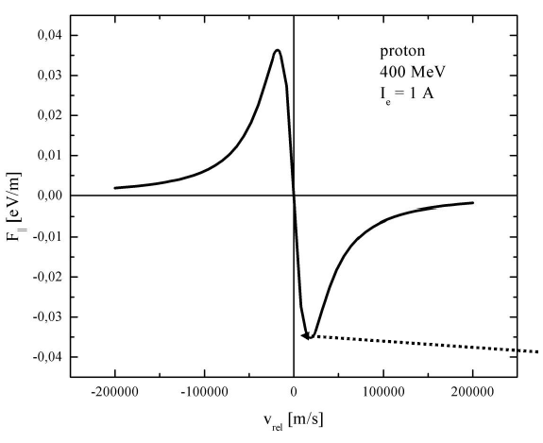


To account for this we have to replace the ion velocity with the ion-electron velocity difference and average over the electron velocity distribution.
The expression for the frictional force becomes:
$$u^{∗}=V_{i}^{∗}−V_{e}^{∗}$$
$$F^{∗}=−4πZ^{2}e^{2}c^{2}r_{e}n_{e}^{∗}L_{c}\int{f(V_{e}^{∗})\frac{u^{∗}}{{\left|u^{∗}\right|}^{3}}}d^{3}V_{e}^{∗}$$

Slide 9

The cooling time
$$τ∝\frac{u^{3}}{ηI_{e}}\frac{A}{Z^{2}}γ^{5}β^{4}$$
u is the relative difference in angle between the ions and electrons
is the ratio of the cooler length to the ring circumference: L_{cooler}/L_{ring}
I_{e} is the electron current
Cooling time : increases with energy
fast for highly charged ions
slow for hot beams
linearly dependent on electron current and cooler length
independent of ion beam intensity
“Electron cooling, theory, experiment, application”, H. Poth, CERN-EP/90-04

Slide 10
How to build an electron cooler
Source: cathode
Beam dump: collector
Acceleration system: electron gun
Beam transport: solenoids, steering magnets
Vacuum, diagnostics

Slide 11
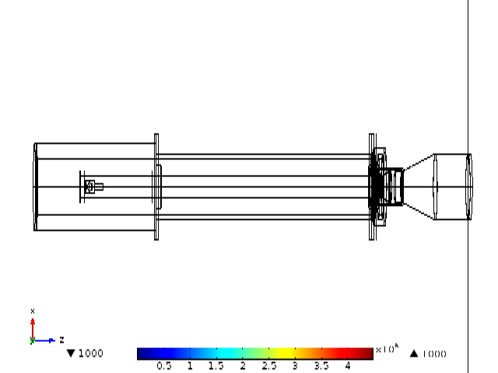
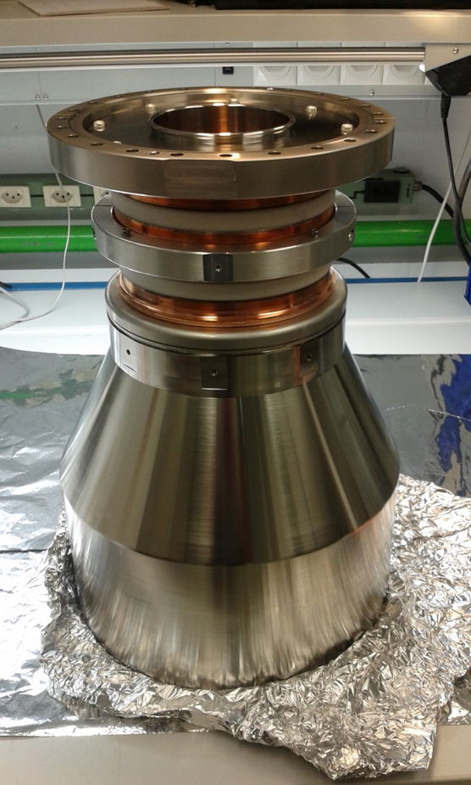
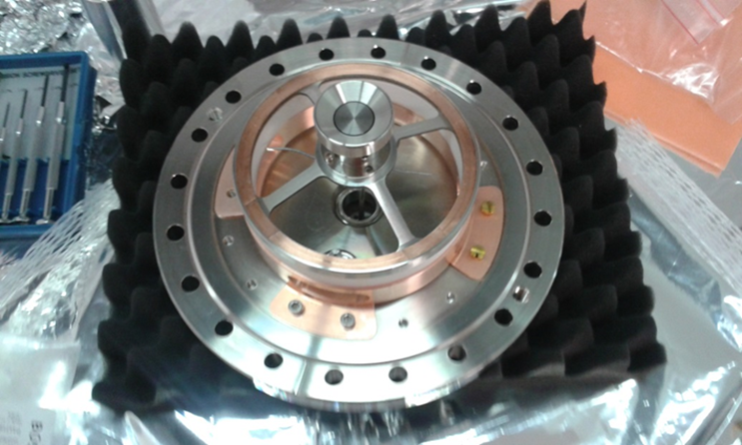
After the gun, the electrons enter a drift region where they are transported to the interaction section where the cooling of the circulating ion beam takes place.
The magnetically confined electrons are bent into the interaction region with a curved solenoid or toroid.
An additional dipole field is required to compensate the centrifugal force experienced by the electrons.
The properties of the magnetic field are important to guarantee a good cooling efficiency of the ion beam and to ensure that the electron beam is not heated. In the cooling region the angle between the magnetic field lines and the ion beam should be small compared to the average transverse temperature of the electron beam.
The collector’s role is to reduce the power of the electron beam to the lowest possible value and capture them with maximum efficiency

Slide 12




Effects of the cooler on the circulating beam
Deflection of the circulating beam due to the vertical field in the toroid.
$$Θ[rad]=\frac{\int{B_{z}dl}}{B_{0}ρ_{0}}$$
$$Δx=\frac{B_{0}R_{t}^{2}}{B_{0}ρ_{0}}\left|φ_{0}−tanφ_{0}\right|$$
Tune shift due to the focusing effect of the electron beam.
$$Δυ=0.5 \left\langle β_{h,v}^{∗}\right\rangle n_{e}r_{p}β^{−2}γ^{−3}L$$
The solenoidal field of the cooler twists the ion beam by an angle:
$$θ\left[rad\right]=\frac{L}{βc}ω_{c}\frac{m_{e}}{m_{i}}$$
Effect is negligible unless working close to a resonance

Slide 13
Electron cooling at CERN

Slide 14
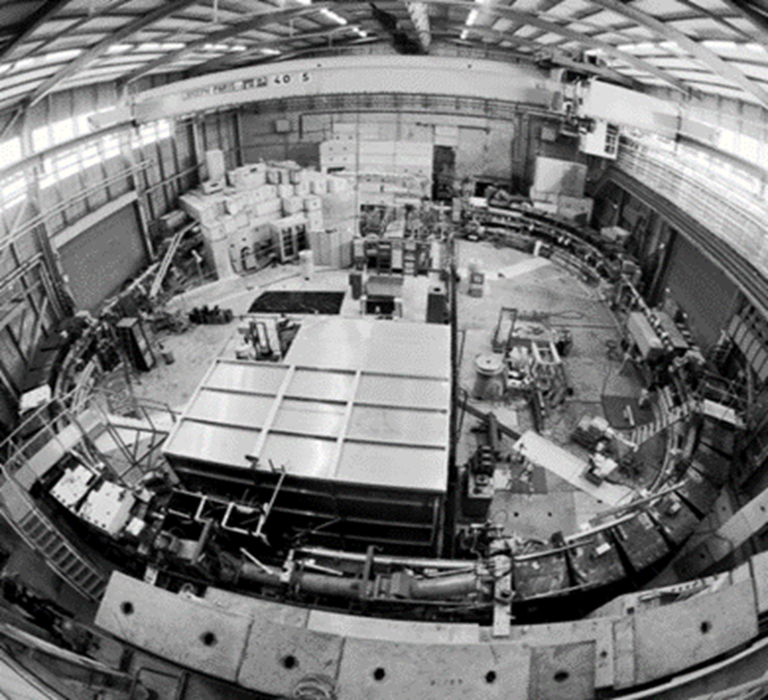
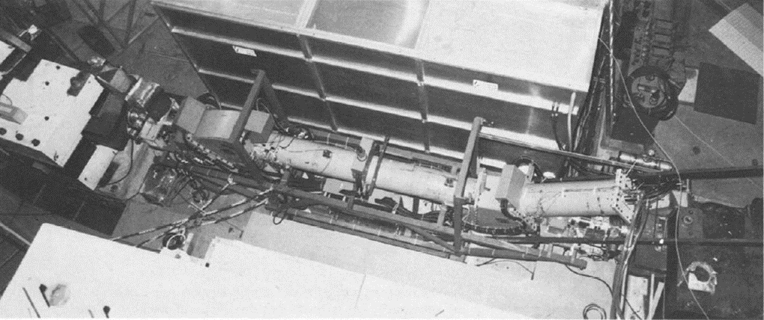
The ICE age (1977-1980)
Initial Cooling Experiment
74.38 m proton storage ring
2.1 to 0.3 GeV/c
Experimental ring to test the principle of beam cooling : stochastic & electron

Slide 15
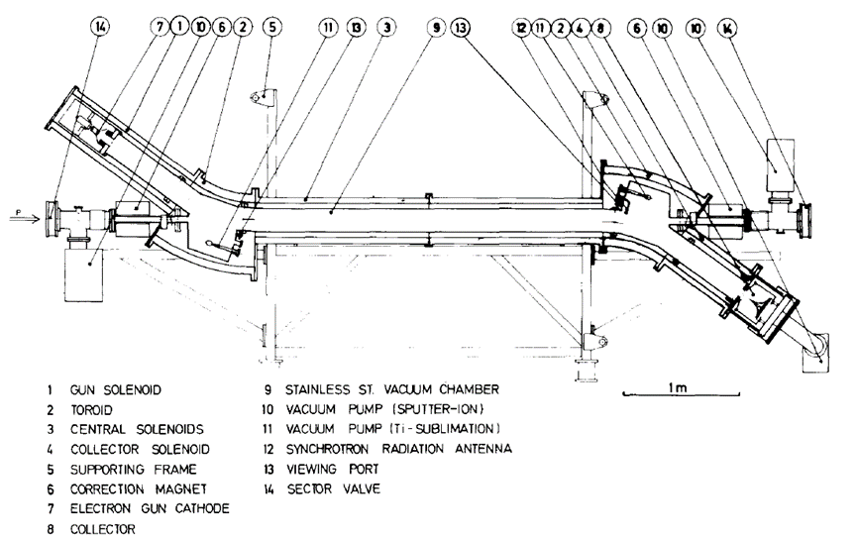
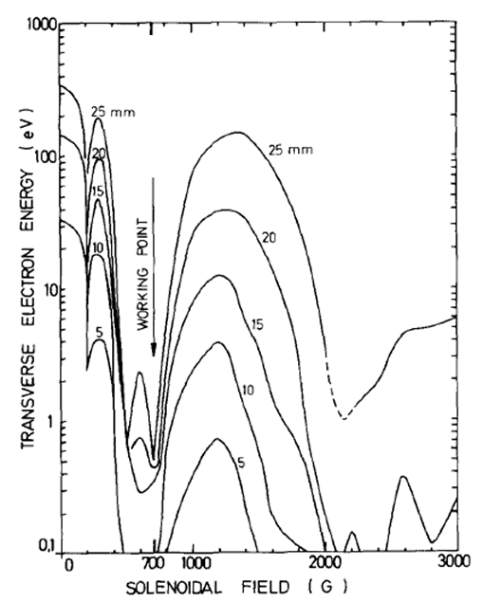
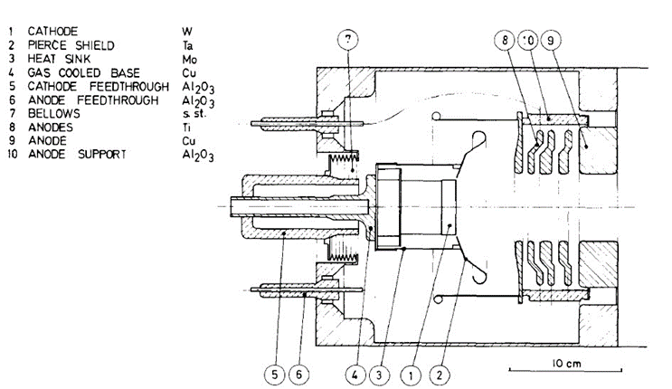
 | Design | Operational
Cathode voltage | -60 kV | -26 kV
Cathode diameter | 5 cm
Electron current | 8.3 A | 1.3 A (2.2 A)
Cooling length | 3 m
Magnetic field | 700 G | 500 G
2” cathode surrounded by a Pierce shield
Five iris shaped electrodes set on increasing potentials
Four operational modes :
  full perveance
  half perveance
  quarter perveance
  temperature limited
Resonant optics

Slide 16
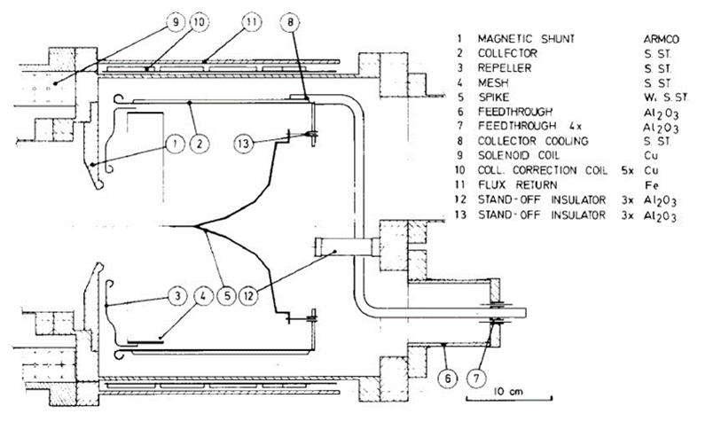
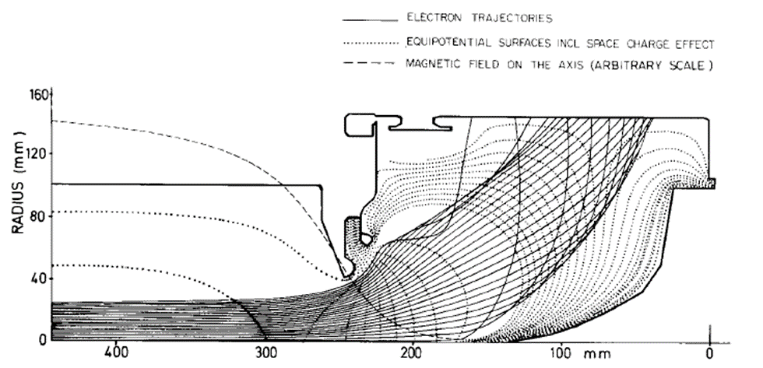
Cylindrical water-cooled anode for absorbing the electrons
Iris shaped shunt at entrance to reduce the magnetic field
Repeller electrode to decelerate the electrons (set a few kV above Vcath)
The spike refelects electrons towards the collector
Mesh electrode repels the low energy secondaries

Slide 17
Cooling experiments & results
Transverse cooling
Longitudinal frictional force
Equilibrium momentum spread
To measure the cooled beam diameters or angular divergences, three methods were used:
  neutral beam profile
  beam scraper
  horizontal ionisation beam profile monitor
Schottky signal used for the longitudinal measurements

Slide 18
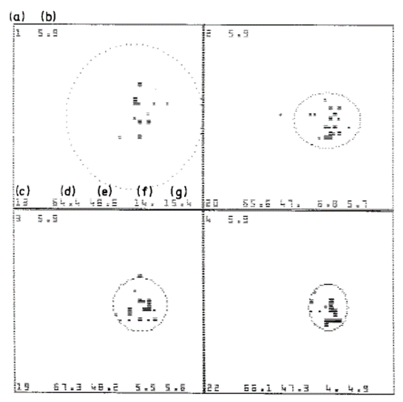
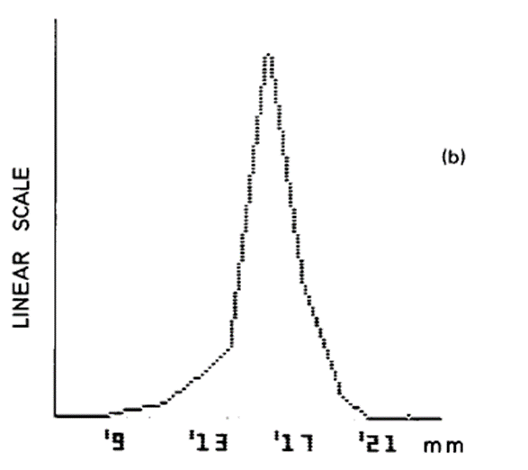
Cross-sections of neutral atom beam as seen by the two-dimensional MWPC
Profile observed on the horizontal IPM

Slide 19
Neutral atom production was measured by a 2-dimensional MWPC, integrated over successive time intervals of 5 s during the cooling process. The r.m.s. horizontal and vertical widths were 2.6 mm and 2.5 mm, respectively.
The corresponding angular divergences are θh(r.m.s.) = 2.3 x 10⁻⁴ θv(r.m.s. ) = 2.3 × 10⁻⁴
The effect of horizontal and vertical scraping on beam intensity allowed measurement of beam sizes at the scraper positions. The fullwidth-half-maximum (fwhm) beam sizes found were σh ~ 2.3 mm σv ~ 2.8 mm.
From the lattice parameters the corresponding angular divergences in the cooling region were θh(fwhm) ~ 2.4 × 10⁻⁴ θv(fwhm ) ~ 2.3 × 10⁻⁴, consistent with the results from the neutral beam profile, which yield a beam size in the cooler region below 1 mm fwhm.
The determination of the profile width was thus limited by the resolution of the IPM device (1 mm), and only an upper limit of 2.4 mm (fwhm) could be established.

Slide 20
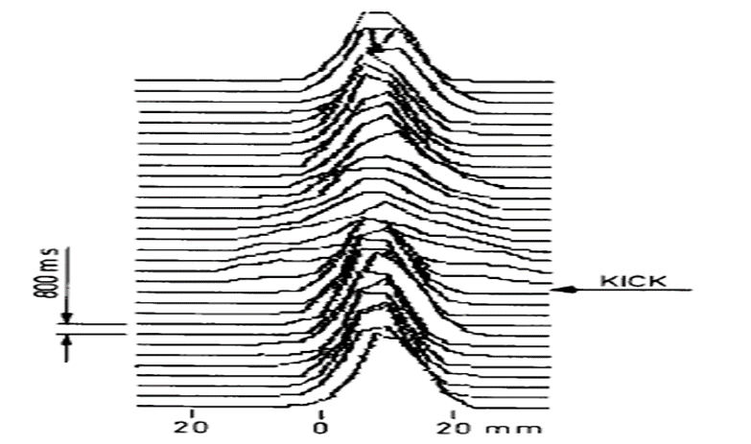
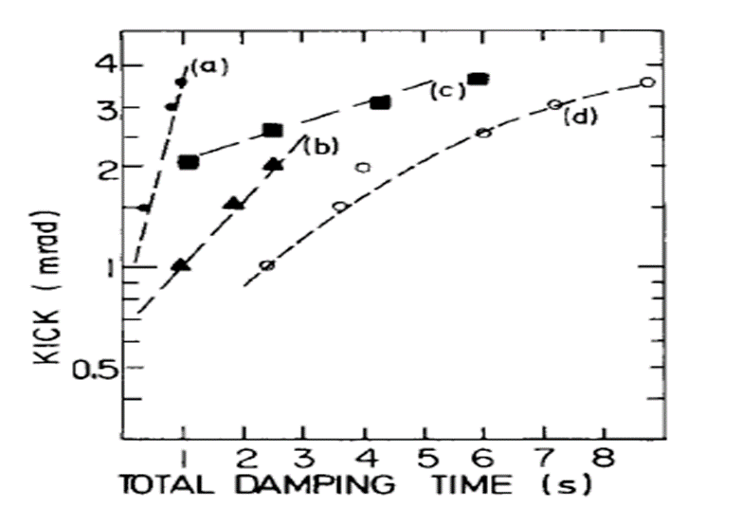
Horizontal betatron oscillations were excited artificially on the cooled beam by a short (700 ns) coherent pulse from the Full Aperture Kicker. Damping was then followed on the horizontal beam profile monitor. Repeated excitation to various amplitudes were made and the total damping time measured as a function of excitation amplitude.
The figure on the top left shows an example of such observations. The time between frames is 800 ms. The total damping time, down to the resolution of the monitor, is here about 7 s.

Slide 21
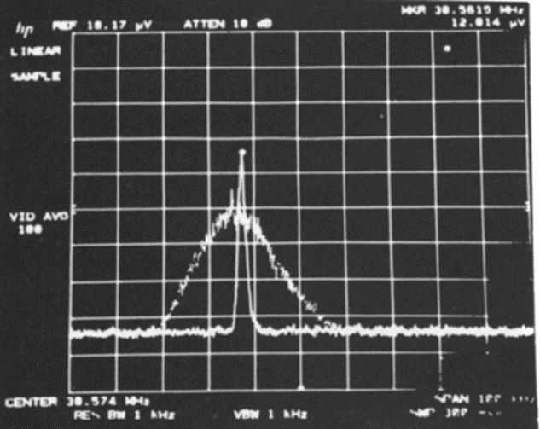
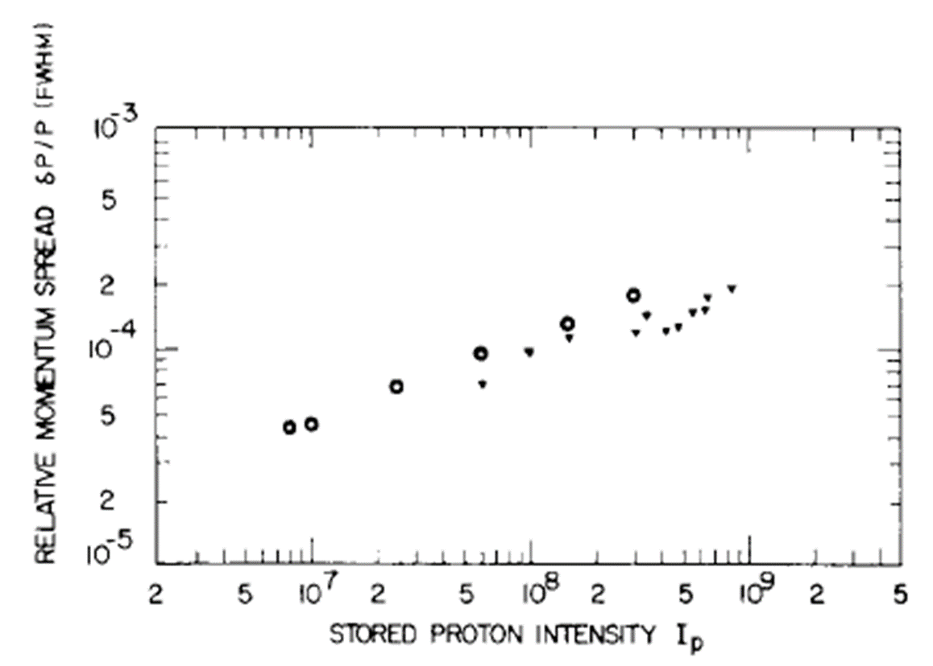
For measurement of equilibrium momentum spread the longitudinal pickup sensitive to Schottky noise was used. Left shows an example of two Fourier analyses of Schottky noise, taken at the beginning and end of the cooling process, at the 24th harmonic of the revolution frequency.. Its momentum spread is Dp/p = 4 × 10⁻⁵ (fwhm).
Equilibrium momentum spread of 45 MeV protons versus intensity. (o) temperature limited T/2 electron beam (590 mA). (∇) space charge limited P/2 electron beam (1250 mA).

Slide 22
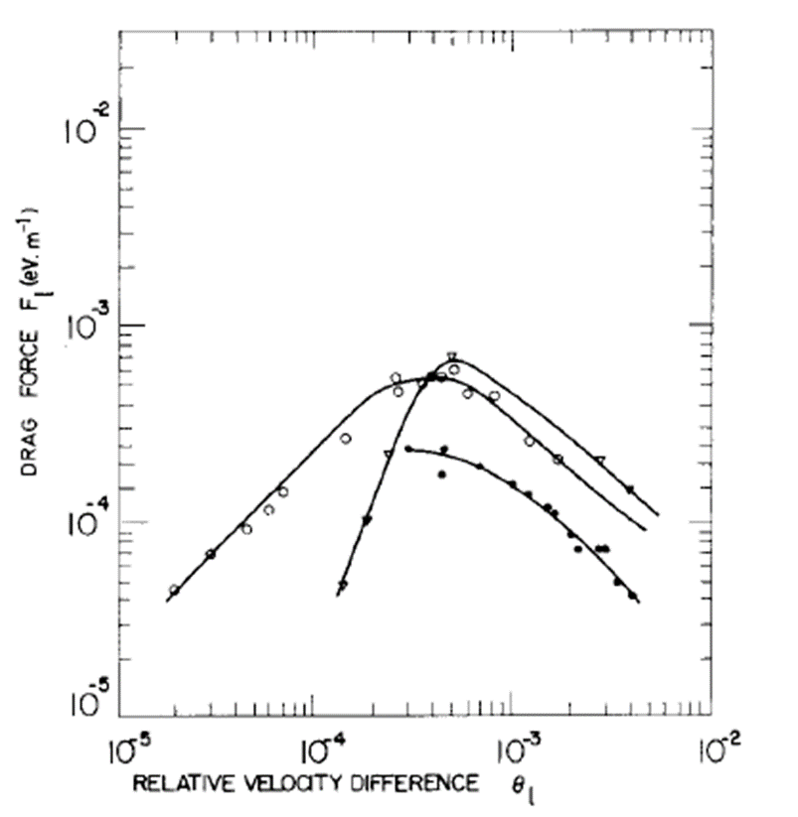
The momentum cooling force, for small betatron amplitudes, was measured separately by first cooling the beam and then suddenly increasing the gun voltage and observing the subsequent acceleration of protons.
By voltage increases in the range 2-300 V fractional relative velocities in the range 5 x 10⁻⁵ to 6 x 10⁻³ were created. The proton acceleration was observed as a change of revolution frequency, with the longitudinal pickup, and as a change in radial beam position, with the horizontal beam profile monitor.

Slide 23
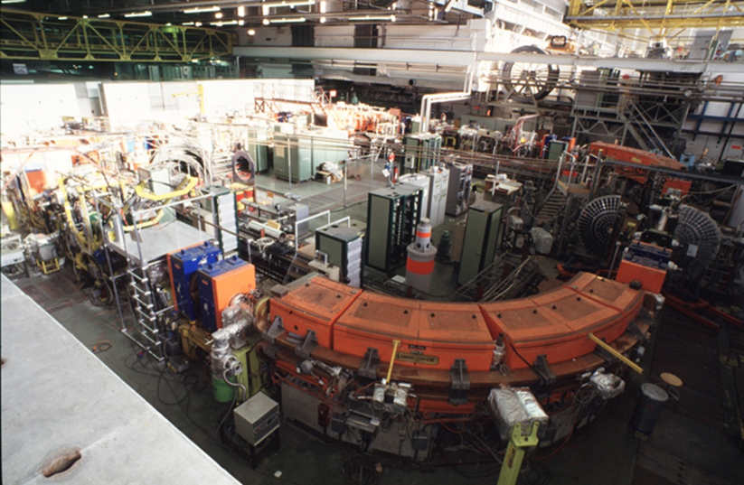
King LEAR (1982-1997)
Low Energy Antiproton Ring
78.54 m storage ring
2 to 0.1 (0.063) GeV/c
Ultra-slow extraction (17 hrs)
UHV 10⁻¹¹ – 10⁻¹² Torr

Slide 24
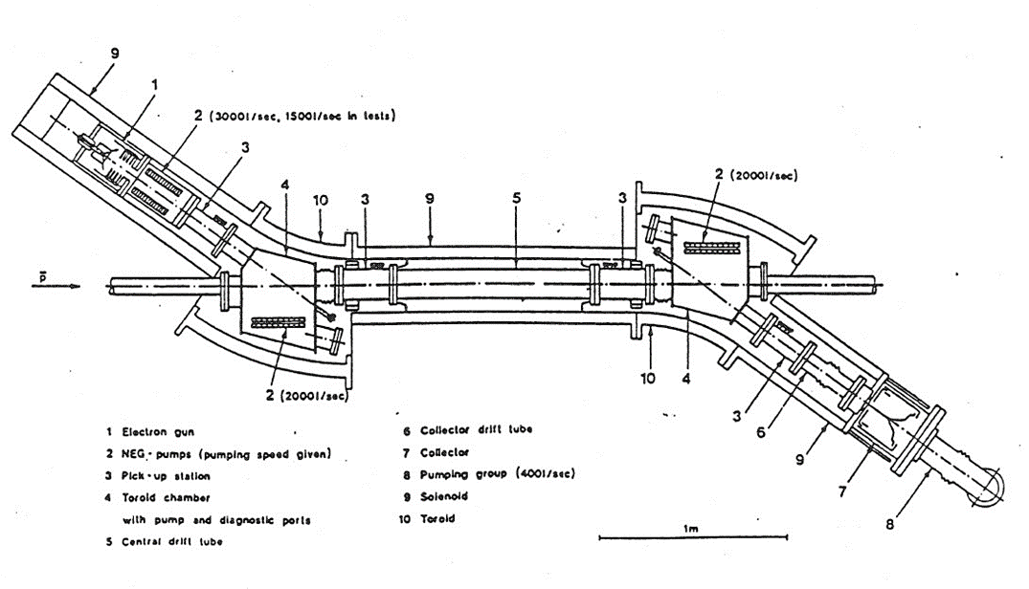
The required static vacuum level of less than 10⁻¹¹ torr meant that the cooler needed a major upgrade of its vacuum system. The high gas load coming from the cathode and collector regions had made the operation on ICE very problematic and the best obtainable vacuum was in the order of 10⁻¹⁰ torr. Higher pumping speeds and a careful choice of materials were needed if any significant reduction in the vacuum level was to be obtained and an extensive study of various techniques was carried out between 1981 and 1984.
the complete vacuum envelope was re-designed and built using high quality AISI 316LN stainless steel
designed to be bakeable at 300˚C in situ (permanently installed jackets)
use of NEG (non evaporable getter) strips

Slide 25
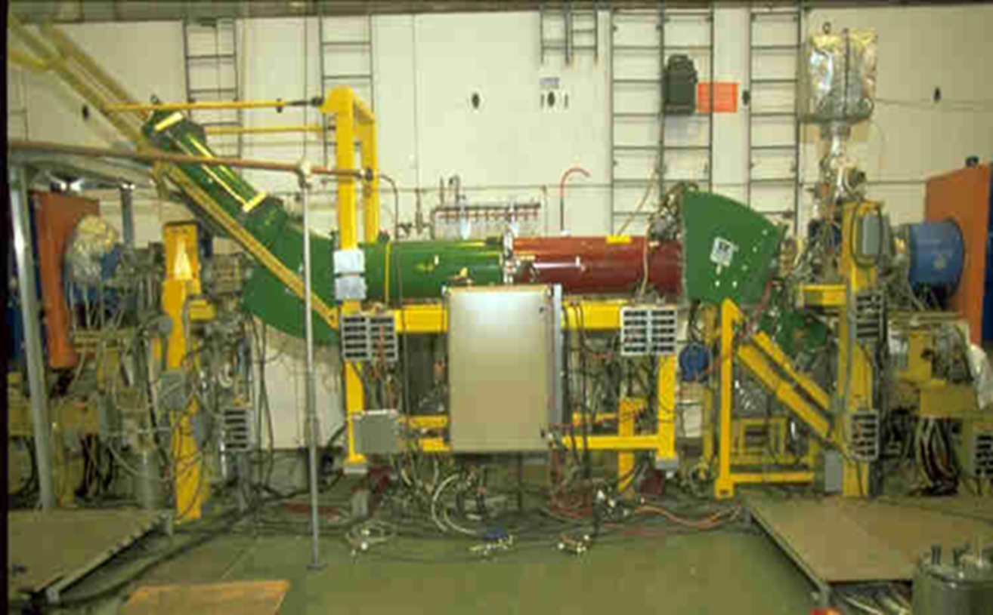
(Anti)proton energy [MeV] | 49.45 | 21.08 | 5.86
Electron energy [keV] | 26.9 | 11.5 | 3.2
Electron current [A] | 2.5 | 0.7 | 0.09
Solenoid field [Gauss] | 455 | 300 | 145

Slide 26
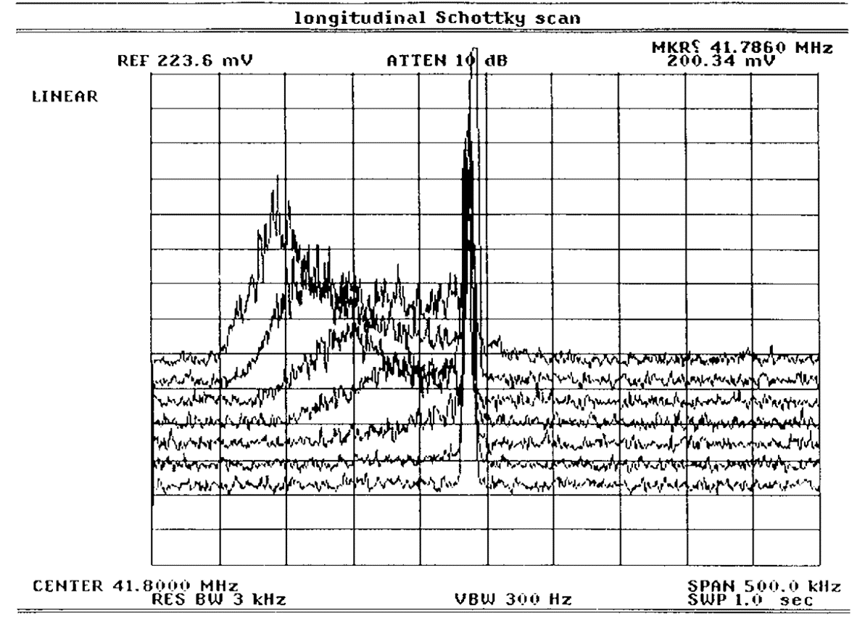
1st cooling of 50 MeV proton from Linac 1 (Oct. 1987)

Slide 27
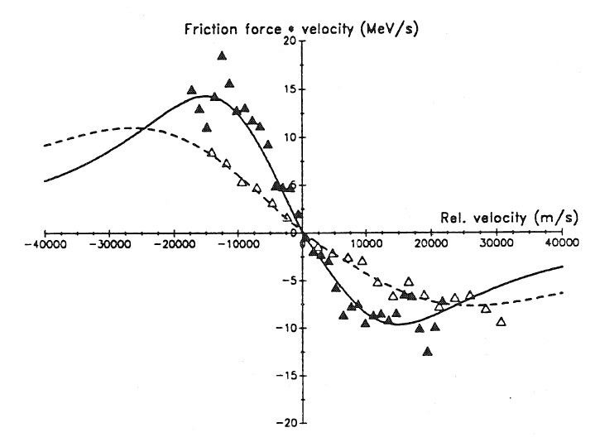
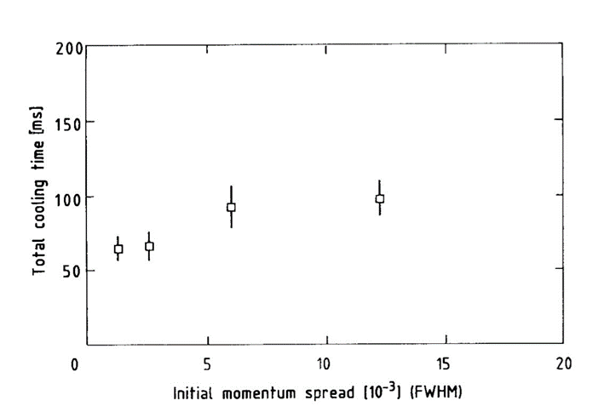
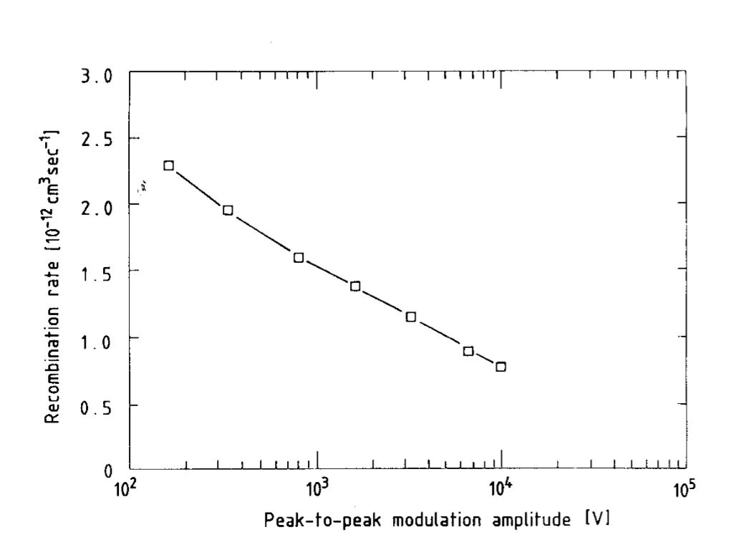
Extensive studies with anti(protons), H⁻, oxygen and lead ions
  Frictional force studies, cooling times……
  Recombination of ions
  First cooling/stacking of ions
  Instabilities – development of a damper
  Influence of lattice parameters on beam cooling
  Electron beam neutralisation

Slide 28
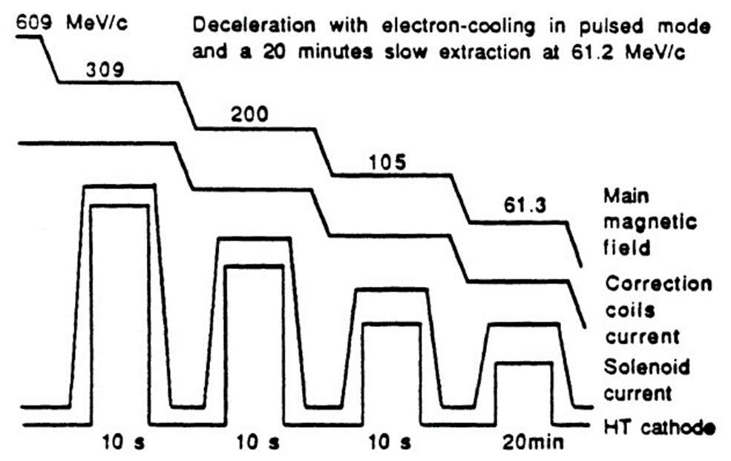
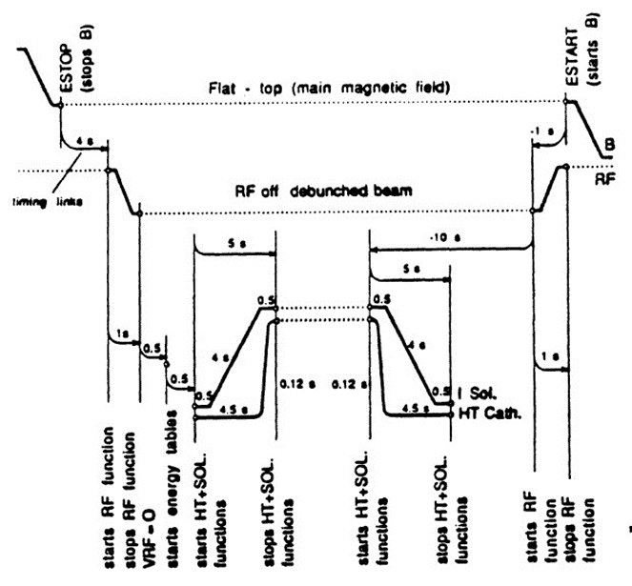
Operation (with antiprotons) of cooler was made in the “pulsed” mode
Electron cooling was applied at fixed flattops (plateaus) during deceleration
Required careful programming and synchronisation of the function generators
New electron collector for reliable operation with full perveance gun (1991)
New electron gun allowing the online control of the electron beam intensity (1992)
Electron beam energy feedback system

Slide 29
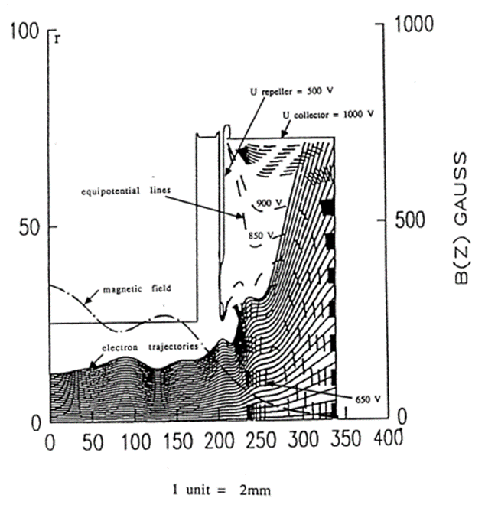
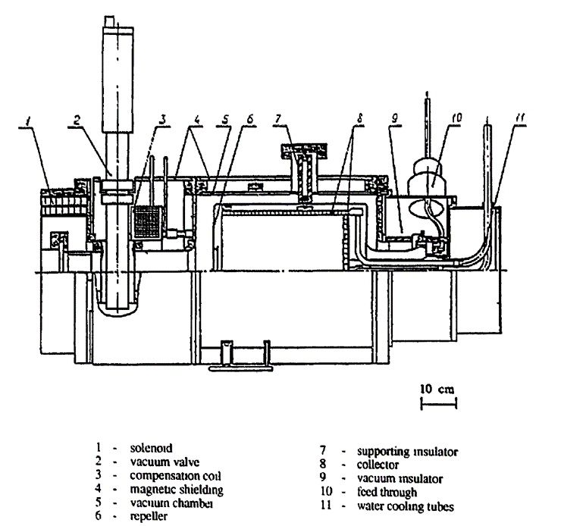
Faraday cup with a suppressor (repeller) electrode at the collector entrance.
Collector is connected to the electron cooling device via a vacuum valve which allows repairs on the collector without disturbing the LEAR vacuum system.
The need to install a vacuum valve resulted in the displacement of the collector from the main solenoid. To compensate for this "'gap" in the magnetic field, a special coil was added just after the valve. It produced an axial field of up to 0.1 T which also created a magnetic trap at the collector entrance. The electron deceleration and expansion occurs in this area of decreasing magnetic field.

Slide 30
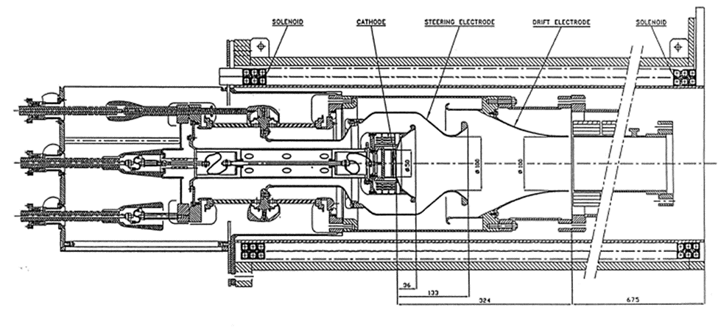
Adiabatic optics
Fixed magnetic field of 600 G (easier for operation)
5 cm Cathode
“Steering” electrode to give the desired current
Anode (drift) at ground potential

Slide 31
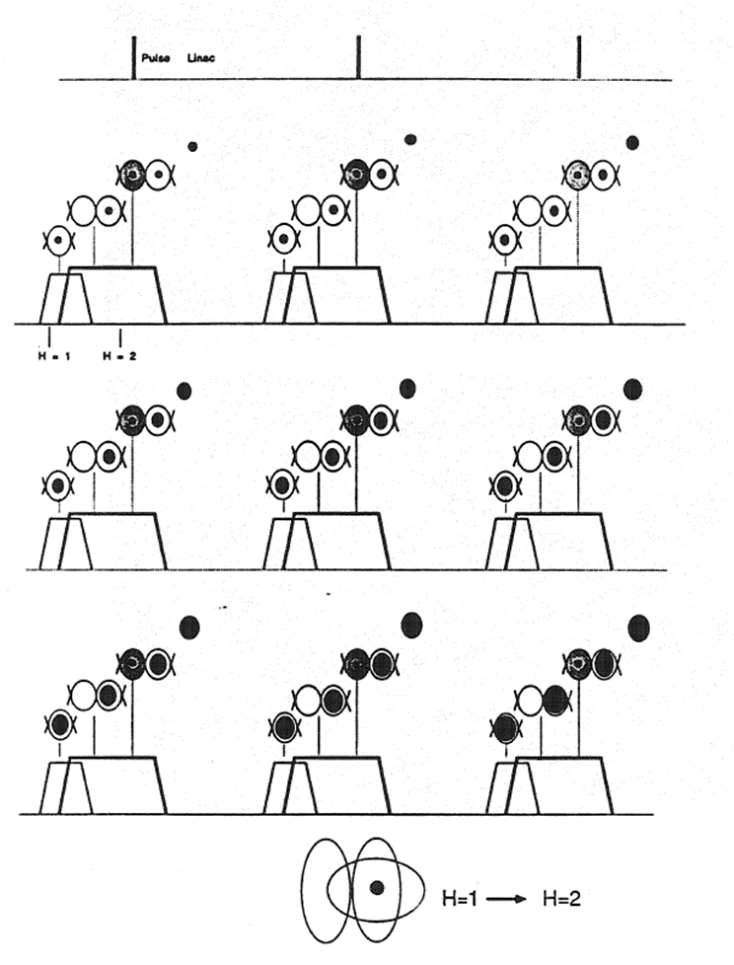
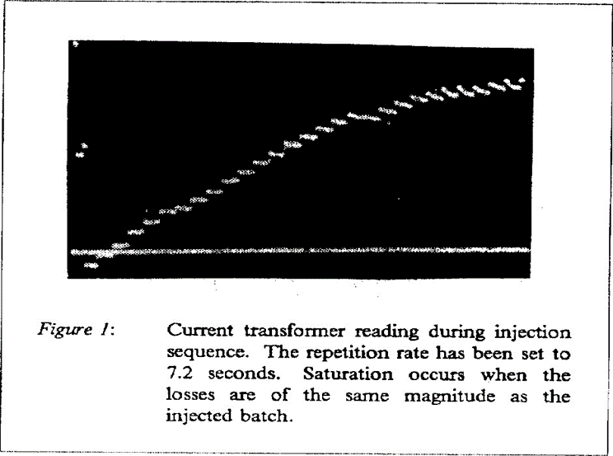
Oxygen ion cooling and accumulation in LEAR
11.4 MeV/nucleon
4 x 10⁸ charges per Linac pulse
On average 8 x 10⁹ charges accumulated (max 13 x 10⁹)
Damper needed to fight instabilities
Accumulation scheme based on H1-H2 bunching with electron cooling and injection into empty bucket

Slide 32
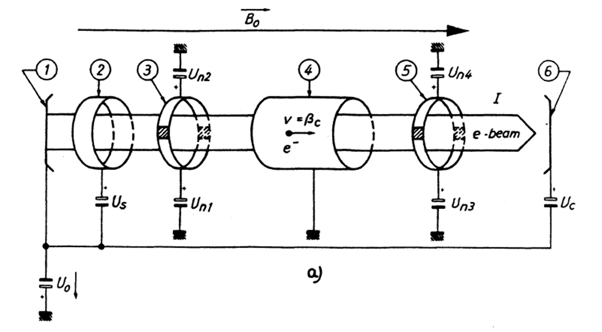
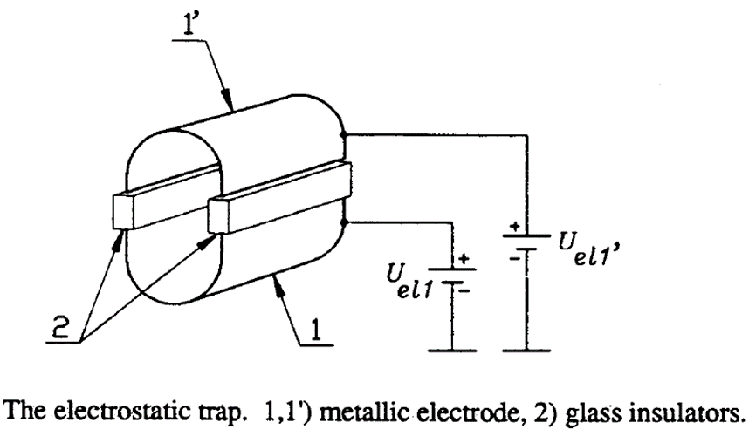
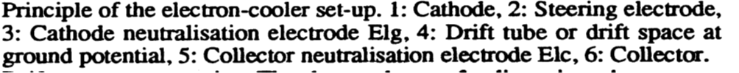
Electron beam space-charge induces an azimuthal drift velocity which is detrimental to the cooling process.
This effect can be reduced by neutralising the electron beam.
Electron beam neutralisation is obtained by trapping ions from the residual gas in a volume between two trap electrodes. These electrodes create a transverse electric field which causes the ions to be reflected at the level of the traps. The ions oscillate and accumulate between the trap electrodes while low energy secondary electrons created through ionization escape due to the crossed electric and magnetic fields.

Slide 33
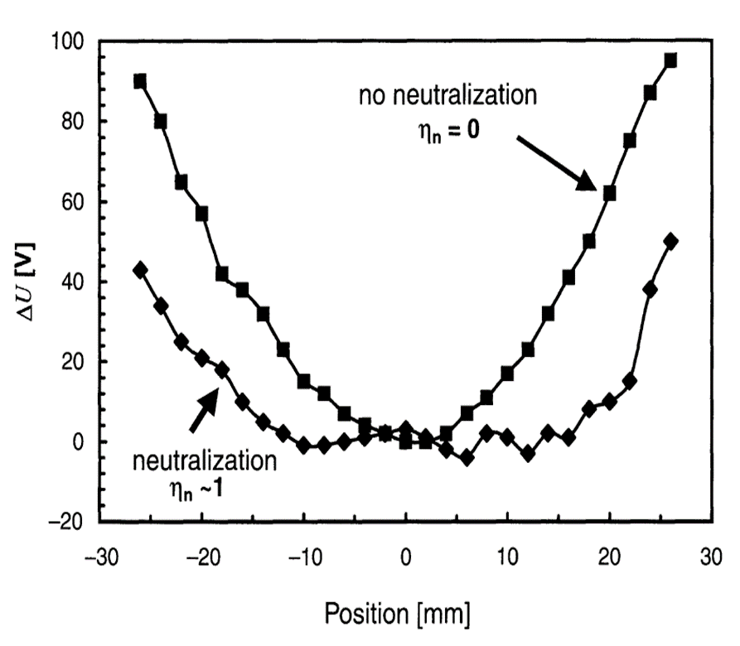
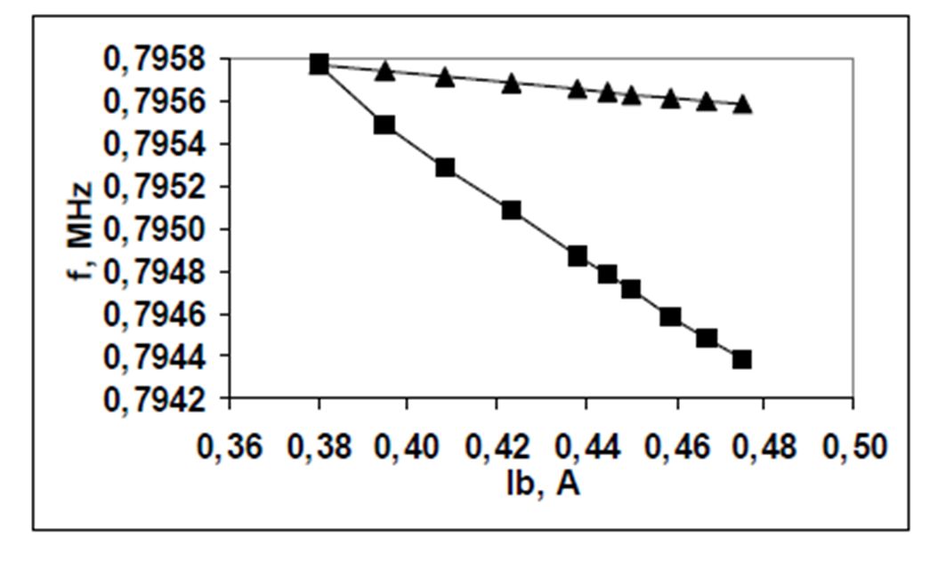
Using the circulating ion beam as a probe it was possible to measure the radial distribution of the electron beam potential. By displacing the ion beam horizontally in the cooling section, the change in electron energy needed in order to bring the circulating beam back to its original momentum was recorded. In this manner we were able to reconstruct the potential distribution within the electron beam.
A classical parabolic distribution which is measured when the electron beam is not neutralised. When neutralisation is switched on, the potential is constant in the central part of the beam and increases abruptly on the edges. The radius over which the potential is constant depends on the degree of neutralisation. Therefore the flatter the distribution, the greater the neutralisation coefficient.

Slide 34
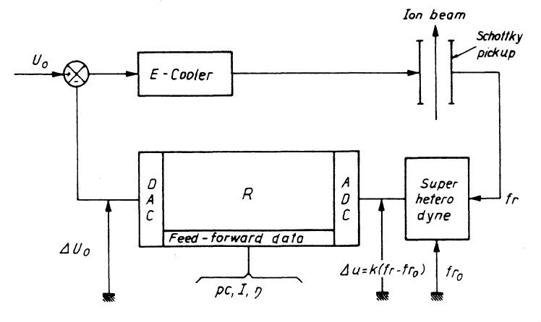
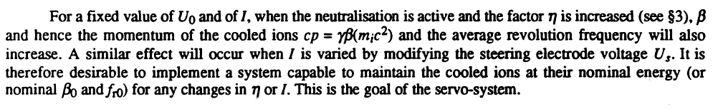

Slide 35
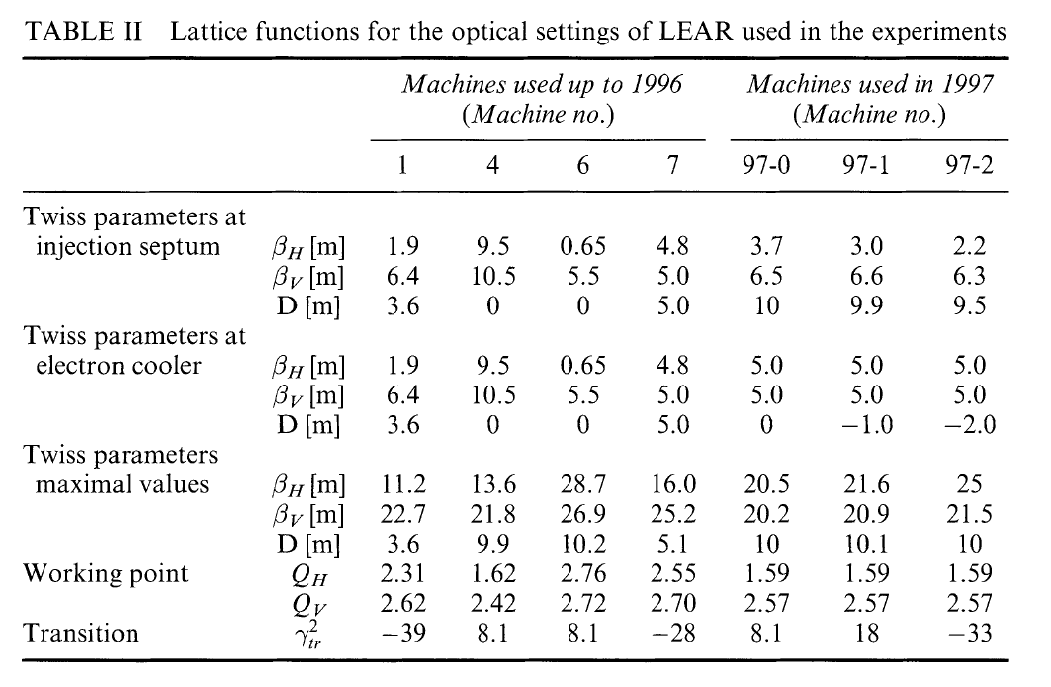
Influence of Lattice Functions

Slide 36
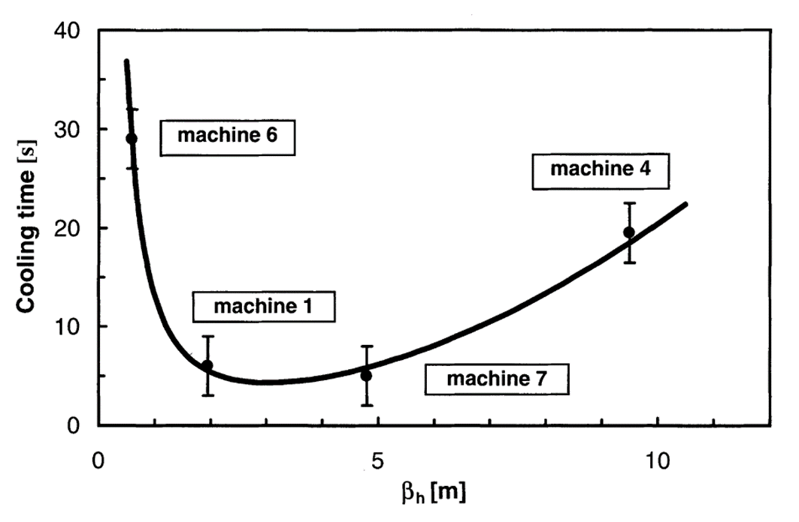
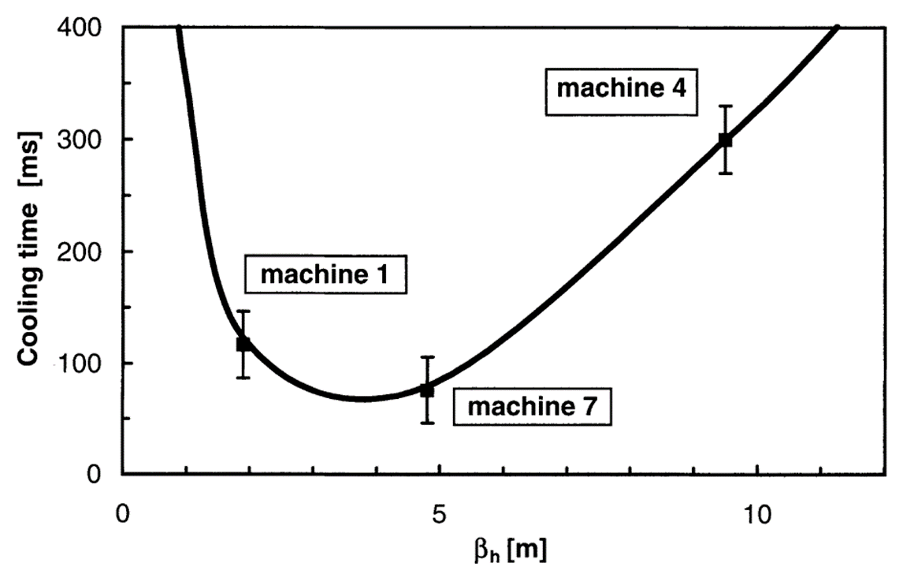
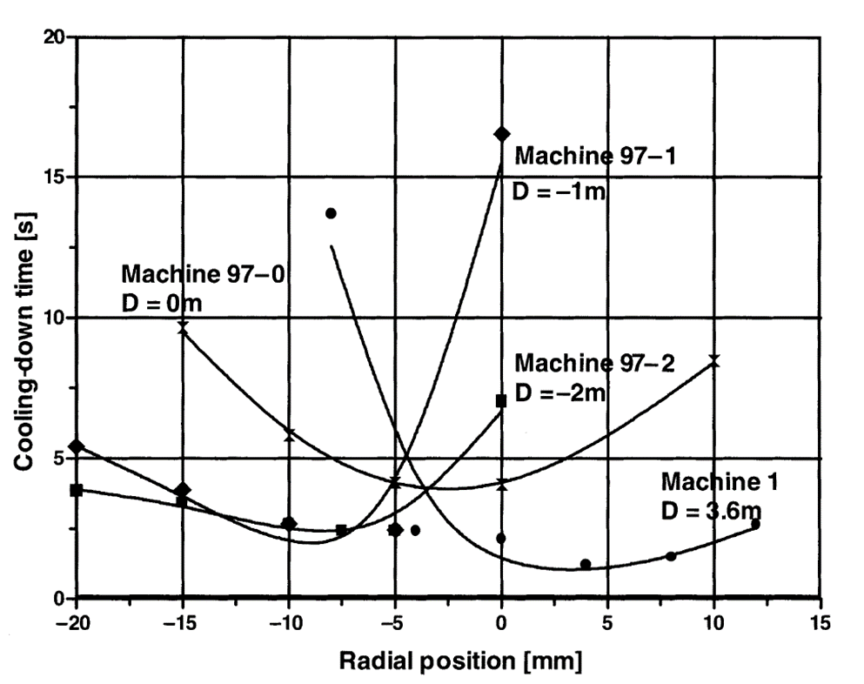
Cooling-down time for Pb⁵⁴⁺ ions at 4.2 MeV/nucleon. The electron current was 350 mA and the cooling length 1.5 m.
Cooling down time for protons at 50 MeV. The electron current was 1.2A and the cooling length 1.5 m. The measured time is the time needed to cool about 2 x 10⁹ from a horizontal emittance of 40π mm mrad down to 4π mm mrad.
Cooling-down time for 50 MeV protons as a function of the horizontal offset between proton and electron beam for machine 1 and machines 97-0, 97-1 and 97-2. The electron current in this measurement series was 1.1 A and the cooling length was 3 m.

Slide 37
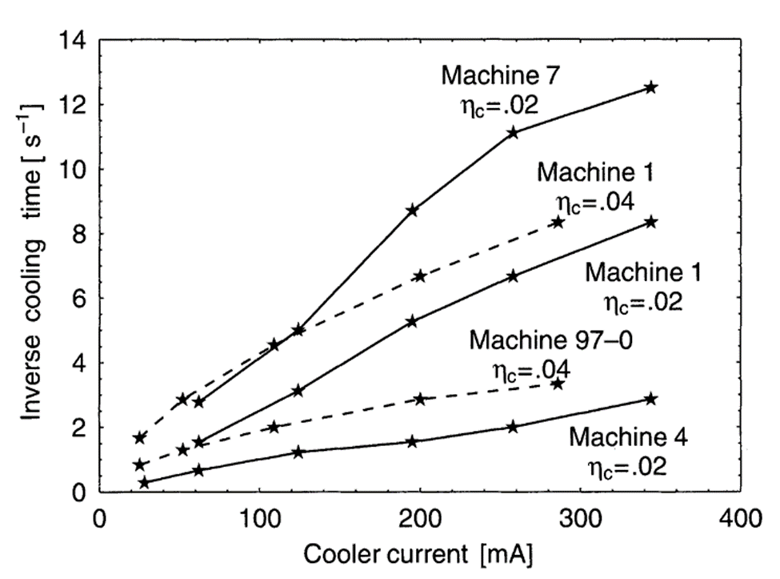
Cooling rate of Pb⁵⁴⁺ ions as a function of the electron-beam current for different lattice parameters and different lengths η = 0.02, i.e. le = 1.5m and η = 0.04, i.e. le = 3m]. The cooling rate is defined as the inverse of time needed to cool from a horizontal emittance 40π mm mrad down to 4π mm mrad. The initial vertical emittance and momentum spread were about 7π mm mrad and 0.5 x 10⁻³ respectively.

Slide 38

From LEAR to LEIR
Low Energy Ion Ring
Cool and accumulate Pb ions
Pb⁵³⁺ originally planned for accumulation
However the short beam lifetime lead us to investigate the possibility of using another more stable charge state.
Pb⁵²⁺ to Pb⁵⁵⁺ lifetimes were measured.
Vacuum lifetime in good agreement with semi-empirical formula of Franzke for a gas composition: 82% H₂ and 18% heavier molecules (CO, N₂).
From the slope one can estimate the recombination rate coefficient.
Measured rates higher than what one would expect for radiative recombination.
For Pb⁵³⁺ the rate is even higher.

Slide 39

E_{e} up to 6.5 keV
Ie = 600 mA
k = 1.8, r = 14 to 25mm
B (in cooling section) = 750 G
Variable density electron gun
Beam expansion
Electrostatic bend
Pancake structure of magnets
NEG coated vacuum chambers
NEG strips in gun/collector regions
Static vacuum pressure 4 x 10⁻¹² Torr

Slide 40



1. 14mm convex cathode
2. Control electrode (modifies density distribution and intensity)
3. Pierce electrode
4. Grid electrode (fixes the intensity)

Slide 41





Slide 42


Hollow electron beam gives best results when cooling at fixed energy (i.e. one injection)
For stacking, a flat electron beam distribution gives the fastest cooling rates

Slide 43


Beam size as a function of electron beam density distribution for constant current

Slide 44

Antiproton Decelerator (1999…)
Old ACOL (antiproton collector) ring
Deceleration of antiprotons to 100 MeV/c (5.3 MeV)
4 x 10⁷ pbars/cycle (~100s)
Deceleration efficiency 85%
Beam cooling on all plateaus:
  Stochastic 3.57 and 2 GeV/c
  Electron 0.3 and 0.1 GeV/c
LEAR electron cooler moved to AD after dedicated PB ion run on LEAR

Slide 45




Slide 46

ECOOL deceleration
Electron cooler used to ”drag ” the antiproton beam to a lower energy.
AD magnets ramped synchronously with electron beam energy.
Small emittances and momentum spread are preserved during the deceleration .
No need for an RF cavity.
time
Revolution frequency
Beam successfully decelerated from 100 MeV/c (5.3 MeV) to 95.3 MeV/c (4.8 MeV).

Slide 47

Low energy antiprotons: ELENA
Extra Low ENergy Antiproton ring
Small post-decelerator employing electron cooling for efficient deceleration down to 100keV kinetic energy
  Injection of a bunched beam followed by deceleration
  Beam cooling at intermediate momentum to counteract beam emittances and momentum spread blow up
  Deceleration down to extraction energy, beam cooling, bunching at harmonic h=4, then compression to provide required bunch length and fast extraction
  The final goal is delivering to experiments beam 1.3m long with 1σ~1mm

Slide 48


Slide 49
Momentum (MeV/c) | 35 | 13.7
β | 0.037 | 0.015
Electron beam energy (eV) | 355 | 55
Electron current (mA) | 5 | 1
B_{gun} (G) | 1000
B_{drift} (G) | 100
Expansion factor | 3.16
Cathode radius (mm) | 8
Electron beam radius (mm) | 25
Operate at very low electron energies (down to 55 eV).
Operate at very low magnetic field to minimize disturbance to circulating low energy antiprotons
  100 Gauss in the cooler.
Have extremely good vacuum.
Adiabatic expansion of electron beam to reduce transverse temperature.
Very good field quality
  cooler solenoid (B_{t}/B_{ǁ} < 5 × 10⁻⁴ ).
Orbit correctors and solenoid compensators.

Slide 50



Slide 51

Magnetic system components
Main (drift) cooler solenoid
Gun solenoid
Collector solenoid
Expansion solenoid
Squeeze coil at collector
2 x Toroid section consisting of 9 racetrack coils each
Various corrector coils to ensure good field quality
Electron beam steerers
Orbit correctors

Slide 52






Slide 53
Magnetic measurement setup
Lakeshore Model 460 Gaussmeter with 3-axis HSE probe (1 mG resolution in range up to 300 G, accuracy of ±0.1%).
Probe holder with mirror for precise alignment. Has 4 possible rotational positions with 3 mounting points (0, 10 and 25 mm).
Counter balanced carbon fibre tube to hold probe holder.
Probe carrier and tube driven and positioned with a CMM arm with ±0.5 mm accuracy.
Precise probe alignment made with an autocollimator and spider fixtures.

Slide 54




Slide 55




Slide 56

First signs of cooling – 4th July
First signs of cooling were visible on the bunched beam signals for the deceleration between the two cooling plateaus. The enhancement of the signal level indicates an increase of the phase-space density of the re-captured beam due to electron cooling at 35 MeV/c.

Slide 57


Slide 58


Slide 59
And the future?
Optimisation of the ELENA cooler
Cold electron source for low energy electron cooling
  Electron generator array (EGA)
  Field emission carbon nanotubes (FE CNT)
New electron cooler for the AD
  Many components of present cooler are dated (issue with spares)
  Cool at a higher energy
  Make use of latest advances in cooler design and vacuum technology
Operation of LEIR cooler at 10 Hz
  Higher electron beam current
  How useful is the hollow electron beam distribution?

Slide 60



FE CNT test bench
A first test bench has been designed to characterise:
  Necessary conditioning process
  Emitted current in function of the applied electric field
  Stability of the emitted current
  Lifetime
Molybdenum Anode
Carbon Nanotubes (CNT)
Ceramic spacer

Slide 61

CNT Array 1
CNT Array 2

Slide 62
Conditioning Tests
CNT Array 1
CNT Array 2
1.48 V/µm
1.48 V/µm
2.63 V/µm
2.52 V/µm

Slide 63
Current Density vs Electric Field
CNT Array1 - Threshold Field (1 mA/cm²):
  E_{tr} = 1.67 V/μm in both cases.
  t1 ~ 380 h, t2 ~ t1 + 300h.
CNT Array 2 - Threshold Field (1 mA/cm²):
  E_{tr} = 2.71 V/μm.
  t1 ~ 250 h.

Slide 64
Lifetime Measurement
Total Burn-out not reached. Total: ~ 1500 h.
E_{a} = 2.26 V/μm
Total Burn-out after ~ 230 h. Total: ~ 500 h.
E_{a} = 3.33 V/μm

Slide 65


Measurement of longitudinal and transverse energy depending on the inter-electrode distance.
Assessment of grid effect and choice of the best grid.
Simulation of the emitted beam.
Design, production and test of the electron gun.
Extracting Grid
Support for CNT
Linear Motion Feedthrough

Slide 66




A new cooler for the AD
Maximum energy: 80 keV
Electron beam energy: 68.125 keV
Antiproton beam momentum: 500 MeV/c
Accelerating voltage: 68.808 kV
Relativistic beta: 0.471
Maximum electron current: 3.5 A
Cathode radius: 1.25 cm
Magnetic field in gun: 2400 G
Magnetic field in drift: 600 G
Expansion factor: 2
Beam radius in drift: 2.5 cm
Horizontal orientation
Electron gun study
Pancake coils
Electron beam collector

Slide 67
What will be different?
Cooling at a higher antiproton momentum (≤500 MeV/c)
  Less blow-up during deceleration
Horizontal orientation
  Easier interventions
Electrostatic plates in each toroid.
  Control losses
NEG coated vacuum chambers.
  Better vacuum
Fast ramping of the expansion solenoid to adapt the electron beam size during cooling.
New solenoid design using pancakes and iron bars for the return-flux.
  Fine tuning of magnetic field
Compact orbit correctors (as used on ELENA).

Slide 68
Summary
Electron cooling has played a pivotal role in the success of the low energy physics program at CERN for 40 years. The first electron cooler has seen two re-incarnations and is still used today to provide cold antiproton beams to the AD experiments. The heavy ion program for the LHC and the fixed target experiments would not be possible without the LEIR electron cooler which accumulates and cools a variety of ions and is central in the whole injection chain. The future looks bright for electron cooling at CERN with a new low energy cooler being commissioned on ELENA and a new cooler foreseen for the AD such that the original ICE cooler can finally retire after so many years of excellent performance.

Slide 69
Thank You

