Slide 1

Summary of the HL-LHC Wire Compensation Meeting
G. Sterbini, Y. Papaphilippou, A. Rossi
on behalf of the participants of the participants of the
WP2/WP13 HL-LHC Wire Compensation Meeting, FERMILAB, 17th October 2019
WP2 meeting, 26th November 2019

Slide 2
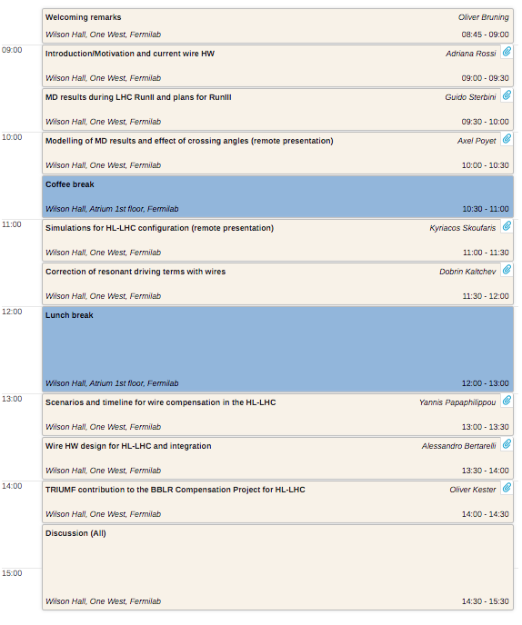

Links and Outline
INDICO link
1. Setting the scene
2. Results RUN2 and perspective RUN3
3. HL-LHC theory, simulation and potential
4. Technical aspects & TRIUMF potential contributions
5. Main conclusions
Minutes of the meeting

Slide 3
Links and Outline
INDICO link
1. Setting the scene
2. Results RUN2 and perspective RUN3
3. HL-LHC theory, simulation and potential
4. Technical aspects & TRIUMF potential contributions
5. Main conclusions
Minutes of the meeting

Slide 4
HL-LHC management perspective
The wire compensation option is NOT in the HL-LHC baseline.
HL-LHC supported the demonstrators constructions and the studies but cannot support the HL-LHC compensators.
It can be envisaged only if additional resources (in-kind contributions) could be allocated.
The HL-LHC management supports and recommends initiatives along this direction. In particular a potential contribution from TRIUMF in the Beam Dynamics studies, in the wire compensator technical design and in its fabrication is welcome, desired and praised.
O. Brüning
Notes:
Since 2018 four wire demonstrators are installed in LHC (B2, IR1+IR5) with the aim to explore the potential of the wires in HL-LHC.
4

Slide 5
The goal of the meeting
To present/discuss the latest experimental and simulation results at LHC with the present demonstrator of wire for Beam-Beam Long Range Compensation.
To present/discuss the predictions for the HL-LHC, together with first ideas for the wire hardware design and possible implementation.
To build upon the existing collaboration between TRIUMF and CERN, look for a framework for future contributions from TRIUMF to HL-LHC for BBLR wire compensation.
A. Rossi
Notes:
Since 2018 four wire demonstrators are installed in LHC (B2, IR1+IR5) with the aim to explore the potential of the wires in HL-LHC.
5

Slide 6
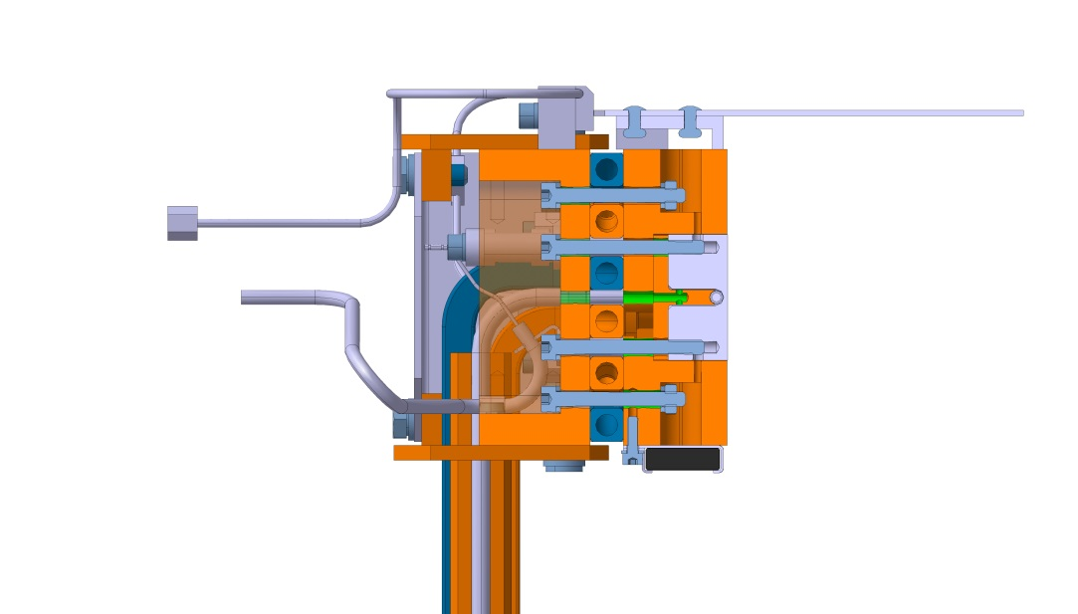
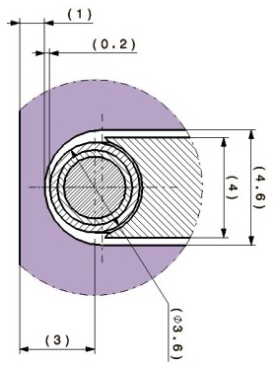

The LHC wire demonstrators
2.48 mm
3 mm
Courtesy of L. Gentini
Layout of the wire installation, not to scale
Front view
Since 2018 four wire demonstrators are installed in LHC (B2, IR1+IR5) with the aim to explore the potential of the wires in
Notes:
Since 2018 four wire demonstrators are installed in LHC (B2, IR1+IR5) with the aim to explore the potential of the wires in HL-LHC.
6

Slide 7
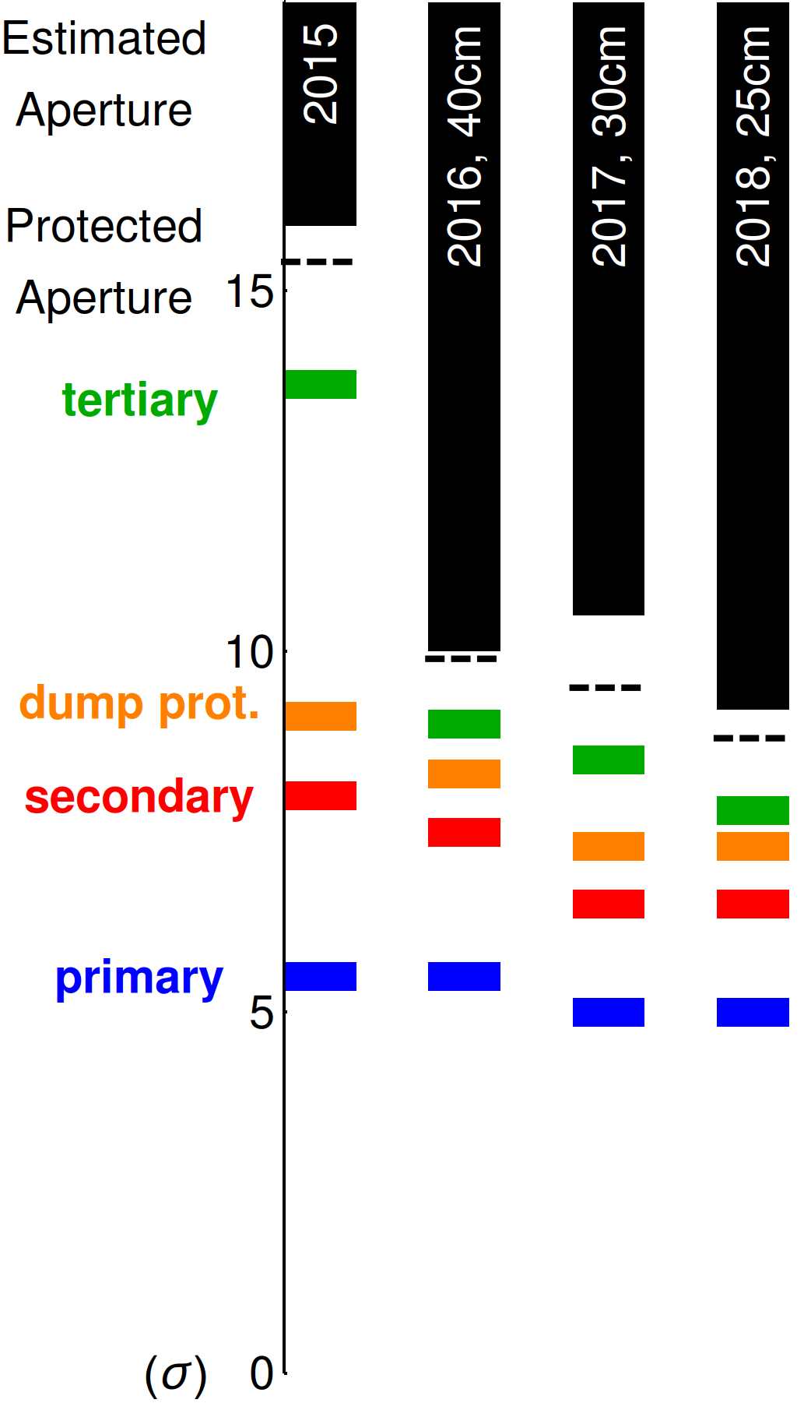
Transverse positions of the wires
The wire are installed in the crossing plane of the Interaction Region, i.e.,
  vertical in IR1,
  horizontal in IR5.
Given the constraints of the LHC collimation hierarchy, two classes of experiments were performed
  LI: Low Intensity experiment with wire-collimator just in the shadow of the primary collimators
  HI: High-Intensity experiment with wire-collimator at the operational position.
HI experiment
wire collimator at operational positions
LHC collimation hierarchy
LI experiment
wire collimator position at 5.5 σ¹
Courtesy of R. Bruce
Wire demonstrator | LI experiment | HI experiment
 | beam-wire distance [mm]
L1 | -7.41 | not powered
R1 | 7.42 | 9.83
L5 | -7.15 | not powered
R5 | 8.24 | 11.10
¹ An ε_{n}=3.5 mm mrad assumed.
Notes:
===READ===
Concerning the transverse position of the wires
The wire are installed in the crossing plane of the Interaction Region, i.e.,
vertical in IR1,
horizontal in IR5.
Given the constraints of the LHC collimation hierarchy and the machine protection, two classes of experiments were performed.
LI: Low Intensity experiment with wire-collimator just in the shadow of the primary collimators.
HI: High-Intensity experiment with wire-collimator at the operational position (tertiary
In the table, you can see that for the LI experiment the beam-wire distance between 7-8 mm whereas for the HI experiment it is 10-11 mm.

Slide 8
Wire current settings
LI experiment: 1-jaw powered
HI experiment: 2-jaws powered
In the wire-collimator, both jaws house a wire.
In the LI experiment only the wire of one single jaw was powered.
For the HI experiments the wires of both jaws where powered: this allowed to double the integrated strength of the quadrupolar, octupolar, etc., components.
OFF
ON
ON
ON
Wire demonstrator | LI experiment | HI experiment
 | Current [A]
L1 | 350 x 1 | not powered
R1 | 320 x 1 | 350 x 2
L5 | 190 x 1 | not powered
R5 | 340 x 1 | 350 x 2
Notes:
To get closer to the target current of the HI experiment, we make use of the second wire available in the wire-collimator demonstrator.
this allowed to double the integrated strength of the quadrupolar, octupolar, etc., components.
In the table the wire current intensity is resported.

Slide 9
The experimental campaign
Winter 2017-18
Installation of the IR1 wires
Experiment with wires in IR5
Experiment with wires in IR1 and IR5
LI experiments
HI experiments
9 h
12 h
14th June 2018
FILL6797-8-9
24th July 2018
FILL6972
1st July 2017
FILL5898-5900
14th September
FILL7169
29th October
FILL7386
Compensation with 2 wires (validation)
From 2 to 4 wires
(validation)
4 wires compensation
Reducing crossing angle
TRAINS and NEW cabling
7 h
26th July 2018
FILL6984
7 h
10 h
10 h
29th Nov 2017
FILL6434-6435
From SETUP BEAM to TRAINS
Compensation with 2 wires
1 h
HI experiments
A rich experimental campaign was performed during the last 2 years: the compensation effect was systematically observed.
Notes:
A rich experimental campaign was performed during the last 2 years (7 different sessions of measurements): the compensation effect was systematically observed.
Most of the times was devoted for the LI experiment. We will show In the following the results of one LI and HI experiment.

Slide 10
HI experiment (operational conditions)
Compensation provides a reduction of B2 losses of ~20%.
Notes:
In the HI experiment, we se the Beam Losses as metric for the compensation.
On the horizontal axis there is time vs wire currents and beam losses.
We started with a relaxed BB crossing angle (160 urad) already observing the beneficial effect of the compensation. The experiment continued exploring more aggressive BB settings. Showing also in this case the systematic beneficial effect of the wires demonstrators.

Slide 11
Simulating the HI experiment
  Second experimental setup: 2-jaws powering configuration
    Both internal/external wires powered
    Only 1 collimator per IP
    Non-safe beam: collimators opened at 8.5𝜎 (operational settings)
    Wires powered up to their maximal possible currents
  From the scan, similar possible improvements (not reachable experimentally)
  In configuration space, effect not so visible but still ~0.8𝜎 gain in minimum DA
HI experiment | beam-wire distance [mm] | Wire Current [A]
L1 | not powered | not powered
R1 | 9.83 | 2 x 350
L5 | not powered | not powered
R5 | 11.10 | 2 x 350
ON
ON
DA dependency on wires current/position (2-jaws powering)
DA in configuration space for MD#4
A. Poyet

Slide 12
Run-III Fill Profile (2021-23)
In 2021: round optics with IP1 crossing in V-plane and IP5 crossing in H-plane.
The wires could be switched on at the end of the leveling.
We assume Run-III collimation settings similar to Run-II ones.
Courtesy of S. Fartoukh and N. Karastathis
Notes:
12

Slide 13
Next steps and proposals
Following these encouraging results, it was proposed
  to use the wires routinely during the next LHC operation period in the High-Intensity configuration
  to equip also the Beam 1 with wires by moving two wire demonstrators (L1 and L5) from Beam 2 to Beam 1.
https://edms.cern.ch/document/2054712/1.0
Notes:
Following these encouraging results, it was proposed
to use the wires routinely during the next LHC operation period in the High-Intensity configuration
to equip also the Beam 1 with wires by moving two wire demonstrators (L1 and L5) from Beam 2 to Beam 1.
First iterations for a HL-LHC wire design are on-going.
13

Slide 14
Towards Run III: Compromise wires/octupoles
  Experimentally, it has been shown that octupoles can be used to mitigate BBLR interactions (with high tele-index) [6]
  Octupoles are needed for coherent stability
  A compromise between wires and octupoles can be considered
  Negative octupoles could help the compensation scheme of the wires
A. Poyet

Slide 15
Run III: Effect on the crossing angle
  Experimentally, we observed that it is possible to reduce the crossing angle, without increasing the losses [1]
  DA dependency on crossing angle and bunch intensity confirms this result
  Run III scenario: crossing angle anti-levelling up to 162 𝜇rad [7]
  Possible use of the wires: power at the end of the fill to reduce the crossing angle, keeping the DA ~ 5𝜎
  Clear possible gain:
    1.2e11 p → 150 𝜇rad
    0.8e11 p → 135 𝜇rad
DA as a function of wire currents (coll. at 8.5 𝜎)
DA with 2 wires (coll at 8.5 𝜎)
A. Poyet

Slide 16
Links and Outline
INDICO link
1. Setting the scene
2. Results RUN2 and perspective RUN3
3. HL-LHC theory, simulation and potential
4. Technical aspects & TRIUMF potential contributions
5. Main conclusions
Minutes of the meeting

Slide 17

Correction of resonant driving terms with wires
THEORY
This approach is alternative to the one presented by S. Fartoukh et al. [PRST-AB 18, 121001] which was based on the kick multipolar expansion.
The rationale is to represent the Hamiltonian associated with the long-range encounter as a 2-D Fourier series using the 2-D generalized Bessel functions.
D. Kaltchev solved numerically the problem assuming horizontal crossing angle. Differently from the approach of [PRST-AB 18, 121001] he did not constrained the left and right wires to have the same physical distance from the weak beam and allowing the wire compensation of all Fourier coefficients for any wire longitudinal positions.
In addition, using the recursive relation of the Fourier coefficients (1D case) D. Kaltchev showed that by compensating the first two non linear Fourier coefficients one compensates all of them.
D. Kalchev

Slide 18
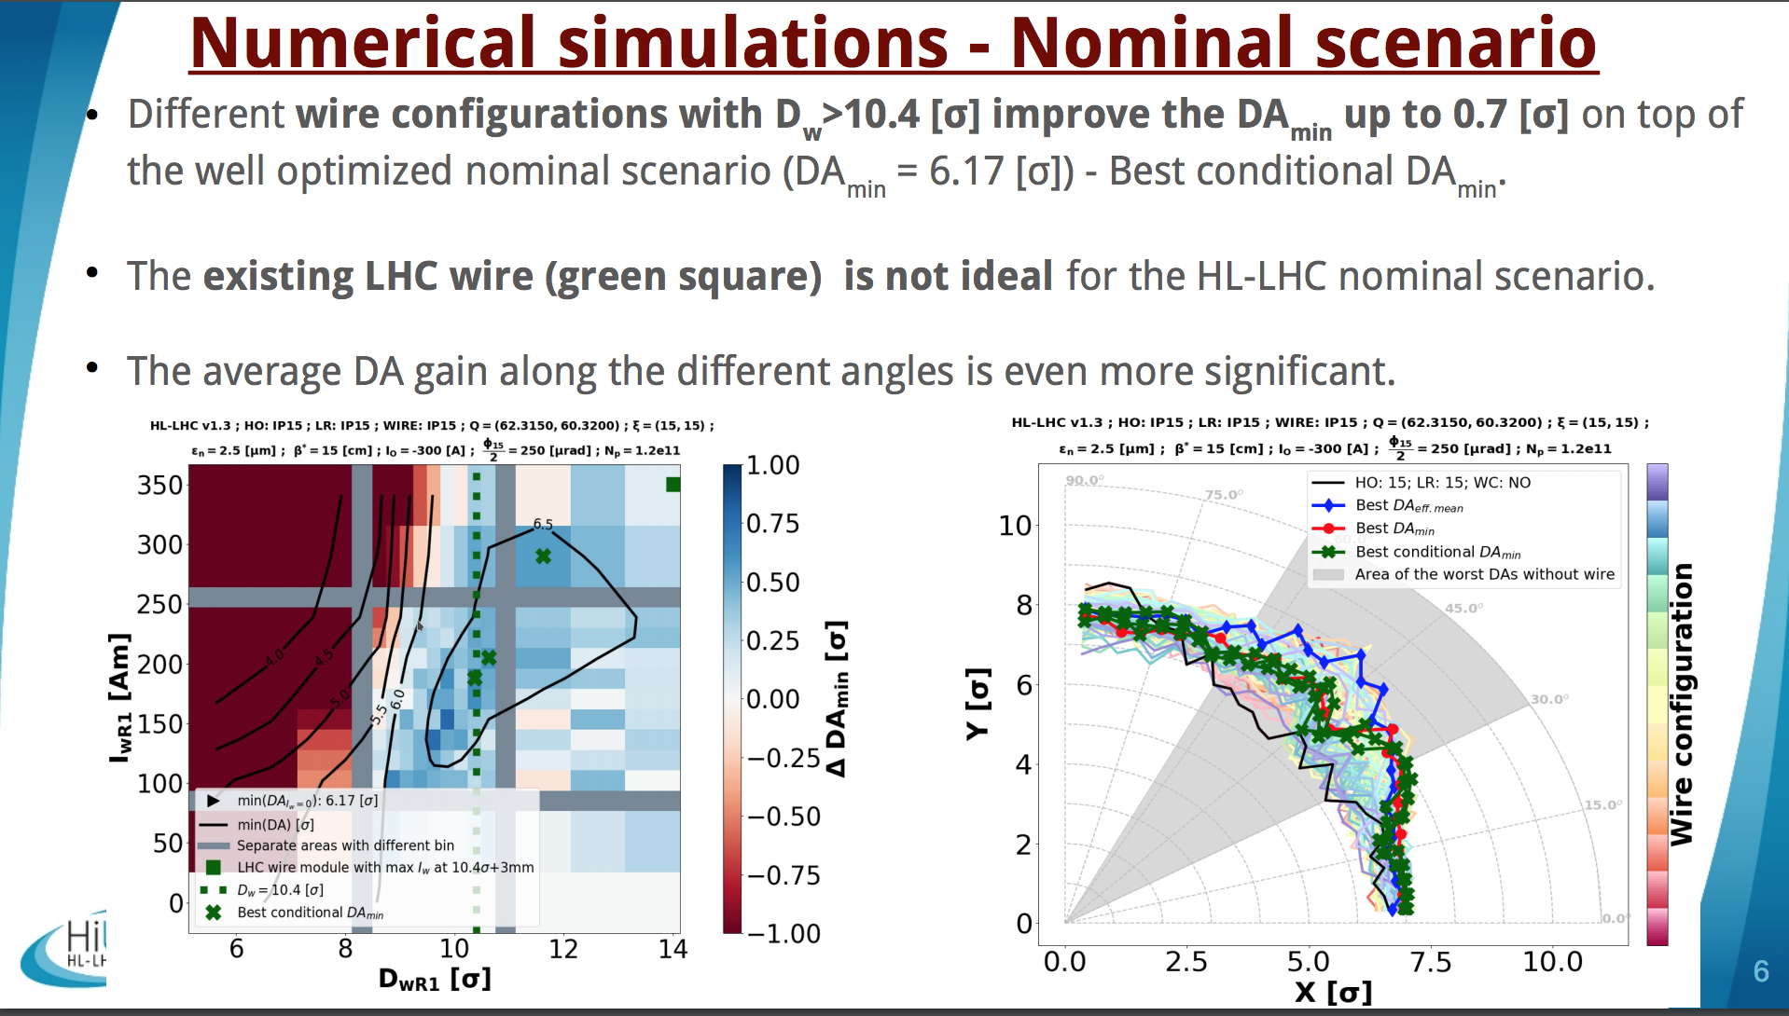
HL-LHC
ROUND
K. Skoufaris

Slide 19
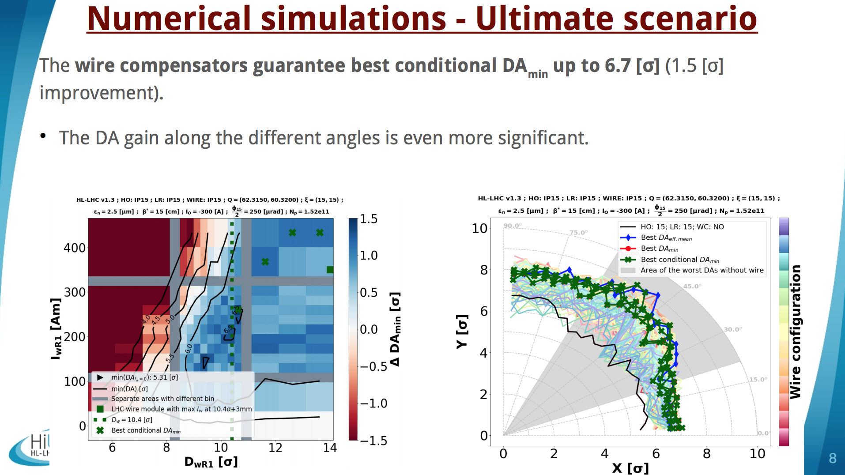
HL-LHC
ROUND
K. Skoufaris

Slide 20
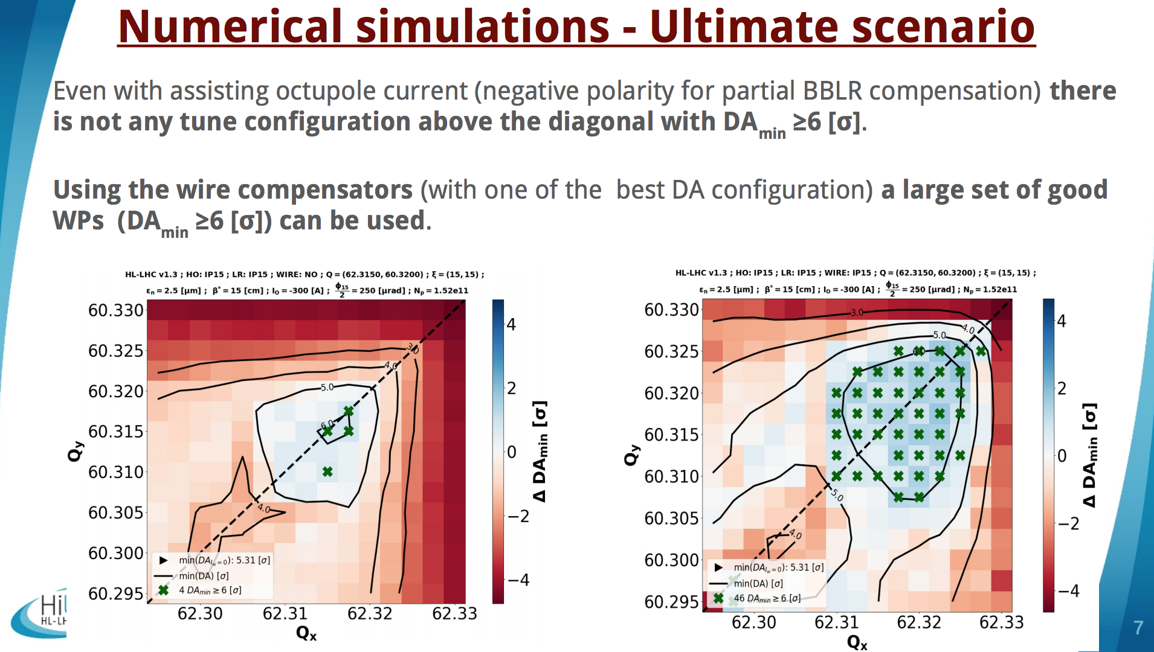
HL-LHC
ROUND
K. Skoufaris

Slide 21
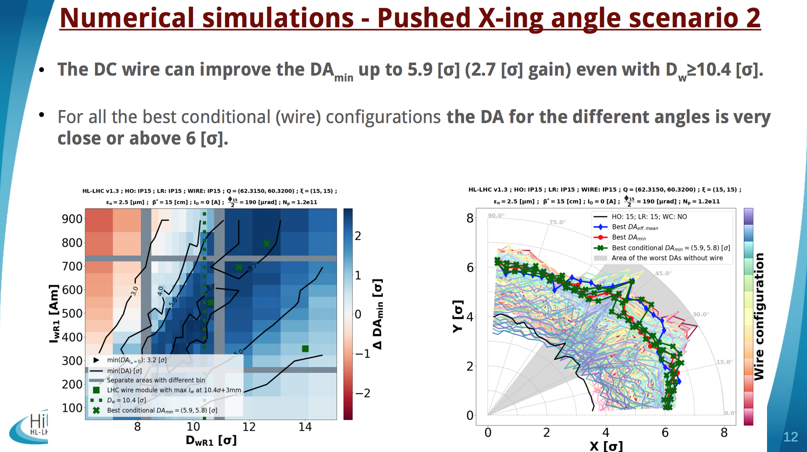
HL-LHC
ROUND
K. Skoufaris

Slide 22
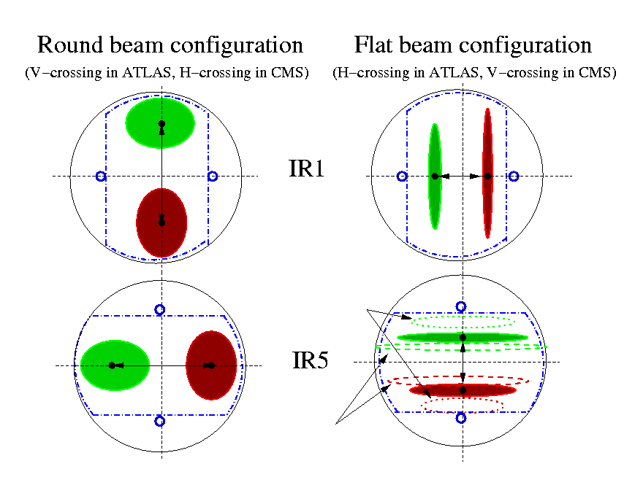
Wire and Flat Optics
HL-LHC
FLAT
Y. Papaphilippou
S. Fartoukh et al, CERN-ACC-2018-0018
  Flat Optics proposed as “plan B” of HL-LHC without CC, due to increased virtual luminosity performance
  Contrary to LHC case, HL-LHC triplet beam screens allow beam flattening in IP1/5 without crossing plane restriction
  By alternating crossing planes, the flat optics reduces HO beam-beam tune shift (and spread) at constant peak luminosity
  BBLR induced tune shift not fully compensated (and similar to HO)
  Feasibility of scheme strongly depends on BBLR compensation
  Detailed operational scenario to be defined, e.g. start colliding at round and then flatten β* more in the parallel plane while intensity decays.

Slide 23
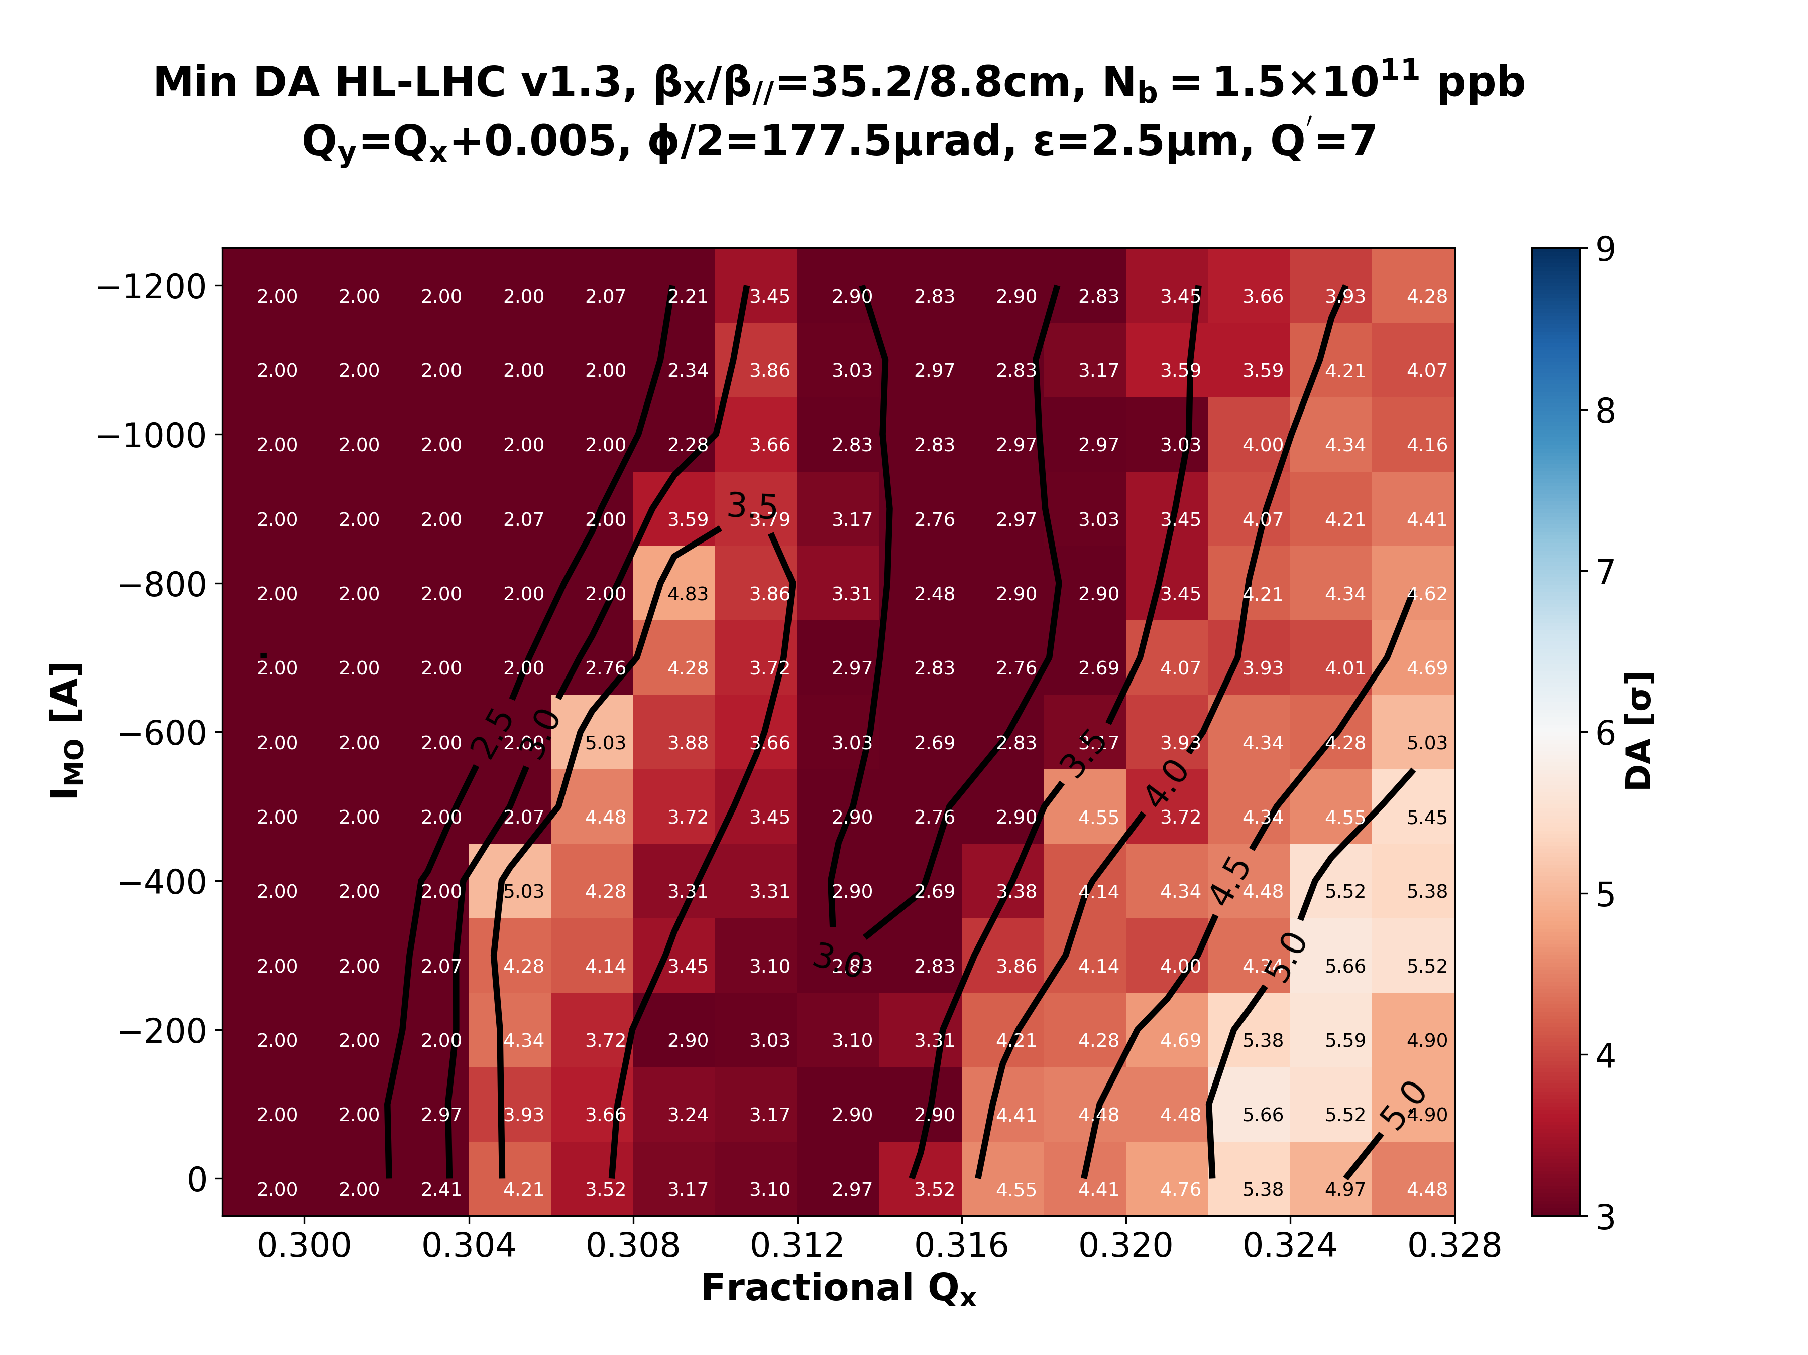
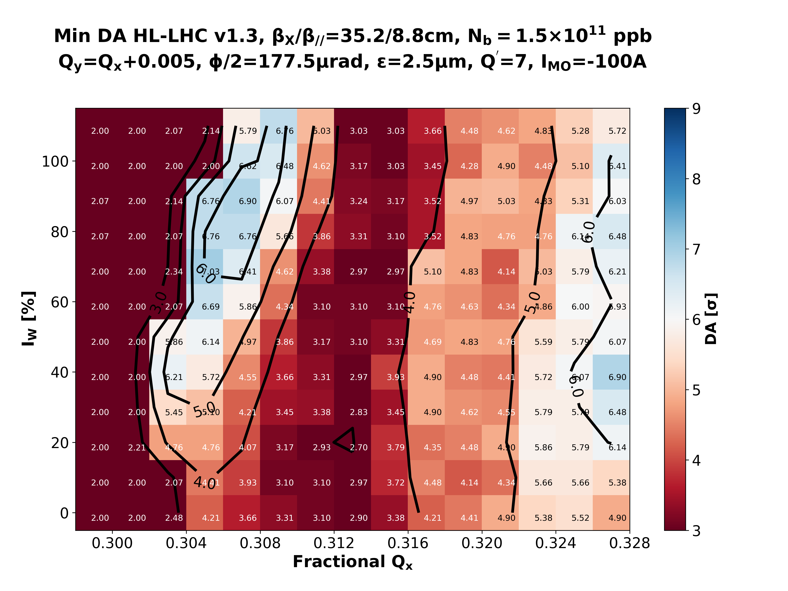
BBLR Compensation
HL-LHC
FLAT
11.5σ – Νο CC
Octupoles
~7σ
island
Wire [IMO=-100A]
Y. Papaphilippou
  The addition of the wire increases DA by ~1.5σ DA at constant normalized crossing angle

Slide 24
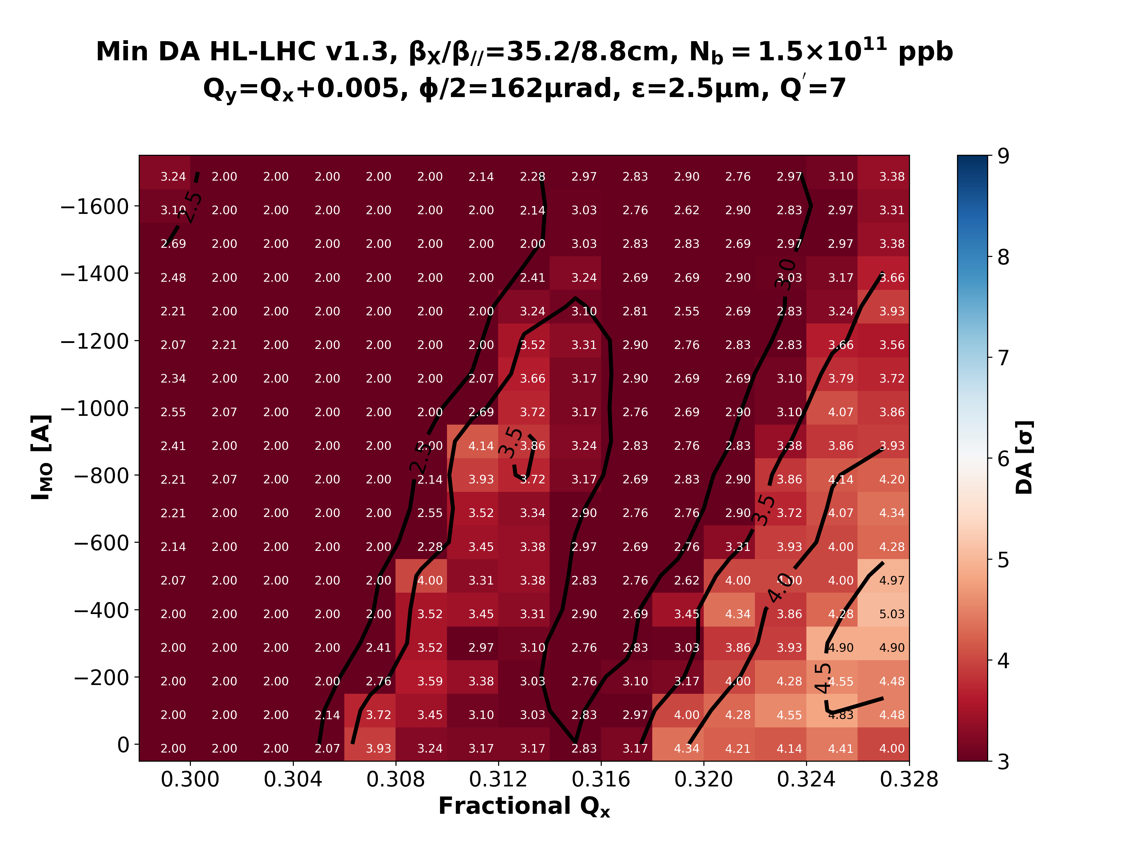
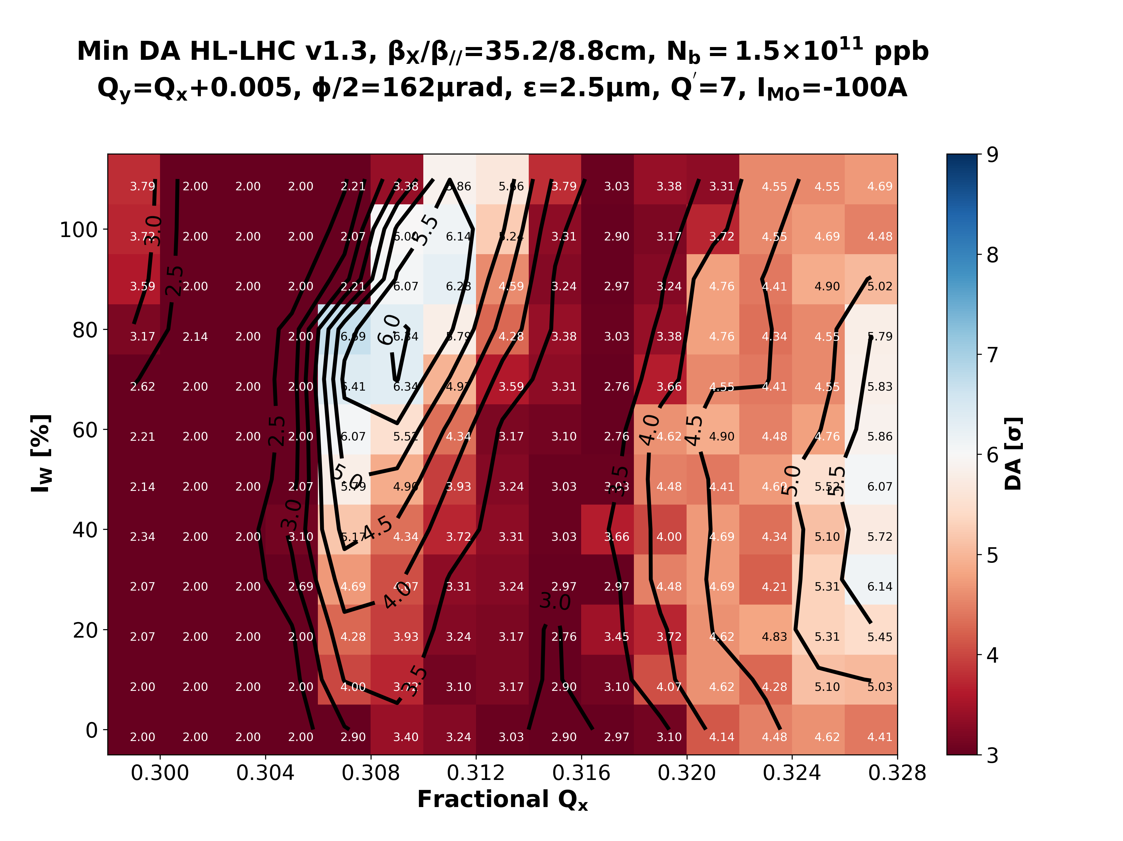
BBLR Compensation
HL-LHC
FLAT
10.5σ – Νο CC
Octupoles
Wire [IMO=-100A]
Y. Papaphilippou
  Field of wire can create all possible multipoles making it feasible to target all the RDTs
  The octupoles only target the b4 component → can be washed out if other multipoles are dominating.

Slide 25
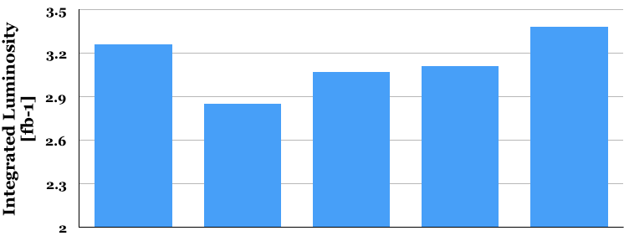
Wire impact on luminosity
Without CC, integrated luminosity (per day) is reduced by 13 %
Wires partially restore lost performance
In the presence of CC and wire a slight increase of integrated luminosity is guaranteed
+3%
-5%
-6%
-13%
[fb⁻¹]
Round
Round
Round
Flat
/ Flat
Round
Baseline
No CC
No CC with Wire
With CC
and Wire
Y. Papaphilippou

Slide 26
Links and Outline
INDICO link
1. Setting the scene
2. Results RUN2 and perspective RUN3
3. HL-LHC theory, simulation and potential
4. Technical aspects & TRIUMF potential contributions
5. Main conclusions
Minutes of the meeting

Slide 27
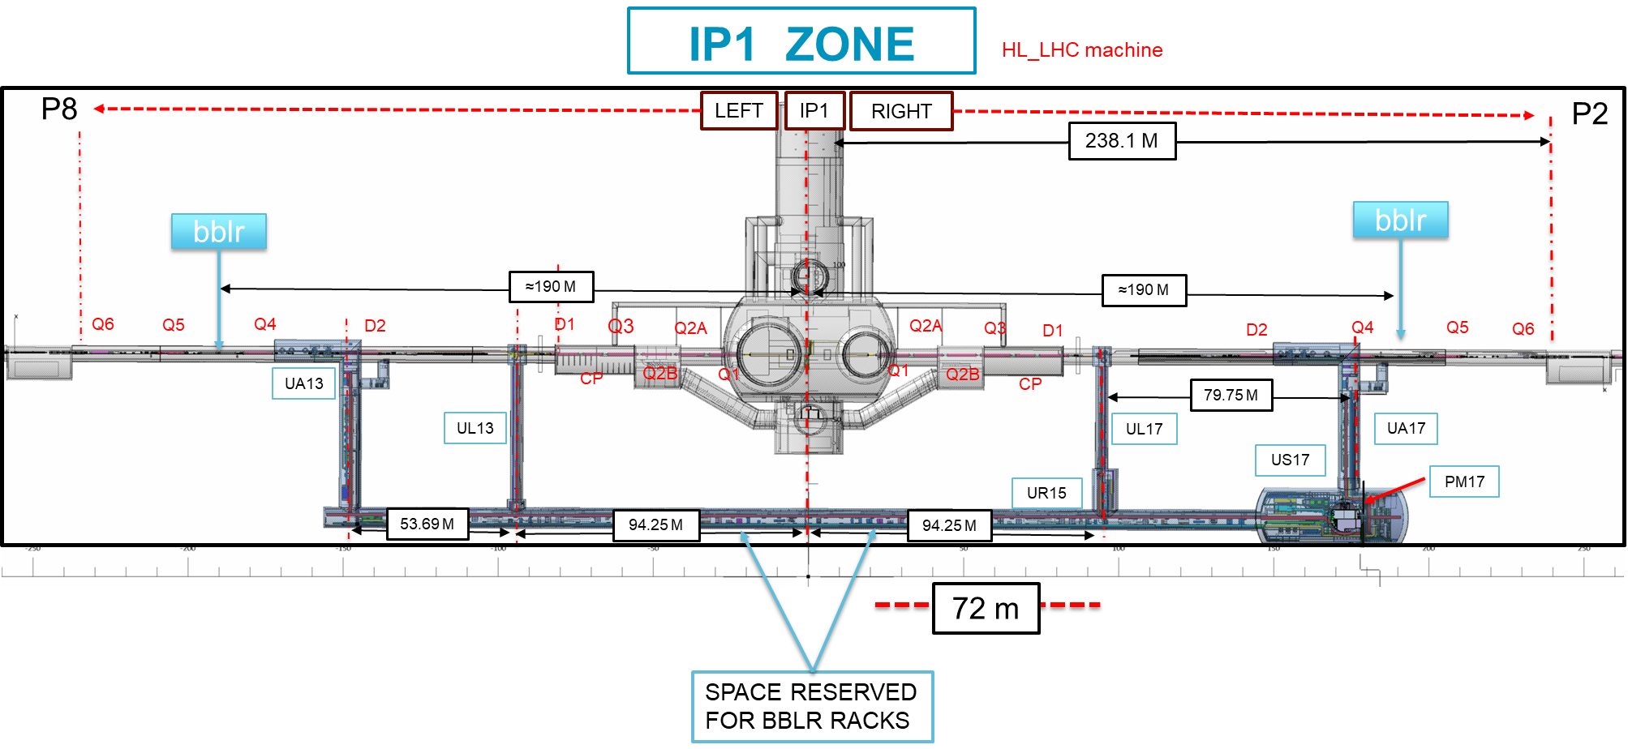
Space Reservation Request HL-LHC IP1/5
A. Bertarelli
https://edms.cern.ch/document/2037987/1.0
27

Slide 28
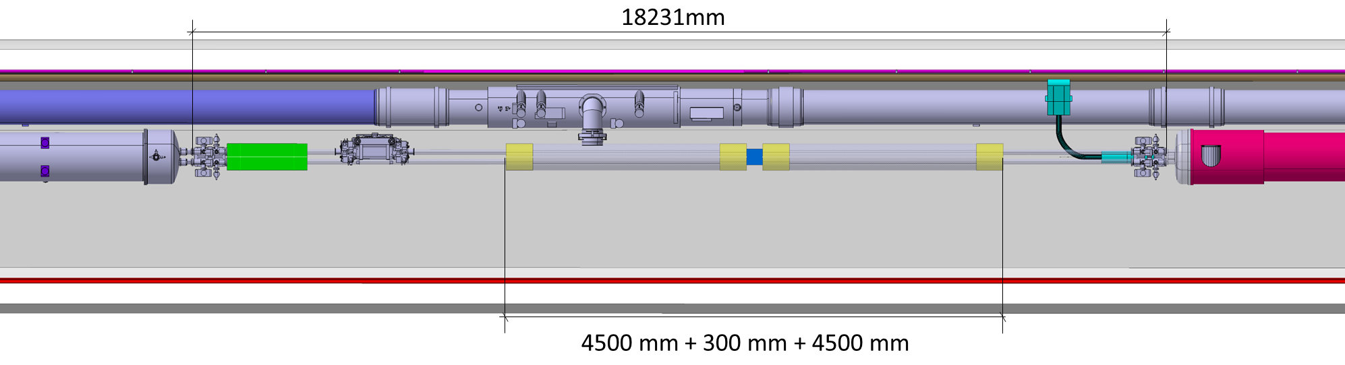
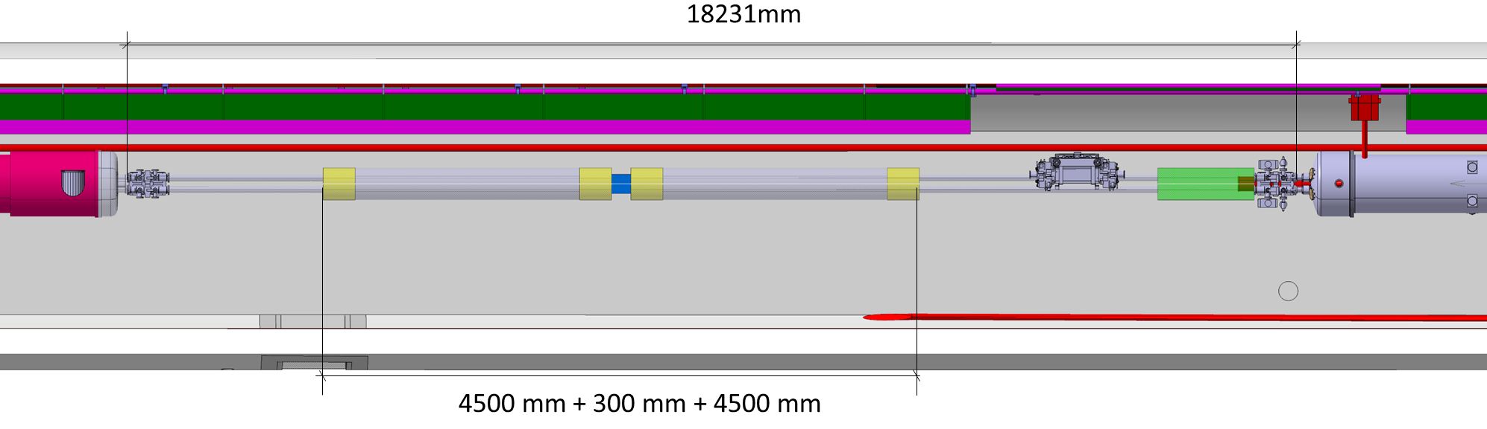
Space Reservation Request HL-LHC IP1/5
Half-cell 5L1/5L5
Half-cell 5R1/5R5
https://edms.cern.ch/document/2037987/1.0
28
A. Rossi

Slide 29
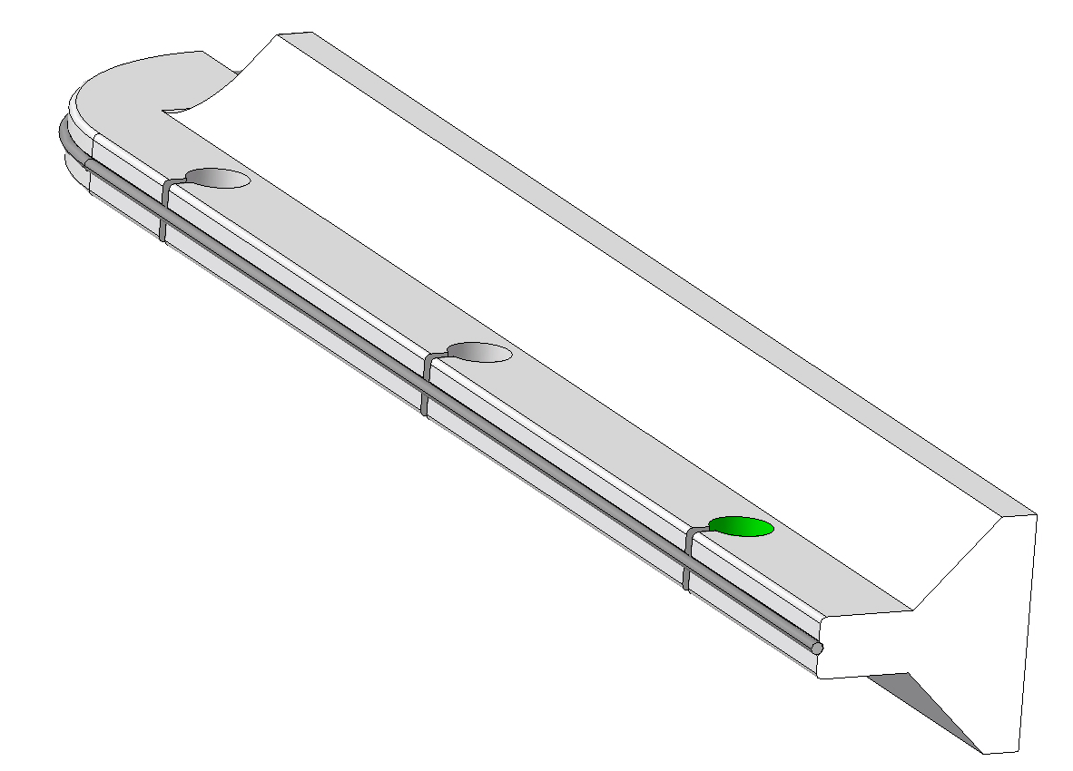
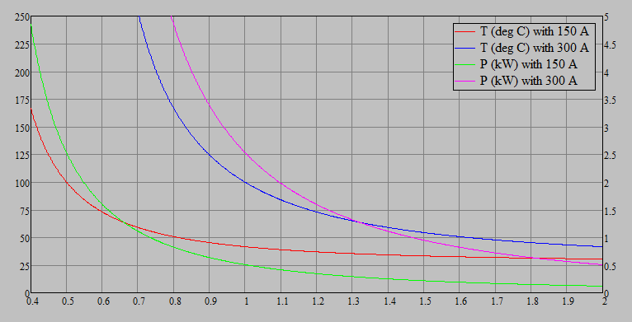
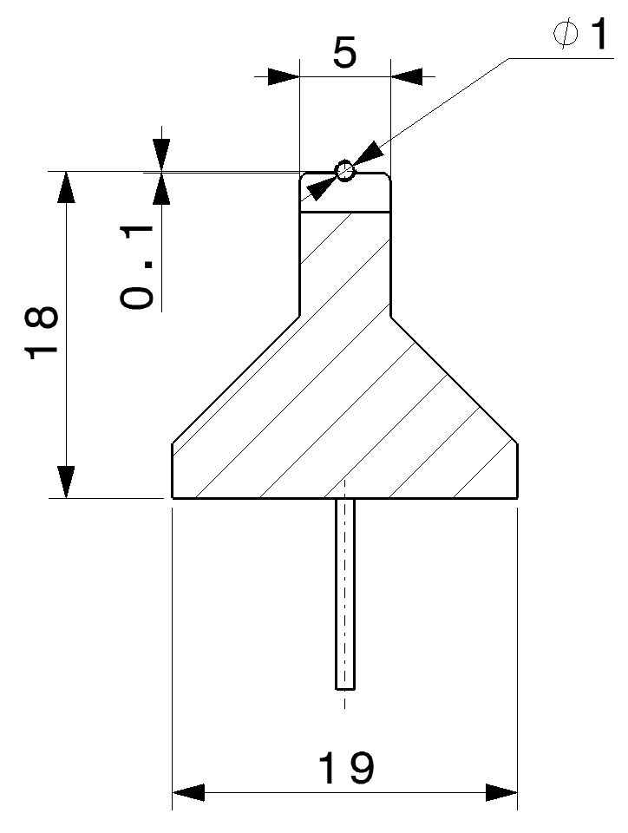
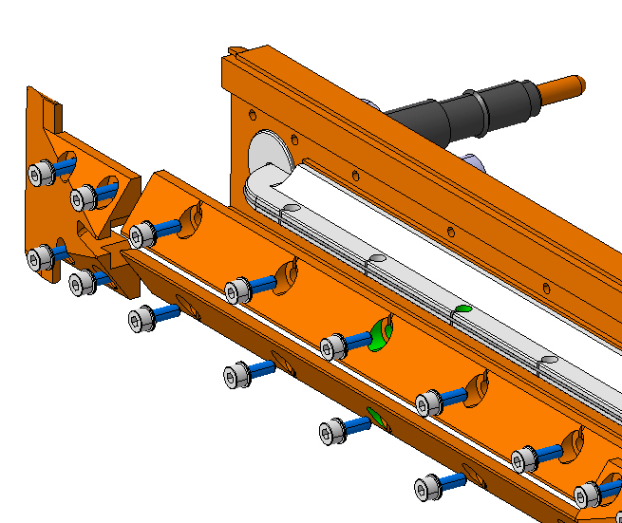
Wire radius vs temperature/power
AlN Segmented ceramic Insulator.
Other options as possible back-up, e.g. BeO, SiC, BN etc.
r<1 mm excluded
at the moment
Slots to reduce thermally induced stresses during brazing
Wire Temp. [°C]
Power [kW]
Mo thin metal wire (Ø 1).
Cu as back-up
Wire radius [mm]
To start, we assume a ∅1 mm 1 m-long Mo wire with 150 A current (Vacuum brazed)
Mo wire has higher electrical resistivity compared to Cu (back-up), but is better matching ceramic CTE and is refractory (higher robustness)
Diameter can hardly be smaller than 1 mm for technological reasons
A. Bertarelli

Slide 30
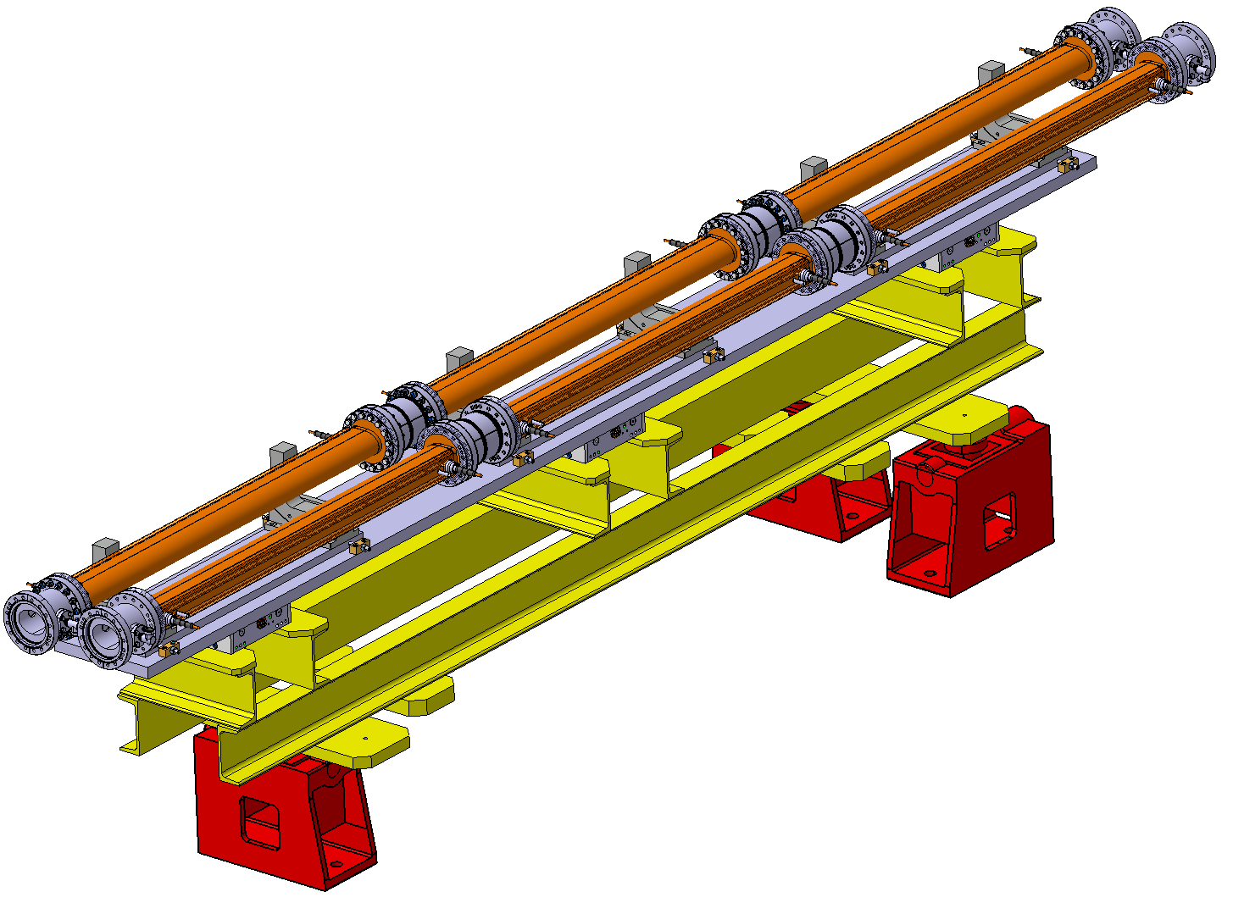
Possible Assembly Layout
Conceptual layout with two parallel assemblies. For discussion only, many details missing, e.g. actuation system …
A. Bertarelli

Slide 31
Proof of Concept of the wire design
Vacuum Brazing is the most critical step in the process (a few mm gap between wire and cooler may induce a thermal runaway of hundreds degrees …) → proof of concept proposed
AlN + Mo (and Cu as back-up) wire specimens ordered, to be brazed to verify feasibility and optimize brazing parameters. Specimens to be delivered in 6 weeks
If results are ok a short demonstrator (290 mm long) will be built, brazed and assembles early 2020, to validate the process and check residual deformations …
A. Bertarelli

Slide 32
Canadian interest to contribute via TRIUMF to the wire compensation project
Canada contributes via TRIUMF beam physics support including the wire compensation activities in the LHC.
Dobrin work on wire optimization with H driving terms – extension into 2D
Short-term tracking test with MadX and the BB Invariant.
Testing wire on sixtrack (long term track and DA tune-scans)
Support for Yannis, Kyriacos and Nikos who are running DA calculations with wire
In the long term → moving to flat-beam optics scenario for both 1. and 2. above.
Work is supported by the Natural Sciences and Engineering Research Council of Canada (NSERC)
O. Karsten

Slide 33
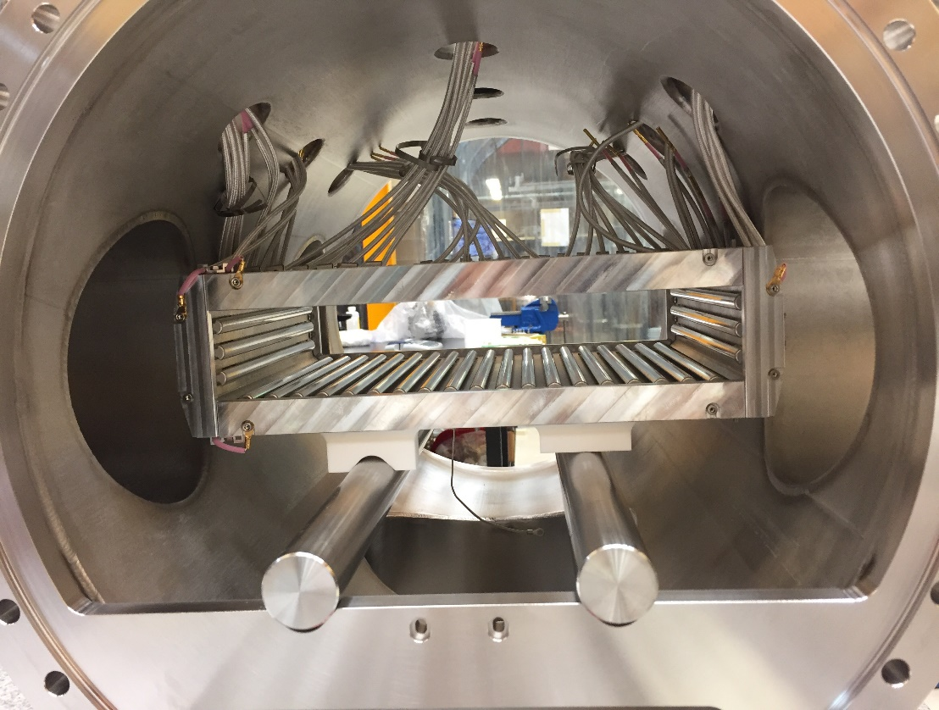
Canadian interest to contribute via TRIUMF to the wire compensation project
First beam tests with DC wire prototypes in LHC have been run successfully and TRIUMF would like to participate in future beam tests.
Canadian community via TRIUMF could contribute to the construction and realization of a wire compensation system for HL-LHC via technical expert groups.
Will need to go through (1) TRIUMF’s Policy and Planning Advisory Committee (PPAC) before we apply for funds from (2) Canadian Foundation for Innovation (CFI) for instance.
Expertise in
Design of multipole corrector
OPERA® Tosca calculation for magnetic field
High manufacturing tolerances
(less than 10 μm)
O. Karsten

Slide 34
Links and Outline
INDICO link
1. Setting the scene
2. Results RUN2 and perspective RUN3
3. HL-LHC theory, simulation and potential
4. Technical aspects & TRIUMF potential contributions
5. Main conclusions
Minutes of the meeting

Slide 35
Summary of wire impact
DC solid wires at distances compatible with collimation hierarchy are able to partially restore integrated luminosity in the absence of CC
Slightly increase luminosity in the baseline scenario
Wires provide a series of positive side effects, e.g.,
  Relax WP choice through levelling
  Recover 6 σ DA for ultimate scenario (round optics)
  Enhance β* reach
  Reduce triplet radiation, increasing significantly (up to 20%) triplet lifetime
  Increase luminous region leading to peak pile-up density reduction
  Enable running with full crabbing through levelling, or reduce impact of limited crab voltage.
Y. Papaphilippou

Slide 36
Timeline
Experimental verification achieved with demonstrator (2016-2018)
Simulations proved potential at present LHC but also for HL-LHC, with a solid DC wire solution (2017-2019)
  Refining flat optics operational scenario (2020)
Wire operation during Run3 will clarify operational and machine protection issues (2021-2023)
Hardware design and short prototype HW tests for HL-LHC (2020)
Technical review (including budget) for using wire compensation in the HL-LHC era (2020)
Prepare locations for integration (during LS3)
Wire installation and operation for HL-LHC (during Run4)
Y. Papaphilippou

Slide 37
Main outcome of the discussion
TRIUMF wish of a strong connection with CERN, and to start collaboration asap, including participation to the beam tests during Run3 in 2021.
Target by end of 2020 an external review to support to the preparation of the TRIUMF proposal for funds where we:
  Present detailed plans for Run-III.
  Show the clear impact of the wire on lifetime (particle diffusion in the beam core) and in presence of the HEL w/ and w/o CC.
  Give an estimate of irradiation reduction to the triplets as a function of Xing angles.
  Review thermo-mechanical design including all thermal loads (wire current, heating via RF coupling or losses).
  Check compliance of the HW design with impedance, vacuum, …
  Review instrumentation for the wire and alignment.
  Verify that the position proposed for wire operations is compatible with Machine Protection (in case of asynch dump), and irradiation (also caused by the wire) to elements downstream the wires (collimation studies + FLUKA simulation).
  Present strategy of interlock on the wire for Machine Protection.
  Review machine integration and staging of installation.
  Discuss a budget envelop.
  Present preliminary results on flat optics if additional manpower is allocated.

Slide 38
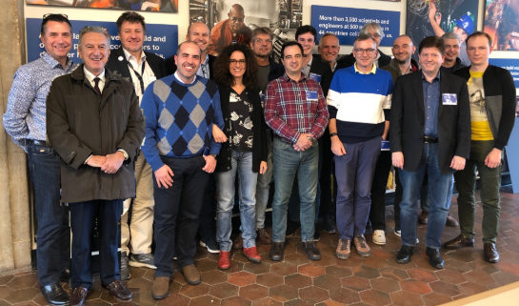
Thank you for the attention!

Slide 39
BACKUP SLIDES

Slide 40
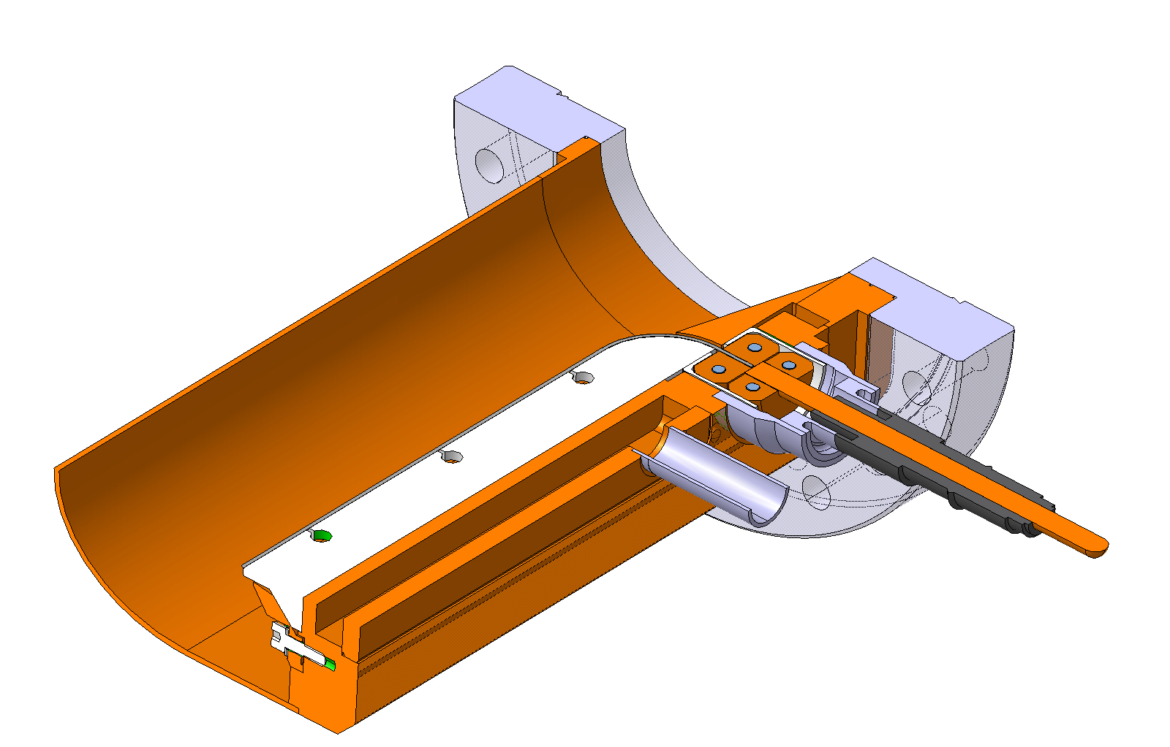
Main Design Features: Vacuum Chamber
Water cooling channel obtained by housing machining and cover welding.
Commercial feedthrough connection carrying up to 185 A. If more current is needed, liquid-cooled feedthroughs should be adopted
Cu half-shell welded to the housing
Stainless steel flange brazed to copper and then welded to vacuum chamber.
Brazing
Weld
Weld
Feedthrough
Weld

Slide 41
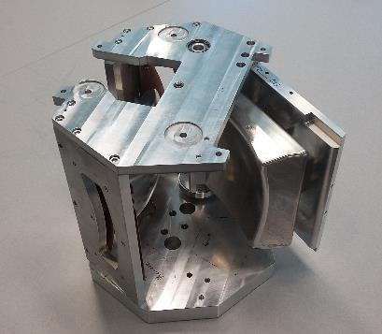
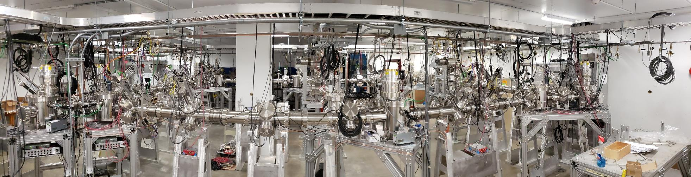
Expertise in beam transport and accelerator systems
Beam line engineering physics group (M. Marchetto)
Beam optics design
Hardware design, engineering and installation of electrostatic and magnetic beam line systems
OPERA® Elektra calculation for electric field
Custom feedthrough developed in collaboration with vender
UHV assembly procedure

Slide 42
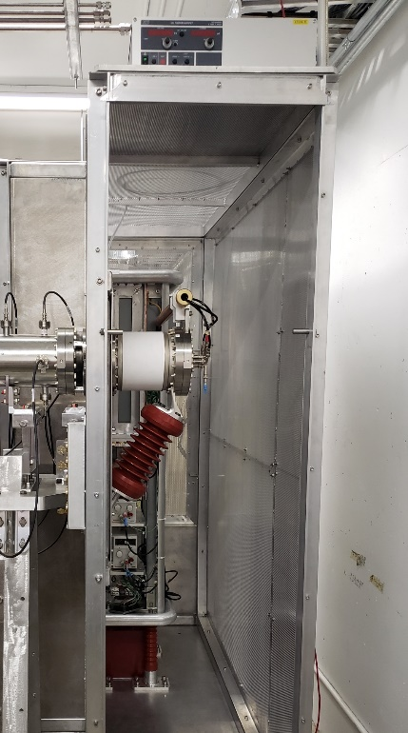
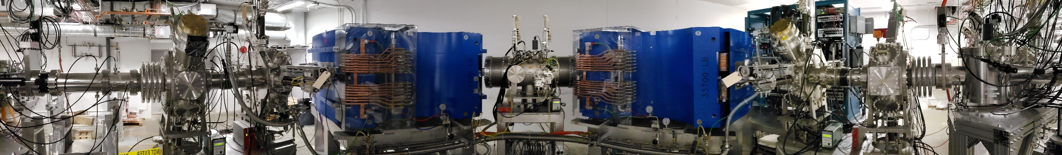
Expertise in special element’s design and construction
Ion source design and engineering
Optics and magnetic dipole design of the high resolution mass separator system (20,000 resolving power for 3 μm transmitted emittance)
Design of multipole corrector
OPERA® Tosca calculation for magnetic field
High manufacturing tolerances
(less than 10 μm)

Slide 43
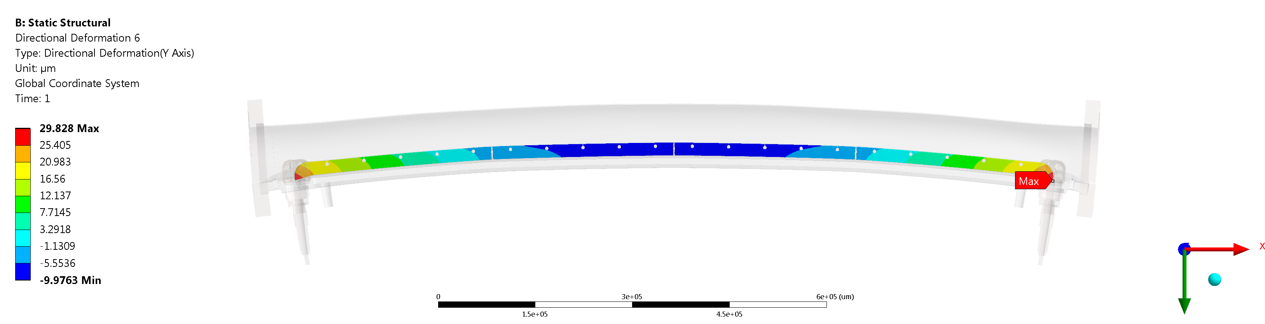
Numerical simulations
Estimated deflection of the vacuum chamber in operating conditions is ~ 30 μm

