Slide 1
R134a COMPRESSOR TEST
-Argon-
31/10/2019

Slide 2
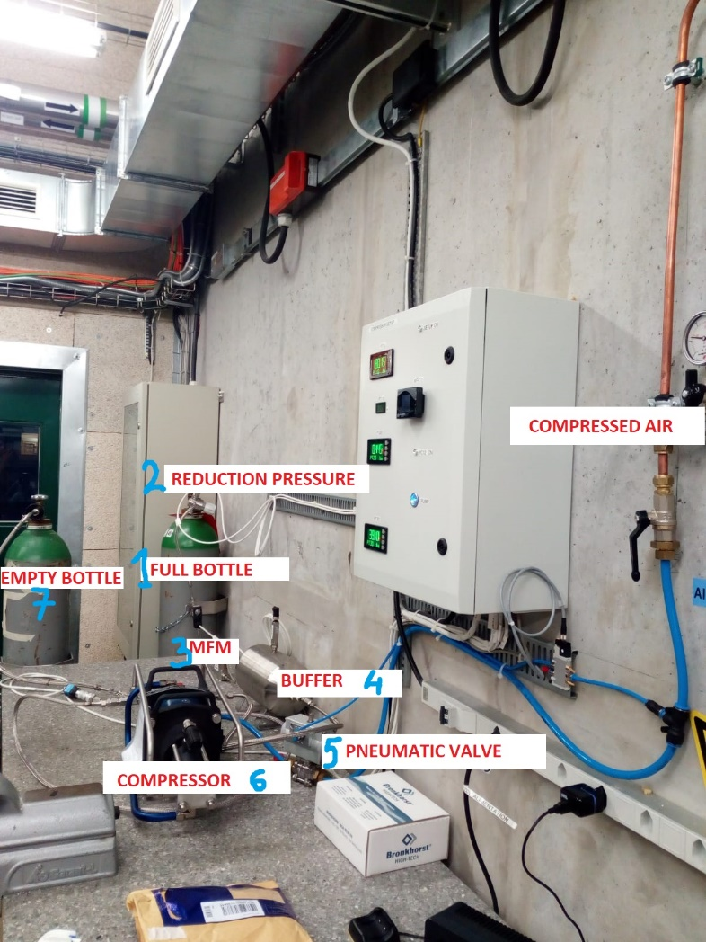

Slide 3
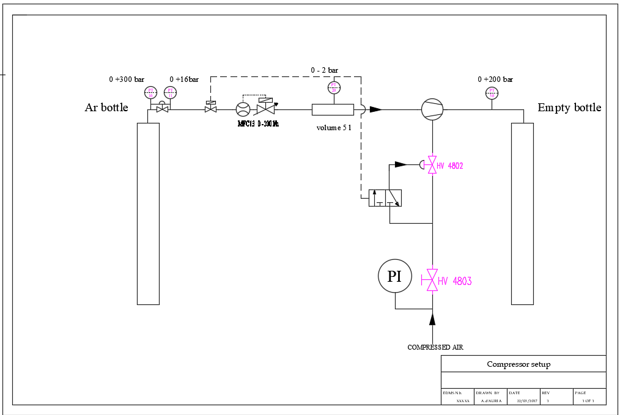
SETUP

Slide 4
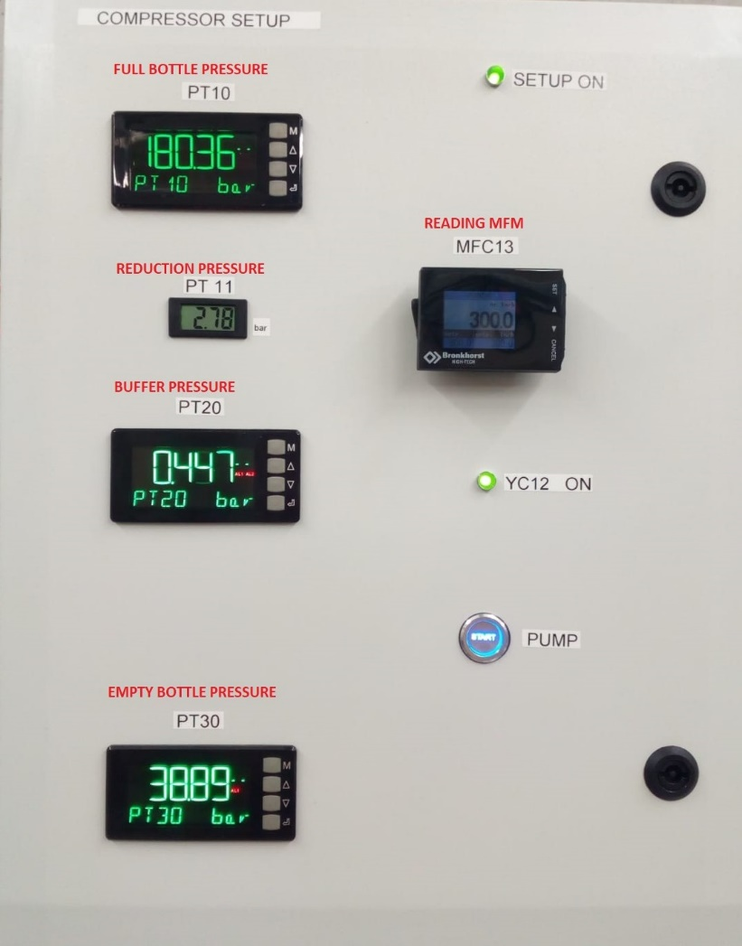
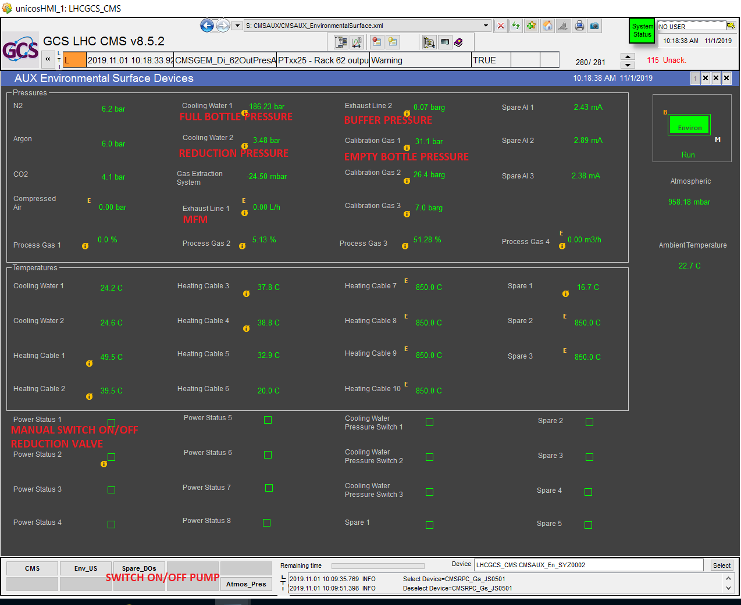
READING PRESSURE
*READING MFC IS NOT WORKING ON WINCCOA*

Slide 5
Pressure compressed air: 8bar , but it decreased at 5,5/6 when the compressor was ON.
The test was done at 300 l/h.
There were about 20 bar in recuperation bottle when we started.

Slide 6
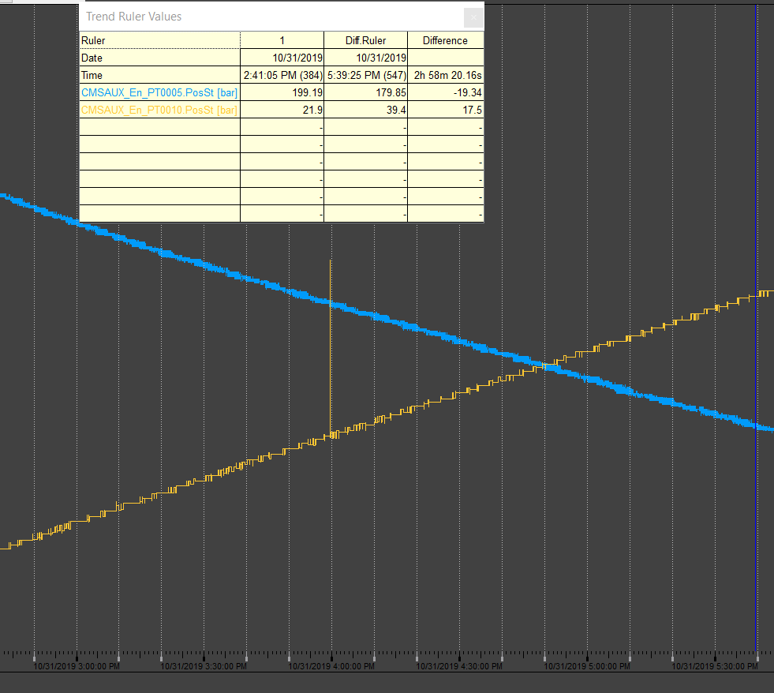
SMALL LEAK
The different pressure in two bottles is different(about 2 bar): there is a small leak in a pipe, but it become important when the pressure increase.
Blue line: full bottle
Orange line: empty bottle
*Fix leaks and repeat test starting from recuperation bottle at 0 barg, and arrive at 10bar.

Slide 7
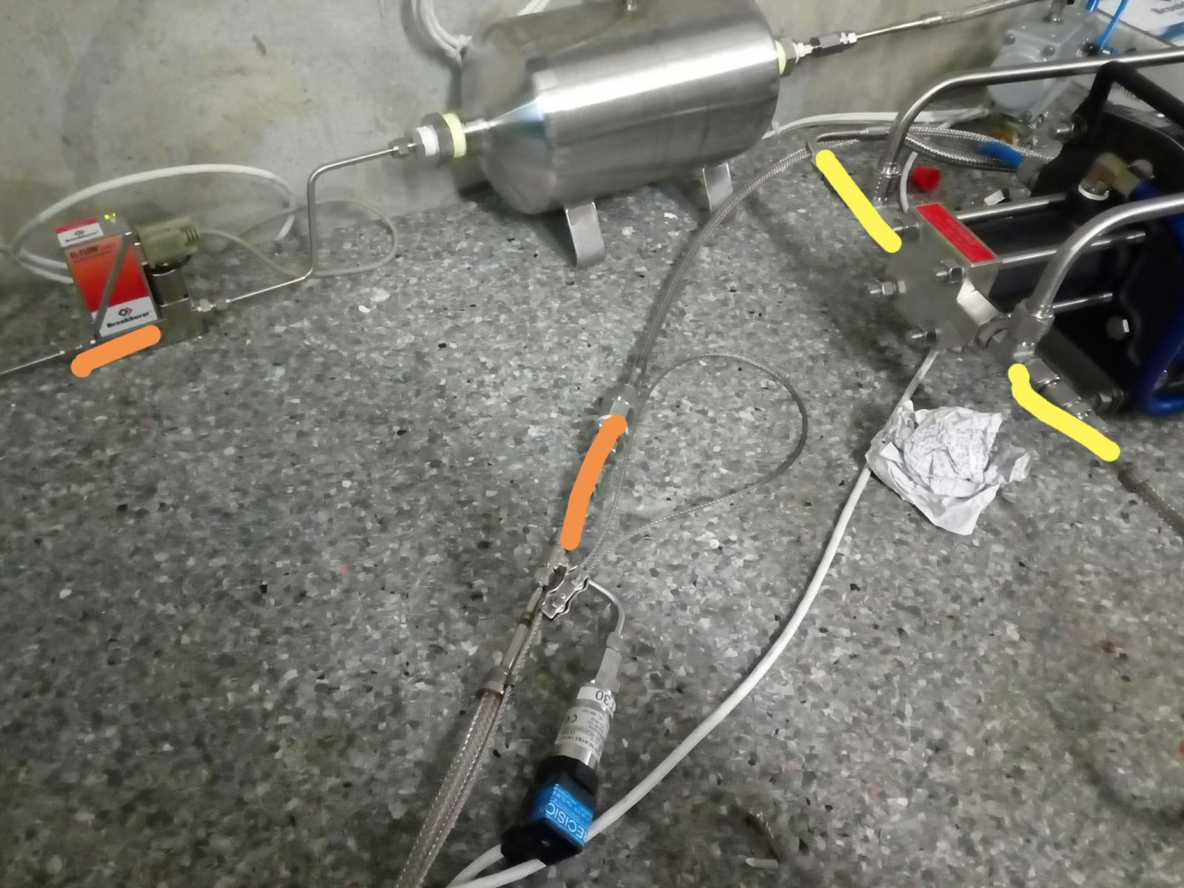
Orange lines: about 400ppm
Yellow lines: about 700ppm
We had switch OFF the test and only the day later we have done the leak test, but there was enough pressure in the system to check.

Slide 8
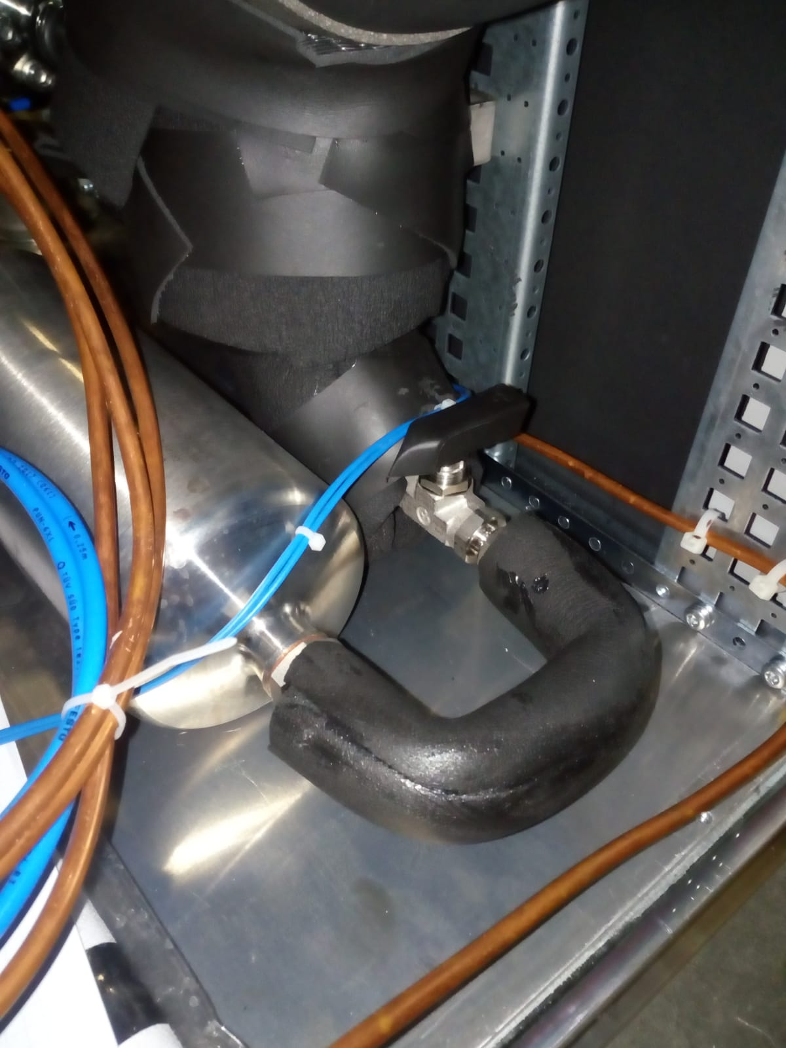
we leave or remove the valve to connect the compressor?

Slide 9
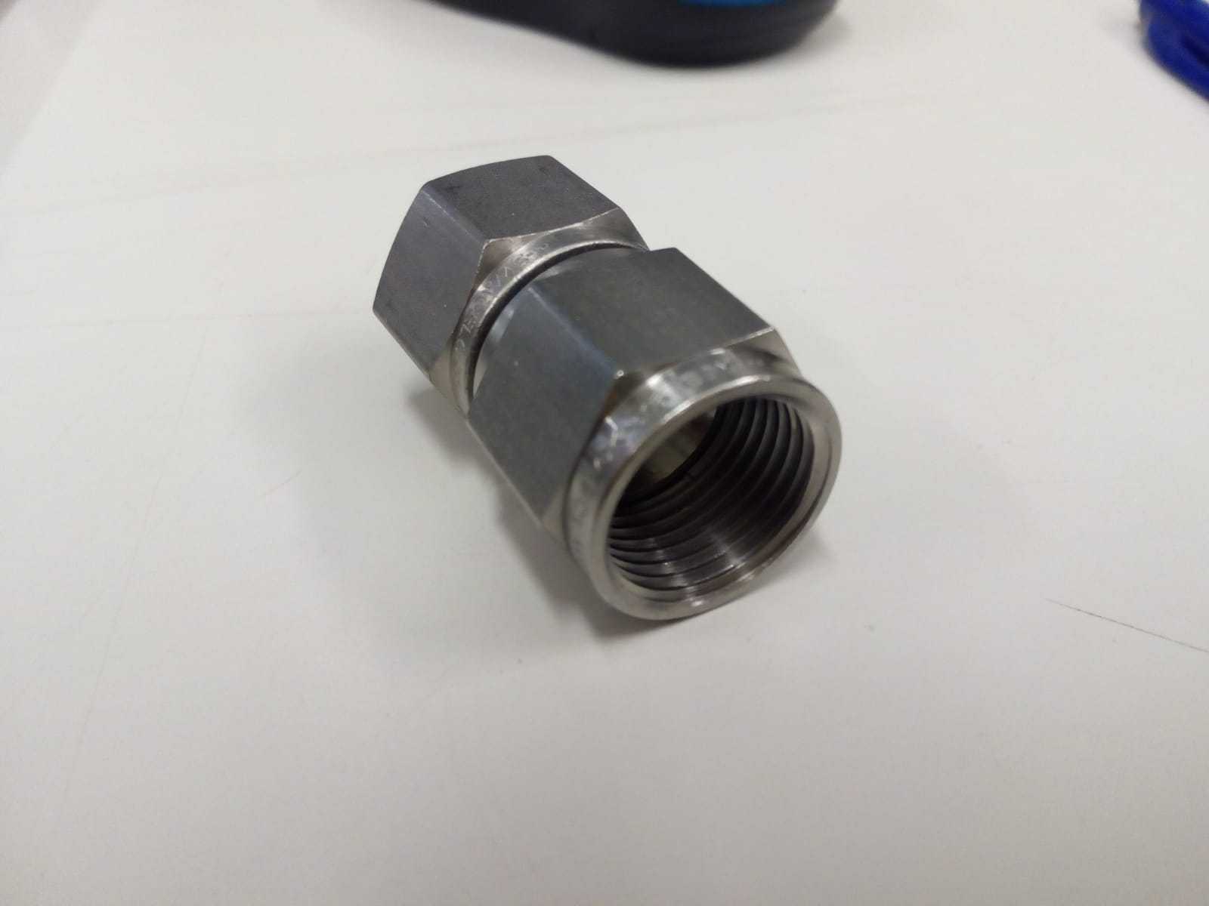
CONNECTORS (Swagelok):
SS-810-A-8ANF

Slide 10
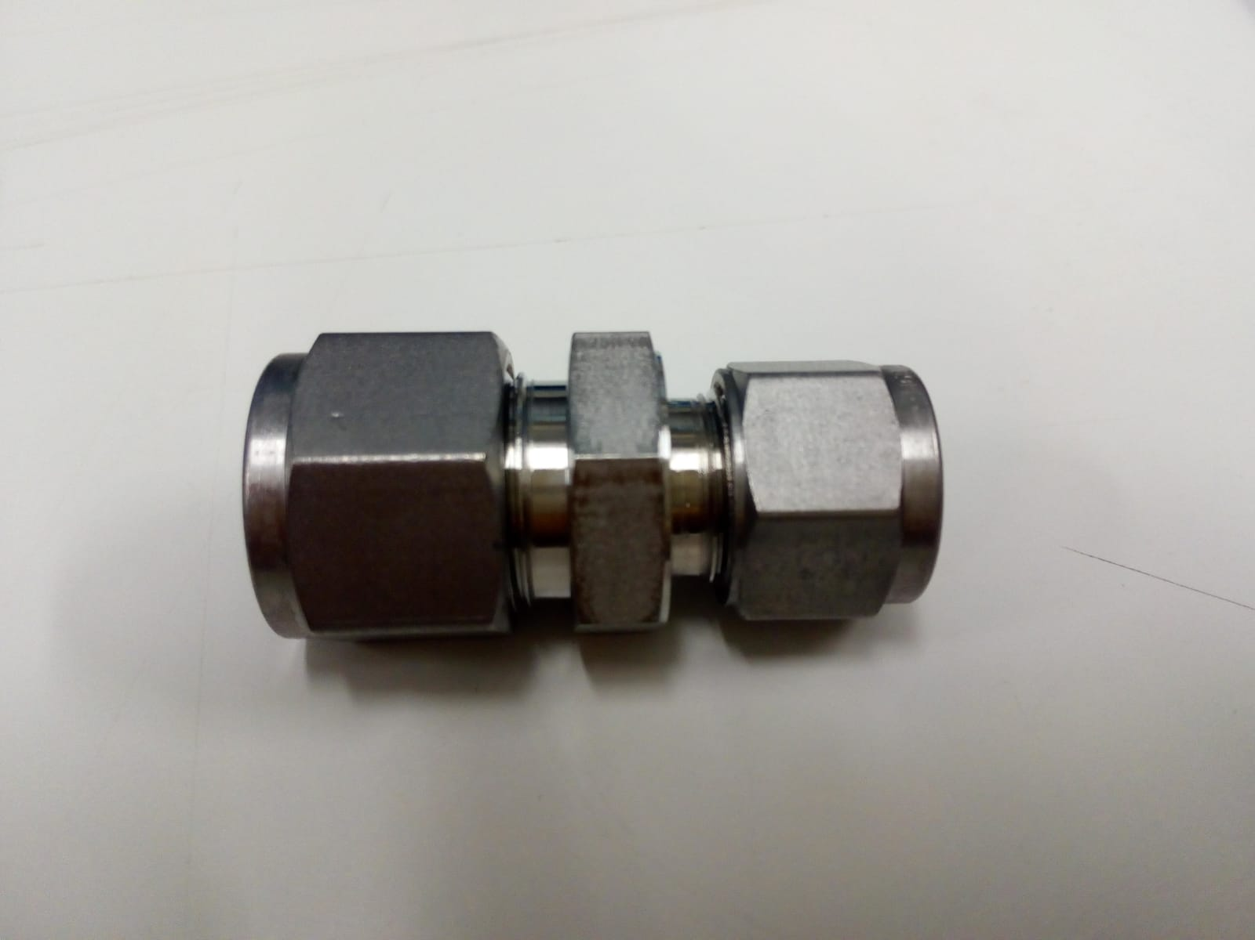
ADAPTER (Swagelok):
SS-10M0-6-8

Slide 11
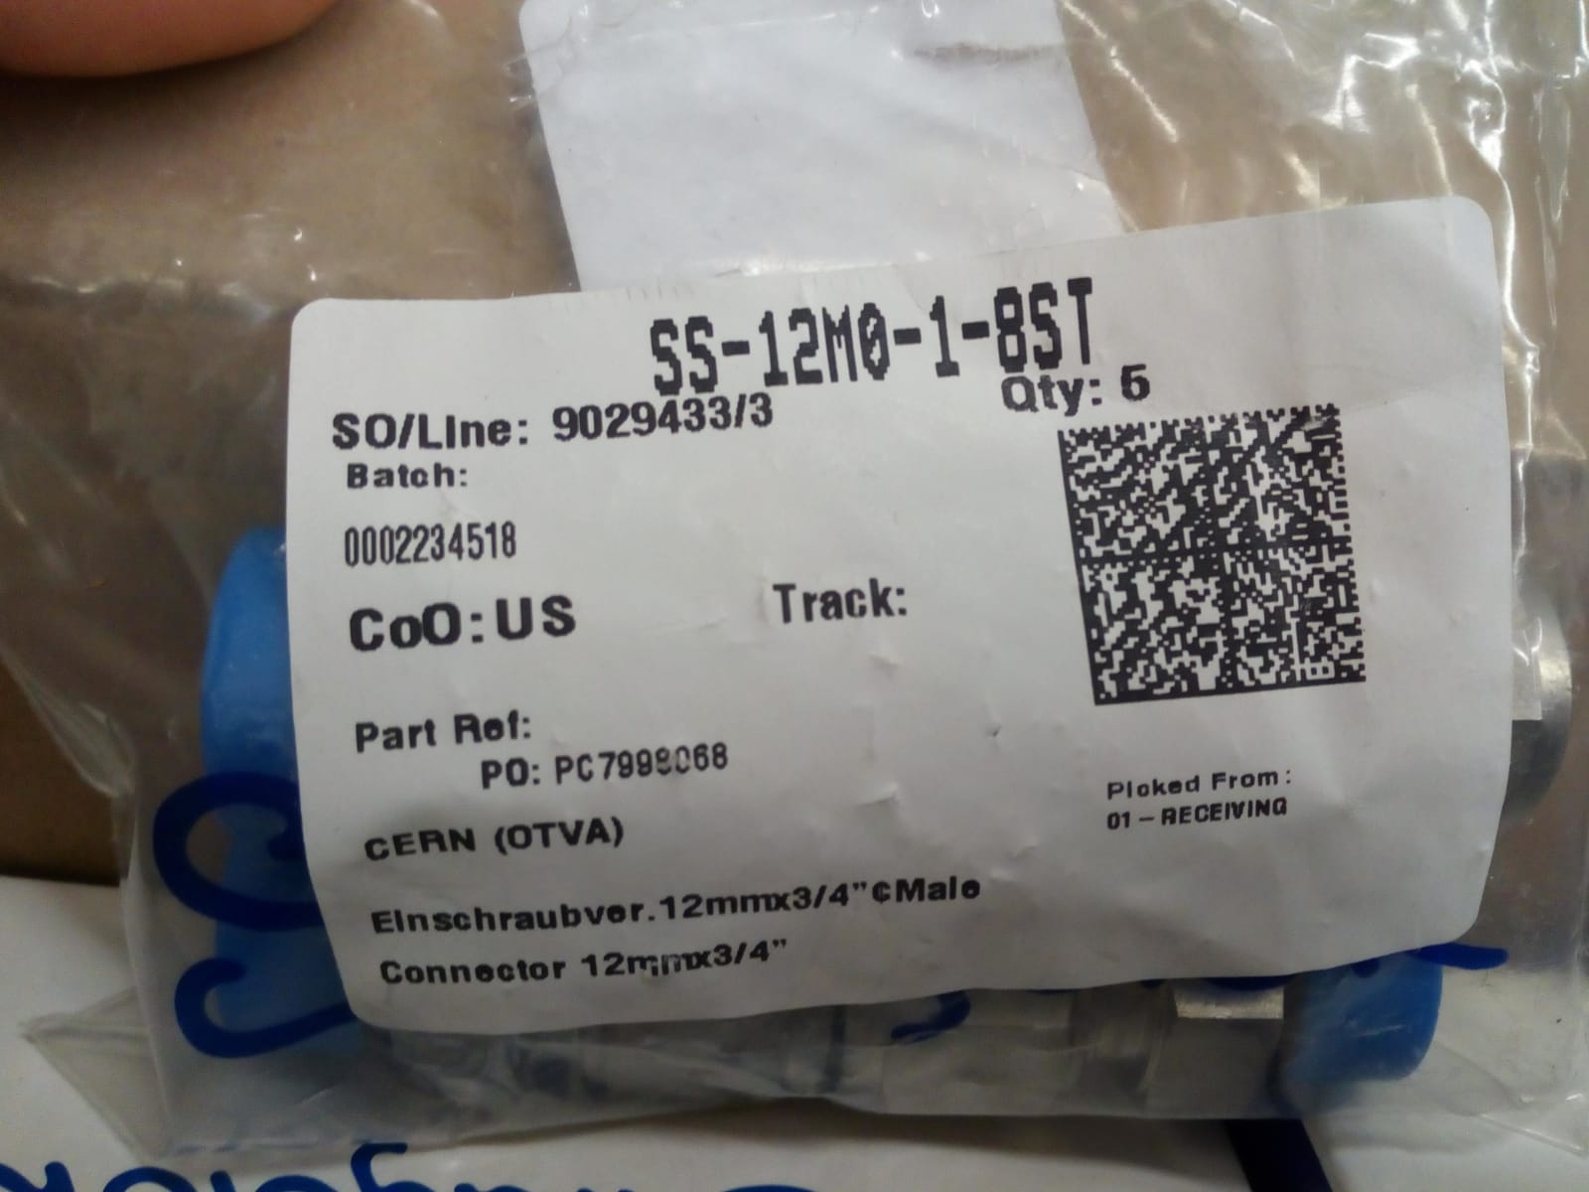
COMPRESSED AIR(Swagelok):
SS-12M0-1-8ST

Slide 12
TO DO LIST
Repeat Argon test
R134a compressor test
Move the compressor near racks
Connect pneumatic valve
Get the CRRP number for R134a buffer
Install the big drum
Modify the drawing

