Slide 1

1st FCC Magnets Collaboration Meeting
December 10th , 2019
Introduction to the meeting
Davide Tommasini

Slide 2
Content
Motivation
Reminder: considerations about a next machine
“Active” collaborations

Slide 3
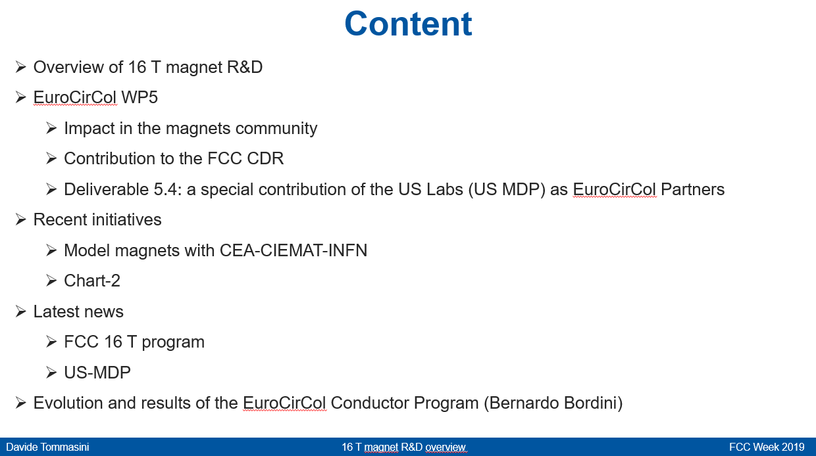
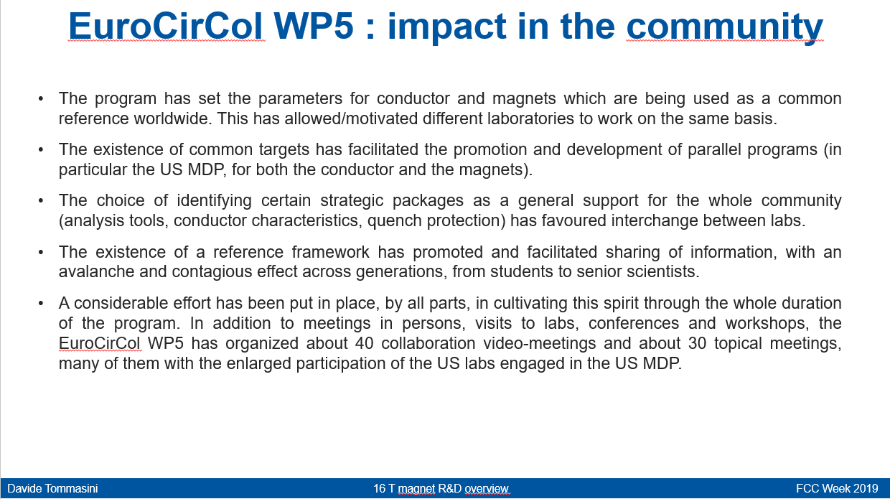
Motivation
EuroCirCol WP5 is now completed
We do not have a “new EuroCirCol”, however we do have established collaboration agreements.
An approval of a next project for HEP will not come tomorrow, but these collaborations are real and do exist.
I would like to keep and maintain a “collaborative” forum for sharing information, similar to that of EuroCirCol

Slide 4
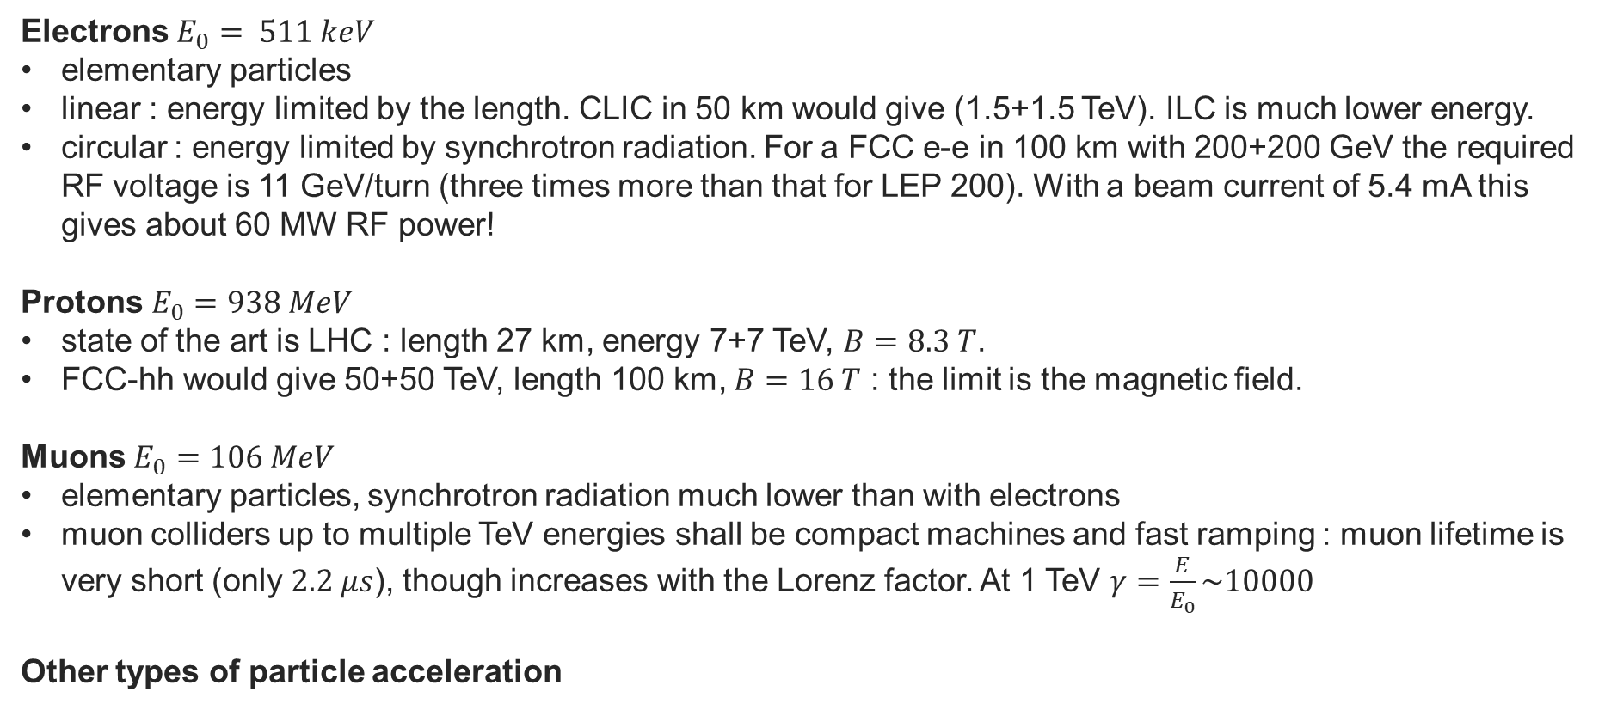
Reminder: considerations about a next machine
$$Synchrotron radiation ∆E_{turn}=P\frac{2πρ}{c}=\frac{e^{2}}{3ε_{0}E_{0}^{4}}\frac{E^{4}}{ρ} ; Magnetic rigidity Bρ\left[Tm\right]=\frac{{10}^{9}p}{cz}=3.3356\frac{p}{z}$$
Electrons $E_{0}= 511 keV$
elementary particles
linear : energy limited by the length. CLIC in 50 km would give (1.5+1.5 TeV). ILC is much lower energy.
circular : energy limited by synchrotron radiation. For a FCC e-e in 100 km with 200+200 GeV the required RF voltage is 11 GeV/turn (three times more than that for LEP 200). With a beam current of 5.4 mA this gives about 60 MW RF power!
Protons $E_{0}=938 MeV$
state of the art is LHC : length 27 km, energy 7+7 TeV, $B=8.3 T$.
FCC-hh would give 50+50 TeV, length 100 km, $B=16 T$ : the limit is the magnetic field.
Muons $E_{0}=106 MeV$
elementary particles, synchrotron radiation much lower than with electrons
muon colliders up to multiple TeV energies shall be compact machines and fast ramping : muon lifetime is very short (only $2.2 μs$), though increases with the Lorenz factor. At 1 TeV $γ=\frac{E}{E_{0}}\sim 10000$
Other types of particle acceleration

Slide 5
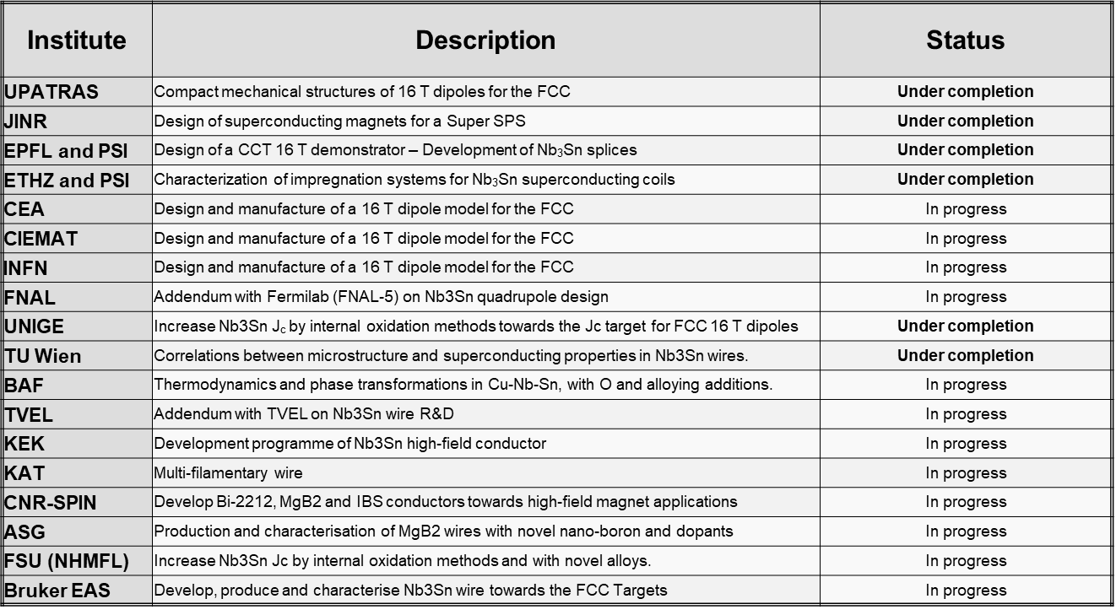
Active collaborations

Slide 6

Thank you for your attention

