Slide 1
High Field Magnet R&D Program A view from CERN
Presented by L. Bottura
With crucial contributions from CERN TE-MSC and FCC collaborators
US-MDP Workshop Washington, DC, 4-5 December 2019
FCC Magnets Collaboration Meetings/Kick-off, 10 December 2019

Slide 2
Outline
The nature of the program
The leading questions for the R&D
The R&D lines responding to the questions
The R&D vehicles
Deliverables and timeline
Summary

Slide 3
Outline
The nature of the program
The leading questions for the R&D
The R&D lines responding to the questions
The R&D vehicles
Deliverables and timeline
Summary

Slide 4
A program responding to demands
FCC-hh, including the specific demands from HE-LHC, has been the main driver of the development of HFM
We have shown that a field of 16 T can be generated by Nb₃Sn (RMC-03, 2015)
We have produced 14.6 T in a 100 mm aperture (FRESCA2, 2018) and 14.1 T in a 60 mm aperture (US-MDP CT1 2019)
We have demonstrated that the J_{C} target of 1500 A/mm² at 16 T and 4.2 K is within reach (2018, 2019), and we have two additional potential suppliers of HL-LHC class wire (TVEL, JASTEC)
All of the above in collaboration with the whole-world community
The HFM development activities have been instrumental to HL-LHC, and in particular the success of the 11T MBH long magnet
CERN has completed the production of the first accelerator Nb₃Sn dipole magnet, an historical milestone for accelerator technology.

Slide 5

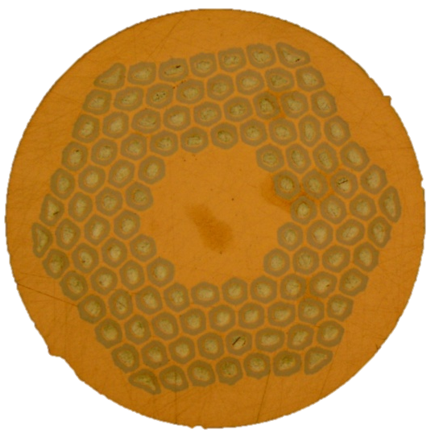
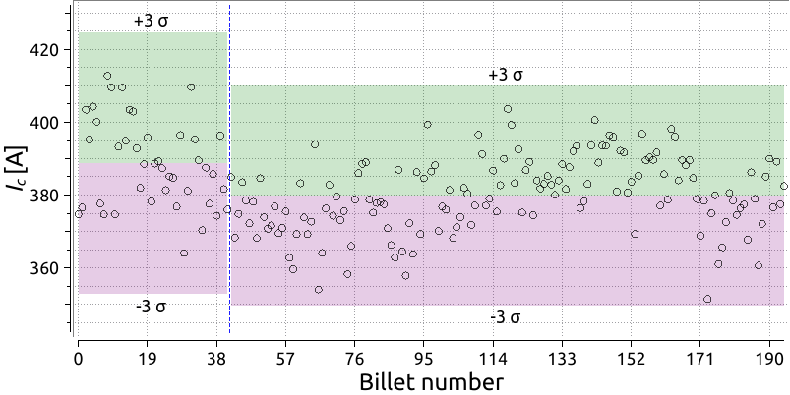
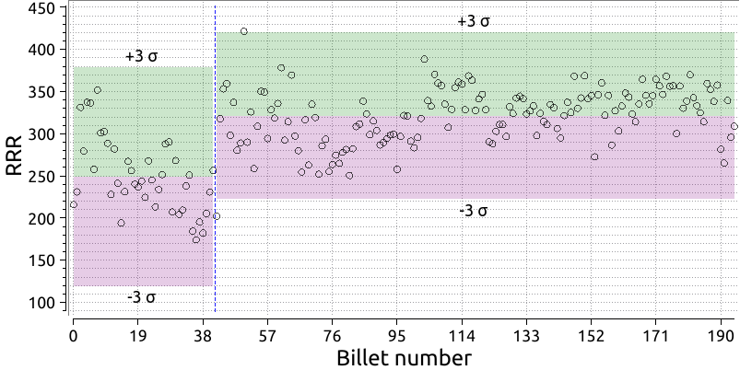
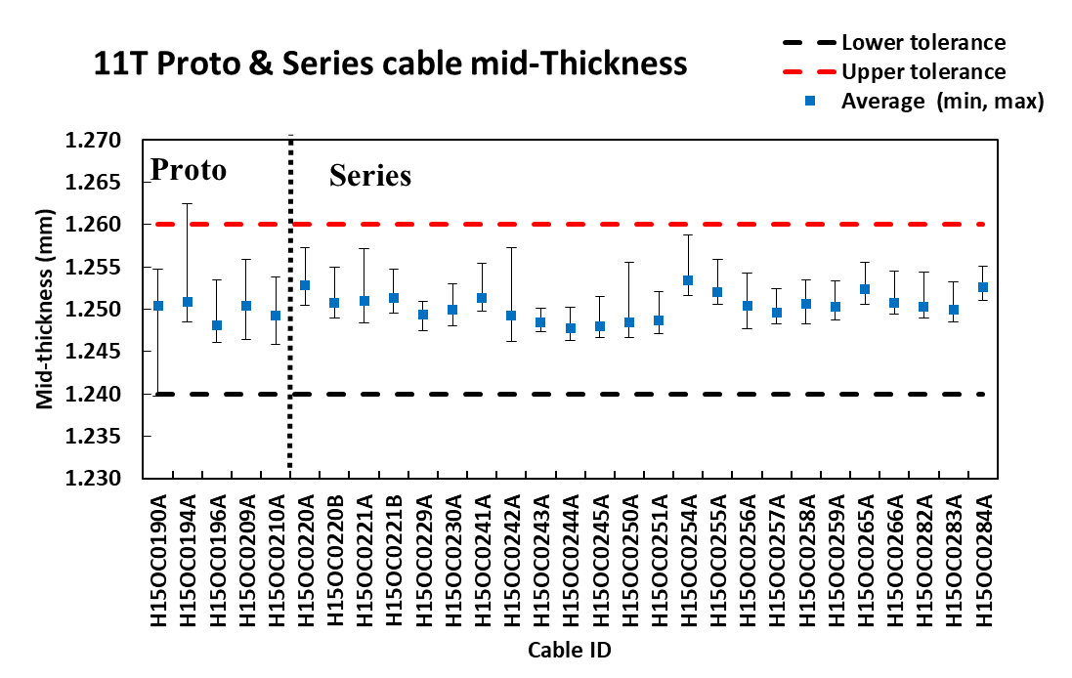
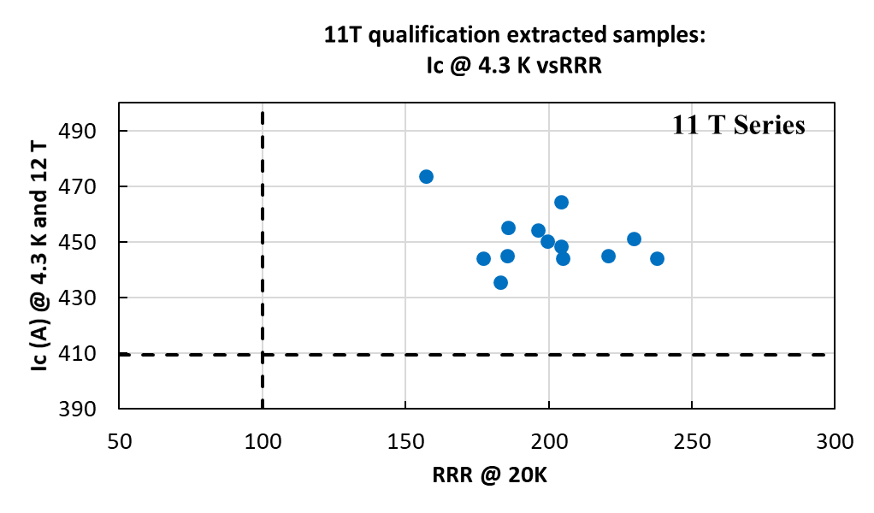
HL-LHC wires and cables
RRP 108/127
RRR ≥ 150
I_{C}(4.2 K, 15 T) ≥ 331 A
RRR ≥ 100
20 μm
I_{C}(4.2 K, 15 T) ≥ 410 A
This is an industrial production !

Slide 6

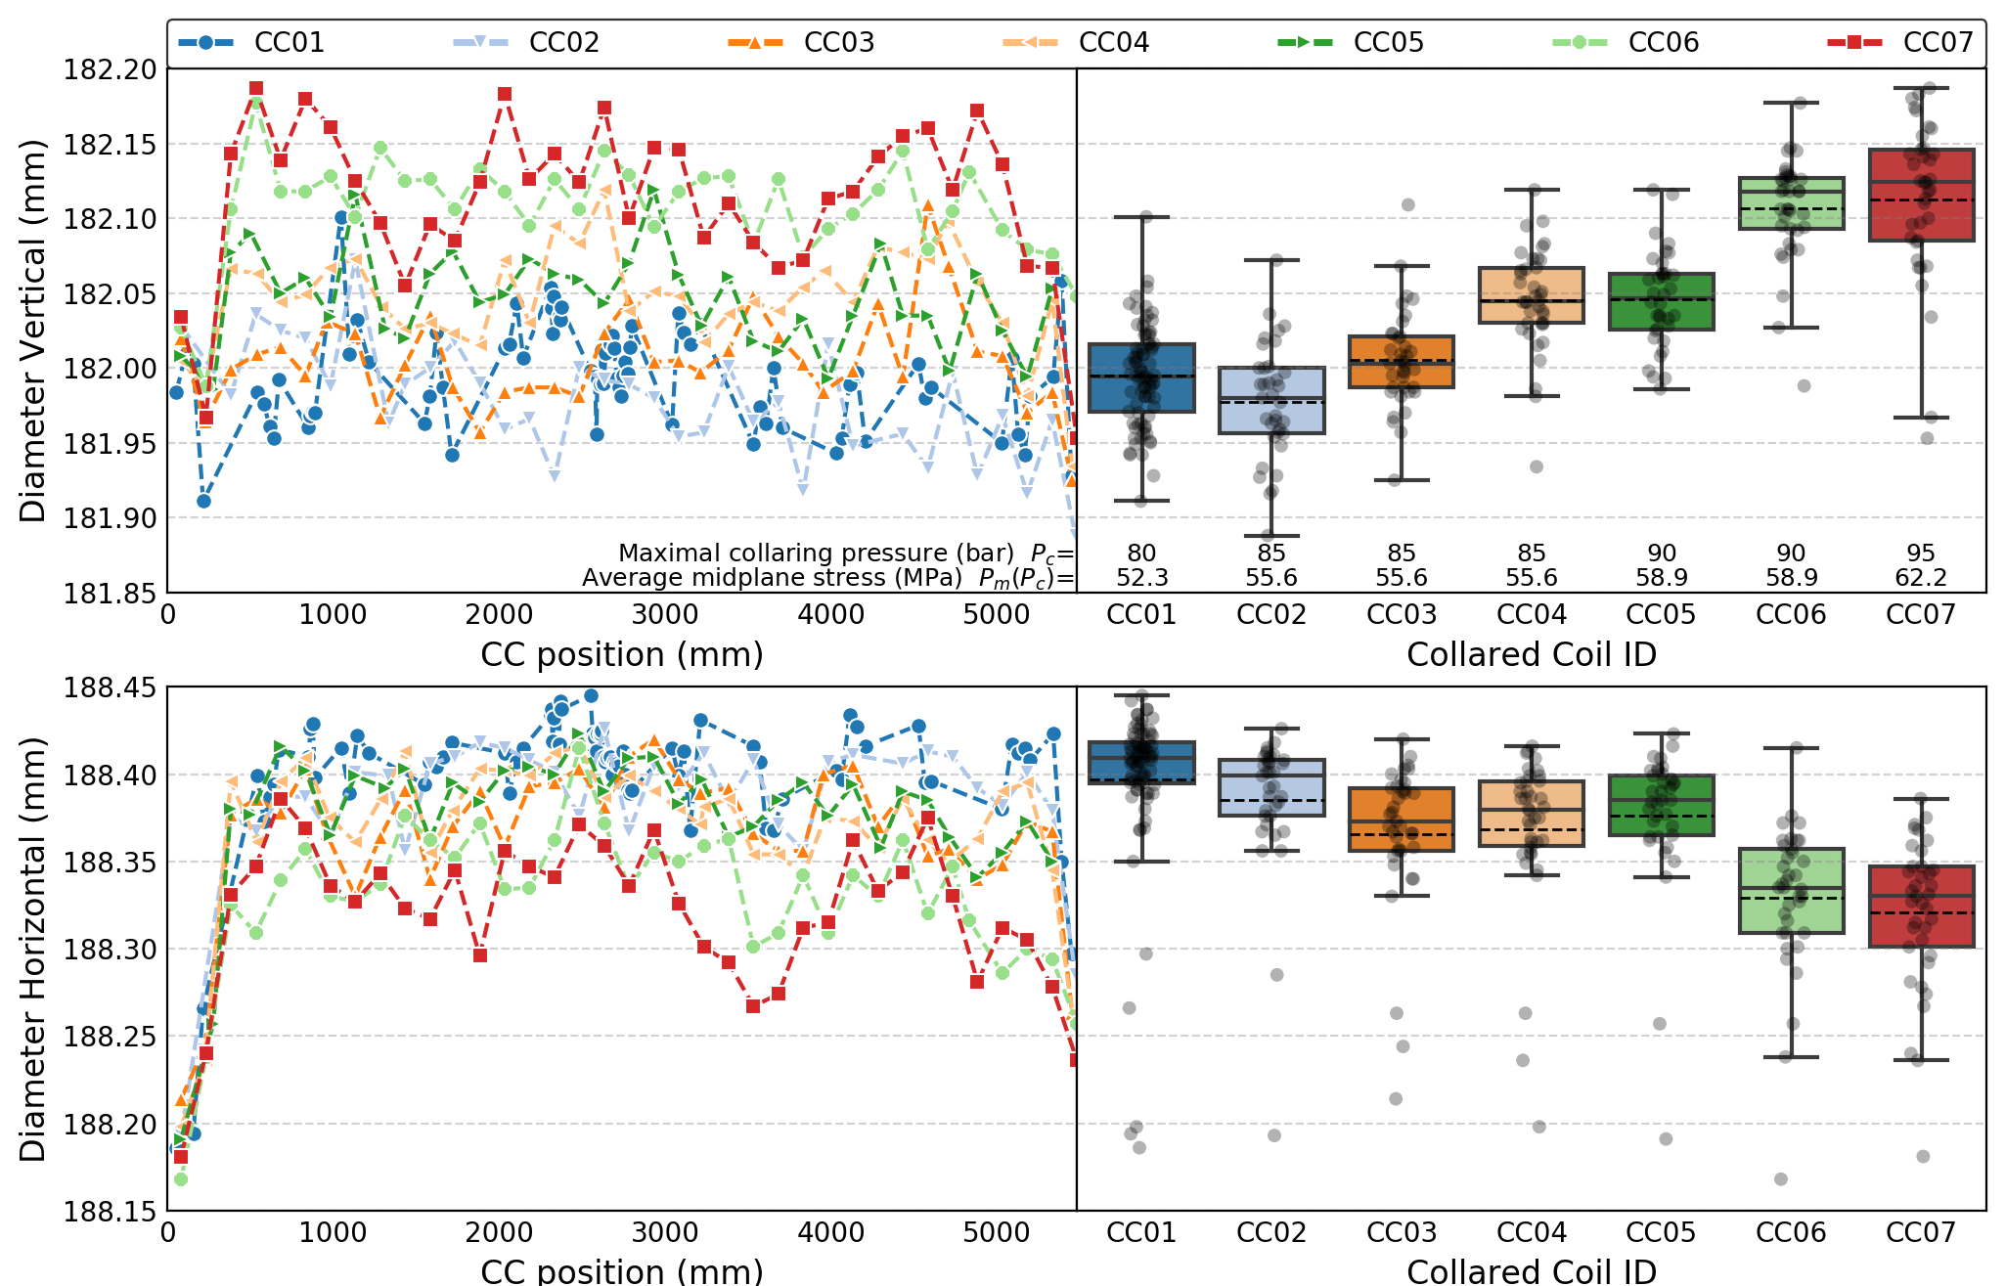
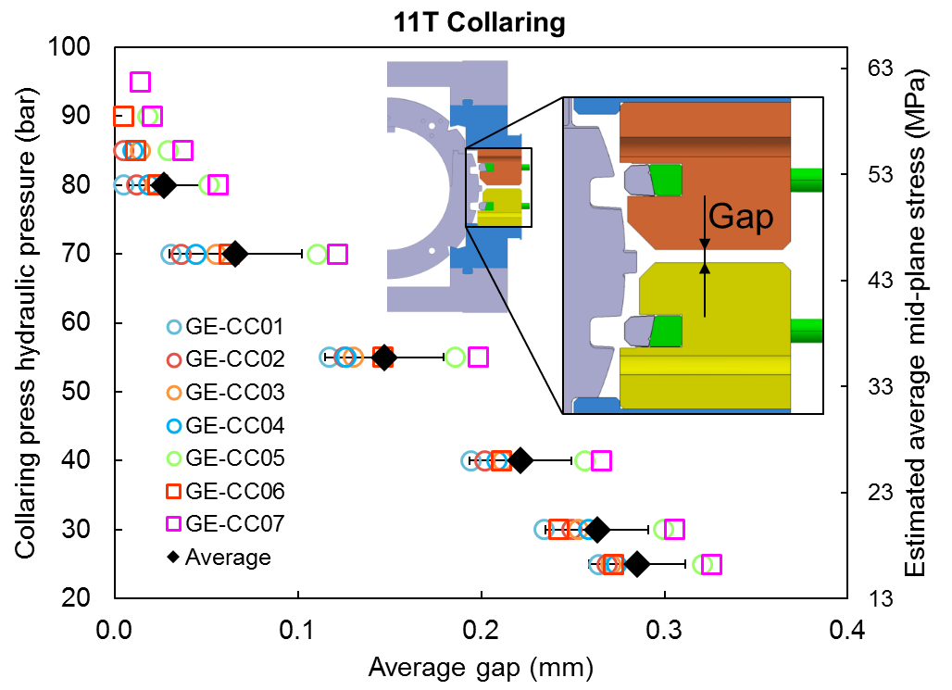
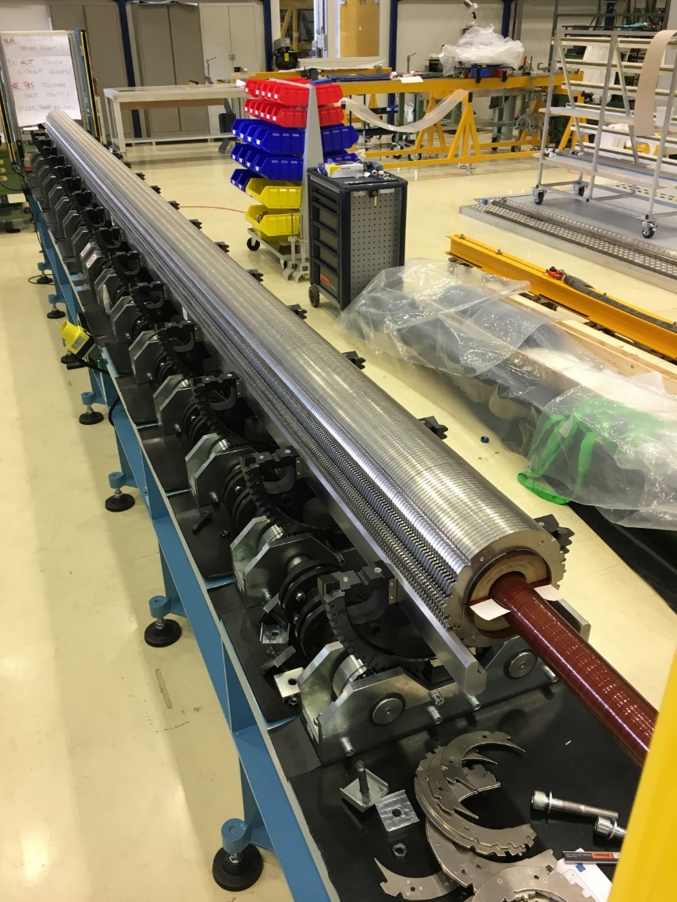
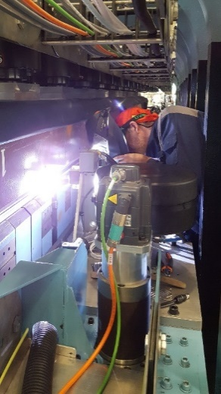
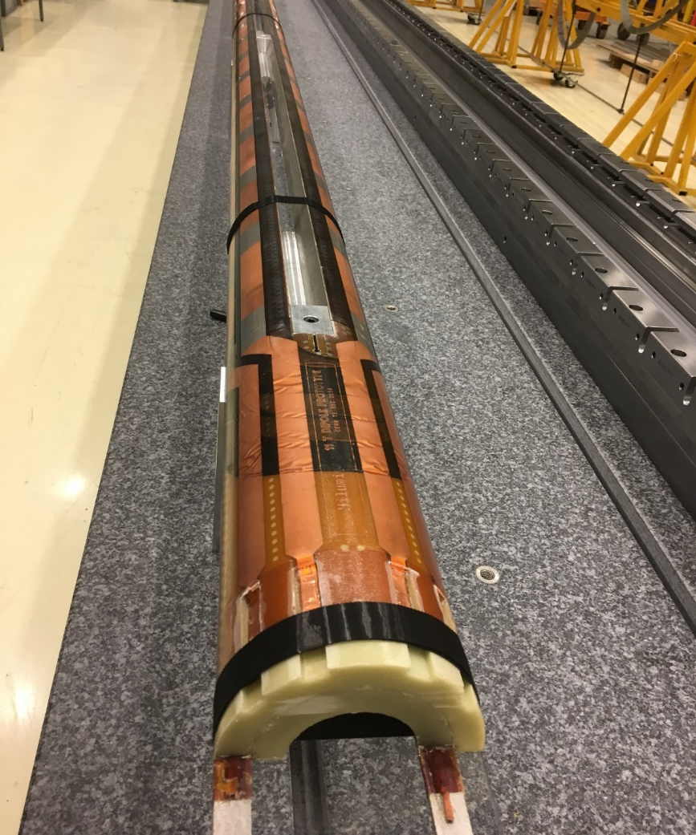
11T collared coils
±50 μm
This is an industrial production !

Slide 7
LMBHB0002

Slide 8
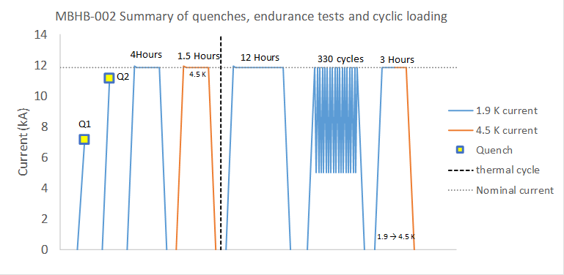
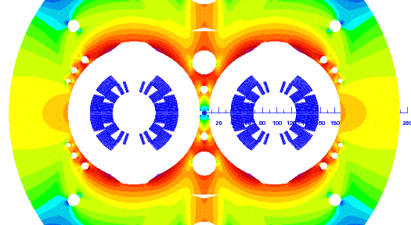
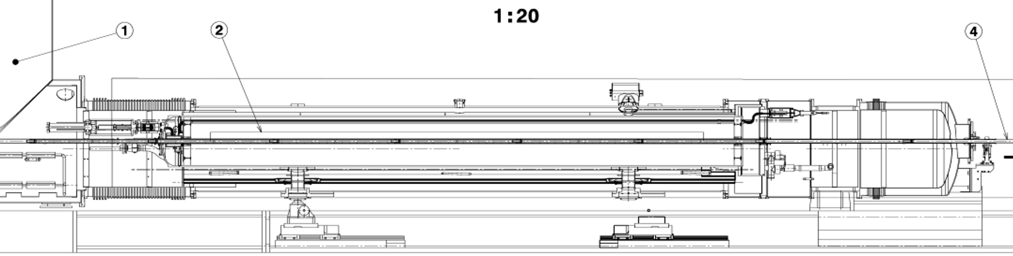
LMBHB002 powering tests
Nominal
7 TeV
6.5 TeV
Present operation
D1
D2
NCS
Q1: 7164 A
Q2: 11135 A
CS
Q2
Q1
This is an accelerator worthy dipole !

Slide 9
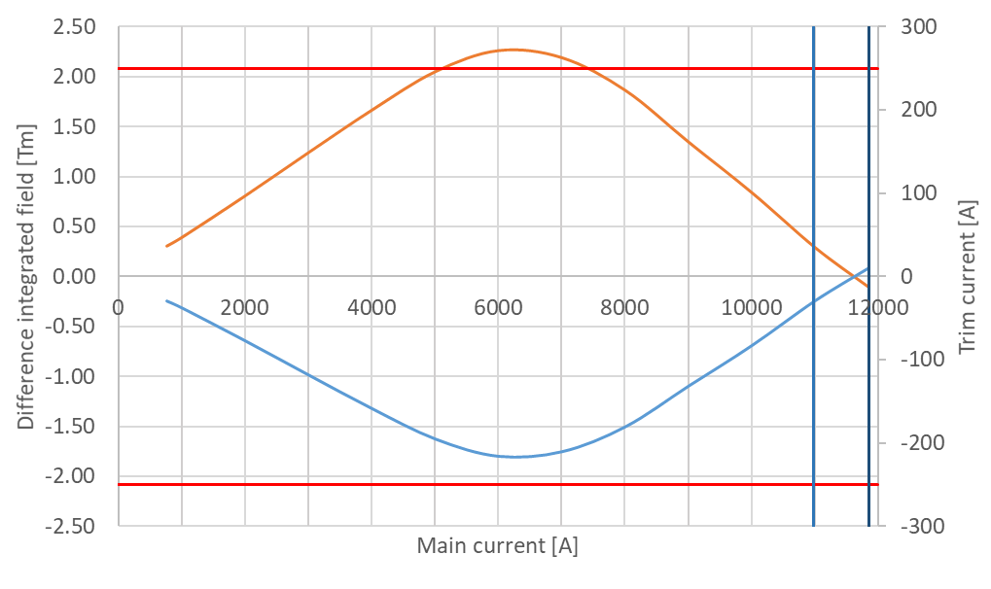
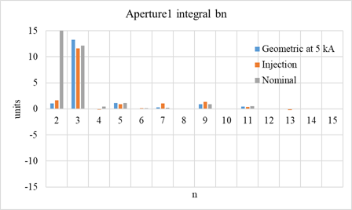
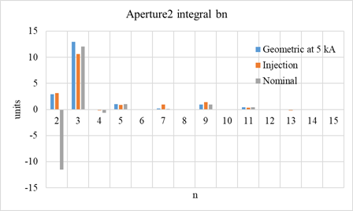
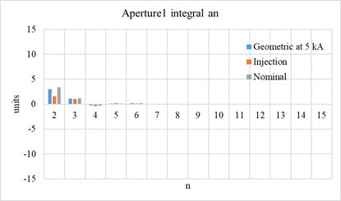
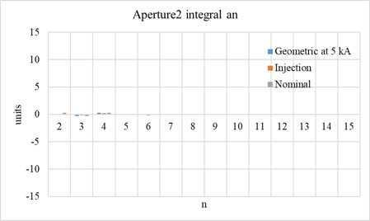
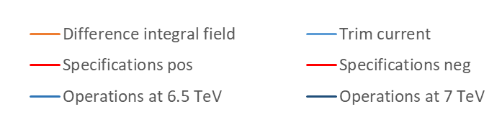
LMBHB002 Field Quality
Transfer Function difference MB vs. MBH
Geometric Multipoles (@17 mm)
+ 250 A
Aperture 1
Aperture 2
Normal
- 250 A
Skew
A trim current is injected in the 11 T dipole circuit to match LHC dipole transfer function (based on average of integral field measurements for the 2 apertures)
b₂ (normal quadrupole) arises from iron saturation
and is as expected (∼±14 u);
b₃ (normal sextupole) is a bit larger than expected (∼7 u).
This is an accelerator worthy dipole !

Slide 10
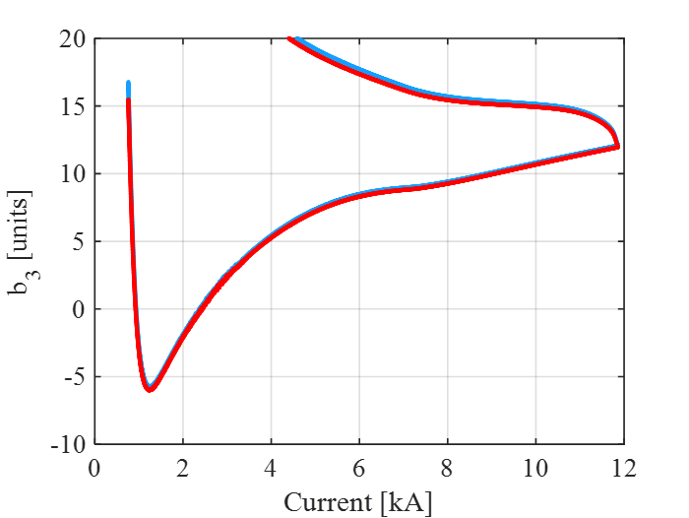
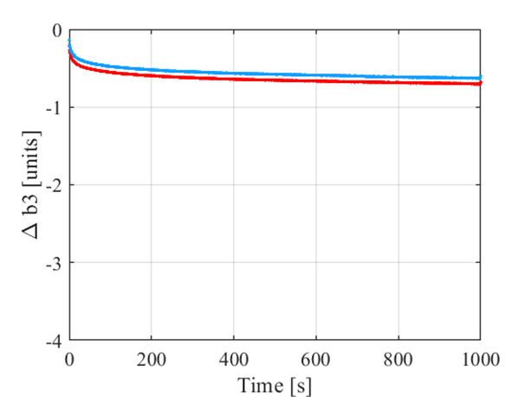
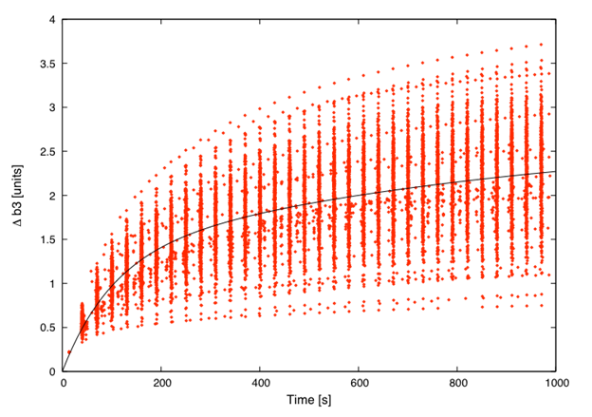
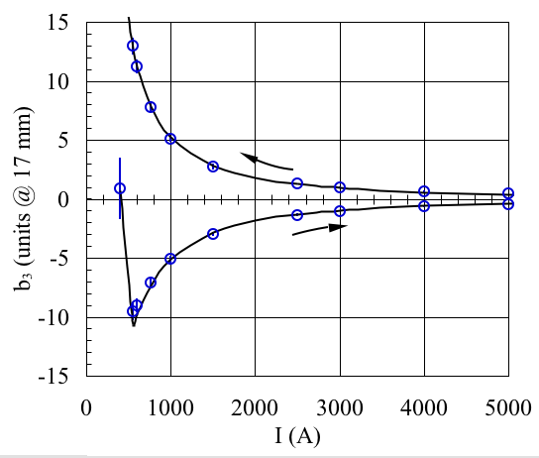
LMBHB002 Field Quality
Persistent Magnetization Currents
(2nd cycle, both apertures)
Time decay at Injection (760 A)
Injection
LHC Dipoles
LHC Dipoles
The injection current is on the “wrong side” of the peak of persistent current sextupole due to the inherent magnetic moment of the SC filaments (approximately 50 μm diameter), and ≈ 2.5 times larger than in the LHC Nb-Ti dipoles
b₃ time decay at injection is “reversed” due to the initial point, and relatively small when compared to the LHC Nb-Ti dipoles
This is an accelerator worthy dipole !

Slide 11
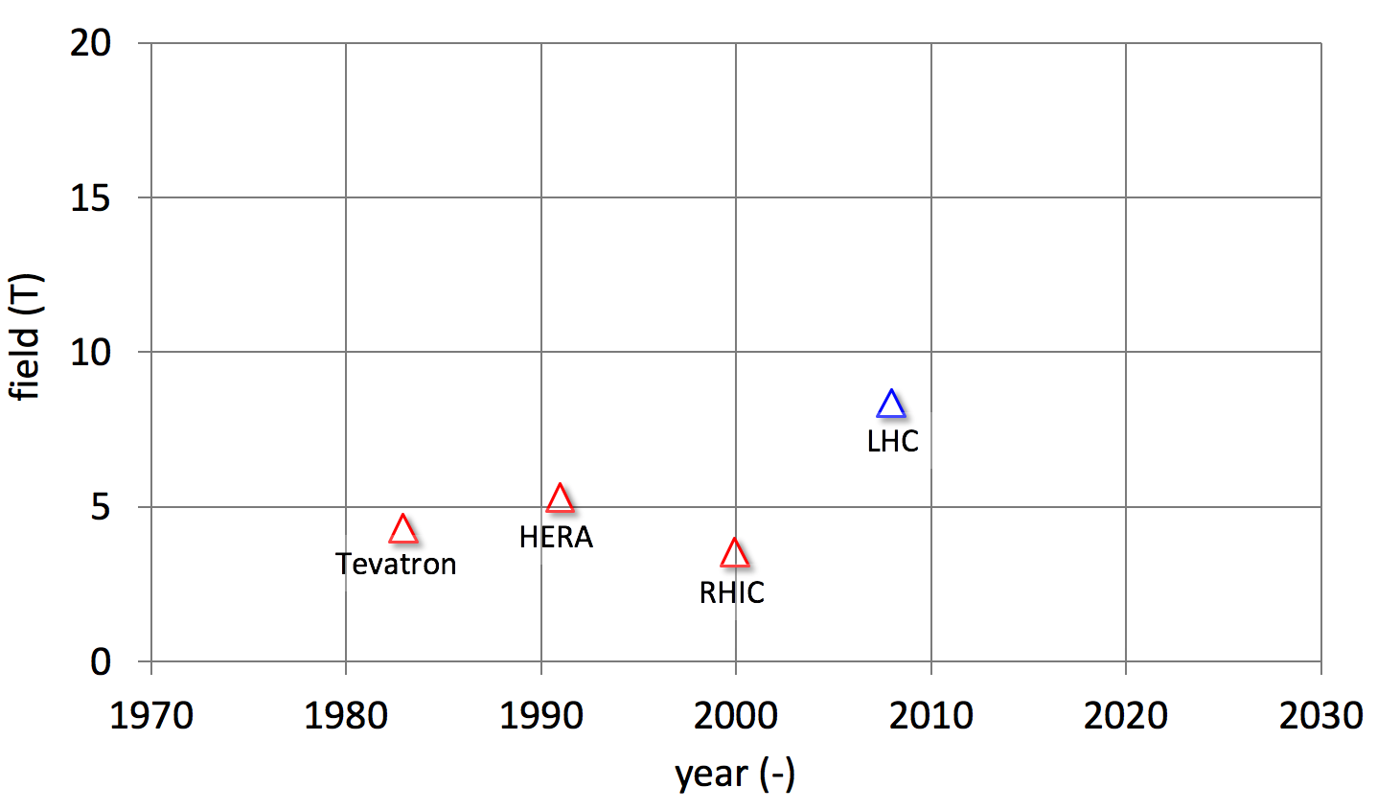
HL-LHC 11T significance
We are confident that the 11T production will achieve consistently nominal performance
MBH
Nb-Ti
The 11T MBH is a technology breakthrough !

Slide 12
A program for the long term
The long and winding road of 11 T has reminded us that there is a long way from demonstrators to model, prototype magnets, pre-series and industrial production. We need continuity, because:
Lead times for the development of high-field magnets are long, a typical cycle lasts ten years. Another ten years will be required for industrialization (see later). Not pursuing technology R&D in-synch with HEP scoping studies of new accelerators may result in missed opportunities.
Development of high-field superconducting magnet technology requires infrastructure of large size and cost. A program that requires such infrastructure is most profitable if pursued with continuity, rather than executed in bursts.
High-field superconducting accelerator magnet development relies on many fields of science and engineering, i.e. a team that is assembled in collaboration with organizations. Such research team also operates most effectively in a continuous mode

Slide 13
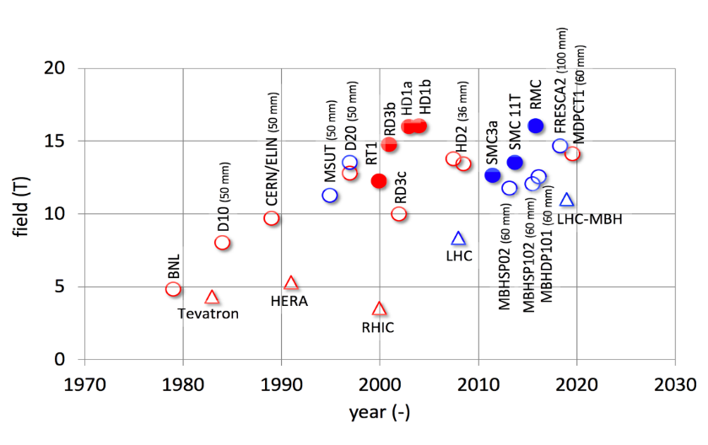
Cycle time
It took ≈ 10 years to establish Nb₃Sn magnet technology
It took ≈ 10 years to make Nb₃Sn accelerator magnets
HL-LHC is possible thanks to ≈ 20 years of Nb₃Sn R&D

Slide 14
A program in collaboration
This is a proposal for a collaborative program. We wish to profit from the competences developed and the team built over the last 15 years (EU-FP6 CARE and NED-JRA, EU-FP7 EuCARD and EuCARD2, EU-H2020 ARIES), and boosted by the FCC activities (EU-H2020 EuroCirCol)
Today, collaborators have key roles in:
Conductor development and characterization (FCC Conductor Development Program)
Develop, demonstrate and decide the technology suitable for future accelerator magnets (model developments at CEA, INFN, CIEMAT, CHART/PSI)
CERN is also a collaborator

Slide 15
What is next ?
The HL-LHC Nb3Sn program has set a new benchmark: we have completed the initial model and prototype magnet development for operation in the 11-12 T field range and the next step is to capitalize on it, use this benchmark to develop industrial, robust and efficient techniques.
We have a few demonstrators showing that Nb3Sn has the potential to operate at fields beyond 14 T, the next step is to confirm this potential with model magnets and prototypes.
We have not yet had the opportunity to explore the potentials of HTS, the next step is to develop demonstrators to assess this technology.

Slide 16
Outline
The nature of the program
The leading questions for the R&D
The R&D lines responding to the questions
The R&D vehicles
Deliverables and timeline
Summary

Slide 17
The “leading questions” – 1/3
Q1: What are the performance limits of Nb₃Sn ?
Is the target of 16T for accelerator magnets realistic ?
Q2: Can we improve training of Nb₃Sn magnets ?
Q3: How do we manage the forces and stresses in a high-field Nb₃Sn accelerator magnet ?
Q4: How do we protect a high-field Nb₃Sn accelerator magnet ?
Q5: Can we improve the design and manufacturing processes to achieve robustness, reduce risk, increase efficiency and decrease cost as required by a large-scale industrial production ?

Slide 18
The “leading questions” – 2/3
Q6: What is the potential of HTS materials to extend the performance reach of high-field superconducting accelerator magnets ?
Basic material and conductor properties
Q7: Are HTS conductors, cables, coils suitable for accelerator magnet applications ?
Cable concept
Field quality
Q8: What engineering solutions are required to build such magnets, including consideration of material and manufacturing cost ?
Winding and mechanics
Quench detection and protection
Splice and joint technology
Insulation and impregnation
Notes:
Please convey my apologies and best wishes for a successful workshop

Slide 19
The “leading questions” – 3/3
Q9: What is the specific infrastructure required for this conductor and magnet R&D, production and test ?

Slide 20
Outline
The nature of the program
The leading questions for the R&D
The R&D lines responding to the questions
The R&D vehicles
Deliverables and timeline
Summary

Slide 21
From leading questions to R&D lines
R&D-1: Nb₃Sn conductor research and development
R&D-2: Nb₃Sn magnet technology research and development, exploring performance limits
R&D-3: Nb₃Sn accelerator magnet development for robust and cost-effective industrial production at large scale
R&D-4: HTS material, conductor and coil technology and accelerator magnet research and development
R&D-4.1: Review engineering specifications for HTS conductor (wires, tapes and cables) and pursue the ensuing development
R&D-4.2: Develop HTS coil and magnet technology in the form of small-scale demonstrators
R&D-5: Insulating materials, polymers and composites.
R&D-6: Infrastructure for development, manufacture, test and measurement.

Slide 22
 |  | Q1: Performance limits of Nb₃Sn | Q2: Training origins and cures | Q3: Mechanics | Q4: Protection | Q5: Production robustness, risk, cost
R&D-1: Wire and conductor R&D
R&D-2: Magnet technology | SMC
 | eRMC/RMM
 | Models
R&D-3: Accelerator magnet development (VE)
LTS (Nb₃Sn) development matrix

Slide 23
HTS development matrix
 |  | Basic conductor properties (Ic(B,T,α,ε), RRR, k, M, R, …) | Cable concept (stacks, Roebel, transposition, defects, current sharing…) | Splice and joint technology | Insulation / impregnation | Quench detection and protection | Winding and mechanics | Field quality
 |  | Q1 | Q2 | Q3 |  |  |  | Q2
R&D-4.1: Conductor R&D | Tape/Wire
 | Cables
 | Joints
R&D-4.2: Magnet technology | Small coils (I, PI, NI)
 | Demo coils

Slide 24
Outline
The nature of the program
The leading questions for the R&D
The R&D lines responding to the questions
The R&D vehicles
Deliverables and timeline
Summary

Slide 25
R&D Vehicles – overview
Cables
Model Coils
Short Model Coil (SMC)
Racetrack Model Coil (RMC)
Racetrack Model Magnet (RMM)
Ultimate Nb₃Sn Dipole Models
Value Engineered Dipole Prototype
HTS Demonstrator Magnets
Heritage realizations
Very High Field Test Station for high field inserts
HTS wiggler/undulator

Slide 26
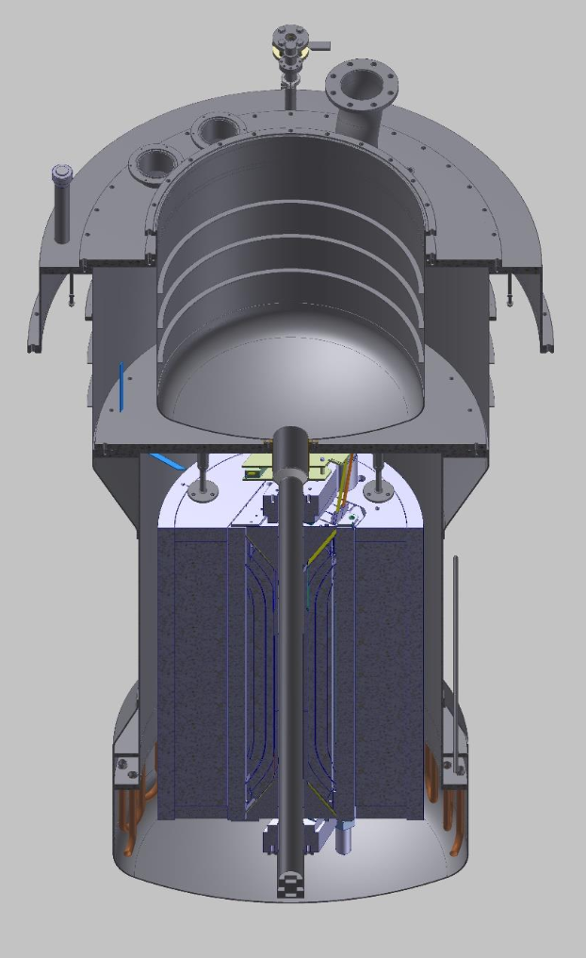
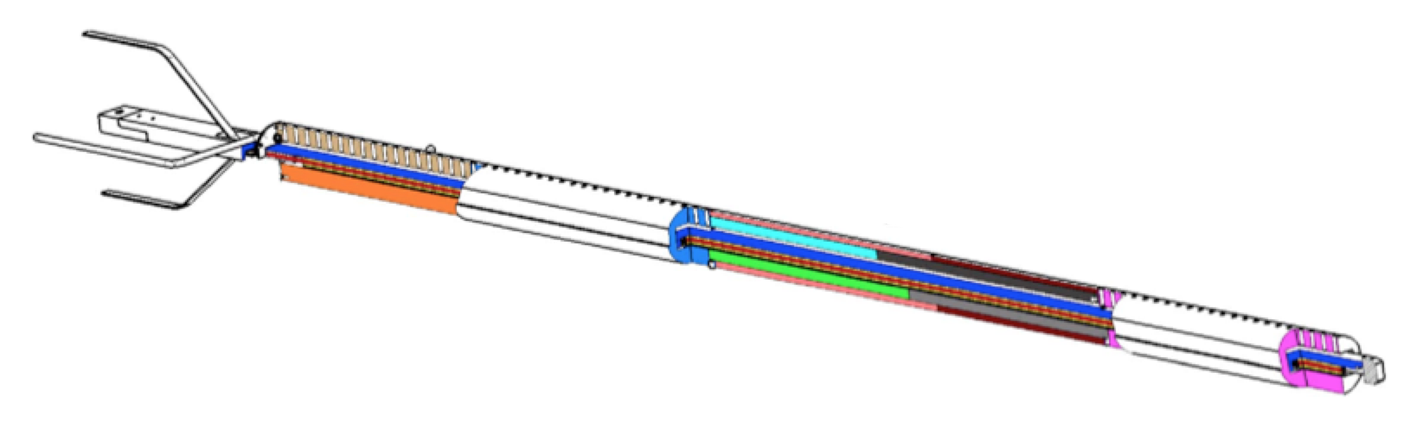
Cable tests
Measurement of properties and validation of variants at cable level
Critical current and stability in FRESCA (FRESCA2) under relevant operation conditions, including sample preparation (resin), deformation, transverse stress and strain, joints
B_{peak} = 12 T (16 T)
L_{sample} = 2 m
W_{strand} ≈ 1 kg (2 kCHF)

Slide 27
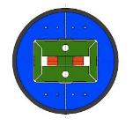
SMC technology exploration
The “Short Model Coil” is an intermediate step between cable and magnet, used to test rapidly technology and manufacturing variants (turnover of three months):
Conductor variants
Insulation systems
Impregnation resins
Sliding and separating surfaces
OD = 530 mm
L = 500 mm
No free bore
B_{ultimate} = 14 T
W_{strand} ≈ 10 kg (20 kCHF)

Slide 28
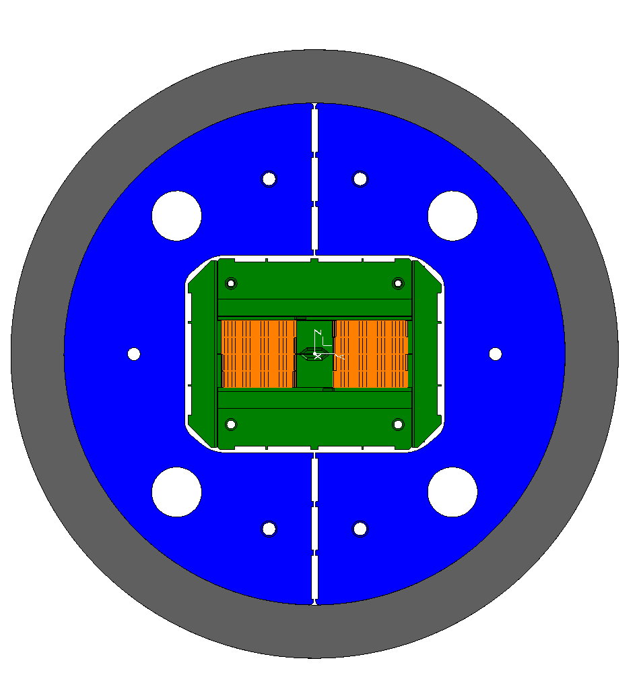
eRMC high-field operation
The “extended Racetrack Model Coil” is a test-bed for full size conductors reproducing full field and force conditions over a representative length, including transitions, used to test manufacturing solutions:
Conductor grading
Layer jumps and splices
Loading conditions
Conductor interfaces to pole and end-spacers
Heat treatment and impregnation
OD = 800 mm
L = 1.5 m
No free bore
B_{ultimate} = 18 T
W_{strand} ≈ 120 kg (250 kCHF)

Slide 29
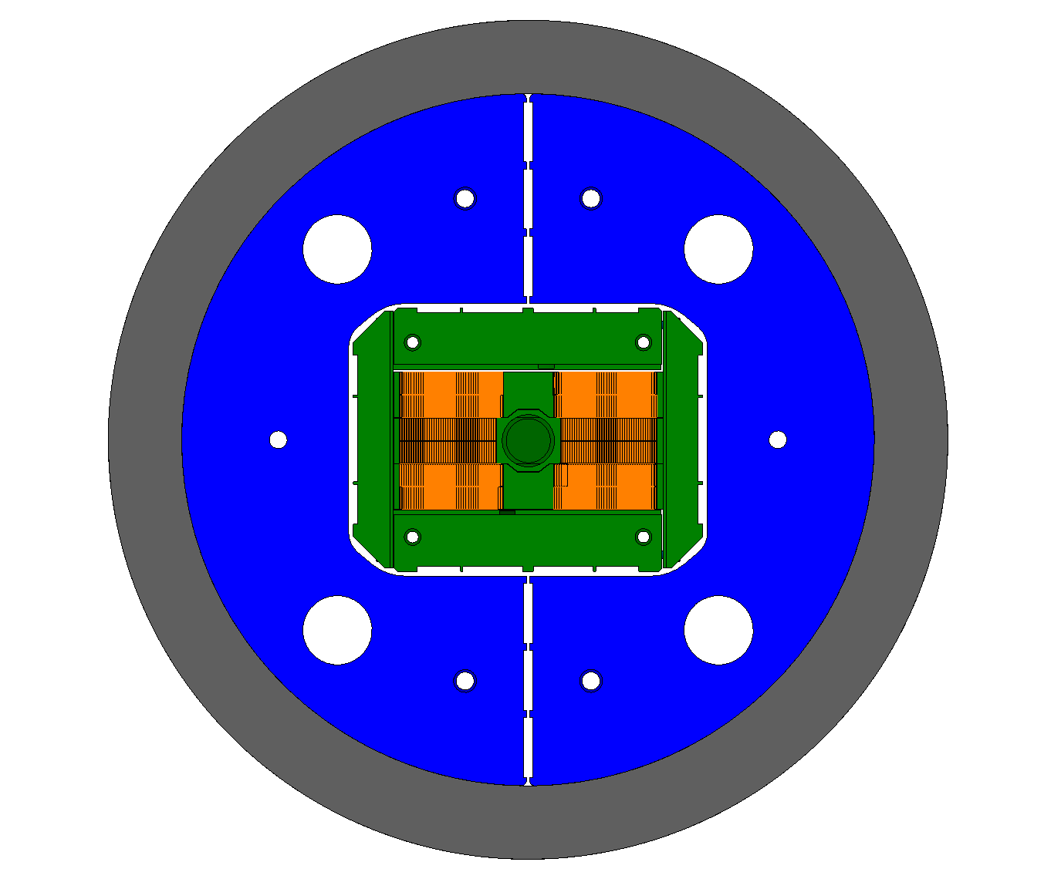
RMM x-section demonstration
The “Racetrack Model Magnet” is a full size test of a block-coil magnet, including a reproduction of the 2D cross section (with a cavity, no bore), and optimized ends (0.5 T field drop) used to validate and test:
Force and stress management
Magnet loading in 3D
Field quality in 2D
OD = 800 mm
L = 1.5 m
50 mm free cavity
B_{ultimate} = 18 T
W_{strand} ≈ 180 kg (350 kCHF)

Slide 30




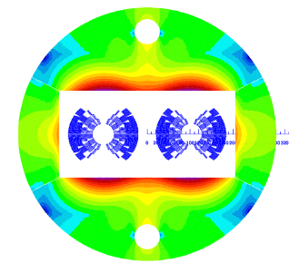
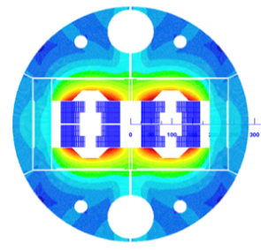
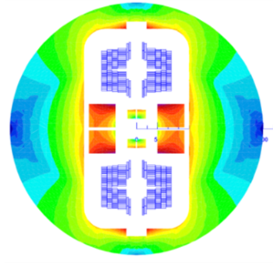
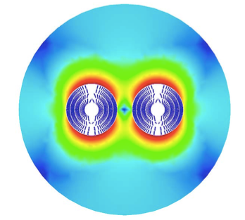
Models – 1/2
OD = 600 mm
L = 2 m
50 mm aperture
B_{ultimate} = 16 T
W_{strand} ≈ 350 kg (700 kCHF)
 |  | cos(θ) | blocks | common coil | CCT
Current | (A) | 10000 | 11230 | 16100 | 18055
Inductance | (mH/m) | 50 | 40 | 19.2 | 19.2
Stored energy | (kJ/m) | 2500 | 2520 | 2490 | 3200
Coil mass | (tons) | 7400 | 7400 | 9200 | 9770

Slide 31
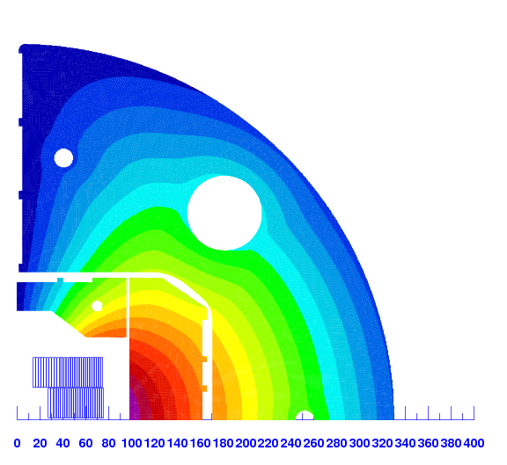
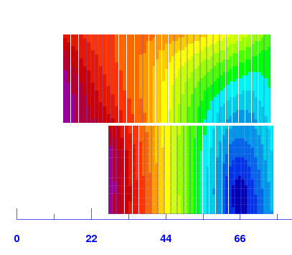
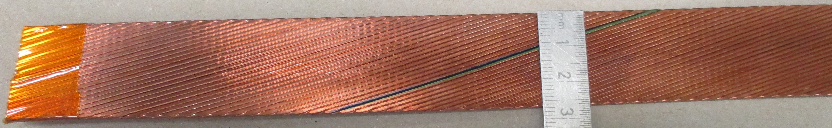
Models – 2/2
R= 13.5 mm
R= 34 mm
 |  | Strands | Dstrand | CU/SC | Width | Thickness
 |  | (-) | (mm) | - | (mm) | (mm)
Cable geometry | DEMO HF | 44 | 1.10 | 0.8 | 25.700 | 2.002
 | DEMO LF | 56 | 0.85 | 1.2 | 25.700 | 1.547
DEMO-HF prototype
Courtesy of I. Pong LBNL

Slide 32
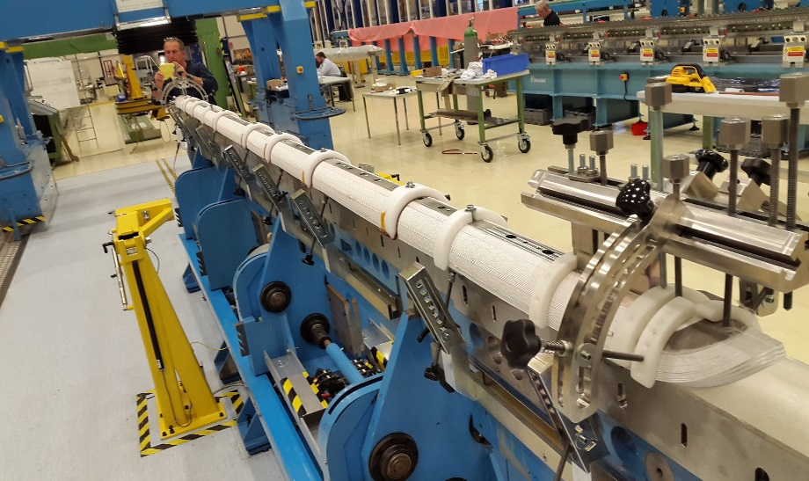
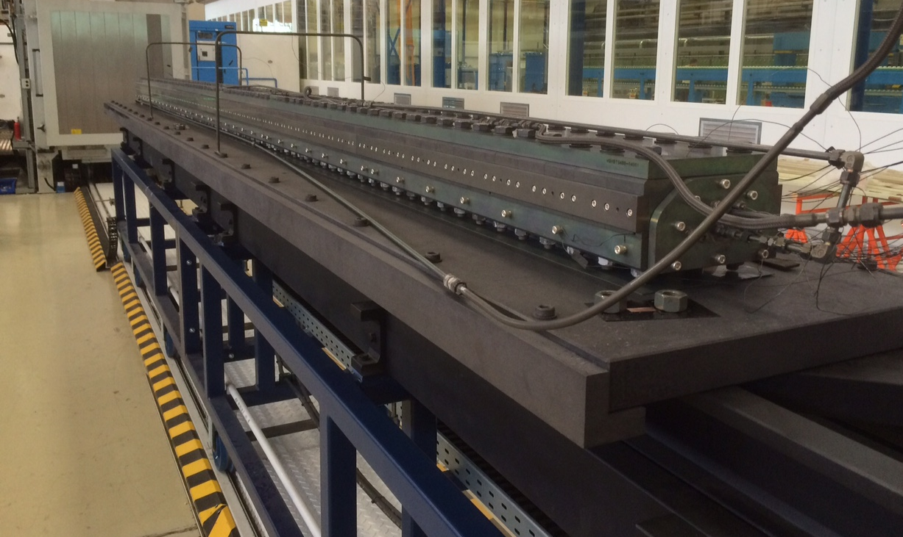
Value Engineered Dipole
Insulation system, fibers, sizing, binder and resins
Coil handling (especially after heat treatment)
Coil geometry measurement and shimming
Splices and instrumentation
…
One mold for HT and impregnation
Armored coils
Magnet assembly (collaring, bladder-and-keys, …)
Cold mass construction
…
Just ideas for the moment

Slide 33
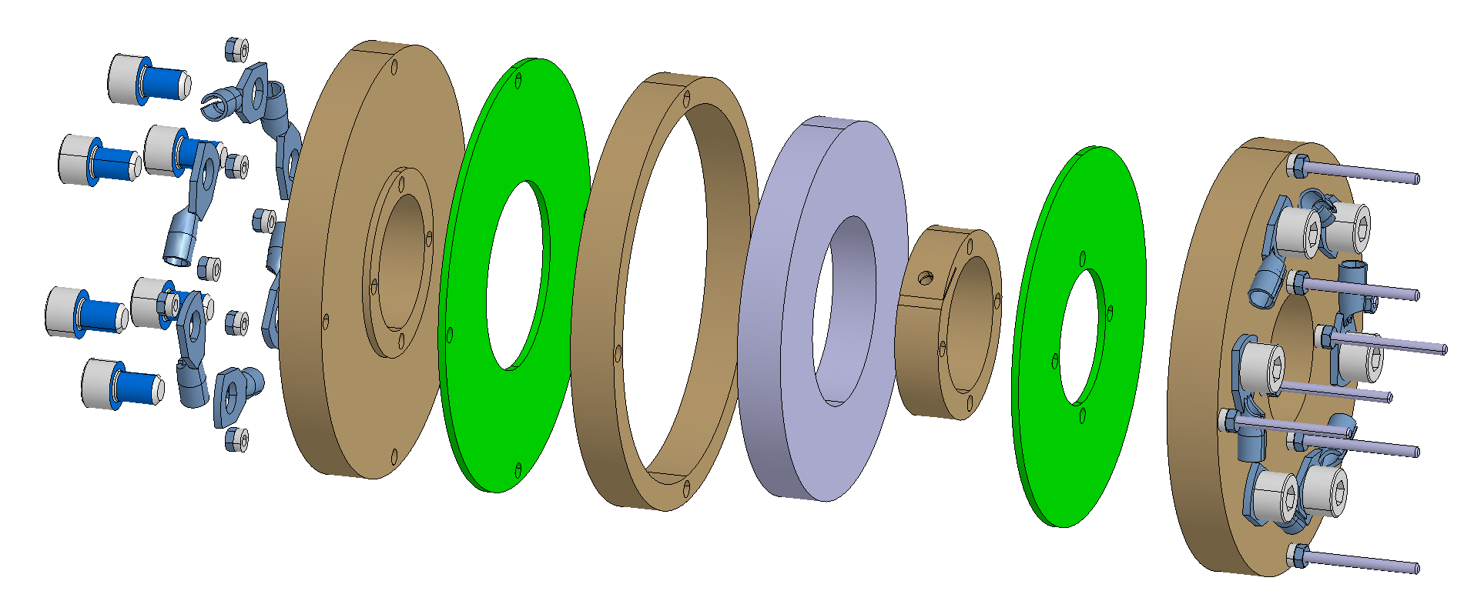
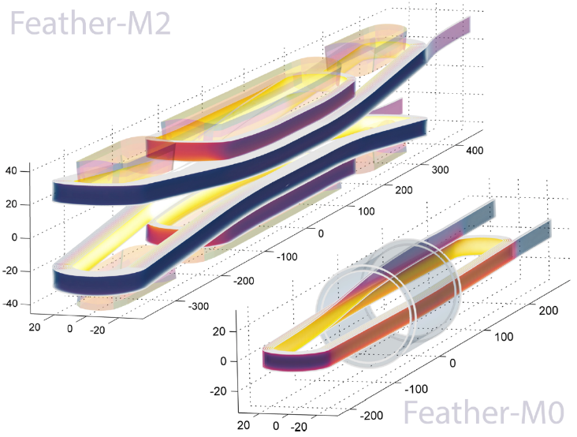
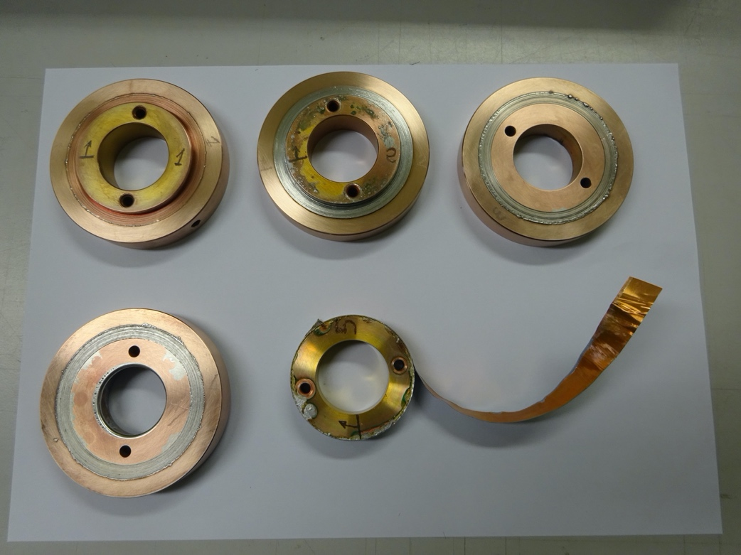
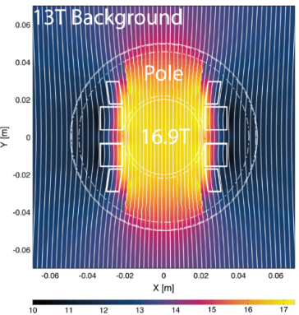
HTS demonstrator magnets
Small coils to test basic magnet properties and technology variants
Insert coils to test in-field behavior and performance reach
Aligned-blocks
Let us make a simple exercise:
A 20 T dipole with 50 mm bore
J_{E} = 600 A/mm²
J_{coil} = 400 A/mm²
w_{coil} = 80 mm
A_{coil} = 400 mm²
L_{tape} = 20 km/m
Cost : o(2 MUSD/m) ?!?
Test solenoids with insulation variants
Field generated by Feather-M2 as insert in a magnet providing background field FRESCA2 (13 T)

Slide 34
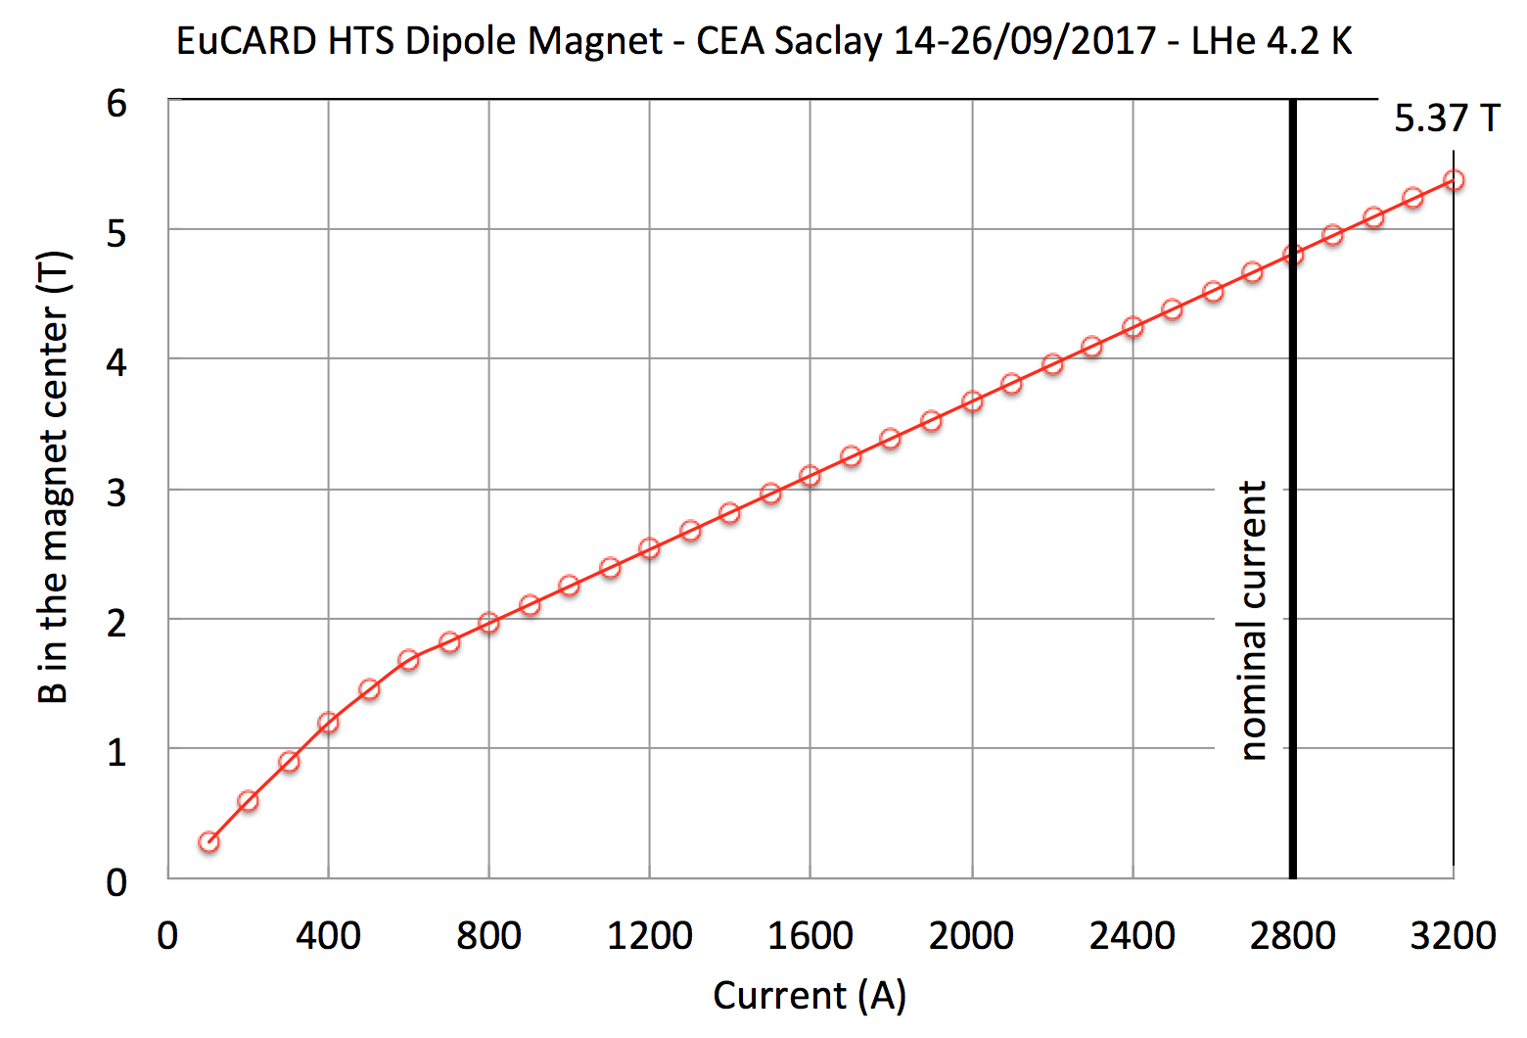
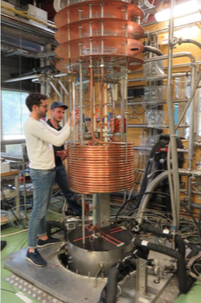

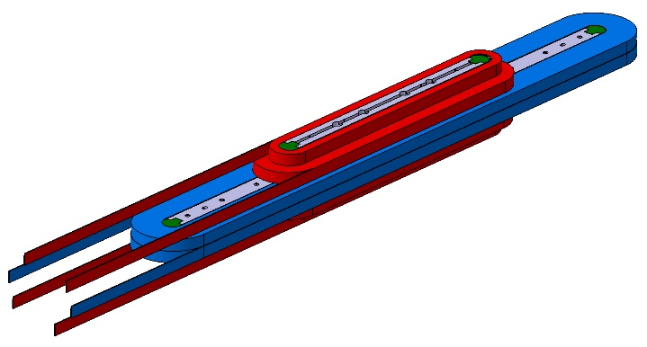

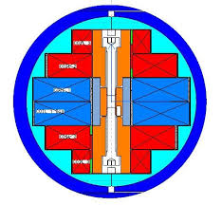
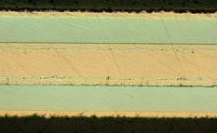
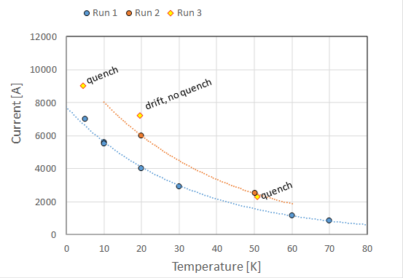
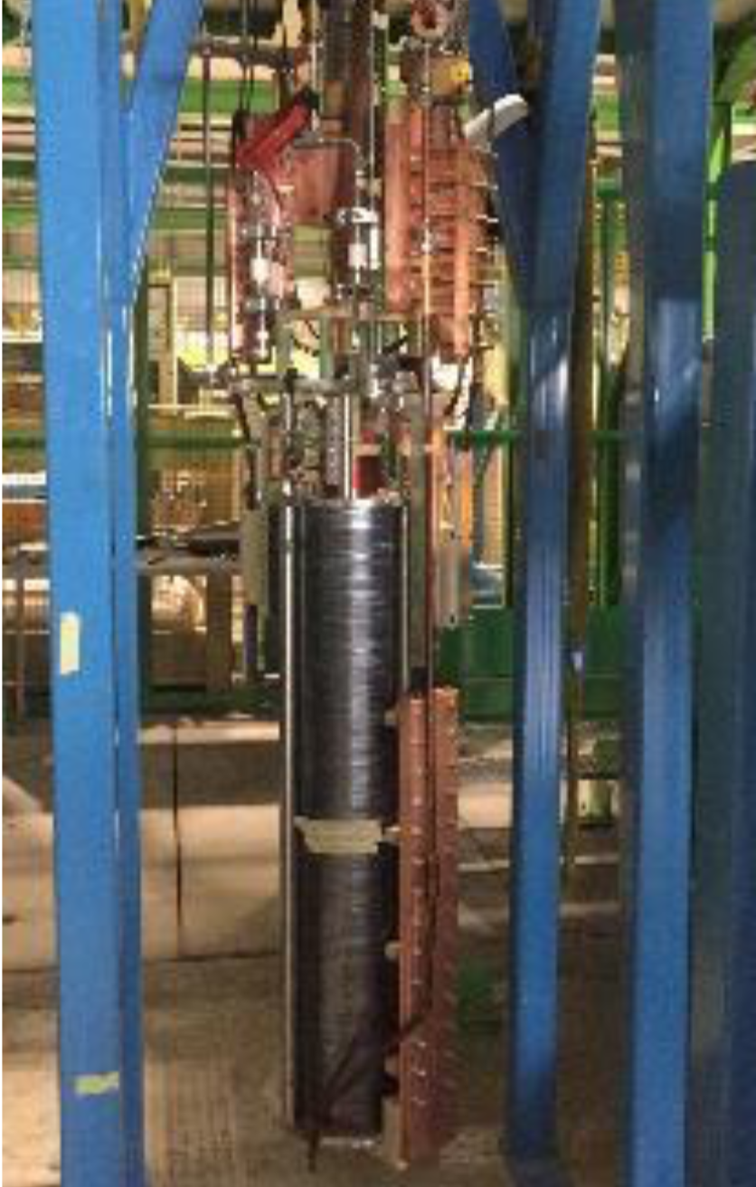



EuCARD/EuCARD² - HTS inserts
5.37 T
REBCO tapes
4.2 T
REBCO Roebel

Slide 35
Outline
The nature of the program
The leading questions for the R&D
The R&D lines responding to the questions
The R&D vehicles
Deliverables and timeline
Summary

Slide 36
After 5 years – PROVISIONAL
LTS program deliverables
Conductor R&D → HL-LHC Nb₃Sn at multiple suppliers, reduced cost. Superconductor with properties approaching FCC targets
Insulating materials R&D → Upgrade of the insulation scheme
Magnet technology R&D → An answer to basic questions on training, protection, and mechanics (SMC, eRMC, RMM). Model magnet results beyond HL-LHC (model magnet results) ready for critical decision
Accelerator magnet R&D → Engineering upgrade and optimization of design, methods, materials and tooling for large series production of long magnets, ready for long magnet prototyping
Infrastructure R&D → New very high-field test station
HTS program deliverables
Conductor R&D → Consolidated development targets. Exploration of alternatives for materials and cables, and associated characterization
Coil and magnet technology R&D → exploration of basic design concepts. Coil and magnet fabrication technology. An answer to basic questions on suitability for accelerator operation (small coils, coil inserts, small models)
Demonstrator undulator ready for test in a beam line
Review the High Field Magnet program at the end of this phase (Gate Review in 2024)

Slide 37




European Strategy for Particle Physics 2018-2020
European Strategy for Particle Physics 2025-2027
Nb₃Sn Roadmap
2020
2021
2022
2023
2024
2025
2026
2027
SMC, RMC, RMM
DEMO
Falcon
R2D2-FD
F2D2
RMC-CC
CCT
Gate: Evaluate design options for ultimate Nb₃Sn performance (16 T)
VE dipole
Models and prototypes
Gate: Demonstrate technology for large scale, ultimate Nb₃Sn accelerator magnets
We need to develop a similar roadmap for HTS

Slide 38
Outline
The nature of the program
The leading questions for the R&D
The R&D lines responding to the questions
The R&D vehicles
Deliverables and timeline
Summary

Slide 39
Summary
Two main aims:
Exploit Nb₃Sn magnet technology up to its practical upper limit, both in terms of maximum performance (maximum field target 16 T) as well as scale (production in large series o(10³) units)
Provide a proof-of-principle for HTS magnet technology beyond the reach of Nb₃Sn, with a target of 20 T dipole field, and sufficient field quality for accelerator application
The program targets to reach critical results for the next season of the European Strategy for Particle Physics (2025-2027)
It will be highly beneficial to integrate programs into a joint High Field Magnet Development Plan

Slide 40

Here Be Dragons

Slide 41
Ultimate Nb₃Sn HF dipole
Objective: Explore conductor and magnet technology at the upper limit of Nb₃Sn (LTS) with a projected upper target of 16 T
Scope: Produce accelerator-relevant short models as technology demonstrators, in connection with progression in basic R&D (conductor and cable, SMC, RMC, RMM,…)
Time scale: 2020…2024
R&D themes: 1, 2, 3, 8

Slide 42
Value engineered HF dipole
Objective: Develop cost-effective design features and robust manufacturing processes that apply to large scale production (10³ magnets) of high-field accelerator magnets, securing the field range achieved with HL-LHC
Scope: Study engineering processes and solutions. Demonstrate initially at small scale (e.g. SMC). Progress to scale increase, from models to long prototypes
Time scale: 2020…2027
R&D themes: 1, 2, 3, 6, 8

Slide 43
HTS HF magnets
Objective: Explore conductor and magnet technology at field beyond Nb₃Sn, using HTS, with a projected upper target of 20 T for dipoles (and equivalent for other magnets)
Scope: Demonstrators are small coils and high-field inserts to be tested in background facilities, relatively small amount of HTS
Time scale: 2020…2024
R&D themes: 4, 7, 8

Slide 44
Very High Field Test Facility
Objective: a new test bed, mostly dedicated to HTS cables and inserts, approaching operating conditions of very high-field accelerator magnets
B_{bkg} ≈ 15 T
I_{op} > 20 kA
T_{op} ≈ 1.9 K … 100 K
Large aperture (≈ 150 mm)
Scope: conductor procurement and magnet construction, this project materializes the R&D on the ultimate Nb₃Sn dipole
Time scale: 2021…2025
R&D themes: 2, 3, 5, 8

Slide 45

The models
Specific issues (e.g. winding geometry, field quality, …) may require to realize small magnets with aperture and intermediate field (range of 5 to 10 T)
Given the charting nature of this R&D, it is important to approach problems gradually, especially in terms of force and energy density
This is best achieved testing at variable temperature
Inspirations towards novel geometries
J. Van Nugteren, IEEE TAS, 28(4), 2018, 4008509

Slide 46
HTS wiggler/undulator
Objective: design and prototype a HTS wiggler/undulator with a combination of field/period/gap that cannot be achieved by LTS
Scope: design a wiggler/undulator demonstrator for a test in a beam line (synchrotron light source or free electron laser). This project materializes the R&D on the HTS dipole
Time scale: 2019…2024
R&D themes: 4, 5, 7, 8

Slide 47





The demonstrations (one example)
HR coil
VR coil
HTSCU H2020 Proposal
B_{gap} ≈ 3 T
Gap ≈ 15 mm
C. Boffo IDMAX10
This is the right scale for a beam test !

Slide 48
R&D Plan Overview − 1
1. Nb₃Sn Conductors
- Bring multiple suppliers to HL-LHC performances (2022), aim at stable production and reduced cost w/r to HL-LHC;
- Support development towards 1500 A/mm² at 4.2 K and 16 T (2024), including through SC Open Laboratory initiative;
- Initiate and support parallel R&D efforts on cabling and cabling degradation (2022-2024).
2. Nb₃Sn Magnet Technology
- Consolidate technology development program and carry out value engineering effort to bring Nb₃Sn accelerator magnet technology to full maturity and enable industrialization (2020-2024);
- Build model dipoles at increasing performances (up to 16 T) devoted at exploring design variants (2020-2024);
- Build a sequence of model dipoles aiming at optimization and proof of reproducibility (2024-2027).
3. Nb₃Sn Accelerator Magnet
- Introduce engineering solutions for risk- and cost-reduction, robust production on a large scale, and secure the field range achieved with HL-LHC (11 T to 12 T; 2020-2024)
- Initiate construction of long prototypes (2024-2027)

Slide 49
R&D Plan Overview − 2
4. Non-LTS Conductors and HTS Coil/Magnet Technology
- Review and consolidate engineering specifications for HTS development (2020) and support development of non-LTS conductors;
- define and initiate HTS technology development program (2020);
- explore potential of HTS through small coils and inserts aiming at boosting field (3 T to 7 T) in a background magnet (13 T to 15 T) (2020-2025).
5. Special HEP Magnets and Know-How Valorisation
- special magnets for future HEP projects: e.g., FCC e-e, CLIC, wigglers, spectrometers;
- valorize Nb₃Sn know-how by supporting other high-field applications: e.g., 14 T MRI;
- valorise development of Medium Temperature Superconductors (MgB₂ or HTS) by exploring new potential applications: e.g., large super-ferric magnets (2020-2030);
- valorize SC magnet know-how by supporting new medical applications and HTS undulators;
- networking with magnet community and industry.

Slide 50
R&D Plan Overview − 3
6. Infrastructures
- maintenance/upgrade of large manufacturing and test infrastructures.
7. Instruments, design & analysis software tools and databases
- develop/upgrade specific instruments for qualification, quality control and testing;
- maintain/consolidate/develop suites of software tools and databases used for design, analysis, data acquisition, data storage and production follow up.
8. Polymers & radiation hard materials and cryostat components
- develop and qualify polymers and radiation hard materials for magnets and other applications at CERN;
- develop and qualify designs and materials for seals, feedthroughs and multilayer insulation.

Slide 51
The “Virtuous Circle”
The pull
Set the performance targets for the specific project
Provide a finite time scale, quantity and budget for the realization
Exploit the technology in the scope of the specific project
The scout
Search for the materials that have the potential to meet the performance targets
Perform material R&D and characterization
Projects
Academia
The bridge
Overlap between the fields of academia (material research) and industry (large scale production)
Demonstrate the viability of the technology on a small scale
Industry
The run
Adopt and adapt the technology for scaling-up to production needs
Produce as from the project demands
Exploit the opportunities and alternative applications
https://indico.cern.ch/event/765096/contributions/3295748/

Slide 52
Future Needs
Realize ultimate performance in Nb₃Sn, as it has been specified for the main magnets of a Future Circular Collider in a new (FCC) or existing (HE-LHC) tunnel
Demonstrate the potential of HTS materials to complement and possibly surpass LTS accelerator magnet technology, providing efficient very-high-field or high operating margin options for specific locations in existing and future colliders, and eventually extending the energy reach of circular synchrotrons
Preserve our accelerators in the long-term, including LHC and HL-LHC
https://indico.cern.ch/event/765096/contributions/3295748/

Slide 53
Comments on the present landscape
Expertise and IP on superconducting wires and tapes is essentially localized in industry
The industry of superconductors produces
LTS for MRI, NMR and science as a commodity: highly competitive, under pressure for continuous cost-reduction, relatively small profit margins
Advanced superconductors, LTS and HTS as a niche: small production volume, material cost negligible, wires/tapes sold under cost, highly subsidized to support operations
Big Science (e.g. LHC and ITER) as one-off: these productions call for specific arrangements, fast production scaling up, and are often followed by dramatic consolidation among suppliers
The market of advanced superconductors is not sustainable (missing killer application), and industry is no longer willing to pay material R&D (superconductivity is no longer a high-tech jewel as it was the case 30-50 years ago)
Academia is attracted by fundamental physics (e.g. “anomalous electronic properties” rather than “superconductivity”), not by metallurgy
The virtuous circle is broken, a gap has formed between academia and industry⁽¹⁾. In practice we witness
High volatility of scientific engagements, results and prices
Loss of general knowledge, specific IP and technology of relevance for HEP (e.g. recent examples of PIT Nb₃Sn, BSCCO powders and wires, Rutherford cables)
⁽¹⁾ China may represent an exception, in that government has promoted a new supplier to fulfill the in-kind superconductor contribution to ITER, and is now moving aggressively into the commercial market while maintaining a very high level of R&D.
https://indico.cern.ch/event/765096/contributions/3295748/

Slide 54




Comments on the present landscape
ITER
LHC
forecast
Total value (A.U.)
HL-LHC
Superconductivity for Big Science is not an attractive market
https://indico.cern.ch/event/765096/contributions/3295748/

Slide 55










“So I tell you: Ask and it will be given to you” (Luke 11:9)
≈ 6 BEUR business
SSC R&D
HL-LHC
wires
US-CDP
EU-FP6/FP7
ITER wires
≈ 0.7 BEUR business
“And this may be known to you: What you do not ask, will not be given to you” (Lucio 1:3)
On the unreasonable request of high J_{C}

Slide 56
The response: SC Open Lab
The bridge
An open laboratory for R&D on applied superconductivity
Research and development of technical superconductors (LTS and HTS) and cables
Demonstration on a small scale (10…100 m) of the viability of a technology, in view of the extrapolation to an industrial production
Secure on the long term the intellectual property and the expertise required for a production on large scale (SC production kit)
Projects
Academia
SC Open Lab
Industry
https://indico.cern.ch/event/765096/contributions/3295748/

Slide 57


On training – example of LHC
Sector 12 training (end 2018)
Series 1000: 8 quenches
Series 2000: 2 quenches
Series 3000: 5 quenches
Quadrupole training is ”faster” relatively rapidly the current corresponding to 7 TeV
Surprising ! previous statistics indicated a faster sector training. Still, no limits to 7 TeV, but time will be needed for training !

Slide 58





On Nb₃Sn limits
Nb₃Sn is brittle and extremely fragile
Irreversible degradation
Stress applied at RT
Allowable stress 150 MPa

Slide 59


On collaring – 11T
Pole
50 MPa
Stoppers thickness
Shim
Midplane
150 MPa
Excess
300 μm
A maximum excess of 300 𝜇m is allowed
This target has been applied for the collaring operations of SP107, SP109, and GE02/GE03

Slide 60

On conductor limits in magnets
The conductor has been degraded during one of the operations, and is stable at its present performance
measured
expected
Special measurement performed using nano-voltmeters to increase resolution, shows a clear resistive transition on the coil midplane

Slide 61
Flux jumps in Nb₃Sn magnets
MQXFS (1.5 m)
MBH 11 T (1.8 m and 5 m)
Similar behavior on Nb₃Sn magnets tested at CERN to date
Amplitude <150 mV
Mainly at low or intermediate field
From the data collected up to now we see same amplitude on MBH full-length proto

