Slide 1
FCC Magnets Collaboration Meetings
Kick – Off:
CIEMAT Status
Javier Munilla, Fernando Toral, Luis Garcia-Tabarés, Jose Manuel Pérez

Slide 2
Introduction
New Magnet laboratory at Ciemat
Near-future plans
Conclusions

Slide 3
Introduction
There is a strong commitment from the Spanish Ministry of Science and the Centre for Technological and Industrial development to foster the activities on high field magnets. They consider CIEMAT as the ideal research center to lead this effort.
A Collaboration agreement has been signed with CERN to this end.
Accelerator Technology Unit at CIEMAT is a small group but with a long tradition, started in 1989. Two main lines of activity:
  Collaboration with CERN projects.
  Development of small accelerators for medical applications.
About superconducting magnets, we have been moving forward assuming more difficult challenges at each stage:
  Last step was the nested orbit correctors for HL-LHC: our first collared magnet, our first coils with Rutherford cable.
  Next step is high field magnets based on Nb₃Sn coils.
We want to keep and enhance the capability to produce magnet prototypes in house.

Slide 4
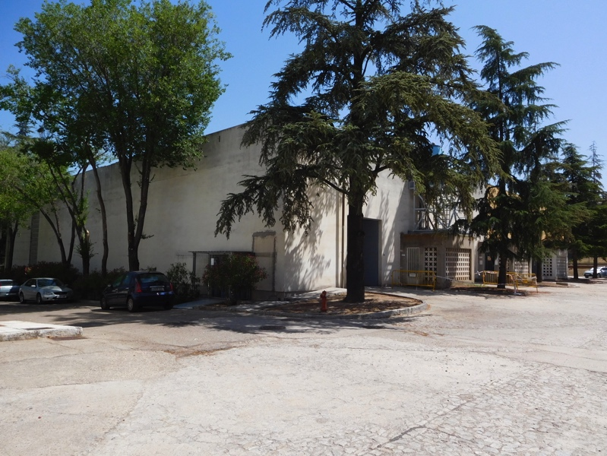
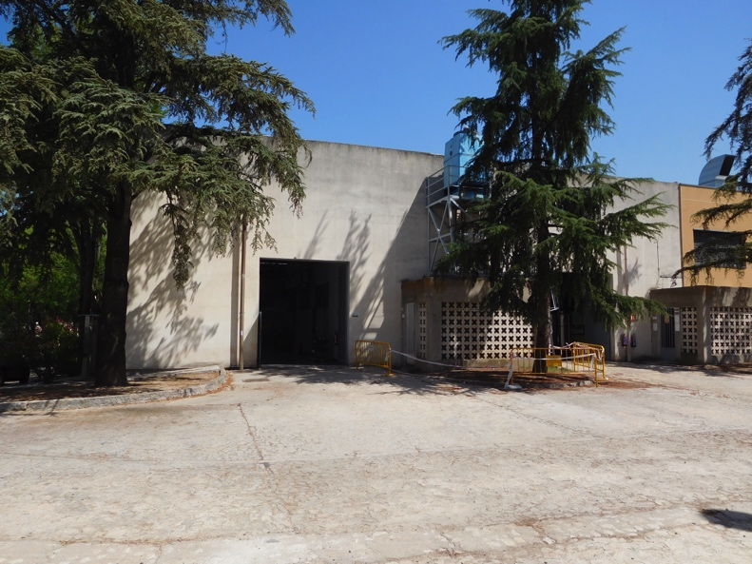
New model magnet laboratory at CIEMAT
Building 31 has been assigned for the construction of the model magnet laboratory at CIEMAT.
The first project basic study has been completed. It is slow because of nuclear energy activities in the past.
Tendering for the execution of the detailed project study is ongoing.
Construction tender is foreseen in May 2020.
Construction work should start on February 2021 and end in October 2021.
No large magnet test facilities are foreseen.

Slide 5
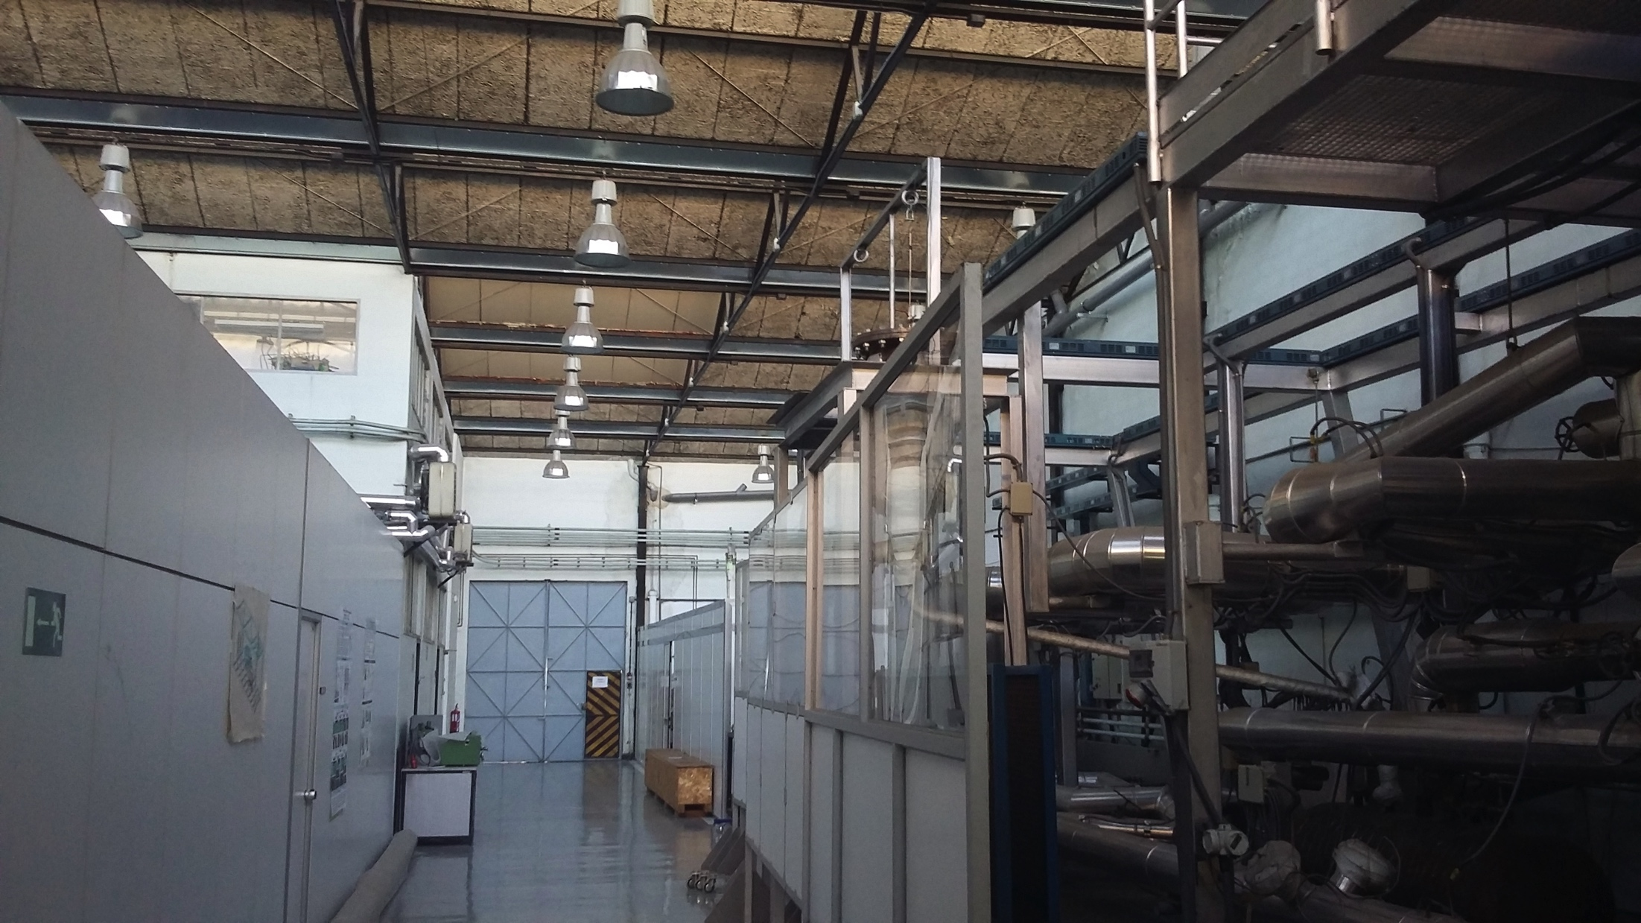
New model magnet laboratory at CIEMAT

Slide 6
Plans (1/2)
Our first commitment is to develop a racetrack model magnet, known as RMM, in collaboration with CERN.
We will go to 927 laboratory at CERN to produce the coils, using existing tooling (Autumn 2020).
We will revisit the support structure to analyze if any modifications are necessary.

Slide 7
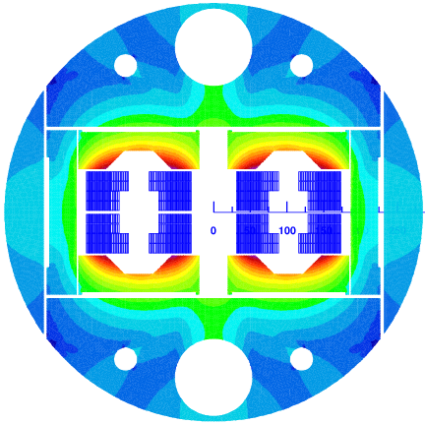
CIEMAT has been working on the design of a 16 T common coil dipole magnet for FCC (EuroCirCol).
Several designs have been studied. It is not clear if such a 16 T magnet could be done cost-efficiently in the near-future
Main conclusions about the studies for the common coil option were:
  Advantages: flat coils, react and wind, low field at coil ends (good for splices).
  Disadvantages: higher stored magnetic energy and horizontal forces.
  Challenge: electromagnetic design is competitive, mechanical design needs to be proved with prototypes.

Slide 8
Plans (2/2)
At this moment, it is worth to explore the advantages of a common coil magnet in the range of 12 to 14 Tesla.
It is not clear today when the reaction furnace will be operative at CIEMAT.
We will keep an eye on the optimization of fabrication techniques:
  Which resin?
  How to do an internal splice?
  Is it worth to explore react and wind techniques?
A prototype magnet about 1.5 m long will be built as deliverable.
No activities on HTS coils are foreseen by the time being.

Slide 9
Conclusions
CIEMAT supports the strategy of CERN for R&D on high field magnets, and its implications at European and World levels.
We want to be part of it.
We will contribute according to our resources and will be pleased to provide inputs according to our scientific opinion and industrial aims.

