Slide 1



Gentner Programme
Very special Gentner Day due to Coronavirus crisis
  video-only
  no cheese fondue
  no in-person coffee break
  no guest speaker (former Gentner student)
  NEW: brief introductions by all connected students

Slide 2
Gentner Overview
35 Gentner students as of 1 April 2020 (39 students nominal)
  start of some students delayed due to coronavirus crisis
  (+ 11 German students in regular Doctoral Student Programme)
now 20% female students
  was only ~13% in 2018, but ~32% in 2016
  only no. of applications by female students now at ~30% again
150 Gentner students since November 2007
  35 active + 115 former students
Students from 36 universities (since November 2007)
  new since last Gentner Day (October 2019): University of Greifswald

Slide 3
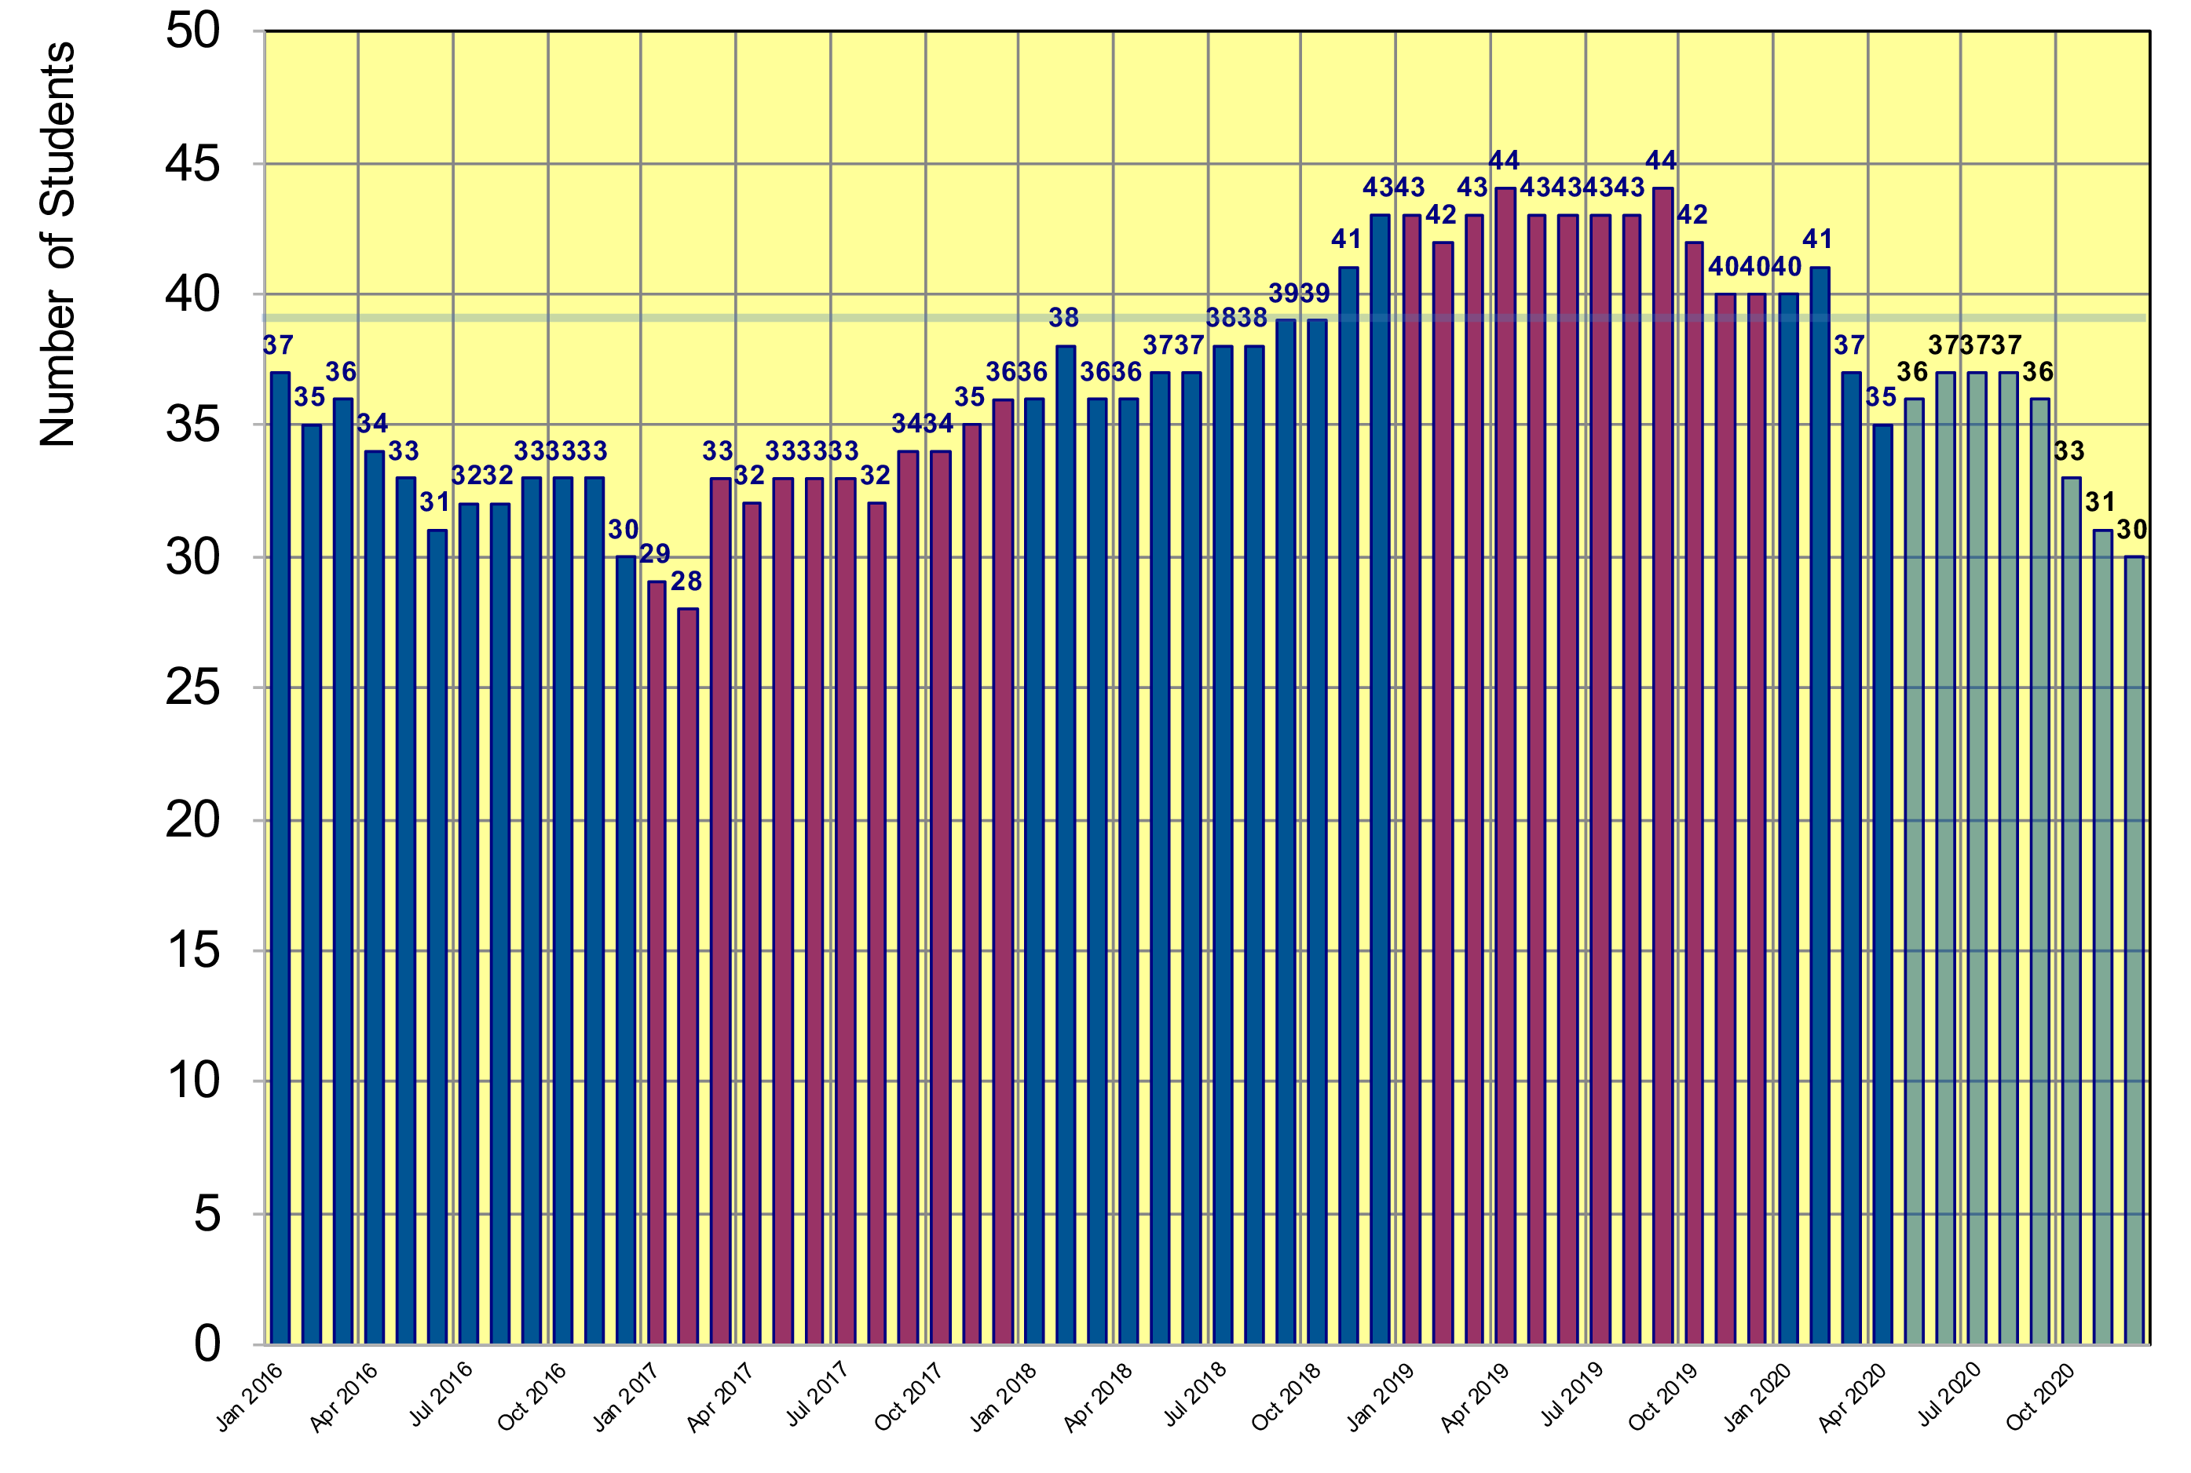
Status Gentner Programme
Number of students + projection until December 2020
    based on preferred starting date given by selected students
projection
Drop due to unfavorable EUR/CHF exchange rate
39 students foreseen in Gentner agreement
drop to be filled by students from 2020-1 selection
2019
2020

Slide 4
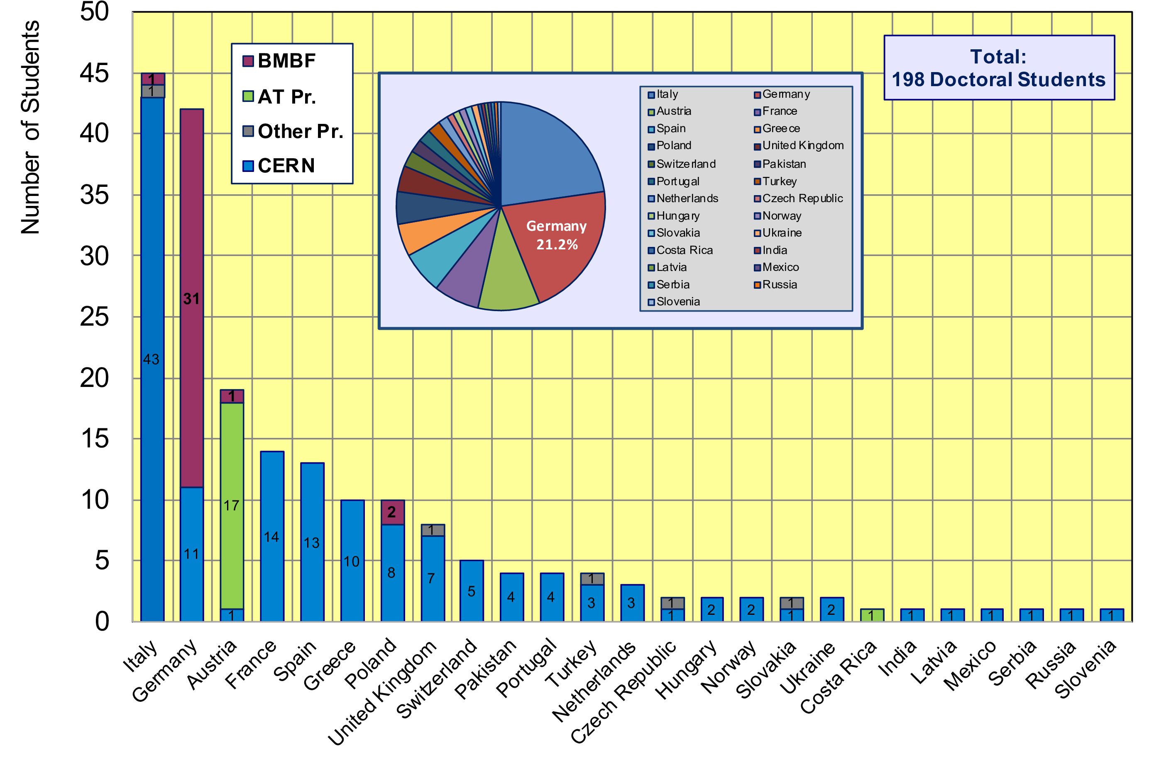
CERN Doctoral Students
Nationalities of all Doctoral Students at CERN
  Germans (42 students, 21.2%) now falling behind Italians (after 2 years leading)

Slide 5
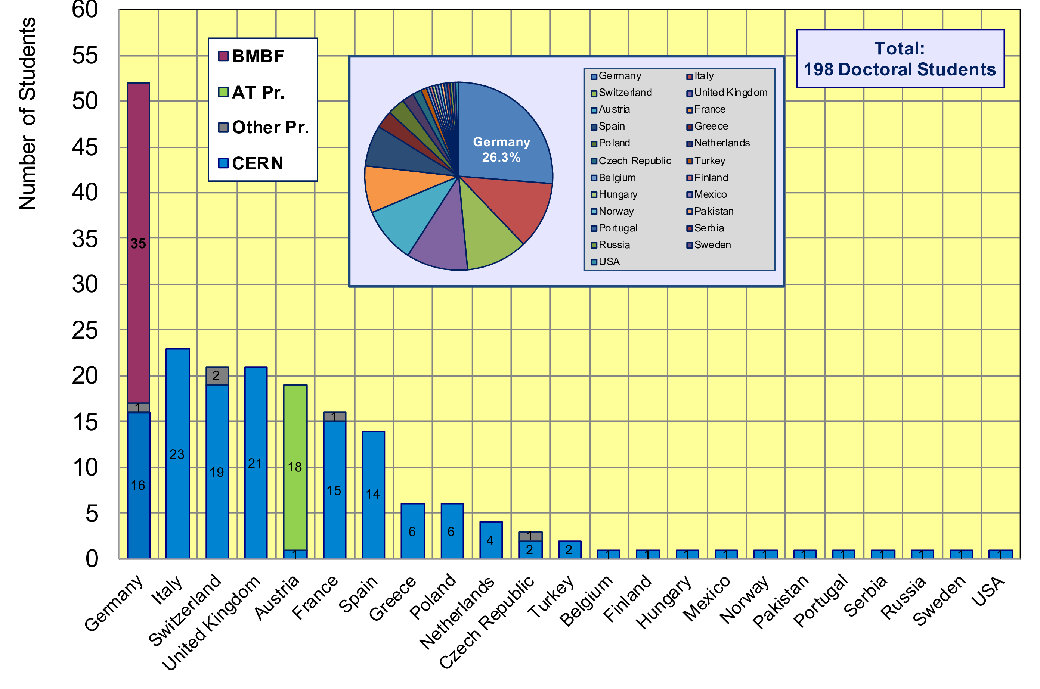
CERN Doctoral Students
Home University Country of all CERN Doctoral Students
  52/198 Students enrolled at German Universities (26.3%)

Slide 6
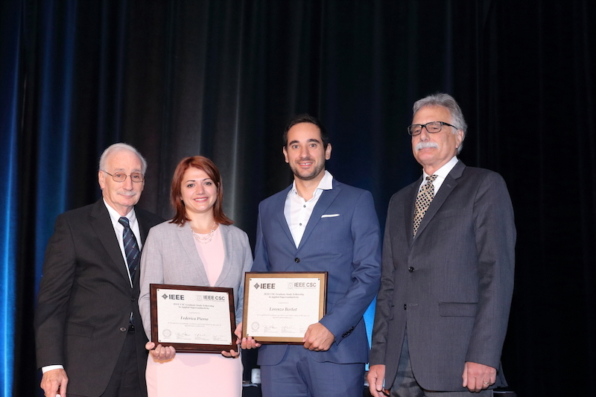
Awards
Lorenzo Bortot (Gentner student since May 2018) received IEEE CSC Graduate Study Fellowship in Applied Superconductivity
  donated with US $5000
  awarded at the International Conference on Magnet Technology MT26 in Vancouver, Canada (22 – 27 September 2019)
Bruce Strauss, Federica Pierro, Lorenzo Bortot, Joe Minervini

Slide 7
Former Gentner Students
(updates since last Gentner Day)
Recent elections to the German Komitee für Beschleunigerphysik (KfB) [Committee for Accelerator Physics] in November/December 2019
  Michaela Schaumann / CERN (Gentner student from January 2012 to December 2014) was elected as Representative of the foreign institutions (CERN and others)
  Bastian Härer / KIT (Gentner student from November 2013 to October 2016) was elected as one of the Representatives for the Helmholtz Research Centres
    now 2 out of 11 KfB members are former Gentner students
Felice Pantaleo (Gentner student from February 2014 to January 2017) started as CERN staff on 1 March 2020
  now 10 former Gentner students became CERN staff

Slide 8
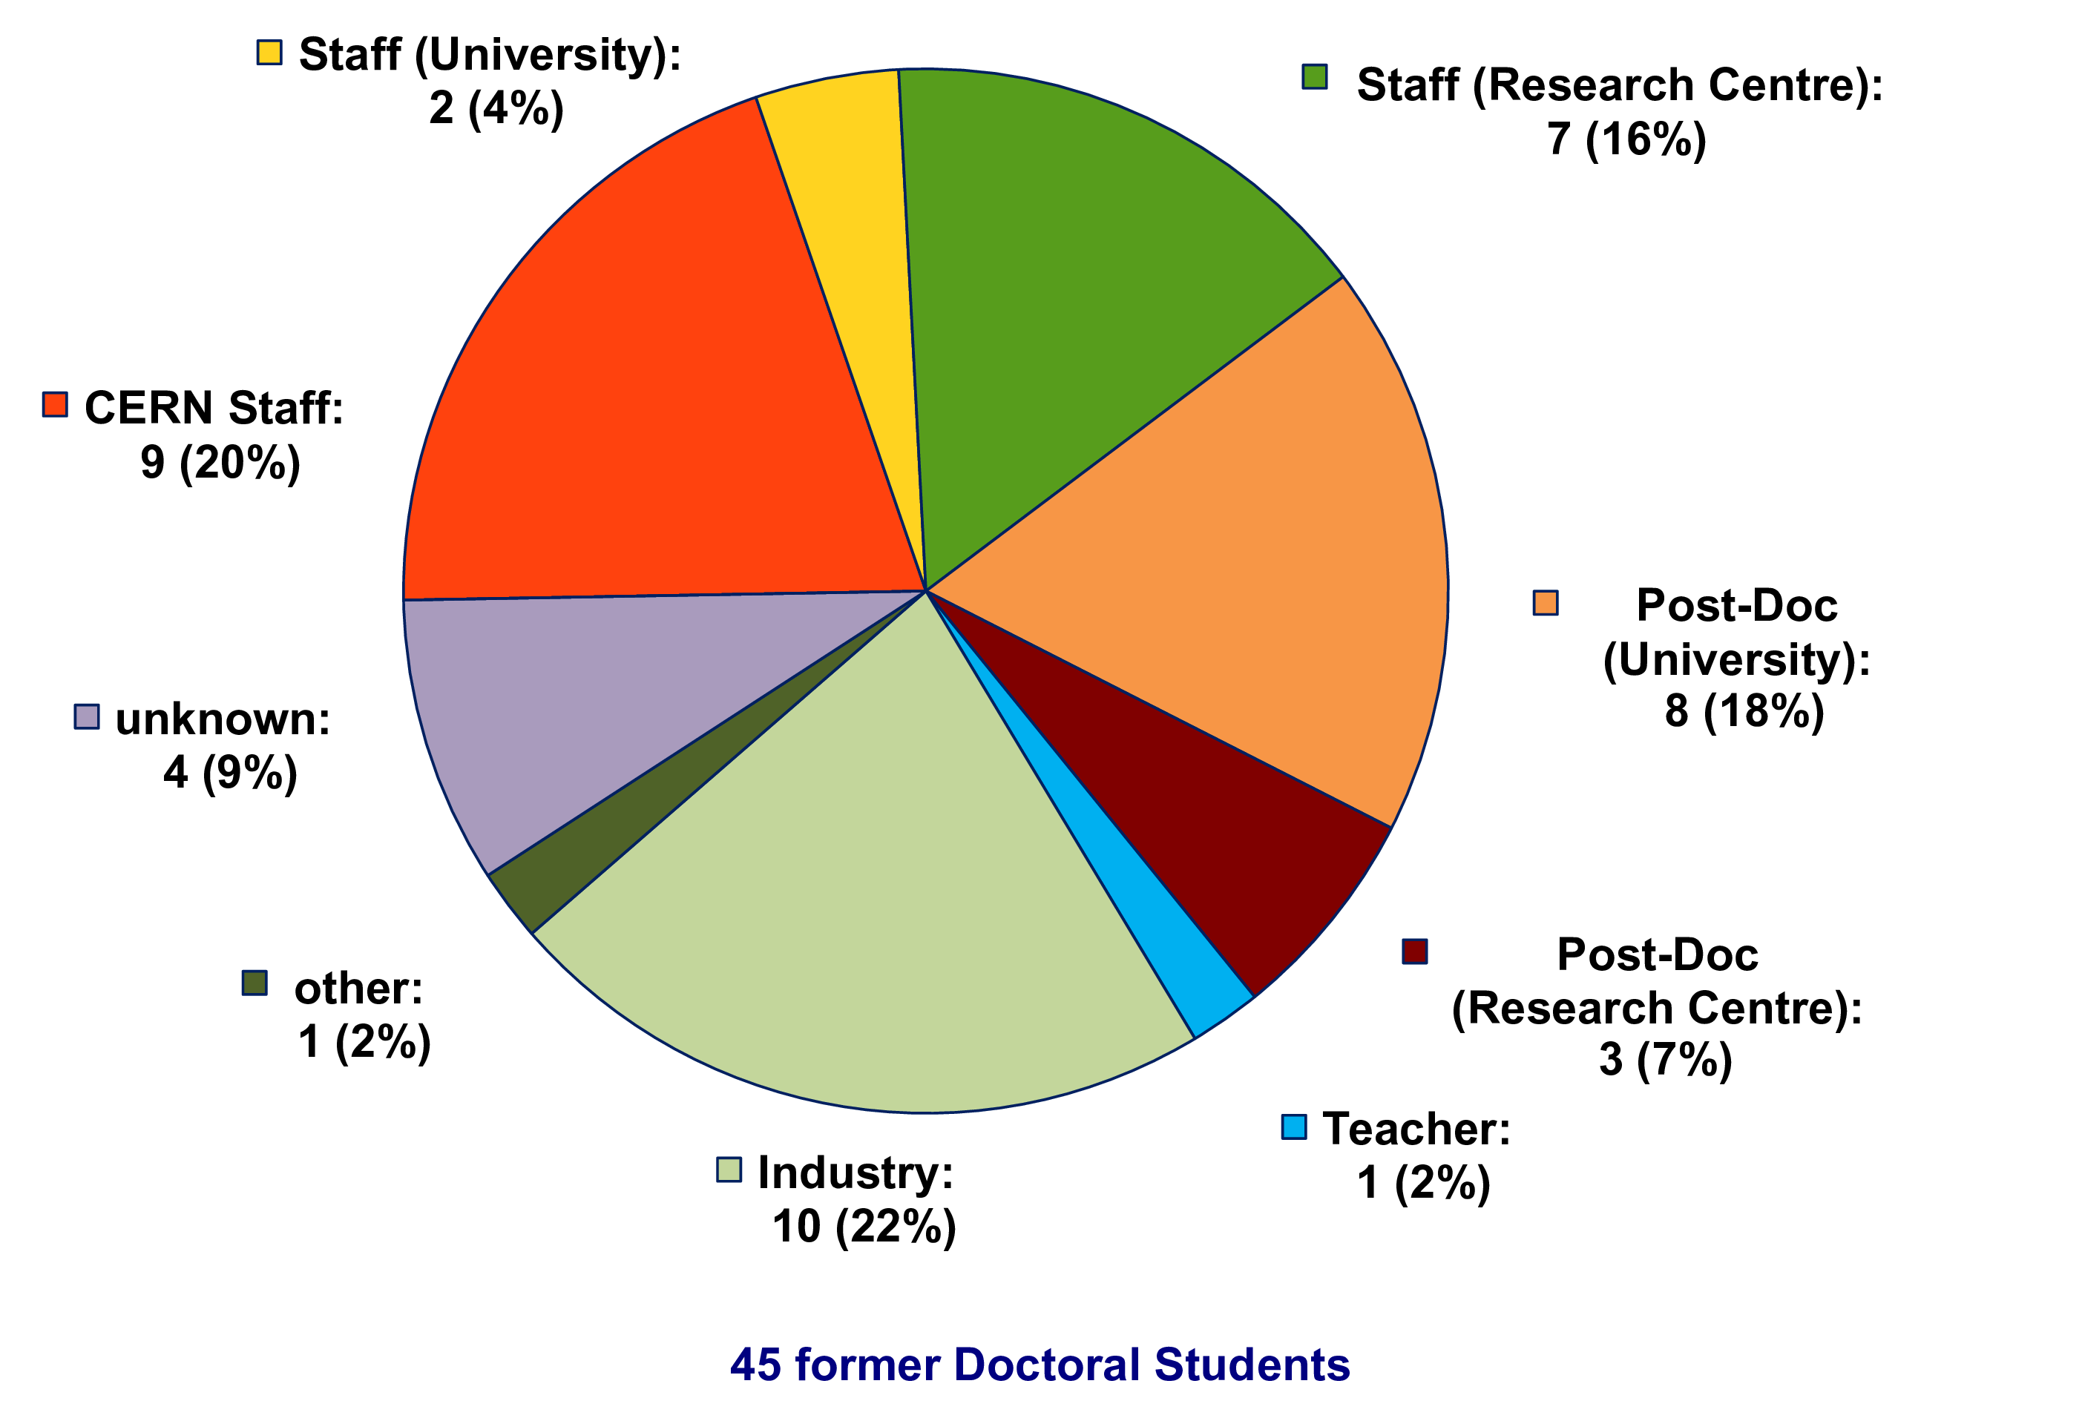
Whereabouts of Fellows
(former Gentner Students)
  many Fellows stay in academic research after their fellowship
    20% became CERN staff, 44% moved to University or Research Centre

Slide 9
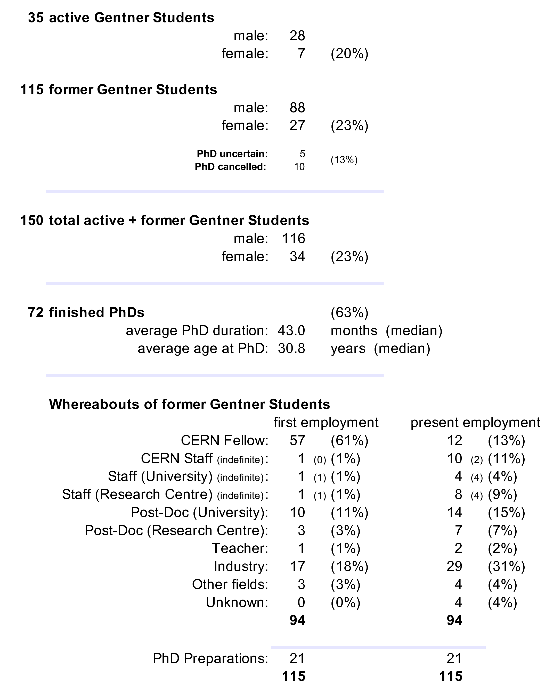
Summary Gentner Programme
  number of students between 35 and 41 over last months
    39 Students nominal
  number of female students now at 20%
    was ~13% in 2018
  former Gentner students are quite successful
    awards, CERN staff positions, elected to KfB committee
Next Gentner Day:
28 October 2020 (tbc)
hopefully in-person again

