Slide 1
FORWARD
(Provisional Name, formerly SAS@LHC)
A Forward Hadron Spectrometer - FHS
for Multi-TeV Forward Particles at the LHC
Michael Albrow, Fermilab
Update: Planning a meeting at CERN April 16th + 17th 2020
Intention: Form a collaboration to propose a new experiment – LoI to LHCC in 2020
Where? 80 -120 m downstream of IR1 (ATLAS) or IR5 (CMS)
> IR2 and IR8 (ALICE and LHCb regions) cluttered with beam injection hardware
When? Ready for data on Day 1 of RUN 4 (2017) – HL-LHC era but not yet HL
Forward LHC Physics Meeting
CERN, December 16+17 2019

Slide 2

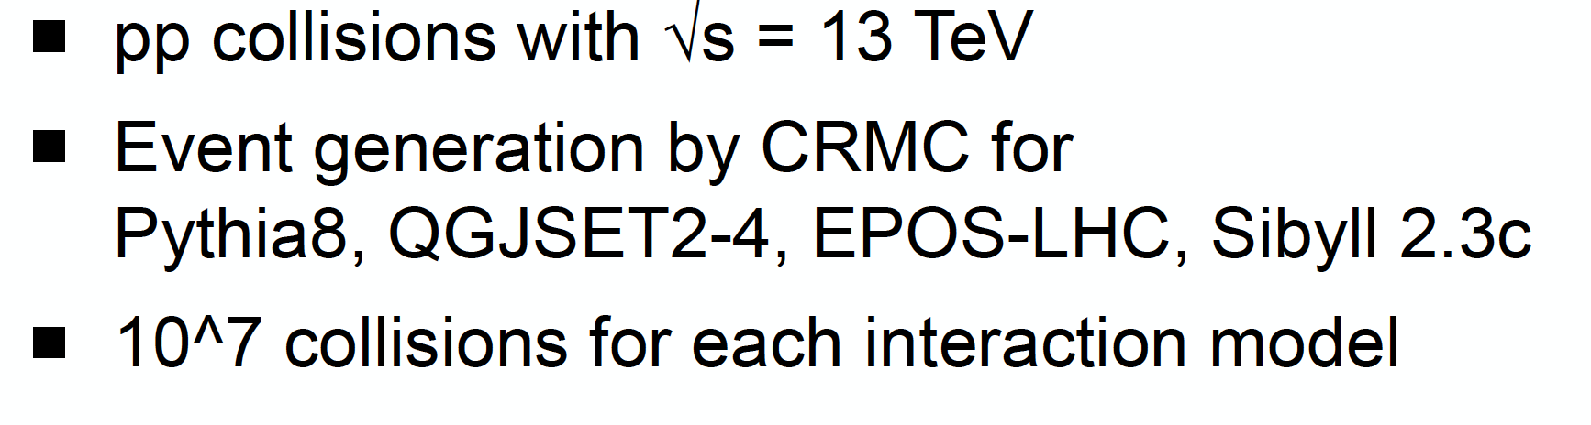
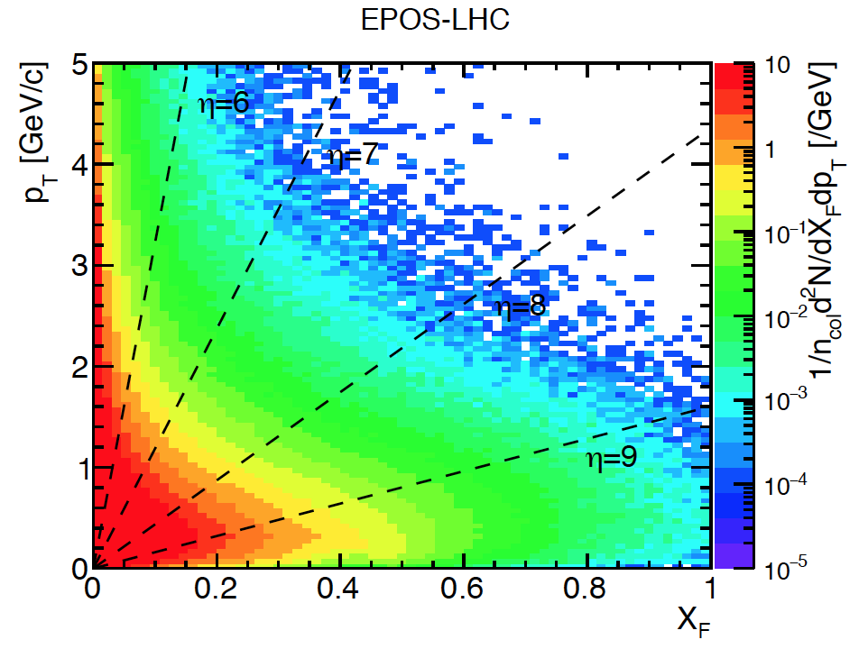
(Dec 5th 2019)
η = 7
Indication of
FORWARD
coverage (approx)
Roman pots
x_{F} > 0.9
Density of charged pions in p_{T}, x_{F}. Most have p_{T} < 1 GeV/c and |η| > 7 – unexplored region
ZDC & LHCf measure neutrals (n + K⁰_{L} , π⁰ →γγ) at θ ~ 0º

Slide 3
FORWARD OVERVIEW
Very forward charged particle production – how to measure it
Use new superconducting D1 dipole (Integral B.dL ~ 30 Tm) as a spectrometer magnet.
Straight section in vacuum from ~ 80 m to ~ 120 m.
Special vacuum chamber design for particles to emerge through thin windows: + & - sides
Detectors over 10 – 12 m in front of TAXN at 130 m:
Precision tracking (silicon strips or pixels) over ~ 2 m (θ_{x}, θ_{y} to a few μrad)
Transition Radiation Detectors for γ = E/m in 10³ – 3. 10⁴ region (novel)
[Possible targets + tracking to study multi-TeV π, K, p, p interactions]
Imaging Hadron Calorimeter for energy measurement and muon filter
Muon tracking behind calorimeter

Slide 4
PHYSICS GOALS (not complete!)
Precise measurements of Feynman-x (x_{F}) spectra at small p_{T} (< ~3 GeV) of:
π+, π-, K+, K-, p, p, d, d, t, t, … possibly K⁰_{s} → π+π- , Λ⁰ → pπ (acceptance?).
In p+p and p+O and O+O collisions (for cosmic ray showers in atmosphere)
(FASERv is proposed z = 400m experiment on TeV neutrino interactions. FLUXES!)
Intrinsic charm: p = {uudcc} giving leading Λ_{c} → pKπ , D⁰ → K+π- & K-π+
(Brodsky) and intrinsic beauty. Full reconstruction challenging but → forward muons
Other reconstruct-able particles: J/ѱ → μ+μ- (6%) ; 𝛶(1S) → μ+μ- (2.5%)
These are ‘intrinsically’ important + to understand μ and ν in cosmic ray showers.
Energy Frontier and Cosmic Frontier are two US-HEP priorities!
Production of light nuclei and antinuclei – antiprotons, antideuterons, antitritons, He³
Needed to understand background to Galactic Center 𝛾-ray excess (Dark Matter Annihilation?)
CAVEAT: Acceptance for 2-particle states not yet known
Diffraction dissociation – products, e.g. p → n π+, p (π+ π-), Λ⁰ K+
Zero-degree calorimeter ZDC/LHCf is included in plan

Slide 5
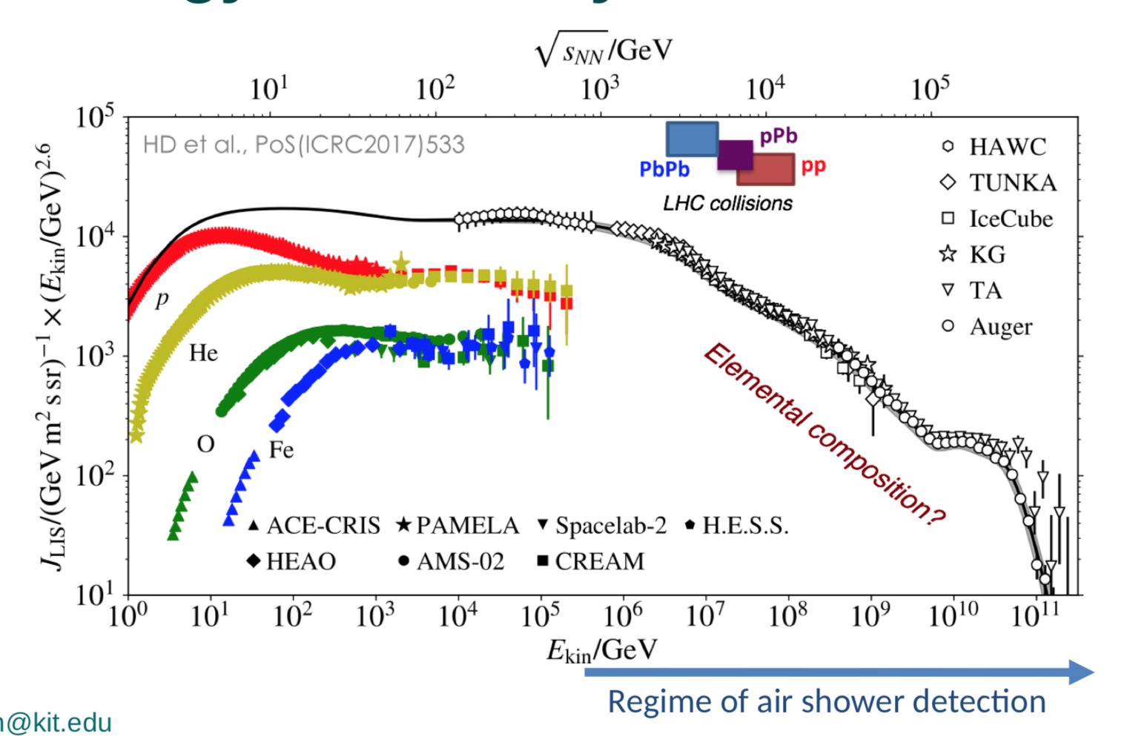
From Ralf Ulrich’s talk : Cosmic ray spectrum x E^{2.5}
ISR at CERN

Slide 6
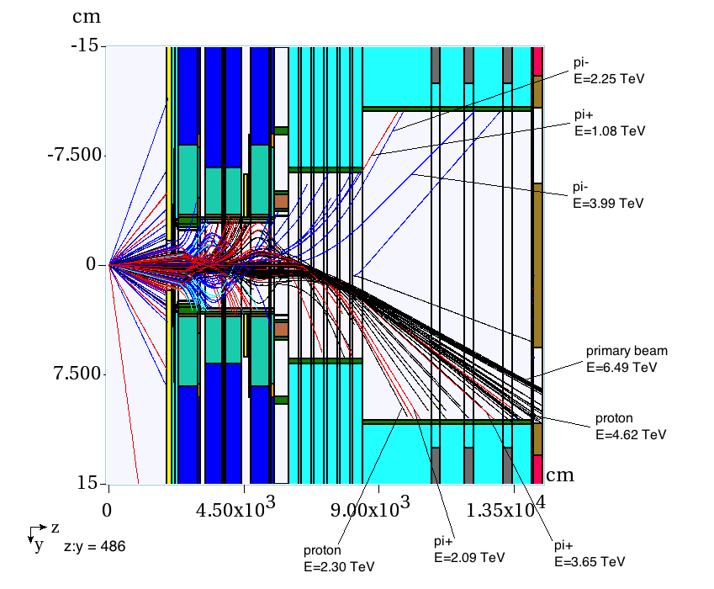
200 inelastic collisions at Pt 5 2018 ( 13 TeV, β* = 0.55 m): MARS
Nikolai Mokhov
Ottavio Fornieri
If μ = 50 this is 4 bunch crossings
TOP VIEW
Scale factor x:z = 486:1
Negatives
From interaction
Neutrals
Λ → pπ-
New D1 S/C
Positives
Need to redo for
14 TeV and Run 4.
New D1, beam pipe
Hitting pipe: 0.5 π- and 1 π+ and about 2 protons / 50 collisions. Near horizontal plane

Slide 7
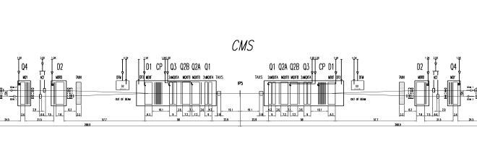
Downstream of CMS & ATLAS in HL-LHC era Run 4
HERE
HERE

Slide 8
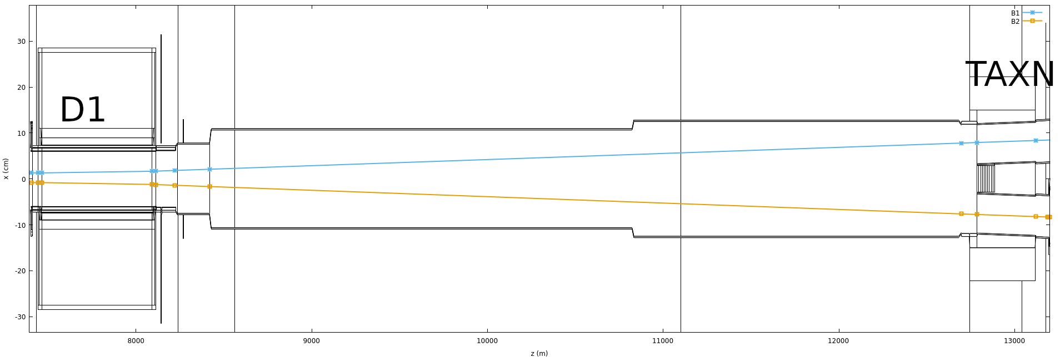
D1 → TAXN Top view, schematic - downstream of ATLAS (IR1) or CMS (IR5)
Red shows proposed modification for FHS
At ~ 95 m
Circular ID 21.27
to ‘elliptical’
At ~ 115 m
Elliptical to circular
with windows L&R
OR
R as small as allowed
DETECTORS (-)
0º cal
DETECTORS (+)
80 m
100 m
120 m

Slide 9
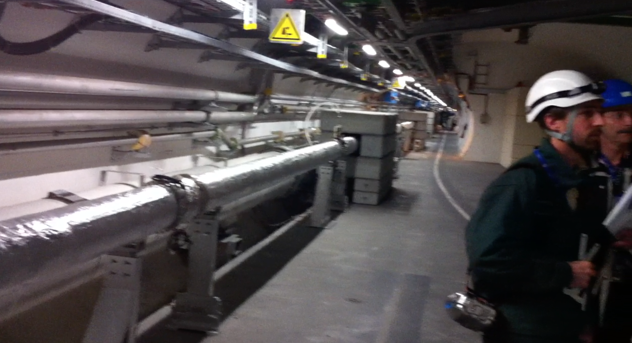
Region looking along LHC tunnel, beam separation dipoles & CMS way behind me.
20 cm diameter straight pipe with both beams for 50 m. (Cladding) We put FSC counters.
Make this pipe larger on Left and Right sides (see next slide)

Slide 10
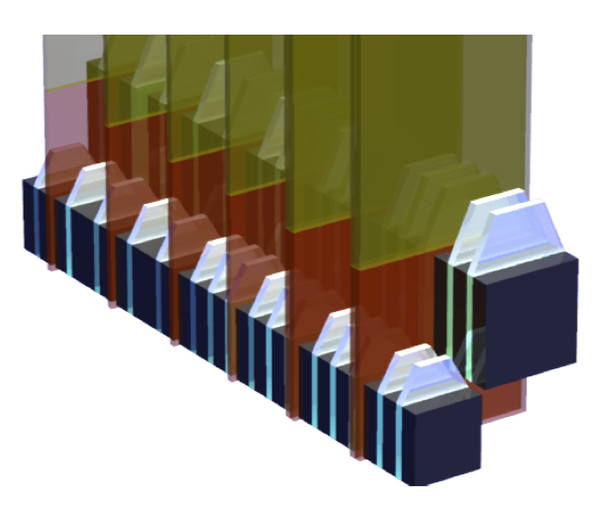
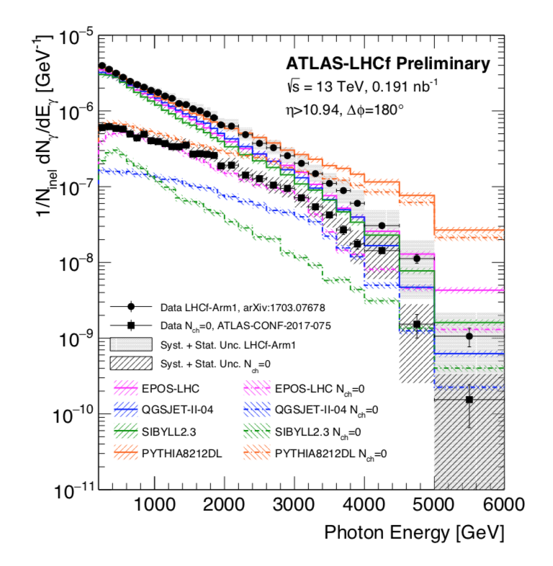
LHCf is a small 0º calorimeter measuring photon-like and n-like showers
Only 1.6 λ_{I} and 4 cm in size, σ(E)/E ~ 40% for neutrons.
Low-PU, High β* runs
Huge spread in predictions:
X 40
Arm 1: 2cm x 2cm & 4cm x 4cm
Arm 2: 2.5 x 2.5 & 3.2 x 3.2 cm
Common data with ATLAS for some
Low-PU runs: diffractive events
ZDC in CMS
7 λ_{I} and 8cm x 10 cm
Must be smaller if in Run 4
A good 3D-imaging calorimeter
for h+/h- : σ(E)/E ~ 5%
INCLUDE 0º Cal in FHS for neutrals +

Slide 11
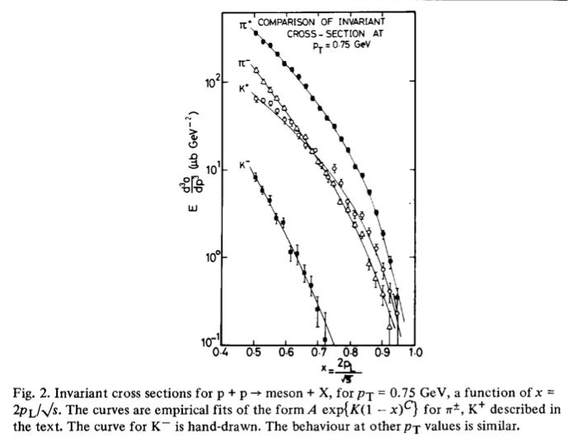
√s = 45 GeV,
CHLM (MGA inter alia) SAS @ ISR
Nucl Phys B 140 (1978) 189
Small transverse momentum
p_{T} (Mean p_{T} ~ 350 MeV/c)
41 years ago !
Valence quark counting
Low mass diffraction dissociation.
Feynman x_{F} = p_{z}/p_{BEAM}

Slide 12
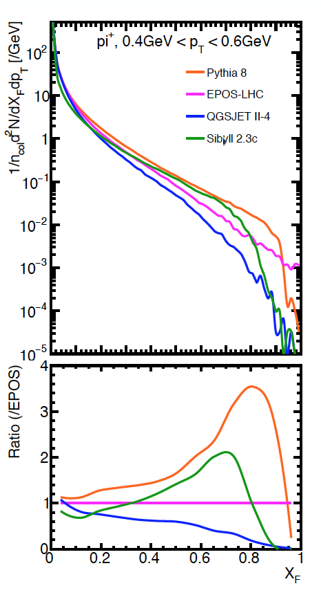
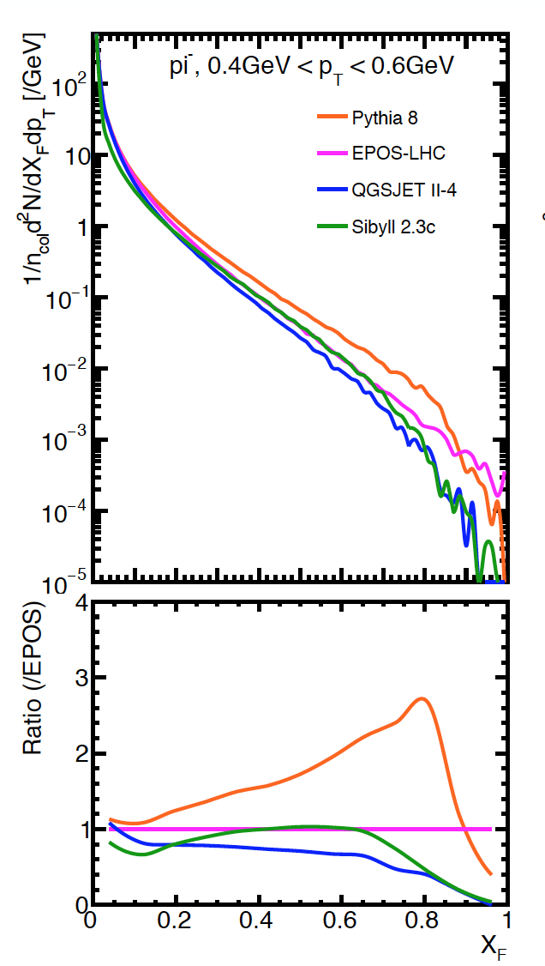
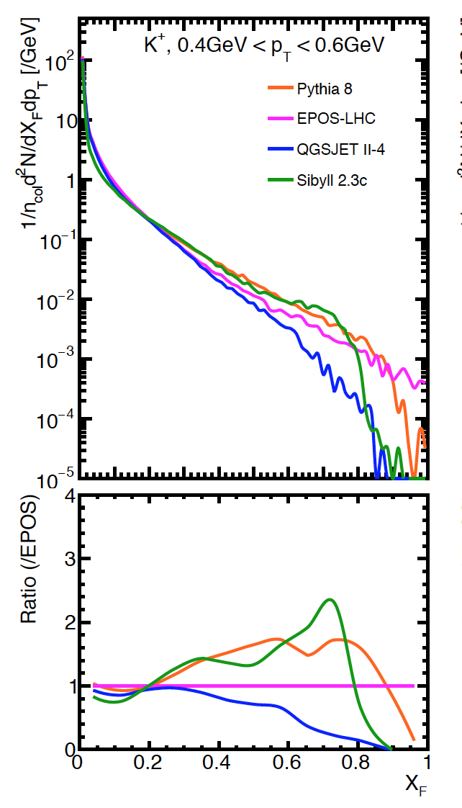
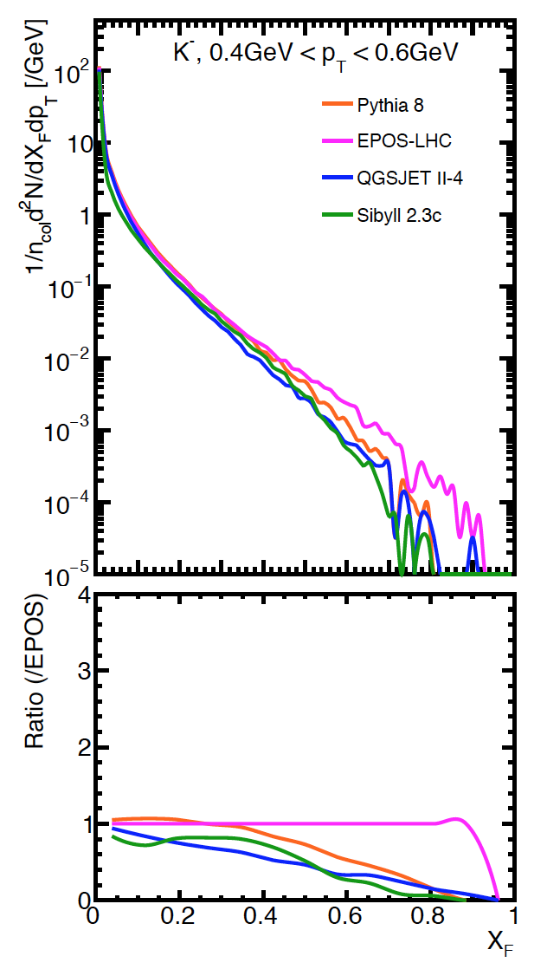
Comparison of Monte Carlo generators, 13 TeV Plots from Menjo Hiroaki
Low-p_{T} pions PYTHIA ~ 50 x QGSJET at x_{F} ~ 0.8
K⁺ and K⁻ (steeper, s-ubar so no valence quarks)
High-x_{F} antiprotons very uncertain, antideuterons etc even more so!

Slide 13
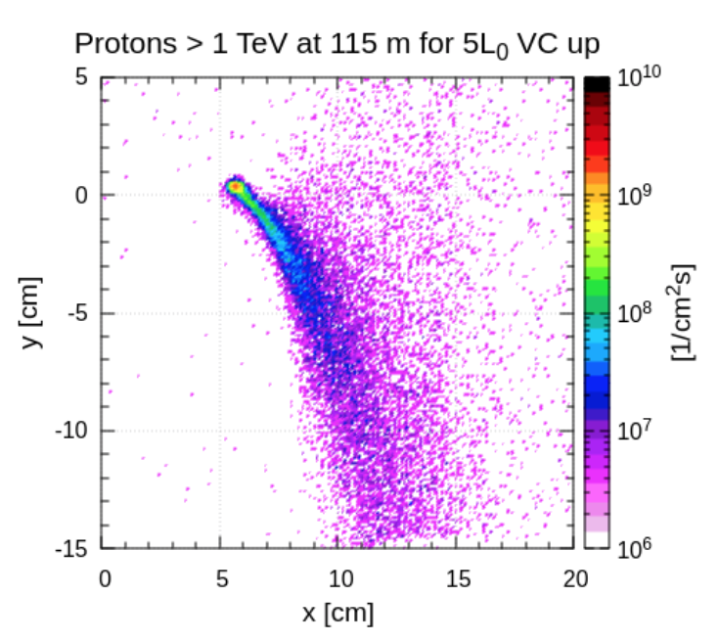
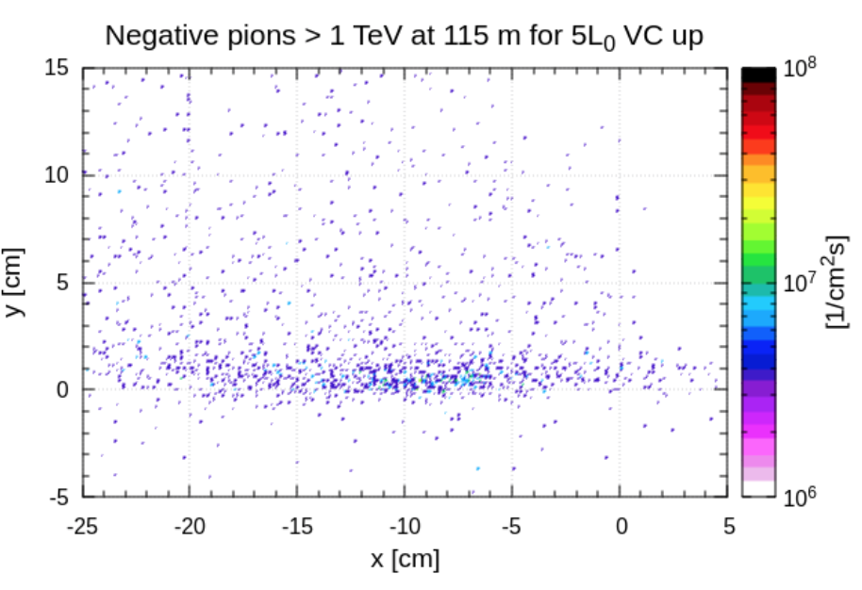
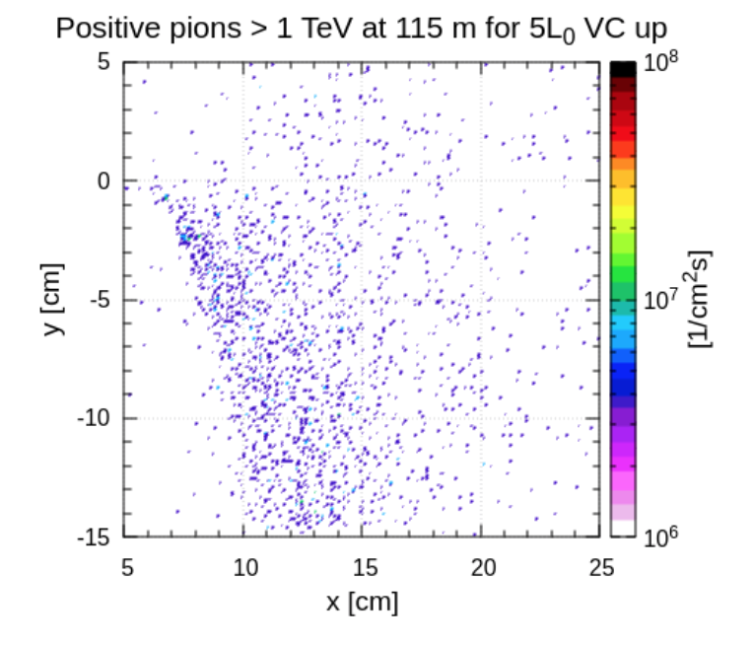
Plots from Francesco Cerutti (CERN) - preliminary
Distributions in x,y at z = 115 m of hadrons with
p_{z} > 1 TeV (through D1 dipole)
Ignoring beam pipe – to be imposed.
For IR 5 (vertical crossing)
IR 1 (horizontal crossing) is not identical.
« Comet tail shape at y<0 tail for protons and positive pions
is due to the upward crossing (y>0), since the quadrupole field pushes
them on the opposite side at the triplet exit (this is a well known effect). »
Diffractive protons here
(Elastics not included)

Slide 14
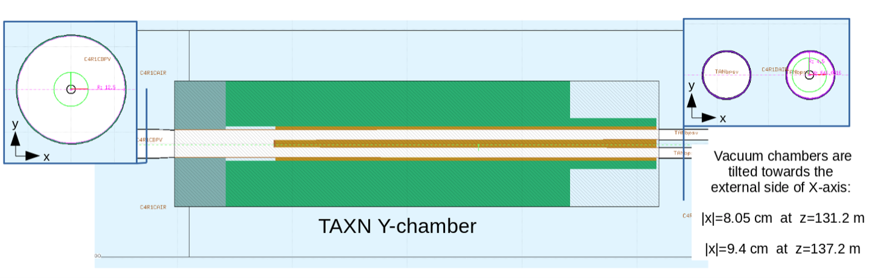
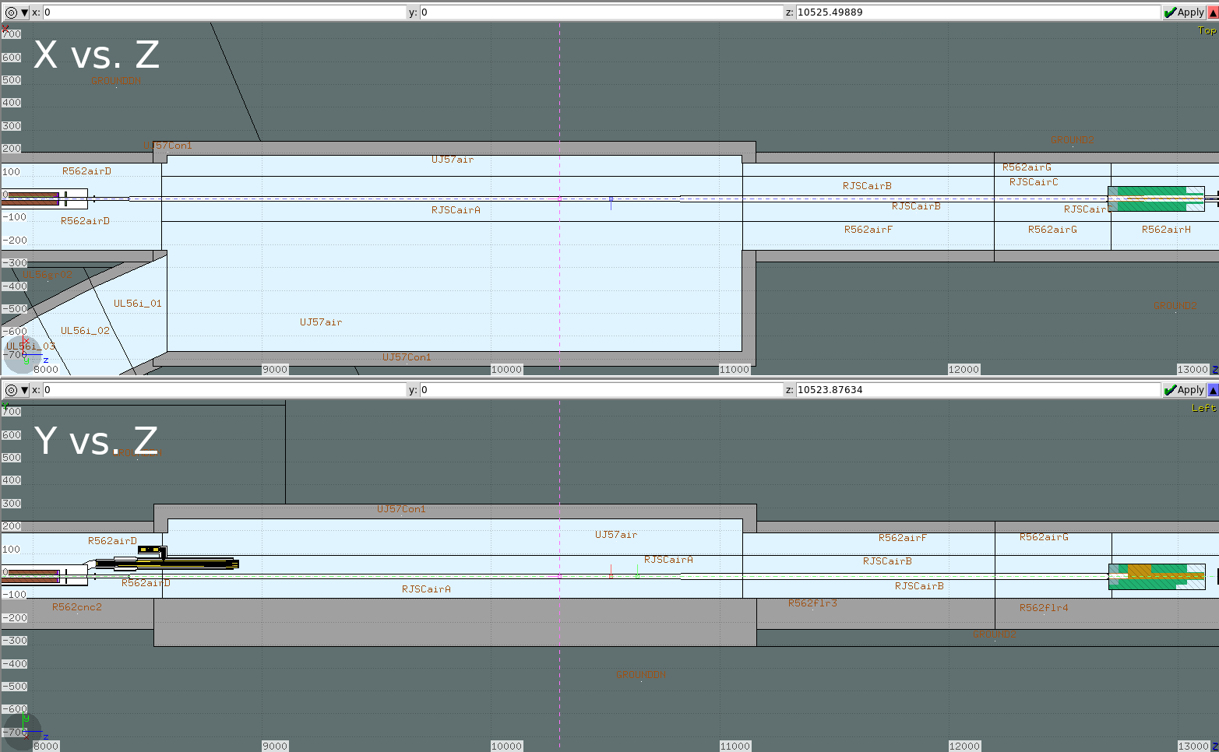
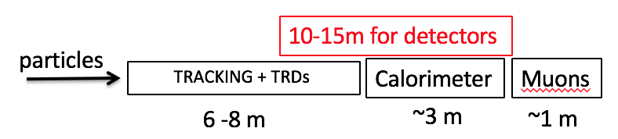
0º calo between pipes (e.g. LHCf’)
+(?) TAXN to ‘calorimetrise’?
(Mike Phipps, Longo et al.
Option: In front of Calorimeter
Thin targets (C & CH4) → 𝜎_{INEL}(π,K), n_{CH}
LGAD x2? 20ps Timing for PU mitigation?

Slide 15
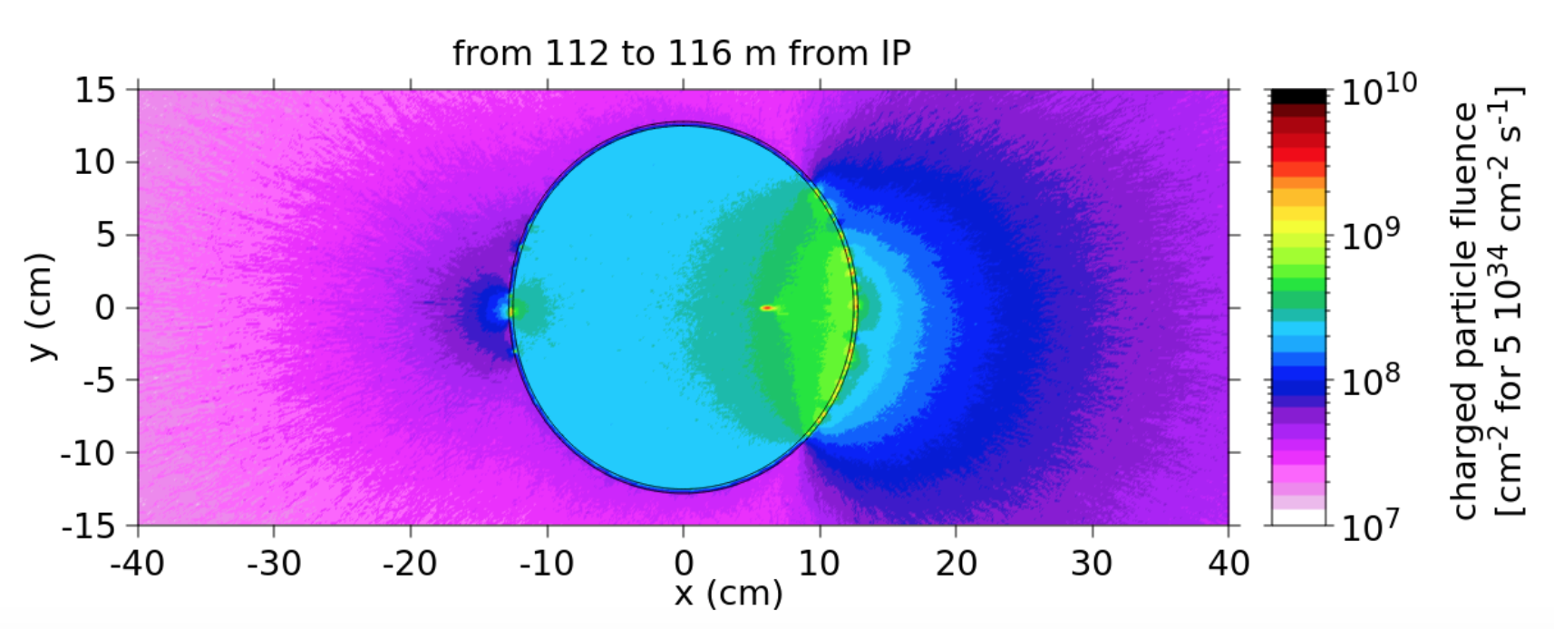
Fluence cm⁻²s⁻¹ charged particles down to low energies (100 keV - 1 MeV)
Calculation by Marta Gilarte (FLUKA)
Diffractive proton spot
(Elastics not included)

Slide 16
FORWARD as a Multi-particle Spectrometer
Acceptance for 2 or more particles from same event. (With pile-up, timing can help)
Positive and negative particles on opposite sides of pipe, near horizontal plane.
Neutrals at 0º between pipes
Acceptances need to be calculated for realistic design – and backgrounds
Potentially:
J/ψ, ψ(2S) → μ+μ-, χ_{c} → J/ψ + γ, Drell-Yan μ+μ- , γγ → μ+μ-
K⁰_{s} → π⁺π⁻, Λ → p π. P* → n π+ ?
D⁰ → K⁺π⁻ … χ_{c} → π⁺π, K⁺K⁻, etc.
Very forward charm and beauty also measured with single leading e and μ
Leptons can be identified (how well? Background from fakes?)
Muons from π, K decay will be known, and their decay lengths are very long!
γcτ (π) = 139 km at 2.5 TeV ! But abundant and - > forward HE μ-neutrinos! (FASER)
γcτ (K+) = 18.5 km at 2.5 TeV !

Slide 17
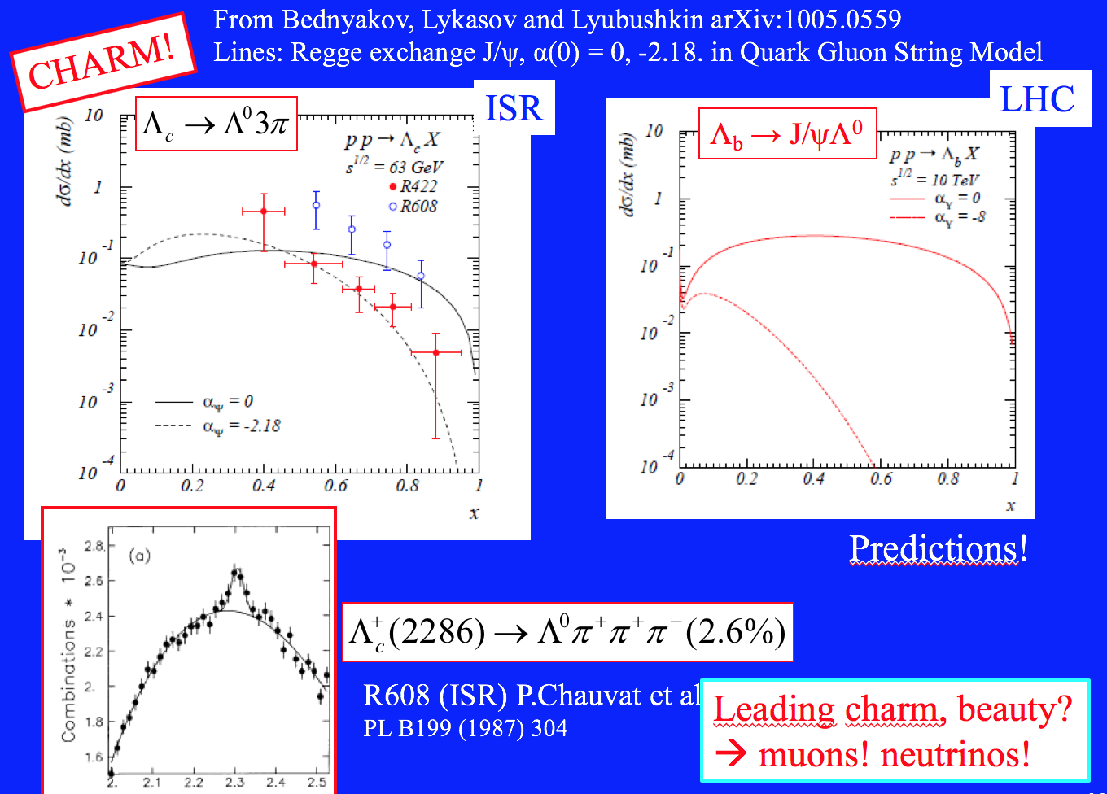

Slide 18
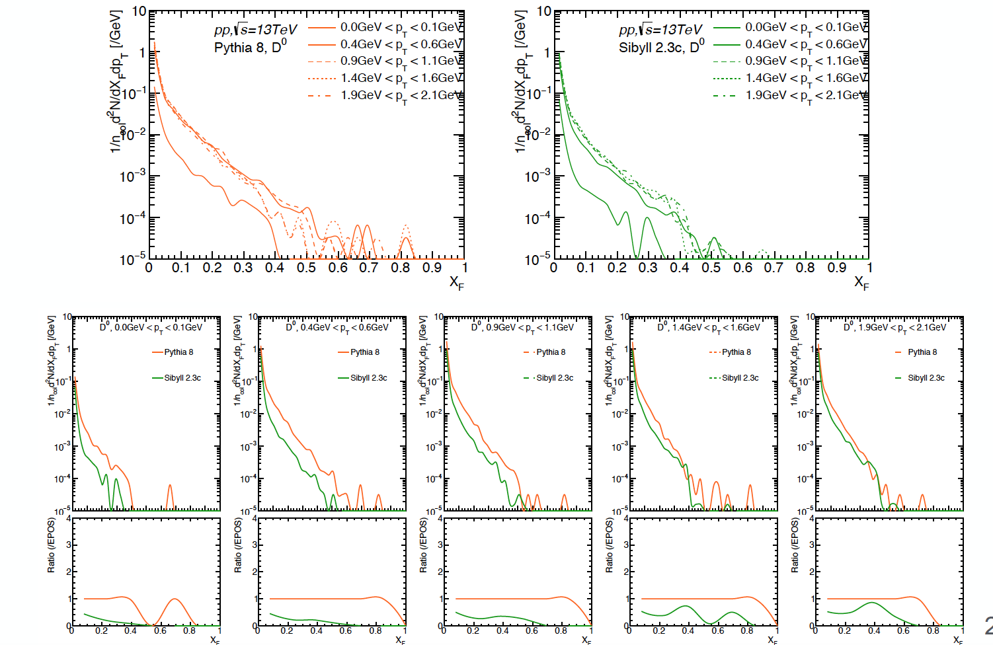
Very forward charm: D⁰. PYTHIA & SIBYLL predictions – Menjo Hiroaki
Charm from g + g → c + cbar all at low-x_{F}. Intrinsic charm {uudcc] – Fock state leading

Slide 19
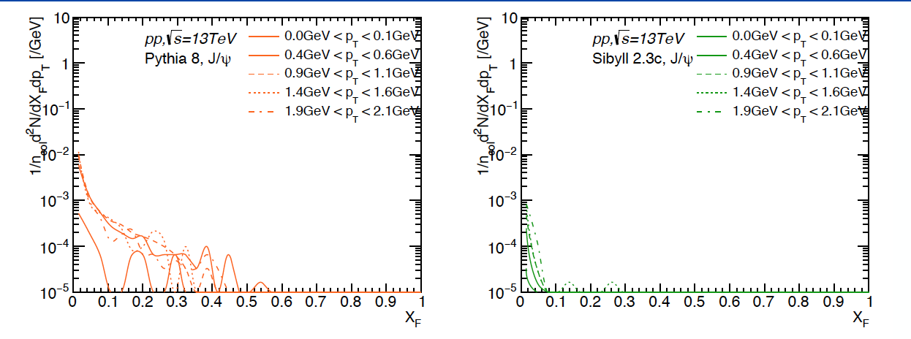
Very forward charm: J/ѱ PYTHIA & SIBYLL predictions – Menjo Hiroaki
PYTHIA and SIBYLL are very different, but both predict
negligible cross section above x_{F} ~ 0.2
Intrinsic charm not included – so observation would be compelling.
DO WE HAVE ACCEPTANCE for J/ѱ → μ+μ- ??
and D0 → K+π- and K-π+ ??

Slide 20
Tracking
Precision tracking immediately behind vacuum pipe window (Be?)
No field so straight tracks.
x, y, dx/dz, dy/dz at z σ(x,y) = 10 μm over 2m -> 5 μrad
Cf bend of 6.5 TeV proton ~ 1500 μrad
Projection of track back → momentum dp/p < ~ 0.5% if from primary vertex.
Can be matched with energy from calorimeter if hadron
Background from showers in upstream pipe etc. can be reduced or even eliminated.
Tracking measures |Q| also.
Θ = 0.3 B.L(Tm) / p (TeV/c)
[x₀,y₀,z₀, p_{x}, p_{y}, p_{z}] [x, y, θ_{x}, θ_{y}, E = p]
at collision at z (Q known)
Areas ~ 10cm x 10cm, Silicon pixels possible, not an issue.
Can make level-1 trigger on tracks f[p_{T}, x_{F}]
Following TRD may incorporate precision tracking

Slide 21
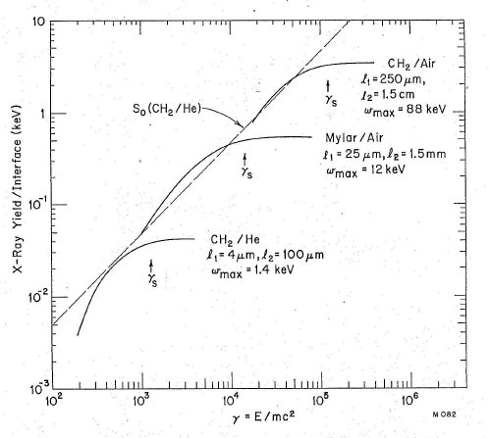
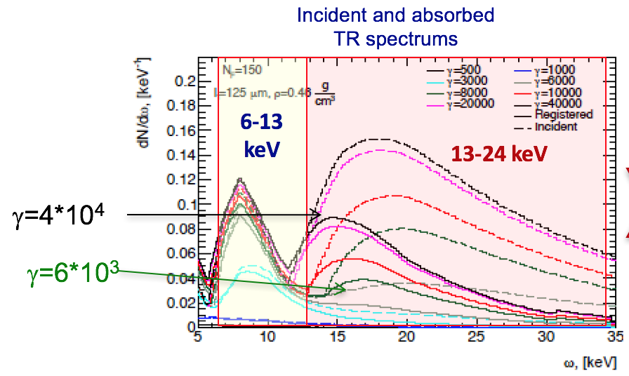
Transition Radiation Detectors - TRD
Anatoli Romaniouk, Mike Cherry et al.
Probably only technique for distinguishing π / K / p at multi-TeV energies
Main technical challenge for SAS@LHC.
Interface between two materials different ε → X-ray emission ~ 1/137
Function of γ = E/m Know E = p from tracking and calorimeter, hence m.
Fastest hadrons in SAS ~ 5 TeV π; γ = 5000/0.14 ~ 3.6 10⁴
Slowest in SAS ~ 1 TeV p; γ = 1000/0.94 ~ 1.1 10³
Can “tune” design
for γ – range : higher γ longer
1 TeV p
5 TeV π

Slide 22
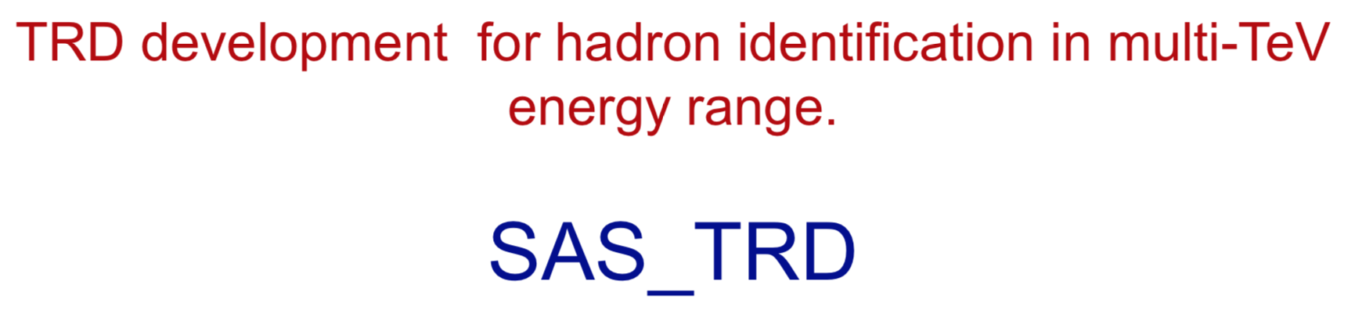
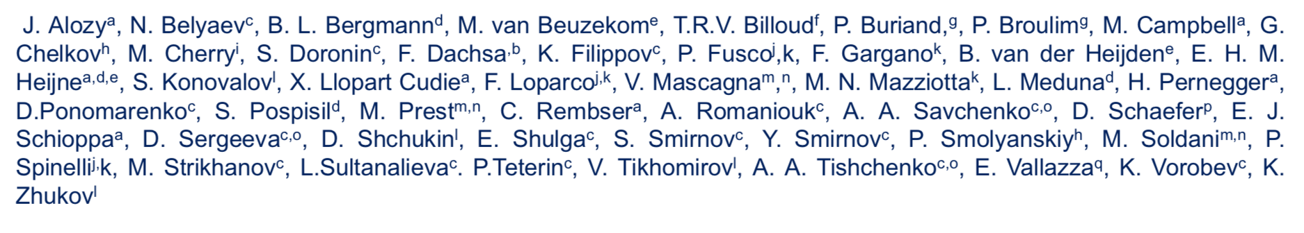
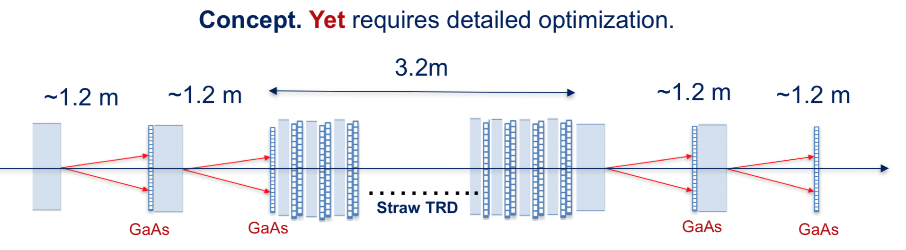
Transition Radiation Detectors : Only known way to identify multi-TeV π/K/p
Anatoli Romaniouk’s talk at Dublin meeting, on behalf of team:
Note : Measurement of π/K/p spectra does not require perfect separation.
But ‘better is better’ especialy for S:B in e.g. D⁰ - > π+K-

Slide 23
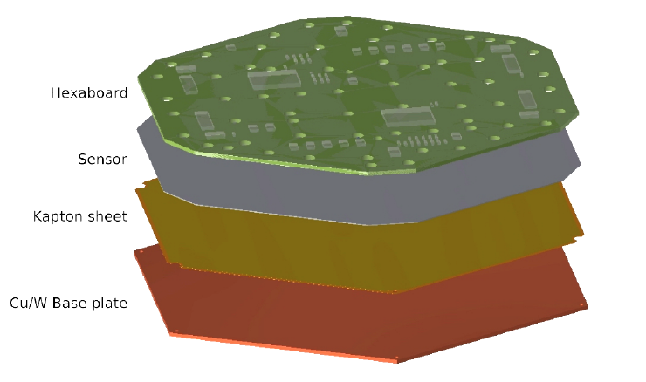
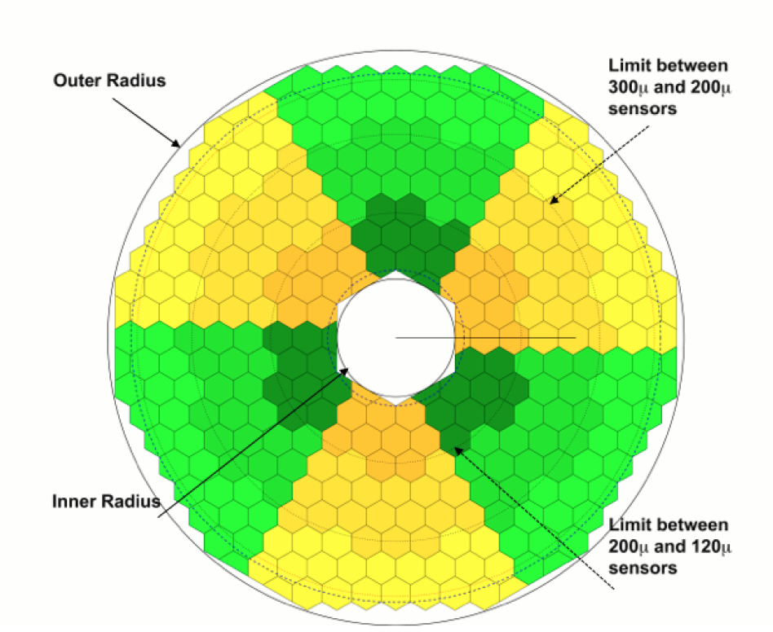

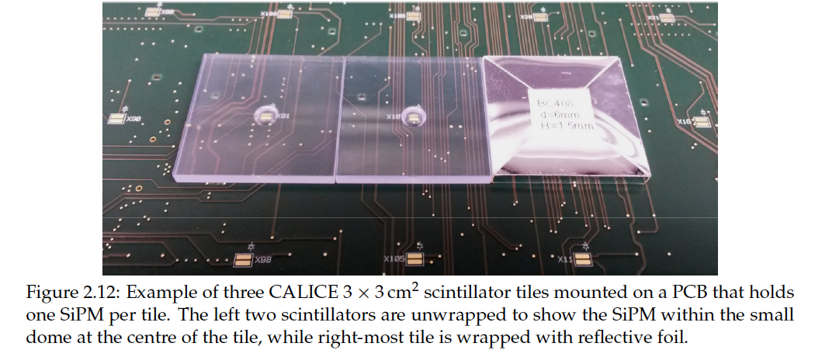
Calorimeter: Why? E-p (2%) matching for background rejection (𝜎_{E} ~ few % prob OK)
Muons important: active muon filter – see muon track through calo.
CMS Detectors for Run 4 – HL-LCC
HGCAL:
Rad-hard, dense, fine longitudinal and lateral granularity, good time resolution
EM: 28 longitudinal samples, Silicon cells ~ 1 cm2. W-Cu absorbers 34 cm total
HAD: Plastic scintillator + wavelength shifting fibers, Steel plates 10.7ƛ
EM Cal layout with 8-inch wafers
Inner radius = 100cm
All we need x2
Hadron calorimeter SiPM+Tile

Slide 24
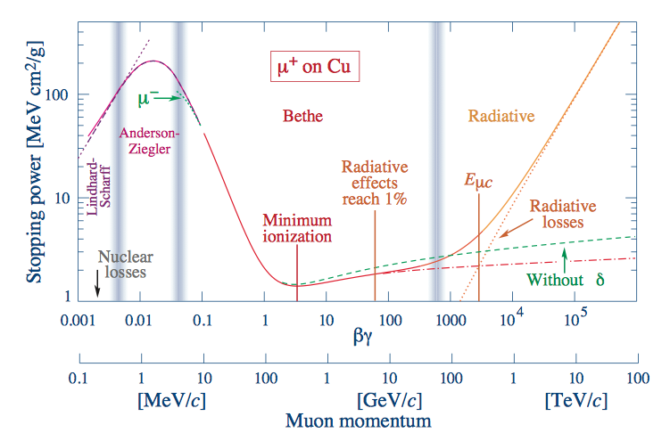
Muon Measurement behind calorimeter
Muons : from primary collision:
Drell-Yan pairs, photo-produced J/ψ, ψ(2S), Υ_{1,2,3} and γγ → μ⁺μ⁻ (especially in AA)
Some acceptance for measuring both! What is it?
Almost prompt, from c, b decays. Note BR ( D⁰ → μ + X) = 6.7%
Background from π, K etc decays. γcτ(π) at 2.8 TeV = 150 km, . γcτ(K⁺) = 70 km
Background from upstream interactions in pipes etc.
Momentum from upstream tracking, penetration and energy loss (fn(E)) through calorimeter
TRD signals consistent with m = p/γ = m(μ) (= m(π) , no separation.)
Many possible technologies
~ m² so high performance
HERE

Slide 25
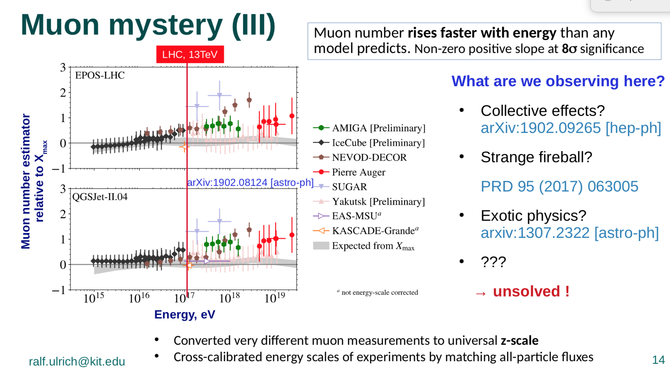
From Ralf Ulrich’s talk : Muon excess now ~ 8𝜎 combining experiments

Slide 26
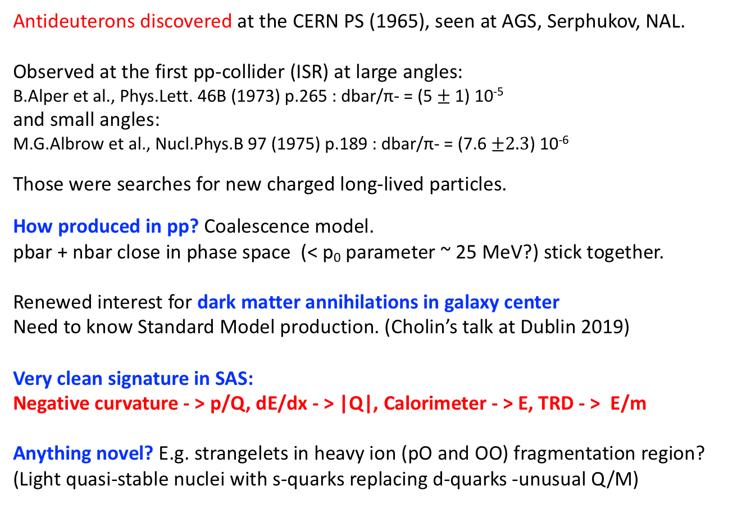
Forward production of antinuclei : antideuterons, anti-He?
Antideuterons discovered at the CERN PS (1965), seen at AGS, Serphukov, NAL.
Observed at the first pp-collider (ISR) at large angles:
B.Alper et al., Phys.Lett. 46B (1973) p.265 : dbar/π- = (5 $±$1) 10⁻⁵
and small angles:
M.G.Albrow et al., Nucl.Phys.B 97 (1975) p.189 : dbar/π- = (7.6 $±2.3$) 10⁻⁶
Those were searches for new charged long-lived particles.
How produced in pp? Coalescence model.
pbar + nbar close in phase space (< p₀ parameter ~ 25 MeV?) stick together.
Renewed interest for dark matter annihilations in galaxy center
Need to know Standard Model production. (Cholin’s talk at Dublin 2019)
Very clean signature in SAS:
Negative curvature - > p/Q, dE/dx - > |Q|, Calorimeter - > E, TRD - > E/m
Anything novel? E.g. strangelets in heavy ion (pO and OO) fragmentation region?
(Light quasi-stable nuclei with s-quarks replacing d-quarks -unusual Q/M)

Slide 27
ANOTHER POTENTIAL USE OF FHS:
Inelastic (& elastic?) cross sections of multi-TeV π±, K±, etc.
IDEA:
Behind TRD-Tracker have multi-TeV identified π±, K±
Can put in front of calorimeter a thin target followed by short tracker:
Known momenta ~ TeV
π±, K±
TRD
CALORIMETER
Thin TARGETs
CH₄, C - subtract
Very simple addition:
𝜎_{inel}, N_{ch}, 𝜎_{el},

Slide 28
Job List – We can make it happen
New collaboration : Independent experiment at IR1 or IR5 for Run 4
(Possibility of sharing events with ATLAS or CMS if motivation – PPS opposite?)
Planning a two-day meeting at CERN provisionally April 16+17
Studies towards a Letter of Intent to LHCC:
Need collaborators to develop project – areas of interest?
CERN contributions – Francesco Cerutti on Vacuum pipe, Marta Gilarte
Radiation levels, Infrastructure etc.
Physics, hardware, computing - including Monte Carlo simulations, theory, …
Develop physics case (SM, Beyond SM including DM, Cosmic rays, astrophysics,…)
Backgrounds
Acceptances for single particles (Q, [x_{F} or y], p_{T}, φ)
& dependence on beam conditions : √s, β*, …. Should not ask for special operations
Acceptances for 2-particle states (e.g. J/ѱ → μ⁺ μ⁻, D⁰ → K⁺π⁻, …)
Initial designs: TRDs (include tracking), calorimetry, muon chambers, trigger, DAQ
Initial estimates of who does what, costs and timescale
FUNDING!

Slide 29
Summary
Terra Incognita : large phase space (in x_{F}, p_{T}) unexplored from √s = 63 – 14,000 GeV !
Justification in itself, but …
Need to understand Strong Interaction in non-perturbative sector
Especially heavy flavors c, b also antinuclei, …
Details of diffractive dissociation in low mass region.
Important to understand UHE cosmic rays : Shower → primary, UHE collisions, muons, ν
Need special vacuum chamber with “thin” exit windows. Feasible.
Tracking, calorimeter, muon could be elements of CMS Upgrade HL-LHC (~spares, test beam)
Particle ID with transition radiation possible (π,K,p) … interesting challenge being developed
Open & ‘accessible’ & small so evolution of techniques natural.
New experiment to propose (LoI) to LHCC in 2020 for start-up of Run 4 (2027)
Want p-O and O-O data as well as p-p – but not special pp running (pile-up allowed, not 150!)
Downstream of either ATLAS or CMS – possibility of common data.
April 16th + 17th meeting at CERN planned – forming collaboration, work for LoI

Slide 30
Want to join the fun?
Thank You
Back Ups →

Slide 31
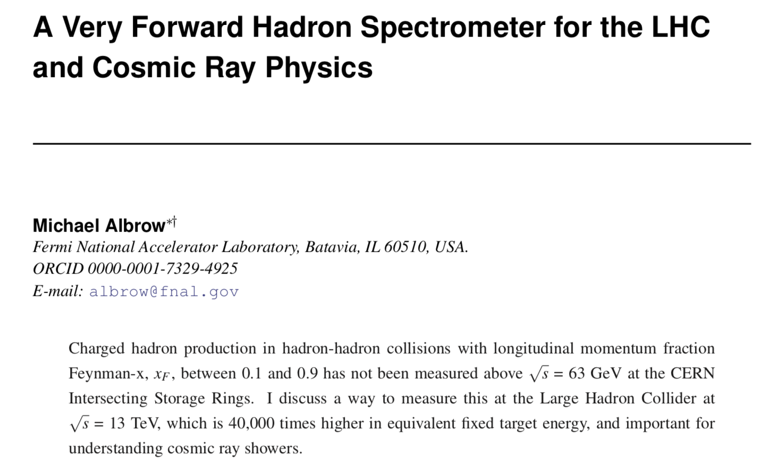


Short write-up
(But w/LHCb or ALICE)

Slide 32
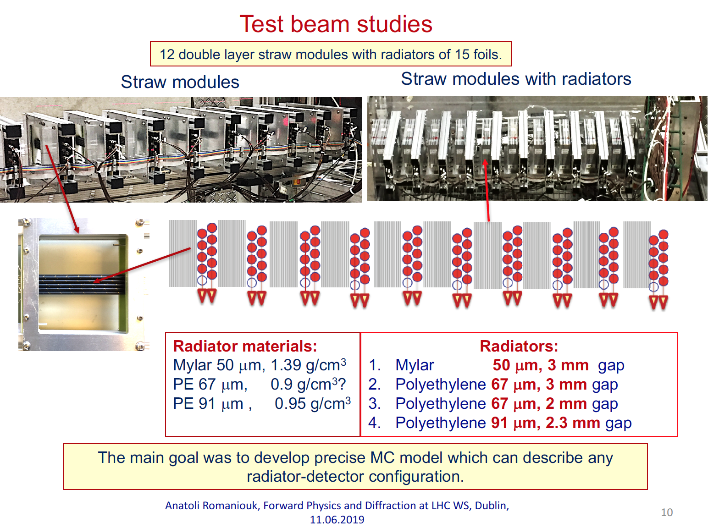
ANATOLI ROMANIOUK et al.

Slide 33
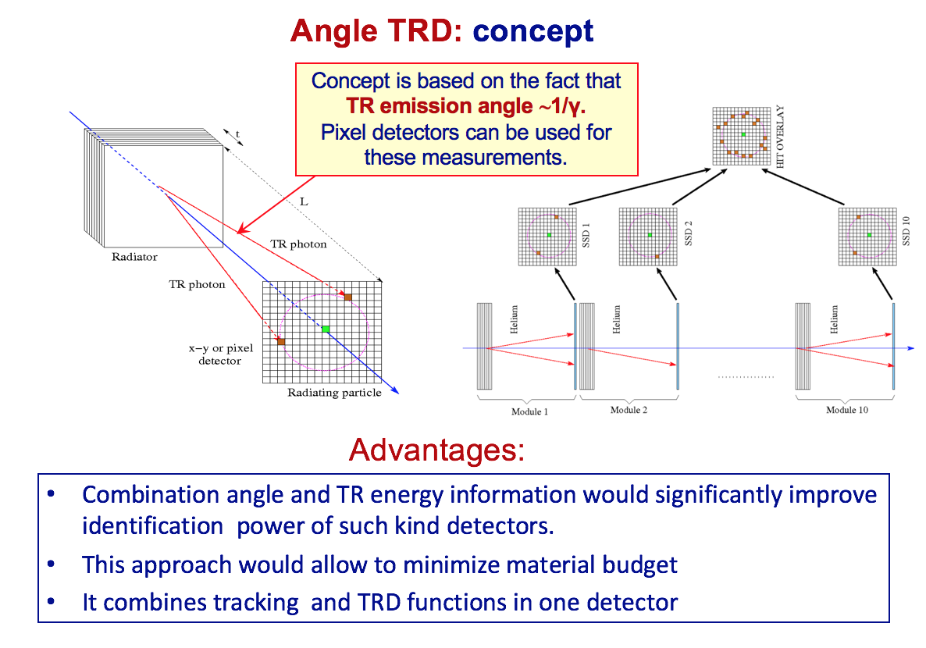

Slide 34
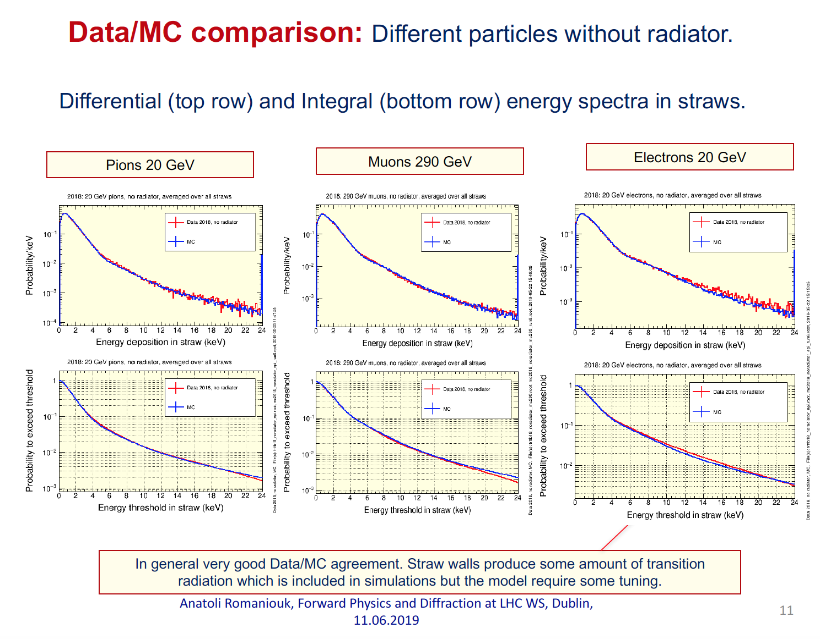
ANATOLI ROMANIOUK et al.

Slide 35
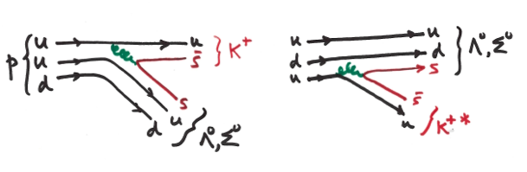
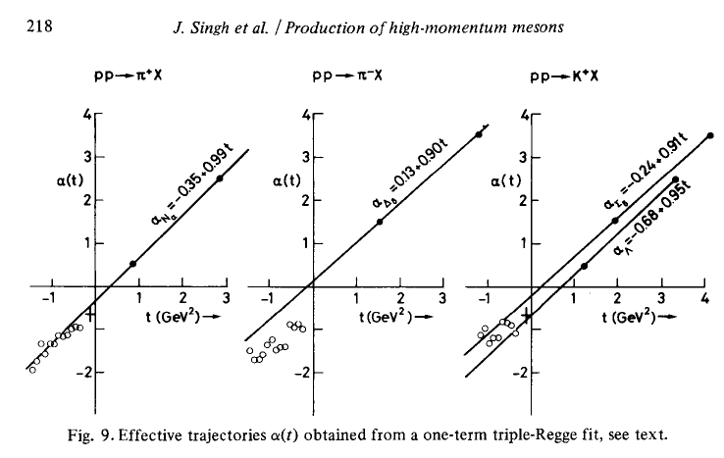
Challenge to theorists
Strong Interactions at low-Q²
Hadron level ~ Regge theory
Parton level ~ QCD (non-perturbative)
Leading (high x_{Bj}) u-quark or [ud] di-quark picks up an sbar or s in “string-breaking”
or from s-sbar sea, to make a leading K⁺ or Λ⁰, Σ⁰
γcτ(Λ) at 4.4 TeV is 316 m, → pπ- (acceptance?). Σ⁰ --> Λ⁰ + γ (100%, prompt)
Virtual (negative mass², t-channel) exchanged
baryon or meson described in
Regge phenomenology :
Analyticity, unitarity and crossing symmetry
+ continuous complex angular momentum.
Derive it from QCD !! ?
Dissociation products sharing
beam momentum (p opposite?)
Quark line description of leading K⁺ or Λ⁰, Σ⁰

Slide 36
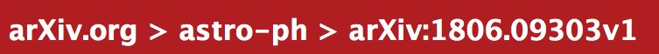
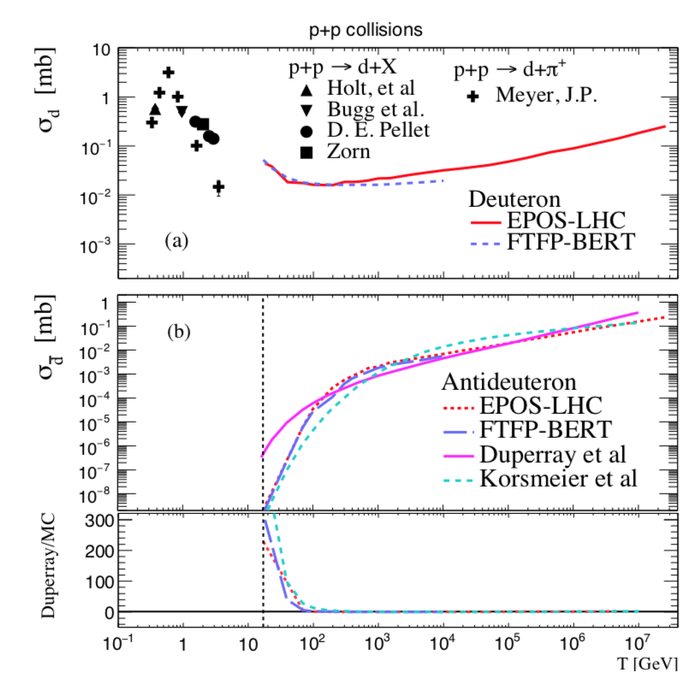
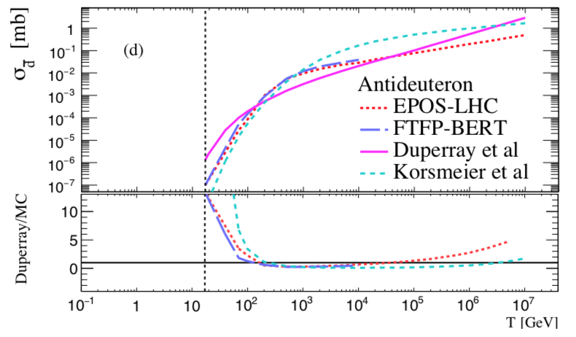
Diego-Mauricio Gomez-Coral et al.
p + p → π+ d
Caveat: These are for total production,
not just very forward.
… and in p + He collisions
LHC @ 13 TeV
Note large difference in predictions
At LHc energies.
LHC @ 13 TeV

Slide 37
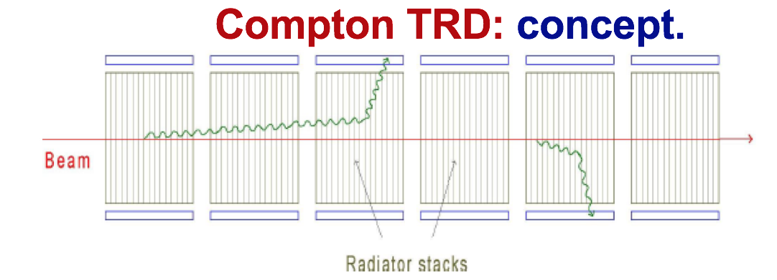
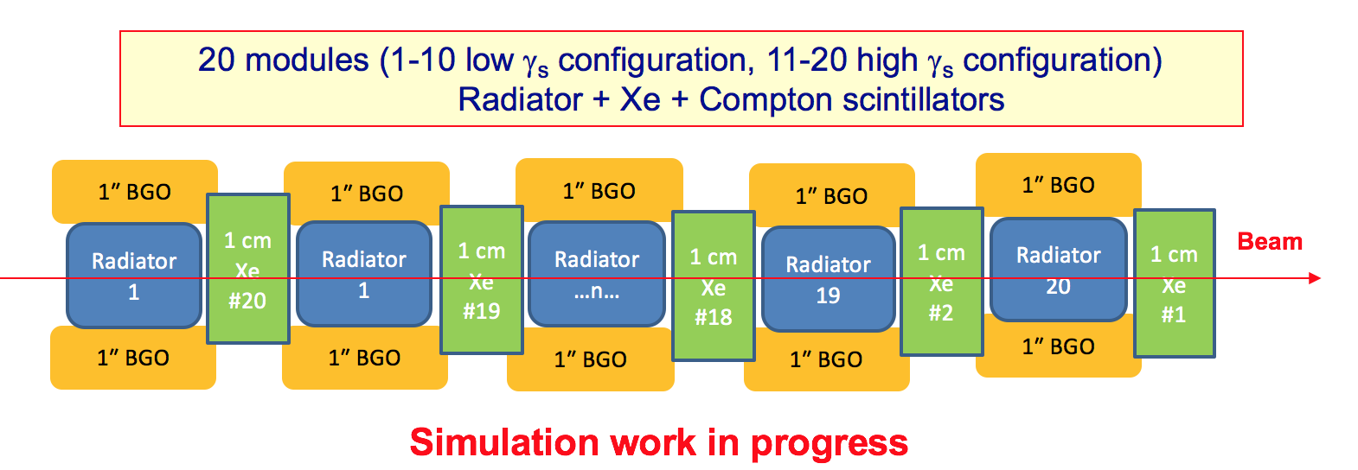
SAS-TRD R&D Group formed : Test beams at CERN (2016, June 2017)
NRNU MEPhi (Russia), Louisiana Uni (USA), Bonn Uni. (Germany)
Bari Uni, (Italy), Lebedev Phys Inst. (Russia), CERN

Slide 38
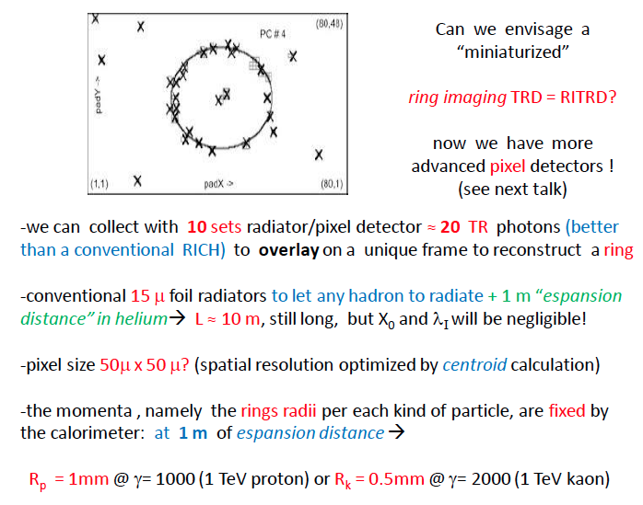
TRD also provides precision tracking information!
Mike Cherry, Louisiana State Univ., summary talk

