Slide 1
Status of R&D on Linear Collider
4th meeting of CERN-KEK committee
March 29, KEK
T. Higo (Accelerator, KEK)

Slide 2
Contents
CERN situation
Basic idea behind KEK X-band R&D
History of X-band R&D
Production of test structures
Test facilities
High gradient test results
Expansion of test facility
Basic studies related to breakdown
Expansion of our collaboration

Slide 3
CERN situation
Multi-TeV machine after LHC
Feasibility study is needed to judge
Key judgment of energy around 2012
Optimization of parameters reached 12GHz in late 2006, presented at APAC in India
Tight collaboration for normal-conducting high-gradient approach among CERN, SLAC and KEK

Slide 4
Present target area of KEK for collaboration on CLIC
Key technologies for CLIC accelerator
  High gradient acceleration
    Present focus in collaboration
    Most benefit to both sides
  RF generation from drive beam
  Low emittance
  ……..

Slide 5
History of X-band structure developments at KEK
Early 1990 by KEK
  Established fabrication technology→1.3m DS
Late 1990 with SLAC
  Realized discharge problem
By 2004 ITRP with SLAC
  Proved 50MV/m in 60cm HDDS with HOM suppression
2007 and later among CERN/SLAC/KEK
  CLIC oriented R&D at X-band toward twice gradient
  Collaboration among three laboratories

Slide 6
Reasoning of X-band collaboration
KEK
  High-frequency technology for higher energy as one of the missions of high energy accelerator laboratory
  Study ground for physical mechanism governing and preventing high gradient acceleration, discharge
CERN
  Demand of high power facility at 12GHz to prove high gradient
  There are only two places now to efficiently run, SLAC and KEK, at very close frequency, 11.4GHz
  Expand the collaboration to support the technology

Slide 7
Formal history of collaboration
  2006: Dec. at APAC in India, X-band choice
2007: Started structure collaboration meeting
  Jun. 1st Collab. mtng at CERN
2008: Addendum in CERN/KEK MoU, ICA-JP-0103
  May 2nd collab. Mtng at KEK
  Addendum 2 in MoU, ICA-JP-0103
    Collaboration of High Gradient Accelerator Technology Centered at Fabrication and Tests of X-band Accelerating Structures
  Supported accelerating structure fabrication and test
  Dec. 3rd Collab. mtng at UK
2009: Pursue under collaboration research contract
  Established collaboration research contract to support KEK activities
2010: Continue and expand collaboration
  Mar. Collab. mtng in China
  May 4th Collab. mtng at CERN

Slide 8
Actual history of collaboration
Red: main financial support from CERN
2007: Started structure collaboration meeting in June
  Structure fabrication started discussion
  Moved test facility to the present area
2008: Addendum in CERN/KEK MoU, ICA-JP-0103 in Aug.
  Structure fabrication (QuadX1, T18X2, TD18X2)
  Establishment of high power facility, Nextef
2009: Pursue under collaboration research contract
  Structure fabrication (C10X2, CD10X2, T24X2, TD24X2)
  Structure test (T18X1, QuadX1, TD18X1)
  Started preparation of extension of Nextef by pulse compression
2010: Continue and expand collaboration
  Structure fabrication (under discussion)
  Structure test (cont. TD18, followed by T24, TD24, ……)
  Establishment of high power facility for basic studies

Slide 9
Preparation of accelerator structures based on GLC/NLC technologies
Technology established for GLC/NLC
  KEK precision machining followed by SLAC assembly
  This is the best starting point for higher gradient.
  Extensive study is ongoing among CERN, SLAC and KEK
Nominal test flow
  Precision machining
  Chemical polish
  Diffusion bonding and brazing
  Baking in vacuum at 650C
  High gradient test at KEK and SLAC

Slide 10
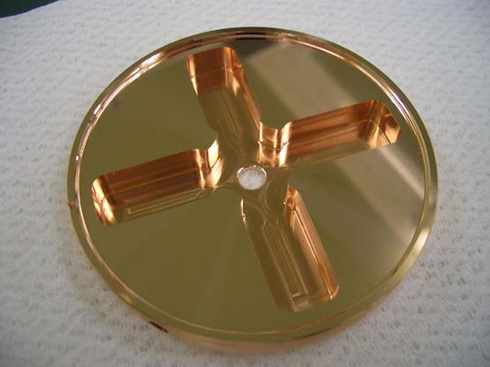
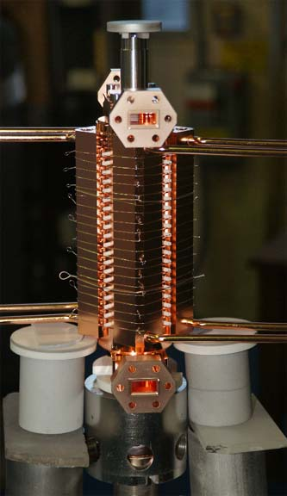
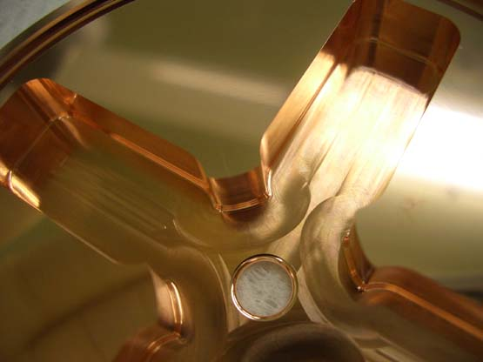
Fabrication of damped structures
KEK fabricated all parts.
SLAC made assembly.

Slide 11
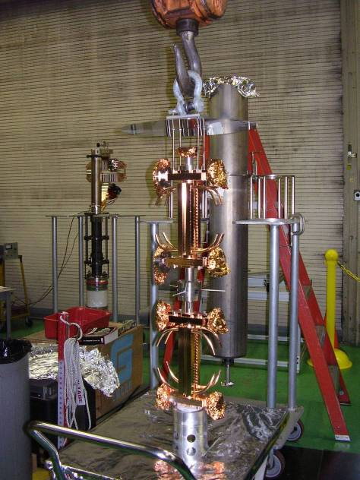
Vacuum Baking of T18_vg2.4_DISC
650° C
10 days
at SLAC
From Sami, Mar. 1

Slide 12
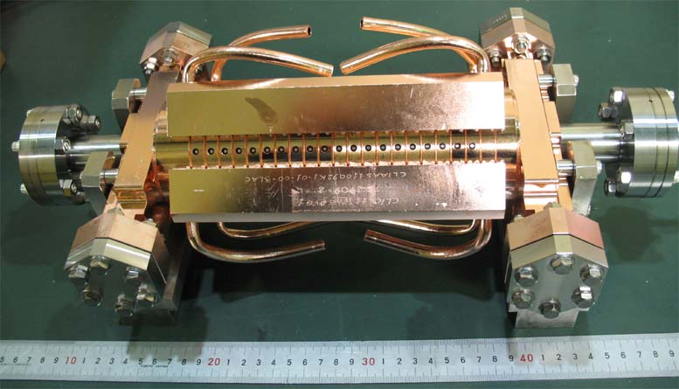
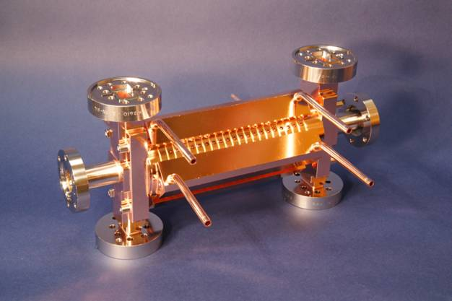
TD18 first pair #2(KEK) & #3(SLAC)
Design = CLIC-C
#3 being tested at SLAC NLCTA
#2 being tested at KEK
Nextef

Slide 13
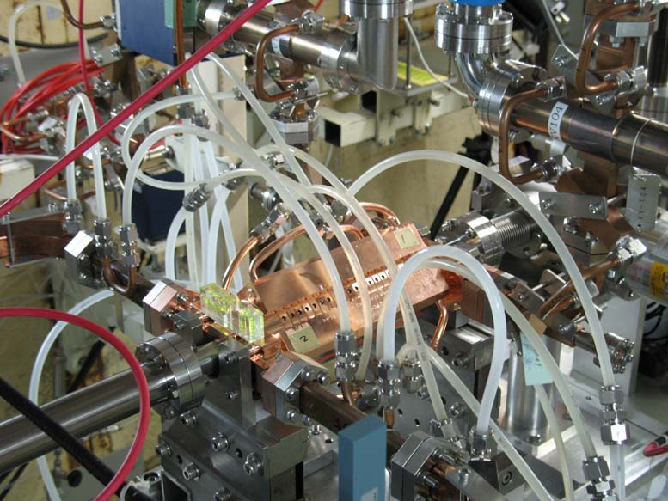
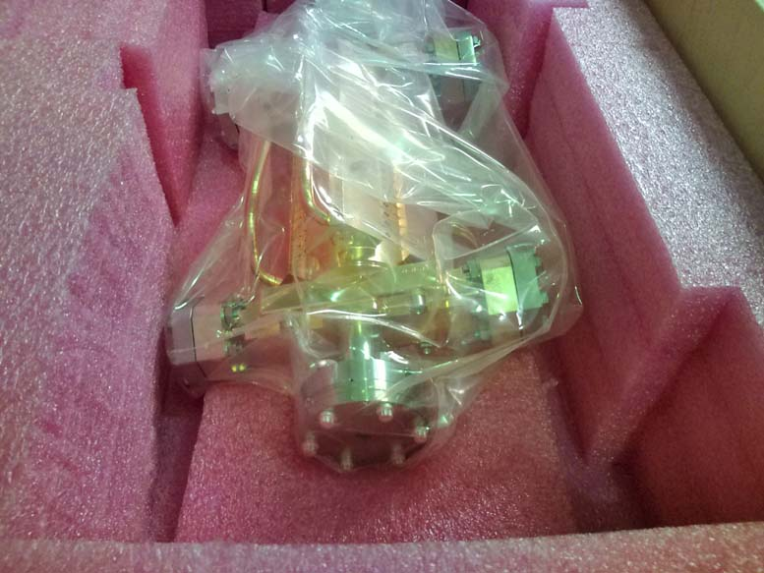
Sent from SLAC and installed at Nextef

Slide 14
Requirement to high gradient test
Evaluate at more than one laboratory
  Independent evaluations
  Equivalent to “S0” idea for ILC
  Aiming at obtaining statistical info and reproducible technology with scientifically proven mechanism
  Start at SLAC and KEK then include CERN test stand
Requirement for facility
  Long-term operation with 100MW or more
Actual facilities
  SLAC NLCTA with pulse compression
  KEK Nextef with two klystrons
  CERN 12GHz test stand (in this year)

Slide 15
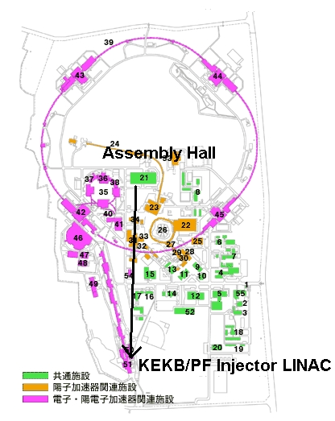
Test facilities of KEK
Nextef
KT-1
Now located at the J-Arc of the KEKB Injector

Slide 16
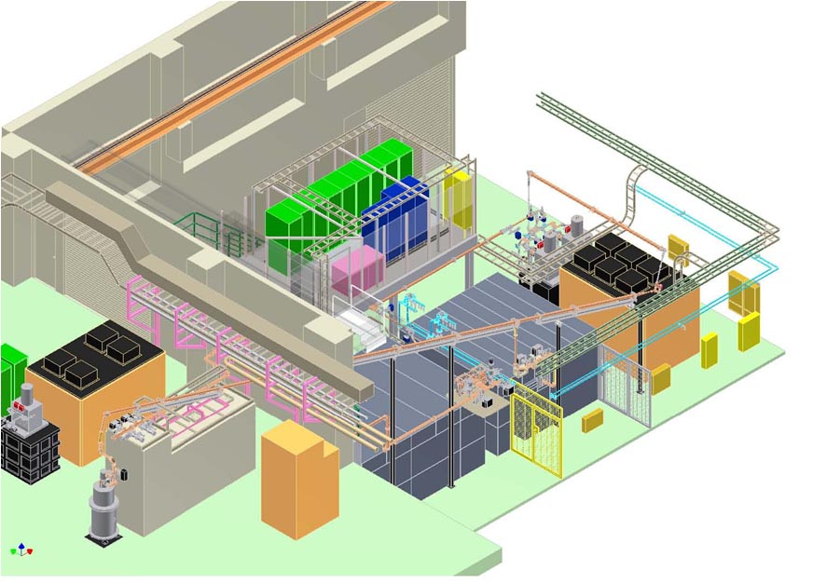
KEK: Nextef Configuration
Nextef
X-band
KT-1
X-band
A

Slide 17
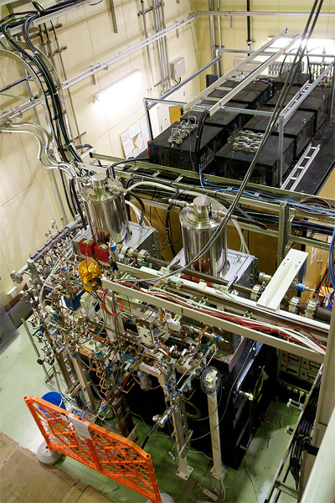
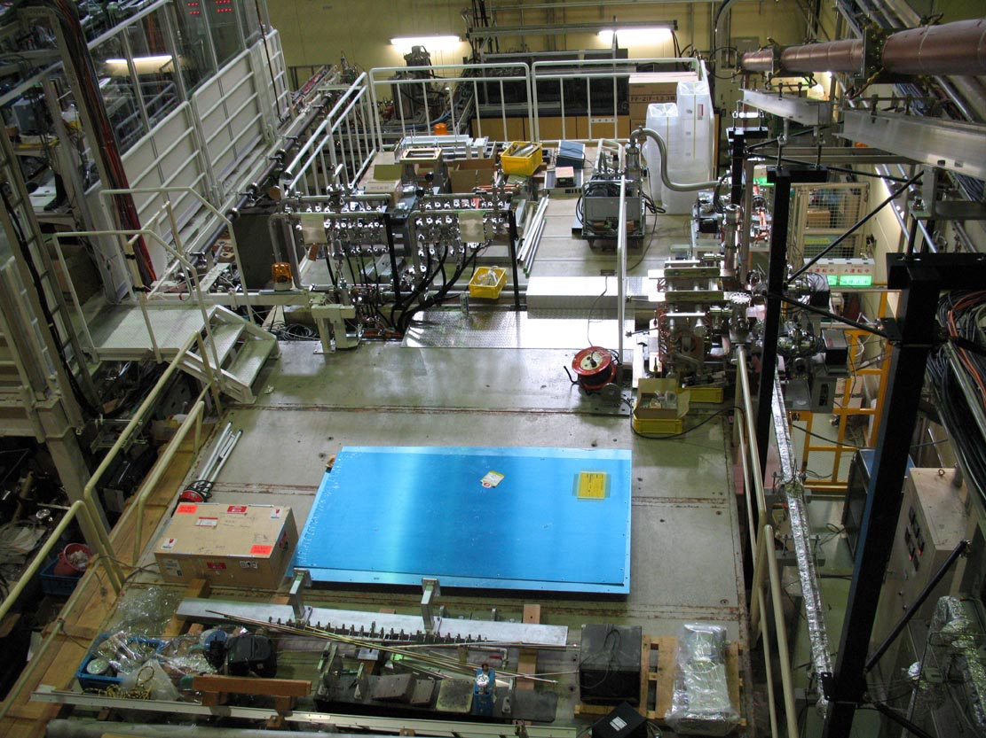
Nextef operation since 2007

Slide 18
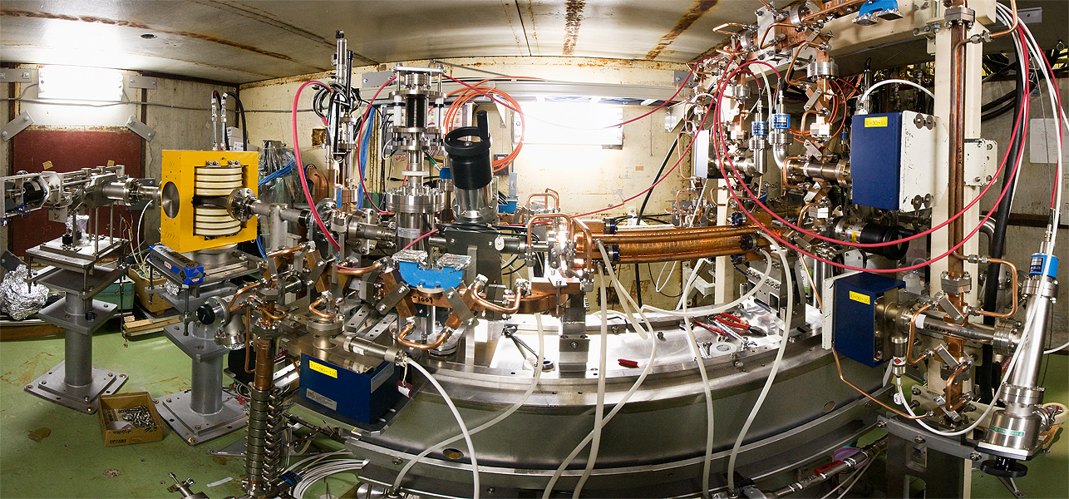
Nextef inside shield room

Slide 19
High gradient test of three CLIC-C prototype structures
Disk-based un-damped
  T18_Disk Oct. 2008~June 2009
  4000hr, 9 months
Quad-based heavily damped
  TD18_Quad_#5 Sep. 2009~Nov. 2009
  1000hr, 3 months
Disk-based heavily damped
  TD18_Disk_#2 Dec. 2009~
  1200hr, 4 month+

Slide 20
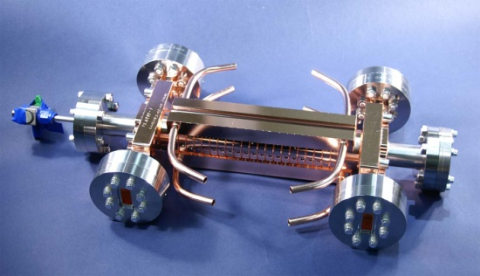
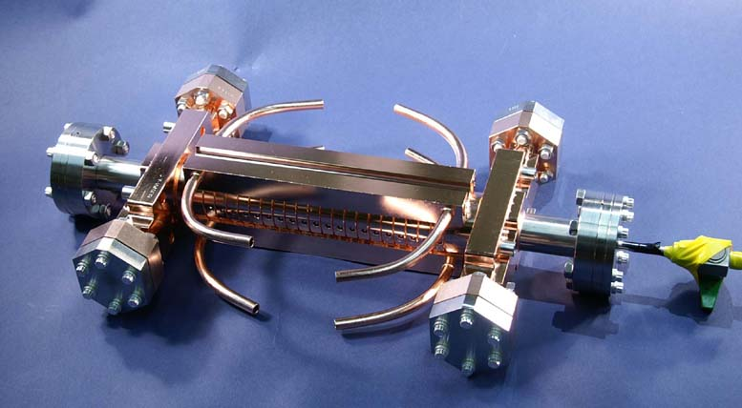
Proof of 100MV/m with a pair of un-damped 18cell prototype structures
#1 test at SLAC
#2 test at KEK
C. Adolphsen, US-HG@ANL, 2009
Roughly the same breakdown rates were observed for a pair of structures.
Will pursue the same comparison again for the second pair.

Slide 21
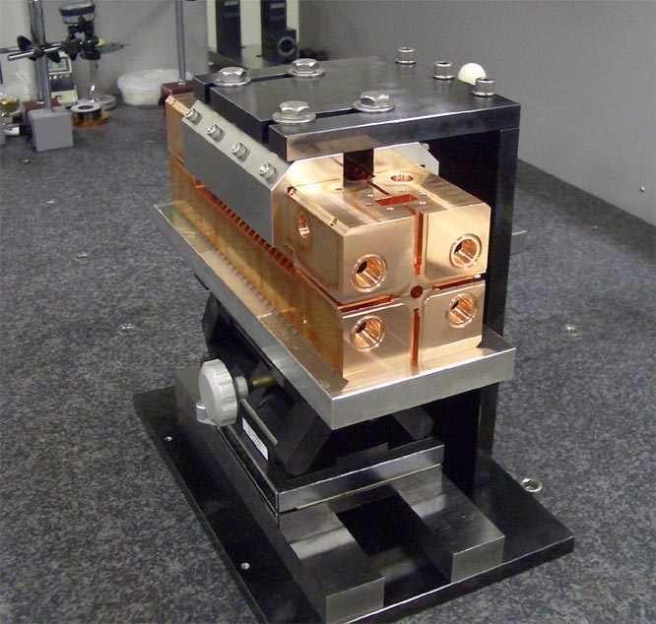
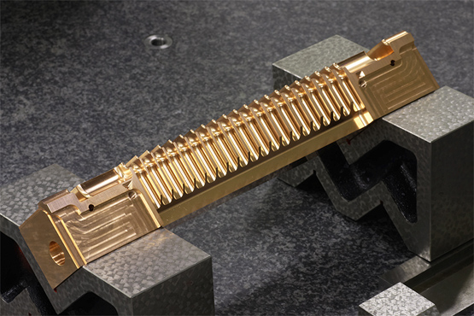
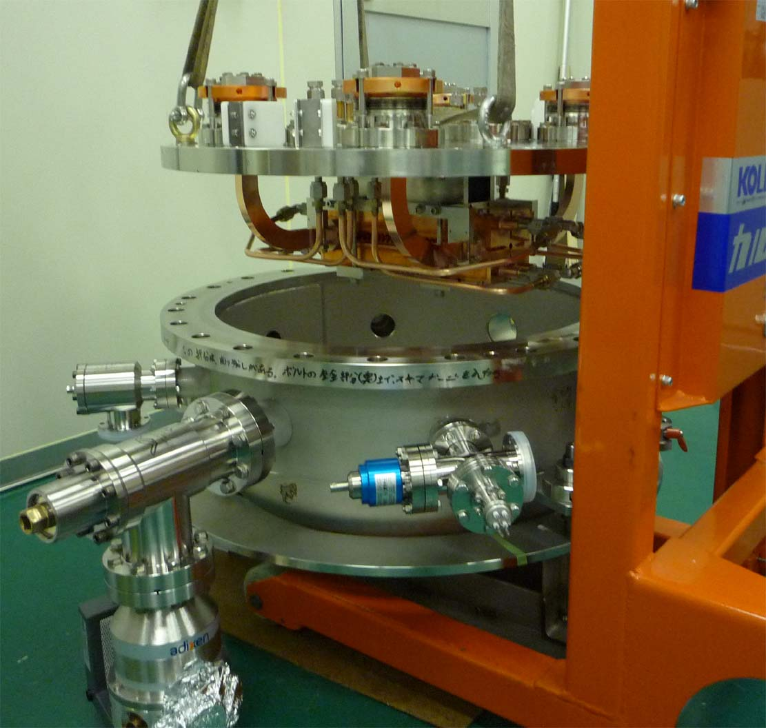
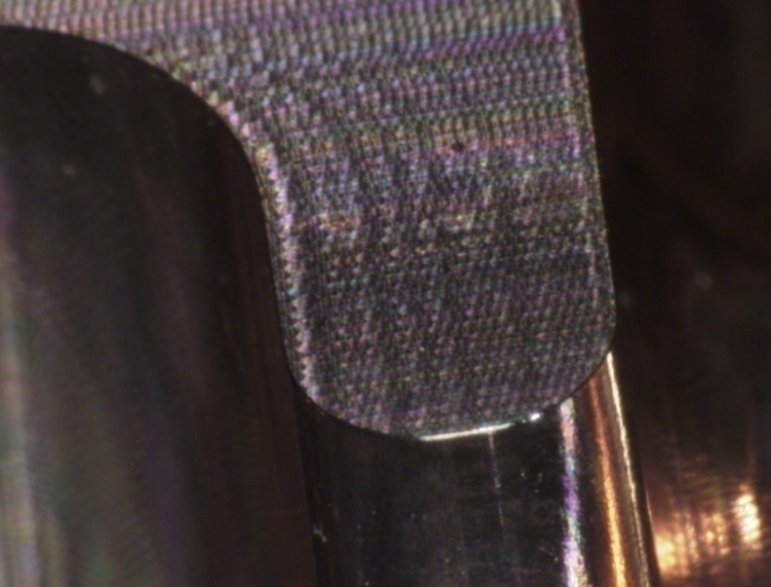
Quad fabrication and test
Must be cheap mass production but high gradient is not yet proved.
Made in Japan
Fine assembly
High gradient test in chamber
With 50 micron rounding

Slide 22
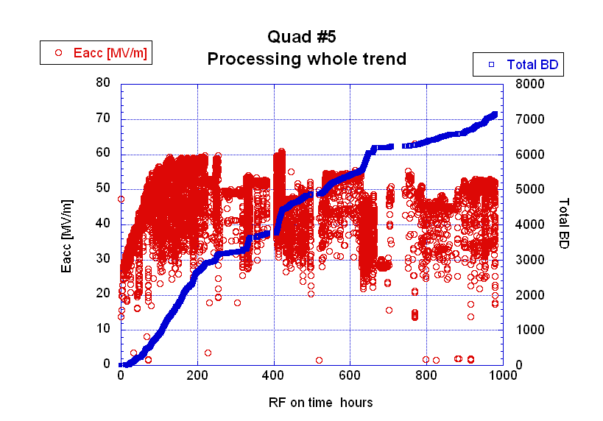
Gradient limited at 50~60MV/m
Difficult to reach 100MV/m!!
All with 50nsec

Slide 23
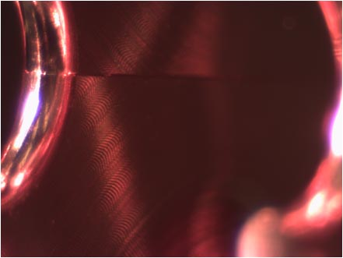
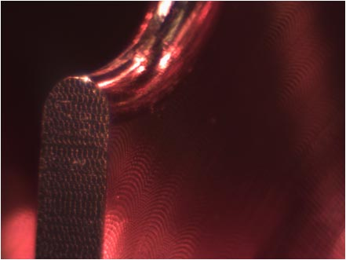
Optical inspection after test
No.18 Q2-2 to match Q1-1
No clear understanding of poor performance!
We will send it to CERN for SEM inspection.
We continue the study of this idea with CERN.

Slide 24
TD18_Disk_#2
Aim: Prove heavily damped structure
  Electric gradient: possibility to realize 100MV/m
Design geometry
  Heavy damping slots with wide opening
  Big increase of gradient toward downstream
  Big pulse heating temperature rise at the damping port opening
  No longitudinal cut but disk-based as T18 structures
Fabrication in practice
  Milling surface in many places
  Fabrication flow the same as T18

Slide 25
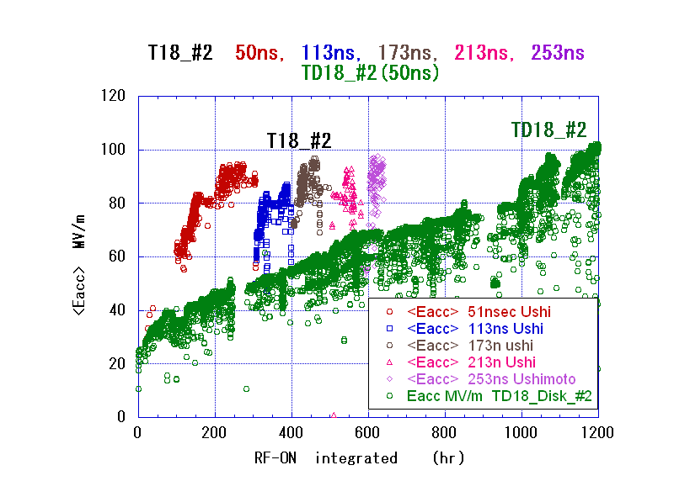
Slow processing on TD18 at KEK

Slide 26
Fast processing but high BDR on TD18 at SLAC
Faya wang
100311
Pulse width 230ns
Green line for TD18
Others for T18
But higher breakdown rate than T18 (un-damped).
Should continue to study the mechanism.
Should study TD24 with lower magnetic field.

Slide 27
Nextef for prototype structure tests
KT1 for basic studies
2008 2009 2010 2011 2012
7 10 1 4 7 10 1 4 7 10 1 4 7 10 1 4 7 10
Nextef
Pulse compression
T18_Disk_#2
TD18_Quad_#5
TD18_Disk_#2
T24_Disk_#3
TD24_Disk_#
T18_Disk_Disk #3
KT1
Narrow waveguide test
High power components test
Narrow waveguide test
RF delivery from KT1 to shield-B
Basic studies at shield-B

Slide 28
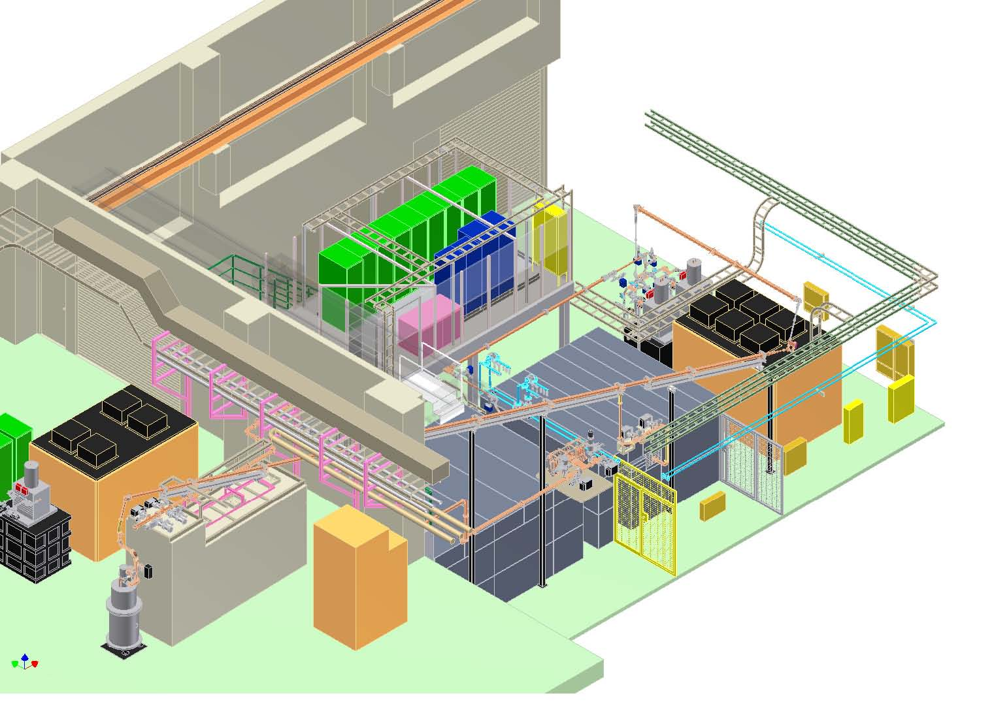
Nextef expansion plan
Nextef → PC → A
KT-1 → B
Nextef
X-band
B
KT-1
X-band
Pulse compressor
A

Slide 29
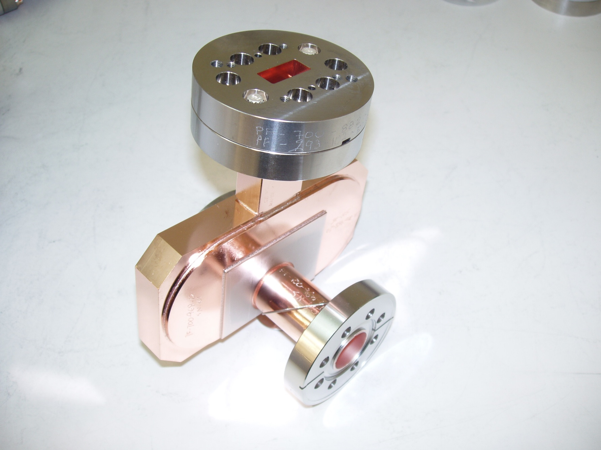
Mode Launcher for basic studies
Reusable coupler for basic studies made in 2009 by SLAC for KEK under US-Japan cooperation program.
Basic studies are to be made at shield-B.
From Sami, Mar. 1

Slide 30
X-band collaboration
Asian collaboration
KEK budget
16M\
KEK
Structure fabrication
Infrastructure & test @ Nextef
IHEP: Components and acc str.
Tsinghua: Choke-mode design
Testing at KEK, SLAC, CERN(2011~),
or in China
US-Japan
6.5/2M\
CERN/KEK collaboration
US-Japan
US-HG
CLIC
SLAC conducts
Structure fabrication
High power test
Basic research
CERN/KEK collaboration
31M\
CERN financially supports
Structure fabrication
High power test
System expansion
Budget in JFY2009

Slide 31
Conclusion
Collaboration between CERN and KEK is very critical for the feasibility proof of CLIC 100MV/m
Nextef is strengthening its high power production by introducing pulse compressor to stably run high gradient test for CLIC prototypes
New test area is being established to conduct basic studies to obtain a firm scientific understanding needed for CLIC
Collaboration is being expanded into an Asian laboratories with KEK as a foot stone
Financial support from CERN is very critical for the present KEK X-band activities

