Slide 1
W and LEPTON ASYMMETRIES at the TEVATRON
Heidi Schellman for CDF, D0

Slide 2
Outline
Overview
D0 muon asymmetry
CDF W asymmetry in the eν channel
Comparison of D0 and CDF lepton asymmetries
Discussion

Slide 3
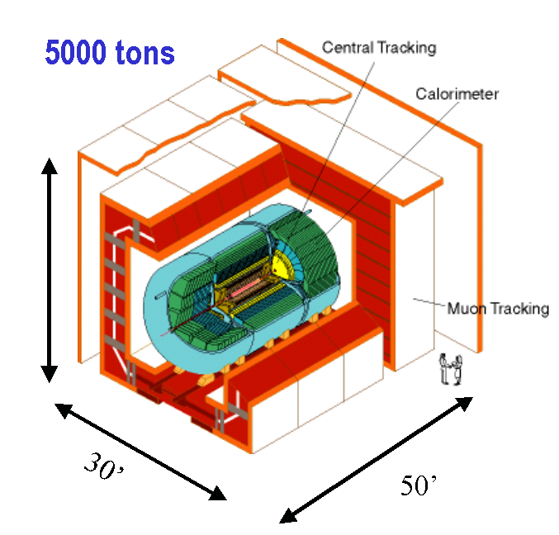
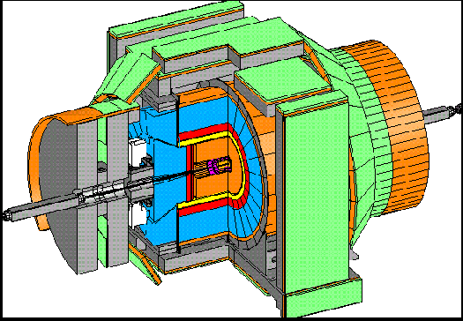
CDF and D0 detectors
CDF
D0
Common features
  High field magnetic trackers with silicon vertexing
  electromagnetic and hadronic calorimeters
  muons systems
Competitive Advantages
  CDF has much better momentum resolution in the central region and displaced track triggers at Level 1
  D0 has more calorimeter segmentation, silicon disks, and a far forward muon system.

Slide 4
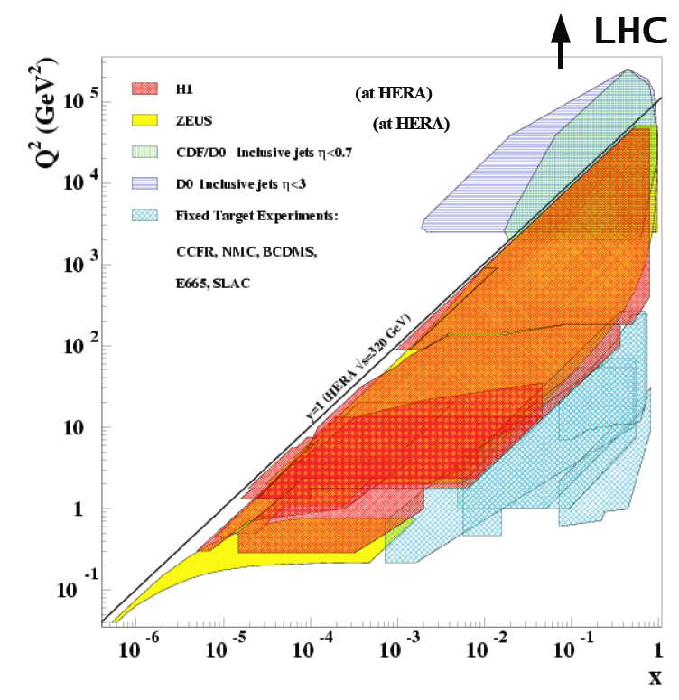
Kinematics
Q² = M²_{W}

Slide 5
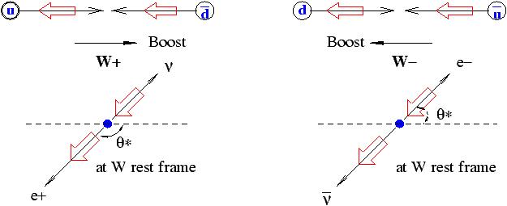
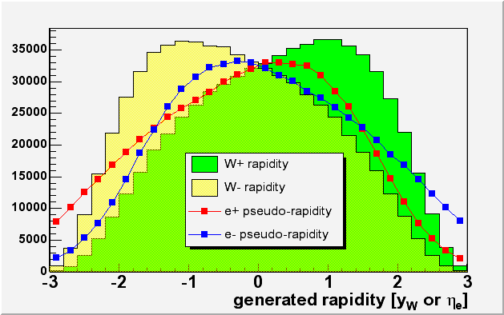
W asymmetry in p-pbar collisions
If u quarks carry more momentum than d quarks, the W⁺ will head in the proton direction preferentially.
Unfortunately, the V-A interaction means that the charged lepton from W decay heads backwards in the W frame
5

Slide 6
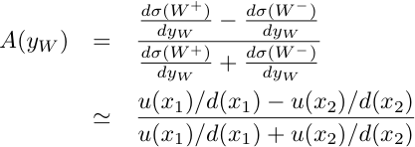
W Asymmetry in p-pbar collisions
Where u(x) and d(x) are the u and d quark parton distribution functions in the proton and
x₁ and x₂ are the momentum fractions in the proton and anti-proton.

Slide 7
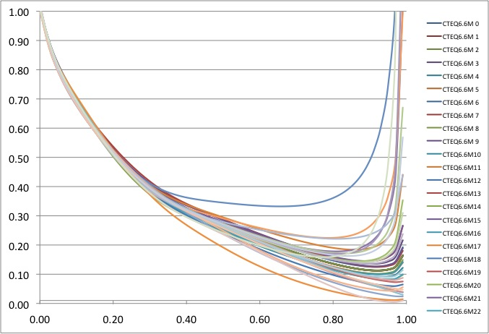
What do we know about d(x)/u(x)?
CTEQ6.6M PDF sets at Q=81.4 GeV
d(x)/u(x)
x

Slide 8
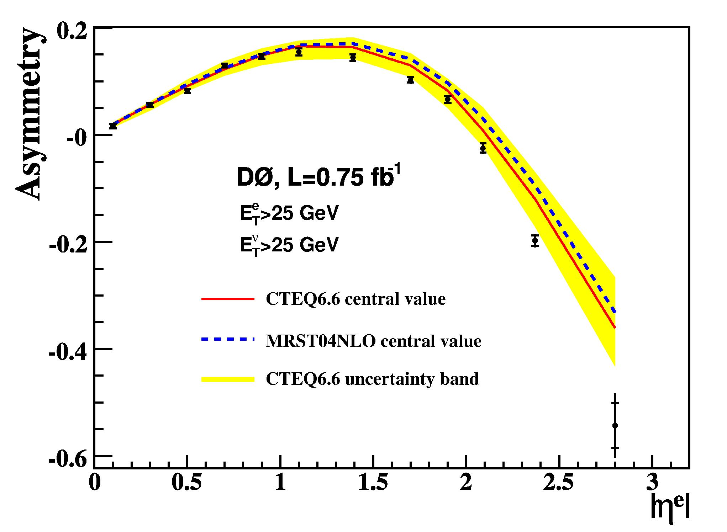
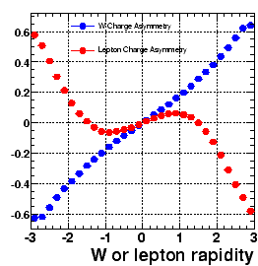

Traditional Lepton method
Lepton Asymmetry
Experimentally very well defined
Theory comparison depends on good knowledge of helicity structure and modeling of PT, rapidity distributions.

Slide 9
New in 2009
D0 muon charge asymmetry
Trang Hoang, FSU student
L = 4.9 fb⁻¹, 2.3 M reconstructed W decays!
Previous Publications from TeV Run II
D0: Measurement of the Muon Charge Asymmetry from W Boson Decays, Phys. Rev. D77, 011106 (2008), 0.3 fb⁻¹
D0: Measurement of the Electron Charge Asymmetry, Phys. Rev. Lett 101, 211801 (2008), 0.7 fb⁻¹
CDF: W boson charge asymmetry vs W rapidity, Phys. Rev. Lett. 102, 181801 (2009), 1 fb⁻¹
CDF: lepton charge asymmetry, Phys. Rev. D71, 051104, 0.17 fb⁻¹

Slide 10
W→μν
Advantages
  Lower trigger thresholds
  Much lower charge misidentification rate
  A different channel than previous W→eν measurements
Disadvantages
  Worse momentum resolution at high momentum
    (not an issue for this measurement)
  Angular coverage out to η = y_{μ} of 2.0 instead of 3.2 for electrons.

Slide 11
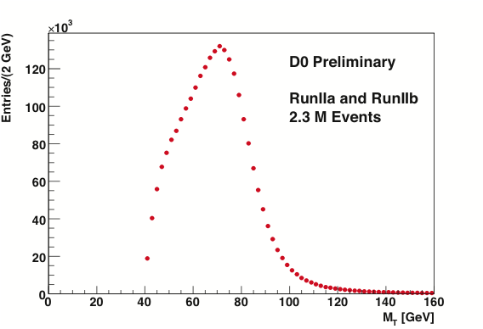
M_{T} distribution for W→μν events
Muon selection
  p_{T}(μ) > 20 GeV
  |η(μ)| < 2
  Missing ET > 20 GeV

Slide 12
Backgrounds for D0 W→μν
Background | Run Iia (low lum) | Run Iib (high lum)
multijet | 2±0.1% | 2.4±0.1%
W->τν | 3±0.02% | 3±0.03%
Z->μμ | 2.7±0.1% | 3.1±0.01%
Z->ττ | 0.16±0.001% | 0.18±0.002%

Slide 13
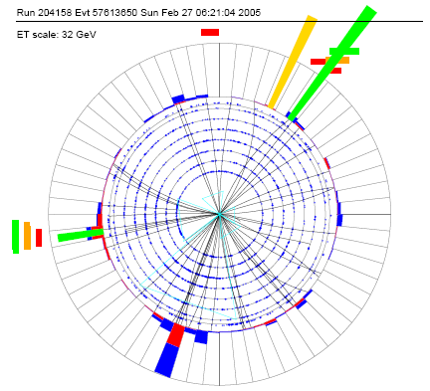

Charge misidentification
Run IIa, 3 same-sign Z’s out of 48452
Run IIb, 14 same-sign Z’s out of 120417
Negligible
D0 flips magnet polarity which largely cancels detector asymmetries
Muon
Track
Muon
Jet

Slide 14
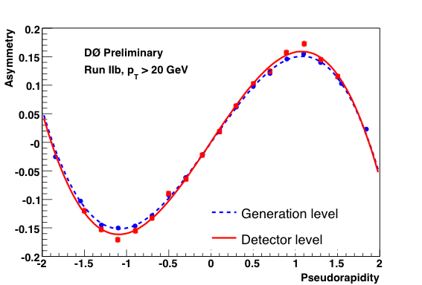
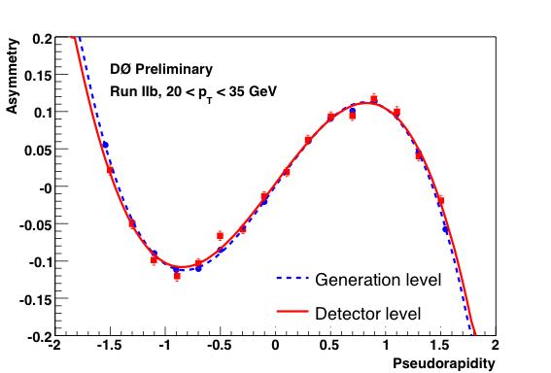
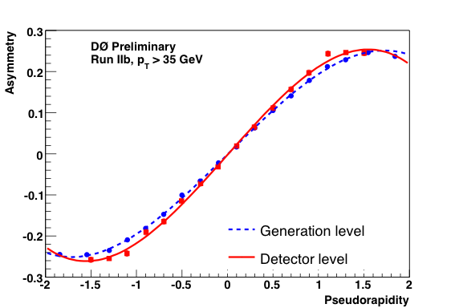
Momentum smearing correction
Momentum smearing can cause events to migrate between PT bins
Rapidity smearing is negligible.
Raw asymmetries are corrected for charge misid, backgrounds and for momentum smearing to get the lepton asymmetry.

Slide 15
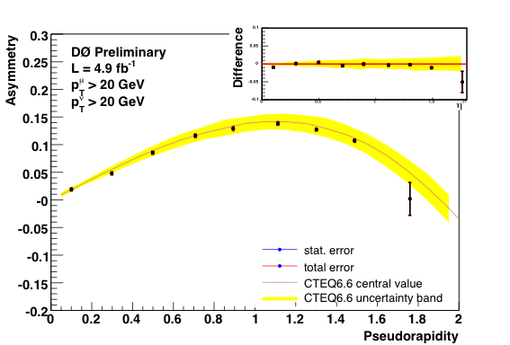
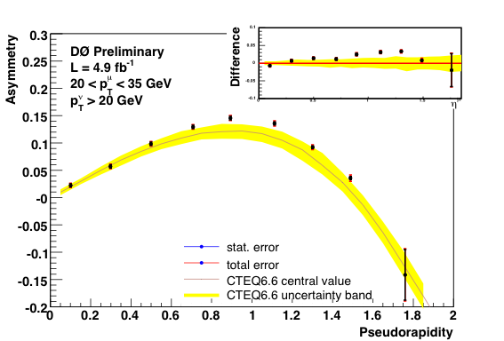
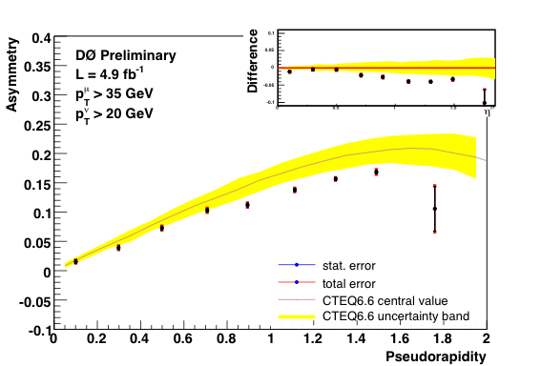
Results compared to RESBOS+CTEQ6.6M
3 muon PT bins, PT(ν) > 20 GeV
Upper Left – PT(μ) > 20 GeV
Upper Right 20 GeV < PT(μ) < 35 GeV
Lower Left PT(μ) > 35 GeV

Slide 16
D0 conclusions
New high statistics measurement in the muon channel.
Reasonable agreement with theoretical predictions for the inclusive p_{T}(μ) >20 GeV sample.
Disagreement when data are divided into p_{T}(μ) > 35 GeV and 20 < p_{T}(μ) < 35 GeV samples.

Slide 17
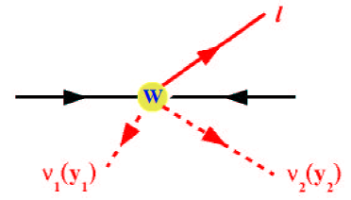
New CDF Technique
B. Han, Rochester student
θ*
Use W mass constraint to
solve eqn.
Get 2 solutions.
Calculate W rapidity for each solution
Use Matrix element methods to weight events/solutions based on theoretical expectations.
Iterate in case theoretical expectations influence the result.
Method documented in: A. Bodek, Y. Chung, E. Halkiadakis, B. Han, K. McFarland, Phys. Rev. D 77, 111301(R) (2009).
P
¯
P
17

Slide 18
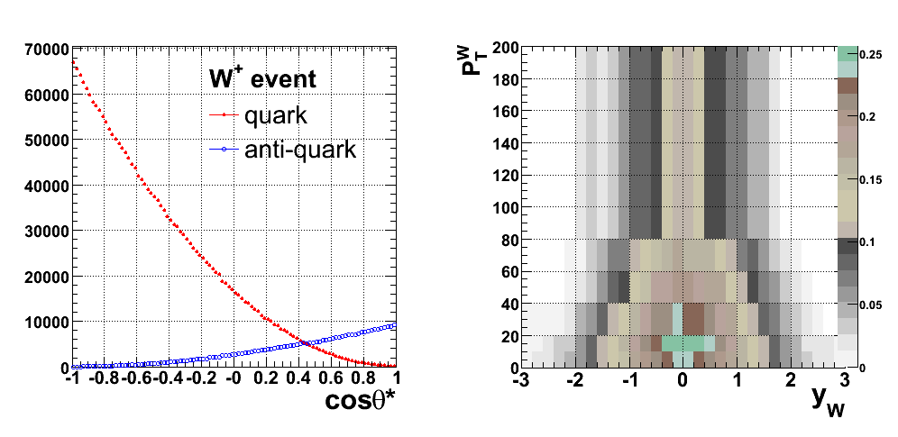
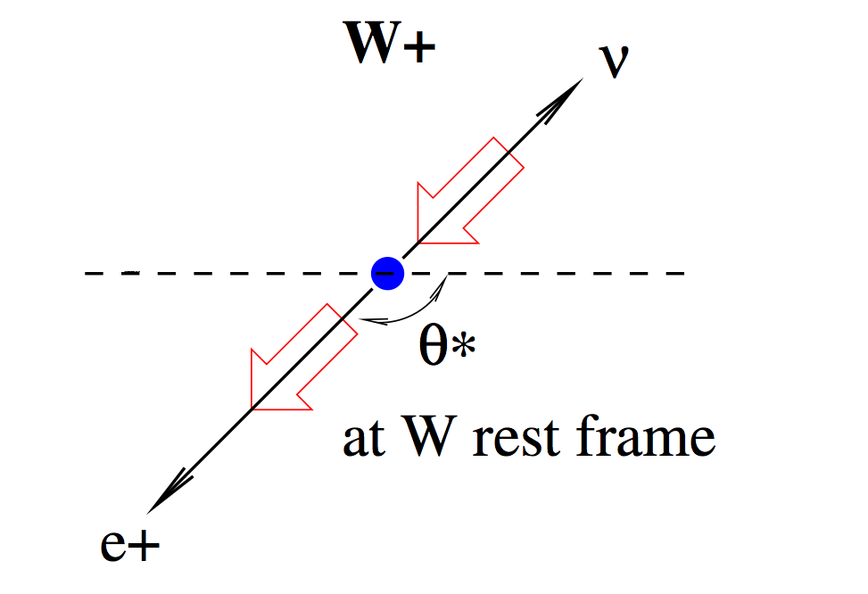
Example: Take into account W production from the sea via Q(y,PT) factor in weight
[cosθ* : in Collins-Soper frame (W rest frame)]
Sign of V-A angular bias flips
when W ± is produced from
anti-quarks
→ take this fraction as an input
ratio of two angular distributions at each rapidity
Notes:
(use MC@NLO)
(if you want to see the details of the Q parametrization, I have it in the backup)
I want to demonstrate that it depends on angular distribution of electron and proton (valence vs. sea quark production) and the differential cross section. We also iterate.
Theta* angle between electron and proton in W rest frame.
2 possible W rapidity solutions can be evaluated statistically based on angle theta*
W production from valence quarks of the proton and and anti-quarks of anti-proton and rarely from sea quarks.
Need at least one high x parton.
Production by sea anti-quarks result in opposite W polarization from valence quark production.

Slide 19
Uncertainties
Statistical:
  Unfolding could correlate the statistical errors in
  nearby bins
  The statistical correlation coefficient between bins is found to be < 0.05.
Systematic:
  Detector response
    energy scale and smearing for electron and recoil
    efficiency to find electron and pass missing E_{T} cut
  Reconstruction & Backgrounds
    Uncertainties on charge fake rate and background estimates
  Inputs
    PDF uncertainties (CTEQ6.1 PDF error sets) for total W production and quark/anti-quark fractions
Notes:
Since our iteration method might am- plify the expected statistical fluctuations the statistical error is measured using a pseudo- experiment technique

Slide 20
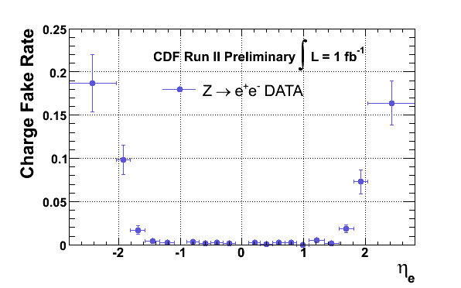
Electron Charge Identification
Use Z decays to determine the charge misID rate
Notes:
One of the challenges of this measurement is to measure very forward electrons and also to understand the charge identification rate well in this very forward region. The charge misid rate is measured using Z’s and ranges from …
Forward tracking has fewer points at shorter lever arm
Determine directly from Zs in data (background subtracted)
To get this as a function of rapidity, needs to be handled very carefully.

Slide 21
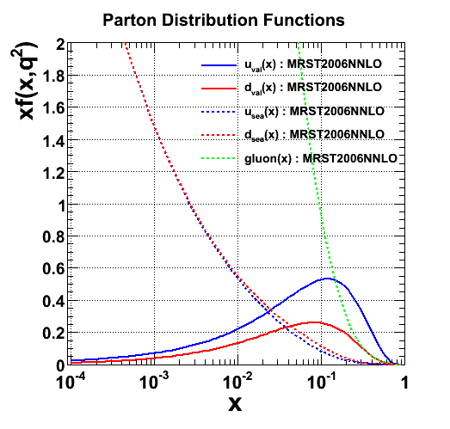
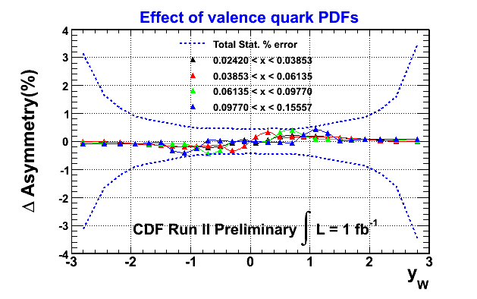
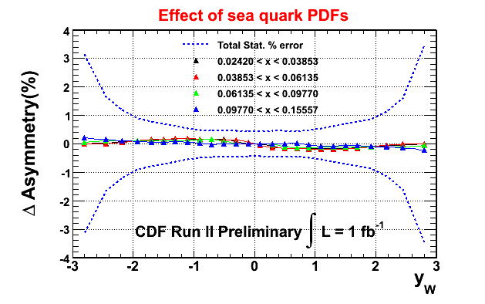
Effect of Input PDFs
effect of increasing valence u+d by +5%
effect of increasing sea u+d by +5%
Notes:
This is a question we often get…
increased by 5%, where the distributions for both proton and antiproton are changed
While keeping the d(x)/u(x) and d(x)/ u(x)constant. Then the rapidity of W boson is reconstructed
Again using our analysis method.

Slide 22
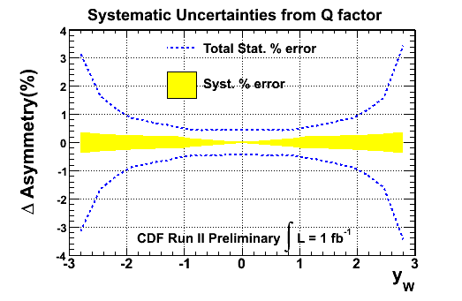
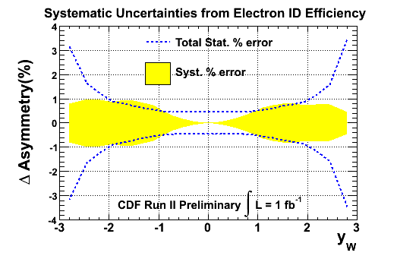
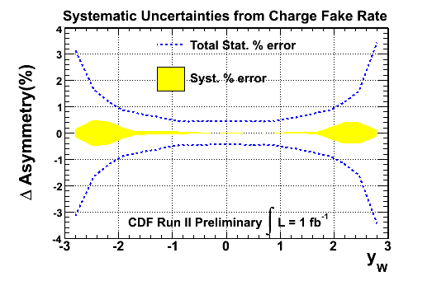
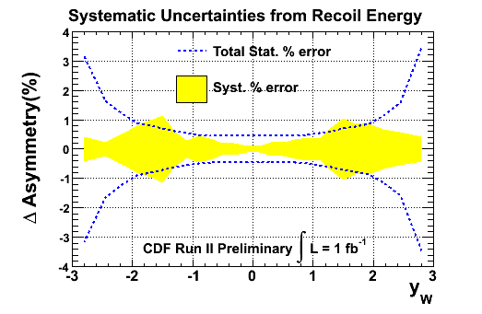
Systematic Uncertainties
Notes:
Showing only some of the largest sytstematics.

Slide 23
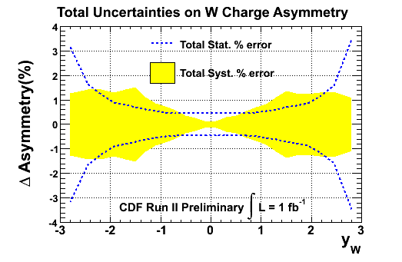
Systematic Uncertainties
Systematics <1.5 % for |y_{W}| > 2.0

Slide 24
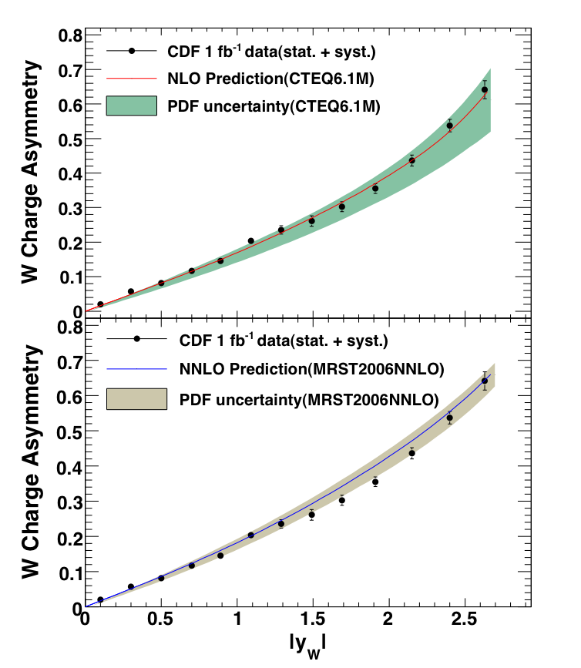
CDF Result (1fb⁻¹)
Phys. Rev. Lett. 102, 181801 (2009).
Compare to CTEQ6.1M (NLO) and MRST2006 (NNLO) PDFs and their uncertainties
Experimental precision is much better than the theoretical error band!
Notes:
Since this measure- ment depends on the width of the W , in particular for the highest yW bin, the bin centers account for the W rapidity and W mass range accepted in each bin. We correct the bin centers to the value of < |yW | > (average of W + and W − rapidities) for which the asymmetry is equal to the one for a fixed W mass of 80.403 GeV/c2 .

Slide 25
What is going on?
CDF W asymmetry agrees pretty well with theoretical predictions
D0 lepton asymmetries agree better if data are not segregated into pt bins.
Is it the data or some aspect of the theoretical predictions we use?

Slide 26
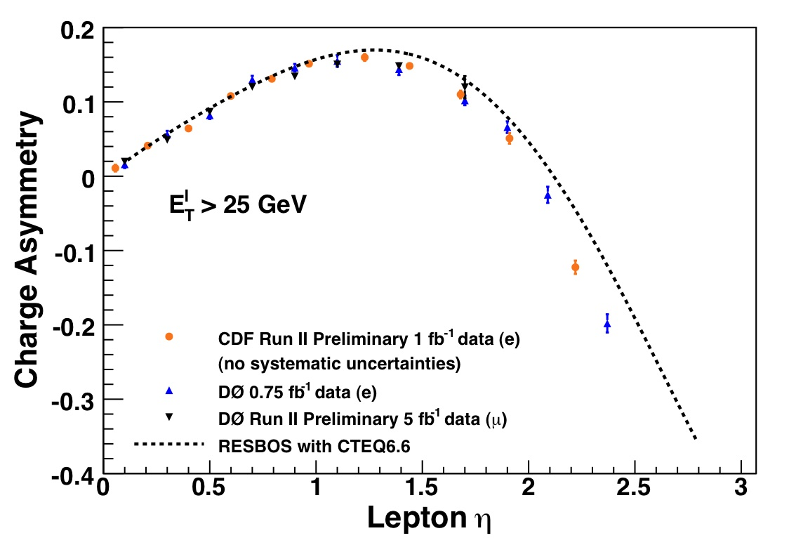
Are CDF and D0 Consistent?
NEW!! CDF have measured the electron asymmetry from the same data sample as their W asymmetry. Compare with D0 muon and electron data – with a higher cut of 25 GeV on both ν and l

Slide 27
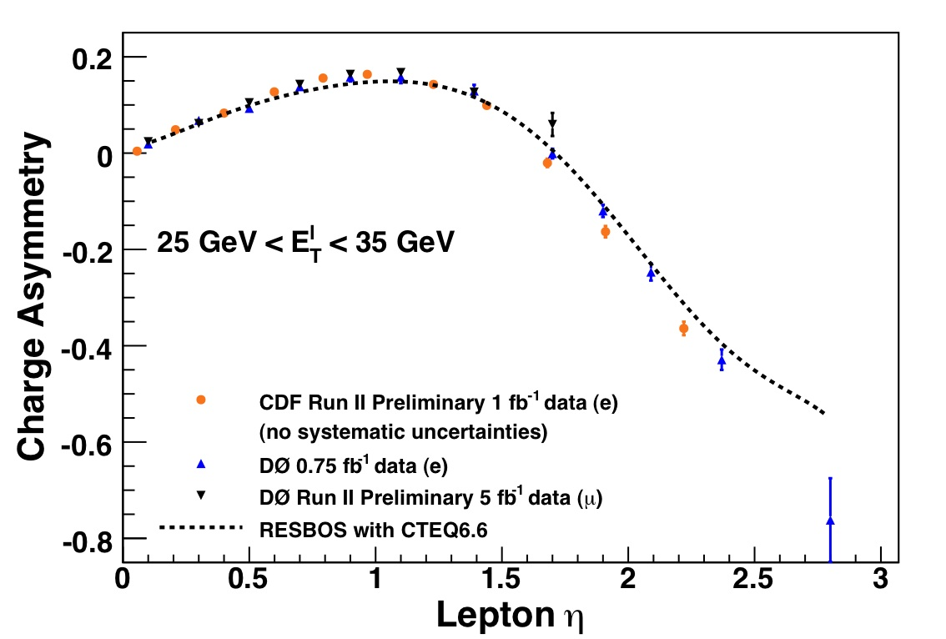

Slide 28
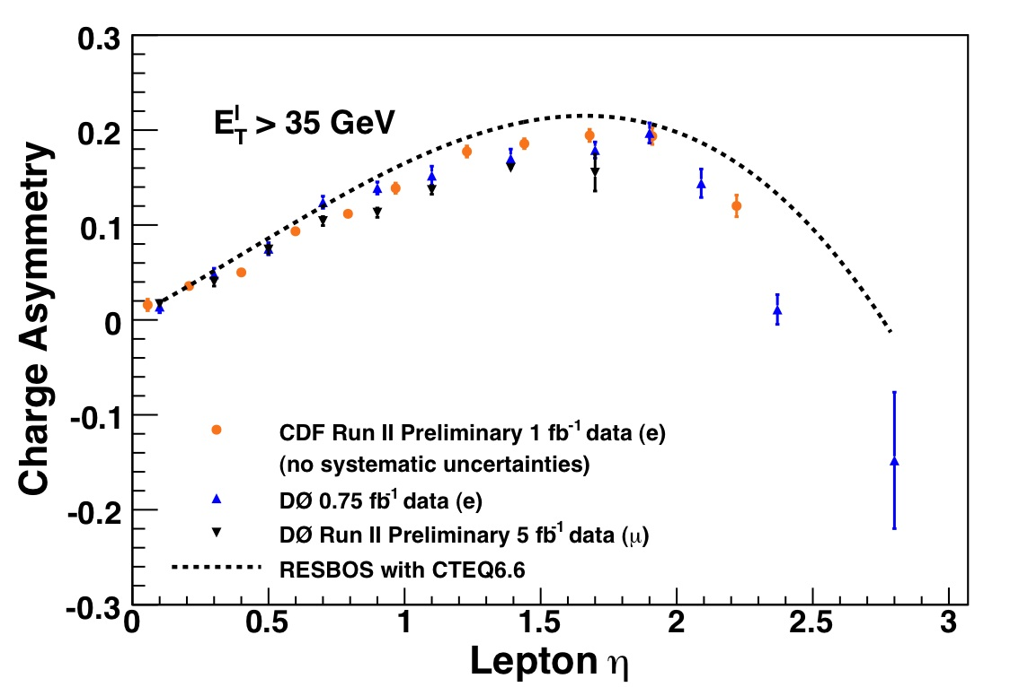

Slide 29
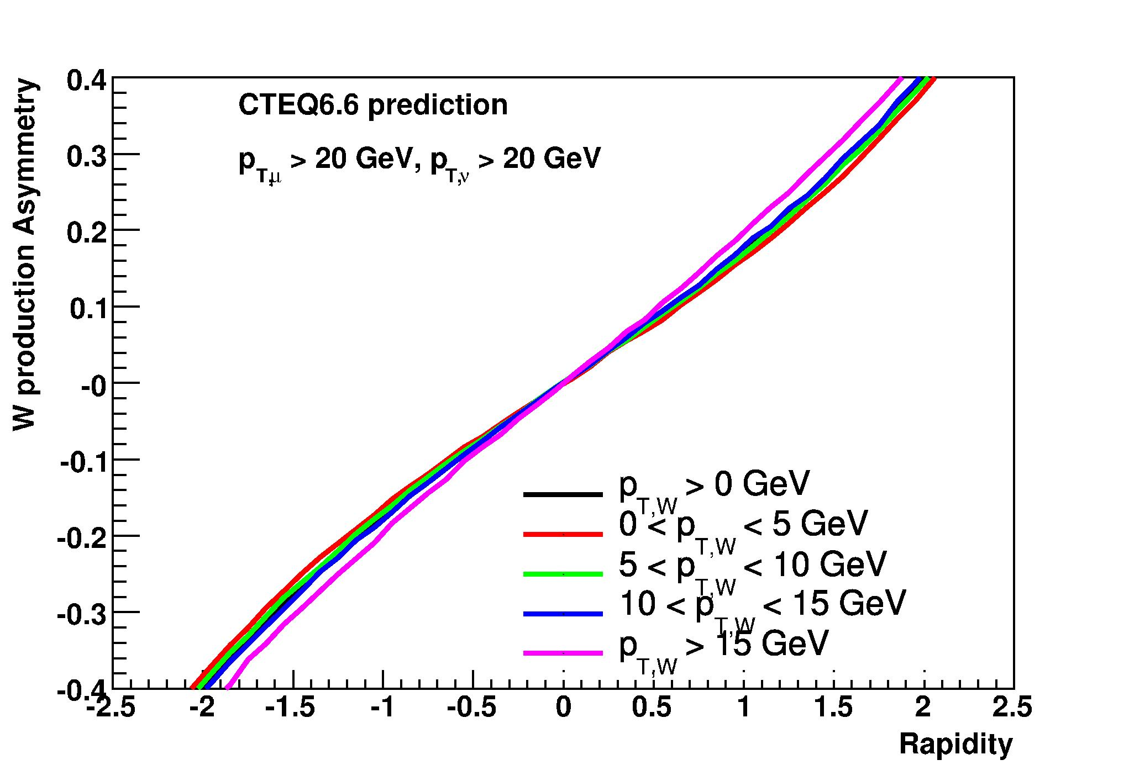
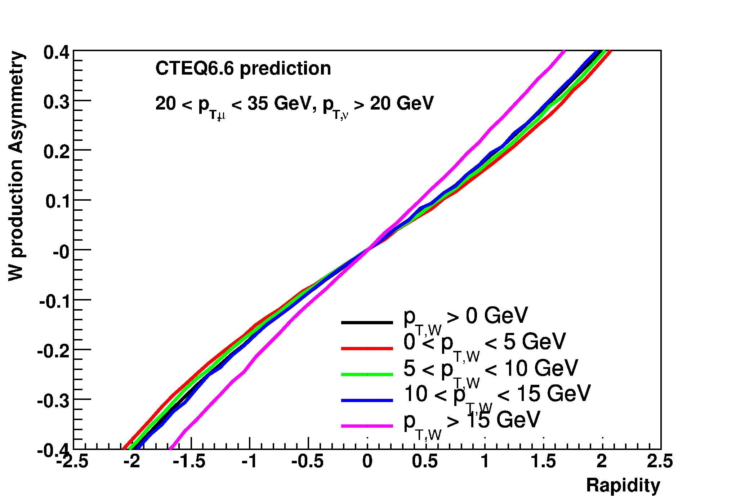
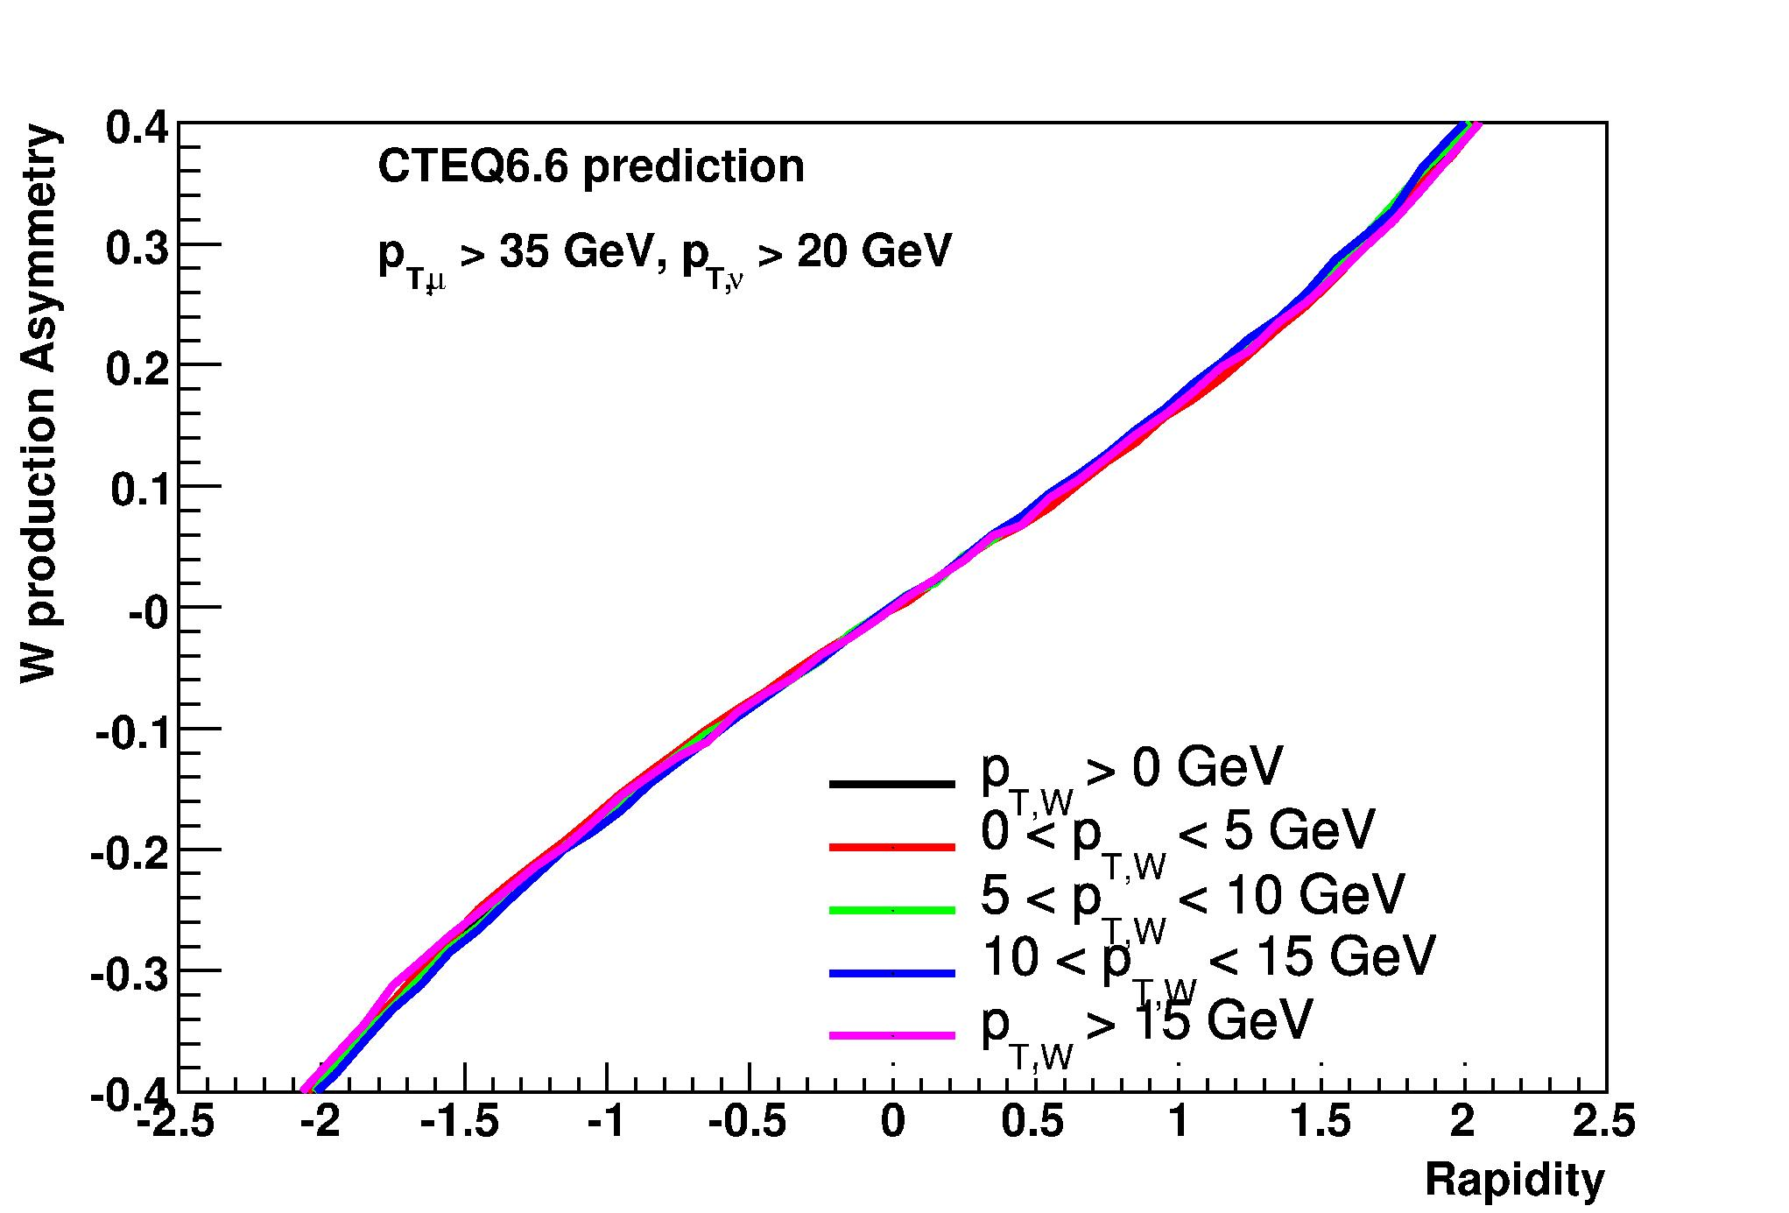
Dependence of W asymmetry on W kinematics.
RESBOS + CTEQ

Slide 30
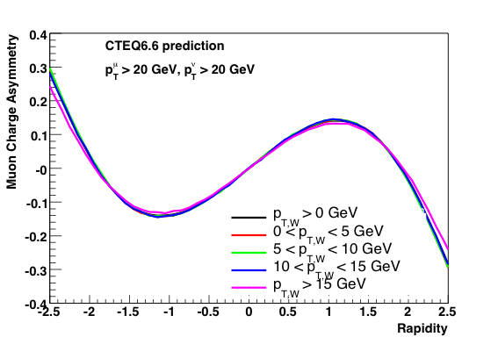
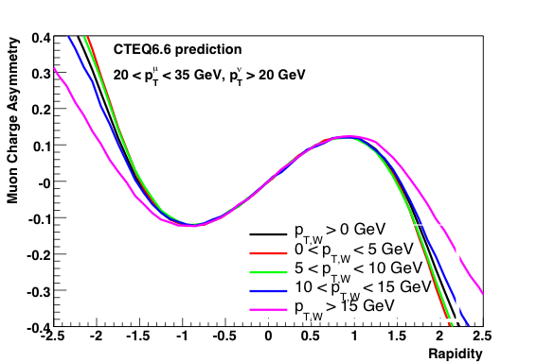
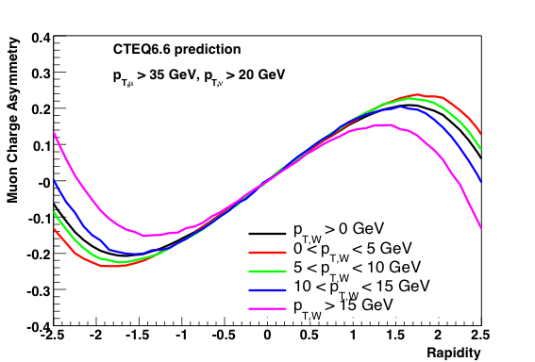
Muon asymmetry predictions
CTEQ6.6M with RESBOS
Note that lepton pt cut introduces correlation between A and pt of the boson.

Slide 31
Tentative conclusions
The CDF W asymmetry agrees well with theoretical predictions.
D0 and CDF lepton asymmetries disagree with theoretical predictions for binned lepton pt, but seem to agree with each other!

Slide 32
Special thanks to our sponsors!
CTEQ6.6 NLO:P. M. Nadolsky et al., Phys. Rev. D 78, 013004 (2008).
CTEQ6.1 error PDFs: D. Stump et al., J. High Energy Phys. 10 (2003) 046.
NNLO Prediction: C. Anastasiou et al., Phys. Rev. D69 , 094008 (2004).
RESBOS: Landry et al., Phys. Rev. D67: 073016, (2003)
MRST 2006 PDFs: A. D. Martin et al., hep-ph/0706.0459, Eur. Phys. J., C28 , 455 (2003).
MSTW 2008 PDFs: A. D. Martin et al. hep-ph/0901.0002

