Slide 1
ALICE TPC
Acces in surface

Slide 2
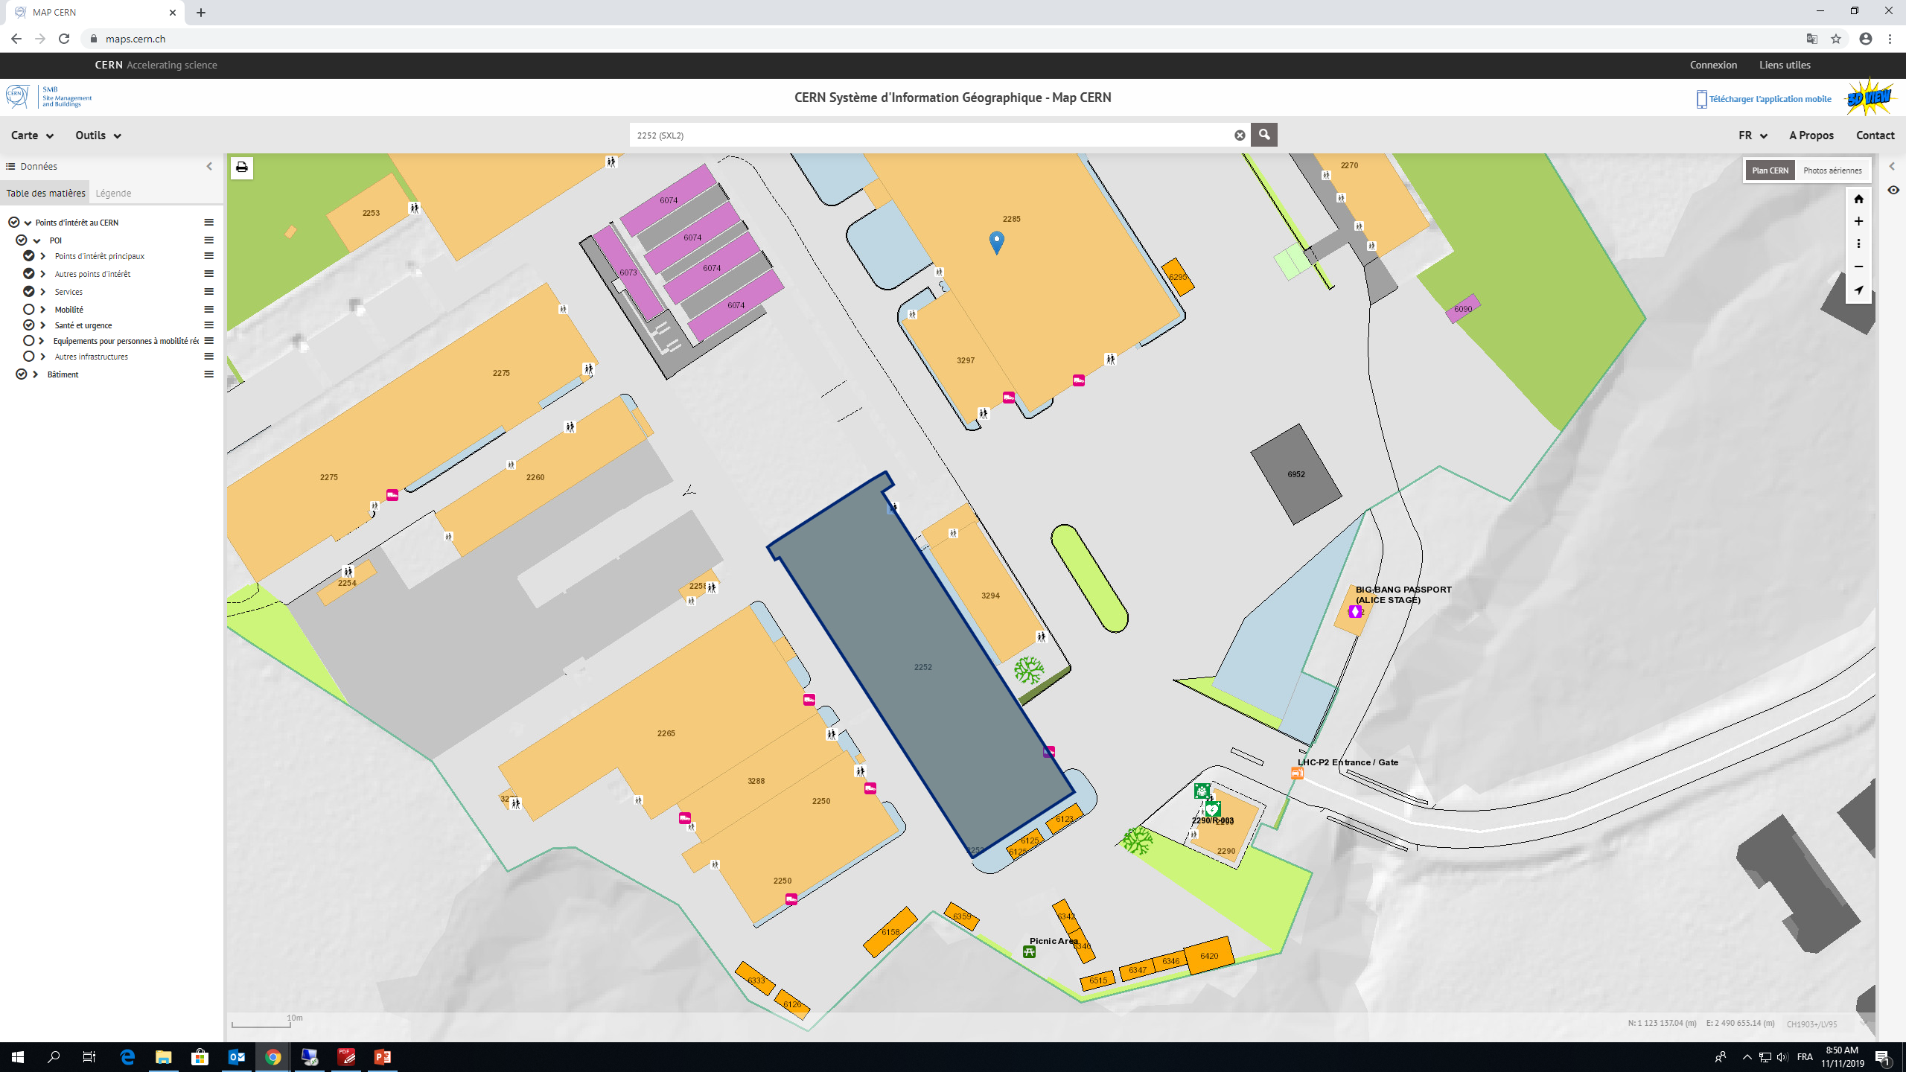
ALICE SITE

Slide 3
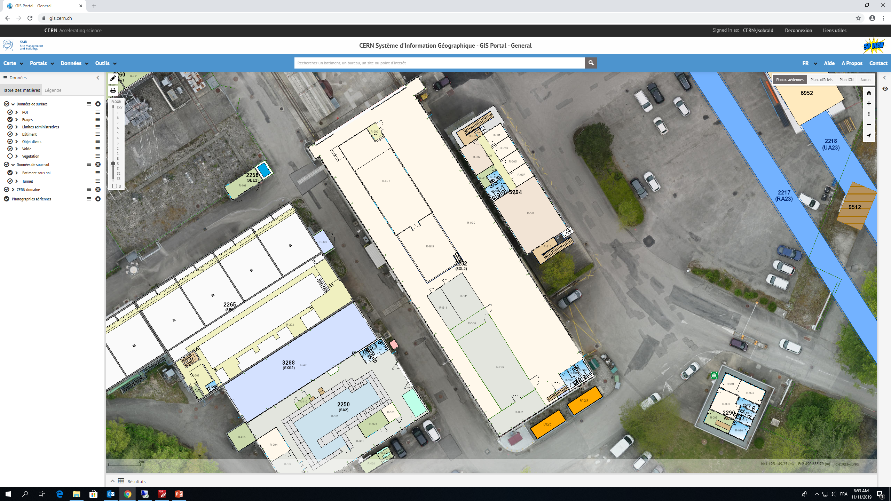
Building 2252 (SXL2)
Clean room

Slide 4
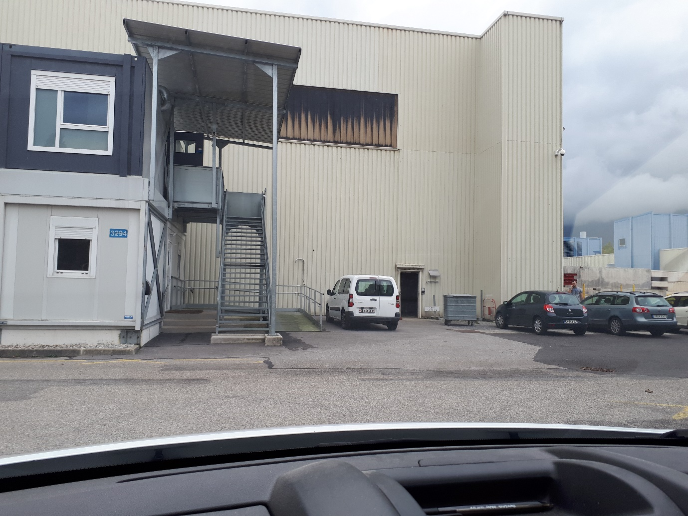
SXL2 entrance

Slide 5
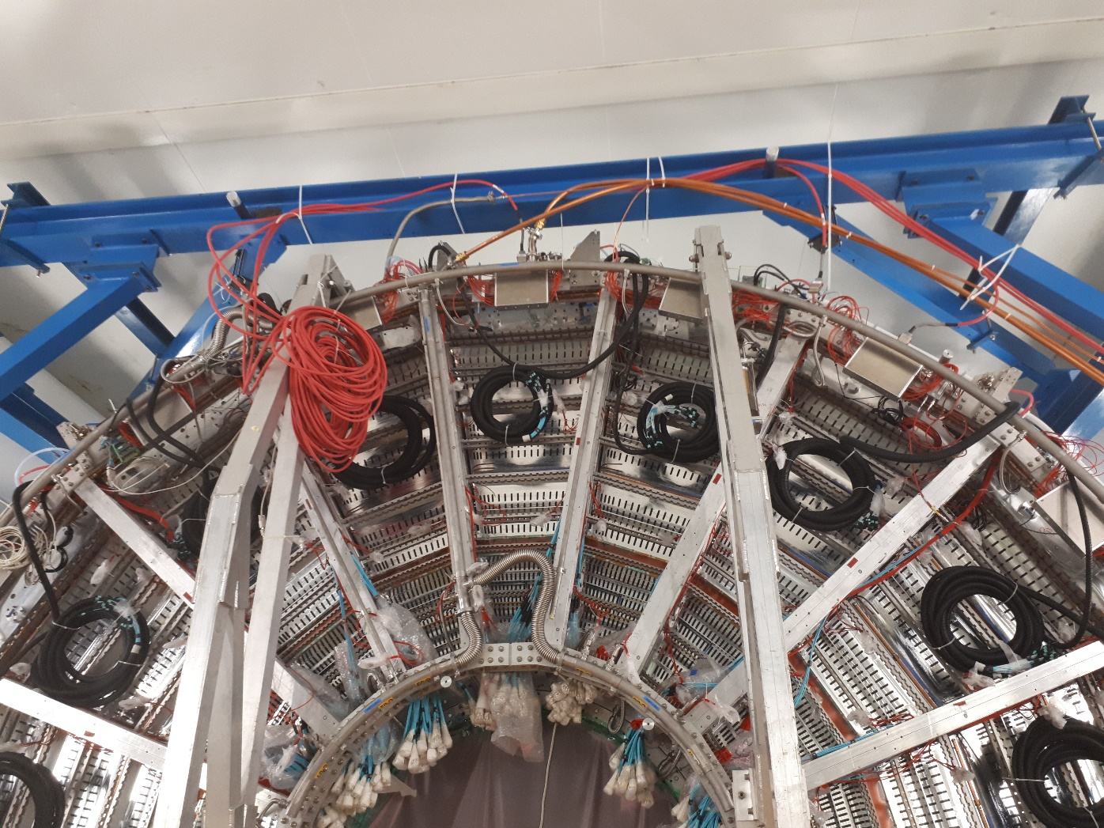
Pressure sensor

