Slide 1
Muon Collider Conceptual Design and Future Plans
Daniel Schulte for
Jean-Pierre Delahaye, Marcella Diemoz, Ken Long, Bruno Mansoulie, Nadia Pastrone (chair), Lenny Rivkin, Alexander Skrinsky, Andrea Wulzer
Many thanks to Mark Palmer, Vladimir Shiltsev and the MAP and LEMMA teams
Also to Donatella Lucchesi, Christian Carli, Alexej Grudiev, Alessandra Lombardi, Gijs De Rijk, Mauricio Vretenar, …

Slide 2
Motivation
High energy lepton colliders are precision and discovery machines
Chiesa, Maltoni, Mantani, Mele, Piccinini, Zhao
Muon Collider - Preparatory Meeting
Precision potential
Measure k₄ to some 10%
With 14 TeV, 20 ab⁻¹
A. Wulzer
Discovery reach
14 TeV lepton collisions are comparable to 100 TeV proton collisions
For s-channel physics target
Luminosity goal
(Factor O(3) less than CLIC at 3 TeV)
4x10³⁵ cm⁻²s⁻¹ at 14 TeV

Slide 3
Proposed Lepton Colliders (Granada)
Luminosity per facility
CLIC can reach 3 TeV
Cost estimate total of 18 GCHF
  In three stages
  Largely main linac, i.e. energy
Power 590 MW
  Part in luminosity, a part in energy
Similar to FCC-hh (24 GCHF, 580 MW)
Technically possible to go higher in energy
But is it affordable?
R&D required towards higher energies (or improvement of 3 TeV)
Reduction of cost per GeV (improved NC acceleration, novel acceleration technologies
Improved power consumption (higher RF to beam efficiency, higher beam quality)

Slide 4
Proton-driven Muon Collider Concept (US)
Acceleration to collision energy
Collision
Short, intense proton bunches to produce hadronic showers
Pions decay into muons that can be captured
Muon are captured, bunched and then cooled
Did find holes in the design
but nothing that does not work
No CDR exists, no coherent baseline of machine
No reliable cost estimate

Slide 5
Target Parameter Examples
From the MAP collaboration: Proton source
Even at 6 TeV above target luminosity with reasonable power consumption
But have to confirm power consumption estimates

Slide 6
Luminosity Comparison
The luminosity per beam power is about constant in linear colliders
It can increase in proton-based muon colliders
Strategy CLIC:
Keep all parameters at IP constant
(charge, norm. emittances, betafunctions, bunch length)
Linear increase of luminosity with energy (beam size reduction)
Strategy muon collider:
Keep all parameters at IP constant
With exception of bunch length and betafunction
Quadratic increase of luminosity with energy (beam size reduction)
Proton-based muon collider promising at high energies

Slide 7
Key Parameters
From the MAP collaboration: Proton source
Parameter | Unit | 1.5 TeV | 3 TeV | 6 TeV
L | 10³⁴ cm⁻²s⁻¹ | 1.25 | 4.4 | 12
N | 10¹² | 2 | 2 | 2
f_{r} | Hz | 15 | 12 | 6
P_{beam} | MW | 6.75 | 10.8 | 10.8
<B> | T | 6.3 | 7 | 10.5
ε_{L} | MeV m | 7.4 | 7.4 | 7.4
σ_{E} / E | % | 0.1 | 0.1 | 0.1
σ_{z} | mm | 10 | 5 | 2(.5)
β | mm | 10 | 5 | 2.5
ε | μm | 25 | 25 | 25
σ_{x,y} | μm | 5.9 | 3.0 | 1.5

Slide 8
Muon Collider Luminosity Scaling
Key assumptions:
Emittances are preserved from source to collision
Higher energy allows shorter bunches and hence smaller betafunctions
No limits from optics, beam-beam etc.
Large energy acceptance
High beam power
High energy
Dense beam
High field in collider ring
For mostly unchanged technologies:
Luminosity per power naturally increases with energy
(Provided we can focus the beam accordingly, …)
Better scaling than other options to high energies

Slide 9
The LEMMA Scheme (2018)
Key concept:
Produce muon beam with low emittance using a positron beam
No cooling required
In design of 2018 two important issues were found
Muon multiple scattering
Issue with phase space
Attempt to consolidate is ongoing
Updates this workshop
Muon current 10¹¹ s⁻¹ is 300 times lower compared to 3 x 10¹³ s⁻¹ for proton driver
Emittance O(10⁻³) smaller than in proton scheme, 40 ns vs. 25 μm

Slide 10
Note: Stacking
Can increase beam density by stacking
Large energy acceptance
High beam power
High energy
Dense beam
High field in collider ring

Slide 11
Other Options
FCC, LHC tunnel, gamma factory, …

Slide 12
Review Conclusion
We think we can answer the following questions
Can muon colliders at this moment be considered for the next project?
  Enormous progress in the proton driven scheme and new ideas emerged
  But at this moment not mature enough for a proposal
Is it worthwhile to do muon collider R&D?
  Yes, it promises the potential to go to very high energy
  It may be the best option for very high lepton collider energies, beyond 3 TeV
  It has strong synergies with other projects, e.g. magnet and RF development
  Has synergies with other physics experiments
  Should not miss this opportunity
What needs to be done?
  Muon production and cooling is key => A new test facility is required.
  A conceptual design of the collider has to be made
  Many components need R&D, e.g. fast ramping magnets, background in the detector
  Site-dependent studies to understand if existing infrastructure can be used
    limitations of existing tunnels, e.g. radiation issues
    optimum use of existing accelerators, e.g. as proton source

Slide 13
Recommendations (2018)
Set-up an international collaboration to promote muon colliders and organize the effort on the development of both accelerators and detectors and to define the road-map towards a CDR by the next Strategy update.
Develop a muon collider concept based on the proton driver and considering the existing infrastructure.
Consolidate the positron driver scheme addressing specifically the target system, bunch combination scheme, beam emittance preservation, acceleration and collider ring issues.
Carry out the R&D program toward the muon collider. Based on the progress of the proton-driver and positron-based approaches, develop hardware and research facilities as well as perform beam tests. Preparing and launching a conclusive R&D program towards a multi-TeV muon collider is mandatory to explore this unique opportunity for high energy physics. A well focused international effort is required in order to exploit existing key competences and to draw the roadmap of this challenging project. The development of new technologies should happen in synergy with other accelerator projects. Moreover, it could also enable novel mid-term experiments.

Slide 14
Proposed Tentative Timeline (2019)
CDRs
TDRs
Technically limited
DETECTOR
R&D detectors
Large Proto/Slice test
Prototypes
MDI & detector simulations
1
2
3
4
5
6
7
8
9
10
11
12
13
14
15
16
17
Design
Baseline design
Design optimisation
Project preparation
Approve
Test Facility
Design
Construct
Exploit
Exploit
MACHINE
Technologies
Design / models
Prototypes / t. f. comp.
Prototypes / pre-series
Ready to decide on test facility
Cost scale known
Ready to commit
to collider
Cost know
Ready to construct

Slide 15
Proposed Tentative Timeline (2019)
CDRs
TDRs
Technically limited
DETECTOR
R&D detectors
Large Proto/Slice test
Prototypes
MDI & detector simulations
1
2
3
4
5
6
7
8
9
10
11
12
13
14
15
16
17
Higher cost for test facility
Specific prototypes
Significant resources
Limited Cost
Mainly paper design
And some hardware component R&D
Design
Higher cost for technical design
Significant resources
Higher cost for preparation
Full project
Baseline design
Design optimisation
Project preparation
Approve
Test Facility
Design
Construct
Exploit
Exploit
MACHINE
Technologies
Design / models
Prototypes / t. f. comp.
Prototypes / pre-series
Ready to decide on test facility
Cost scale known
Ready to commit
to collider
Cost know
Ready to construct

Slide 16
Tentative Considerations on Baseline
Develop baseline design of first stage O(3 TeV)
  To match highest CLIC energy
  To come after a Higgs-factory with different technology
  Using the high-energy strength of muon colliders
  Realistic design for implementation at CERN
  Determine cost, power and risk scale
  If successful, feasibility demonstration for CDR
Explore 14 TeV as further step
  To match FCC-hh discovery potential
  Mainly exploration of parameters to guide choices
  Provide evidence for feasibility, maybe cost frame
Even higher energies?
Some exploration of lower energies / Higgs factory
  Scaling from higher energies
  Not a main focus, except if other projects do not cover lower energies

Slide 17
Baseline Work
Put together coherent sets of parameters and layouts
  Understand parameter choices and drivers, technological challenges
  Includes both, MAP and LEMMA, scheme
  MAP currently baseline, LEMMA alternative in particular for high energies
  This is important step that is missing in the US effort
Define key R&D list (tentative list started)
  Identify key / feasibility issues
    i.e. largest technical risks
    Key cost driver, if critical
    Key power consumption, if critical
  Prime examples
    Background in experiments
    Radiation to the public

Slide 18
One Potential Ingredient: ARIES2
Proposed network-like activity
  MUST: MUon collider STudy network
Goal is to foster preparation of an organised study if the European Strategy so recommends
  Start identification of feasibility issues
  Identify resources required to address most critical issues
  Prepare engagement of collaboration
Support communication of a muon collider study
  Organise workshops and meeting for the study
You are welcome to join
  Will further develop the proposal

Slide 19
Potential Key R&D Items
Integrated design (to make sure that things fit)
  Definition of parameters for key systems
  Choices between different options
  Many systems could be difficult, depending on choices, see US study
  E.g. lose 90% of muons before collision, can this be reduced?
  Important cross effects, e.g. beam emittance
Neutrino radiation (critical limit at highest energies)
  How can it be reduced? (Better cooling, orbit variations, high energy at other site?,…)
  What can be defended to the public?
Experimental conditions (obvious, isn’t it?)

Slide 20
Potential Key R&D Items, cont.
Beam production and cooling (critical parameter driver)
  Emittance drives design, lower emittance: less radiation to public, detector, …; less power; less risk
  Proton beam production / compression
  Paper design of cooling does not reach full performance
  Many key components: robust targets, RF with gas, high-field solenoids
  Take full advantage of MICE (data, installation)
  Likely will find need new facility to improve test compared to MICE
  Anticipated to be core of new testing programme
    6-D cooling, stages to reach significant emittance reduction, radiation effect on equipment, …
    Parametric cooling to be tested
    Likely the core of the experimental programme
Acceleration complex design (important cost driver)
  Is it affordable (cost and power)?
  Fast ramping magnets (for RCS), magnet powering scheme
  High-field superconducting magnets
  Beamline design
  Collimation
  …

Slide 21
Potential Key R&D Items, cont.
Collider ring design (important parameter and cost driver)
  Is it affordable (cost)?
  High field superconducting magnets, minimal gap, radiation hard
  Improved lattice design beyond 3 TeV
  Injection, safety concept
Reuse of existing infrastructure (potential cost saving)
  Proton facilities
  Tunnels (maybe more for acceleration than for collision)
LEMMA concept and new ideas (could be breakthrough for parameters)
  Consolidation
  Alternative low-emittance sources (gamma factory, crystals, …)
  Could define the source test facility
  Long-term alternative development

Slide 22
US View on Key Issues
M. Palmer et al.
Many points agree
We mainly consider experimental conditions and neutrino radiation also as critical
Level of many issues has not been clear because no baseline existed
We anticipate critical issues there, e.g. design and cost of accelerator complex

Slide 23
Key Accelerator Technologies
High-field, robust collider magnets with minimum gap
  Dipoles, solenoids, …
Efficient fast ramping magnets with efficient energy recovery
  For the beam acceleration
Efficient cryogenics, vacuum and shielding systems
  Significant beam loss
Robust targets and beam cleaning
High field cavities
  In a solenoid for the cooling system
Efficient RF power production
Civil engineering
Other systems
  E.g. instrumentation
  …
Beamdynamics and accelerator design
  Start-to-end design and simulations, source design, …

Slide 24
Beam Acceleration
An important cost driver
Important for power consumption
A trade-off between cost and muon survival
Not detailed design, several approaches considered
Linacs
Recirculating linacs
FFAGs
Rapid cycling synchrotrons
Challenge is large bunch charge but single bunch
Much larger than collider ring

Slide 25
Potential Approaches
Acceleration is important for cost and power consumption
No conceptual baseline design yet
But different options considered
A whole chain is needed from source to full energy
Recirculating linacs
Fast acceleration but typically only a few passages through RF, hence high RF cost
Rapid cycling synchrotron (RCS)
Potentially important acceleration range at affordable cost
Could use combination of static superconducting and ramping normal-conducting magnets
But have to deal with energy in fast pulsing magnets
Efficient energy storage is required
FFAGs
Static high field magnets, can reach factor up to 4 increase in energy, needs design work
Challenge to achieve a combination of high efficiency, low cost and good beam quality

Slide 26
Collider Ring
Strong focusing at IP to maximise luminosity
Becomes harder with increasing energy
High field dipoles to minimise collider ring size and maximise luminosity
Minimise distances with no bending
Proposal to combine last accelerator ring and collider ring (Neuffer/Shiltsev) might reduce cost but creates many specific challenges
Decaying muons impact accelerator components, detector and public
The latter becomes much worse with energy
Radiation to public in case LHC tunnel use
Might be best to use LHC tunnel to house muon accelerator and have dedicated new collider tunnel

Slide 27
How Could 14 TeV Look Like?
Very tentative target parameters to be studied
Parameter | Unit | 1.5 TeV | 3 TeV | 6 TeV | 14 TeV
L | 10³⁴ cm⁻²s⁻¹ | 1.25 | 4.4 | 12 | 40
N | 10¹² | 2 | 2 | 2 | 2
f_{r} | Hz | 15 | 12 | 6 | 3.7
P_{beam} | MW | 6.75 | 11.5 | 11.5 | 16.6
<B> | T | 6.3 | 7 | 10.5 | 10.5
ε_{L} | MeV m | 7.5 | 7.5 | 7.5 | 7.5
σ_{E} / E | % | 0.1 | 0.1 | 0.1 | 0.1
σ_{z} | mm | 10 | 5 | 2(.5) | 1.07
β | mm | 10 | 5 | 2.5 | 1.07
ε | μm | 25 | 25 | 25 | 25
σ_{x,y} | μm | 5.9 | 3.0 | 1.5 | 0.63
At 6 TeV MAP design consistent with FNAL site
Radiation at 14 TeV is ~8 times higher than at 6 TeV

Slide 28
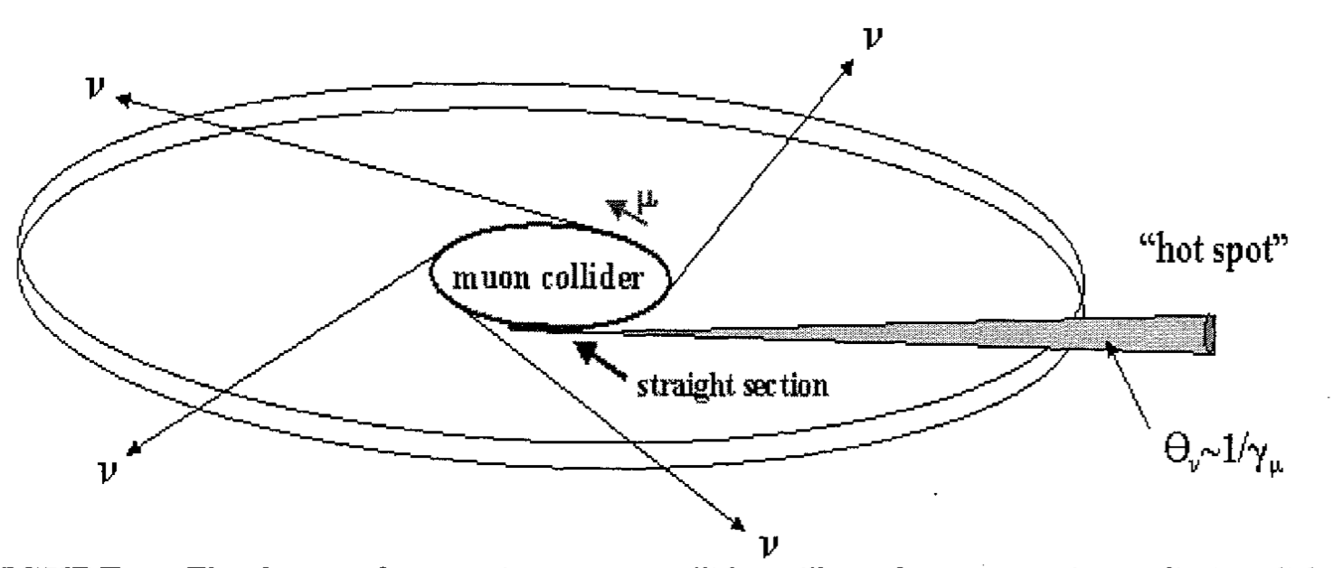
Neutrino Radiation Hazard
Neutrinos from decaying muons can produce showers just when they exit the earth
Potential mitigation by
Owning the land in direction of experimental insertion
Having a dynamic beam orbit so it points in different directions at each turn in the arcs
Some gymnastics with beam in straights to make it point in different directions
Becomes more important at higher energies (scaling E³)
US study concluded that 6 TeV parameters are OK
But our 14 TeV would have ~8-times the radiation

Slide 29
Muon Collider Luminosity Scaling
Scaling of radiation per integrated luminosity with parameters
Note: target integrated luminosity increases with energy
D: radiation dose
E: beam energy
B: Magnetic field
d: depth underground
Based on Bruce Kings parametrisation of radiation with beam current one finds
Reasonable goal could be 0.1 mSv/year

Slide 30
Radiation at 14 TeV
Target of 4 ab⁻¹ per year
E = 7 TeV
MAP-type beam
B = 10.5 T
L = 0.2 m
d = 500 m
Note: find 0.1 mSv/Year for MAP at 6 TeV,
i.e. consistent with this set being limited by radiation
I.e. 8 times too large
Need to improve

Slide 31
Muon Collider Luminosity Scaling
Tricks
e.g. beam wiggling, dumping the beam, …
Higher field in collider ring
And shorter gaps
Denser beam
Larger energy spread acceptance
Deeper tunnel
Source design
Magnet design
Civil engineering
Lattice design work
More efficient physics
More years of running
How to gain a factor 8 in radiation?
Seems hard but not impossible

Slide 32
Some Tools to Reduce Radiation
Shorter gaps between magnets
  e.g. 7 cm halves radiation
More brilliant beams
  Halving emittance halves radiation
Wiggling the beam
  O(8 sigma) starts to help (for 100 m beta-function)
Dumping the beam before fully decayed
  Fractional saving
Cutting large amplitude muons
  Does not help
Spread out programme over more years
Add the two detectors
…

Slide 33
Collision in LHC / FCC Tunnel
Collision in LHC tunnel:
The straights increase neutrino radiation (L = 500 m)
Equivalent depth of LHC is only 23 m (using shortest distance from straight to surface)
  At 14 TeV cm and for 4 ab⁻¹ per year 33x10³ mSv/year (B = 8 T, L = 500 m)
  Can we use special optics or wiggle the beam enough?
  Typically need to wiggles beam by 10 sigma to obtain some spreading of radiation
Even arcs are limiting
  For 14 TeV and 4 ab⁻¹ per year 18.8 mSv/year (B = 8 T, L = 0.2 m)
Collision in FCC tunnel:
Would be at even higher energies, so radiation is much worse
But can still change layout
  In particular arrange straights
Solutions with acceleration and collision in LHC or FCC tunnel will have even more radiation from arcs since the average field is lower
Low emittance beam would help
Need factor 200 less current

Slide 34
Acceleration in LHC / FCC Tunnel
Logical choice since accelerator needs longer tunnel
Fewer turns and mostly lower energy
Gain one or two orders of magnitude in radiation
Maybe can distribute radiation more due using beam energy change in some clever fashion
Use LHC tunnel for acceleration only:
For 1.5 TeV beams, require 1.4-1.8 T magnets
  e.g. can be fast ramping, normal conducting
For 3 TeV beams, require 2.8-3.6 T average field
  e.g. could be mixture of superconducting and fast-ramping normal magnets
Tunnel can be used for LEMMA scheme

Slide 35
Conclusion
Have a tentative plan for the future
  In case muon collider R&D is proposed by the European Strategy
  But need people and money
  Try to obtain network-like activity (via ARIES2)
Need to develop baseline
  Energy and luminosity choice
  For MAP and LEMMA approach important gaps exist
  Need to bring knowledge to life again
  And address holes
  For LEMMA consolidation is attempted
Need to address neutrino radiation
  Confirm results from US study
  Lower radiation at 14 TeV
  Strong point of the LEMMA scheme
Need to develop experimental R&D plan
  Key is likely test facility for muon generation
  Will depend on progress of baseline design

Slide 36
Reserve

Slide 37
Linear Collider Scaling with Energy
Normalised emittances always used
Beamstrahlung limited by physics requirements
Bunch length limited by acceleration and detector background
Beam quality and focusing design
RF-to-beam efficiency
Power consumption
At high energy
For unchanged technologies:
Luminosity per power remains constant with energy
Provided we can focus the beam accordingly
R=σ_{x}/σ_{y}

Slide 38
Findings of Muon Collider Working Group
A first, high-level review of the two schemes with proton-based (MAP) and positron-based (LEMMA):
Muon-based technology represents a unique opportunity for the future of high energy physics research: the multi-TeV energy domain exploration.
First focus promising positron-based scheme, but identified need for consolidation
No showstopper found for proton scheme, but much more detailed understanding is required to judge performance, cost and power. No CDR exists.
Important progress of the technologies, addressing the feasibility of major technical issues with R&D performed by international collaborations.
In Europe, the reuse of existing facilities and infrastructure for a muon collider is of interest (e.g. LHC).
Documents: see first slide of the reserve

Slide 39
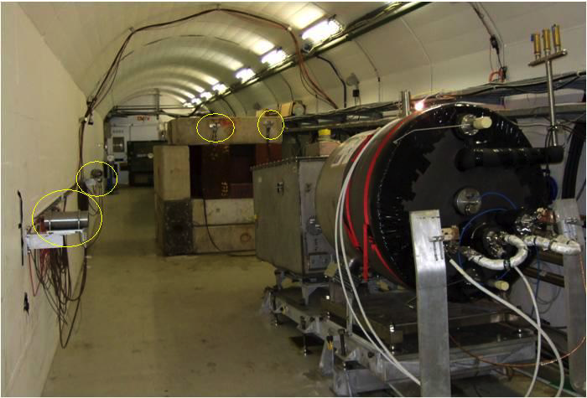
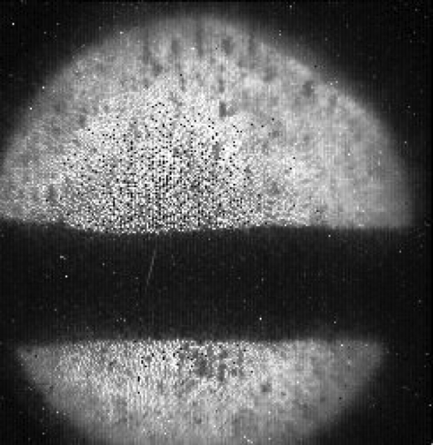
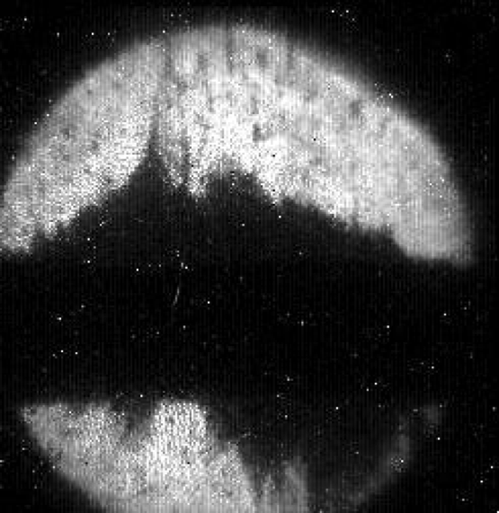
Source
High power target (8 MW vs. 1.6-4 MW or even less required) has been demonstrated
Maximum pulse tested 30x10¹² protons with 24 GeV
9x10¹² muons (loose 90%)
But radiation issues?
Maybe can use solid target
What could be made available at CERN (or elsewhere) as a proton driver for a potential test facility?

Slide 40
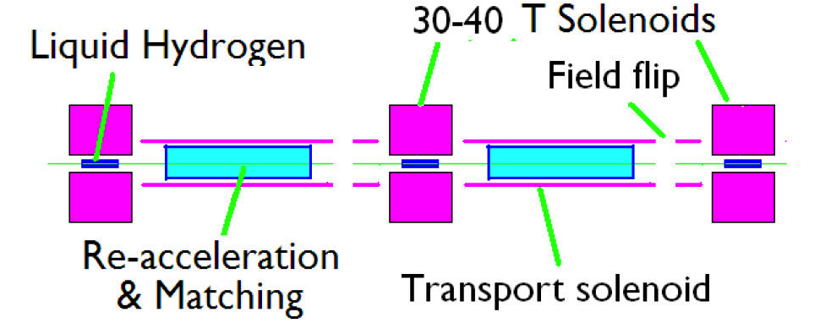
Transverse Cooling Concept

Slide 41
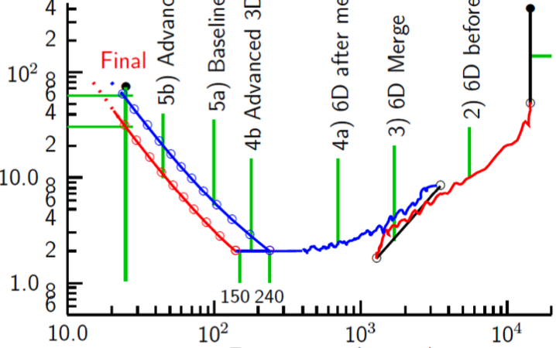
Cooling: The Emittance Path
Target
Y
Specification
Achieved (simulations)
•
•
•
For acceleration to
multi-TeV collider
Front End
For acceleration to NuMAX (325MHz injector acceptance 3mm,24mm)
Phase
Rotator
Final
Exit Front End
(15mm,45mm)
Initial Cooling
Longitudinal Emittance (mm)
Initial
(X)
Initial
(Y)
Final
Cooling
post-merge 6D Cooling
pre-merge
6D Cooling (original design)
For acceleration
to Higgs Factory
HCC
Bunch
Merge
VCC &
Hybrid
Transverse Emittance (microns)

Slide 42
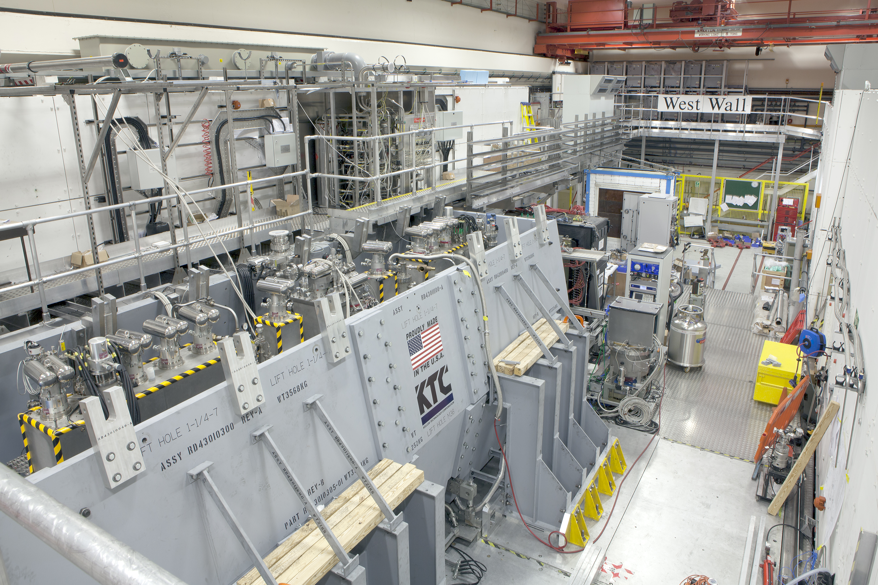
Cooling and MICE
MICE allows to address 4D cooling with low muon flux rate

Slide 43
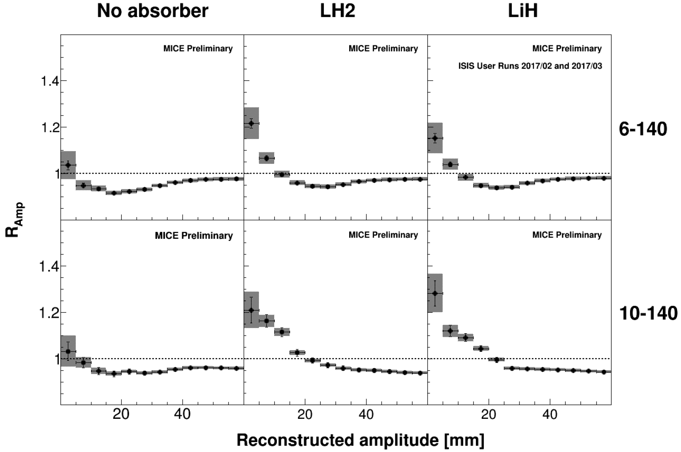
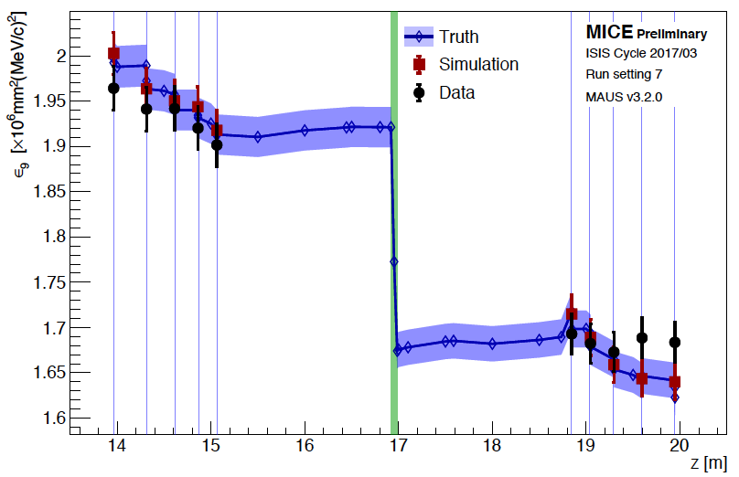
MICE Results
The absorber reduces the number of particle with large amplitude
They appear with smaller amplitude
Noticeable reduction of 9% emittance
But still some way to go
6D cooling
Stages
Small emittances

Slide 44
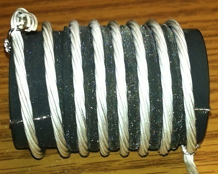
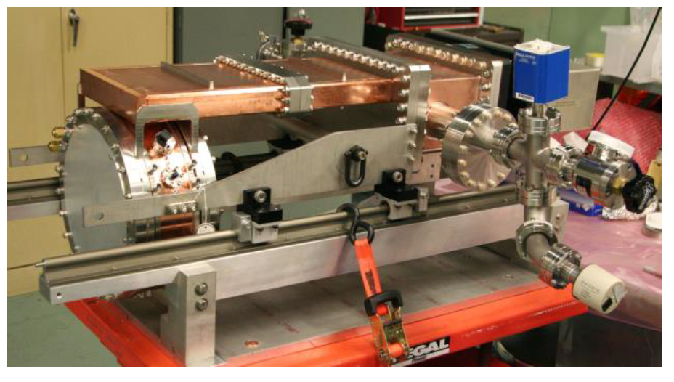
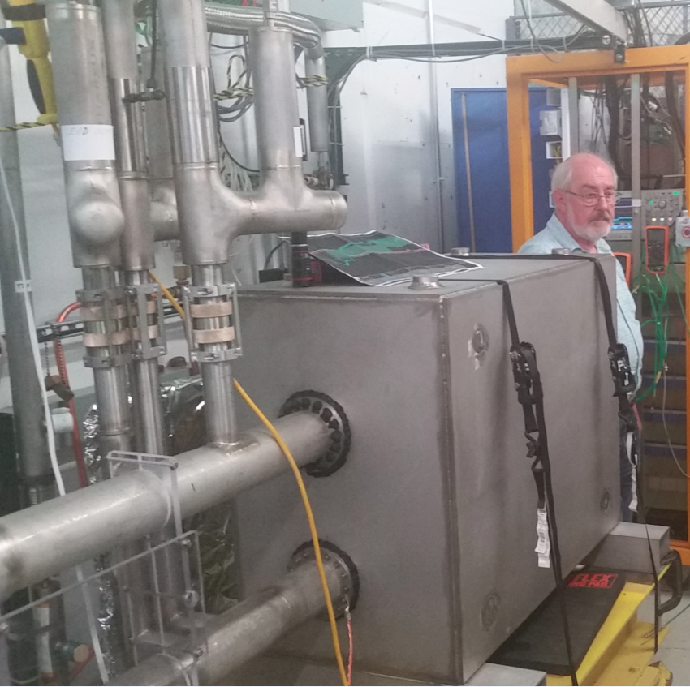
Other Tests
MuCool: >50 MV/m in 5 T field
A number of key components has been developed
FNAL
Breakthrough in HTS cables
FNAL
12 T/s HTS
0.6 T max
NHFML
32 T solenoid with low-temperature HTS
Mark Palmer

Slide 45
The LEMMA Scheme
Key concept:
Produce muon beam with low emittance using a positron beam
No cooling required
In design of 2018 two important issues were found
Muon multiple scattering
Issue with phase space
Attempt to consolidate is ongoing
Nadia’s talk
Muon current 10¹¹ s⁻¹ is 300 times lower compared to 3 x 10¹³ s⁻¹ for proton driver
Emittance O(10⁻³) smaller than in proton scheme, 40 ns vs. 25 μm

Slide 46
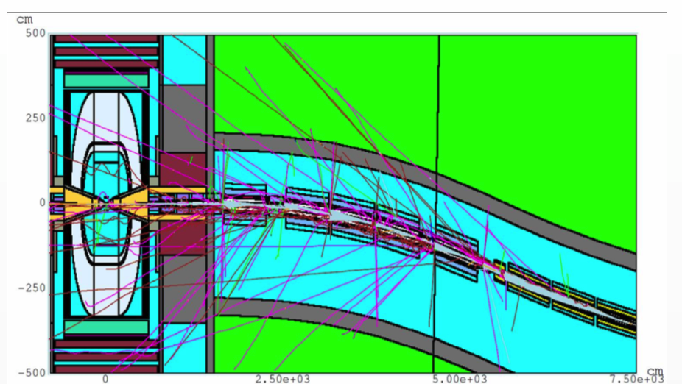
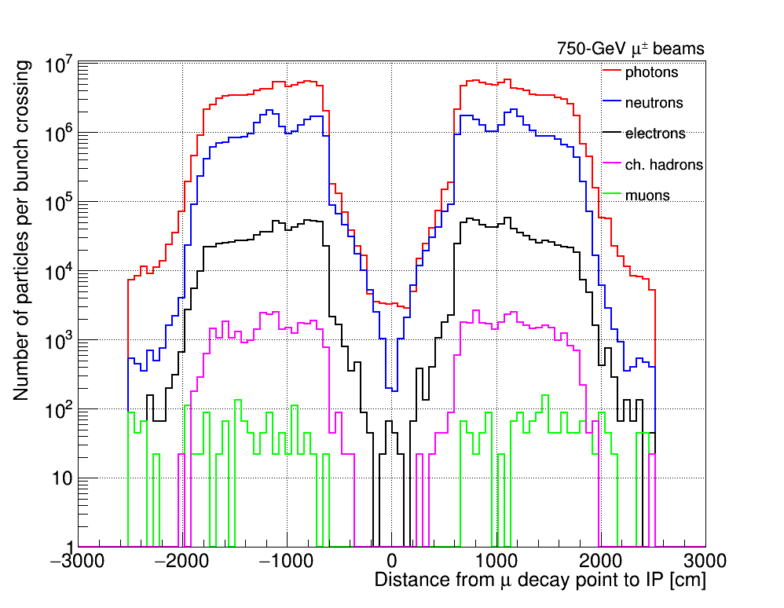
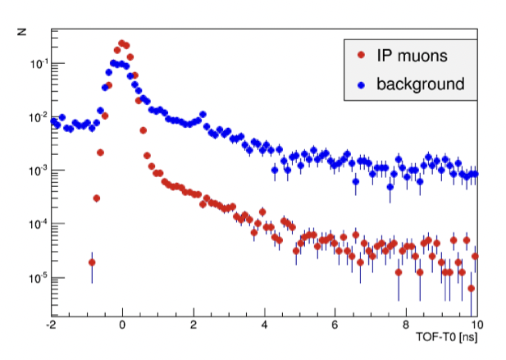
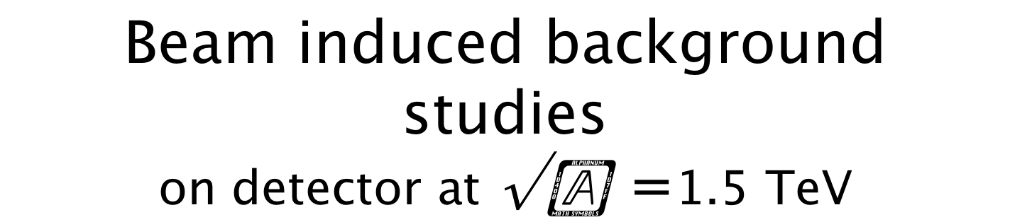
Beam induced background studies on detector at $\sqrt{s}=$1.5 TeV
arXiv:1905.03725
MARS15 simulation in a range of ±100 m around the interaction point
750 GeV beam
Particle composition of the beam-induced background as a function of the muon decay distance from the interaction point
Simulated time of arrival (TOF) of the beam background particles to the tracker modules with respect to the expected time (T0) of a photon emitted from IP

Slide 47
Muon Collider Working Group
Jean Pierre Delahaye, CERN, Marcella Diemoz, INFN, Italy,
Ken Long, Imperial College, UK, Bruno Mansoulie, IRFU, France,
Nadia Pastrone, INFN, Italy (chair), Lenny Rivkin, EPFL and PSI, Switzerland,
Daniel Schulte, CERN, Alexander Skrinsky, BINP, Russia, Andrea Wulzer, EPFL and CERN
appointed by CERN Laboratory Directors Group in September 2017
to prepare the Input Document to the European Strategy Update
“Muon Colliders,” arXiv:1901.06150
de facto it is the seed for a renewed international effort
Past experiences and new ideas discussed at the joint ARIES Workshop
July 2-3, 2018
Università di Padova - Orto Botanico
https://indico.cern.ch/event/719240/overview
Preparatory meeting to review progress for the ESPPU Symposium
April 10-11, 2019
CERN – Council Room
https://indico.cern.ch/event/801616

Slide 48
Test Facility Example
Carlo Rubbia: The experimental realization of the presently described μ+μ- Ring Collider may
represent the most attractive addition of the future programs on the Standard Model to
further elucidate the physics of the Ho, requiring however a substantial amount of prior
R&D developments, which must be experimentally confirmed by the help of the Initial
Muon Cooling Experiment(al) program.
Initial Cooling Experiment
Use 100 ns ESS pre-pulse with 3x10¹¹ protons
Yields 3x10⁷ μ⁻ and 6x10⁷ μ⁺ around 250 MeV

Slide 49
Linear Collider Scaling with Energy
Normalised emittances always used
Beamstrahlung limited by physics requirements
RF-to-beam efficiency
Power consumption
Beam quality and focusing design
At high energy
For unchanged technologies:
Luminosity per power remains constant with energy
Provided we can focus the beam accordingly
R=σ_{x}/σ_{y}

Slide 50
Note: Total Power Consumption
Power consumption estimates are based on a table calculated by R. Palmer
Leaves out a number of components, e.g. magnets
Quote: “These numbers are preliminary, with large uncertainties”
J.-P. Delahaye added a constant value
Need to have conceptual start-to-end design to estimate power correctly
Efficiency of wall plug to beam is not very different from CLIC

Slide 51
LHC Tunnel
For the arcs (presumably worst point, based on straights)
E = 0.85 TeV
MAP-type beam
B = 1 T
L = 0.2 m
d_{equiv} = 23 m

Slide 52
LHC Tunnel
For the straights (worst point)
E = 0.1 TeV
MAP-type beam
B = 1 T
L = 500 m
d_{equiv} = 23 m - 5430 m

Slide 53
Muon Collider Luminosity Scaling
How to gain a factor 8 in radiation?
Seems hard but not impossible

Slide 54
Muon Collider Luminosity Scaling
Higher field in collider ring
And shorter gaps
Denser beam
Larger energy spread acceptance
Deeper tunnel
How to gain a factor 8 in radiation?
Seems hard but not impossible

Slide 55
Muon Collider Luminosity Scaling
Higher field in collider ring
And shorter gaps
Denser beam
Larger energy spread acceptance
Deeper tunnel
Source design
Magnet design
Civil engineering
Lattice design work
How to gain a factor 8 in radiation?
Seems hard but not impossible

Slide 56
Muon Collider Luminosity Scaling
Higher field in collider ring
And shorter gaps
Denser beam
Larger energy spread acceptance
Deeper tunnel
Source design
Magnet design
Civil engineering
Lattice design work
More efficient physics
More years of running
How to gain a factor 8 in radiation?
Seems hard but not impossible

