Slide 1
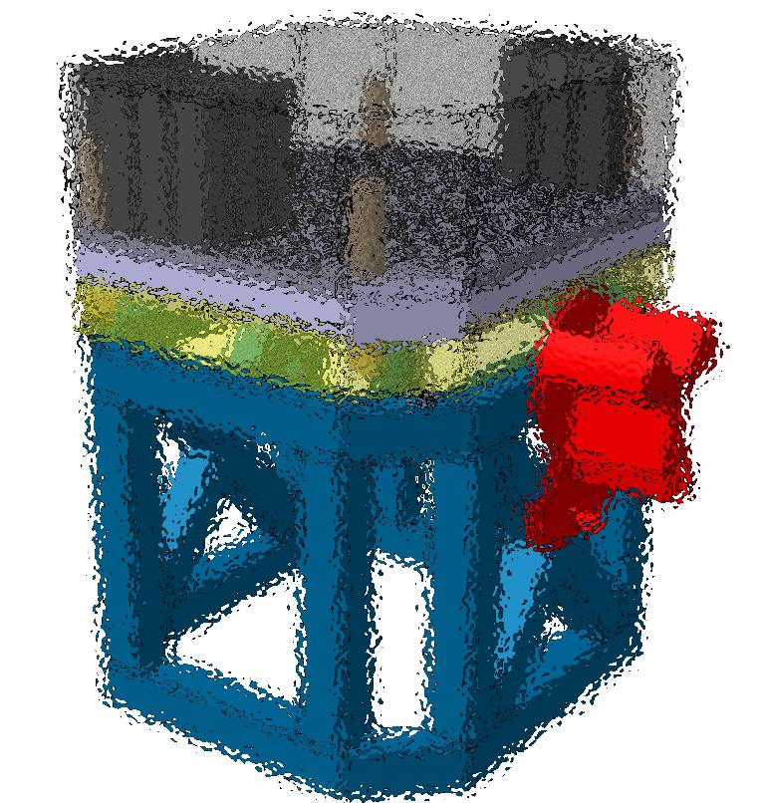
POLAR2 Mechanics Overview on Integration

Slide 2
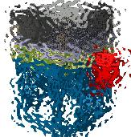
Outline
SiPM & Module design (to set the constraints)
POLAR2 Frame assembly
POLAR2 Envelope & Interface definitions

Slide 3
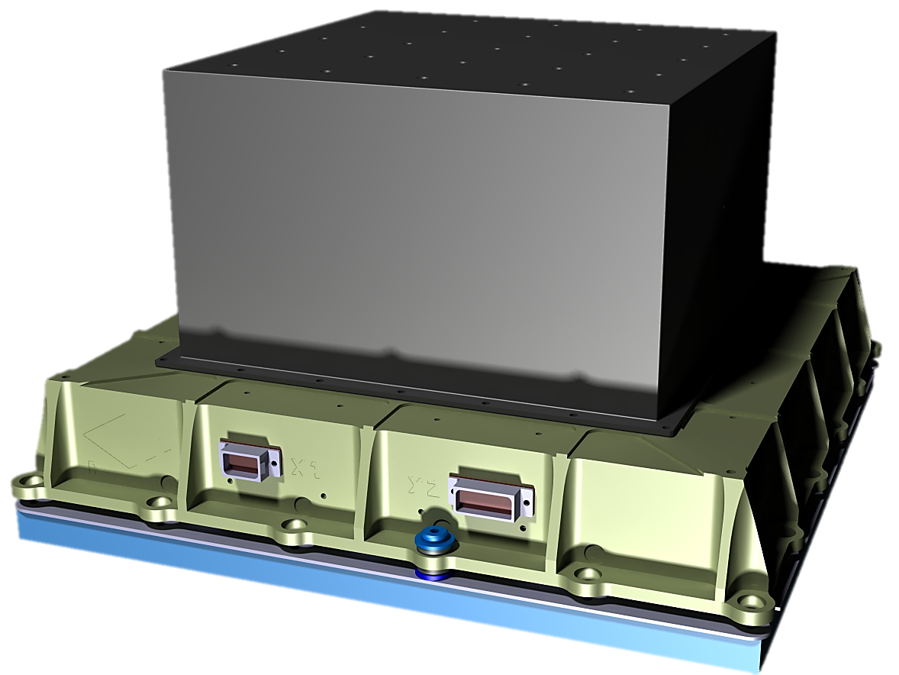
SiPM & Module design
Towards POLAR2

Slide 4
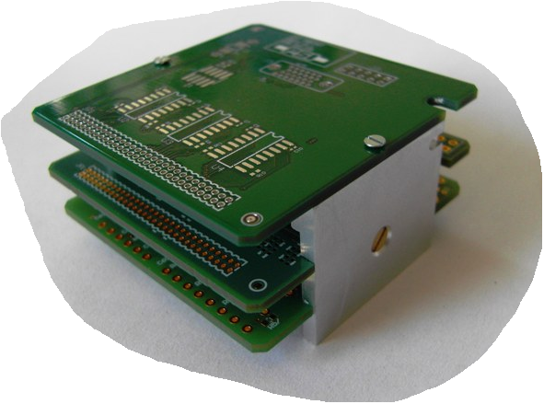
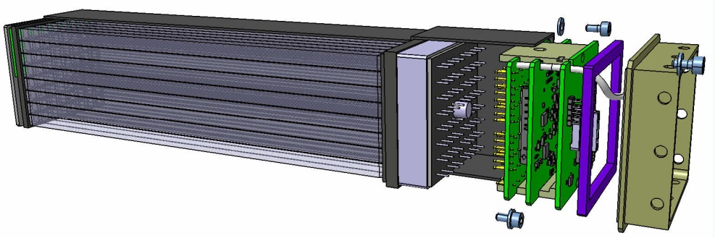
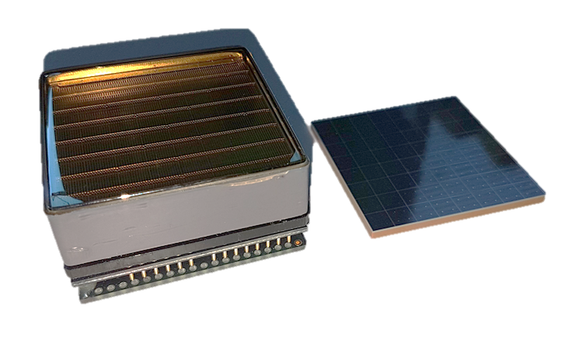
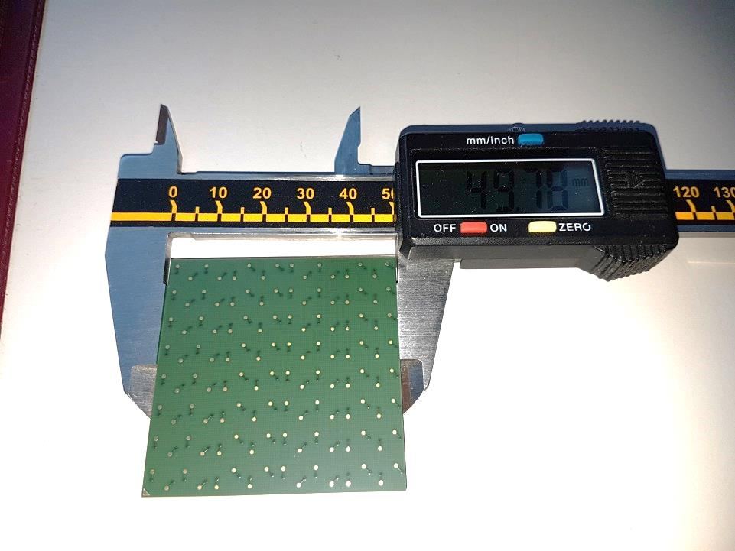
SiPM & Module design
SiPM Module design inherited from POLAR1
POLAR1_FEE
POLAR1
POLAR1_FEE
POLAR2
SiPM
(64 channels)
49.8mm x 49.8mm
Photomultiplier
(64 channels)
51.5mmx51.5mm
POLAR2 work based on POLAR1 design (Module + Frame)…with optimization
SiPM back side

Slide 5
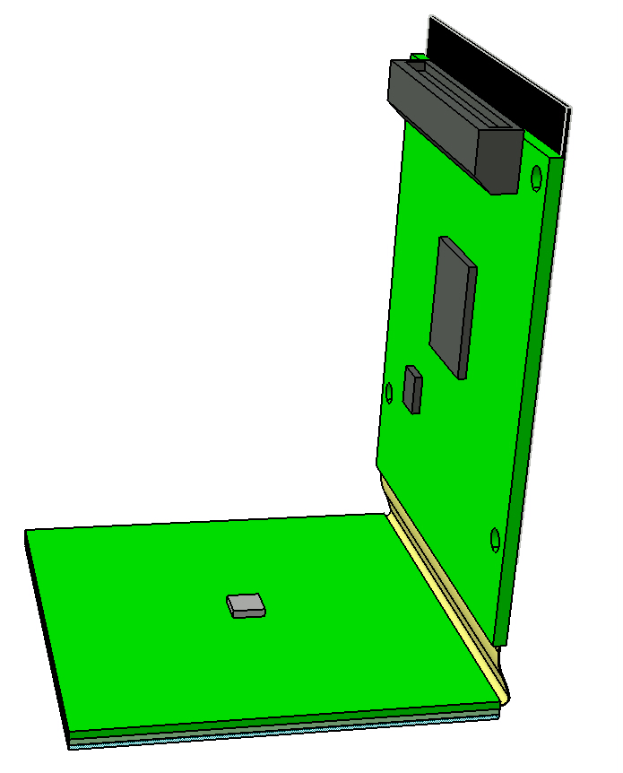
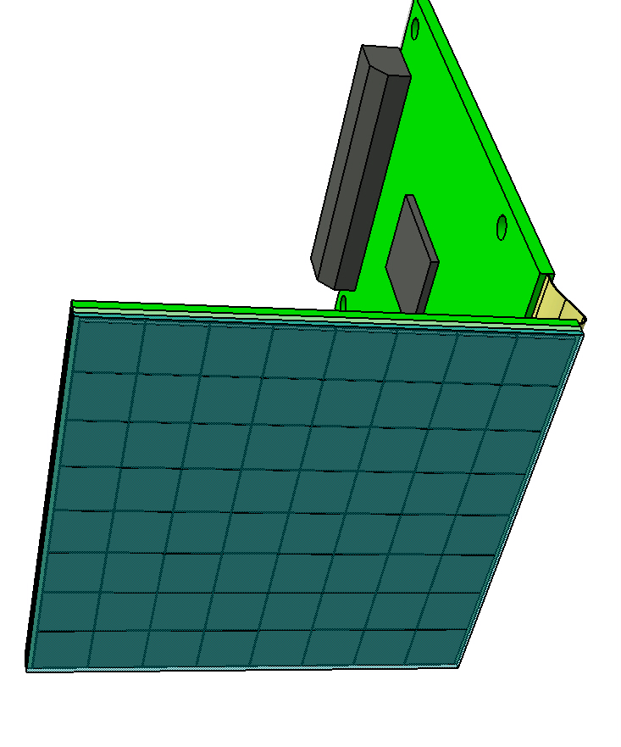
SiPM & Module design
SiPM Module design (FEE + flex)
FEE with flex
SiPM part
49.8mm
FEE size not yet frozen
DPNC is working on it…
Direct soldering wrt SiPM grid
Flex to be optimized (length, bending)
Decoupling for thermal design purpose
49.8mm

Slide 6
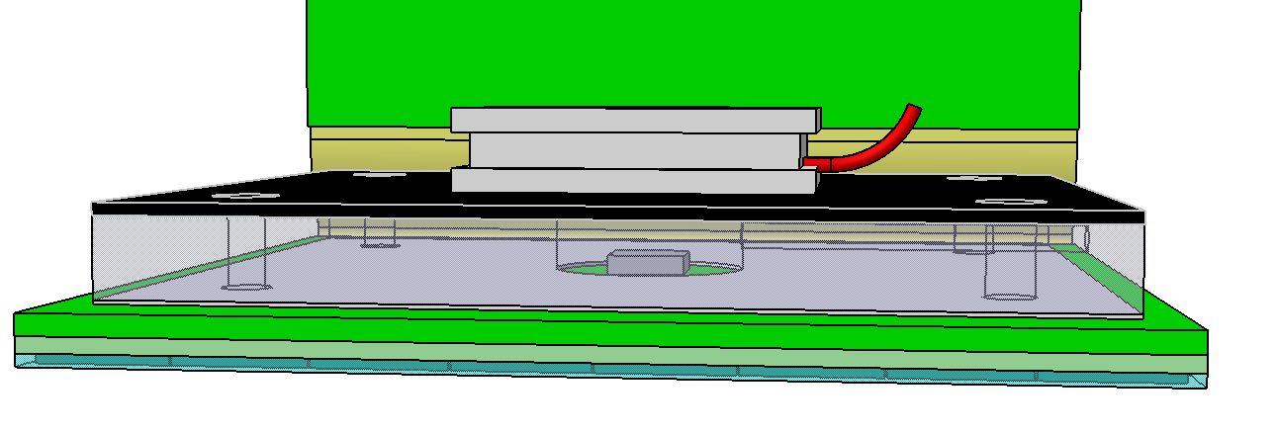
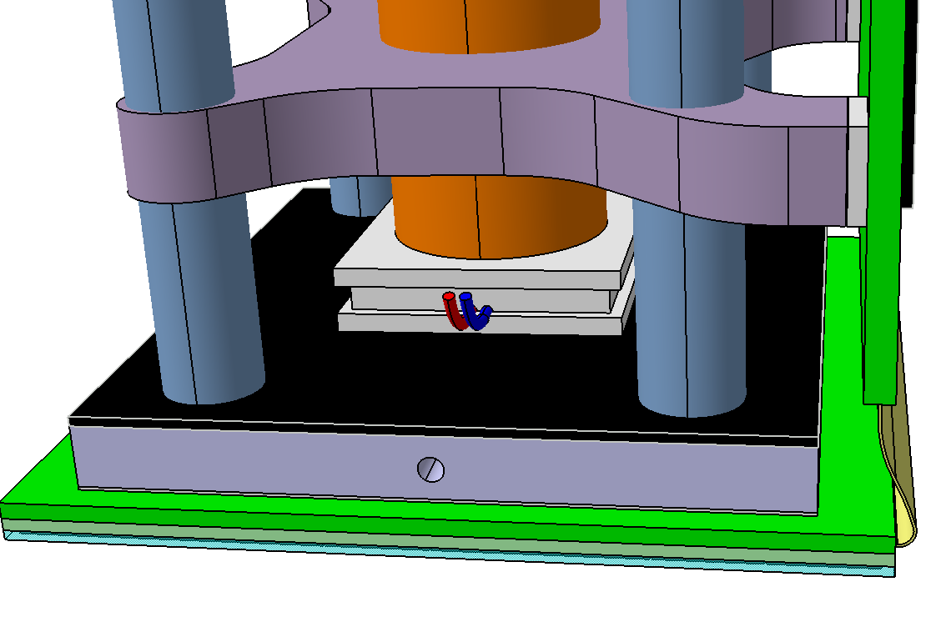
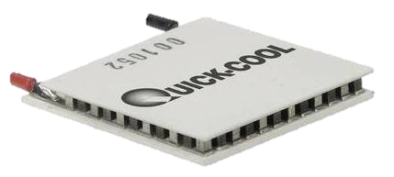
SiPM & Module design
SiPM Module design (Cooling system with Peltier… under study!)
Aluminium
+ TPG
(glued to the SiPM)
Peltier device
1rst prototype is under testing
Peltier to be evaluated

Slide 7
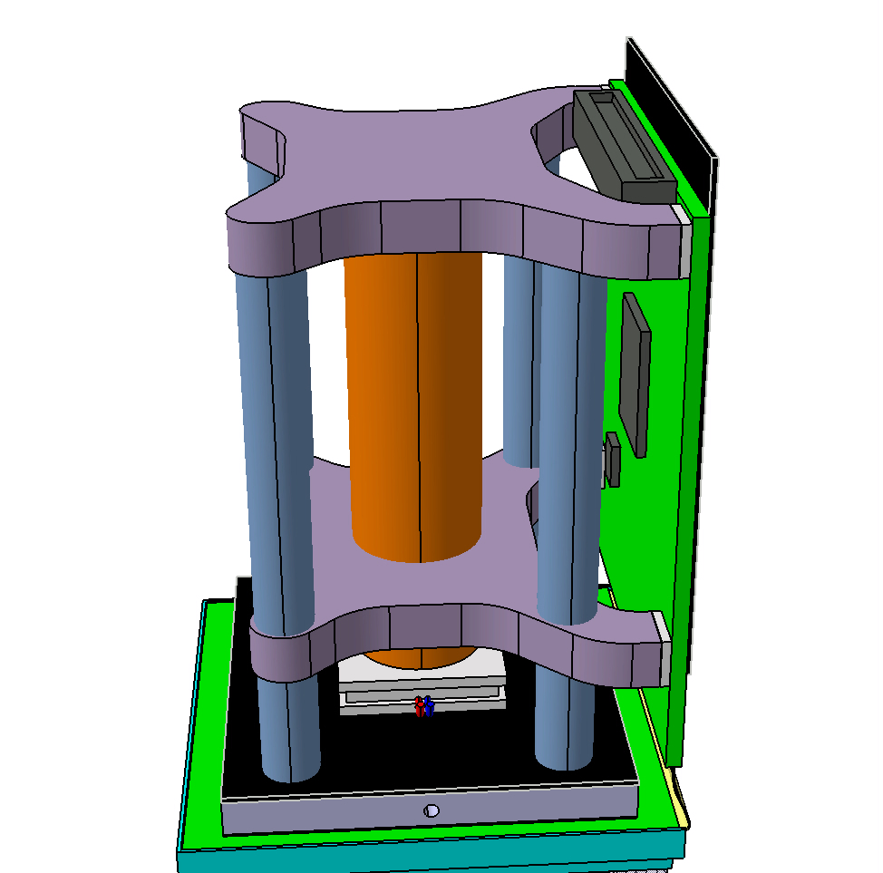
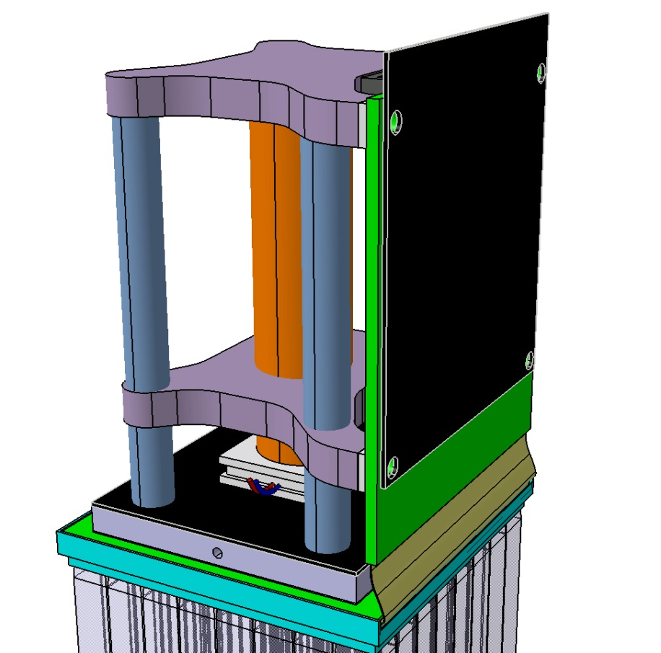
SiPM & Module design
SiPM Module design (Spacer)
FEE thermal
(PGS or TPG)
Copper bar or
heat pipe
Key issue: bring the Peltier power to the outside
Force cooling power to the SiPM area (front side)
Minimize the thermal resistance on the back side

Slide 8
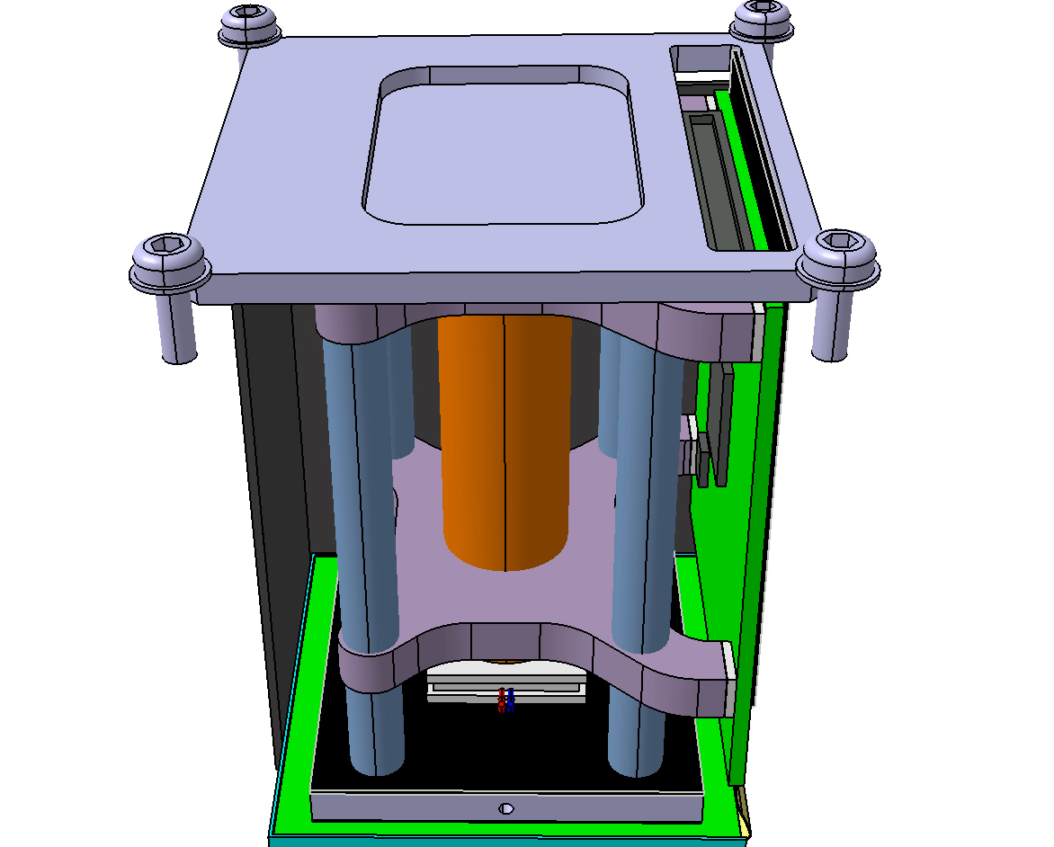
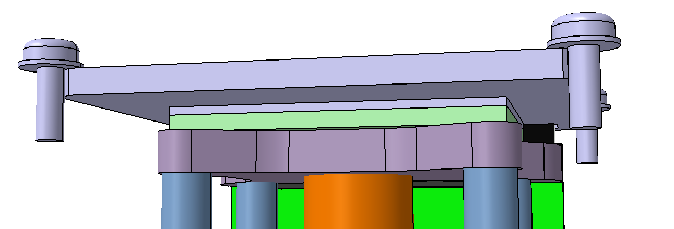
SiPM & Module design
SiPM Module design (End Cap, adaptation to POLAR1)
Only few Kg force needed
End cap will apply pressure force to the module
Therm a Gap (TAG) seal as for POLAR1
TAG Thickness will be limited

Slide 9
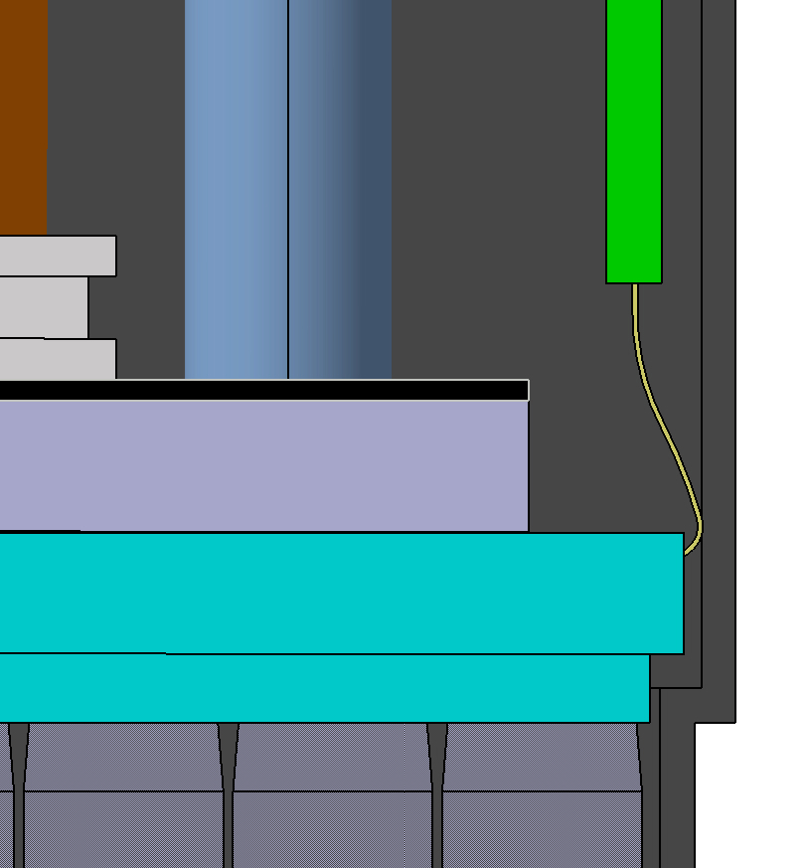
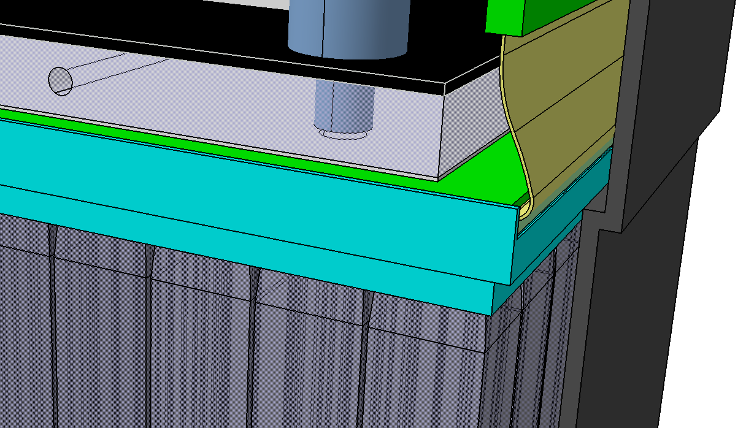
SiPM & Module design
SiPM Module design (into the CFRP socket, 1mm thick, T300 fiber)
FEE
64 bars aligned wrt siPM (thanks to the grid)
Grid opened on 1 side to ease the flex bending
Centring grid

Slide 10
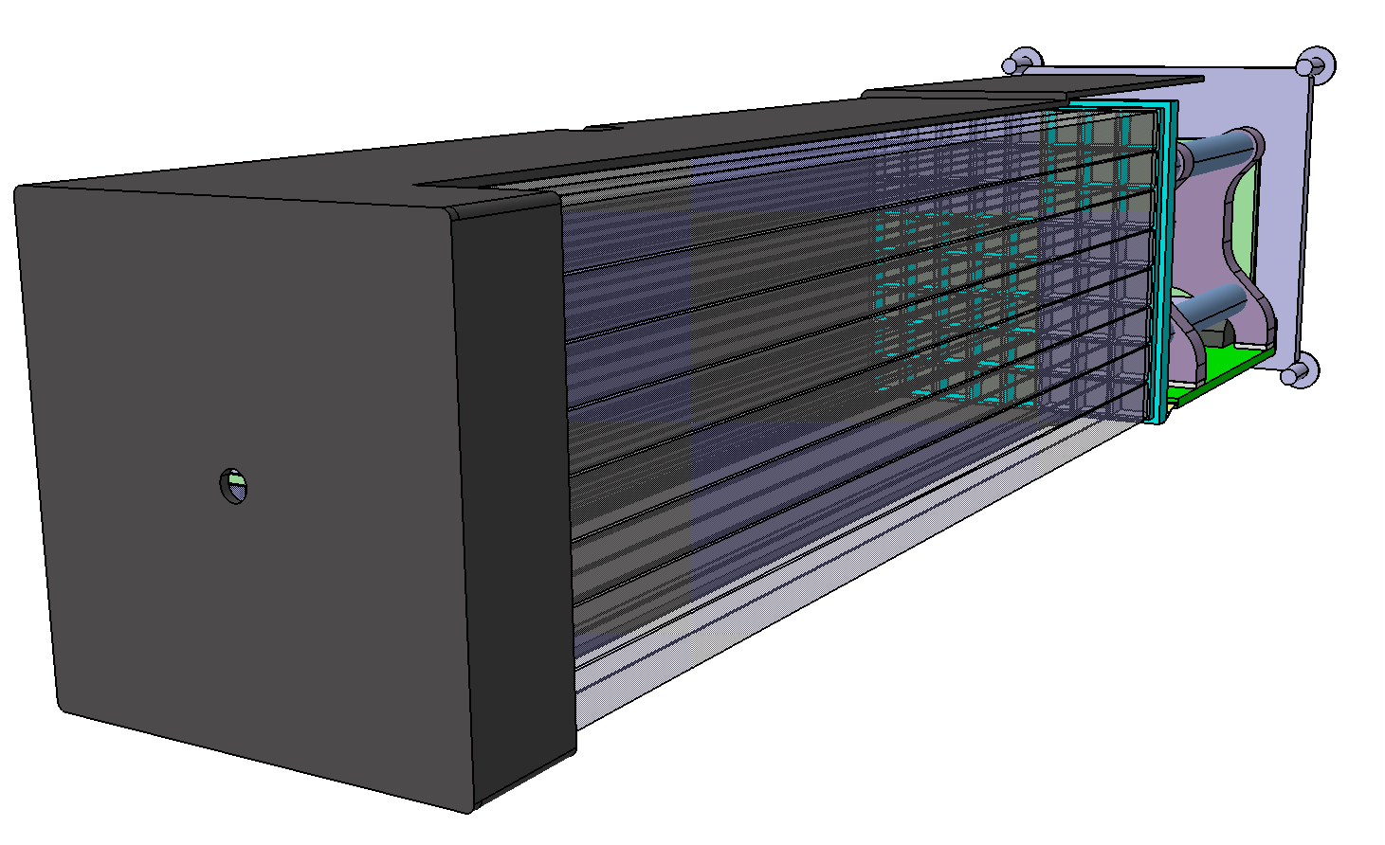
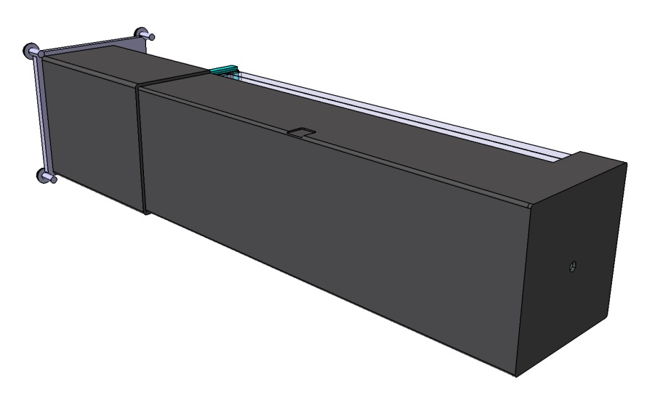
SiPM & Module design
SiPM Module design (into the CFRP socket, 1mm thick, T300 fiber)
Module estimated weight: 500 gr.
Leading to 50 Kg overall (100 modules)

Slide 11
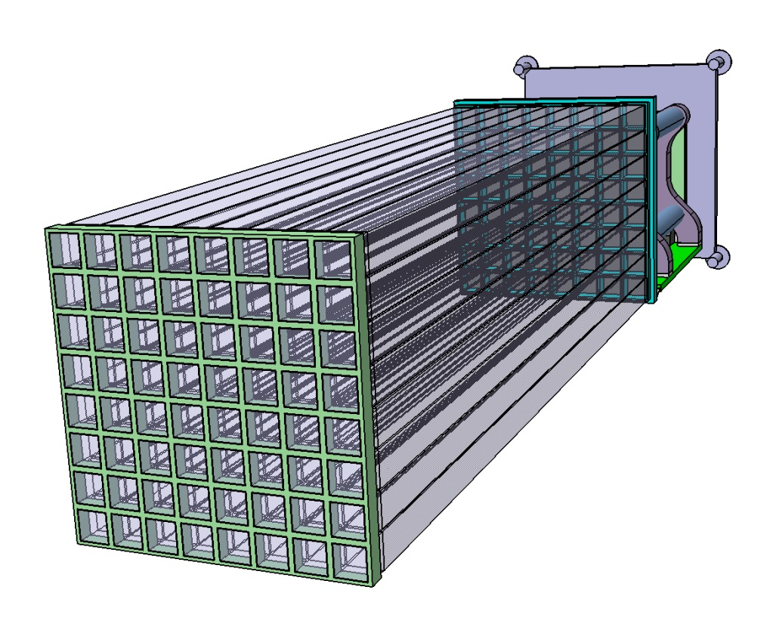
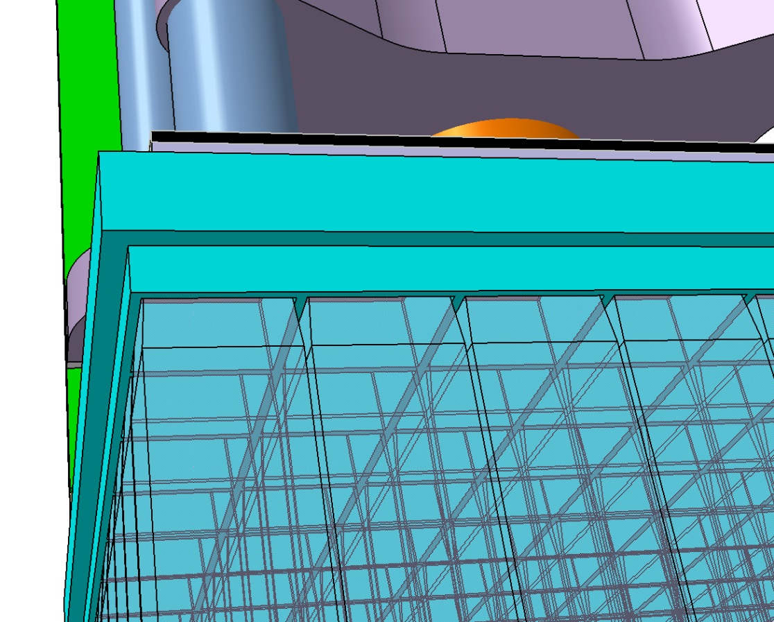
SiPM & Module design
SiPM Module design (2 centring grids)

Slide 12
POLAR2 Frame Assembly

Slide 13
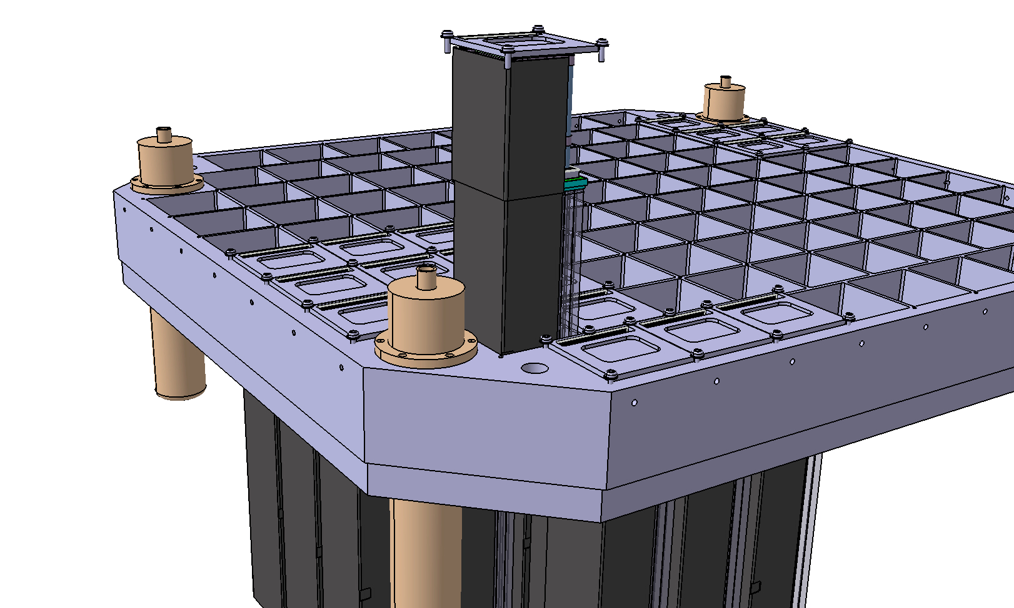
POLAR2 Frame Assembly
An “100 modules” design fitting inside the envelope (see next!)
Aluminum frame (CNC machined)

Slide 14
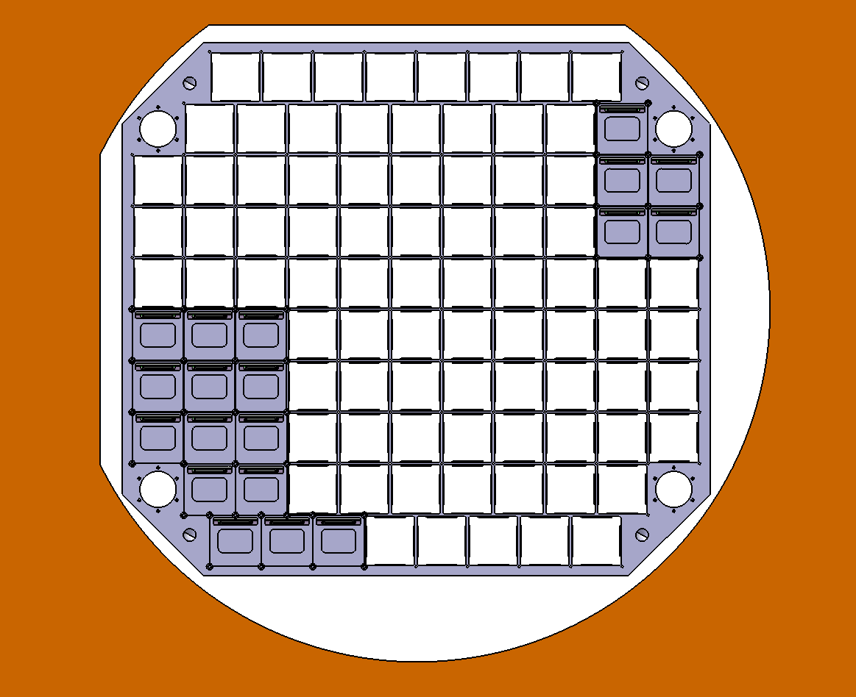
POLAR2 Frame Assembly
An “100 modules” design (main constraint... access door)
315mm
350mm
360 mm radius

Slide 15
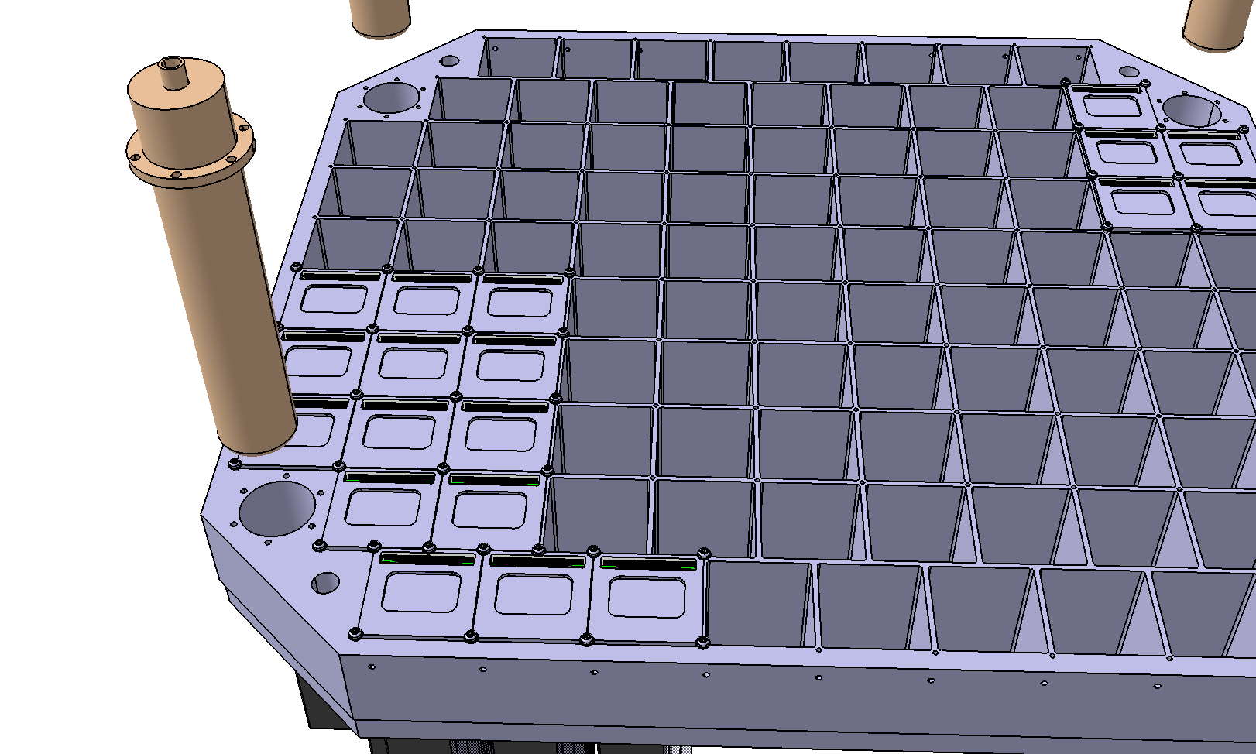
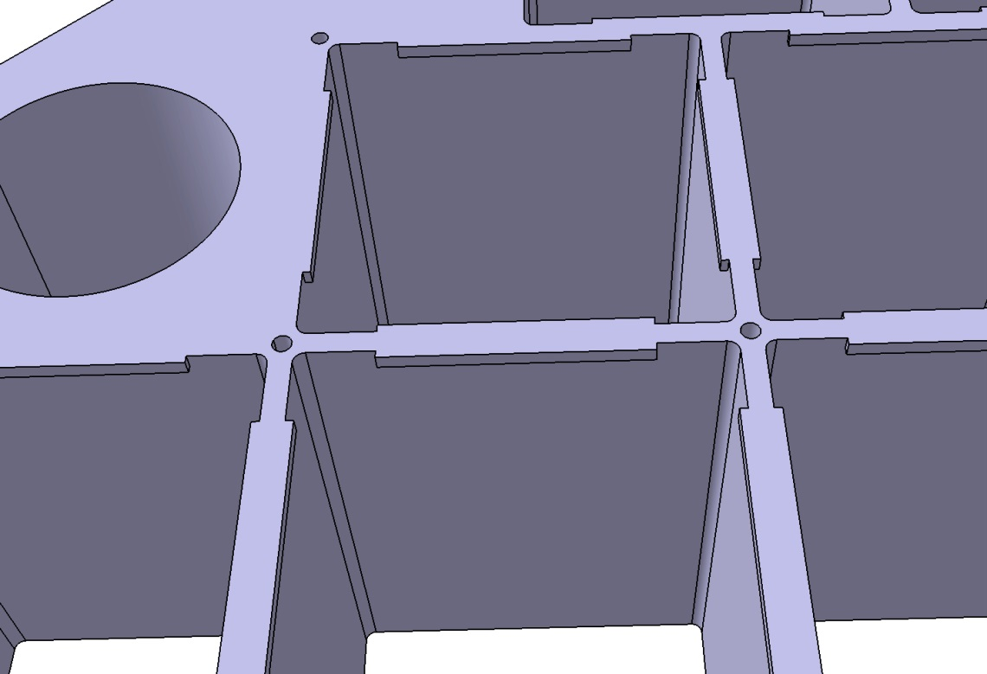
POLAR2 Frame Assembly
An “100 modules” design (key issue: Module design & Frame)
Wall thickness for M3 screws

Slide 16
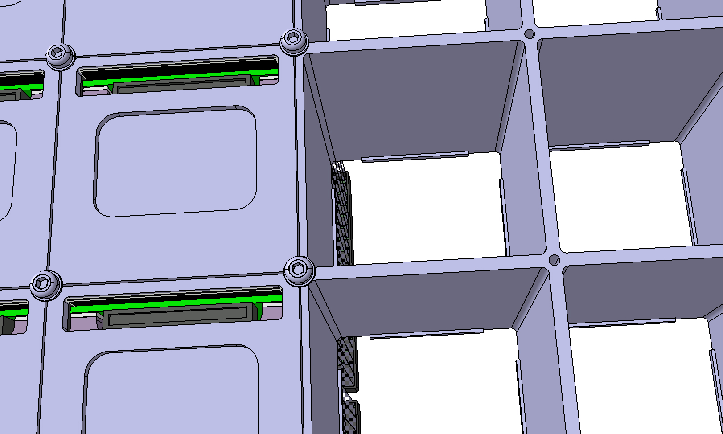
POLAR2 Frame Assembly
An “100 modules” design (access to FEE connector and heat exchange…not shown)
Mix of CNC machining and electro erosion by wire
AW7075T7351 aluminium type (stabilized)
1mm Bottom shoulders for module fixation

Slide 17
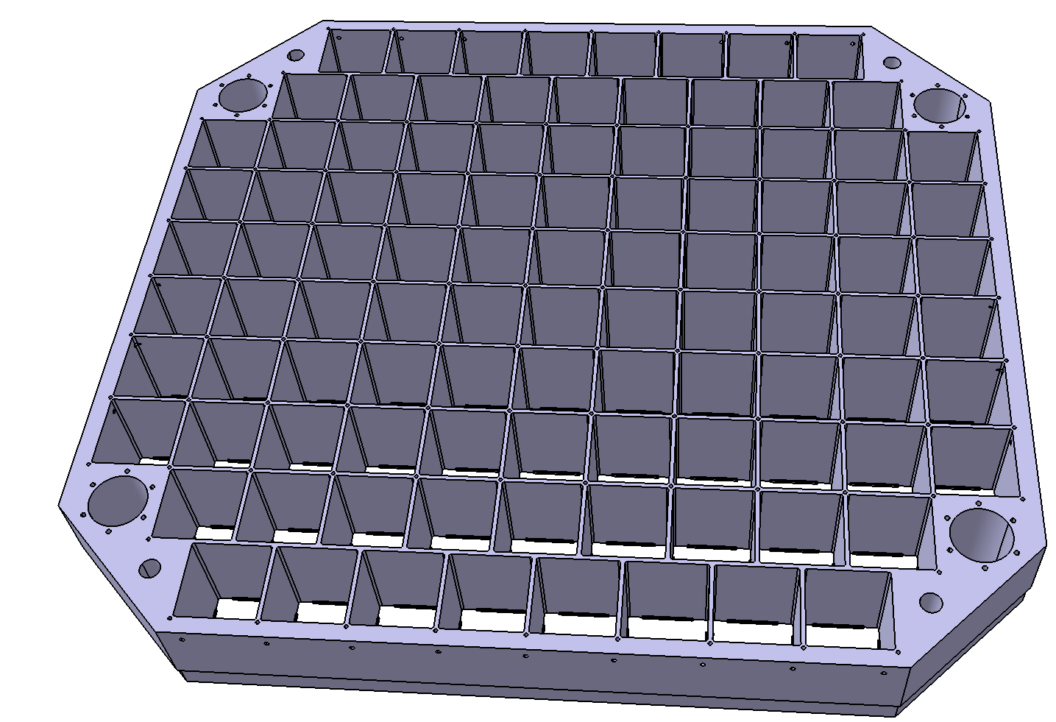
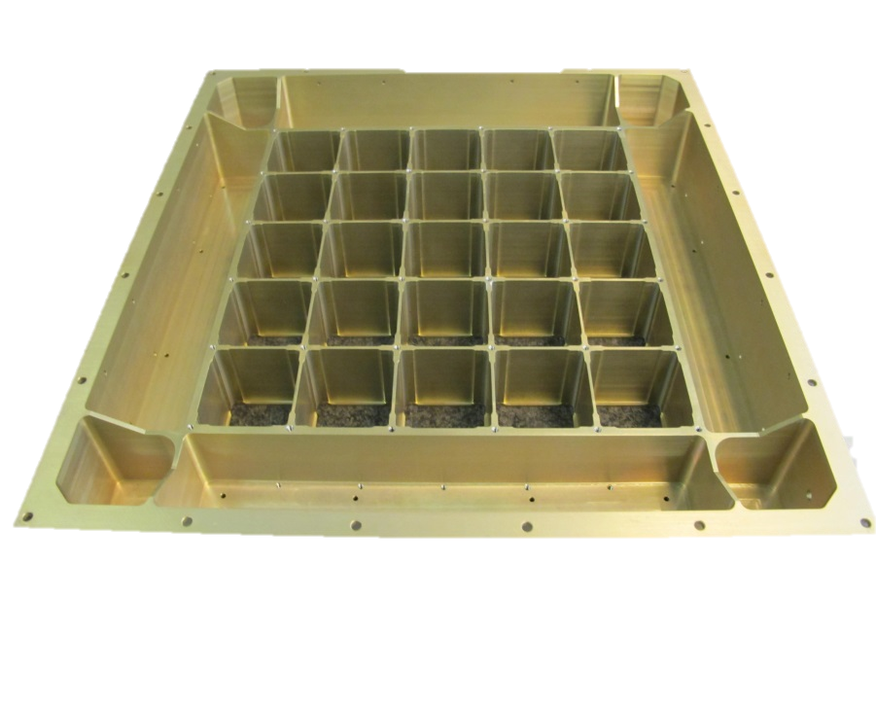
POLAR2 Frame Assembly
An “100 modules” design (aluminium Frame, POLAR2 primary structure!)
Main mechanical interface (Electronics, Space frame..)
Rigidity provided by overall thickness (74mm)
Max envelope: 650mmx590mmx74mm
Estimated weight: 14 Kg only
POLAR1 Frame

Slide 18
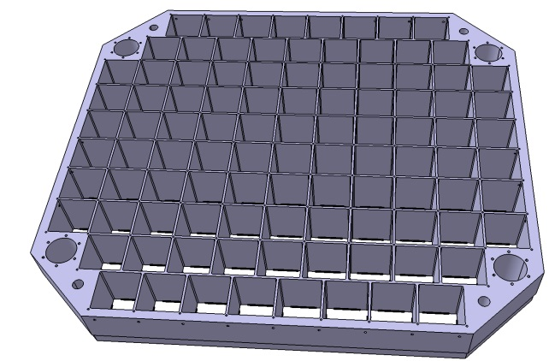
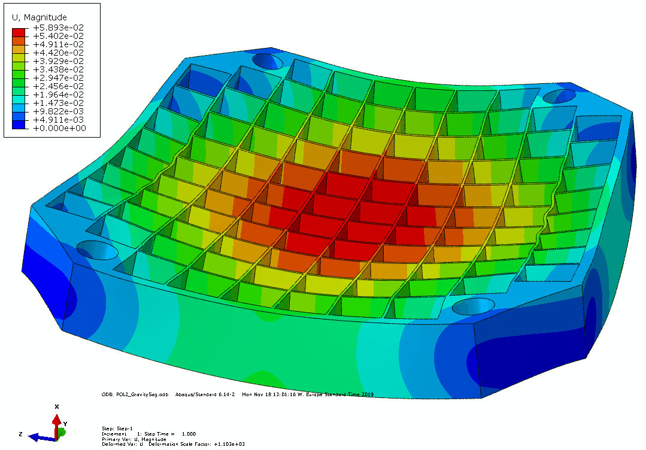
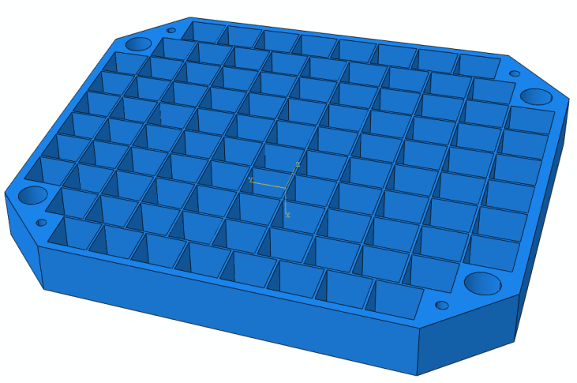
POLAR2 Frame Assembly
An “100 modules” design (preliminary FEA)
Simplified FE model
Conservative approach: 10 G normal to grid
Simply supported on 4 points (at M16 corners)
SiPM modules non structural weight (50Kg)
Top cover not considered here…
Looks quite OK: 60 microns deformation / 50 Mpa VonMisses stresses

Slide 19
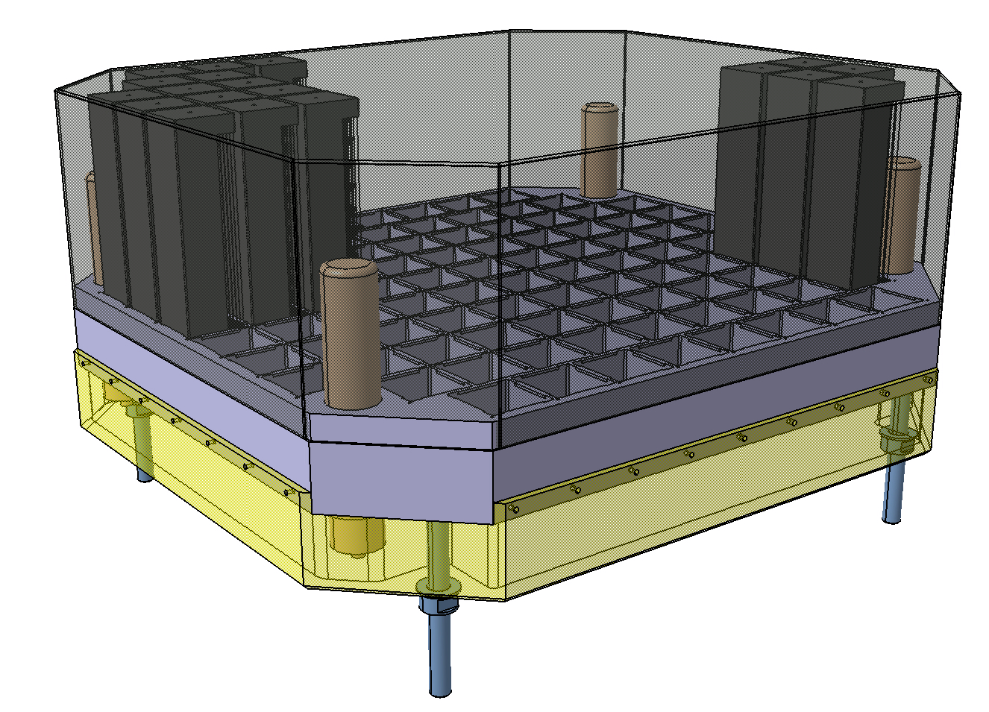
POLAR2 Frame Assembly
An “100 modules” design (Top Cover & Back end Electronics)
CFRP top cover
(to be redesigned!)
Back end electronics box
+ services
Design of top cover ongoing
Electronics box is purely conceptual…

Slide 20
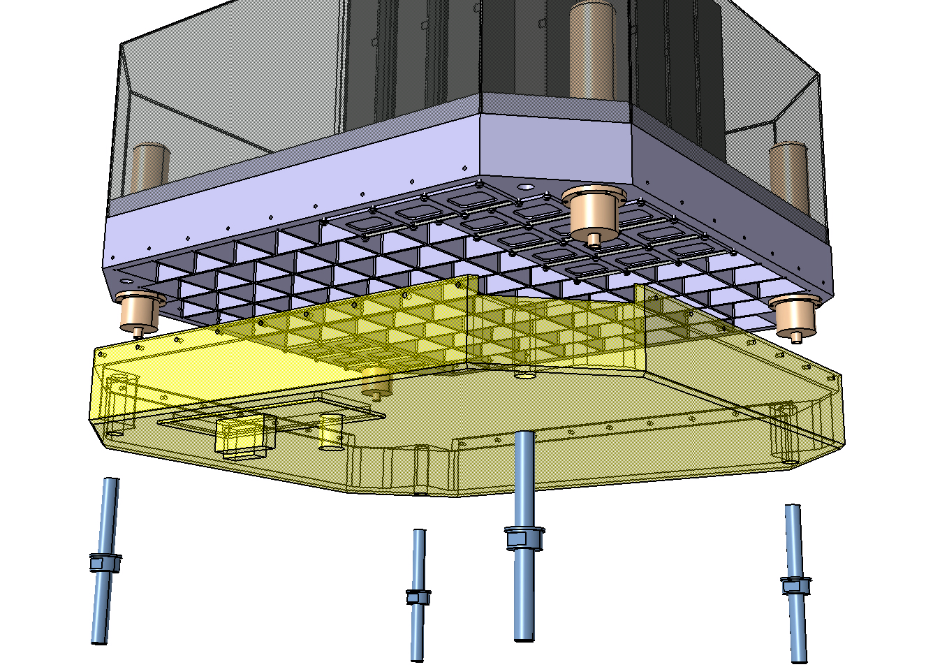
POLAR2 Frame Assembly
An “100 modules” design (Top Cover & Back end Electronics)
Fixation by
M4 side screws
+
4x M16 screws
Bottom patch panel

Slide 21
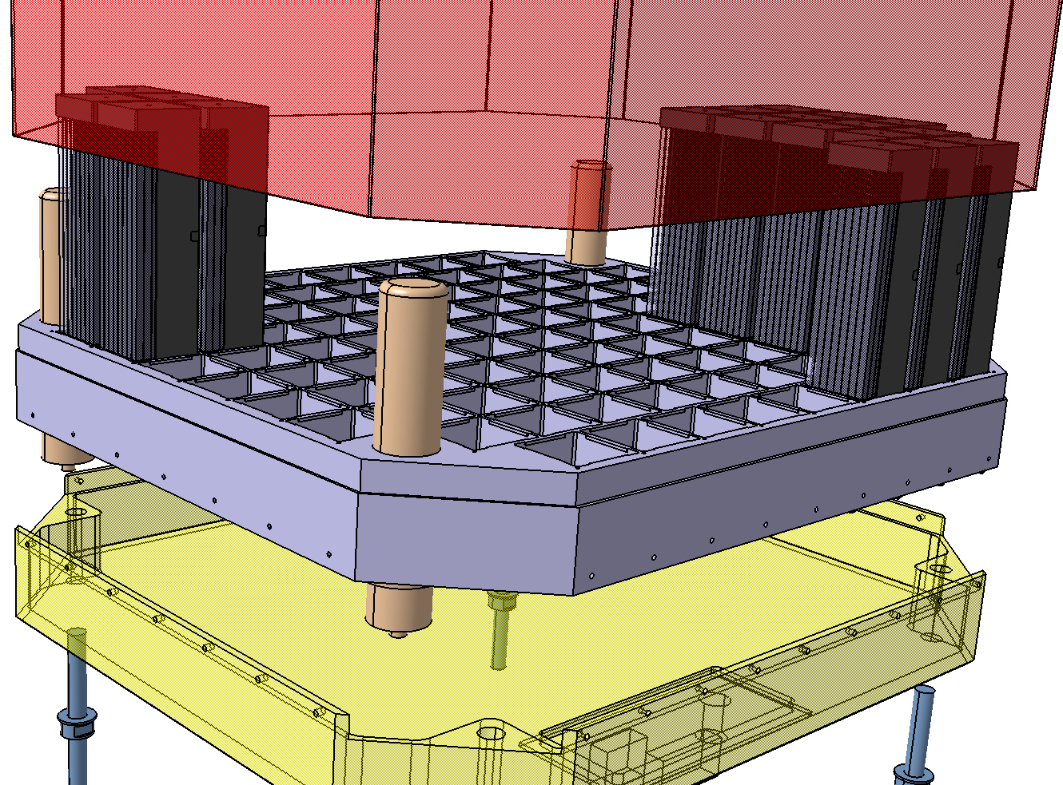
POLAR2 Frame Assembly
An “100 modules” design (Top Cover & Back end Electronics… exploded view)
M16 fixations on rigid corners

Slide 22
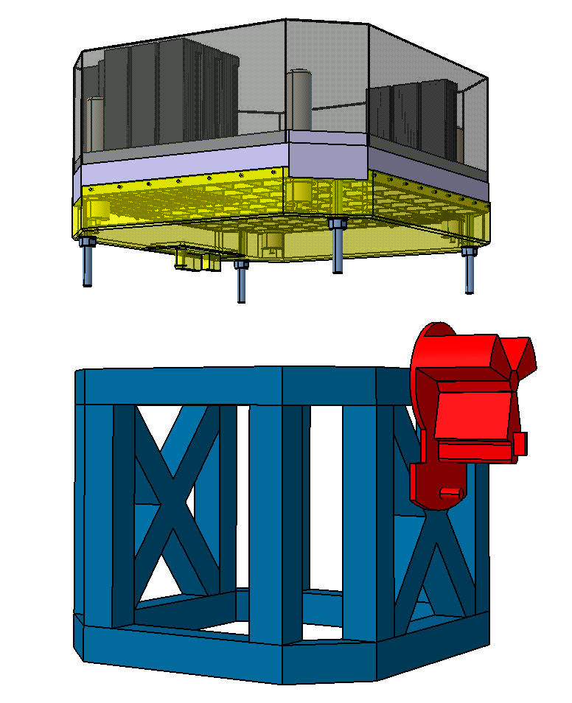
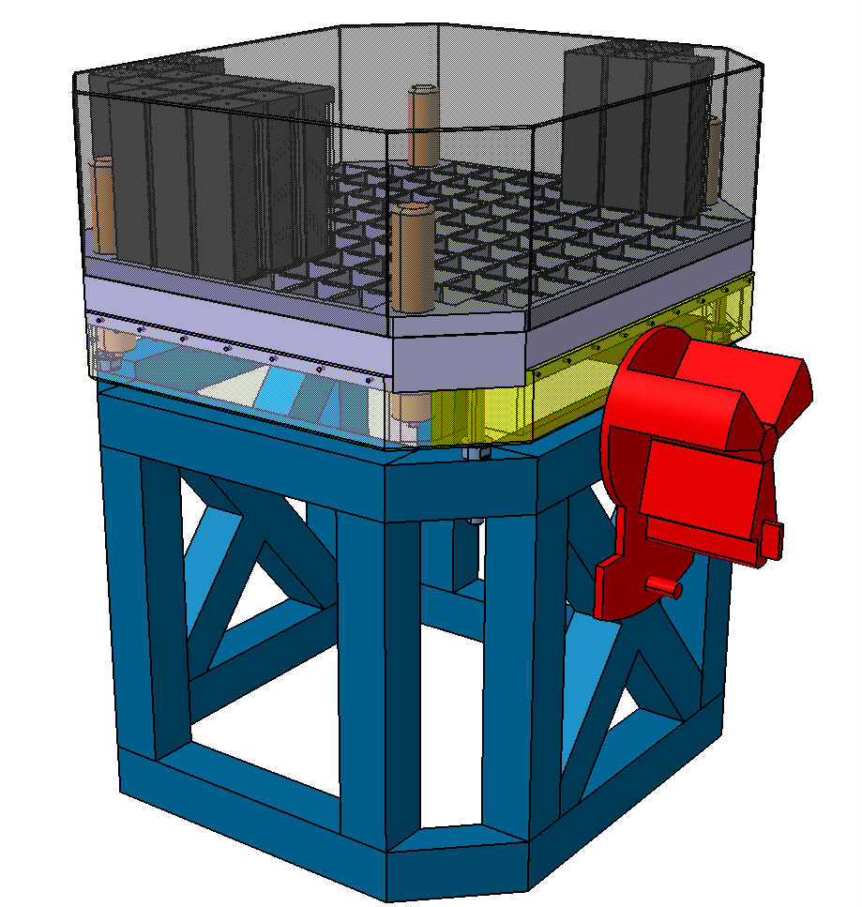
POLAR2 Frame Assembly
An “100 modules” design (Top Cover & Back end Electronics)
Fixation to Space Frame by 4x M16 bolts
Space Frame designed to support POLAR2 and grabbing system

Slide 23
POLAR2 Envelope
&
Interface definitions

Slide 24
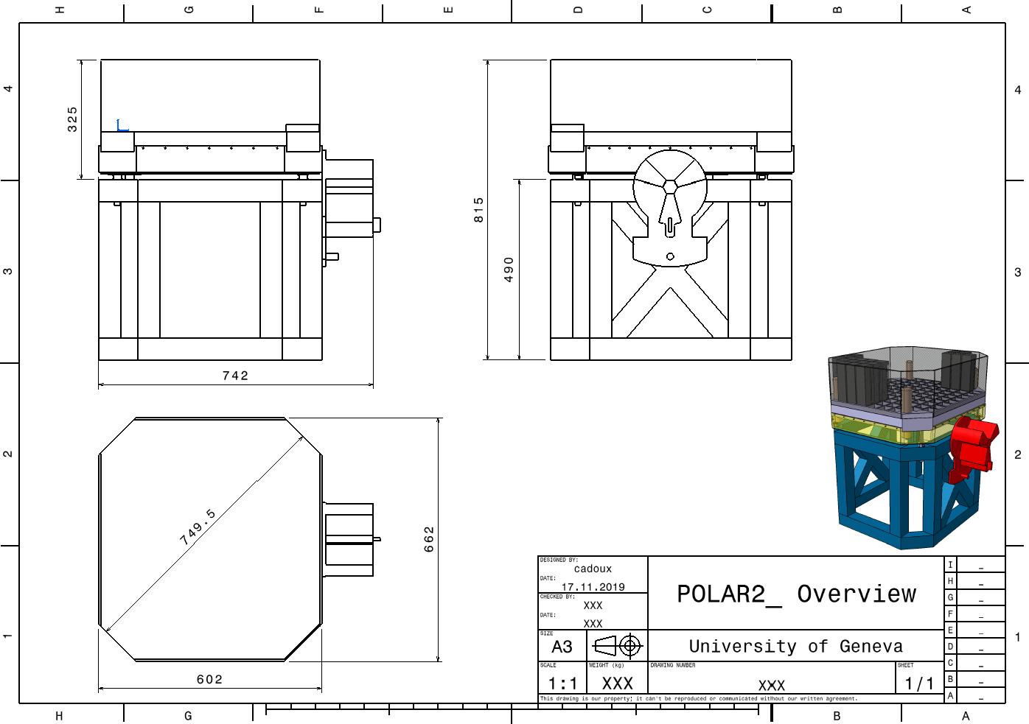
POLAR2 Envelope definition
POLAR2 design (drawing and dimensions)

Slide 25
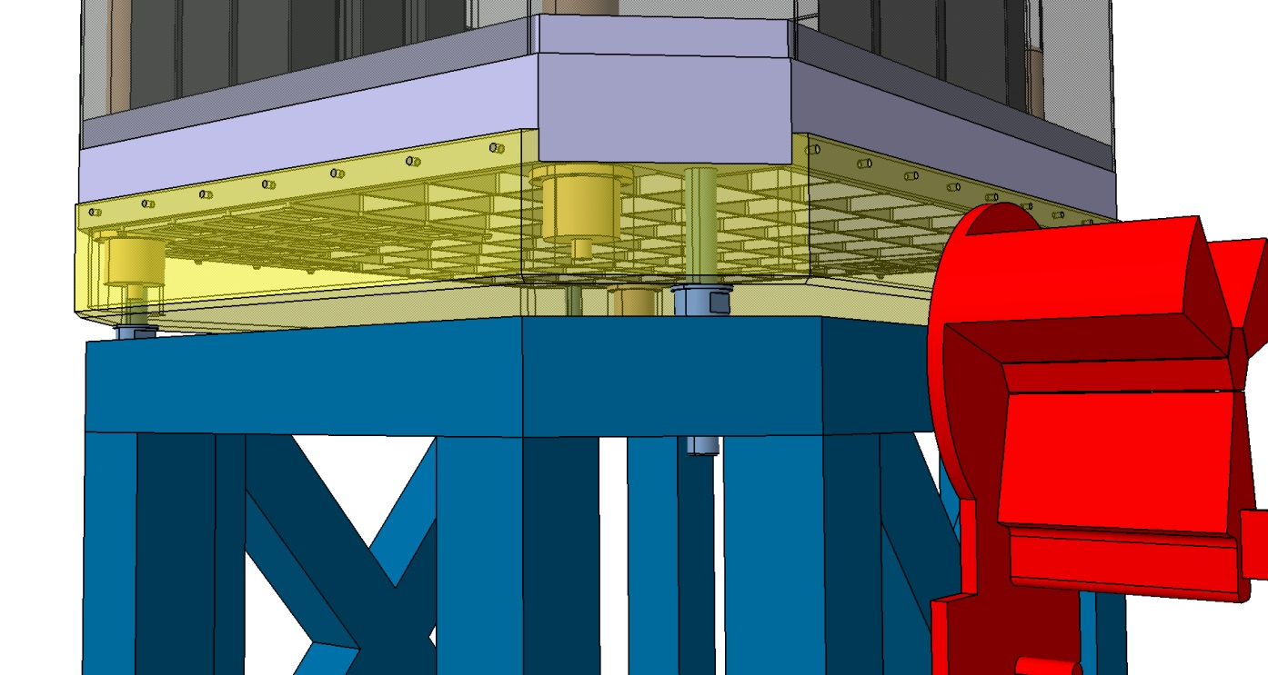
POLAR2 Interface definition
POLAR2 design (Interfaces to the Chinese Space Station)
Mechanical I/F to the space frame (and to CSS)
Services I/F to CSS (power, signal..)
I/F with Thermal Heat Exchanger (on CSS?)
What is the expected thermal environment?

