Slide 2
Single Bunch Instabilities at Injection Energy
22nd November 2019 E-Cloud Meeting 71
L. Sabato, G. Iadarola
luca.sabato@cern.ch
Acknowledgements: L. Mether, K. Paraschou

Slide 3
Outline
Introduction
Convergence Studies
Bunch Length and RF Voltage Amplitude
Effect of SEY and Bunch Charge
Chromaticity and Damper
Octupoles
Conclusions and Future Developments

Slide 4
Outline
Introduction
Convergence Studies
Bunch Length and RF Voltage Amplitude
Effect of SEY and Bunch Charge
Chromaticity and Damper
Octupoles
Conclusions and Future Developments

Slide 5
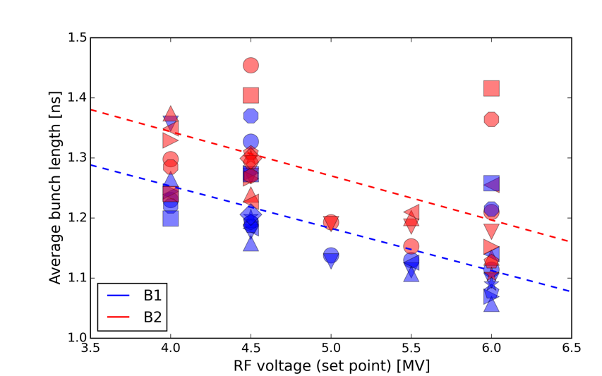
Introduction
The possibility of lowering the RF voltage at injection is being considered to cope with RF power limitations
  An extensive simulation study has been conducted to address the impact on e-cloud driven instabilities
In the simulations the bunch length has been adapted to the RF voltage following the dependence measured at the LHC
  In all simulations the longitudinal distribution is matched to the bucket
LHC measurements
H. Timko, presentation at LMC meeting, 5 Sep 2018
Simulated

Slide 6
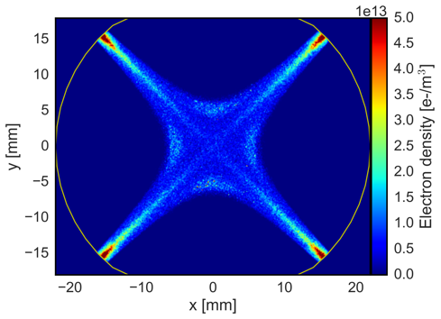
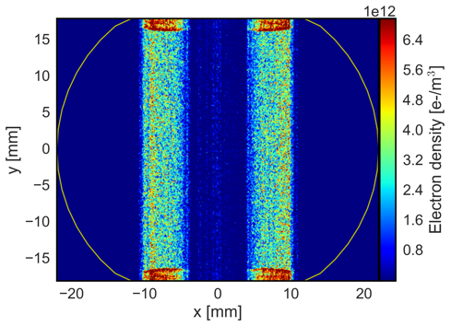
Introduction
Electrons in the arc quadrupoles are expected to be the strongest contributor (quadrupolar field concentrates a large electron density at the beam location)
  Instabilities driven by e-cloud in the quadrupoles will be considered in the following

Slide 7
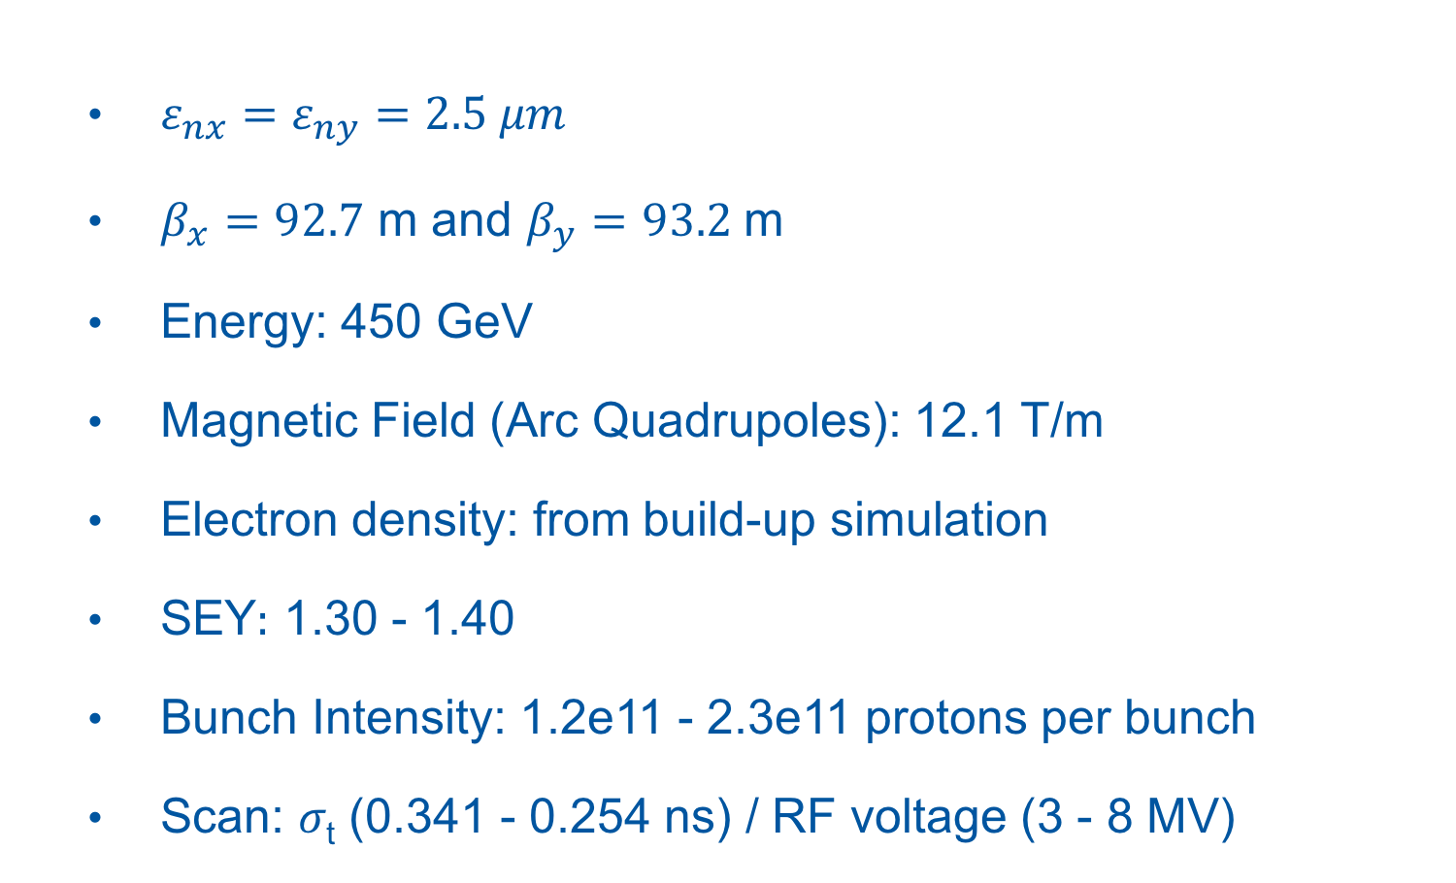
Introduction: Simulation Parameters
  $ε_{nx}=ε_{ny}=2.5 μm$
  $β_{x}=92.7$ m and $β_{y}=93.2$ m
  Energy: 450 GeV
  Magnetic Field (Arc Quadrupoles): 12.1 T/m
  Electron density: from build-up simulation
  SEY$:$ 1.30 - 1.40
  Bunch Intensity: 1.2e11 - 2.3e11 protons per bunch
  Scan: 𝜎_{t} (0.341 - 0.254 ns) / RF voltage (3 - 8 MV)

Slide 8
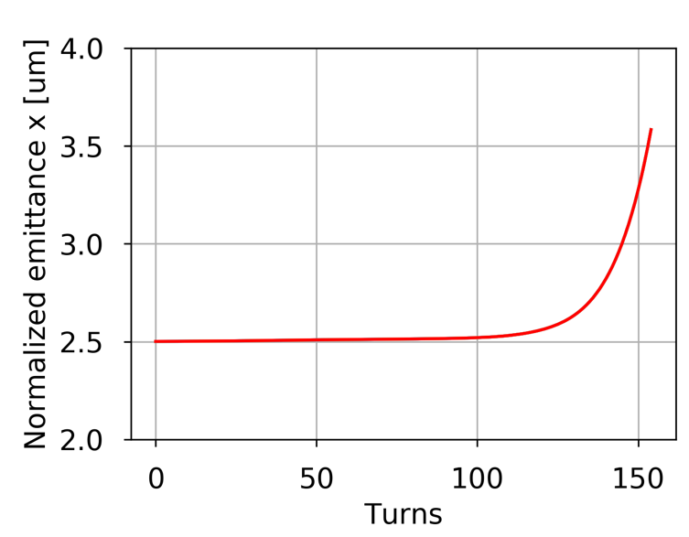
Introduction: Instability Study Observables
Blow-up time: time required for observing an emittance blow-up of 12% (2.5 µm ➔ 2.8 µm)
No EC kick on the vertical plane
The maximum number of turns is fixed: 20,000
2.8
Blow-up time

Slide 9
Outline
Introduction
Convergence Studies
Bunch Length and RF Voltage Amplitude
Effect of SEY and Bunch Charge
Chromaticity and Damper
Octupoles
Conclusions and Future Developments

Slide 10
Convergence Studies
The motivation of these convergence studies is to find the lower acceptable values for the numerical parameters:
  number of slices of the bunch
  number of MacroParticles (MPs) / slice
  number of kicks (or segments) for each e⁻ cloud element
  number of electron MPs for each kick
  transverse grids (Multigrid [1])
10
9
8
7
6
5
4
3
2
1
Bunch length
MP₁
MP₂
MP₃
…
MP_{N}
[1] E. Belli, “PyPIC: the multigrid solver”, EC Meeting #32 – September 2, 2016

Slide 11
Convergence Studies
Strategy
Scan every numerical parameter, using conservative values for the other parameters:
    Slices = 750
    MPs/slice = 5,000
    Segments = 8
    e⁻ MPs = 500,000
    Transverse Grid: T₀

Slide 12
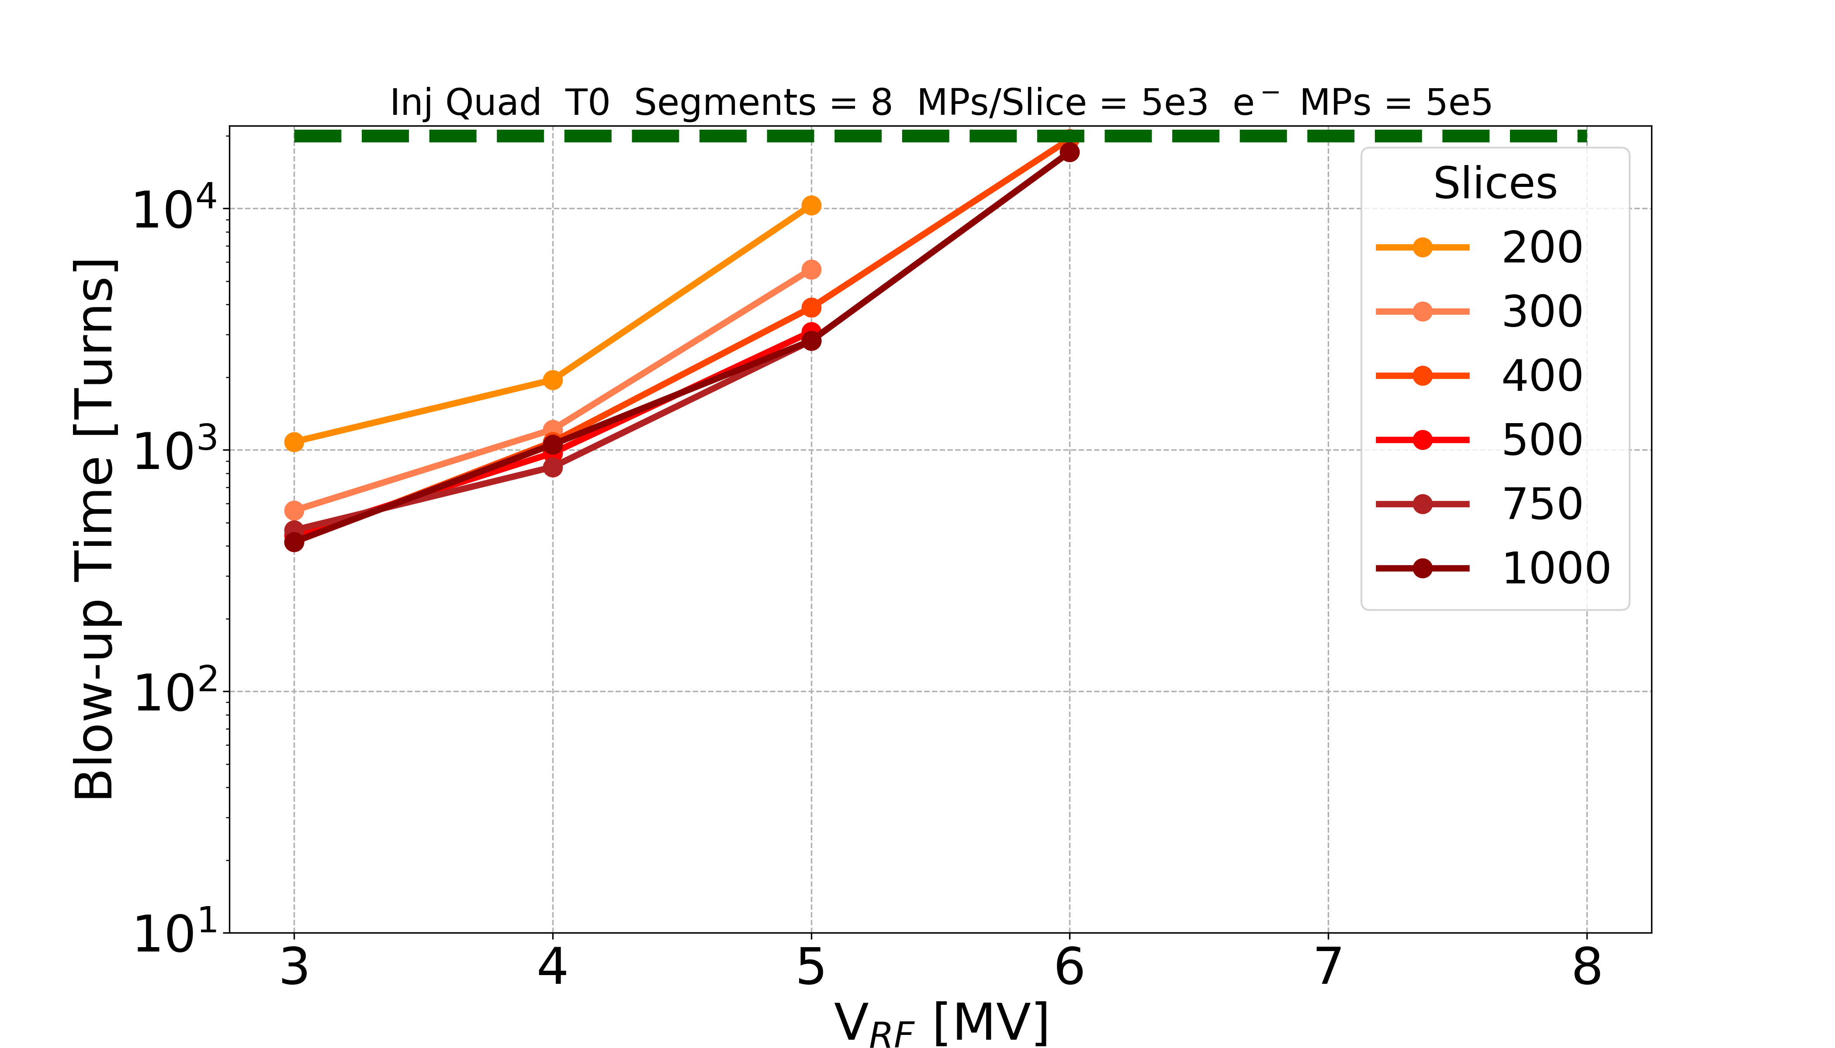
Convergence Studies: Slices
No instability observed over 20k turns
Instability detected when transverse emittance increases from 2.5 μm to 2.8 μm
(presence of coherent motion verified)
Old setting 150 slices is not adequate
500 slices is chosen

Slide 13
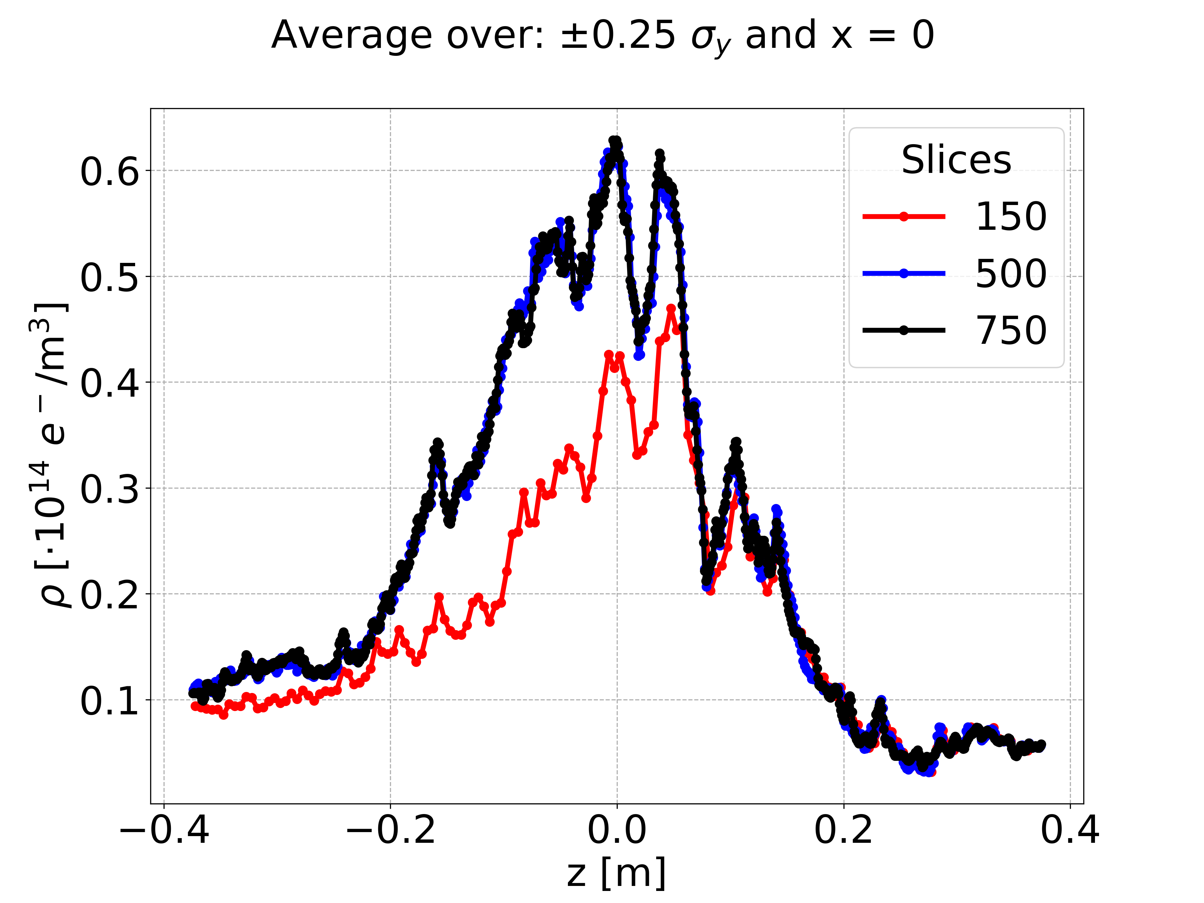
Convergence Studies: Pinch
To understand why such a large number of slices is required we look at the electron evolution during the individual pinch
Electron density average (|y| < 0.25𝜎_{y} and x = 0) along the bunch
Single passage simulation confirms: 150 slices are not enough
Smaller electron density peak (around 20%) during the pinch ➔ bunch more stable

Slide 14
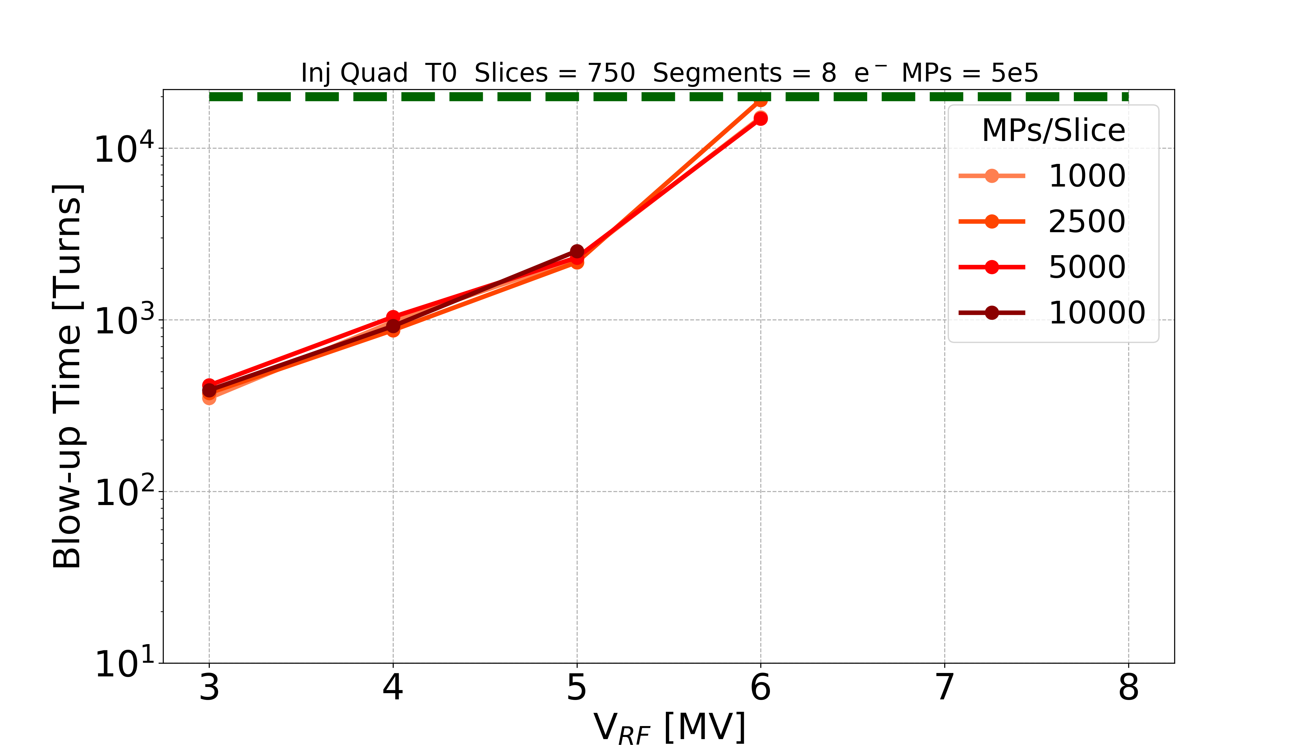
Convergence Studies: MPs/Slice
No instability observed over 20k turns
No surprise found
2,500 MPs/slice is chosen

Slide 15
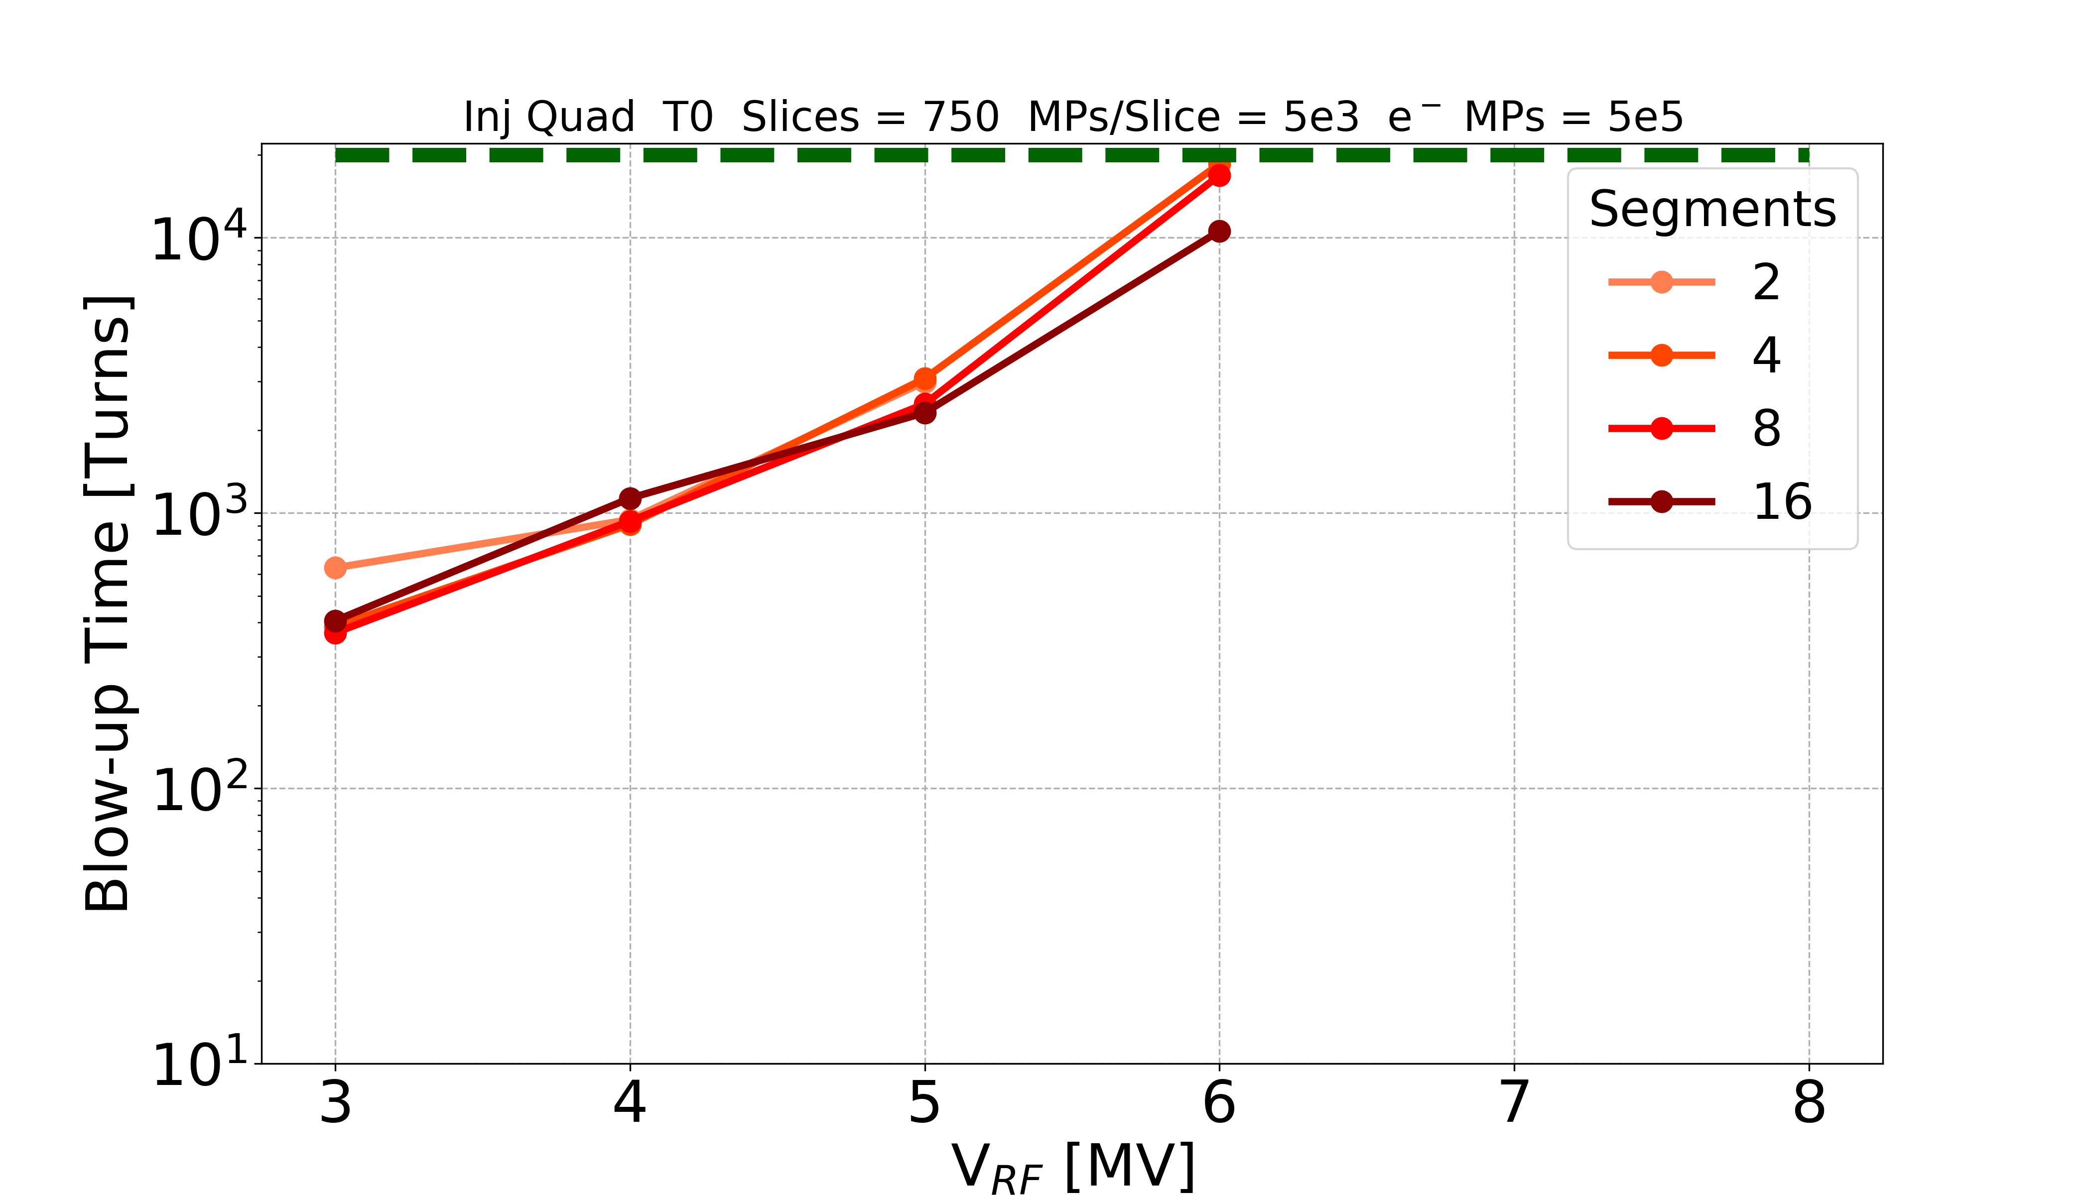
Convergence Studies: Kicks
Kicks
No instability observed over 20k turns
No surprise found
8 kicks is chosen

Slide 16
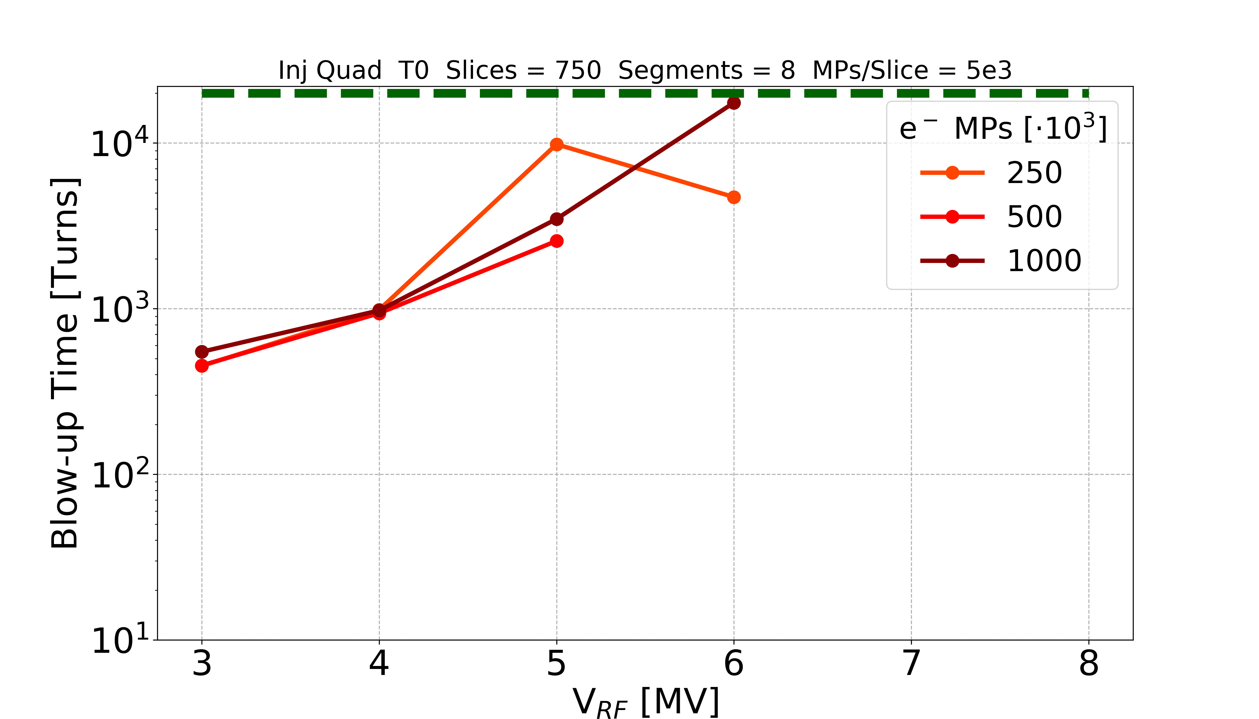
Convergence Studies: e⁻ MPs
No instability observed over 20k turns
500,000 e⁻ MPs is chosen

Slide 17
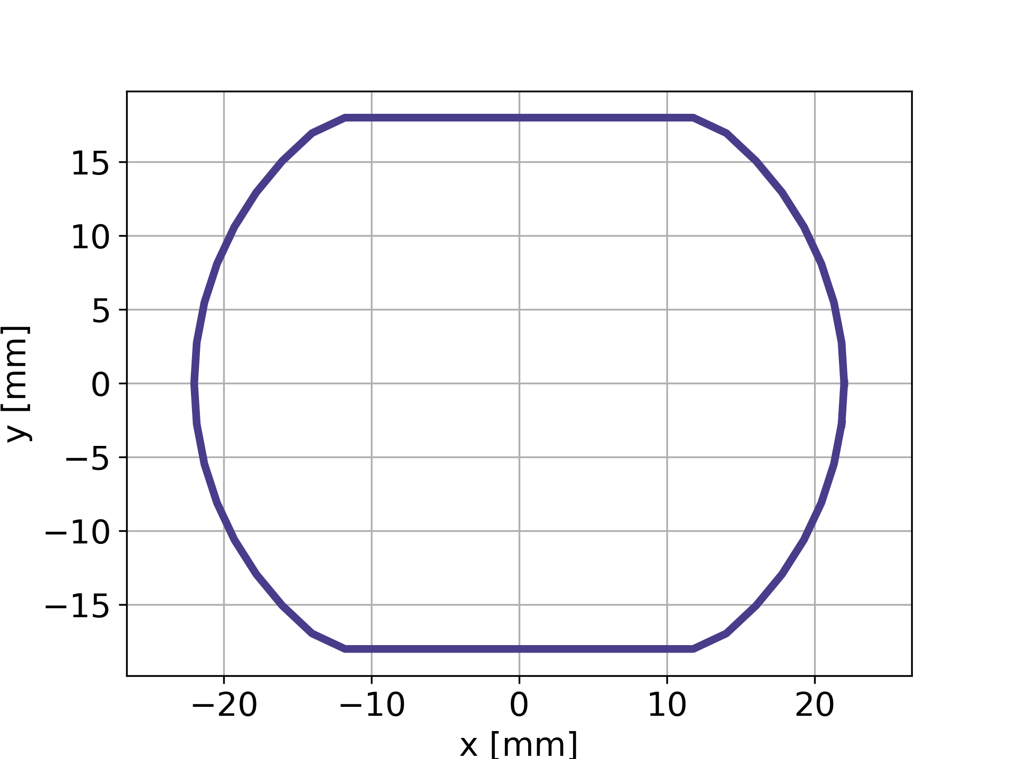
Convergence Studies: Transverse Grid
T₀
T_{inj}
Parameter | Value
f (magnification factor) | 0.3
Internal grid coverage [mm] | 6.95 (10𝜎)
Internal grid cell size [mm] | 0.139 (0.2𝜎)
External grid cell size [mm] | 0.8
N_nodes_discard | 5
N_min_Dh_main | 10
Value | Value | Value
0.5 | 0.5 | 0.5
10.5 (15𝜎) | 10.5 (15𝜎) | 10.5 (15𝜎)
0.139 (0.2𝜎) | 0.0697 (0.1𝜎) | 0.0349 (0.05𝜎)
0.4 | 0.4 | 0.4
10 | 10 | 10
40 | 40 | 40
External grid
Internal grid
Beam chamber

Slide 18
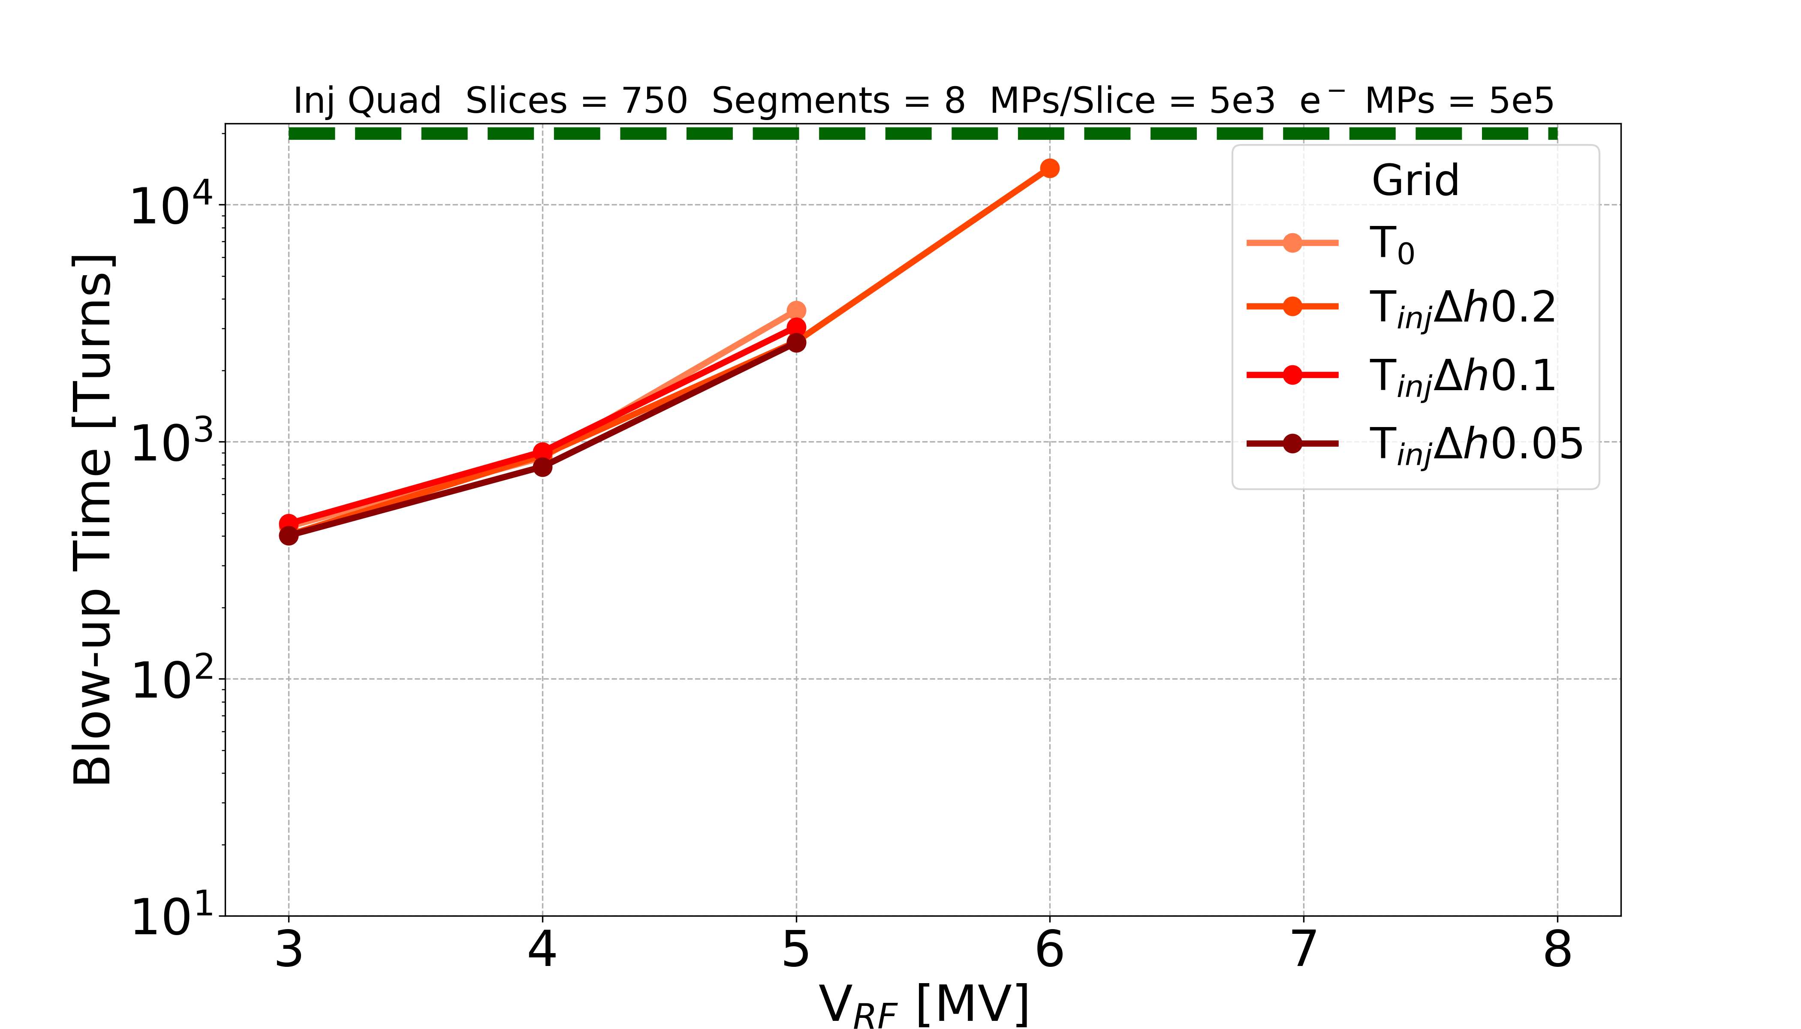
Convergence Studies: Transverse Grid
Still running (3)
No instability observed over 20k turns
T₀ is chosen
  Internal grid coverage: 6.95 mm (10𝜎)
  Internal grid cell size: 0.139 mm (0.2𝜎)
  External grid cell size: 0.8 mm

Slide 19
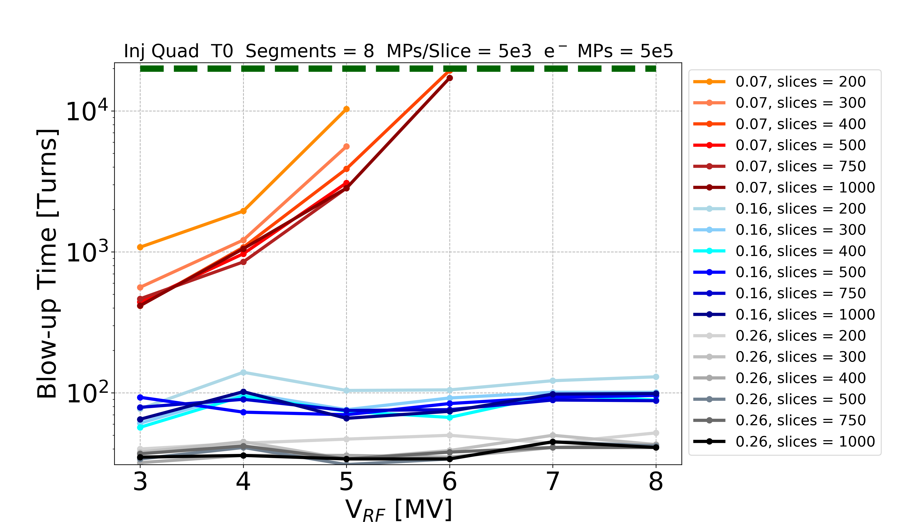
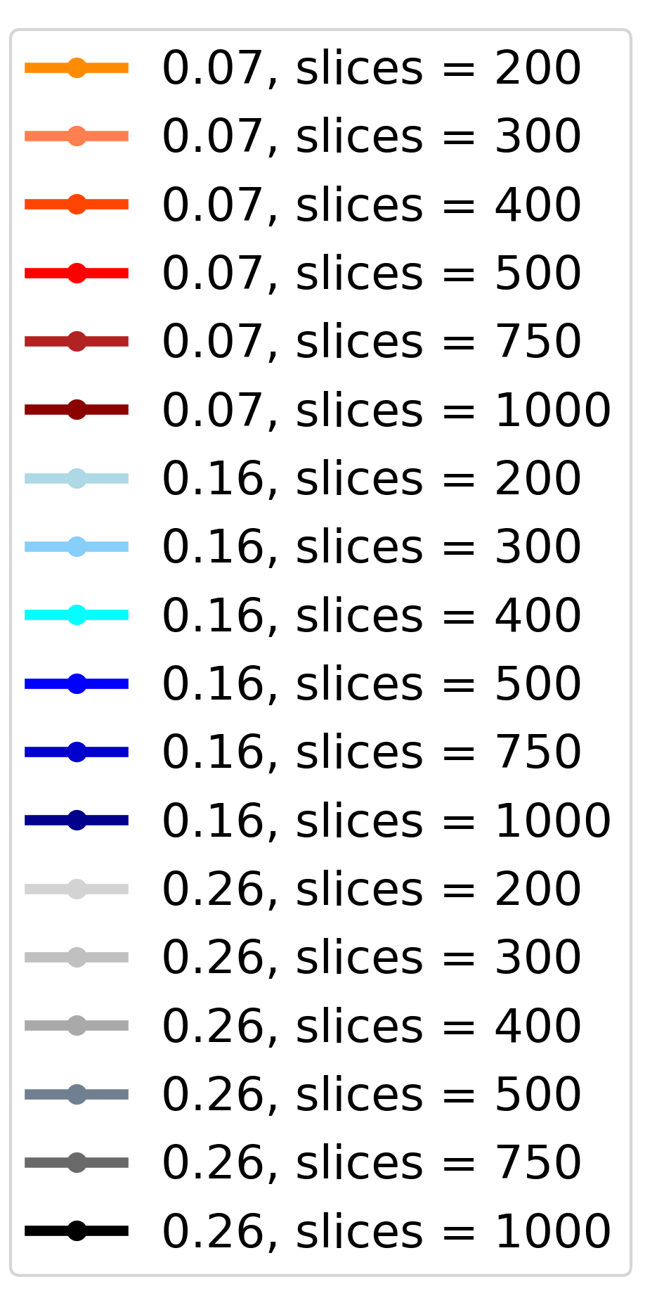
Convergence Studies: 16% - 26%
No instability observed over 20k turns
Scans of the length of the quadrupoles (equivalent to have stronger electron cloud kicks) for each numerical parameter
They confirm the previous conclusions

Slide 20
Convergence Studies: Summary
378 multi-core simulations
Total computational time: ~ 32672 CPUcores*days
It took months using the full CNAF cluster
~127 GB stored

Slide 21
Convergence Studies: Chosen Parameters
Numerical Parameter | Chosen Value
Slices/bucket | 500
MPs/Slice | 2,500
Segments | 8
e⁻ MPs | 5e5
Transverse Grid | T₀ Internal grid coverage: 6.95 mm (10𝜎) Internal grid cell size: 0.139 mm (0.2𝜎) External grid cell size: 0.8 mm

Slide 22
Outline
Build-up
Convergence Studies
Bunch Length and RF Voltage Amplitude
Effect of SEY and Bunch Charge
Chromaticity and Damper
Octupoles
Conclusions and Future Developments

Slide 23
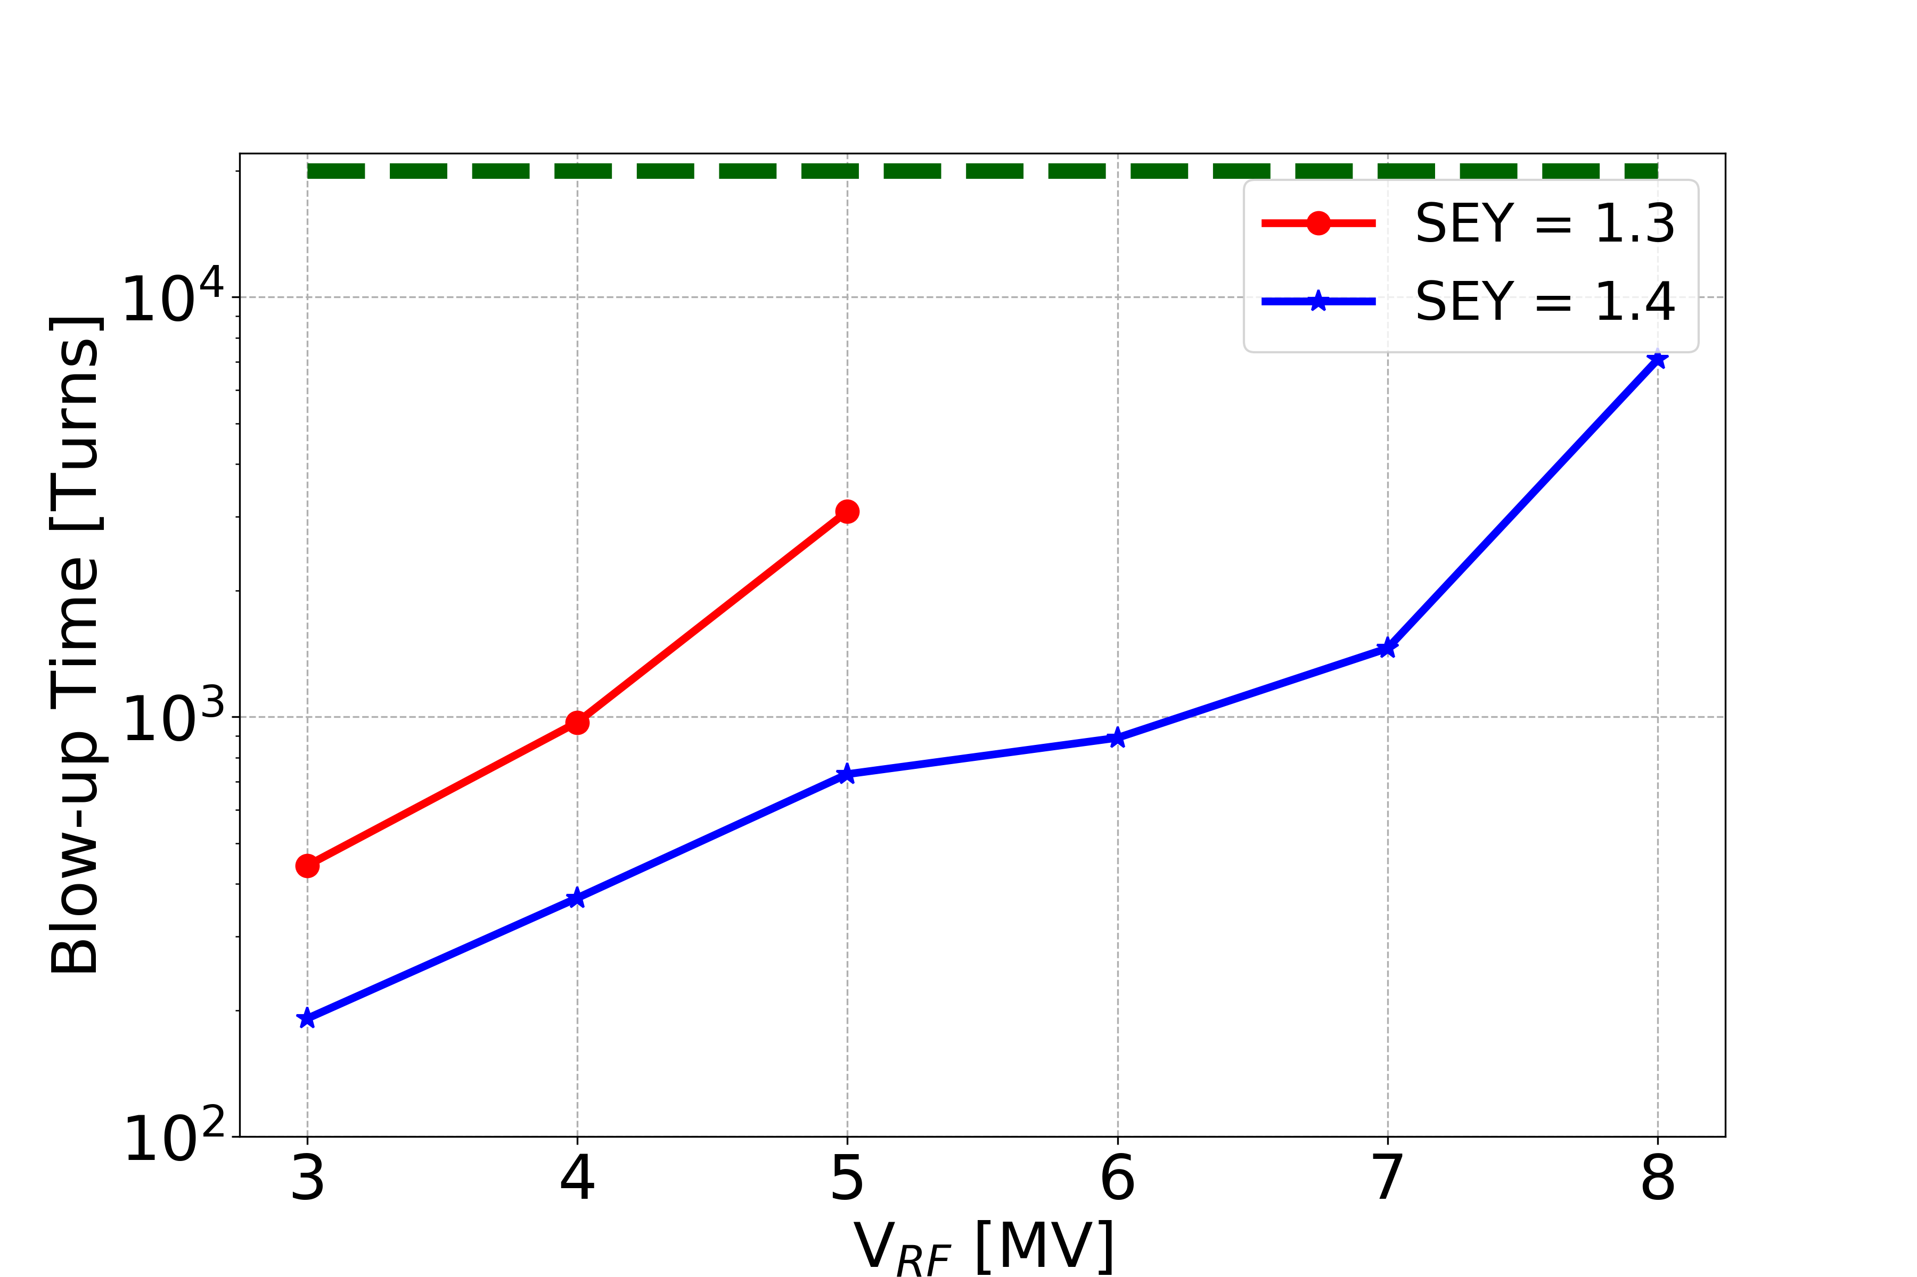
Bunch Length and RF Voltage Amplitude
1.2 x 10¹¹ p/bunch
No instability observed over 20k turns for: V_{RF} > 5 MV,
SEY = 1.3
Increasing V_{RF} and decreasing the bunch length, the bunch is more stable
  → Which is dominant?

Slide 24
Bunch Length and RF Voltage Amplitude
Increasing V_{RF}, we change
Faster synchrotron tune Q_{s} Bunch length
Stabilising mechanism EC dynamics
Longer bunches → more e⁻
Shorter bunches → less e⁻

Slide 25
Bunch Length and RF Voltage Amplitude
Increasing V_{RF}, we change
Faster synchrotron tune Q_{s} Bunch length
Stabilising mechanism EC dynamics
Longer bunches → more e⁻
Shorter bunches → less e⁻
We can block the build-up, without changing the bunch length, in order to see which effect is dominant

Slide 26
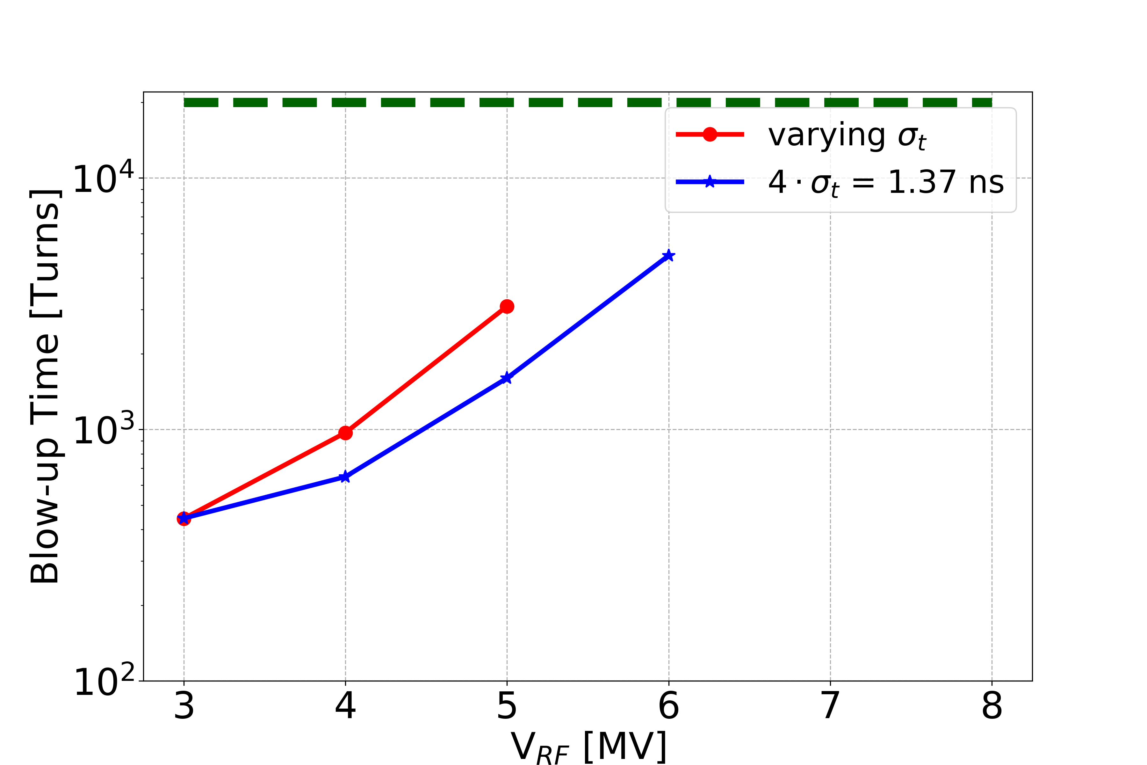
Bunch Length and RF Voltage Amplitude
1.2 x 10¹¹ p/bunch, SEY = 1.3
Fixed bunch length (same electron pinch)
Changing V_{RF} (matched bunch, changing Q_{s}, long. emittance)
The slope as a function of the RF remains when fixing the bunch length: → the dominant stabilizing factor is the change of Q_{s}

Slide 27
Outline
Build-up
Convergence Studies
Bunch Length and RF Voltage Amplitude
Effect of SEY and Bunch Charge
Chromaticity and Damper
Octupoles
Conclusions and Future Developments

Slide 28
Effect of SEY and Bunch Charge
Increasing the SEY, the bunch is more unstable
No instability for 2.3e¹¹ ppb in this entire range of parameters

Slide 29
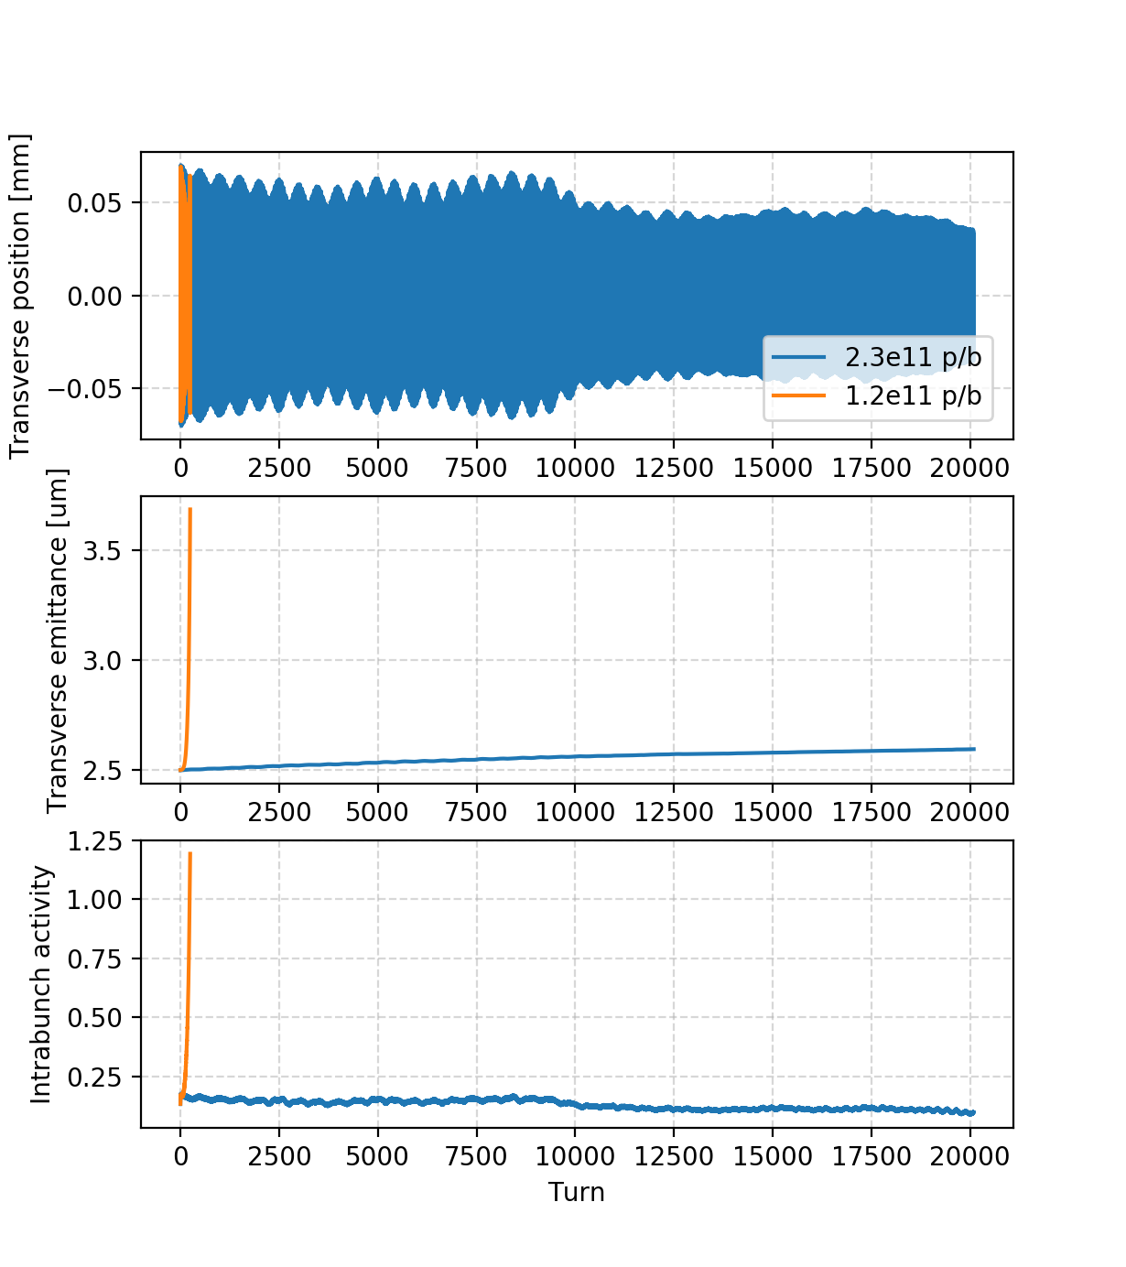
Effect of SEY and Bunch Charge
Increasing the SEY, the bunch is more unstable
No instability for 2.3e¹¹ ppb in this entire range of parameters

Slide 30
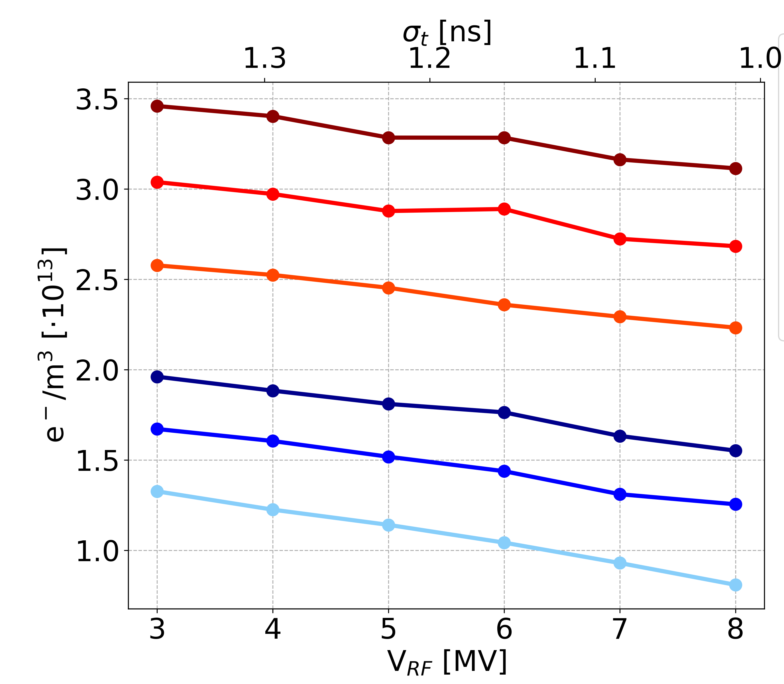
  Why no Instability at High Intensity?
Effect of SEY and Bunch Charge
1.2 x 10¹¹ p/b, SEY=1.5
1.2 x 10¹¹ p/b, SEY=1.4
1.2 x 10¹¹ p/b, SEY=1.3
2.3 x 10¹¹ p/b, SEY=1.5
2.3 x 10¹¹ p/b, SEY=1.4
2.3 x 10¹¹ p/b, SEY=1.3
The electron density average, close to the bunch, during the pinch is significantly smaller for high intensity

Slide 31
Outline
Build-up
Convergence Studies
Bunch Length and RF Voltage Amplitude
Effect of SEY and Bunch Charge
Chromaticity and Damper
Octupoles
Conclusions and Future Developments

Slide 32
Chromaticity and Damper
Scanned around these points

Slide 33
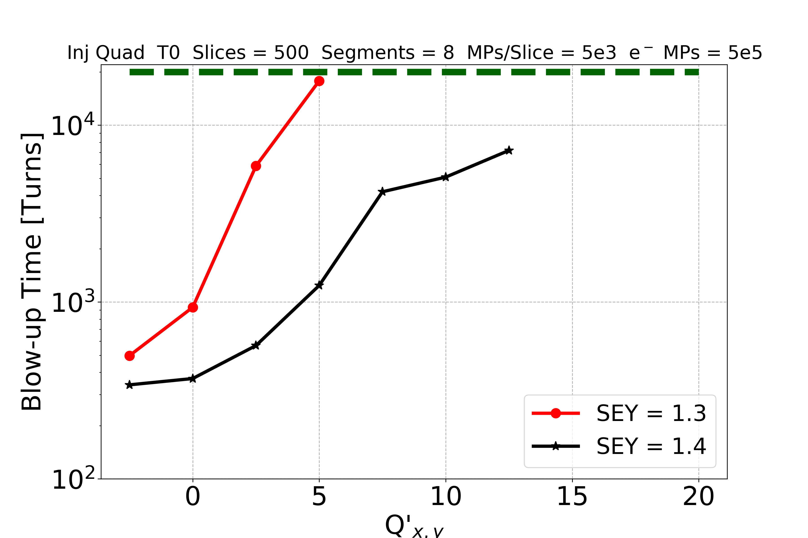
Chromaticity and Damper
V_{RF} = 4 MV
SEY = 1.3 – 1.4
Feedback damping time is 10 turns
No instability observed over 20k turns for Q’ > 12.5!
For the case of LHC intensity (which an instability could be observed) the effectiveness of different mitigation measures has been investigated:
  The instability is strongly mitigated by increasing the chromaticity settings

Slide 34
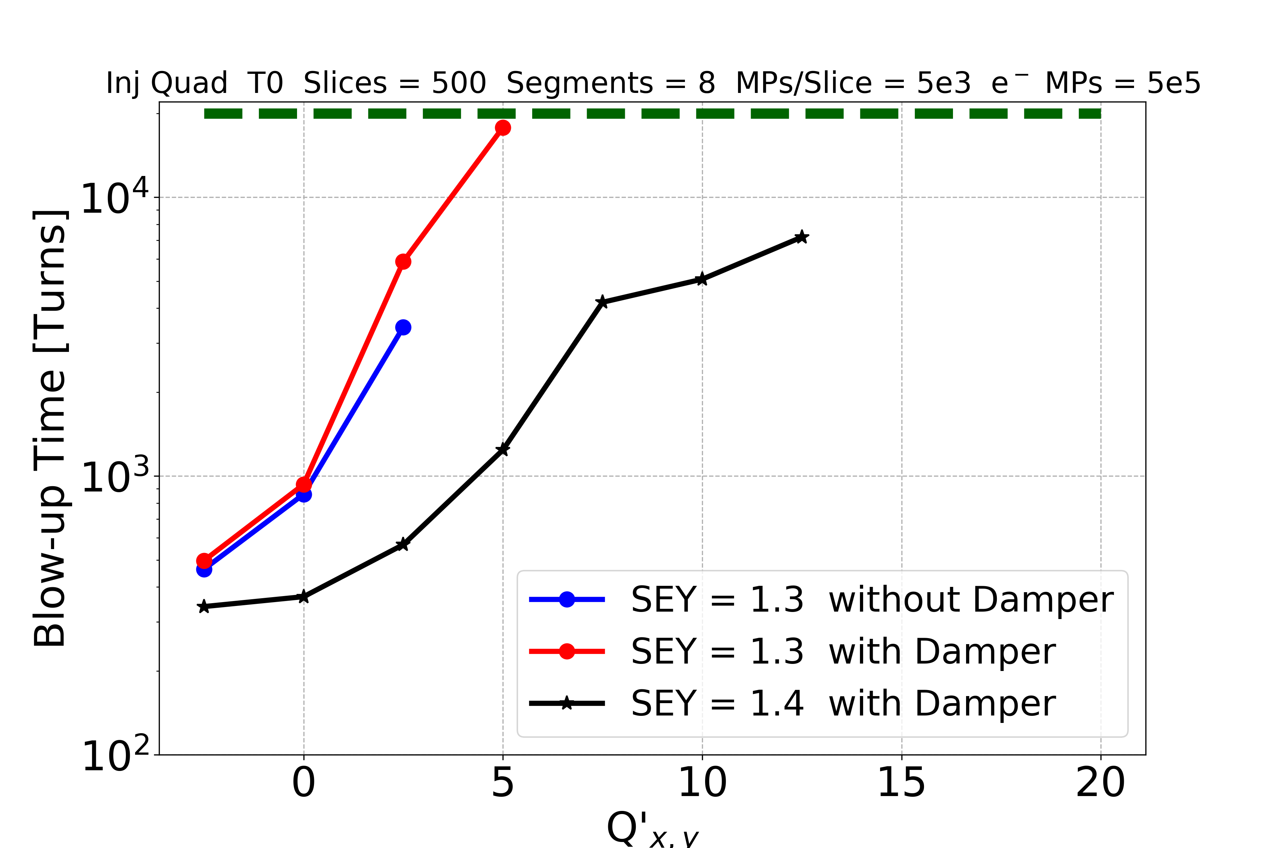
Chromaticity and Damper
V_{RF} = 4 MV
SEY = 1.3 – 1.4
Feedback damping time is 10 turns
No instability observed over 20k turns for Q’ > 12.5!
For the case of LHC intensity (in which an instability could be observed) the effectiveness of different mitigation measures has been investigated:
  The instability is strongly mitigated by increasing the chromaticity settings
  The transverse feedback is mostly ineffective → cannot damp intra-bunch motion

Slide 35
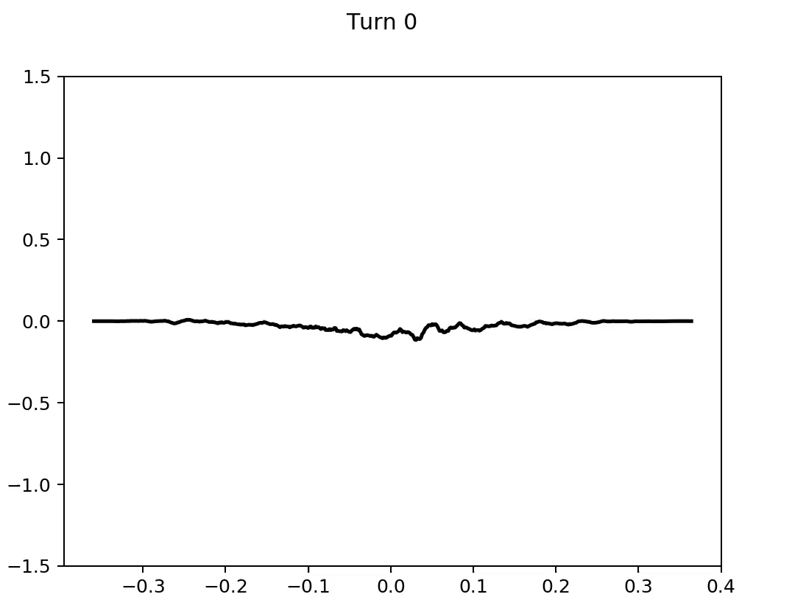
Chromaticity and Damper
Example: V_{RF} = 4MV, SEY = 1.4, Q’ = 2.5…?
Feedback ON
Pickup Δ-signal
z [m]
Strong intra-bunch motion → transverse feedback is mostly ineffective

Slide 36
Outline
Build-up
Convergence Studies
Bunch Length and RF Voltage Amplitude
Effect of SEY and Bunch Charge
Chromaticity and Damper
Octupoles
Conclusions and Future Developments

Slide 37
Octupoles
Explored starting from this point

Slide 38
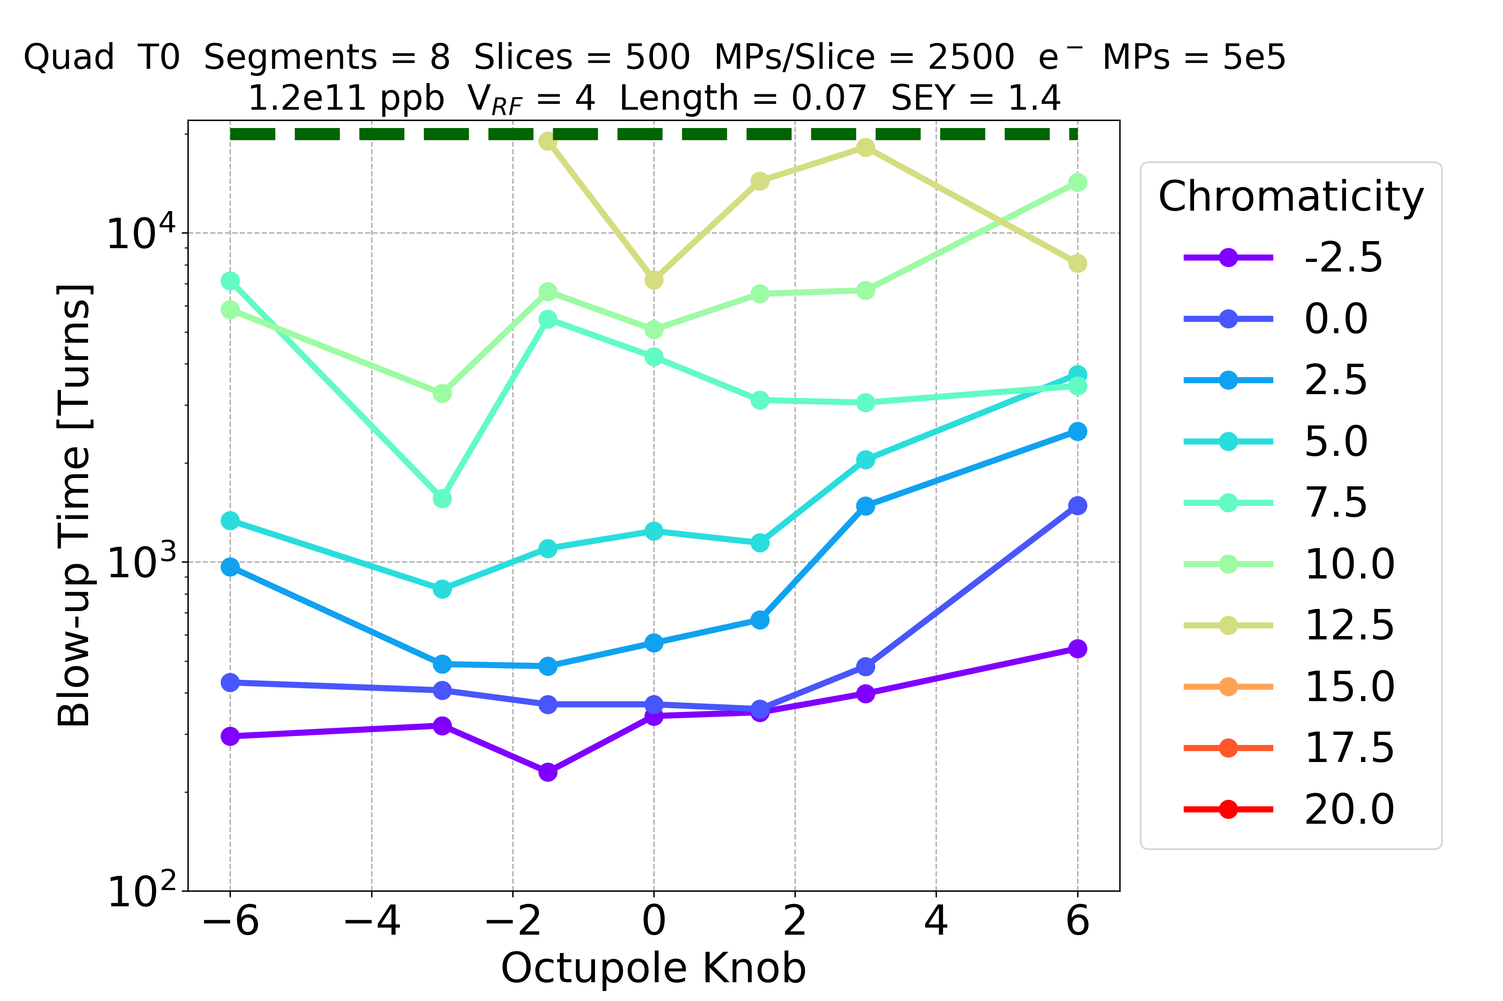
Octupoles
V_{RF} = 4 MV
SEY = 1.4
Damper = 10 turns
I = 78 A
I = -78 A
For the case of LHC intensity the octupole current has also been scanned (between -78 A and 78 A)
  → less effective compared to chromaticity
38

Slide 39
Outline
Build-up
Convergence Studies
Bunch Length and RF Voltage Amplitude
Effect of SEY and Bunch Charge
Chromaticity and Damper
Octupoles
Conclusions and Future Developments

Slide 40
Conclusions
  Extensive convergence studies at injection are carried out
  Decreasing V_{RF} the bunch is more unstable
    dominant factor is the de-stabilising effect due to the change of the synchrotron tune
  No instability for 2.3e11 ppb in the entire range of parameters
    electron density average is smaller for high intensity
  Damper does not affect significantly the blow-up time (unable to suppress intra-bunch motion)
  Positive chromaticity strongly mitigates the instability
  Octupoles are less effective compared to chromaticity

Slide 41
Thanks for your attention

Slide 45
Spares

Slide 46
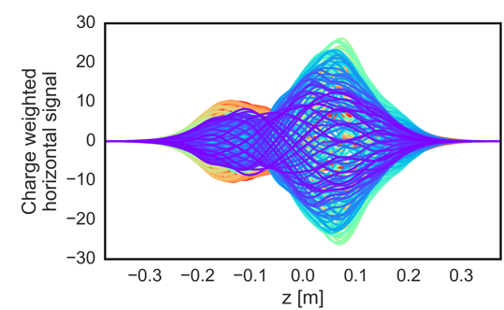
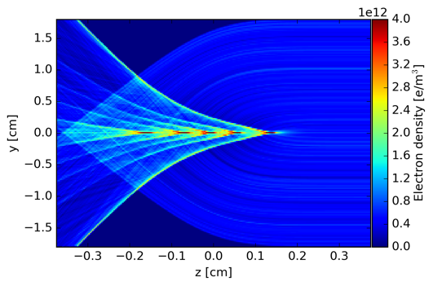
Introduction: Motivation
The electron motion is fast enough to act as a coupling mechanism between the head and the tail of the bunch (dominated by electrons at the beam location)
  Stronger at injection energy due to lower beam rigidity
Proton bunch
oscillations
Electron dynamics
Tail
Head

Slide 47
Introduction: Numerical Parameters
The motivation of these convergence studies is to find the lower acceptable values for the numerical parameters:
  transverse grids

Slide 48
Introduction: Numerical Parameters
The motivation of these convergence studies is to find the lower acceptable values for the numerical parameters:
  transverse grids
    Single grid
      PyPICmode = ‘FiniteDifference_ShortleyWeller’
      Dh_sc_ext

Slide 49
Introduction: Numerical Parameters
The motivation of these convergence studies is to find the lower acceptable values for the numerical parameters:
  transverse grids
    Multigrid [1]:
[1] E. Belli, “PyPIC: the multigrid solver”, EC Meeting #32 – September 2, 2016

Slide 50
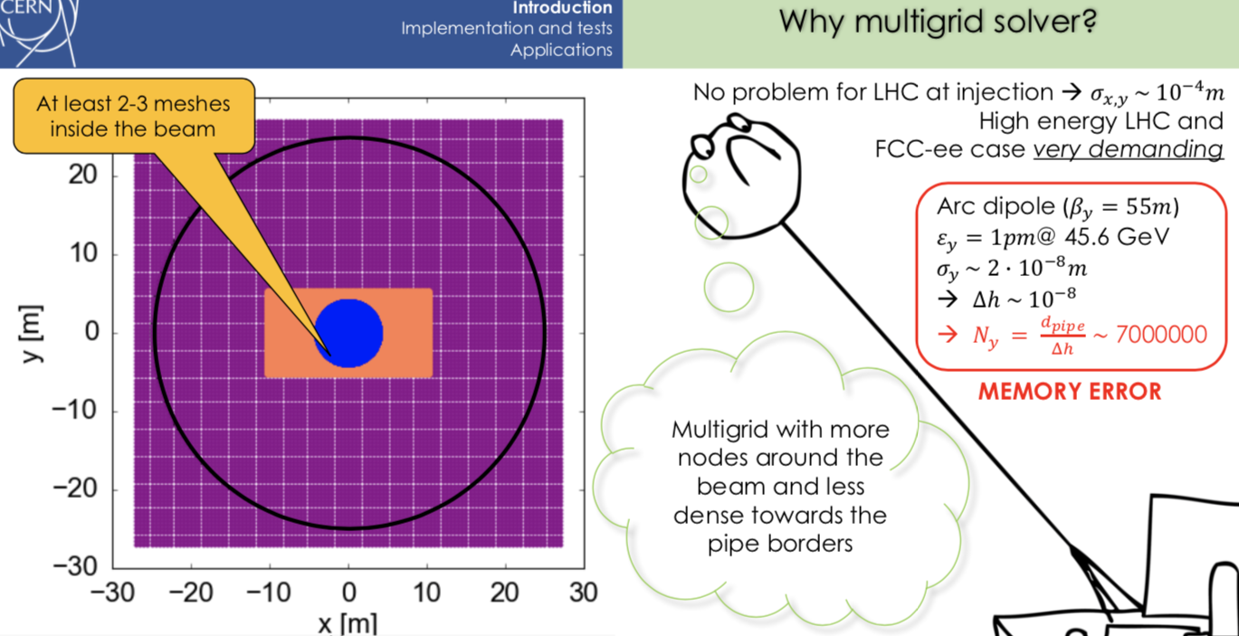
Introduction: Numerical Parameters
The motivation of these convergence studies is to find the lower acceptable values for the numerical parameters:
  transverse grids
    Multigrid:
Courtesy of
E. Belli

Slide 51
Introduction: Numerical Parameters
The motivation of these convergence studies is to find the lower acceptable values for the numerical parameters:
  transverse grids
    Multigrid:
      PyPICmode = ‘ShortleyWeller_WithTelescopicGrids’
      f_telescope
      target_grid
        target_size_internal_grid_sigma
        target_Dh_internal_grid_sigma
      N_nodes_discard
      N_min_Dh_main
      Dh_sc_ext

Slide 52
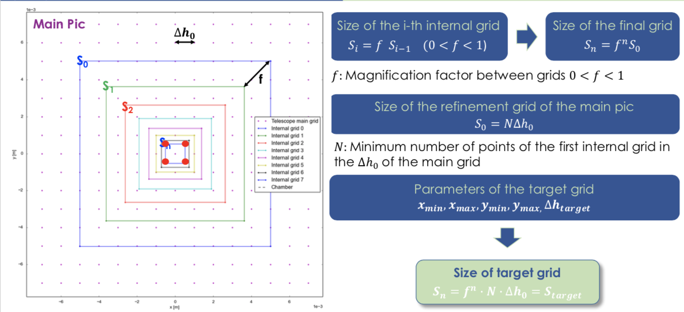
Introduction: Numerical Parameters
The motivation of these convergence studies is to find the lower acceptable values for the numerical parameters:
  transverse grids
    Multigrid:
      f_telescope: Magnification factor between grids (0 < f < 1)
Courtesy of
E. Belli

Slide 53
Introduction: Numerical Parameters
The motivation of these convergence studies is to find the lower acceptable values for the numerical parameters:
  transverse grids
    Multigrid:
      target_grid: dictionary with the internal grid parameters: ‘x_min_target’, ‘x_max_target’, ‘y_min_target’, ‘y_max_target’, ‘Dh_target’
Courtesy of
E. Belli

Slide 54

Introduction: Numerical Parameters
The motivation of these convergence studies is to find the lower acceptable values for the numerical parameters:
  transverse grids
    Multigrid:
      target_grid: dictionary with the internal grid parameters
Can be given also in terms of transverse sigma of the beam:
        target_size_internal_grid_sigma
        target_Dh_internal_grid_sigma

Slide 55
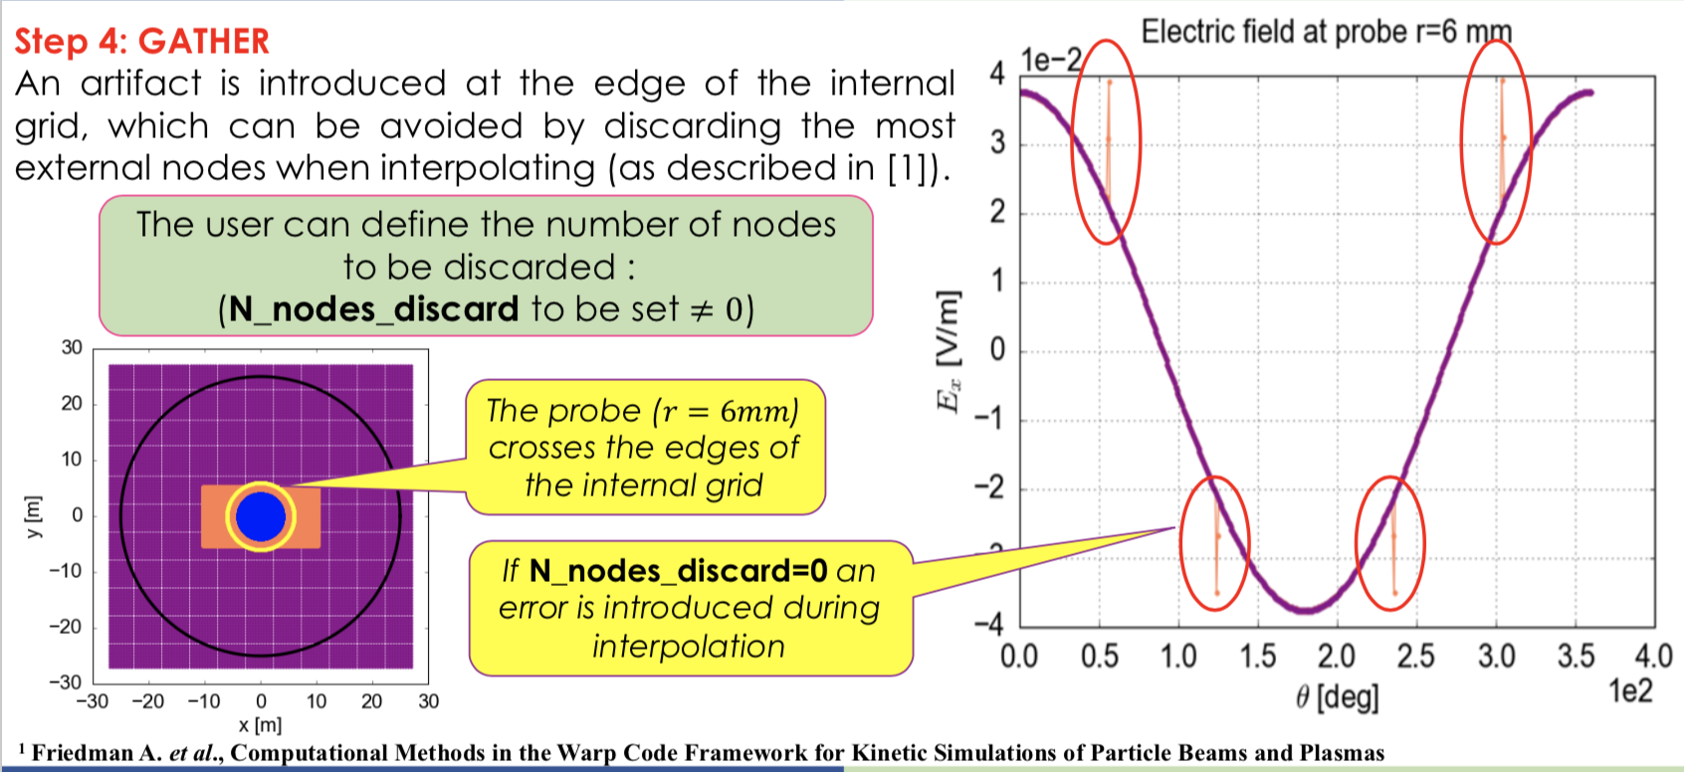
Introduction: Numerical Parameters
The motivation of these convergence studies is to find the lower acceptable values for the numerical parameters:
  transverse grids
    Multigrid:
      N_nodes_discard: number of nodes at the edge of the internal grids which are discarded in the field interpolation
Courtesy of
E. Belli

Slide 56
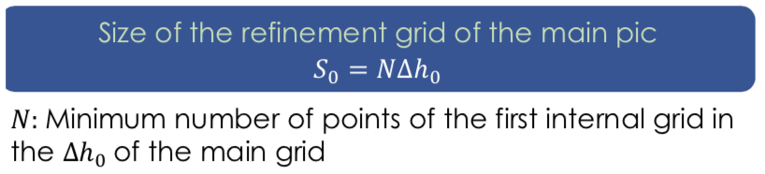
Introduction: Numerical Parameters
The motivation of these convergence studies is to find the lower acceptable values for the numerical parameters:
  transverse grids
    Multigrid:
      N_min_Dh_main: minimum size of the first internal grid, in number of points of the step of the main grid
Courtesy of
E. Belli

Slide 57
Introduction: Numerical Parameters
The motivation of these convergence studies is to find the lower acceptable values for the numerical parameters:
  transverse grids
    Multigrid:
      Dh_sc_ext: step of the external grid

Slide 58
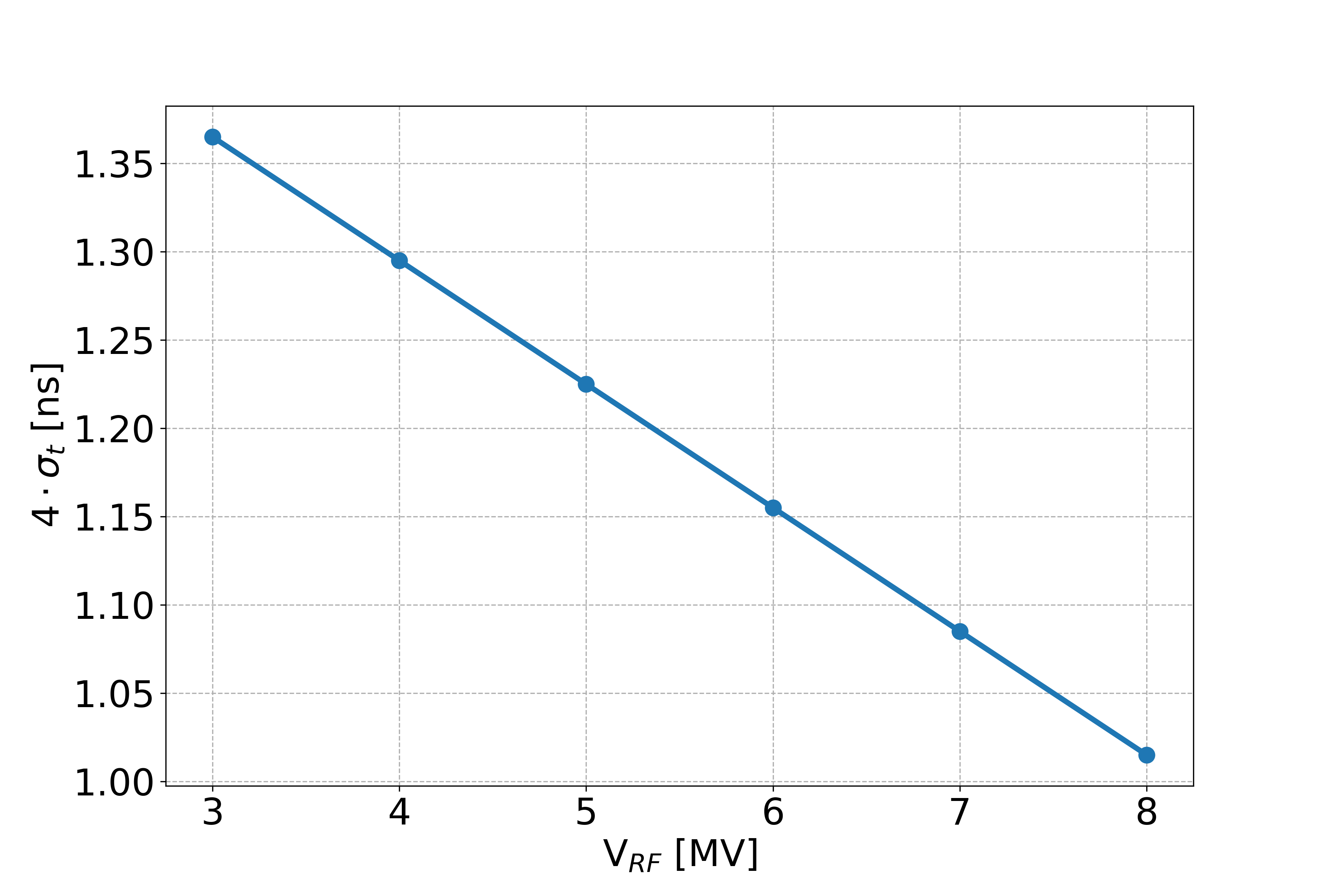
Introduction: Numerical Parameters
  Scan: 4𝜎_{t} (1.37 – 1.02 ns) / RF voltage (3 - 8 MV)
[1] H. Timko, “Injection Voltage Reduction In the LHC” – September 5, 2018

Slide 59
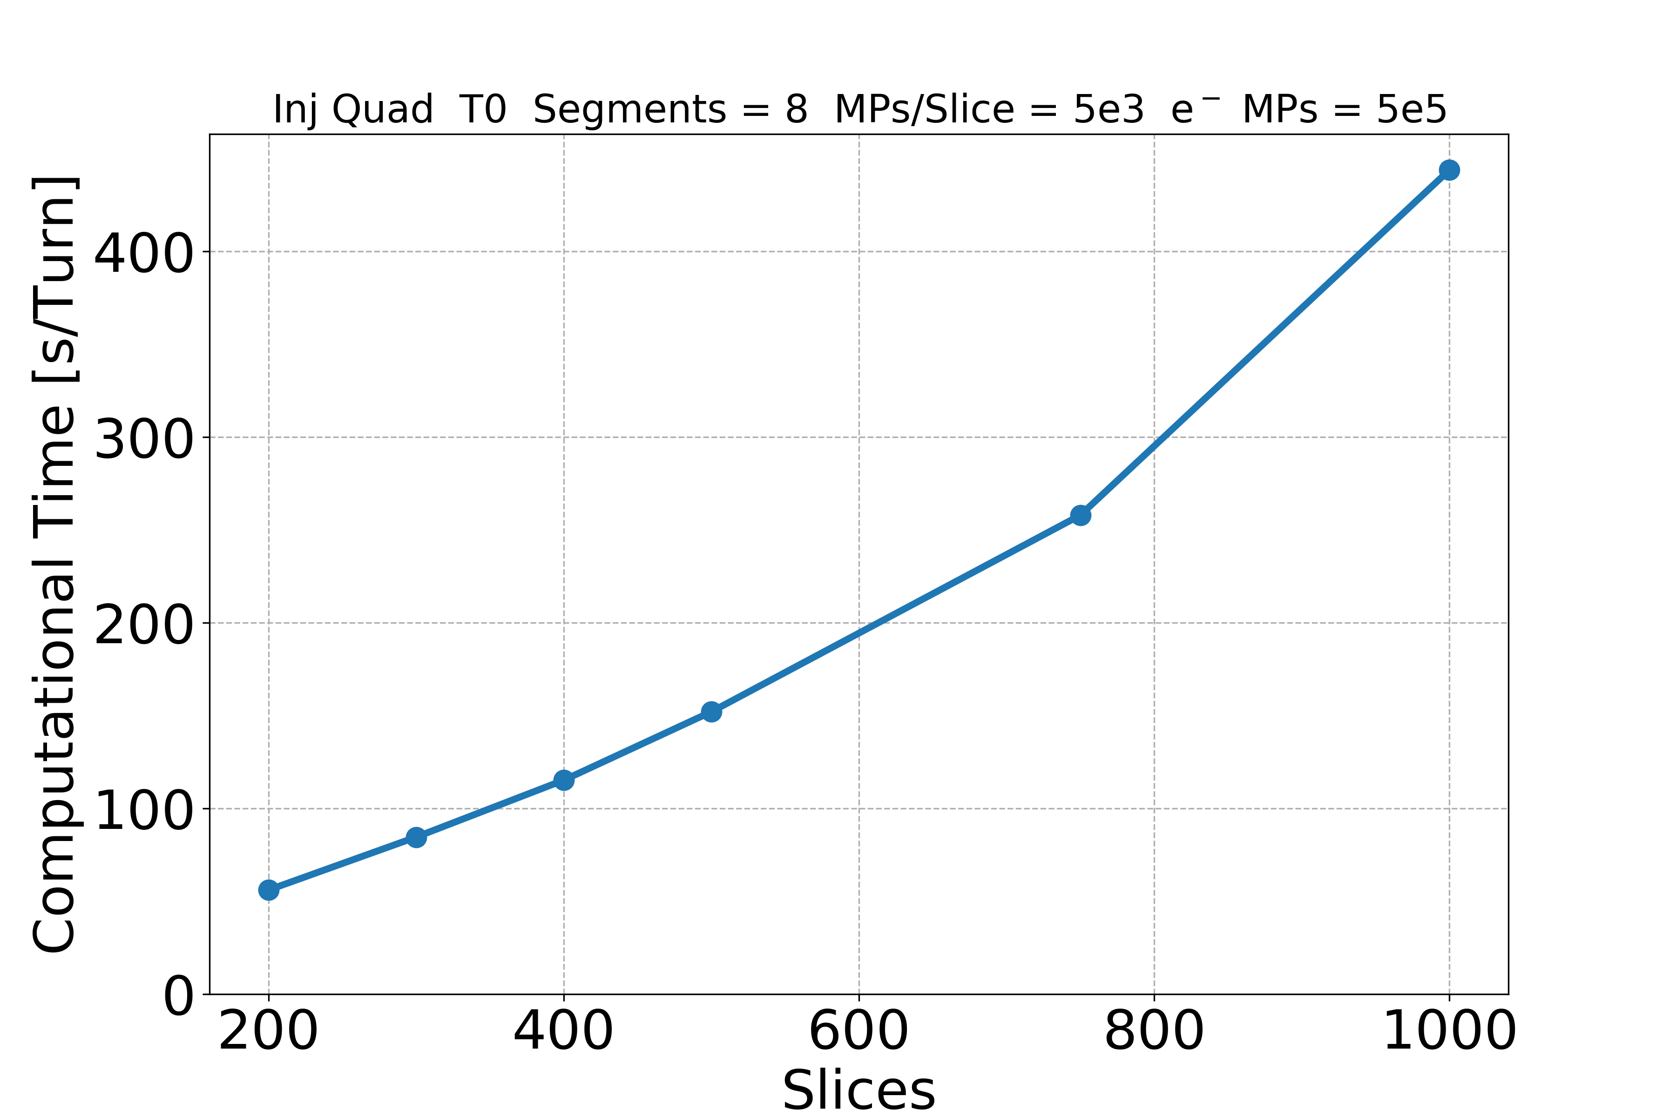
Convergence Studies: Slices
Computational Time
The simulations are: 108.
The finished simulations are: 108. The killed simulations are: 0.
Total computational time: 858 days (8 cores).
28.5 GB stored.

Slide 60
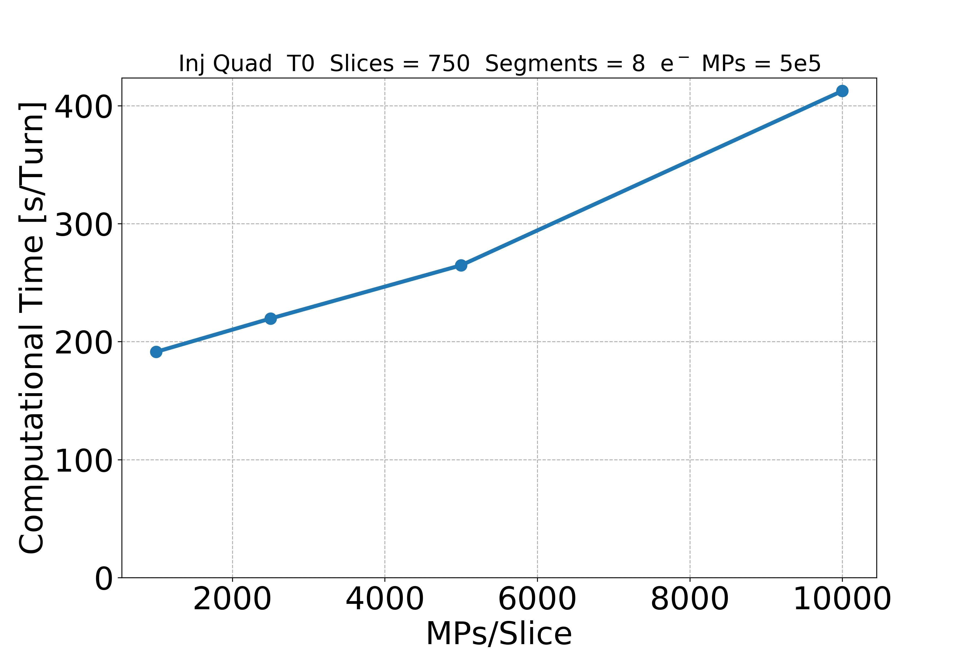
Convergence Studies: MPs/Slice
Computational Time
The simulations are: 72.
The finished simulations are: 72. The killed simulations are: 0.
Total computational time: 818 days (8 cores).
24.6 GB stored.

Slide 61
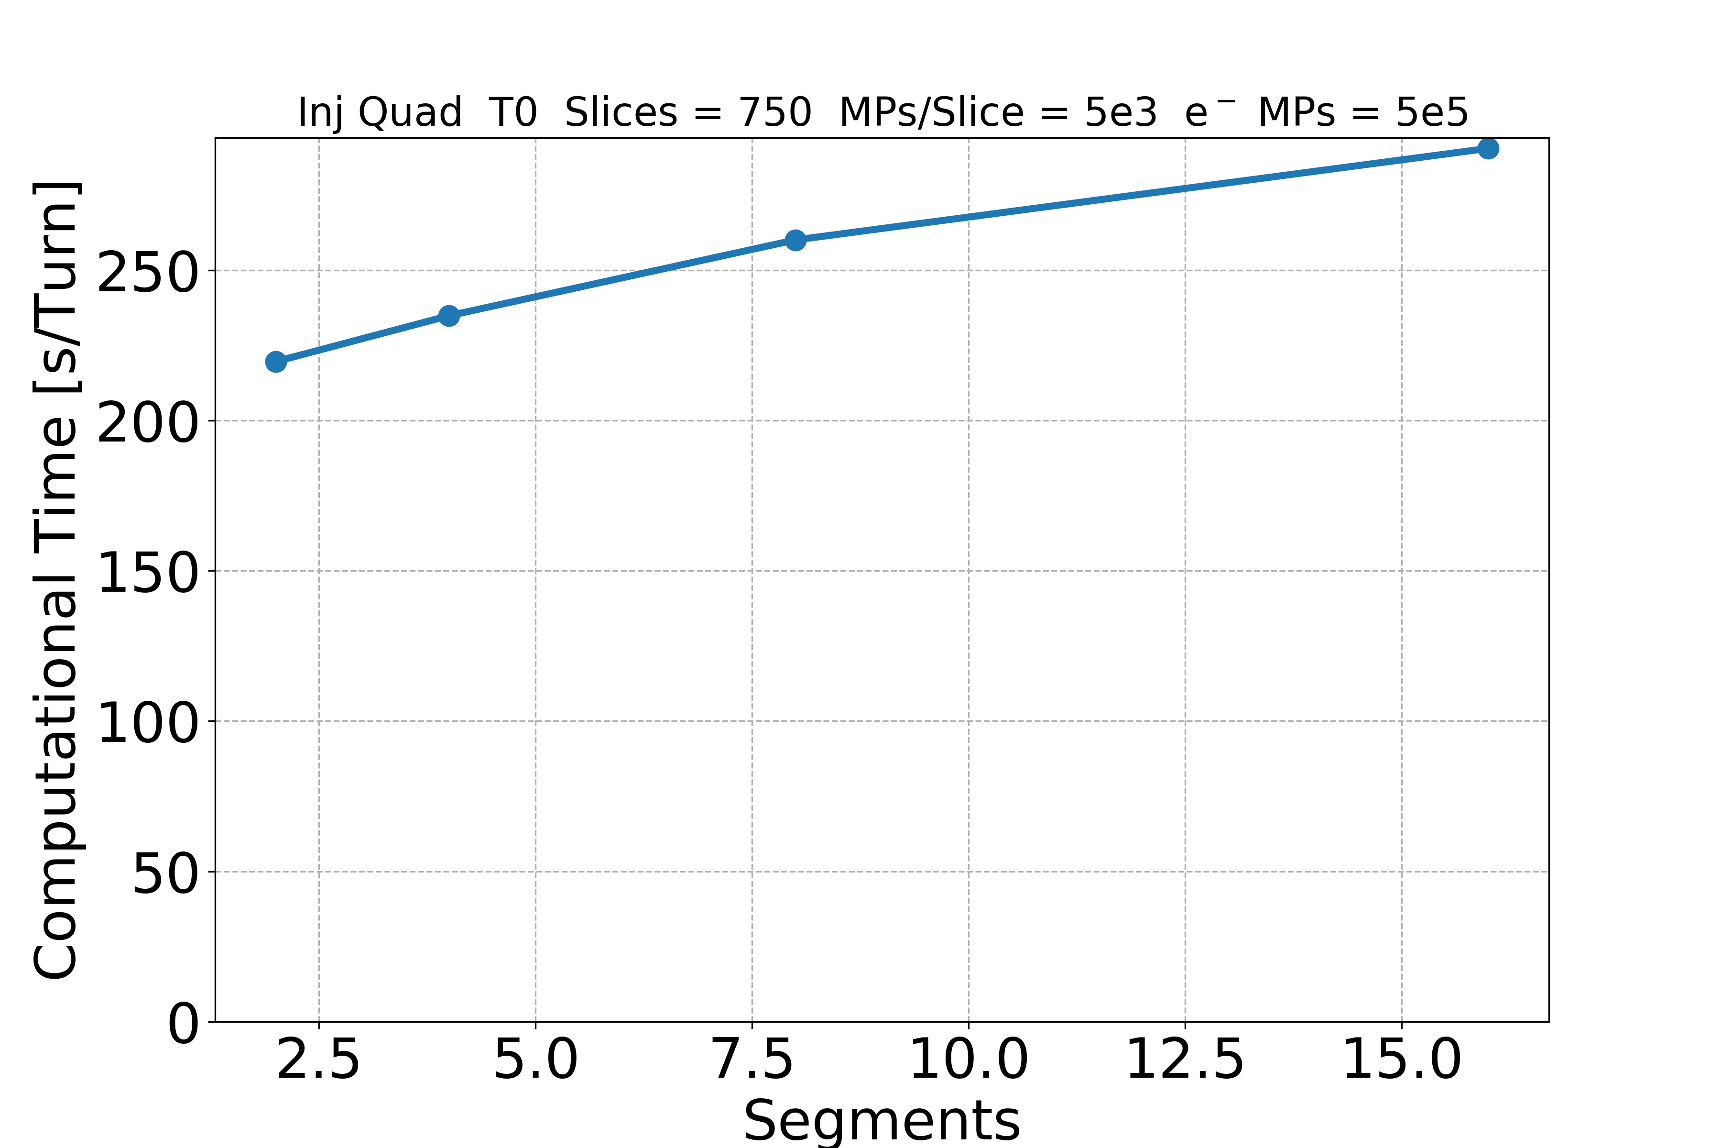
Convergence Studies: Segments
Computational Time
The simulations are: 72.
The finished simulations are: 72. The killed simulations are: 0.
Total computational time: 748 days (number of cores depends on segments).
25.7 GB stored.

Slide 62
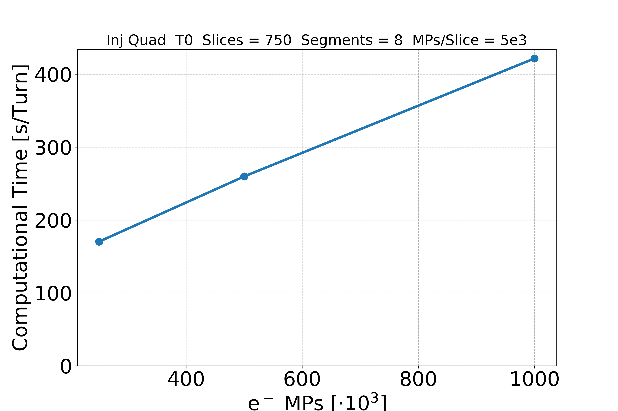
Convergence Studies: e⁻ MPs
Computational Time
The simulations are: 54.
The finished simulations are: 54. The killed simulations are: 0.
Total computational time: 645 days (8 cores).
19.7 GB stored.

Slide 63
Convergence Studies: Transverse Grid
T₀
Parameter | Value
f (magnification factor) | 0.3
S_{N} [mm] | 6.95 (10𝜎)
Δh_{N} [mm] | 0.139 (0.2𝜎)
Δh₀ [mm] | 0.8
N_nodes_discard | 5
N_min_Dh_main | 10
Δh_{N}
2*S_{N}
…
Δh₁
Δh₀
2*S₁
2*S₀

Slide 64
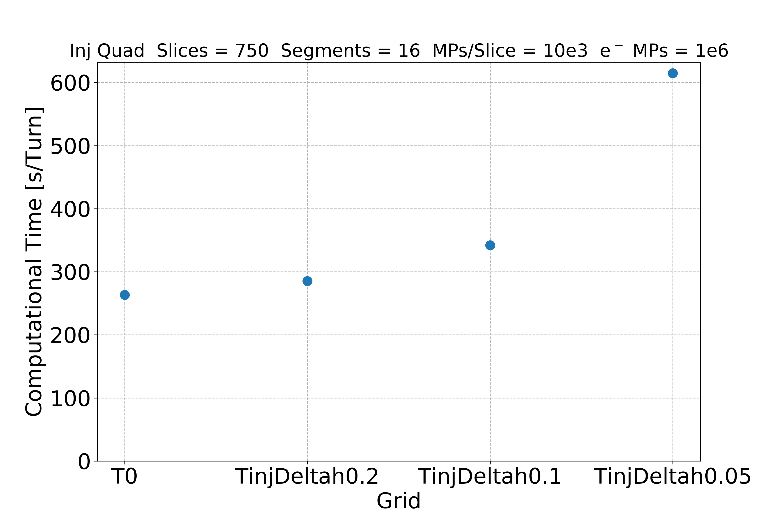
Convergence Studies: Transverse Grid
Computational Time
The simulations are: 72.
The finished simulations are: 69. The killed simulations are: 0.
Total computational time: 1035 days (8 cores).
25.4 GB stored.
The slowest simulation needs 35 days to reach 20,000 turns.
The fastest simulation needs 26 days to reach 20,000 turns.
(last download 19/11/2019)

Slide 66
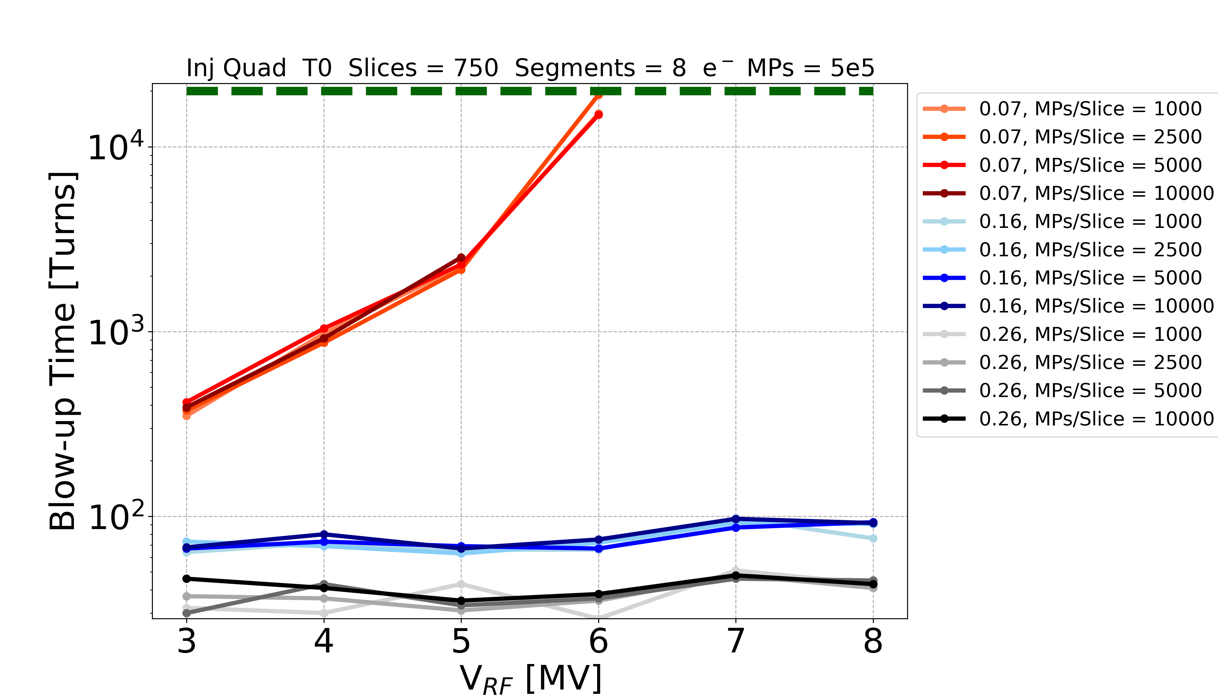
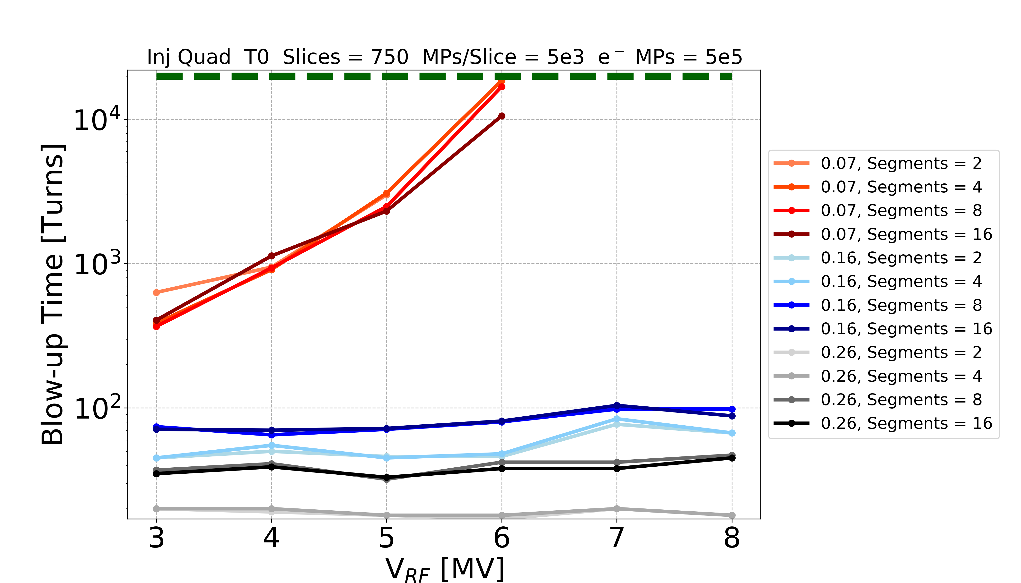
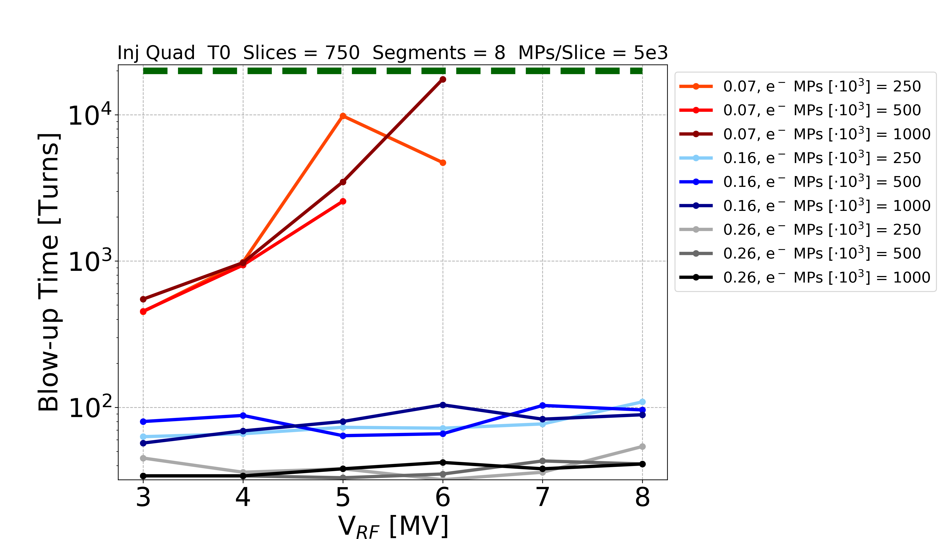
Convergence Studies: 16% - 26%
Slices MPs/Slice
Segments e⁻ MPs

Slide 67
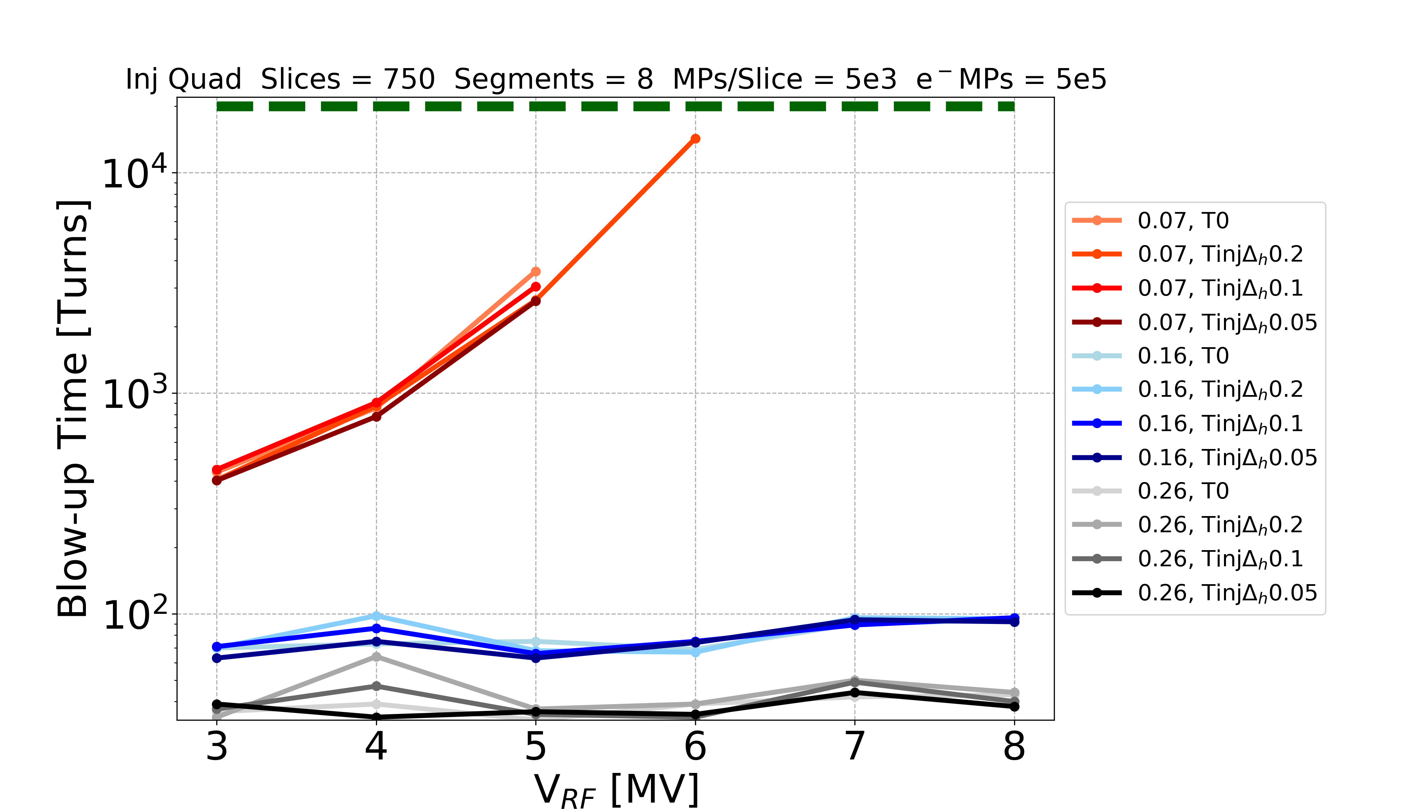
Convergence Studies: 16% - 26%
Transverse Grids

Slide 69
  Why no Instability at High Intensity?
It can be related to the number of electrons around the chamber centre (from build-up simulations)
Useful Parameter in PyECLOUD
cen_density [e⁻/m³]: electron volumetric density in a sphere around the chamber centre with radius r_center (input simulation parameter)
r_center = 1 mm
y
r_center
x

Slide 70
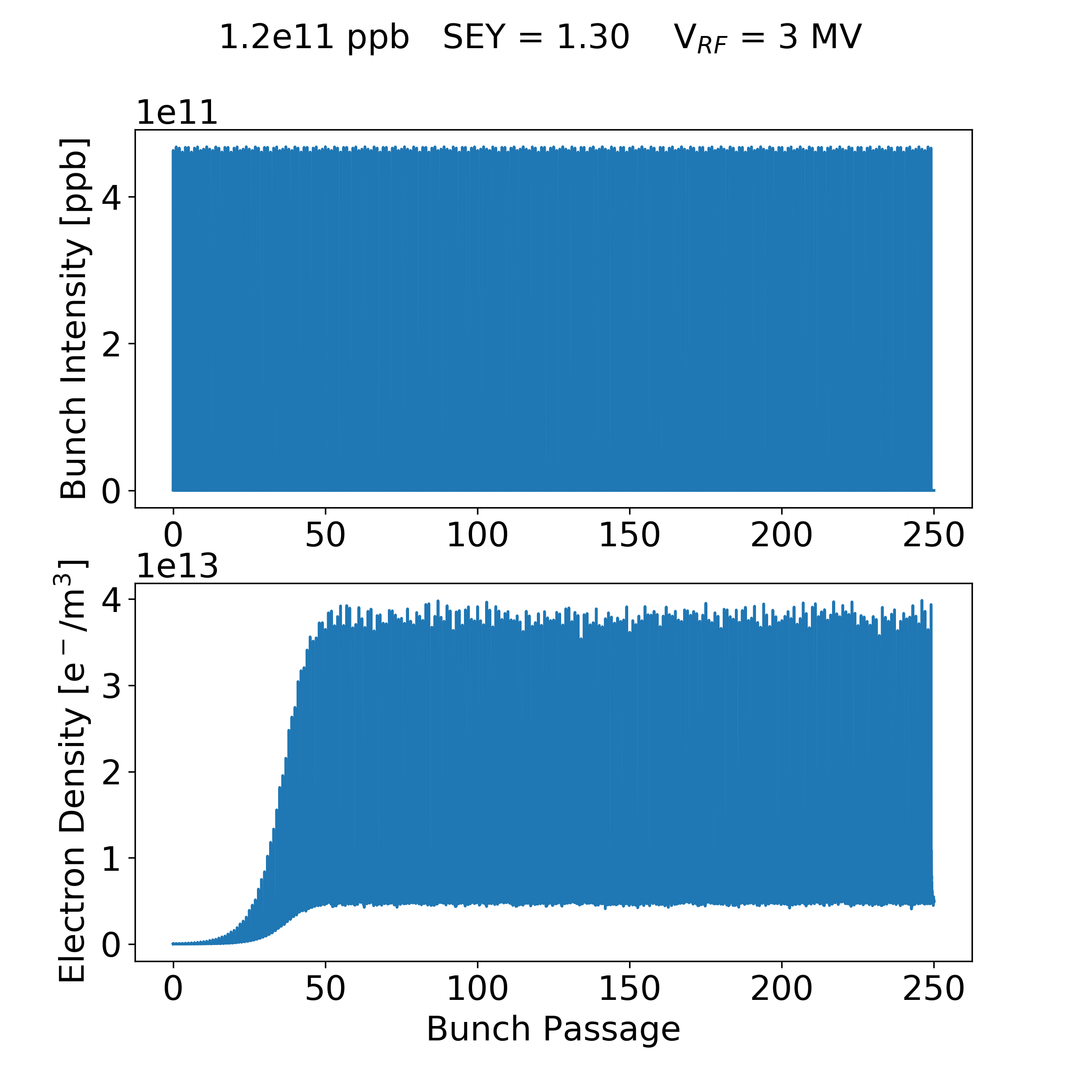
  Build-up: Full Plot
  Why no Instability at High Intensity?

Slide 71
  Build-up: Full Plot
  Why no Instability at High Intensity?
The combined build-up status are: 196 – 204 bunches
Build-up in saturation

Slide 72
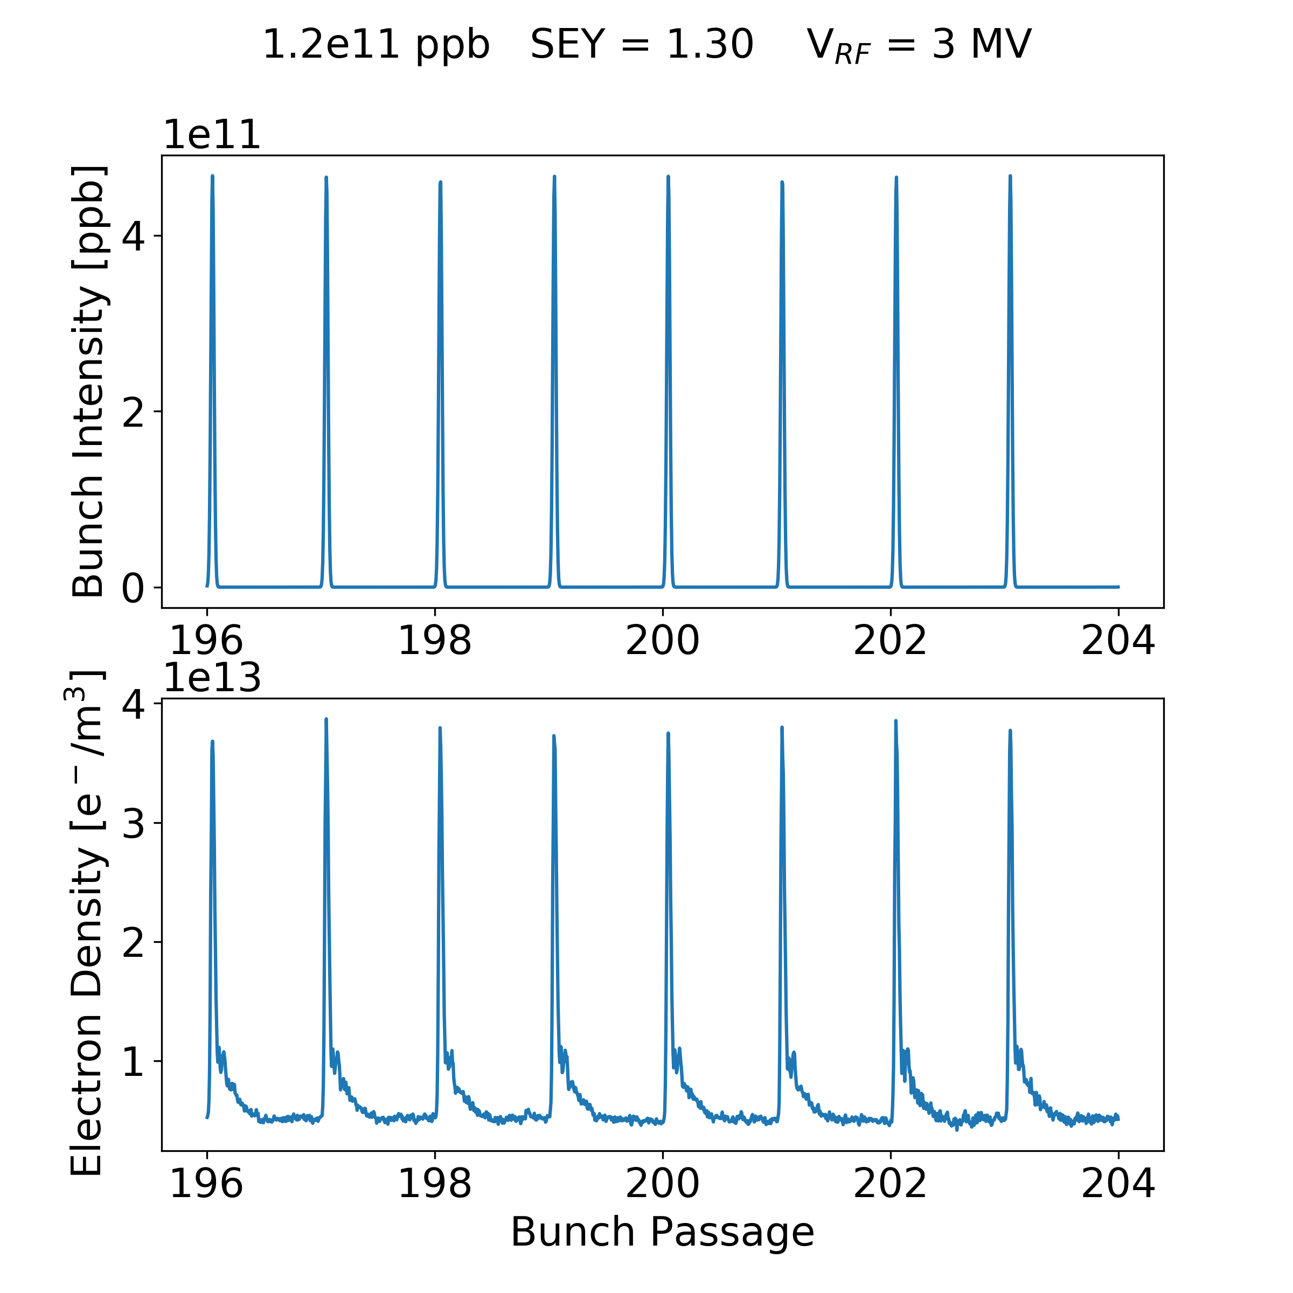
  Build-up: Zoom Plot
  Why no Instability at High Intensity?

Slide 73
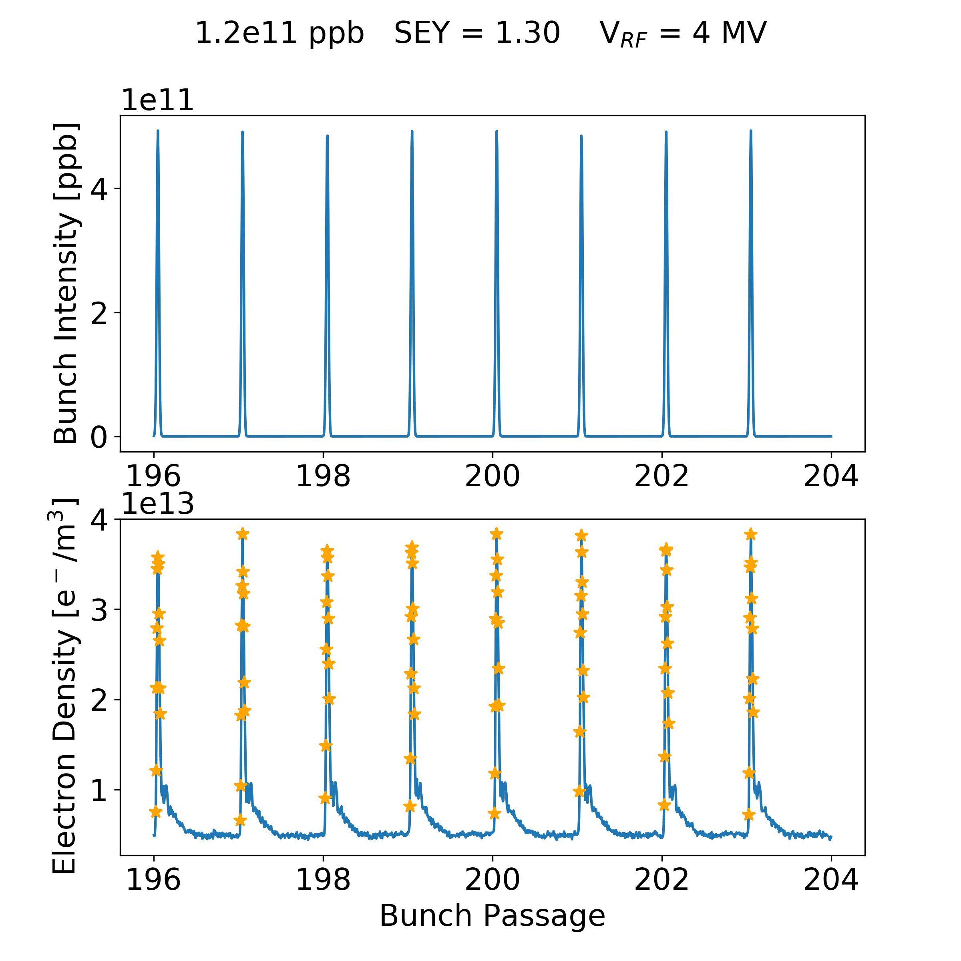
  Build-up: Zoom Plot
  Why no Instability at High Intensity?
Mask: points only when the number of the proton bunch is larger than 10% of the maximum

Slide 74
  Build-up: Zoom Plot
  Why no Instability at High Intensity?
Average of these values
2.5e13 e⁻/m³

Slide 76
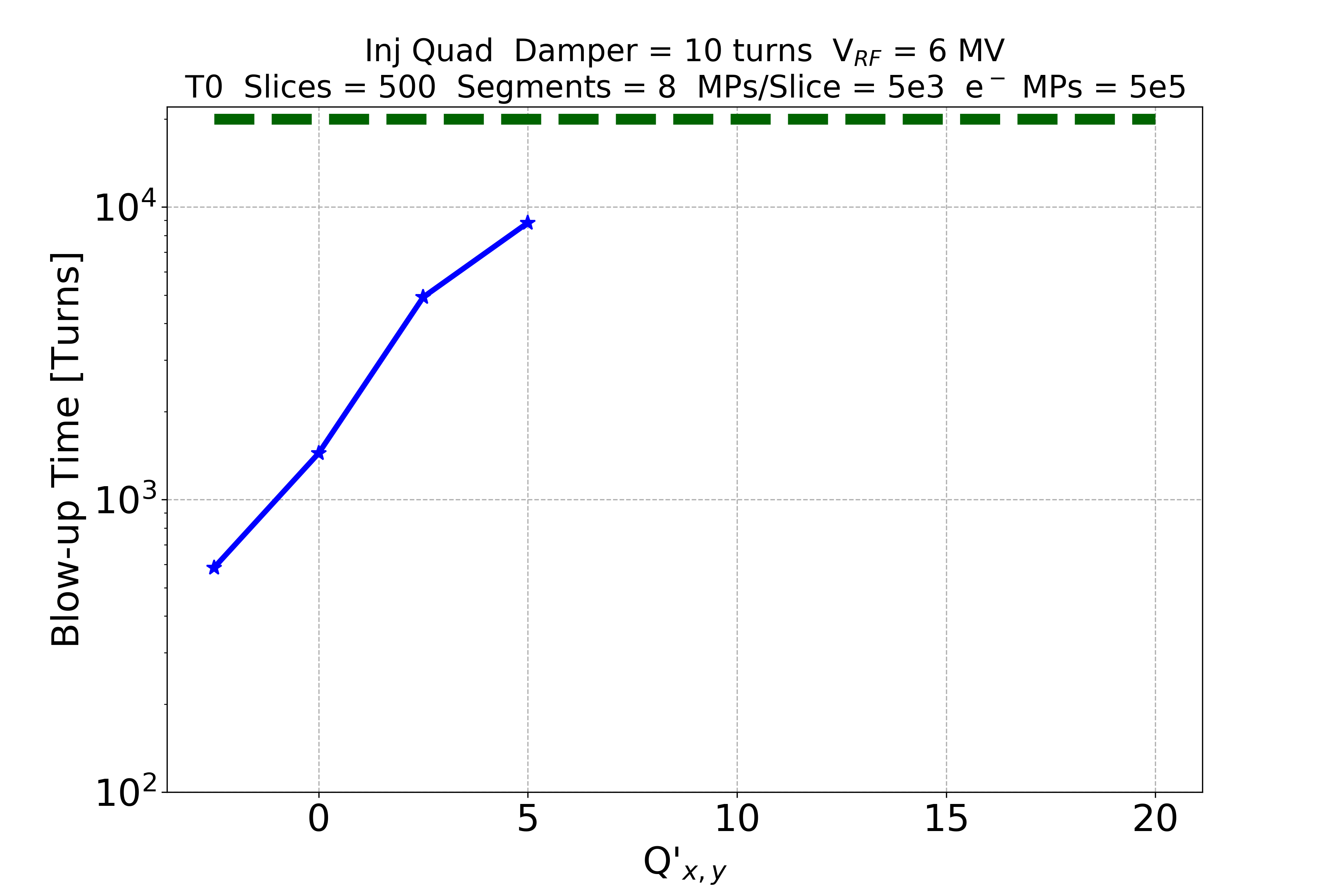
Chromaticity
V_{RF} = 6 MV
SEY = 1.4
Damper = 10 turns
76

Slide 78
Chromaticity and Damper
V_{RF} = 4 MV
SEY = 1.3 – 1.4
Feedback damping time is 10 turns
No instability observed over 20k turns for Q’ > 12.5!
For the case of LHC intensity (which an instability could be observed) the effectiveness of different mitigation measures has been investigated:
  The instability is strongly mitigated by increasing the chromaticity settings
  The transverse feedback is mostly ineffective →cannot damp intra-bunch motion

Slide 79
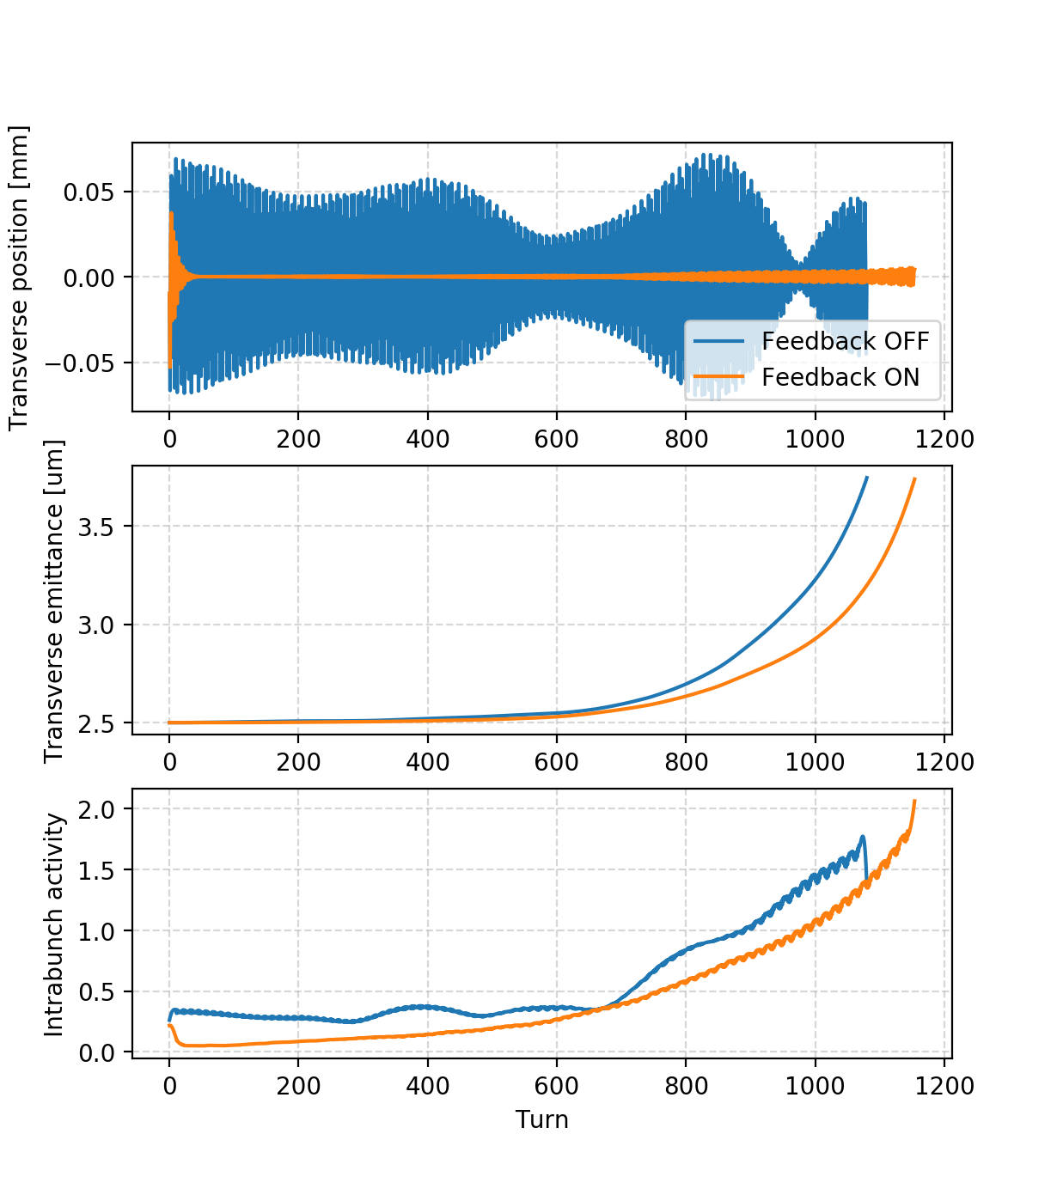
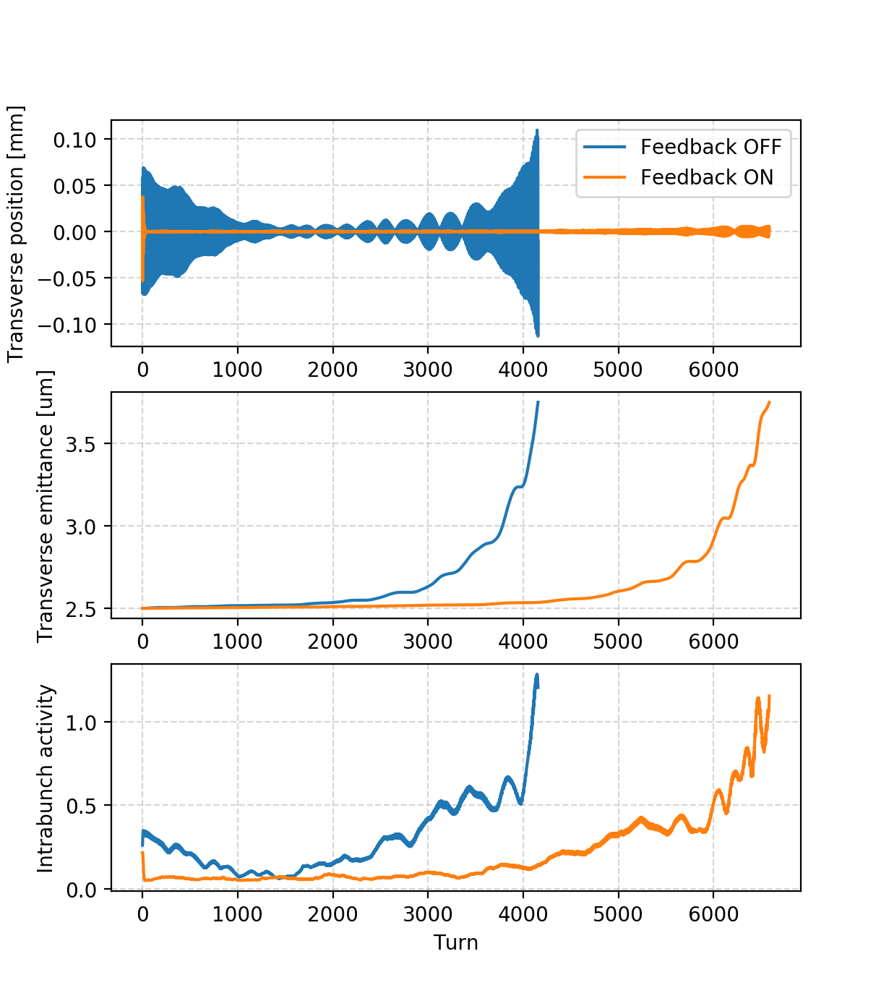
Chromaticity and Damper
SEY = 1.3, Q’ = 0
SEY = 1.3, Q’ = 2.5
For the case of LHC intensity (which an instability could be observed) the effectiveness of different mitigation measures has been investigated:
  The instability is strongly mitigated by increasing the chromaticity settings
  The transverse feedback (bunch-by-bunch, damping time of 10 turns) is mostly ineffective → cannot damp intra-bunch motion

Slide 80
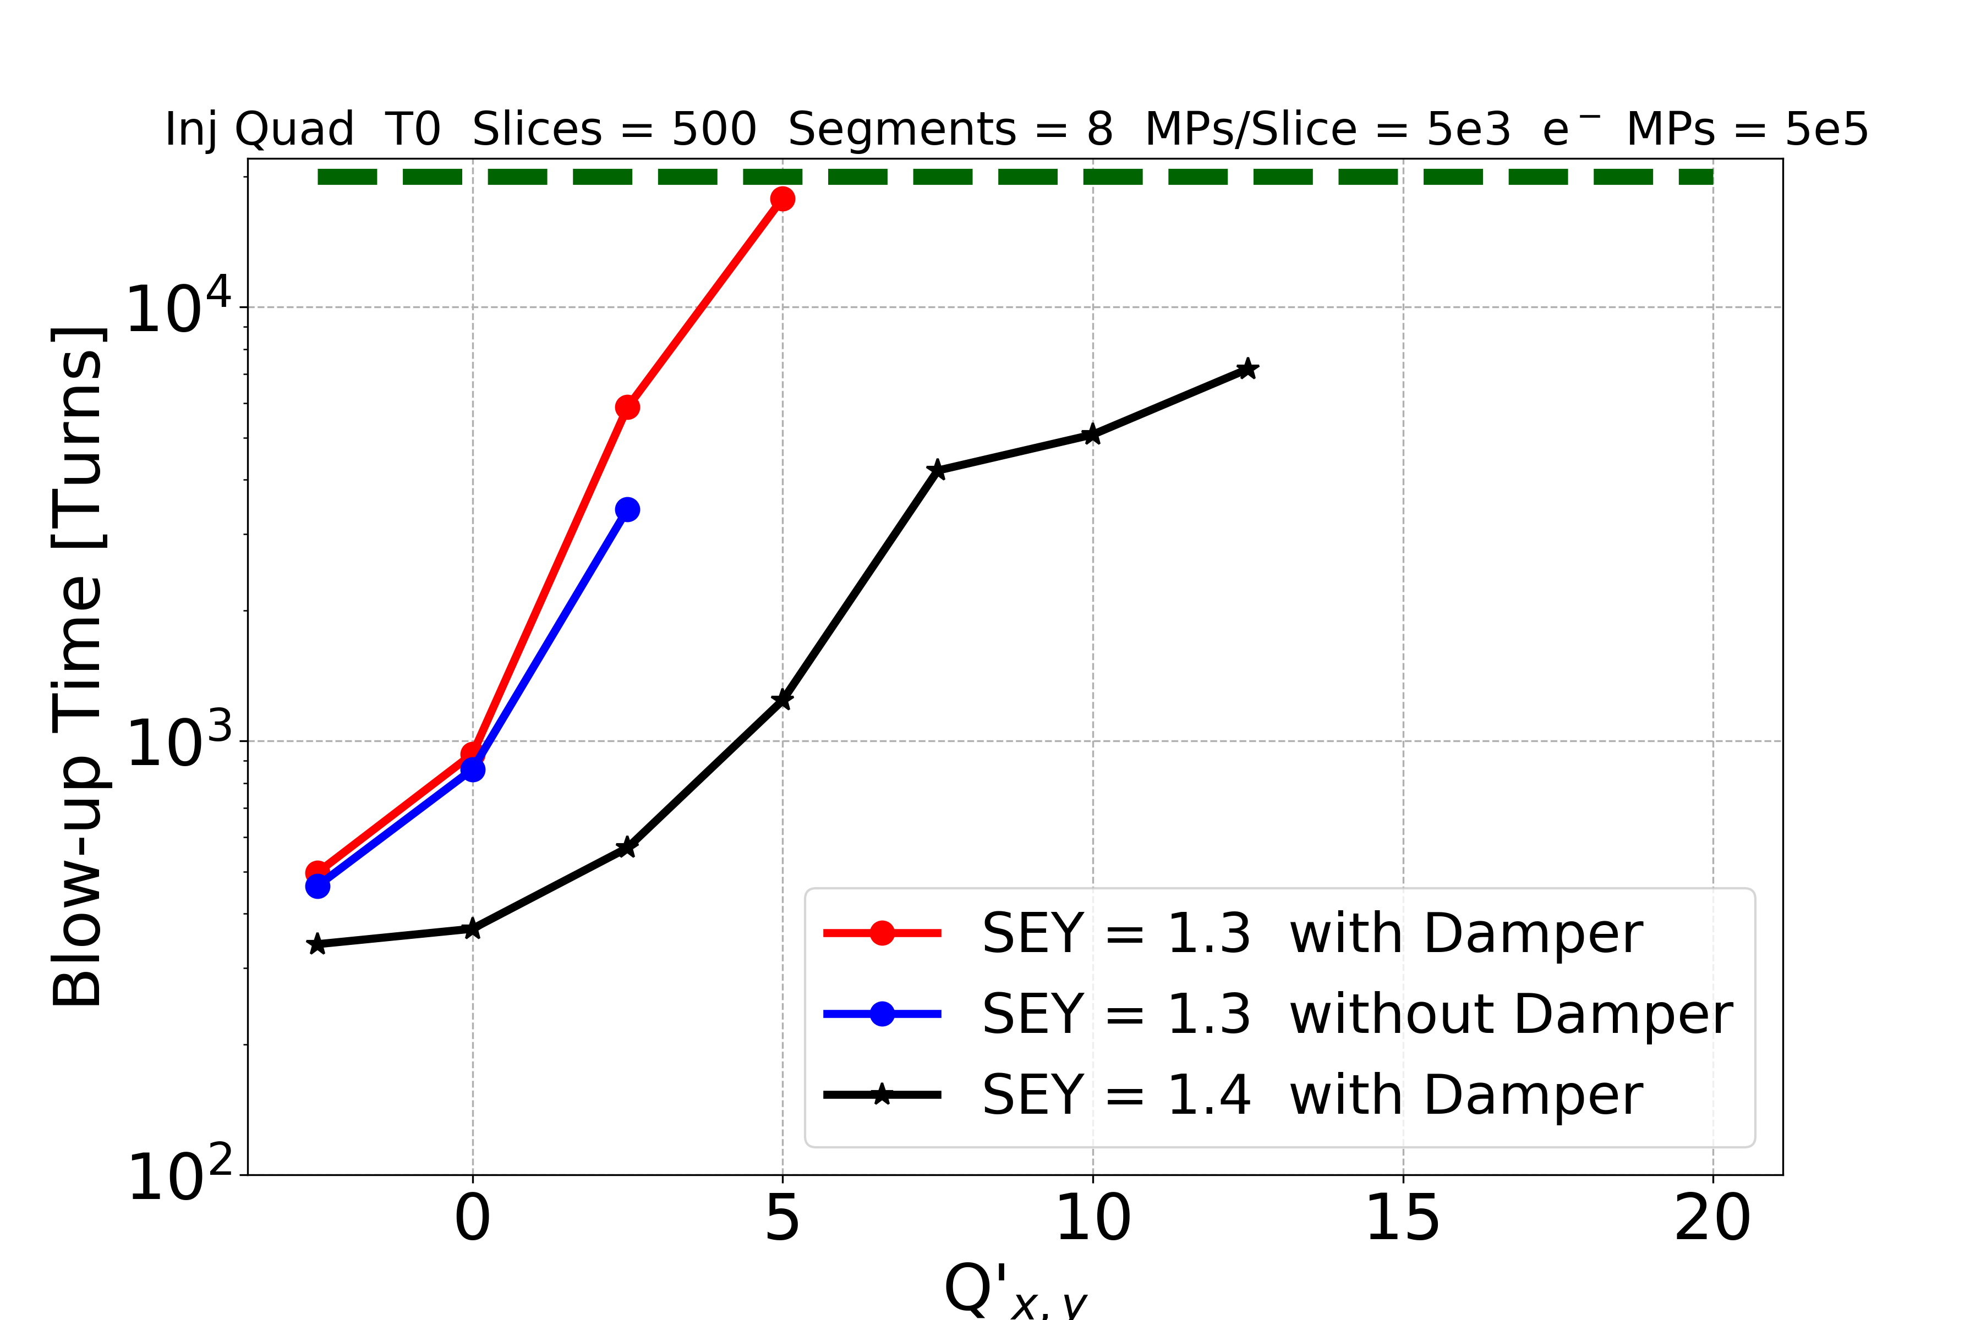
Chromaticity and Damper
V_{RF} = 4 MV
SEY = 1.3 – 1.4
Feedback damping time is 10 turns
No instability observed over 20k turns for Q’ > 12.5!
Positive chromaticity strongly mitigates the instability
The damper does not affect significantly the blow-up time (unable to suppress intra-bunch motion)

Slide 81
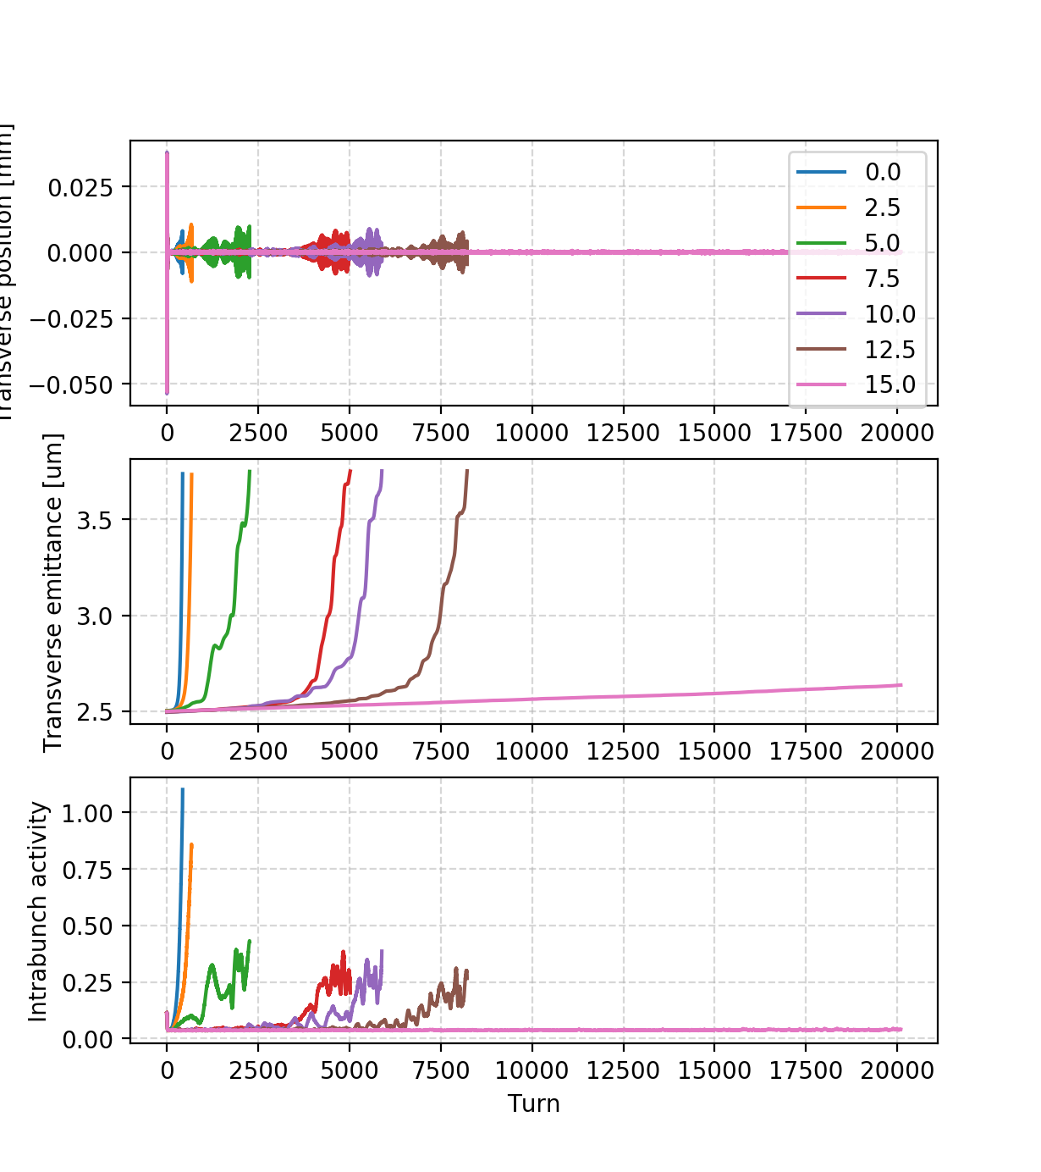
Chromaticity and Damper
SEY = 1.4, Damper ON

