Slide 1

Indications from spectral analysis
G. Iadarola and L. Sabato
Many thanks to:
H. Bartosik, E. Métral, L. Mether, N. Mounet, G. Rumolo

Slide 2
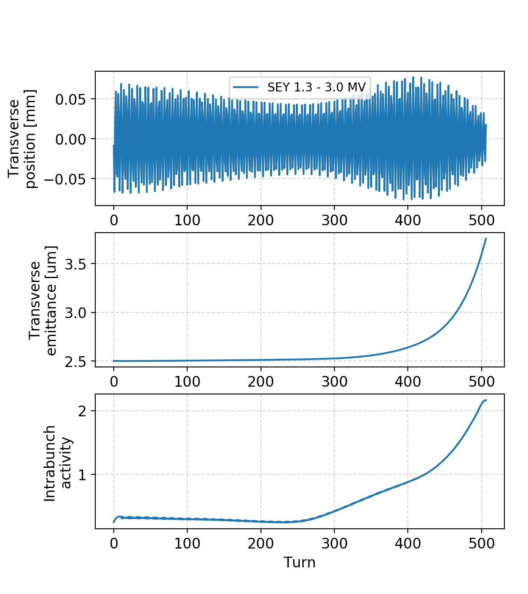
General observations
An ~exponential rise is visible on the transverse emittance
The centroid motion does not show clear signs of instability

Slide 3
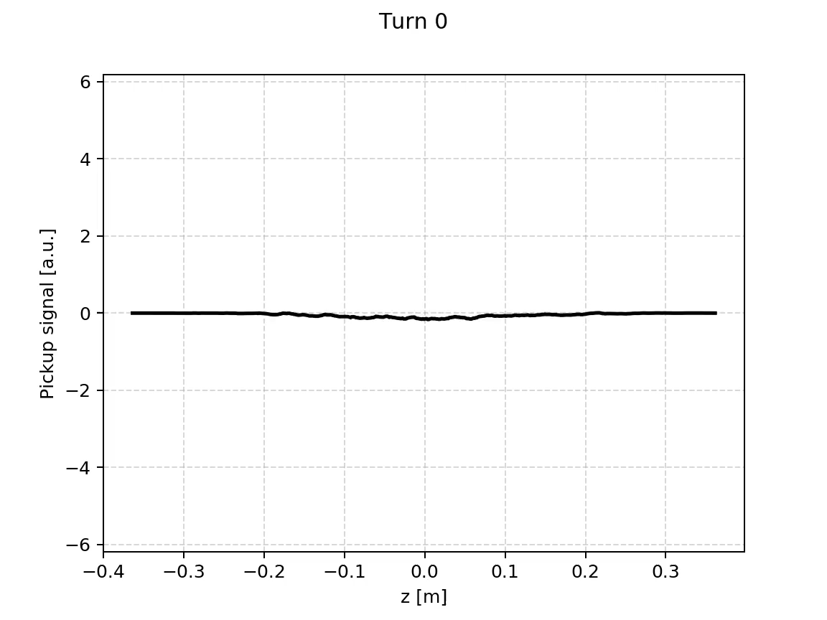
General observations
An ~exponential rise is visible on the transverse emittance
The centroid motion does not show clear signs of instability
The development of the instability is visible on the intra-bunch motion

Slide 4
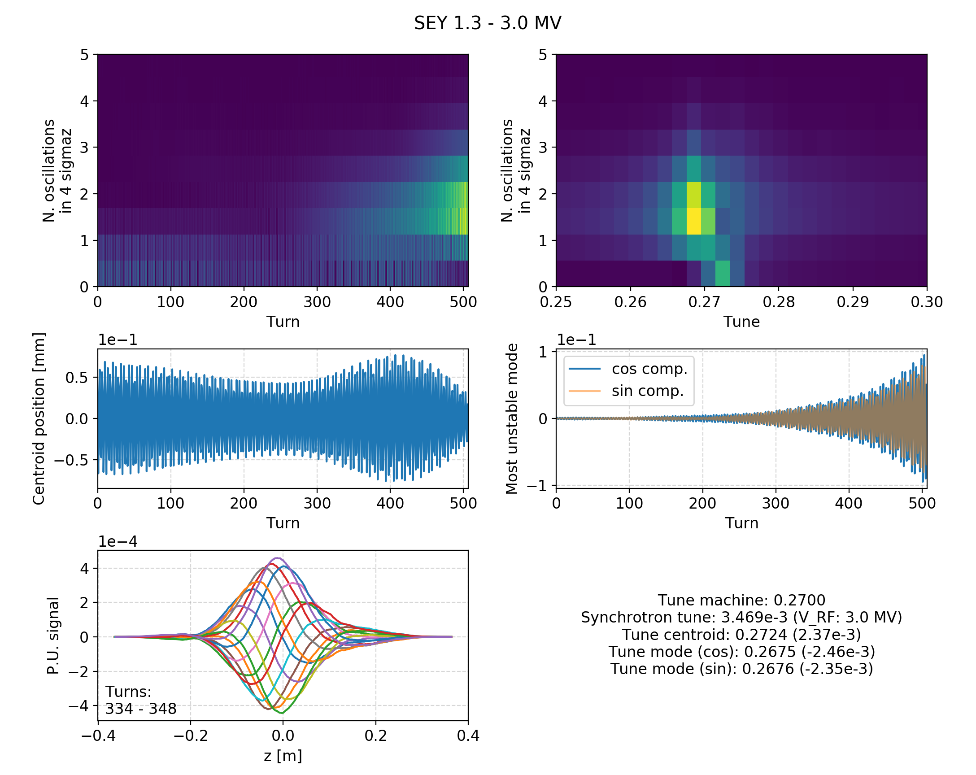
Spectral analysis
We perform a Fourier transform of the intra-bunch motion
We are measuring the number of the intra-bunch oscillations

Slide 5
Spectral analysis
We perform a Fourier transform of the intra-bunch motion
We are measuring the number of the intra-bunch oscillations
Not much activity on the “rigid bunch” line

Slide 6
Spectral analysis
We perform a Fourier transform of the intra-bunch motion
We are measuring the number of the intra-bunch oscillations
Instability clearly visible on higher intra-bunch ””mode””

Slide 7
Spectral analysis
We perform a Fourier transform of the intra-bunch motion
We are measuring the number of the intra-bunch oscillations
Instability clearly visible on higher intra-bunch ””mode””

Slide 8
Spectral analysis
We perform a Fourier transform of the intra-bunch motion
We are measuring the number of the intra-bunch oscillations
We apply another Fourier transform w.r.t. turn number
The rigid bunch line that has a positive tune shift (typical for e-cloud)
The unstable “”mode”” has a negative tune shift

Slide 9
Spectral analysis
These features are observed systematically over the simulation set
The tune of the unstable line seems correlated to Q_{s}

Slide 10
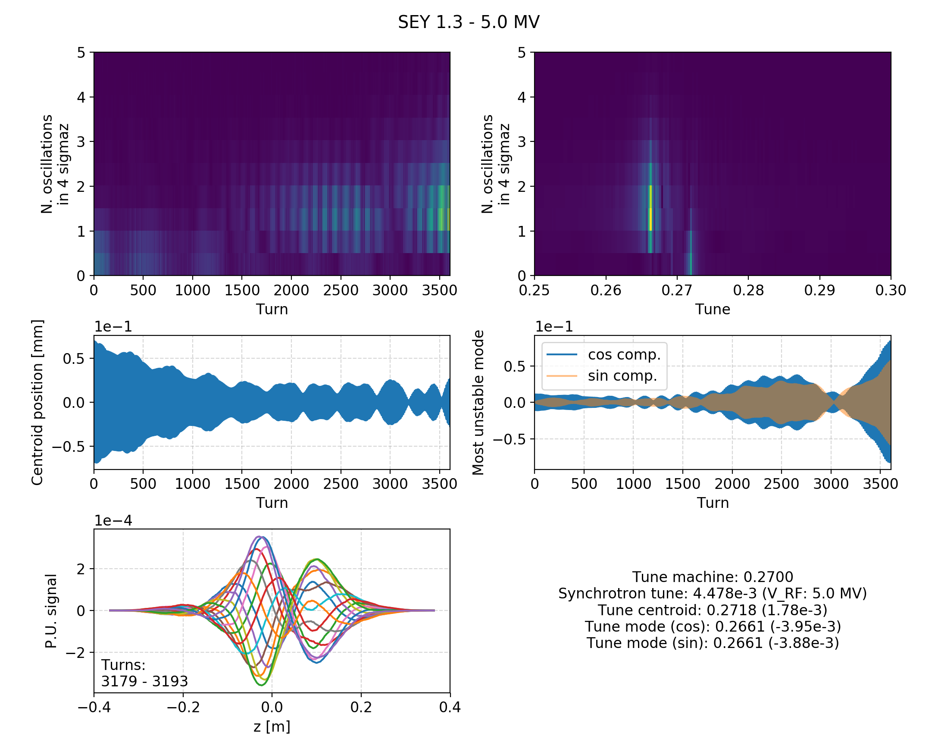
Spectral analysis
These features are observed systematically over the simulation set
The tune of the unstable line seems correlated to Q_{s}

Slide 11
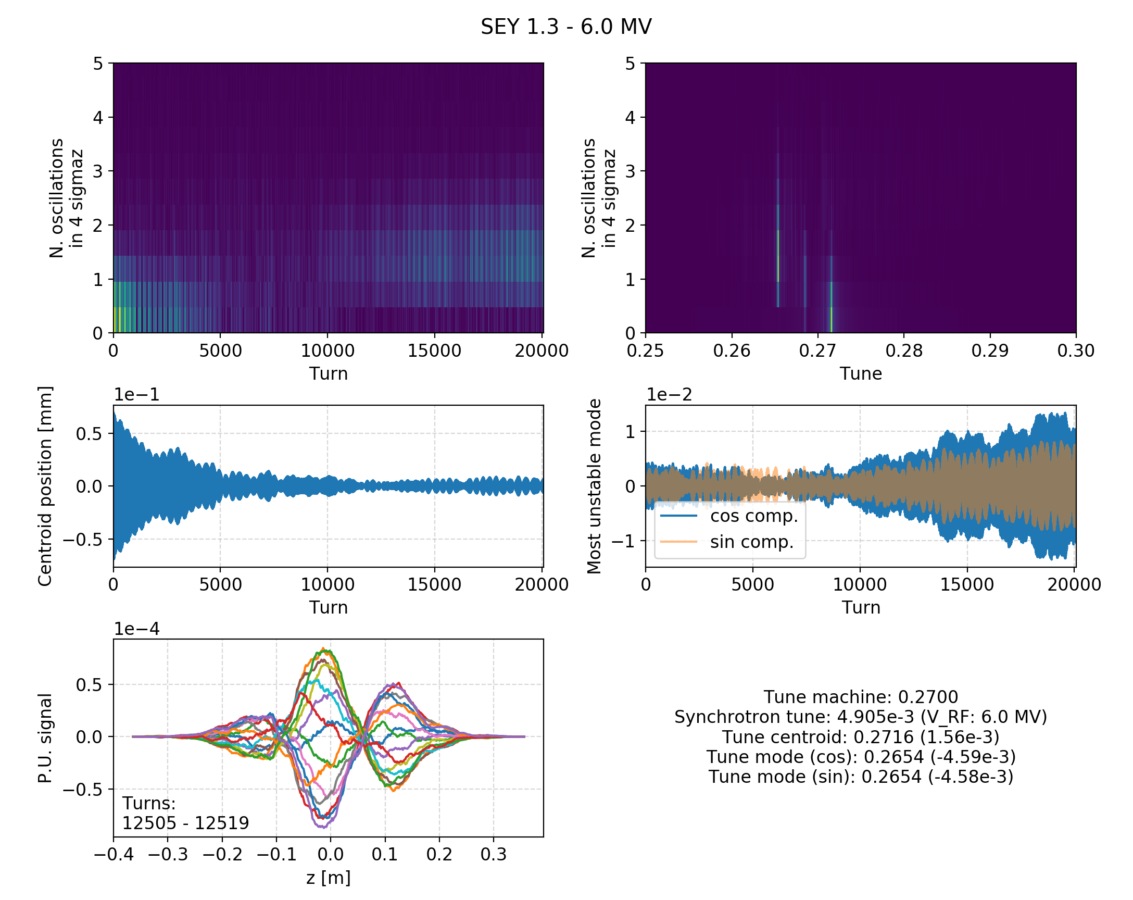
Spectral analysis
These features are observed systematically over the simulation set
The tune of the unstable line seems correlated to Q_{s}

Slide 12
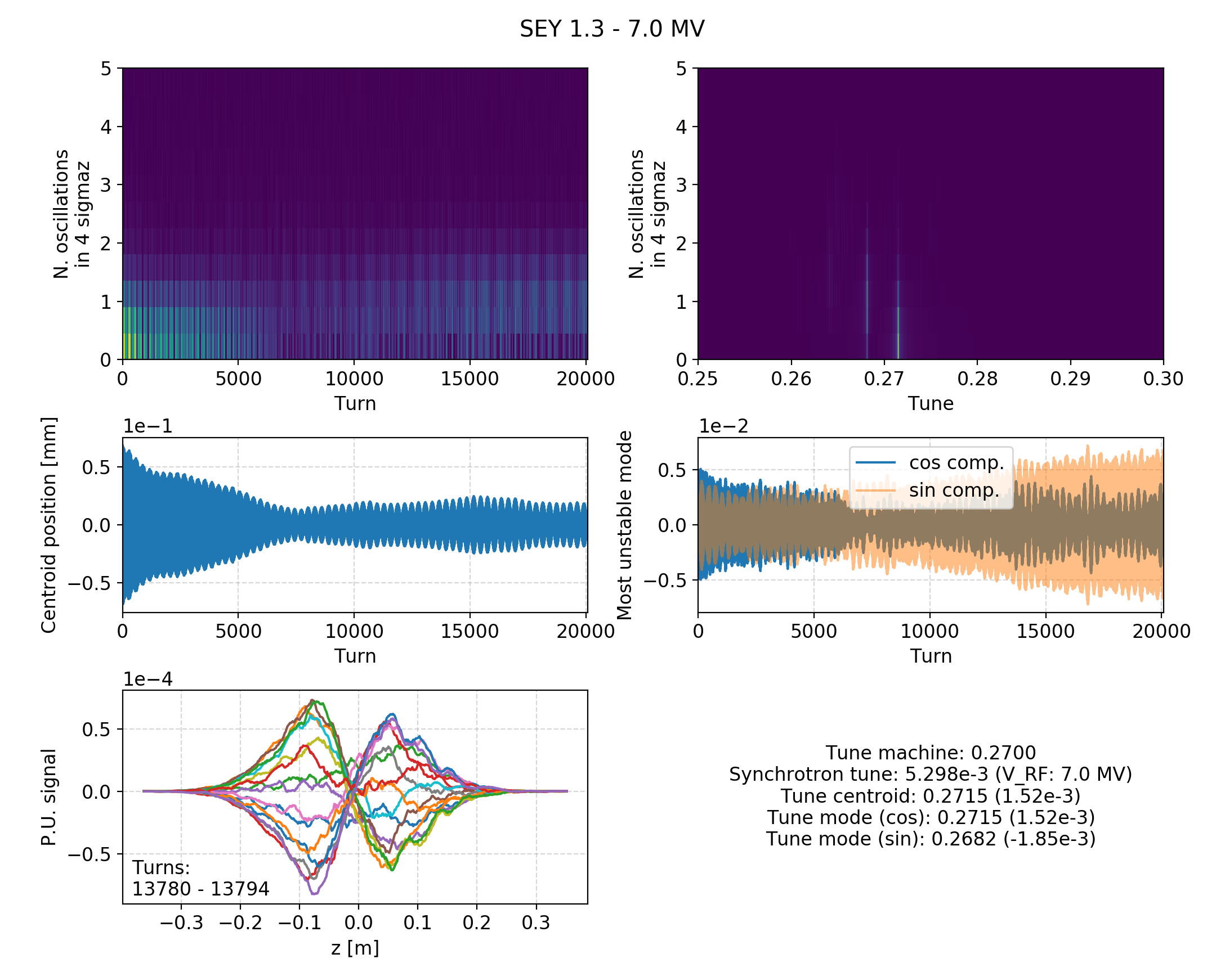
Spectral analysis
These features are observed systematically over the simulation set
The tune of the unstable line seems correlated to Q_{s}

Slide 13
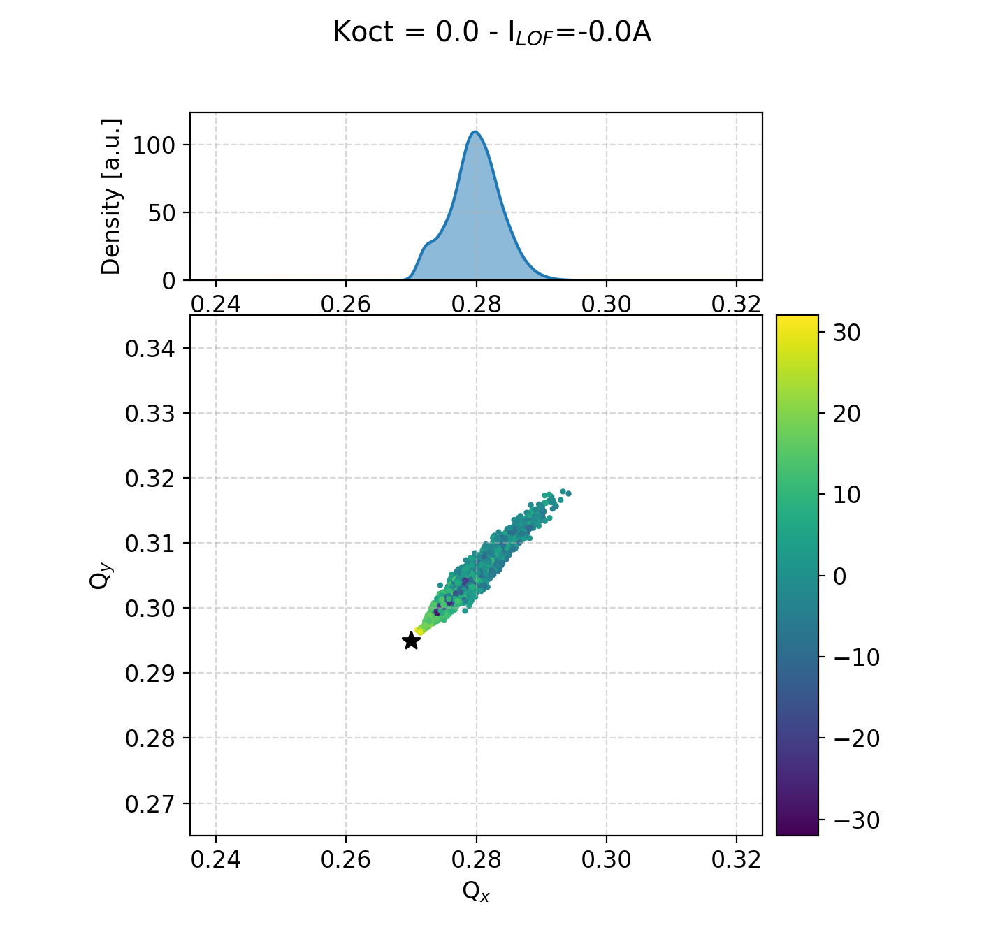
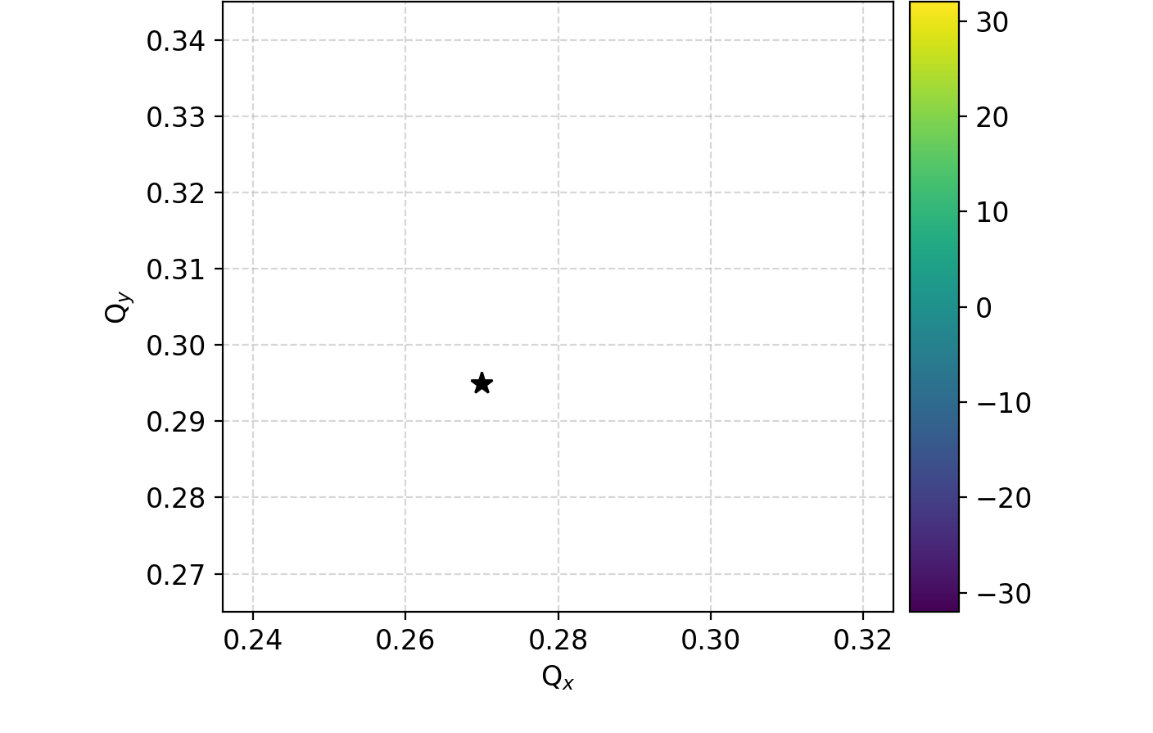
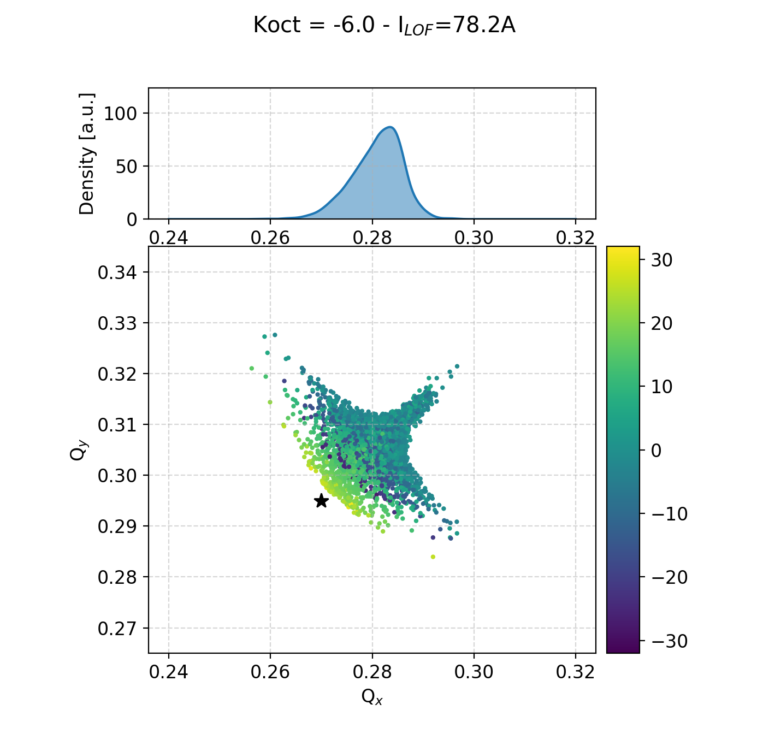
Unstable frequency vs tune spread
There no overlap between the spread and the unstable frequency
e-cloud alone
z [cm]
e-cloud
+ octupoles
octupoles alone
z [cm]
z [cm]
Machine tune
Instability freq.
Centroid freq.

Slide 14
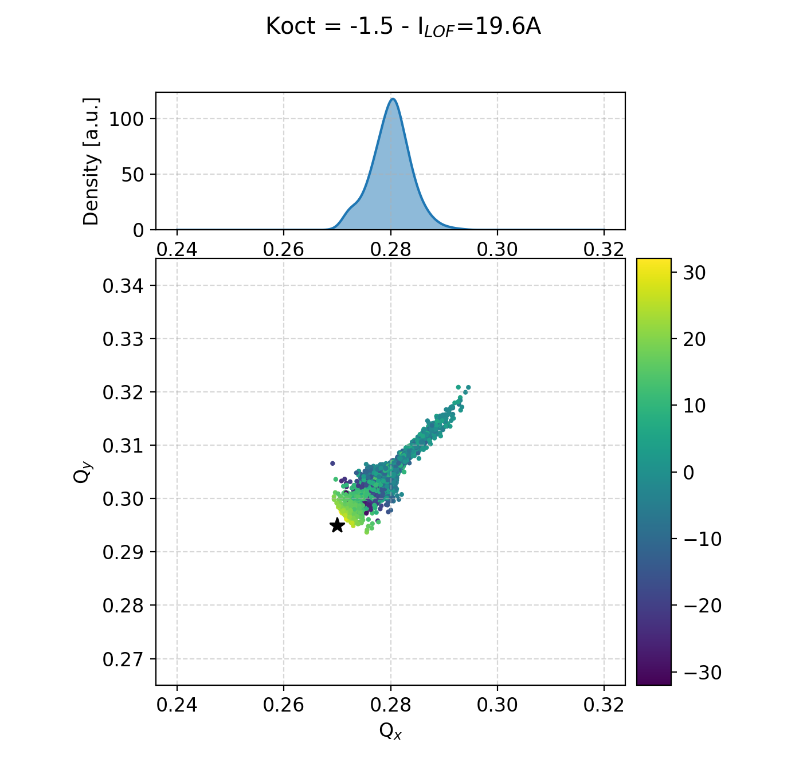
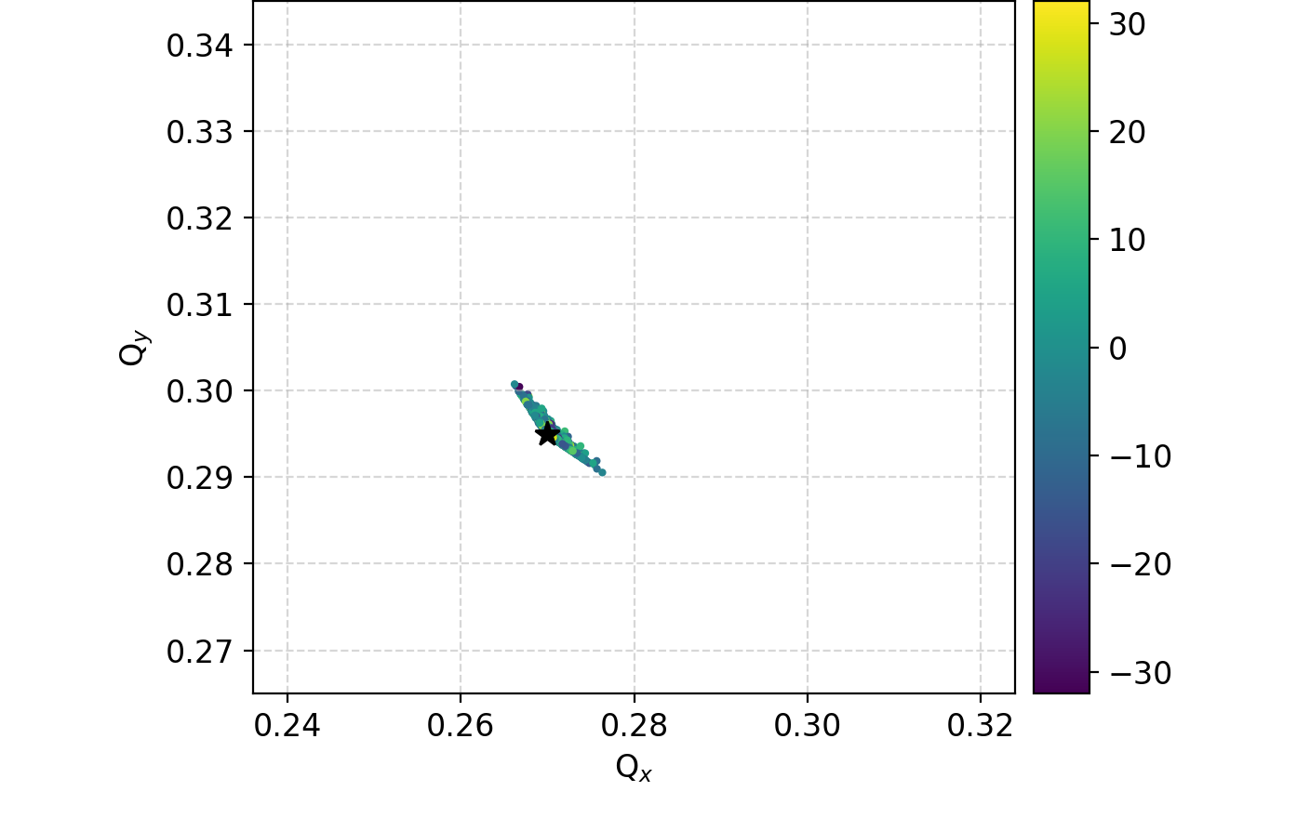
Unstable frequency vs tune spread
There no overlap between the spread and the unstable frequency
e-cloud alone
z [cm]
e-cloud
+ octupoles
octupoles alone
z [cm]
z [cm]
Machine tune
Instability freq.
Centroid freq.

Slide 15
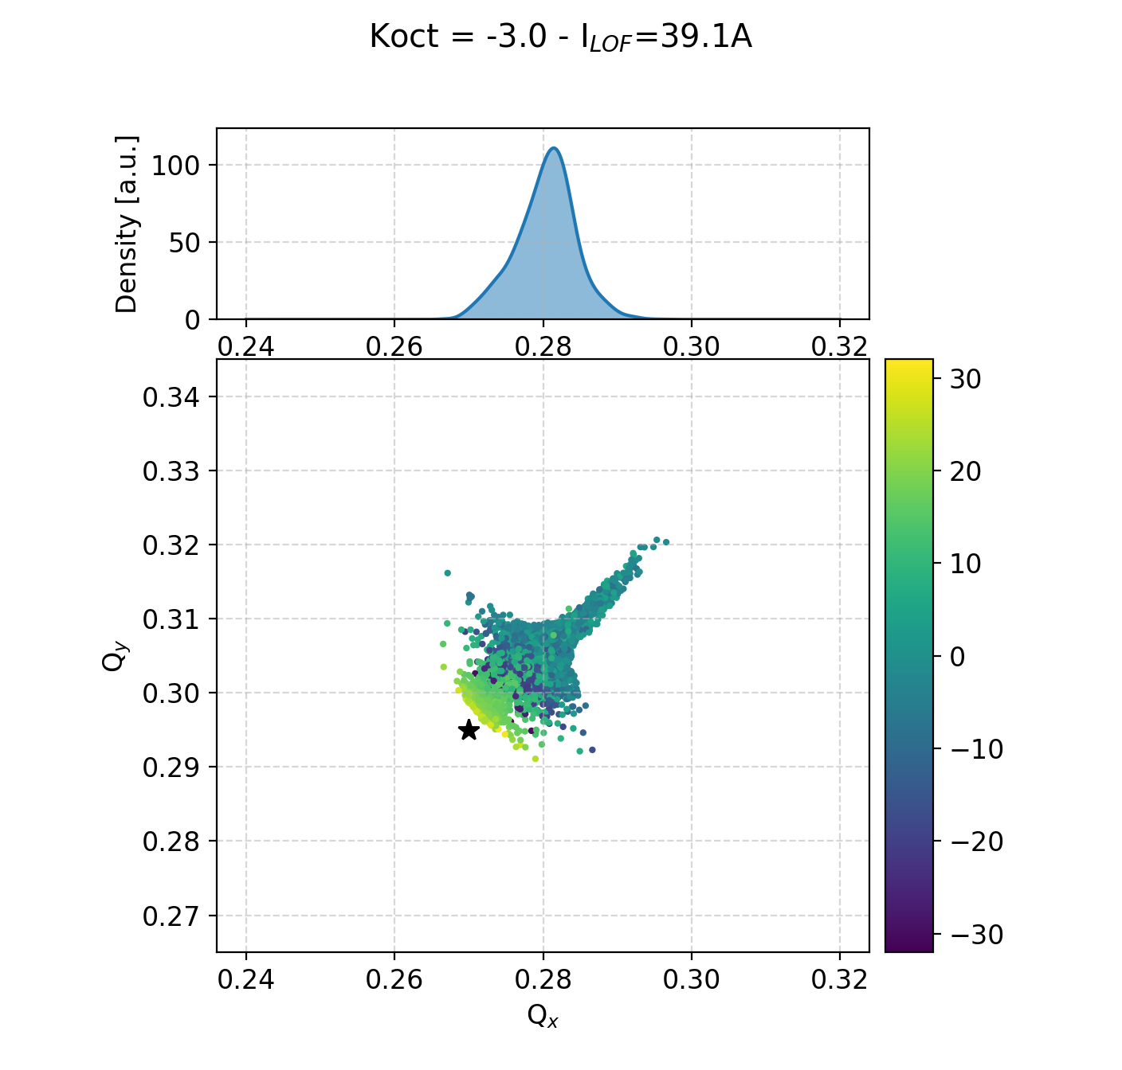
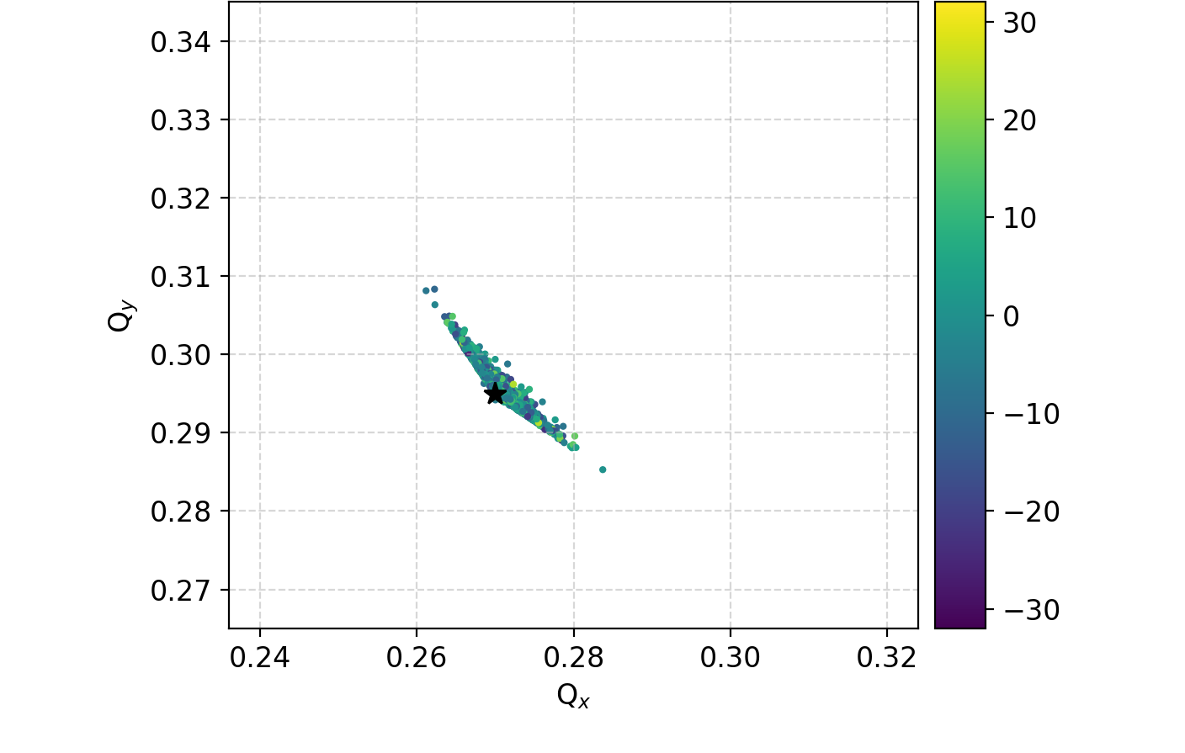
Unstable frequency vs tune spread
There no overlap between the spread and the unstable frequency
e-cloud alone
z [cm]
e-cloud
+ octupoles
octupoles alone
z [cm]
z [cm]
Machine tune
Instability freq.
Centroid freq.

Slide 16
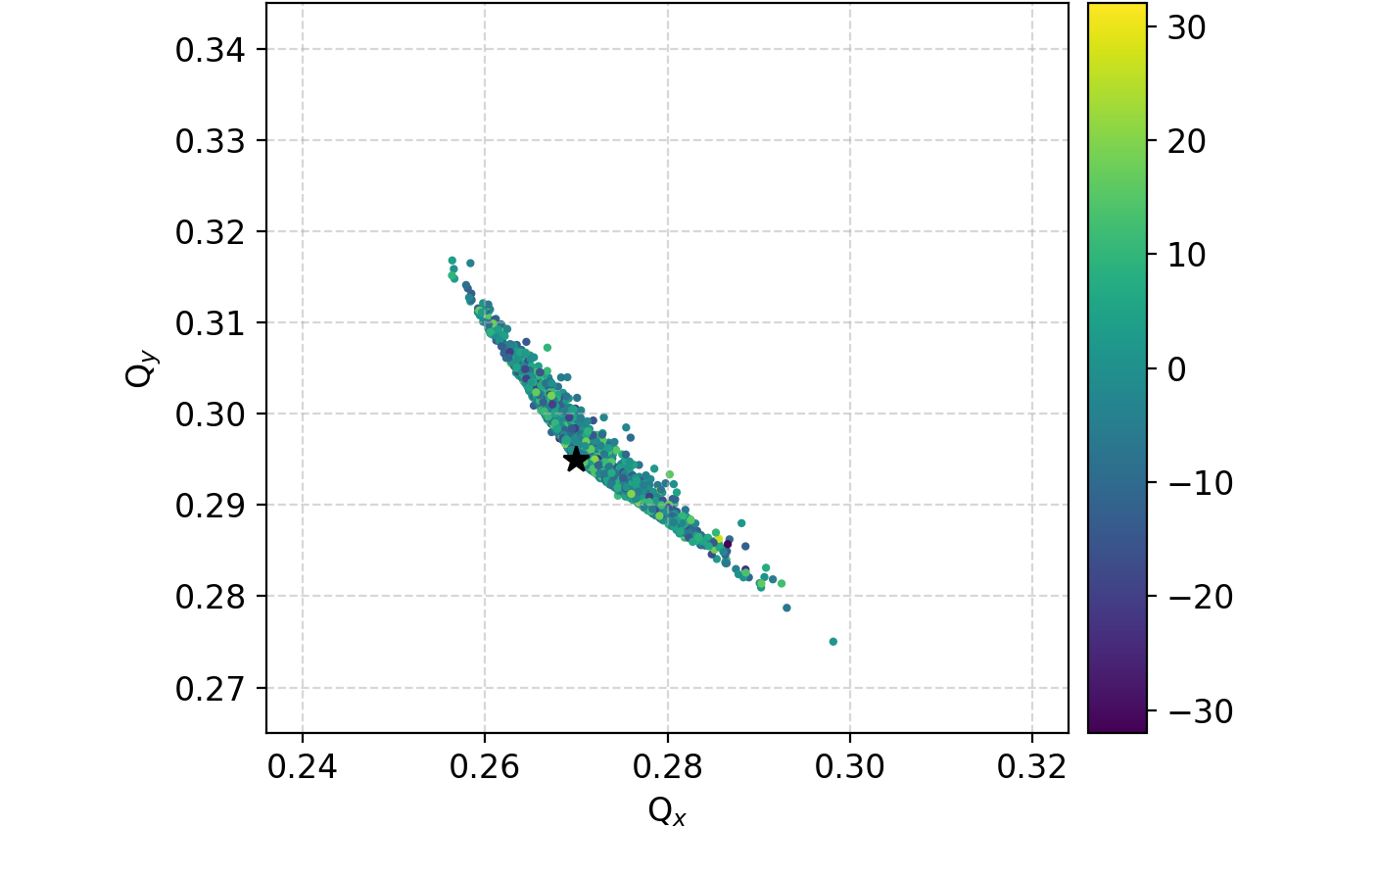
Unstable frequency vs tune spread
There no overlap between the spread and the unstable frequency
e-cloud alone
z [cm]
e-cloud
+ octupoles
octupoles alone
z [cm]
z [cm]
Machine tune
Instability freq.
Centroid freq.

Slide 17
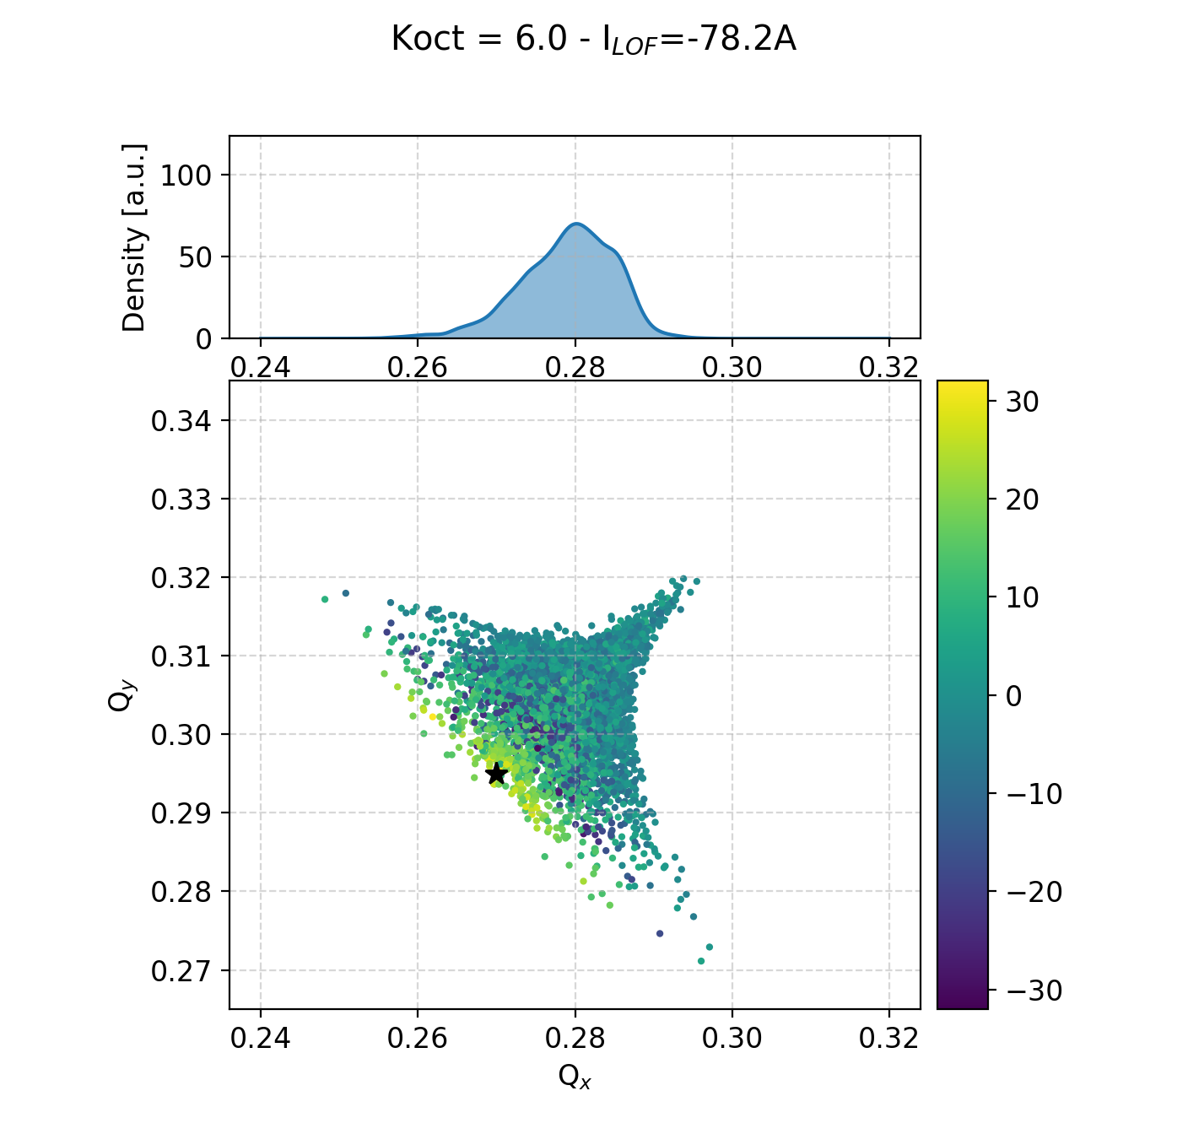
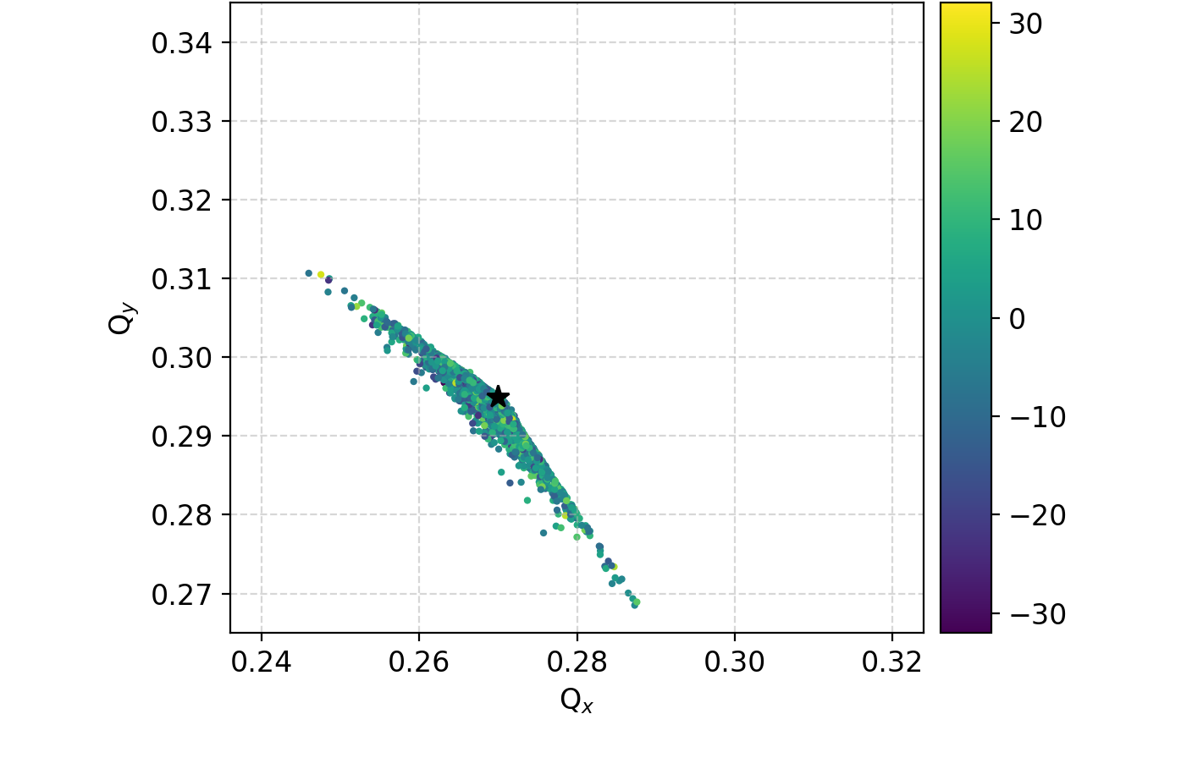
Unstable frequency vs tune spread
There no overlap between the spread and the unstable frequency
e-cloud alone
z [cm]
e-cloud
+ octupoles
octupoles alone
z [cm]
z [cm]
Machine tune
Instability freq.
Centroid freq.

Slide 18
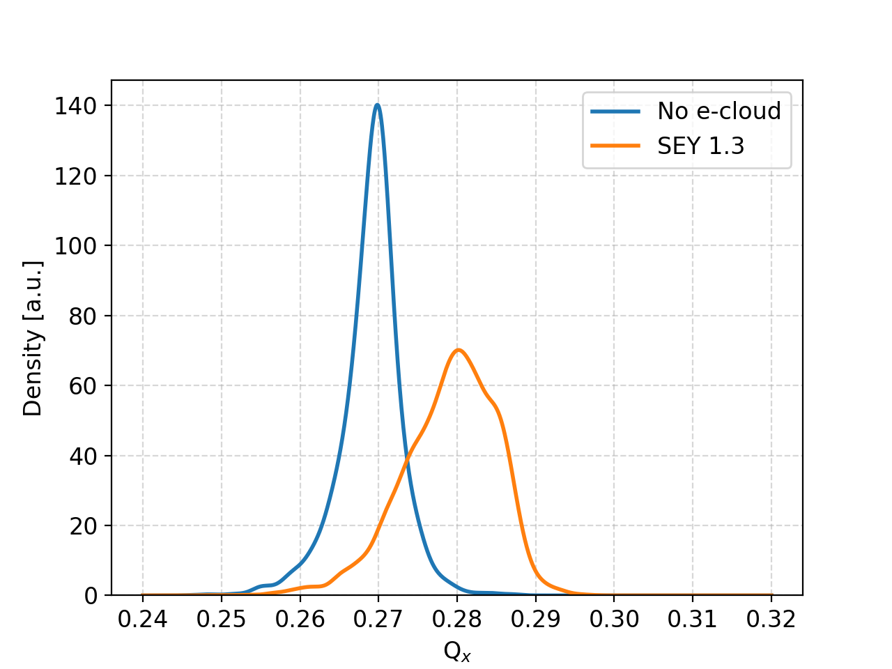
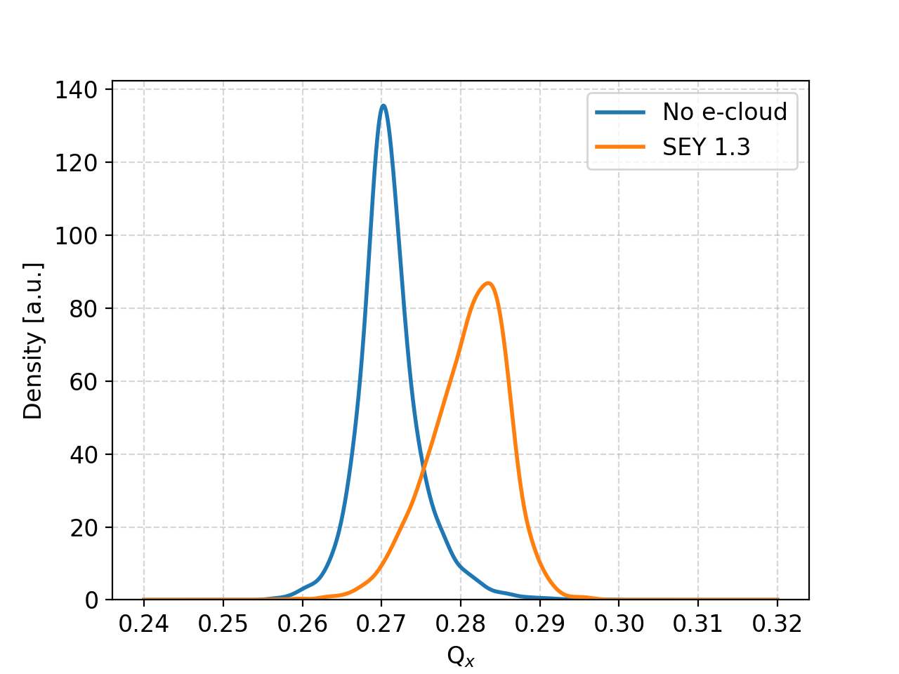
Octupoles + e-cloud
K_{OCT} = +6.0 (I_{LOF} = -78 A)
K_{OCT} = -6.0 (I_{LOF} = +78 A)
Instability freq.
Centroid freq.
The e-cloud is pushing the tune spread away from the the instability frequency
Effect of octupole polarity is minor but visible

Slide 19
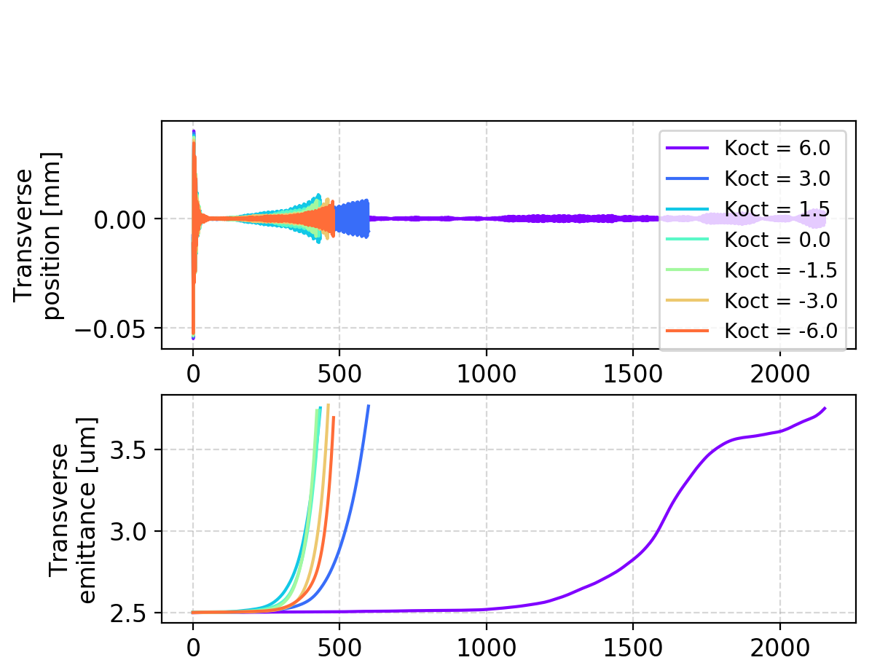
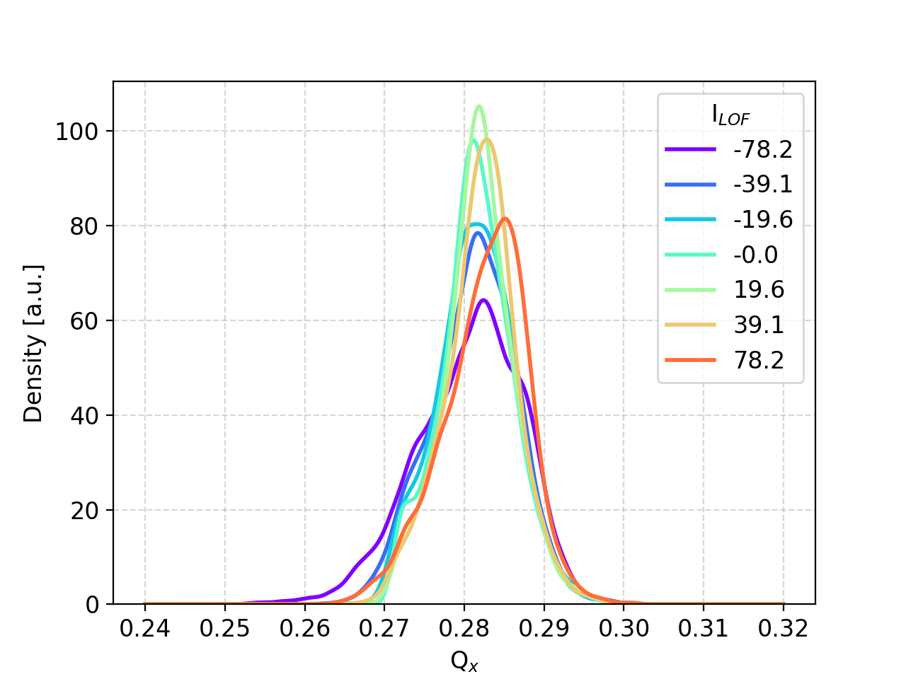
Octupoles + e-cloud
The instability risetime looks correlated with the tune-spread population around the unstable frequency
Tune spreads
Coherent instability (Q’ = 0)
Instability freq.
Centroid freq.

Slide 20
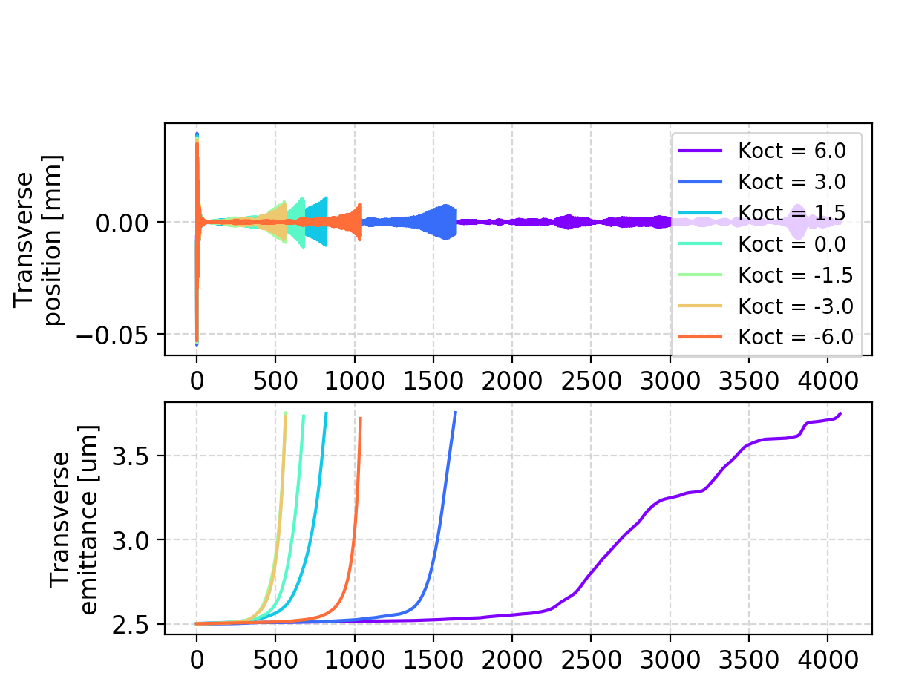
Octupoles + e-cloud
The instability risetime looks correlated with the tune-spread population around the unstable frequency
Tune spreads
Coherent instability (Q’ = 2.5)
Instability freq.
Centroid freq.

Slide 21
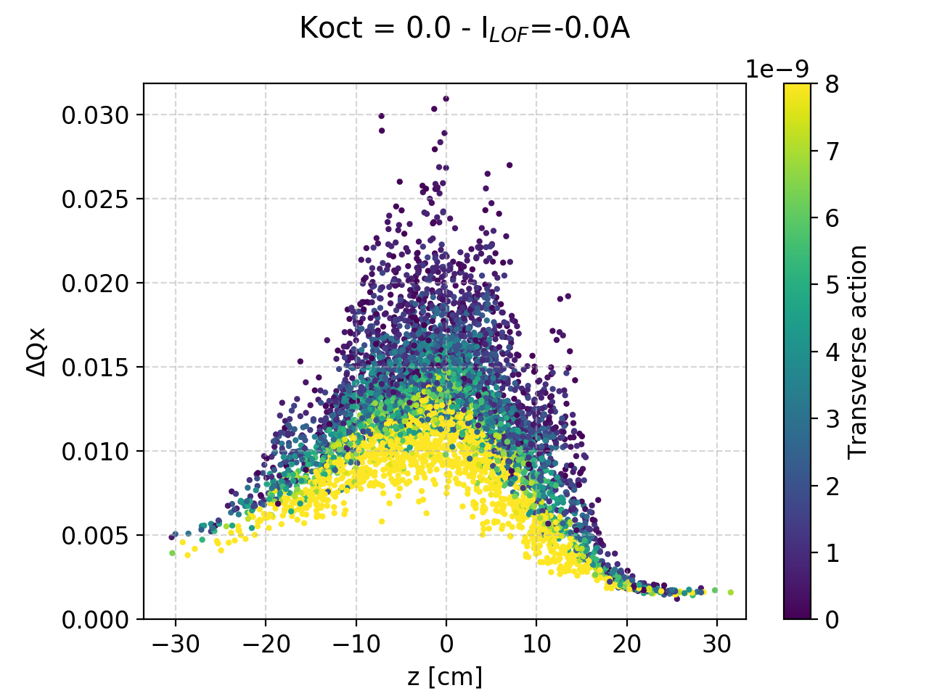
Head-tail phase shift
The presence of an head-tail phase shift is not surprising, as the e-cloud introduces a detuning along the bunch

Slide 22
Some analogies
 | e-cloud | Imped. (dip.) | Q’ | Q’’ | RFQ | Octup.
Dipolar kick (ch.ing along z) | Y | Y | N | N | N | N
Head-tail phase shift | Y | Y? | Y | Y | Y | N
Detuning with J_{x,y} | Y | N | N | N | N | Y
Detuning with z (single part.) | Y | N | N | N | Y | N
Detuning with DP/P | N | N | Y | Y | N | N
Detuning with J_{z} (averaged over synch. period) | Y | N | N | Y | Y | N
With some code development most of these effects could be switched ON/OFF in the simulation to study their impact separately

Slide 23
Backup

Slide 24
e-cloud - beam dynamics simulations
Machine tune
Instability freq.
Centroid freq.

Slide 25
Octupoles + e-cloud
K_{OCT} = 6 (I_{LOF} = -78 A)
K_{OCT} = -6 (I_{LOF} = +78 A)

