Slide 1
Multi-species simulations with cross-ionization: investigation of numerical runaway
L. Mether and G. Iadarola
Acknowledgements: K. Poland, G. Rumolo

Slide 2
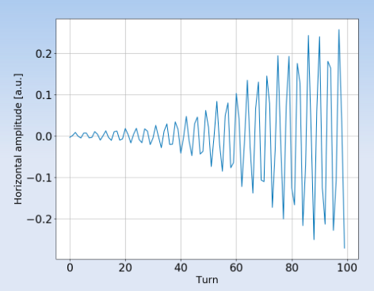

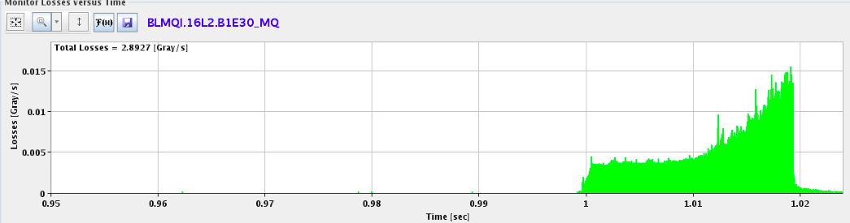
Motivation
  Throughout 2017 operation, abnormal losses were observed in the LHC
  Located in the 16th half-cell left of Point 2 (‘16L2’)
68 premature dumps with the following signature occurred during 2017:
Sudden onset of high beam losses in 16L2
Coherent beam motion with extremely fast rise times
Beam dump either due to losses on the collimation system or directly in 16L2
To stay operational, the LHC was limited to fewer than the nominal number of bunches for most of the 2017 run. Several 16L2 events occurred also in 2018.
X. Buffat
L. Ponce et al.

Slide 3
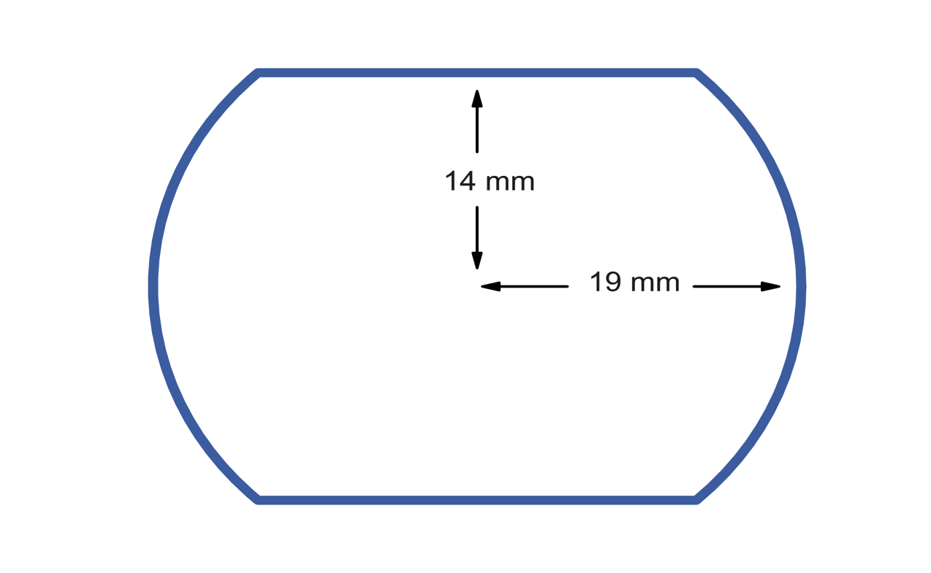
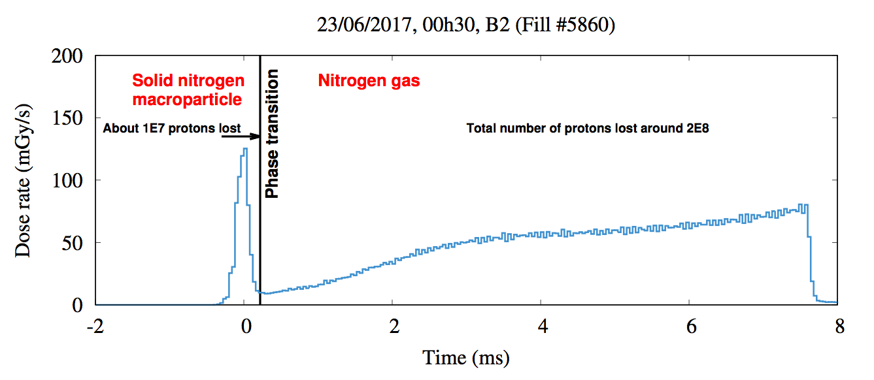
Sequence of events in 16L2
The problems in 16L2 are thought to have been caused by air frozen inside the beam chamber, through the following sequence of events:
A macro-particle of frozen air
(N₂, O₂) is detached,
possibly triggered by e-cloud,
and enters the beam
frozen air
beam
electron
macro-particle
The macro-particle undergoes a phase transition to a gas, leading to a a high local gas density
gas
ion
A. Lechner
The beam ionizes some of the gas in its path. Its interaction with the
The beam ionizes some of the gas in its path. Its interaction with the
generated electrons/ions causes the fast instabilities

Slide 4
Sequence of events in 16L2
The problems in 16L2 are thought to have been caused by air frozen inside the beam chamber, through the following sequence of events:
A macro-particle of frozen air
(N₂, O₂) is detached,
possibly triggered by e-cloud,
and enters the beam
Our aim is to model the last part of this sequence of events:
If we assume a high gas density in the beam chamber, can we reproduce the observations in a consistent manner?
Previous studies and development (2017-18):
Implementation of multi-species simulations
Multi-species build-up and stability simulations with beam-induced ionization of N₂ gas
See e.g. LBOC #82
Recent model ingredient (2019):
Implementation of cross-species ionization
First simulation study with cross-ionization
See e-cloud meeting #69
The macro-particle undergoes a phase transition to a gas, leading to a a high local gas density
The beam ionizes some of the gas in its path. Its interaction with the
The beam ionizes some of the gas in its path. Its interaction with the
generated electrons/ions causes the fast instabilities

Slide 5
Cross-species ionization model
For the implementation of the cross-species ionization, we wanted to keep the same simplifying assumptions as are made for the beam-induced ionization
Assume a uniform gas density in the chamber
(no neutral macro-particles, no collisions → not full-scale plasma simulations)
Consider single ionization only

Slide 6
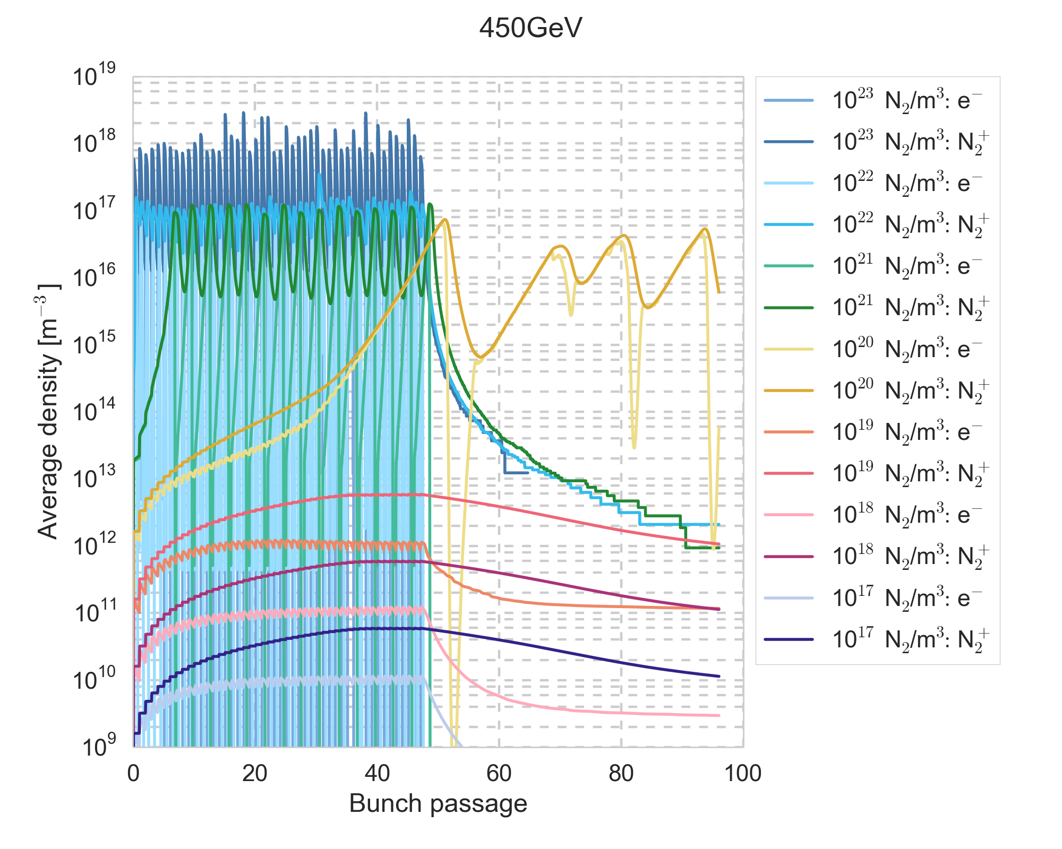
First cross-ionization simulations
Cross-ionization starts to have a significant impact as of gas densities of 10²⁰ m⁻³
450 GeV, SEY=1.25
An unexpected self-sustaining behaviour is observed for a gas density of 10²⁰ N₂/m³ – is it physical?
Sudden drops of the electron density occur for higher gas densities – are they physical?

Slide 7
First cross-ionization simulations
Cross-ionization starts to have a significant impact as of gas densities of 10²⁰ m⁻³
450 GeV, SEY=1.25
In this presentation we try to address these questions. We focus mainly on the case with gas density 10²⁰ N₂/m³
An unexpected self-sustaining behaviour is observed for a gas density of 10²⁰ N₂/m³ – is it physical?
Sudden drops of the electron density occur for higher gas densities – are they physical?

Slide 8
Energy evolution
As a first consistency check, we monitor the total energy in the system
Previously only the kinetic energies of each cloud were saved
Calculation and saving of the electrostatic energy was implemented as
  → energy of the total charge system, not individual clouds

Slide 9
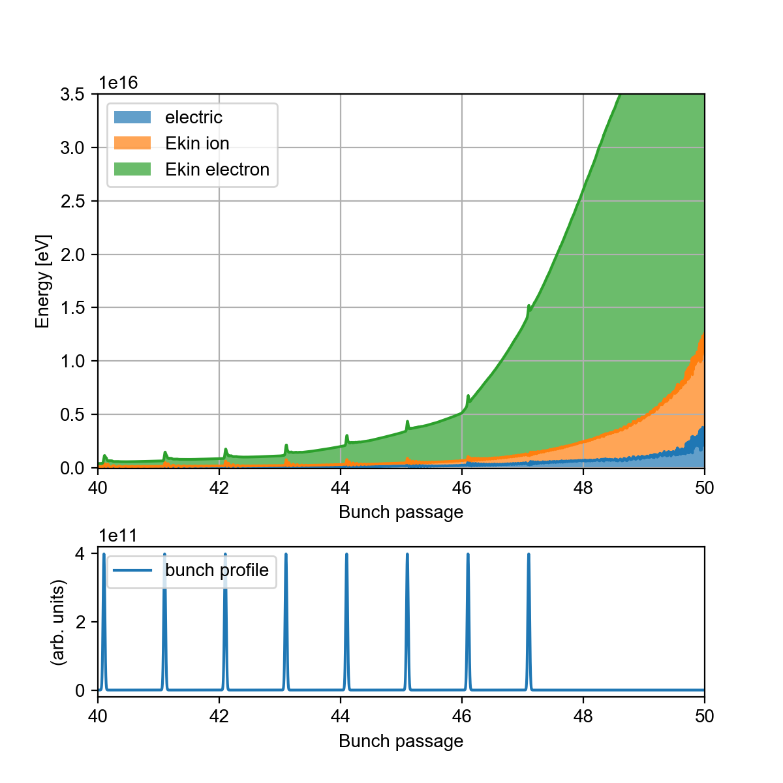
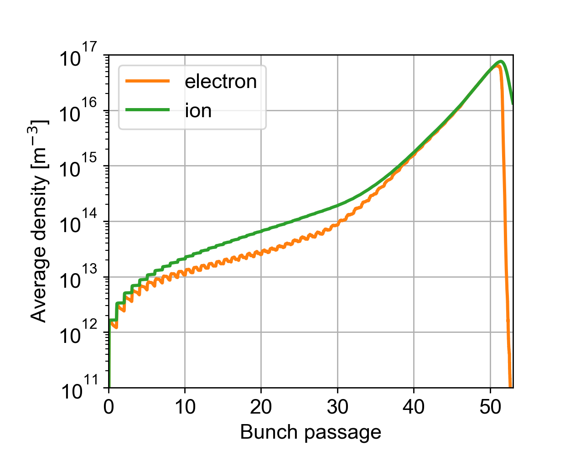
Energy evolution
After the last bunch passage no external energy is injected into the system
The total energy should stay constant or decrease
Instead, an increase is observed in
every energy component
The evolution after the bunch
train is unphysical
The wall is a net energy absorber
Unphysical evolution correlates roughly with neutralisation of system

Slide 10
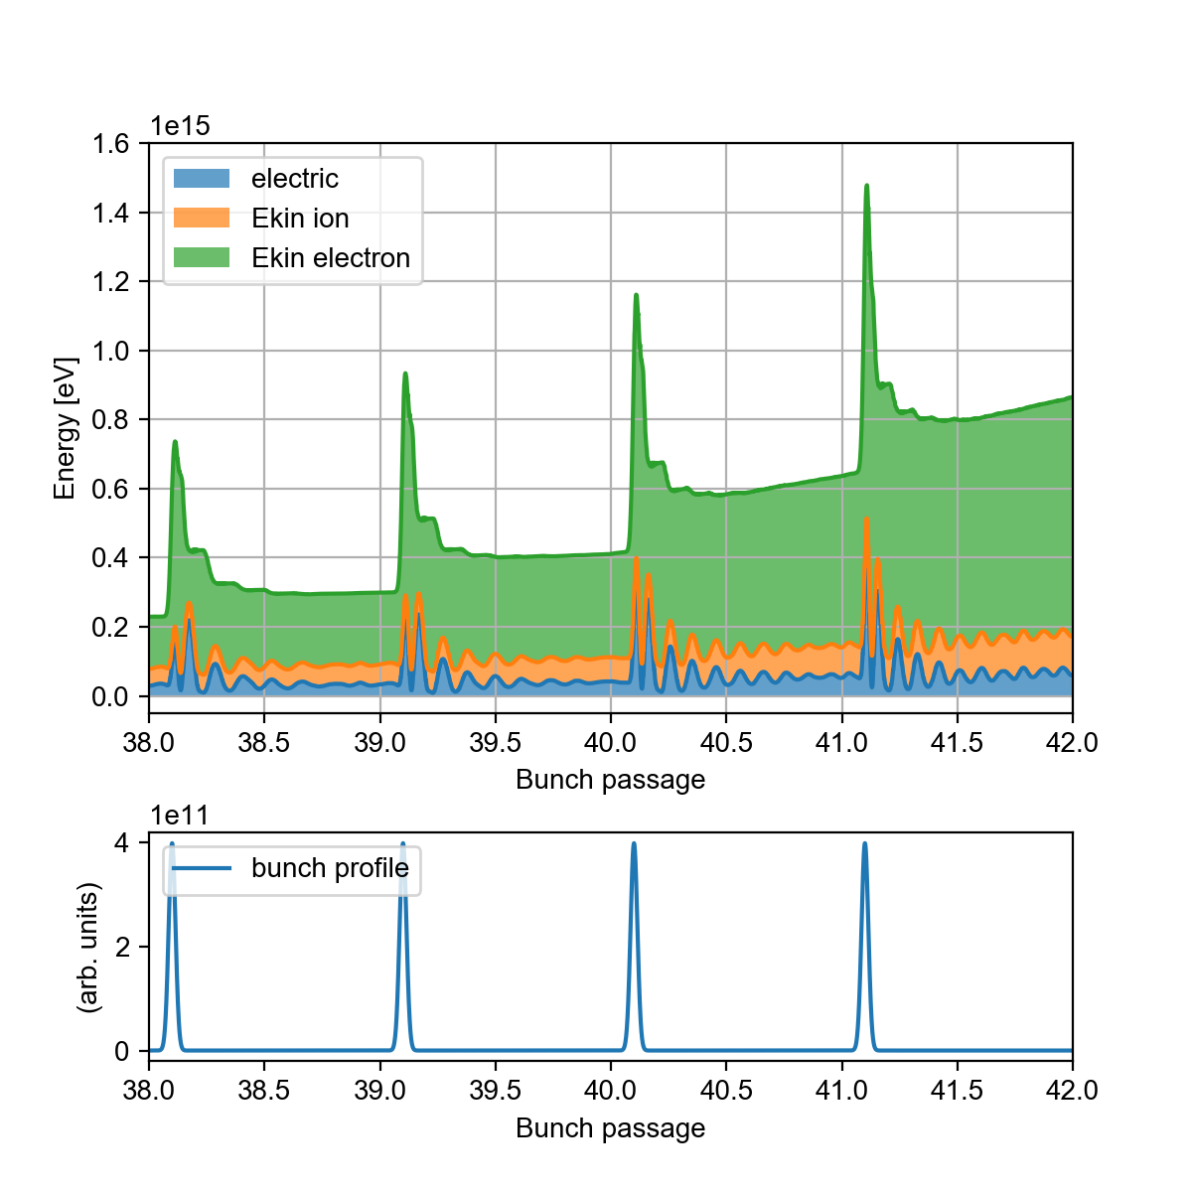
Energy evolution
During the bunch train passage, external energy is injected only during
individual bunch passages
An energy increase is observed also
between bunch passages
The evolution becomes unphysical
already during the bunch train
passage
The wall is a net energy absorber

Slide 11
Detailed studies
To investigate the unphysical evolution, detailed studies were performed
Saved full simulation state at regular intervals along the simulation
Restarted simulations from saved states could be run interactively in small steps, allowing the examination of different quantities along the simulation
Both time-consuming and data-intensive
On the next slides some observations from these studies…

Slide 12
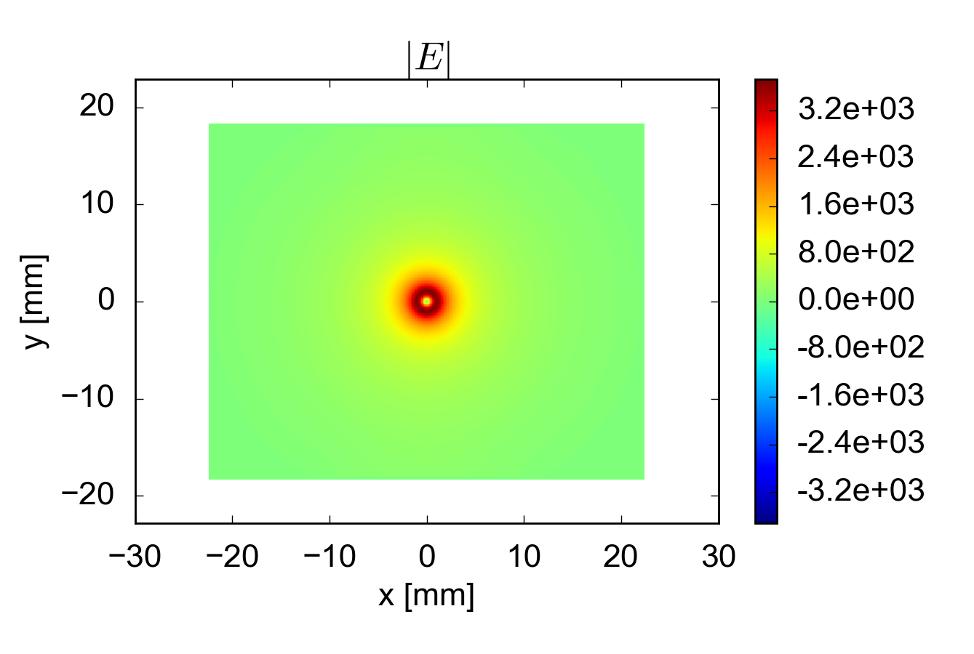
E-field evolution
There appears to be a correlation between the artificial energy growth, the (quasi-) neutralization of the system and increasingly noisy e-fields
Bunch passage 1
[V/m]

Slide 13
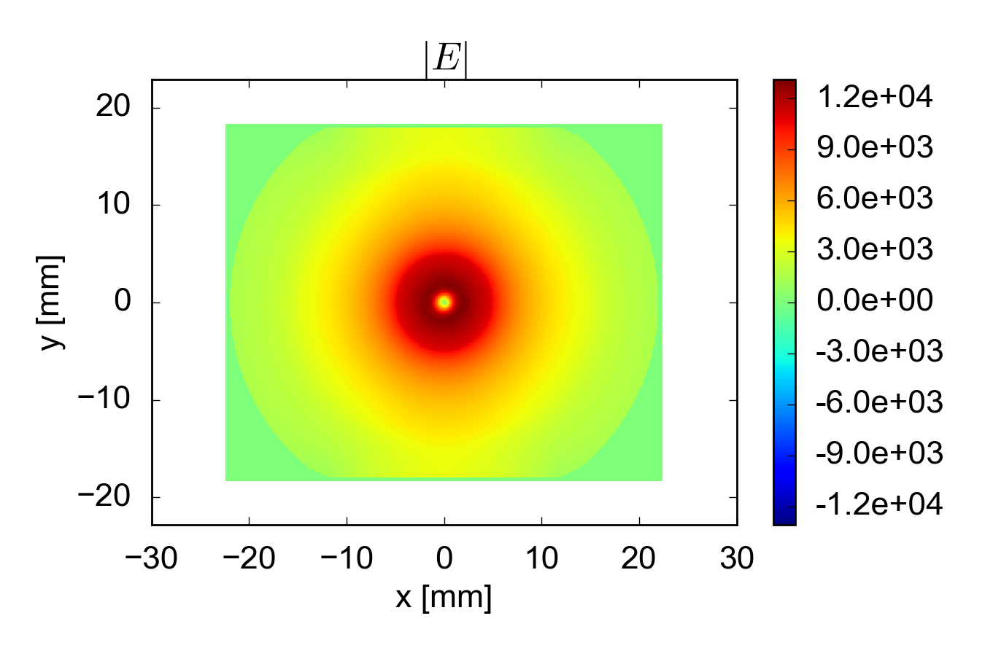
E-field evolution
There appears to be a correlation between the artificial energy growth, the (quasi-) neutralization of the system and increasingly noisy e-fields
Bunch passage 10
[V/m]

Slide 14
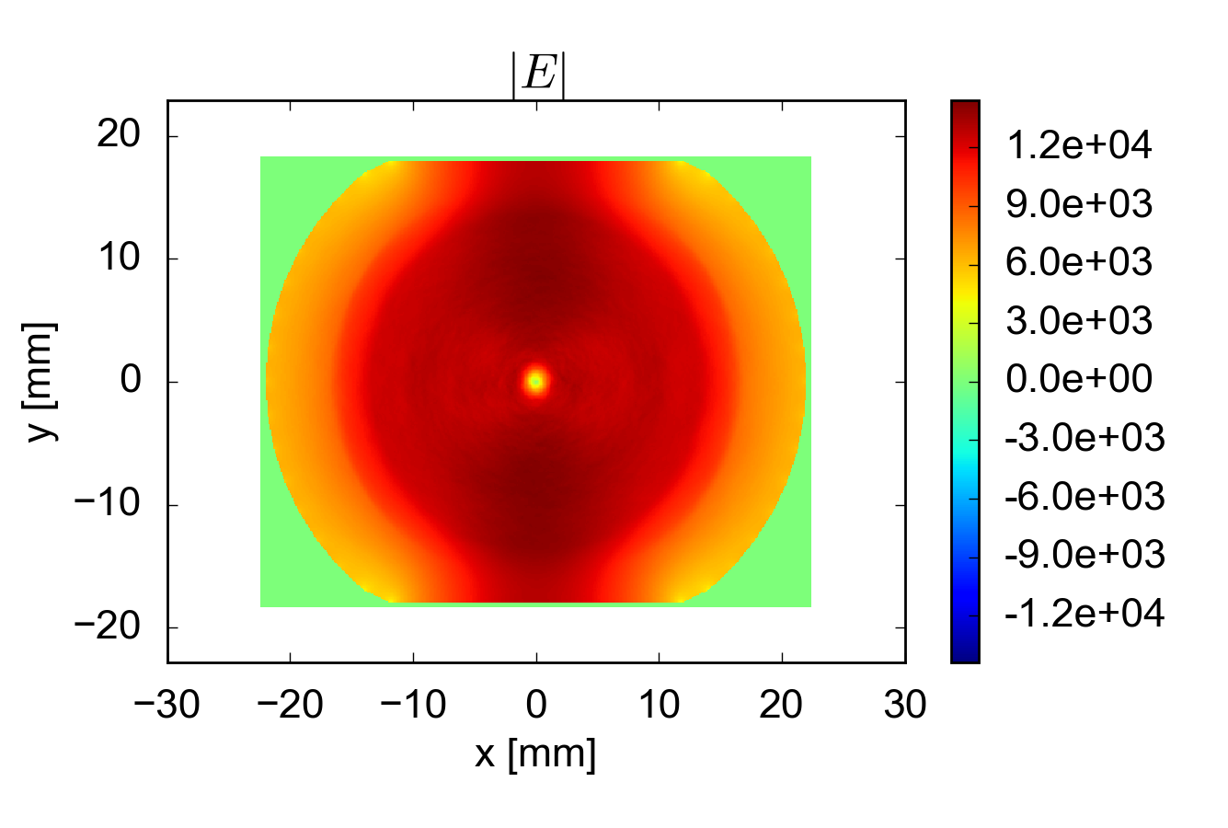
E-field evolution
There appears to be a correlation between the artificial energy growth, the (quasi-) neutralization of the system and increasingly noisy e-fields
Bunch passage 20
[V/m]

Slide 15
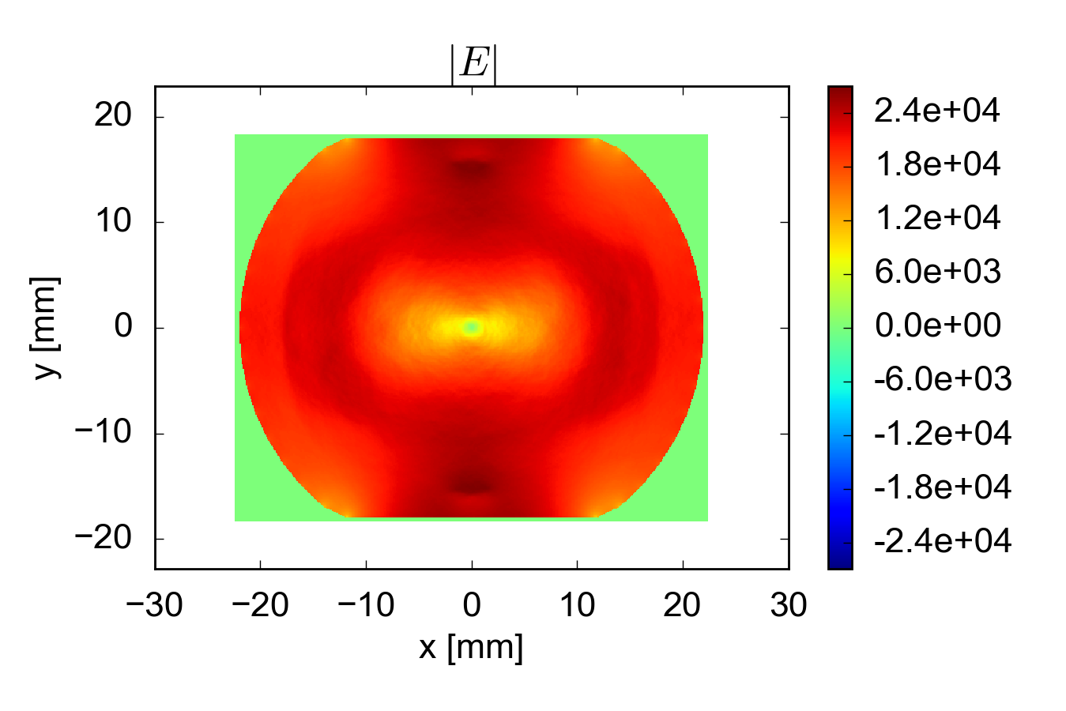
E-field evolution
There appears to be a correlation between the artificial energy growth, the (quasi-) neutralization of the system and increasingly noisy e-fields
Bunch passage 30
[V/m]

Slide 16
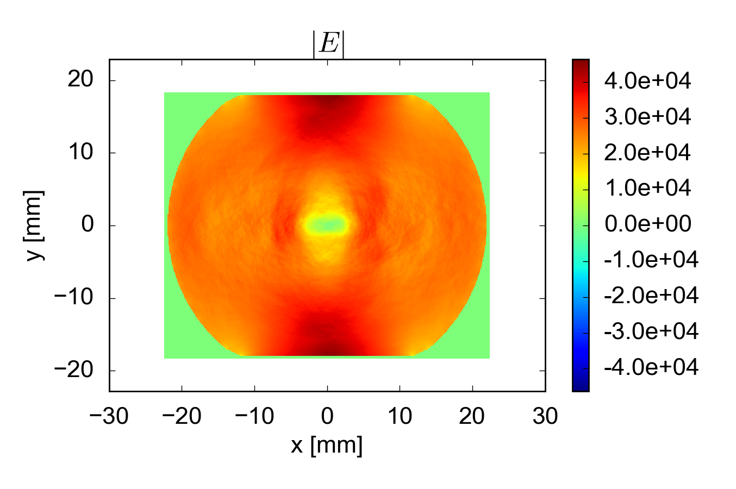
E-field evolution
There appears to be a correlation between the artificial energy growth, the (quasi-) neutralization of the system and increasingly noisy e-fields
Bunch passage 35
[V/m]

Slide 17
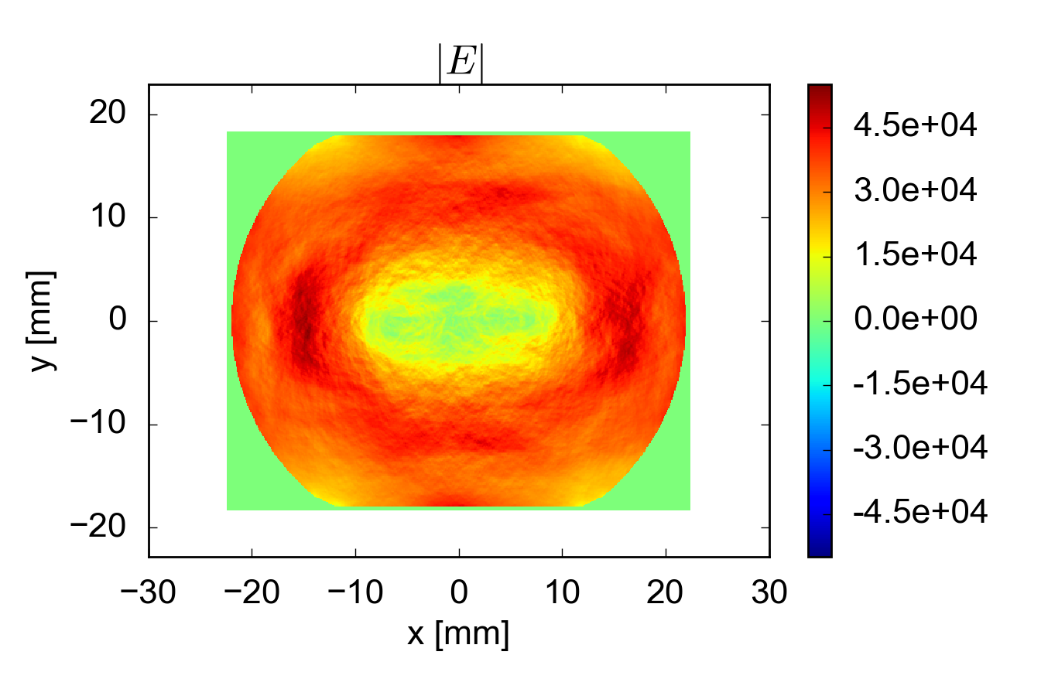
E-field evolution
There appears to be a correlation between the artificial energy growth, the (quasi-) neutralization of the system and increasingly noisy e-fields
Bunch passage 40
[V/m]
Here the energy evolution is already unphysical

Slide 18
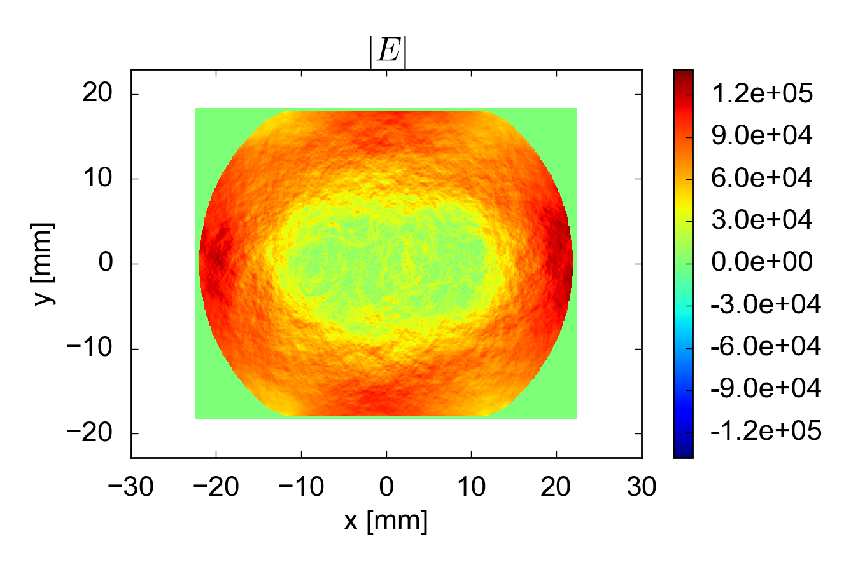
E-field evolution
There appears to be a correlation between the artificial energy growth, the (quasi-) neutralization of the system and increasingly noisy e-fields
Also the e-field magnitude becomes suspiciously large
Bunch passage 45
[V/m]
Here the energy evolution is already unphysical

Slide 19
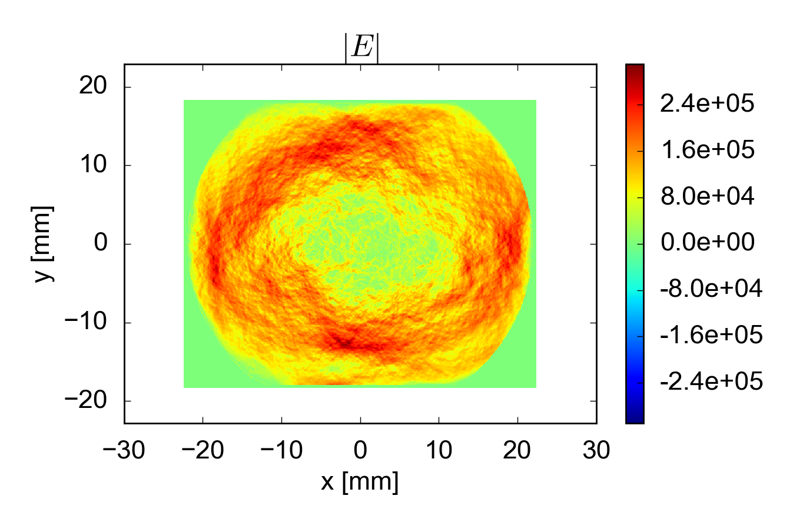
E-field evolution
There appears to be a correlation between the artificial energy growth, the (quasi-) neutralization of the system and increasingly noisy e-fields
Also the e-field magnitude becomes suspiciously large
Bunch passage 48
[V/m]
Here the energy evolution is already unphysical

Slide 20
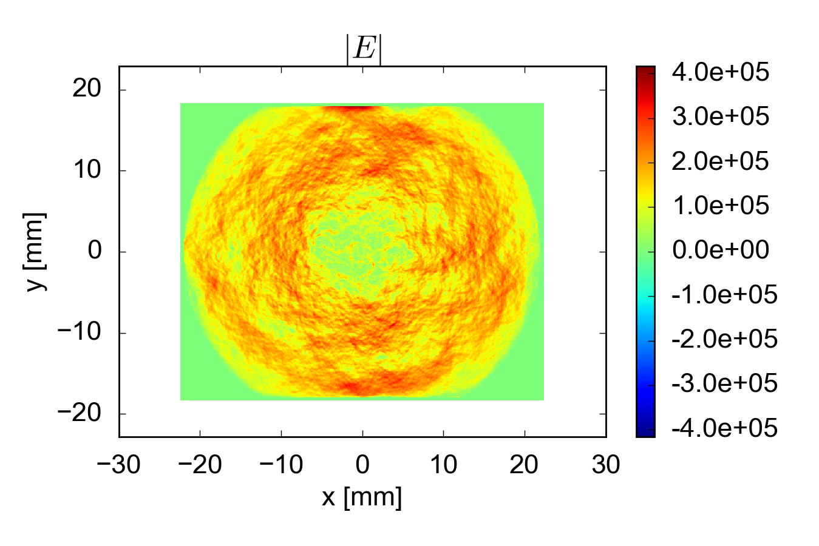
E-field evolution
There appears to be a correlation between the artificial energy growth, the (quasi-) neutralization of the system and increasingly noisy e-fields
Also the e-field magnitude becomes suspiciously large
Bunch passage 49
[V/m]
Here the energy evolution is already unphysical

Slide 21
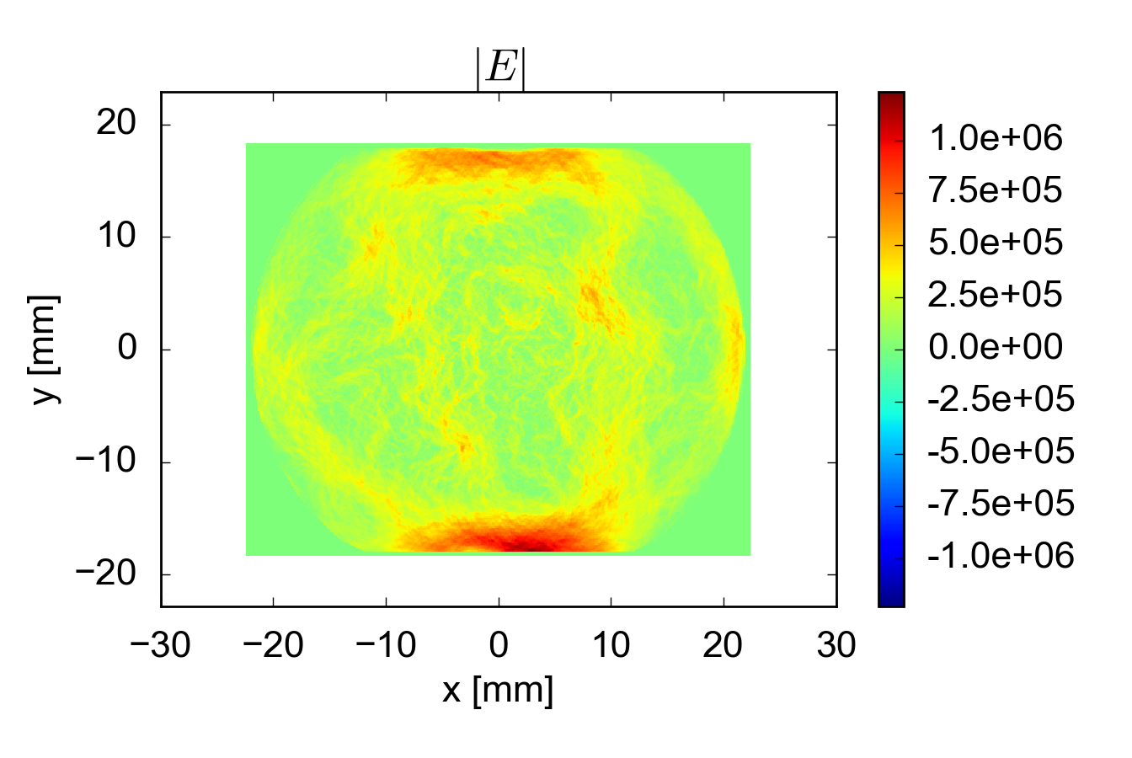
E-field evolution
There appears to be a correlation between the artificial energy growth, the (quasi-) neutralization of the system and increasingly noisy e-fields
Also the e-field magnitude becomes suspiciously large
Bunch passage 50
[V/m]
Here the energy evolution is already unphysical

Slide 22
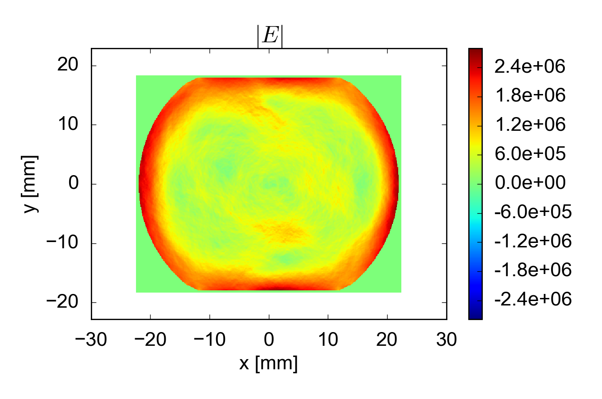
E-field evolution
There appears to be a correlation between the artificial energy growth, the (quasi-) neutralization of the system and increasingly noisy e-fields
Also the e-field magnitude becomes suspiciously large
Bunch passage 51
[V/m]
Here the energy evolution is already unphysical

Slide 23
E-field evolution
There appears to be a correlation between the artificial energy growth, the (quasi-) neutralization of the system and increasingly noisy e-fields
It looks like the simulation suffers from numerical heating, where local noise in the electric field artificially accelerates the electrons → unphysical energy growth
Also the e-field magnitude becomes suspiciously large
Bunch passage 51
[V/m]
Here the energy evolution is already unphysical

Slide 24
Numerical heating
Well known phenomenon in PIC plasma codes
Can typically be avoided by ensuring the stability conditions:
  Based on saved average quantities, these conditions are satisfied in our simulation
However, it is based on assumption of thermal Maxwell-Boltzmann distribution
Generally a problem for “cold” plasmas, with no spread in velocities
  e.g. astrophysical plasmas

Slide 25
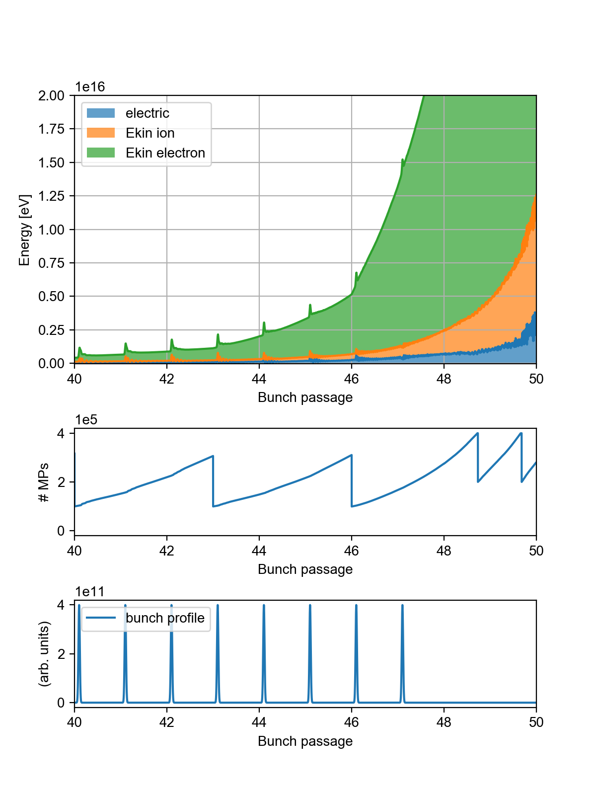
Regeneration
To keep the number of macro-particles manageable during simulations (with exponentially increasing number of particles), macro-particles are merged throughout the simulation, to keep their number within requested limits
When merged in large steps, a correlation is observed between the merging events (regenerations) and the slope of the (unphysical) energy growth

Slide 26
Regeneration
To keep the number of macro-particles manageable during simulations (with exponentially increasing number of particles), macro-particles are merged throughout the simulation, to keep their number within requested limits
When merged in large steps, a correlation is observed between the merging events (regenerations) and the slope of the (unphysical) energy growth
The regenerations inject more noise into the system

Slide 27
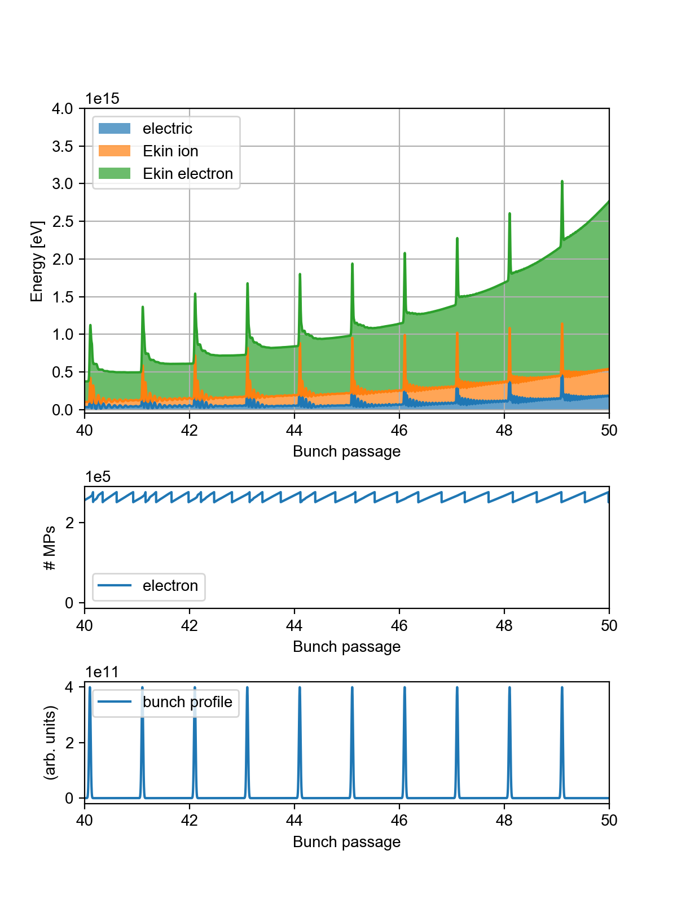
Regeneration
To keep the number of macro-particles manageable during simulations (with exponentially increasing number of particles), macro-particles are merged throughout the simulation, to keep their number within requested limits
When merged in large steps, a correlation is observed between the merging events (regenerations) and the slope of the (unphysical) energy growth
The regenerations inject more noise into the system
With smaller regenerations, no evident correlation occurs. The unphysical evolution is slightly damped and postponed, but not mitigated

Slide 28
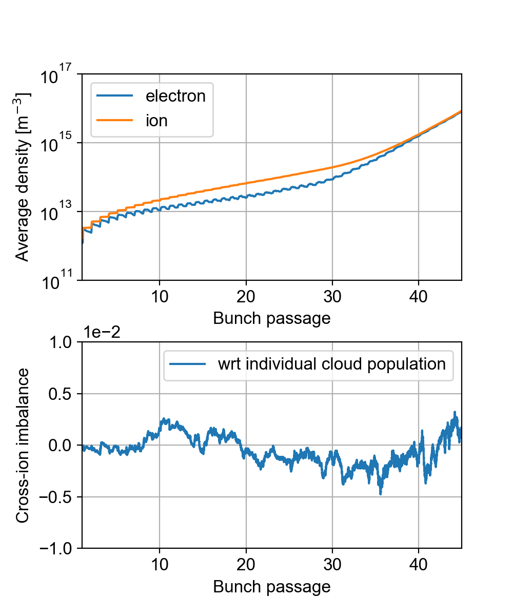
Cross-ionization imbalance
Another source of artificial imbalance is introduced in the system by the cross-ionization
In principle the same amount of electrons and ions should be generated
Since a probabilistic algorithm is used,
which depends on the macro-particle
weight of each cloud, small fluctuations
in the numbers occur
The introduced imbalance is small
compared to the number of particles
in the clouds

Slide 29
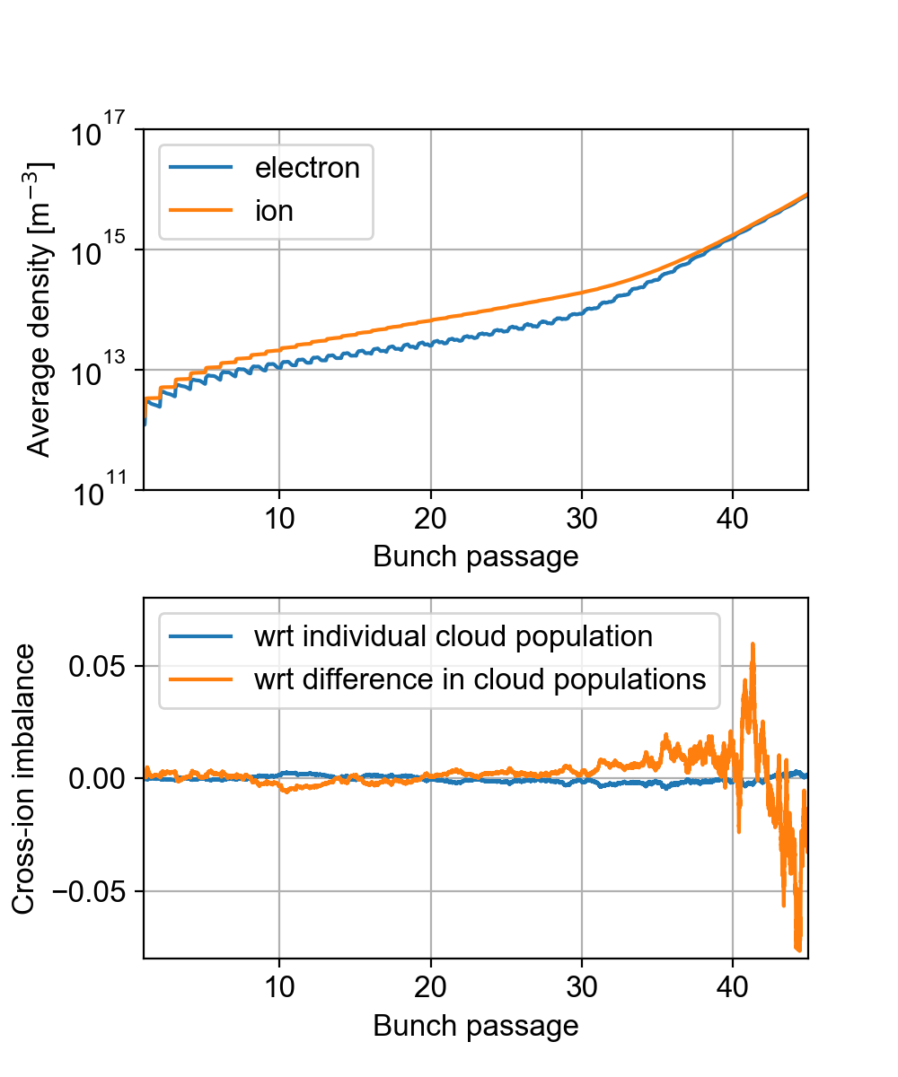
Cross-ionization imbalance
Another source of artificial imbalance is introduced in the system by the cross-ionization
In principle the same amount of electrons and ions should be generated
Since a probabilistic algorithm is used,
which depends on the macro-particle
weight of each cloud, small fluctuations
in the numbers occur
The introduced imbalance is small
compared to the number of particles
in the clouds
But not so small with respect to the
net charge (electrons - ions), which
essentially determines the fields
An option was implemented to enforce the algorithm to use the same probabilities for all clouds, removing the imbalance, but this didn’t cure the simulation

Slide 30
Noise reduction
To decrease numerical noise, the number of macro-particles needs to be increased
A clean e-cloud build-up simulation typically requires around 250 000 macro-particles
For these studies the number was pushed up to 8 million per cloud
In order to keep the computational time within reasonable limits a parallelization scheme had to be introduced in the build-up simulation (not available up to now)
The parallelization is done on the particle-by-particle operation and is effective only for a very large number of particles

Slide 31
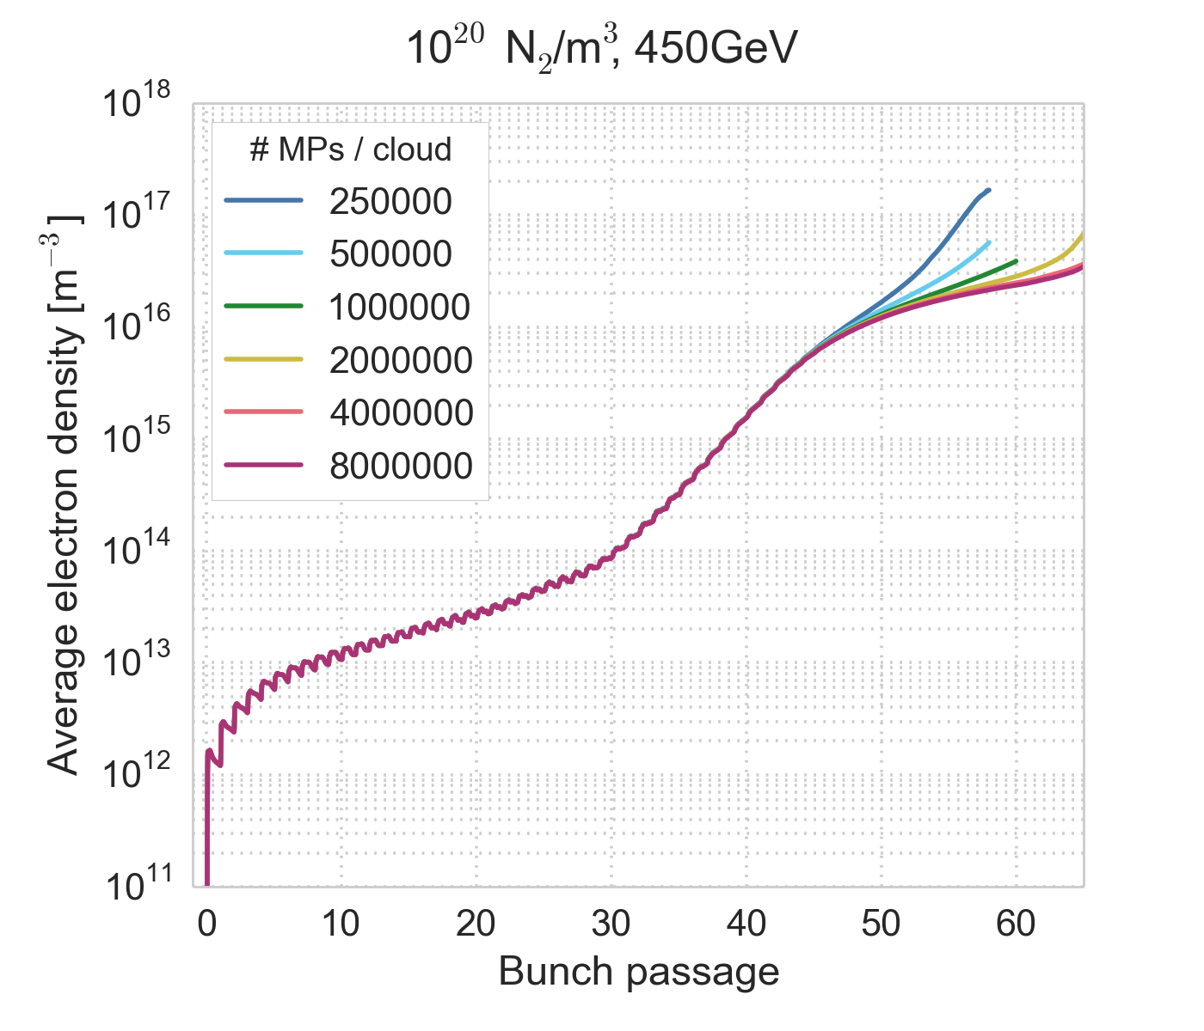
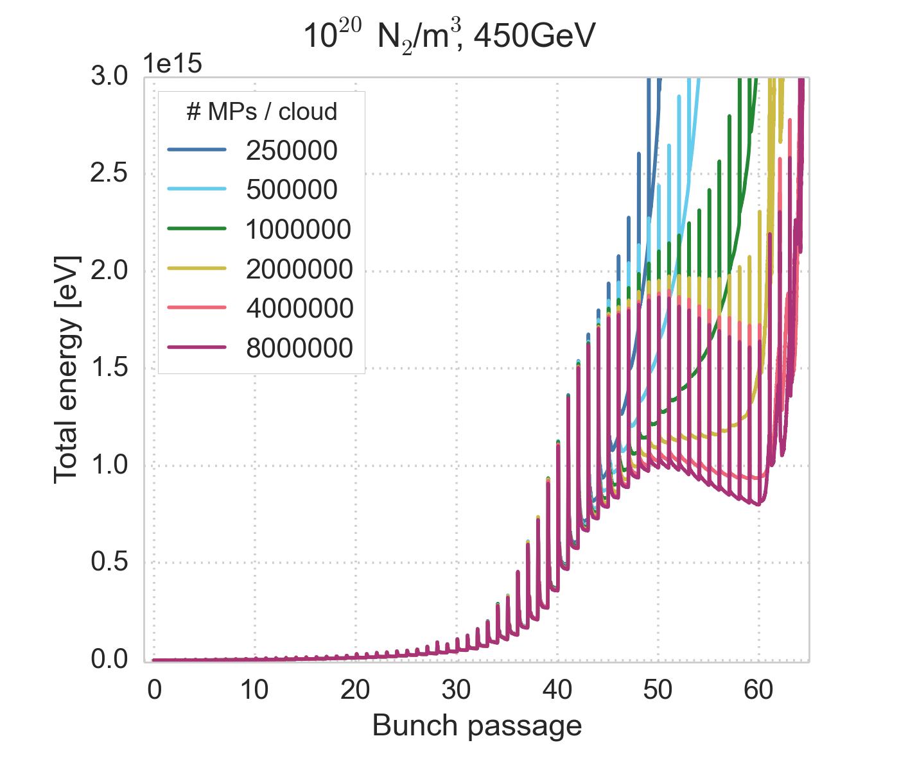
Macro-particle number scan
We scan the number of macro-particles per cloud
The numerical breakdown can be pushed to later in the bunch train with increasing macro-particle numbers
Before the breakdown, the simulation is converged wrt the macro-particle number

Slide 32
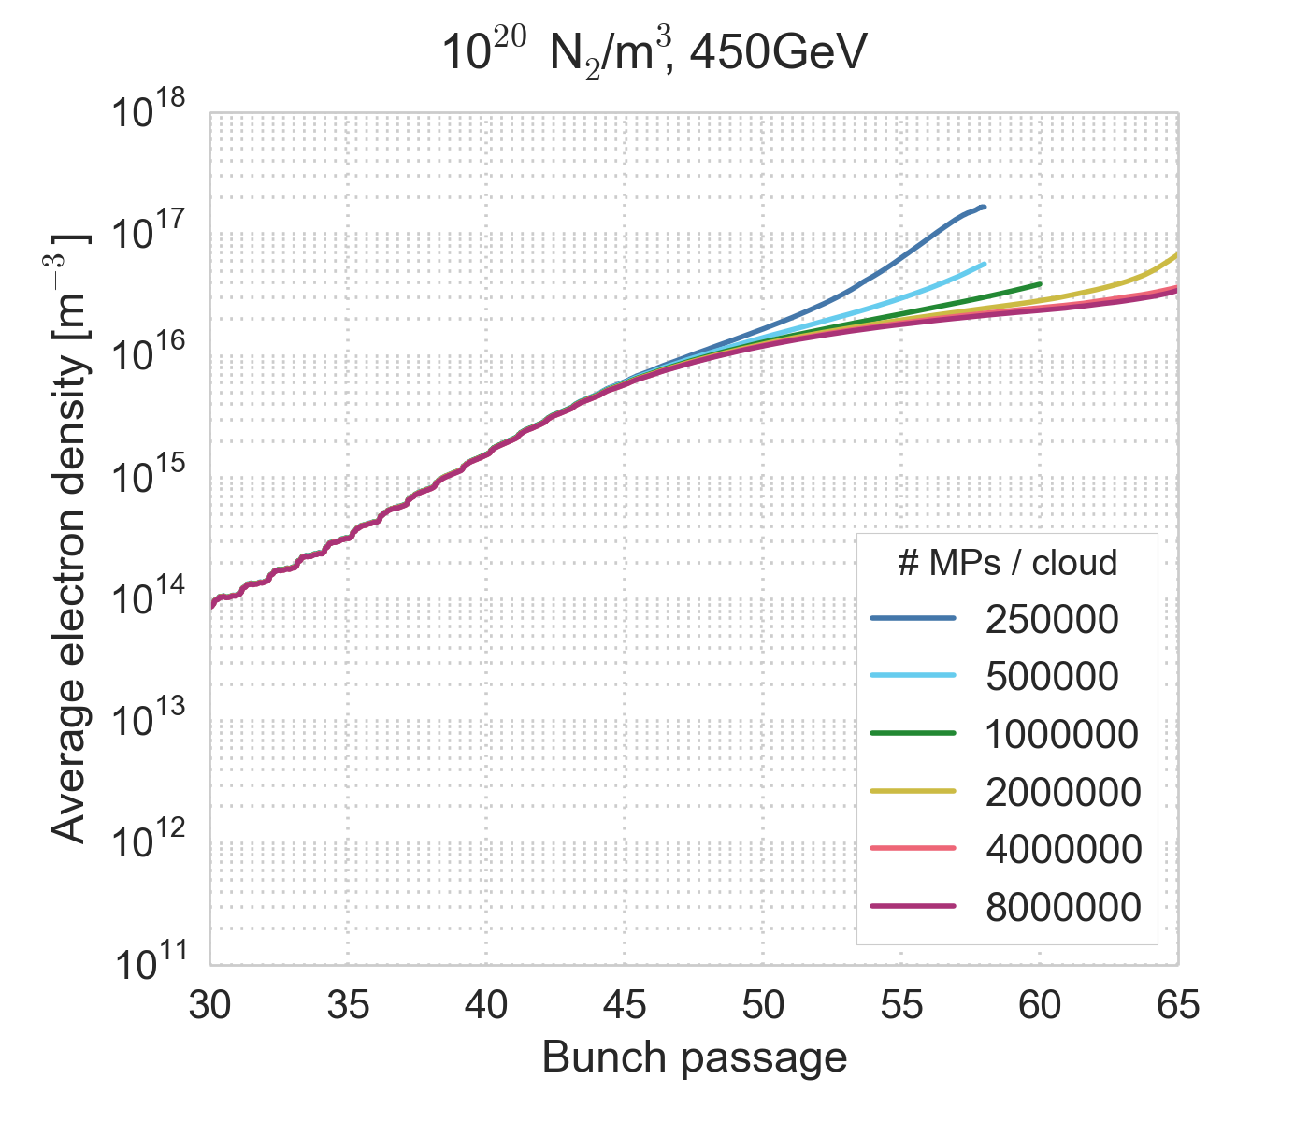
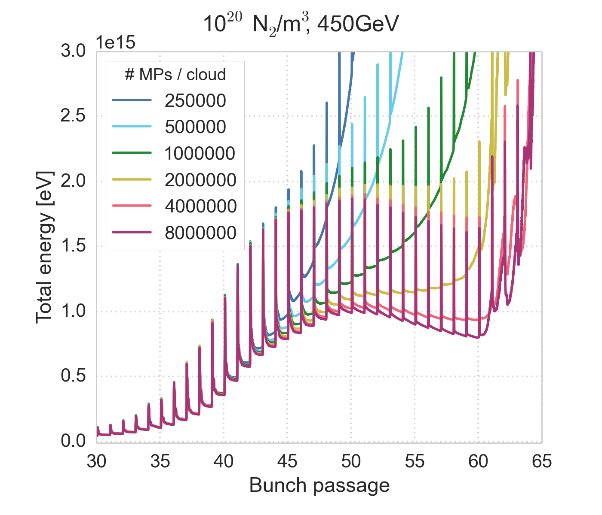
Macro-particle number scan
We scan the number of macro-particles per cloud
The numerical breakdown can be pushed to later in the bunch train with increasing macro-particle numbers
Before the breakdown, the simulation is converged wrt the macro-particle number

Slide 33
Macro-particle number scan
We scan the number of macro-particles per cloud
The numerical breakdown can be pushed to later in the bunch train with increasing macro-particle numbers
Before the breakdown, the simulation is converged wrt the macro-particle number
The first part of the simulation can be trusted

Slide 34
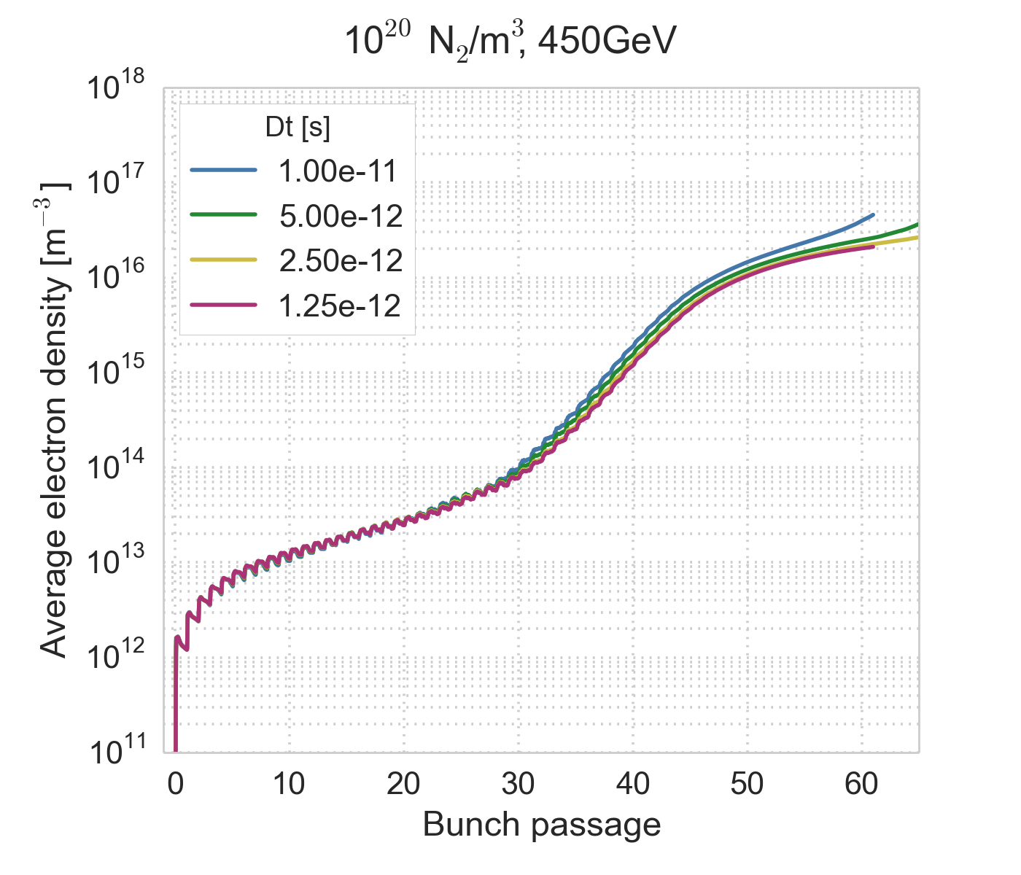
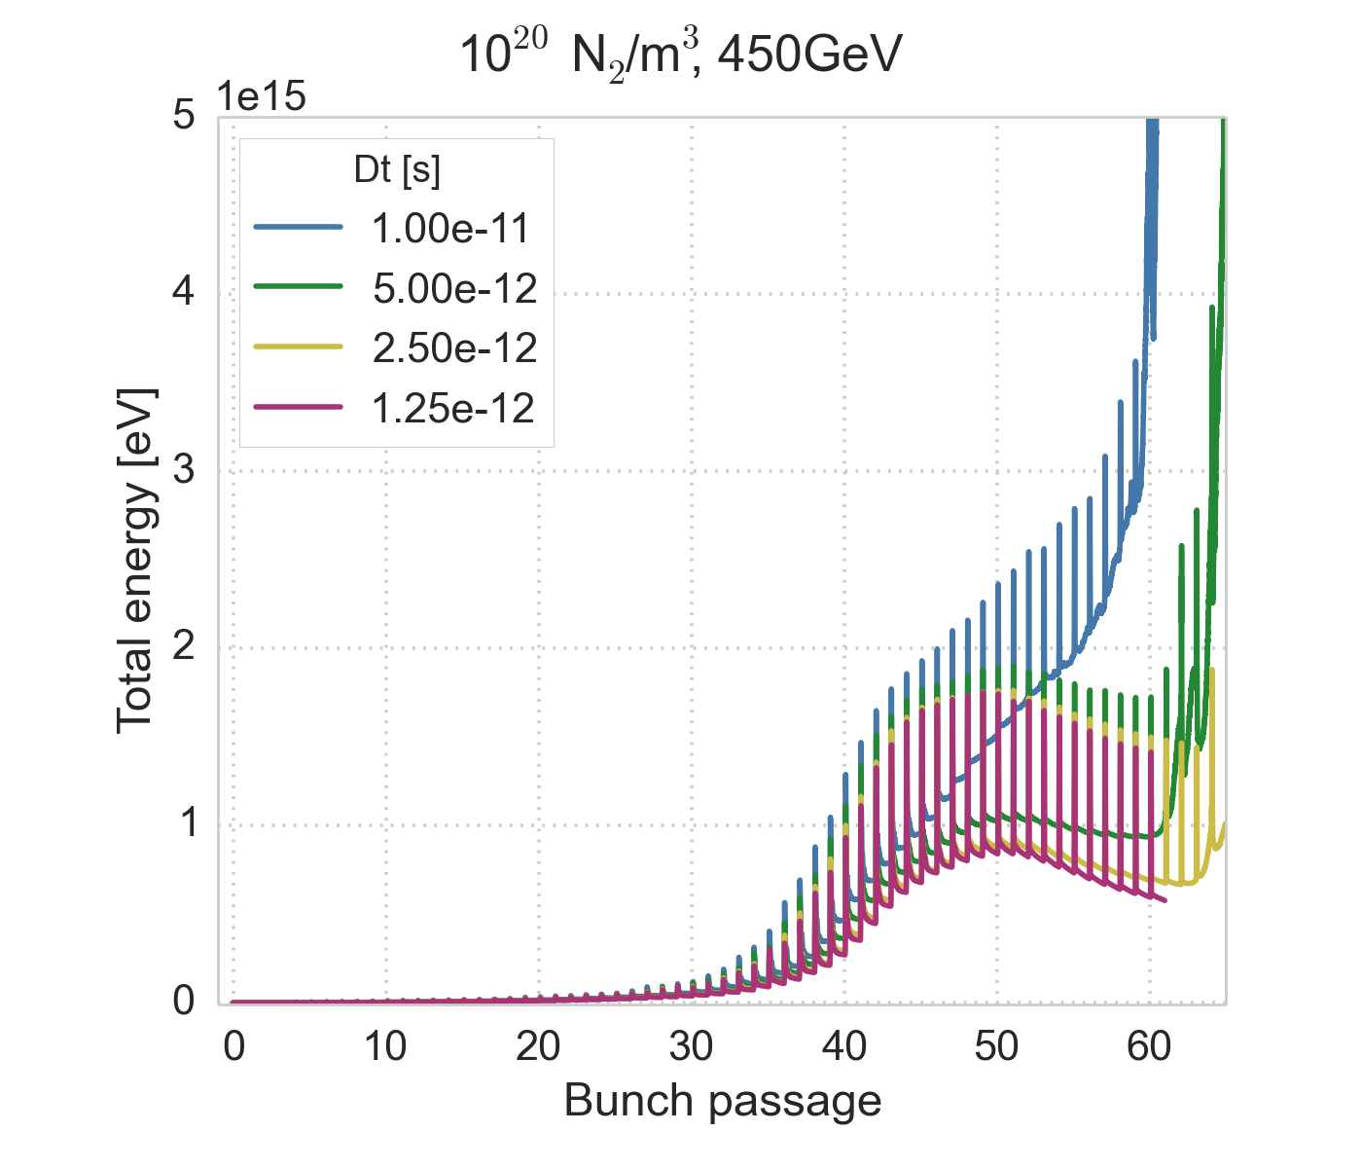
Time step scan
We scan the time step, keeping a large number of macro-particles
Here electric fields are updated at each step (in typical build-up simulations updates can be done every 5-10 time steps)
The numerical breakdown can be pushed to later in the bunch train also with decreasing simulation time step
Before the breakdown convergence wrt the time step is decent
Simulating 60 bunch passages has taken about 10 days

Slide 35
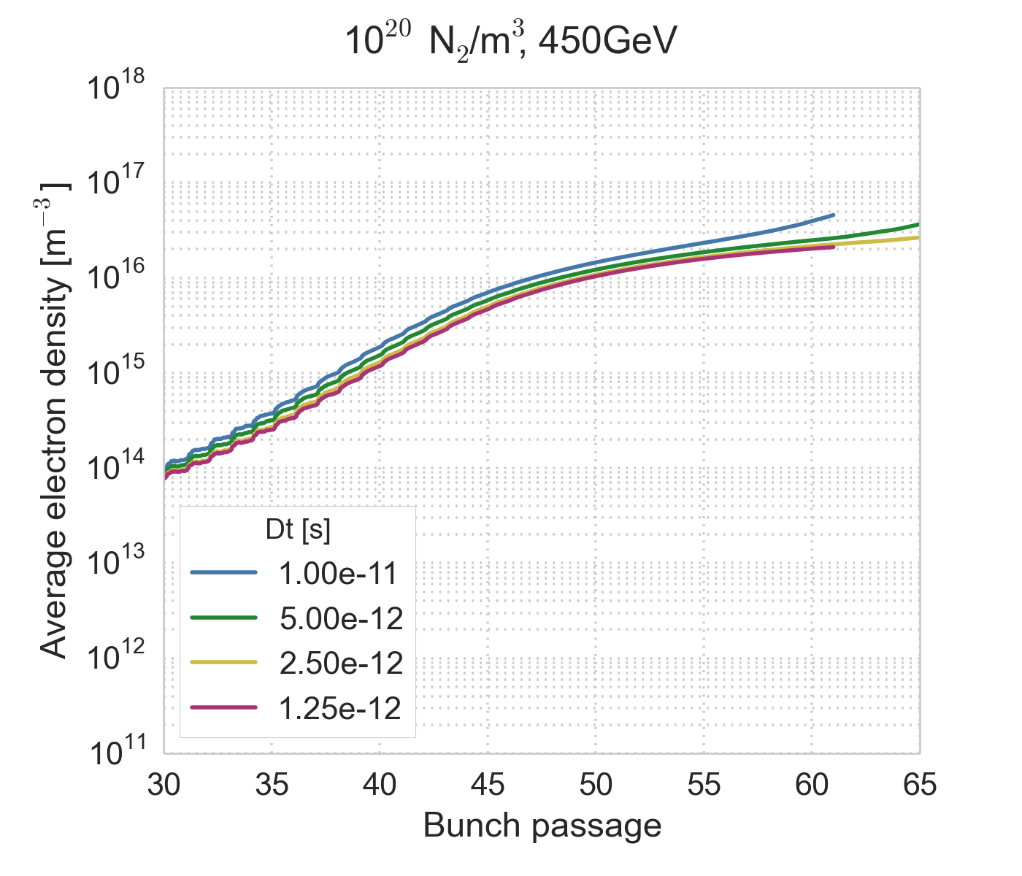
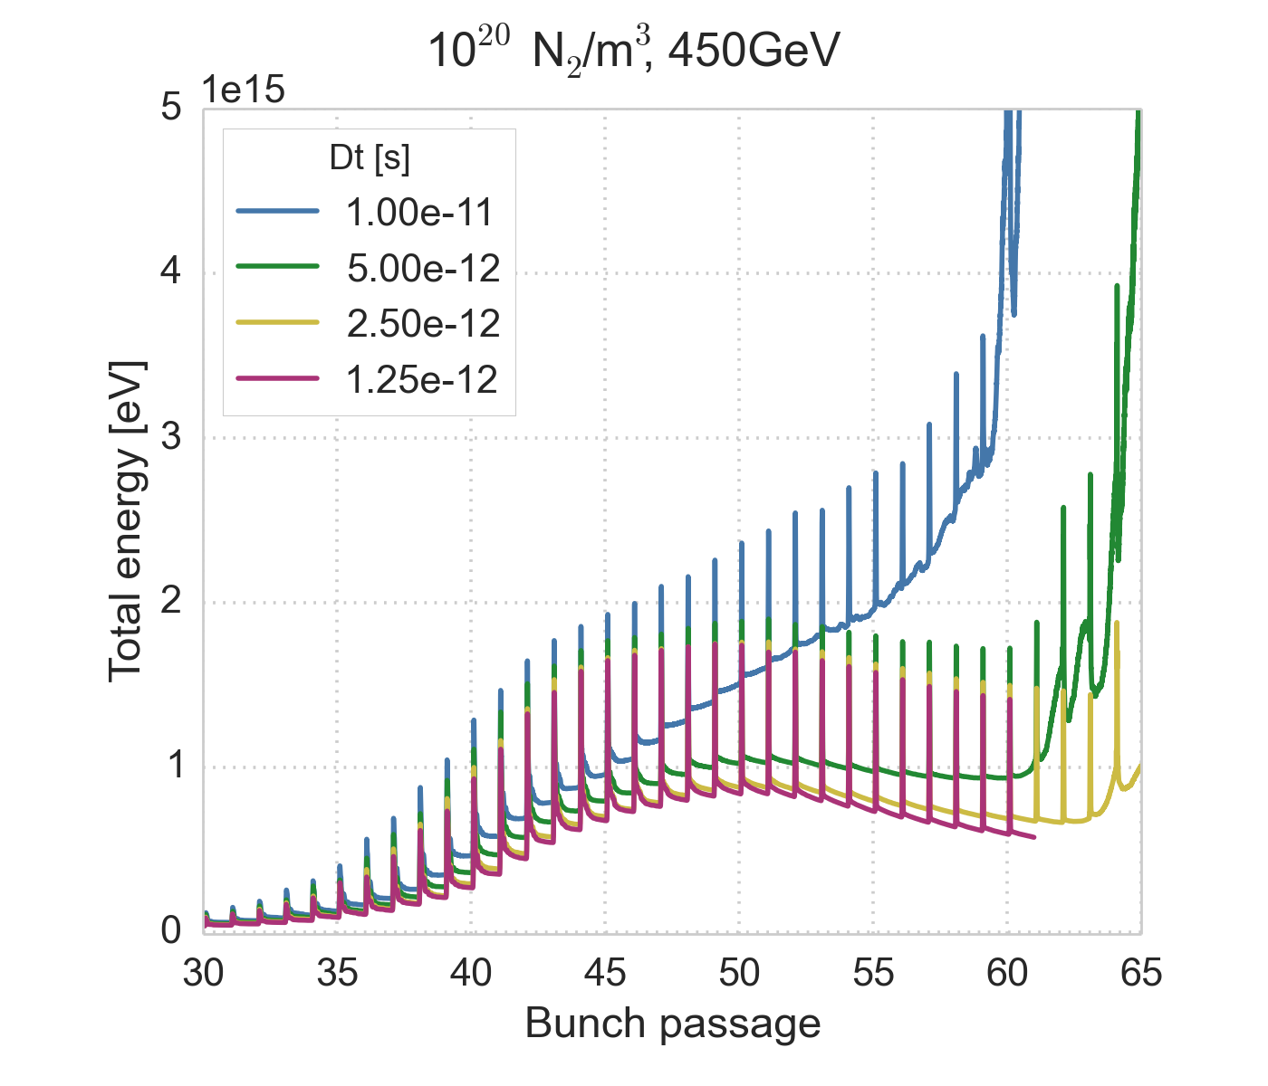
Time step scan
We scan the time step, keeping a large number of macro-particles
Here electric fields are updated at each step (in typical build-up simulations updates can be done every 5-10 time steps)
The numerical breakdown can be pushed to later in the bunch train also with decreasing simulation time step
Before the breakdown convergence wrt the time step is decent

Slide 36
Time step scan
We scan the time step, keeping a large number of macro-particles
Here electric fields are updated at each step (in typical build-up simulations updates can be done every 5-10 time steps)
The numerical breakdown can be pushed to later in the bunch train also with decreasing simulation time step
Before the breakdown convergence wrt the time step is decent
The first part of the simulation can be trusted

Slide 37
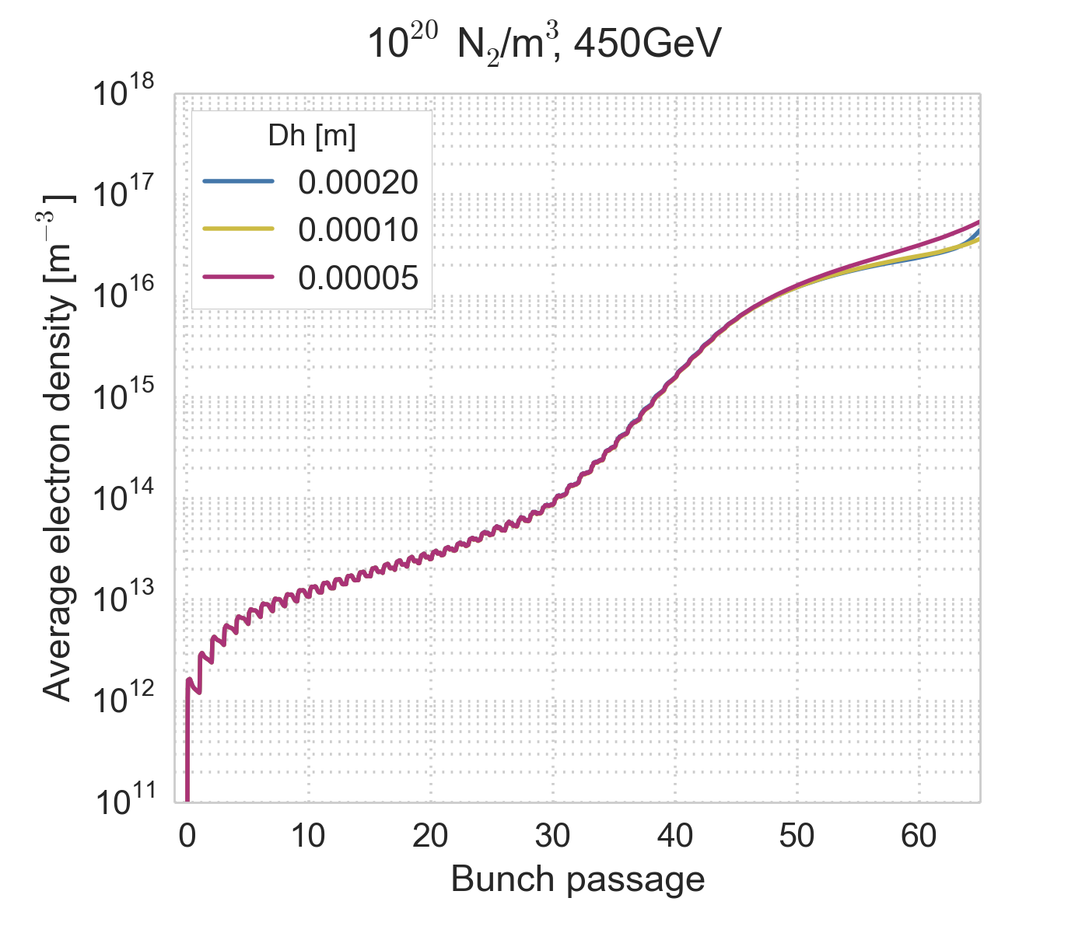
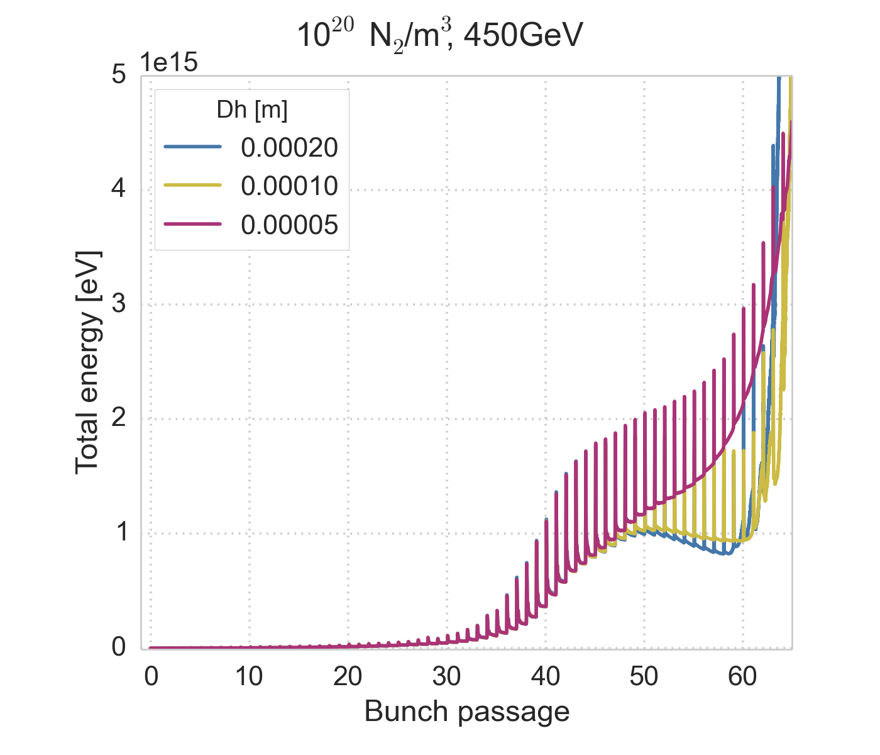
Grid cell size scan
We keep a large number of macro-particles and a time step of 5 ps and scan the grid size
The dependence on the grid cell size is non-linear
  For a fixed number of macro-particles, going to a smaller cell size makes the fields more noisy and the numerical instability set in earlier, but a larger cell size is also prone to numerical instability
Before the breakdown, the simulation is converged also wrt to the grid cell size

Slide 38
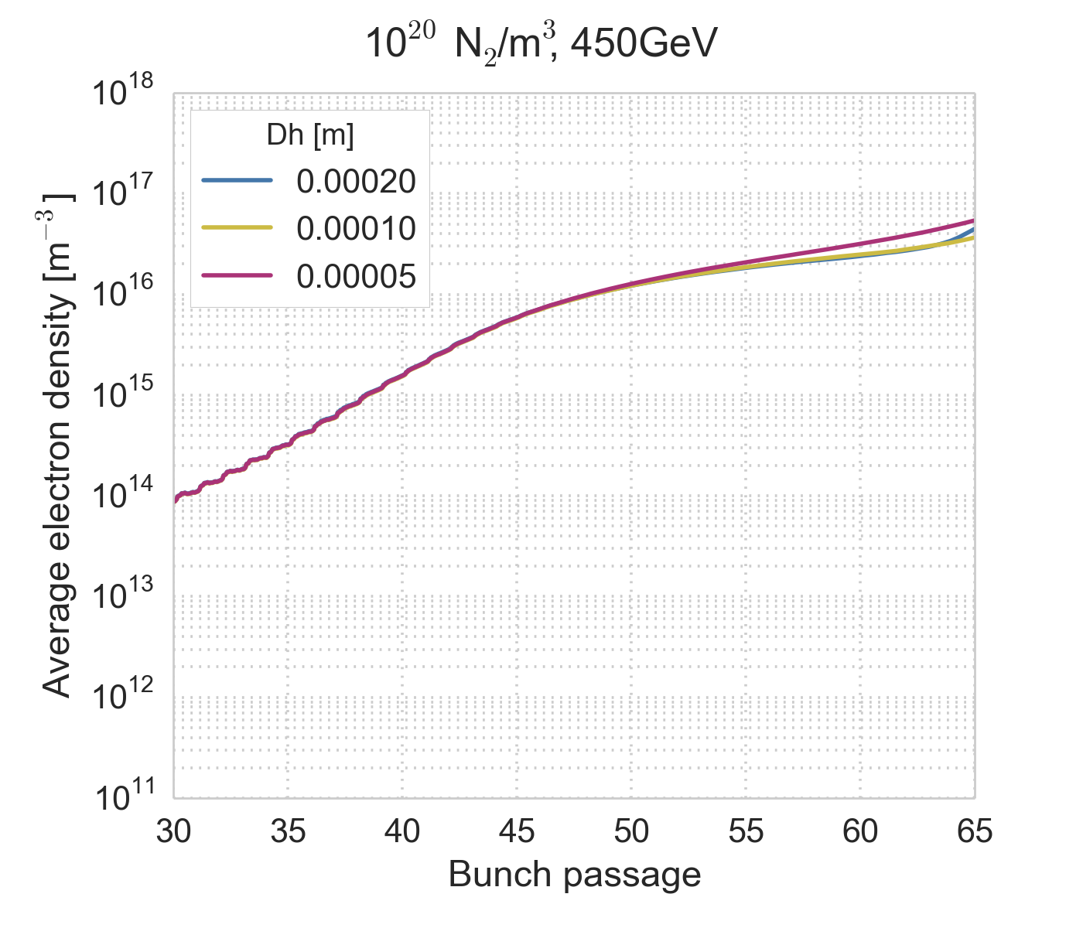
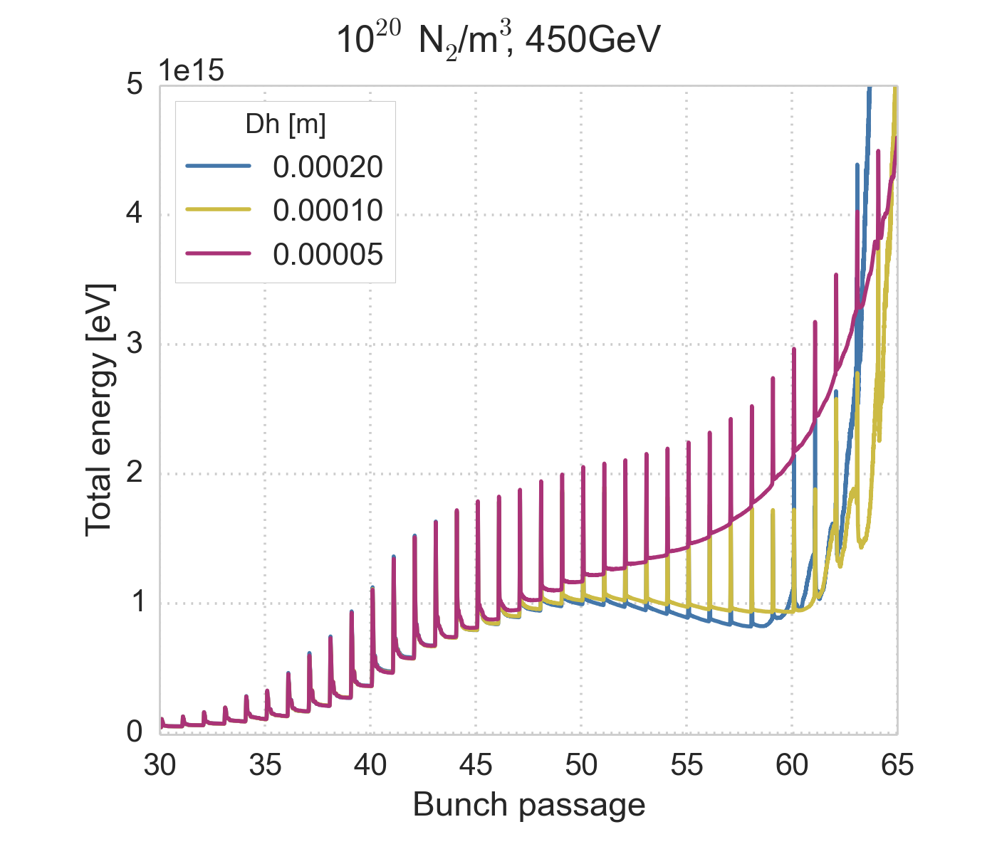
Grid cell size scan
We keep a large number of macro-particles and a time step of 5 ps and scan the grid size
The dependence on the grid cell size is non-linear
  For a fixed number of macro-particles, going to a smaller cell size makes the fields more noisy and the numerical instability set in earlier, but a larger cell size is also prone to numerical instability
Before the breakdown, the simulation is converged also wrt to the grid cell size

Slide 39
Grid cell size scan
We keep a large number of macro-particles and a time step of 5 ps and scan the grid size
The dependence on the grid cell size is non-linear
  For a fixed number of macro-particles, going to a smaller cell size makes the fields more noisy and the numerical instability set in earlier, but a larger cell size is also prone to numerical instability
Before the breakdown, the simulation is converged also wrt to the grid cell size
The first part of the simulation can be trusted

Slide 40
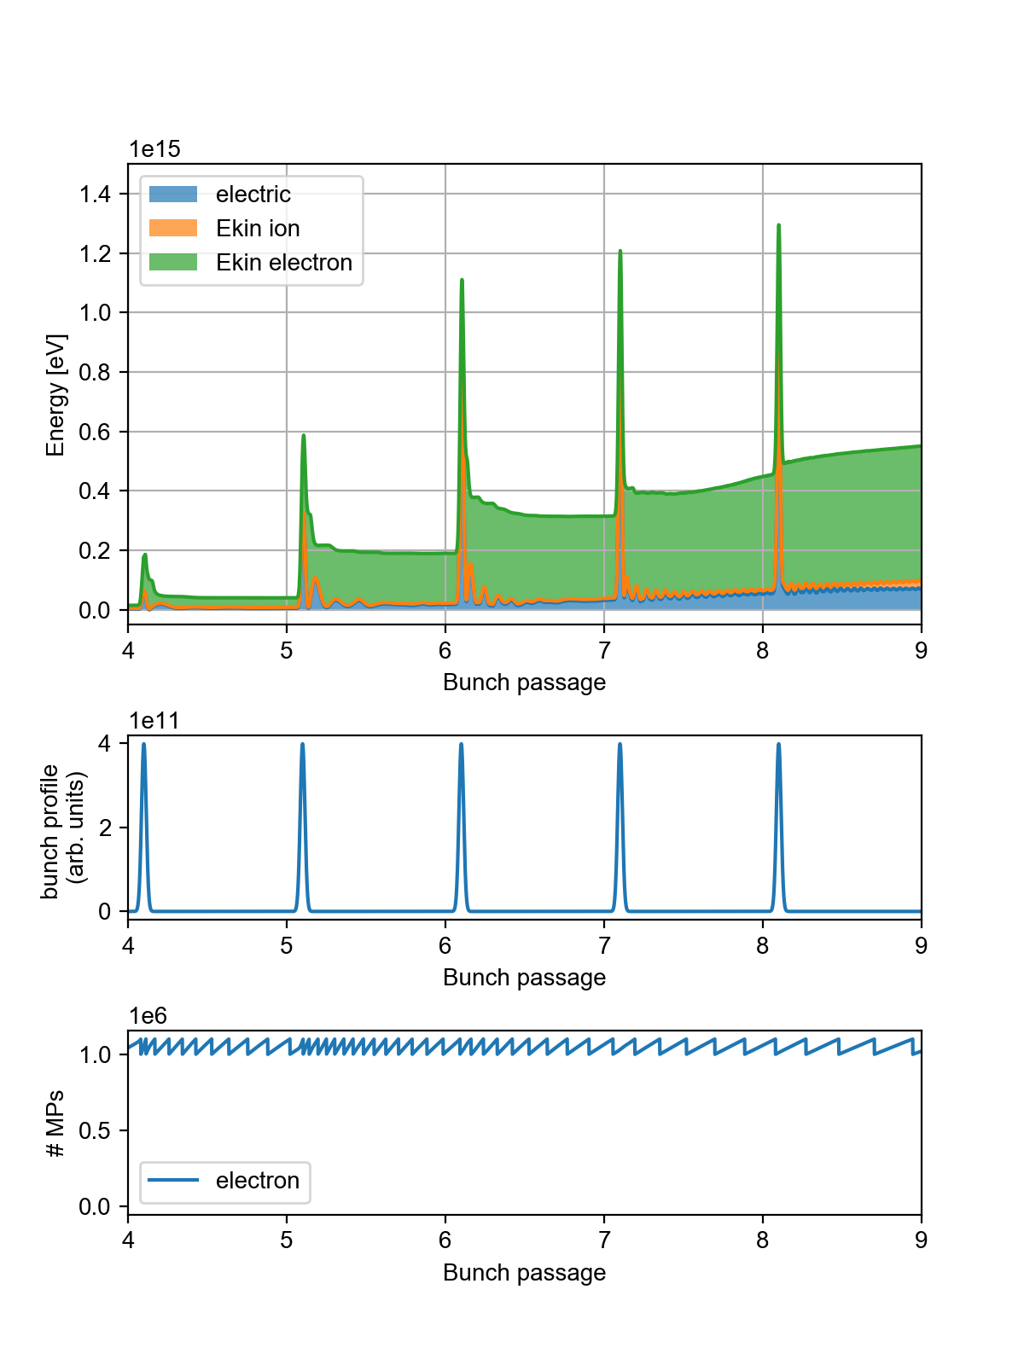
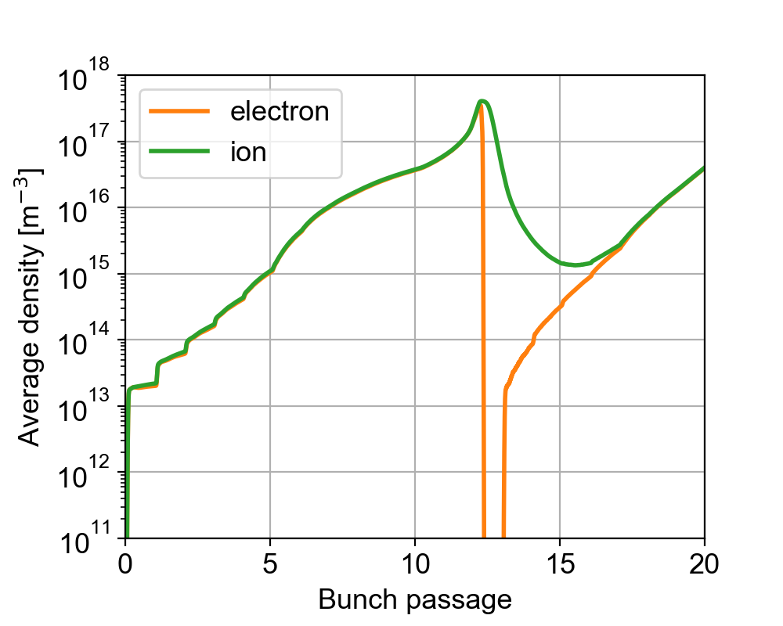
Higher gas densities
Increasing the gas density by a factor of 10
to 10²¹ m⁻³, the numerical breakdown
occurs already at the beginning of the
simulation

Slide 41
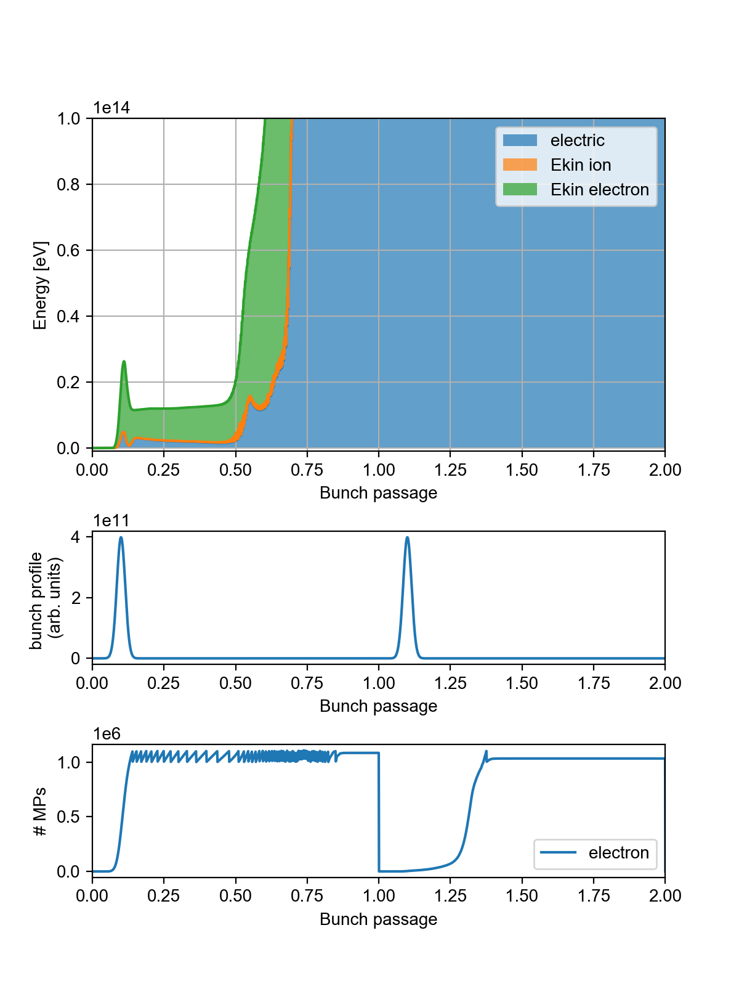
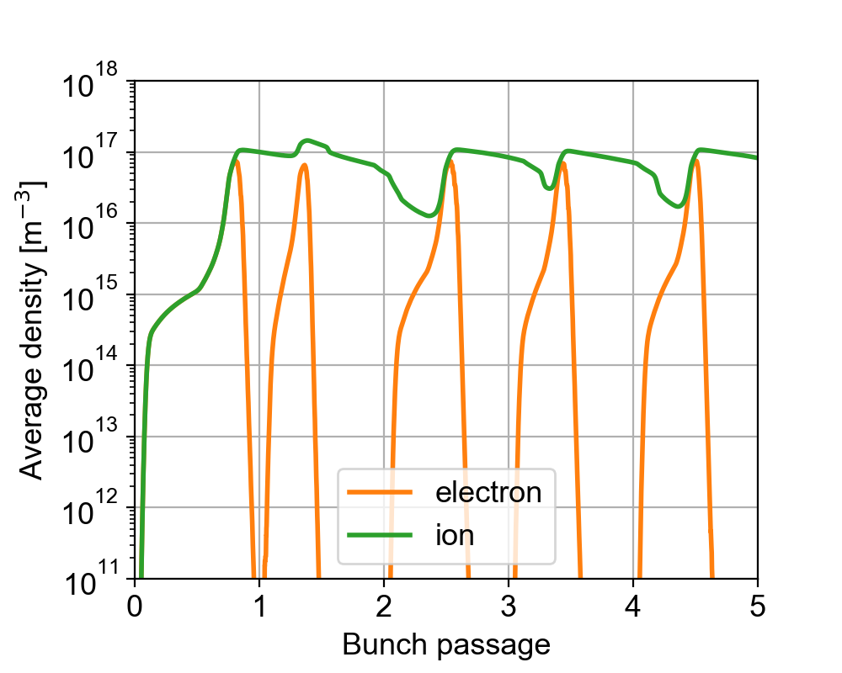
Higher gas densities
Increasing the gas density by another
factor of 10 to 10²² m⁻³, the numerical
breakdown occurs during the first
bunch passage
Sudden drops of the electron density occur when the simulation is already compromised

Slide 42
Conclusions
We have identified the limit of our simulation model due to numerical heating
For a gas density of 10²⁰ m⁻³ the simulation is converged for about 50 bunch passages
We cannot currently simulate gas densities above 10²⁰ m⁻³, as the breakdown occurs after only a few bunch passages
The simulation is converged wrt numerical parameters until the runaway starts
This indicates that this model is sufficient to cover the evolution until that point
To improve the simulation further neutrals would need to be tracked and collisions modelled → full-scale plasma simulations (would require huge development efforts)

Slide 43
Conclusions
Based on what we have so far, we can conclude that
Cross-ionization increases the electron and ion densities up to at least 10¹⁷ m⁻³
Based on previous instability simulation studies (with a different initial state without cross-ionization, but similar average electron and ion densities), this could be compatible with the observed instabilities
Refined instability simulations could be done starting from the results of build-up simulations with cross-ionization with a reasonable effort (a few more weeks of work)

Slide 45
Further ingredients
Neutrals
Collisions respecting momentum conservation laws
  Impact ionization (could we take into account the ionization energy)
  e⁻ + N₂
  Coulomb collisions between charged particles (compensate for underestimation within individual cells in PIC)
  e⁻ + e⁻ , N₂⁺ + N₂⁺ , e⁻ + N₂⁺
  Elastic collisions
  e⁻ + N₂ , N₂ + N₂
  Charge exchange and momentum transfer
  N₂⁺ + N₂

Slide 46
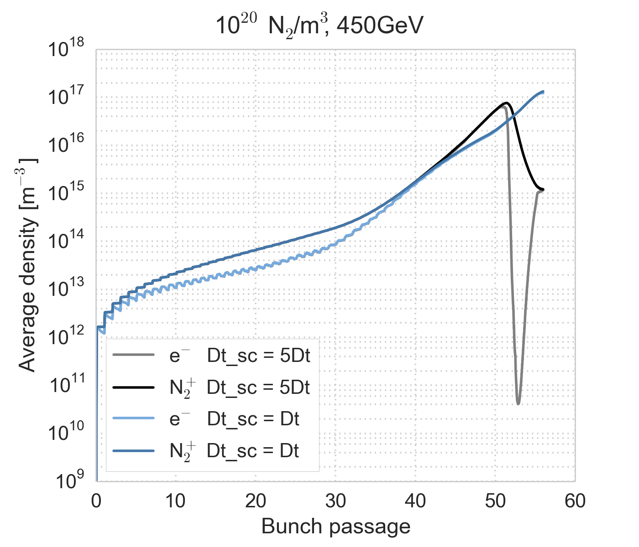
Time steps
A PyECLOUD build-up simulation has 2 different time steps
The main time step that determines the propagation of the beam etc
typically set to Δt ≈ 25 ps
A time step for updating the electric fields from the charge distribution
typically set to Δt_sc = 5 * Δt ≈ 125 ps
In the cross-ionization simulations the
time steps were set much smaller
than for a standard build-up simulation
Δt = 5 ps
Δt_sc = 5 * Δt = 25 ps
Still, it was found that even more
frequent updates of the electric fields
are required
A convergence scan wrt the time step
with Δt_sc = Δt was performed

