Slide 1
High-Available Samba for CERNBox
Giuseppe Lo Presti, CERN IT-ST

Slide 2
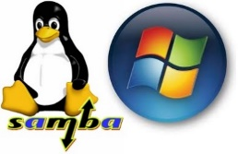
Storage for MALT
Windows DFS at CERN phase-out started
  Users being migrated to CERNBox
  A growing base of Windows users expect online
  (Samba-based) access to EOS/CERNBox
Samba gateways from prototype to production
  High Available cluster in place since Sep 2019
    IP-based load balancing
  Monitoring and alarming + performance analysis to identify shortcomings of the SMB/CIFS protocol
  CERN Terminal Service permanently connected
  to it as of Oct 2019

Slide 3






HA Samba Architecture
  The clustered Samba software requires
    Floating IPs, one per host
    A small /cephfs mount to share the state
      Yes, to provide a shared filesystem we need a(nother) shared filesystem…
  Windows Domain (AD) joined in dedicated keytab mode, using the credentials of the load-balanced alias
    Forbidden to join with hosts credentials, because they are resolved with their own IPs, not the floating ones!
  EOS FUSE mounted
  Fully puppetized configuration
Load-balanced
alias
SAMBA
Gateways
/cephfs
/eos/...

Slide 4
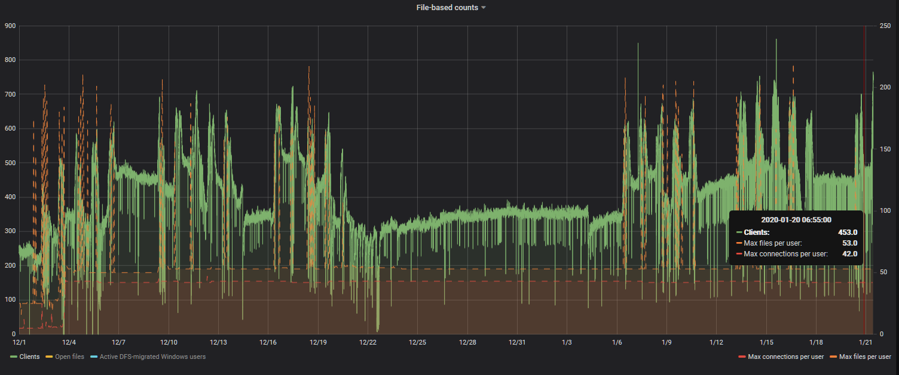
Usage and current issues
Growing usage trend,
service permanently used
Transparent interventions
  Floating IPs get
  reassigned seamlessly

Slide 5
Usage and current issues
Growing usage trend,
service permanently used
Transparent interventions
  Floating IPs get
  reassigned seamlessly
Permissions and ACLs
  Work in progress

Slide 6
Usage and current issues
Growing usage trend,
service permanently used
Transparent interventions
  Floating IPs get
  reassigned seamlessly
Permissions and ACLs
  Work in progress
“Concurrent” Microsoft Office editing
  Issue: multiple users accessing the same remote file via different gateways miss the notification that the file is being edited by another user
  Related to how Office uses locks over CIFS/SMB
    Investigating possible fixes and alternatives

