Slide 1
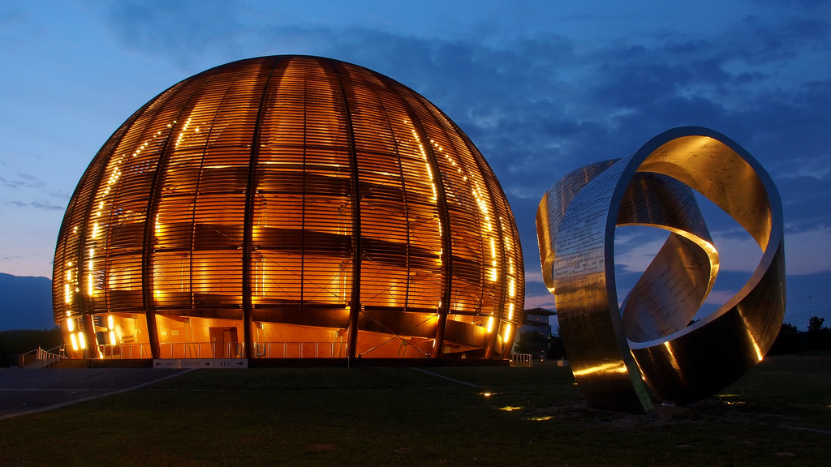
Ishkhan Gorgisyan
Fellow
AWAKE experiment
PhD from EPFL at Paul Scherrer Institute
Master from EPFL

Slide 2
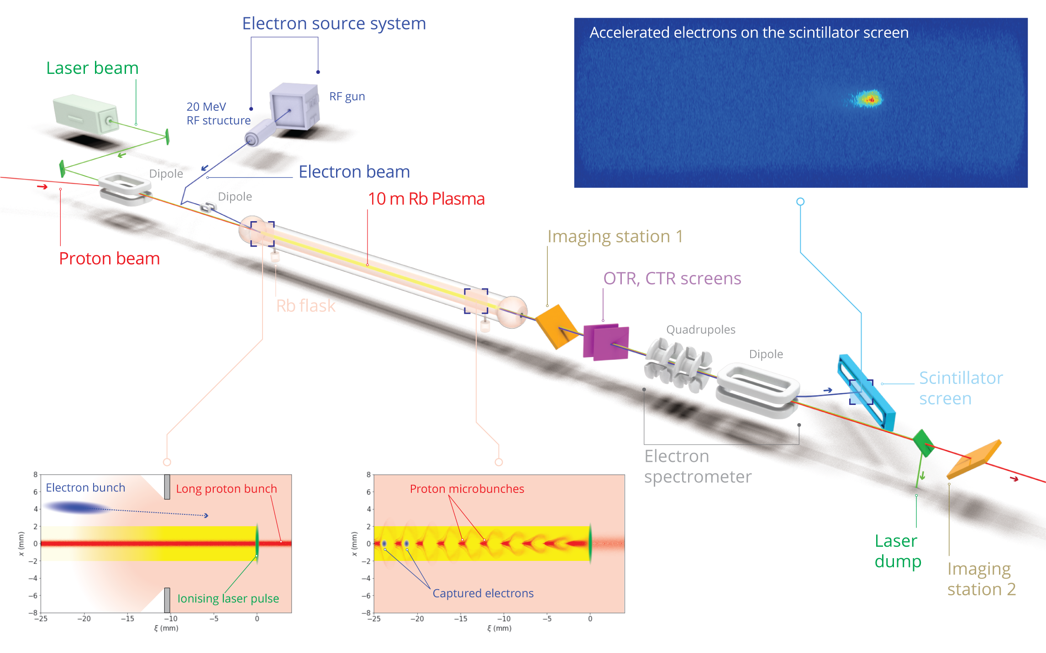

Slide 3
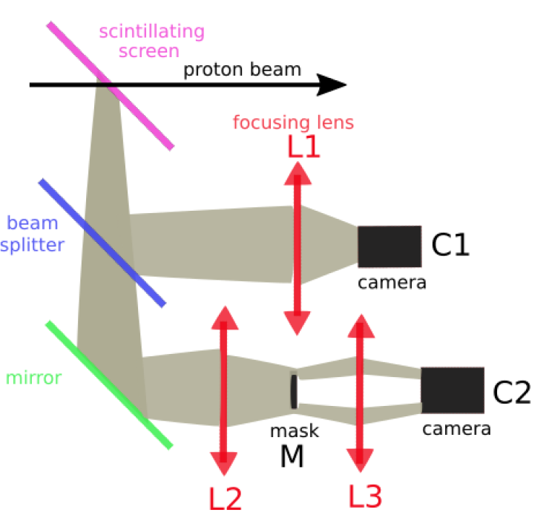
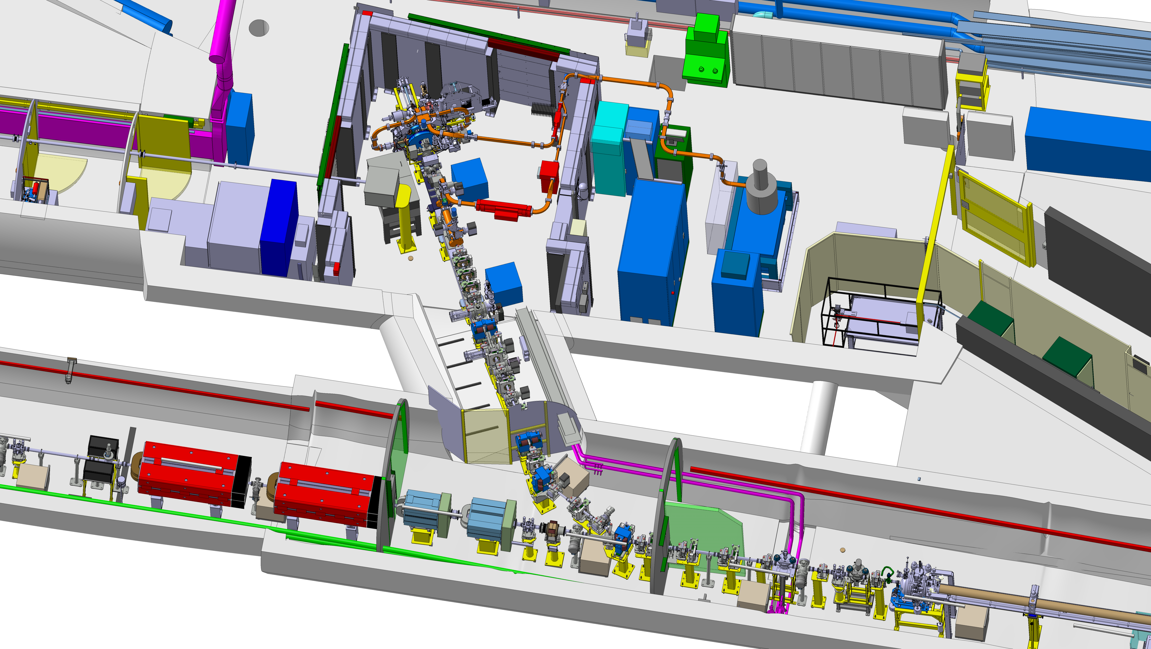
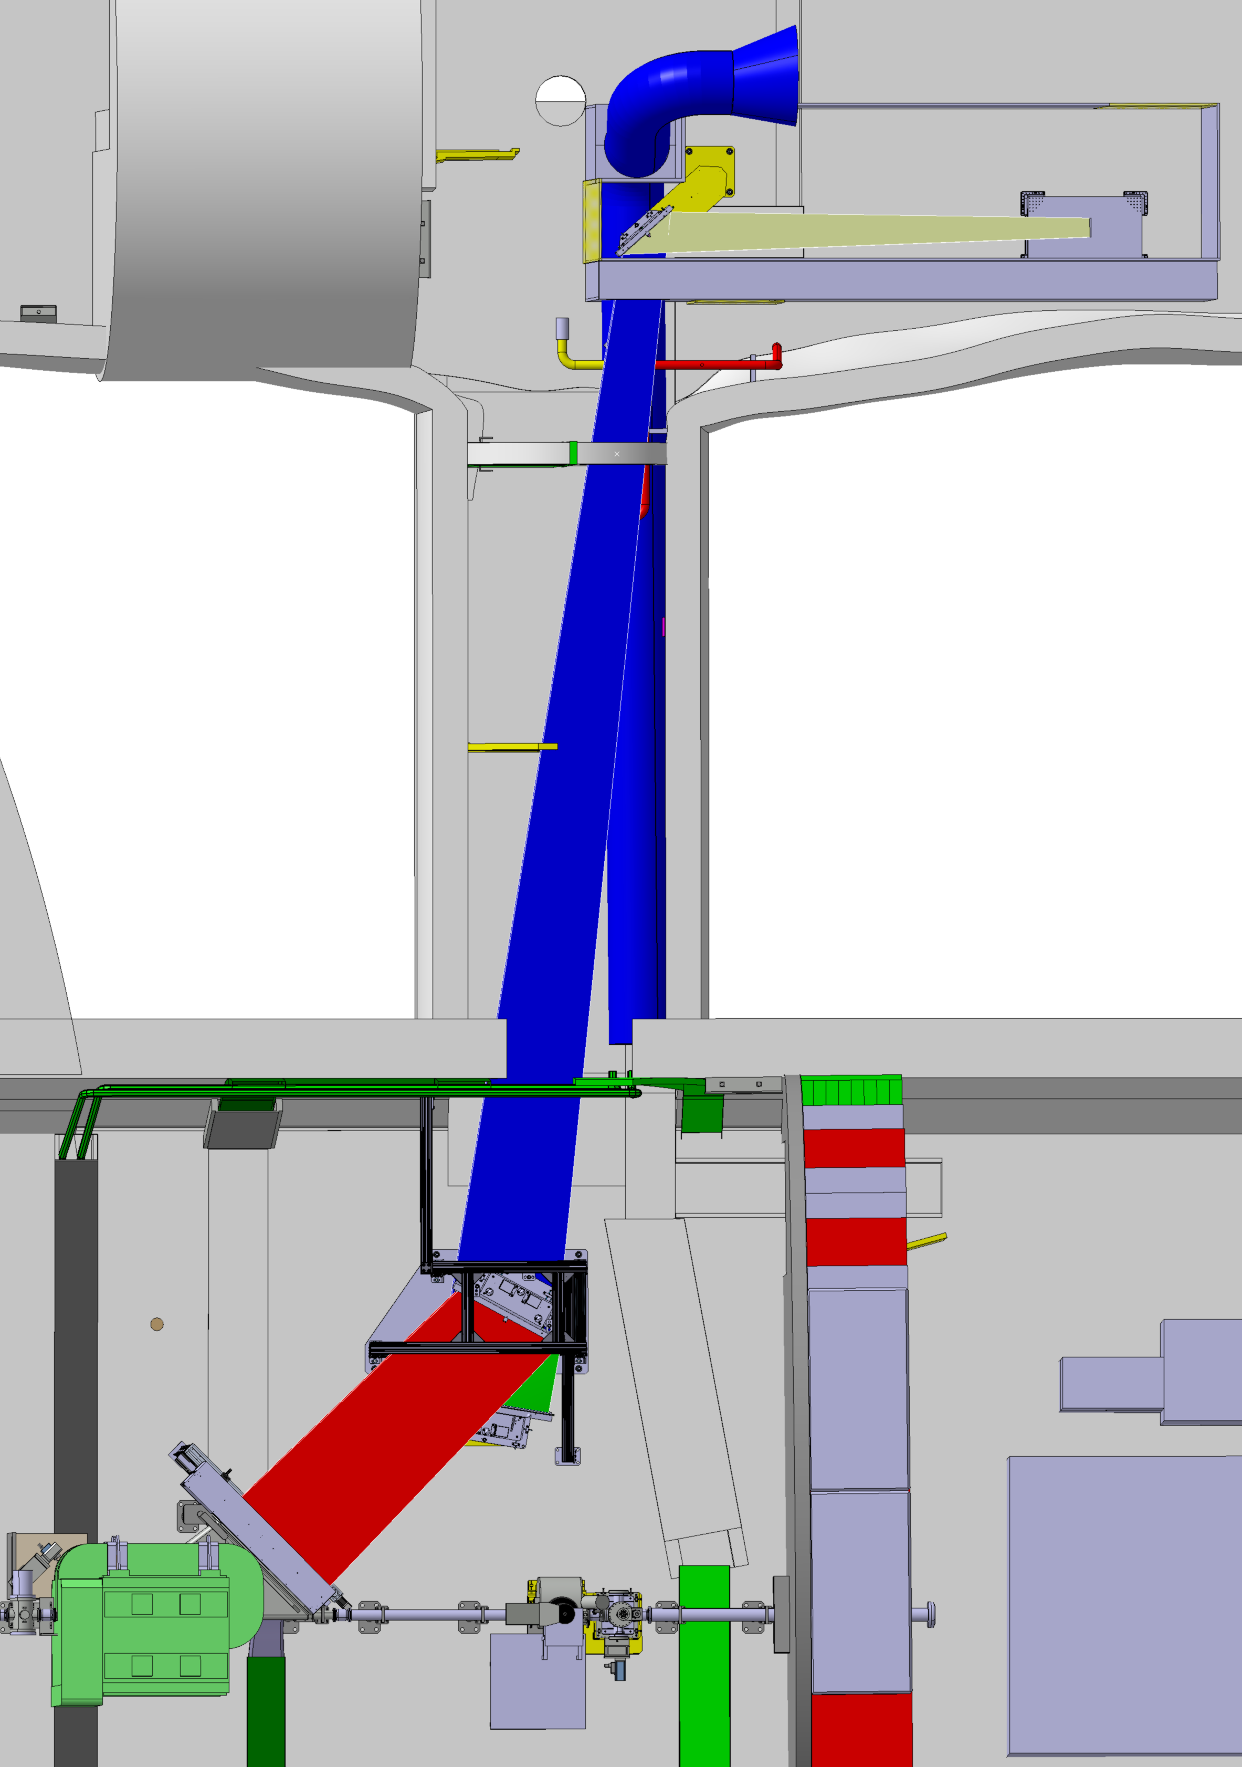
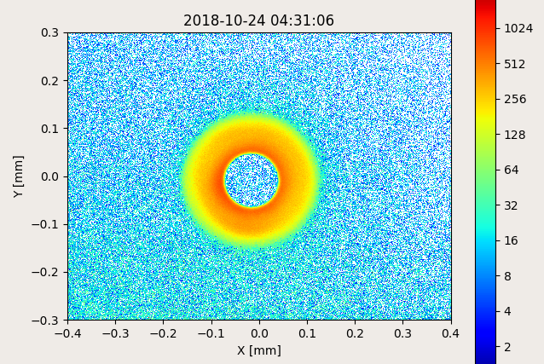
Transverse and longitudinal profile measurements of e⁻ beam, p⁺ beam and laser
Proton halo system
Streak camera system
Electron spectrometer optics

Slide 4
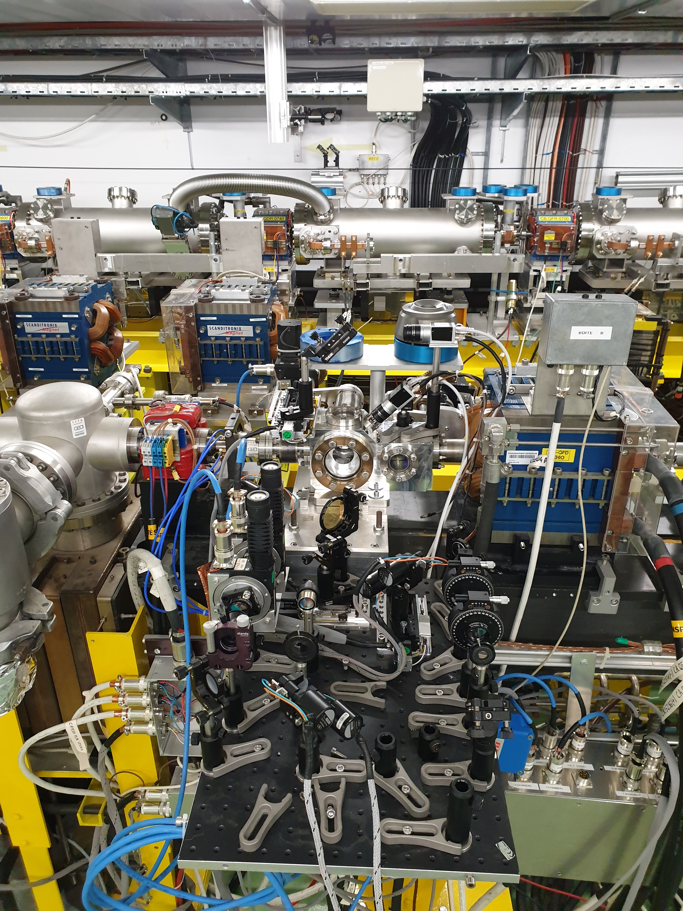
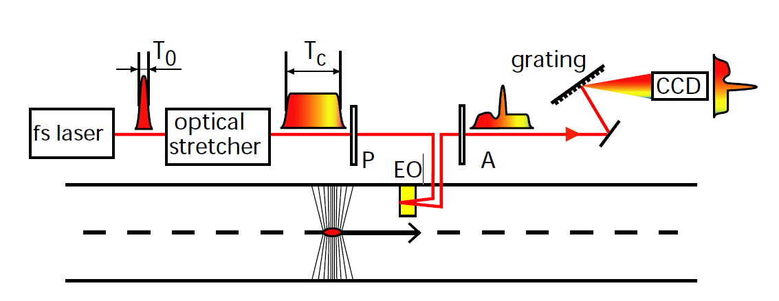
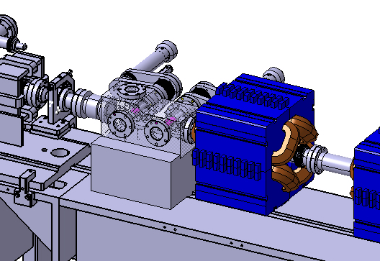
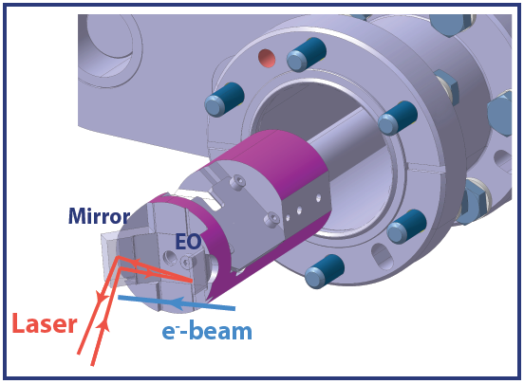
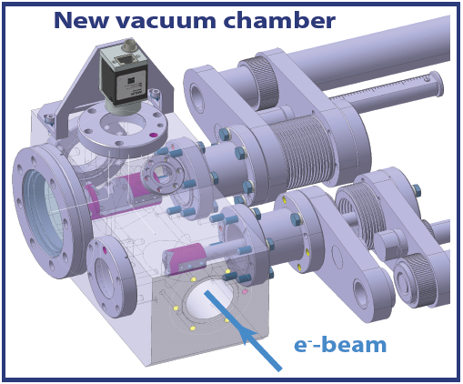
EO system for sub-ps bunch length measurement
Developed at CLEAR for AWAKE Run 2
Linearly chirped laser pulse
e⁻ profile encoded in laser pulse spectrum
Single-shot and non-invasive measurements
Currently being tested at CLEAR

Slide 5
Thank you for attention

