Slide 1
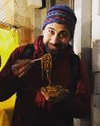
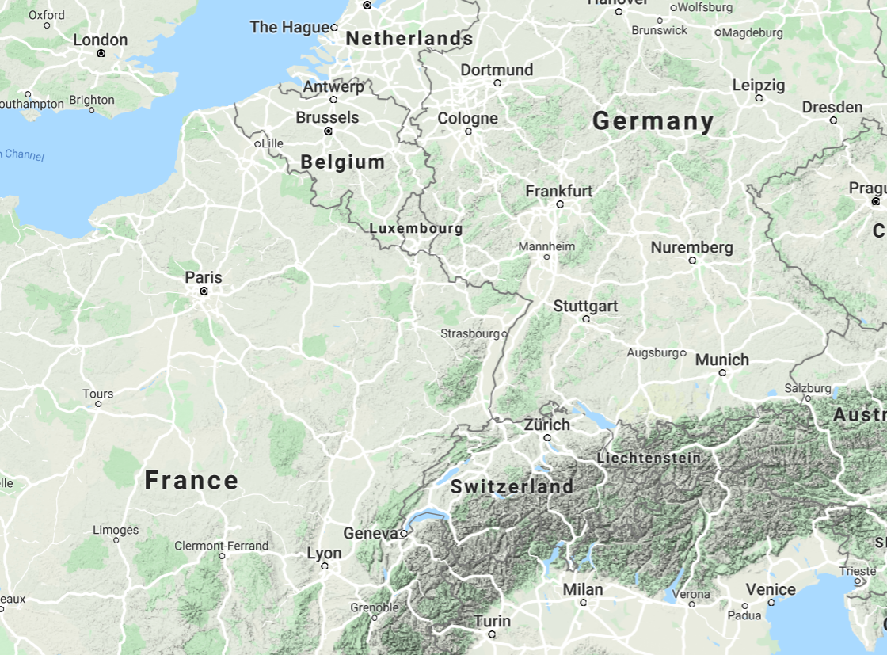
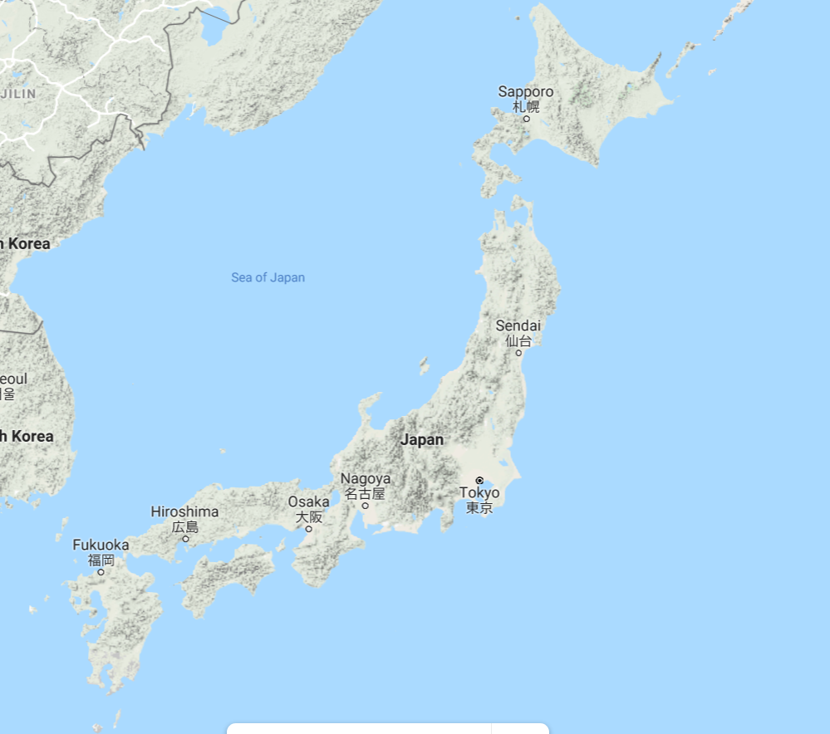
About me
Born on 07/09/2019, in Verona, Italy
Fellow at CERN BE/BI/PM section
PhD in Physics at Royal Holloway, University of London
Master degree in Nuclear Engineering at Politecnico di Milano
Bachelor degree in Energy Engineering at Politecnico di Milano
Michele Bergamaschi

Slide 2
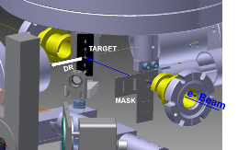
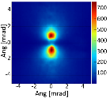
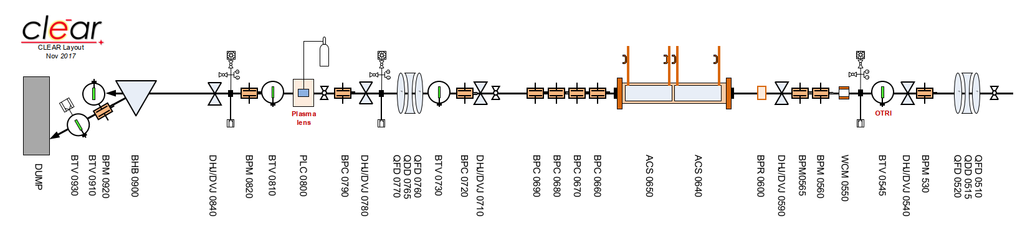
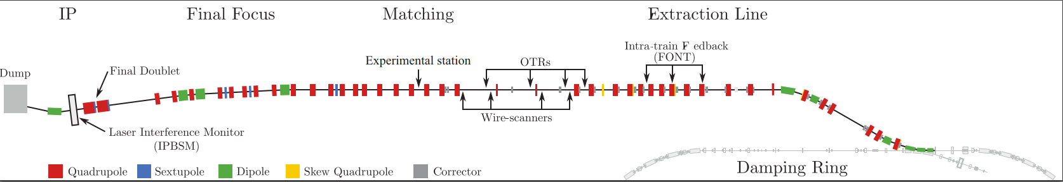
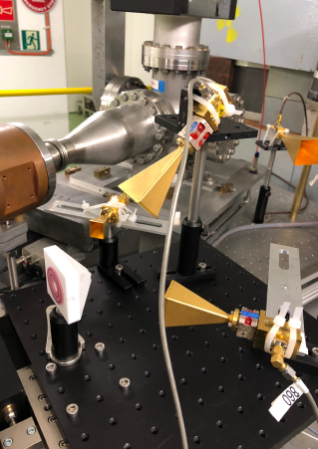
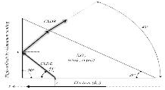
My work at CERN
My PhD in PM section: “Development of a combined transition and diffraction radiation station for non-invasive beam size monitoring on linear accelerators”
Simulation and analysis of Transition Radiation and Diffraction radiation
Work mainly on CLEAR @ CERN, and ATF2@ KEK. Now move to AWAKE
ATF2
Study of Diffraction Cherenkov radiation for beam diagnostic
Coherent TR, DR and ChDR for beam position and beam temporal profile

