Slide 1
Applications of X-band and high-gradient technology
CLIC project meeting, 5 December 2019

Slide 2
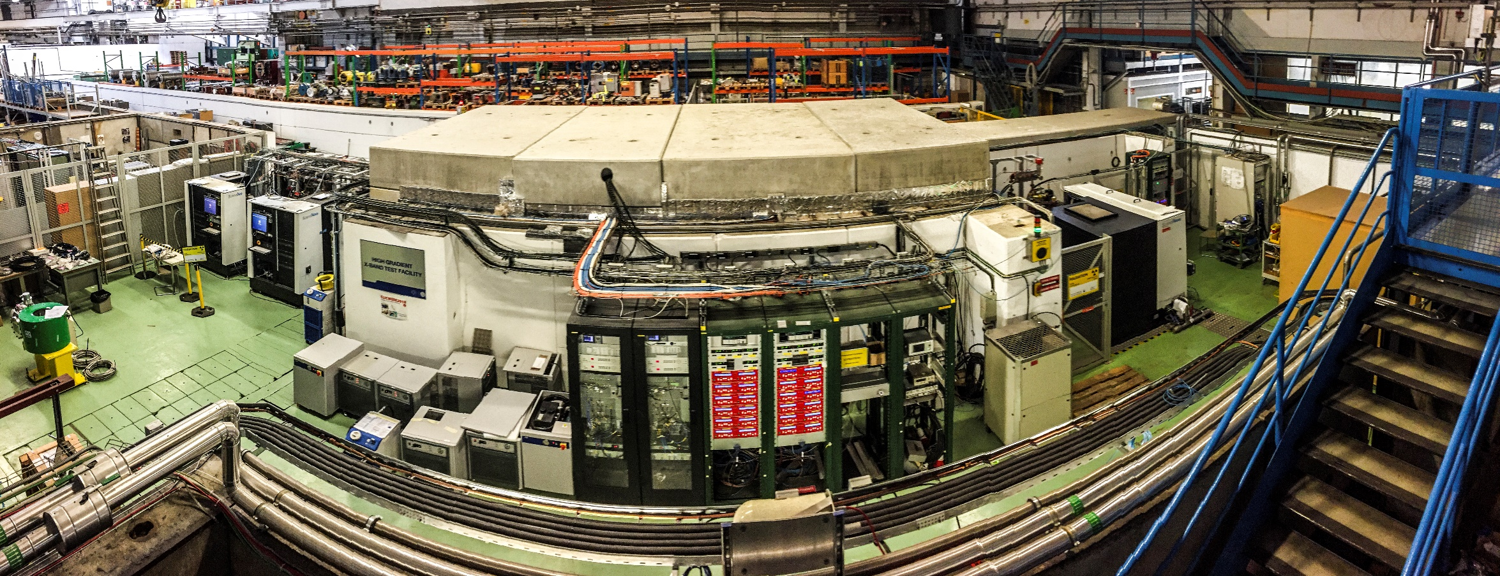
Introduction
An important aspect of the CLIC R&D strategy is to assist and promote application of high-gradient, X-band and advanced normal conducting technology.
The objective is to add to direct resources with those in other projects and broaden the technical base.
I will now present a selection of examples of projects CLIC actively collaborates with.

Slide 3
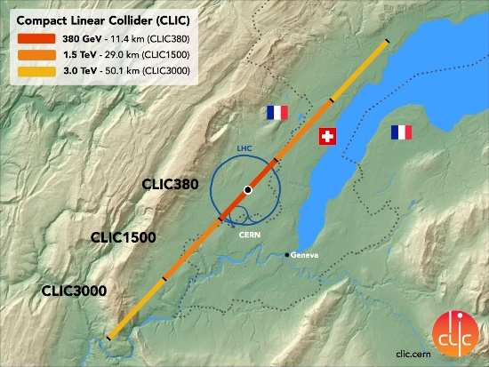
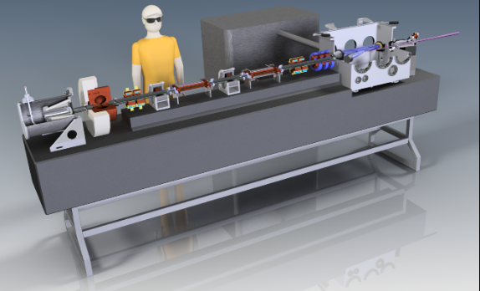
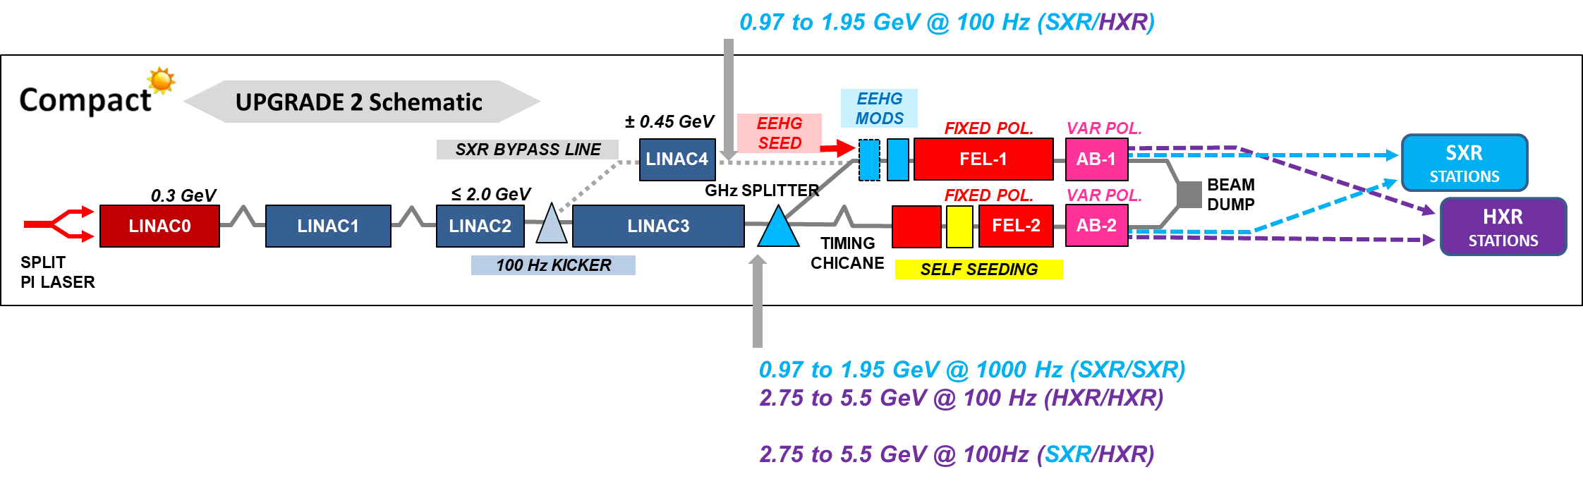
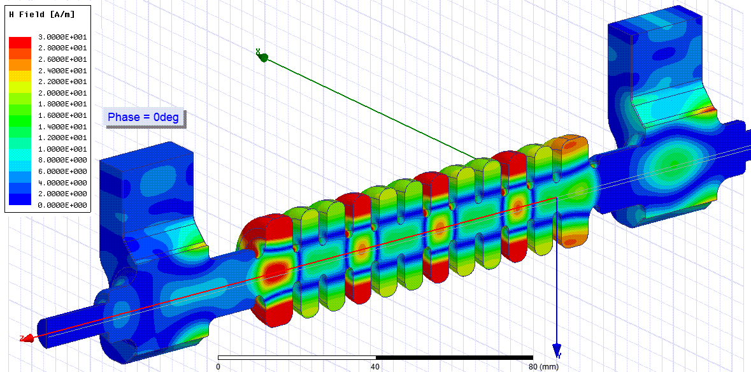
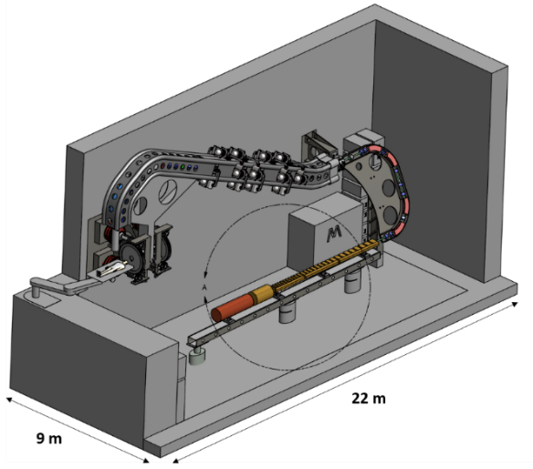
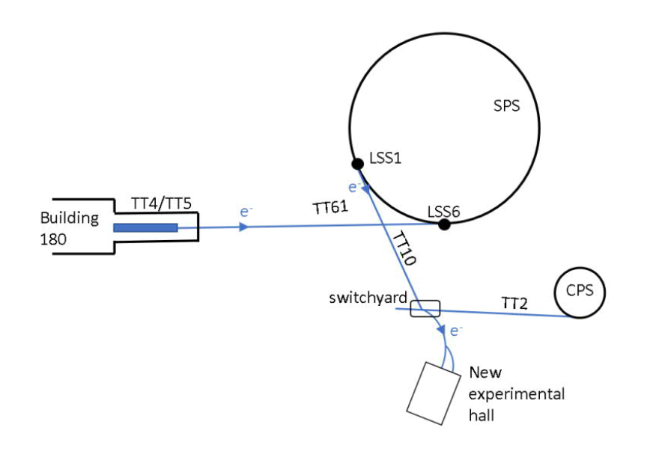
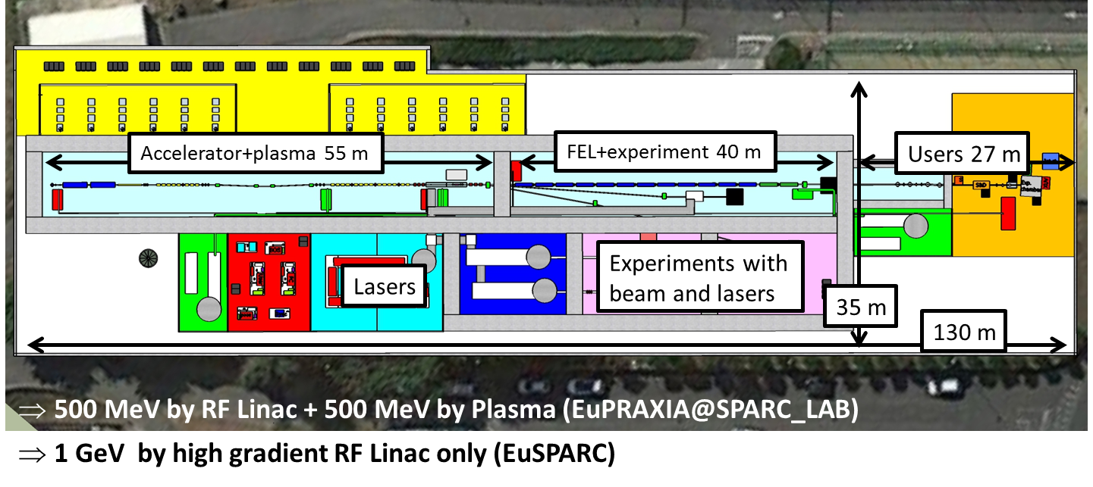
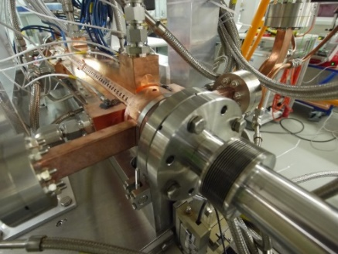
X-band and high-gradient applications overview
Linear collider
Inverse Compton Scattering Source
XFEL
Medical applications
GeV-range research linacs
Beam manipulation

Slide 4
X-band and high-gradient applications *selection*
Smart*Light – Compact Inverse Compton Source
POLARIX – Variable polarization deflector
SwissFEL – Operational C-band linac
XARA – CLARA energy upgrade
EuPRAXIA@SPARC_Lab – Advanced accelerator development
FERMI – XFFEL Energy upgrade
Tsinghua – Thompson source energy upgrade
PSI, FERMI, SINAP – Energy spread linearizers
eSPS – 3.5 GeV linac
CompactLight – XFEL Gerardo D’Auria

Slide 5

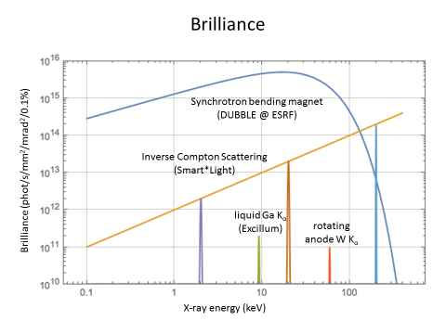
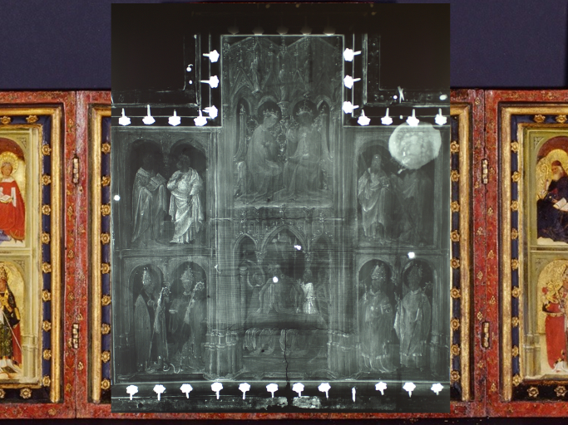
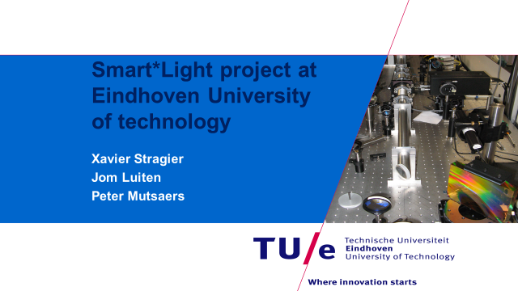
Inverse Compton Scattering Source – Smart*Light
Compact, highly monochromatic X-ray source.
Complementary to X-ray tube and synchrotron light source.
Applications in cultural heritage, material science, medical, etc.

Slide 6
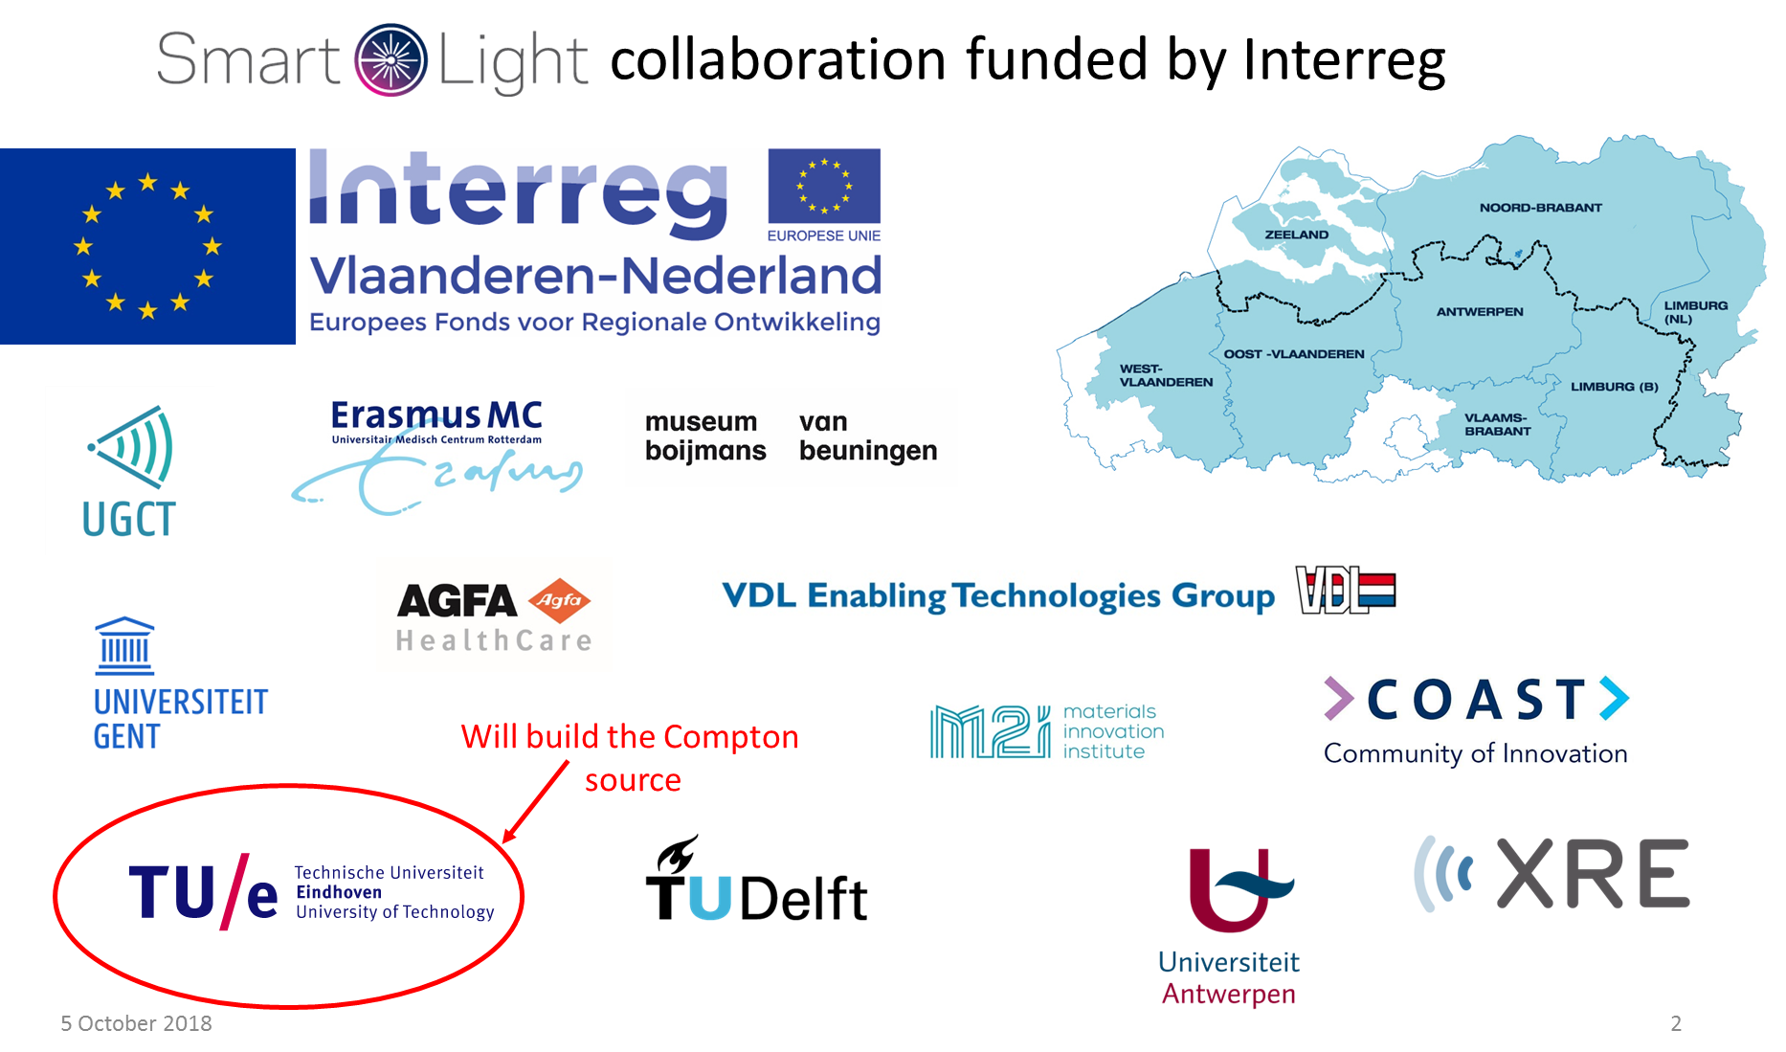
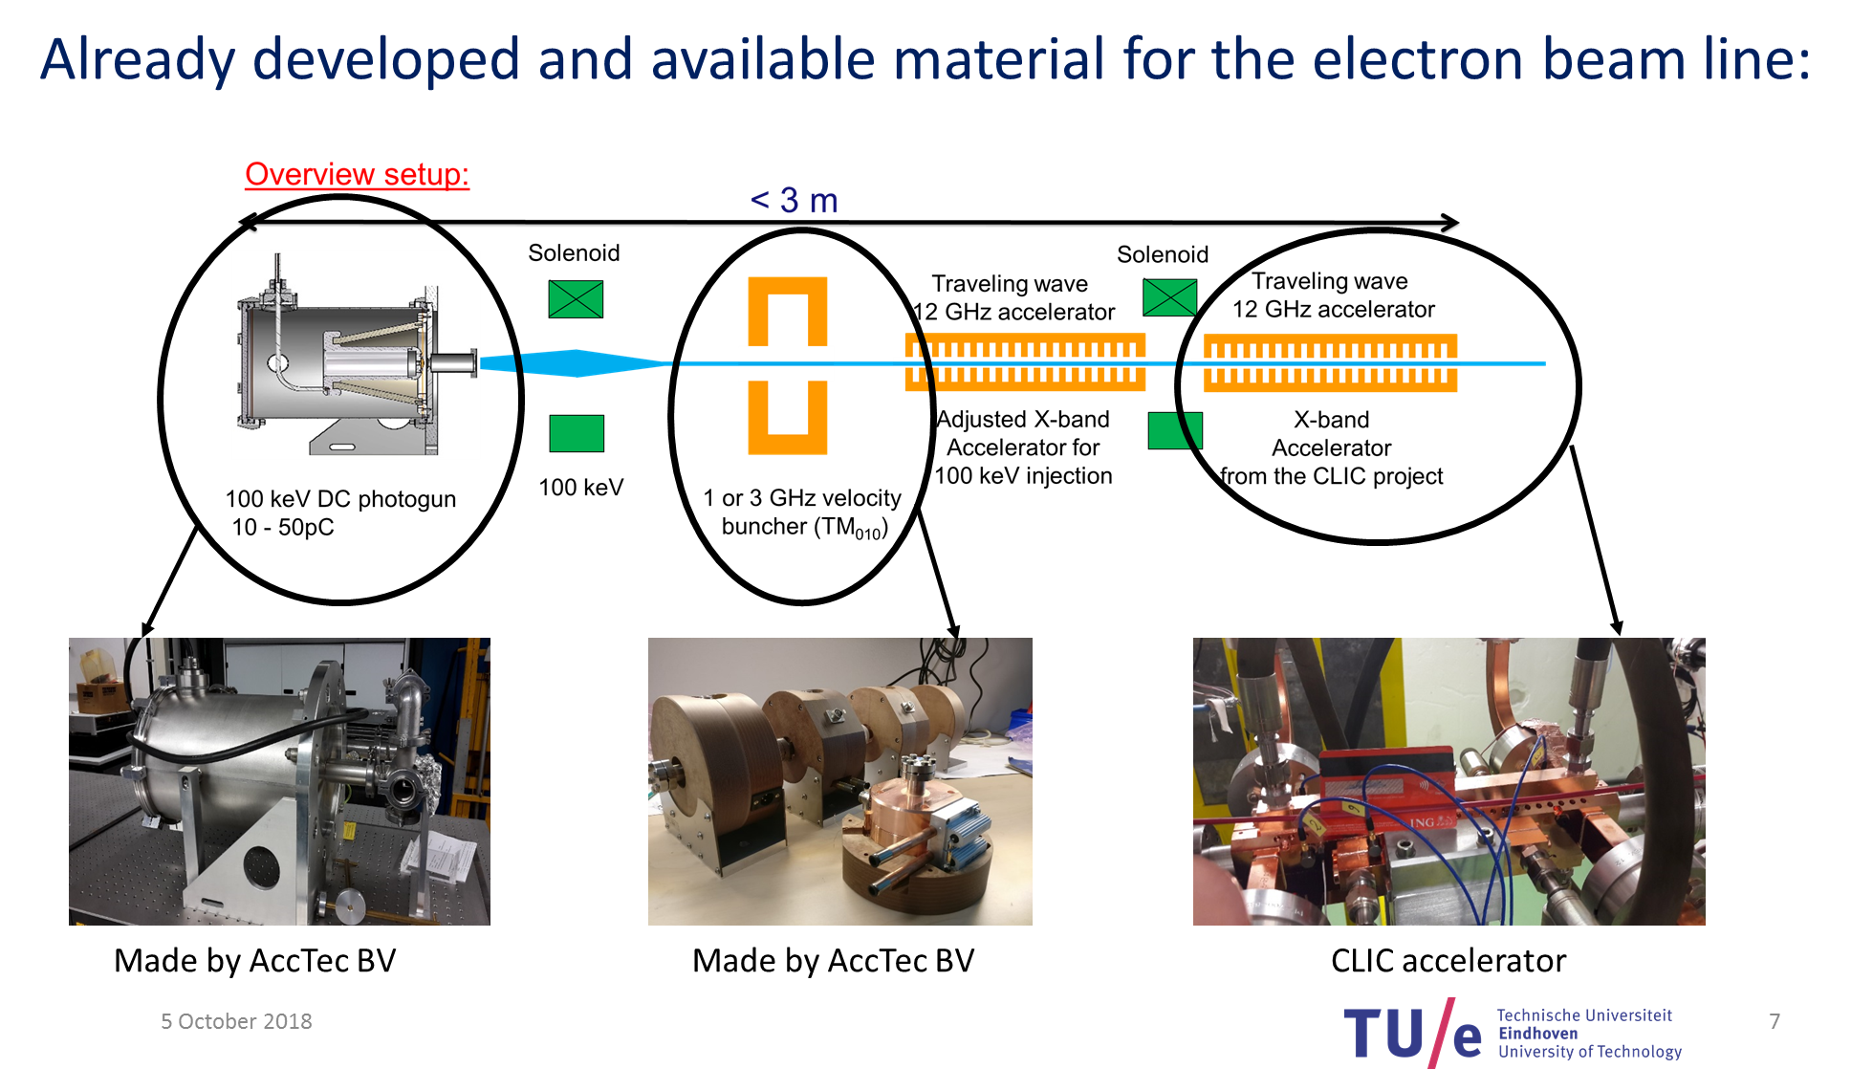
Inverse Compton Scattering Source – Smart*Light

Slide 7
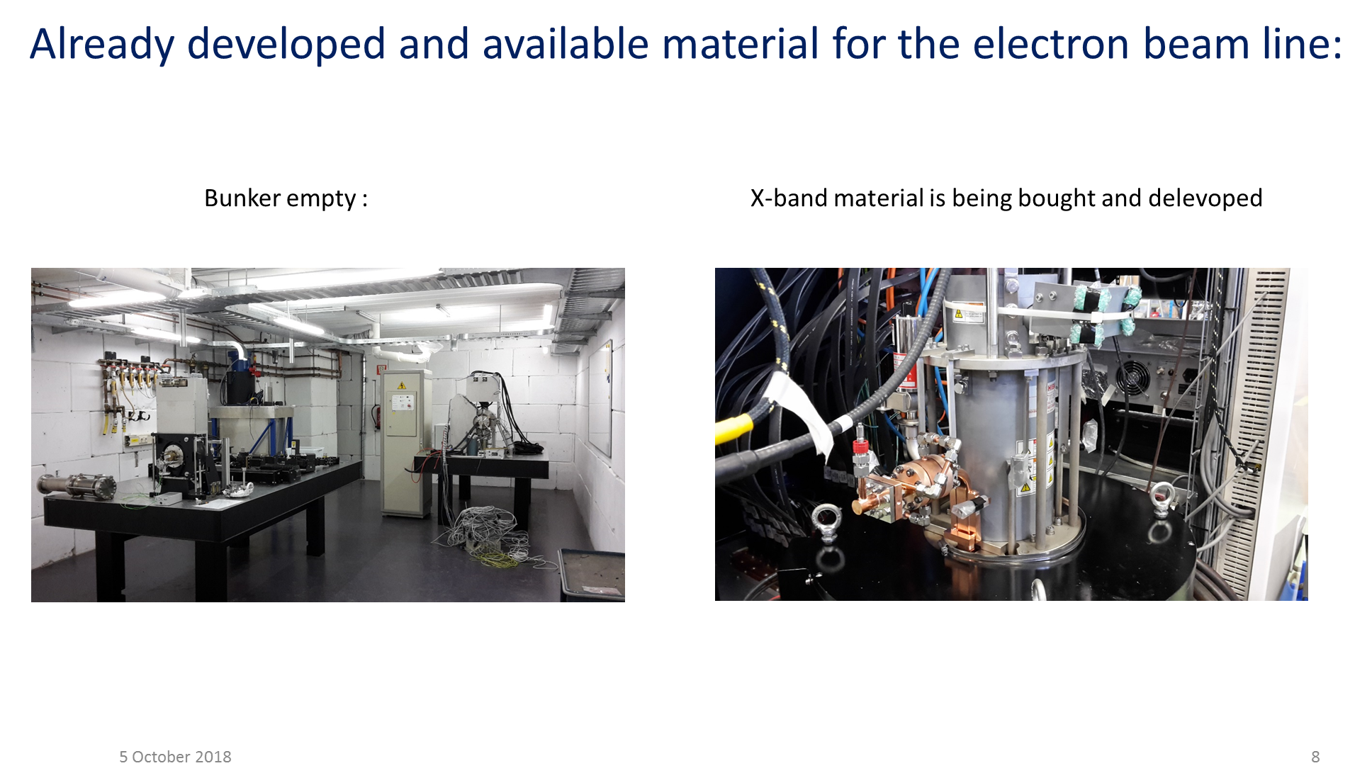
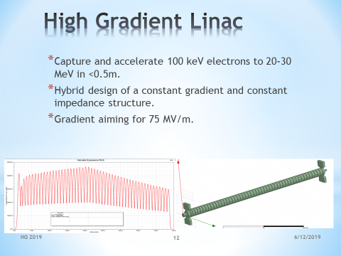
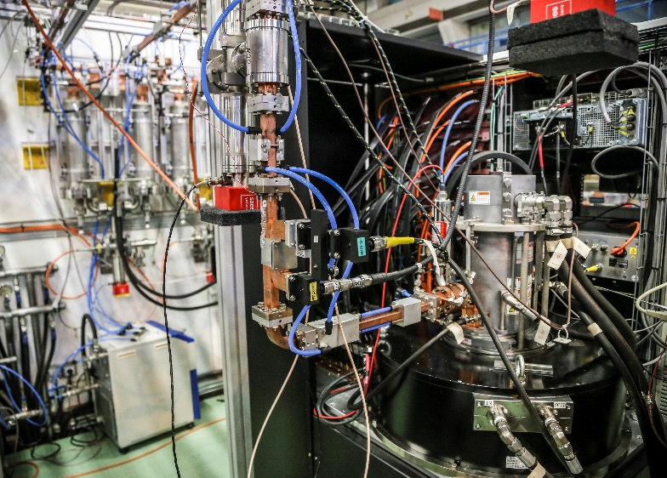
Inverse Compton Scattering Source – Smart*Light
Based on one unit of XBox-3

Slide 8
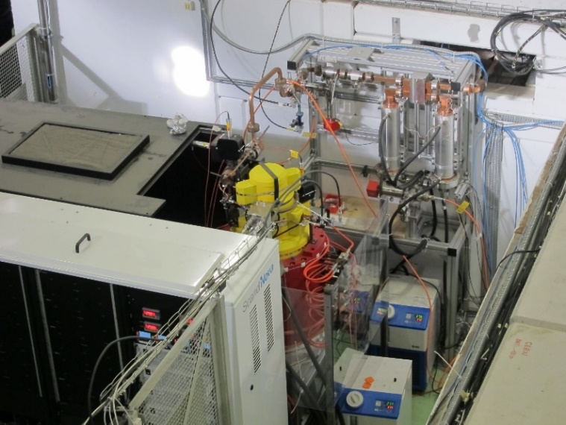
POLARIX transverse deflector
Variable polarization transverse deflector for measurement of phase space of short bunches.
Joint collaboration between CERN, DESY and PSI
CLIC structure concept and rf design
High-power systems based on XBox-1 and 2 (PSI) and XBox-3 (DESY)
PSI fabrication based on SwissFEL technology
High-power structure validation at CERN
Operational at DESY in FLASH2
Preparation at PSI

Slide 9
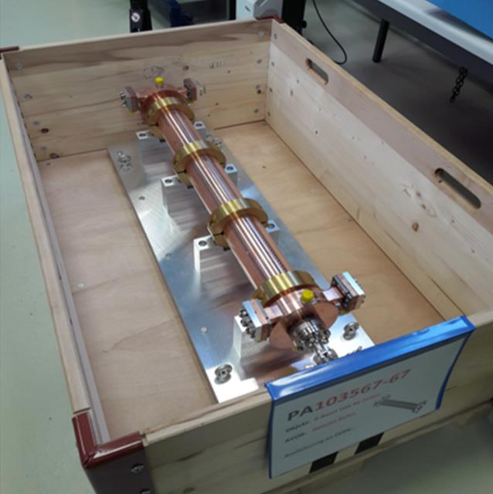
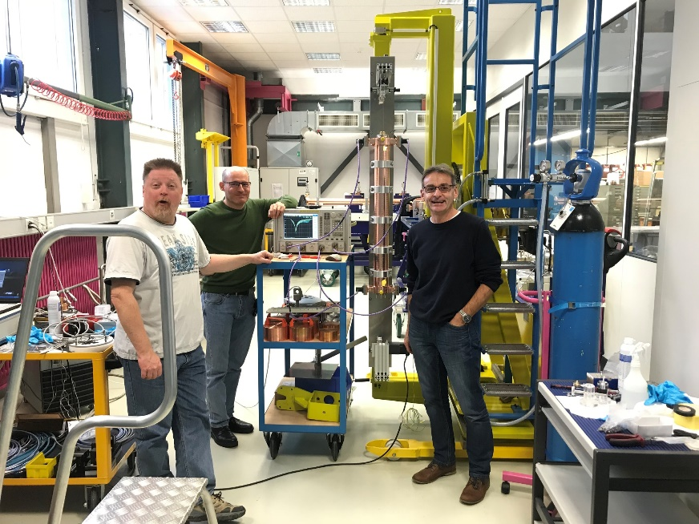
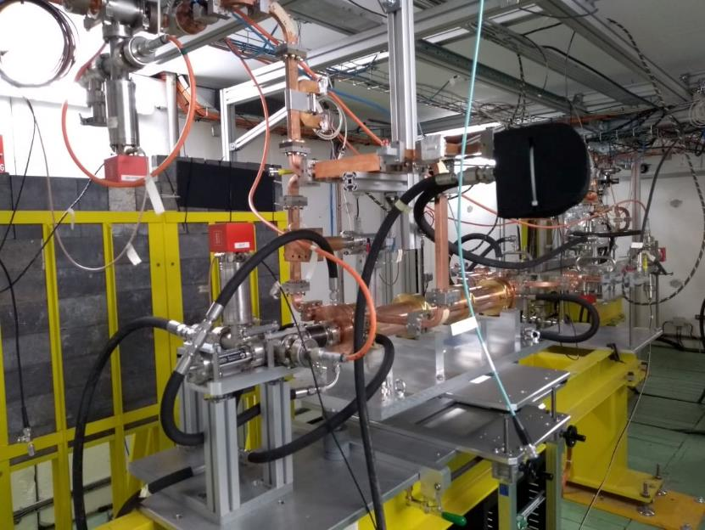
POLARIX transverse deflector
First POLARIX structure under fabrication at PSI
Installed in XBox-2 for high-power testing
It arrives at CERN

Slide 10
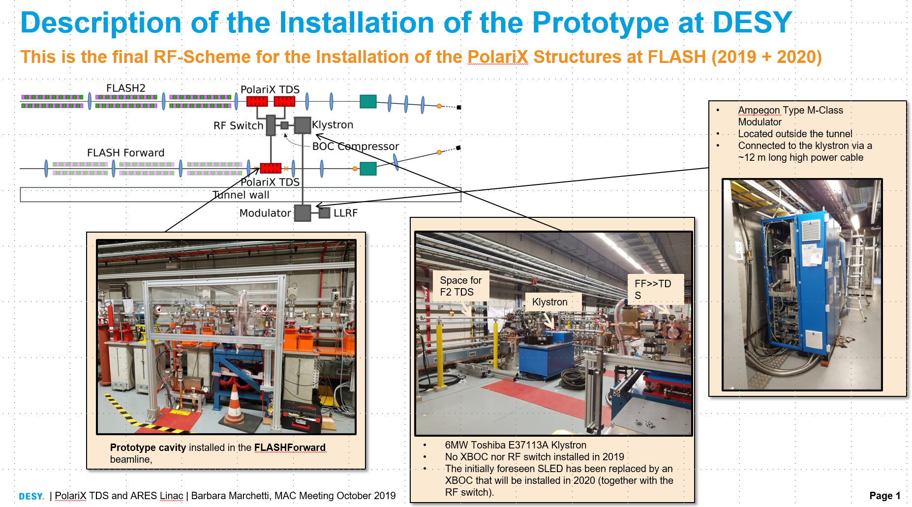
POLARIX transverse deflector

Slide 11
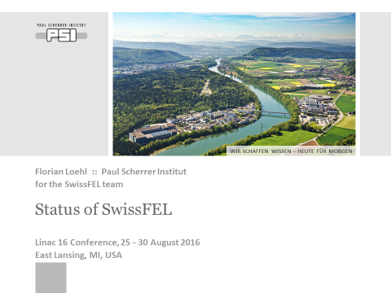
SwissFEL
Recent implementation of a large-scale normal-conducting linac – 5.8 GeV, over 100 accelerating structures.
Strong linear collider technology heritage and with implementation many important lessons have been learned.

Slide 12
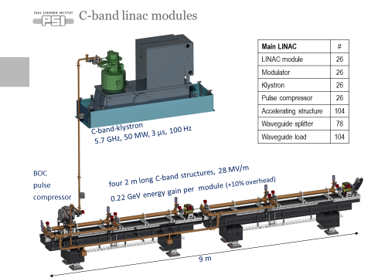
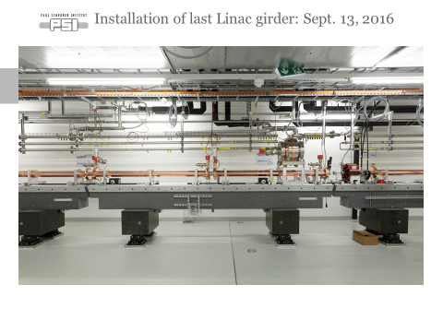
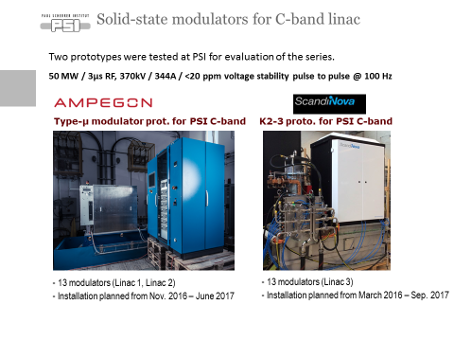
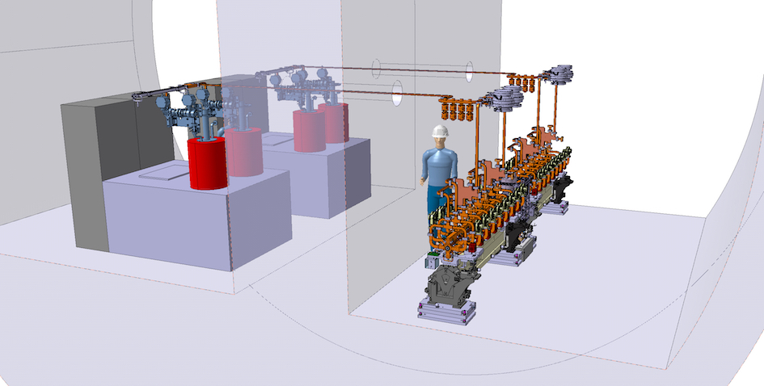
SwissFEL rf unit
Same rf “topology” as CLIC klystron

Slide 13
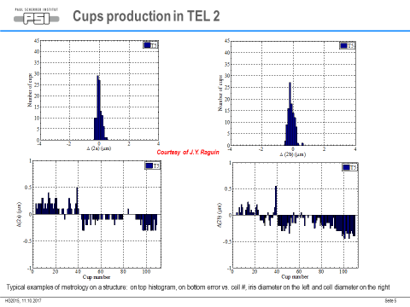
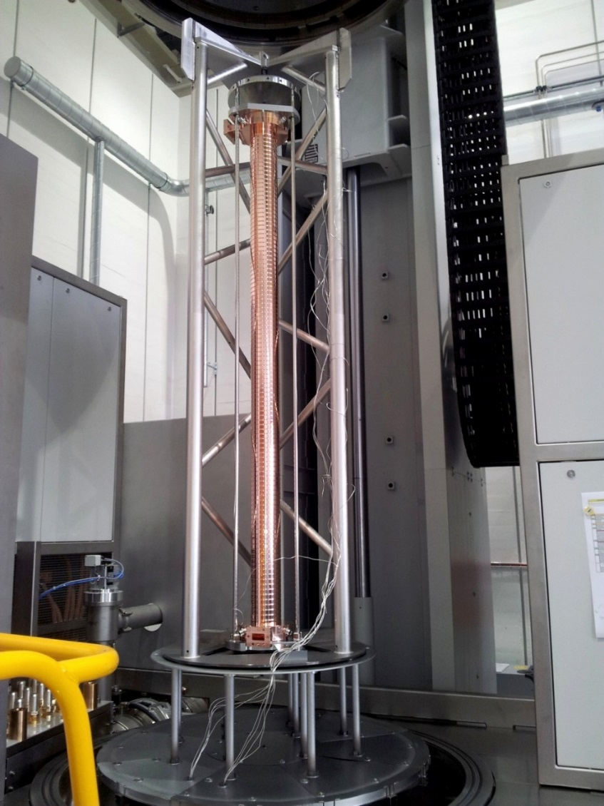
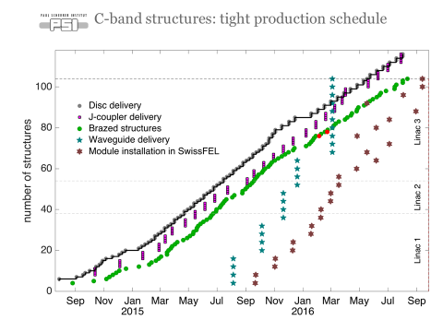
SwissFEL micron tolerances
Sub-micron precision achieved in production!

Slide 14
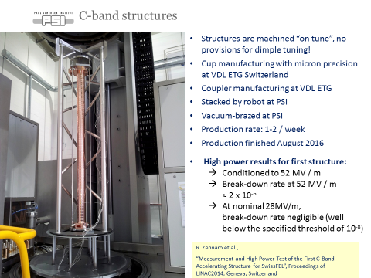
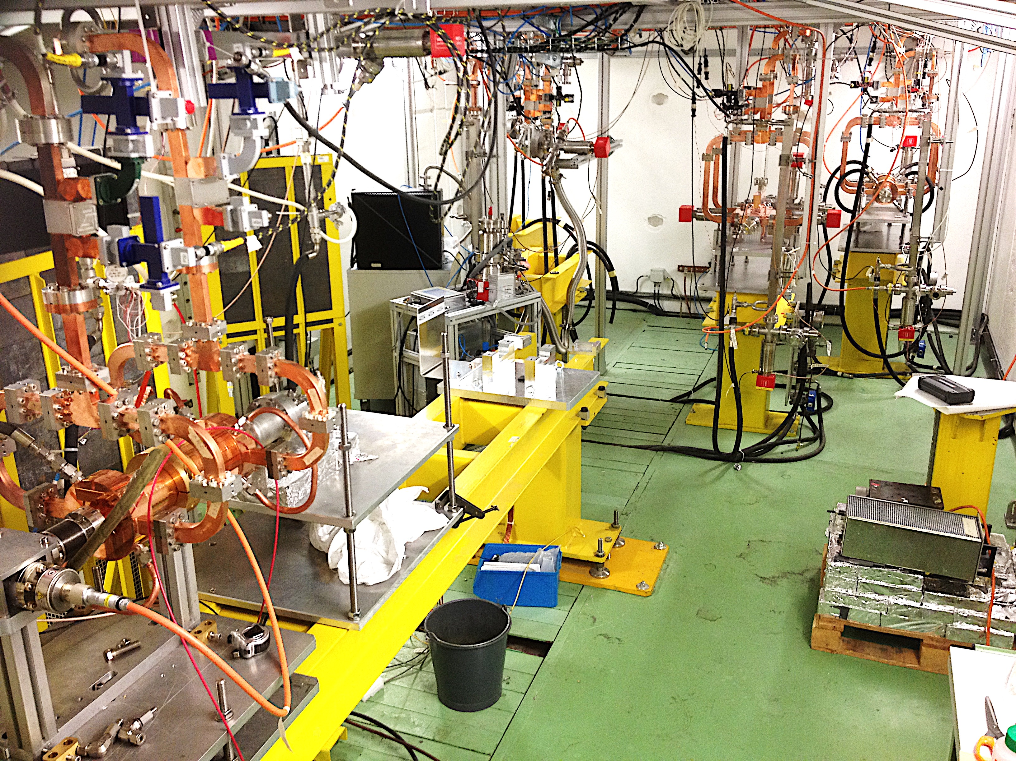
SwissFEL gradient
Two PSI-built X-band structures have been tested in the Xboxes – both operated at over 115 MV/m.
Gradient only limited by C-band power source

Slide 15
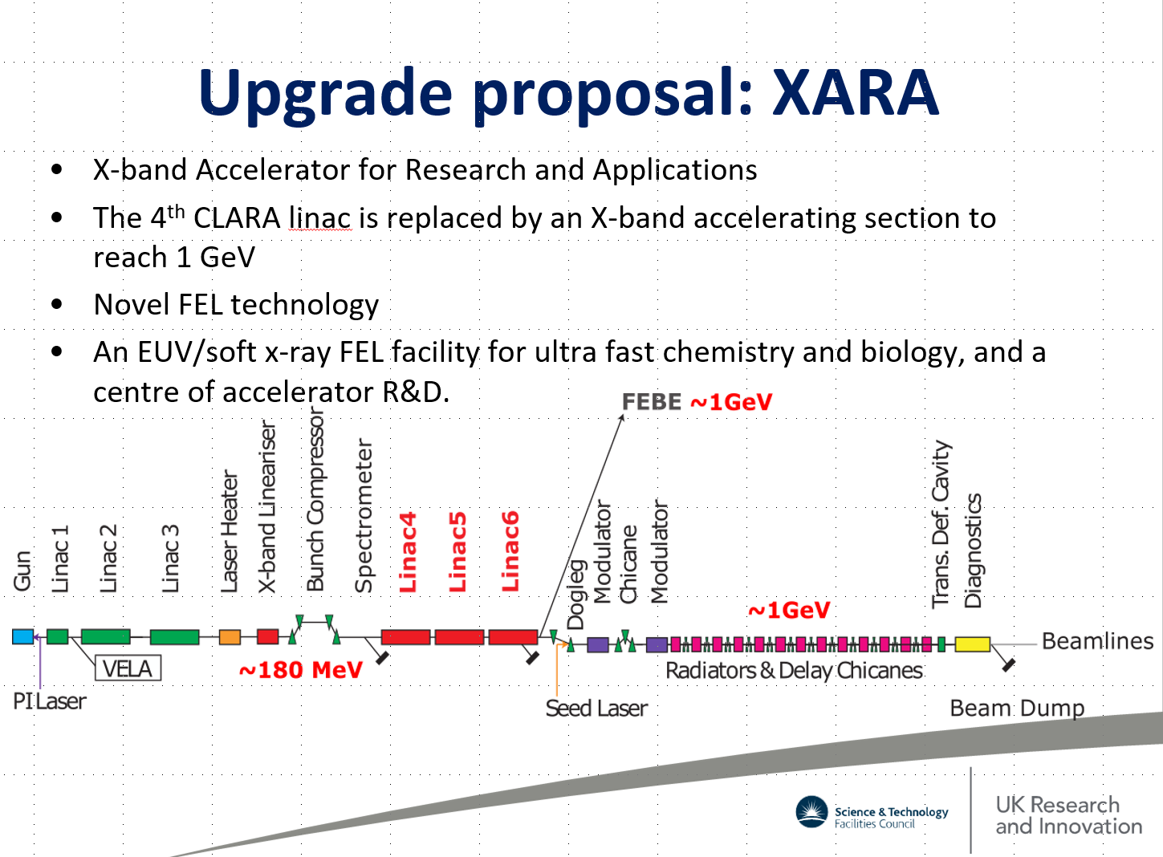
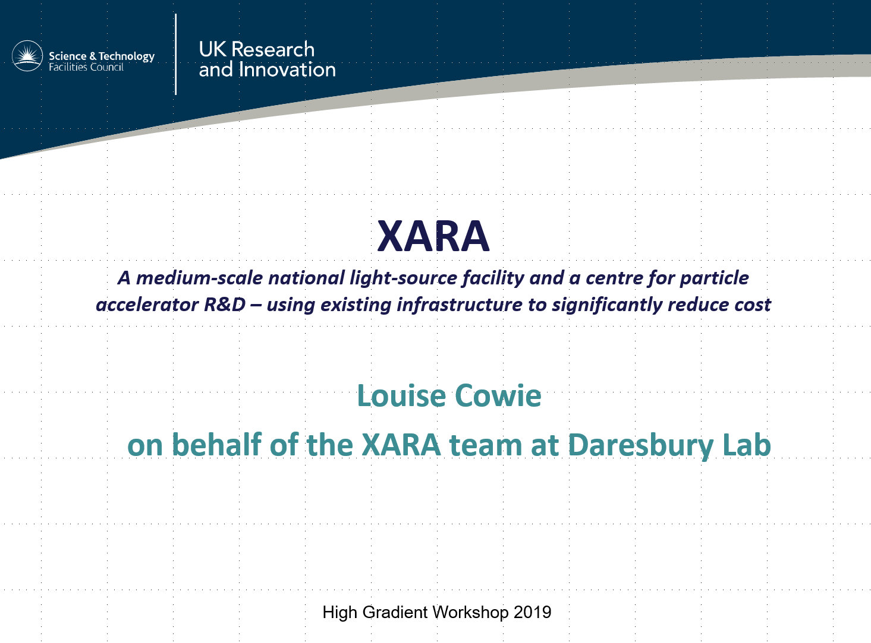
XARA
Upgrade to the CLARA facility at Daresbury

Slide 16
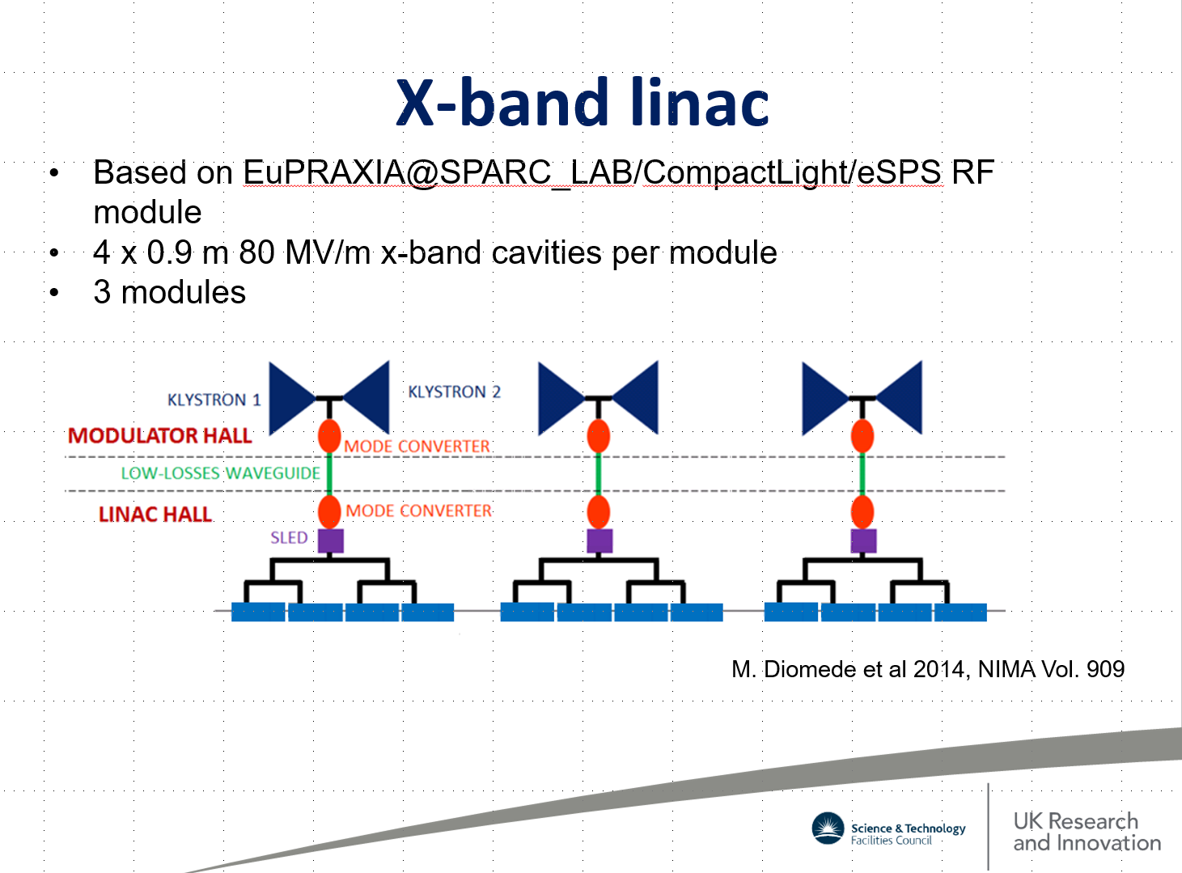
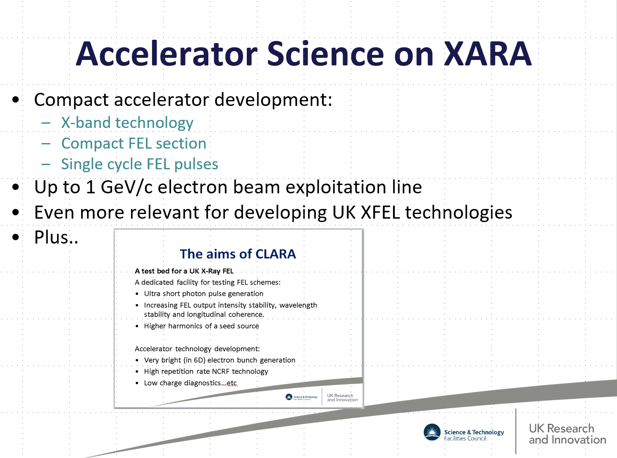
XARA

Slide 17
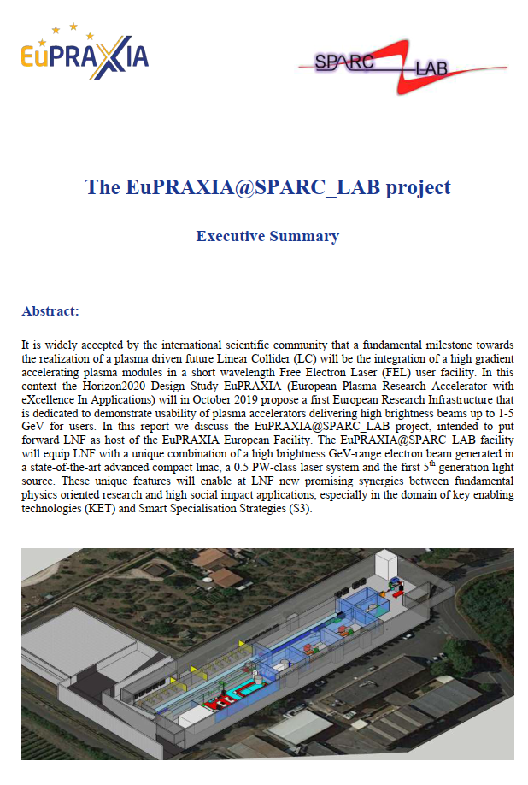
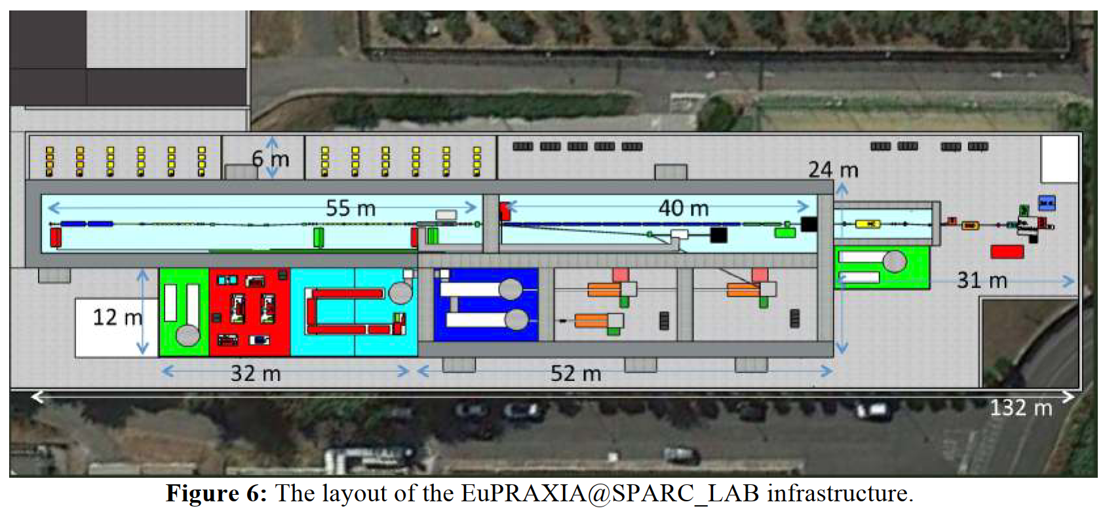
EuPRAXIA@SPARC_LAB
Electron linac facility for XFEL and plasma acceleration research at INFN Frascati, CDR submitted.
Central element is 1 GeV linac using X-band technology.
Strong collaboration on linac between Frascati and CERN, including X-band test stand at Frascati.

Slide 18
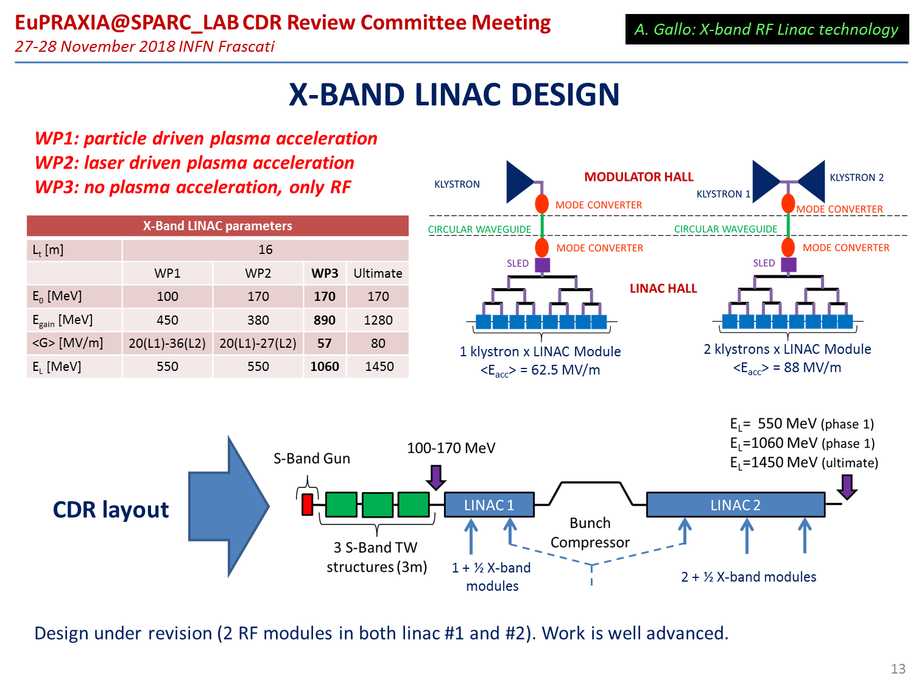
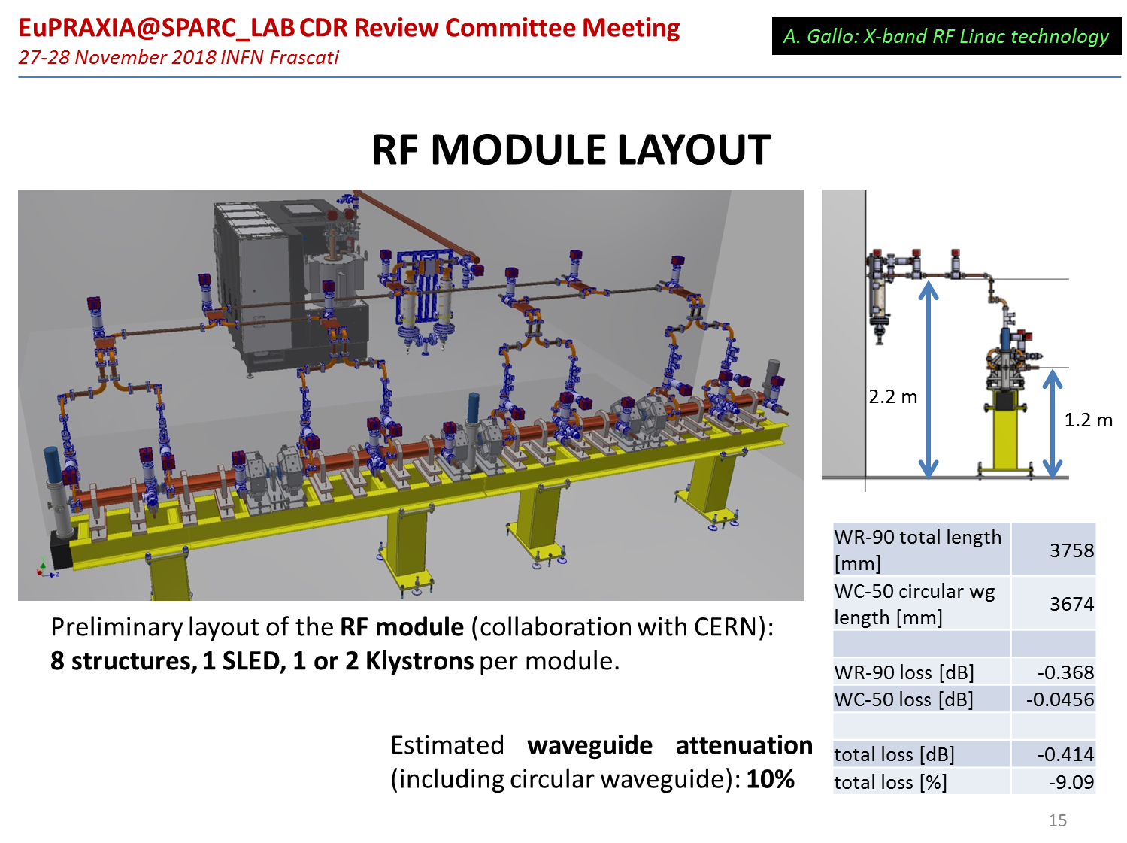
EuPRAXIA@SPARC_LAB

Slide 19
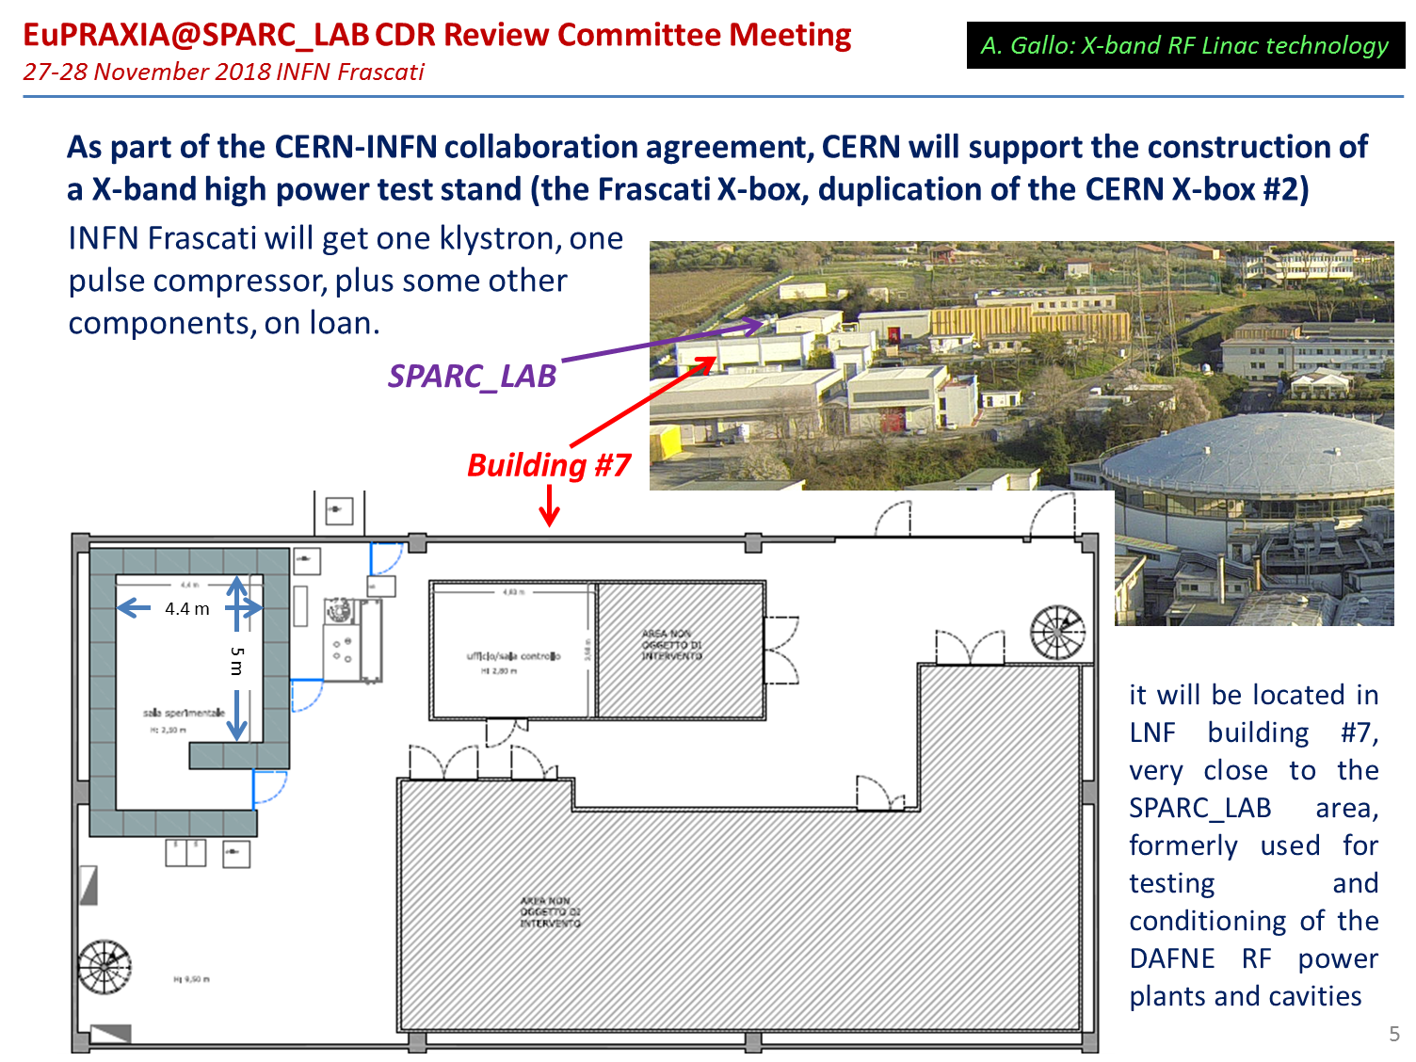

EuPRAXIA@SPARC_LAB
Based on XBox-2

Slide 20
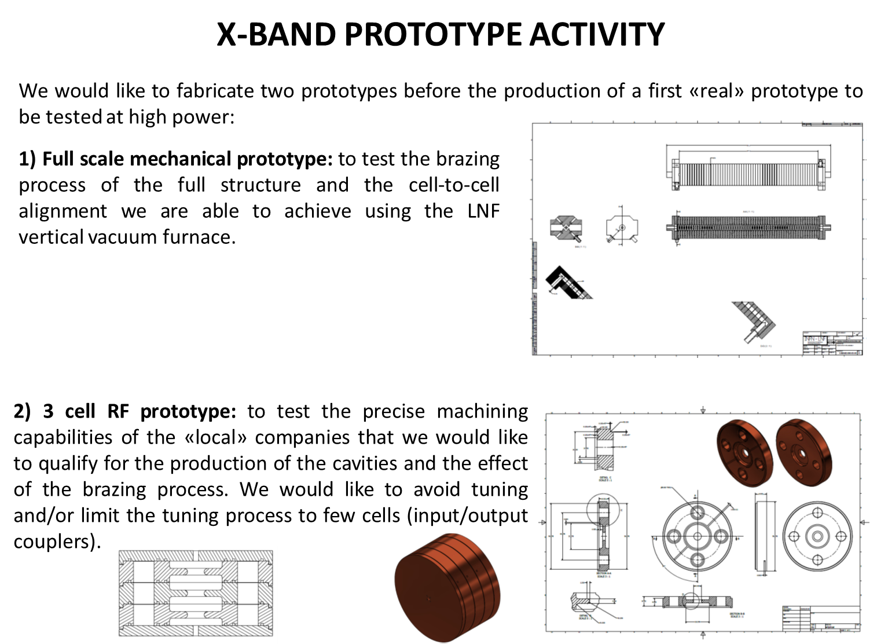
EuPRAXIA@SPARC_LAB
Technology return:
Based on ELI-NP linac production experience, INFN is pursuing fabrication of brazed accelerating structures.
Will provide important experience for medium series production and possibly lower cost alternative to CLIC baseline.
D. Alesini

Slide 21
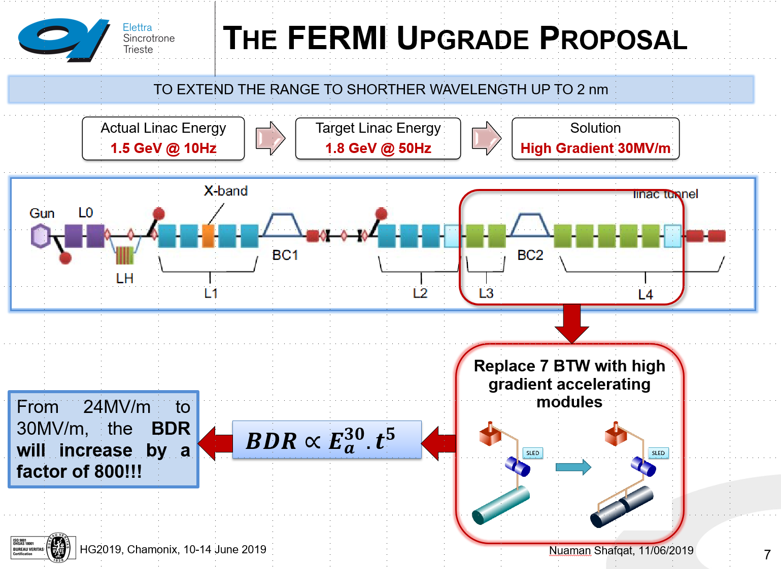
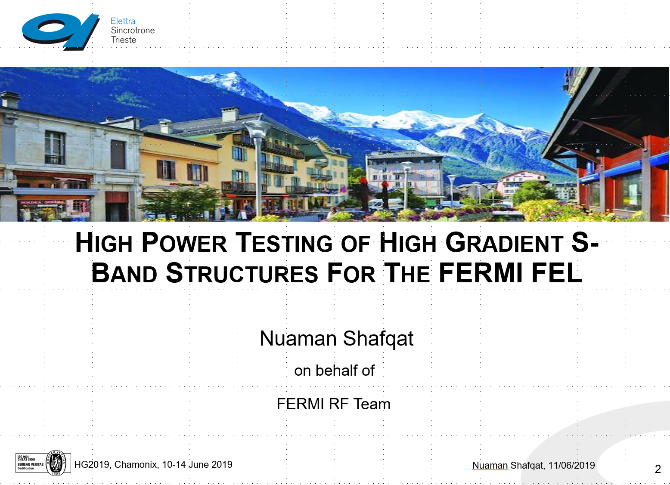
FERMI energy upgrade
Upgrade FERMI linac by keeping existing S-band klystron/modulator power stations and rebuild rest of rf system based on latest high-gradient ideas.
Linear collider developed high-gradient methodology is broadly applicable!

Slide 22
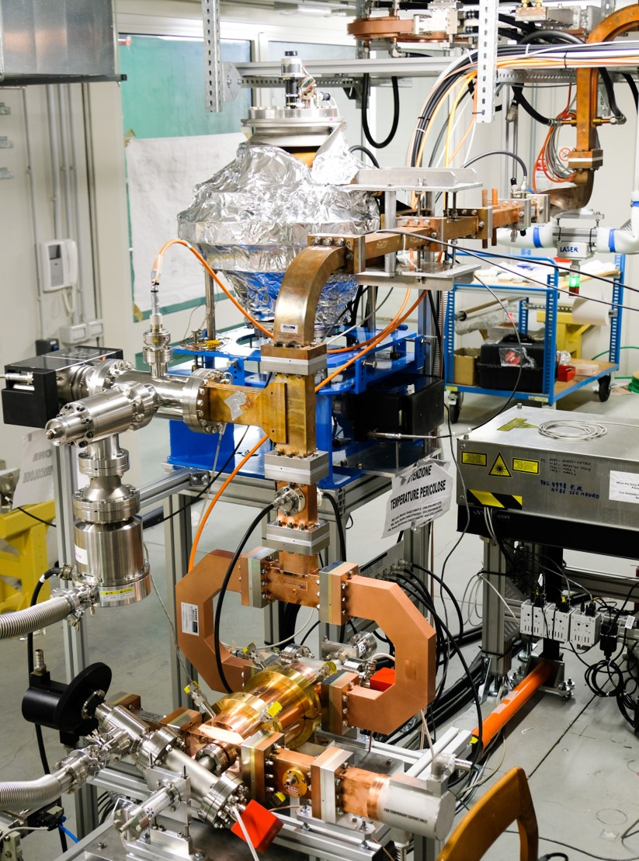
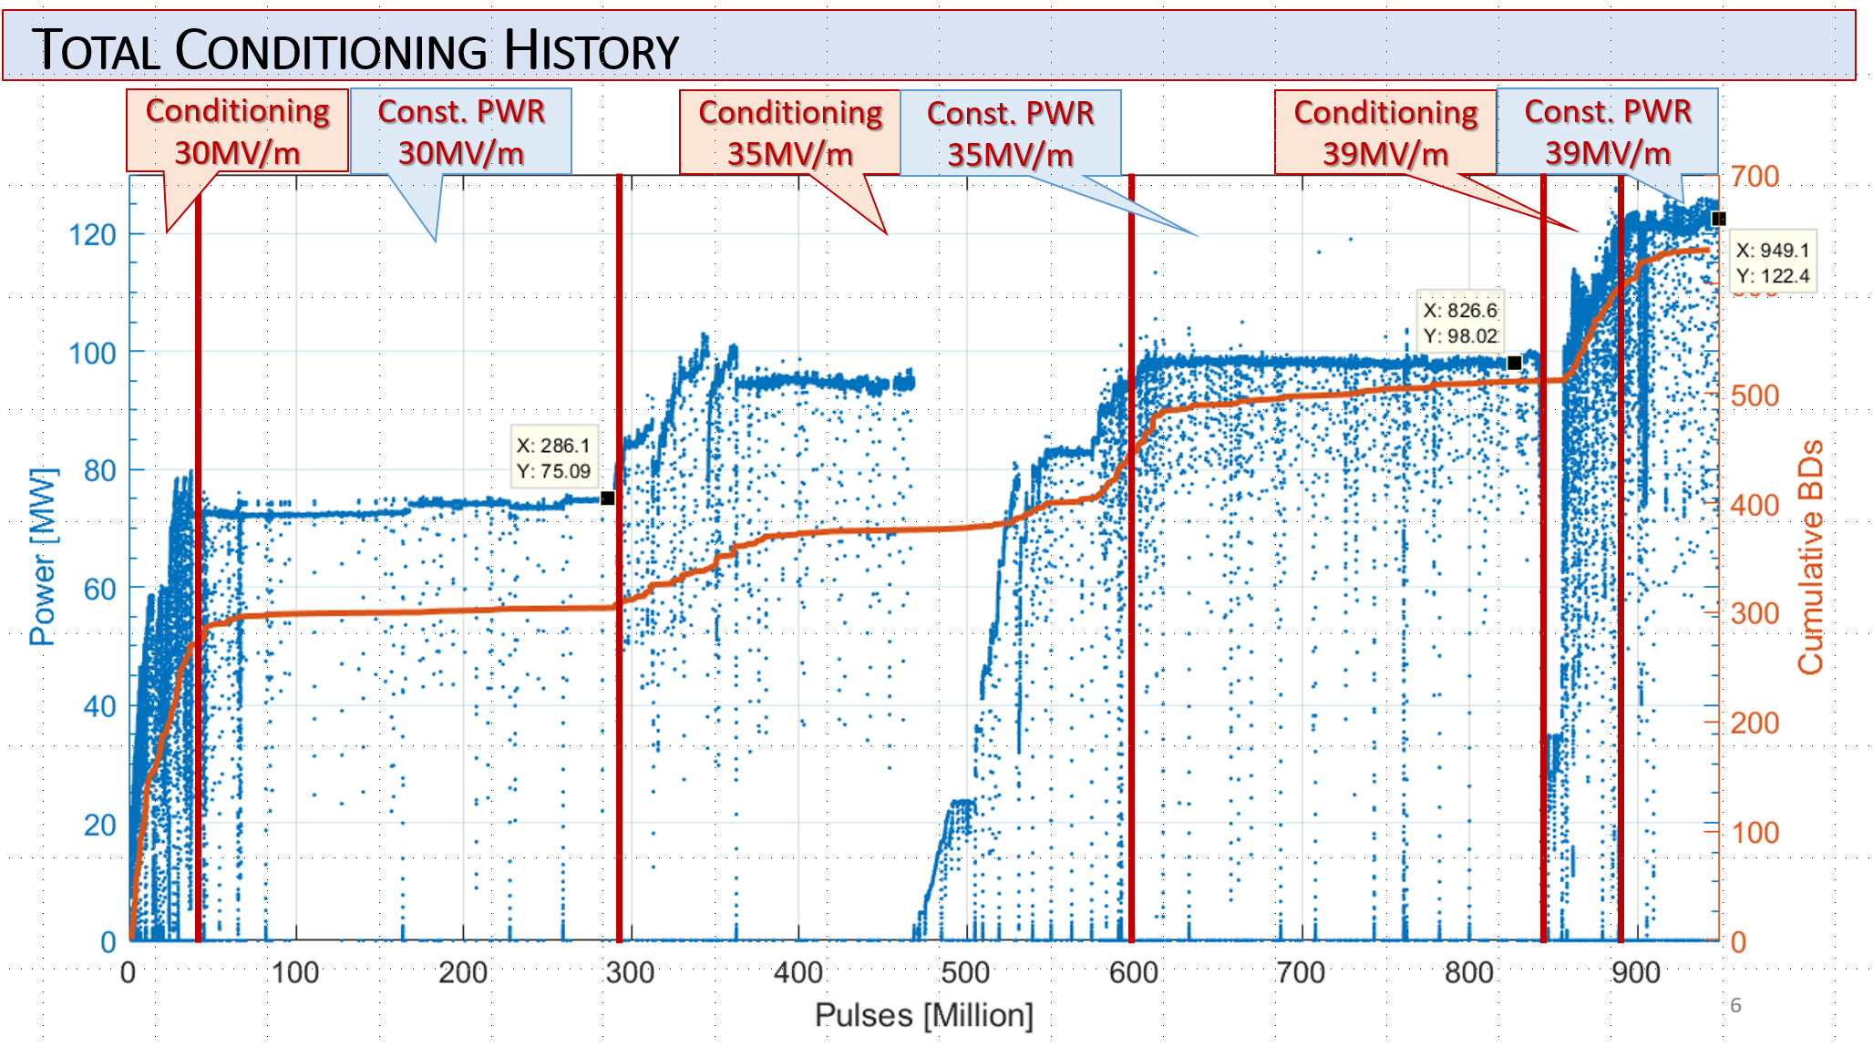
FERMI energy upgrade
N. Shafqat
Conditioning history – test continues!
Structure built by PSI and installed in Trieste.

Slide 23
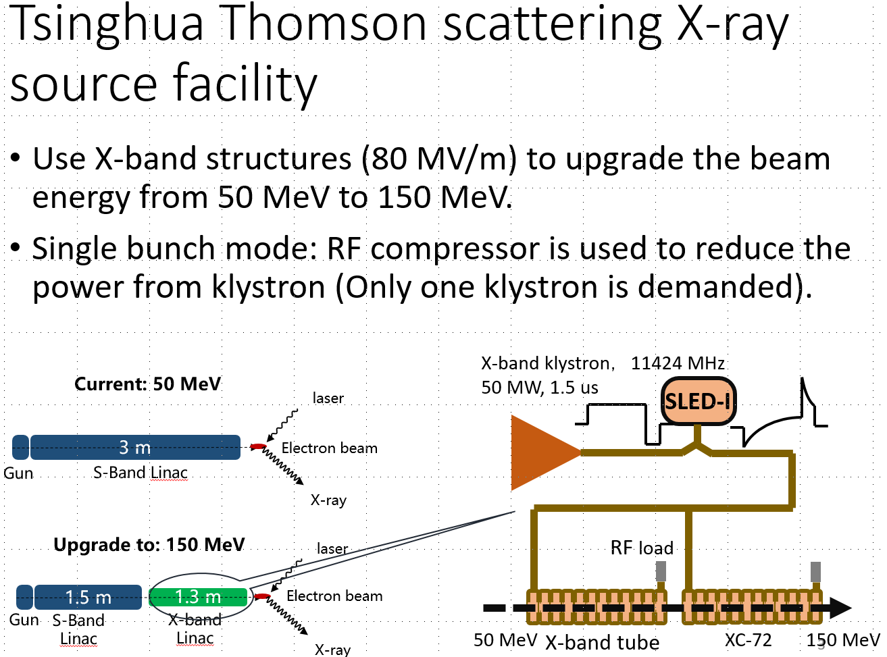
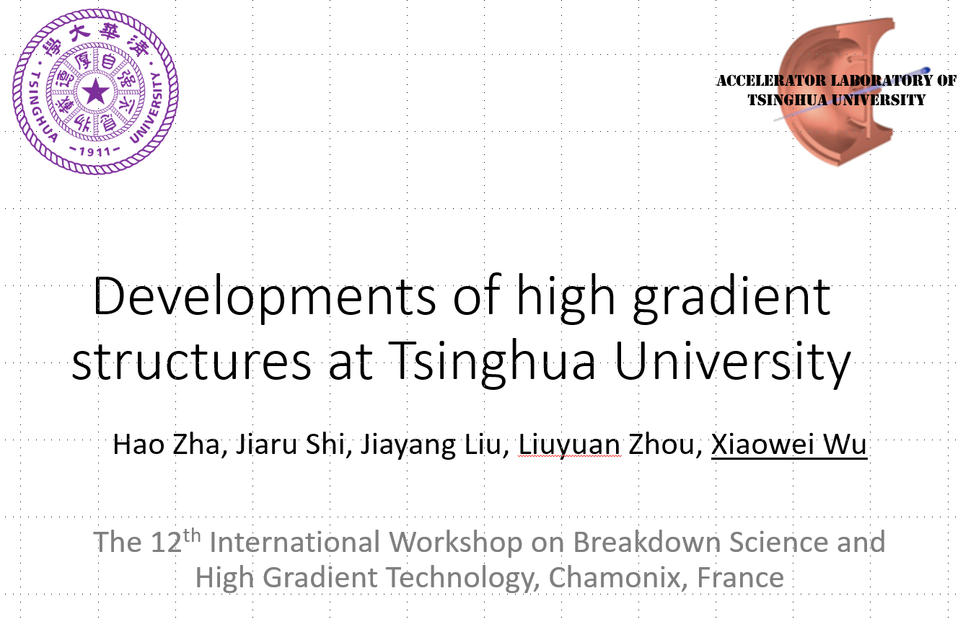
Tsinghua Thompson source energy upgrade

Slide 24
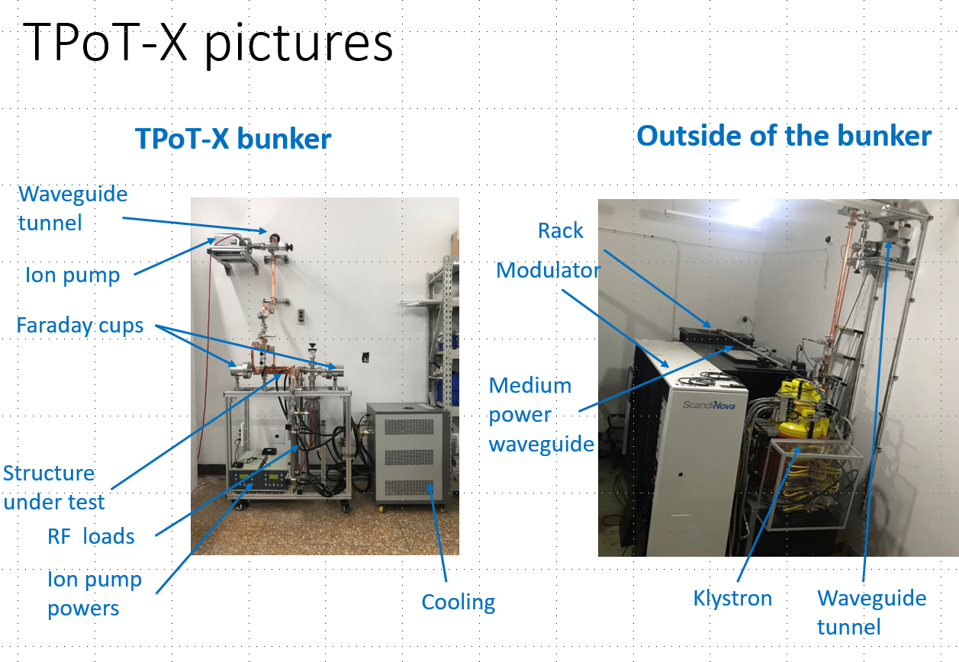
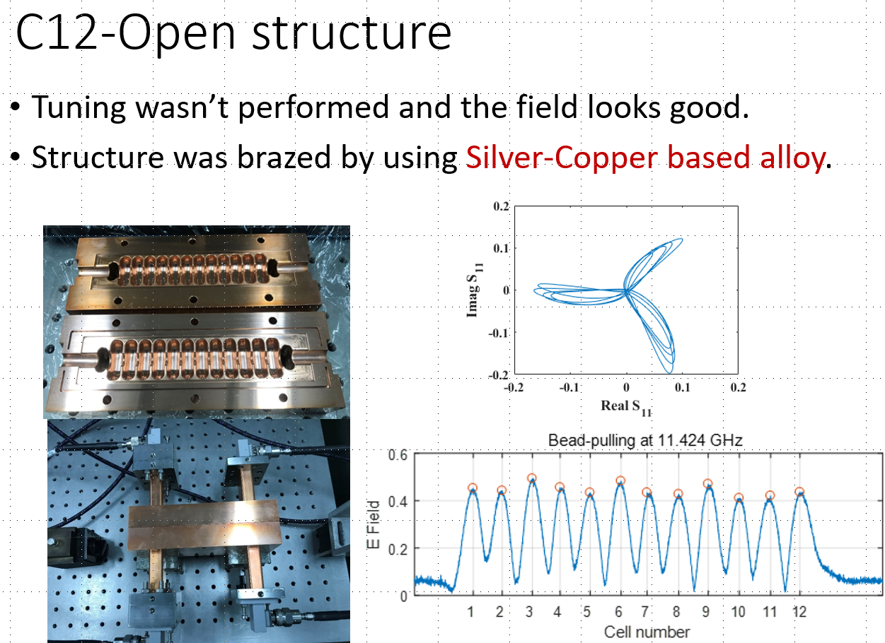
Tsinghua X-band test stand

Slide 25






X-band energy spread linearizers at XFELs
SINAP
PSI
FERMI

Slide 26


eSPS

Slide 27


eSPS

Slide 28
High-gradient test infrastructure
CERN | XBox-1 | 50 MW, 12 GHz | Operational (later to CLEAR)
 | Xbox-2 | 50 MW, 12 GHz | Operational
 | XBox-3 | 4x6 MW, 12 GHz | Operational
KEK | NEXTEF | 2x50 MW | Reorganizing following fire
Tsinghua | TPOT-X | 50 MW, 11 GHz | Operational
Trieste | CTF | 45 MW, 3 GHz | Operational
Valencia |  | 2x10 MW, 3 GHz | Commissioning
Frascati |  | 50 MW, 12 GHz | Procurement
Shanghai |  | 50 MW, 12 GHz | Installation
Melbourne, ALS |  | 2x6 MW, 12 GHz | Planning
SLAC | NLCTA+XTA | 2x50 MW, 11 GHz | Operational
 | Klystron Test Lab | 2x50 MW, 11 GHz | Operational
Los Alamos | CERF-NM | 50 MW, 5.7 GHz | Commissioning

Slide 29
X-band linearizers and deflectors
Trieste | Linearizer for Fermi | 50 MW | Operational
PSI | Linearizer for SwissFEL | 50 MW | Operational
 | Deflector for SwissFEL | 50 MW | Procurement
DESY | Deflector for FLASHforward | 6 MW | Operational
 | Deflector for FLASH2 | “ | Installation
 | Deflector for Sinbad | 10 MW | Procurement
SINAP | Linearizer for soft X-ray FEL | 6 MW | Operational
 | Deflectors for soft X-ray FEL | 2x50 MW | Procurement
Daresbury | Linearizer | 6 MW | Procurement
SLAC | LCWS linearizer | 50 MW | Operational
 | LCWS deflector | 50 MW | Operational
Dalian | Linearizer for DCLS | 50 MW | Design

Slide 30
X-band linacs
SLAC | NLCTA+XTA | 2x50 MW, 11 GHz | Operational
Eindhoven | Smart*Light ICS - 25 MeV | 6 MW | Procurement
Arizona | CXLS ICS/XFEL – 35 XFEL | 2x6 MW 9.3 GHz | Installation
CERN | CLEAR – 50 MeV (from Xbox-1) | 50 MW | Installation
Tsinghua | Thompson source upgrade + 50 MeV | 50 MW | Procurement
 | 200 MeV Thompson source | 2x50 MW | Proposal
Frascati | XFEL, injector to plasma - 1 GeV | 8x50 MW | CDR submitted
Daresbury | Xara – 1 GeV | 6x50 MW | Design study
Collaboration | CompactLight – 5.5 GeV | 30x50 MW | Design study
CERN | eSPS – 3.5 GeV | 24x50 MW | Letter of intent submitted
Groningen | 1.4 GEV XFEL Accelerator - 1.4 GeV |  | NL roadmap
CERN | CLIC – 380 GeV | 5800x50 MW | European Strategy Update

Slide 31

Further information on these applications can be found at HG2019 held this past June https://indico.cern.ch/event/766929/.

Slide 32
Conclusions
The high-gradient linac technology developed for CLIC is turning out to be of importance for many small to medium scale applications.
Excellent examples of “spin out” of developments in fundamental science.
Strong return for the CLIC project.
Applications growing!
Thank you for your attention!

