Slide 1
Report from the
CLIC Communication Initiative (CCI)
Konrad Elsener, CERN
CLIC project meeting
5 December 2019

Slide 2
CLIC Communication Initiative (CCI)
What do we do?
• Coordinate the communication of the CLIC project
• CLIC Accelerator and CLIC Detector and Physics
• Media coverage (CERN editorial meetings, …)
• Visibility (graphics, showroom, wiki, …)
• General outreach, both inside and outside CERN
Who are we?
Alexia Augier, Philip Burrows, Konrad Elsener, Davide Gamba,
Nikos Kokkinis, Lucie Linssen, Aidan Robson, Steinar Stapnes,
Rickard Ström, Walter Wuensch
How to reach us:
clic-communication@cern.ch

Slide 3
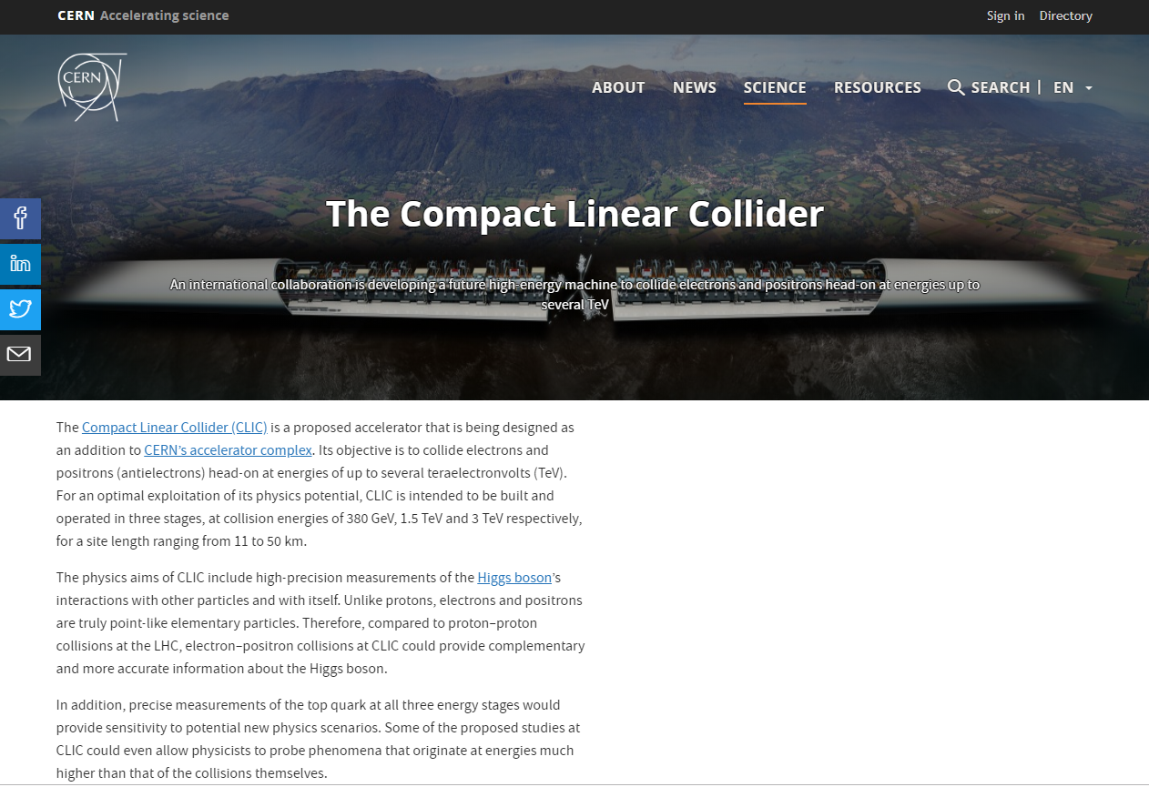
improved on cern.ch

Slide 4
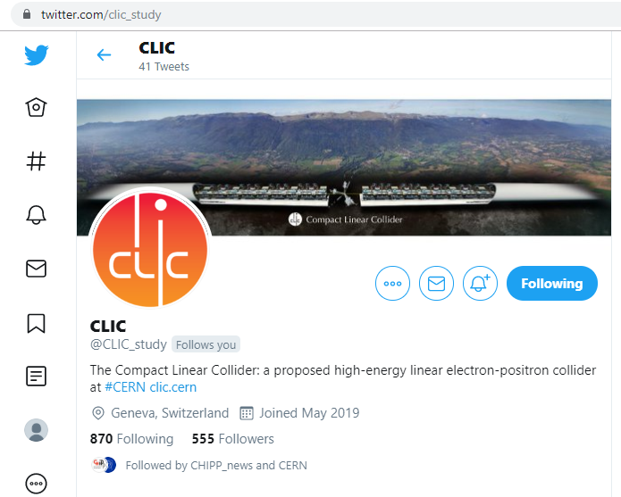
new on Twitter: @CLIC_study

Slide 5
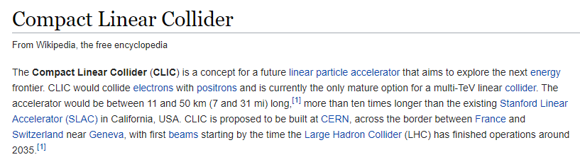
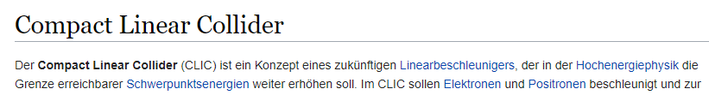
revised on Wikipedia:
[several pages, 7 Figures, 1 Table, 22 references]
… and someone created a (shorter) version in German …

Slide 6
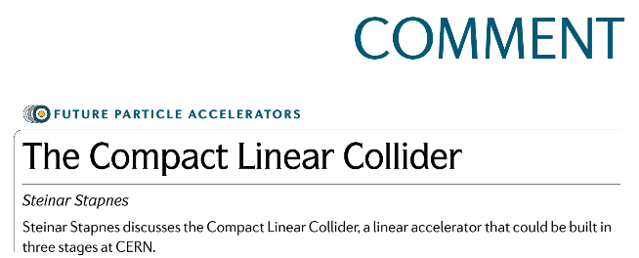
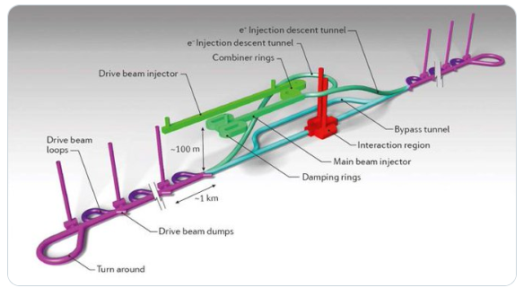
Nature Reviews Physics March 2019
http://rdcu.be/bq1gh

Slide 7
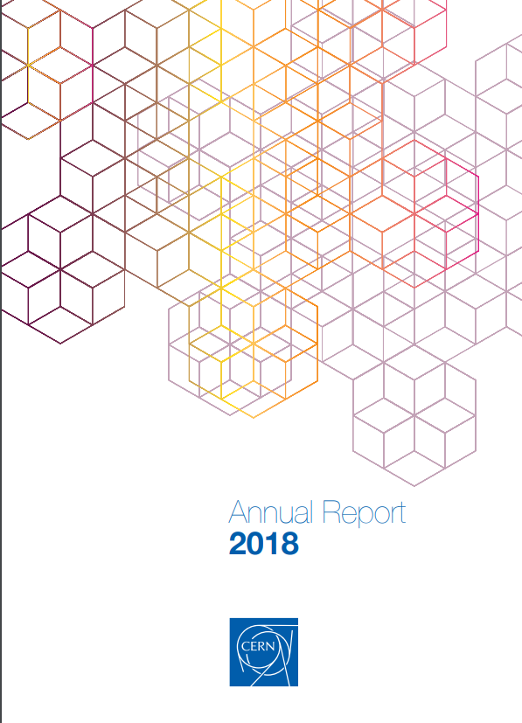
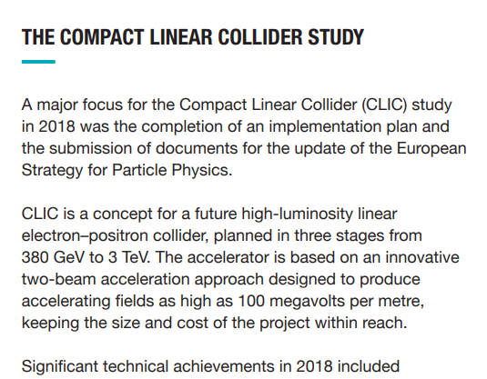
CERN Annual Report
…

Slide 8
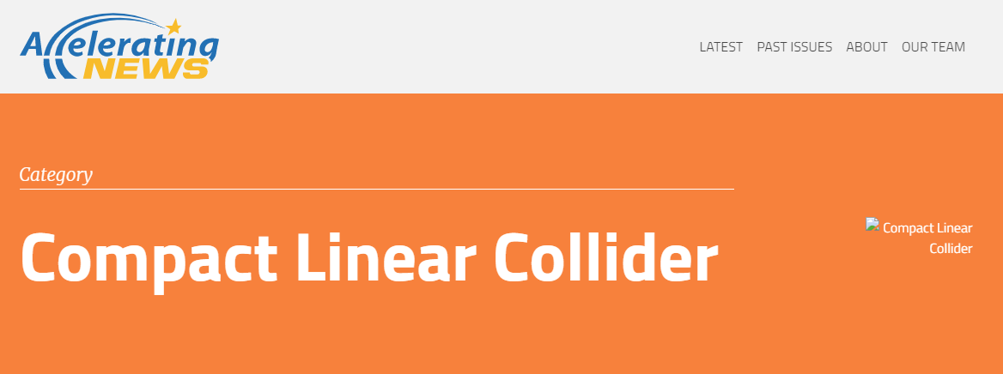
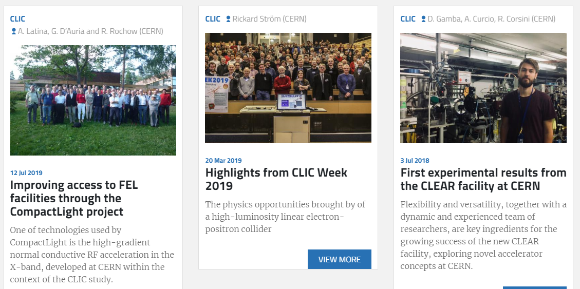
new:
CLIC got its category in
Accelerating News

Slide 9
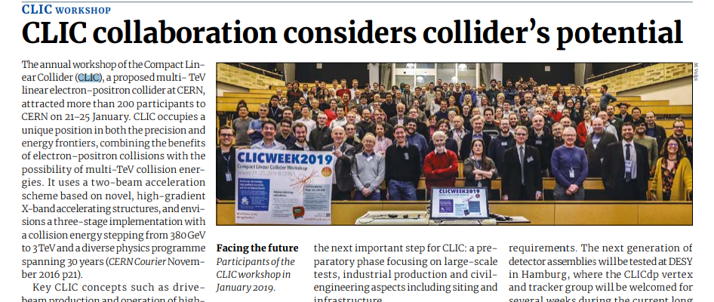
CERN Courier (May/June 2019)
forthcoming articles:
International High-Gradient Linac Technology Workshop (report by W. Wunsch)
From precision physics to the energy frontier with the Compact Linear Collider
(to be published in Nature Physics, early 2020)

Slide 10
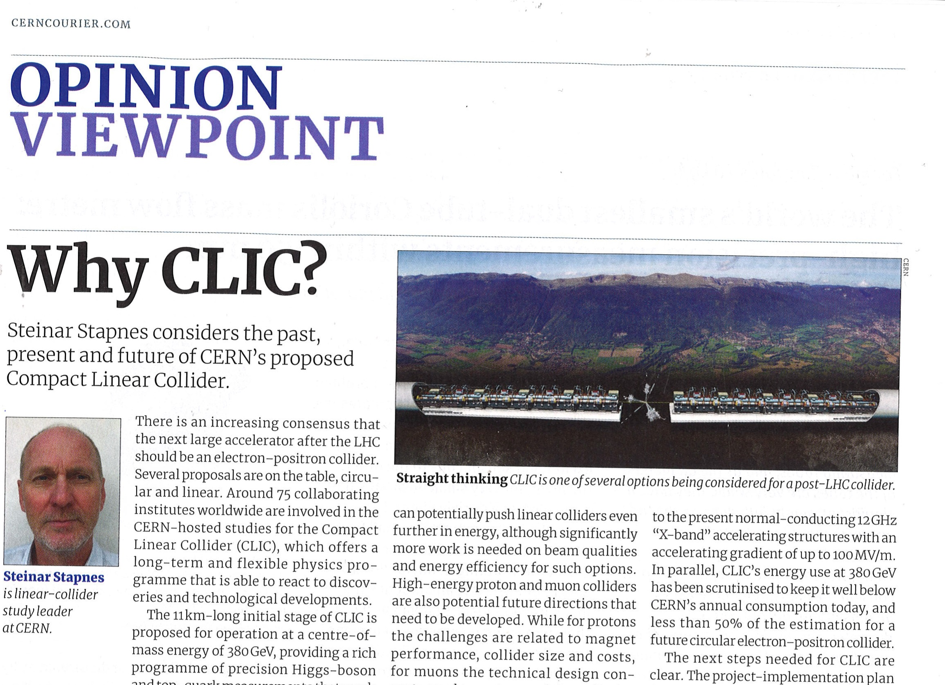
CERN Courier (Nov./Dec. 2019)

Slide 11
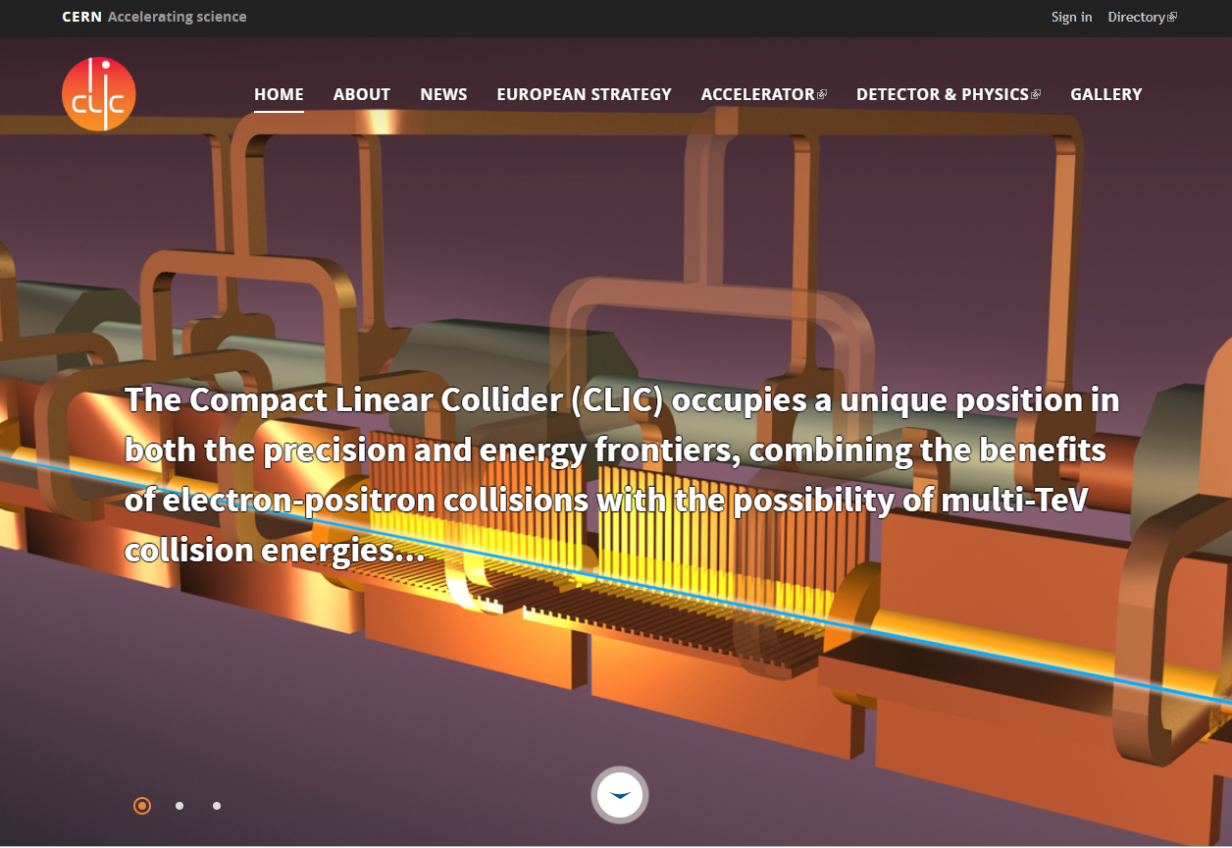
now using Drupal 8: clic.cern
Nikos Kokkinis

Slide 12
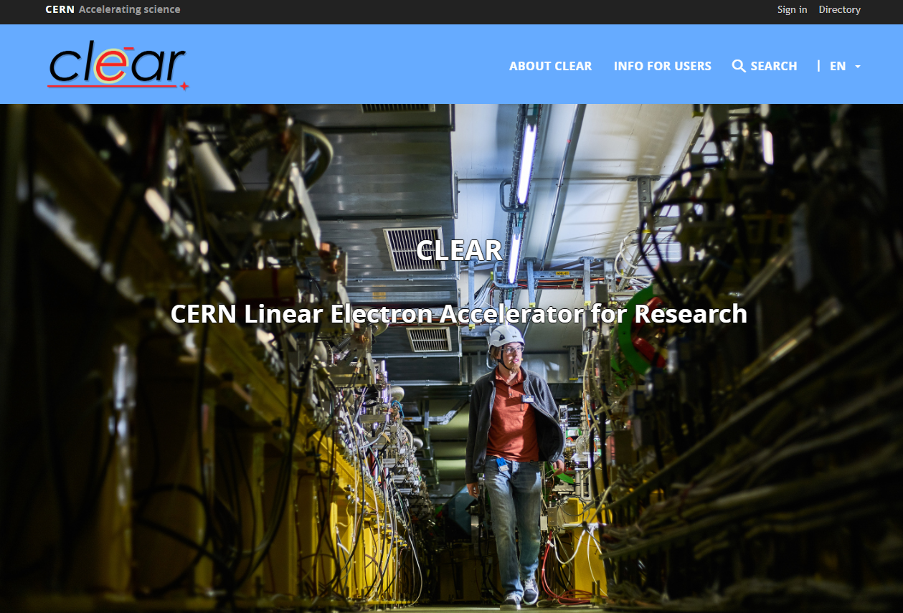
also available: clear.cern
Davide Gamba
coming soon: clicdp and clic-study in Drupal 8
Nikos Kokkinis

Slide 13
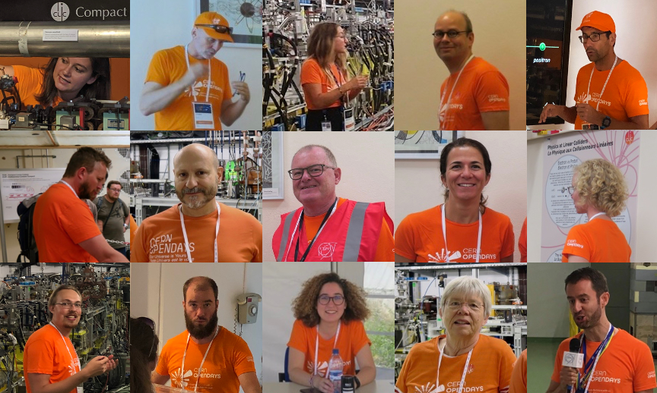
CERN Open Days (1)
@CLIC_study

Slide 14
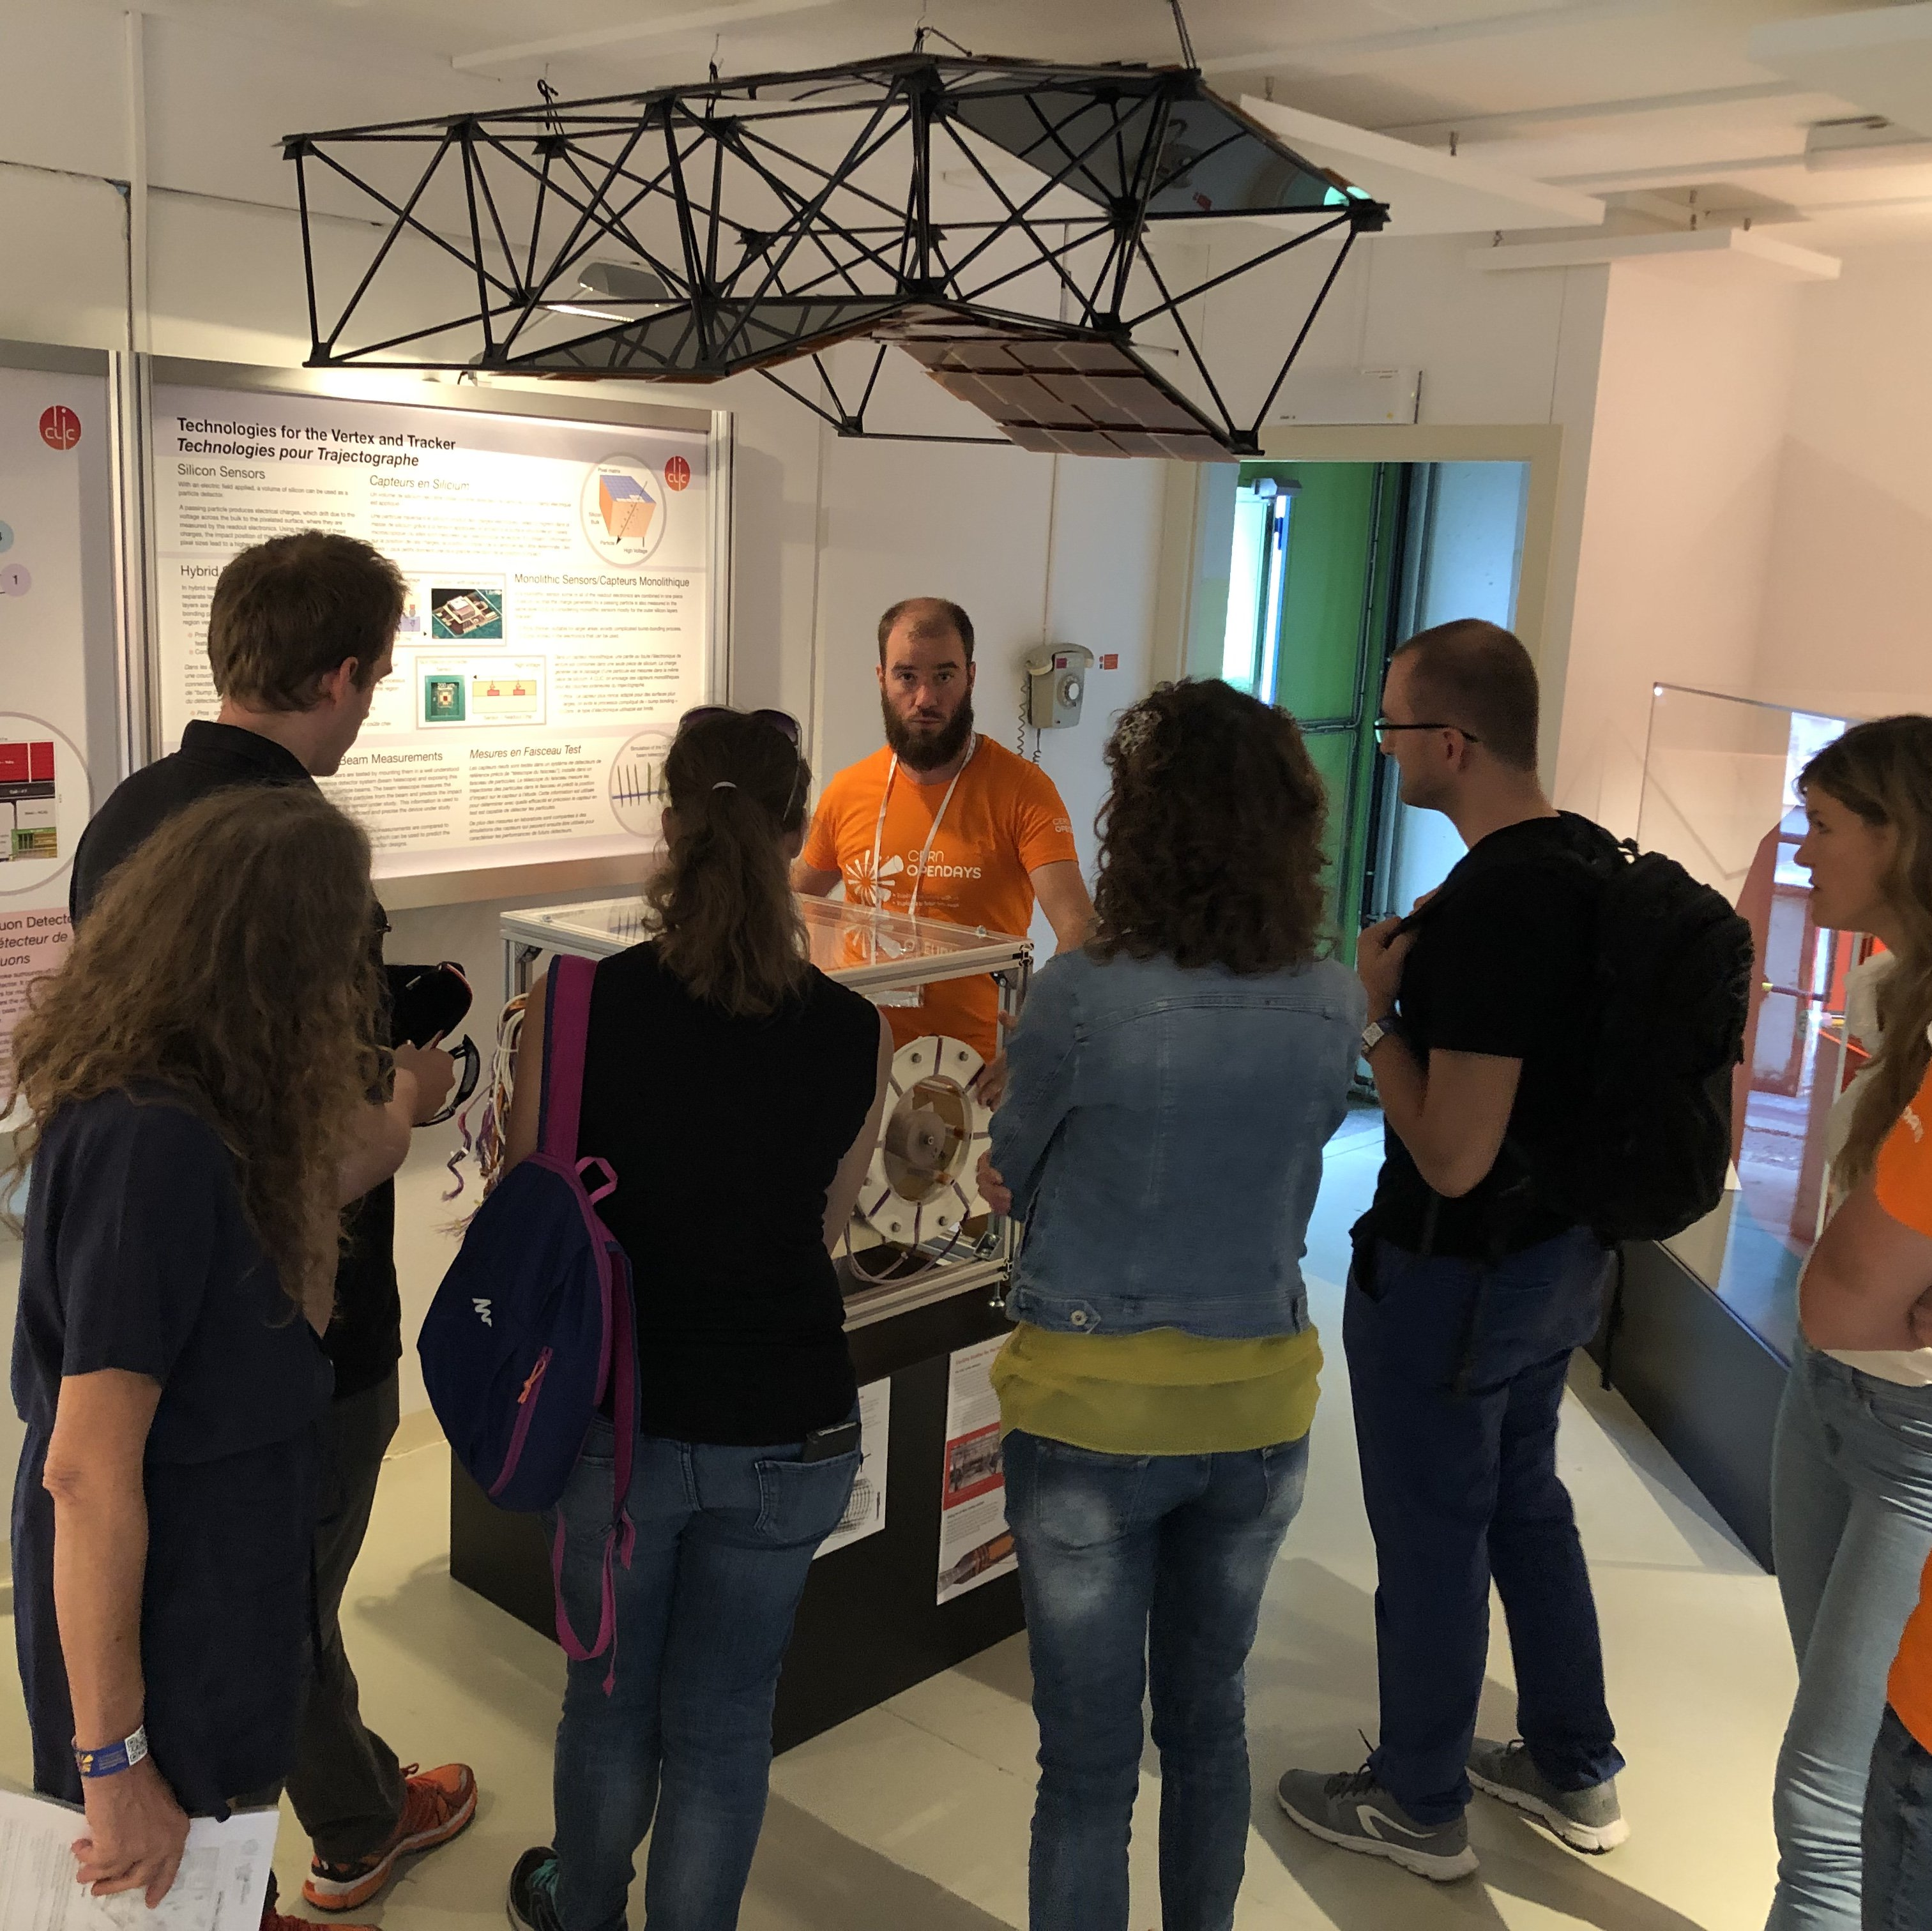
CERN Open Days (2)
@CLIC_study
CLIC showroom –
fully refurbished
THANKS to everyone !!
all posters new
many new labels
NB.
Calendar for bookings
of CLIC showroom:
contact Davide Gamba

Slide 15
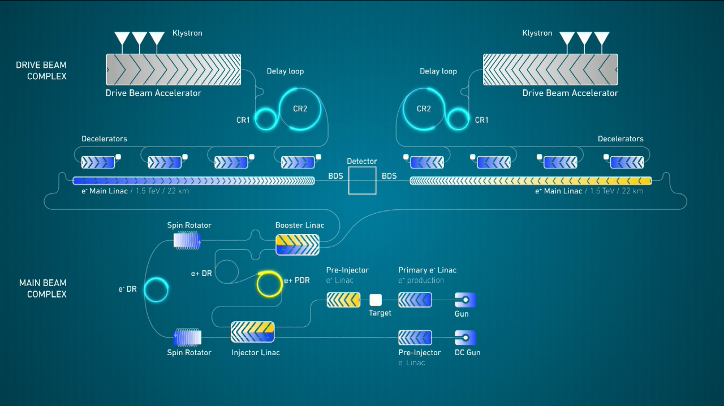
CERN Open Days (3)
new CLIC animations:
Daniel Dominguez

Slide 16
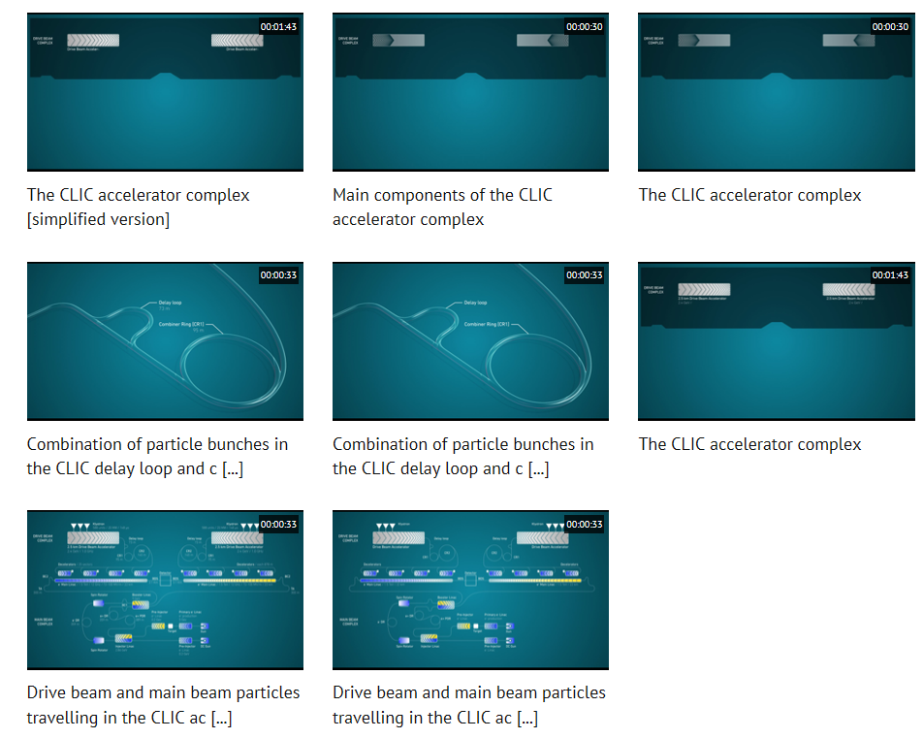
all versions of these animations can be found on
https://videos.cern.ch/search?page=1&size=21&q=clic
“simplified” versions:
- less text,
- fewer numbers
Look around !

Slide 17
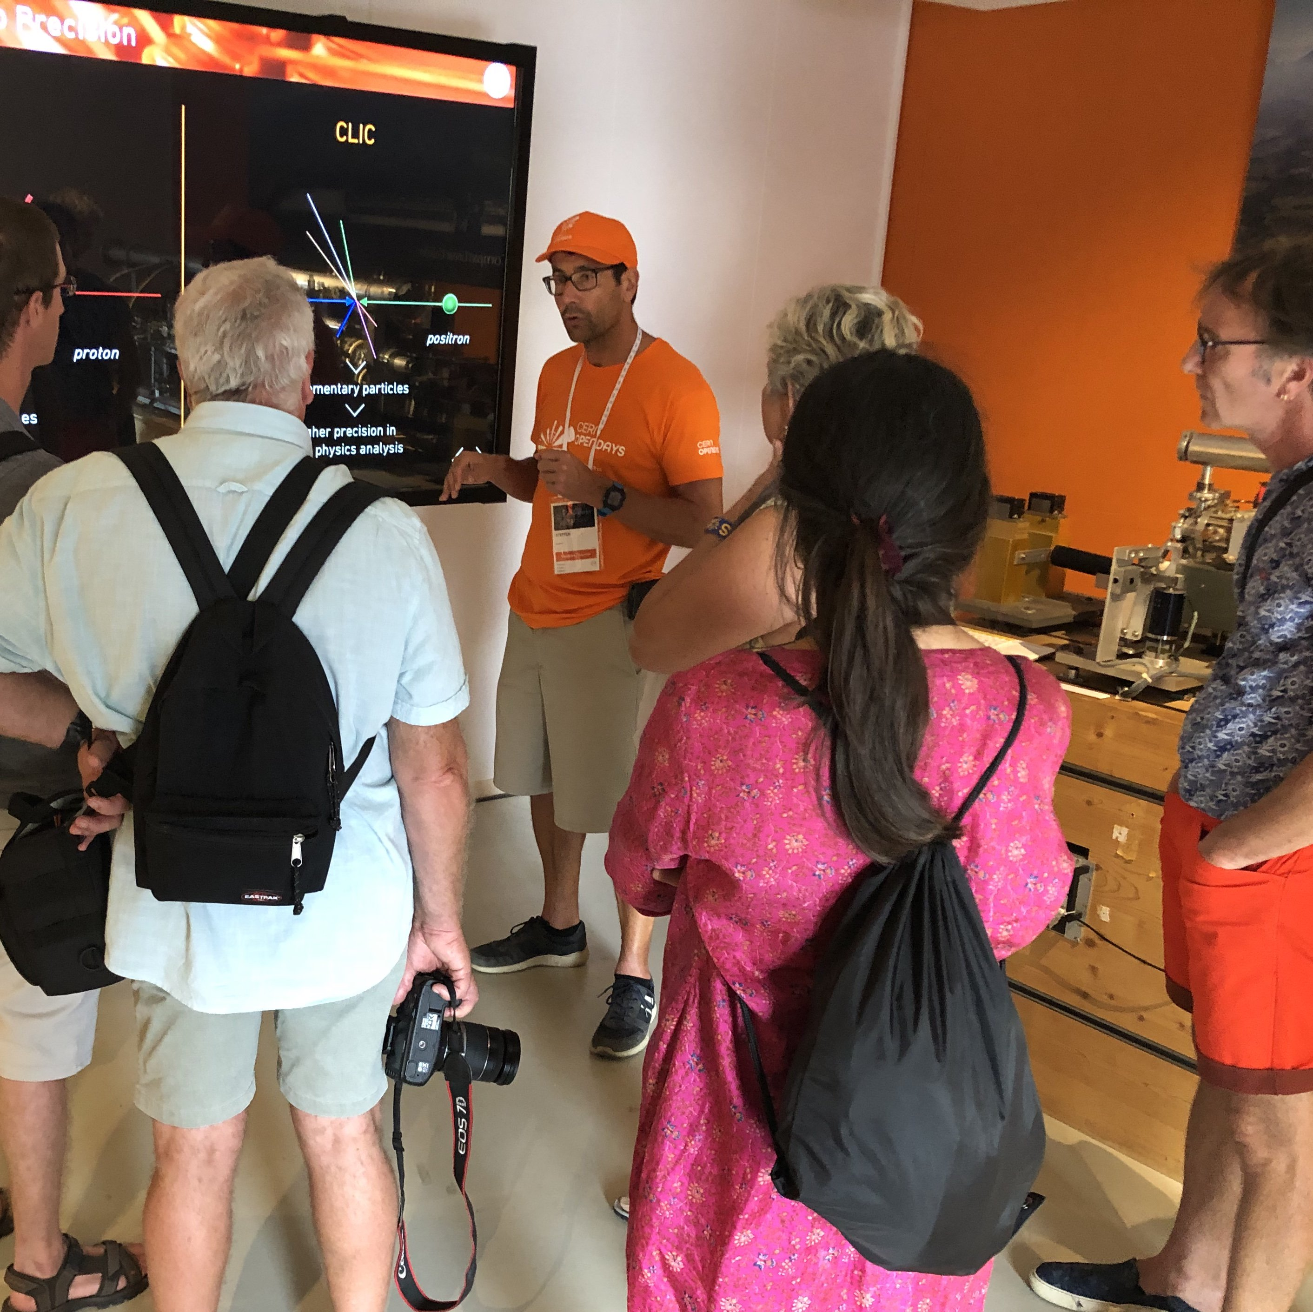
NB.
CLIC animations are now also available on the big screen in the CLIC showroom:
-> take the keyboard,
switch POWER ON
-> use ALT+TAB to toggle
from standard video to
CLIC animations and back

Slide 18
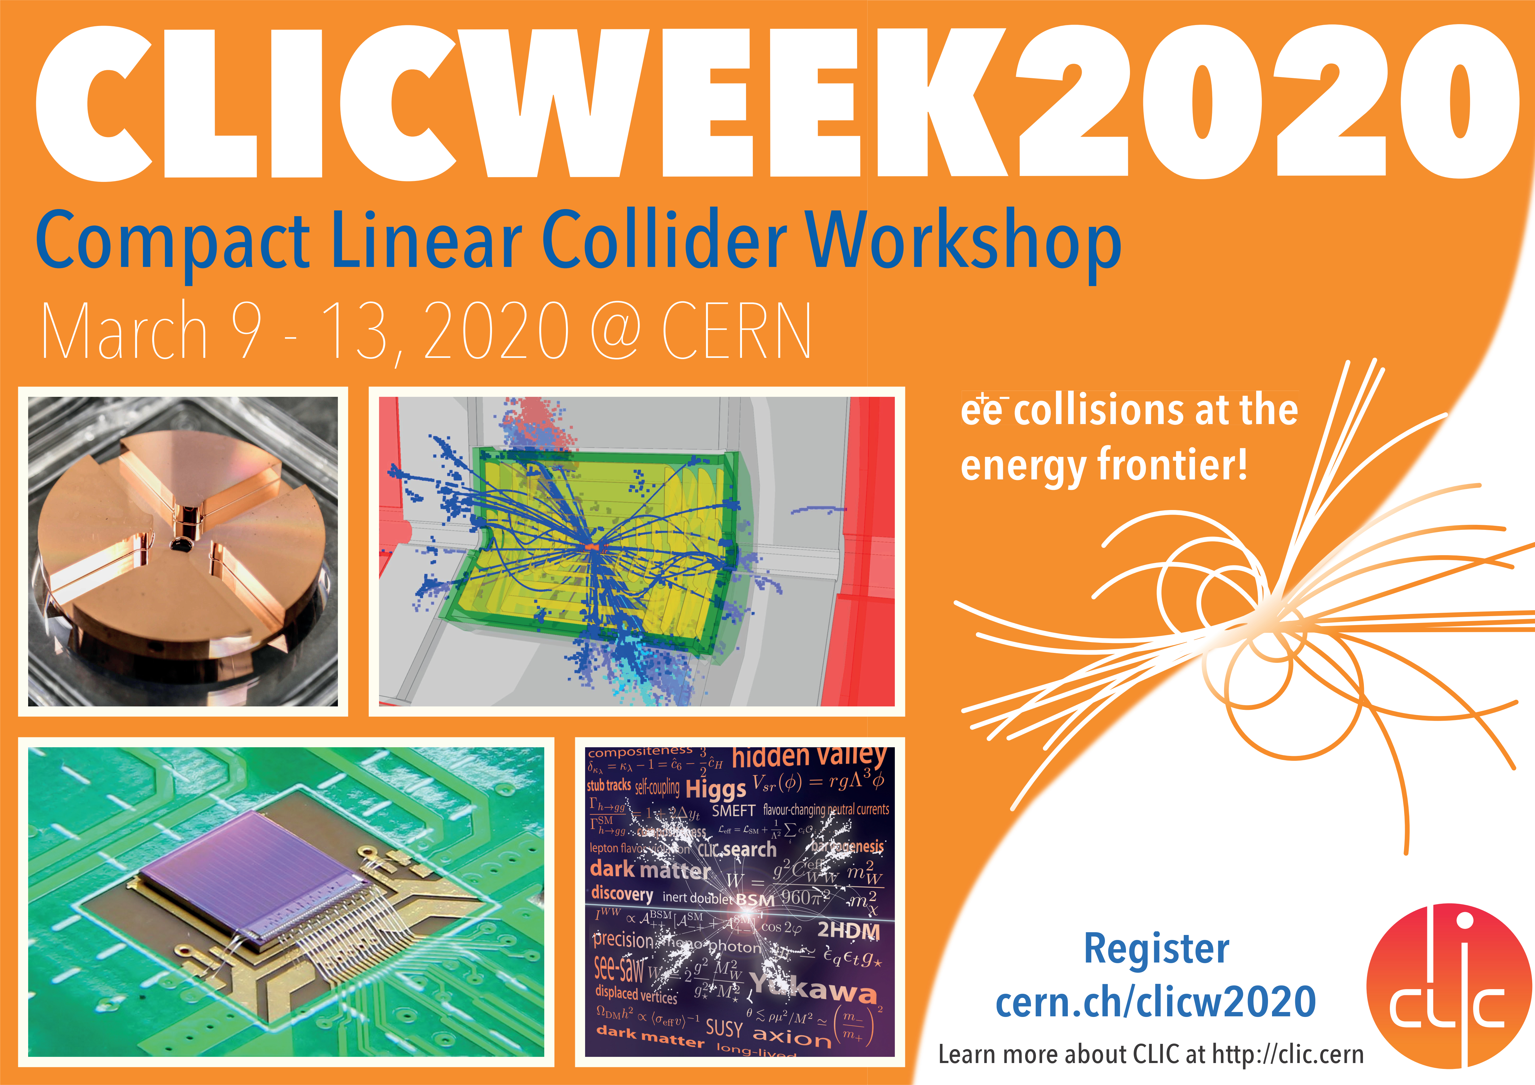
next: CLIC week 6-13 March 2020
Marko Petric

Slide 19
Your suggestions / ideas / input
are always welcome –Thank you!
clic-communication@cern.ch

