Slide 1
Where are we ?

Slide 2
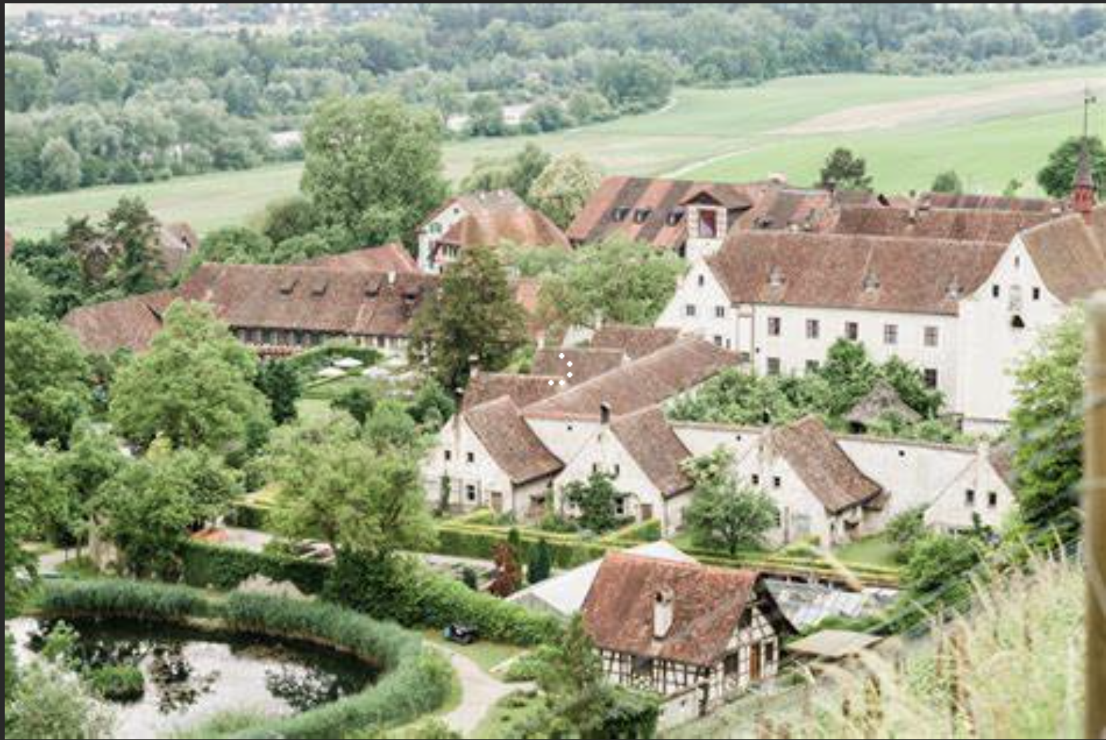

Slide 3
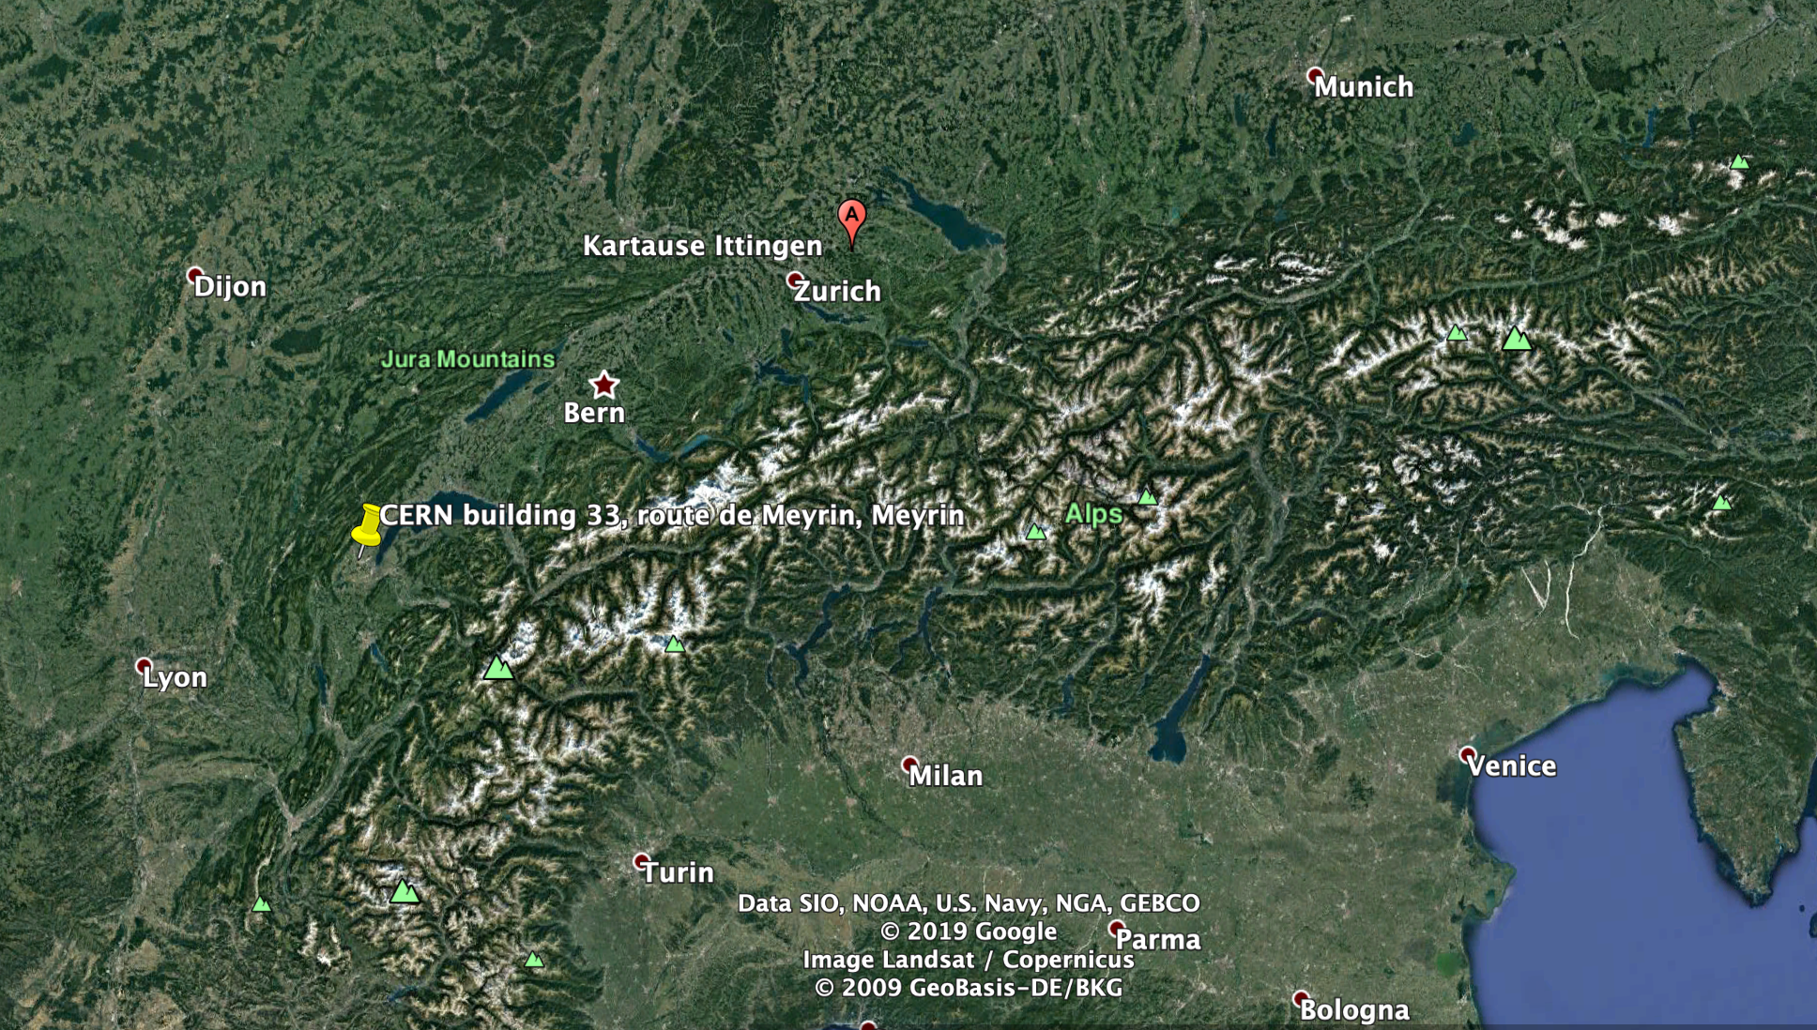

Slide 4
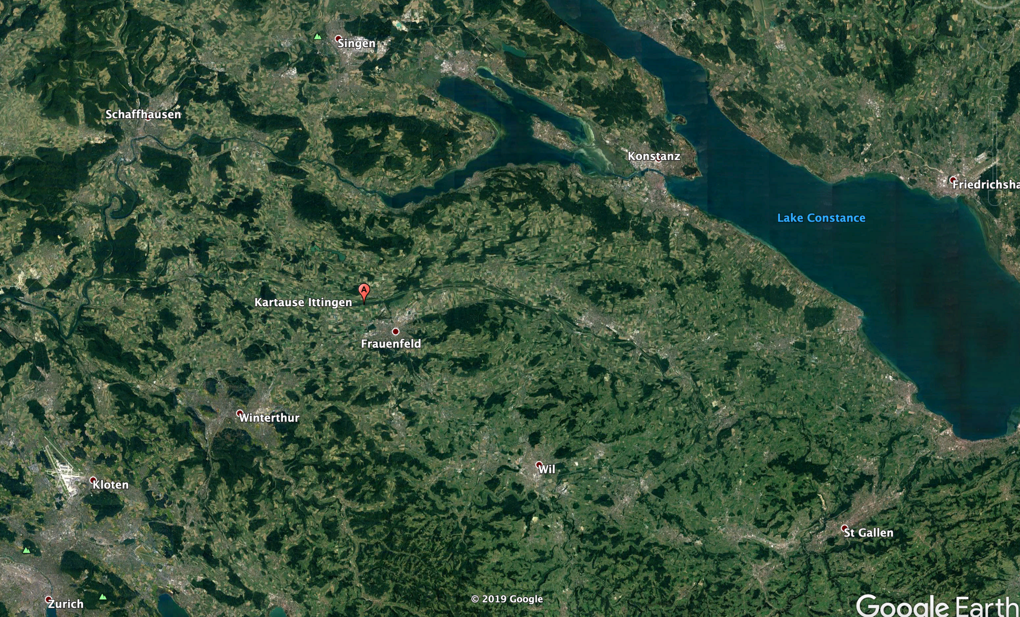

Slide 5
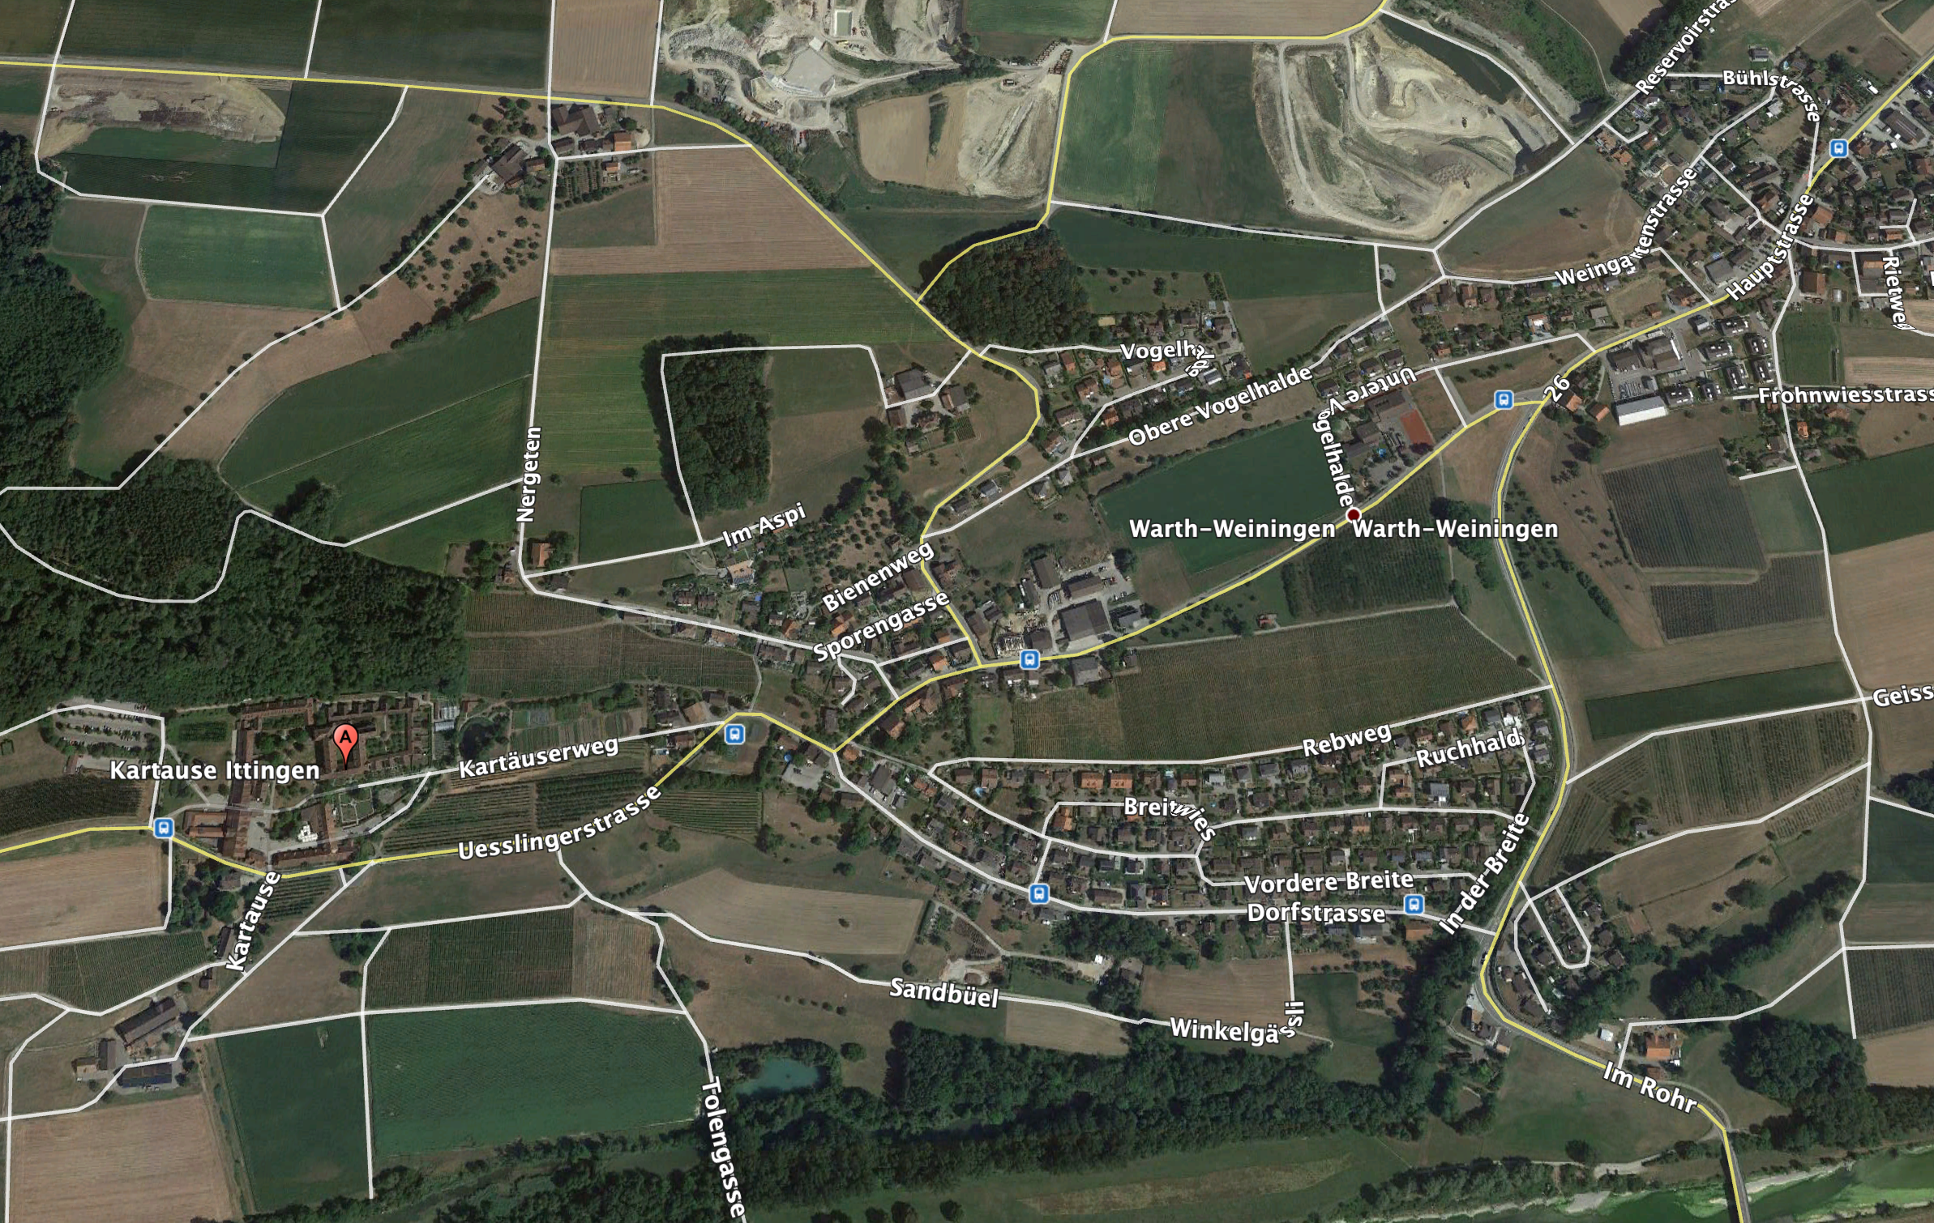

Slide 6
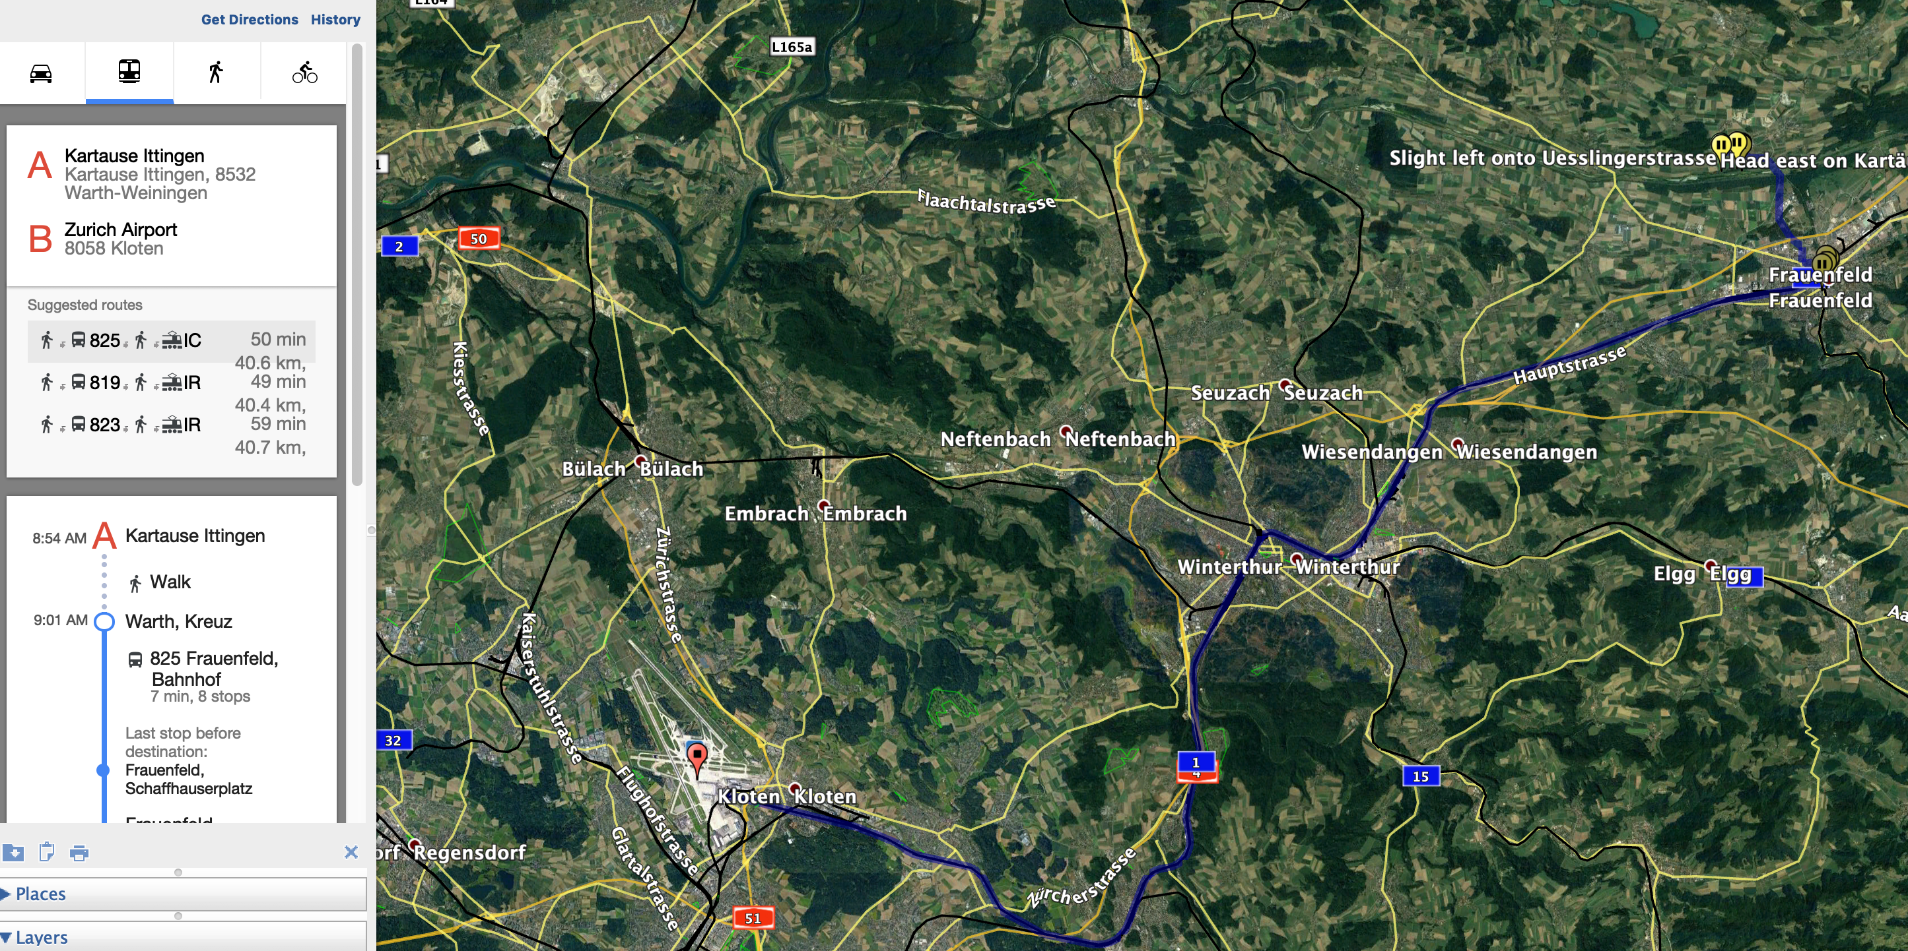

Slide 7
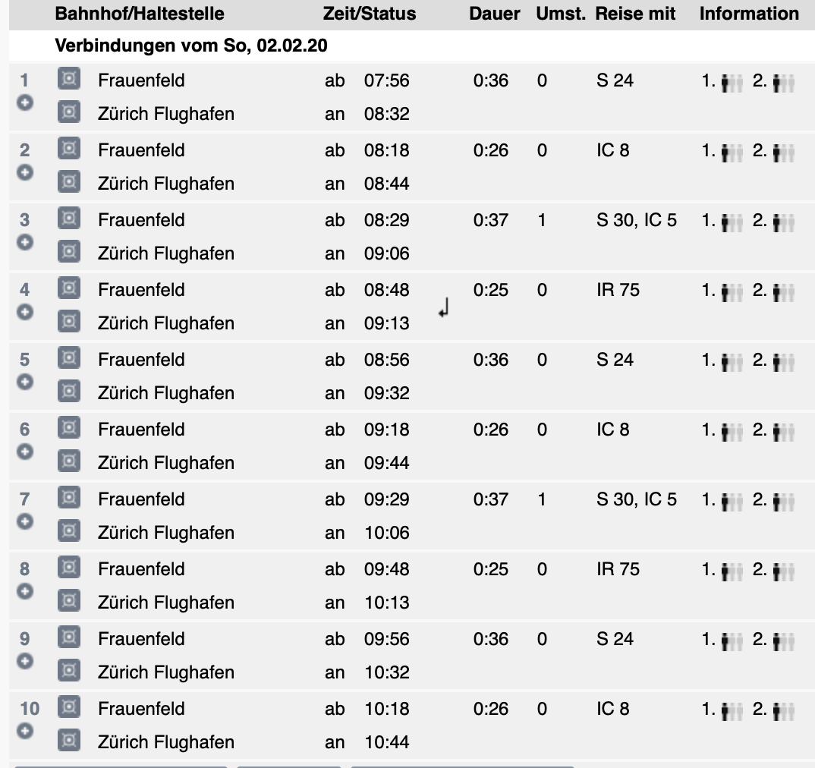
BUS to Frauenfeld : xx:29
Trains to Zurich : http://fahrplan.sbb.ch/bin/query.exe/dn?

