Slide 1
ESH Experience - FSCF Pre-Excavation
Michael P. Andrews
LBNF/DUNE Installation Workshop
2 - 4 February 2020

Slide 2
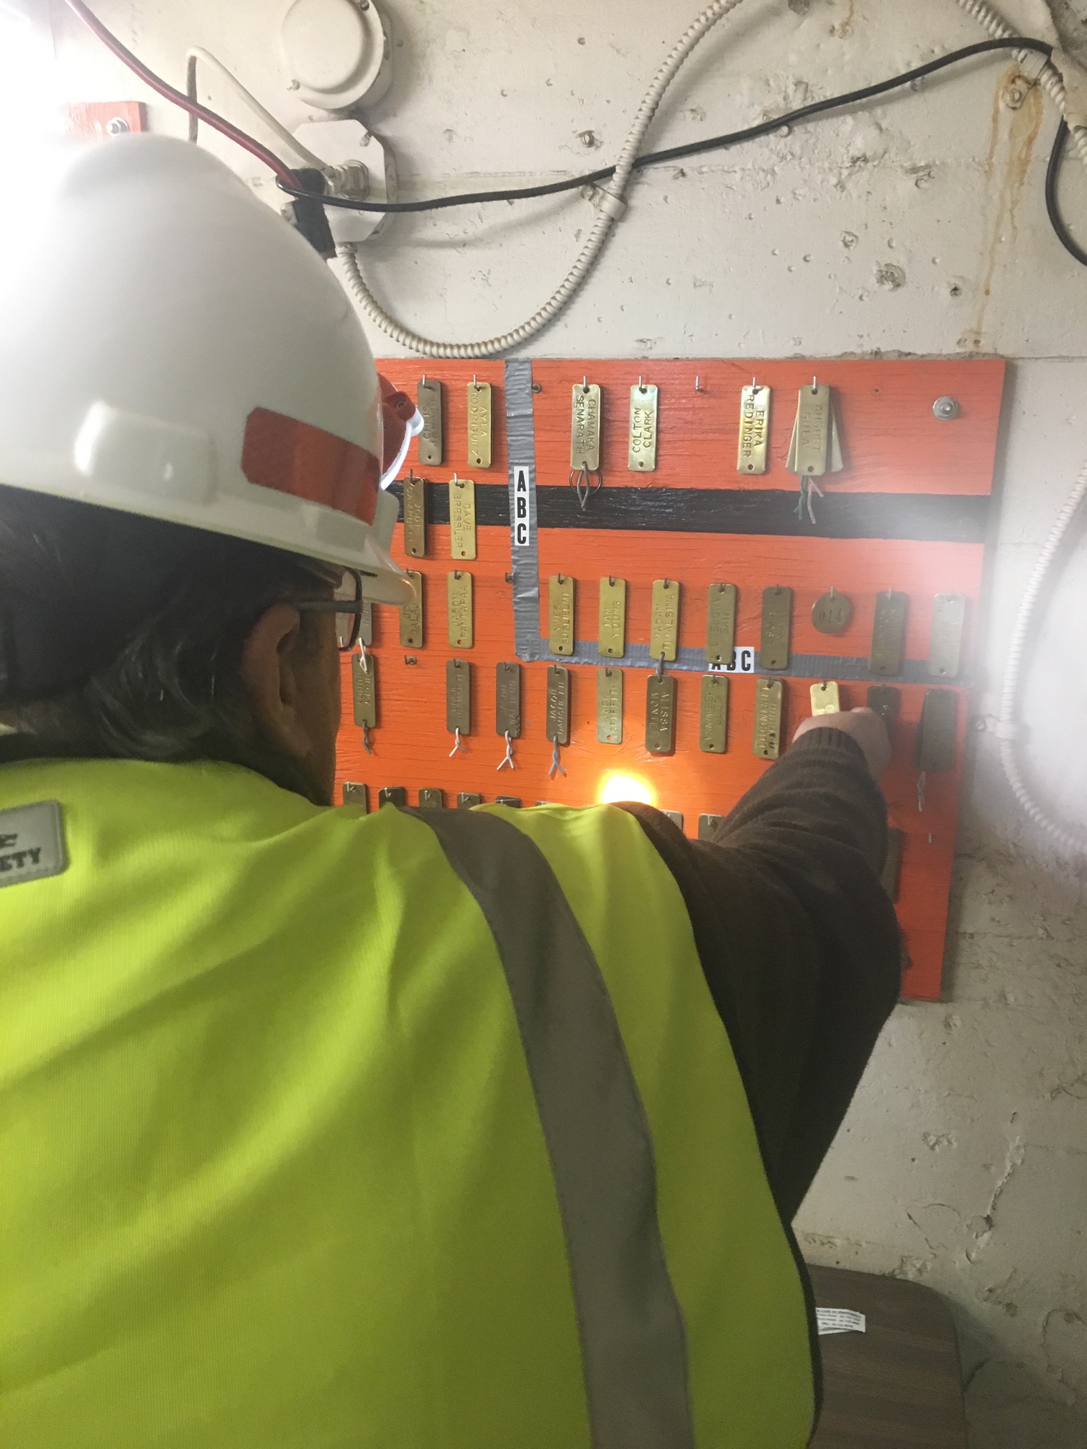
Outline
Far Site Staffing
ESH program requirements
Personnel Accountability & Training
Work Planning & Controls
ESH Support & Oversight
Emergency Management
Environmental
Ventilation
Project Safety Statistics

Slide 3
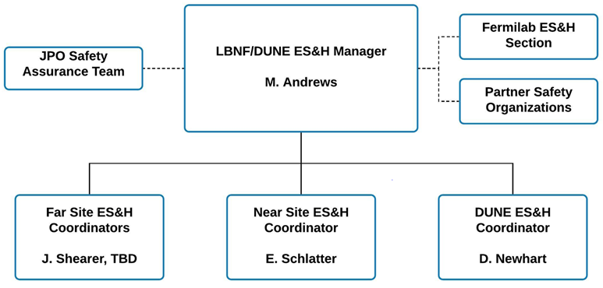
LBNF/DUNE Present ESH Staffing
FS ESH Coordinator started in April 2019
  Daily ESH field support
  ESH POC for SDSTA & KAJV activities
DUNE ESH Coordinator started in June 2019
  Support for the consortia leads
  ESH POC production factories
NS ESH Coordinator started in Sept. 2019
  ESH support for site prep construction activities

Slide 4
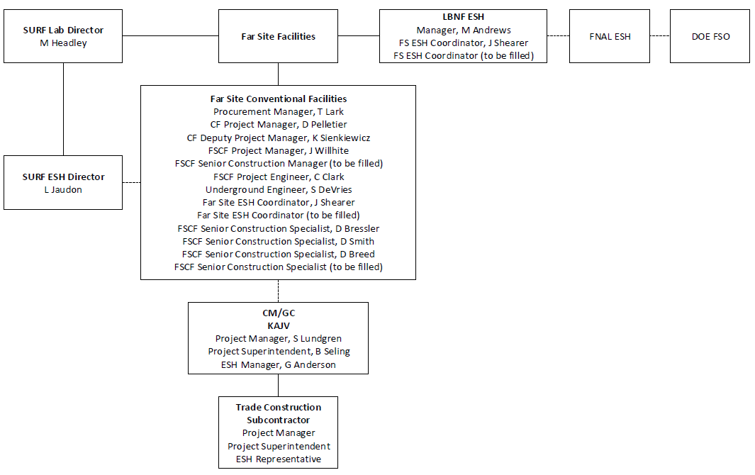
LBNF Far Site Conventional Facilities ESH Oversight

Slide 5
LBNF CF ESH Support Systems & Documentation
Project Management & ESH documentation complete
  LBNF/DUNE Hazard Analysis Report
  LBNF FSCF Construction Management Plan
  LBNF Far Site Construction ESH Plan
  LBNF Near Site Construction Management Plan
  LBNF Near Site Construction ESH Plan
  FSCF Interactions and Communications Guidelines
Following Fermilab’s ESH Program for Construction, implementing DOE 10CFR851
  Completing assurance visits to validate compliance

Slide 6
Communicating ESH Requirements & Expectations
ESH coordination & support through
  LBNF Project Management Meetings
  L2 Project Office Meetings
  Far Site & Near Site Integration Meetings
  Conventional Facilities Coordination Meetings
  LBNF/DUNE/CERN Interface Meetings
Interfaces with major stakeholders ESH organization
  Weekly meeting with Fermilab ESH Section Management
  FRA-SDSTA joint coordination team
  Bi-weekly ESH stakeholder meetings at the Far Site
  Weekly subcontractor progress meetings
  Daily working planning meetings at the field level

Slide 7
Communication of ESH Requirements to Subcontractors
Regulatory requirements referenced in construction subcontracts

Slide 8
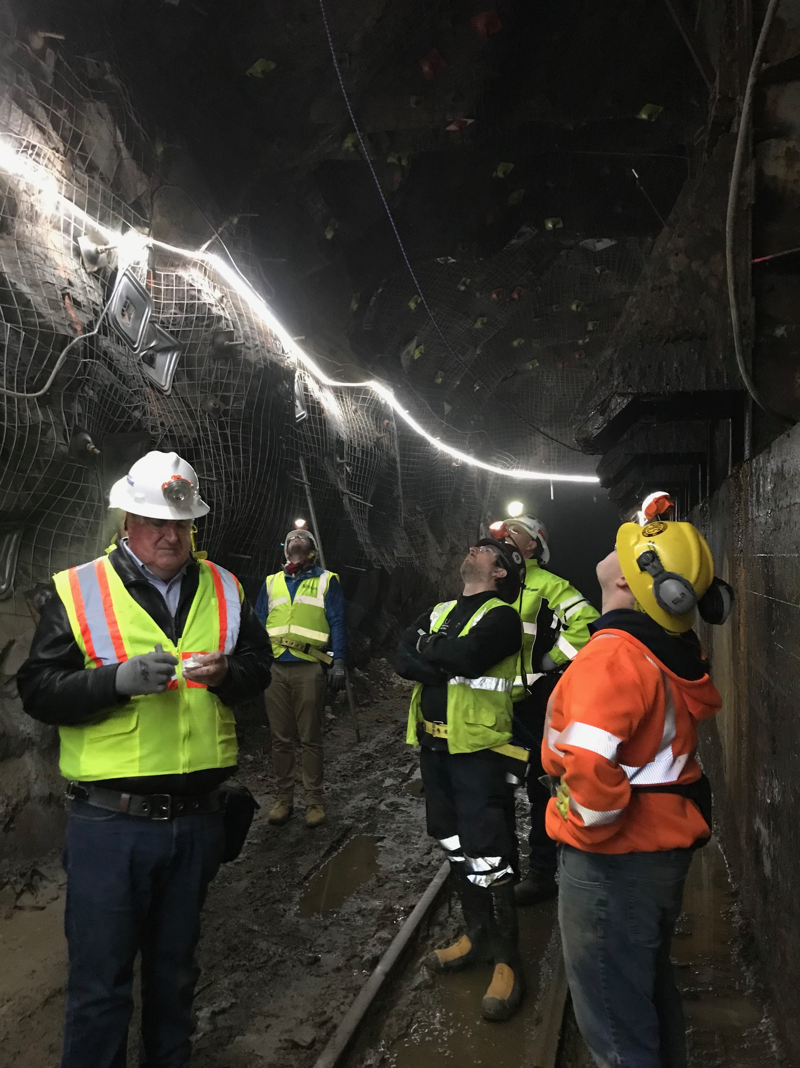
Getting Ready to Work at Far Site
Request Fermilab ID through SDSD
Complete KAJV/SURF ESH orientation training
Obtain SURF ID Badge
Review work planning documentation
Attend daily planning meeting
Get to work!

Slide 9
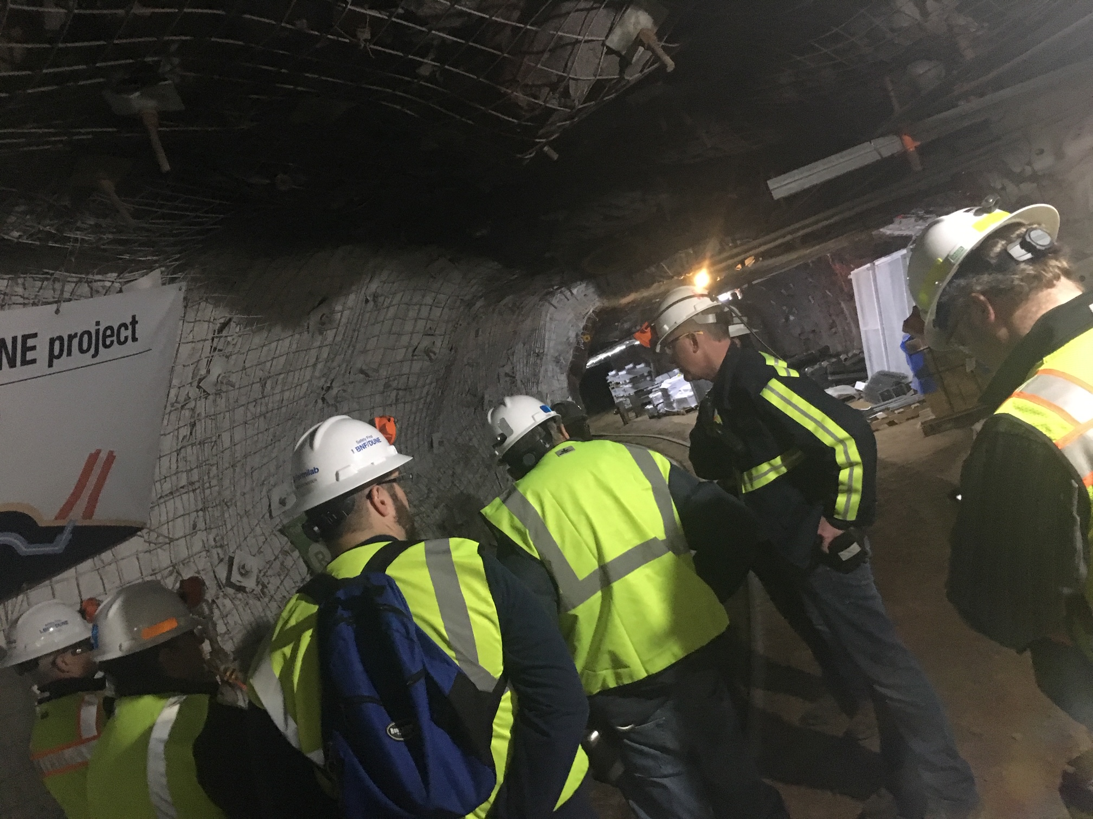
Personnel Protective Equipment Requirements
Hard Hat w/ tether
Steel toes boots above ankle
Class 2 reflective vest
Safety Glasses
Gloves
Underground Only
  Cap Lamp & Belts
  Self rescuer/Emergency Escape Breathing Apparatus
Based on hazards analysis
  Hearing protection (plugs/muffs)
  Face shield
  Respirators
  Fall protection (harness w/retractable lanyards)

Slide 10
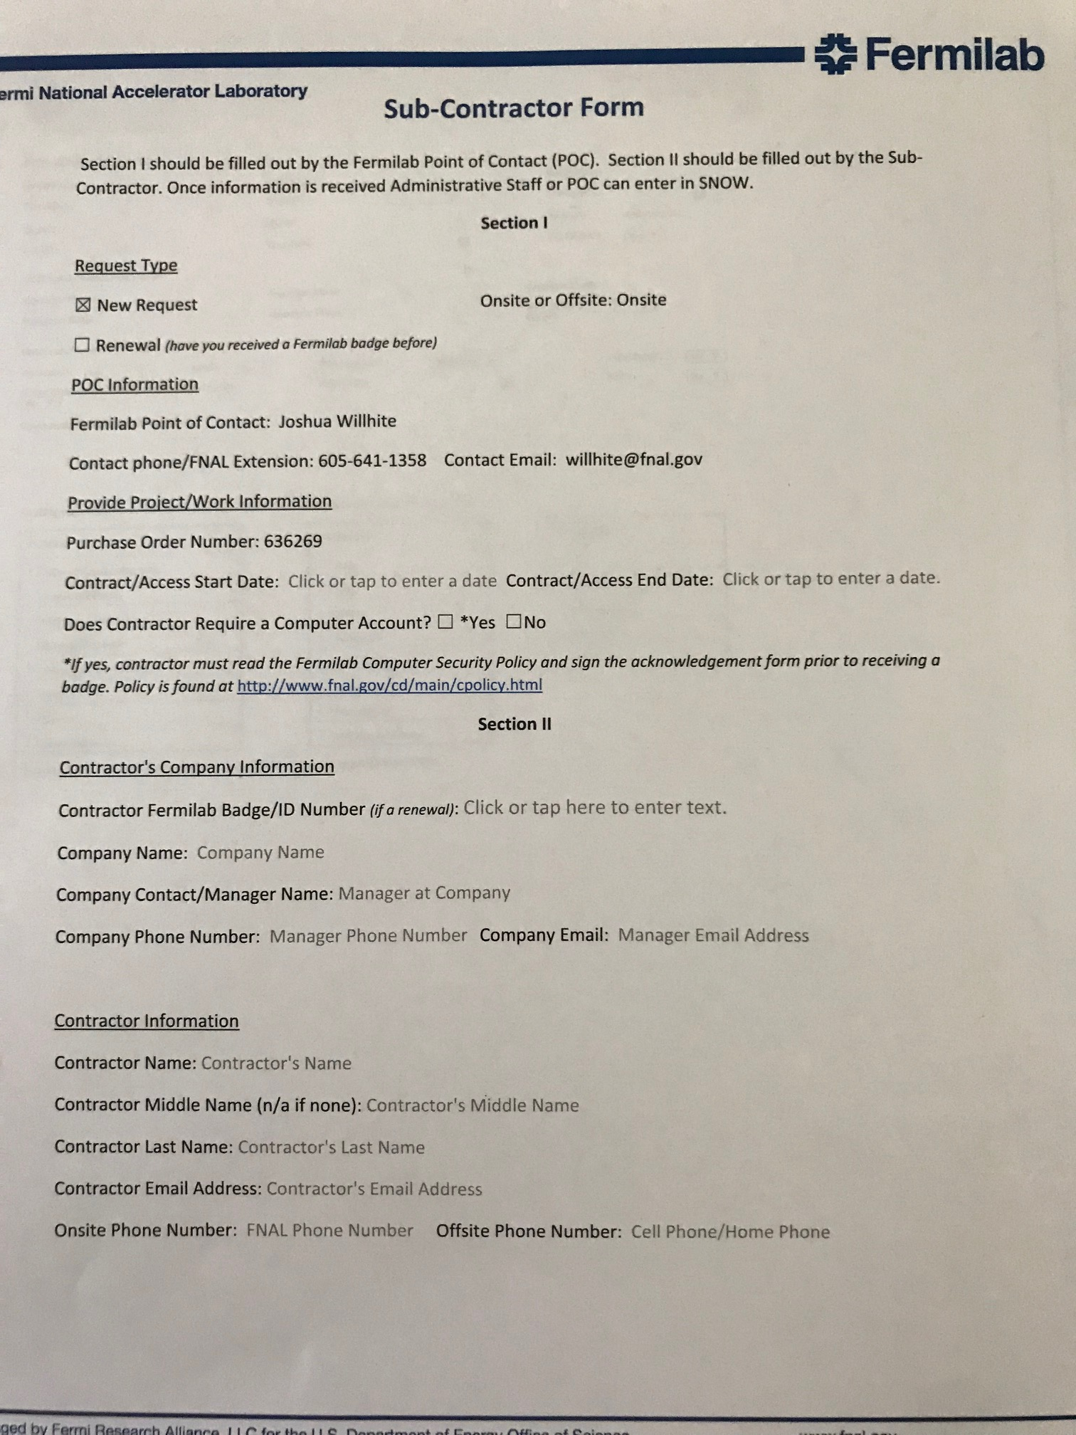
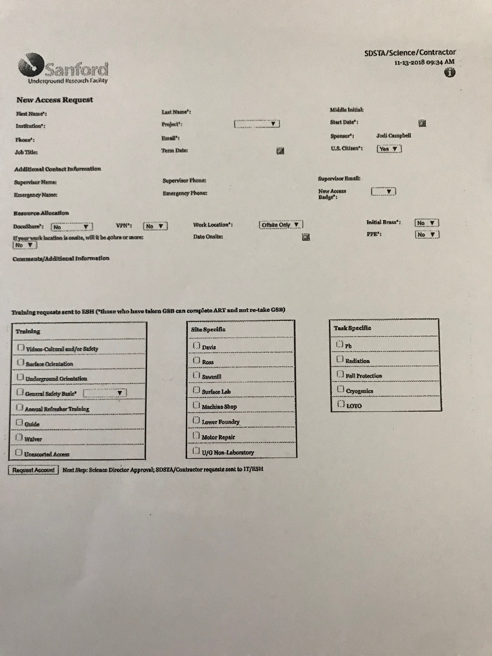
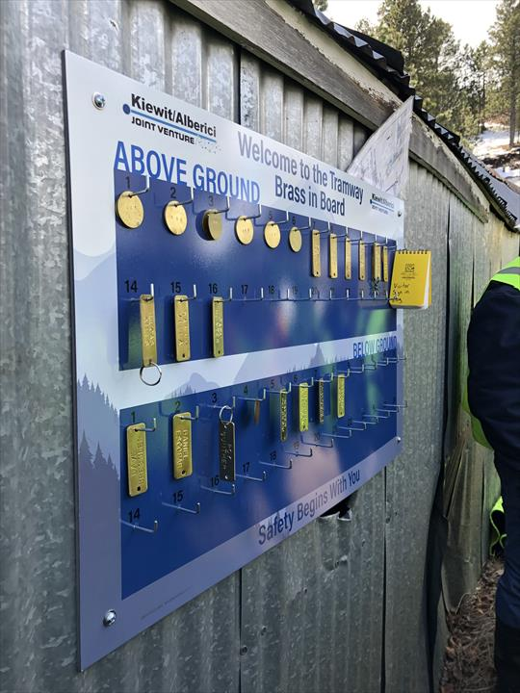
Far Site Access & Personnel Accountability
Fermilab Sub-Contractor ID Request Form
  Submitted to Fermilab Global Services for review & authorization
  Fermilab ID number issued
SURF Access Request Form
  SURF ID Badge Issued after ESH orientation
Construction Coordinators track active work areas & personnel
Underground Access Controls
  SURF Trip Action Plan (TAP)
    TAP’s can be copied for daily use
  Individual Brass Boards at Ross Shaft

Slide 11
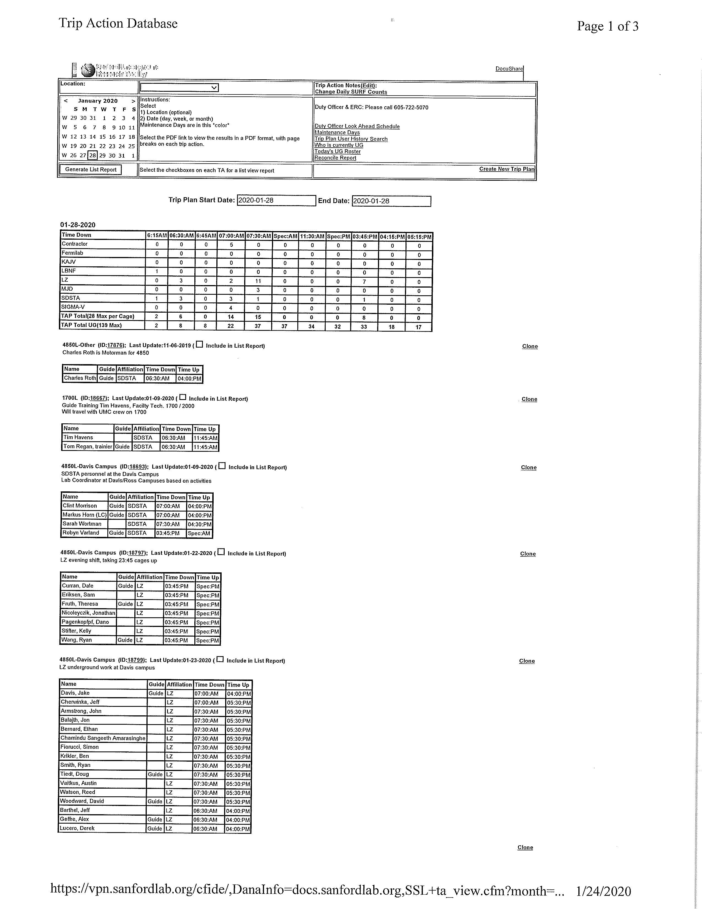
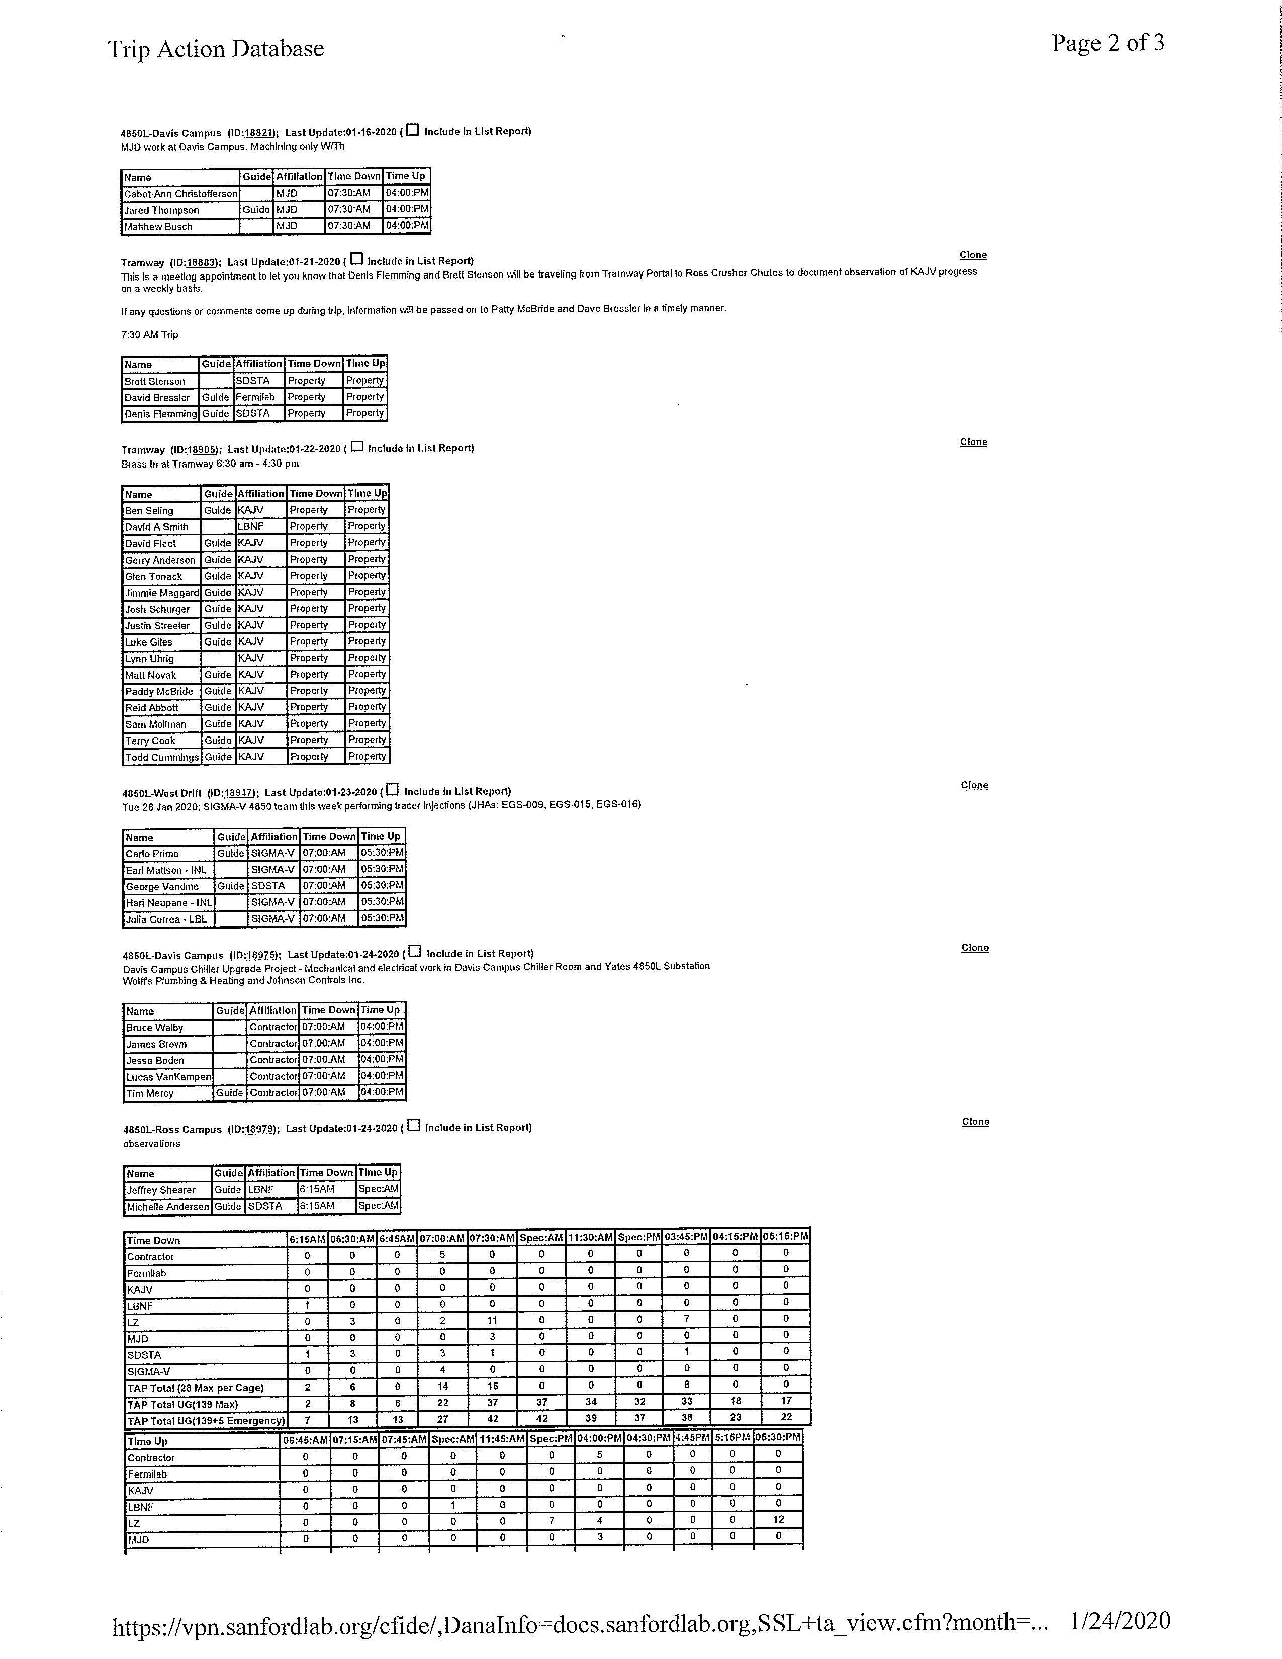
SURF Trip Action Plan Database Example

Slide 12
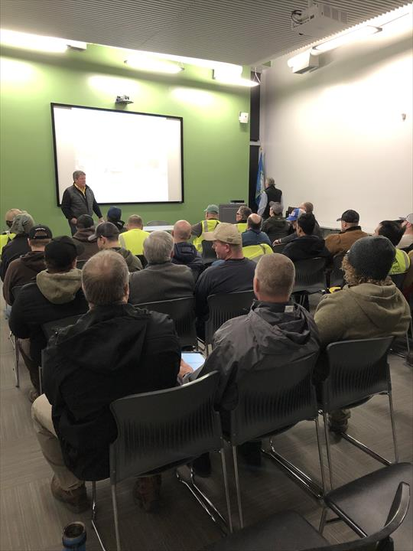
Far Site ESH Training
FS Construction Management
  Fermilab Construction Coordinator Training
  Human Performance Improvement Training
  Ocenco self-rescuer & EBA
  Fall Protection
  OSHA 30 Hour
  Remote training capability
SURF ESH Training
  Surface & Underground
  Unescorted Worker by level
  Guide training
  KAJV has been authorized by SURF ESH to provide this training
Weekly KAJV ESH Indoctrination

Slide 13
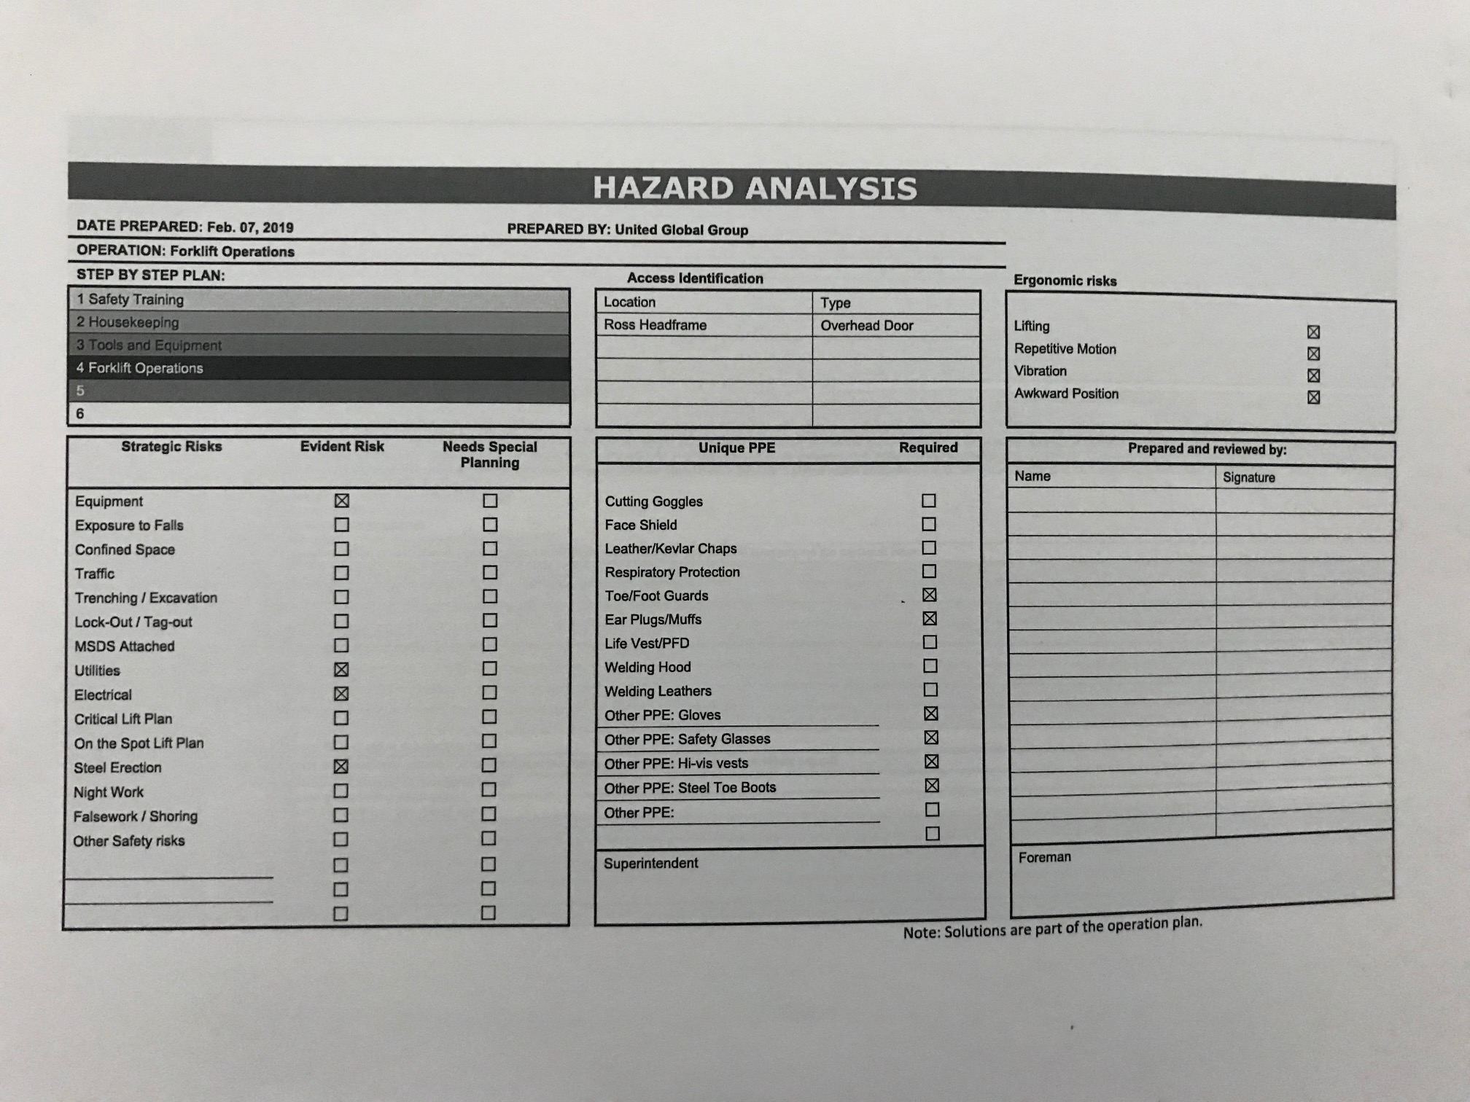
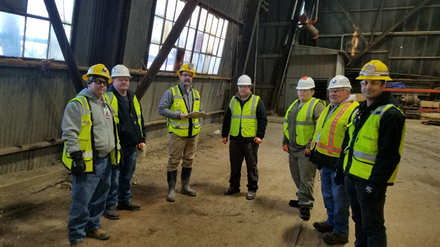
Work Planning and Controls (WPC)
Documentation reviewed through shared databases with stakeholders
  Build Plans, Standard Operating Procedures
  Hazard Analysis
  Hot work permits & Safety Data Sheet’s
  Pre-Activity Meetings
Field level Work Planning Controls
  Mini Job Hazard Analysis’s
  Joint task planning meetings
  Daily Planning Meetings
  Monthly Safety Meetings
Reviewing Work Planning documentation for all subcontractor work activities

Slide 14
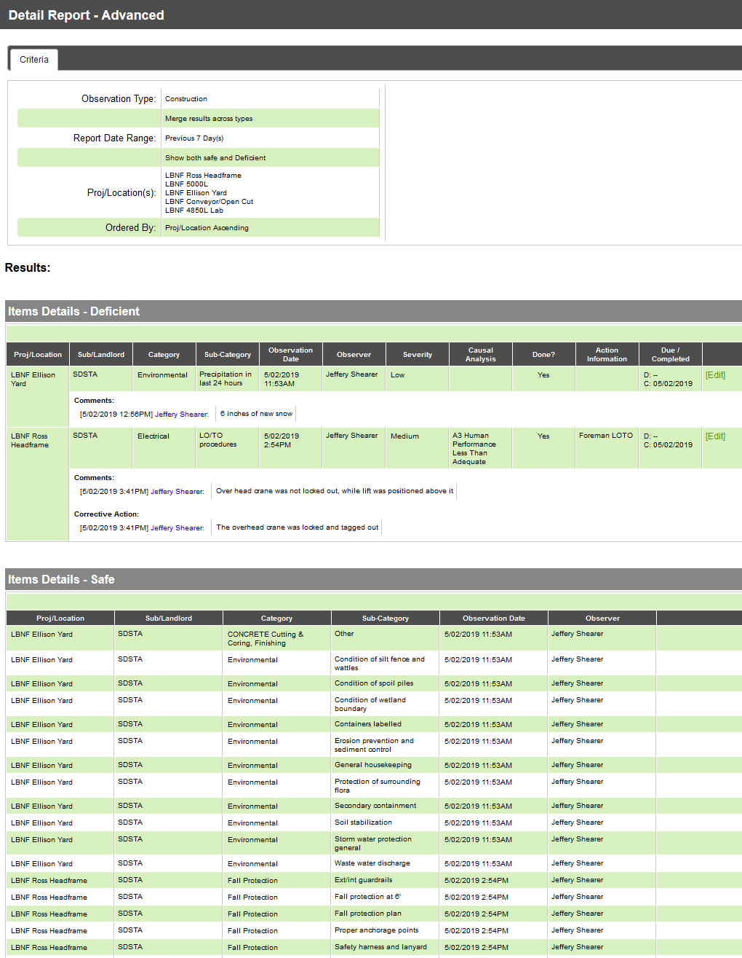
ESH Field Support & Oversight
Construction Coordinator
  Daily Reports
ESH Coordinator
  Document findings
Weekly jobsite walkthroughs by stakeholders
Management walkthroughs
Fermilab ESH Subject Matter Expert’s
Subcontractor ESH representatives

Slide 15
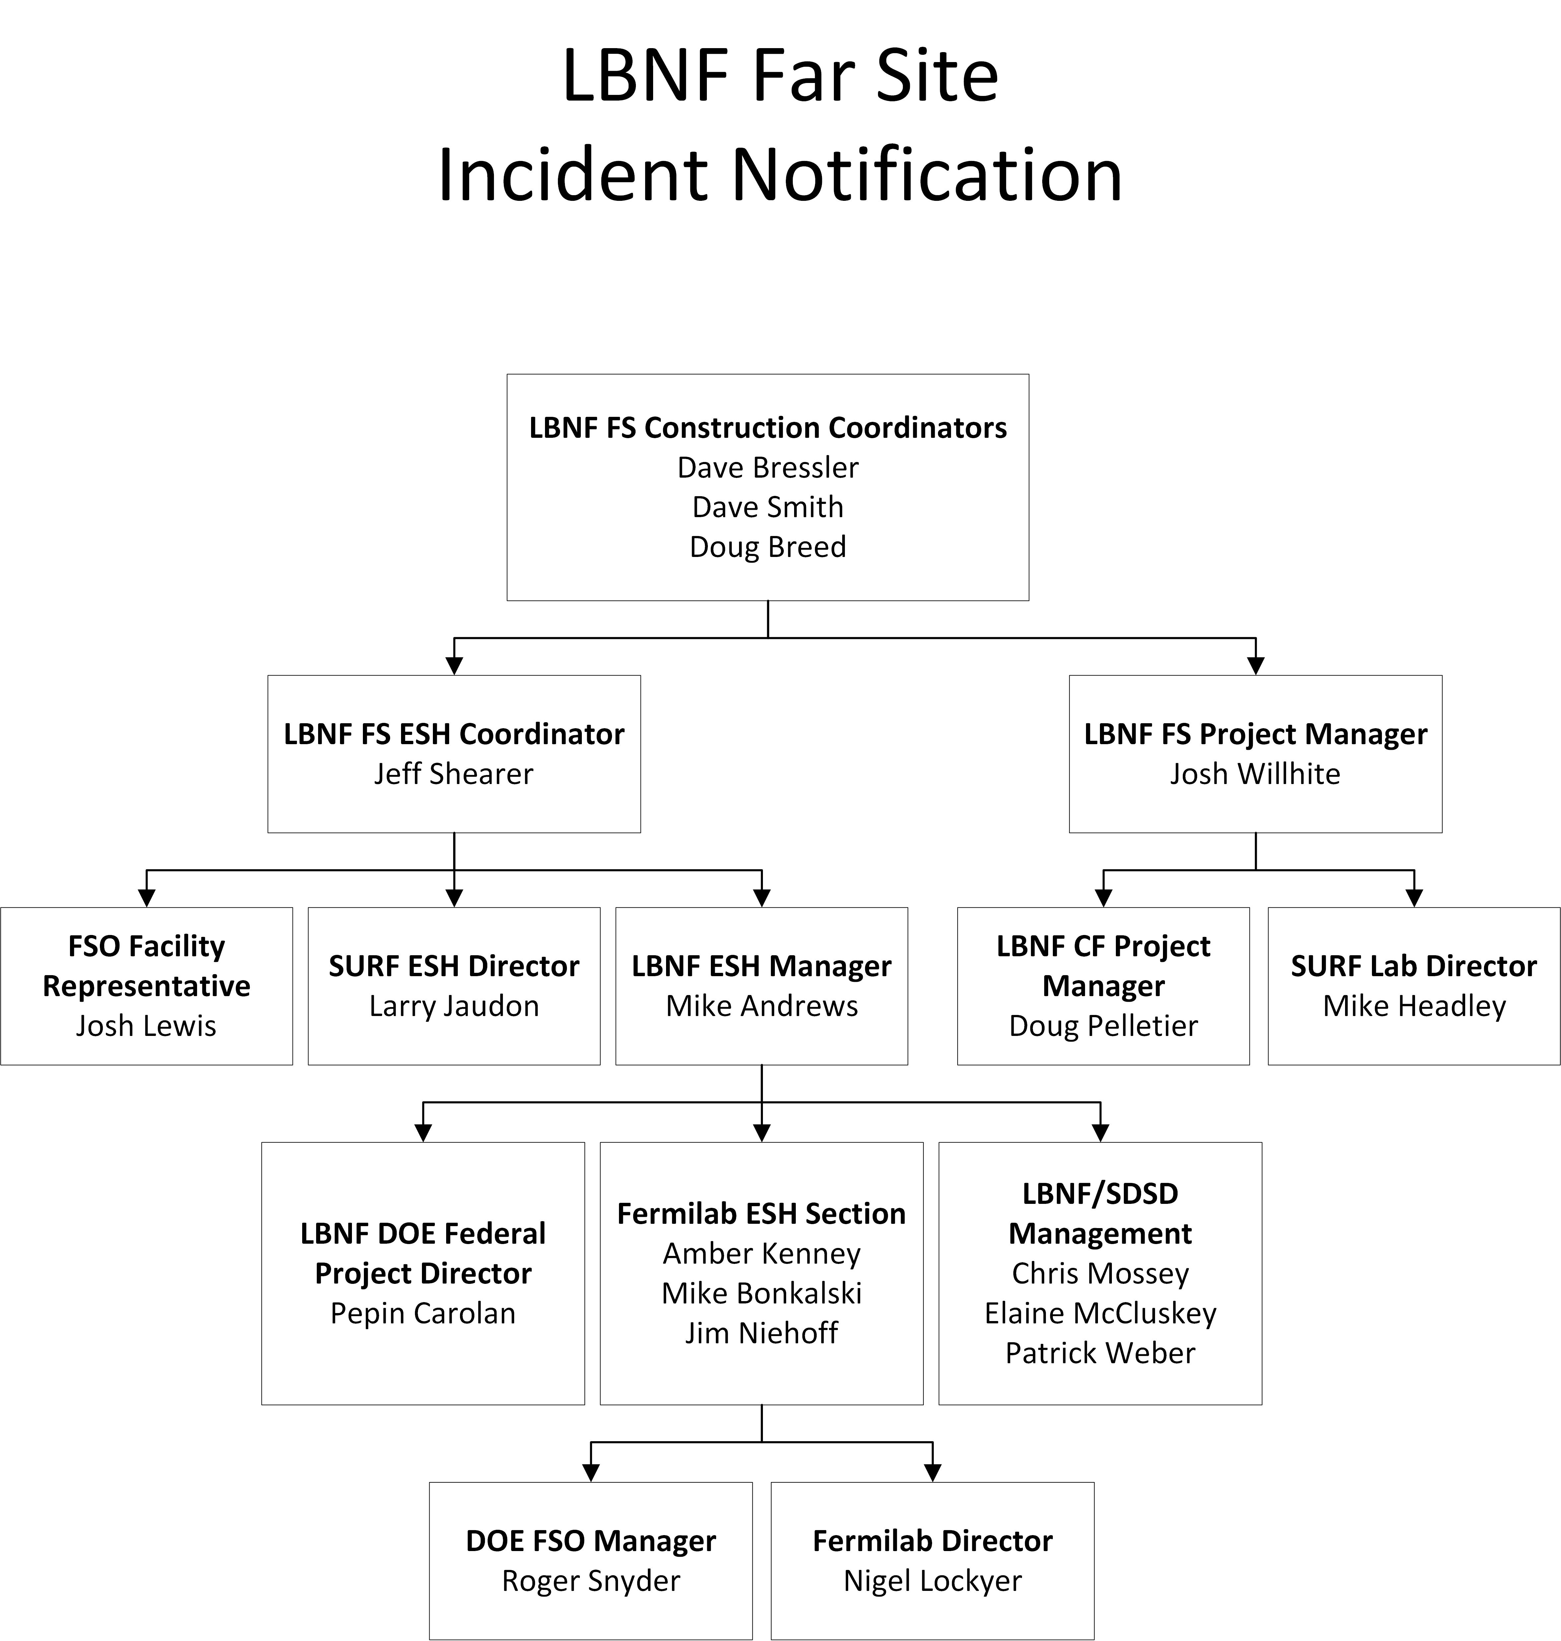
Far Site Emergency Management
LBNF Far Site Emergency Operations Plan
SDSTA ERT providing support on all shifts
Participating in SURF quarterly underground evacuation & bi-annual surface drills
KAJV Crisis Management Plan
KAJV Severe weather plan
KAJV paramedic on-site for all shifts (ALS certified)
Refuge chamber upgrade completed to increase capacity to 144

Slide 16
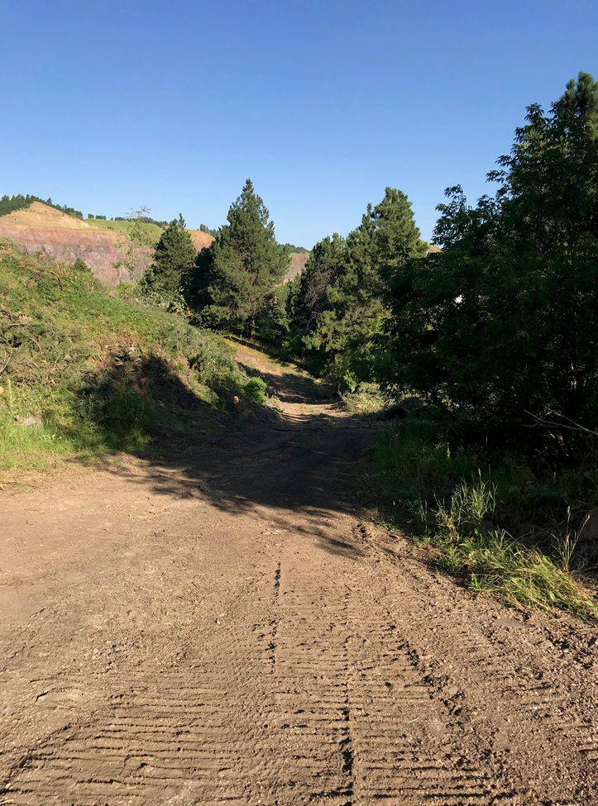
Far Site Environmental
Environmental Assessment & FONSI completed in Sept. 2015
Water discharge permit in place with the State of SD for the tramway
Established air permit requirements associated with the conveyor
Evaluating impacts of excavation activities on the SURF water treatment facility
Lead/asbestos abatement processes well developed for construction activities in the headframe and crusher areas
Weekly SWPPP inspections
  Silt fence, stockpile storage, etc.
EA commitments reviewed as part of the work planning process
  Raptor Study completed for conveyor installation
  Traffic management plan

Slide 17
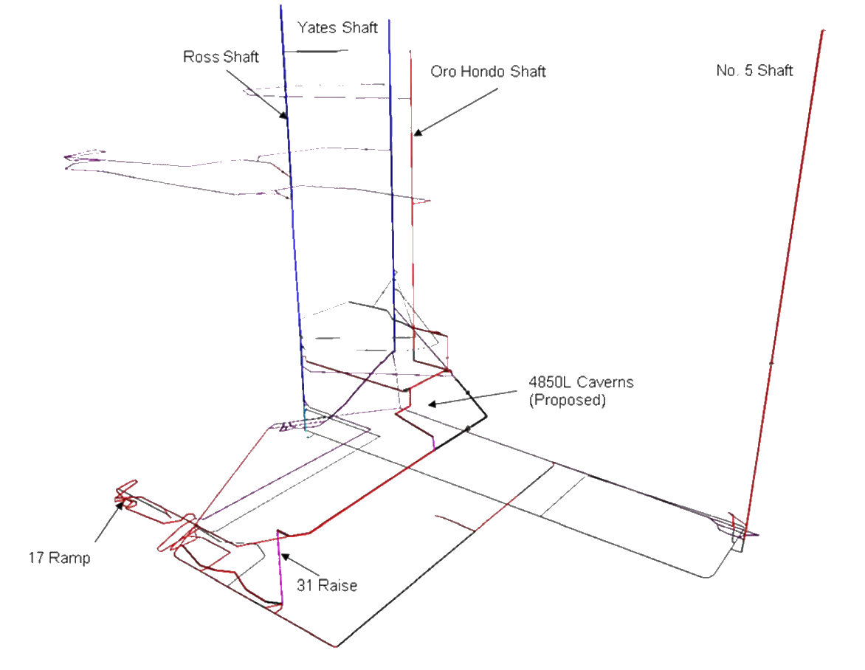
Far Site Ventilation
ARUP has developed multiple ventilation models reflecting phases of construction and final operations for LBNF
ARUP modeling software utilized is industry standard, Vnet
Ventilation consultant validated the LBNF ventilation modeling to verify alignment with the ODH analysis. Presently no major issues identified
KAJV subcontract modified to accommodate change in ventilation compliance requirements from OSHA 1926.800 to MSHA 30 CFR 57

Slide 18
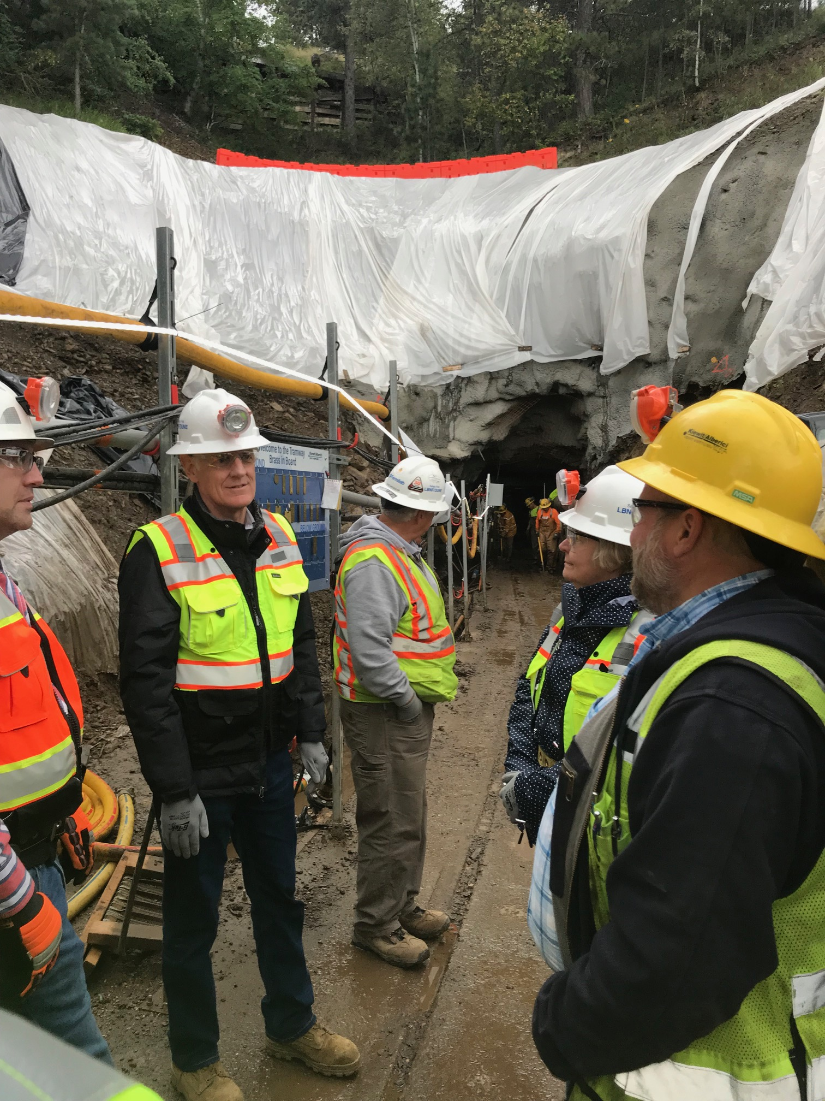
Lessons Learned Communication
Management meetings
Weekly Fermilab ESH summary reports
Monthly DOE ORPS summary reports
Monthly Fermilab ESH committee meetings
Daily work planning meetings
Weekly subcontractor progress meetings
Monthly safety meetings
SDSTA flash reports

Slide 19
Safety: LBNF/DUNE-US Incident Statistics
Current Calendar Year to Date | Cumulative to Date
Organization | Manhours* | DART Cases | DART Rate | TRC Cases | TRC Rate | Manhours* | DART Cases | DART Rate | TRC Cases | TRC Rate
LBNF/DUNE-US | 139,689 | 0 | 0 | 0 | 0 | 858,890 | 0 | 0 | 0 | 0
SDSTA | 51,944 | 0 | 0 | 0 | 0 | 128,032 | 1 | 1.6 | 2 | 3.1
KAJV | 112,960 | 0 | 0 | 0 | 0 | 112,960 | 0 | 0 | 0 | 0
KENNY/JACOBS | 794 | 0 | 0 | 0 | 0 | 794 | 0 | 0 | 0 | 0
OTHER SUBCONTRACTORS | 2114 | 0 | 0 | 0 | 0 | 2114 | 0 | 0 | 0 | 0
Total | 307,501 | 0 | 0 | 0 | 0 | 1,102,790 | 1 | 0.2 | 2 | 0.4
*Reflects manhours through December 2019
Good safety record, but not without minor incidents
  One first aid case – hand injury
Response to issues-actively investigate ALL incidents to drive change and continuous improvement
Communicate lessons learned to all levels of the project team

Slide 20
Summary
Site access & badging process established
Training requirements developed and in place
PPE requirements defined
Underground access process coordinated with SDSTA
Work planning and control process implemented for all activities
Support, oversight, & assurance of the ESH program at multiple levels of project oversight
Frequent coordination with FNAL ESH

