Slide 1
Compliance Office (CO)
Mandate and guidelines
O. Beltramello – 01.02.2020

Slide 2
The mandate
The Compliance Office is part of the
Integration Project Office
The Compliance Office defines, leads and implements the process of assessment, validation and sign-off for the equipment compliance to mechanical and the electrical standards and regulations.

Slide 3
What do we deal with ?
Any equipment associated with the LBNF/DUNE project to be installed in service or experimental caverns at SURF or at Fermilab, from design, to fabrication, installation, commissioning and operation.
Only equipment with major safety implications are assessed. Equipment will be classified after screening by the CO.
Equipment can be commercial or custom.
Any tool, lifting device, or structure used to transport or manipulate equipment that will end in the near or far site must be assessed.
Equipment that are part of civil construction
Tools developed in the Institutes to construct their detector
Equipment at construction factory
Equipment related to the Neutrino Beam Line
But we are open to discussions, case by case …
We do NOT take care of:

Slide 4
We act in 3 main complementary domains :
Applicable Rules and Regulations for the Project and US / EU standards equivalencies
Due to the international nature and the complexity of the LBNF / DUNE, we need to define what are the applicable rules and regulations for our Project.
This is done in collaboration with FNAL and SURF responsible parties.
This covers all life-time of the equipment including design, fabrication, transport, installation, commissioning and operation.
Our non-negotiable goal: we must be compliant with the US and DOE regulations.
The CO is defining the applicable the standards and assisting the sub-projects to interpret them when required.
The CO determines the list of required equivalency checks between the US and the EU standards
… and we do perform these equivalency analyses.

Slide 5
We do have equivalencies already performed by Fermilab defined and agreed with DOE:
US AISC and European EN 1993, EN 1990, EN 1991, EN 1999
and EN 14620.
The process of equivalency is not always straight forward.
We are currently working on equivalency between US and EU lifting devices standards ..
EN 13155 versus ASME BTH-1
Directive machine 2006/42/CE ASME B30.20
… and they are not fully equivalent.
The US standard covers the EU one for the design aspects.
We have decided to use the US standard for the APA lifting frame (See Giuseppe’s talk) but we increase the load factor
up to the level of Machine Directive (1.5 instead of 1.25 for ASME)

Slide 6
2. Equipment mechanical compliance checks and validation
A team of several engineers is being set up to perform these checks and take responsibility to validate the compliance of equipment.
Mechanical team: O. Beltramello, G. Gallo, J-L. Grenard, M. Zimbru
Electrical team : T. Shaw and engineers to be clarified …
We are working closely with the project engineers to :
- clarify what is required from regulations and standards
- help them to propose an analysis plan and to provide the required documentation all along the project
We have issued a set of mechanical guidelines tailored for the LBNF/DUNE project in order to help the engineers to present the compliance of their equipment and request approval of the CO in a coherent and efficient way.

Slide 7
Released

Slide 8
The document defines the CO requirements and especially what must contain
the engineering file and in which format :
The technical 2D drawings and geometrical 3D models
The transportation, the installation and the operation technical specifications
Standards and regulations for design, fabrication, testing, operation.
Some classification of equipment are being agreed with the project management.
For example: the execution class as required by EN1090 (defines the severity of the controls on fabrication), type of lift (critical lifts or not) for lifting devices, ..
Operational (or serviceability requirements) … This is today not clear enough – Urgent
These requirements that are not required by standards (safety) but are derived from the project needs (max. deformations, positioning for physics). They need to be approved by the management.
These requirement might be more stringent than the ones from standards and can be the sizing case
It is mandatory to clarify them at the beginning of the design phases (urgent for the APA lifting frame for example) …
The structural design calculation notes
  mass budget (dry/wet, contingencies) and materials (from standards or provider or tests)
  load cases and combinations (with justifications !!)
  type of mechanical analyses (FEA, analytical) , required verifications (stresses, connections, buckling, linear/ non-linear , etc. ..)
Mandatory to authorize the equipment production

Slide 9
The required QA/QC documentation (that will be channeled to the CO by the DUNE QA/QC responsible).
To prove compliance with the Standards ..
This could be factory production control by the manufacturer, including inspections and testing of products sampled, materials certificates, batch numbers and origin, procedure to manage the changes and non-conformity, declaration of conformity, strength conformity, welding procedures, welders certificates, welds examination results, testing results, etc.…
The eventual testing documentation on structures and structural components of the equipment.
Test justification and strategy, the test procedure and results ..
The final in situ equipment inspections before commissioning or operation
This will be performed and documented by the Compliance Office Engineer in charge
The engineering file will contain all the documentation related to the acceptance or recommendations from the CO and the LBNF/DUNE ES&H manager.
The engineering file will expand during the life-time of the equipment and should always be kept up to date by the technical leaders of the consortium.
Mandatory to authorize the equipment installation
Mandatory to authorize the equipment commissioning or operation

Slide 10
How do we interact with the Review Office
The CO validation process summary documentation and conclusions will be provided as an input to the Project Review Office.
The mechanical and electrical recommendations issued from the Reviews committees will be included in the engineering file and followed up by the CO.
How do we interact with the ES&H manager
The Compliance Office will keep inform the ES&H manager of the process of structural compliance checks and of the status of the engineering file.
Any variance or derogation will be submitted to the approval of the ES&H manager by the CO who will technically justify the request in collaboration with the equipment responsible.

Slide 11
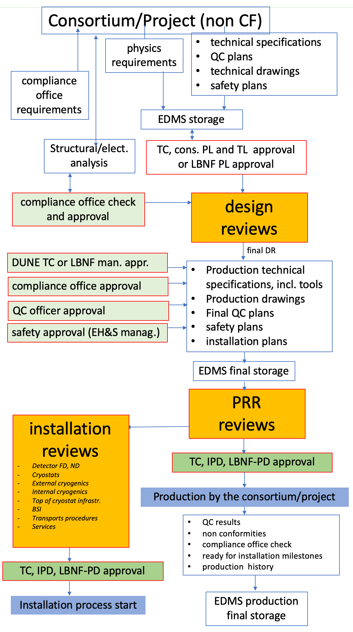
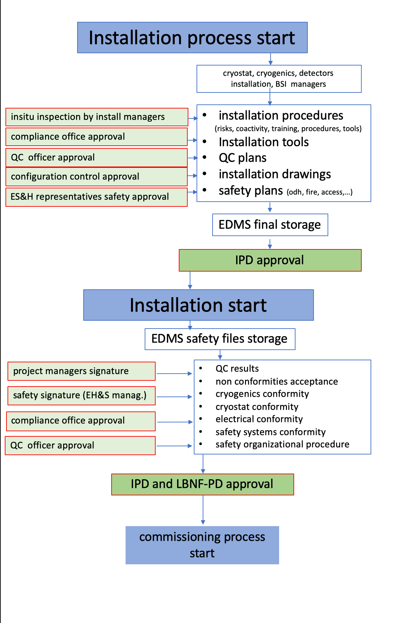
The Compliance is part of the approval process at various stage of the project.
This is done in agreement with the main project sign-off strategy.
The CO defines what is required to get the CO approval all along the project life-time ( content, milestones and responsibilities).

Slide 12
EDMS – Compliance Office

Slide 13
Conclusion
We are now starting quite intensively …
Even if we set up requirements .. , we also actively participate to the projects and we try to help you solving issues when any.
We are here to help you and make sure that your equipment is safe and fulfill DOE requirements.
We will accompany the projects all along their life-time up from design to operation.
Don’t hesitate to contact us and implicate us, this will make the process much efficient and easier.
Tell us what you need !!!

