Slide 1
LBNF/DUNE Installation Workshop, 2-4 February 2020
Logistics Planning Overview
Ladia Jakubec, Joe Pygott, and Patrick Weber
SDSD
Kartause Ittingen, February 2, 2020

Slide 2
Project Logistics Phases & Responsibilities
PHASE 2 & 3 FOCUS OF THIS PRESENTATION

Slide 3
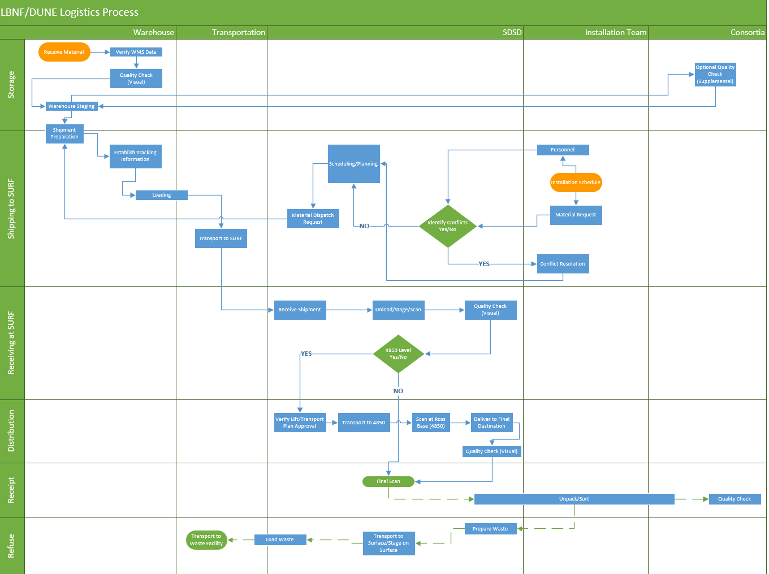

Slide 4
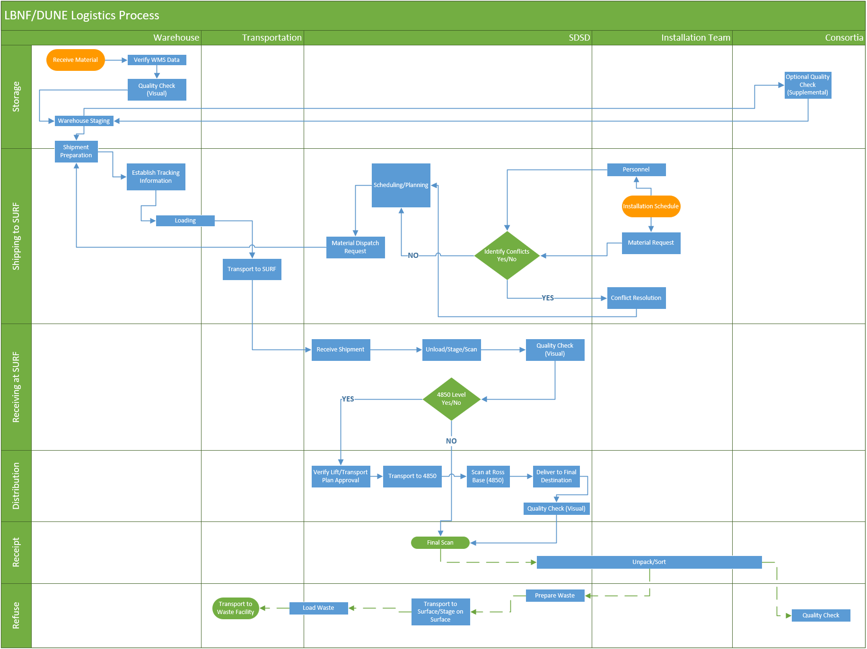
Storage
General
  Warehouse in SD will be primary staging area for all FS activities.
  A warehouse management system (WMS) will be required by the RFP.
  This system will be informed by load list information provided by members of the consortia or consortia.
  The smallest unit of the database will be the packages – WMS will not track individual parts.
Quality
  The warehouse will provide a basic visual check of the packages for obvious visual defects.
  Supplemental quality checks need to be defined – we will need to include information about access for these in the warehouse RFP.
    Physical modifications to the facility will likely not be possible.
    Cleanroom will not be available.

Slide 5
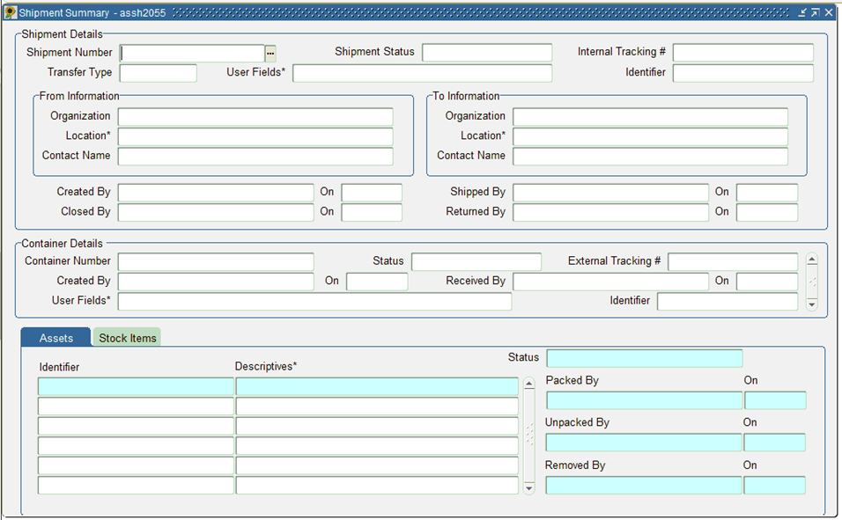
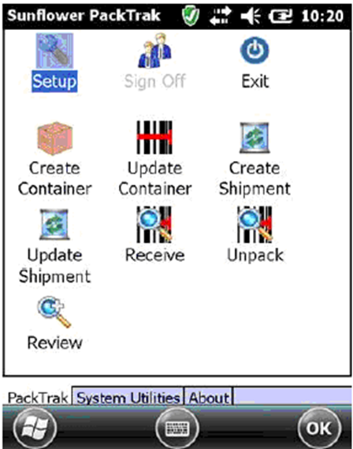
Storage
Utilize Fermilab’s existing inventory control software – Sunflower
  Cost effective
  Use existing expertise & support
Track shipments/containers/assets
Scanners will be used for Receipt and Inventory Management
Sunflower will be populated with data from Warehouse Management System
SURF
  Ross Shaft surface receipt (scan): SDSD
  Ross Shaft 4850 receipt (scan): SDSD
  Cavern or CUC receipt (scan): SDSD / Integration Team
Sunflower data will be exported in a format that other databases can access.

Slide 6
Shipping to SURF
This will be the most critical phase of the far site logistics chain.
The installation schedule will be the primary input into the entire chain and will drive underground personnel availability and material movement requests from the warehouse.
After these requests are received, they will be evaluated for conflicts.
Any conflicts will be resolved by installation management.
Only when material is scheduled for delivery underground will it be sent from the warehouse to SURF.
The orders will be prepared by the warehouse and transported by the trucking contractors to SURF.
Movement of material and personnel down the shaft is dictated by the assumed transport times.
The warehouse management system will export data to the logistics database (Sunflower).

Slide 7
Action Item: 81933
Rigging - get feedback from CERN and others to get a feel for the real times of rigging and delivery down shaft for large items, including rigging test
Basic rigging and transportation times as discussed with SDSTA:

Slide 8
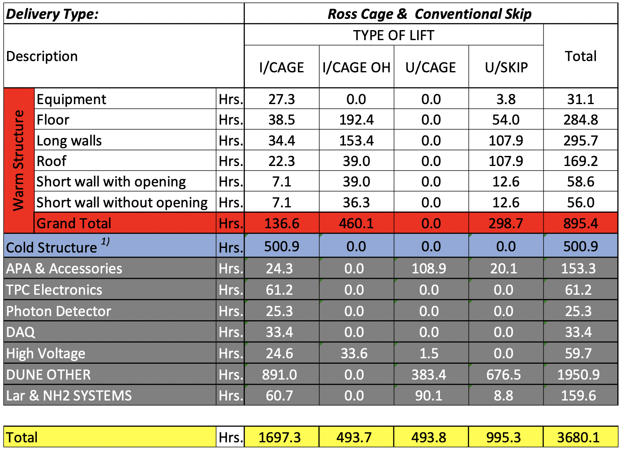
Action Items: 81901 & 81913
Evaluate shaft usage w/ CF + steel; floor first / SDSD - identify which items are slung loads & need guide shoes
Evaluated LBNF Warm and Cold Structure Lists as to rigging requirements against the cage and shaft design parameters.
Developed time requirements based on preliminary basic shaft operation data.
The DUNE Lists analysis followed the same methodology.
This is based on the list from each consortia and all integration activities.
The Cryogenic LAr and NH2 systems are based on preliminary estimates.
Specifically derived time requirements for the updated Post CF logistics plan.
Required Transportation Time-Table by Materials Group:

Slide 9
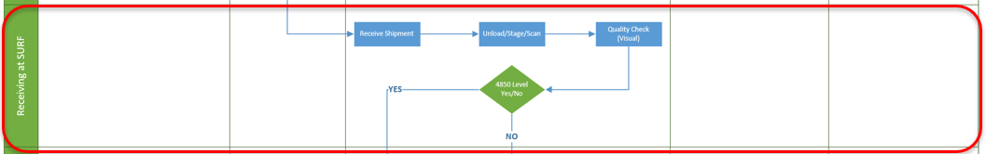
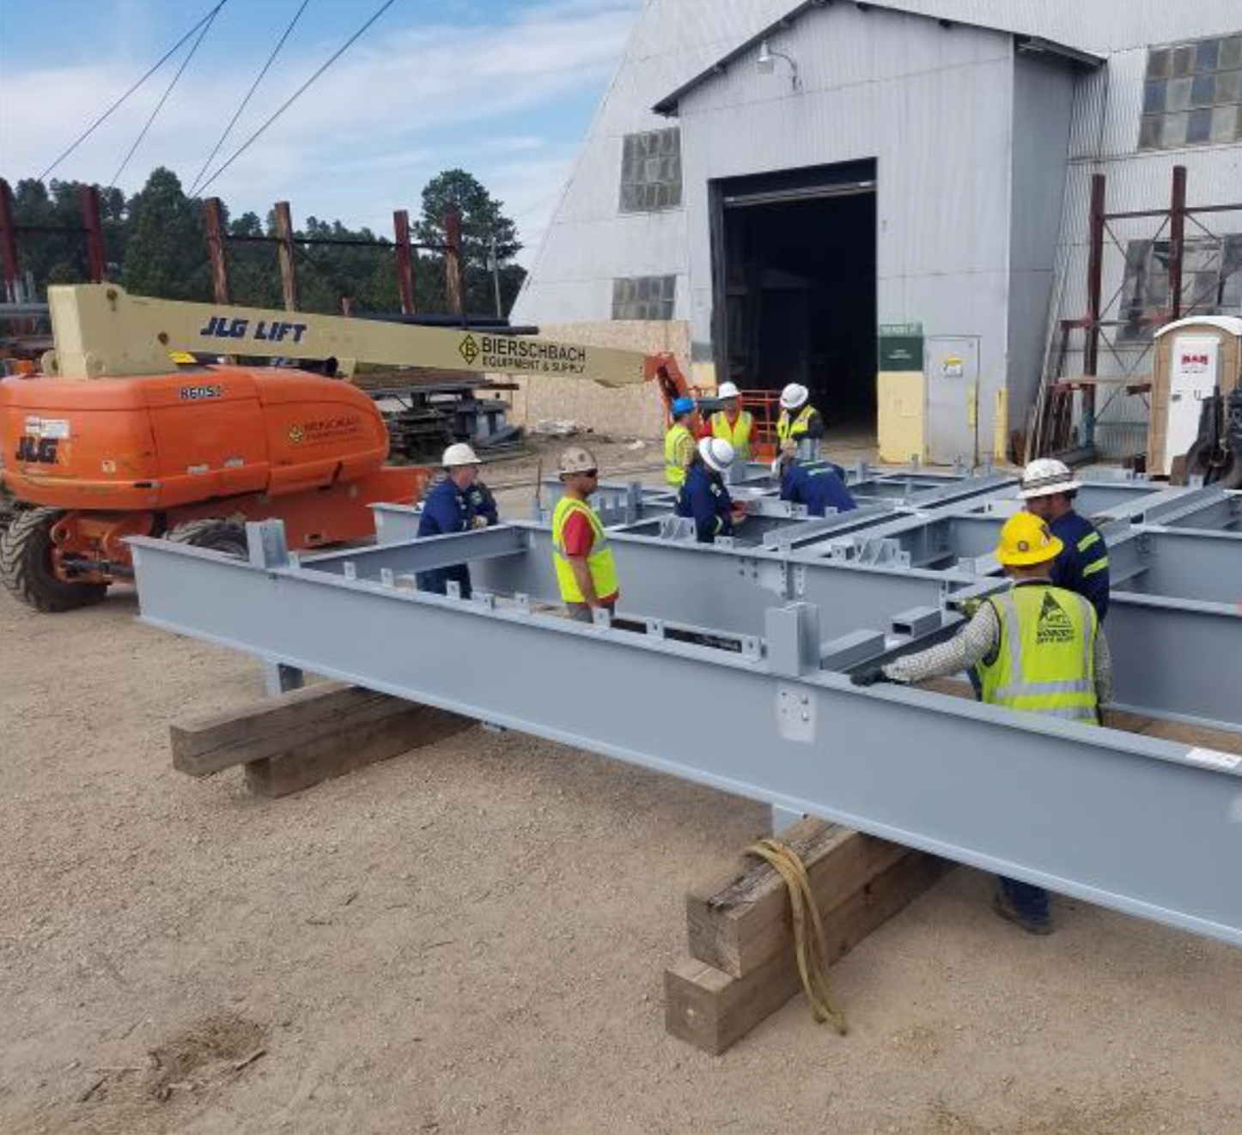
Receiving at SURF
Items that arrive at SURF will be scanned and then their location will be updated in the logistics database (Sunflower).
Items will be given a visual inspection to check for damage.
Damaged boxes will undergo further inspection and if necessary, be returned to the warehouse.
A small amount of space in headframe will be used to stage items for movement underground.

Slide 10
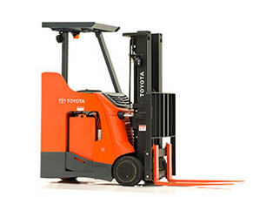
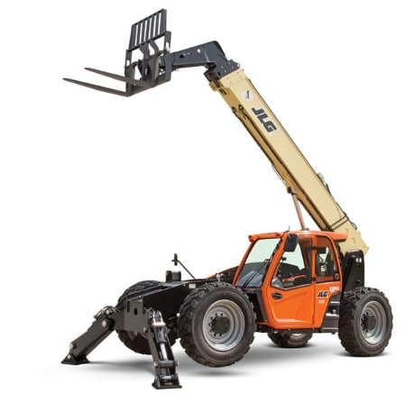
Distribution
Verify Lift/Transport Plans (SDSD)
  Should be developed and approved well before this point
Transport to 4850
Material will receive Scan at Ross base (SDSD)
Delivery to final destination (SDSD)
    North Cavern
    South Cavern
    CUC
Visual Quality Check (SDSD)

Slide 11
Action Item: 81912
SDSD - develop template for information needed for material handling in Ross Headframe, through shaft, through drifts to cavern
The Check Sheet must be completed for any loads that require rigging. This checklist must be received by the time the item arrives at the SDWF. SDSD and ESH will review to create a specific lifting plan.

Slide 12
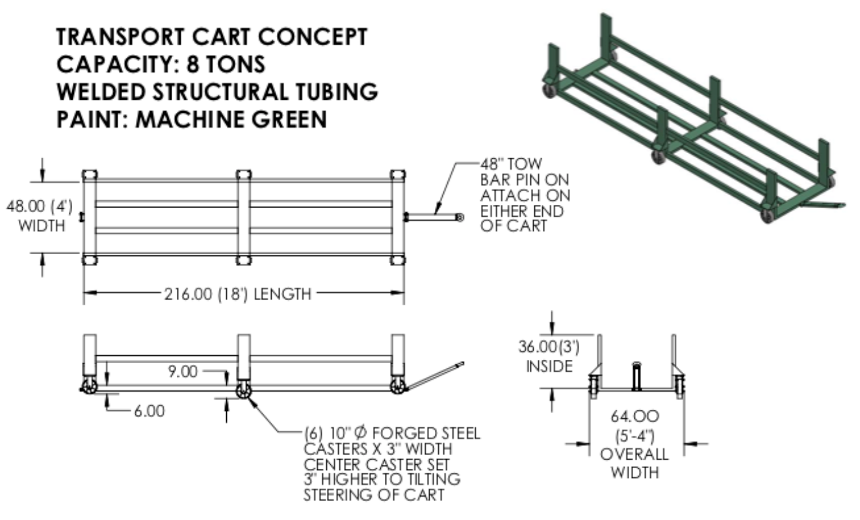
Action Item: 81914
SDSD - establish the specifications of the transport cart based on largest objects (L cryostat pieces, APAs)
  Design Specifications:
  Weight Max: 8 mt
  Material Height Max: 5.498 m
  Floor Height Cart Max: 0.202 m (resulting in 0.19 m space under ceiling)
  Drift floor incline: 1.98 deg
  Maneuverability: 360 degrees pivot

Slide 13
Receipt
Material will receive final scan by integration personnel at point of final delivery
  Surface
  4850
    North Cavern
    South Cavern
    CUC
Unpack and Sort Material (SDSD, Installation Team, Consortia)
  Will need to identify staging areas for certain materials
Detailed quality checks (Consortia)

Slide 14
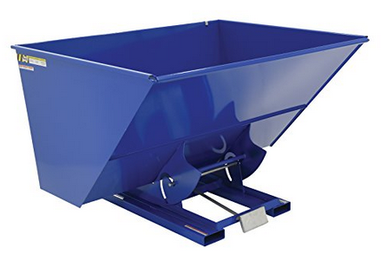
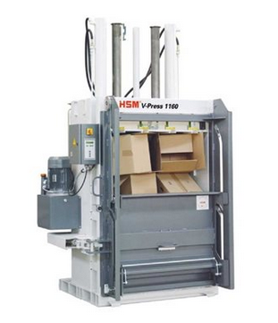
Refuse
Types of Packaging
  Wood
  Cardboard
  Plastic
  Other?
Prepare waste at 4850 (SDSD)
Shaft scheduling (SDSD)
  Cage times account for refuse loading at the 4850 and unloading at the headframe.
Utilize shipping transport to haul waste away from SURF (SDSD)

Slide 15
SDWF & SURF QA/QC Functions
South Dakota Warehouse Facility
  Warehouse Personnel – visual check for obvious packaging damages only
  Consortia QA/QC specifications need to be advised as soon as possible to be incorporated into RFP:
    Frequency
    Personnel number
    Space and Equipment requirement
SURF Headframe Surface
  SDSTA/Rigging Personnel – visual check for damages (return to SDWF for investigation/resolution)
Caverns & CUC
  SDSD visual inspection
  Consortia Personnel – according to consortia needs

Slide 16
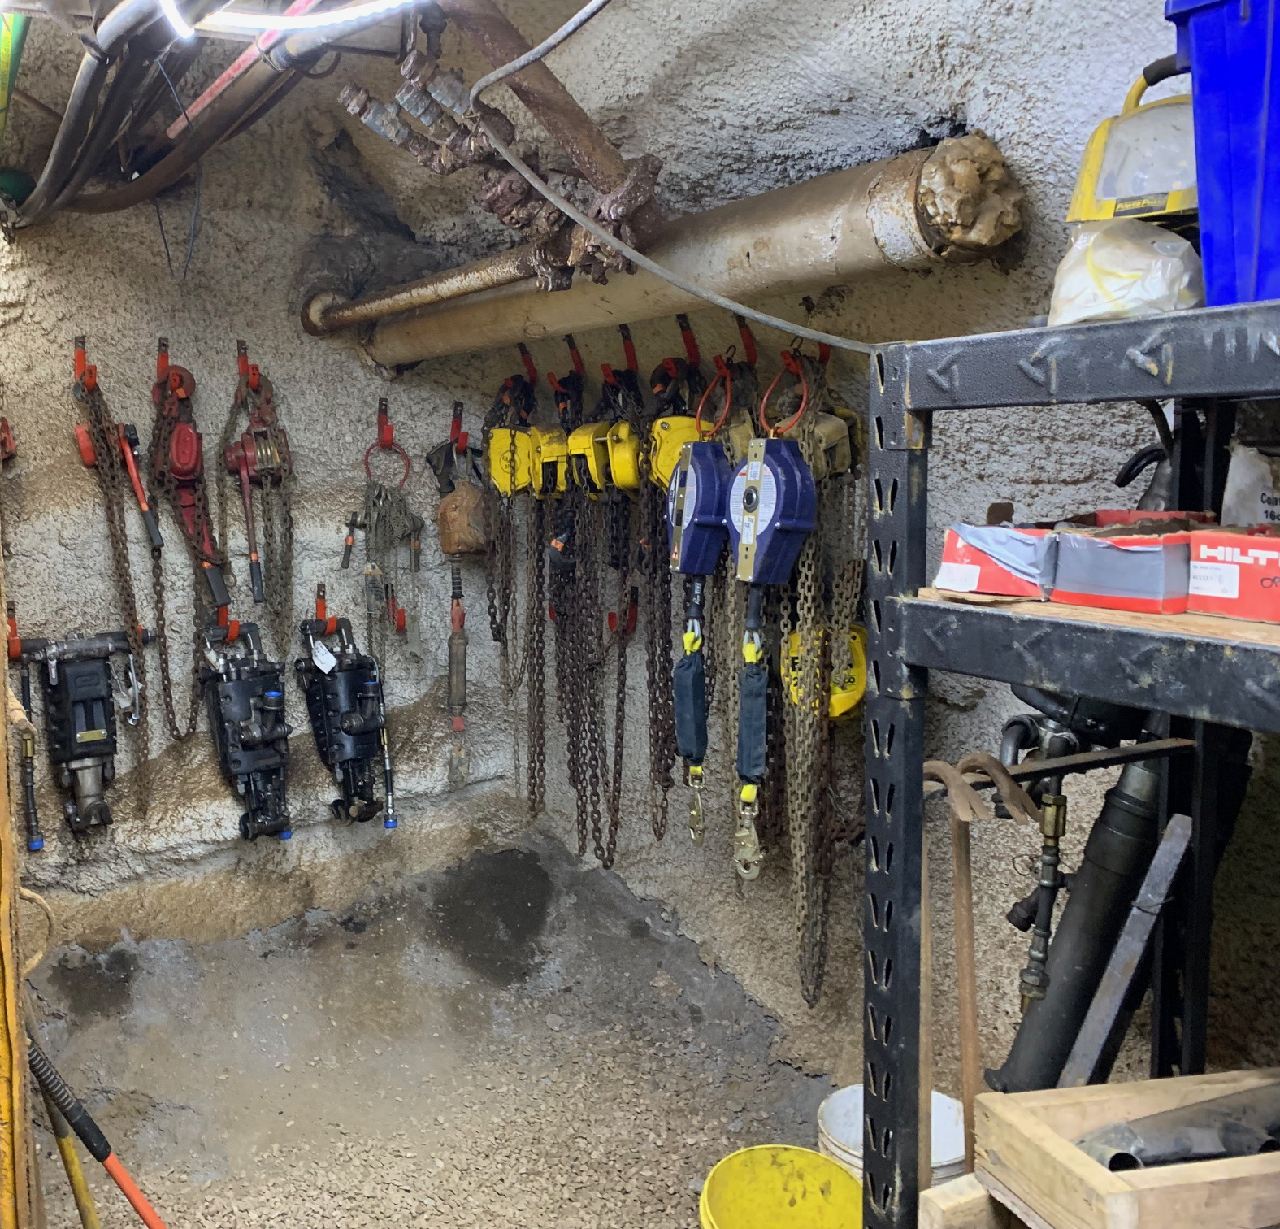
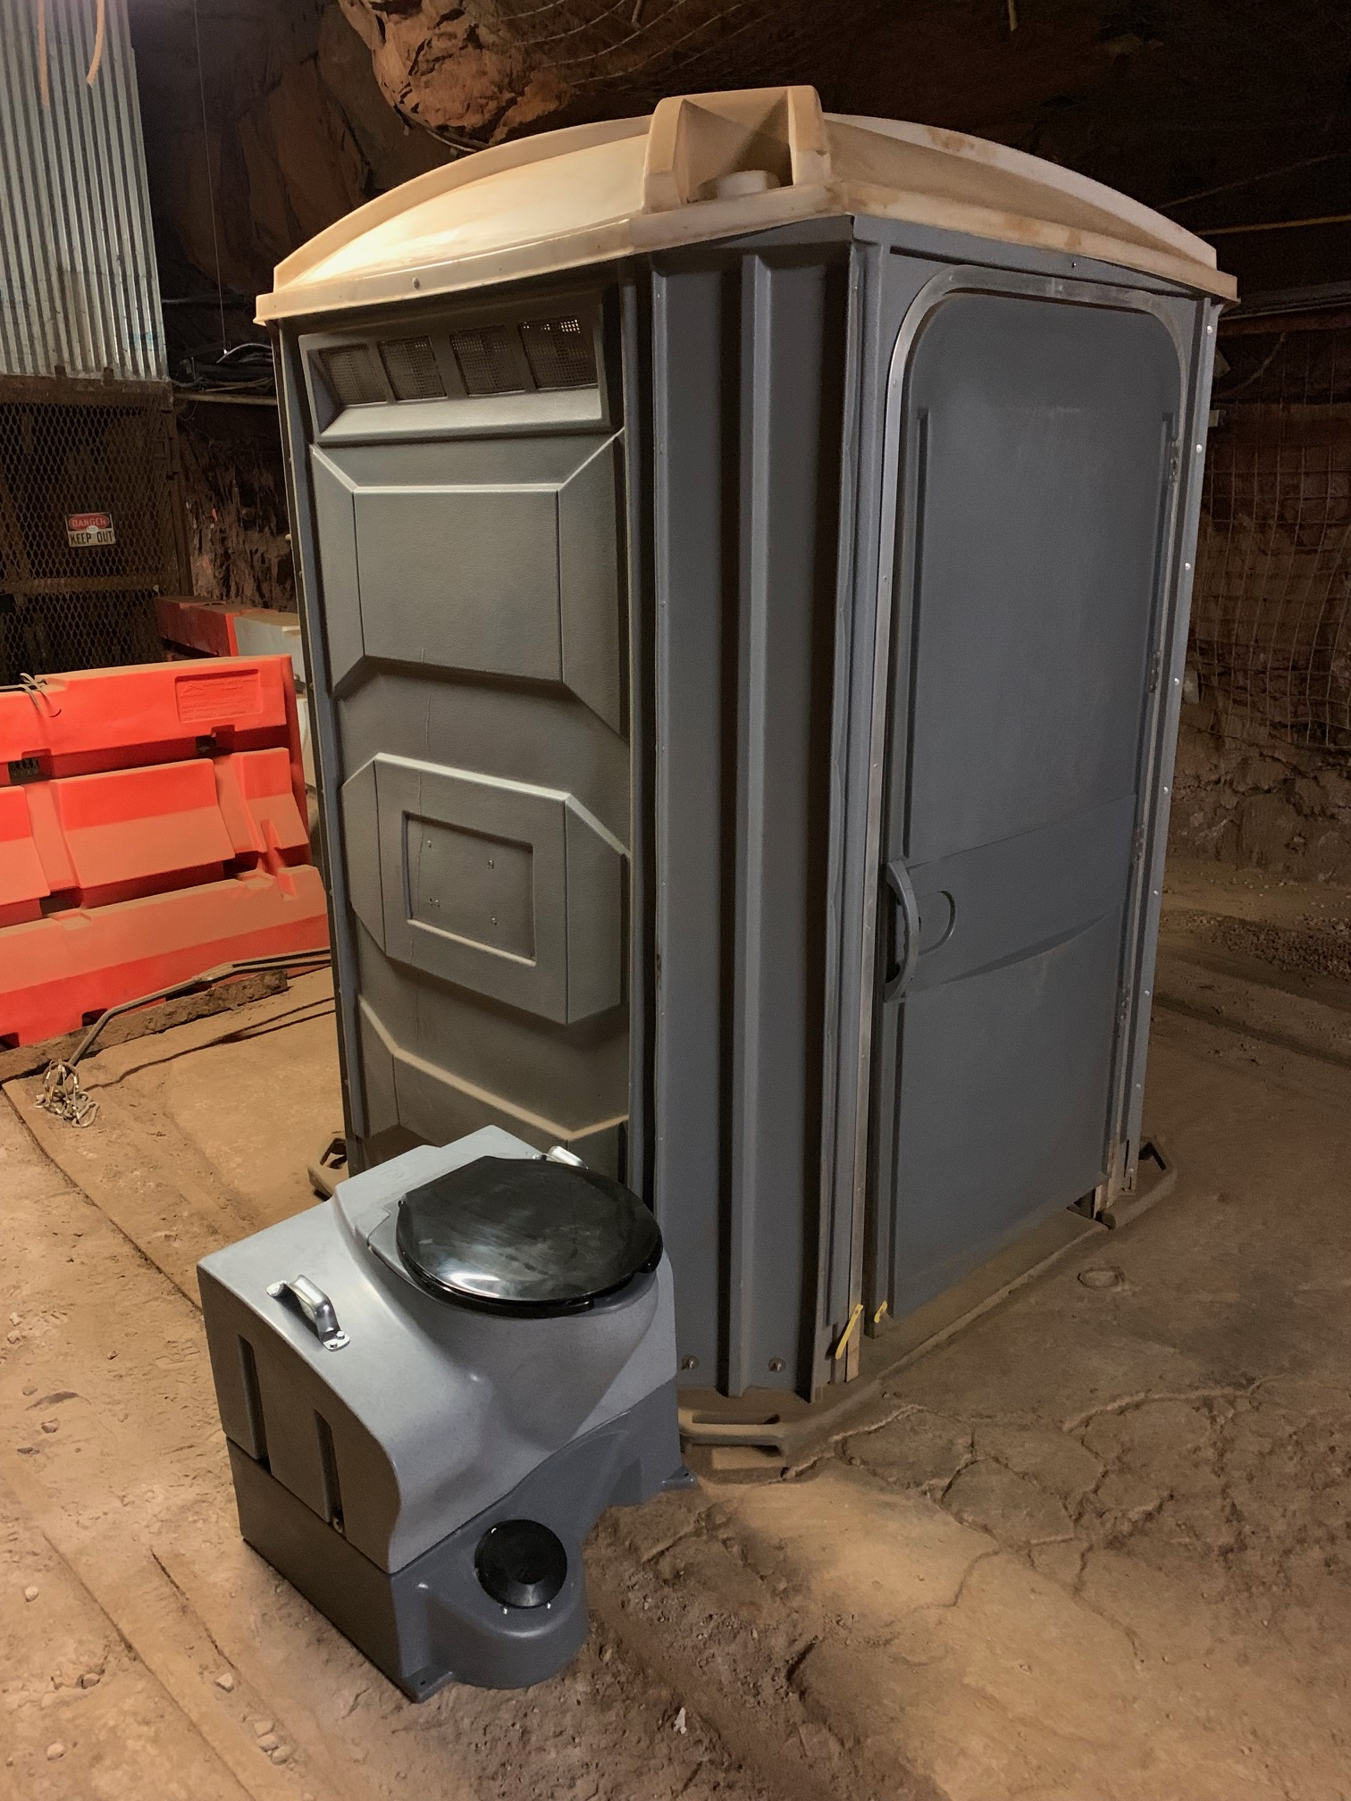
Other Logistical Items
Movement of equipment
  Forklifts
  Carts
Placement of Accommodations
  Toilets
  Handwashing Stations
  Tables/Chairs (break area)
  Storage
    Tools
    Personal Belongings
  Temp Office/Computing
Material Staging

Slide 17
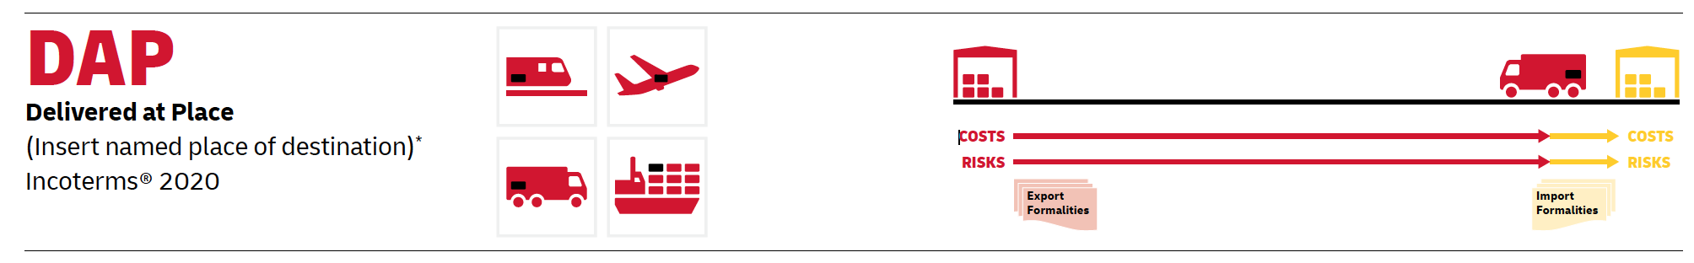
Action Item: 81929
Clarify incoterms. Clarify customs broker payment / arrangement with freight forwarder, FNAL. Who pays customs broker? Informational summary about freight forwarder role
INCOTERMS 2020: Selection based on current delivery practice to FNAL for foreign contributions.
Import Fees borne by FNAL based on above Incoterms
Applicable to Ocean Freight Only:
US Import Fees:
  Freight Forwarder/Customs Broker Charges
  Importer Security Filing (ISF) $25
    Applicable per shipment (Bill of Lading)
    Applicable at US ports of entry only
  Customs Brokerage $125
  Document Transfer Fee ~$95 (from outside freight forwarder)
  Wharfage (Gulf ports only)
  Destination Terminal Handling Charge (DTHC)
  Chassis Fee $35 – 40/container per day
  Airport Terminal Fee $105 (air freight only) (destination airport)
Customs Charges:
  Merchandise processing fee lesser of $500 or 0.3464% imported value
  Duties (if applicable, depending on HTS code)
  Harbor maintenance 0.125% (only if first port of calling US)
Shipping manual is still in progress.
All shipments must be coordinated with Fermilab to have import fees paid.

