Slide 1
Slow Control Architecture Strategy
G. Lehmann Miotto
FS Integration/Installation Planning
February 2nd 2020

Slide 2
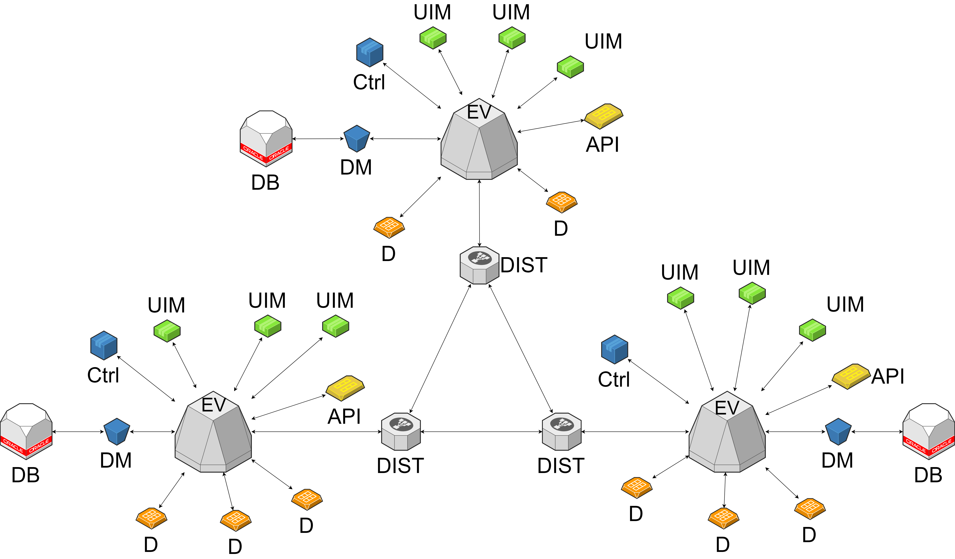
Slow control architecture
Usual industrial control layering

Slide 3
Slow control architecture
If possible and sufficiently safe, base all user interfaces on web technologies
  Client authentication & authorization
    Role based access control
  Web server behind firewall with reverse proxy?
Distributed system
  Independently develop projects for different sub-components
    Support distributed developers community
  Be able to combine sub-projects into one overall control system
    The final user doesn’t need to see how the system was built, but rather have a central view on the experiment

Slide 4
SC working group in DUNE
The SC is organized as one of the working groups within the DAQ/SC consortium
At present there are no resources to develop a SCADA system
  Choose a commercial tool with clear licensing/support model
  Epics remains an option, if dedicated resources are committed
Two solutions are being considered
  WinCC OA -> used in ProtoDUNE, large software/tools base and expertise available at CERN (and in the HEP community through all LHC experiments); linked to other large science projects with similar timescales
  Ignition -> used at SURF for LZ experiment, being considered by cryogenics group for DUNE

Slide 5
Towards a SW choice
NP04 cold-box control system being re-implemented using Ignition as a first training
  Connection to power supplies (OPC UA) worked seamlessly
  Attempting to connection to PLC exposed a bug in the communication (!)
    Still, good response from support team experienced and work-around provided
If successful, aim at implementing NP04 control system on Ignition and start getting a more realistic feeling for scalability, data archival, multi-client access, ….
  Test web based WinCC OA interface, to compare systems at the same level
Continue discussions with companies to understand licensing model
Continue collaboration with DUNE cryogenics control experts in order to share studies and preferences
Make the final decision at the latest after ProtoDUNE II
  This is quite late, but feasible, if in the meantime we have a clear inventory of devices to support, control logics to implement and ways of representing the whole of DUNE effectively.

Slide 6
DUNE SC dimensions per module
Preliminary estimate: ~1500 network endpoints
  ~60x 1G/10G 48-ports switches/routers
  Part of those network links is shared with DAQ control (CE/PD)
1 redundant 100G uplink to surface
< 10 servers for data collection, processing, archiving
Number of PLCs and/or FPGAs for interlocks and control logics to be defined, but should be O(10)
  Interfaces to cryogenics instrumentation and calibration to be better clarified
  Interconnections with cryogenics and general safety to be understood
Data points to readout/monitor/archive O(300k)

Slide 7
A word on costing
There are almost no material costs specified for SC in the WBS
  Network (devices + connectivity) is a non negligible cost -> facility?
  Underground servers were costed and are covered by DAQ
  Database hardware/administration not costed and probably not negligible
  Logic control not costed -> still need more detail to understand how much would be needed
  No license costs included (+support in M&O?)
    My personal estimate per module ~200k + 20% annual support
  To date, no commitment from any institution for funding the SC

Slide 8
SC underground distribution
network + timing uplinks
to network room -> surface
network uplinks
Cryostat top
SC servers;
bulk SC network
Note:
It makes sense to
put networking equipment in the DAQ barrack, that is cooled.
This corresponds to 2 racks and ~10 kW
Power supplies,
cryogenics
instrumentation,
calibration devices,
control logic and
interlocks;
few concentrator
switches
DAQ
…
Detector mezzanine
Cryo mezzanine

Slide 9
Installation plan
SC main servers on surface installed first (like surface DAQ)
  Allows to setup archive and general SCADA sw
Local stations + network devices installed in DAQ barrack with DAQ
  Fibers routing paths to be defined
Installation timeline has to be mapped to the needs of first power supplies and electronics installation
  Are all power supplies installed in one go?
  This is preferable for the SC, even if they are not all connected to their endpoints
  A lot of development will actually occur during installation and commissioning
    May be avoidable, in theory, but is unlikely to happen

Slide 10
Summary
The slow control concept for DUNE is still in an embryonic phase
  We start understanding where SC equipment can be located
We know how to structure a large supervisory system
  2 commercial tools are candidate solutions and are being evaluated
  Know-how for user interfaces development is mandatory
Interfaces definition (and endpoint counts) with the consortia are progressing, but not complete
  Biggest uncertainty related to CALCI
Interfaces with facility to be refined
While SC is surely not a cost driver for the experiment, it still requires funding, which at the moment is neither well defined nor covered
  Work on WBS aiming to have a first pass by end of February

