Slide 1

Review Office
Steve Kettell
LBNF/DUNE Installation Retreat
2−4 February 2020

Slide 2
What is the Review Office
Integration Project Office
https://edms.cern.ch/document/2173197/LAST_RELEASED
The Review Office is part of the Joint Project Office and reports to the Project Integration Director.
Mechanical Integration
Reviews organized by the Review Office
Final Design Review (FDR)
Production Readiness Review (PPR)
Installation Readiness Review (IRR)
Operations Readiness Review (ORR)
+ progress reviews
Electrical Integration
Compliance office
Review office draws from all of IPO
The Review Office works with the DUNE TC, LBNF PM and DUNE Consortia leadership teams to organize reviews and the followup to those reviews… FDR recommendations must be signed off by the Review Office before proceeding to a PRR. Before significant funds can be obligated for production purchases, the DUNE TC or LBNF PM will verify that PRR recommendations have been signed off by the Review Office.
Review office
Schedule office
QC librarian/EDMS
FS detectors installation
NS detectors installation

Slide 3
Who is the Review Office
The Review Office members consist of
Steve Kettell
Sam Zeller
Philippe Farthouat
We rely heavily on and coordinate closely with the entire integration team:
Systems Engineering
Compliance Office (CO)
Quality Assurance
ES&H
Coordinate closely with CO on mechanical and electrical design safety (EDMS-204072)
We draw on scientific and technical personnel within and from outside the collaboration
We work closely with consortia and LBNF subsystems managers.
We have accomplished quite a few reviews for ProtoDUNE and have now initiated several Preliminary Design Reviews for LBNF and for DUNE.
We expect to move to the first FDRs and PRRs this year.
Our mandate is for full system FDR, PRR, IRR and ORR; but if you want us to help organize other reviews, please let us know ⎯ we have been doing many PDRs for example

Slide 4
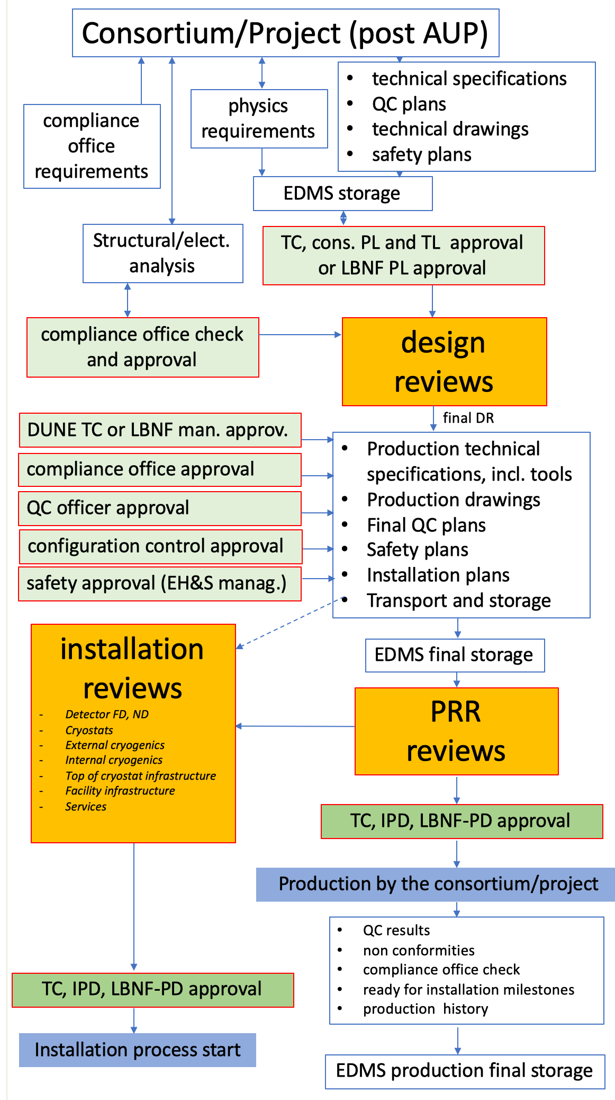
Overall review process
Verify requirements
Insure engineering design safety via CO
Verify model and drawings
Verify interfaces
Update manufacturing plans, QC plans, installation plans, safety plans
Review schedule, risks resources

Slide 5
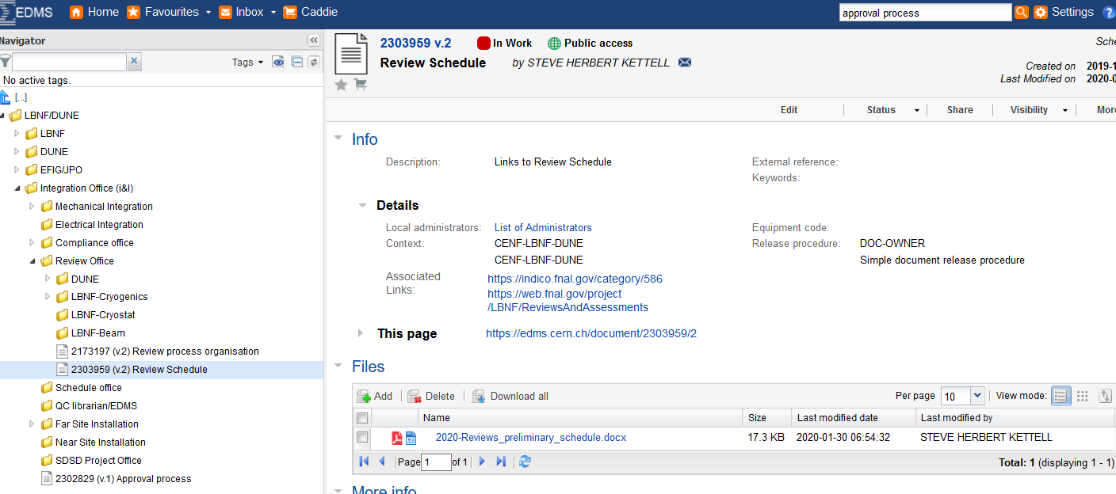
Review schedule
https://edms.cern.ch/document/2303959

Slide 6
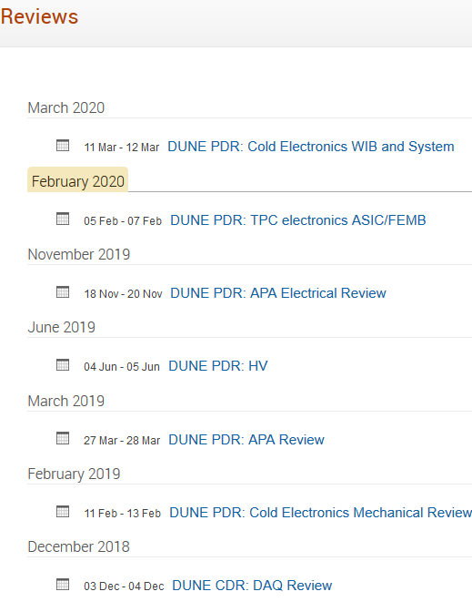
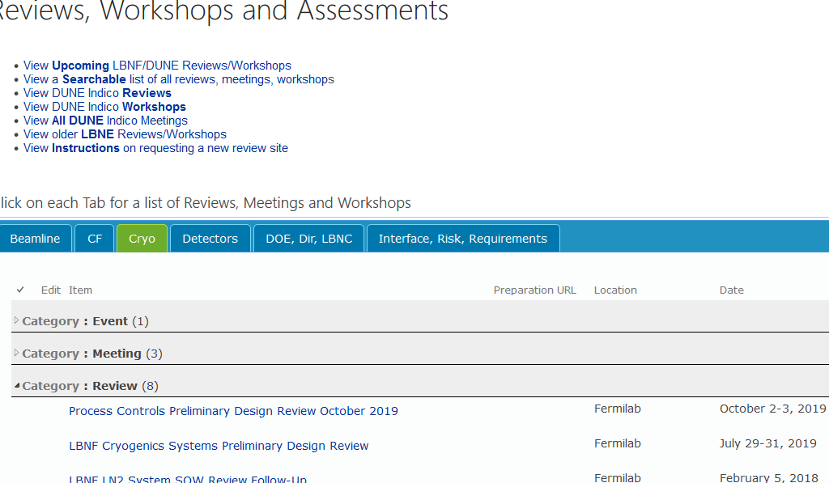
Past Reviews
DUNE & ProtoDUNE
LBNF: Beam, Cryogenics, Cryostat
https://indico.fnal.gov/category/586
https://web.fnal.gov/project/LBNF/ReviewsAndAssessments/SitePages/Reviews,%20Workshops,%20Meetings.aspx

Slide 7
Current Schedule of Reviews
Cold Electronics ASIC/FEMB Review at CERN (February 5-7)
Proton beam transport optics FDR at FNAL (February 24)
Far Site I&I Review at FNAL (February 27)
LBNC Meeting at FNAL (March 4-6)
Cold Electronics Systems Review at BNL (March 10-11)
APA Shipping Box Review at Liverpool (~April 24)
Cryogenics PDR KLOE/MPD at FNAL (April)
Cryogenics PDR LAr-ND at FNAL (April)
LBNF/DUNE Director’s Review at FNAL (April 28 – May 1)
DSS Review at CERN (May 11-12)
HV System Review at CERN (May 13-14)
PD System Review at FNAL (May 27-28)
APA Final Design Review (June/July)
DOE IPR at FNAL (July 14-17)
LBNC Meeting at FNAL (July 15-17)
Post AUP facility needs review (August 2020)
Calibration Design Review (September 2020?)
Cryogenic Instrumentation Design Review (September 2020?)
APA PRR (~October 2020)
HV FDR (December 2020)
CE FDR (February 2021)
PD FDR (Feb 2021)
DAQ preliminary Design Review (April 2021)
Cryostat Readiness Review (April 2021)
DAQ FDR (April 2022)
Confirmed Reviews
Tentative (estimated) Review
External events
What are we missing? What else do we need to fit in?
Do we need to change any of these proposed dates?
https://edms.cern.ch/document/2303959

Slide 8
Preliminary Design Review deliverables
Design choice identified
Design in accordance with detector requirements
Detail engineering drawings, schematics, models, interface drawings and preliminary parts list
Interface documentation review with other systems
Engineering analyses and documentation
Installation and testing plans
Incorporation of ProtoDUNE & other prototyping lessons learned
Finalization of applicable design codes and standards
Manufacturing methods and acquisition strategy
Plans for production and evaluation of prototypes
Draft manufacturing, quality assurance, testing and procurement plans
Installation plans including special tools and fixtures
Preliminary cost and schedule estimate
Value engineering exercise
Resolution of TDR or relevant ProtoDUNE review recommendations

Slide 9
Final Design Review deliverables
Approved system requirements
Complete manufacturing drawings, schematics, and specifications
Engineering and safety analysis reports including calculations related to the design
Procurement specifications
Interface drawings and documents
Production site plans for all production sites
Evaluation of prototypes and design modifications
Final quality assurance plan and quality control tools
Final cost and schedule estimate
Related risks and mitigations
List of deliverables to the installation sites (Parts Breakdown Structure)
Resolution of PDR recommendations
Installation plans, schedules, procedures as understood at the time, to assess the adequacy of design related to installation.

Slide 10
Production Readiness Review deliverables
Validation of a “module-0” is expected as input to a PRR.
Final QA plans
Final list of deliverables and Parts Breakdown Structure (PBS)
Final production drawings, specifications and manufacturing and test procedures
Final assembly drawings, where applicable
Final safety documents (i.e., Hazard Analysis documentation and engineering final safety reports)
Component QC plan (i.e., travellers, test plans and reports, software verification and validation documents, supplier documentation)
Final procurement documents per institution practice,
Completion and evaluation of prototypes, review of production process and QC results
Resolution of FDR recommendations
Acquisition Plan and Advanced Procurement Plan packages as required
RFIs, RFPs and RFQs
Total estimated cost and baseline cost estimate
Delivery Schedule, timeframe, total number of calendar days
Specific Roles and Responsibilities
QA and ES&H requirements for purchasing
Risks summary

Slide 11
Review process is critical for our own internal validation (and provide confidence to external stakeholders)
Work with the Review Office to schedule reviews as needed
Check our draft schedule and provide updates
Respond to recommendations
Prepare all documentation in EDMS (with required approvals)

