Slide 1

Schedule Status and Management
Mohammed Elrafih
FS Installation/Integration Planning
2 February 2020

Slide 2
This talk
This talk will explain the schedule and where the projects stands
This talk will, hopefully, not be boring
If you fall asleep please don’t snore too loudly
Please ask questions!
The schedule is the plan to make sure this project happens, you should all be familiar with it
How can you plan your work if you don’t know the plan?

Slide 3
What is P6?
Planning tool
  Plan your work, work your plan
  Planning your work requires a lot of… planning and thought
Resource tracking (labor, M&S)
Can build projects at any detail level
  High level planning or Shutdown level planning
Industry standard for major projects across all industries
Used by Fermilab and all DOE funded laboratories
Not user friendly for beginners
  Requires a lot of patience and practice

Slide 4
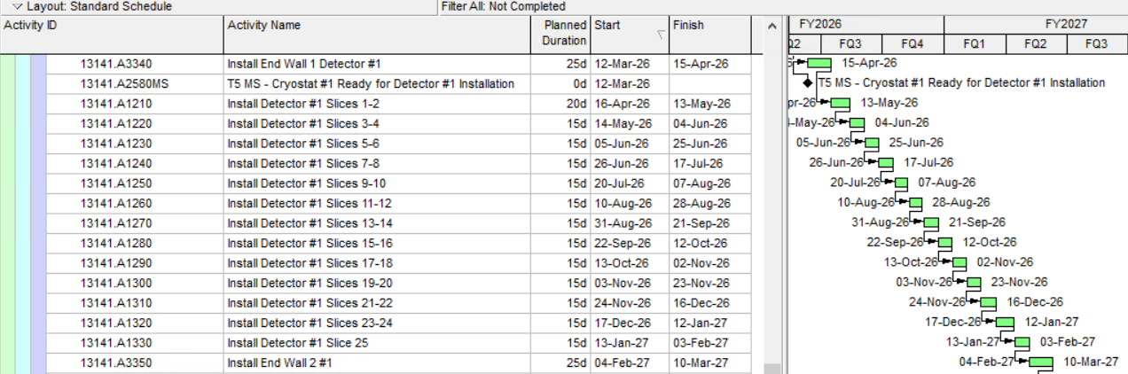
What is P6?
Unique Identifier
Description of Work
Length of Task
Start and Finish
Gantt Chart with Logic Links

Slide 5
Why is the schedule important?
Why do we need it?
  Funding
  Planning your work
  Without it, the project will not happen ← cannot emphasize enough
EVMS tool
  Where budget and status are entered
  Critical path
Not in the plan → not on project → not allowed to happen
  Deviations from the plan need to be tracked and explained, or the plan needs to be changed with enough foresight
  Changing the plan becomes more difficult once baselined
  No more major overhauls allowed once baselined

Slide 6
What the schedule isn’t
Just a deliverable
  A check box item to meet a requirement from your boss
A day to day planning tool
  Activities in your P6 schedule should not be entered at the day to day level. Doing this will make it unmanageable
  Need to find the goldilocks zone of schedule detail
  Too detailed? Not detailed enough? Just right
  Your plan is an estimate, won’t be perfect, can’t predict the future. Your plan will change, must ensure the schedule you built is flexible enough to modify

Slide 7
What the schedule isn’t
Easily changeable
  Modifications to your plan require strict change control with numerous levels of approval
  You can’t change your schedule to correct past errors
  History can never be changed, as well as in-progress activities

Slide 8
Current P6 Schedule
12 P6 Schedules for Far Site and Near Site
  15,934 activities with over 25,000 relationships
  Far Site Integration has 442 activities total
    This is only 2.8% of all activities in LBNF/DUNE
    Is this bad?
  Far Site Integration has 248 activities with no resource assignments
    56% of activities have no resources
    Is this bad?
Far Site Integration is integral to the success of the project
Currently on Far Site critical path
Everything in P6 – nothing in MS Project
← Activity Count not an indicator of schedule quality
← All activities must be resources loaded, otherwise labelled as Schedule Visibility Task (SVT)

Slide 9
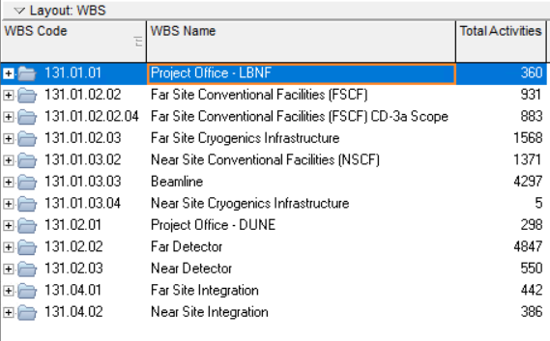
WBS
Full LBNF/DUNE WBS
Items circled in red are Far Site subprojects

Slide 10
Status of Subprojects
Developed & Detailed
Needs more Detail
All subprojects have room for improvement, however the subprojects with green arrows above require a larger effort to get ready for CD-2

Slide 11
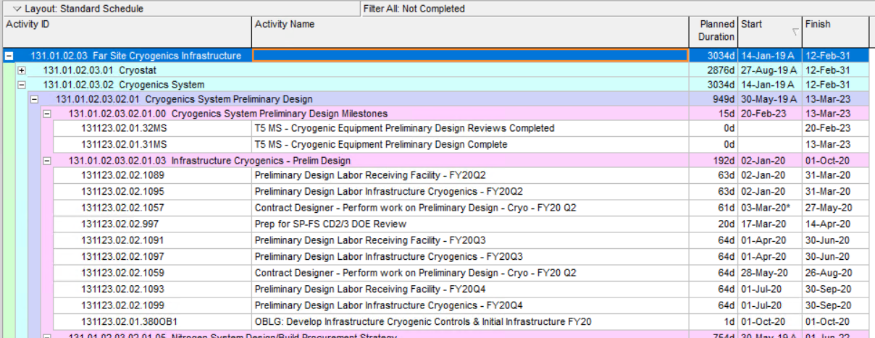
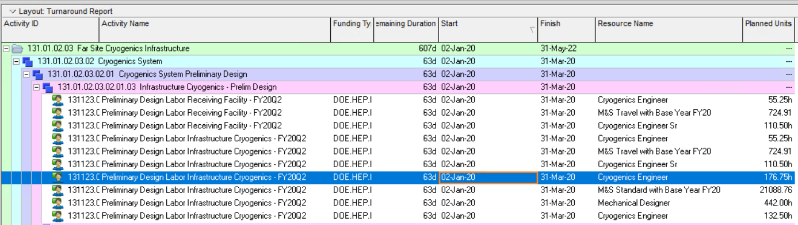
Reporting
P6 is not a secret
Just ask and you shall receive

Slide 12
How it all ties together
FS Excavation
Cryostat #1 Warm Installation
Cryostat #1 Cold Installation
Cryostat #2 Warm Installation
Cryostat #2 Cold Installation
Detector #1 Installation
Detector #1 Close TCO
Far Site CF
Detector #1 Finalize Installation
Detector #1 Manhole Closed / Safety Approvals
Far Site Integration
Far Site Cryo
Detector #1 Purge/Cooldown
Detector #1 Fill
Critical Path to Detector #1 Filling

Slide 13
Ownership of the Schedule
If you are the CAM / Manager you own everything in the WBS
  Activities, Resources, Coding, Relationships, BOEs
  Chargeable task codes (actual costs)
You should build your schedule and understand it completely
  You will be drilled down and asked detailed questions about everything in your WBS
  Reviewers will not be kind, they will try to trip you up and confuse you
  Project controls helps by entering into P6 and generating reports, but you as the owner have to give direction on how to build the schedule
WBS | Title | CAM
131.04.01 | Far Site Integration | P. Weber
131.04.01.01 | FS Integration Project Office | E. James
131.04.01.02 | FS Facility Support & Services | P. Weber
131.04.01.03 | FS Cavern Outfitting | J. Macier
131.04.01.04 | Far Detector Installation | J. Stewart

Slide 14
Fun facts about Switzerland
Switzerland produces the most chocolate in the world
Switzerland is the only country that has a square flag
The Swiss eat more chocolate compared to any other country
Nescafe, the world’s first instant coffee was invented in Switzerland
Switzerland’s Sonnenberg Tunnel is the largest nuclear shelter in the world
Switzerland has more banks than dentists
Switzerland accidentally invaded its neighbor Liechtenstein in 2007

Slide 15
Multiple Schedules
MS Project schedules floating around?
This causes major confusion to DOE and reviewers
Are we telling a consistent story?
Need to ensure all schedules are talking and are in sync
  Activity Durations
  Logic
  Resources / Manpower / M&S
MS Project schedules can be used for your own detailed tracking, however your schedule must be completely consistent with the official P6 schedule

Slide 16
What’s missing from our schedule
Ash River activities (underdeveloped and no owner)
ProtoDUNE 2 activities (non existent – no owner)
Resource loaded activities for FSI (requires detailed discussions)
DAQ NSF & UK Work
Consortia Milestones, Activities, Resources
Anything other gaps?

Slide 17
How to get the schedule ready for CD-2
Fully resource loaded activities for all schedules
Schedules must be logically linked together – no open ends
Fully compliant with EVMS guidelines
All gaps filled from previous slide
  Need to set up meetings / additional workshops
Practice Baselining starting imminently
FSI schedule frozen Feb 14th for internal review
All schedules frozen after Feb status for April IPR

Slide 18
Summary
P6 is a planning tool to plan your work and resources
CAMs must be ready for baselining, drill downs, and must own their schedules
All schedules must be in sync
Need to fill in gaps in schedule
CD-2 is coming up and we need to be ready for it
Project Controls is here to help, don’t hesitate to ask!

Slide 19
Questions?

Slide 20
Additional Slides

Slide 21
EVMS Crash Course
Traditional cost management tracked Planned Cost vs Actual Costs
Positive value indicates an underrun
  Suggests a healthy project
  Expectation the project will be completed under-budget
Negative value indicates an overrun
  Suggests performance issues
  Expectation the project will be completed over-budget

Slide 22
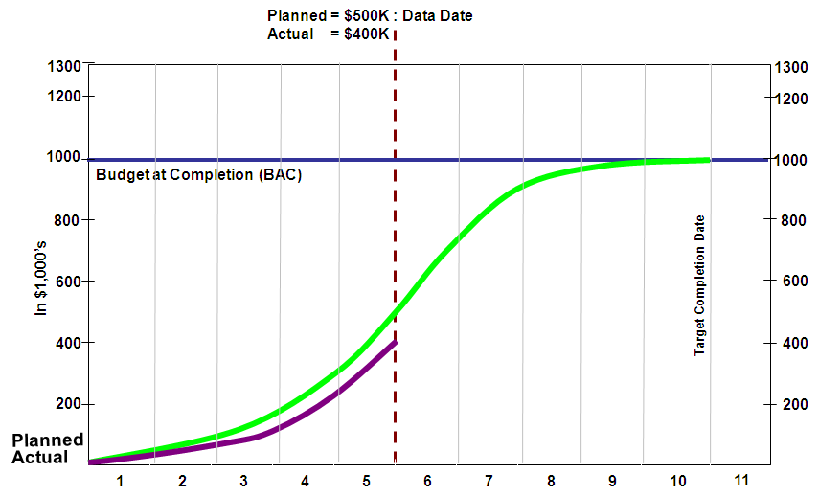
EVMS Crash Course
Example indicates a performance underrun: $500K - $400K = $100K

Slide 23
EVMS Crash Course
New component not found in traditional evaluation process – Earned Value
  Measure of work actually performed
  % Complete x Budget at Completion = Earned Value
Comparing Earned Value to other components derives variances
  Earned Value - Actual = Cost Variance
  Earned Value - Planned Value = Schedule Variance
  Positive variances indicate healthy performance
  Negative variances indicate performance issues

Slide 24
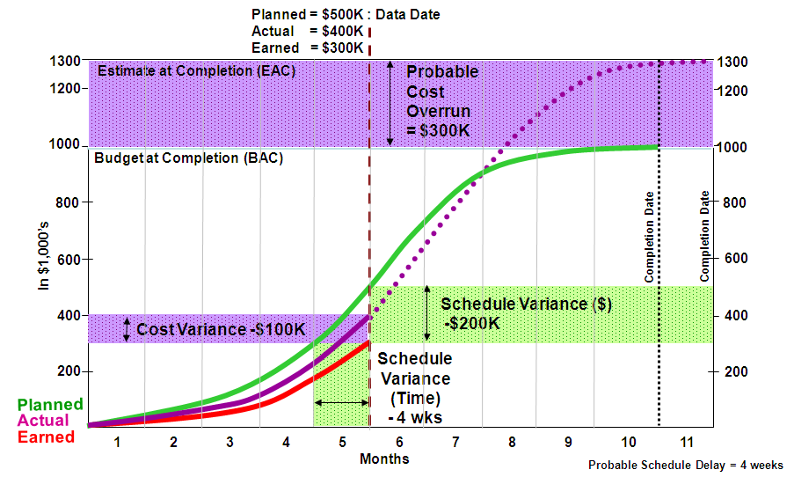
EVMS Crash Course

