Slide 1
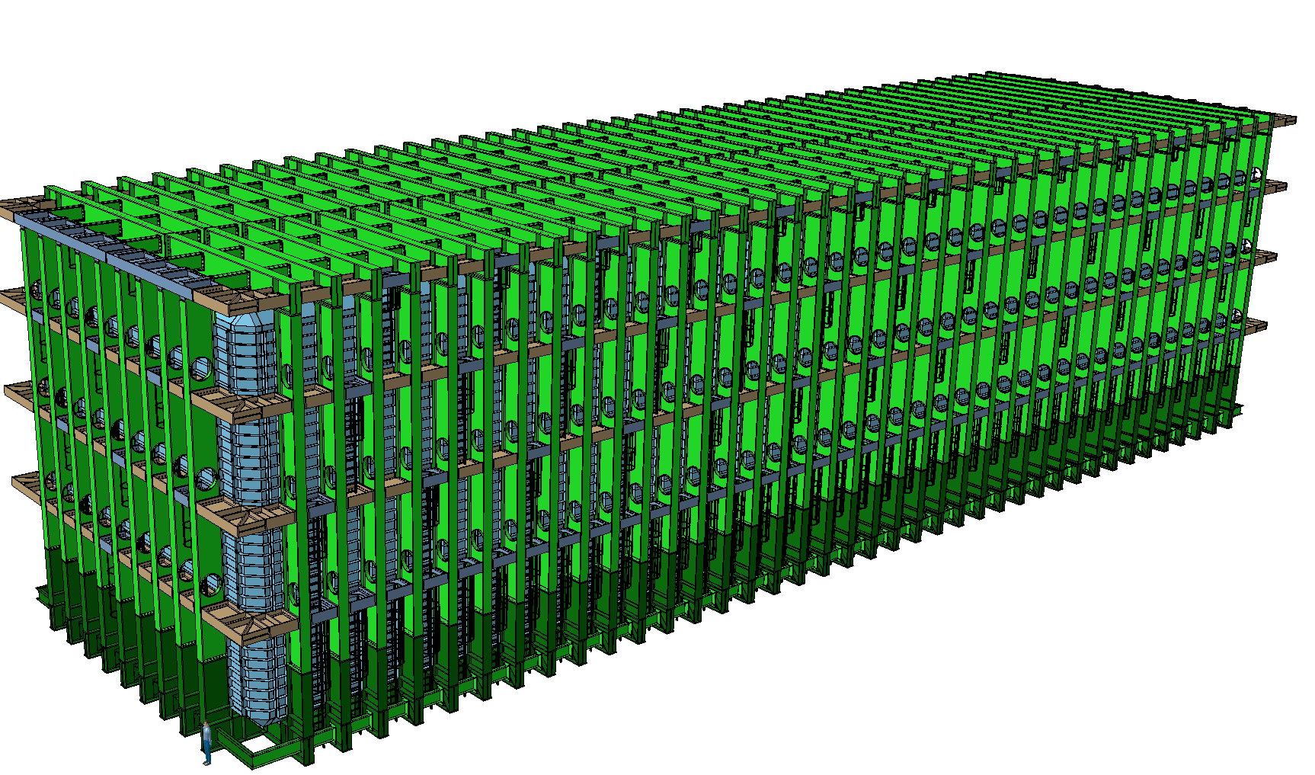
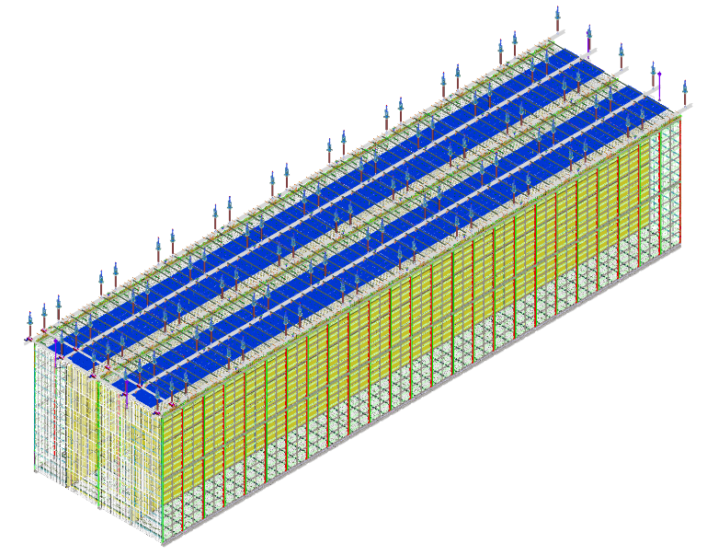


LBNF – DSS Integration & Scope
Dimitar MLADENOV & The entire CERN Team
FS Integration/Installation Planning
Kartause Ittingen, 02-04 January 2020

Slide 2
Outline
Design Updates to the structural elements
Design Updates to the Interfaces
Installation and operation scenario updates
To be decided:
  Clear definition of interfaces responsibilities
  Clear definition of main elements responsibility
  Clear definition of the word “responsibility”

Slide 3
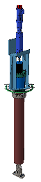
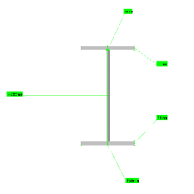
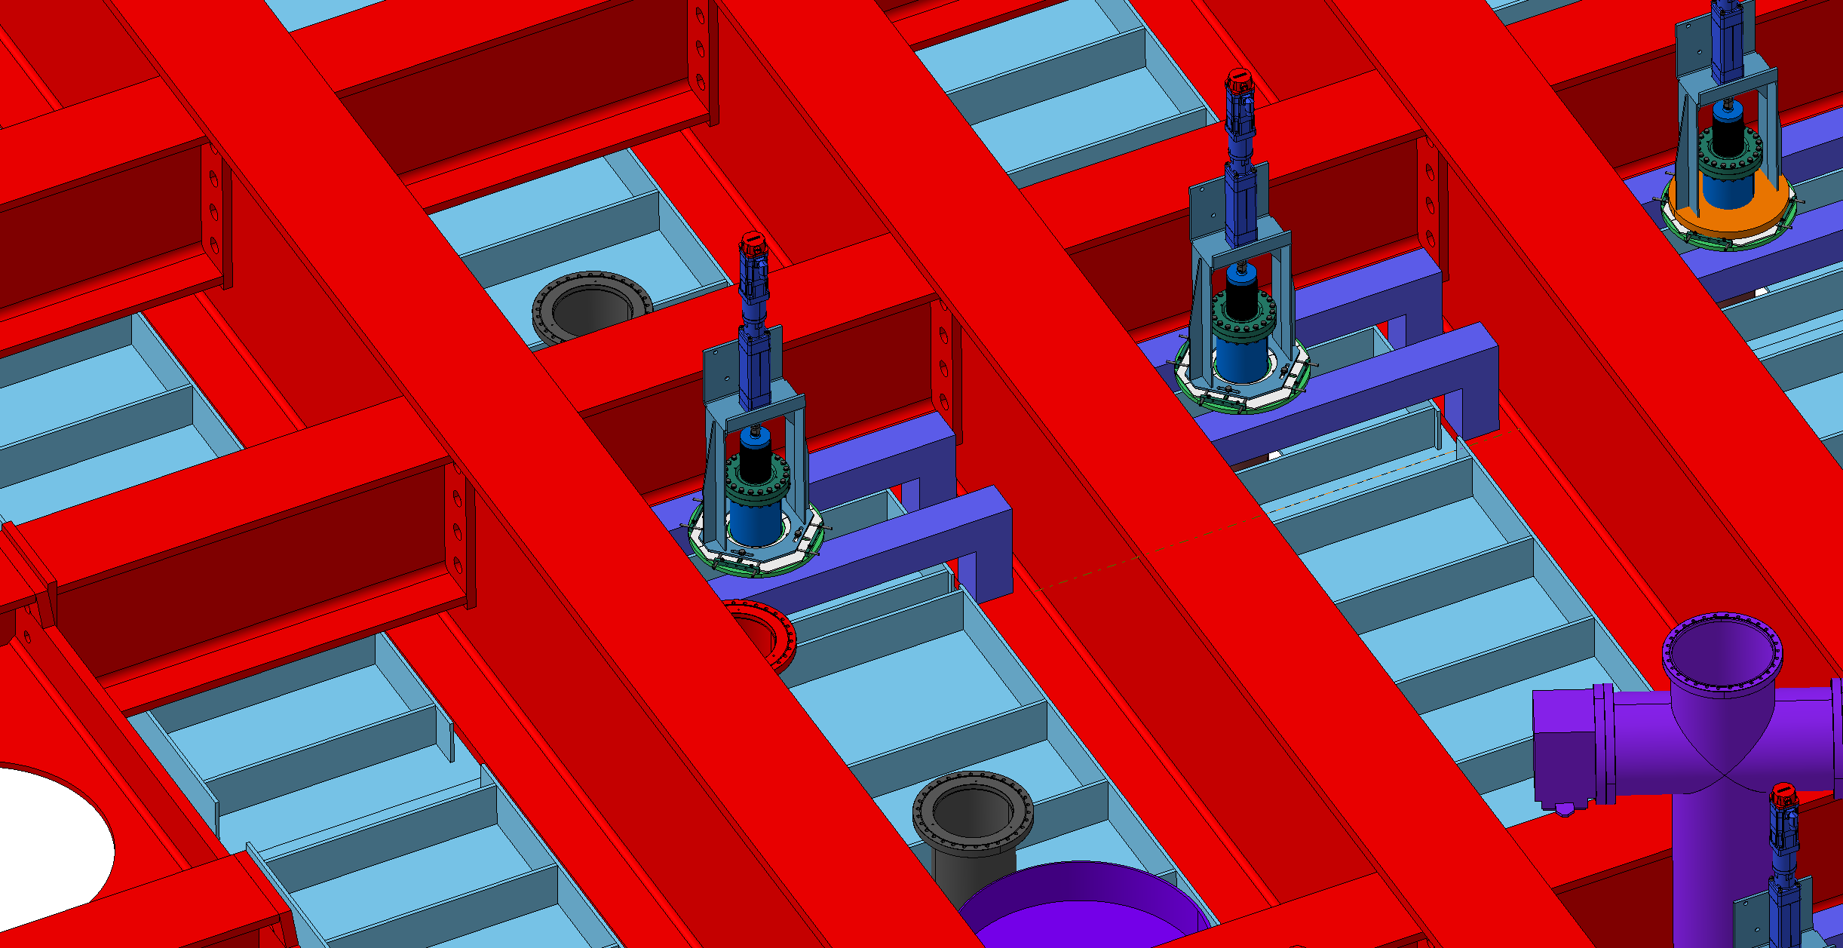
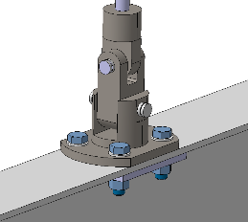
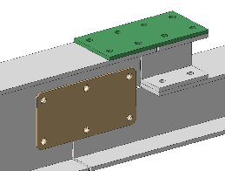
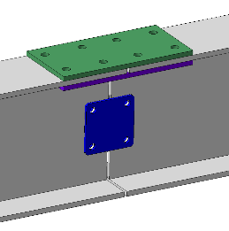
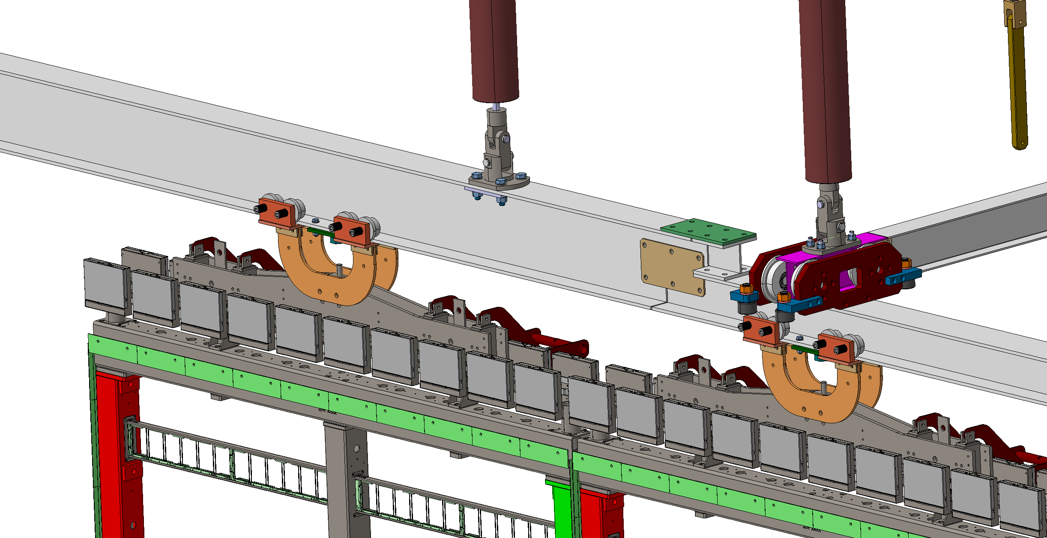
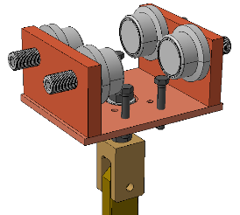
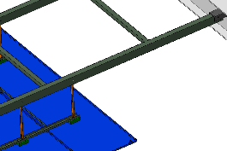
List of the updates
Feedthrough
DSS Rail
Interfaces:
  Feedthrough-to-roof
  Feedthrough-to-DSS
  DSS-to-DSS
  DSS-to-Yoke
  DSS-to-CPA
  DSS-to-GP

Slide 4
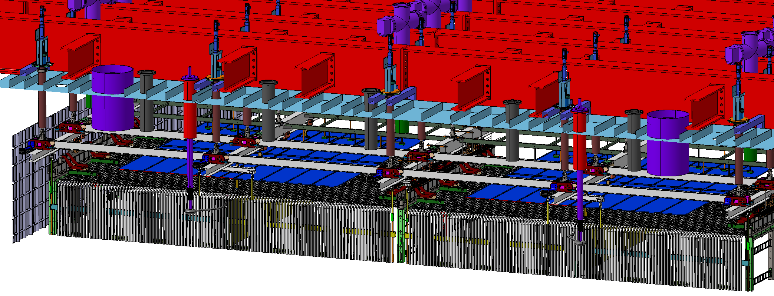
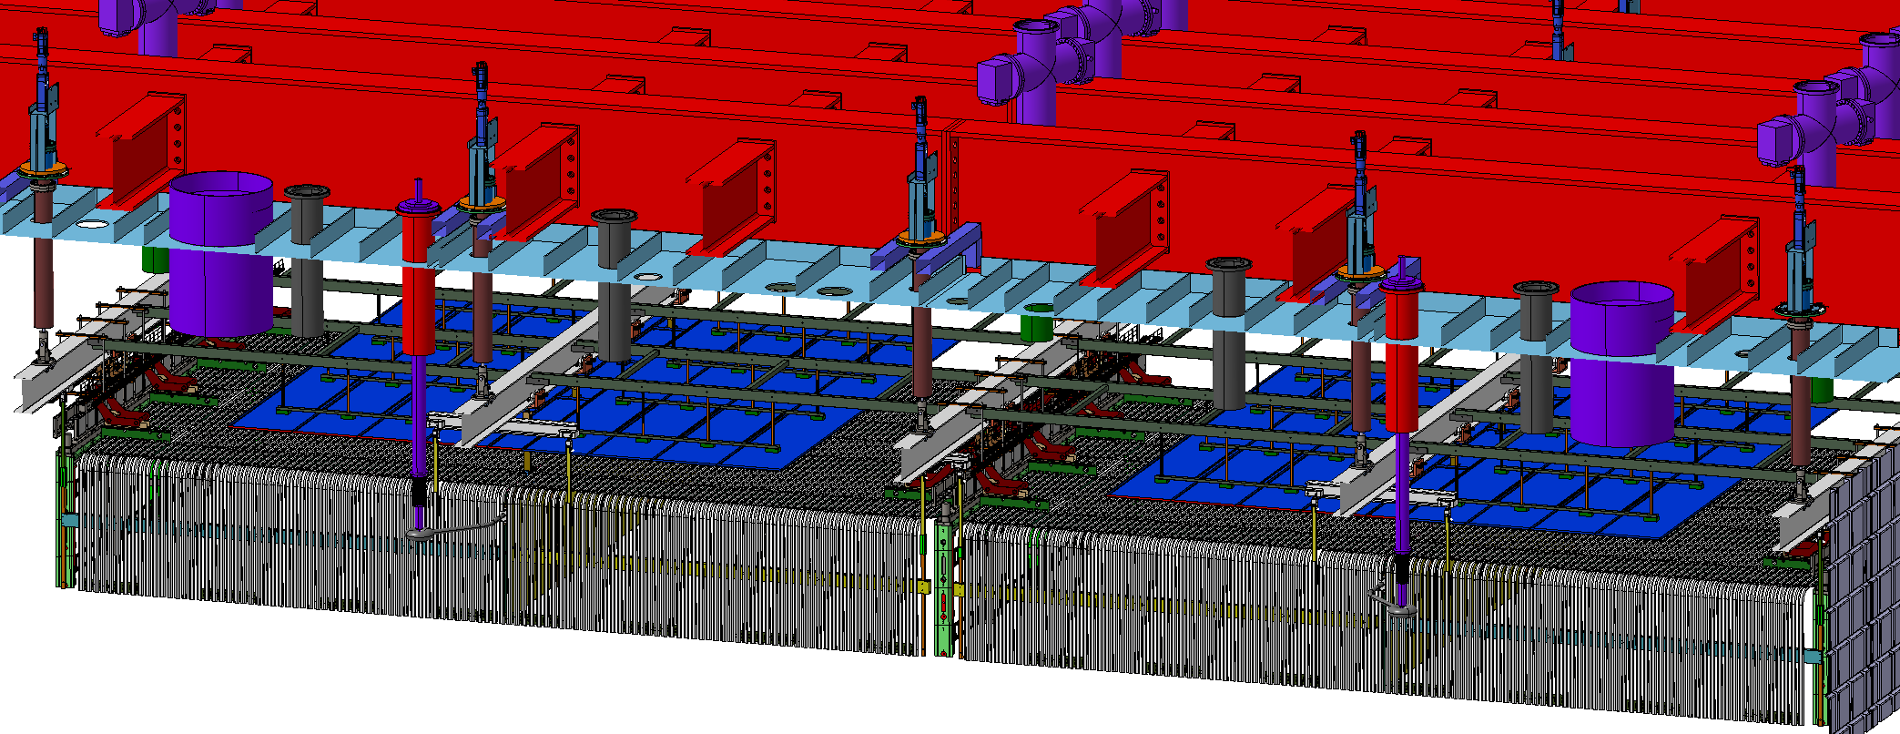
DSS
DSS Feedthrough
Feedthrough Supp.
DSS Rail
GP
APA
FC
CPA
DSS-to-Feedthrough

Slide 5
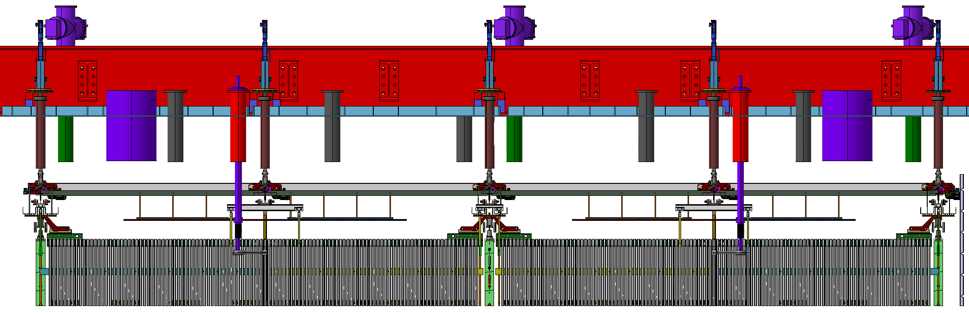
DSS
DSS Rail
DSS Feedthrough
Feedthrough Support
GP
APA
CPA
FC

Slide 6
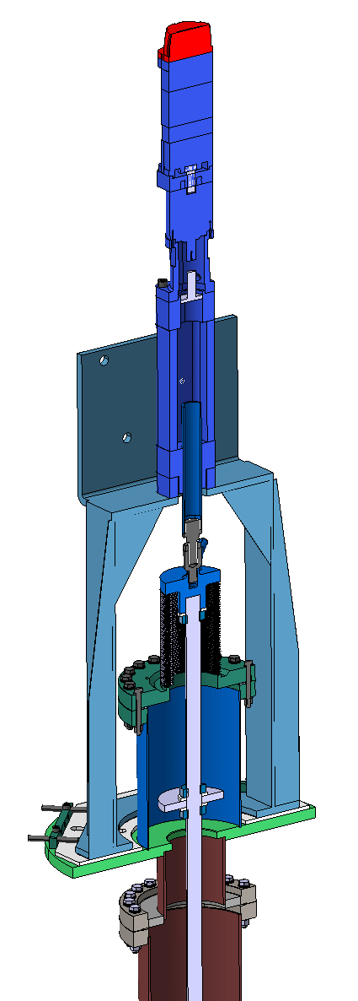

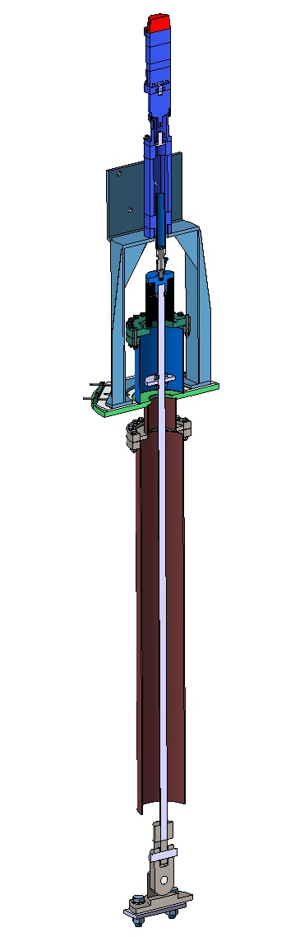
The Feedthrough

Slide 7
Feedthrough – to – Roof

Slide 8
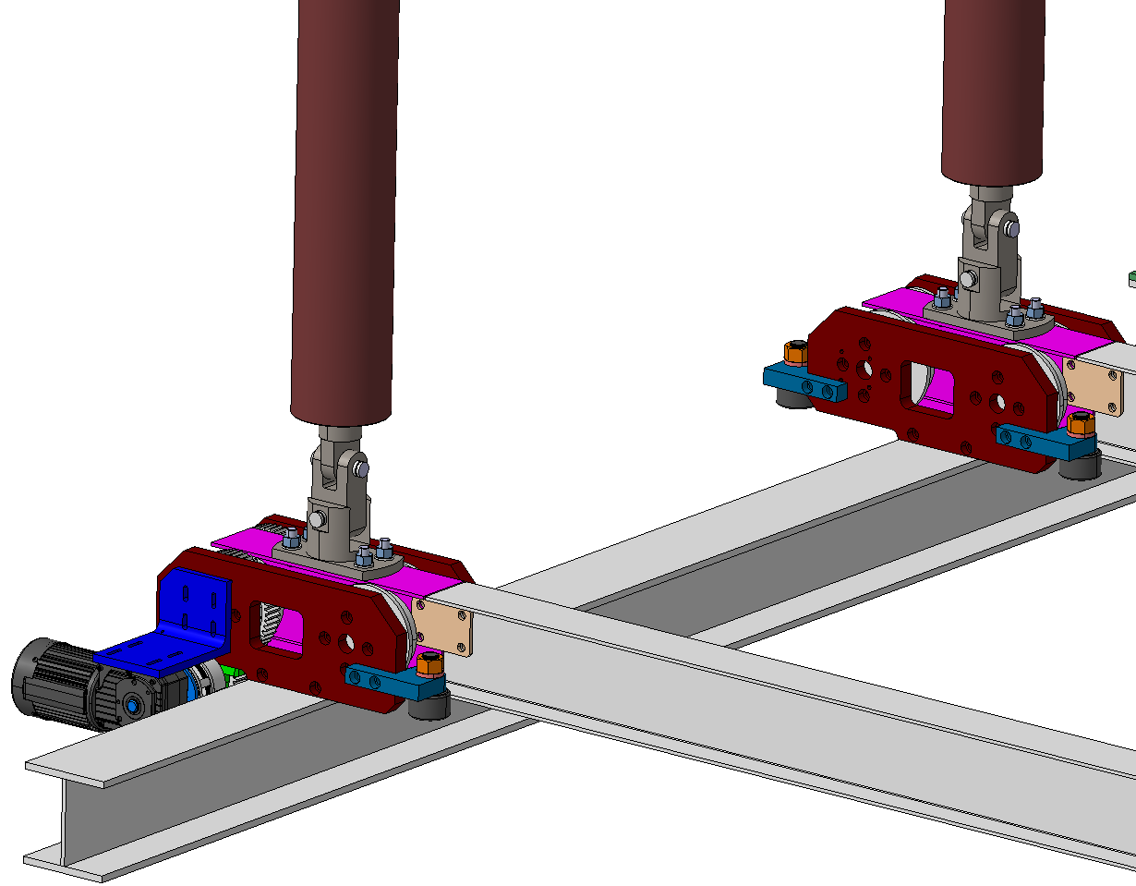

Feedthrough – to – DSS

Slide 9


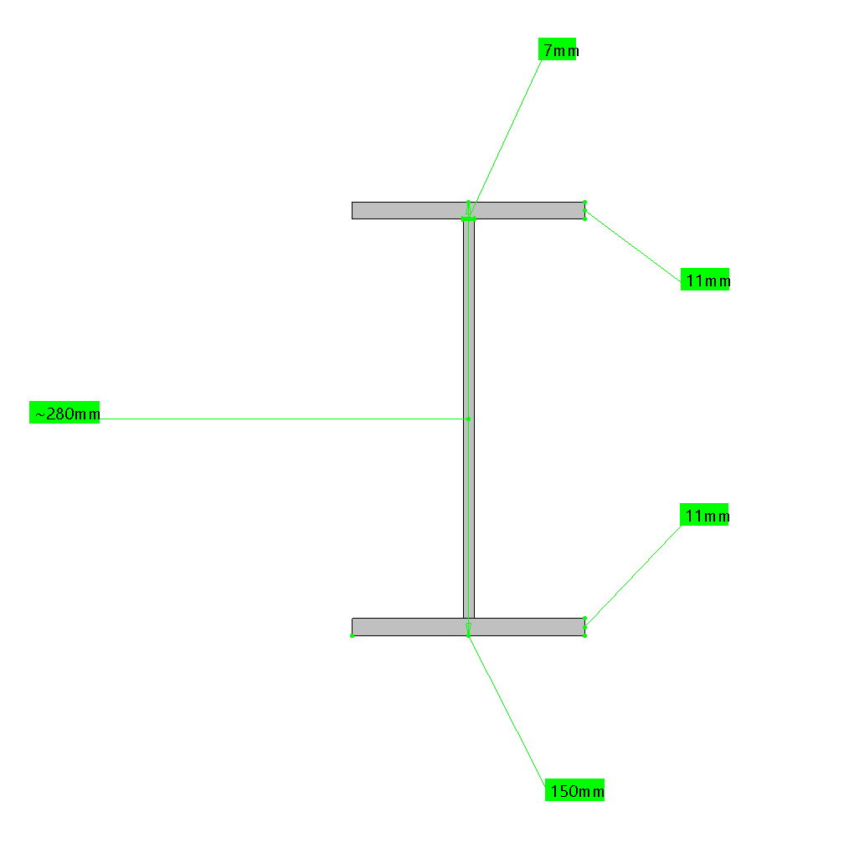
DSS – to – DSS

Slide 10
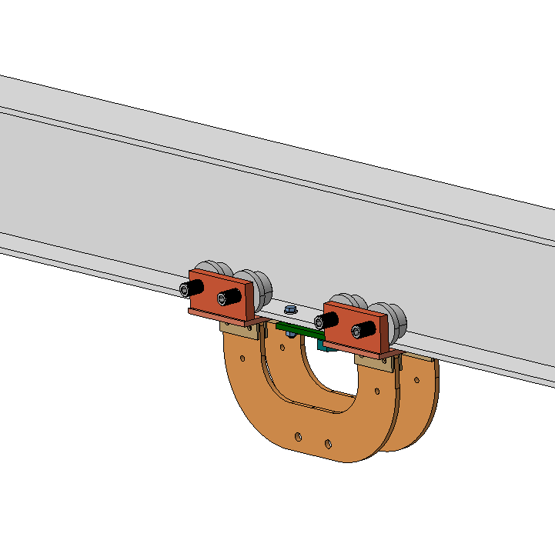
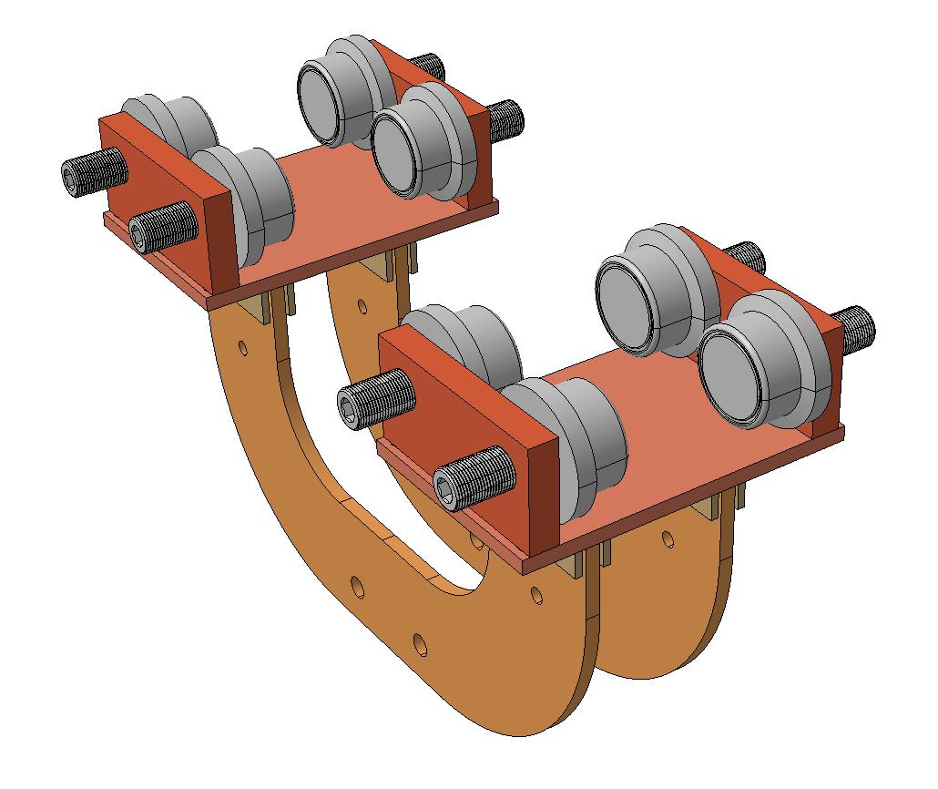
DSS – to – Yoke (APA Trolley)

Slide 11
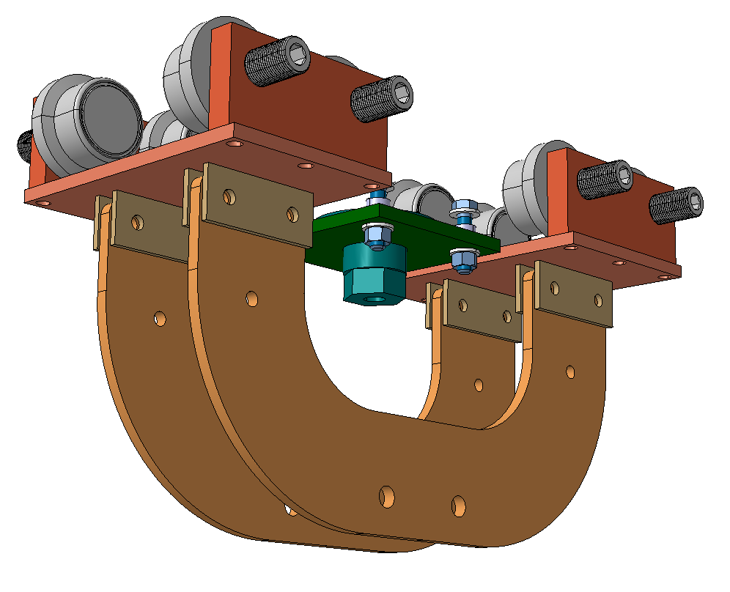
DSS – to – Yoke (APA Trolley)

Slide 12
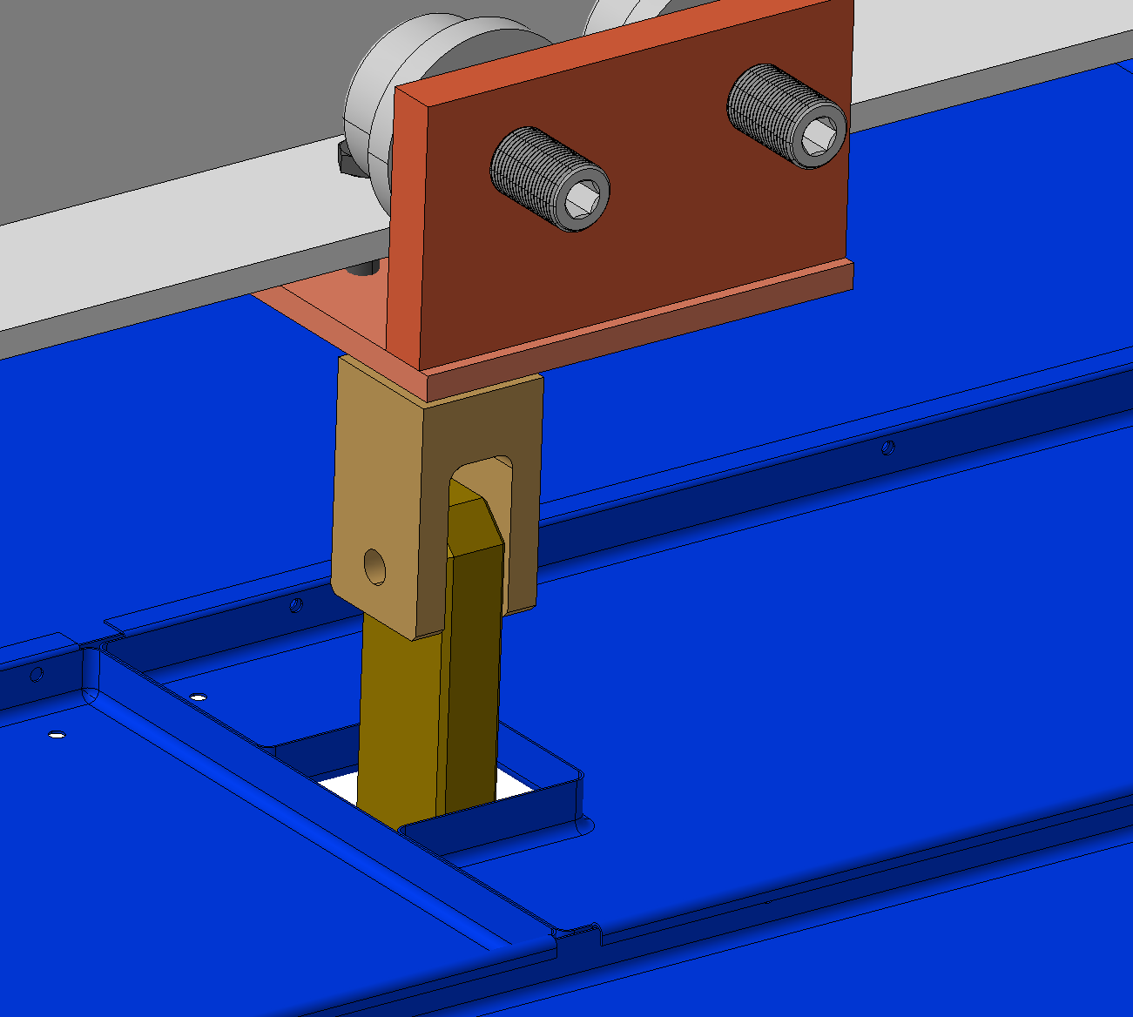
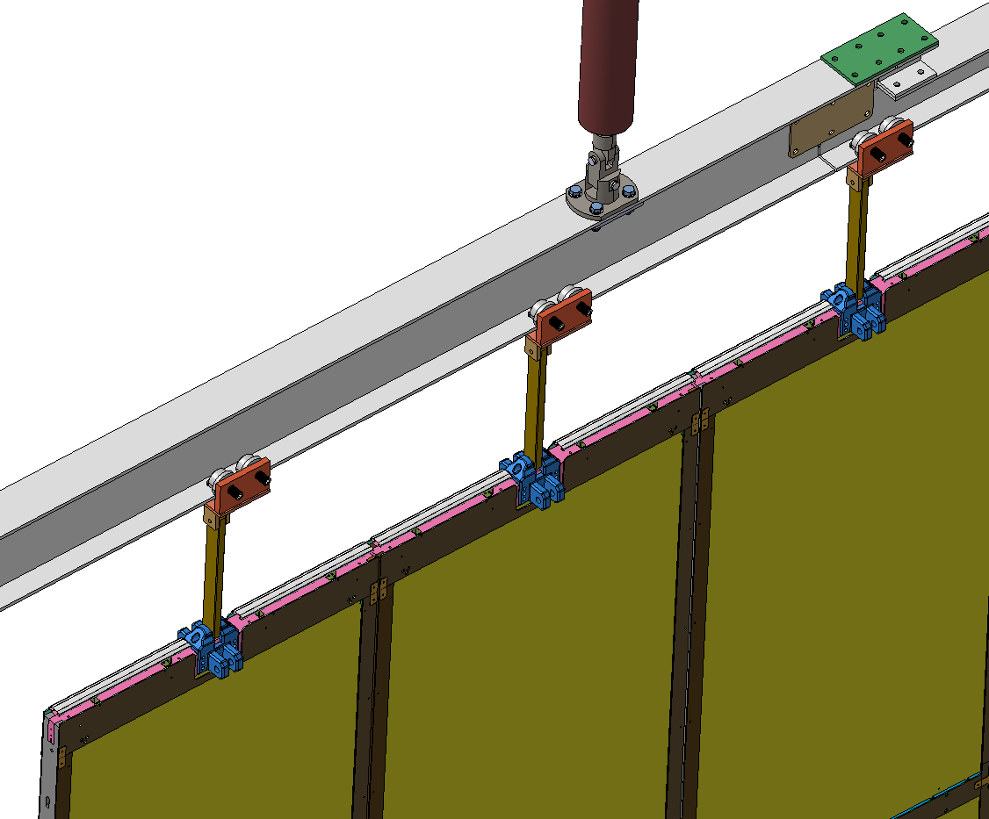
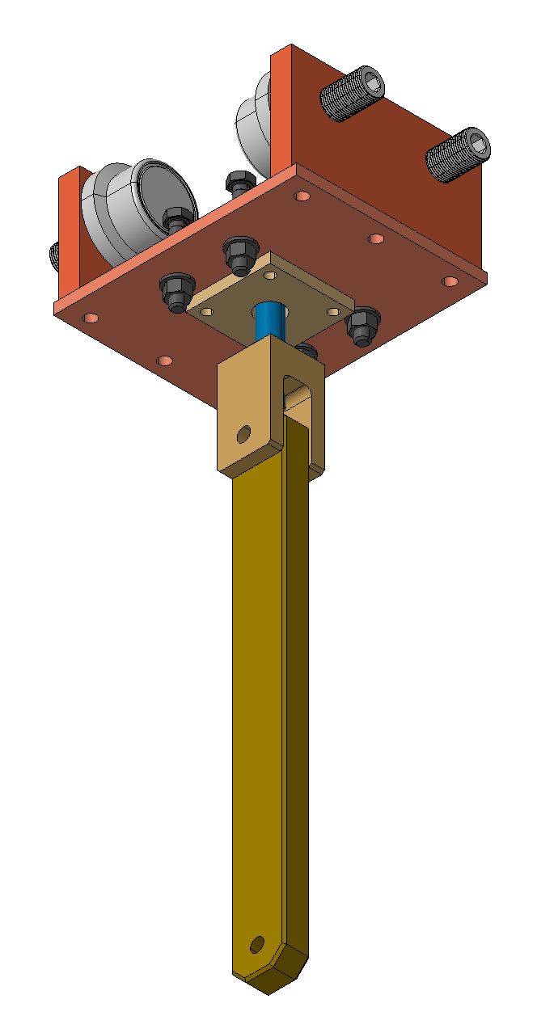
DSS – to – CPA (CPA Trolley)

Slide 13
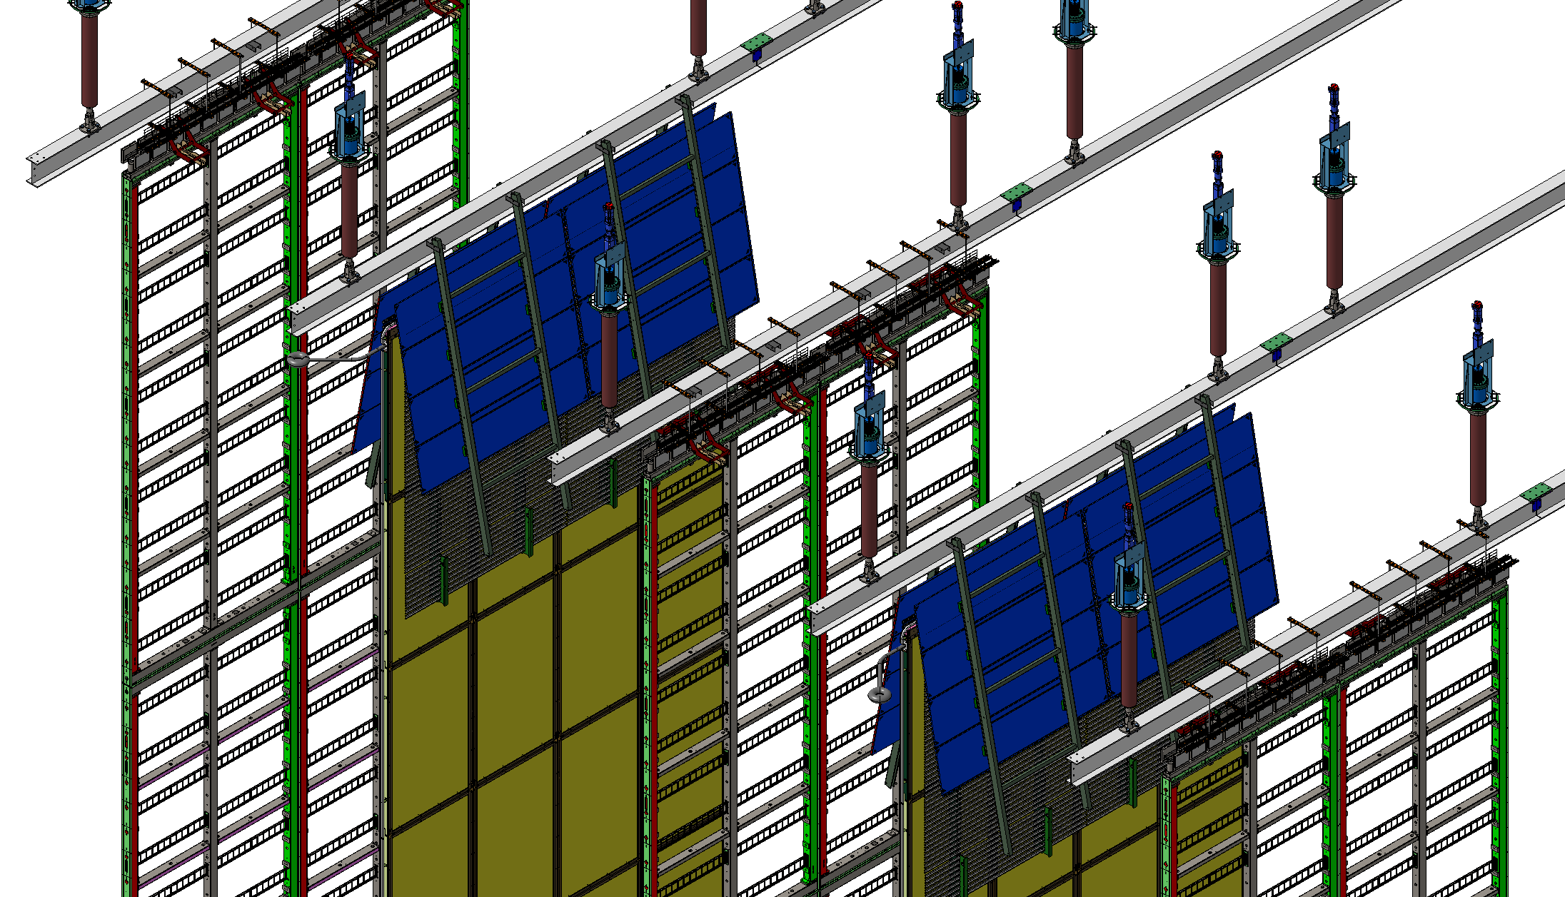
DSS – to – GP
Position down

Slide 14
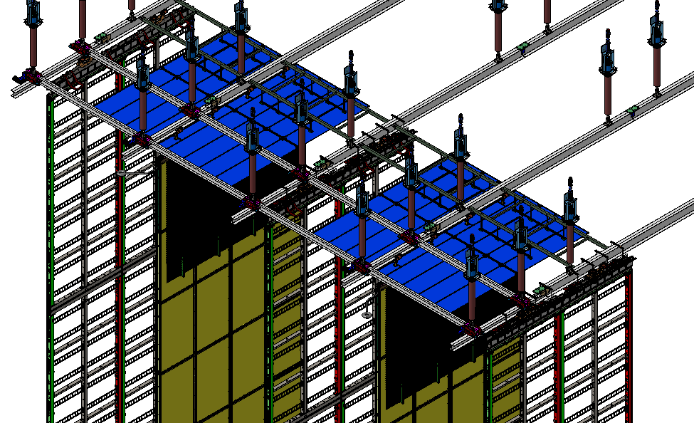
DSS – to – GP

Slide 15
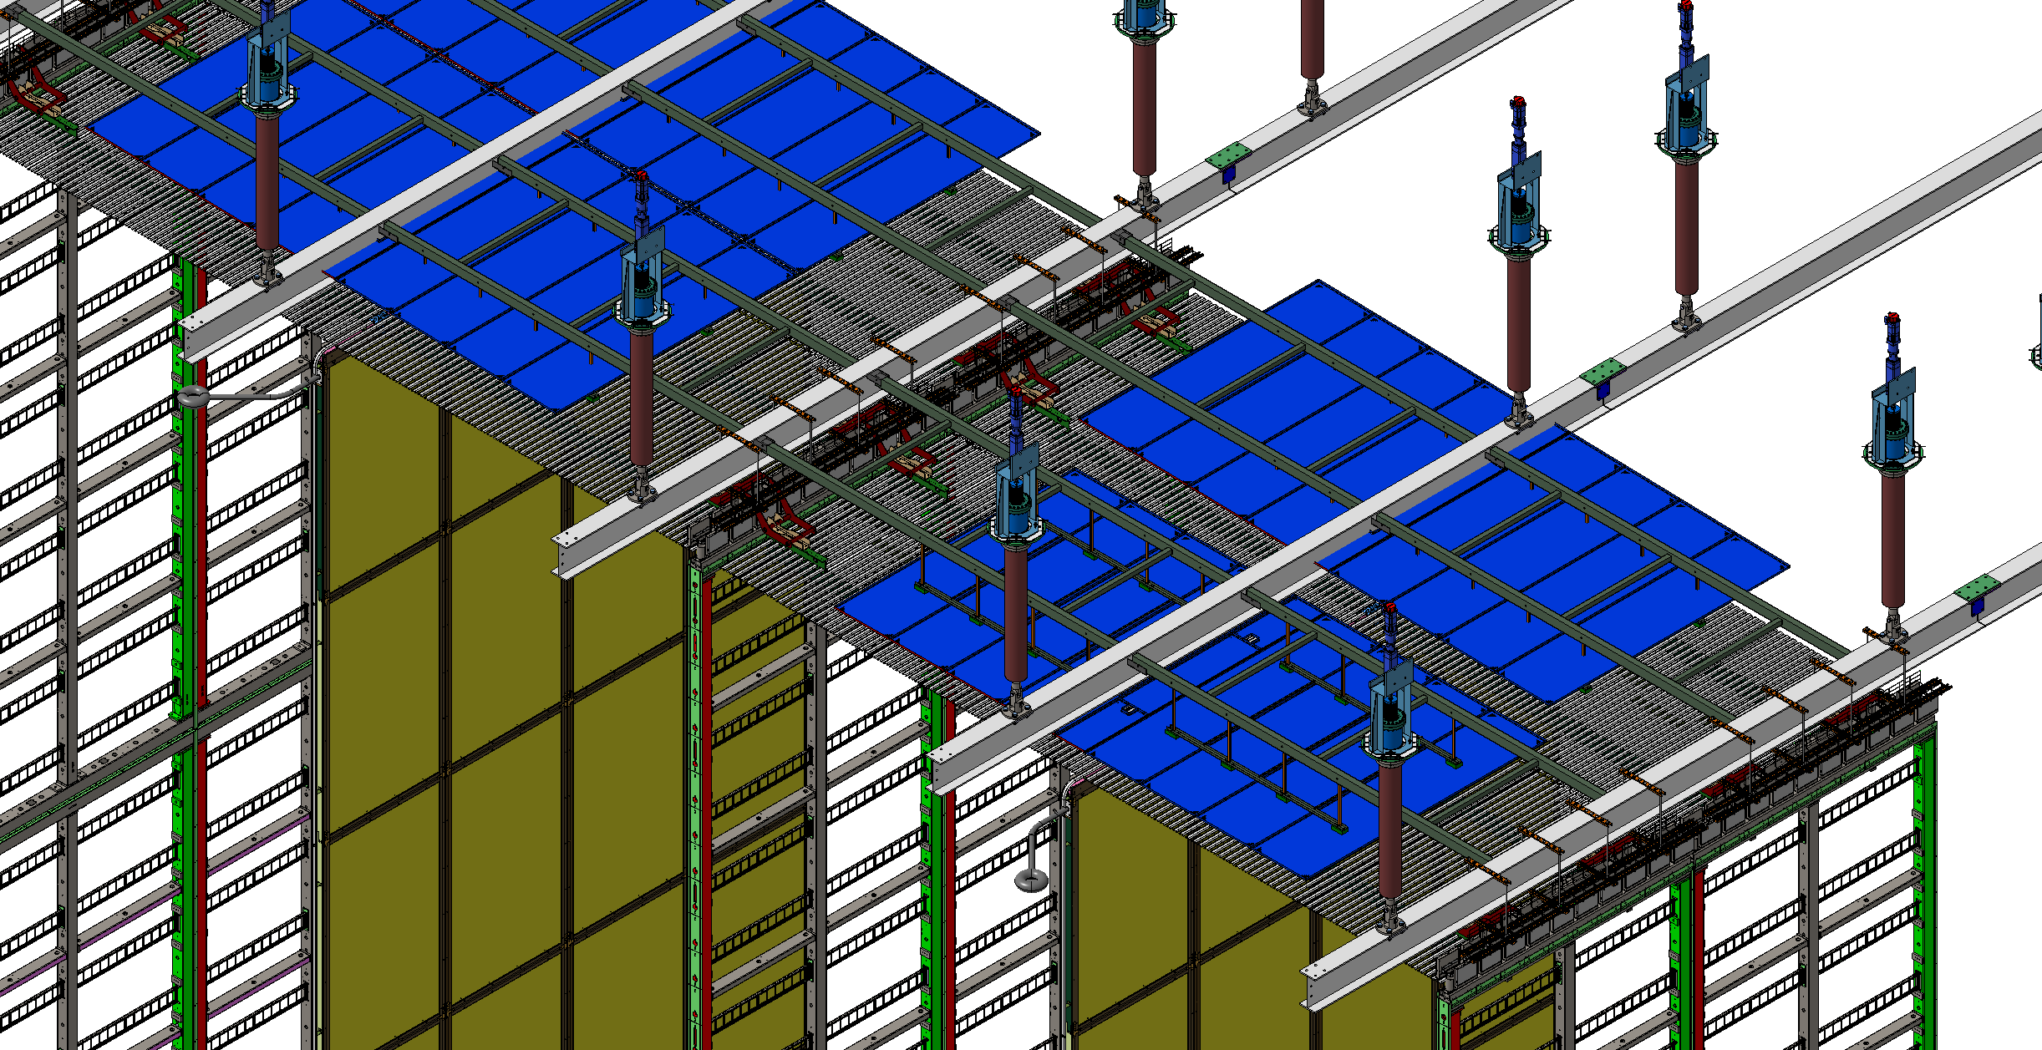
DSS – to – GP
Position UP

Slide 16
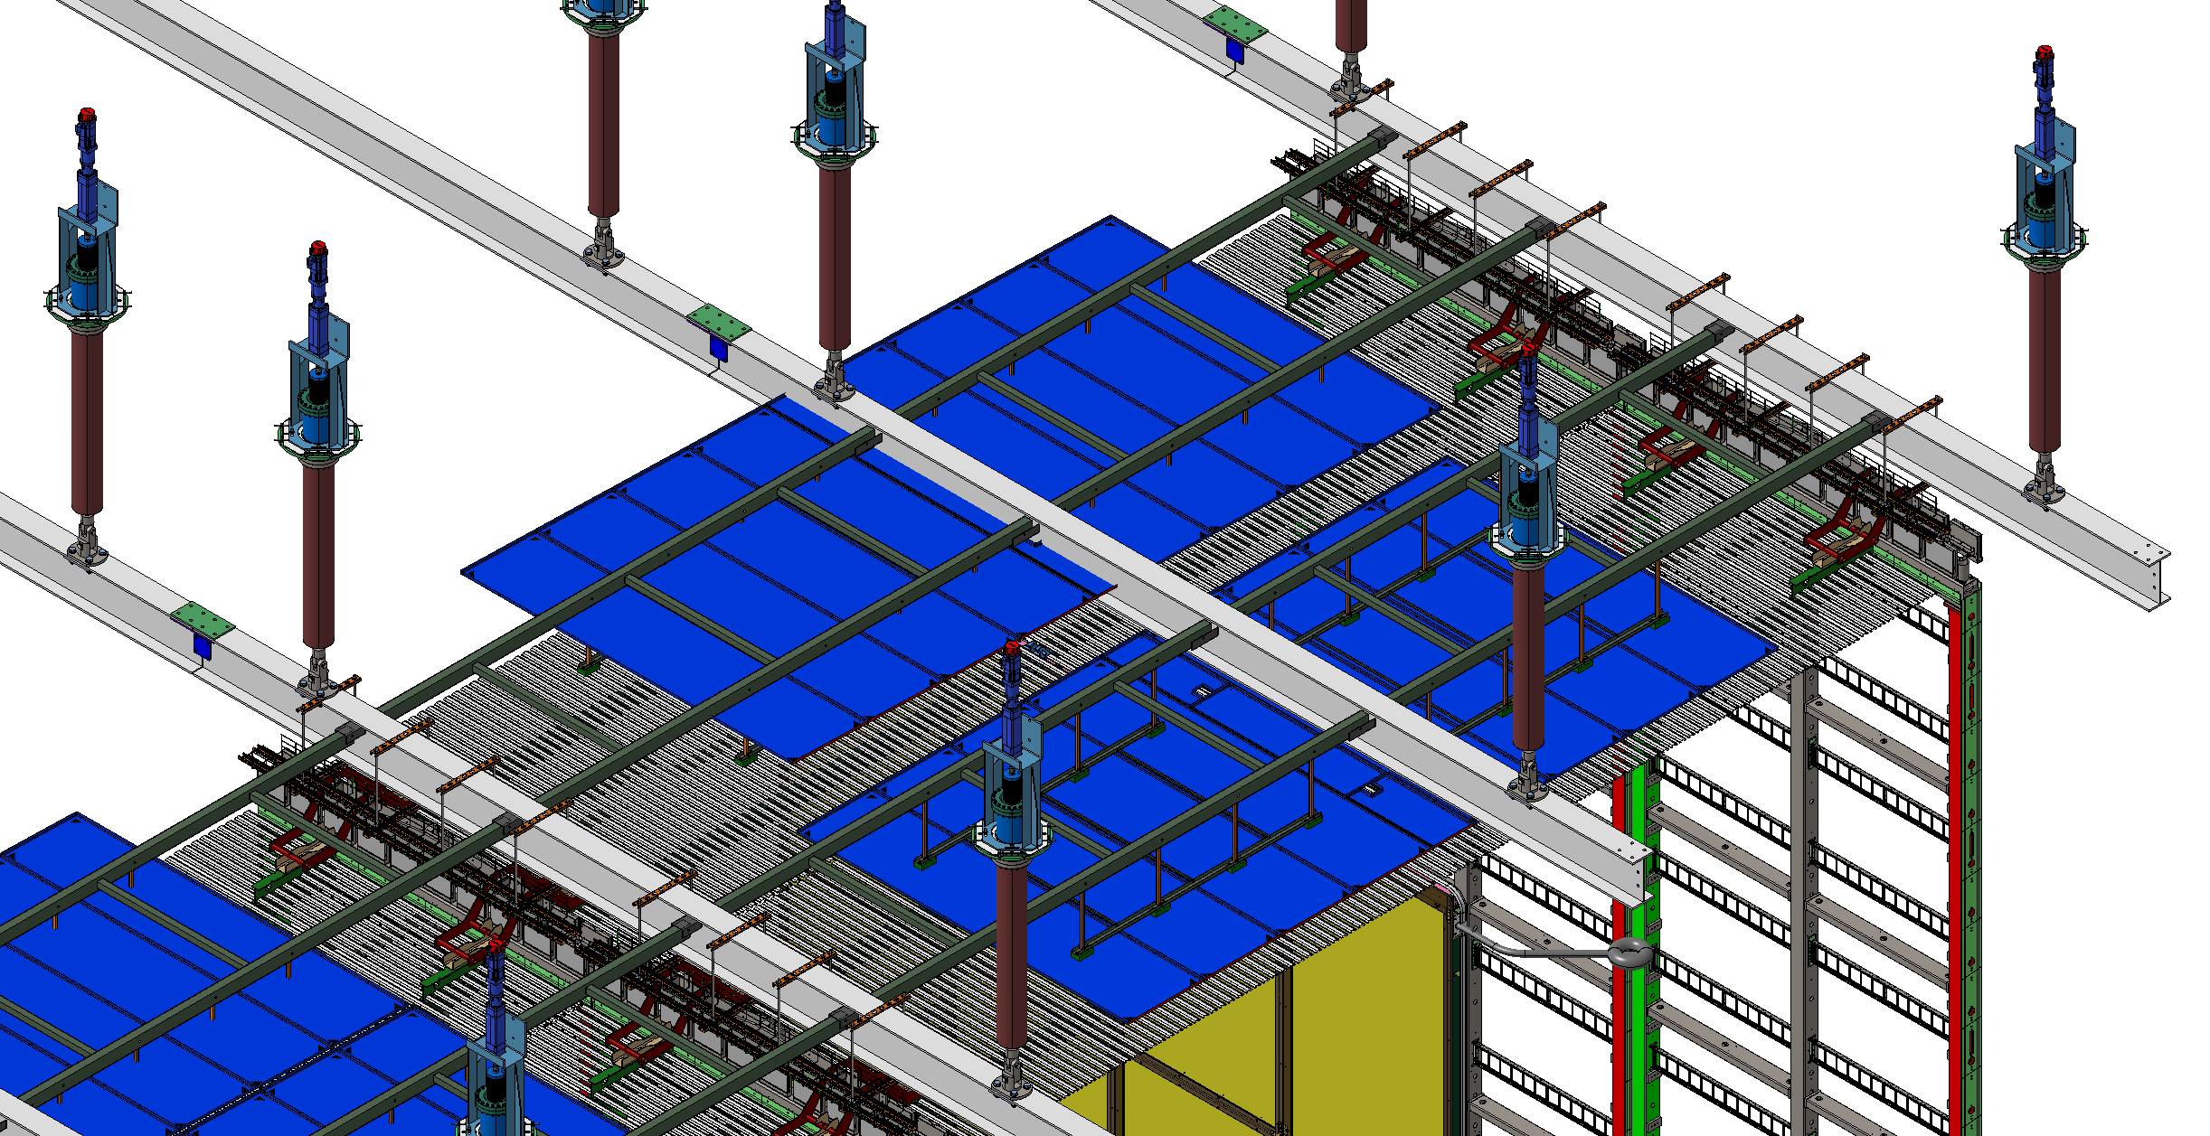
DSS – to – GP
Position UP

Slide 17
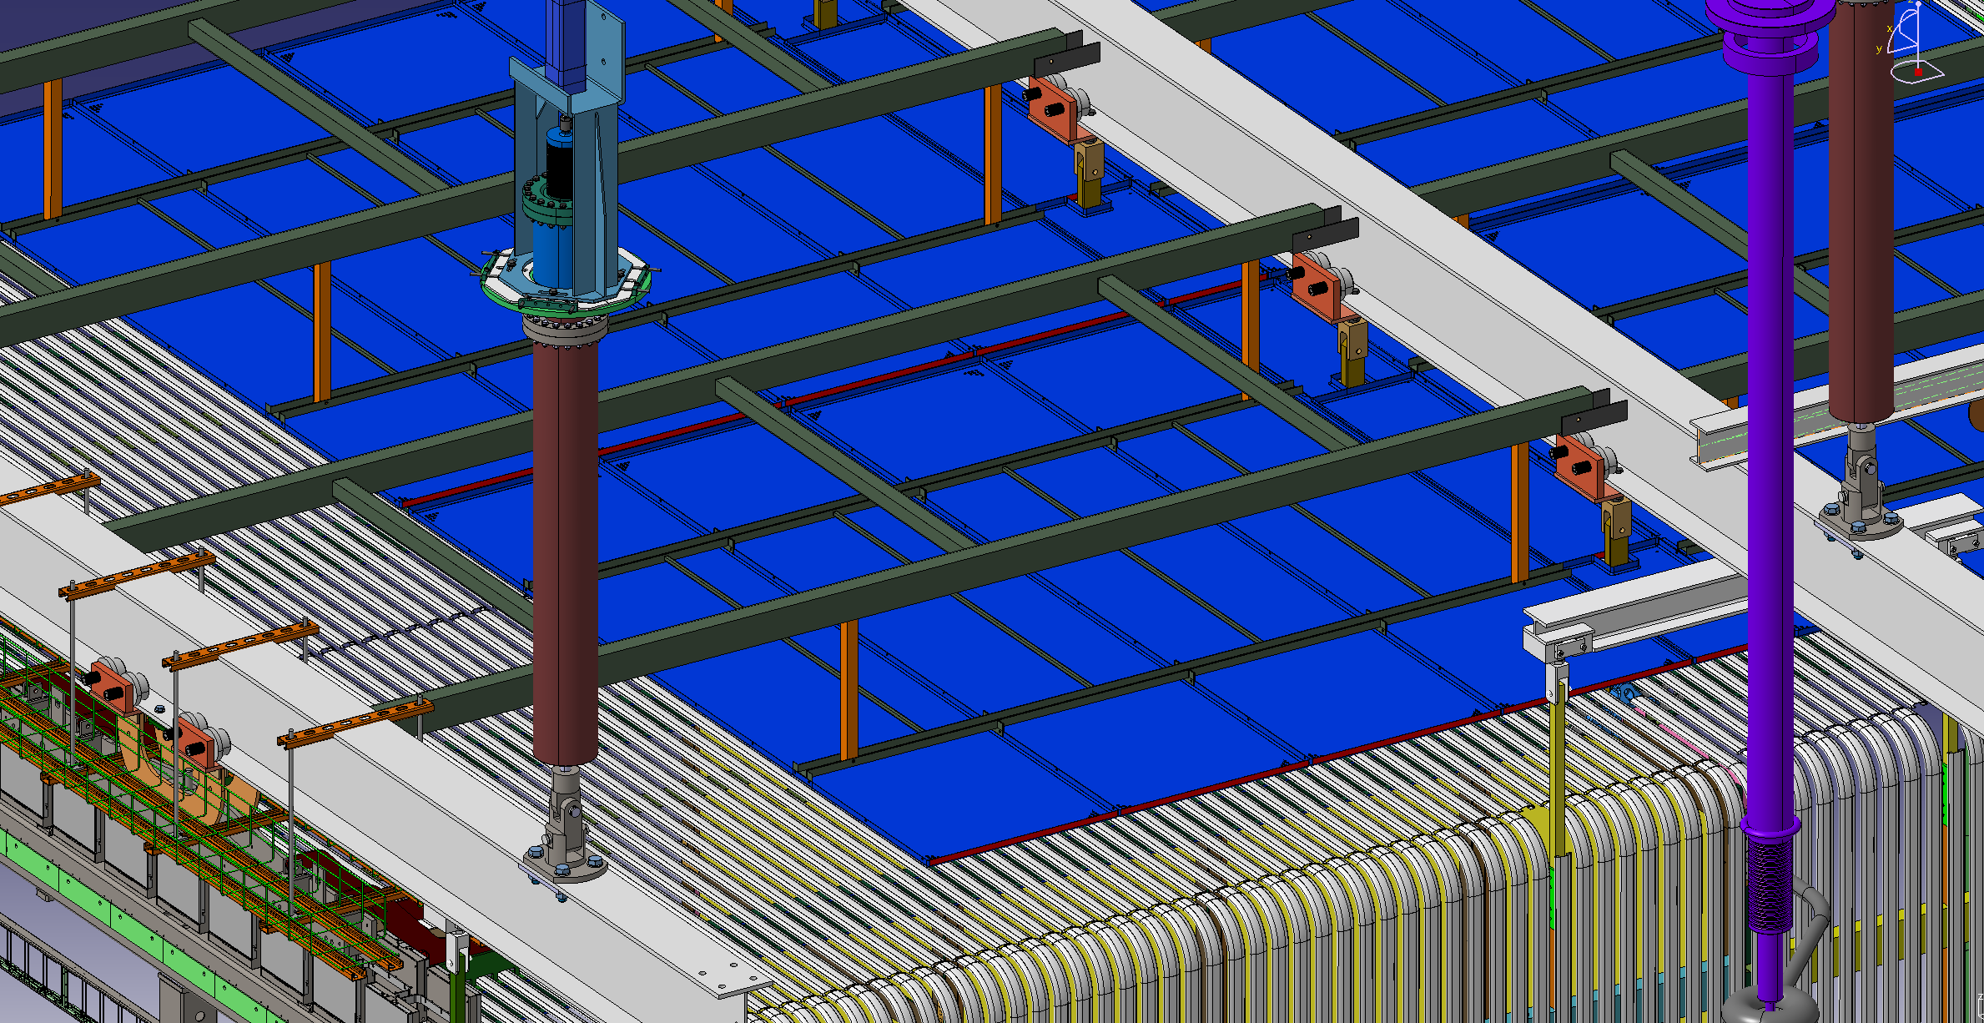
DSS – to – GP

Slide 18
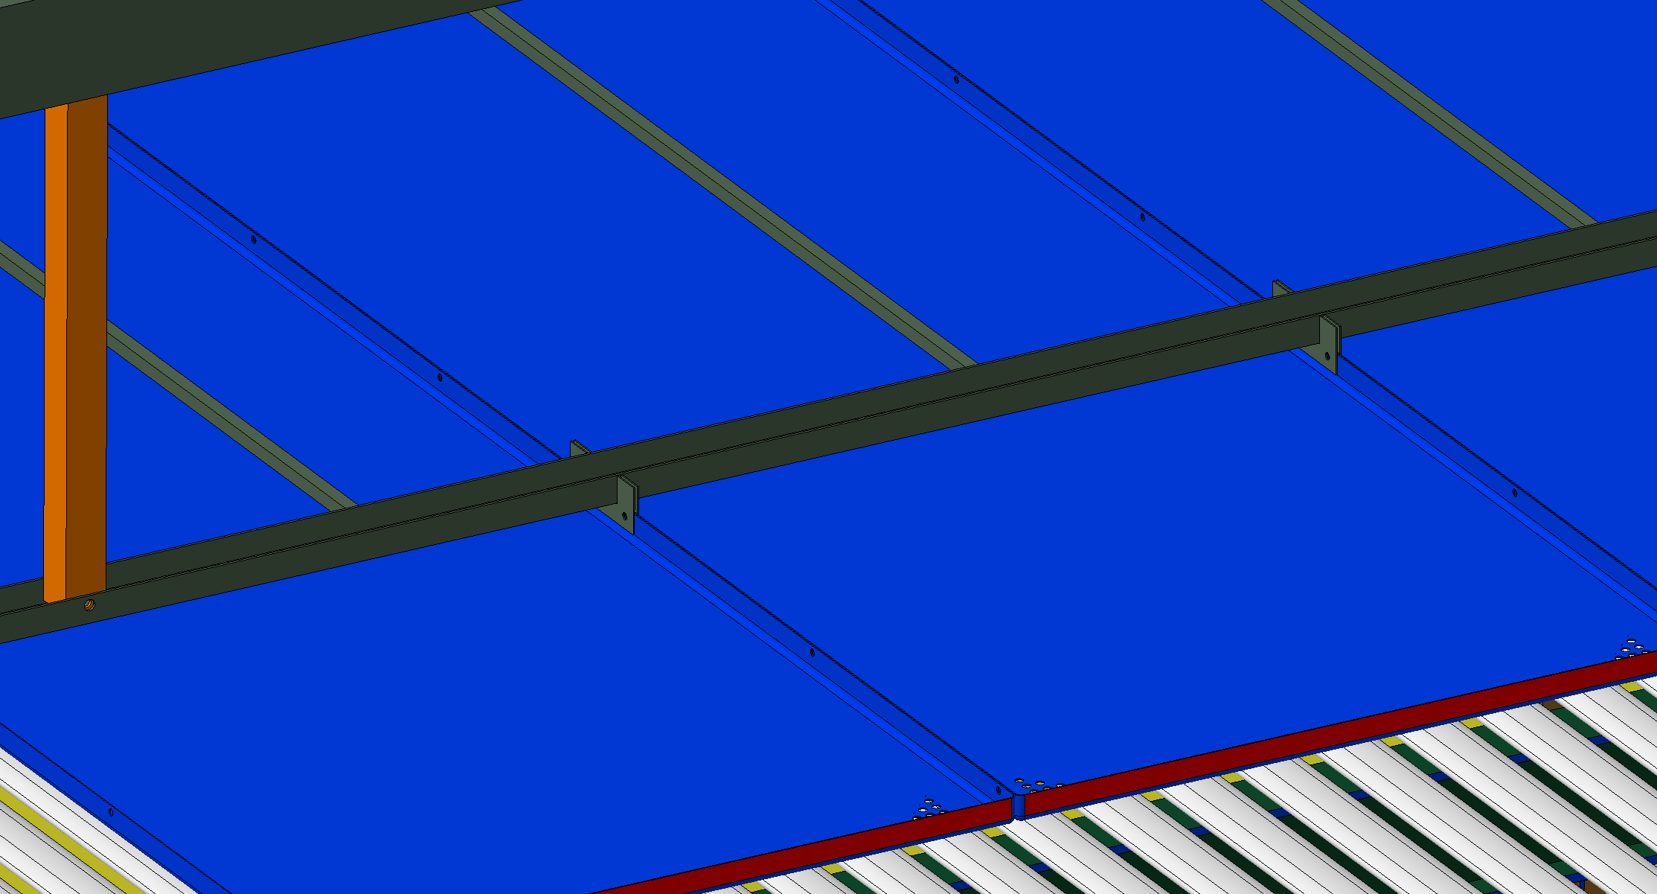
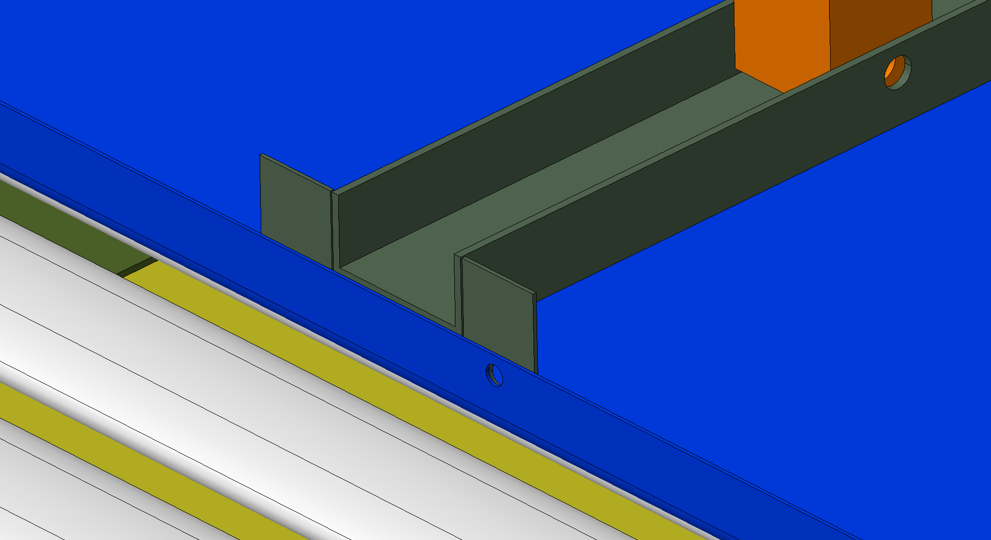
DSS – to – GP

Slide 19
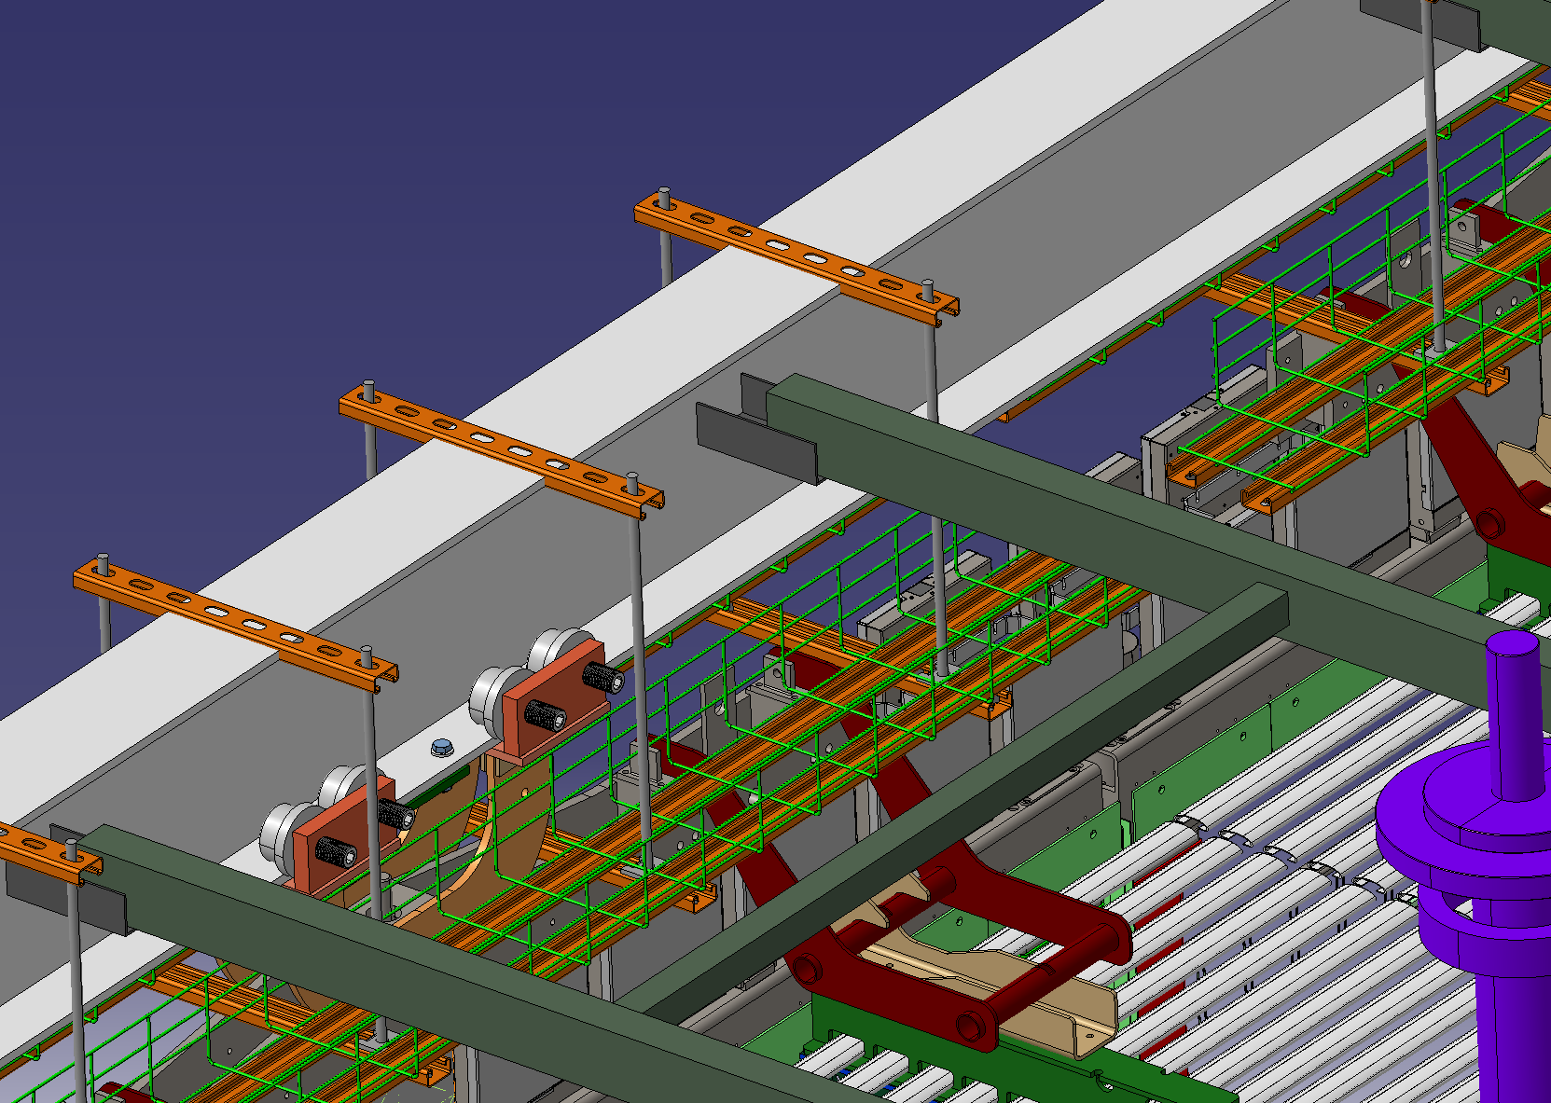
DSS – to – GP

Slide 20
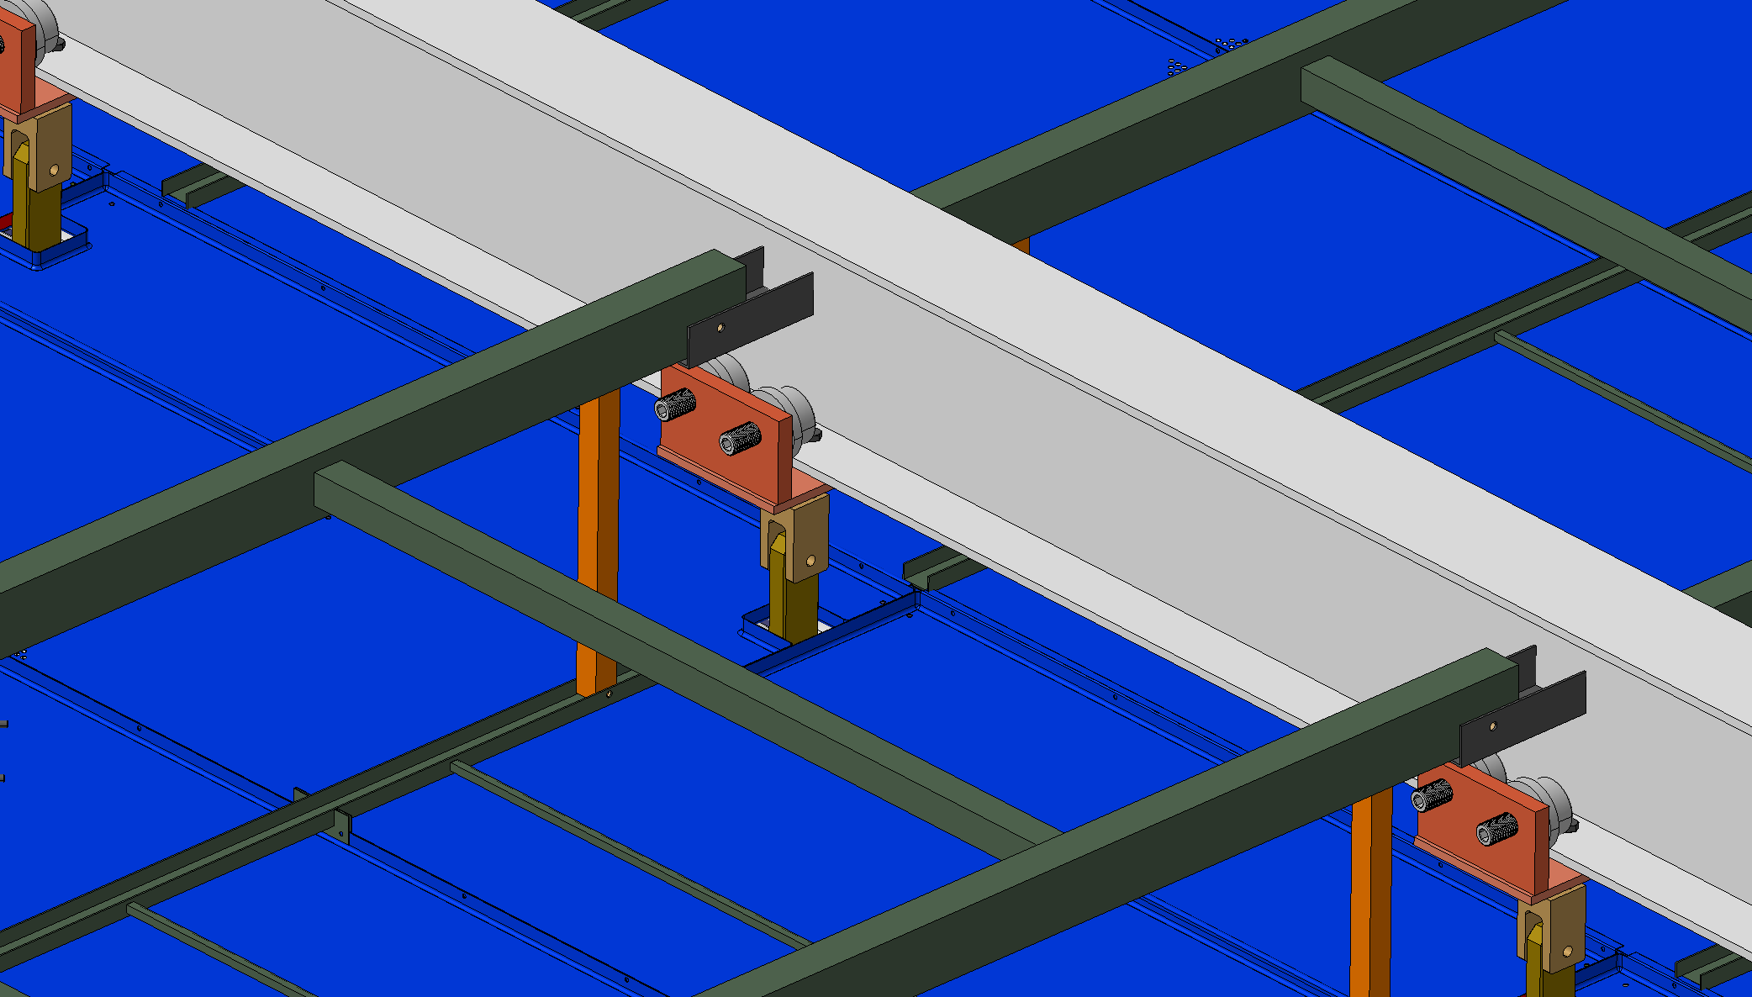
DSS – to – GP

Slide 21
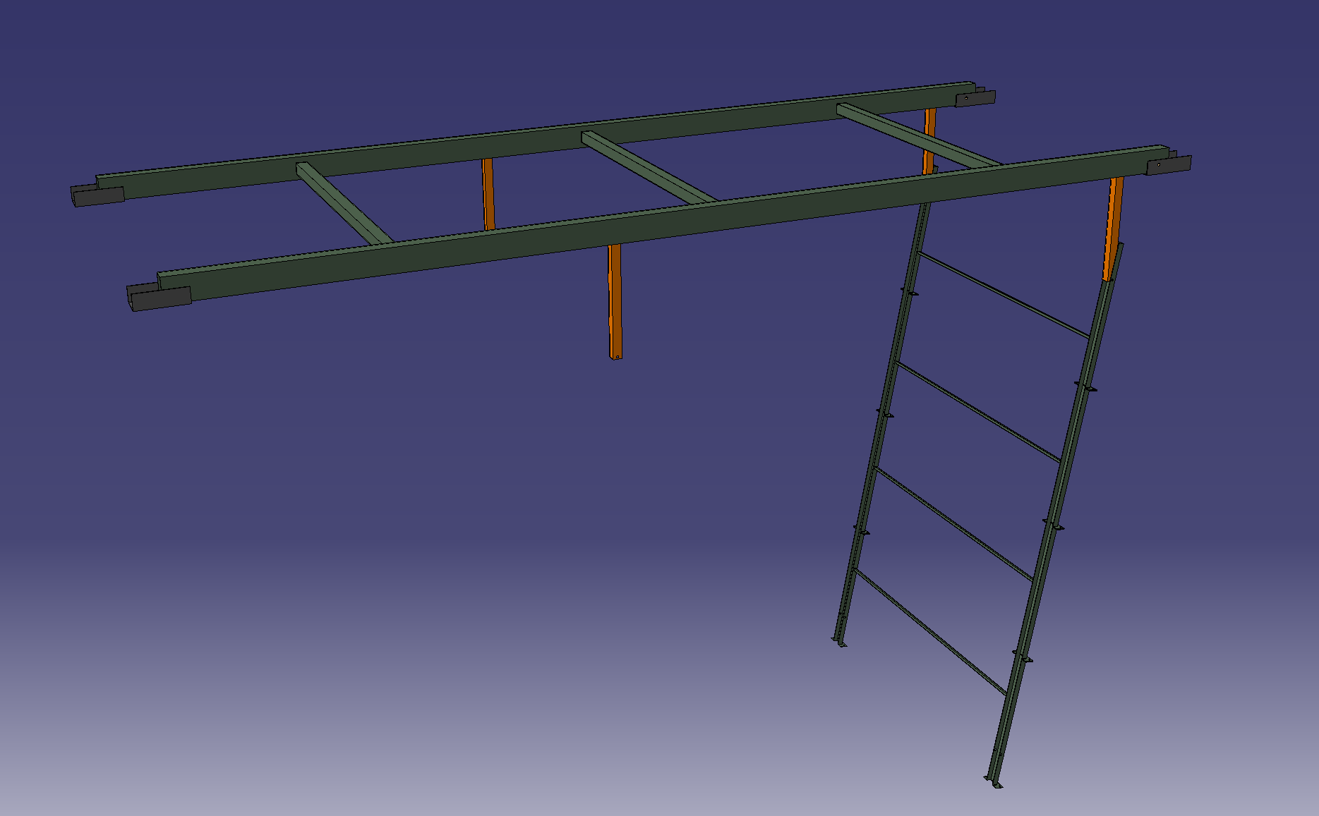
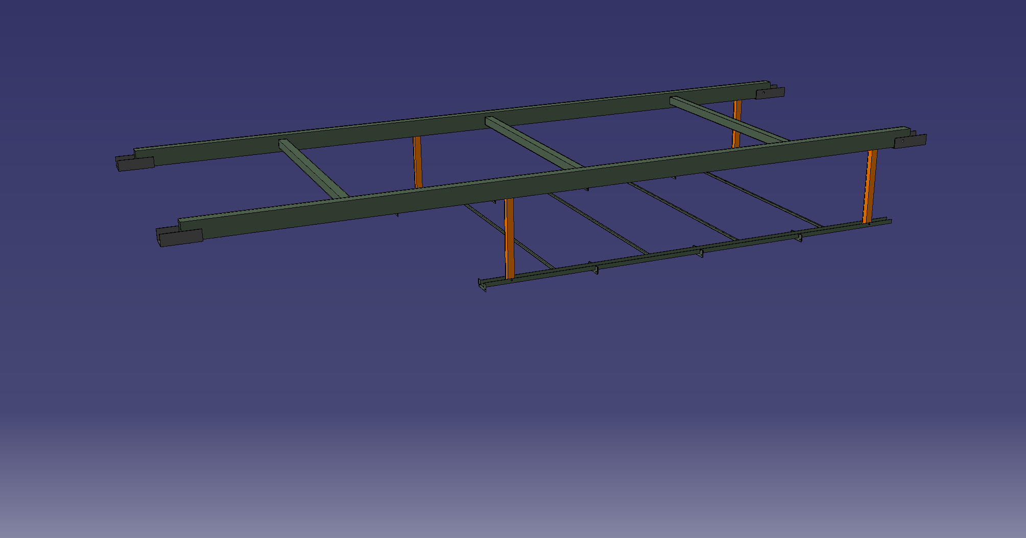
DSS – to – GP

Slide 22
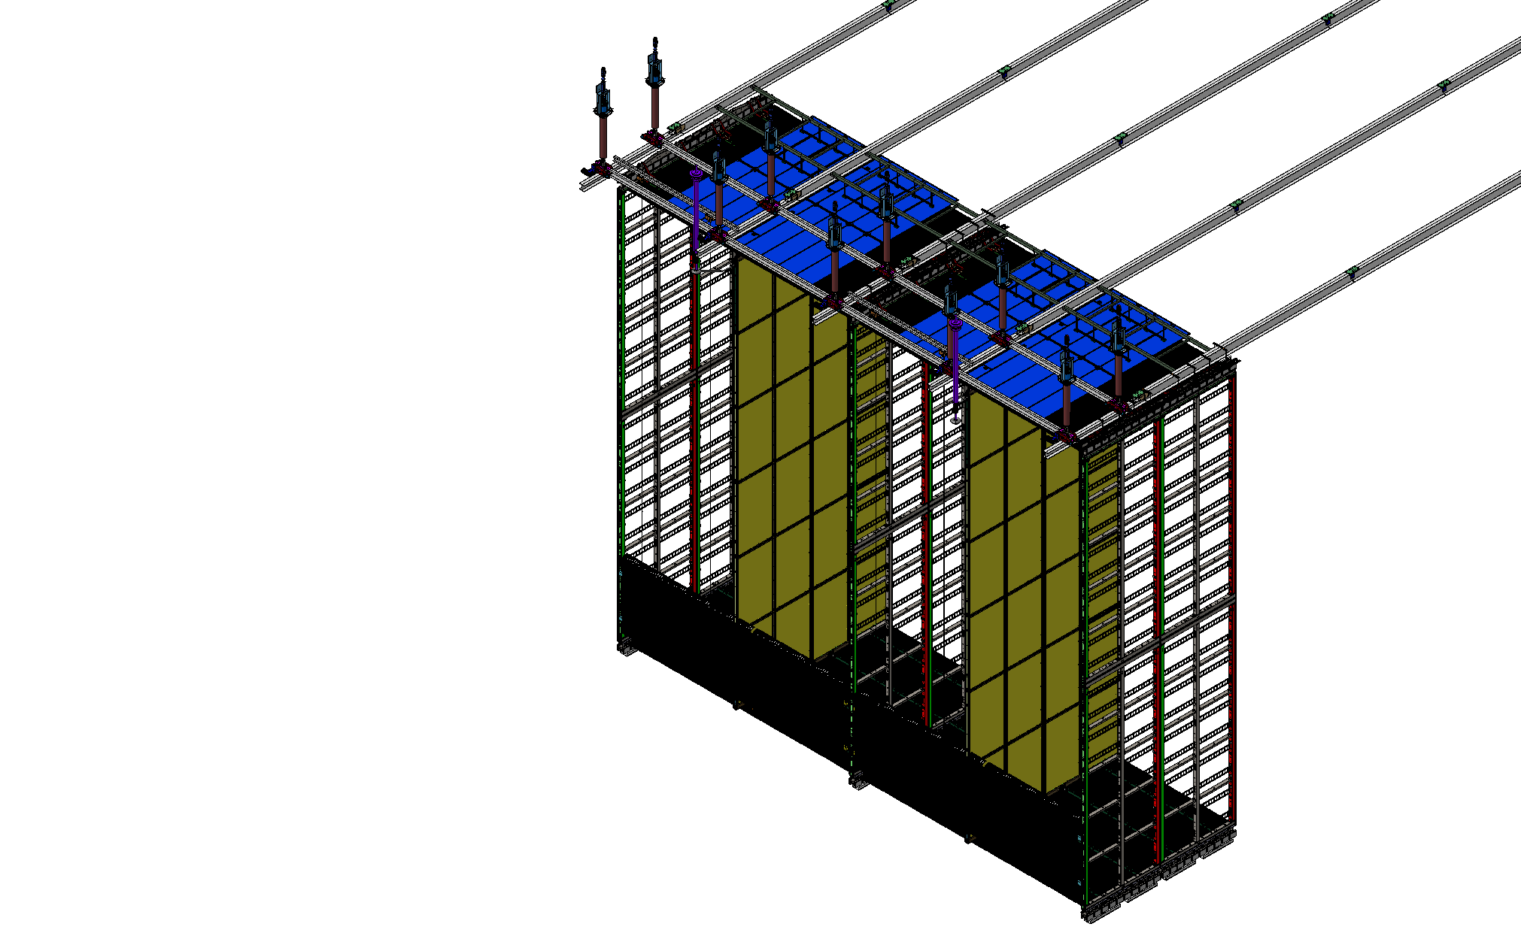
End Wall – Installation

Slide 23
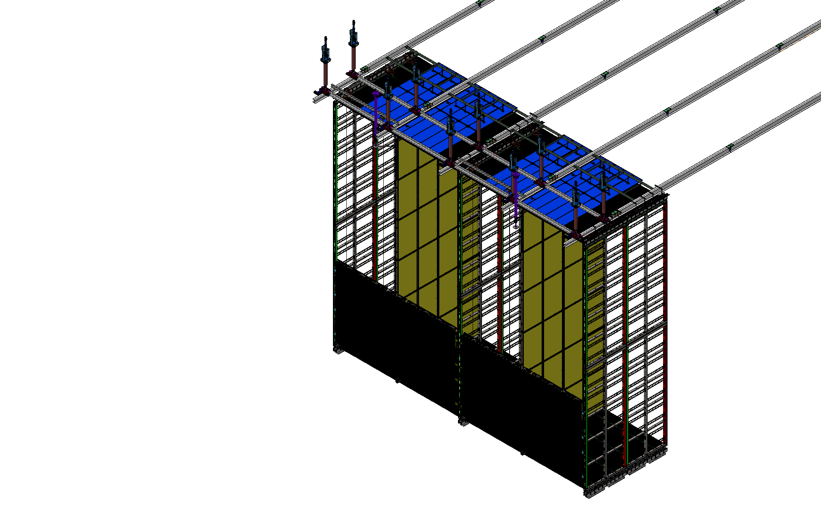
End Wall – Installation

Slide 24
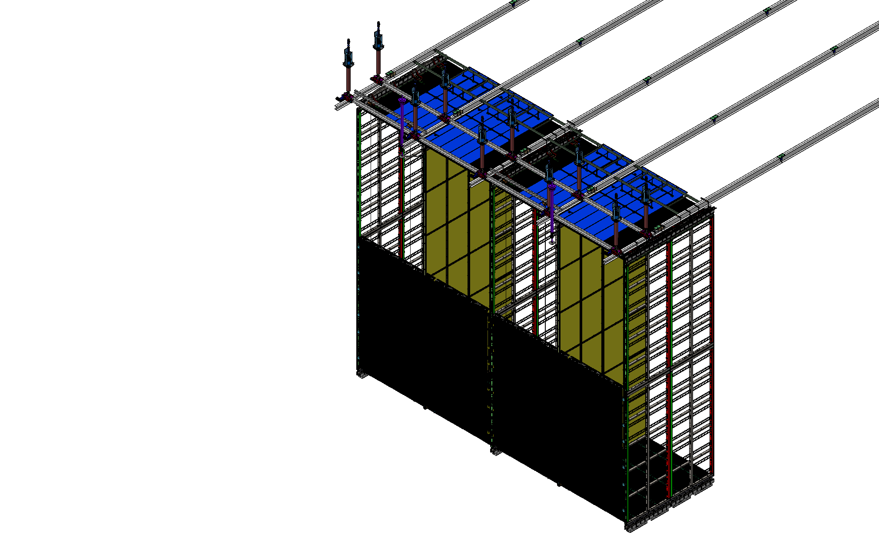
End Wall – Installation

Slide 25
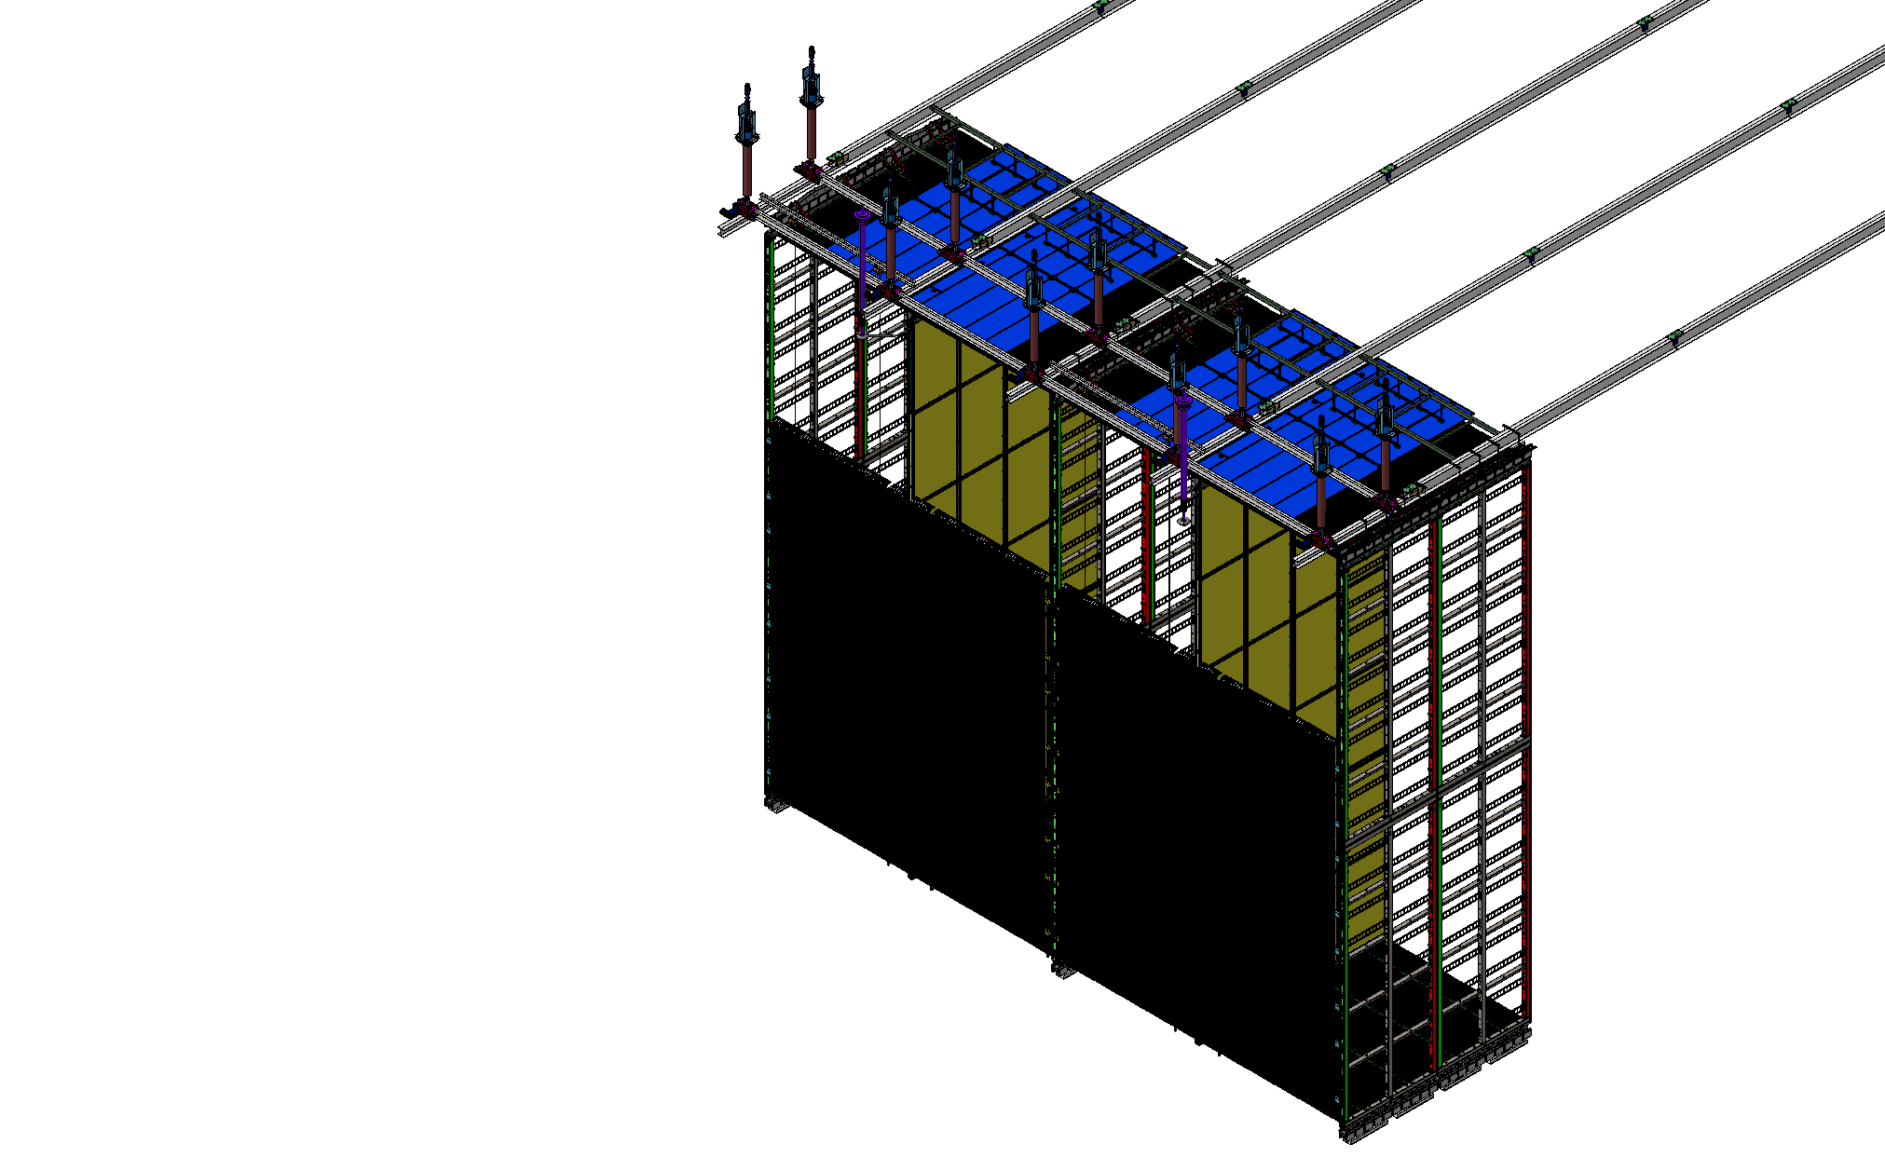
End Wall – Installation

Slide 26
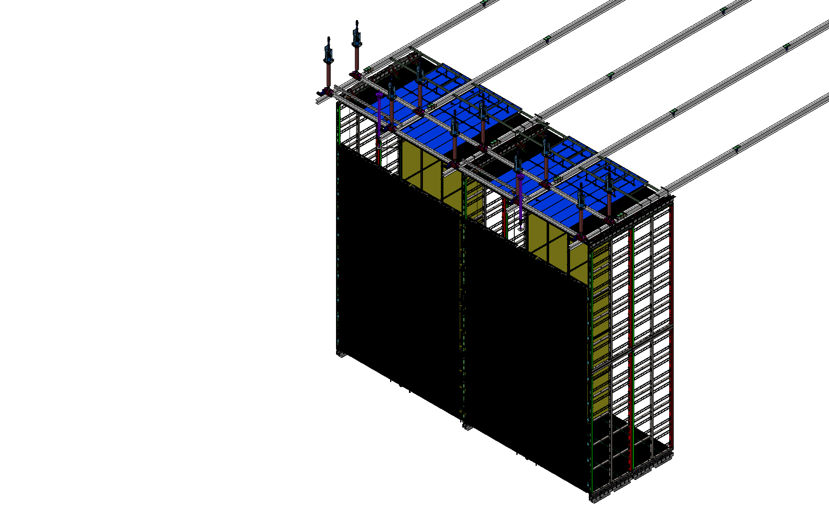
End Wall – Installation

Slide 27
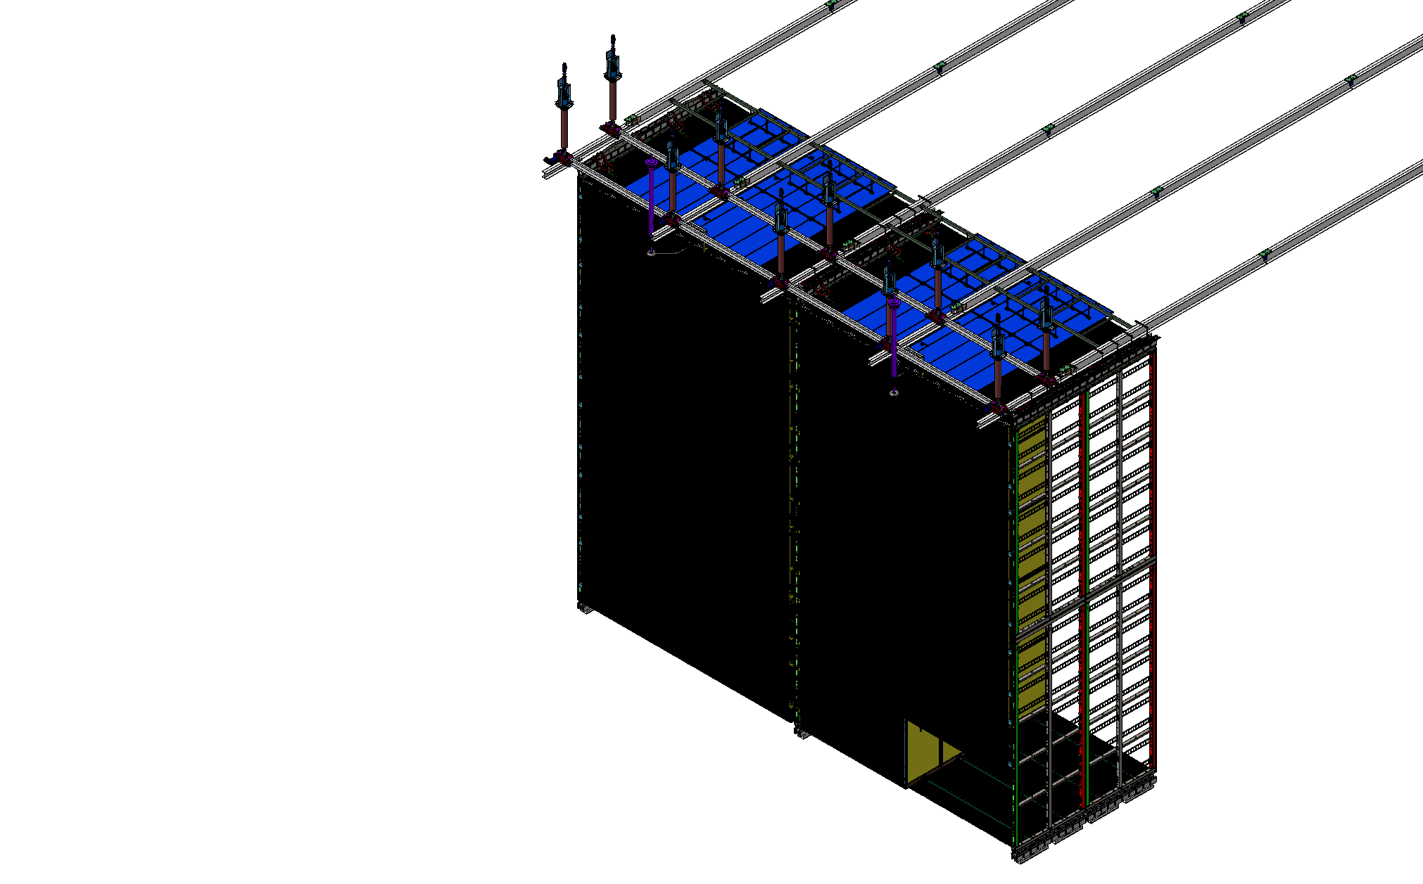
End Wall – Installation

Slide 28
Thank you!

Slide 29
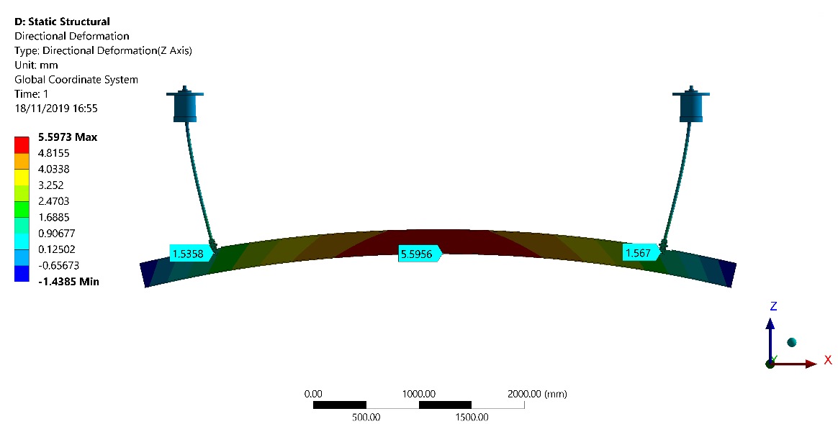
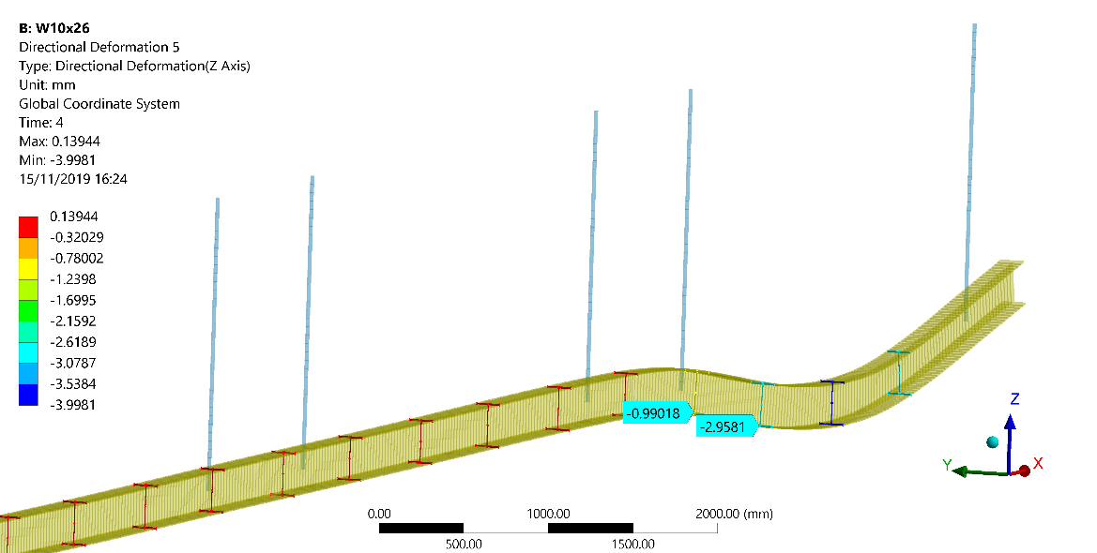
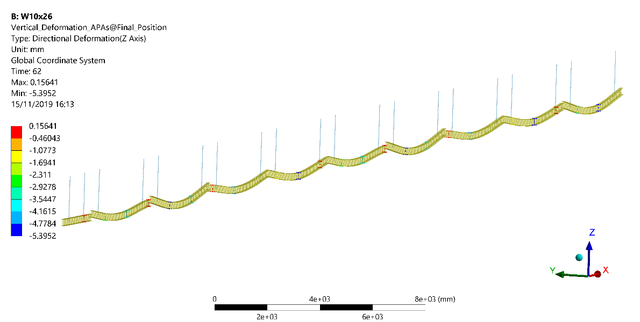
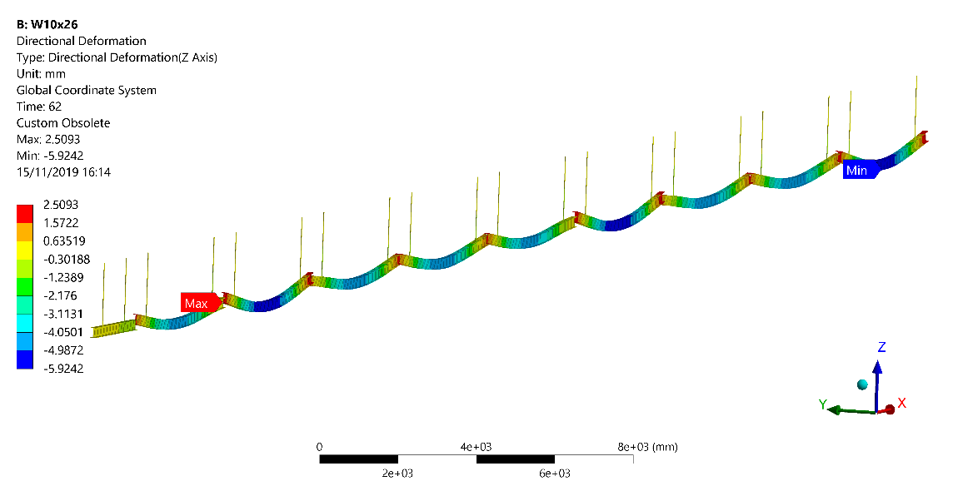
DSS Rail - Deformations

Slide 30
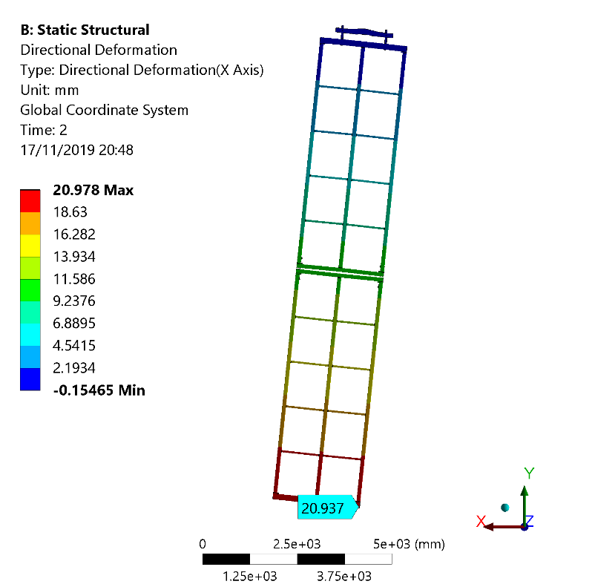
DSS Rail - Deformations
2mm
rail misalignment

