Slide 1
Installation Plan
J Stewart
I&I workshop
February 2020

Slide 2
DAQ and slow control installation on the surface
The first detector installation step is setting up the DAQ in the surface room.
Prerequisites:
  Work in the surface room by CF is finished including fire safety.
  The 8 racks are in place.
  Power, water cooling (50kVA), detector safety system, and cable trays are installed.
  Connectivity to FNAL is established.
Will need about one month and roughly 4 people.
Needs to be done well before work underground starts.
Surface room is available August 2024.

Slide 3
DAQ UG Installation
Here I assume an installation on the cryogenics mezzanine.
The prerequisites for the installation of the DAQ underground are:
The barracks are complete with all fire safety.
The racks are in position.
Cable trays are installed.
100kW cooling is installed and commissioned. Check?
  Could start with lower cooling supply
Power to the racks
  UPS can come later.
Long range fibers are installed and tested to the facility room.
  Extension fibers are installed. How are extension fibers installed? (Fibers are in DAQ but not installation)
Office space for 10-20 people on the surface

Slide 4
DAQ installation UG
DAQ hardware installation in barracks: 5 people x 6 shifts
  QA: PDU tests, grounding check
DAQ OS installation in barracks: 2 people x 15 shifts
  QA: connectivity test of each server, standalone FPGA tests, health check of servers and switches
DAQ standalone testing: 2 people x 30 shifts
  Loopback tests injecting test data patterns and testing the complete end-to-end DAQ
Electronics integration to DAQ 2 people
Coldbox slice preparation: 2 people x 2 shifts
  fibers extension/connection
Coldbox DAQ running: 1 person underground -> sync with CE/PD
TPC/PD electronics connection/test on cryostat: 2 people x 2 shifts per APA pair

Slide 5
Slow control
The prerequisites are:
  Surface room available.
  Network in the cavern.
  Access to Cryogenics barracks and detector mezzanines.
  Cable tray installation complete.
Needs 2 people 1 month to setup the slow control system and test connections. (Assumes modules are installed in one campaign.)
Periodic access underground as new equipment is added.

Slide 6
TPE Elec. crosses and CTCS installation
The TPC elec. crosses and cable support are installed as the cryostat crossing tubes are installed. The crossing tubes without the flanges are installed as the foam is installed.
The CE crosses and crossing-tube-cable-supports are test installed prior to welding the flanges on the cryostat cryostat crossing tubes. The flanges are tacked once the clearance inside the cryostat is checked. Then the cross and CTCS are removed for the final flange welding and leak testing.
This activity is decoupled from the cryostat internal construction so it can be performed late in the cryostat cold structure construction phase.
How many people?
How long?

Slide 7
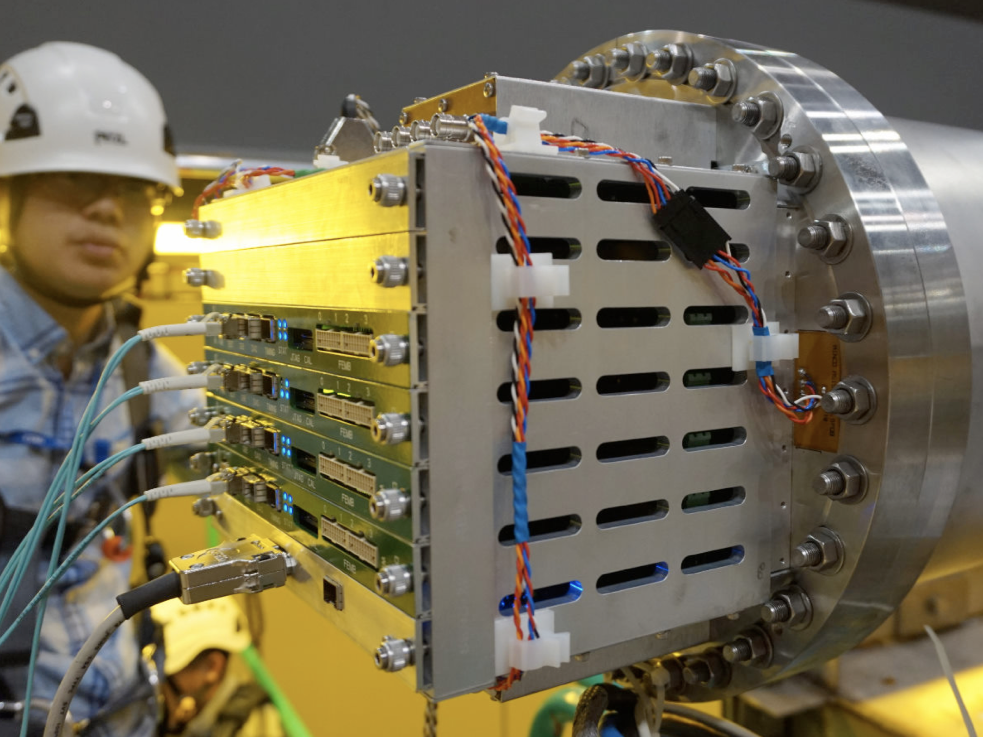
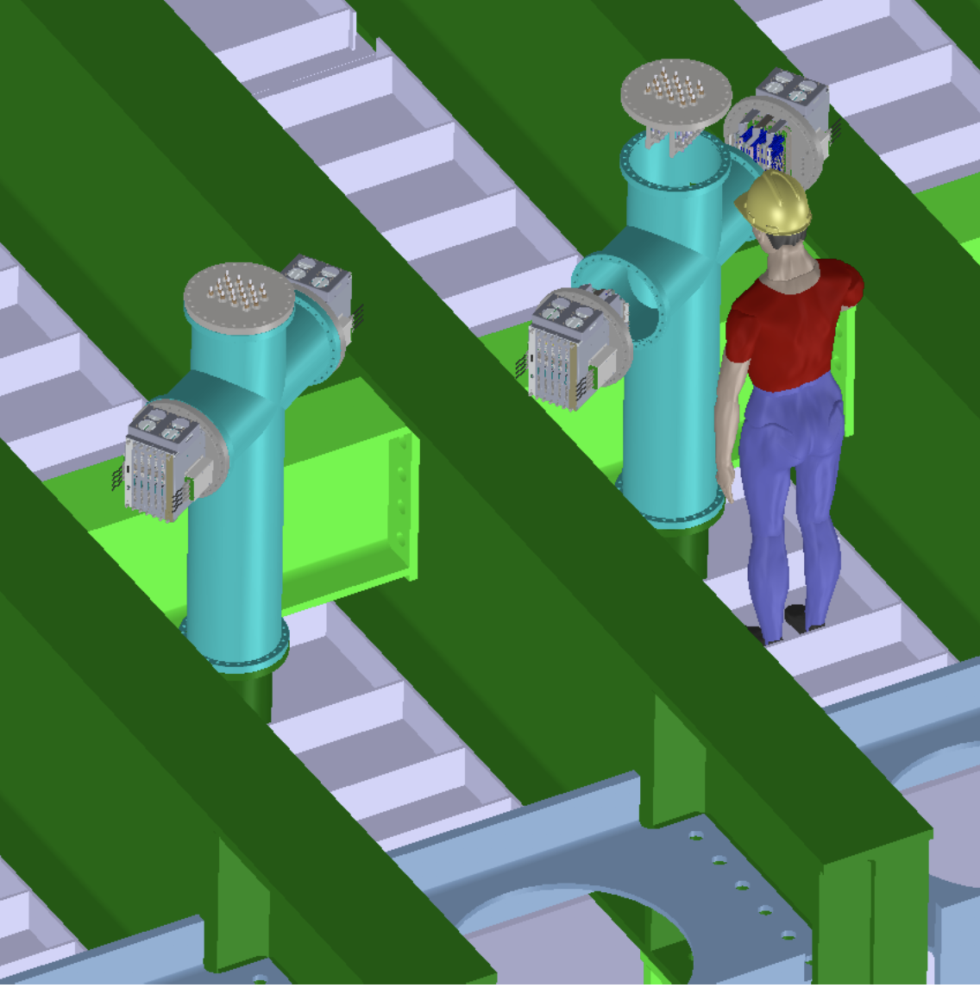
TPC elect. WEIC, PD readout, LV power, and cabling installation.
The TPC elec. and PD readout can be installed after all the heavy work on the cryostat is complete. This includes cable tray installation and argon purge piping installation. The same is true for the modules on the electronic mezzanine.
This will occur in the last 5 months of the cold cryostat installation.
How are the cable installations coordinated? Who places the contract for the installation crew and how is oversight performed?
Junbin Zhang cabling the WIEC

Slide 8
Cryostat status
The last step in the cold structure construction is cleaning. Here the floor is covered in plastic and a 6-7m wide path of flooring is installed. The roof and walls are then washed. The floor and covering are removed and the cryostat floor is washed.
When the cryostat cold structure is complete the false floor is not installed as it had to be removed for cleaning.
The first installation step inside the cryostat is to install a narrow path of flooring to the end of the cryostat and then install enough flooring to work on the calibration and instrumentation equipment.
As the calibration equipment is installed the remaining floor can be installed.
We need to plan where the HV endwall are assembled as the cleanroom may not yet be functional and the floor may not be ready in the cleanroom.

Slide 9
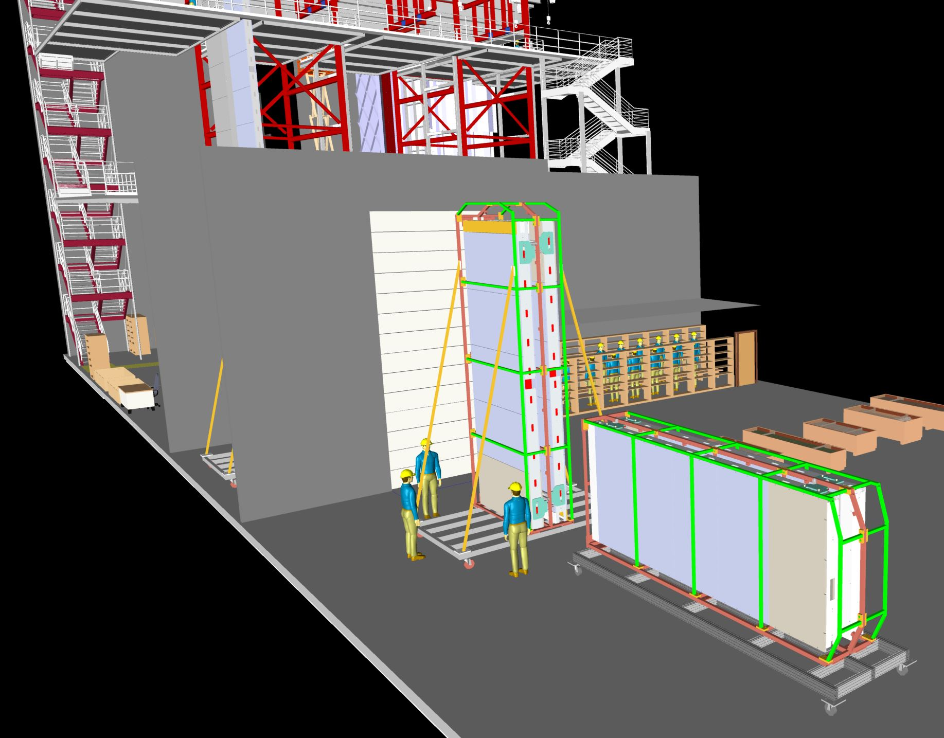
TPC Components
Basic Assumptions
8 FTE INT techs per shift
Filler job for core technicians is to organize ~1 month of materials in open cavern and stage items needed for each day at Materials SAS
All TPC components: APAs, HV, cables, CE, etc. are all delivered to the SDWF (South Dakota Warehouse Facility) where it is inventoried (QC checked if needed) until it is shipped underground
The SDSD is responsible for the common technical resources which includes the Transport team of Riggers and Equipment operators that deliver the TPC components underground and places them in the empty cavern
At this point the INT technicians are responsible for moving the TPC components into cleanroom and finally into the cryostat with help from the hall crane operator.

Slide 10
CAL/CI Initial Installation
The details of the CAL/CI installation have not been worked through.
The CAL/CI groups plans to install all the thermometry cables at the beginning of the installation.
  The number and location of the sensors needs fixed.
  Purity monitors, Capacitance level meters and possibly cameras will be installed near the East wall.
  The interfaces need to be defined especially for the cabling.
  After this a reasonable time and labor estimates can be established.
The installation of CAL/CI should be treated as a sequence of planning packages in the schedule.
Here it is assumed that the cryogenic instrumentation and the End Wall can be installed in <1 month period.
Some CAL/CI work needs to run in parallel to TPC installation and a month long planning packages should be inserted at the end of the installation.
Do we need to add CAL testing activities that stop other installation work?

Slide 11
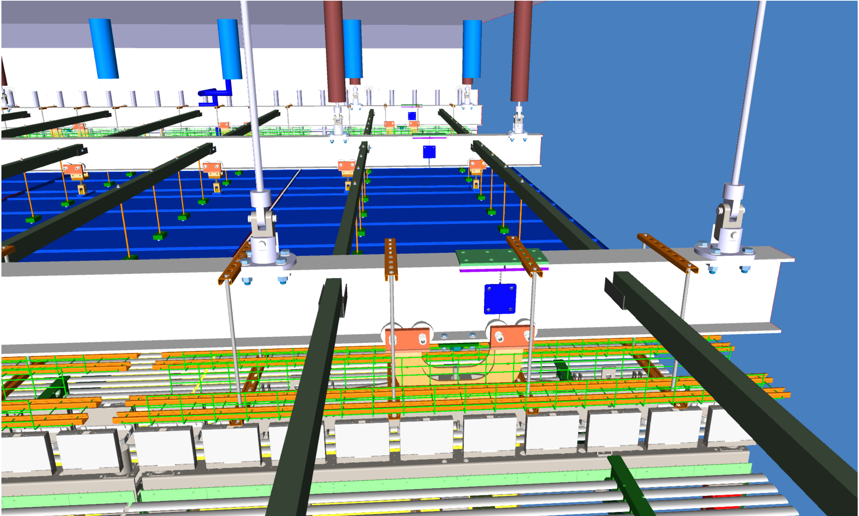
Ground plane mount installation
A network of north-south support bars need to be installed for hanging the ground plane from the DSS structure.
  This disconnects the FC from the ground plane except through the CPA mounts.
The ground planes can also be installed in this time as they are hinged and do not interfere with the CPA-FC installation.
This work can be performed in parallel to the end wall installation.

Slide 12
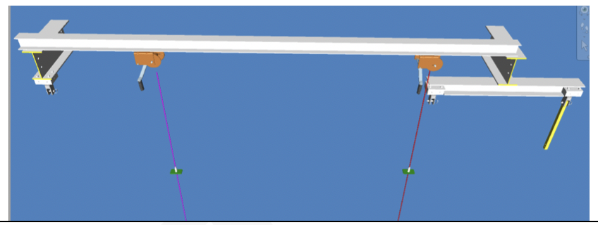
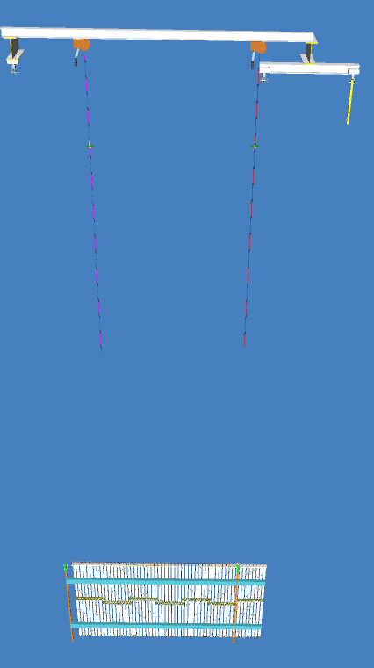
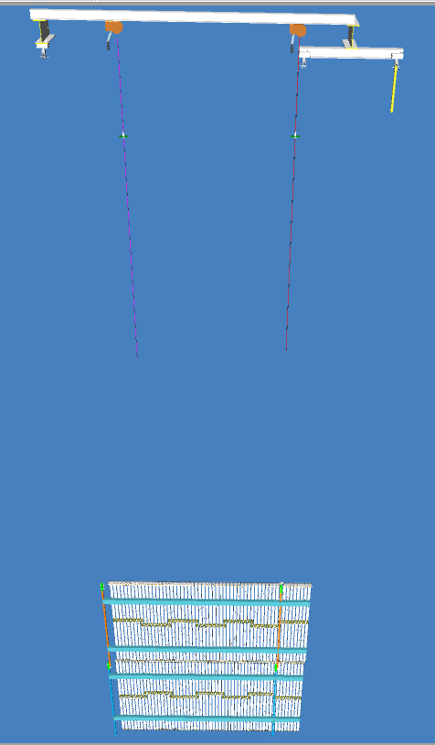
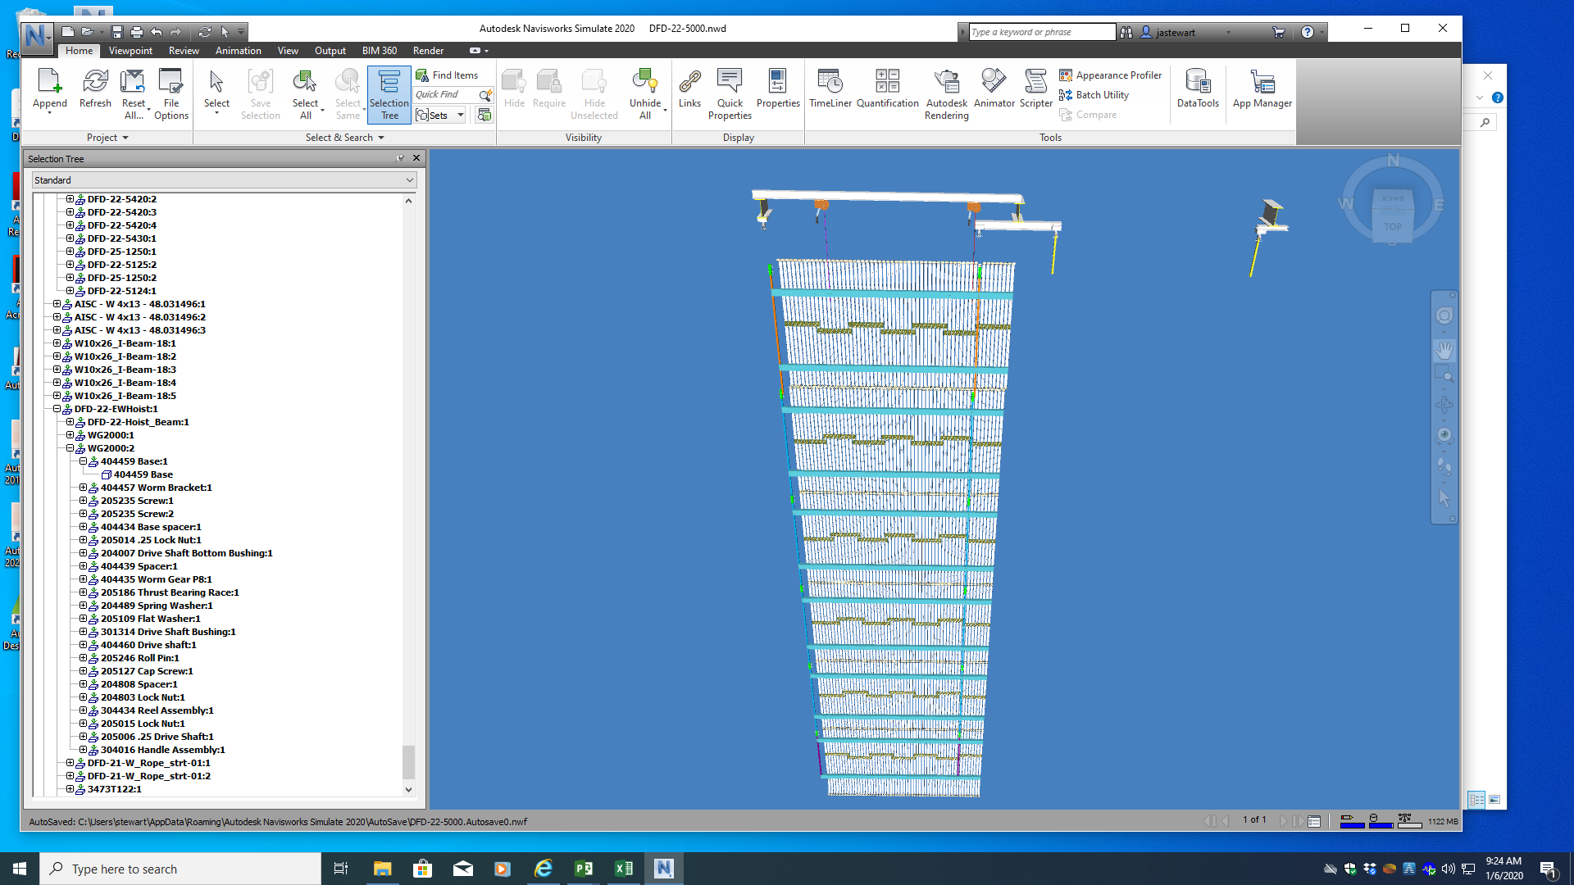
HV End Wall Installation
The exact sequence of the EW installation is not fixed. This will be finalized at the AR phase 2 test.
EW are installed using a dedicated removable beam with winches.
EW panels are lifted one after the other to form an EW panel.
Row 1 of the cathode must also be installed at this time in order to install the HV cup and feedthrough. (No access after EW is complete!)
1 or 2 endwall panels must be installed after HV installed to allow the scissor lift to be removed. Cryogenic piping limits scissor lift access behind the endwall.

Slide 13
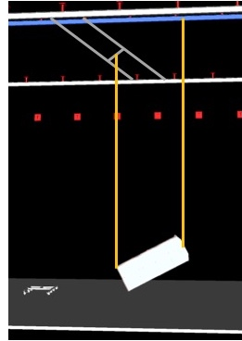
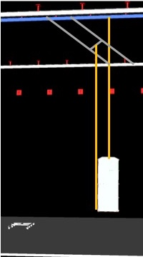
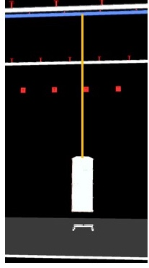
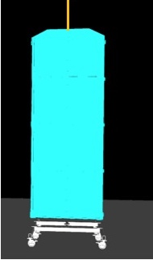
Getting APA into the experimental cavern
The APA arrive to the hall at the 4850 level West end.
Propose to rotate the APA to vertical and mount them on vertical transport carts when they are craned down to the 4910 level.
This reduces the number of rigging steps.
Need ~12 vertical transport carts for APA storage and work in the cryostat.
APA will be stored vertically in the cavern.

Slide 14
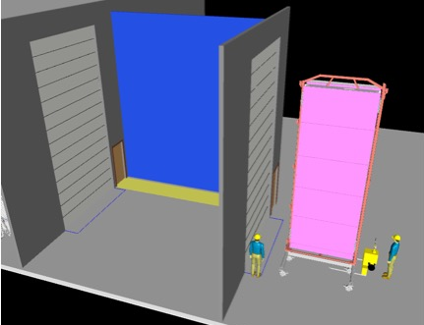
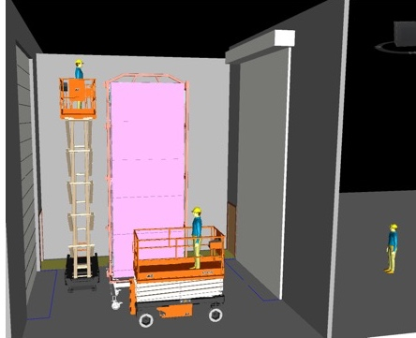
Bring APA into the cleanroom
The outer covers of the transport box are removed in the detector hall. (crane can be used)
  Outer covers are not hermetic.
The APA enter the SAS (airlock) and are cleaned.
Air is purified 15-30 min.
Inner protective bags are removed.
Again air is filtered
APA are moved into the cleanroom and to the PD area.

Slide 15
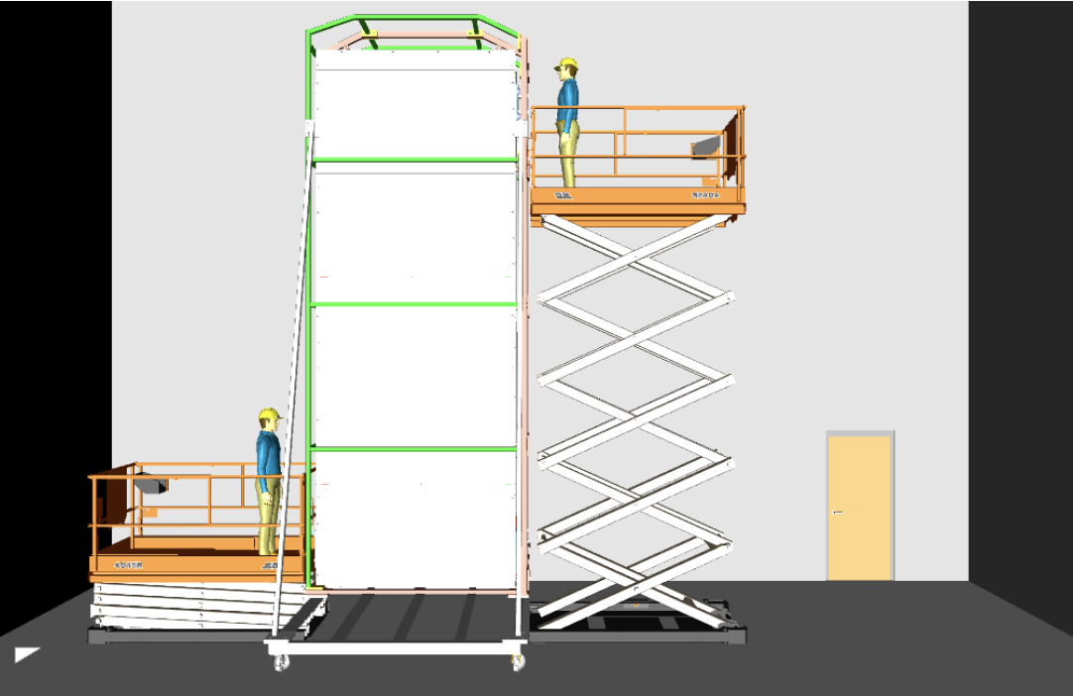
Photon Detector Integration
PD modules are inserted in the sides and connectors are accessible top and bottom.
Standard scissor lifts are used for PD integration.
New cart design allows access to the face of the APA. Propose to use a single person lift to check the PD electrically and to install T-brackets… Will look into ramp or special lift for access.
The latest cart does has open areas around the APA faces.

Slide 16
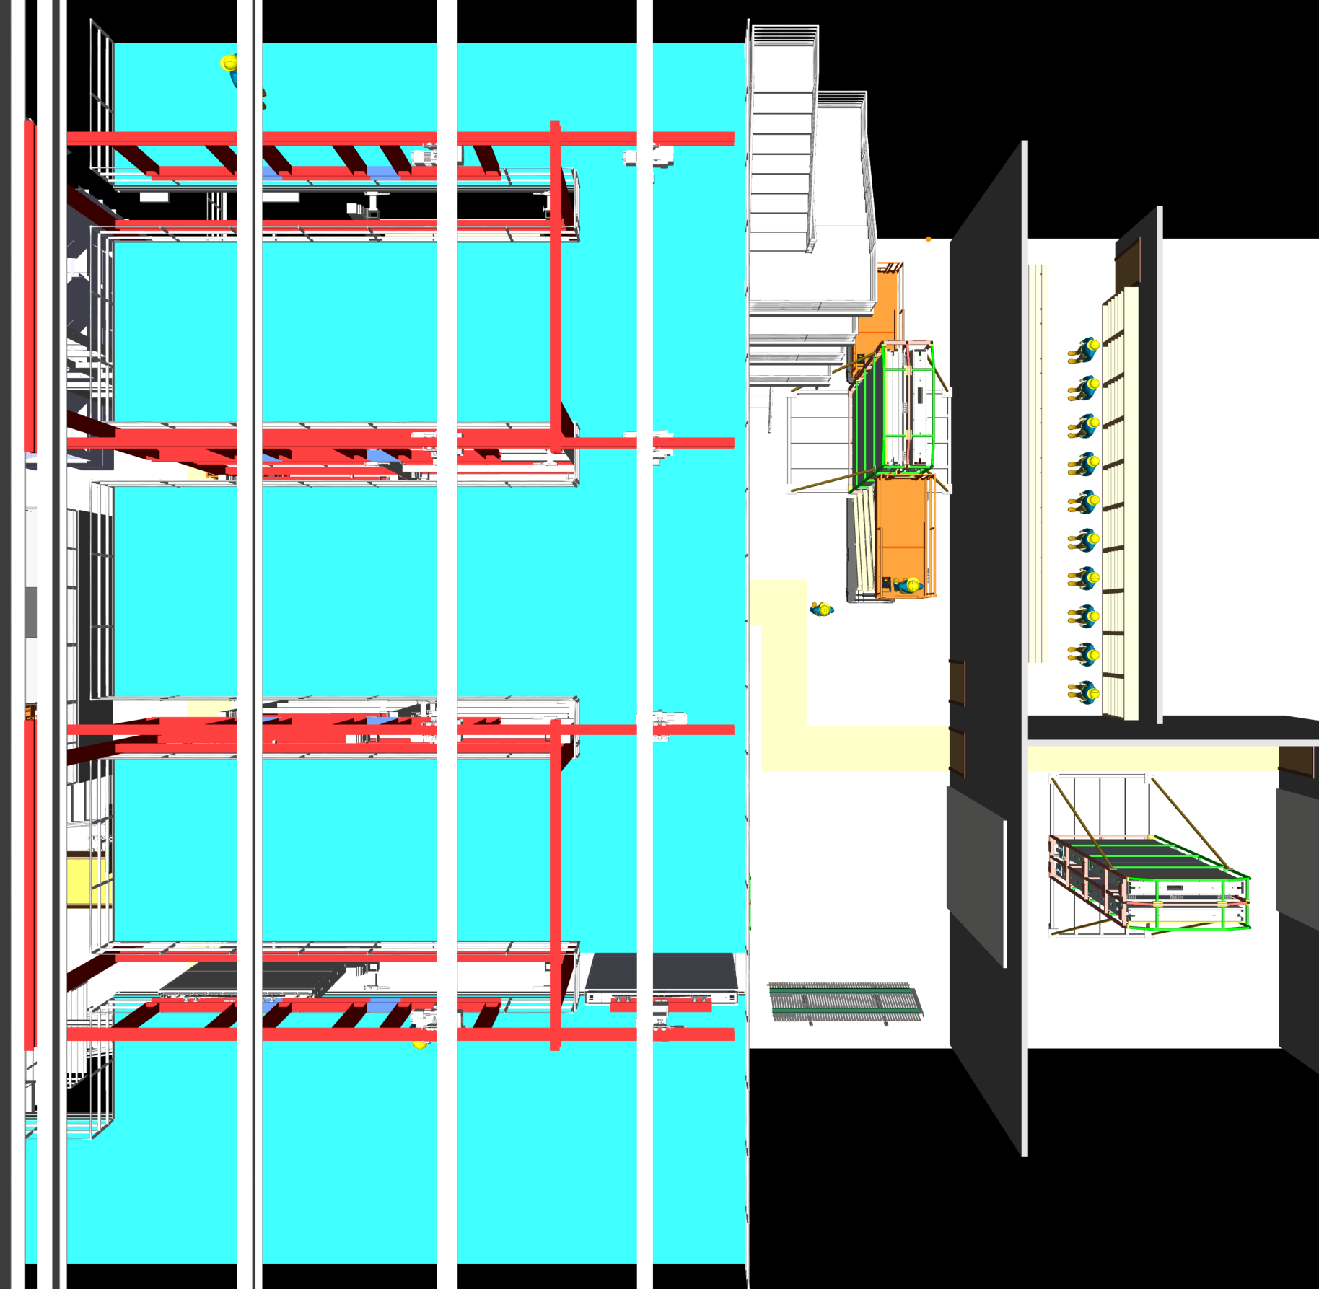
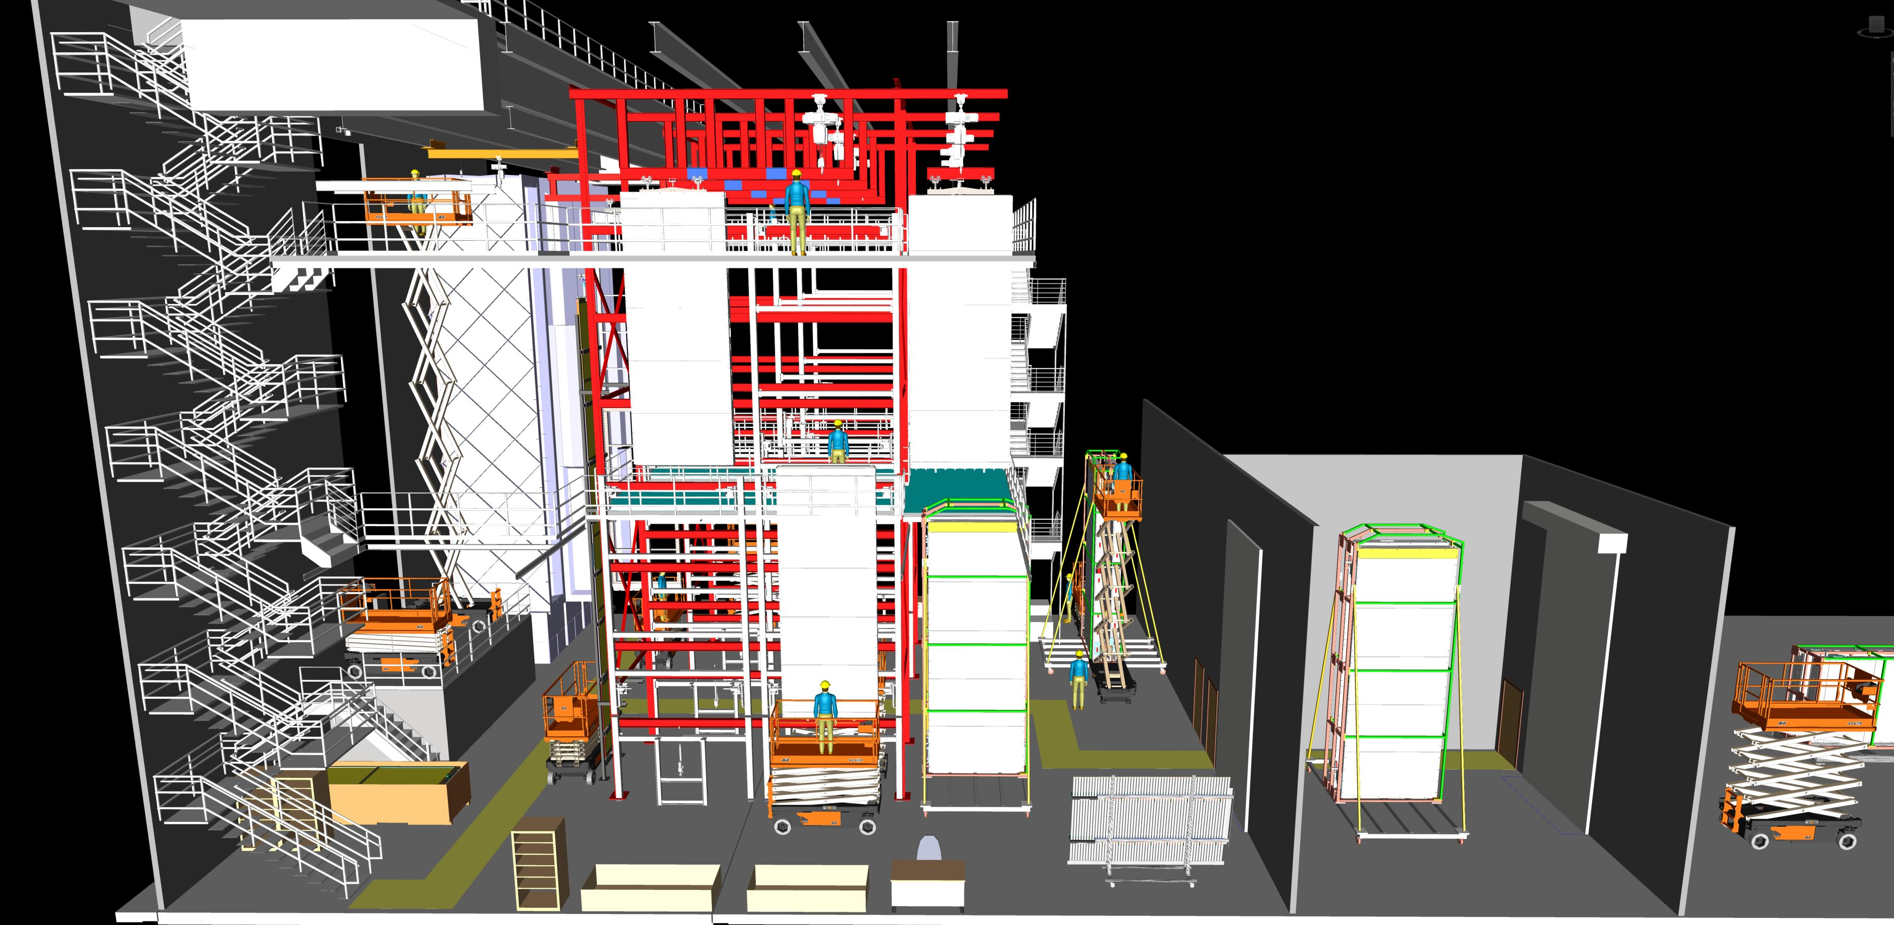
APA doublet assembly
Slot 1
Slot 2
2 APA are assembled into doubled on the assembly cabling towers.
This sets the size of the cleanroom.
Two towers allows 4 assembly lines.
Intermediate platform level abandoned.
Assembly sequence is well defined.
Initial assembly steps have been tested at AR. Went much faster than projected.
Conduits can be factory installed.
Slot 3
Slot 4

Slide 17
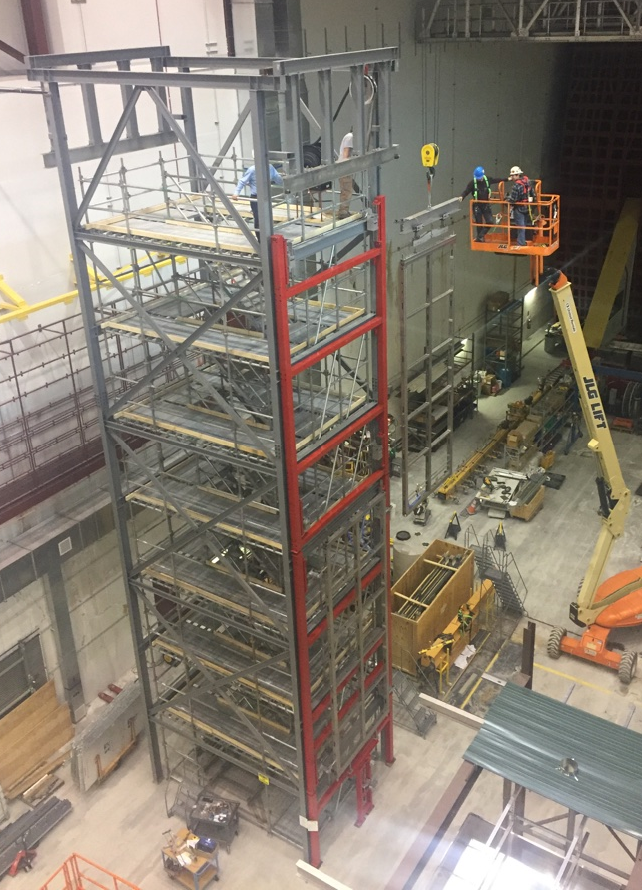
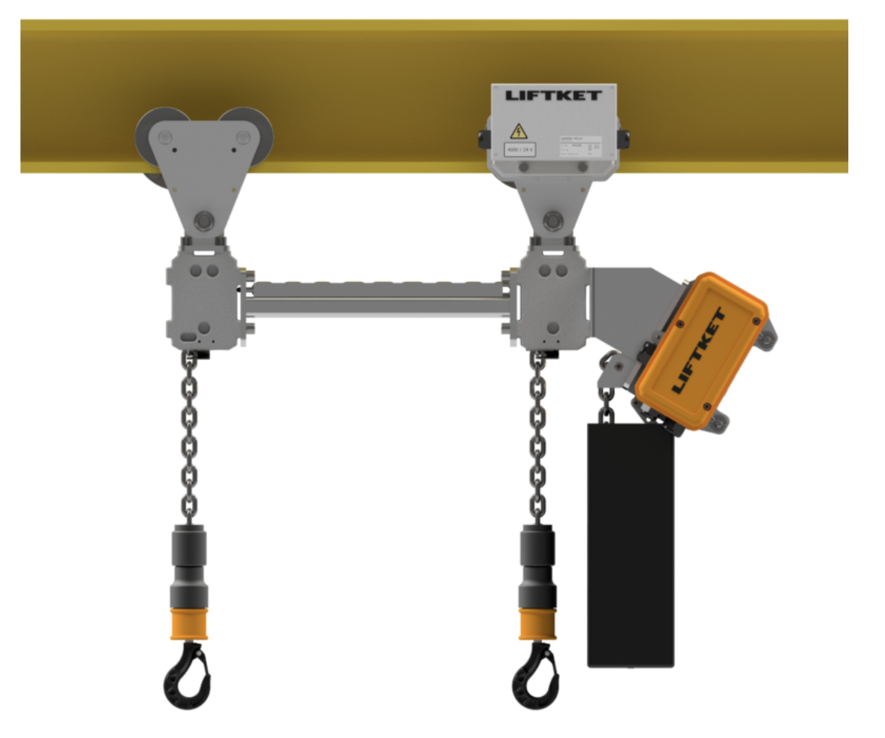
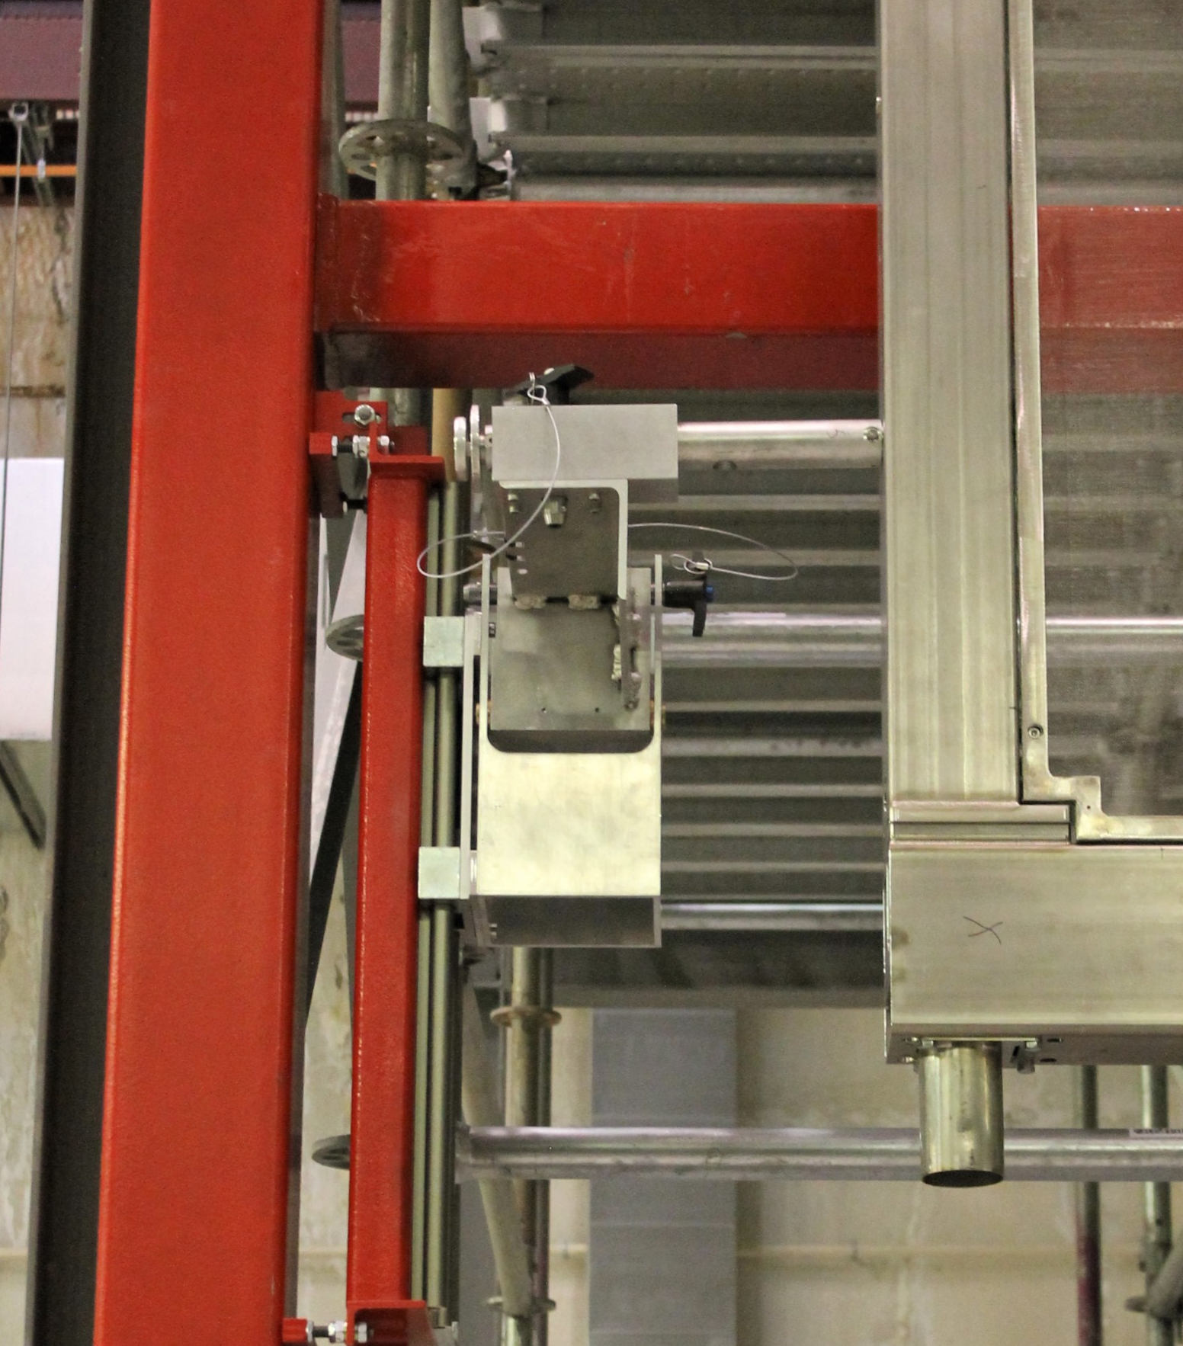
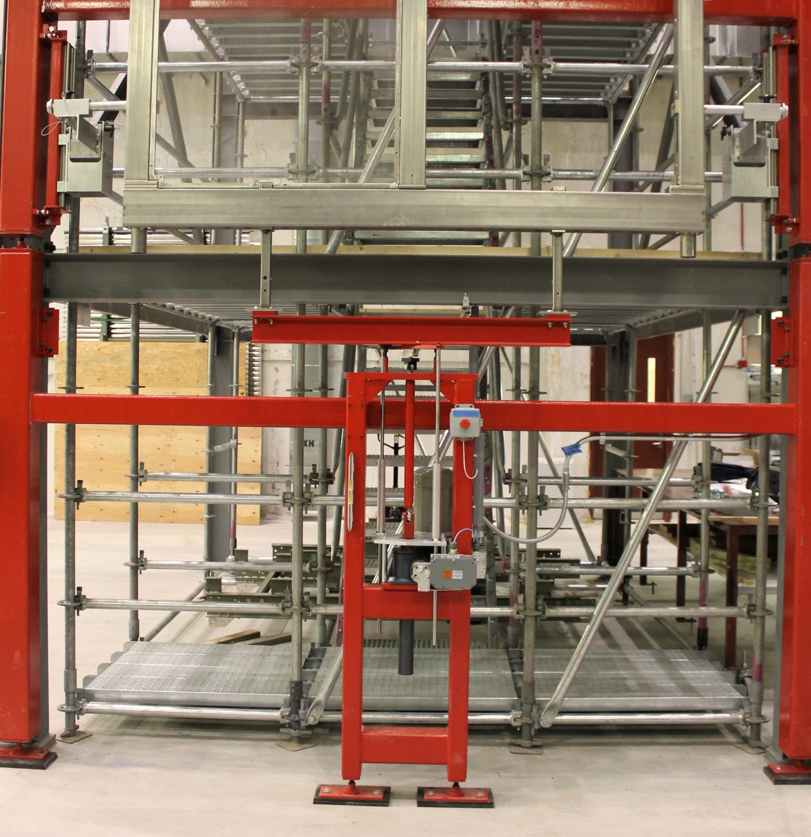
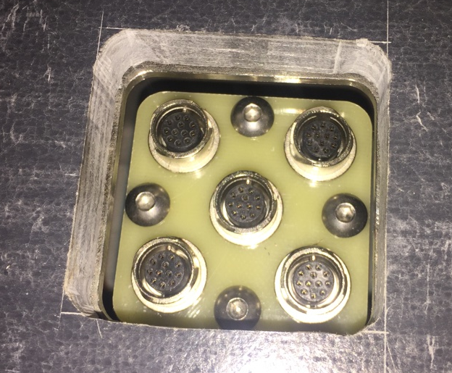
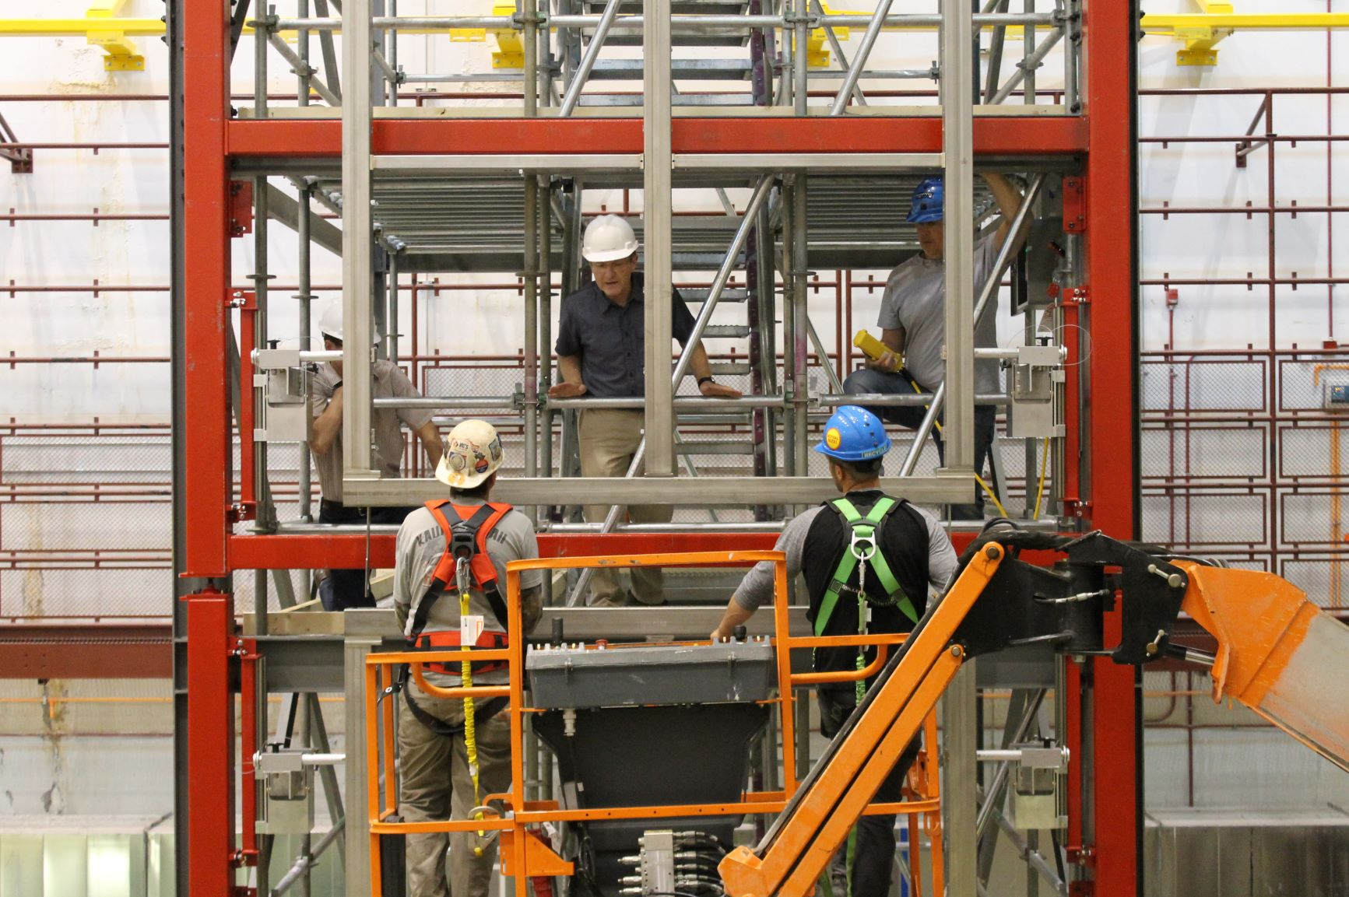
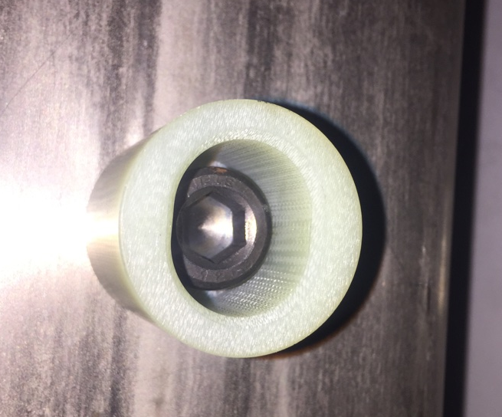
APA doublet assembly
2 APA are assembled into doubled on the assembly cabling towers.
This sets the size of the cleanroom.
Two towers allows 4 assembly lines.
Intermediate platform level abandoned.
Assembly sequence is well defined.
Initial assembly steps have been tested at AR. Went much faster than projected.
Conduits can be factory installed.

Slide 18
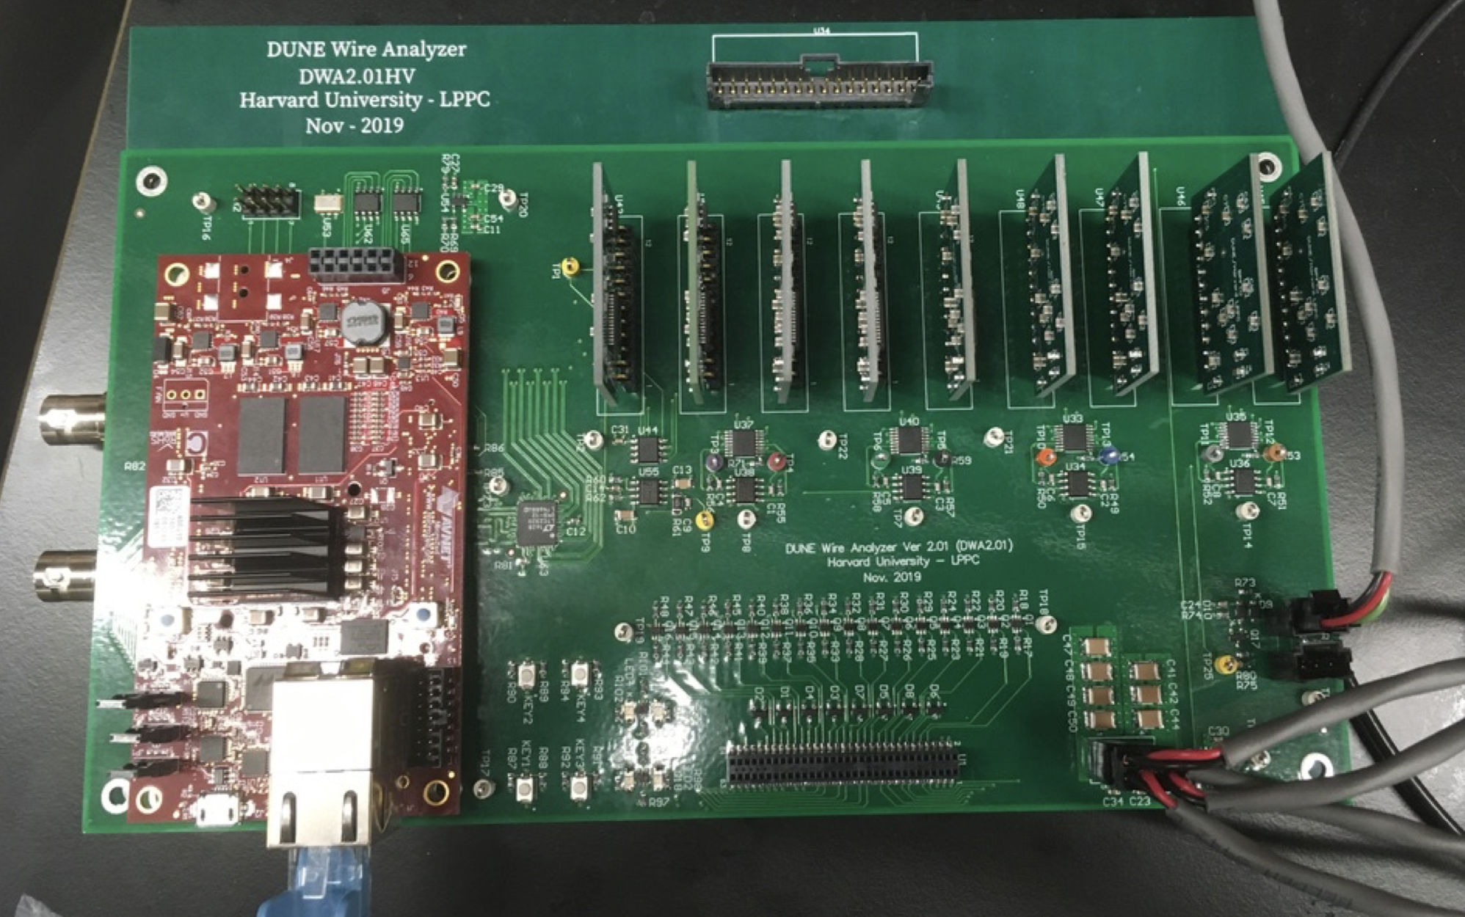
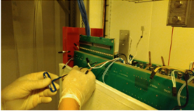
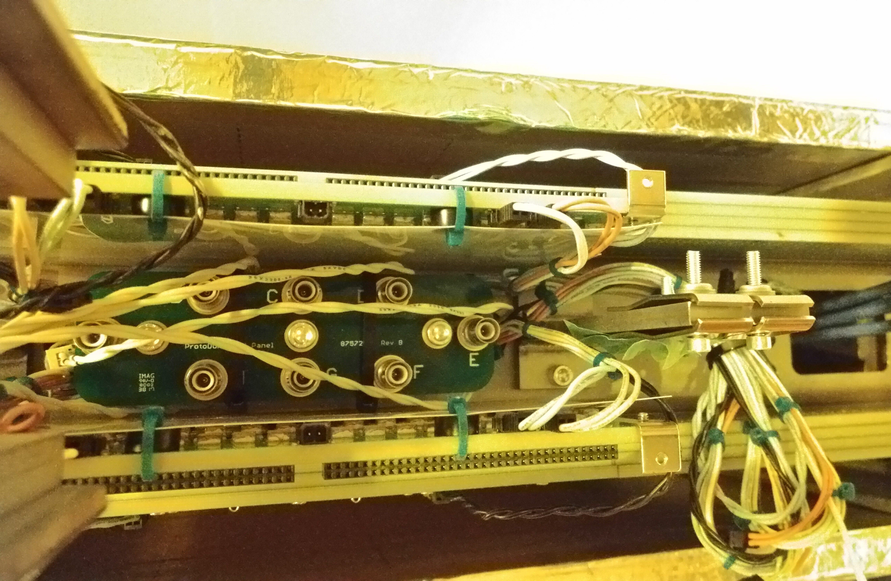
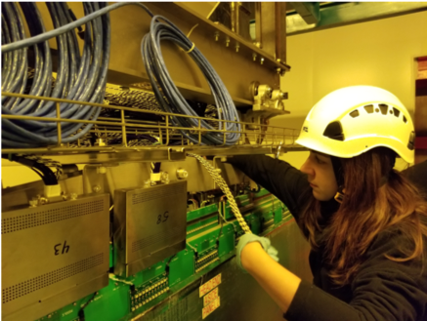
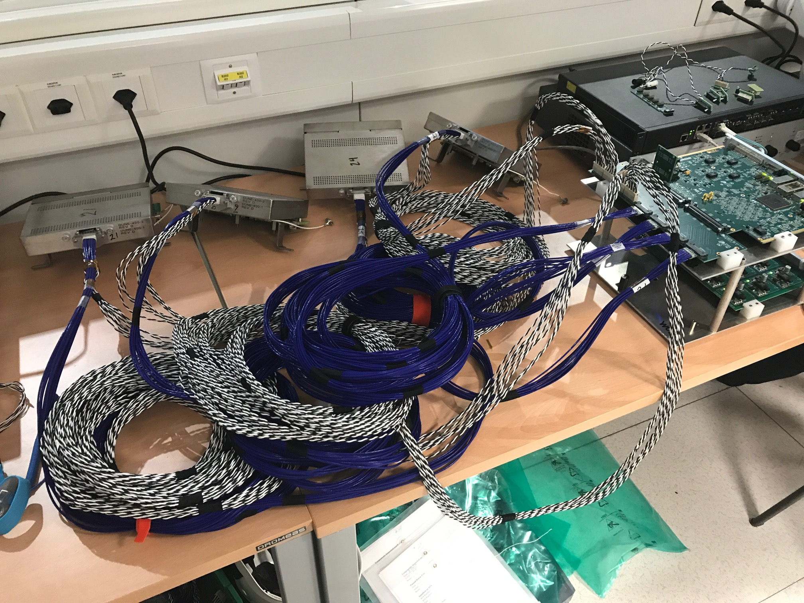
Wire tension test and FEMB installation
The wire tensions are measured after the doublet is assembled in the final orientation. (Lower T and C brackets also installed.)
CR boards are installed after wire tension tests.
Bias cable harness and patch panel is installed.
FEMB are installed and tested when the CR boards are installed.
Tension
CR boards
Bias cabling
FEMB install
4 FEMB test setup

Slide 19
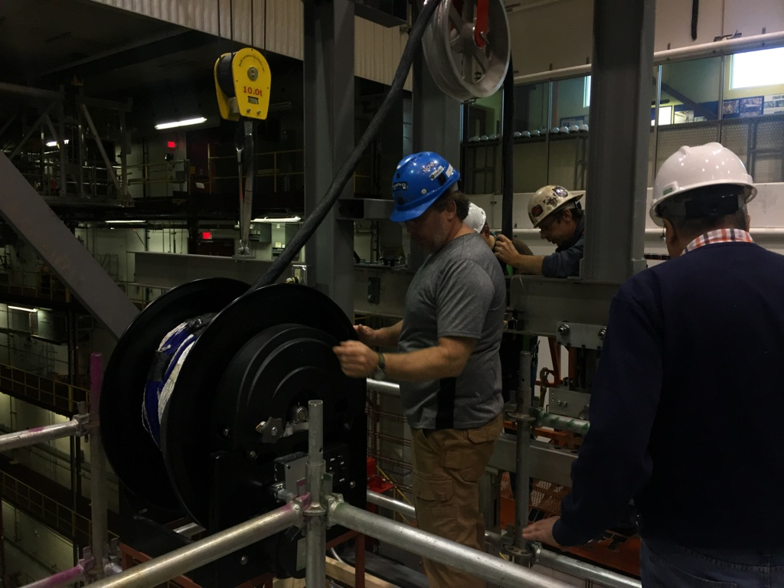
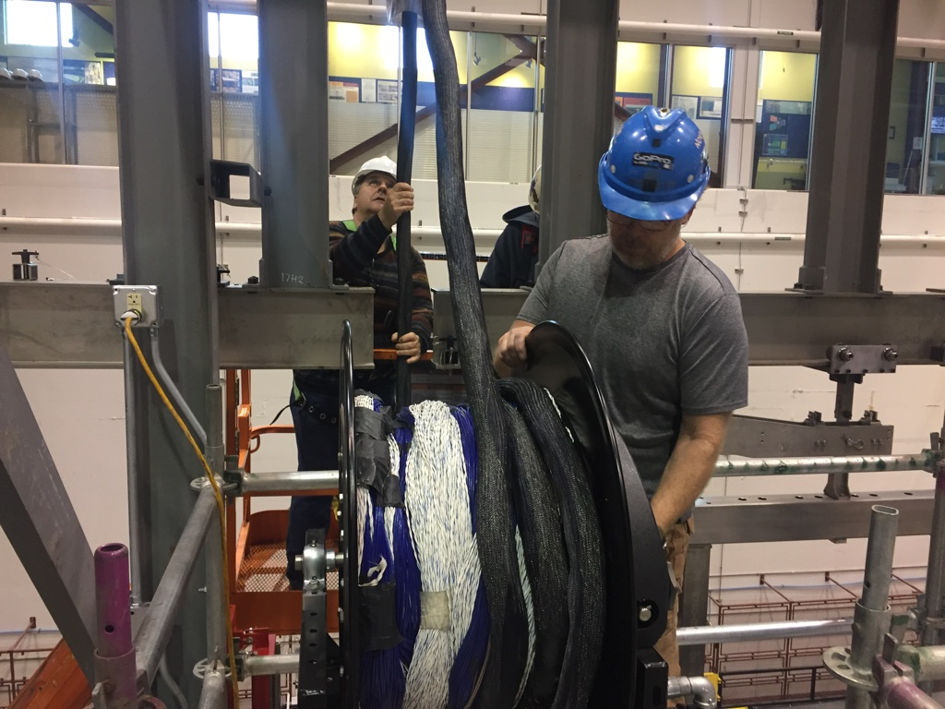
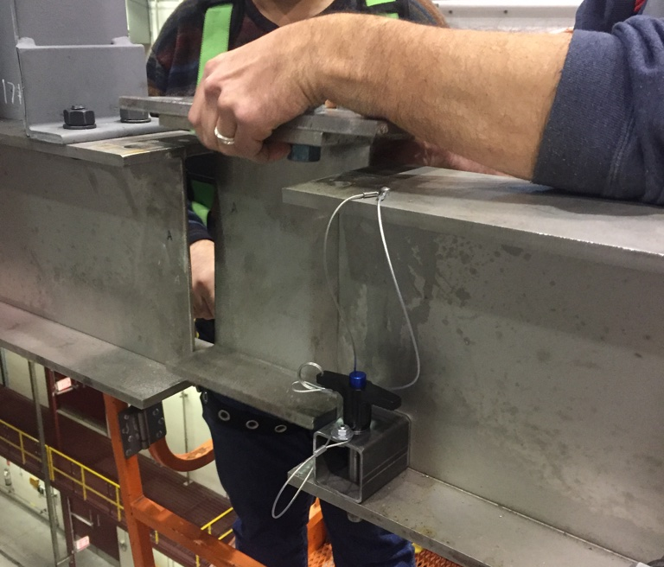
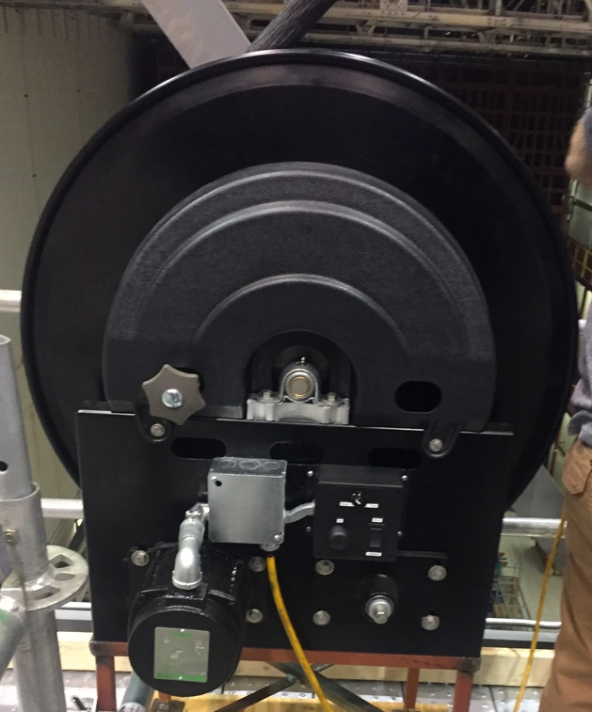
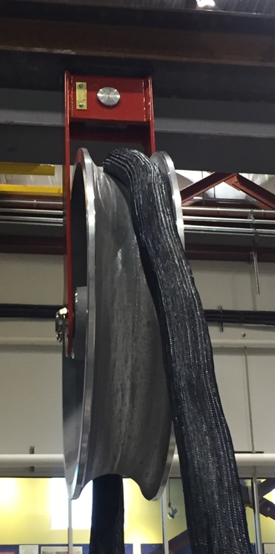
APA cabling
After the electronics are mounted and tested the APA pair is shifted to the next assembly station.
The cable tray assemblies are installed.
The long cables for the bottom APA are inserted and connected to the lower FEMB and dressed in the cable trays.
The shorter cables are laid in the cable trays and connected to the FEMB
All FEMB are quickly re-tested.
Installation process needs to be further developed at BNL.
Need to test cabling in detail. How cables are deployed in cable trays is a big open question. (Talk from Manhong)

Slide 20
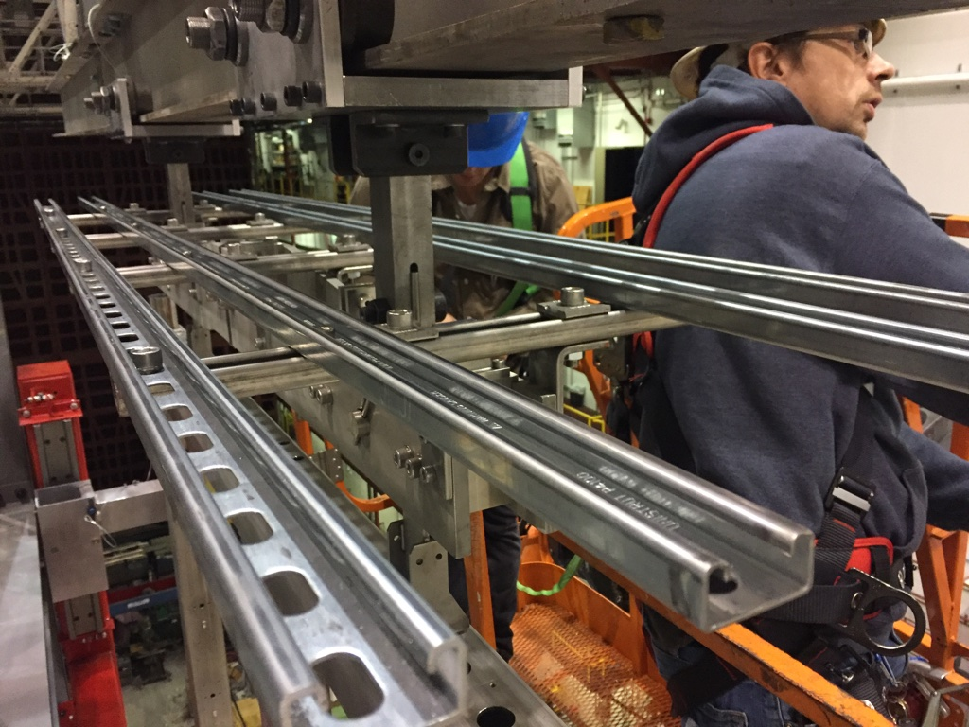
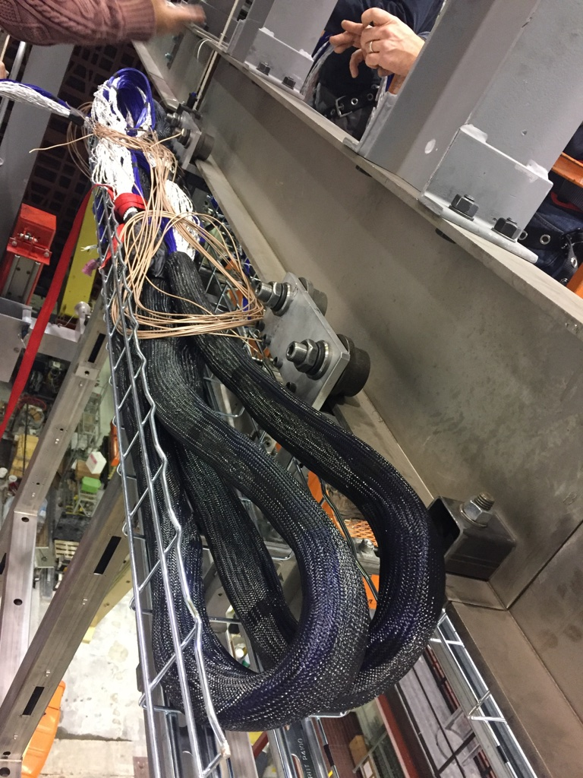
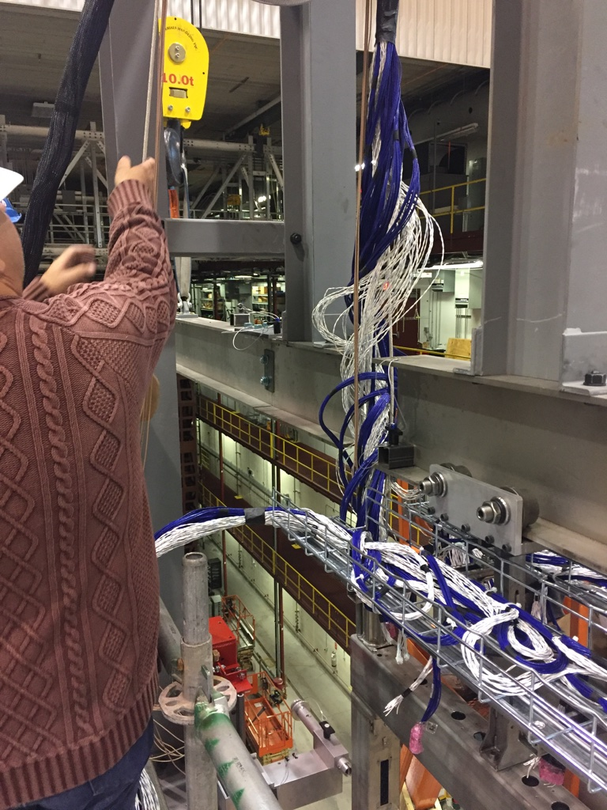
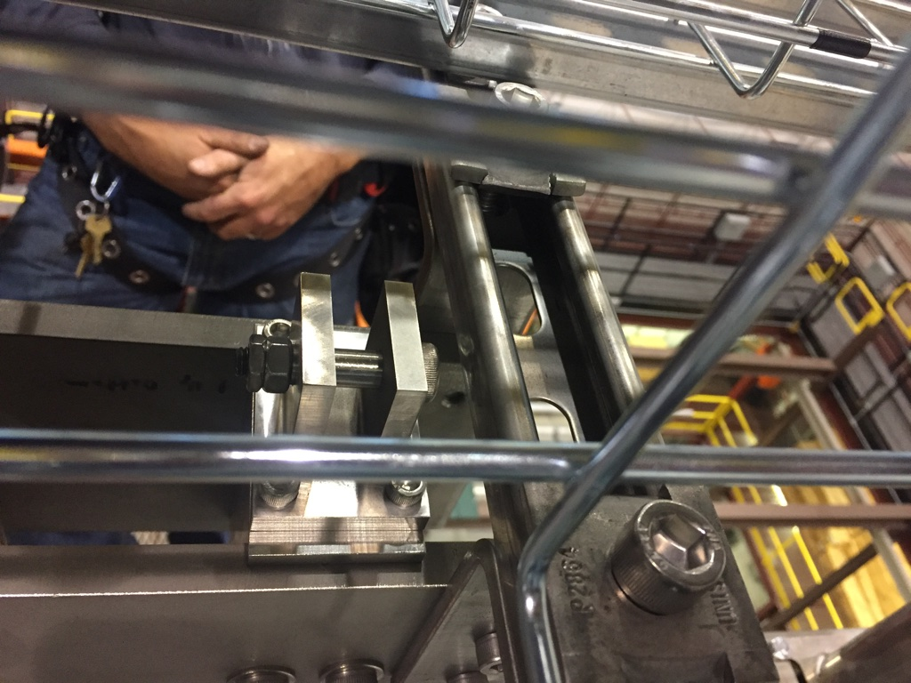
APA cabling
After the electronics are mounted and tested the APA pair is shifted to the next assembly station.
The cable tray assemblies are installed.
The long cables for the bottom APA are inserted and connected to the lower FEMB and dressed in the cable trays.
The shorter cables are laid in the cable trays and connected to the FEMB
All FEMB are quickly re-tested.
Installation process needs to be further developed at BNL.
Need to test cabling in detail. How cables are deployed in cable trays is a big open question. (Talk from Manhong)

Slide 21
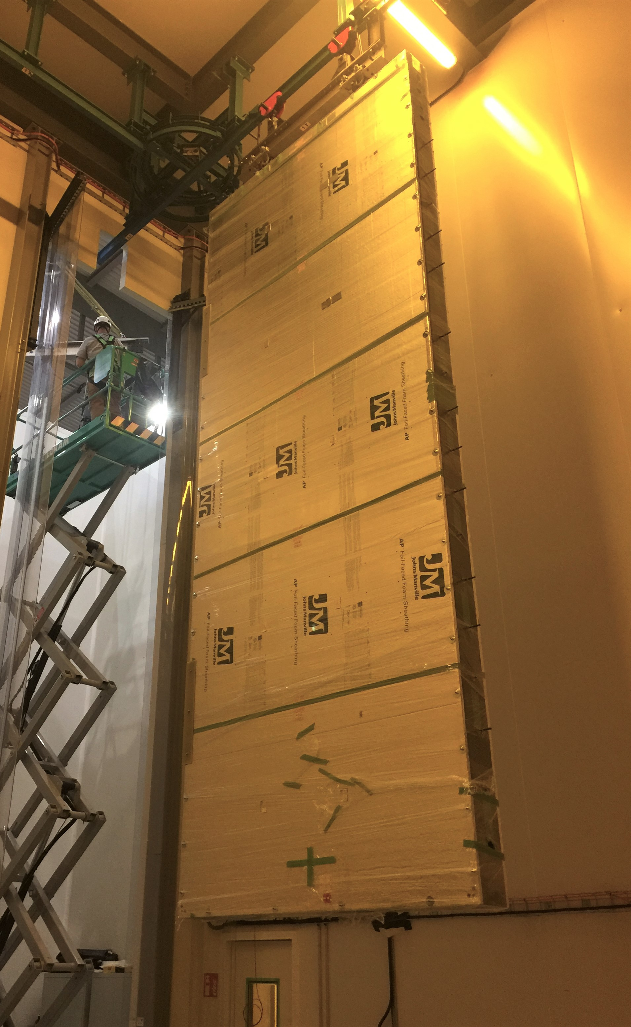
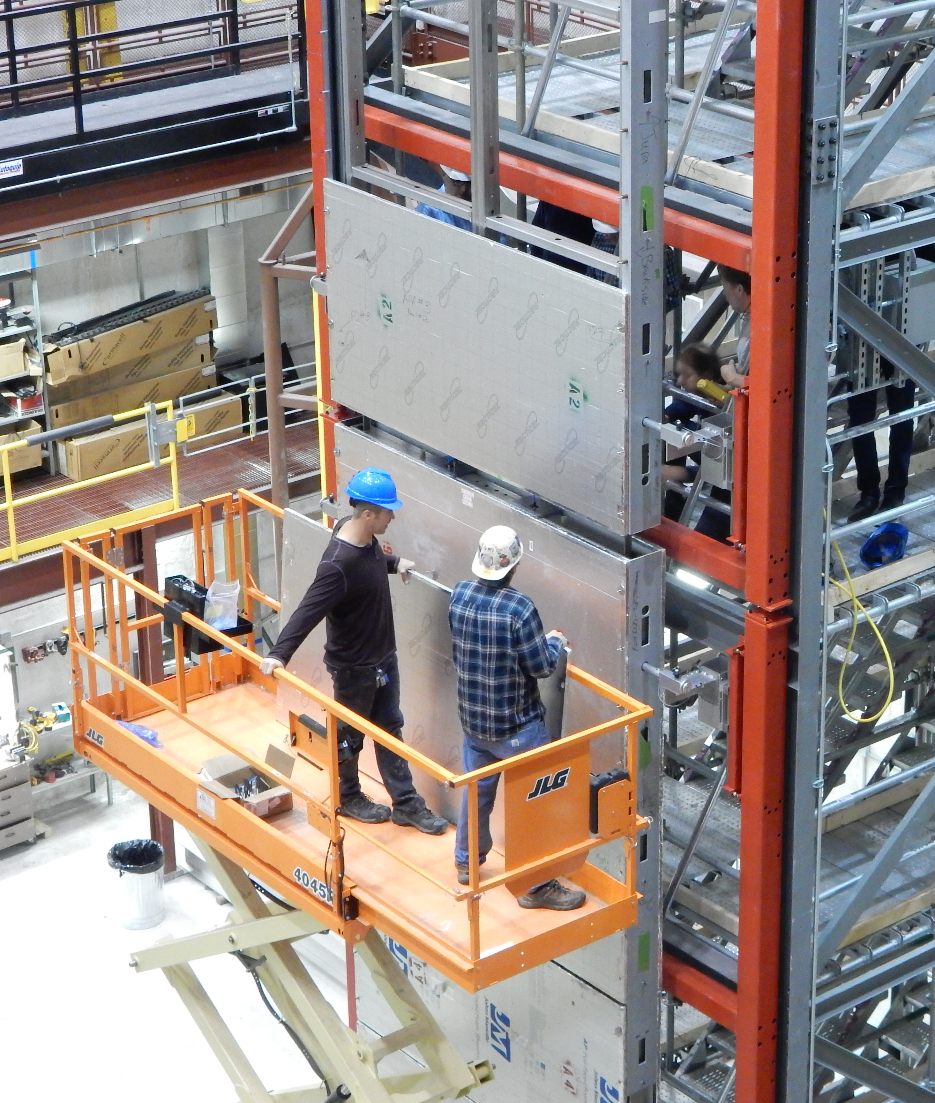
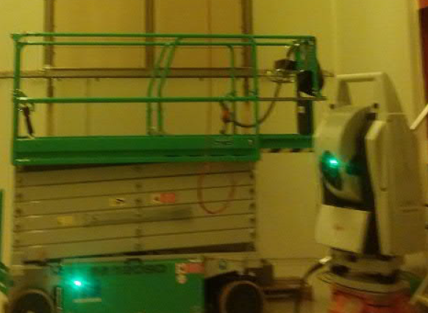
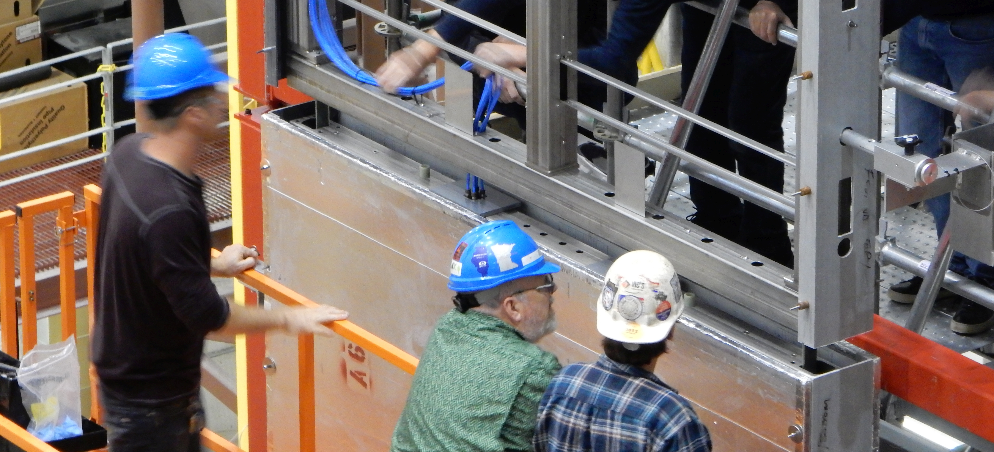
Remove covers and photogrammetry
The protective covers are removed as late as possible to keep the wire protected.
Tests were performed at Ash River using old C-channels and cover panels.
  Aluminized foam sheets seems to be a good material. Edges need sealed.
  Design needs changed to give visual access to critical areas during APA assembly.
  C-channels are heavy and clumsy. Need better design and tooling for removal.
The photogrammetry needs planned in detail. Have the ProtoDUNE-SP reports.

Slide 22
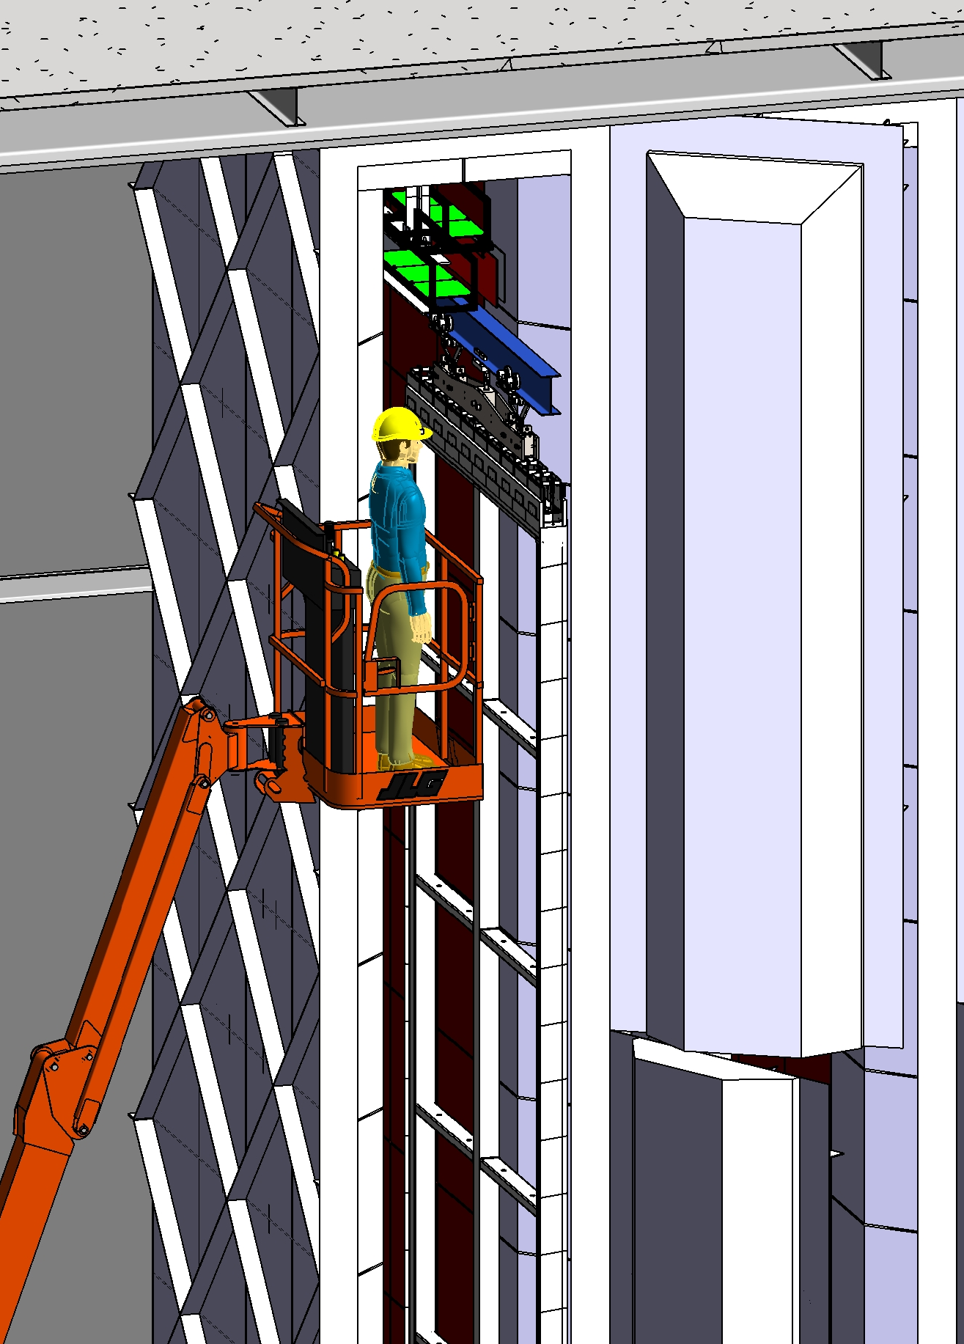
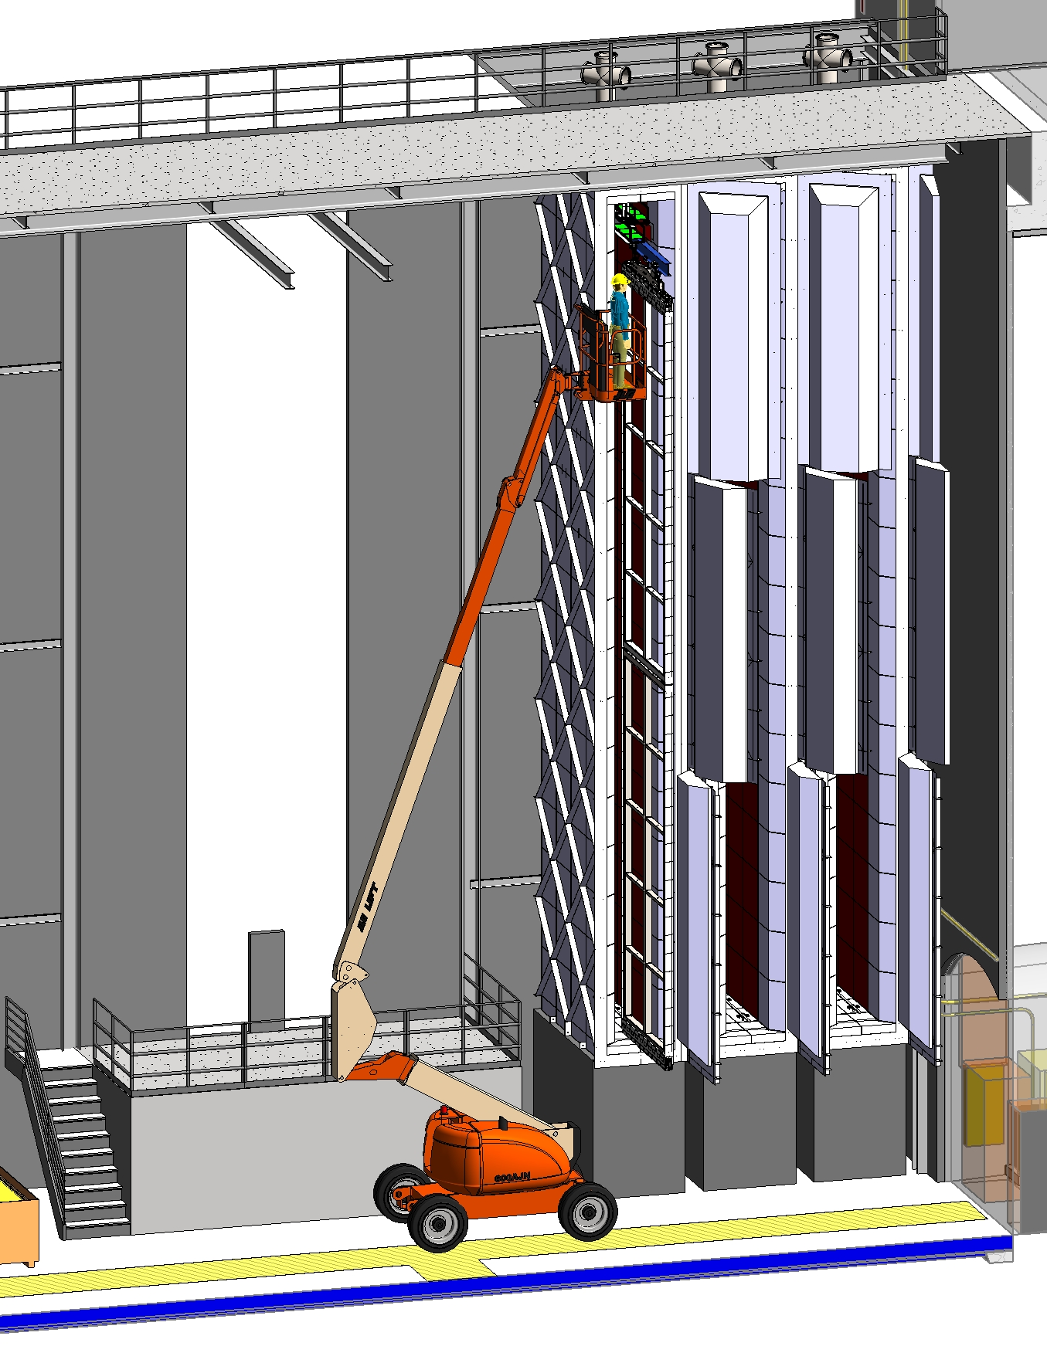
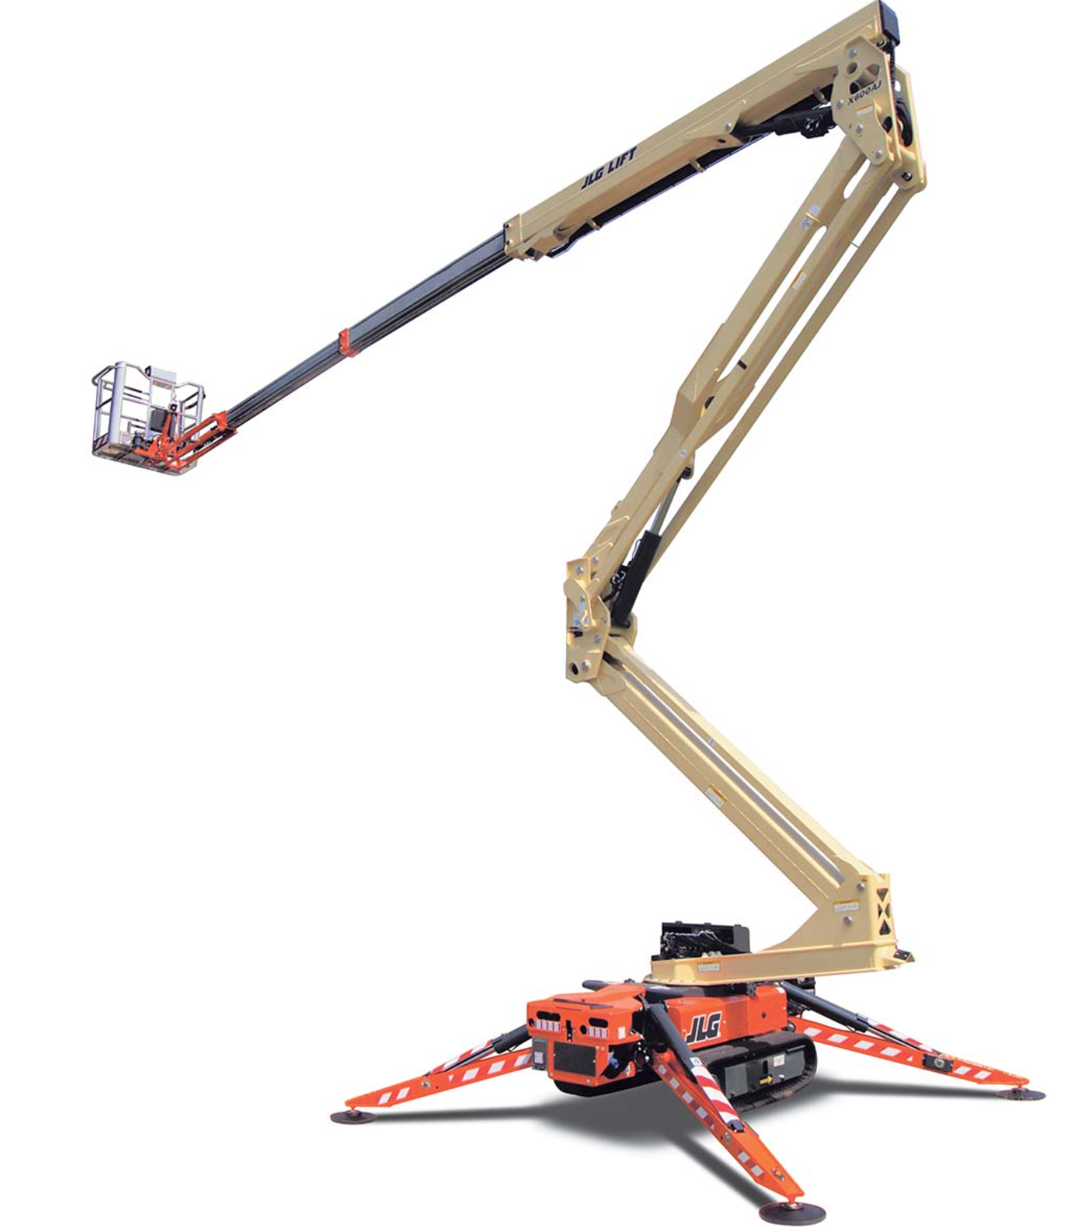
Cold testing
The APA are moved to the coldbox.
The cleanroom bridge crane will be designed to be able to move toward and away from the cold box.
A spider lift is used to connect the bridge crane rails to the coldbox so the APA can be moved inside and also to connect the cables to the patch panel.
The doors are hinged so they can be easily opened.
The cold box can operate 24/7.
  24 hr. cool down, 24-48 hr. testing, and 24 hr. warmup.

Slide 23
APA installation in the cryostat
The APA is moved into the cryostat through the TCO and the internal switchyard is used to move the APA to the correct row.
  This process will be first tested in Phase-II AR.
The cables are then fed through the feedthrough and connected to the WEIC and PD flange.
The PD and CE readout can them be tested and the flanges closed.

Slide 24
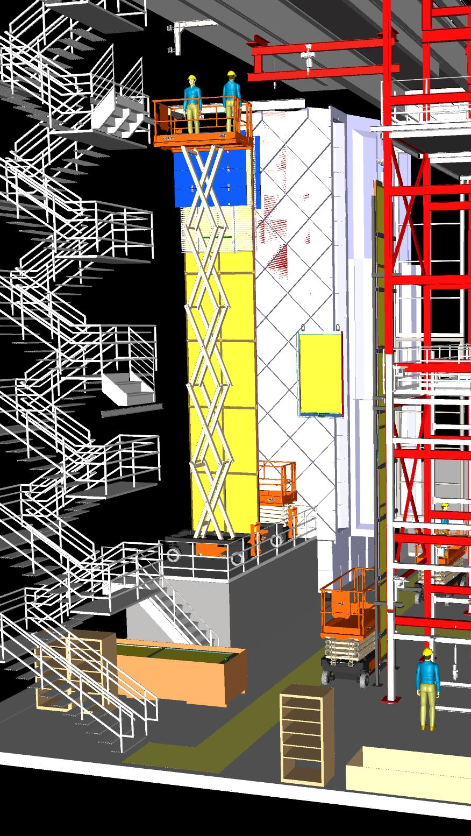
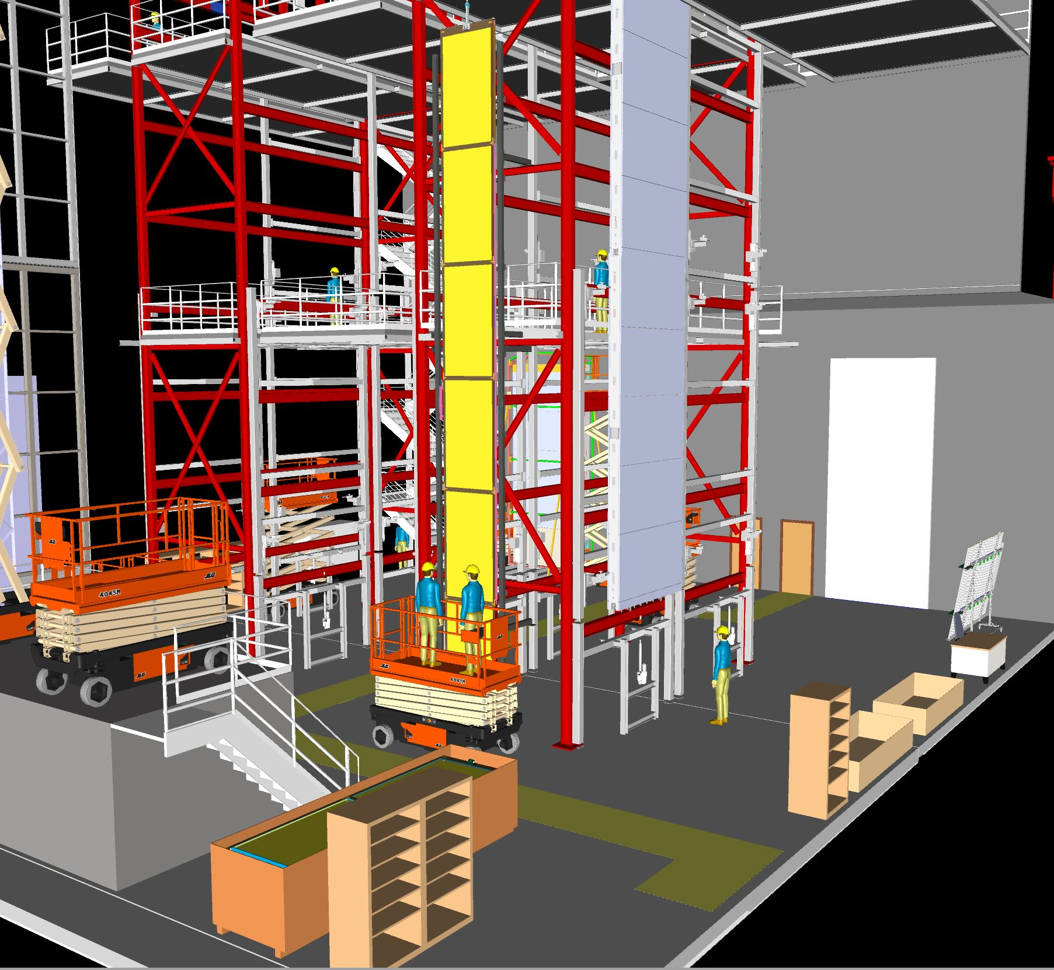
CPA panel assembly
CPA modules arrive underground in a CR compatible shipping box.
The bridge crane is used to lift the 4m sections onto the assembly frame.
A custom assembly frame is used to assemble the sections into a 12m tall panel.

Slide 25
FC module assembly
The top and bottom field cage modules are assembled underground.
Expect to fit two assembly frames in the assembly area.
Storage of assembled FC modules is an issue that needs solved.

Slide 26
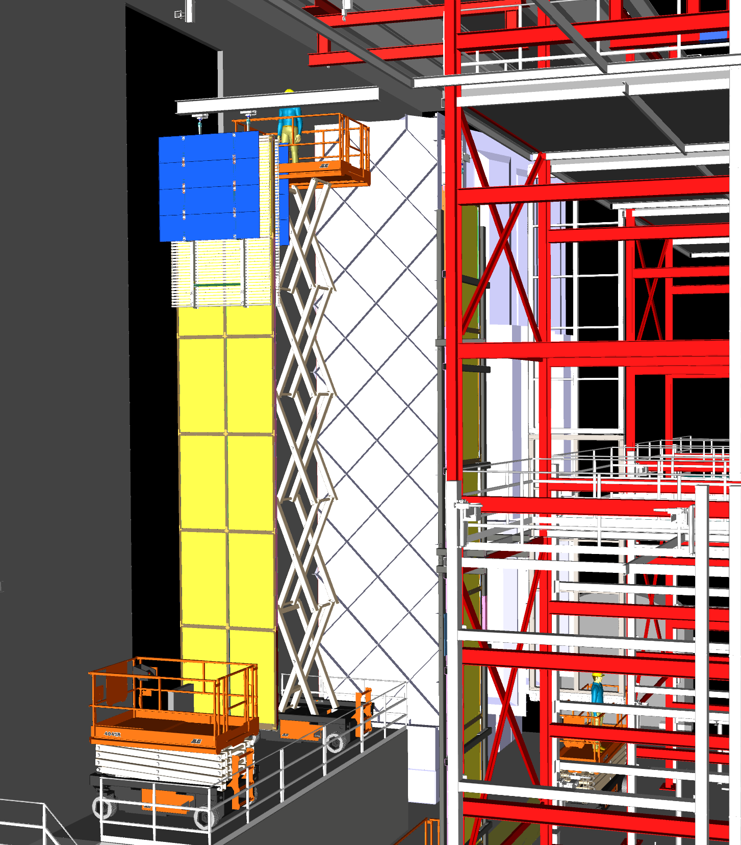
CPA-FC assembly
The 1.15m wide CPA panels are moved from the assembly frame and hung from the TCO beam. The second CPA panel is assembled and mounted next to the first.
The two panels are connected together.
The bottom FC modules are hoisted into position using a small jib crane.
The top FC modules are lifted into position using the same crane. Access to the top is provided 2 scissor lifts.
Need Phase-2 to verify the bottom FC deployment which effects if it is installed at this step.

Slide 27
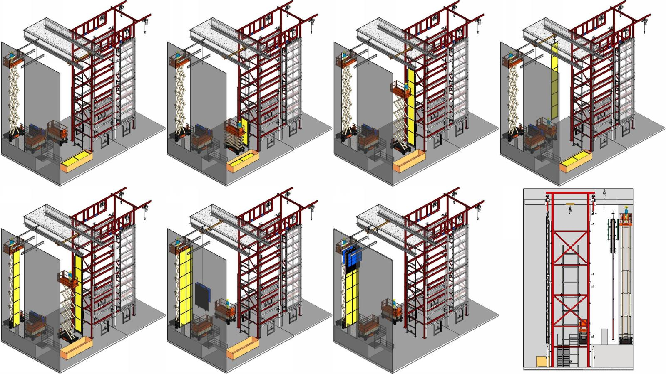

Slide 28
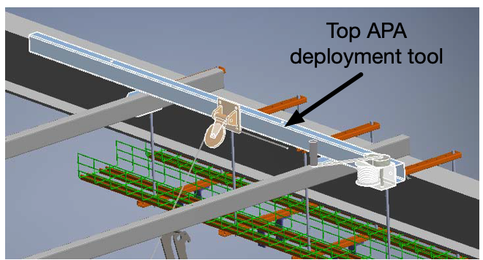

Deploying FC modules
The plan is to first install all the CPA and then begin deploying the field cages.
First step in FC deployment is to install the ground plane and deployment winch.
A floor section is then removed and the cryostat floor cleaned.
The winch is used to lower the bottom FC module, the latch is locked, and electrical connections are made. (not clear how the motion is controlled)
Then the upper FC is then raised, locked in position, electrical connections made, and the winch is removed.
The interference with the GP needs prototyped.
The present planning schedule has the deployment finishing around the time the last APA is installed.
This needs to be tested at Ash River

Slide 29

End Wall and TCO closing
The 1.7m space between the end wall and the membrane is considered sufficient to close the TCO. This will allow the full end wall to be installed prior to TCO closing.
The CAL/CI equipment can also be installed prior to closing the TCO.
The scissor lift will then need to be craned out using the TOC beam and hoists.
  Space is tight.
https://edms.cern.ch/document/2060543/1

Slide 30

Switchyard removal
Switchyard is dismantled as the last FC row is deployed.
Need to work through the detailed steps

Slide 31
Final end wall installation
I do not have a detailed plan for the final end wall installation.
Possibly the wall will need constructed offset, the FC deployed and the wall moved into position.
More work is needed here.
Must be tested at Ash River.

Slide 32
Discussion

