Slide 1

Single-Phase Photon Detector
Cryostat Top SP-PD Work Summary
David Warner for SP-PD Consortium
Winter 2020 DUNE Collaboration Meeting
February 3, 2020

Slide 2
Outline
Action item from August I&I meeting (Lead)
Electronics in the mini-rack
PD Cryostat Top Connections
  Fiber connections
    Slow control fibers
    Module readout
    PD monitoring fibers
  Copper connections
    Daphne
    Monitoring
PD cryostat top access during detector installation/QC testing
  Installation/Initial continuity checks
  Weekly operational tests
Summary of outstanding issues

Slide 3
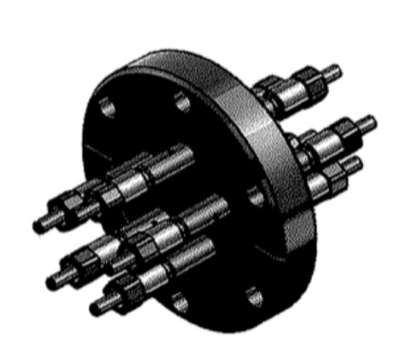
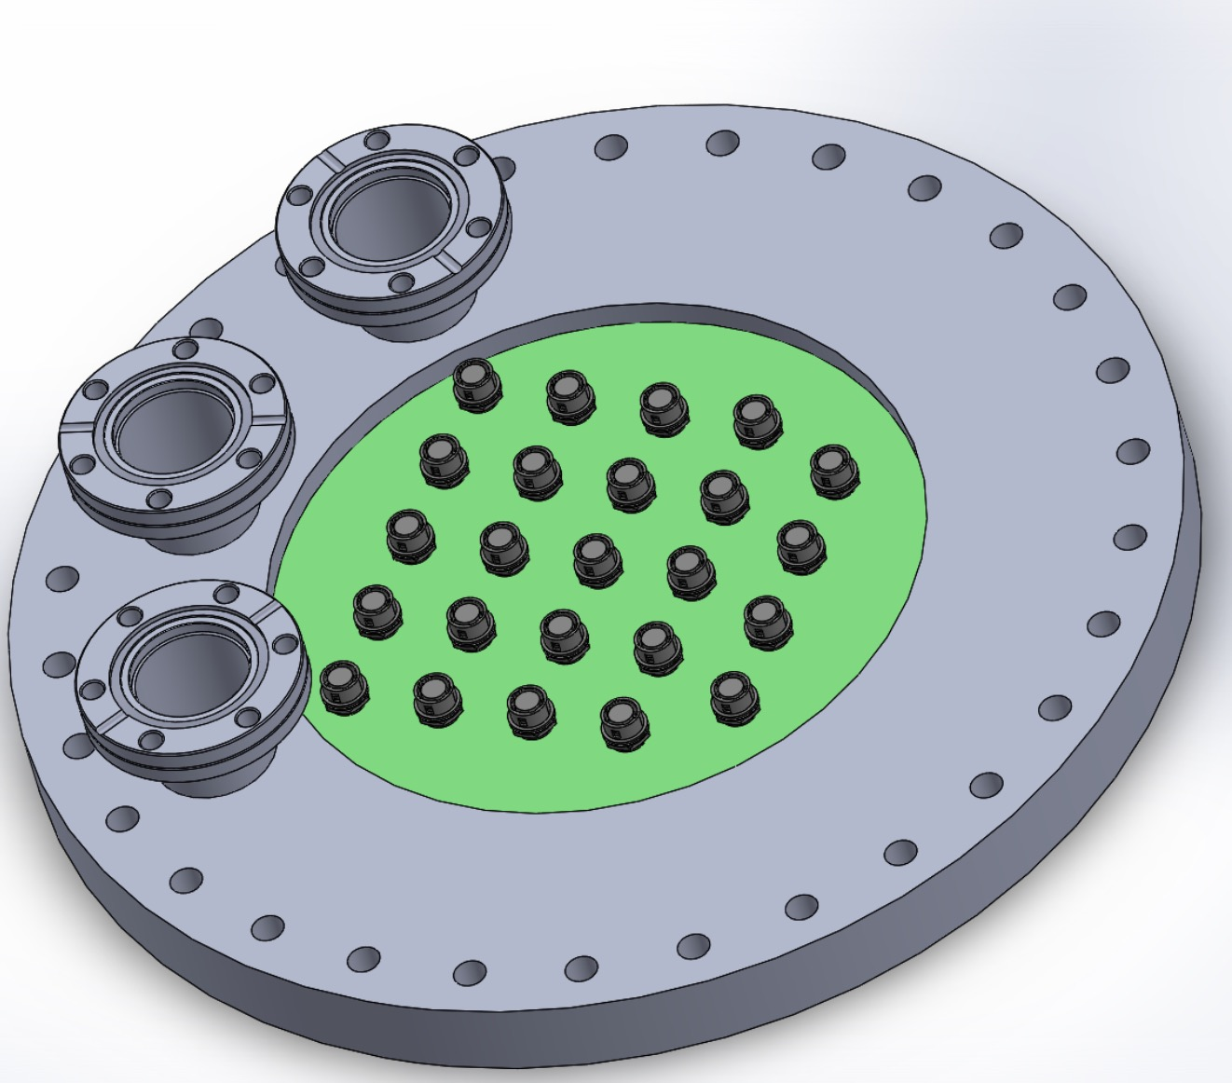
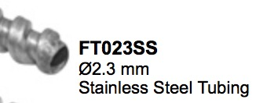
Action Item 18971: PD Monitoring System Fiber
Provisional decision: Fibers for the PD monitoring system will be routed through the PD signal flange
  8 positions on each outer APA row
  16 total positions
Will use the same SMA connector flanges as in ProtoDUNE (3 per flange, 15 total fiber positions)
ProtoDUNE Fiber Flange

Slide 4
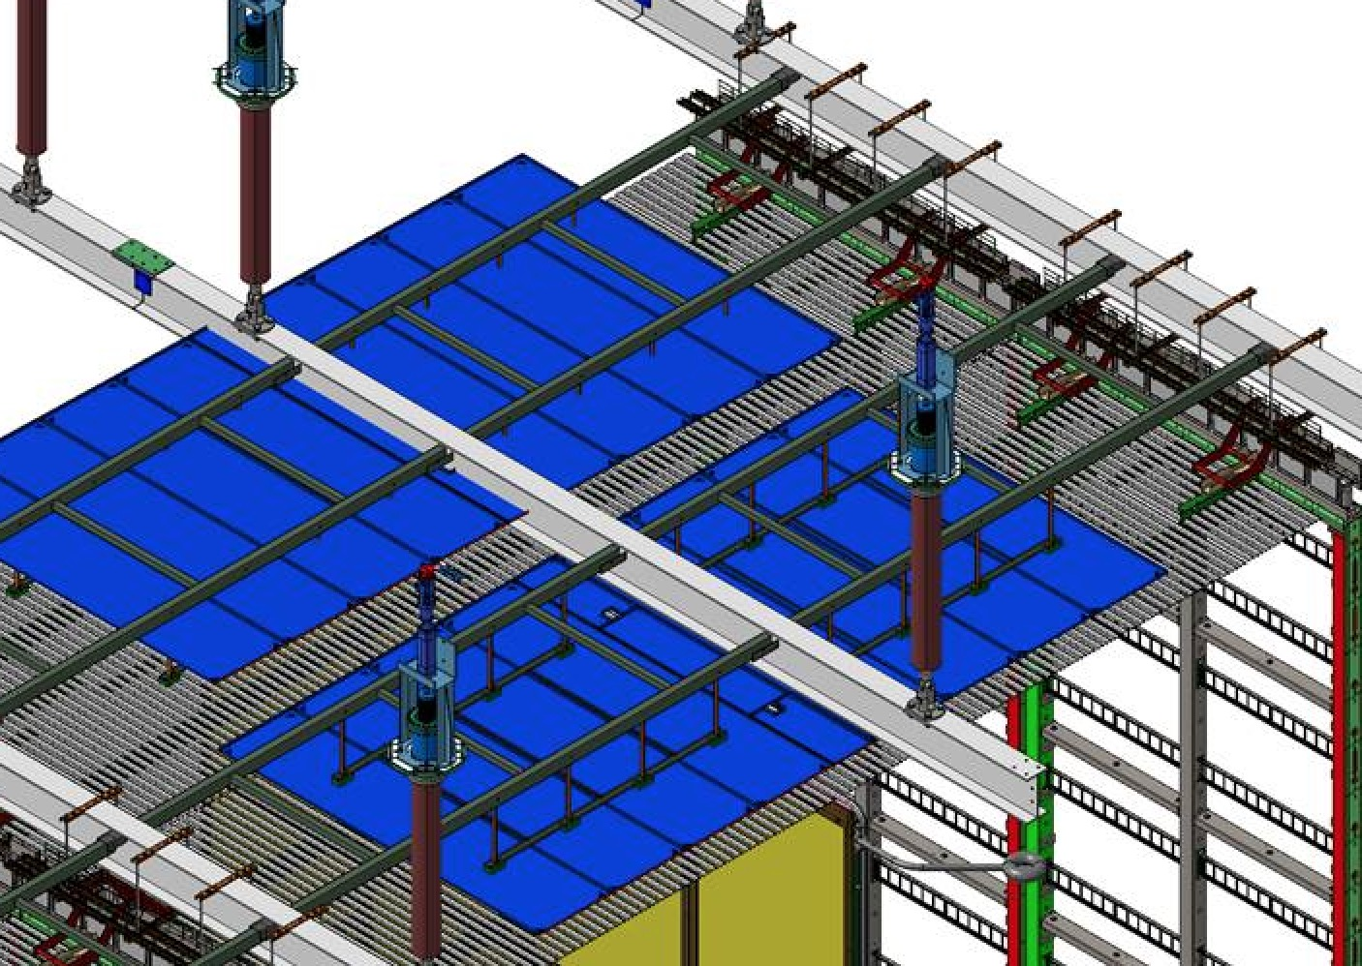
Monitoring Fiber Routing Path
PD Fibers
SMA
Connectors

Slide 5
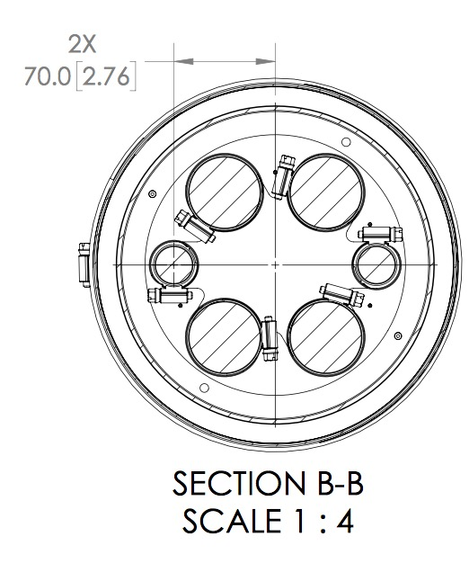
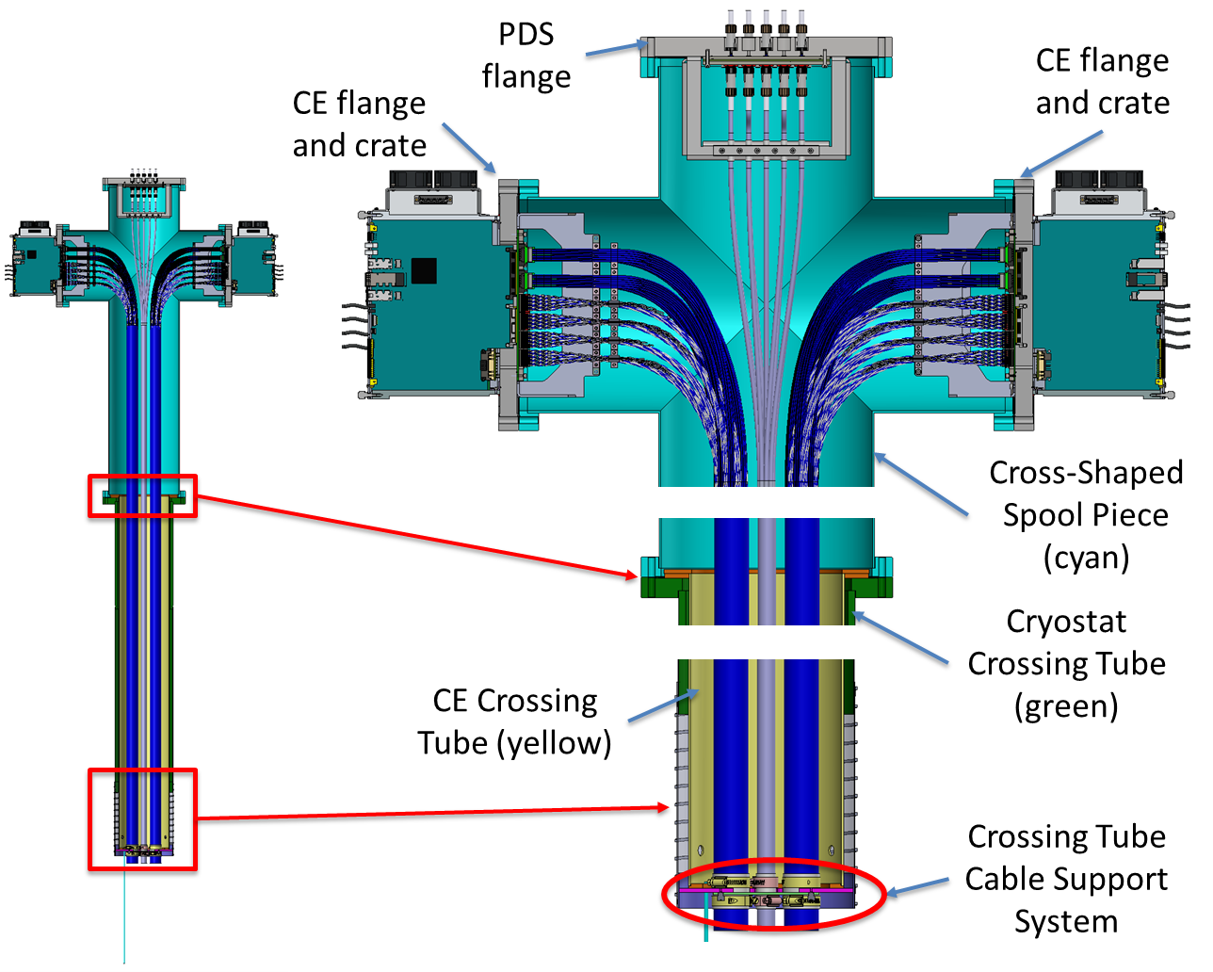
Fiber Routing Through Crossing T
Fiber Flanges Here
Space needs to be found
For fiber bundle inside
conduit (Manhong)

Slide 6
February Item 18971Summary:
PROPOSAL: All PD fibers/cables will route through PD flange
  No PD fibers passing through DSS feedthroughs
Outstanding details:
  Routing and anchoring of fibers to DSS beams
  Routing of fibers through crossing T
  Mounting of PD monitoring system electronics in mini-racks

Slide 7
Mini-rack Electronics Mounting
Warm Electronics (DAPHNE)
  Baseline: Two 2U tall modules per crossing tube
  Available for installation March 2024 (full system)
Monitoring System (Baseline design SSP)
  Baseline: 3U of modules at 16 positions along outer APA (8 per side)
  Available for installation October 2023 (full system)
(Est.) 2U fiber patch panel at each mini-rack location (Pre-installed by I&I team)
Additional room for cryogenic instrumentation?

Slide 8
PD Connections
Fibers
  3 fibers per DAPHNE module (Data, slow control, timing)
  3 fibers (max) per monitoring electronics module (16 total)
Copper
  48VDC (~25W) per DAPHNE module
  Similar (not yet finalized) power requirement for PD monitoring/flashers
  Not clear if power will be routed in one shielded cable and distributed at minirack or if we will use multiple cables.
Fibers and power will be routed by electrical technicians prior to PD electronics module installation (Needed April 2026 in P6)

Slide 9
Cryostat Top Electronics Installation
PD readout and monitoring electronics are required for detector installation QC checks
Strong PD consortium preference for PD consortium scientists/technicians performing installation/checkout (with DAQ support)
P6 currently shows 25 PD electronics installation/testing periods (one per APA row, approximately 15d duration)
  PD consortium preference to compress to installing all at one time and testing, which would revise P6

Slide 10
Installation QC on Cryostat Top
PD cable continuity checks and operational check immediately upon APA stack installation
  PD cables inside crossing tube installed by I&I and TPC personnel
  PD personnel will connect warm cables from flanges to warm electronics
    I&I personnel may pre-position cables in tray
  PD will connect monitoring system fibers if present at hatch
  PD will conduct end-to-end check of readout at this time (DAQ support?).
Periodic (upon completion of an APA row?) darkening of cryostat to allow operating photosensors for end-to-end checkout
  “Weekend shift”
  Requires 2 PD personnel

Slide 11
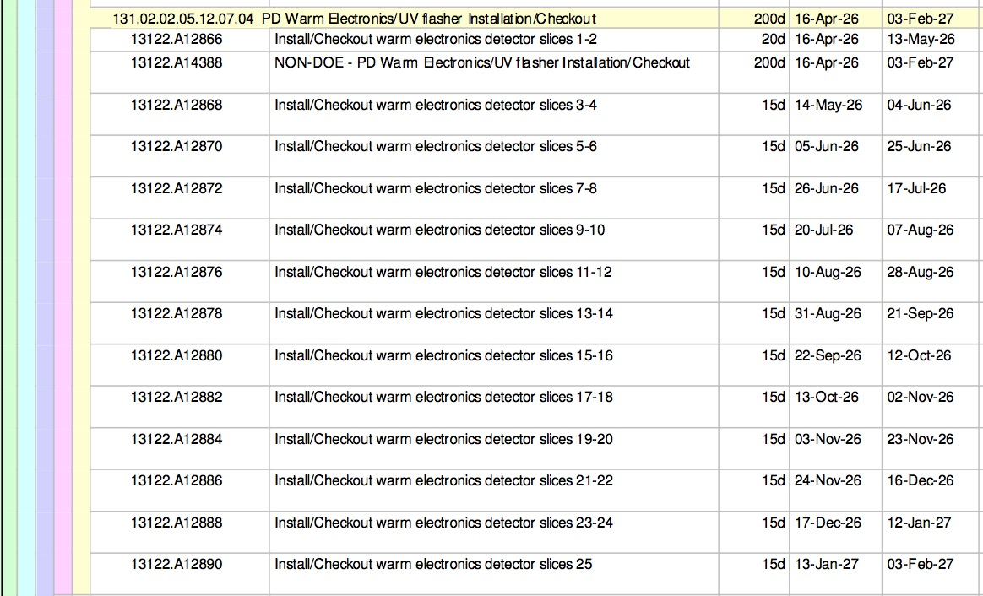
PD Cryostat Top Installation Schedule

Slide 12
Outstanding Issues
PD monitoring
  Flange layout
    Space for cryo temp sensors?
    Space for calibration optical fibers?
  Fiber routing on DSS
Mini-Racks
  Mini-rack size
  Finalize power requirements
  Finalize layout of mini-rack
    Include space for cryogenic instrumentation module(s)?
    Include cooling fans?
Installation schedule detail
  Electronics installation & testing
  PD End-to-end checks

