Slide 1
Discussion of Milestones
J Stewart
I&I workshop February 2020

Slide 2
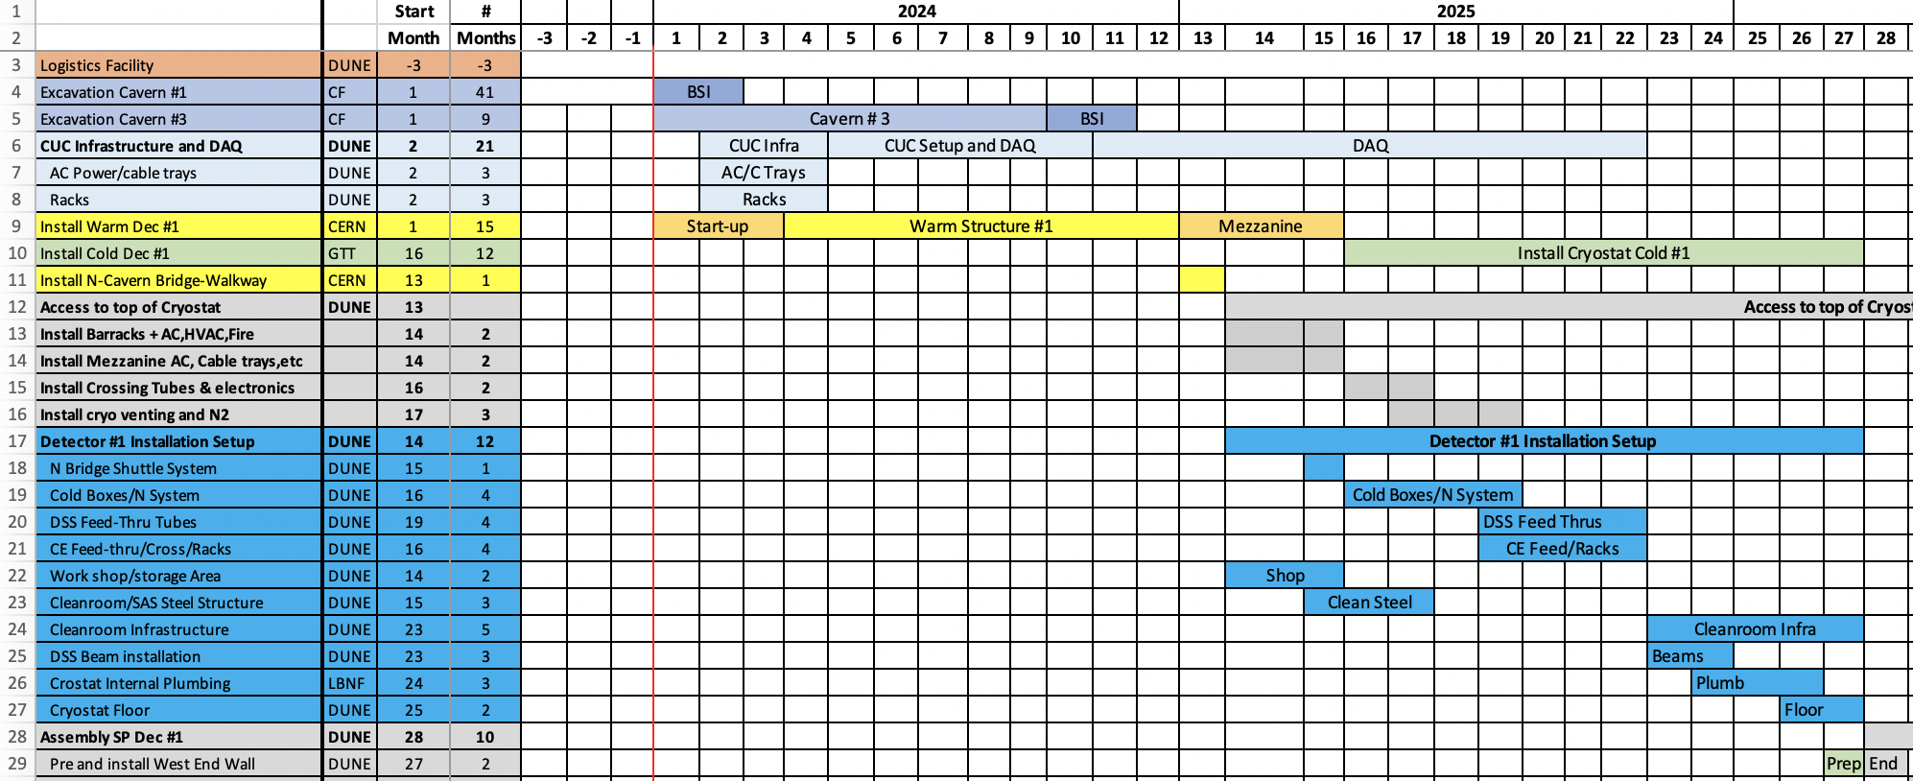
General Overview of the Setup period
Last 3 months of the warm structure fabrication will be internal welding. Access to the top is possible. Mainly infrastructure work.
When the cold structure work starts work on the cleanroom needs to stop as large amounts of material and many people are needed for the foam.
~7 months after the start of the cold installation the foam is installed. The space required and number of people reduces to a point where the cleanroom installation can start.

Slide 3
Top list of milestones Detector #1
Authorization for use and possession (AUP)
Avail: AUP Cavern 1 and 2
Begin: Warm cryostat#1 construction
Begin: Work on cryostat roof and initial cleanroom Prep
Complete: Cryostat#1 warm structure
Begin: Cryostat Cold Structure construction
Avail: Authorization to start final cleanroom prep
Avail: Cryostat Cold Structure (cryostat clean)
Detector#1 Ready for Installation
Begin closing TCO detector #1
Detector #1 installation complete
Cryostat Warm
Cryostat Cold
Detector Installation

Slide 4
The top level milestones divide up the periods where work can be performed. The main blocks of work are the installation of the warm and cold cryostat and the detector installation. In parallel the detector infrastructure and the cleanroom need installed.
Installation of consortia deliverables can start when the prerequisite infrastructure is in place. Milestones are needed to define these interfaces.
The 3 month period at the end of the warm structure construction will be exclusively the heavy setup work so no consortia activities are planned.
  Activities include installing the North-South bridge, installing the mezzanines, installing the barracks, installing the steel for the cleanroom, and installing the crane under the bridge.

Slide 5
Proposed primary interface milestones to consortia and detector installation
Avail: DAQ surface room
Avail: Cryo. Mezzanine barracks
Avail: Detector mezzanine racks
Ready to start crossing tube and CE cross installaiton
Avail: Cryostat roof ready for Det. Install
Avail: Cryostat Cold Structure

Slide 6
Avail: DAQ Surface Room
The DAQ can take occupancy of the surface room when the CF work is complete.
The conditions of the room at this time will be:
Power, lighting, and ventilation will be installed.
Fire life safety equipment are in place.
CF provided racks will be in place.
Fiber optic cables to the underground area are installed.
  Cables are terminated and tested.
Rack cooling for 8 50 kVA racks?
Installation of the 8 DAQ racks can begin. Setting up the DAQ with communication to FNAL can start.

Slide 7
Avail: Cryogenics Mezzanine barracks
It is assumed here the DAQ will be installed in the barracks on the cryogenics mezzanine.
Milestone predecessors are:
The Mezzanine must be installed and the barracks erected.
The barracks must be equipped with AC power, ventilation, and fire suppression.
  UPS is not in installation scope. Check infrastructure?
The racks and cable trays are installed and water cooling is run to the racks.
The detector safety system is enabled for the rack protection.
Where are the fibers to the surface terminated?
  Who extends them to the barracks?
This milestone determines the earliest date the DAQ installation can start.

Slide 8
Avail: Detector mezzanine racks
The detector mezzanine racks hold all the consortia power supplies and readout electronics (except for what is on top of the cryostat).
The conditions that must be met for this milestone are:
The detector mezzanine, stairs, and guardrails must be in place.
The AC power must be run to the mezzanine.
The racks are mounted and power is run to the racks.
The detector safety system is active and the rack protection is enabled.
Cable trays connected to the mezzanine are installed.
The installation of electronics in the racks can start

Slide 9
Ready to start crossing tube and CE crosses
The crossing tube installation depends on the cold structure installation. The foam on the roof needs to be installed.
When the construction of the cryostat top membrane begins the crossing tubes need to be installed.
As the crossing tubes are installed the flanges on top of the cryostat are welded to the crossing tubes and cross braced to the cryostat steel.
It is assumed the CE cross and internal cable support structure are installed at this time to ensure the cable support tube is well centered inside the cryostat penetrations.
Need to verify that the CTC supports are needed here with Dimitar.

Slide 10
Avail: Cryostat roof ready for Det. Install
The consortia work on the cryostat roof includes installation of the WEIC, installing the PD electronics, and routing detector cables and fibers.
These activities can begin when the heavy work on the cryostat roof is done.
The mezzanines are in place.
All racks on the mezzanines are operational.
Lighting and fire suppression under the mezzanines are complete.
The deck on the cryostat is finished.
All piping for Ar purge are installed (heavy work with welding).
The cable trays on the cryostat roof are in place.
The 12U racks are in place.
The CE crosses are installed.

Slide 11
Installation milestones?
What is missing?

Slide 12
Comments
The milestones need duplicated for detector #2.
The final phrasing needs iterated with management.
This gives 31 milestones over 3 years.
Additional internal milestones will be needed for I&I procurements.

Slide 13
Action Items
81922 - Identify methodology for ongoing cleaning of the cryostat during detector installation - Miller, James
Cleaning of accessible areas will be included in the cleaning plan. No safe method has been found to clean behind the APA.
81937 Assess activities wrt work on top of the cryostat concurrent with cryostat completion to ensure optimization - Resnati + consortia + Miller
An initial sequence of activities has been identified. This is presented at this meeting.
81934 Rigging - calculate rigging hours per day in clean room for all activities – Miller
Propose to train the cleanroom techs to use the equipment in the cleanroom
81956 Refine underground personnel counts from each consortia - Miller + consortia
First estimate is available at https://edms.cern.ch/document/2273468
Propose Patrick and Joe take over negotiating this.

